Slide 1

12T cosθ FALCOND dipole program – Mechanical mockup 2 (LMK 2 collared coil)
March 11th, 2025
Sachin Gowrishankar, Arnaud Foussat, Nicola Sala on behalf of HFM WP3.1 team
Notes:
Hello everyone, in the context of the 12T cos theta FALCOND program, today, I’ll present the work done on the mechanical mockup 2 (abbreviated as LMK 2), which is a collared coil mockup.

Slide 2
Outline
Motivation & objectives of LMK 2
Details of LMK 2
Vertically & horizontally split yokes
Summary & next steps
Notes:
The following is the outline of the presentation. First, I introduce the motivation & objectives of LMK 2. This is followed by the design details of the mockup. Then, we compare 2 yoke configurations of the same mockup – vertical & horizontal split. Finally, a summary of the work is given along with the next steps that are planned.

Slide 3
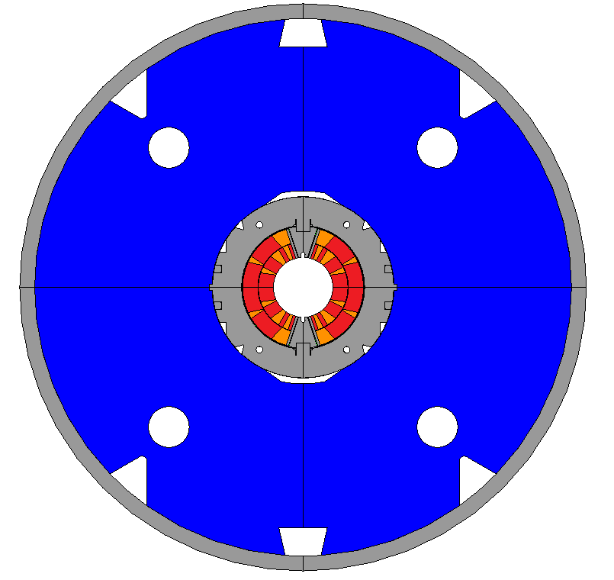
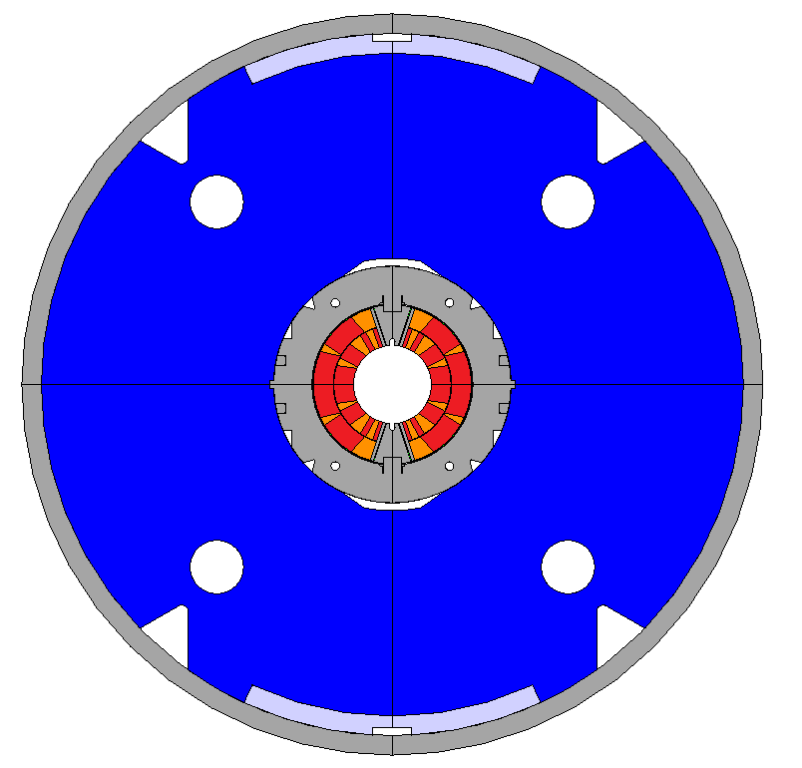
Motivation for LMK 2
Utilize existing 11T Nb₃Sn coils, collars & shell; study stopper integration for future 12T FALCOND coils.
Validate aluminum stopper and welded shell on cosϴ collared aperture.
Explore a cost-effective design for 12T-13T long magnets.
Objectives
Compare horizontal vs. vertical yoke split, focusing on vertical due to 11T collar limitations.
Validate assembly with shell preload scaled to a 12T field-equivalent load (~ 3.5 MN/m).
Instrumented load test @ R.T & cold; benchmark coil and structure stress using FE models.
Weld
Yoke
Shell
Vertically split yokes
Alu-stopper
Collar pack
Coils
Reference 11 T model [2016-2021]
LMK 2 mockup [2024]
Notes:
The motivation for LMK 2 is to use the existing 11T coils, collars & shell. Only modify the yoke to accommodate a mechanical stopper. Study the behavior of this new structure. Apply this knowledge to future 12T FALCOND coils.
Validate the concept of aluminum stopper & welded shell on the cos theta collared aperture.
Explore a potential cost-effective design for high field long magnets in the 12-13T range.

Slide 4

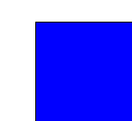
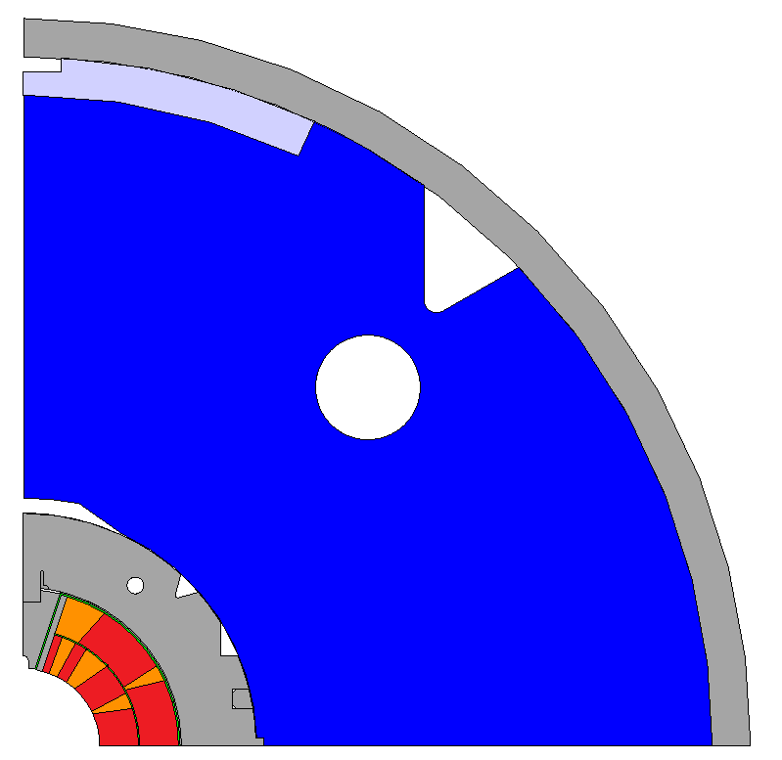
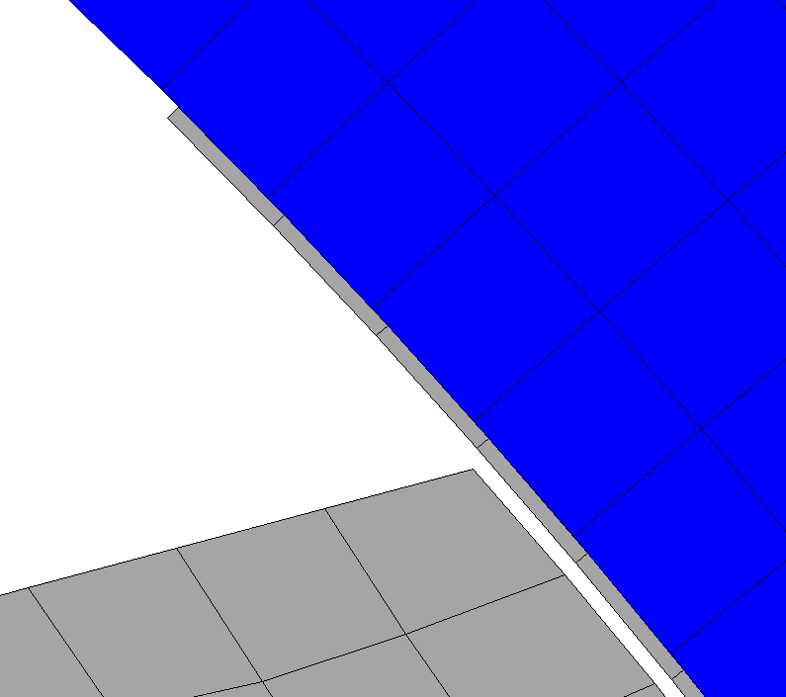

Design description
Why aluminum stopper?
NOT overstress coils during assembly (shell welding) at R.T.
Maintain coil pre-stress at COLD
Geometry
$dbore,11T$= 60 mm
$thshell, 11T$ = 15 mm
$lengthshell, 11T sections$ = 600 mm
$stopperlength$= 114 mm
$stopperthickness$= 15 mm
  (CTE_{alu} = 4.2 mm/m).
Parting plane
2. Yoke-yoke half gap
3. Yoke-stopper gap = 0 mm
1. Yoke-collar gap
Shim = 0.4 mm (nominal)
Design parameters
Yoke-collar gap (nominal = 0 mm).
Yoke-yoke half gap.
Yoke-stopper gap (= 0 mm always).
LMK 2 mockup [2024]
Notes:
The idea is NOT to pre-stress the coils too much when the shell halves are pressed and welded. In case the shell is loaded off the nominal load, the stopper takes the load and NOT the coils.
Why specifically aluminum? – Has high CTE of 0.42%. At cold, alu shrinks and disappears. The strain energy stored in the shell at R.T is released to the coils through the structure. This helps to maintain the coil pre-stress at COLD.

Slide 5
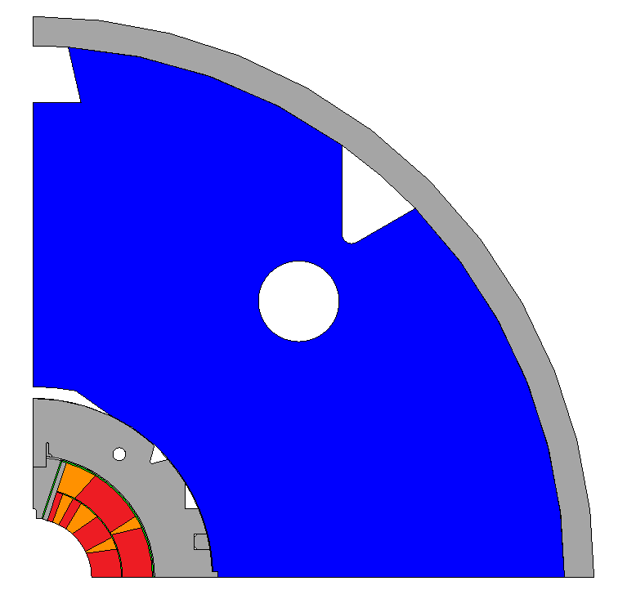
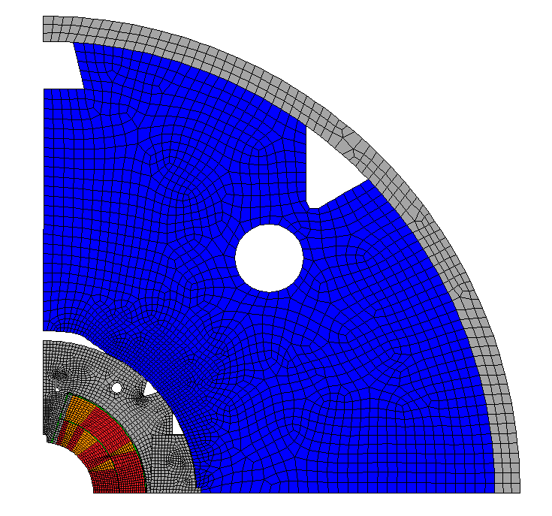
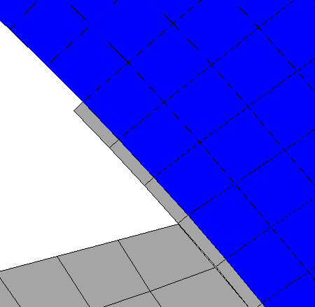



Reference 11T – FE model description
Geometry
Contacts & B.C.s
Material legend
0.1 mm
Parting plane
$$δweld$$
Nb₃Sn coils
Rigid - deformable contact: yoke-yoke
Copper wedges
Iron yoke
Symmetry: collars & pole
Stainless steel shell, collars, pole
0 mm
Yoke-collar gap = 0 mm (nominal)
Rigid-deformable contact: coil-ground
Symmetry: yoke & shell
Key points
Bonded inner & outer coil layers.
Vertically split yokes.
Tapered yokes.
For all contacts, $μ=0.2$
$δweld$ = 0.6 mm
Yoke-collar gap = 0 mm (nominal).
Material properties [11T, 2016-2021]
11T coils (Nb₃Sn)
  E = 31 GPa, CTE = 3.88 mm/m.
Stainless steel 316LN (shell)
  E = 210 GPa, CTE = 2.84 mm/m.
  $σyield$ = 250 MPa.

Slide 6

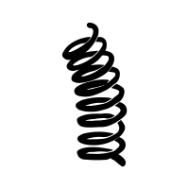



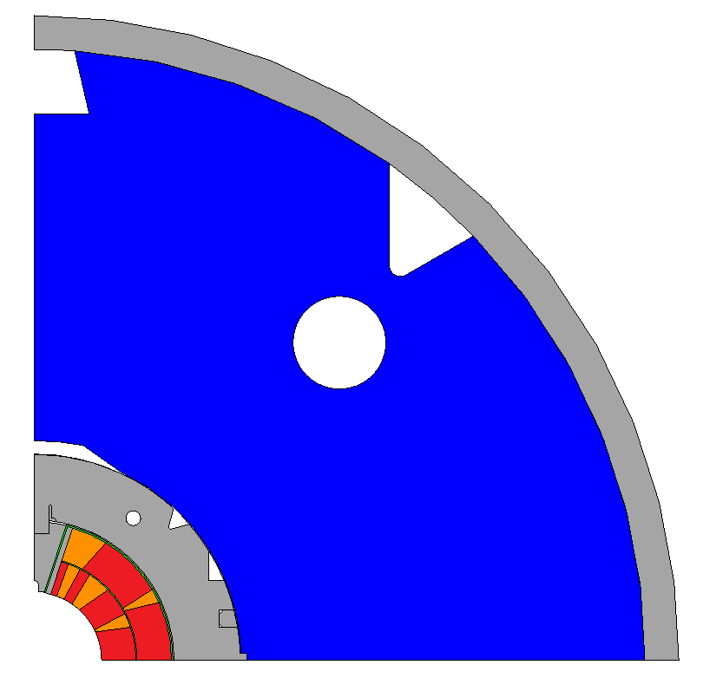
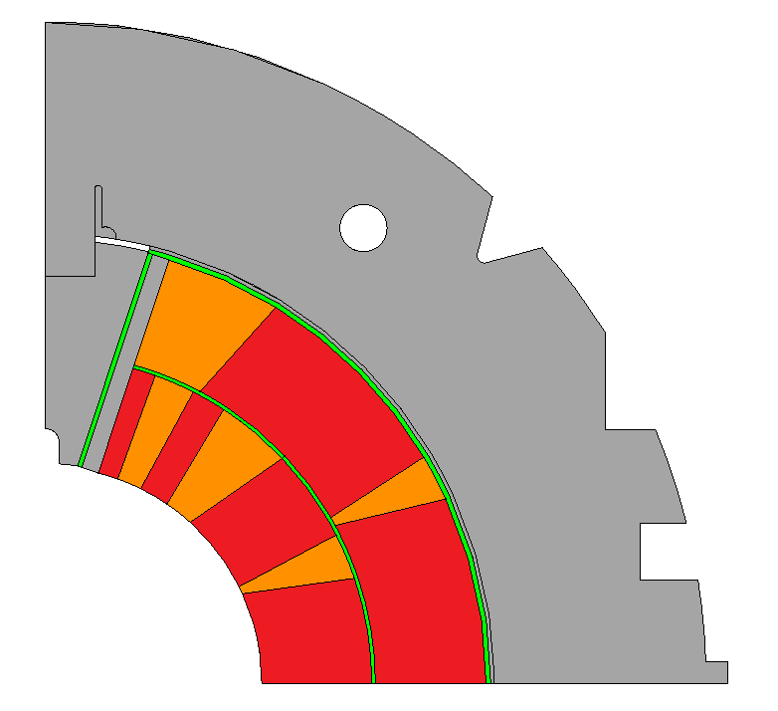
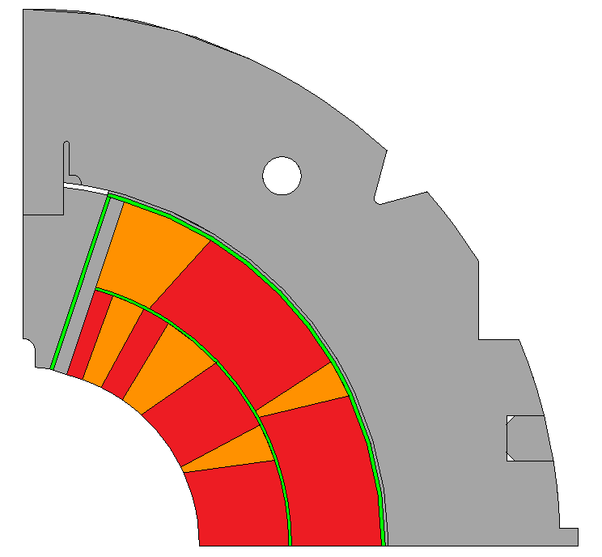
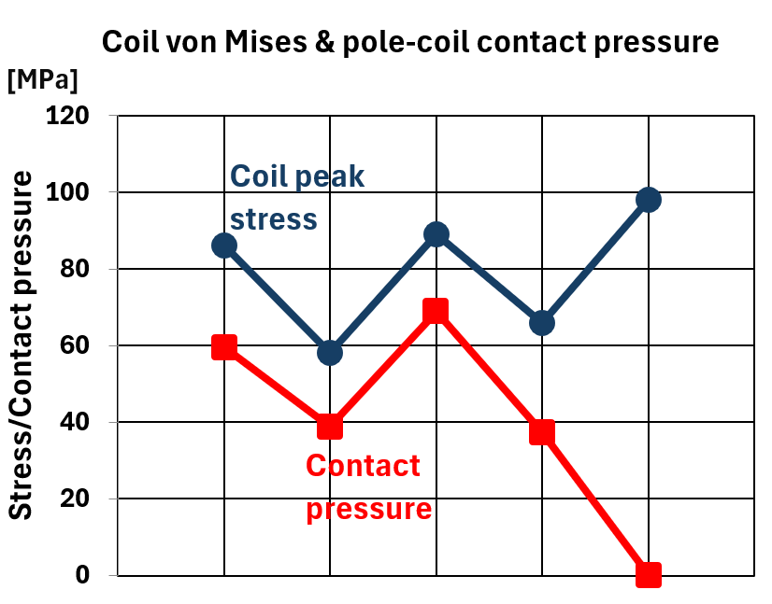
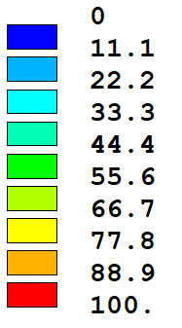
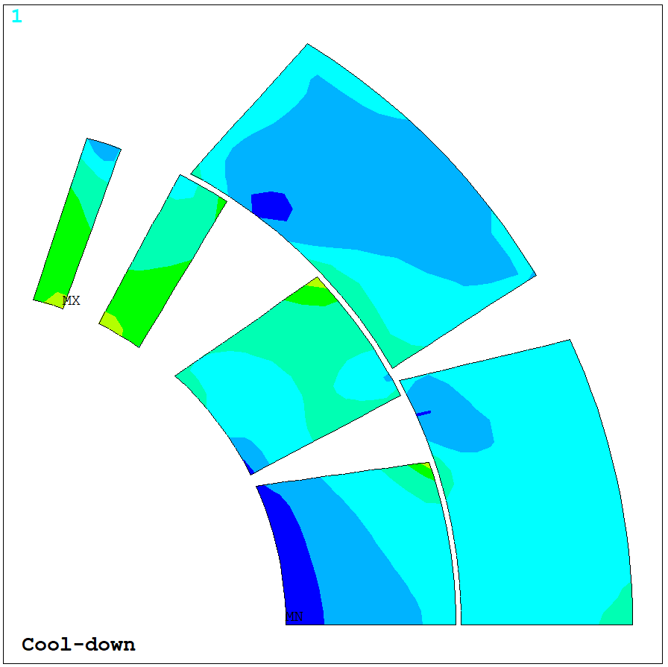
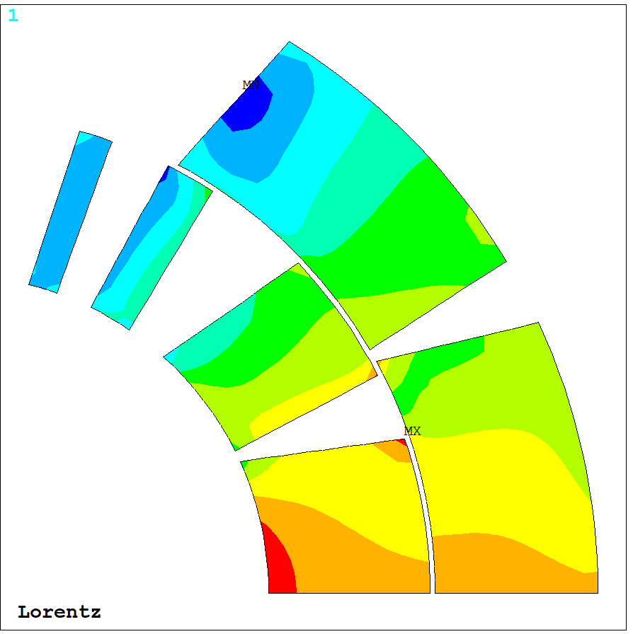




Reference 11T – Results summary
[Collaring]
[Spring back]
[Welding]
[Cool down]
[Powering]
R.T.
4K
$$Fcollaring$$
$$δweld$$
Key
$$FLorentz$$
$$\text{Coil} σvon Mises$$
[MPa]
Pole detaches here
[COLD]
[POW]

Slide 7
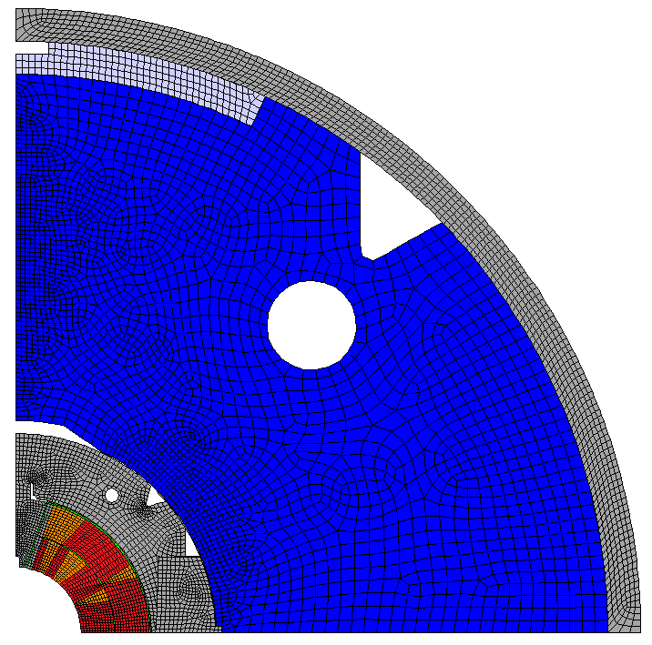



LMK 2 mockup – FE model description
Geometry
Contacts & B.C.s
Material legend
Parting plane
$$δweld$$
Yoke-yoke half gap
Nb₃Sn coils
Rigid - deformable contact: yoke-yoke
Copper wedges
Iron yoke
Symmetry: collars & pole
Stainless steel shell, collars, pole
Yoke-collar gap
Rigid-deformable contact: coil-ground
Symmetry: yoke & shell
Key points
Bonded inner & outer coil layers.
Vertically split yokes.
Straight yokes.
For all contacts, $μ=0.2$
$δweld$ = 0.6 mm
Yoke-collar gap & yoke-yoke half gap are design parameters.
Material properties [11T, 2016-2021]
11T coils (Nb₃Sn)
  E = 31 GPa, CTE = 3.88 mm/m.
Stainless steel 316LN (shell)
  E = 210 GPa, CTE = 2.84 mm/m.
  $σyield$ = 250 MPa.
Aluminum (stopper): E = 70 GPa, CTE = 4.2 mm/m.

Slide 8
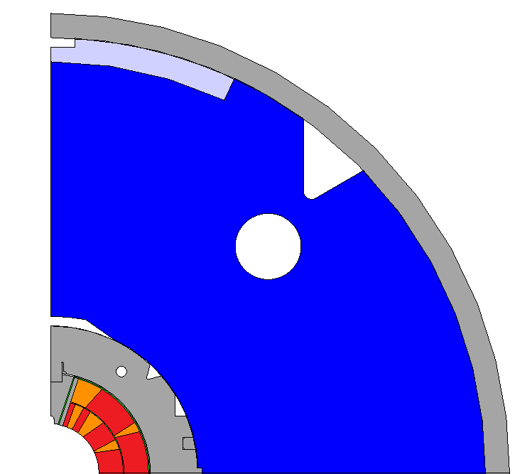
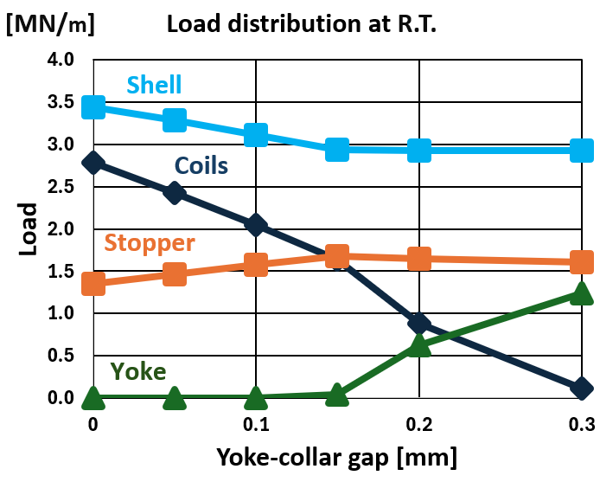
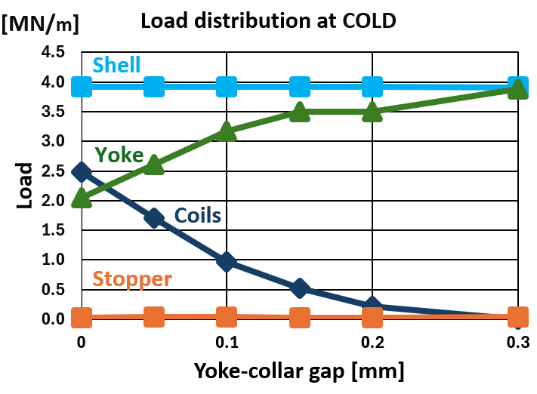






Sensitivity of yoke-collar gap
$Fshell$ = $Fstopper$ + $Fyoke$ + $Fcoils$
$$Fshell$$
For $δweld$ = 0.6 mm, yoke-yoke half gap = 0.2 mm, yoke-collar gap is varied from [0 mm – 0.3 mm].
Assembly @ R.T. (shell welding)
  As the gap increases, coil load decreases, stopper load increases, and reduced coil resistance causes the yokes to close, increasing yoke load.
Cold @ 4K
  For larger gaps, yokes close and DO NOT pre-stress the coils!
$$Fstopper$$
$$Fyoke$$
$$Fcoils$$
Y
X
As a next, vary yoke-yoke half gap for yoke-collar gap = 0.15 mm.
Yoke-collar gap
Stopper disappears (CTE = 0.42%)

Slide 9
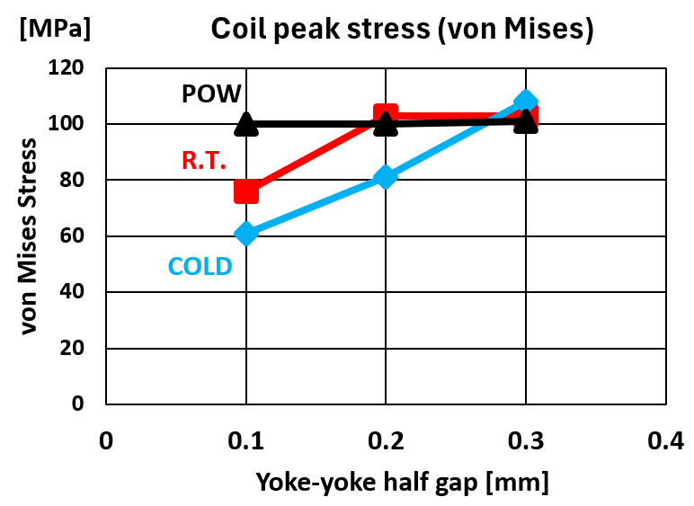
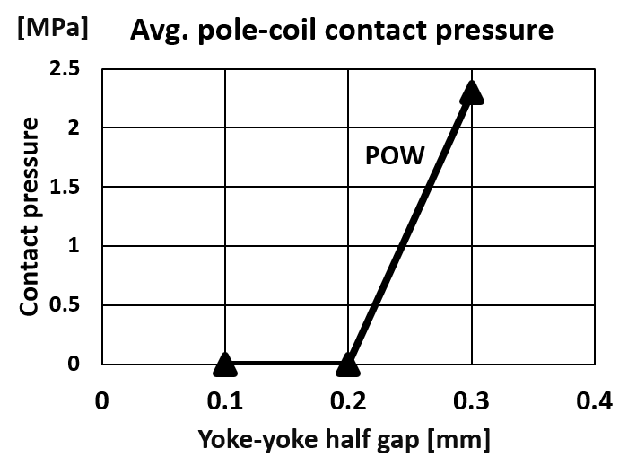

Sensitivity of yoke-yoke half gap
Yoke-stopper gap = 0 mm
Parting plane
Yoke-yoke half gap
Yoke-collar gap = 0.15 mm
For yoke-collar gap = 0.15 mm, yoke-yoke half gap was studied for [0.1 mm, 0.2 mm, 0.3 mm].
Important to maintain contact between collar & yoke @ COLD.
10% contact
$$δstress$$
Pole detaches here
Yokes close too early here

Slide 10
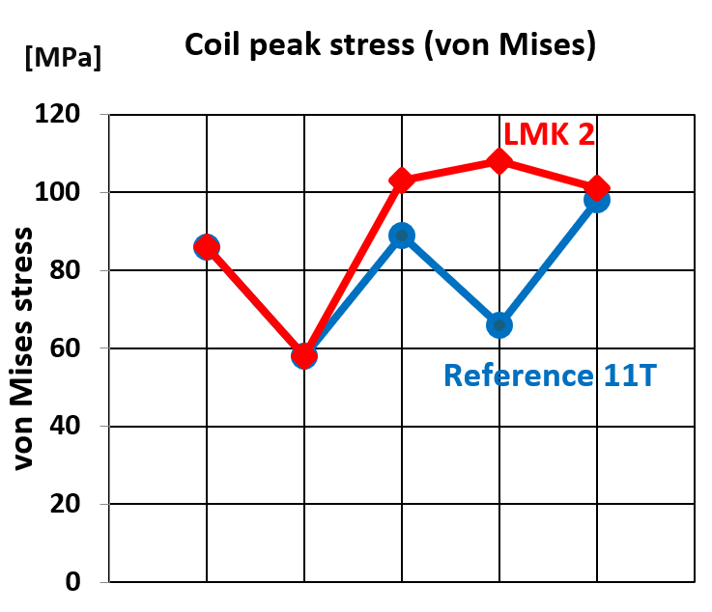
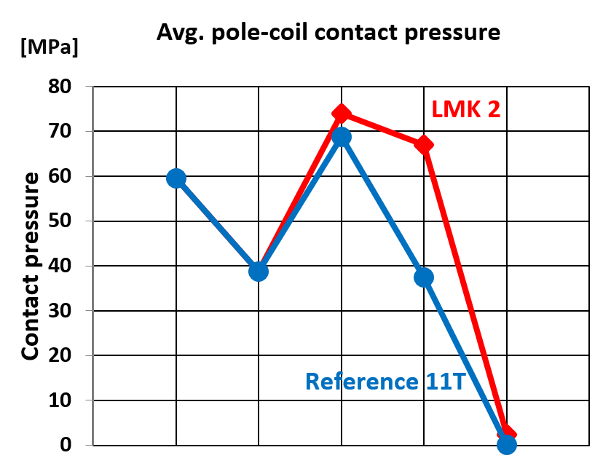

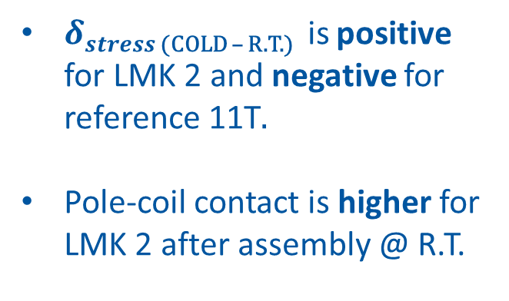
Results for yoke-collar = 0.15 mm, yoke-yoke = 0.3 mm
Parting plane
$δstress$ _{(COLD – R.T.)} is positive for LMK 2 and negative for reference 11T.
Pole-coil contact is higher for LMK 2 after assembly @ R.T.
0.3 mm
0.15 mm
$$δstress$$
2.3 MPa
0 MPa

Slide 11
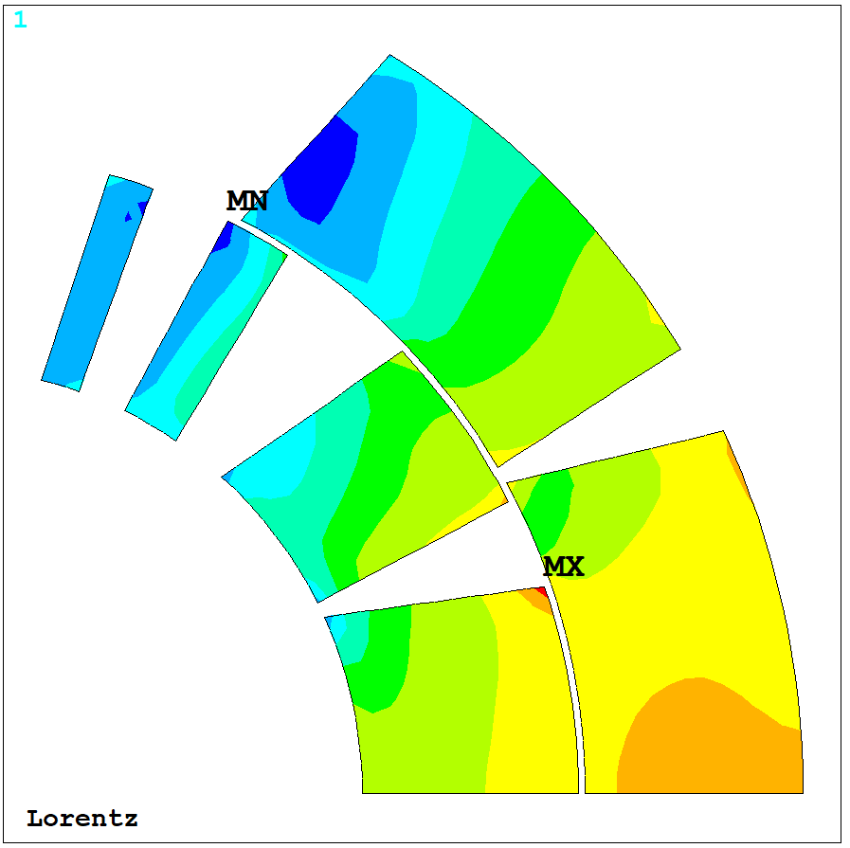
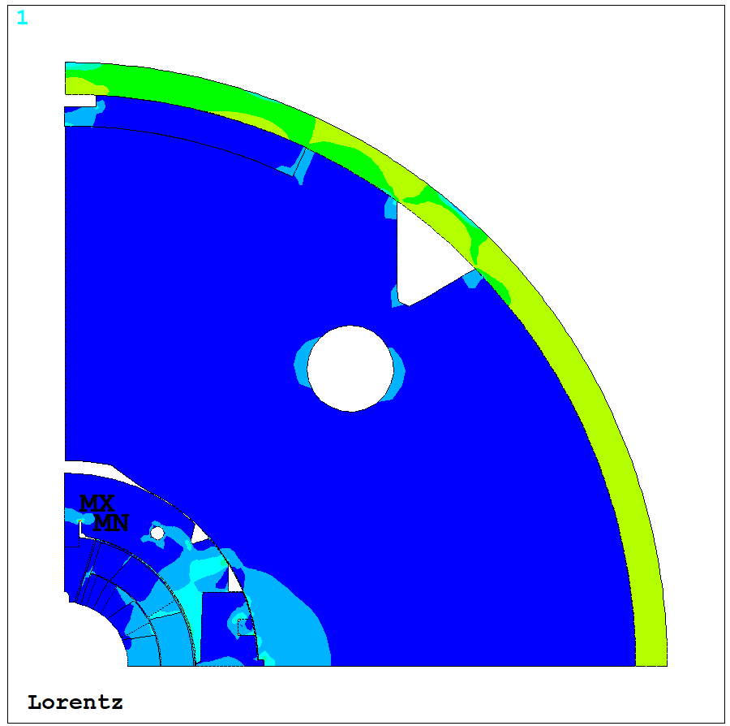
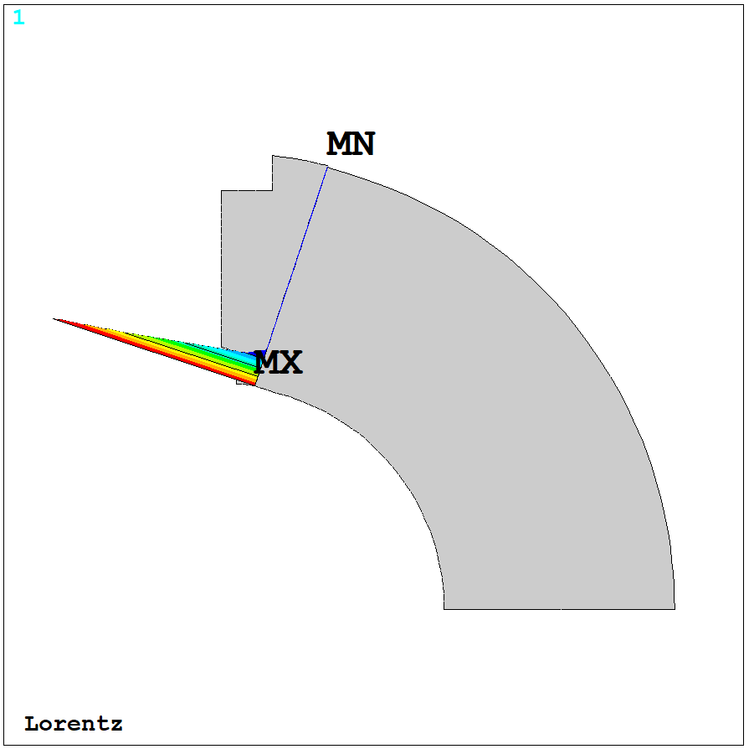
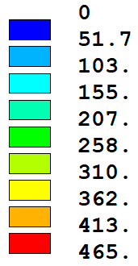
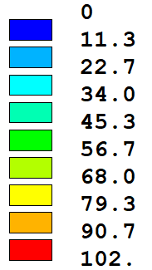
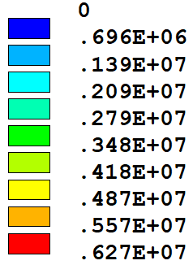
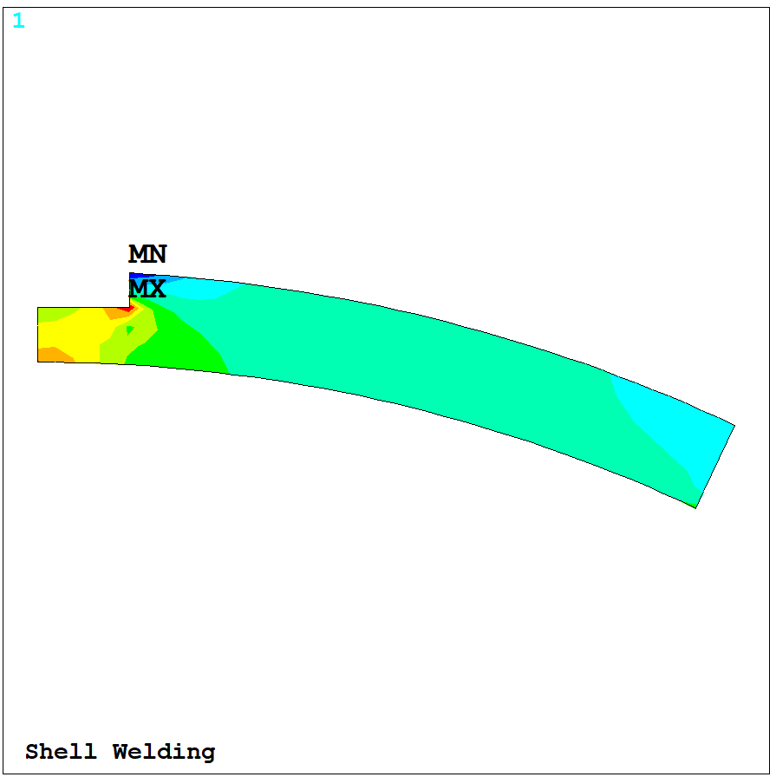
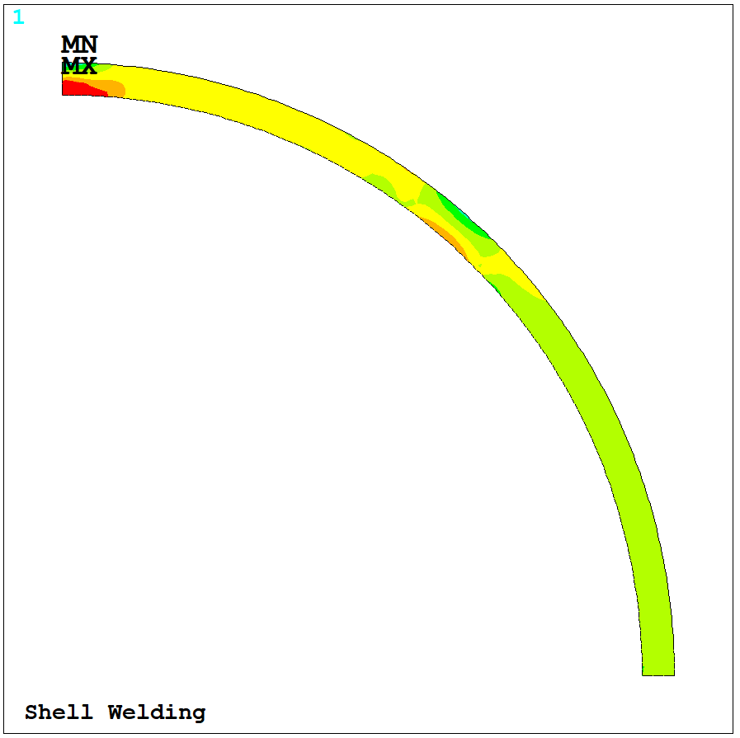
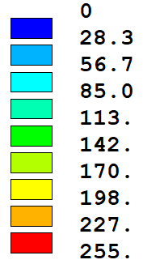
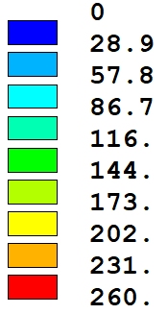



Results for yoke-collar = 0.15 mm, yoke-yoke = 0.3 mm
General stress state
$$\text{Coil} σvon Mises$$
Pole-coil contact
[MPa]
[MPa]
[POW]
[Pa]
[POW]
[POW]
6 MPa
10% contact
Shell $σazimuthal$
$$\text{Stopper} σvon Mises$$
[MPa]
[MPa]
[R.T.]
[R.T.]

Slide 12
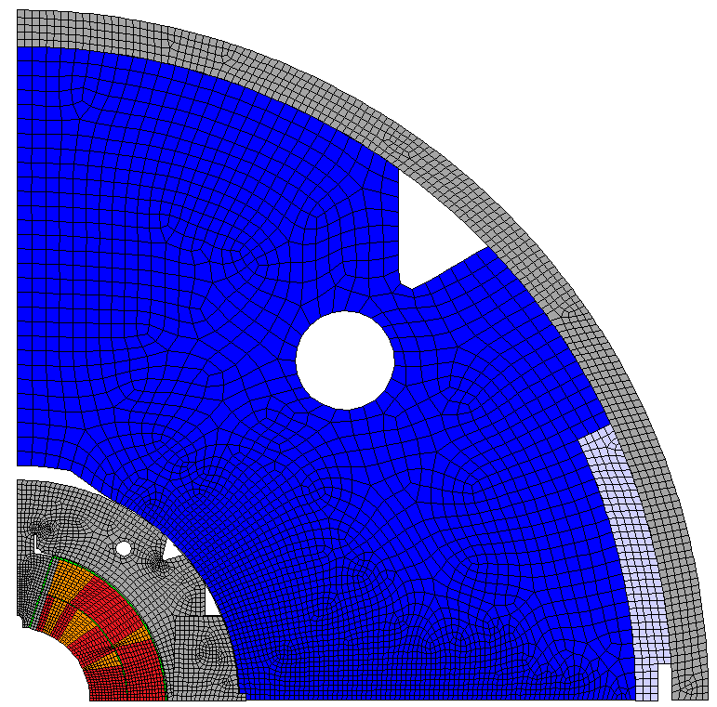
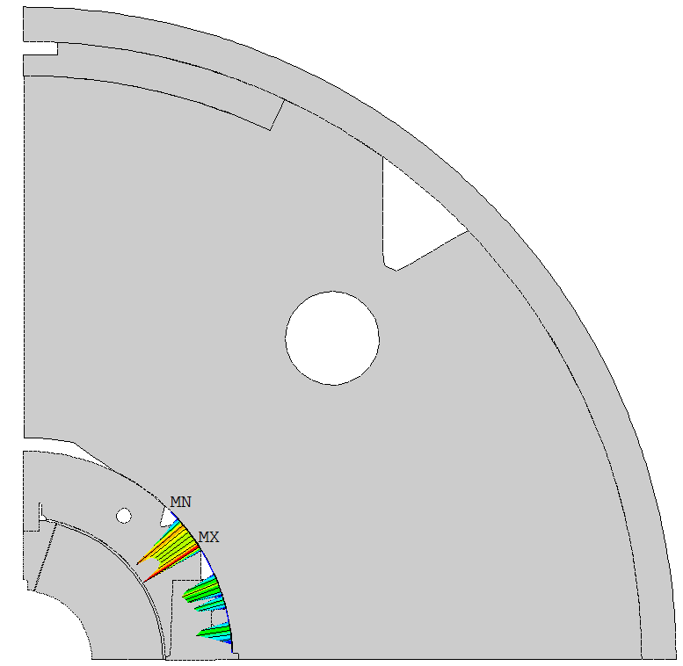
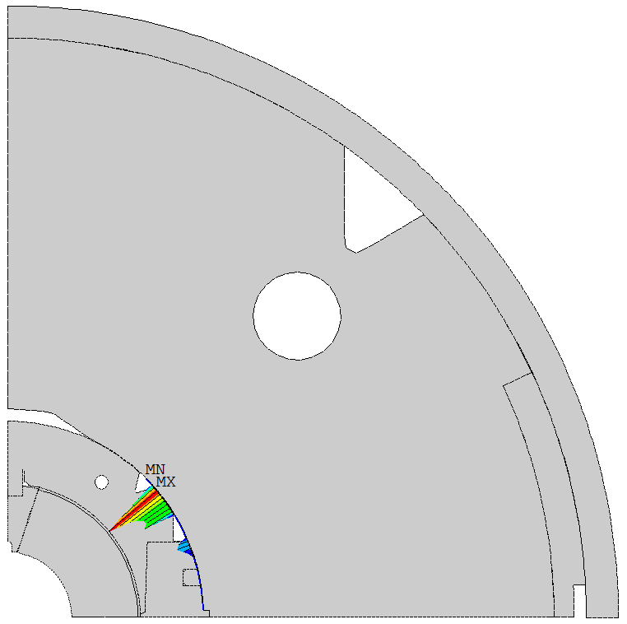
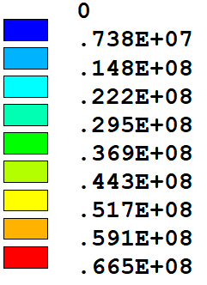
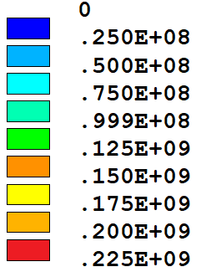
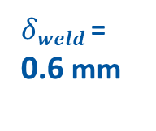

Comparison with horizontal split yokes
Yoke-collar = 0.15 mm, yoke-yoke = 0.3 mm
Yoke-collar = 0 mm (nominal), yoke-yoke = 0.2 mm
$δweld$ = 0.6 mm
Vertical split
Horizontal split
$δweld$ = 0.6 mm
Y
Y
[Pa]
X
[Pa]
X
[R.T.]
[R.T.]
More contact
Little contact

Slide 13
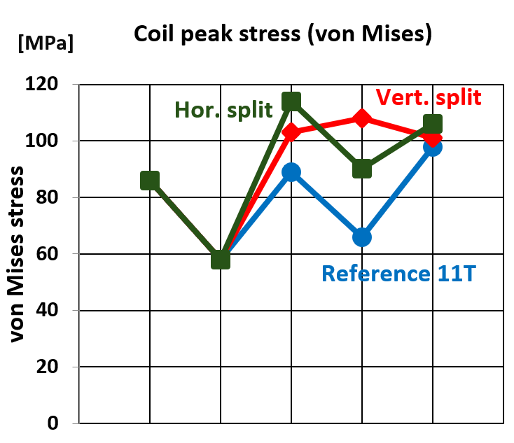
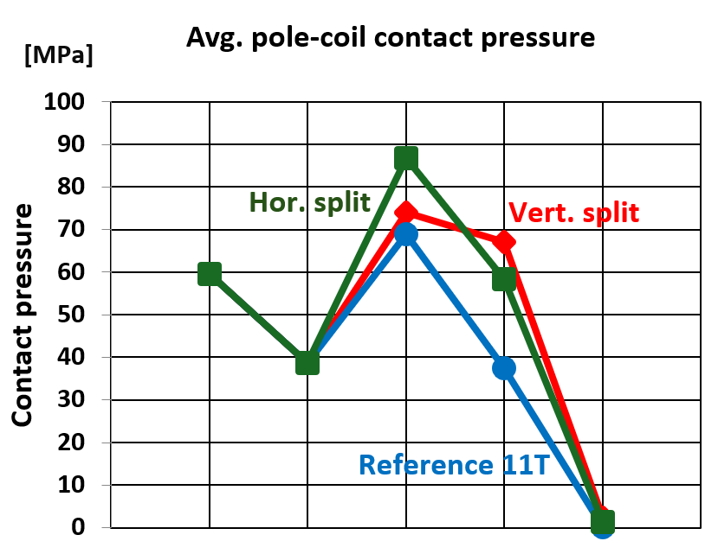
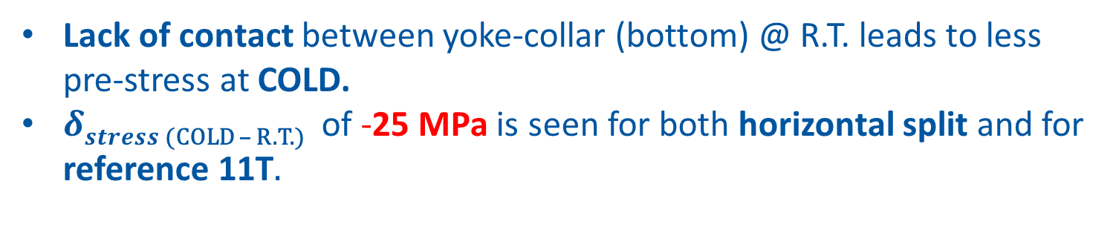

Comparison with horizontal split yokes
Lack of contact between yoke-collar (bottom) @ R.T. leads to less pre-stress at COLD.
$δstress$ _{(COLD – R.T.)} of -25 MPa is seen for both horizontal split and for reference 11T.
$$δstress$$
2.3 MPa
1.7 MPa
0 MPa

Slide 14
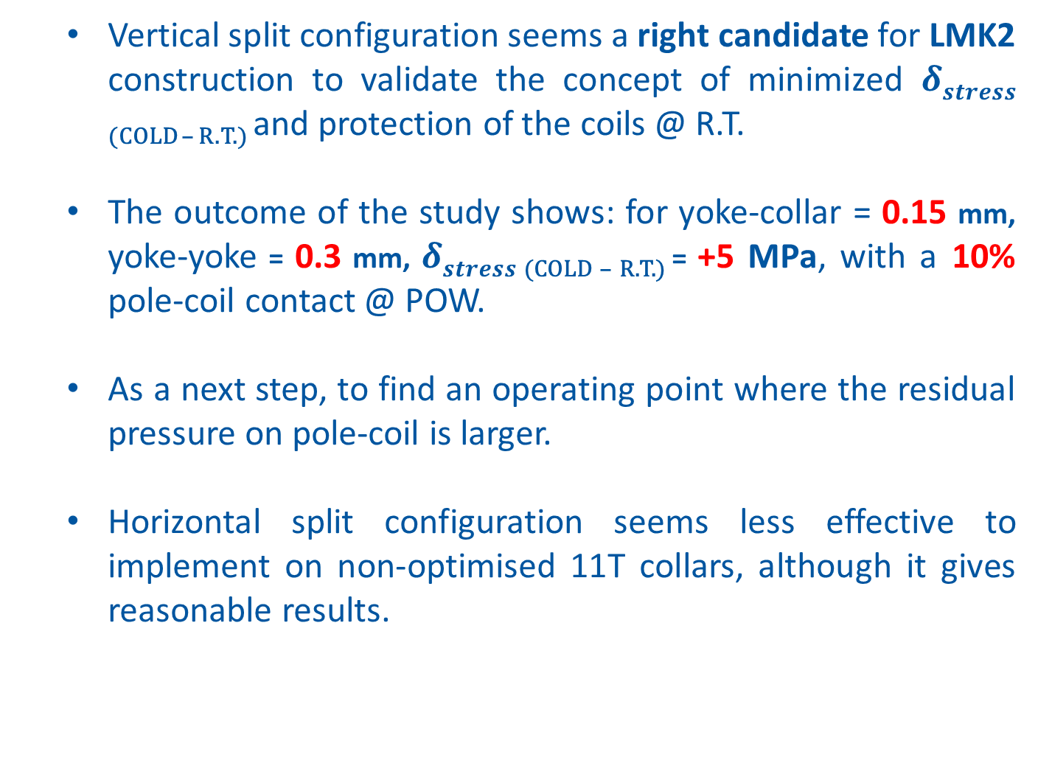
Summary & next steps
  Vertical split configuration seems a right candidate for LMK2 construction to validate the concept of minimized $δstress$ _{(COLD – R.T.)} and protection of the coils @ R.T.
  The outcome of the study shows: for yoke-collar = 0.15 mm, yoke-yoke = 0.3 mm, $δstress$ _{(COLD – R.T.)} = +5 MPa, with a 10% pole-coil contact @ POW.
  As a next step, to find an operating point where the residual pressure on pole-coil is larger.
  Horizontal split configuration seems less effective to implement on non-optimised 11T collars, although it gives reasonable results.

Slide 15
APPENDIX

Slide 16



Sensitivity of yoke-collar gap
Yoke-stopper gap = 0 mm
Parting plane
Yoke-yoke half gap = 0.2 mm
Yoke-collar gap
For gap = 0 mm (nominal), stress is too high at R.T. & COLD.
$$δstress$$
Pole detaches here

Slide 17






Results (Reference 11T model)
Coil Peak Stress:
$σvon Mises$ [MPa]

Slide 18





Results (Reference 11T model)
General Stress State:
$σvon Mises$ [MPa]

