Slide 1
Open Science at CERN
March 2024
Dr. Kamran Naim
Head of Open Science
European Organization for Nuclear Research (CERN)

Slide 2
Overview
Holistic perspective on Open Science
Aligning Policies and Practice
Conclusions

Slide 3

“… and the results of its experimental and theoretical work shall be published or otherwise made generally available.”
CERN CONVENTION, 1954

Slide 4


Open Science
Structures & Process
DATA
PUBLICATIONS
SOFTWARE
HARDWARE

Slide 5

Open Access
1991-2024
2024
SCOAP³ Introduces Open Science Elements
2014
CERN Open Access Policy
1991
arXiv.org
2014
Launch of SCOAP³
2018
APS joins SCOAP³, 90% of OA in HEP

Slide 6
Open Access
Mechanisms
SCOAP³
COLLECTIVE MODELS
Sponsoring consortium for Open Access publishing in Particle Physics.
CERN supports other OA Model transparent for the author (S2O, sponsorship).
OA AGREEMENTS
INDIVIDUAL APC
CERN has negotiated Open Access Agreements with 10+ publishers for 4000+ journals.
For other articles fees can
be centrally covered under Certain conditions.

Slide 7
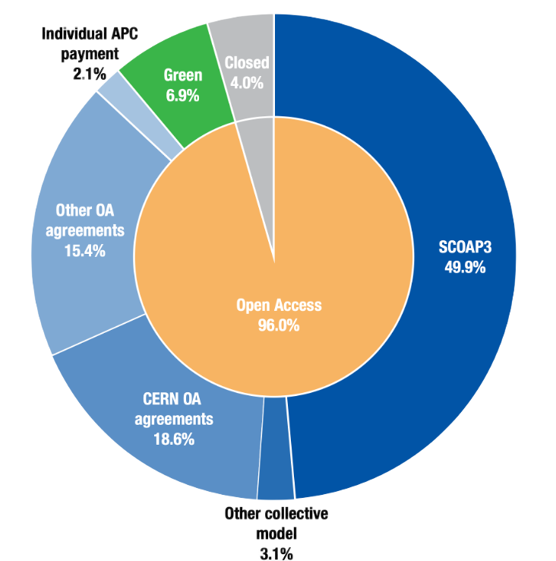
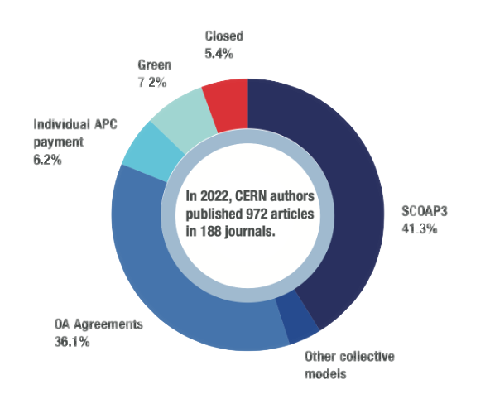
Open Access Statistics
Groundbreaking Results: 96% Open Access in 2023

Slide 8







Supporting Global Open Access & Open Science Infrastructures
Open Access and Open science need a globalized infrastructure…
  With standardized metadata and persistent identifiers (ORCID, ROR, CrossRef, OA Switchboard…)
  And Open Infrastructure created and used by the community (DOAJ, OAPEN, OJS…)

Slide 9
Open Data

Slide 10

Open Data
2012-2024
2020
LHC Open Data Policy
2012
CMS Open Data Policy
2024
2012
2014
More than 5000TB of data in CERN Open Data Portal
HEPdata connected with INSPIRE
CERN Open Data Portal

Slide 11

Open Data
Akopov et al., Status report of the DPHEP Study Group: Towards a global effort for sustainable data preservation in high energy physics. arXiv preprint arXiv:1205.4667 (2012).
1
Additional documentation
for published results.
Data Levels
GigaBytes
2
Simplified data formats for analysis in outreach and training exercises.
TeraBytes
3
Reconstructed data & simulations
for scientific analysis.
PetaBytes
4
EXaBytes
Basic raw level data and their associated software which
allows access to full potential of experimental data.

Slide 12


Published in 2020
All experiments engage into opening datasets to the world.
4 levels of data: commitment is for levels 1, 2, 3, due to level 4 volumes and complexity.
All data are released with persistent identifiers.
Data and associated data services apply open and FAIR principles.
CC-0 waivers are applied as standard.
Researchers and experiments are expected to develop data management plans for their research activities.
Level 3 Releases: calibrated reconstructed data with the level of detail useful for algorithmic, performance and physics studies.
Release of these data will be accompanied by:
  provenance metadata;
  simulated data samples;
  Analysis software;
  Reproducible example analysis workflows; and
  Virtual computing environments.
Full Policy Text

Slide 13
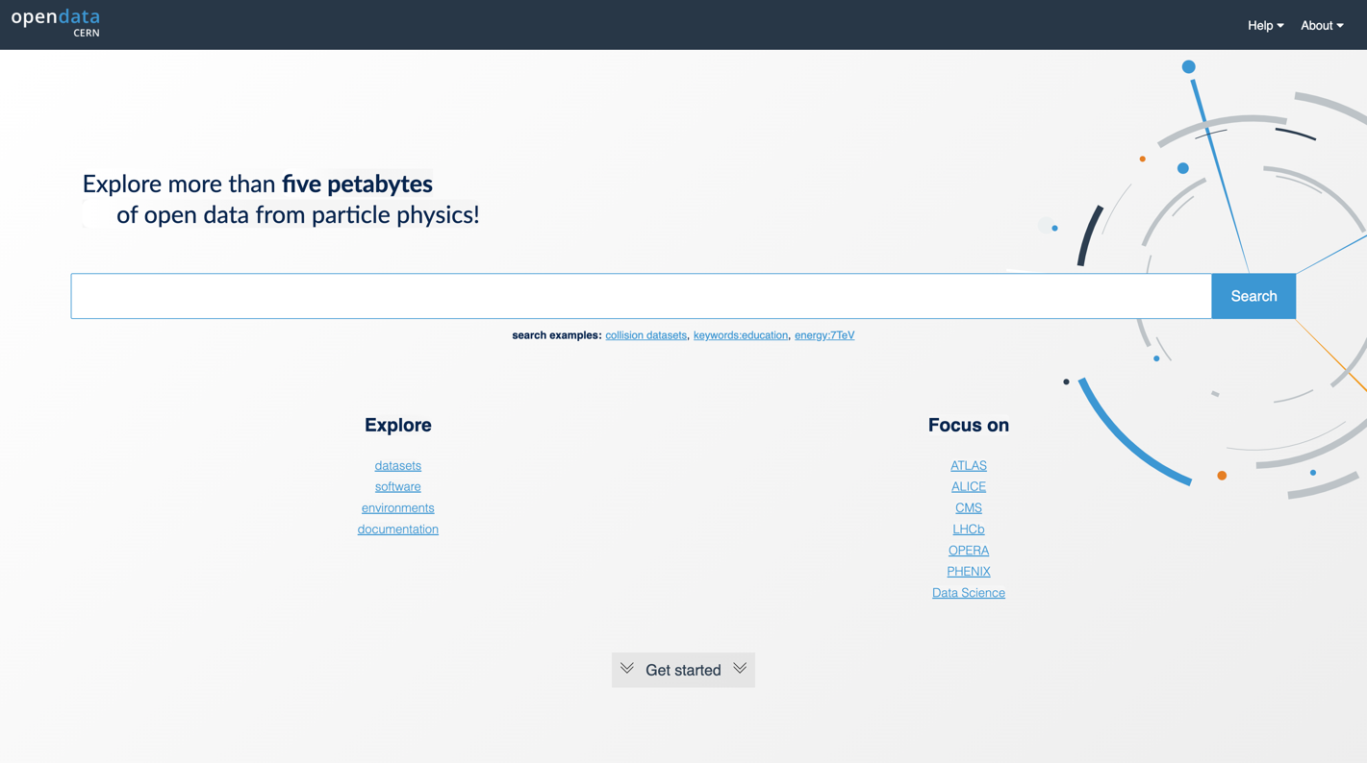
https://opendata.cern.ch/

Slide 14

Open Software
1993-2023
1993
WWW released into public domain
2002
Indico, Invenio
1995
ROOT
2023
CERN Open Source Program Office (OSPO) launched

Slide 15

Open Hardware
2008-2024
2020
2011
CERN OHL V2
2023
CERN Open Hardware License V1
CERN OSPO
2008
White Rabbit
2024
White Rabbit Collaboration established
2023
2011
KiCad supported through commercial company
CERN joins KiCad development
2009
Open Hardware Repository

Slide 16
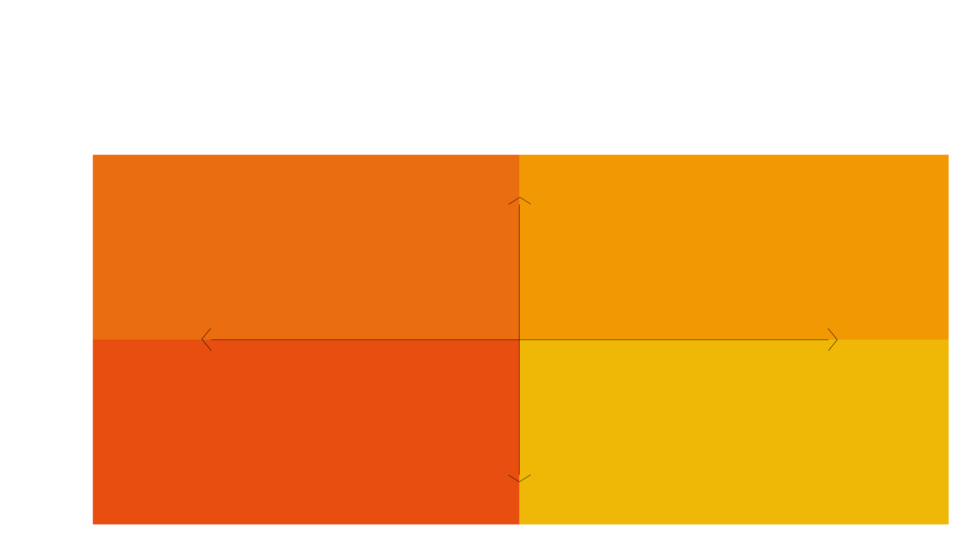
CERN
Open Source
Program Office
STRATEGIC
OS Policy
OSPO Mandate
OSPO Outreach
OS Partnership
INTERNAL
EXTERNAL
Licensing
Tips & Tools
OSPO Catalogue
CLA Management
OPERATIONAL

Slide 17

Incentives
2022-2024
2024
Preliminary CoARA Action Plan prepared
2022
CERN signs CoARA Agreement

Slide 18
18
Research
Asessment
Recognize the diversity of contributions to, and careers in, research in accordance with the needs and nature of the research.
Base research assessment primarily on qualitative evaluation for which peer review is central, supported by responsible use of quantitative indicators.
Abandon inappropriate uses in research assessment of journal and publication-based metrics, in particular inappropriate uses of Journal Impact Factor (JIF) and h-index.
Avoid the use of rankings of research organizations in research assessment.
CoARA

Slide 19
Research
Assessment
The CoARA principles are well aligned with CERN Values and established particles physics practices.
To further enhance this alignment, the following actions will be taken in the next five years:
Promote open science, teaching outreach activities.
Acknowledge diverse career trajectories within
the institution.
Acknowledge the societal impact of research taking
place at CERN.
CoARA at CERN

Slide 20

Policies
2023
2014-2025
OS Governance Framework
implement of OS Policy
align with CERN strategy
2021
2014
CERN Open Science Strategy Working group to devise organisational
OS policy
CERN Open Access Policy Published
2025
CERN to publish first OS report
2020
LHC Open Data Policy Published
2021
CERN contributes to development of UNESCO Open Science recommendation
2023
CERN publishes OS implementation plan
2020
ESSP Update states:
“The particle physics community should work with the relevant authorities to help, shape the emerging consensus on Open Science to be adopted for publicly-funded research, and should then implement a policy of Open Science field.”
2022
CERN publishes its first organizational OS Policy

Slide 21
Policy accompanied by implementation document outlining roles, responsibilities, mechanisms & resources
Includes actionable measures to support the policy’s implementation across the organization and in the experiments@CERN
Implementation led by Communities of Practice across the various OS activities
Identifies/surfaces both existing and required resources for policy implementation
Published openly here.

Slide 22
Open Science
Creating efficient and effective coordination
of CERN´s Open Science efforts.
Governance Framework
OPEN SCIENCE STEERING BOARD
To oversee OS efforts at the strategic level.
Reports to DRC.
Inter-departmental body (currently 15 members).
OPEN SCIENCE PRACTITIONERS' FORUM
De-facto continuation of the OSWG
CERN-wide Exchange amongst different OS expert groups.
OSPF elects a member to represent it at the OSSB.
OPEN SCIENCE OFFICE
Organisationally set up in RCS-SIS-OS
Support of different expert groups, OSPF and OSSB, coordinates communication efforts and creation of OS Report.
Provides additional concrete services to CERN community (e.g. advice on creating Data Management Plans)

Slide 23

Open Science
Creating efficient and effective coordination of CERN´s Open Science efforts.
Director of Research
and Computing
Governance
Framework
Open Science
Steering Board
OS Practitioners Forum
OS Office
Open Data WG
CoARA Implementation WG
Interest Groups
SIPB
OSPO

Slide 24

CERN
Infrastructure
A set of technological tools and services that support and enable open science practices.

Slide 25
Open
Infrastructure
Services & Activities
CERN
Open Data
Portal
CERN
Analysis
Preservation
REANA
(Reproducible Analysis)
INSPIRE
CERN
Document
Server
Open
Hardware
Repository
Indico
Zenodo

Slide 27
Grassroots efforts aligned with evolving policy frameworks, organizational resources, and technical developments to support implementation.
Building sustainable solutions requires resources and cooperative approaches.
Public goods well supported through collaborative approaches/governance models.
Building community around technological solutions can support development and sustainability.
Interface between research communities mediated by infrastructure: software, services.
Collaboration is key!

Slide 28
Dr. Kamran Naim
Head of Open Science
European Organization for Nuclear Research (CERN)
kamran.naim@cern.ch

