Slide 1
Grayloc Discussion
10/03/2025

Slide 2
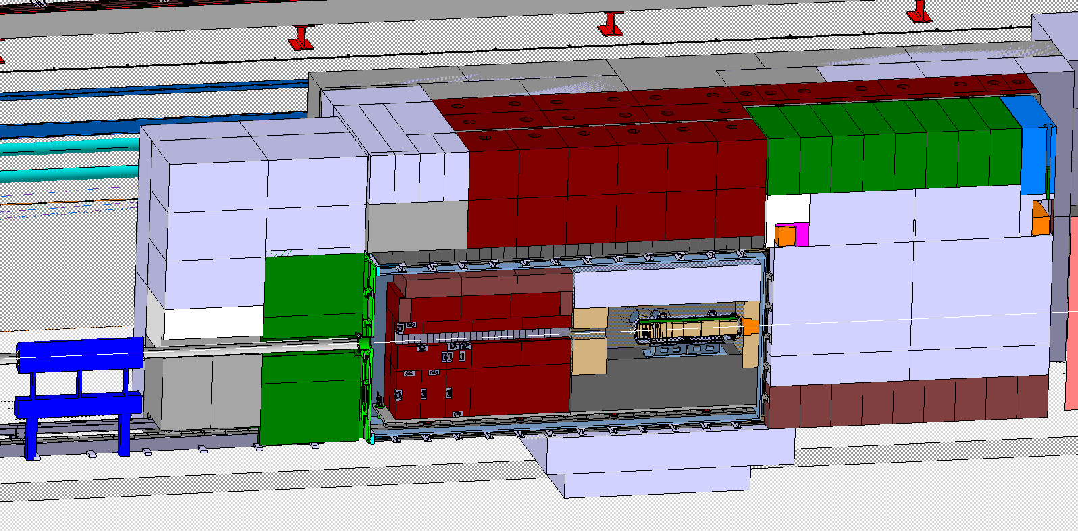
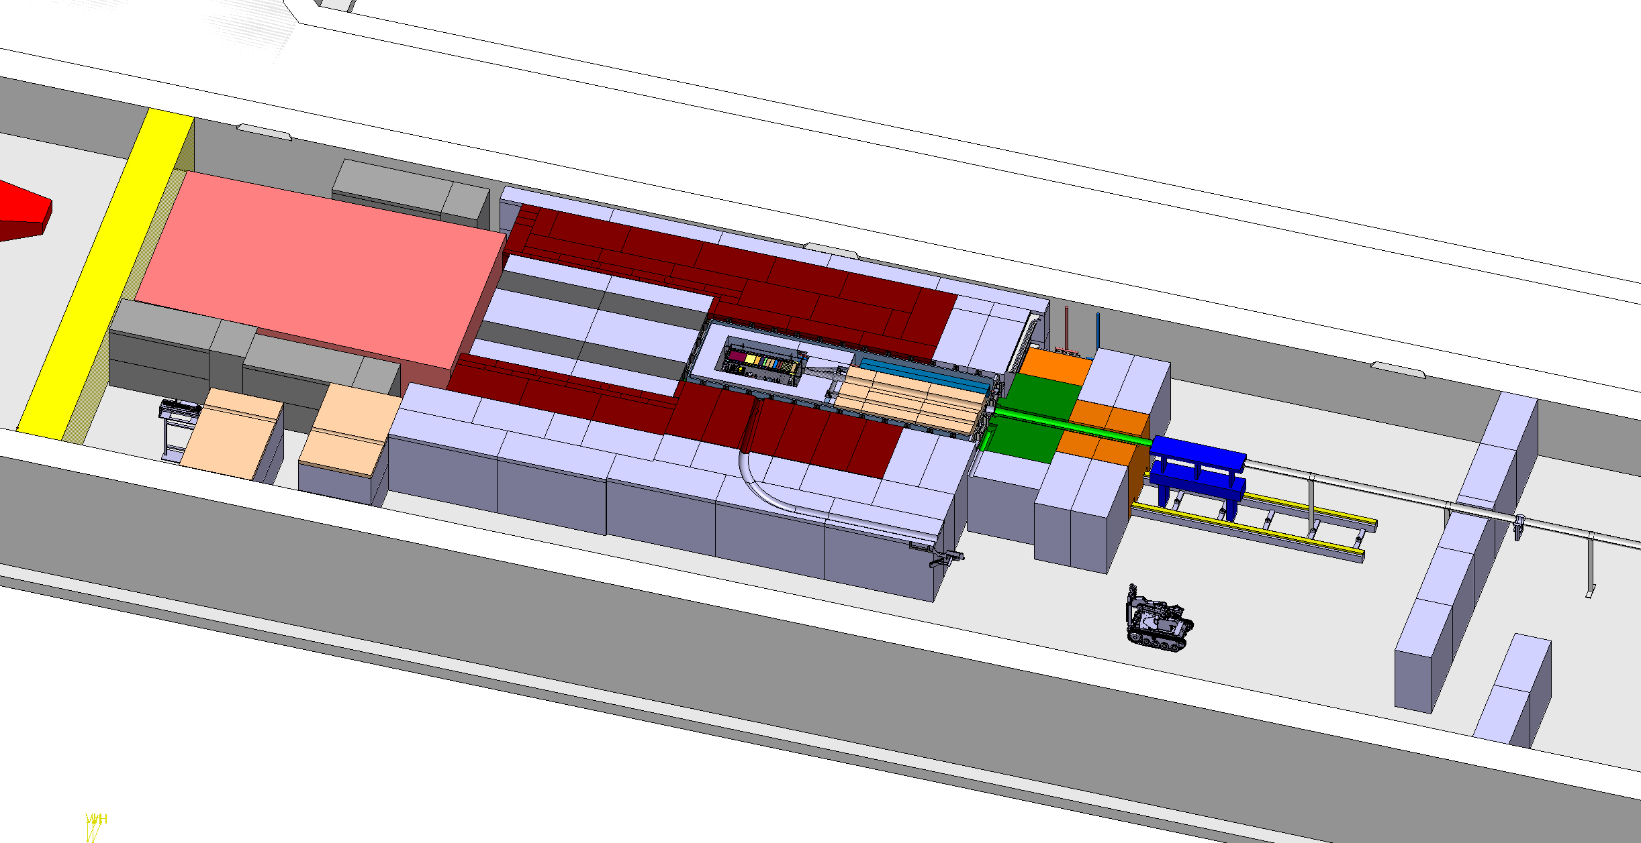
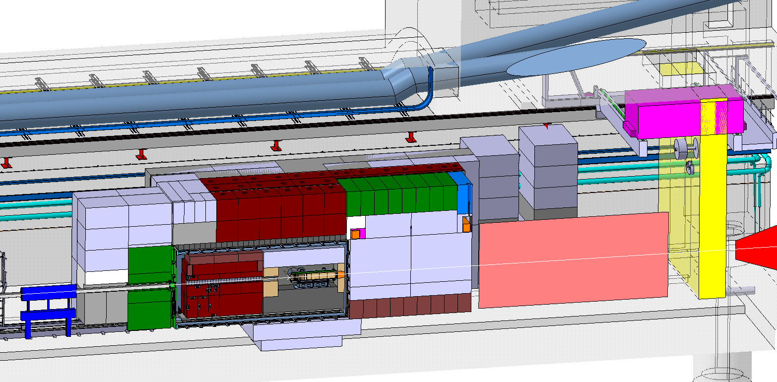
BDF Target complex integration
Upstream Shielding
Above Coil Shielding
Target area
Confinement wall
Beam instrumentation
Diluted Proton beam from SPS
Magnetised
shielding
SHIP experiment
Vacuum confinement
Mobile Shielding
Target
Water cooled proximity shielding
Space for shielding temporary storage
Target station
Collimator
Access chicane
In-Ground Shielding

Slide 3
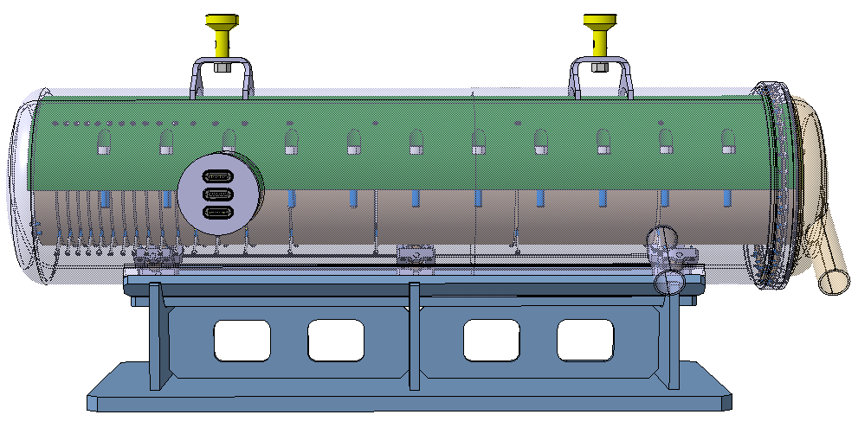
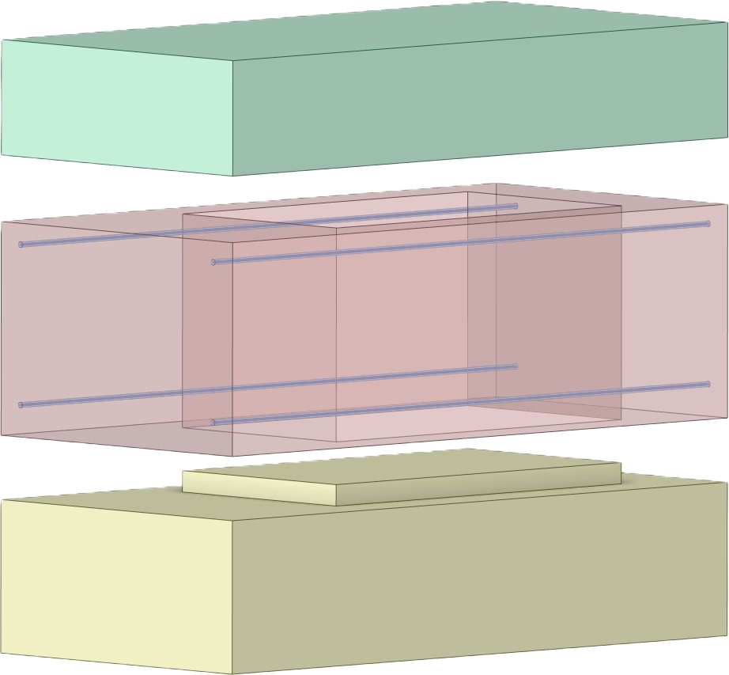
Vacuum Vessel Overview
2050mm
6410mm
2965mm
1.5m Tungsten Target
Cooling Pipes
Vacuum vessel containing helium-cooled target and water-cooled proximity shielding with a 10-3mbar vacuum
1.58 m
3.16 m
Copper Alloy Proximity Shielding

Slide 4
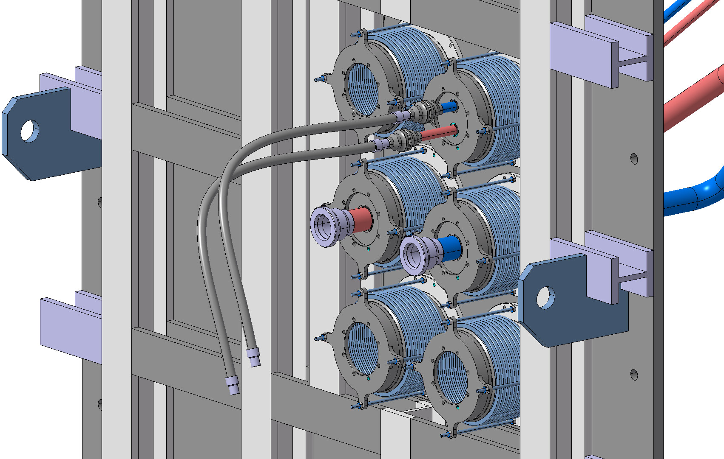
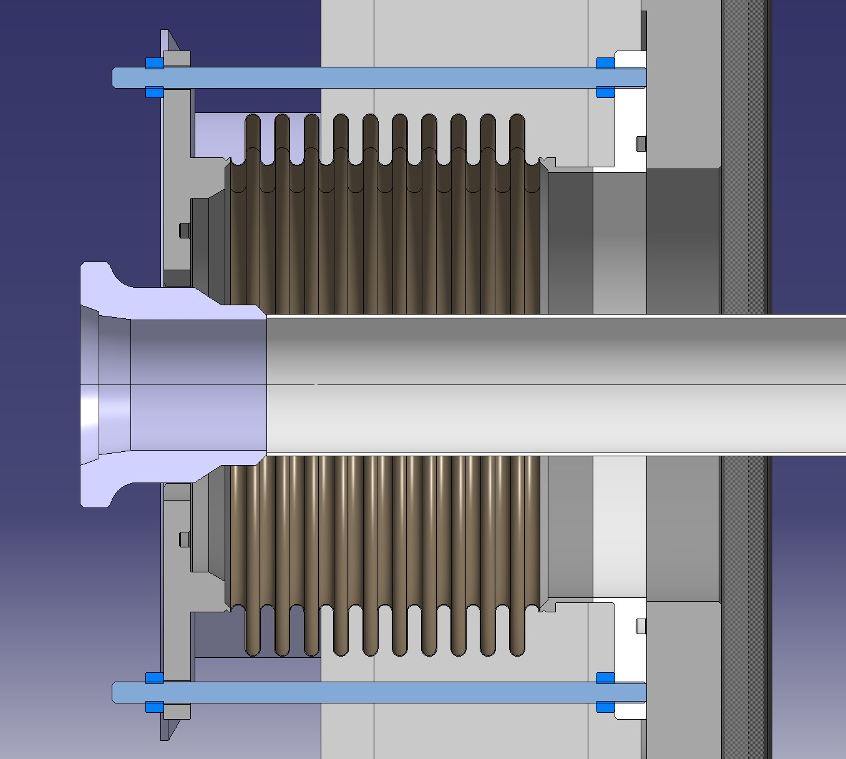
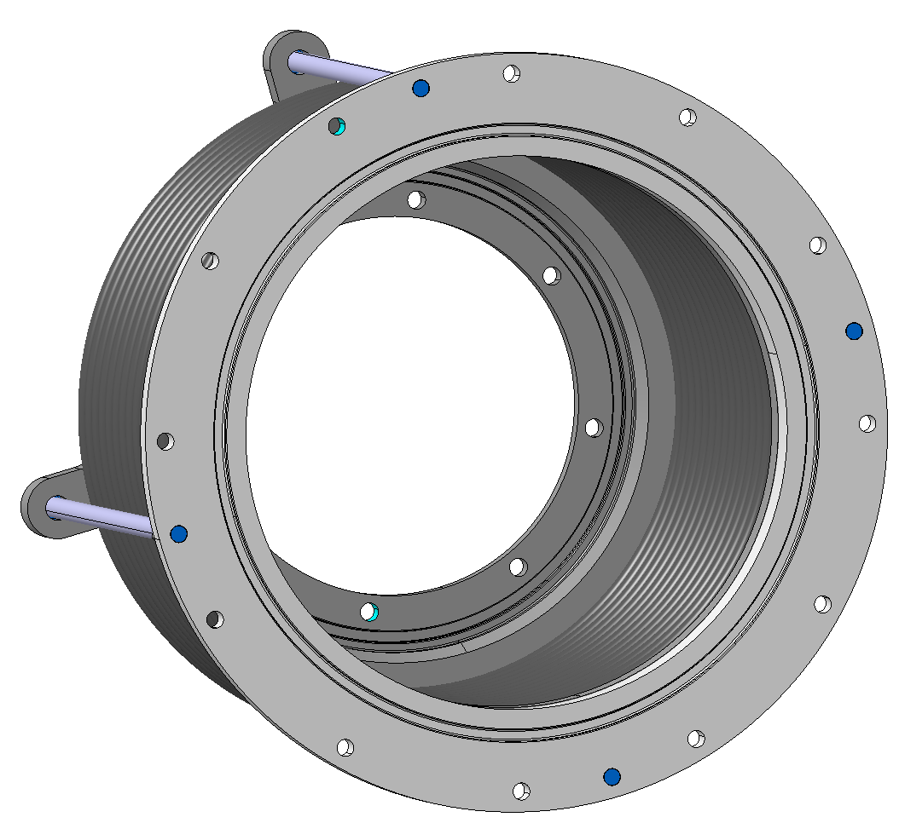
Feedthrough Connections
Proximity Shielding water cooling
DN200 Bellow
Grayloc connection to be fitted onwards from the bellows
Extra feedthroughs for instrumentation
Target Helium Cooling

Slide 5
Foreseen Parameters
Pipe Size: DN50
Pipe thickness: potentially 8-10mm
Pressure: 16 bar (a)
Temperature: 200 °C
Radiation level in this area: 1-5kGy/year
Flow rate: 400g/s
Leak rate: 10^-6 mbar.l/s
Medium: Helium gas
Expected lifetime: at least 15 years

