Slide 1
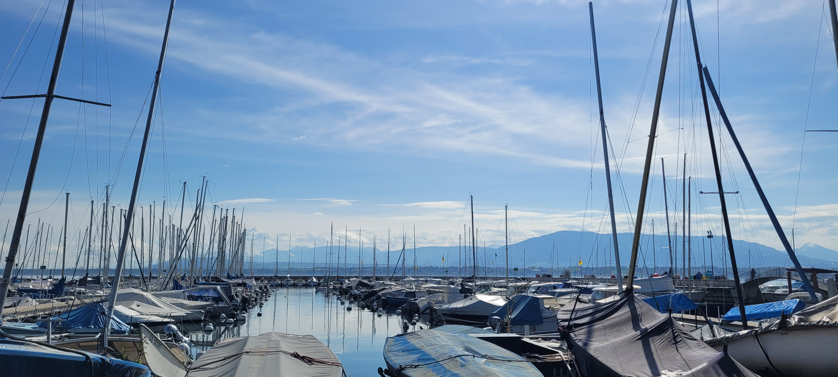

Level 0 course 2025
by Anastazja Sędzicka and Mathias Monier
Level 0 course coordinators

Slide 2
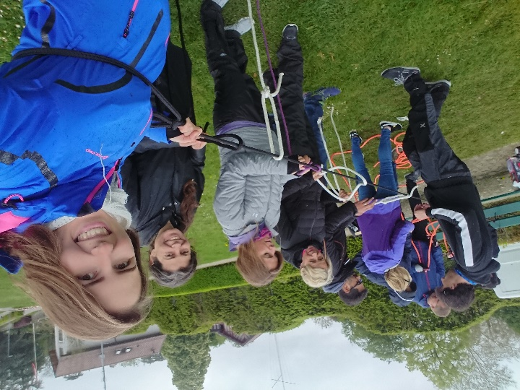
Program
Level 0
Theoretical introduction
  Safety (what is my responsibility as a skipper/crew/YCC member? How I keep myself and others safe?)
  Equipment needed for sailing
  Port Choiseul in Versoix (YCC boats)
  Sailing basics (how sailing works? What are the points of wind? How do I manoeuver?)
  Social aspect of the club
  Sailing theory for beginners introduction (on-site at CERN and online) by Sebastian Łopieński
1-day course (~ 8h30-16h00 OR 18h00)
  Surprise sailing 2 hours
  Rigging the dinghy 1 hour
  Knots 1 hour
Summery + questions
Preliminary dates: April 12 (Sat)
April 13 (Sun)
May 11 (Sun)

Slide 3
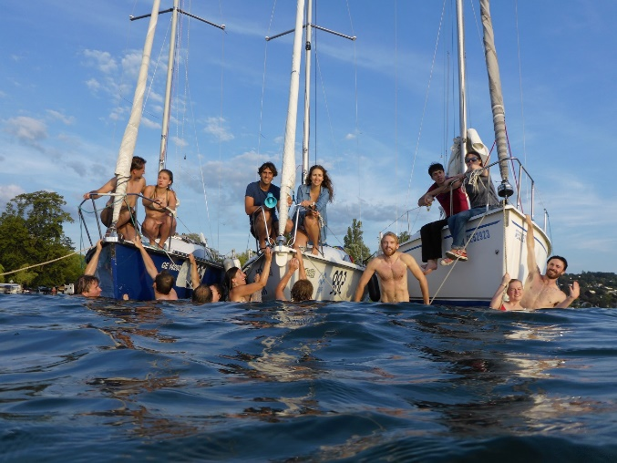

Info
Level 0
  To take part you need:
  to already be a ycc member the day before the course
  … and be a new member of the club for 2024
  To join our level 0 WhatsApp group, click the link
Subscriptions possible by:
1. ‘interested in level 0’ while subscribing part in the lottery
(possible also if you do not want to take part in any lottery course!)
2. Filling the subscription form (after the lottery is over or before)
  Your subscription will await verification as only active YCC members are accepted.
  Other useful links: YCC webpage, YCC fb page

