Slide 1
CERN Archives & Library section Presentation of the library
Lydia Pieper & Salomé Rohr
17 March 2025

Slide 2
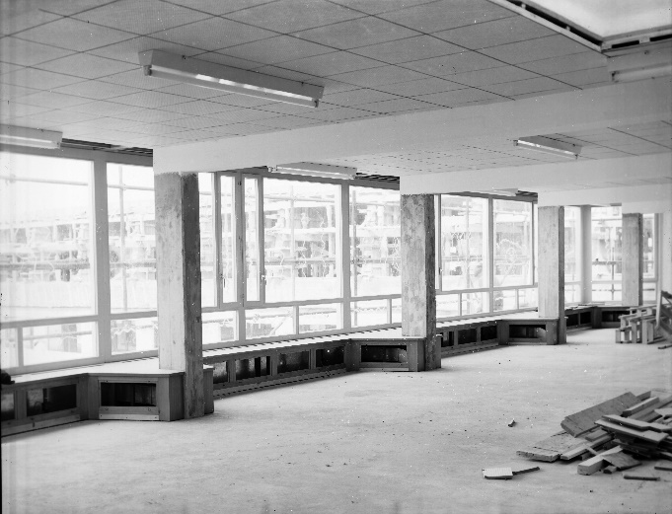
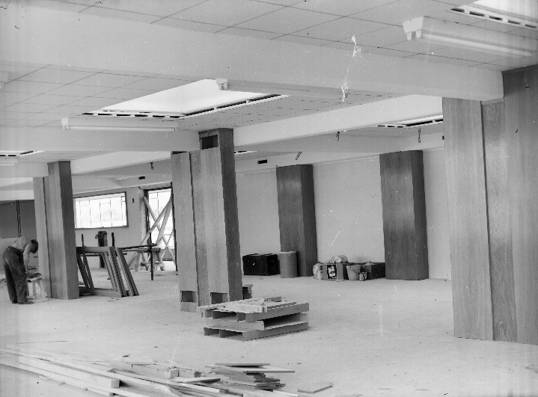
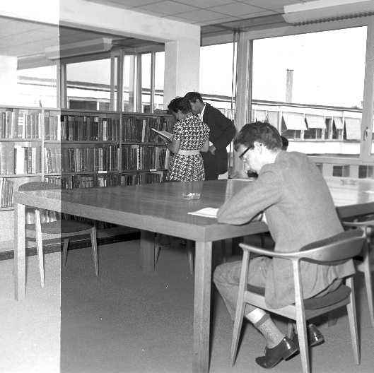
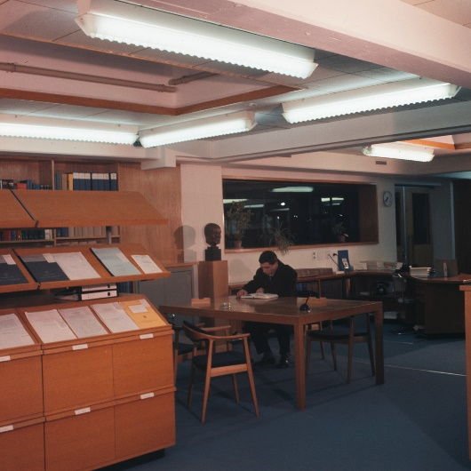
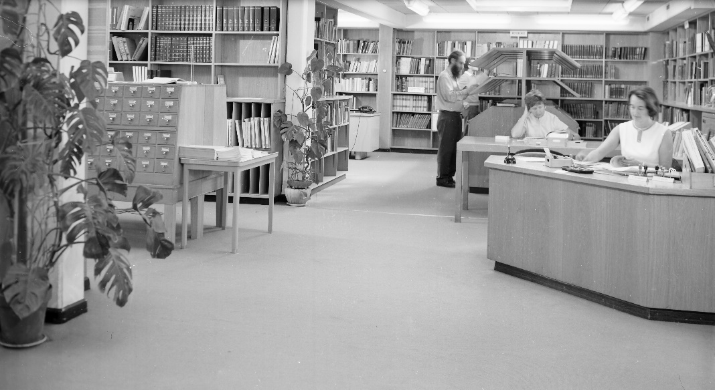
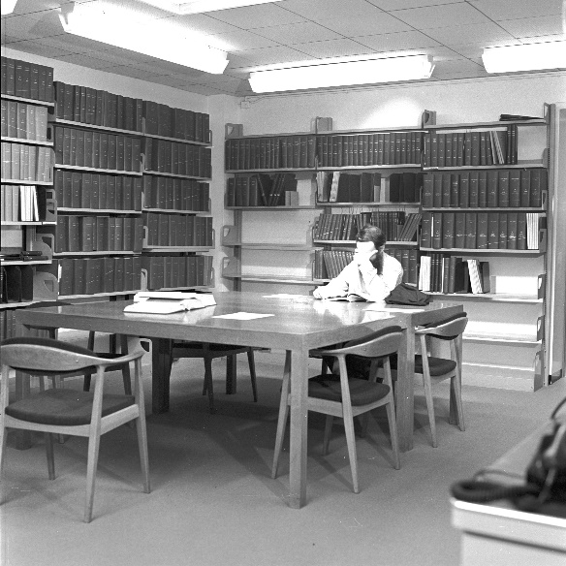
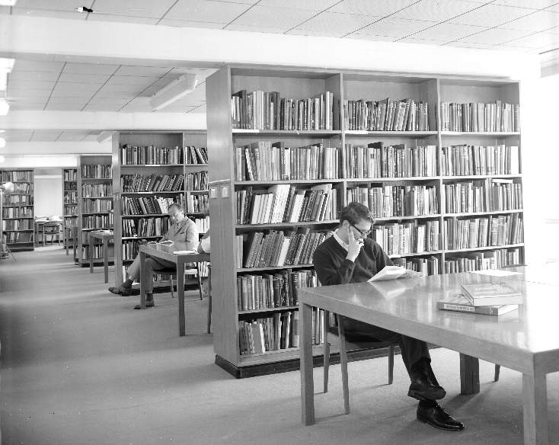
Historical views of the Library
1957 - Construction
1962
1964
1968

Slide 3
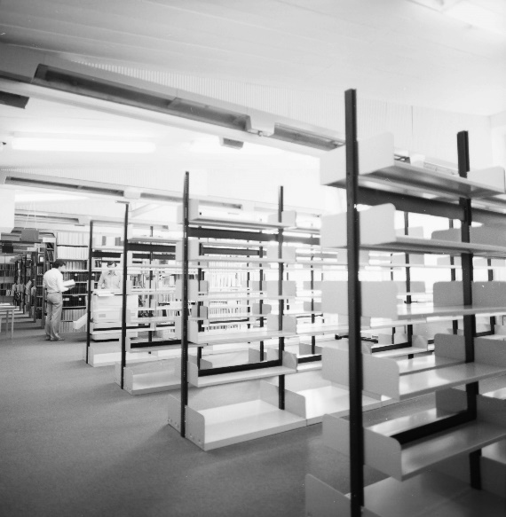
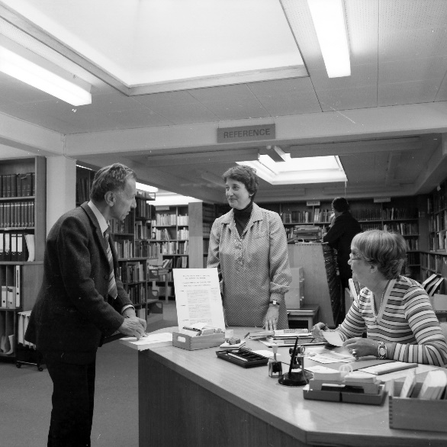
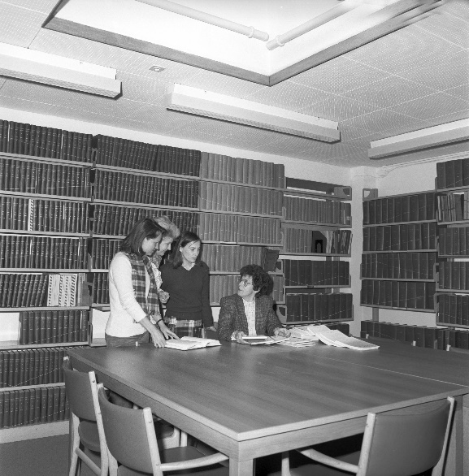
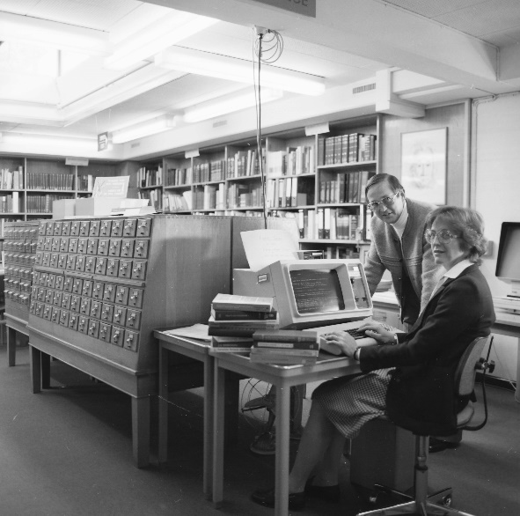
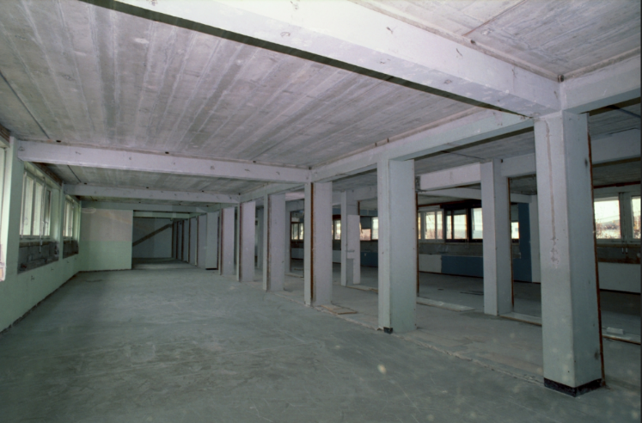
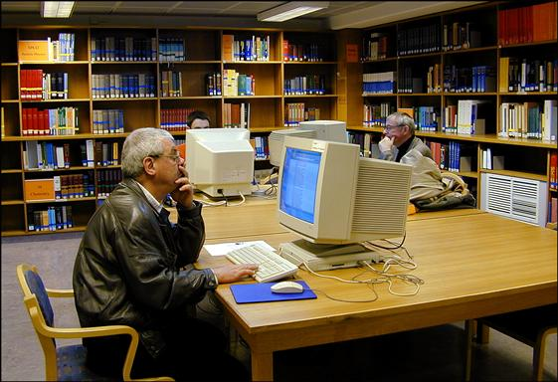
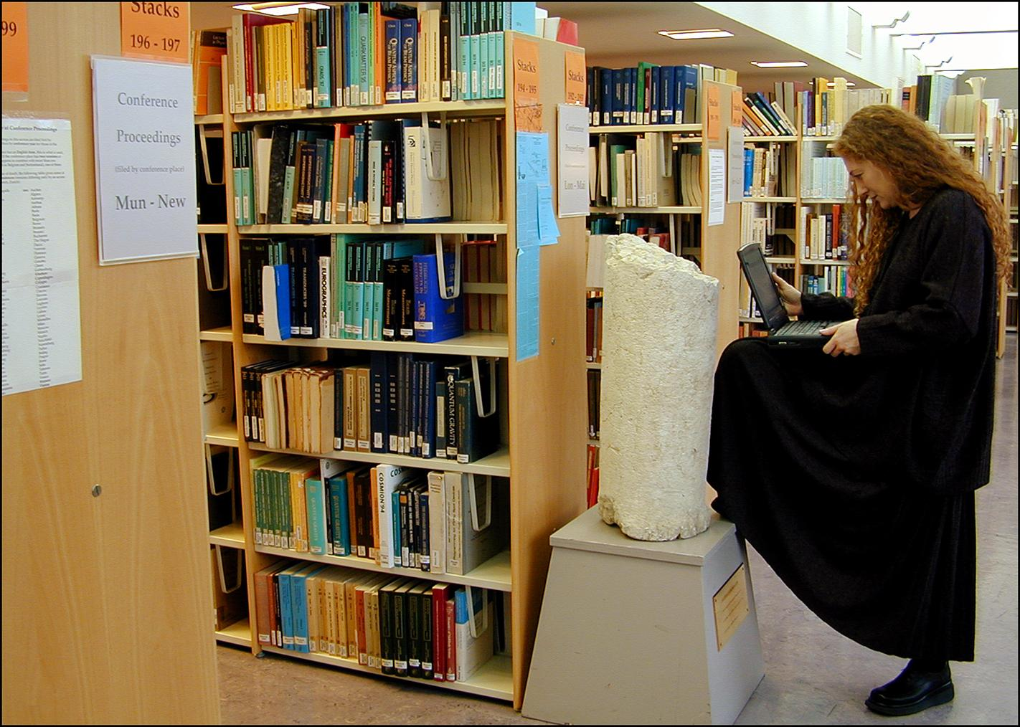
Historical views of the Library
1979 - Extension of the Central Library into building 3
1981
1983
1996 - Expansion of the Library to the ground-floor of building 52
2001

Slide 4
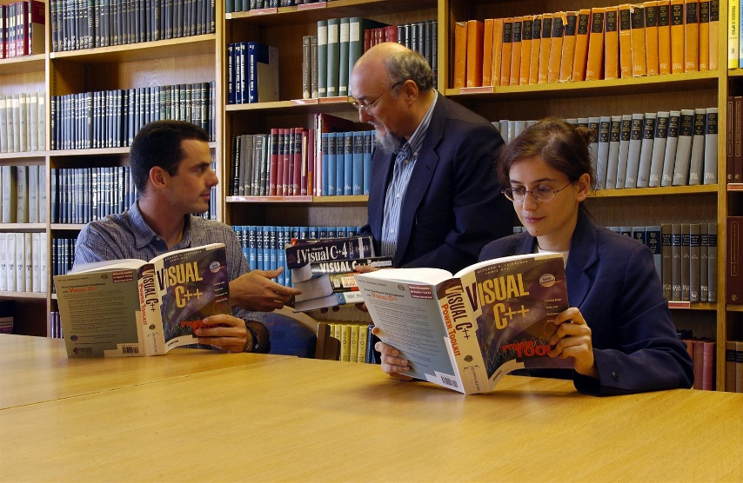
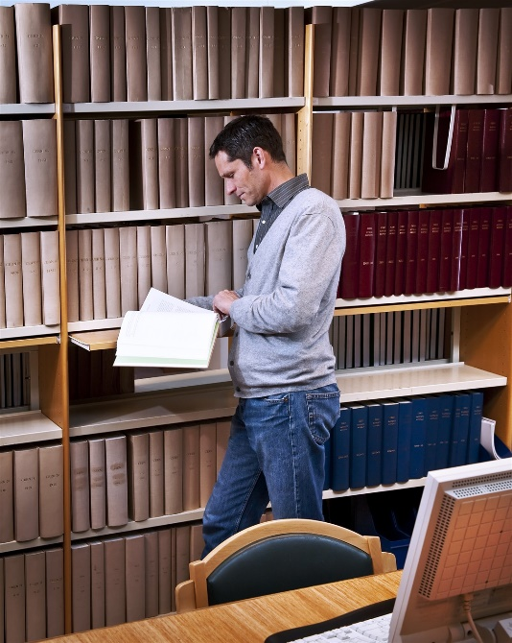
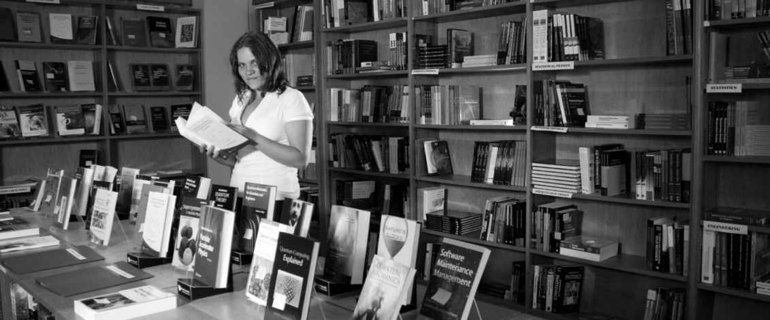
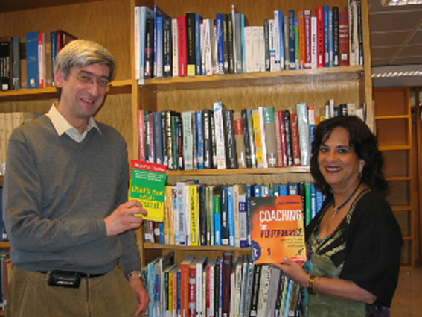
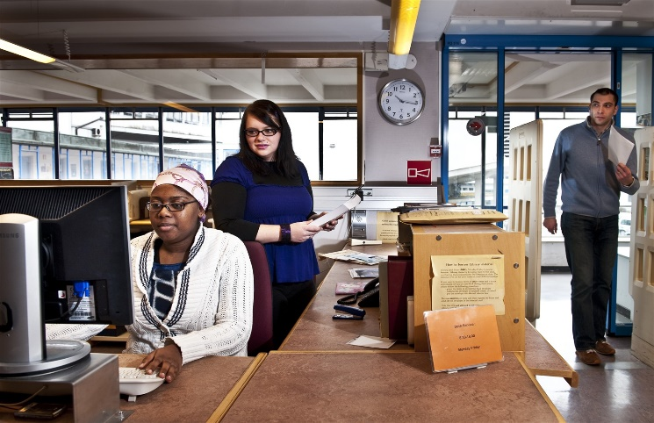
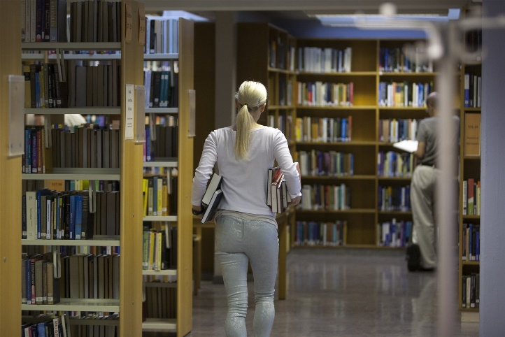
Historical views of the Library
2003
2008
2009
2012

Slide 5
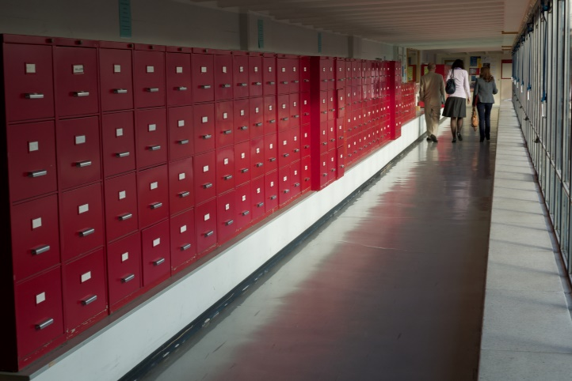
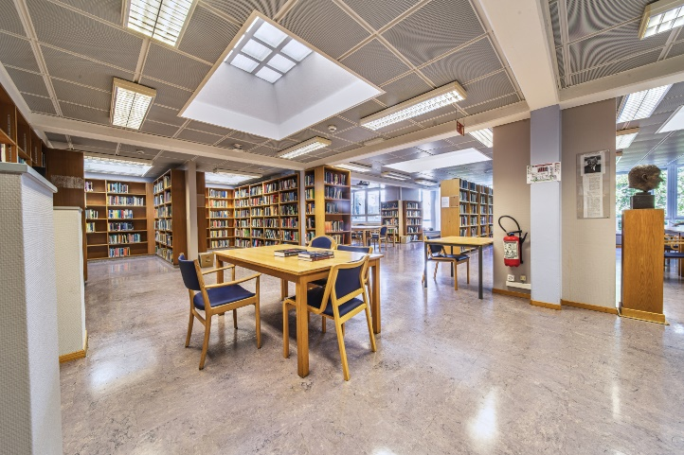
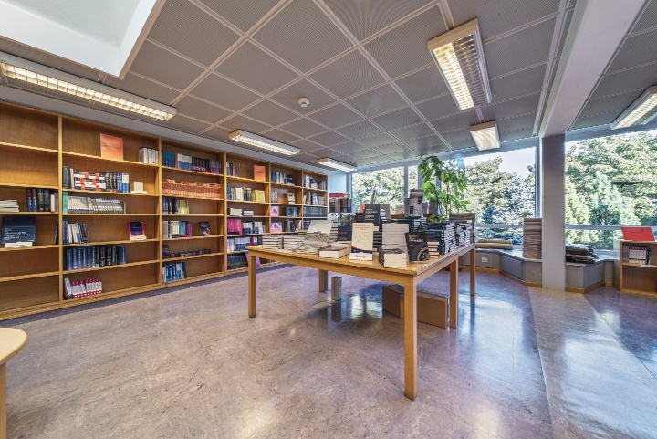
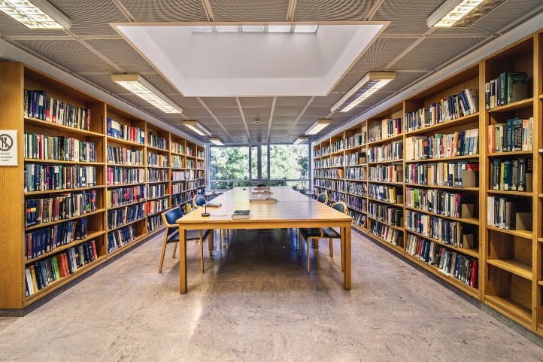
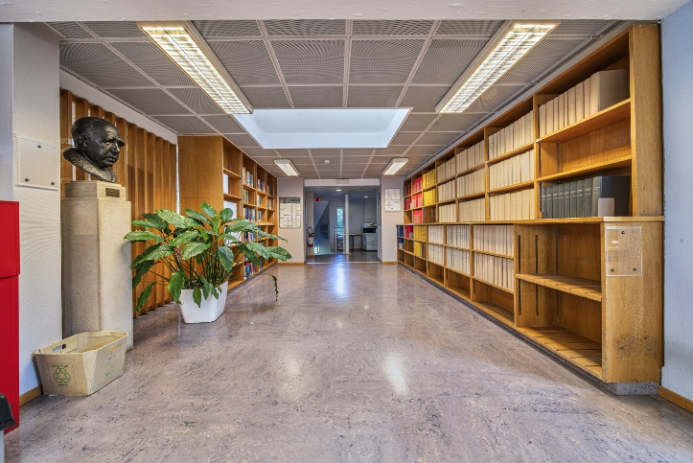
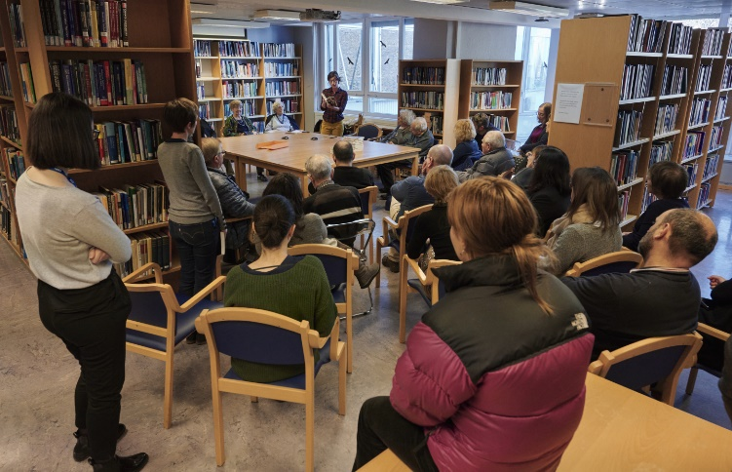
Historical views of the Library
2019
2020

Slide 6

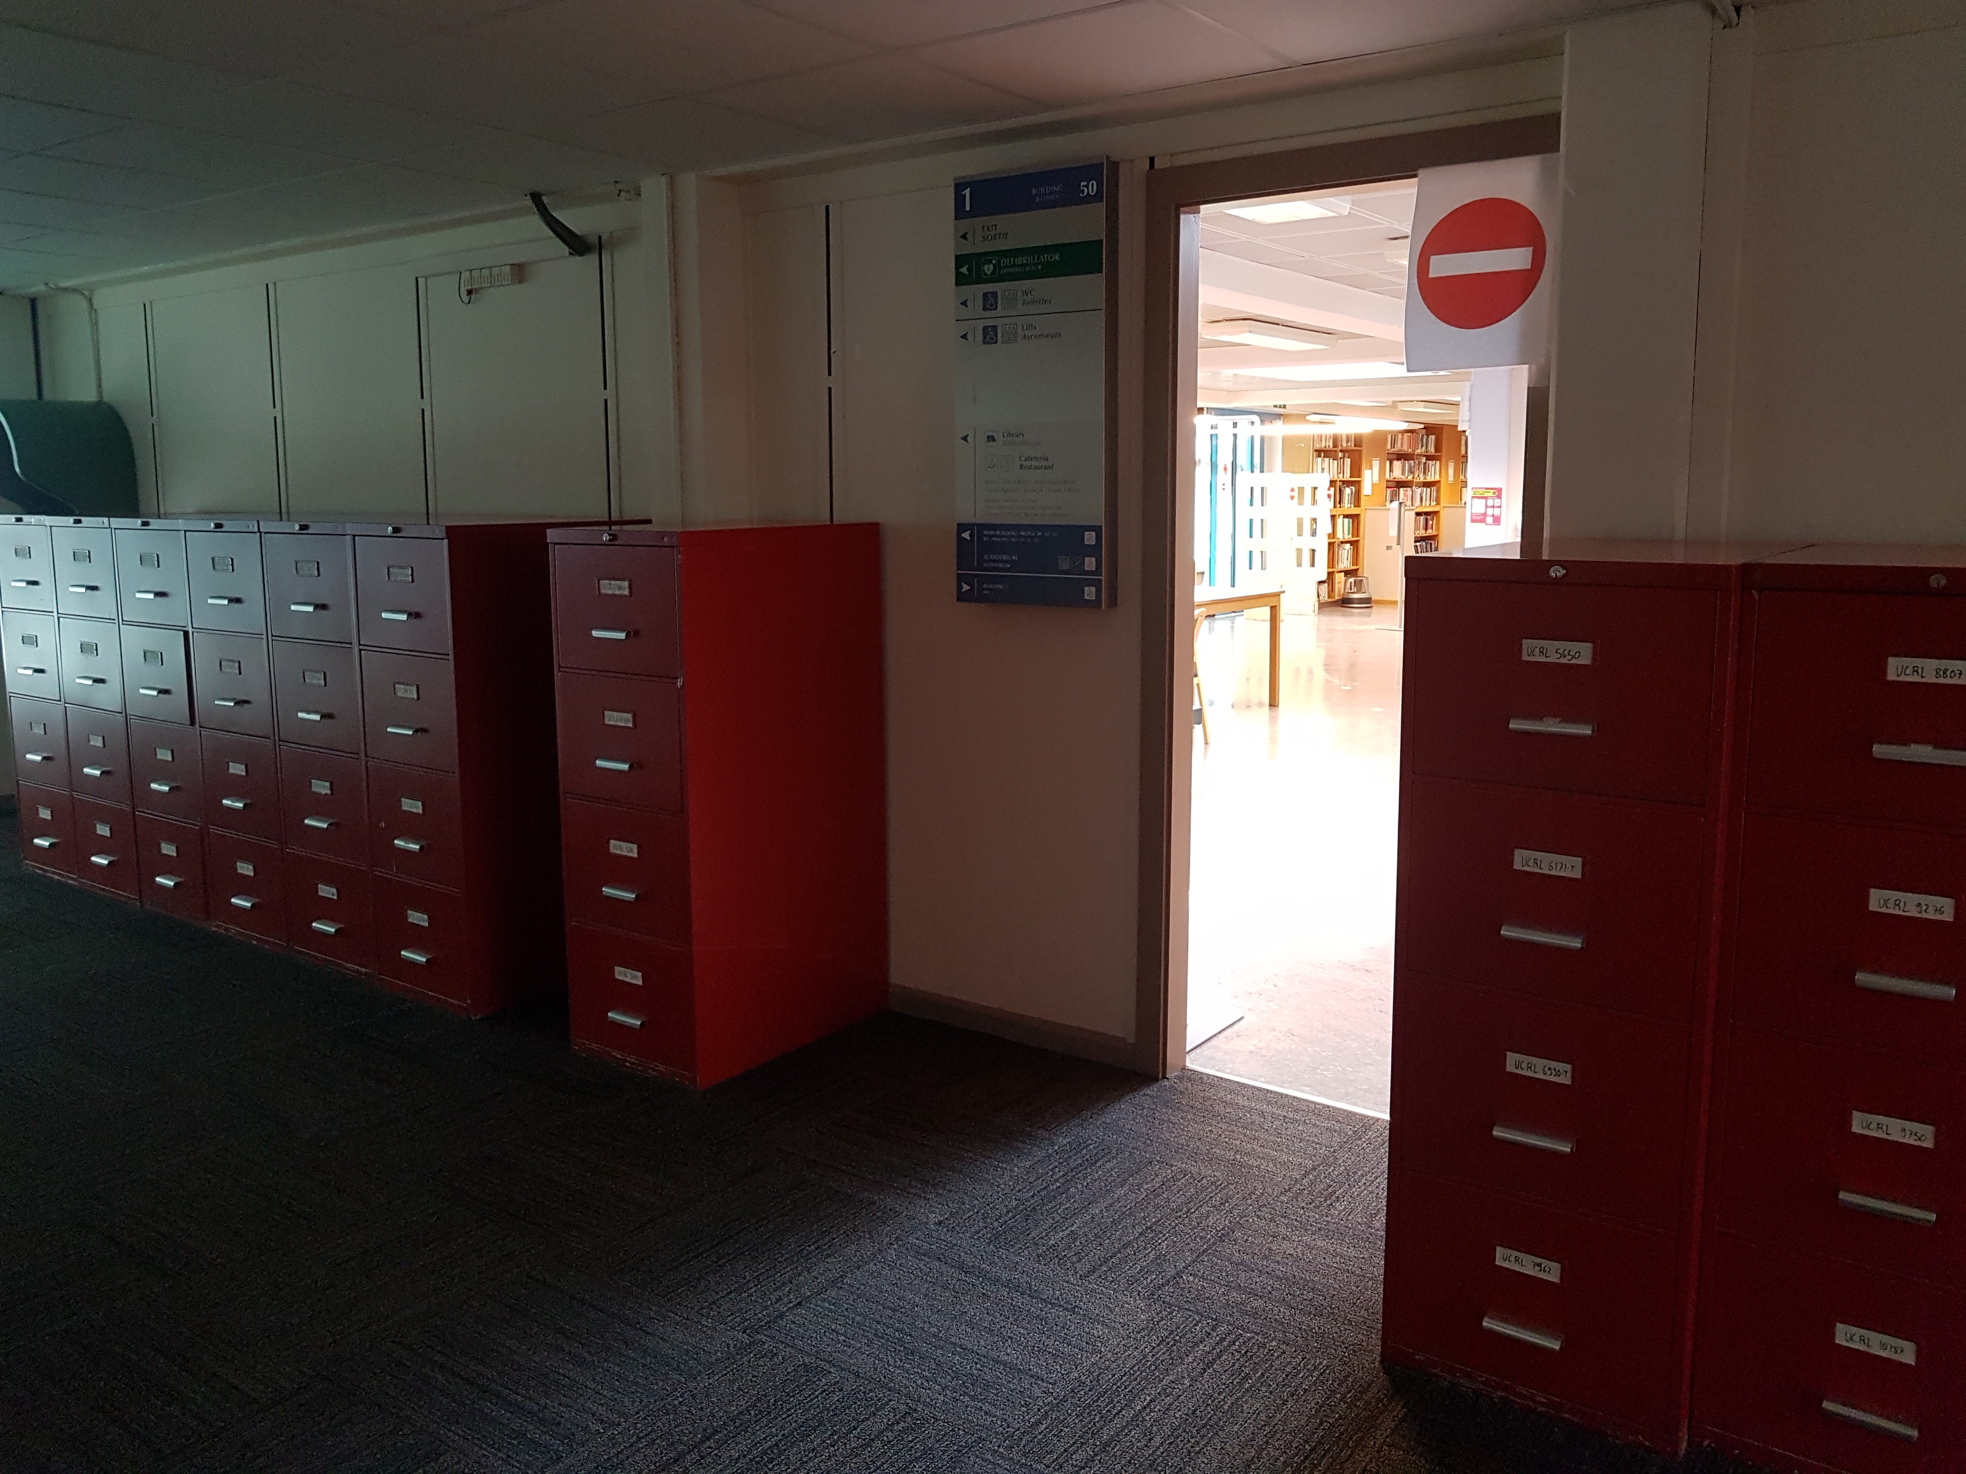
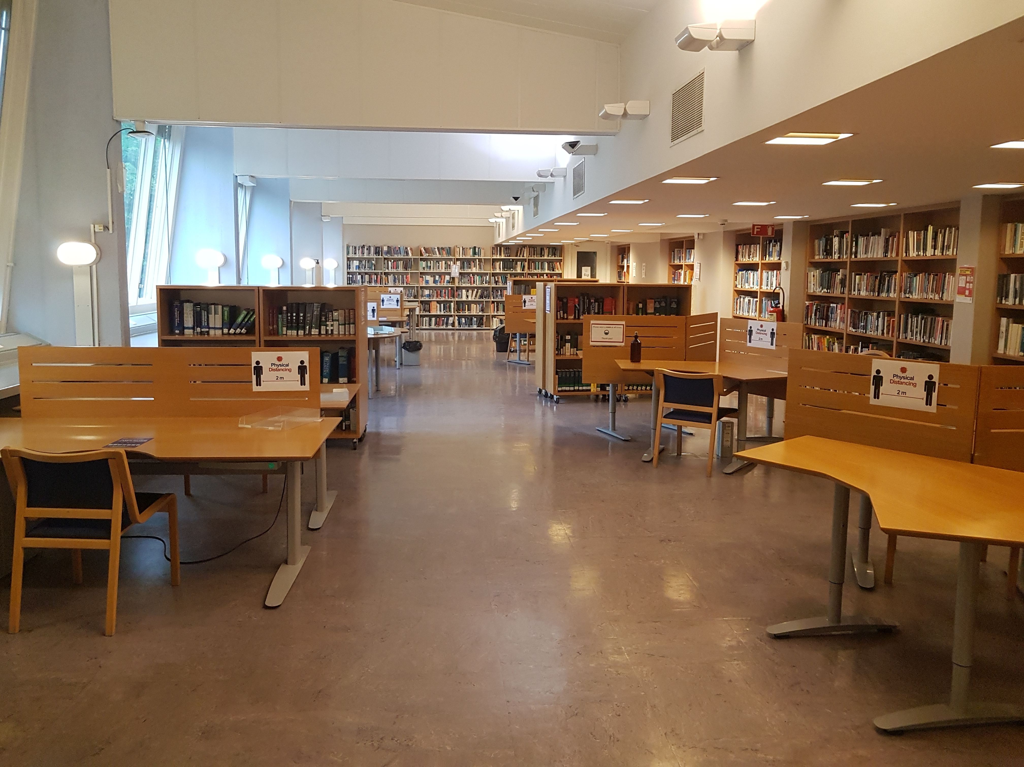
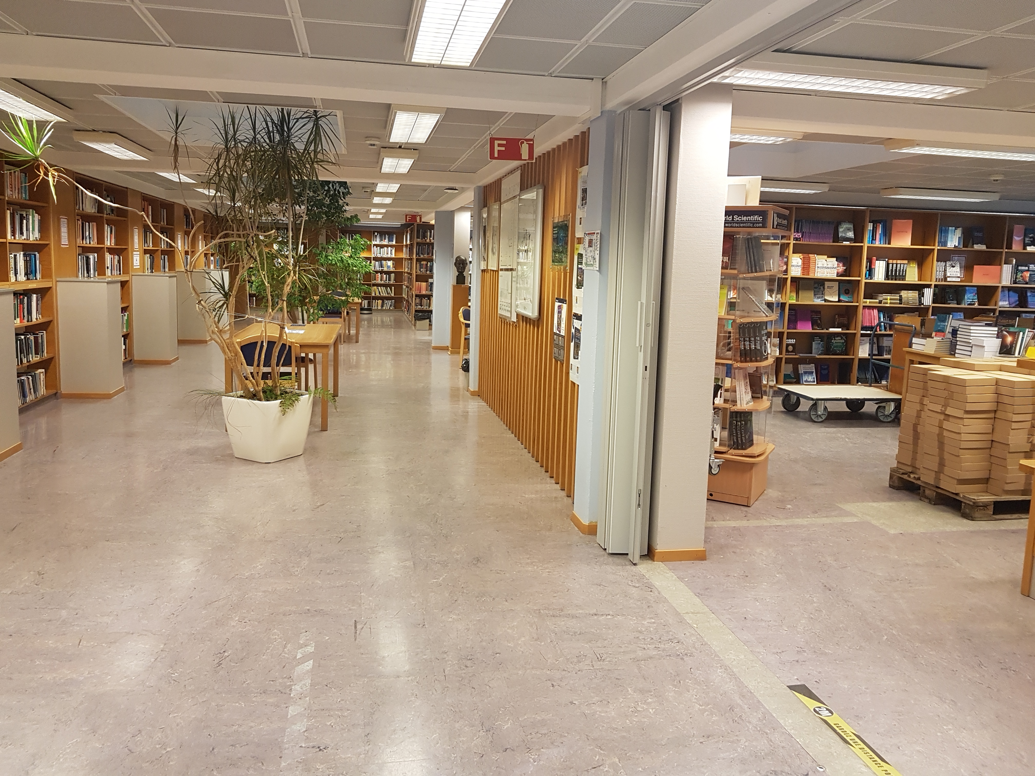
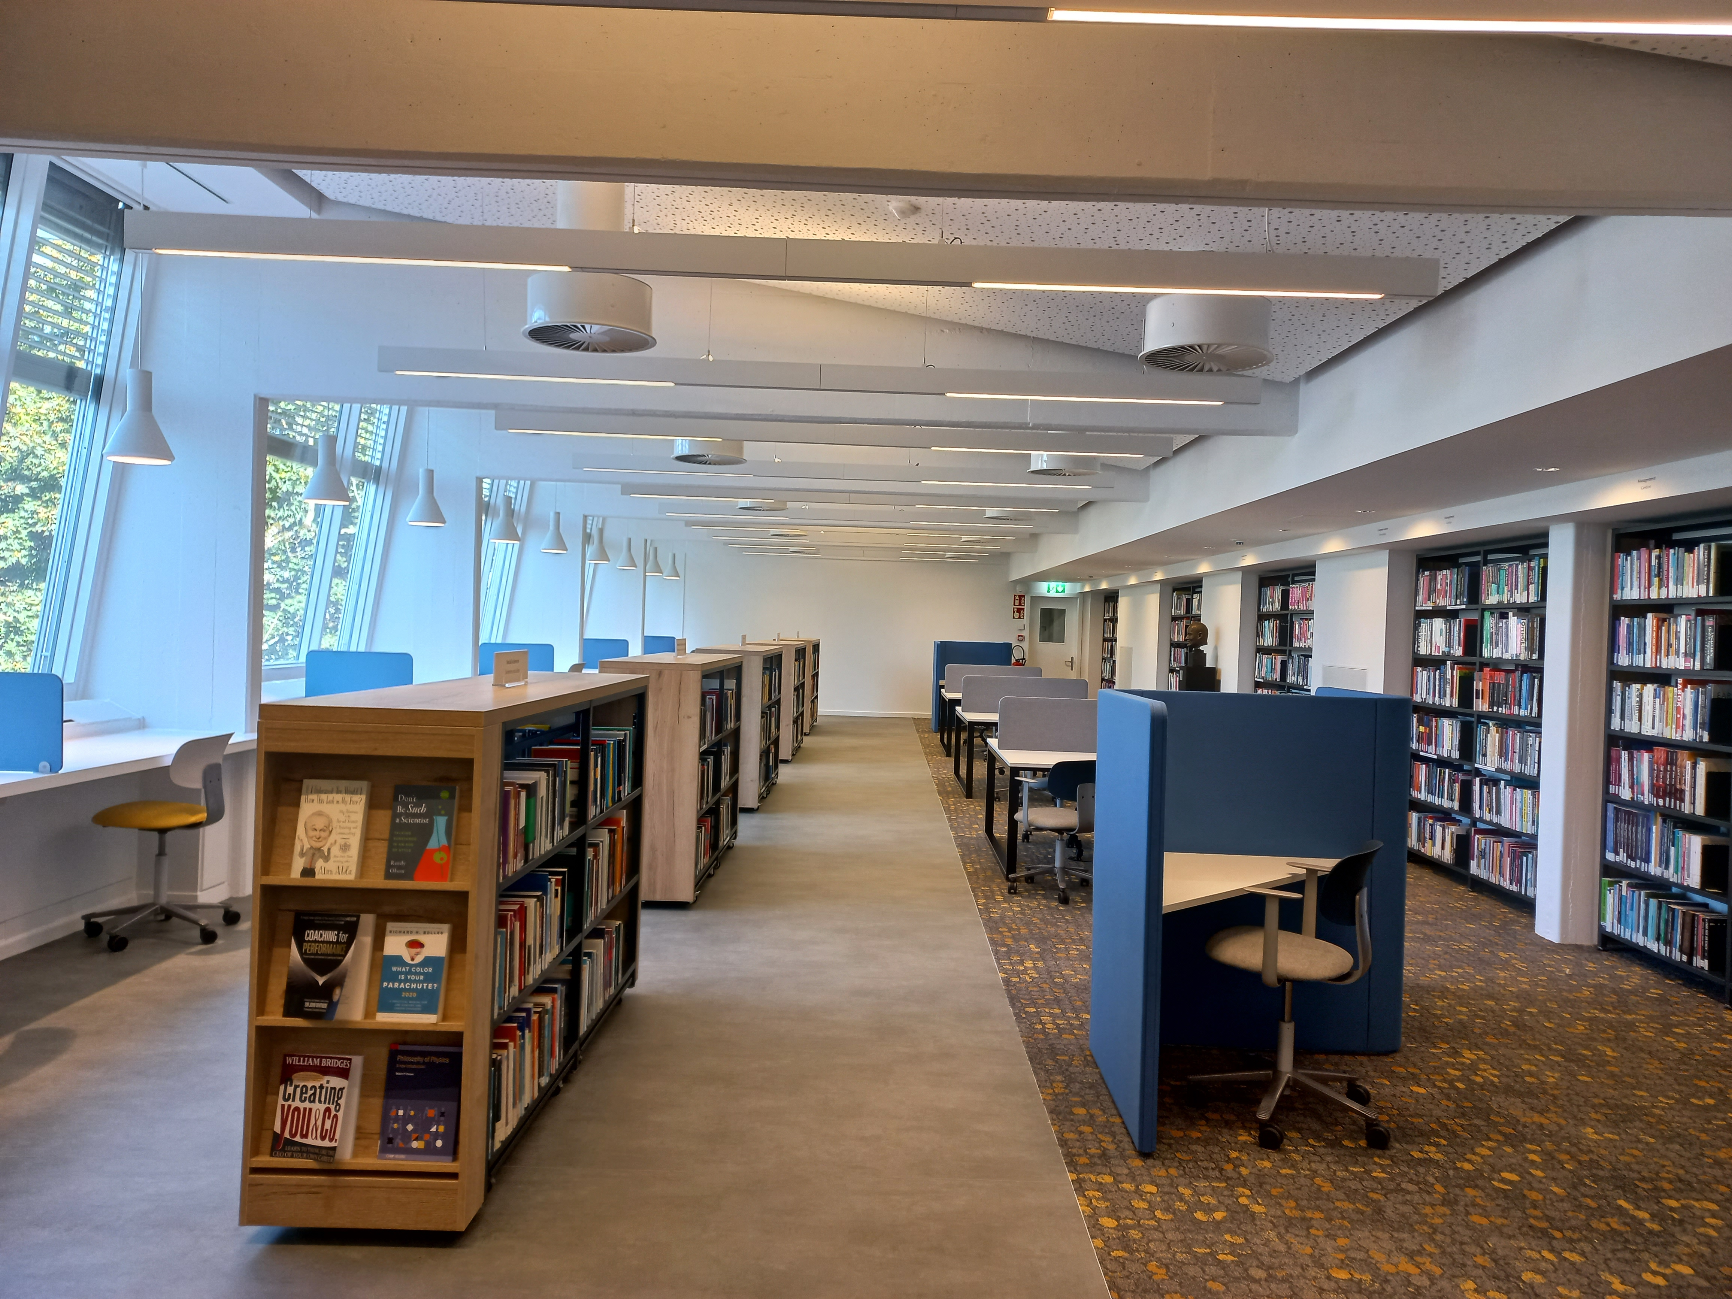
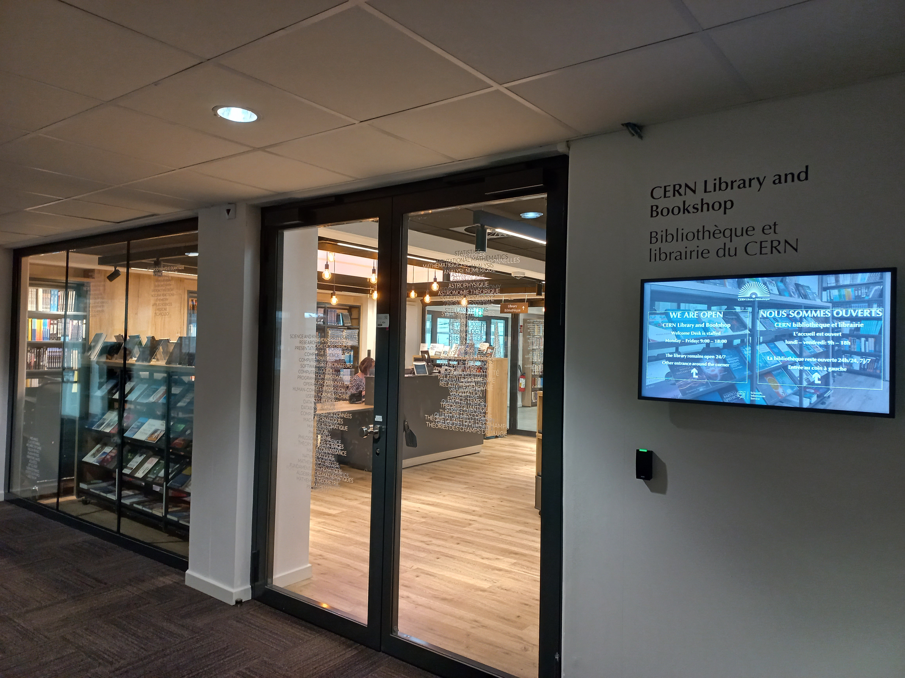
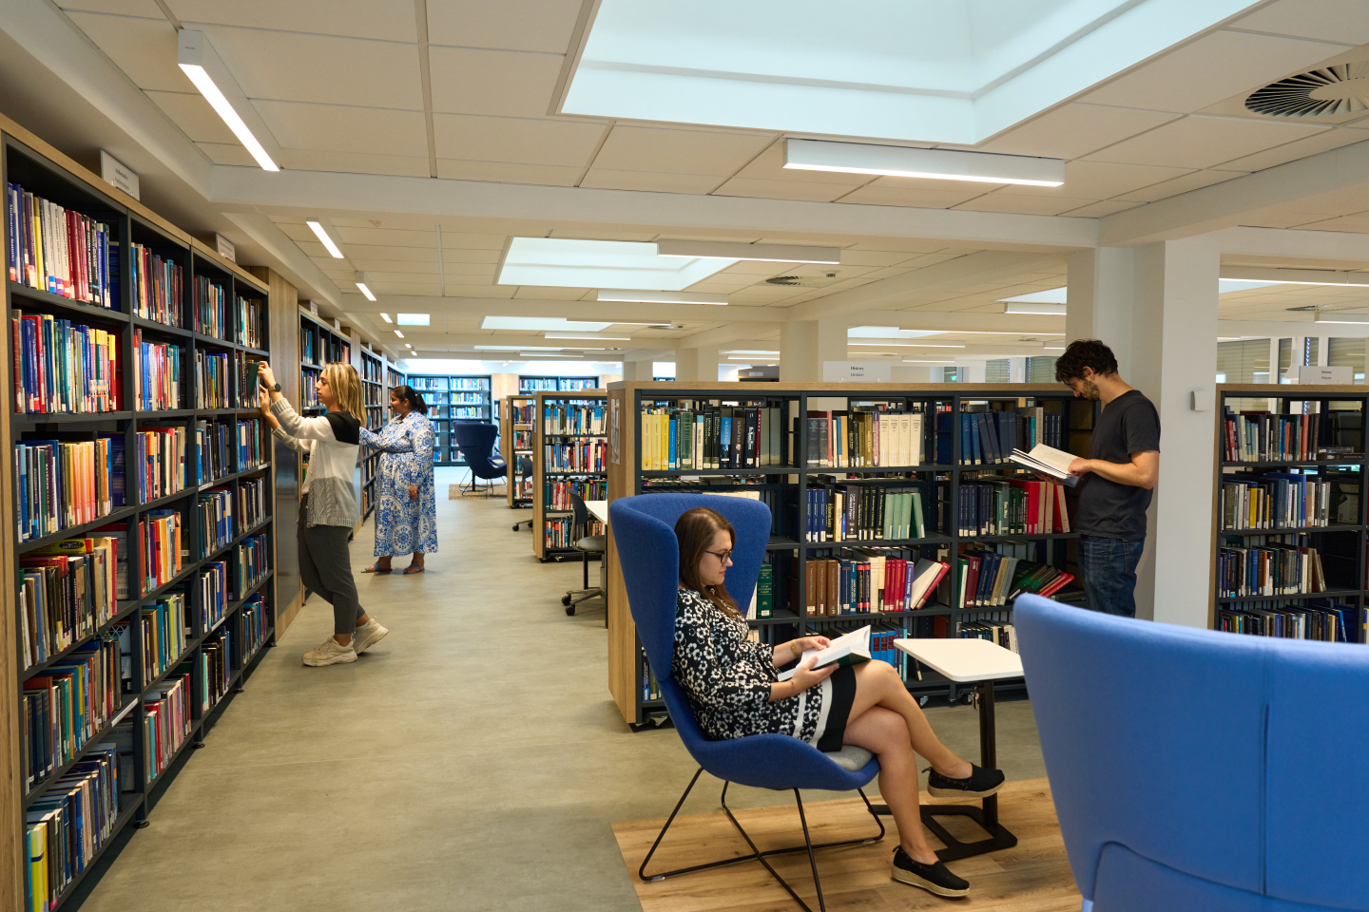
Library facilities – renovated in 2023!

Slide 7
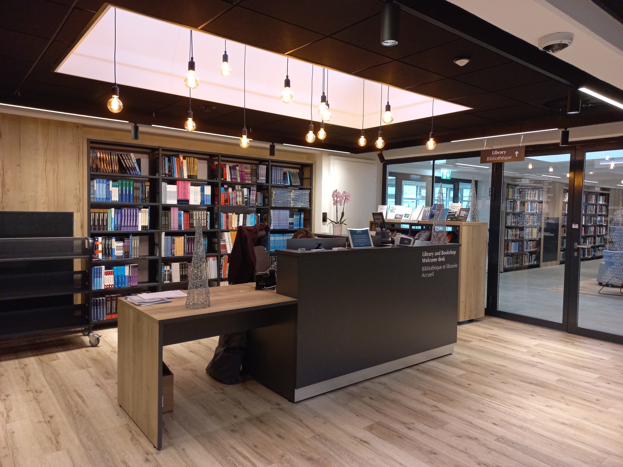
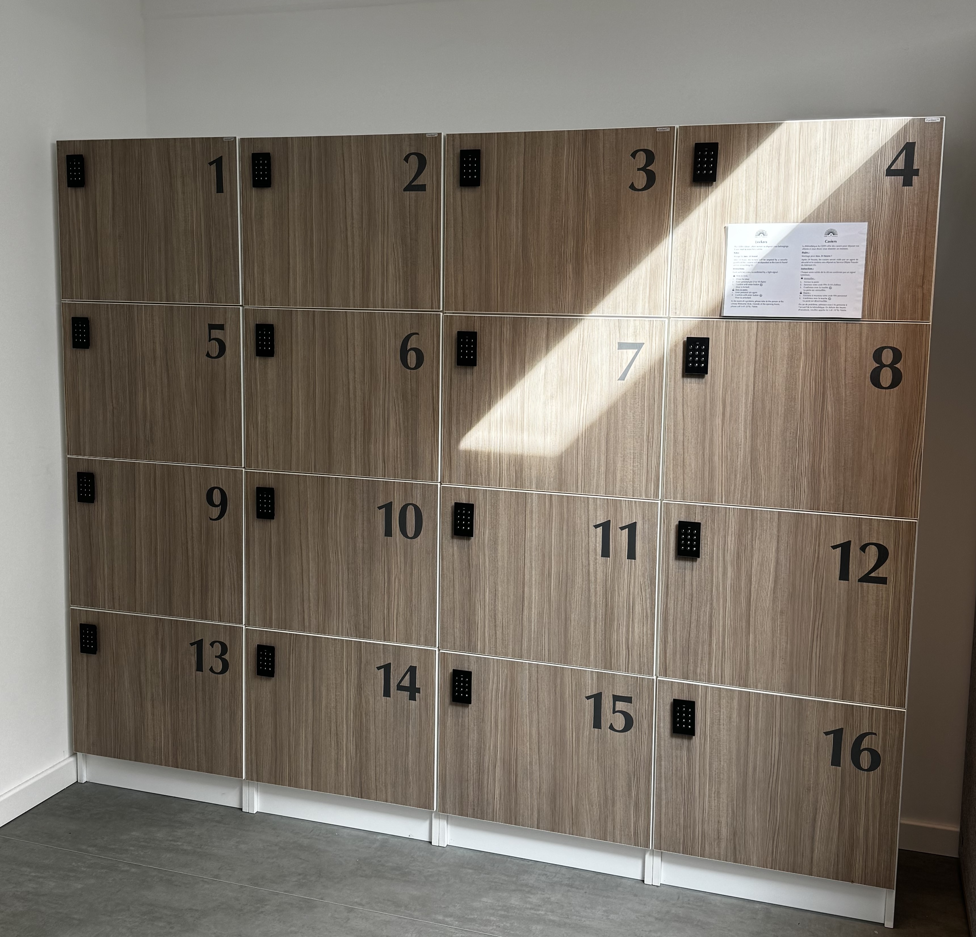
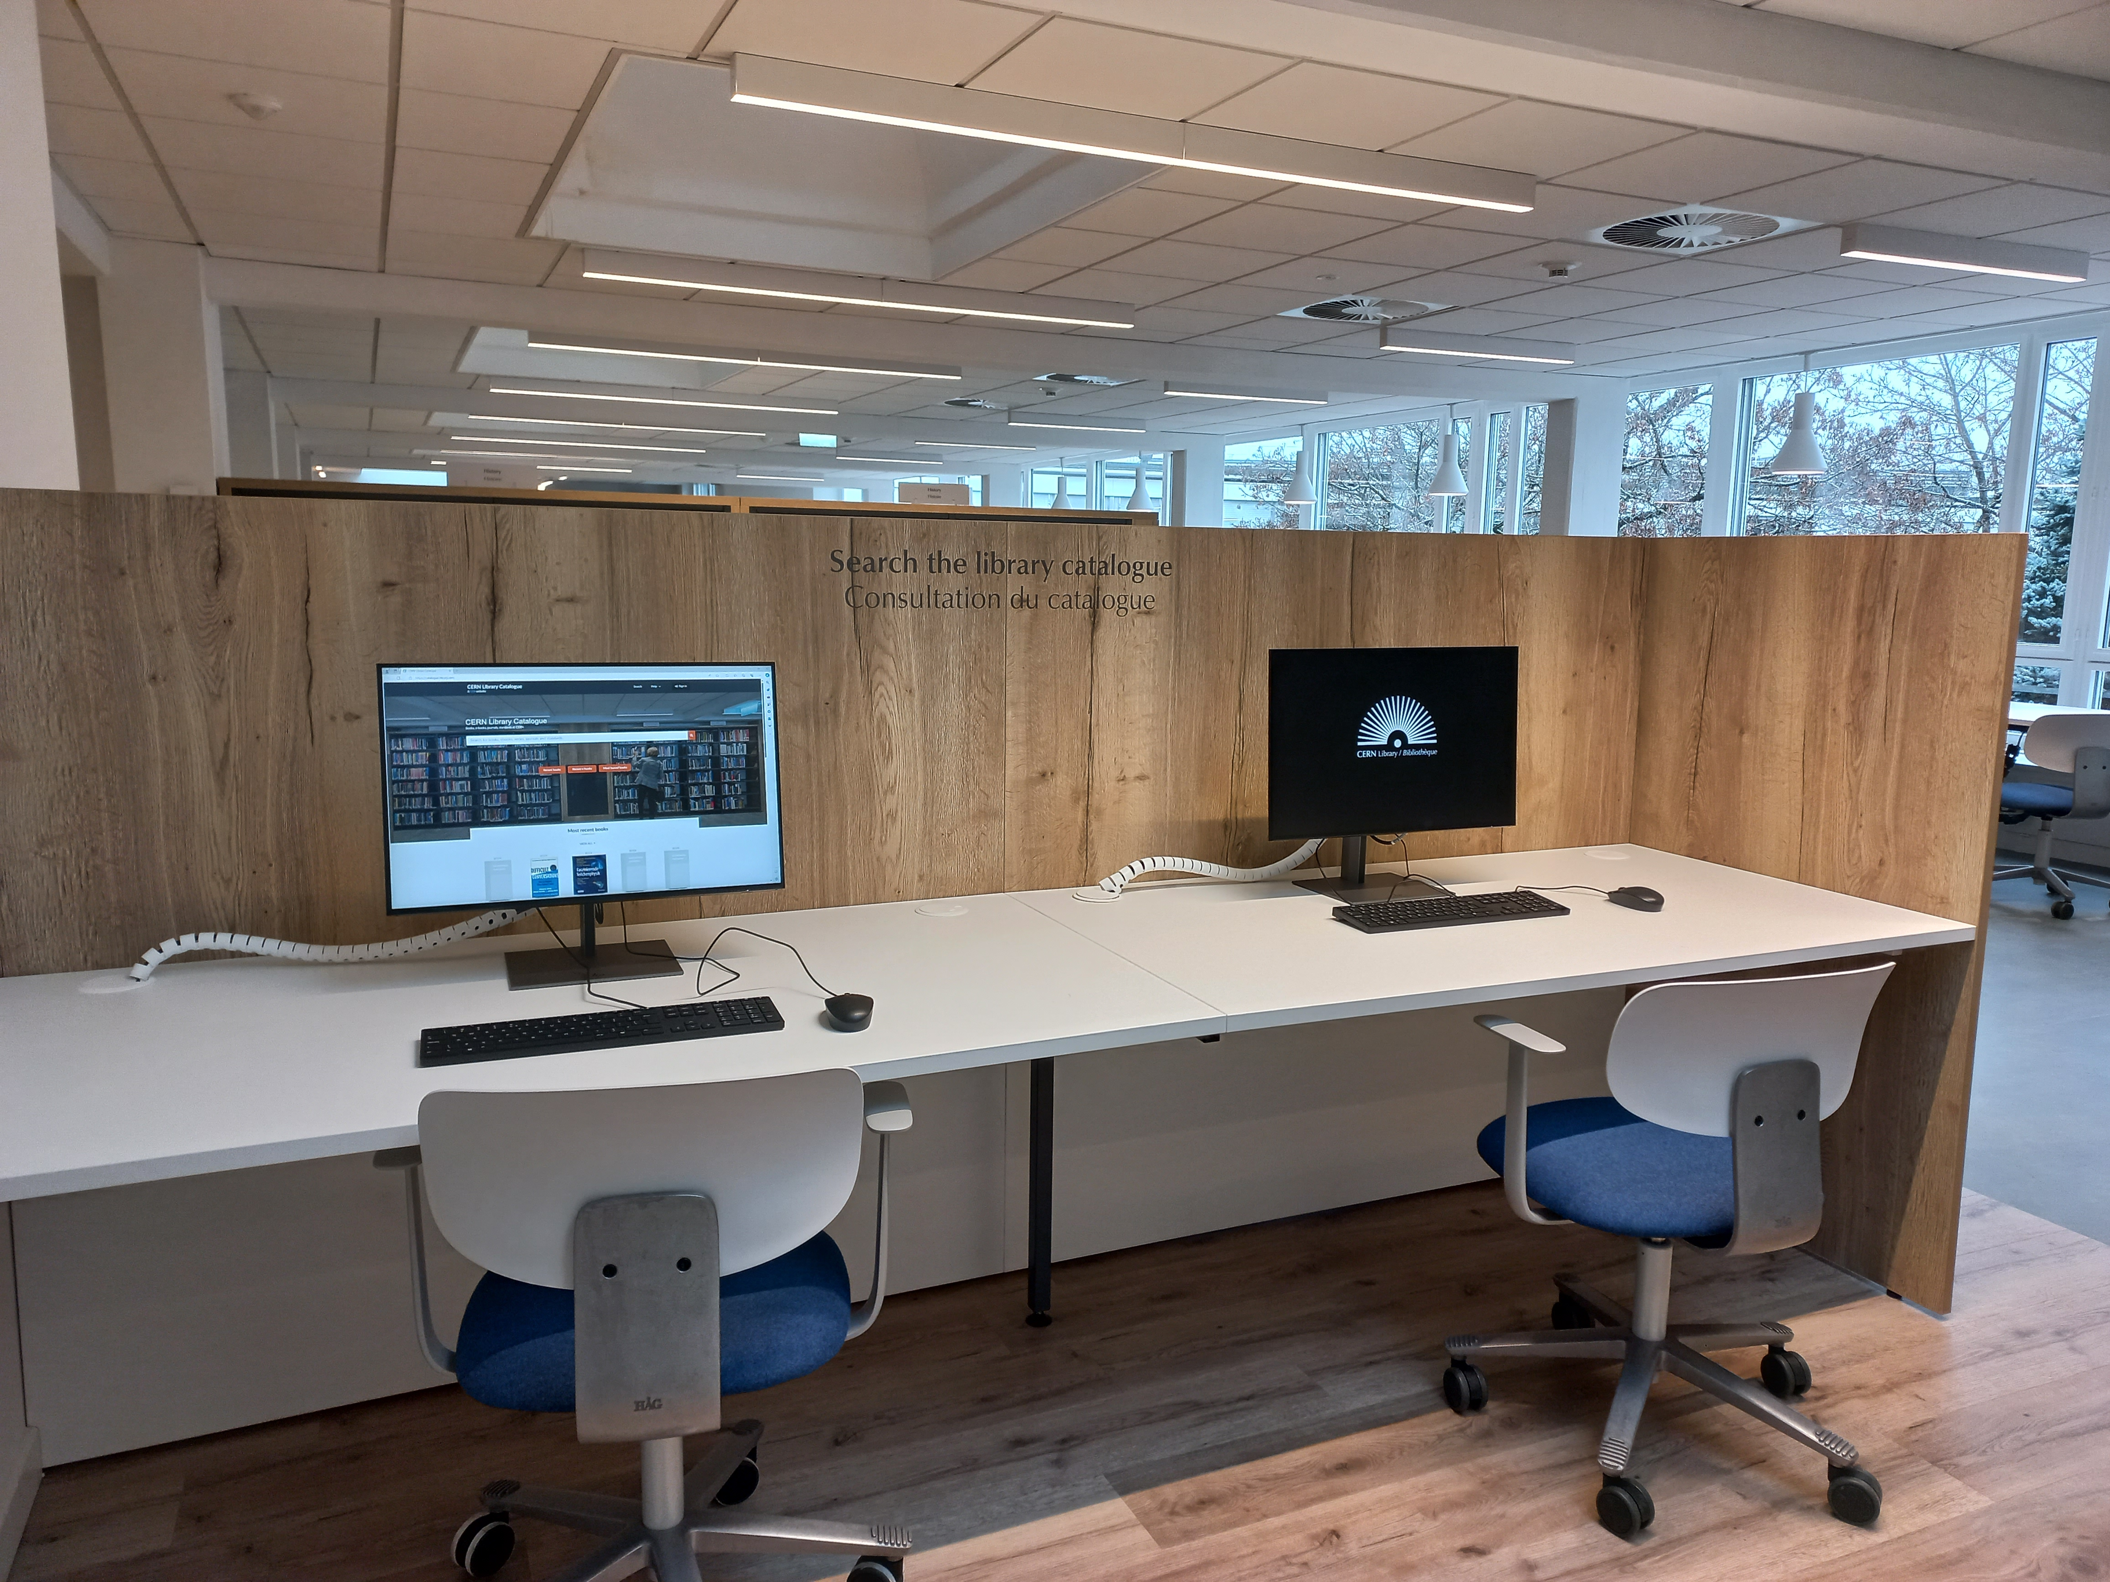
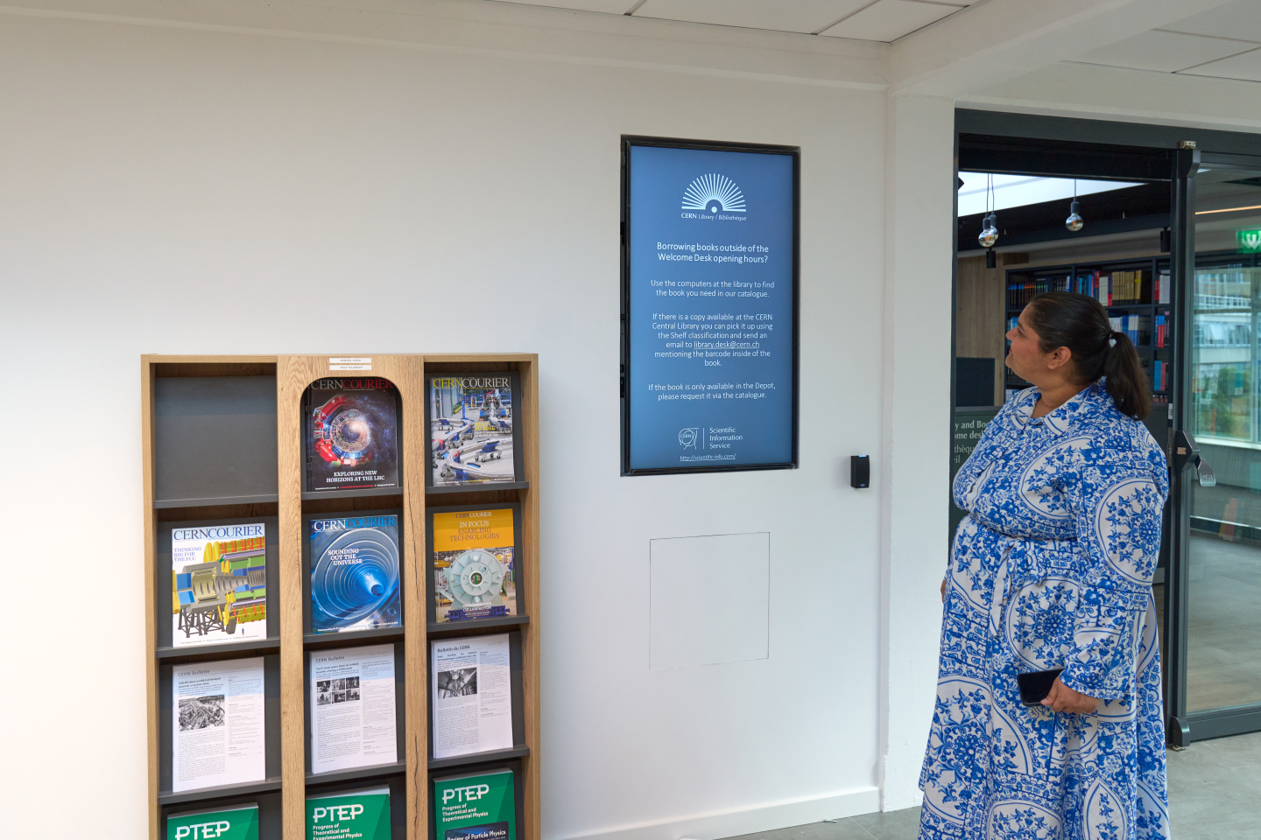
Library facilities
Public PCs to search the library catalogue; four screens for connecting laptops
The library is open 24/7! Desk is open from Monday-Friday 9:00 – 18:00
Library lockers and a water fountain
Recent CERN publications display
Location: Building 52/1-052

Slide 8
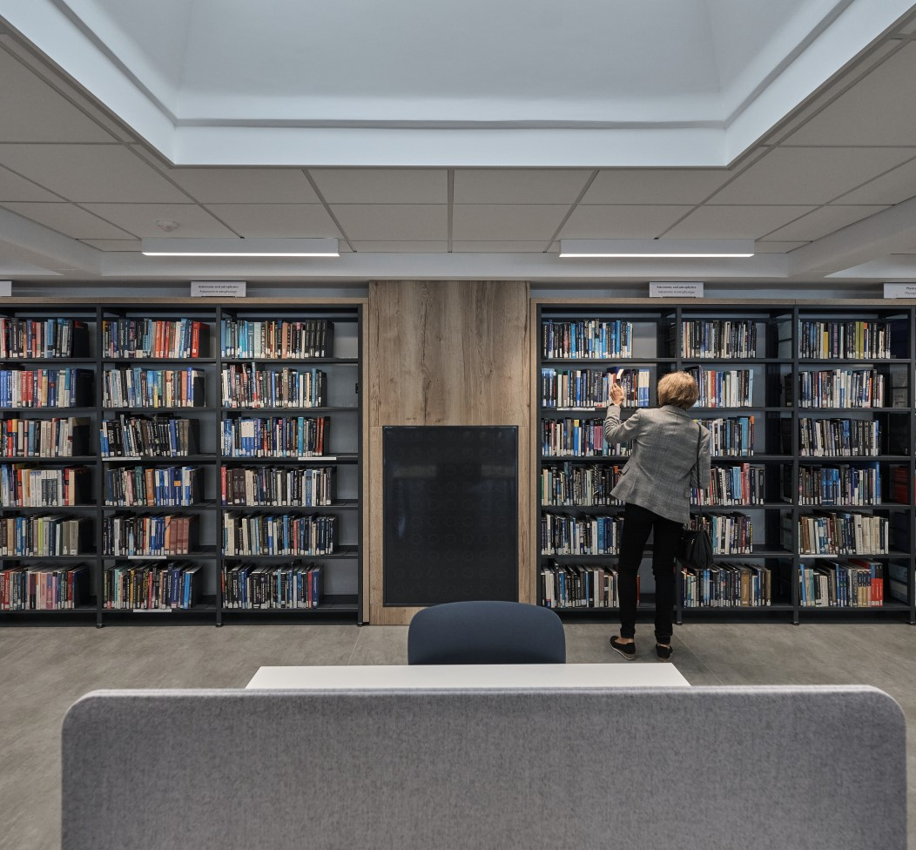
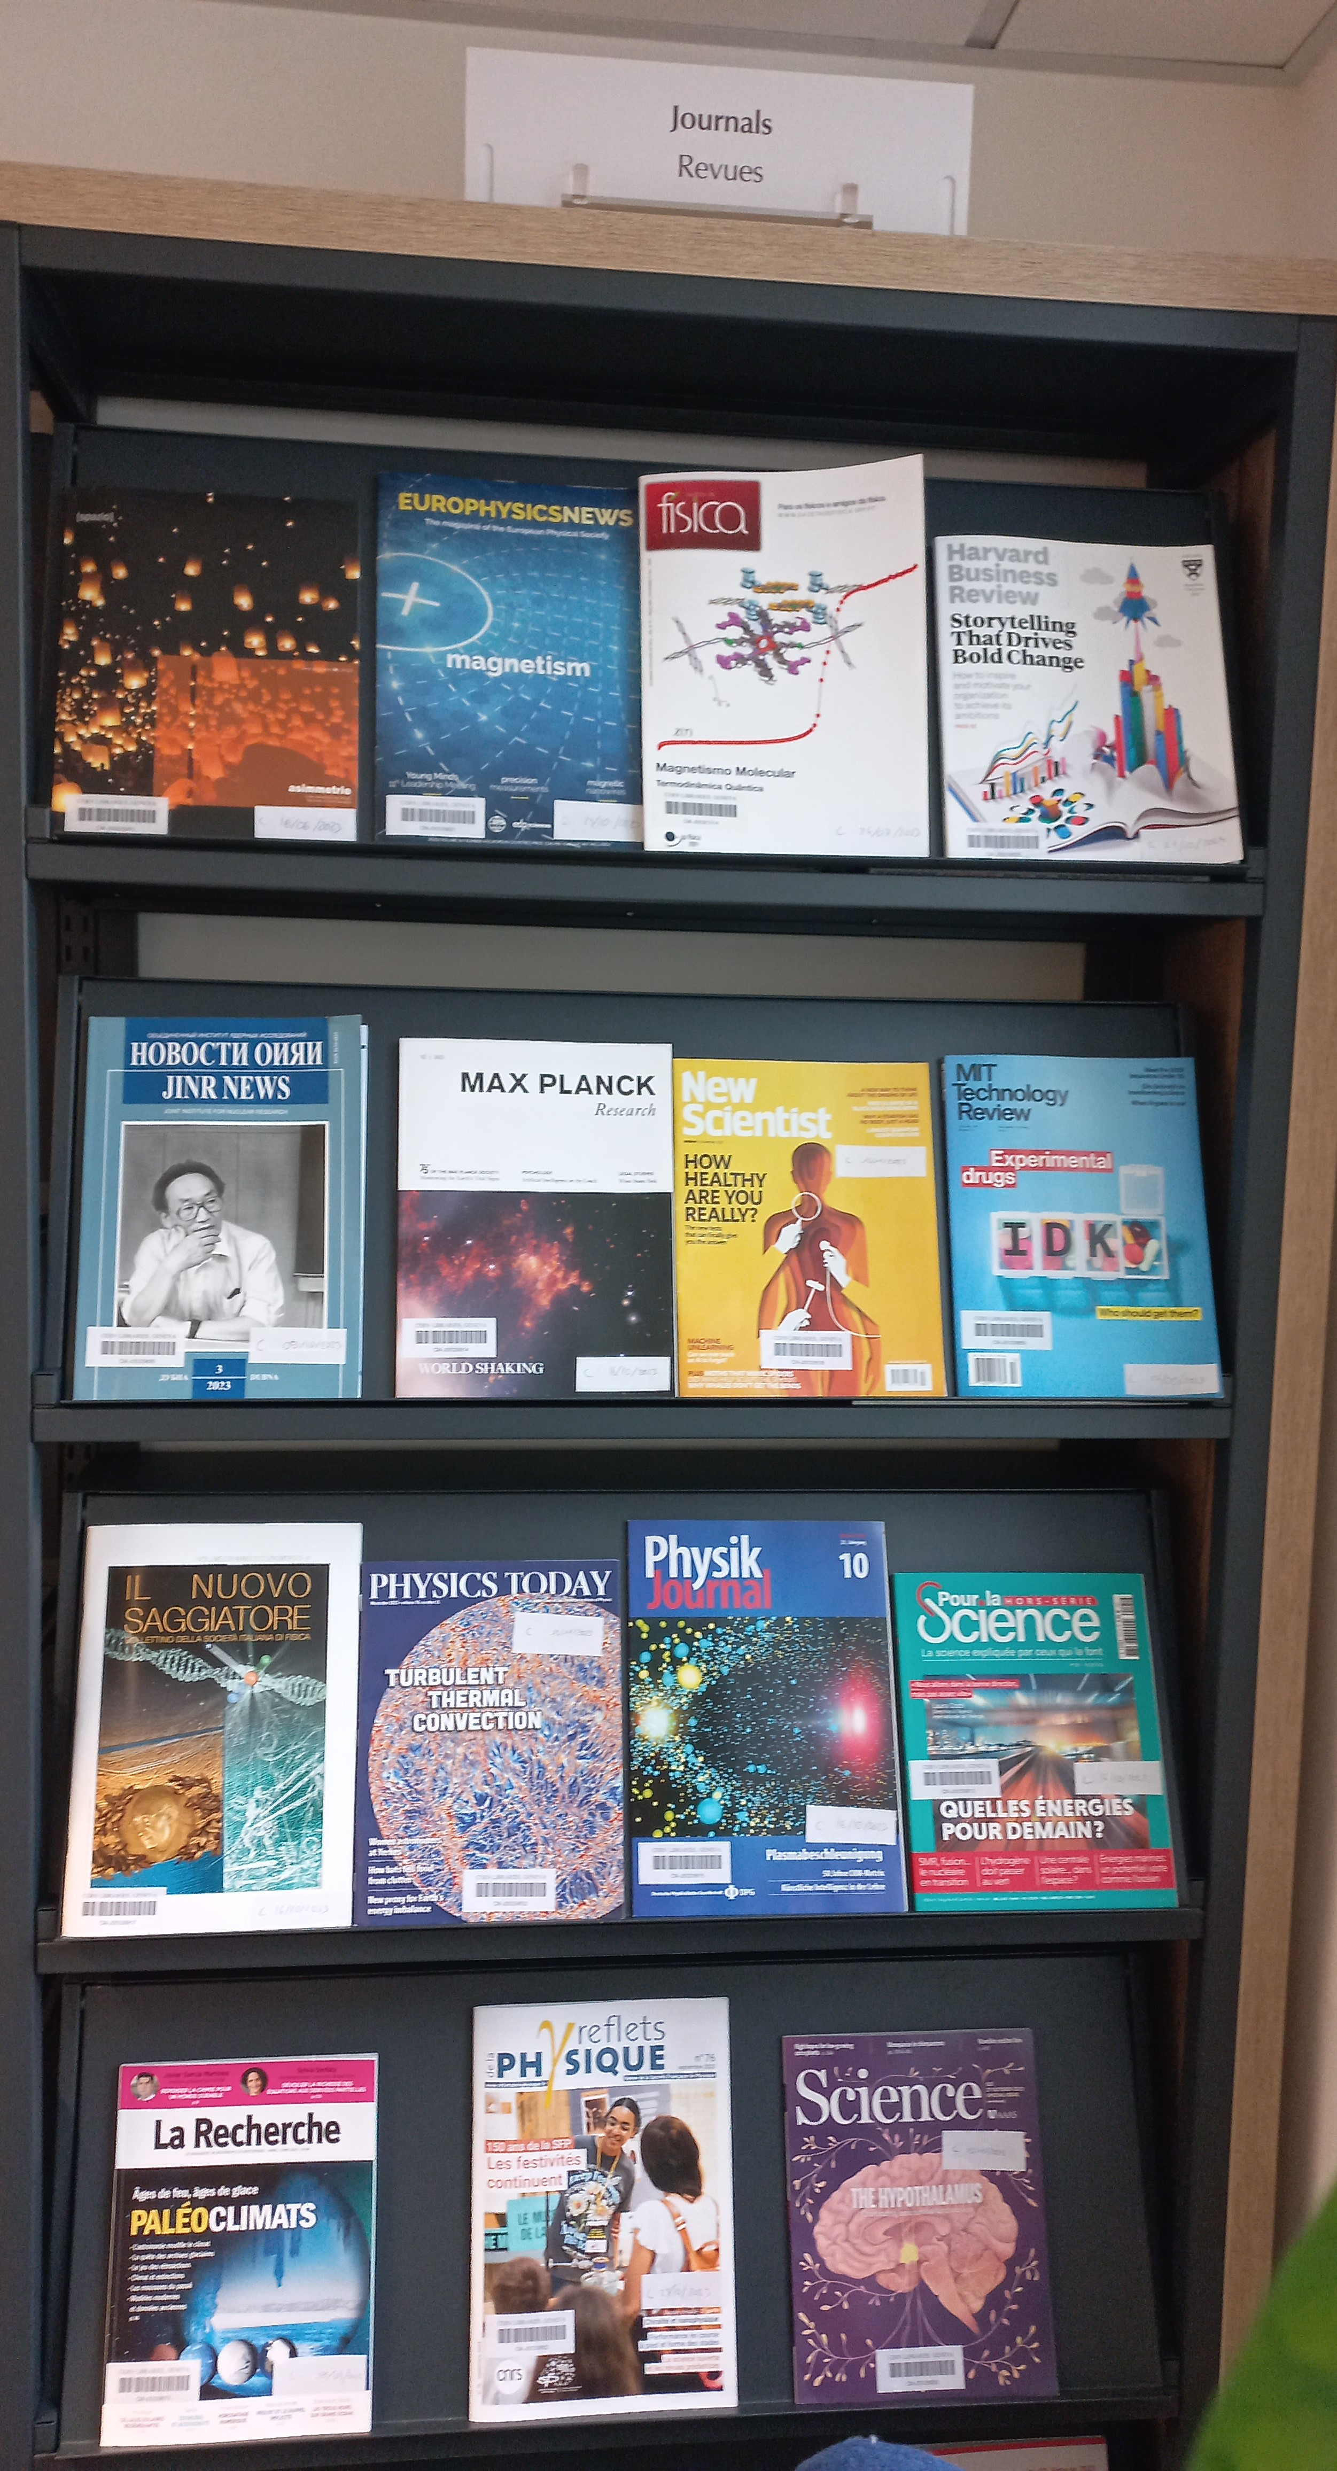
CERN Library collection
16’000 paper books freely available, 40’000 paper books in total
More than 110’000 e-books
20’000 proceedings
45’000 standards
2’300 journals

Slide 9
Online resources external to the Library catalogue
Beside e-books and e-journals available in the catalogue, CERN SIS provides a wide range of online resources in various disciplines:
Dictionaries and reference books (e.g. Oxford English Dictionary, Oxford References, Grand Robert)
Online databases (e.g. Total Materia, Nucleonica)
Scientific writing references (e.g. Chicago Manual of Style, Oxford Style guide)
Online trainings and videos (O’Reilly learning platform)
Online standards (SNV Connect): more than 45’000 standards accessible for CERN
All resources available here: https://sis.web.cern.ch/search-and-read/online-resources

Slide 10
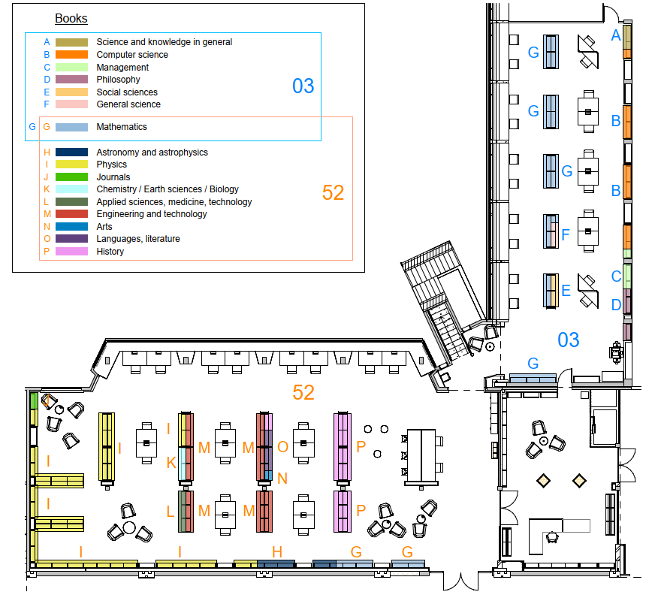
CERN Library catalogue: Which subjects are covered?
Physics and Mathematics are our biggest subject groups, but we also offer books in other fields:
Applied Sciences
Arts
Astronomy
Chemistry & Biology
Computer Science
Engineering
General Science
History
Languages
Management
Philosophy
Social Sciences
etc.

Slide 11
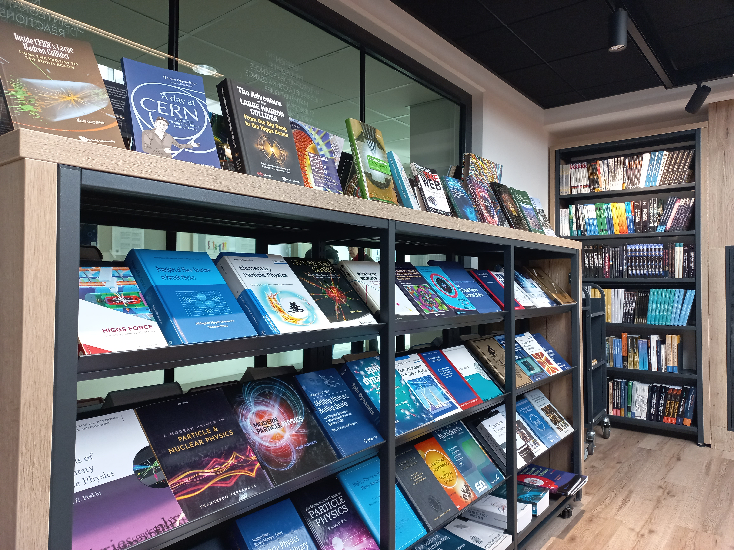
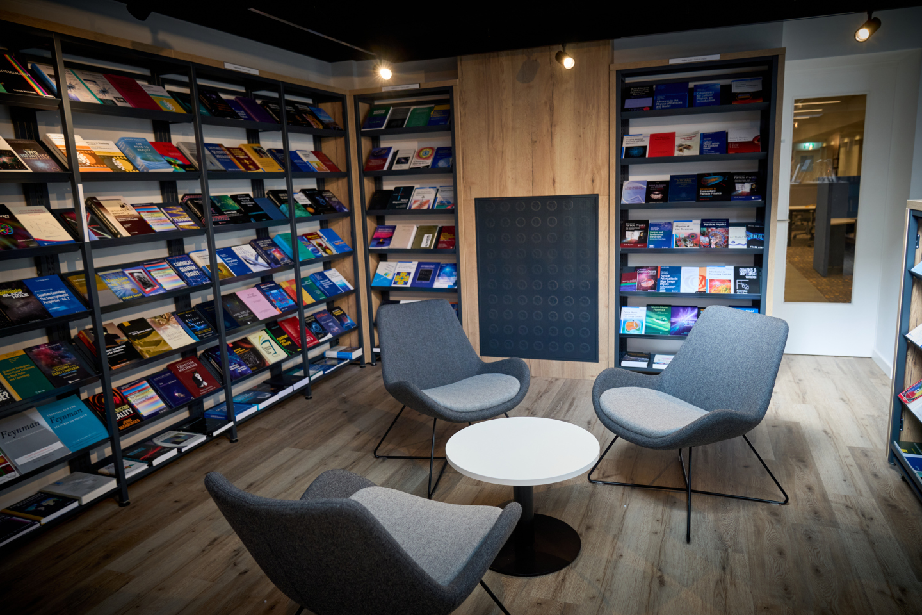
CERN Bookshop – part of the CERN Library!
Bookshop catalogue
We offer not only physics and mathematics books but also popular science, children’s books, CERN photo books, as well as books in different languages (English, French, Italian, German)
Location and opening hours are the same as the Library Welcome Desk:
Monday-Friday: 09:00 – 18:00
Payment: cash/card or CERN budget code

Slide 12
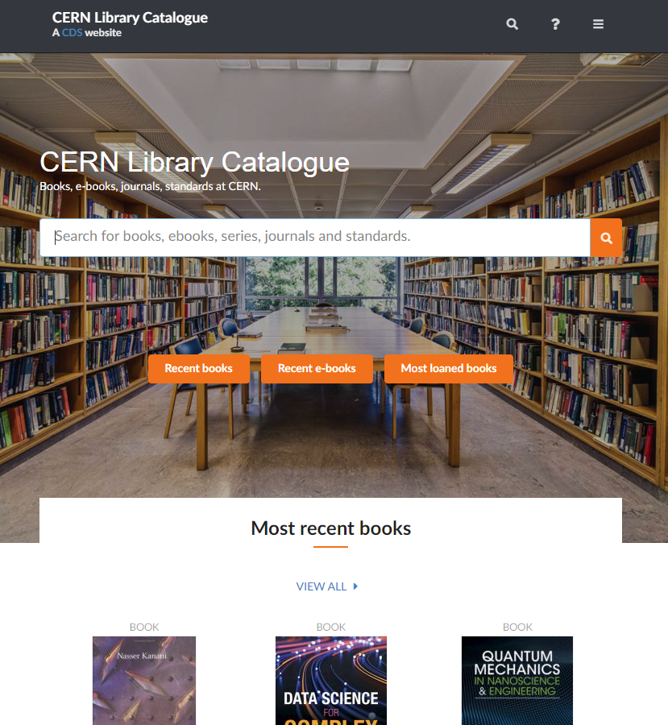
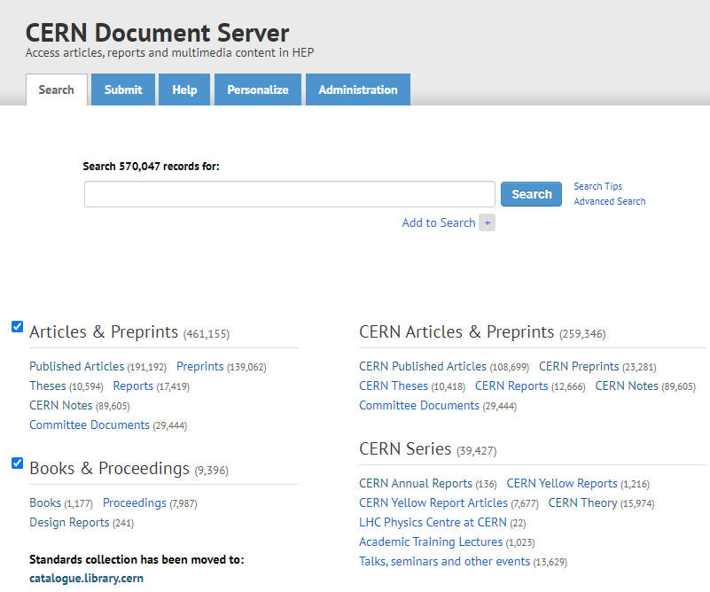
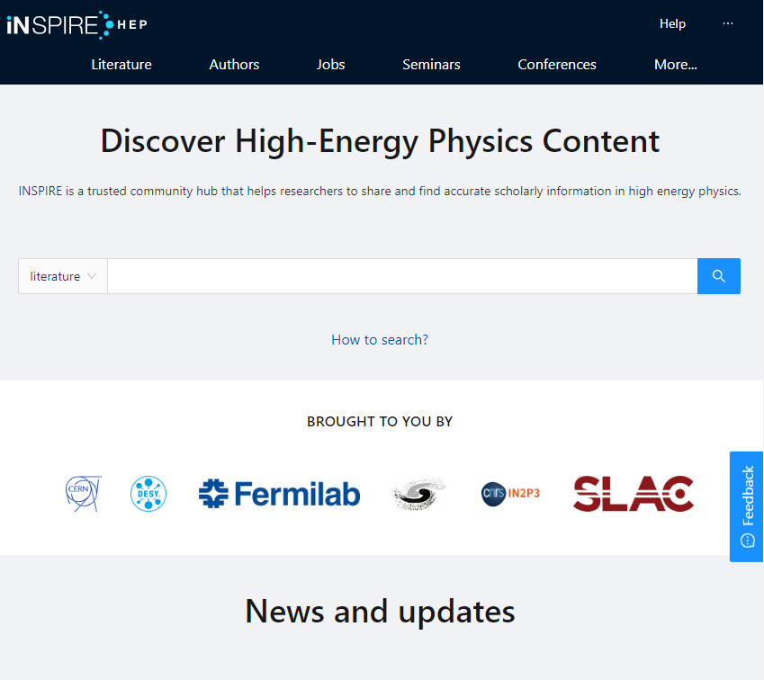
Where to find information?
Library catalogue: https://catalogue.library.cern/ Books, proceedings, journals, standards, in all fields of relevance to the Organisation
CERN Document Server (CDS): http://cds.cern.ch/ CERN institutional repository which stores documents written by CERN authors and collaborations: CERN articles, reports, Yellow Reports, theses, photos, lectures, Archive collections… and much more!
INSPIRE: https://inspirehep.net/​
High energy physics (HEP) content: interlinked database on literature, conferences, institutions, seminars, researchers, experiments, job

Slide 13
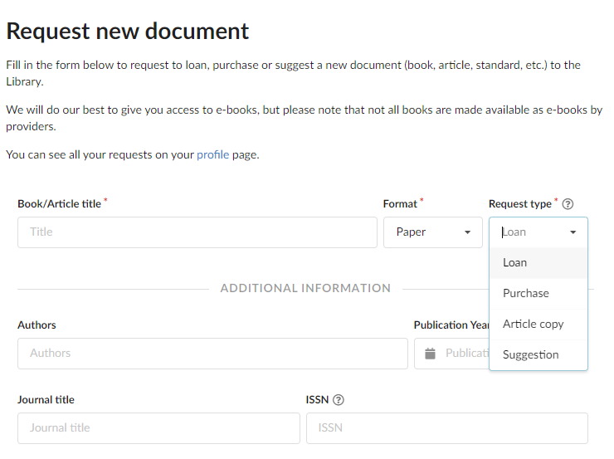
Library and bookshop services
Request for a document by submitting this form https://catalogue.library.cern/request:
Loan: We can get books that we do not have in our catalogue – Usually delivered in 2-5 days
Purchase: We can order books for you with payment by cash/card or budget code
Article copy: If you cannot access an article you would like to read online, we can deliver it within 24h
Suggestion: Let us know if an important document or book is missing in our collections – We can purchase it for the library

Slide 14
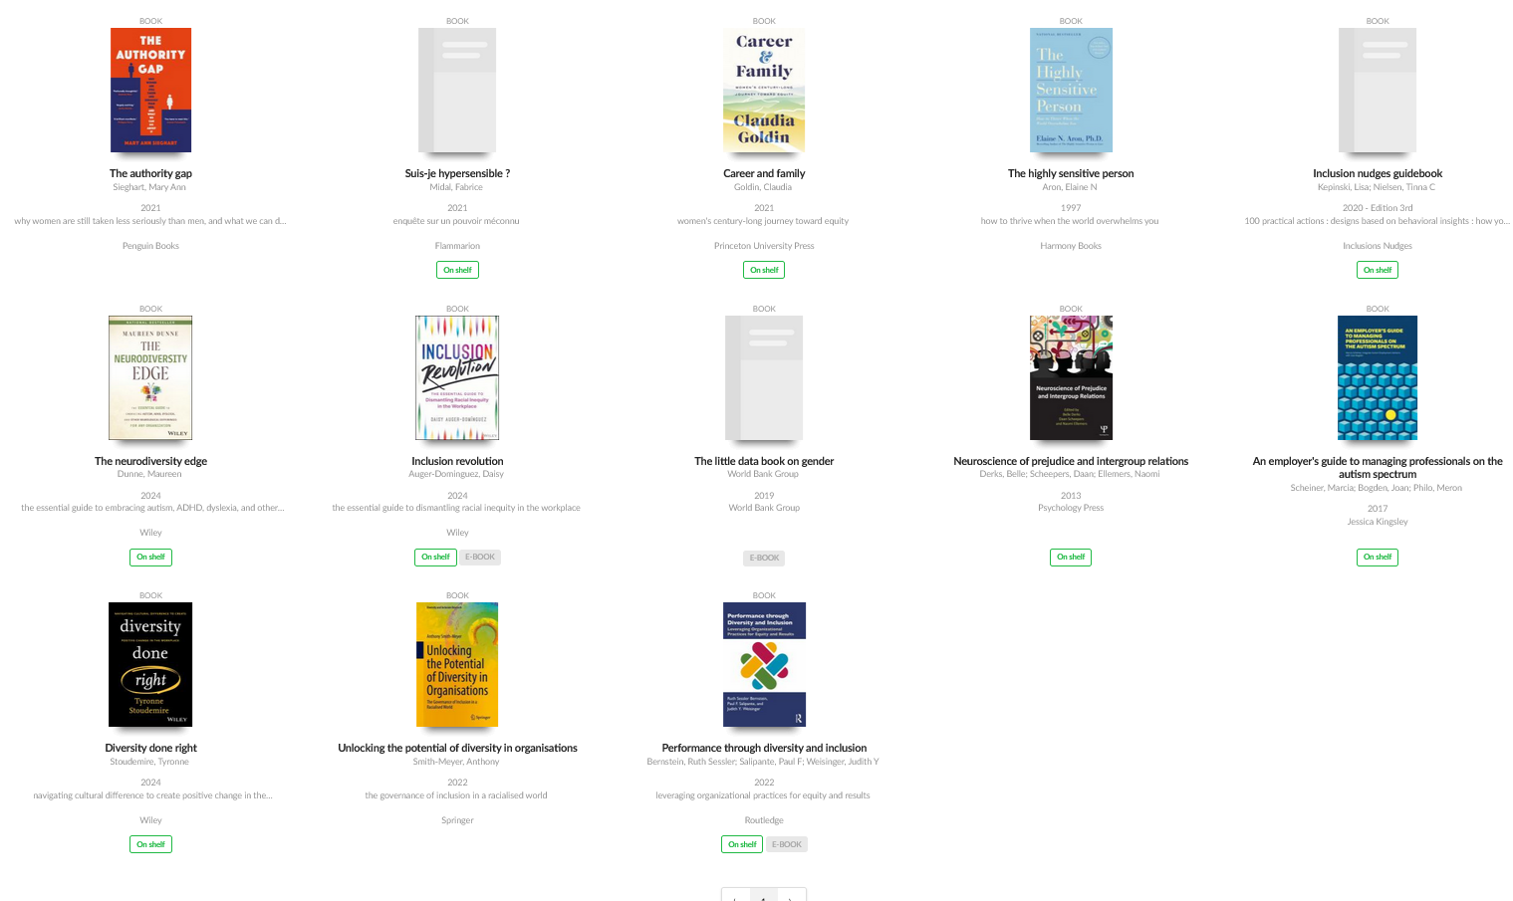
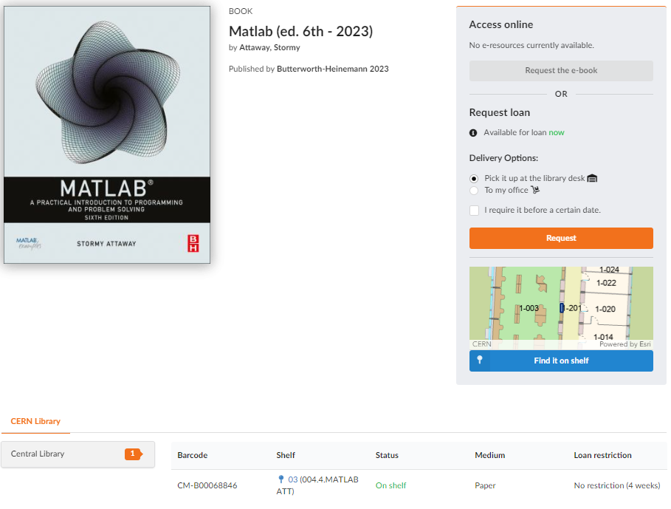

The library is becoming more accessible (1)
Reading corner with books about Diversity & Inclusion: selection made with Diversity & Inclusion Office and dedicated tag
Location of the book on the shelf in the catalogue. Implemented with MapCERN

Slide 15
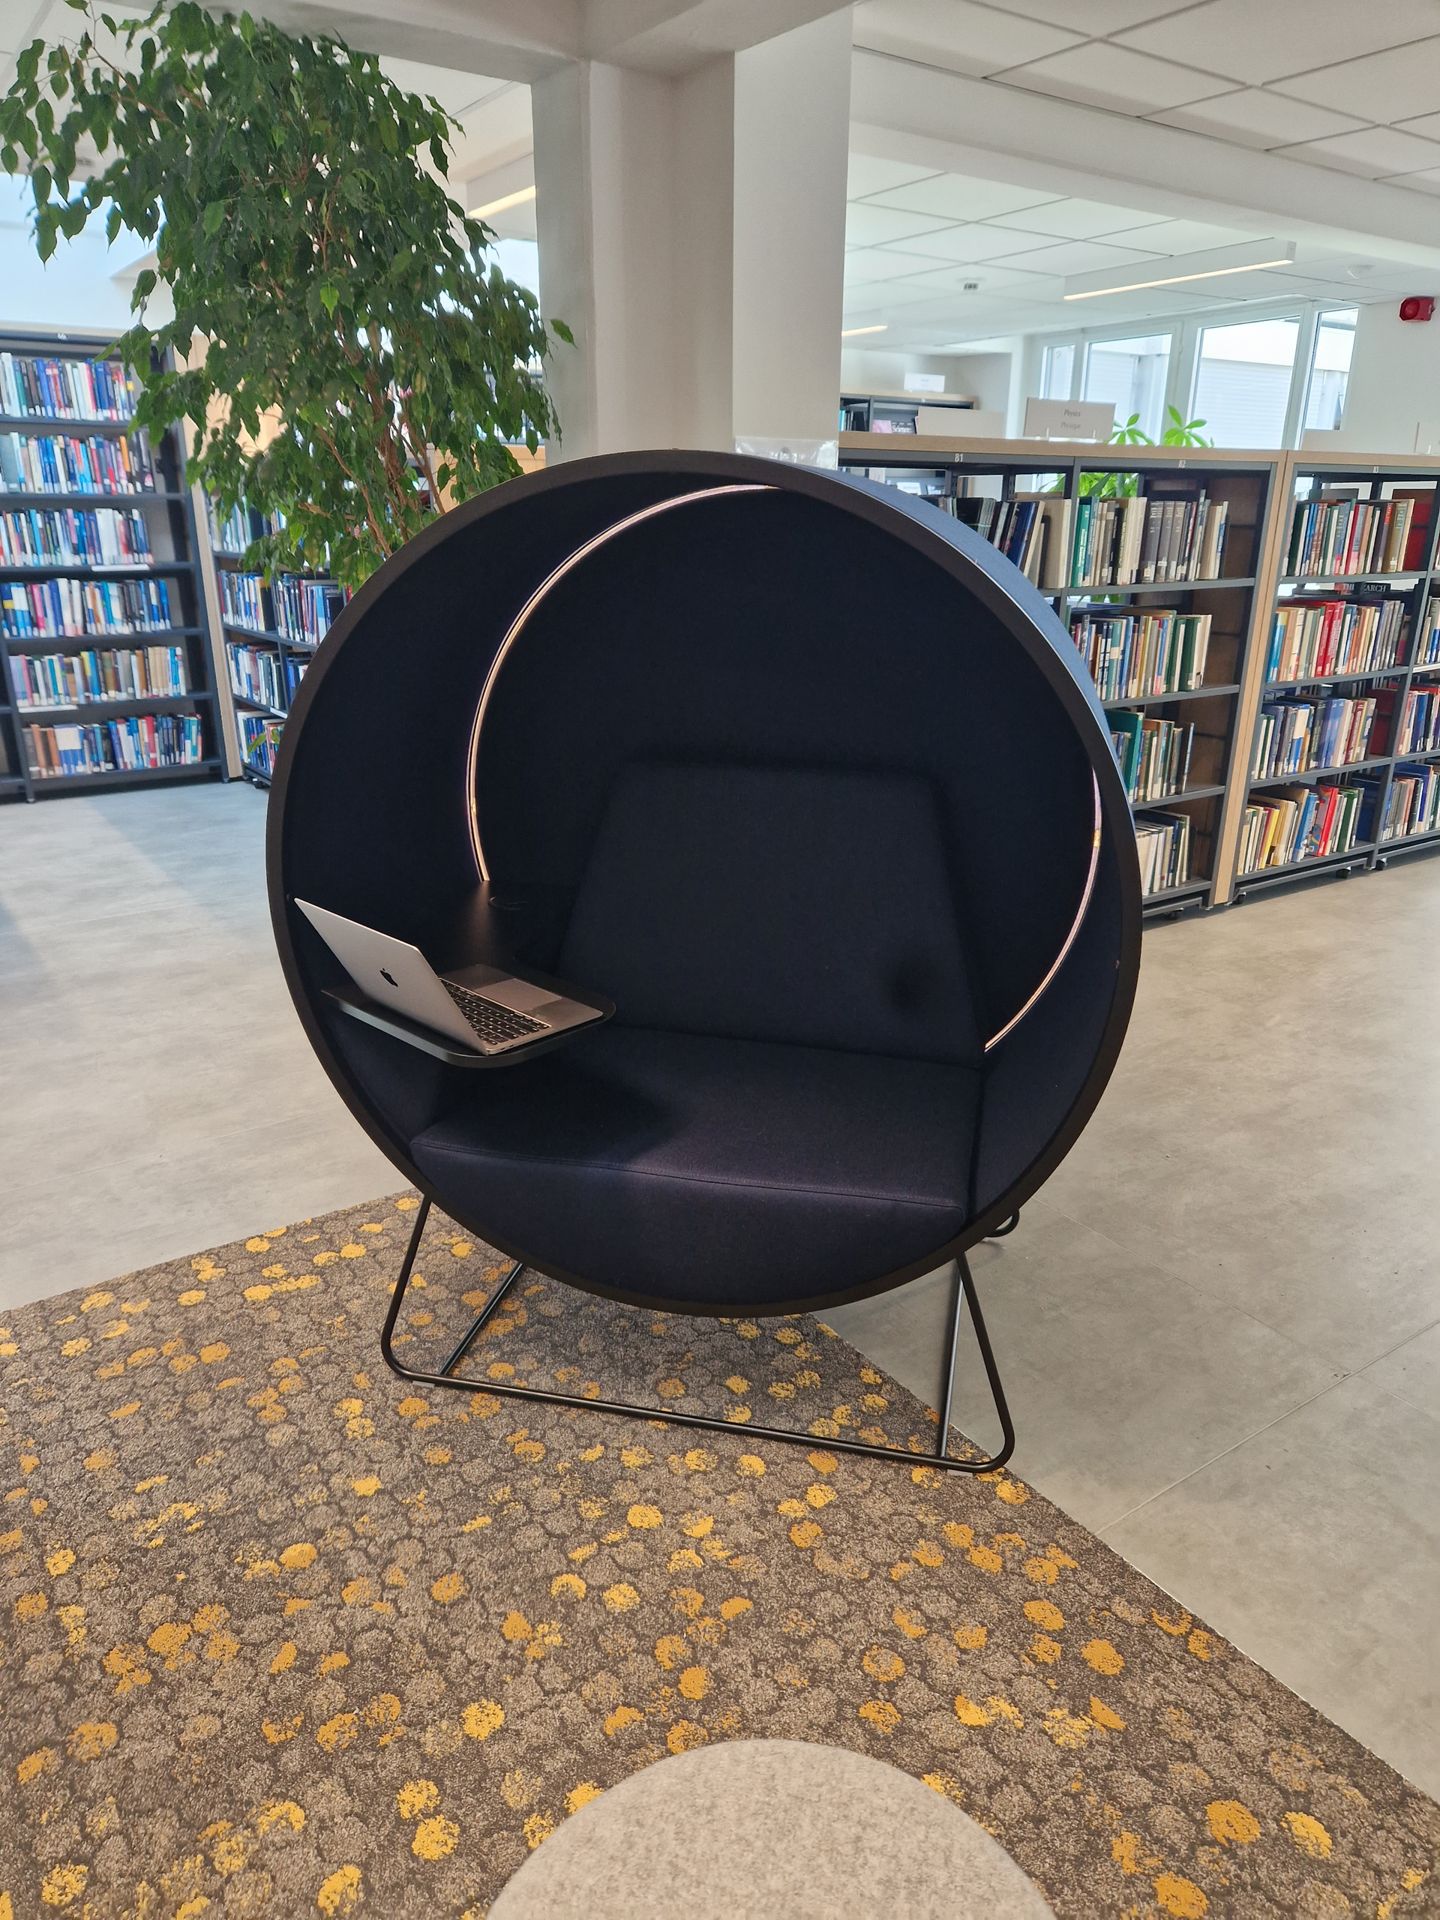
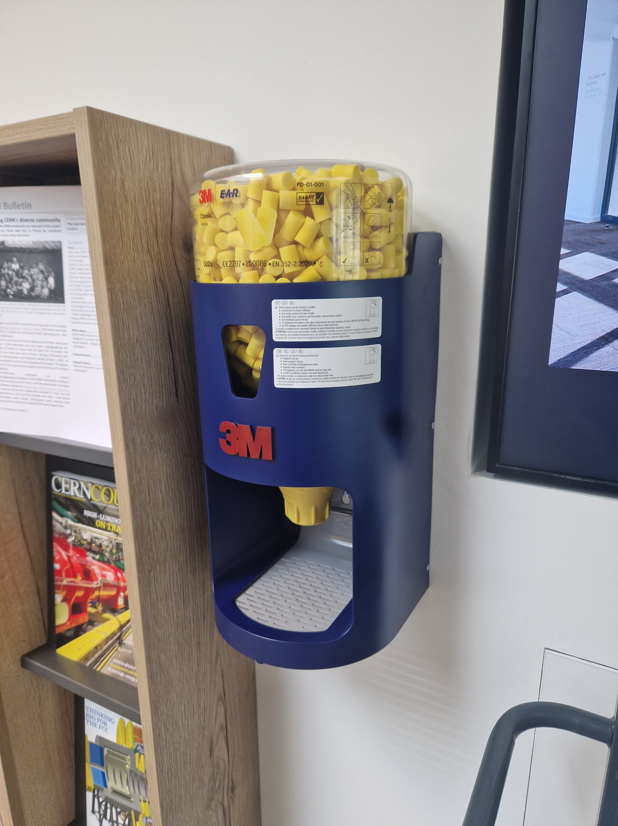
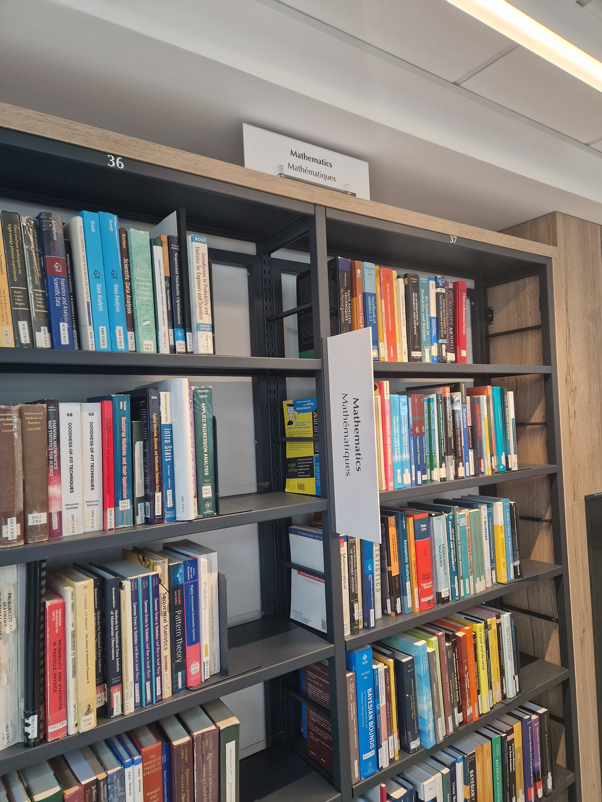

The library is becoming more accessible (2)
“Kuppel” chair: reduces surrounding noise and soft light.
Ear plug dispenser, noise cancelling headphones and magnifying glasses can be borrowed
Better visible signs in the library
Audiobooks and videos are available since July in the catalogue

Slide 16


The library is becoming more accessible (3)
We have automatic doors since October to access the library!
They can be opened manually or by pushing a button.
Notes:
Next steps:
Accessibility of SIS Drupal website, ok → accessibility of CERN Library Catalogue to be done

Slide 17


New: Island SOLO booth
Island SOLO is an acoustic booth for calls and video conferences without being disturbed or disturbing others.
It is located next to the lockers in the CERN Library.

Slide 18

New: Test phase for self-checkout
Scan the QR code
Login with CERN SSO
Scan the barcode inside the book
Register the loan

Slide 19

Library reopened one year ago What happened since then?
> 66K people came to use the Library premises and services in 2024!

Slide 20
And series of events in the Library
Meet the Author:
5 October 2023: Ottantesimo parallelo
3 November 2023: Advance in cosmology
14 November 2023: Quantum steampunk
27 November 2023: Interstellar
4 December 2023: Prima del Big Bang
25 January 2024: Grace in all simplicity
7 June 2024: Big science, innovation and societal contributions
13 August 2024: New challenges and opportunities in physics education
19 September 2024: The future of the Large Hadron Collider
2 October 2024: The beauty of falling
17 October 2024: Relic gravitons
6 November 2024: Le CERN, quelle aventure !
6 December 2024: The star’s last dance / La dernière danse des étoiles
11 December 2024: Léon Photon découvre les particules élémentaires
28 January 2025: Detectors in particle physics
The Voice of Science: a series on science communication
3 September 2024: Meet Zach Weinersmith
24 September 2024: Meet Dr. Katie Mack (AstroKatie)
21 November 2024: Meet Claire Malone
21 January 2025: Meet Dr Jean-Christophe Denis
14 February 2025: Meet Prof. Carsten Welsch

Slide 21
Thanks for your attention!
Any questions?

