Slide 1
Open Science at CERN
March 2024
Anne Gentil-Beccot
Open Science coordinator
European Organization for Nuclear Research (CERN)

Slide 2

“… and the results of its experimental and theoretical work shall be published or otherwise made generally available.”
CERN CONVENTION, 1954

Slide 3

Open Access
1991-2024
2024
SCOAP³ Introduces Open Science Elements
2014
CERN Open Access Policy
1991
arXiv.org
2014
Launch of SCOAP³
2018
APS joins SCOAP³, 90% of OA in HEP

Slide 4
Open Access
Mechanisms
SCOAP³
COLLECTIVE MODELS
Sponsoring consortium for Open Access publishing in Particle Physics.
CERN supports other OA Model transparent for the author (S2O, sponsorship).
OA AGREEMENTS
INDIVIDUAL APC
CERN has negotiated Open Access Agreements with 10+ publishers for 4000+ journals.
For other articles fees can
be centrally covered under Certain conditions.

Slide 5


Slide 6
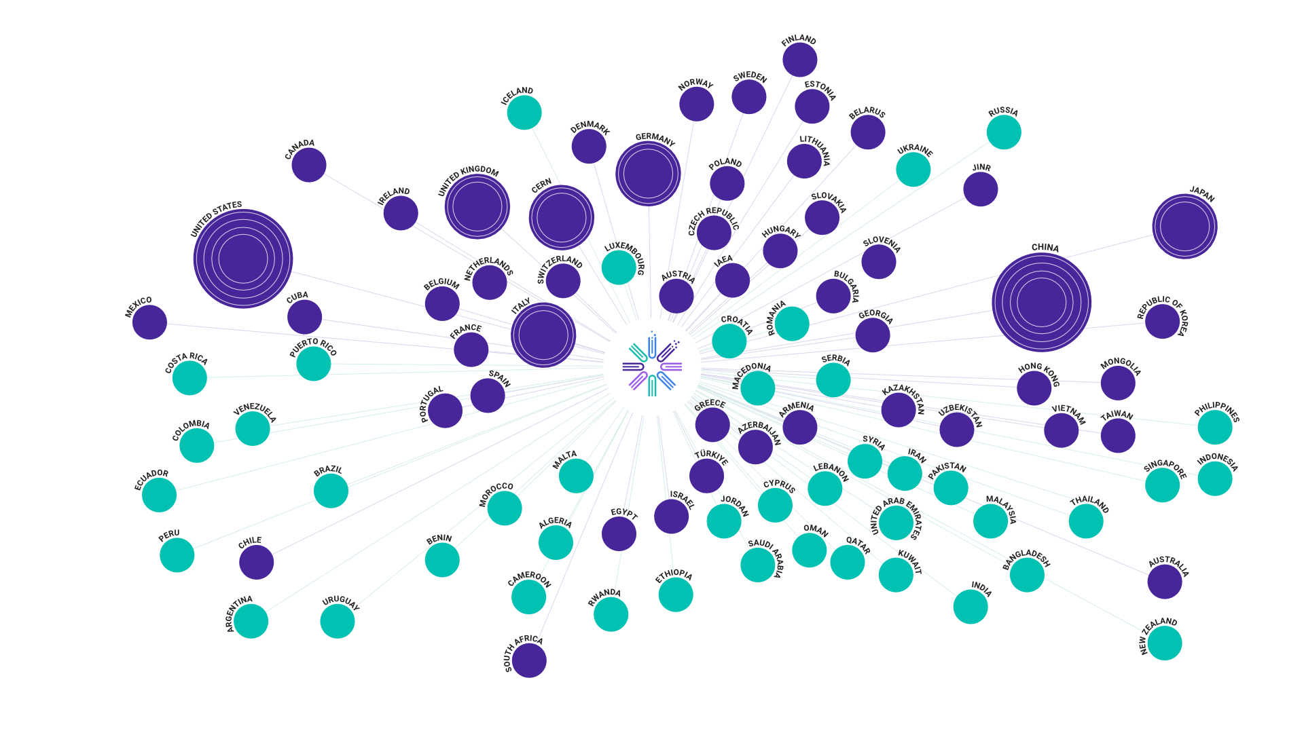

Partners in the SCOAP3 Collaboration
Countries & Territories with at least one SCOAP3 Author
Global Partners

Slide 7
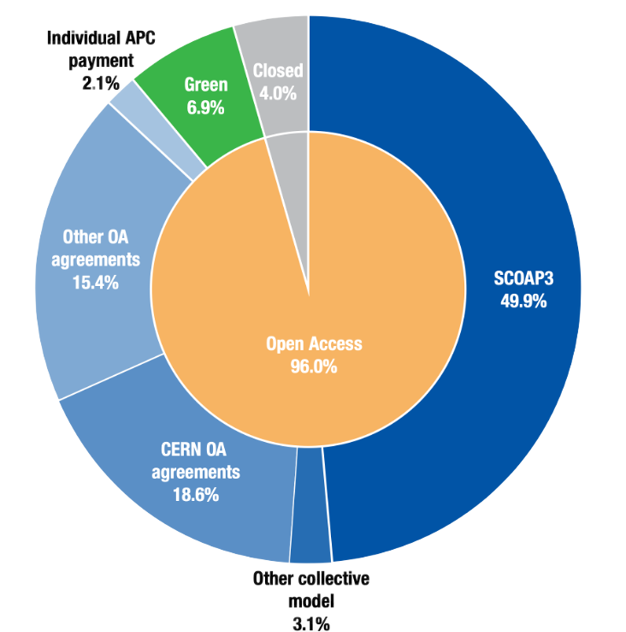
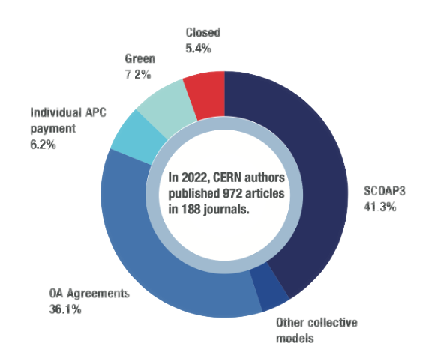
Open Access Statistics
Groundbreaking Results: 96% Open Access in 2023

Slide 8







Supporting Global Open Access & Open Science Infrastructures
Open Access and Open science need a globalized infrastructure…
  With standardized metadata and persistent identifiers (ORCID, ROR, CrossRef, OA Switchboard…)
  And Open Infrastructure created and used by the community (DOAJ, OAPEN, OJS…)

Slide 9
Open Data

Slide 10

Open Data
Akopov et al., Status report of the DPHEP Study Group: Towards a global effort for sustainable data preservation in high energy physics. arXiv preprint arXiv:1205.4667 (2012).
1
Additional documentation
for published results.
Data Levels
2
Simplified data formats for analysis in outreach and training exercises.
3
Reconstructed data & simulations
for scientific analysis.
4
Basic raw level data and their associated software which
allows access to full potential of experimental data.

Slide 11


Published in 2020
All experiments engage into opening datasets to the world.
4 levels of data: commitment is for levels 1, 2, 3, due to level 4 volumes and complexity.
All data are released with persistent identifiers.
Data and associated data services apply open and FAIR principles.
CC-0 waivers are applied as standard.
Researchers and experiments are expected to develop data management plans for their research activities.
Level 3 Releases: calibrated reconstructed data with the level of detail useful for algorithmic, performance and physics studies.
Release of these data will be accompanied by:
  provenance metadata;
  simulated data samples;
  Analysis software;
  Reproducible example analysis workflows; and
  Virtual computing environments.
Full Policy Text

Slide 12
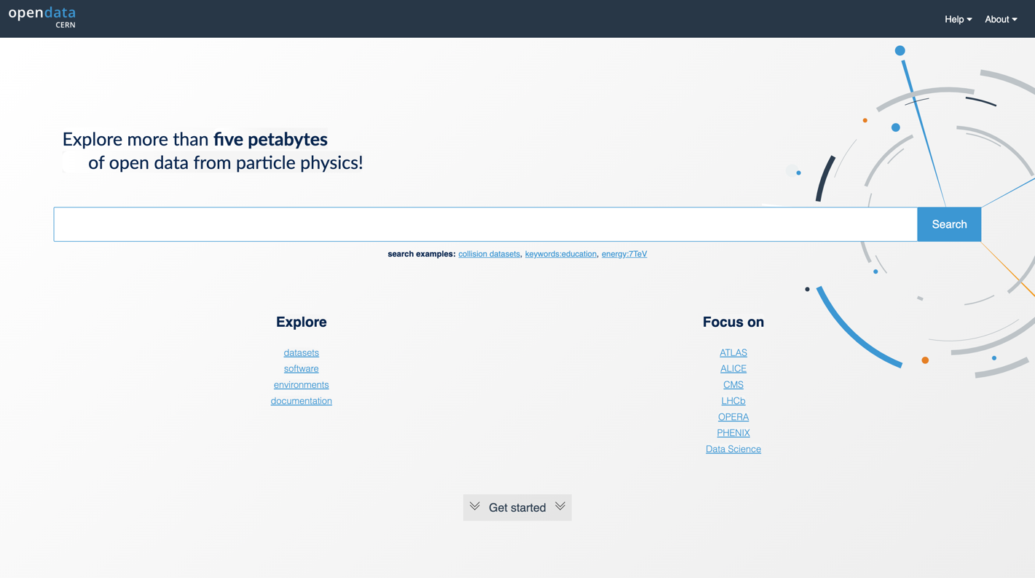
https://opendata.cern.ch/

Slide 13

Open Software
1993-2023
1993
WWW released into public domain
2002
Indico, Invenio
1995
ROOT
2023
CERN Open Source Program Office (OSPO) launched

Slide 14
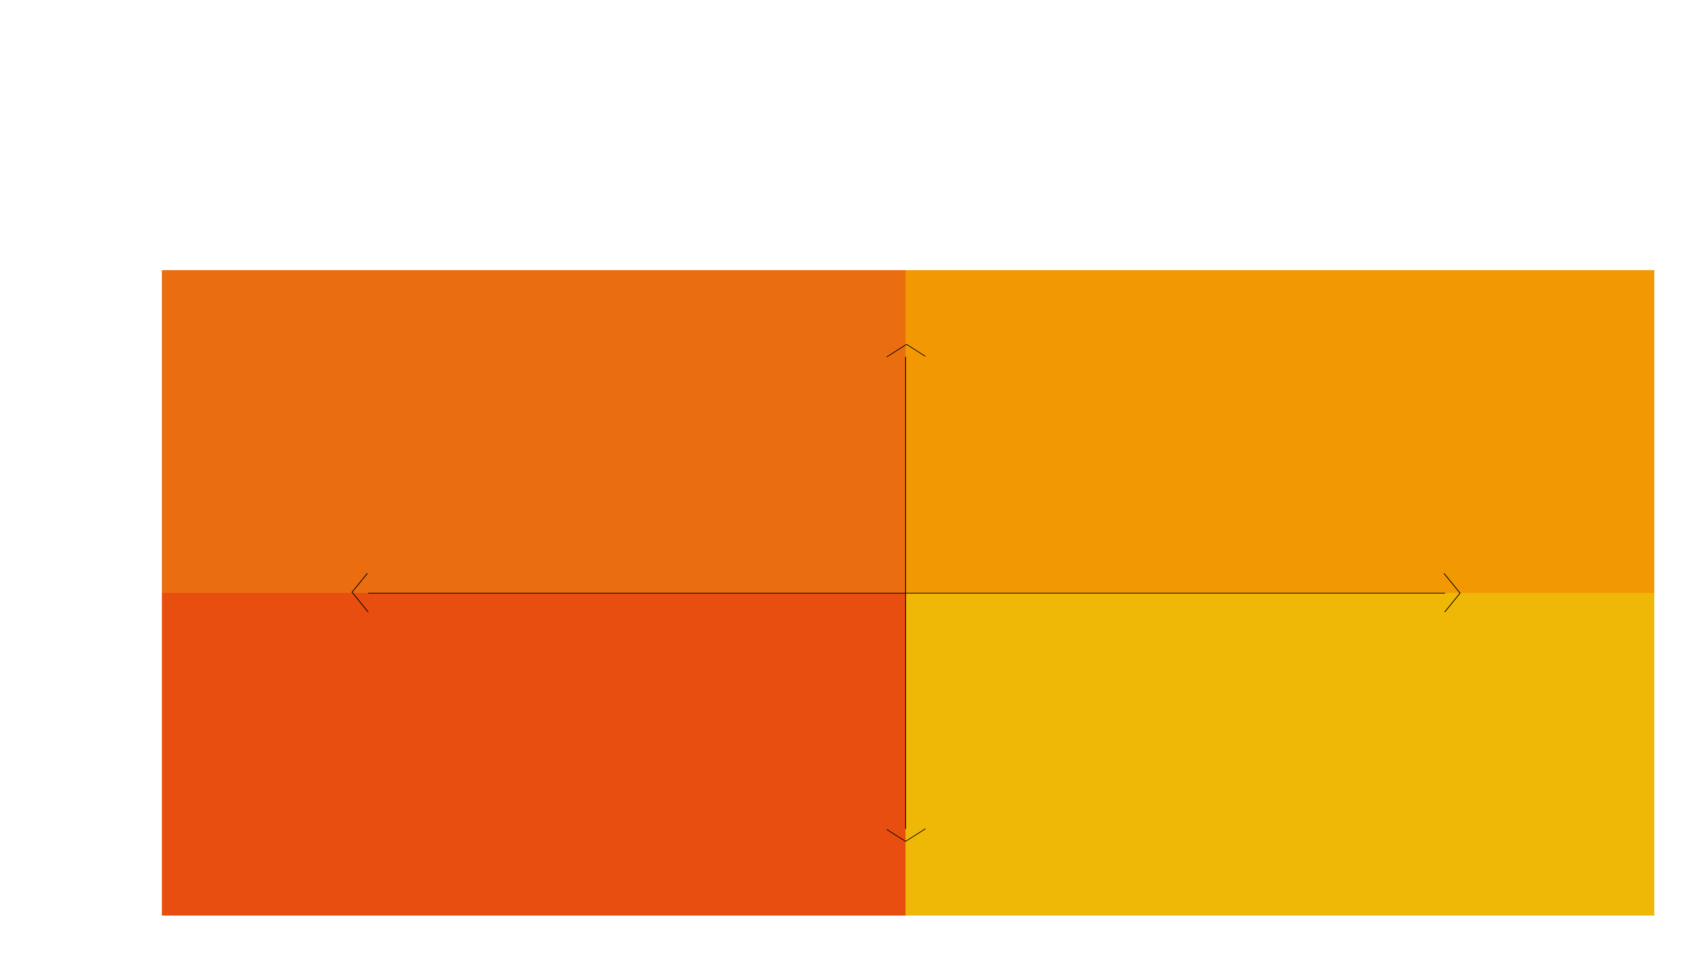
CERN
Open Source
Program Office
STRATEGIC
OS Policy
OSPO Mandate
OSPO Outreach
OS Partnership
INTERNAL
EXTERNAL
Licensing
Tips & Tools
OSPO Catalogue
CLA Management
OPERATIONAL

Slide 15
15
Research
Assessment
Recognize the diversity of contributions to, and careers in, research in accordance with the needs and nature of the research.
Base research assessment primarily on qualitative evaluation for which peer review is central, supported by responsible use of quantitative indicators.
Abandon inappropriate uses in research assessment of journal and publication-based metrics, in particular inappropriate uses of Journal Impact Factor (JIF) and h-index.
Avoid the use of rankings of research organizations in research assessment.
CoARA

Slide 16
Research
Assessment
The CoARA principles are well aligned with CERN Values and established particles physics practices.
To further enhance this alignment, the following actions will be taken in the next five years:
Promote open science, teaching outreach activities.
Acknowledge diverse career trajectories within
the institution.
Acknowledge the societal impact of research taking
place at CERN.
CoARA at CERN

Slide 17

CERN
Infrastructure
A set of technological tools and services that support and enable open science practices.

Slide 18
Open
Infrastructure
Services & Activities
CERN
Open Data
Portal
CERN
Analysis
Preservation
REANA
(Reproducible Analysis)
INSPIRE
CERN
Document
Server
Open
Hardware
Repository
Indico
Zenodo

Slide 19

Policies
2023
2014-2025
OS Governance Framework
implement of OS Policy
align with CERN strategy
2021
2014
CERN Open Science Strategy Working group to devise organisational
OS policy
CERN Open Access Policy Published
2025
CERN to publish first OS report
2020
LHC Open Data Policy Published
2021
CERN contributes to development of UNESCO Open Science recommendation
2023
CERN publishes OS implementation plan
2020
ESPP Update states:
“The particle physics community should work with the relevant authorities to help, shape the emerging consensus on Open Science to be adopted for publicly-funded research, and should then implement a policy of Open Science field.”
2022
CERN publishes its first organizational OS Policy

Slide 20
Policy accompanied by implementation document outlining roles, responsibilities, mechanisms & resources
Includes actionable measures to support the policy’s implementation across the organization and in the experiments
Implementation led by Communities of Practice across the various OS activities
Identifies/surfaces both existing and required resources for policy implementation
Published openly here.

Slide 21

Open Science
Creating efficient and effective coordination of CERN´s Open Science efforts.
Director of Research
and Computing
Governance
Framework
Open Science
Steering Board
OS Practitioners Forum
OS Office
Open Data WG
CoARA Implementation WG
SIPB
OSPO

Slide 22
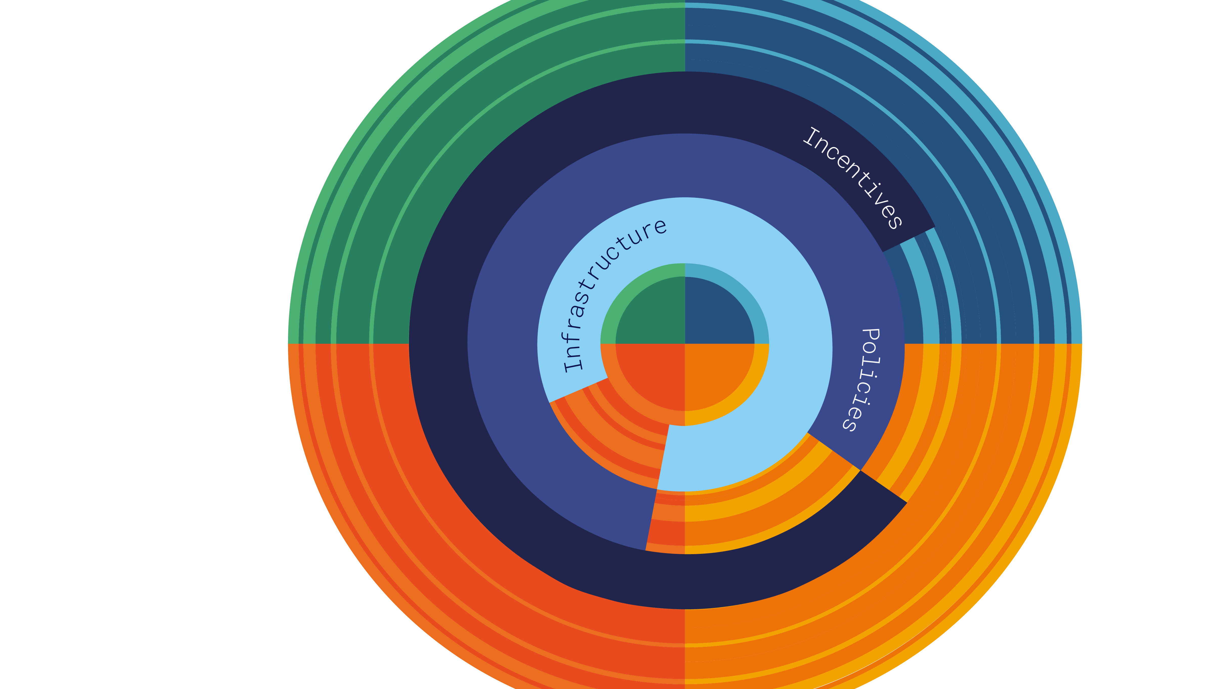
Open Science
Structures & Process
DATA
PUBLICATIONS
SOFTWARE
HARDWARE

Slide 23
Anne Gentil-Beccot
Open Science Coordinator
European Organization for Nuclear Research (CERN)
Anne.Gentil-Beccot@cern.ch
https://openscience.cern

