Slide 1
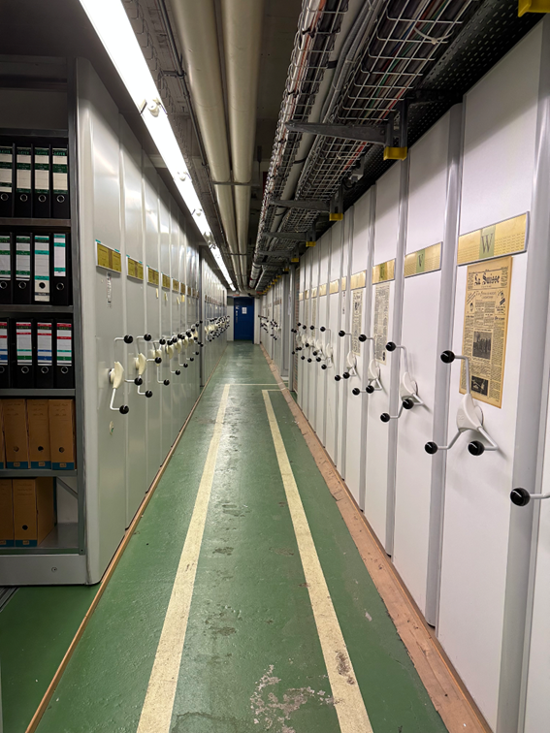
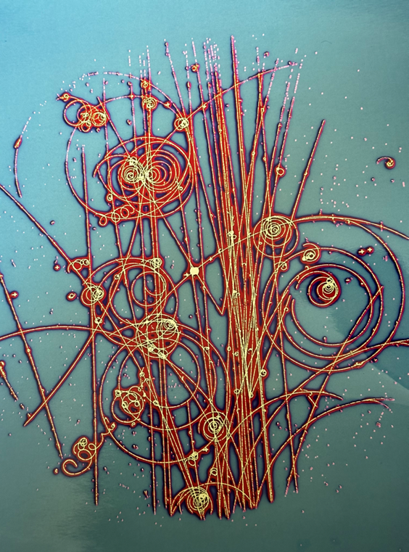

CERN Archives

Slide 2
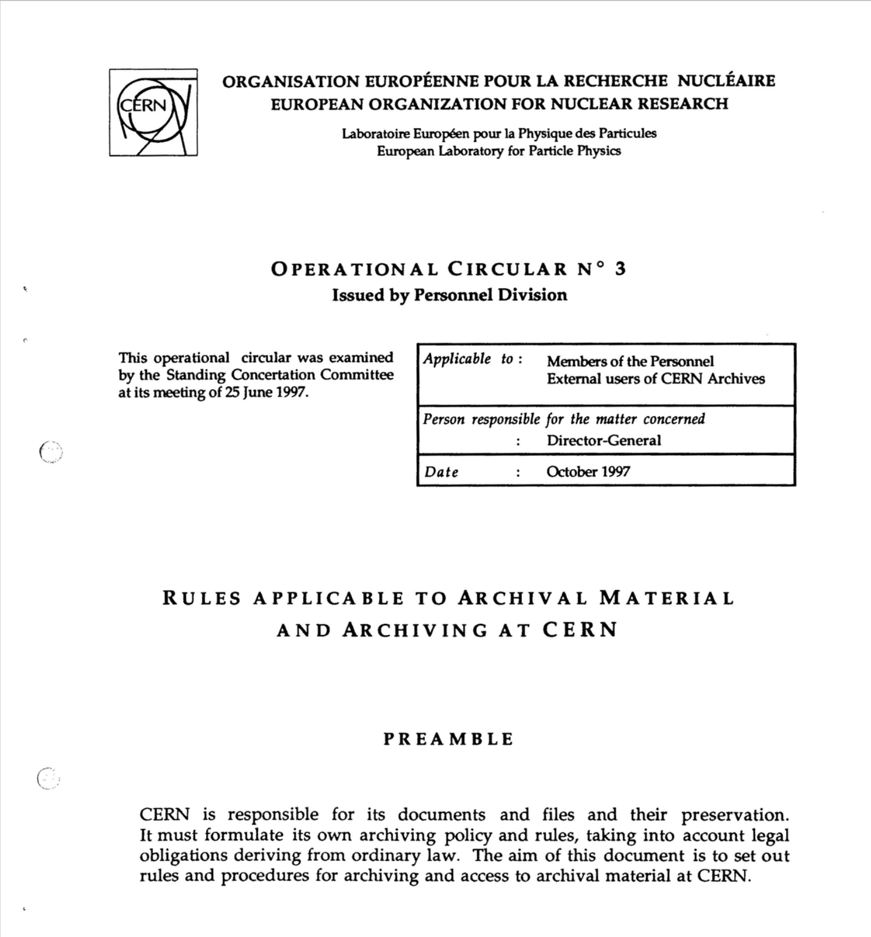
History & founding
CERN Council established the archives in 1979 in celebration of the Organization’s 25th anniversary
Adopted official rules and procedures (OC3) for archiving in 1997; hasn’t been updated since
Notes:
Currently in the process of updating the policy to be more aligned with the Organization’s current structure and needs, including addressing born-digital records

Slide 3
https://videos.cern.ch/record/2268196

Slide 4
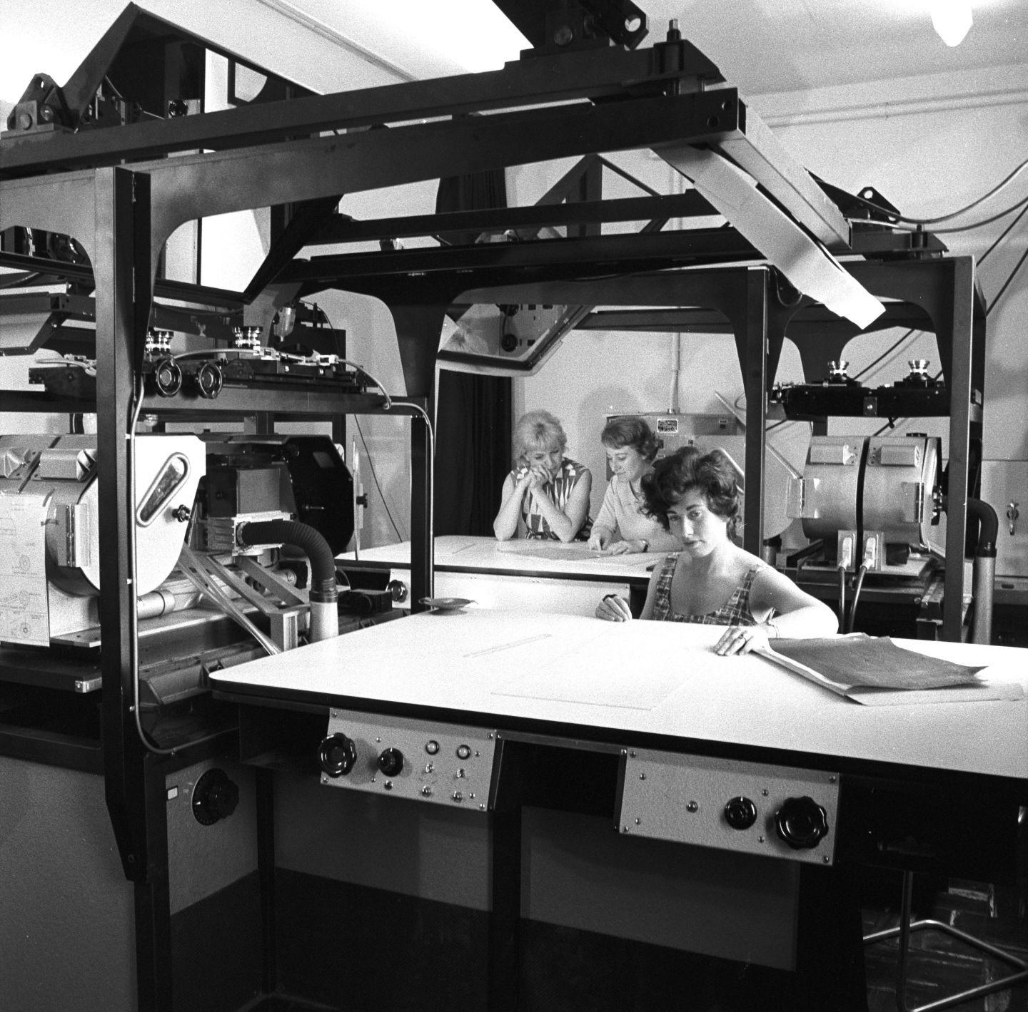
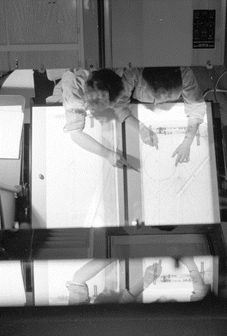
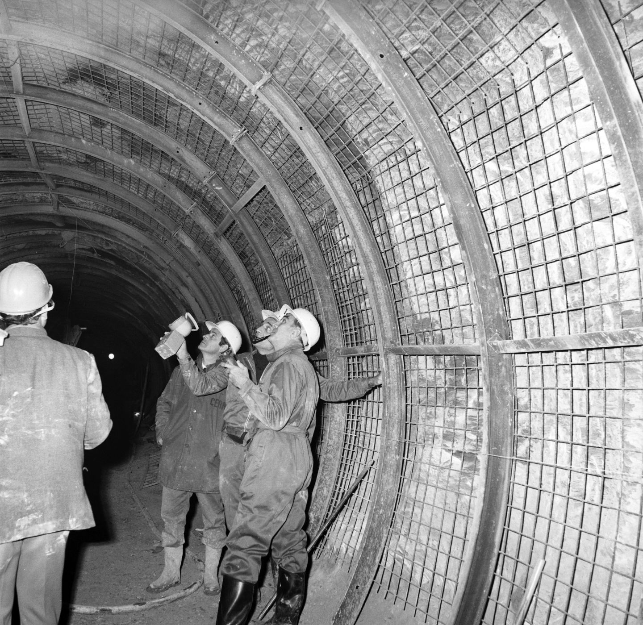
collections
2 linear kilometres of materials, housed in ~16,000 document boxes
Online catalog (CDS) contains 38,000 archival bibliographic records and some digitized documents
Notes:
We have materials from CERN’s founding in the early 1950s up until present day
The CERN archives holds scientific, technical, and administrative documents, relating to:
CERN Council, which is the decision-making authority of the Organization, composed by delegates of all its twenty-four Member States;
Administration and management;
Accelerators, detectors, and
facilities: planning, construction and operation;
Research facilities, experiment collaborations; Theoretical and experimental physics;
Technologies: computing, electronics, vacuum, cryogenics, etc.;
CERN's social and cultural life;
World Wide Web collection (you may know that the Web was invented by Tim Berners-Lee in 1989, who was working at CERN at the time)
Approximately only 13% of our holdings are currently digitized.

Slide 5
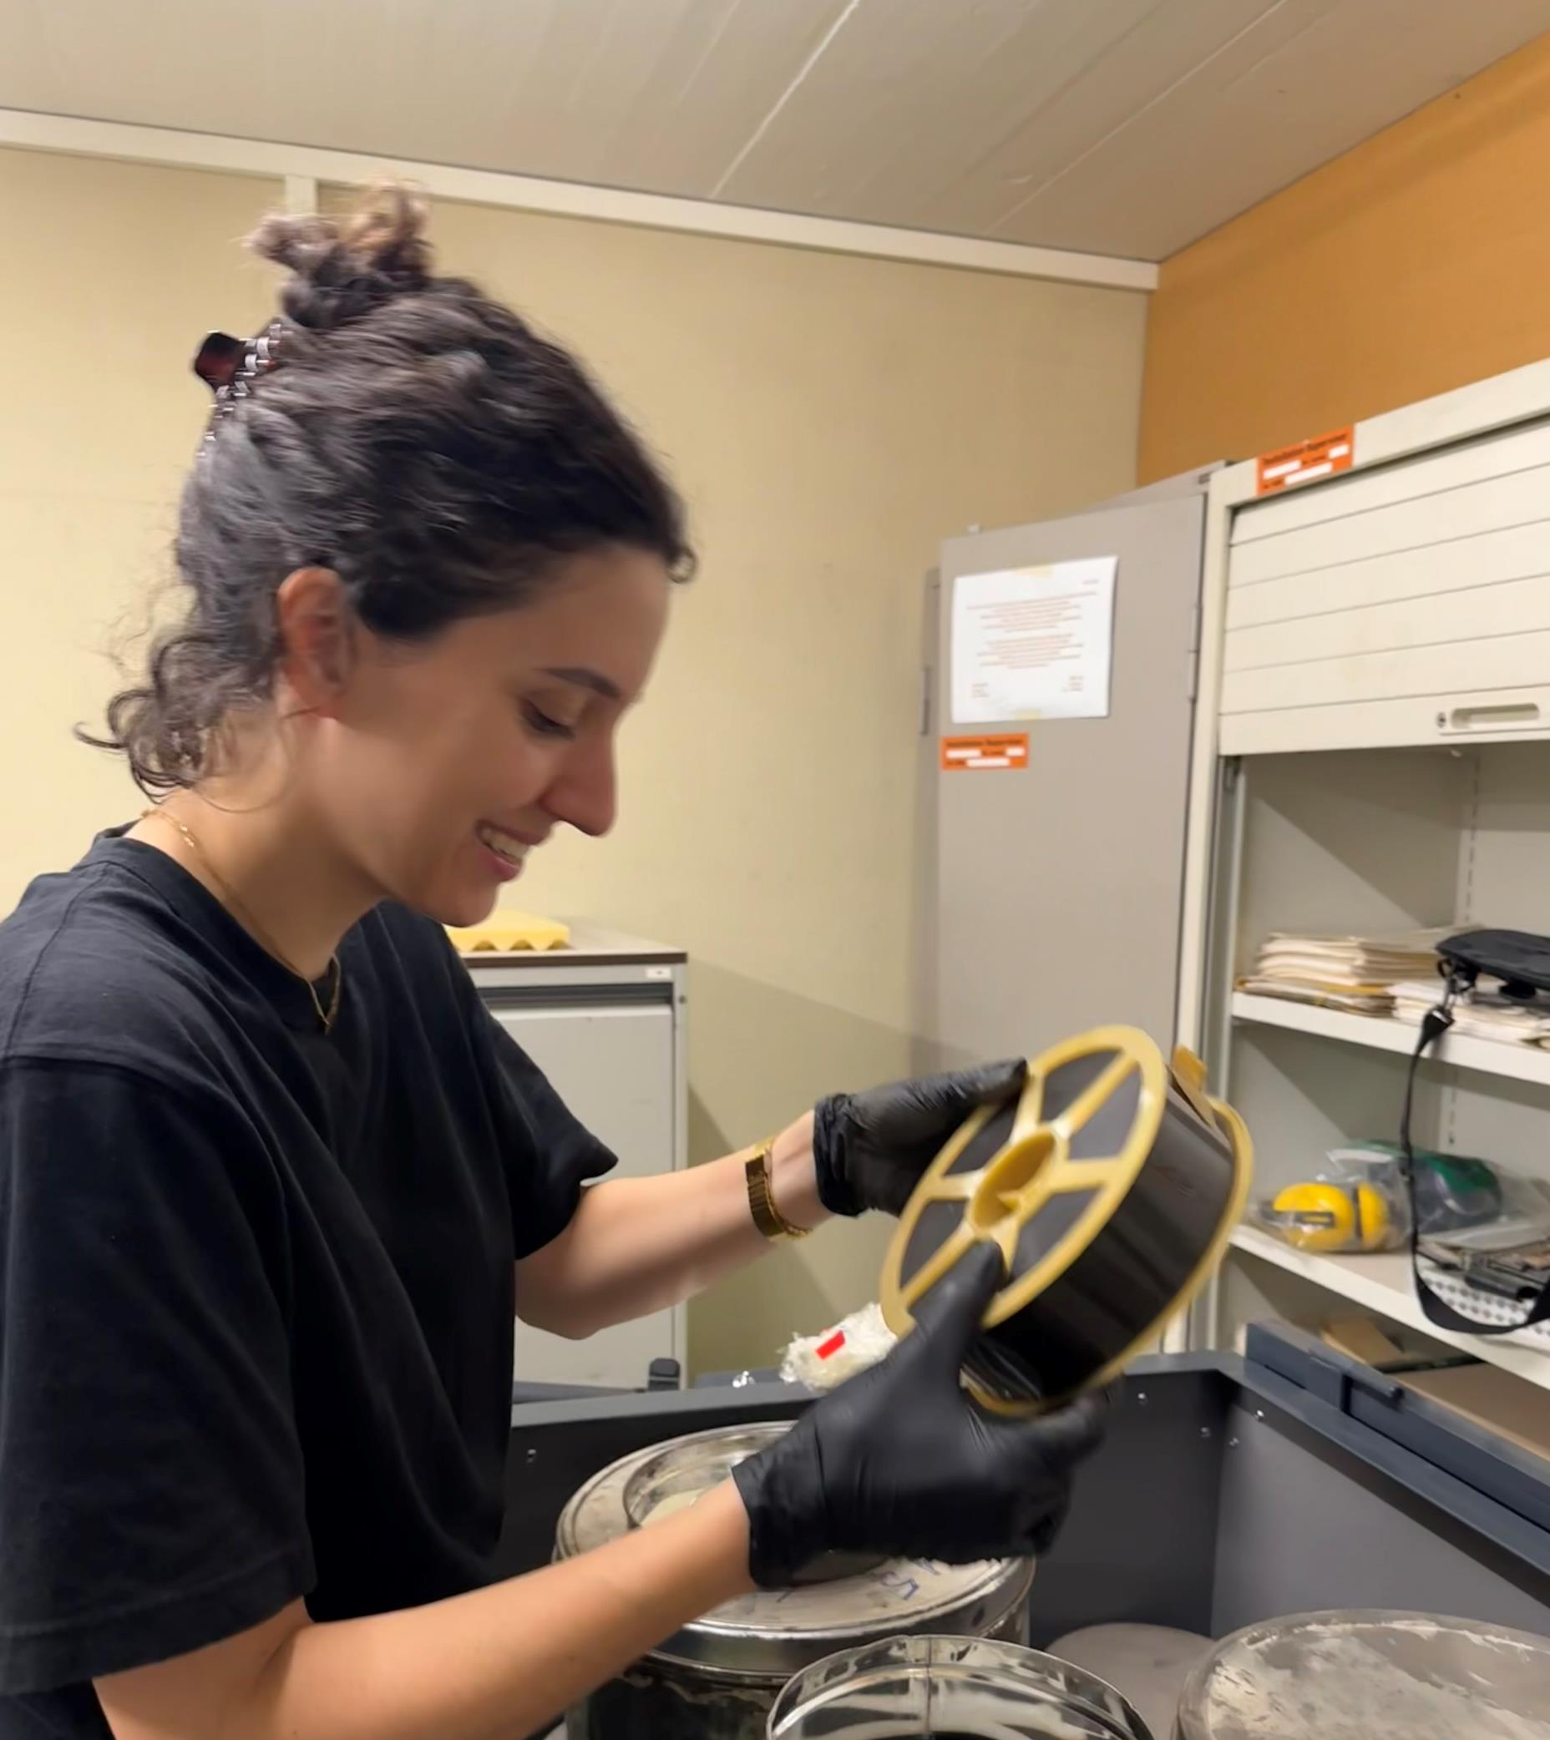
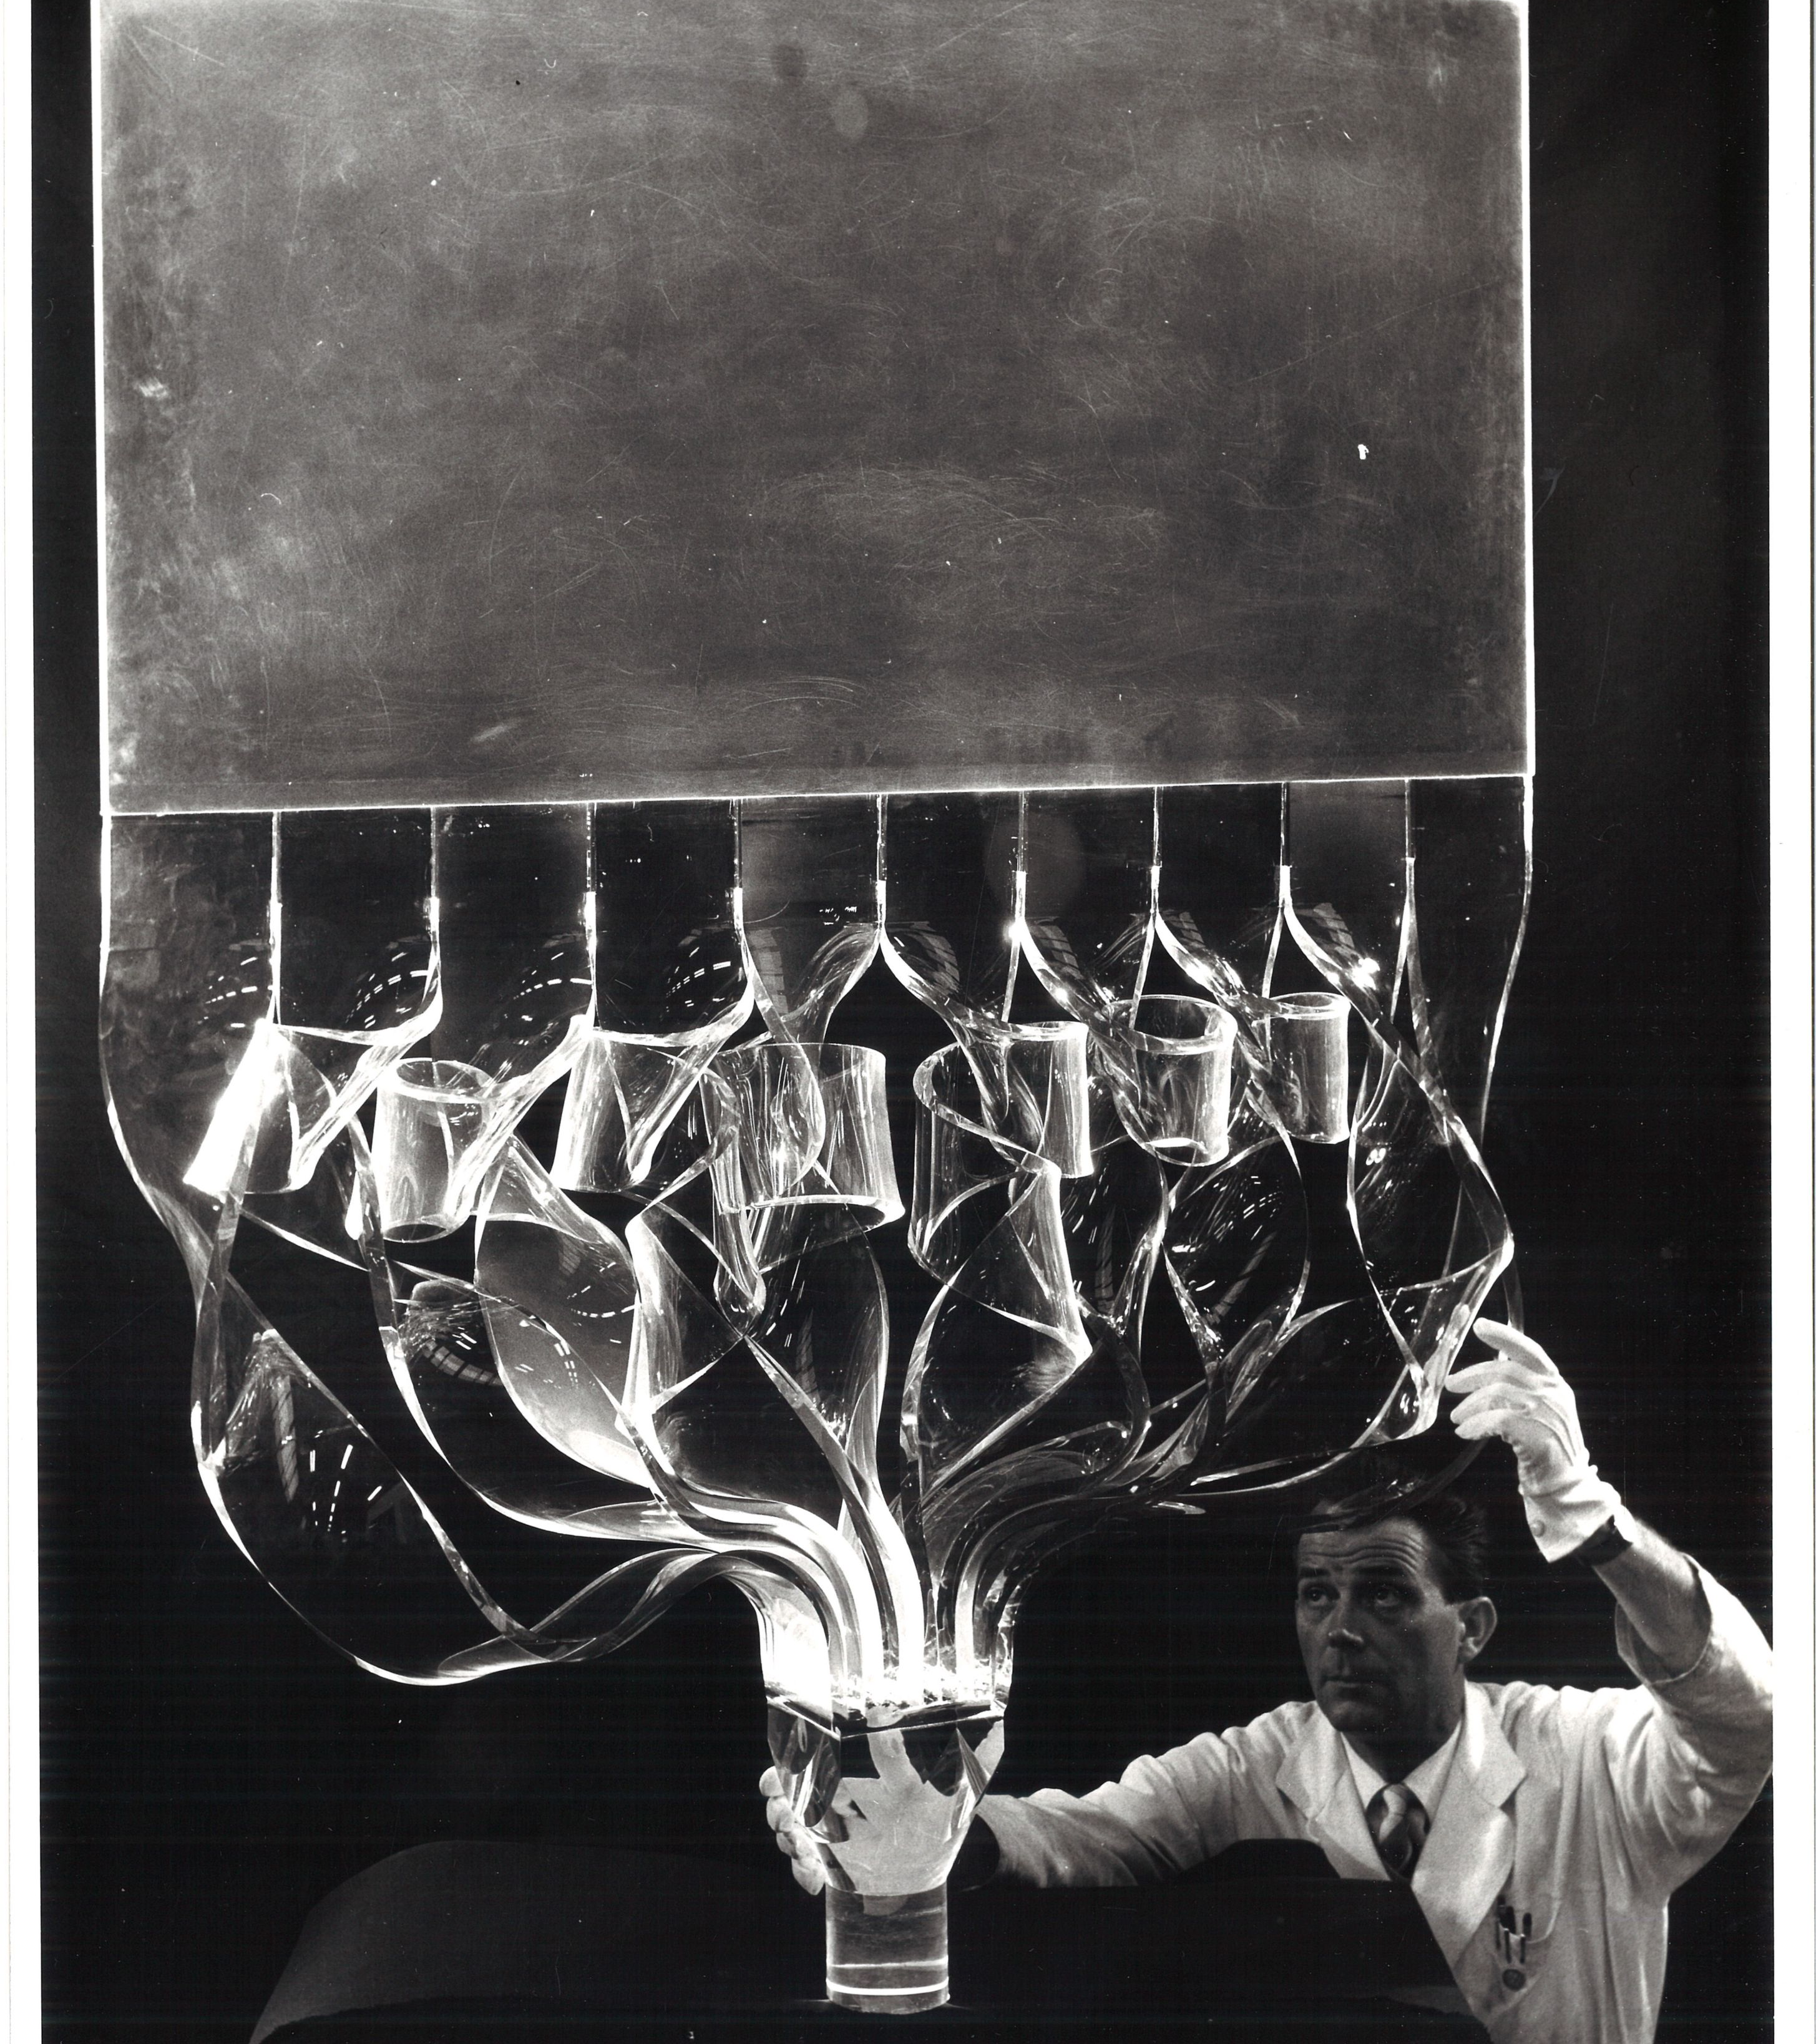
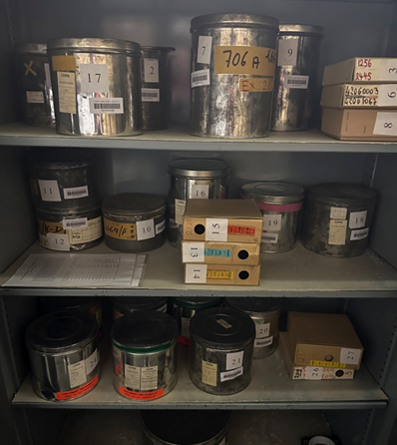
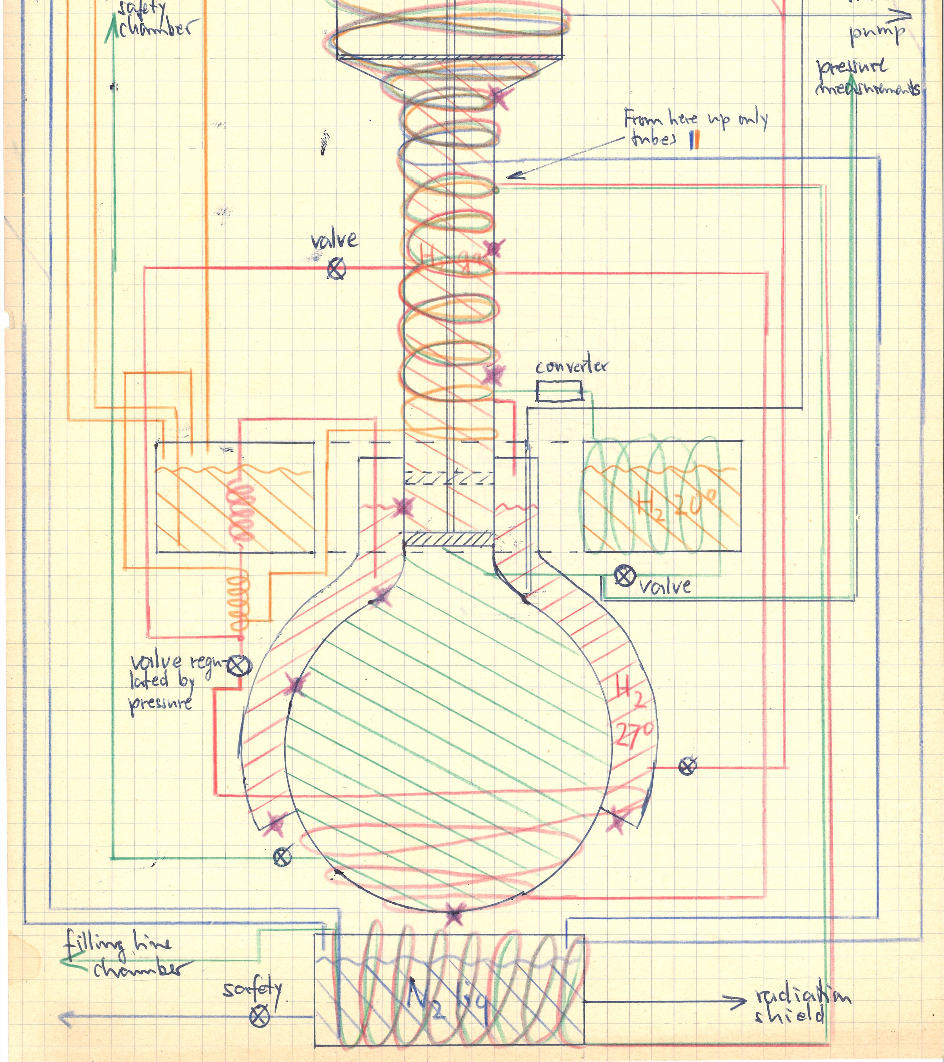
FORMATS
Mostly documents, but also : drawings ; blueprints ; film reels ; photographs ; small number of objects

Slide 6
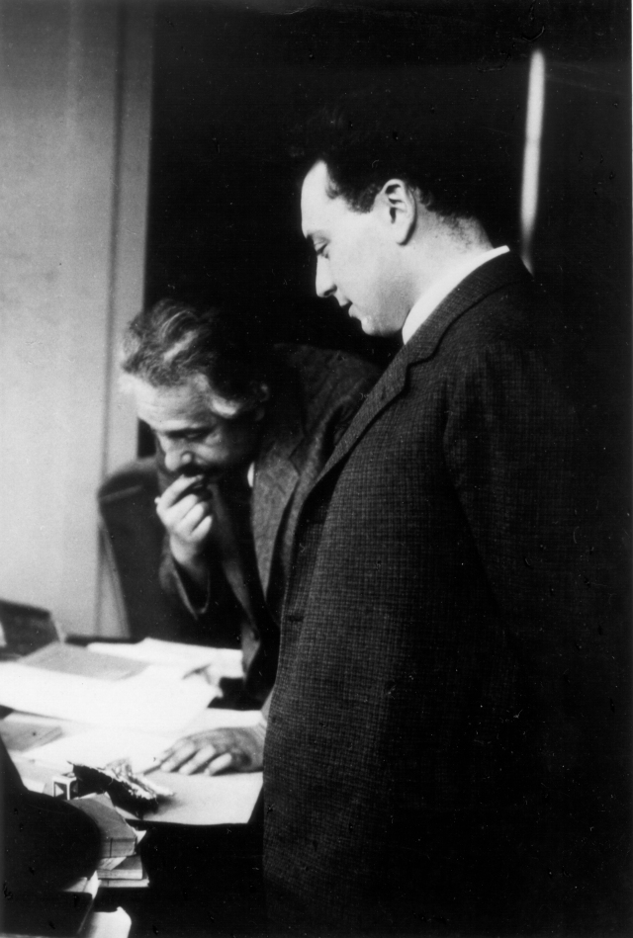
Wolfgang pauli
Was awarded the Nobel Prize in 1945 for the discovery of the Exclusion Principle, also called the Pauli Principle
From 1928 until his death in 1958 Wolfgang Pauli was a professor at the Eidgenössische Technische Hochschule (ETH) Zürich
Pauli and Einstein working together, 1933
Notes:
The CERN Archives has custody of the Pauli Archive, a private collection of scientific books, reprints, correspondence and manuscripts of the late Professor Wolfgang Pauli, Nobel Laureate, 1945. The Pauli Archive also includes many photographs, Pauli's Nobel Prize and other scientific awards. Consult the Pauli Archive guide to find more information about Pauli Archive.
CERN received this collection of documents after Pauli's death in 1958. Then his widow assisted by Charles Enz, Pauli's last assistant, took on the task of administering Pauli's scientific legacy. They approached colleagues to help in reassembling his imposing scientific correspondence. In these letters the new ideas in physics were discussed much as they now are in journals.
Mrs. Pauli was also assisted by Victor Weisskopf, one of Pauli's first assistants, who was to become Director-General of CERN in 1961. In 1960 she began the process of bequeathing Pauli's scientific legacy to CERN, where a specially dedicated Pauli Memorial Room (Salle Pauli) has been created.
His correspondence with Bohr, Heisenberg Einstein and others, discussing many of the new ideas in physics, has been published (link) and provides an invaluable resource for those interested in studying the development of 20th century science. Unlike the main CERN Archive, most items in the Pauli collection have been digitised and are available online.
[medal, letter from Einstein]

Slide 7
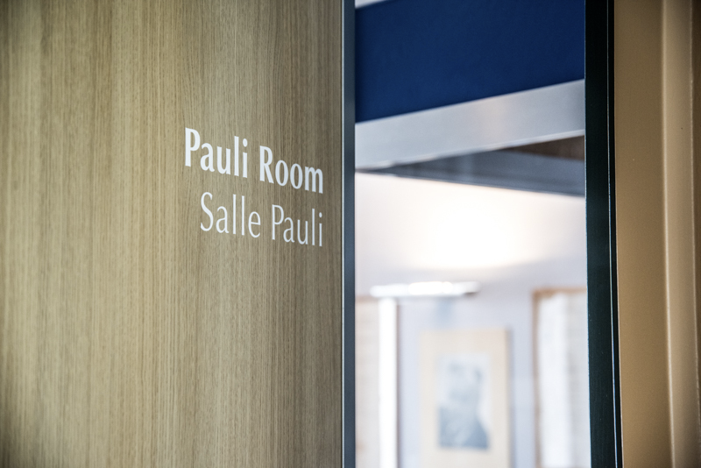
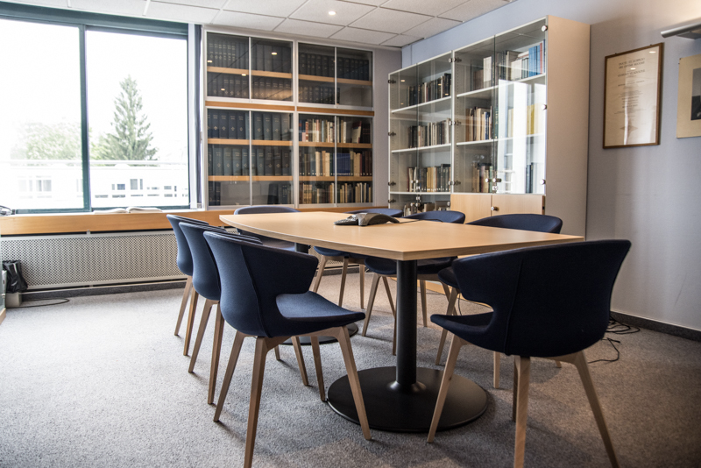

Pauli room
Notes:
Pauli Room contains his personal book collection and other ephemera belonging to Pauli. The room is used for researchers and for high level CERN administrative meetings.

Slide 8
New boxes
Notes:
Currently in the process of replacing all of our boxes to acid-free archival containers ; in the beginning stages of exploring possibly moving to a new building.

Slide 9
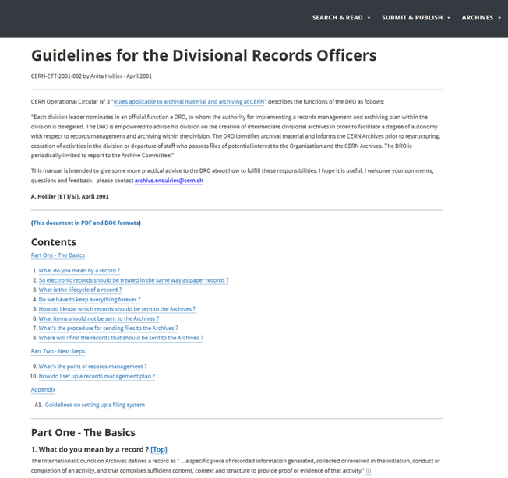
Records transfer
Departmental Records Officers (DROs) are appointed by their Department Heads to liaise with the Archives to identify and transfer relevant records; representatives from 13 departments and experiments within CERN
Notes:
"Each division leader nominates in an official function a DRO, to whom the authority for implementing a records management and archiving plan within the division is delegated. The DRO is empowered to advise his division on the creation of intermediate divisional archives in order to facilitate a degree of autonomy with respect to records management and archiving within the division. The DRO identifies archival material and informs the CERN Archives prior to restructuring, cessation of activities in the division or departure of staff who possess files of potential interest to the Organization and the CERN Archives. The DRO is periodically invited to report to the Archive Committee."

Slide 10
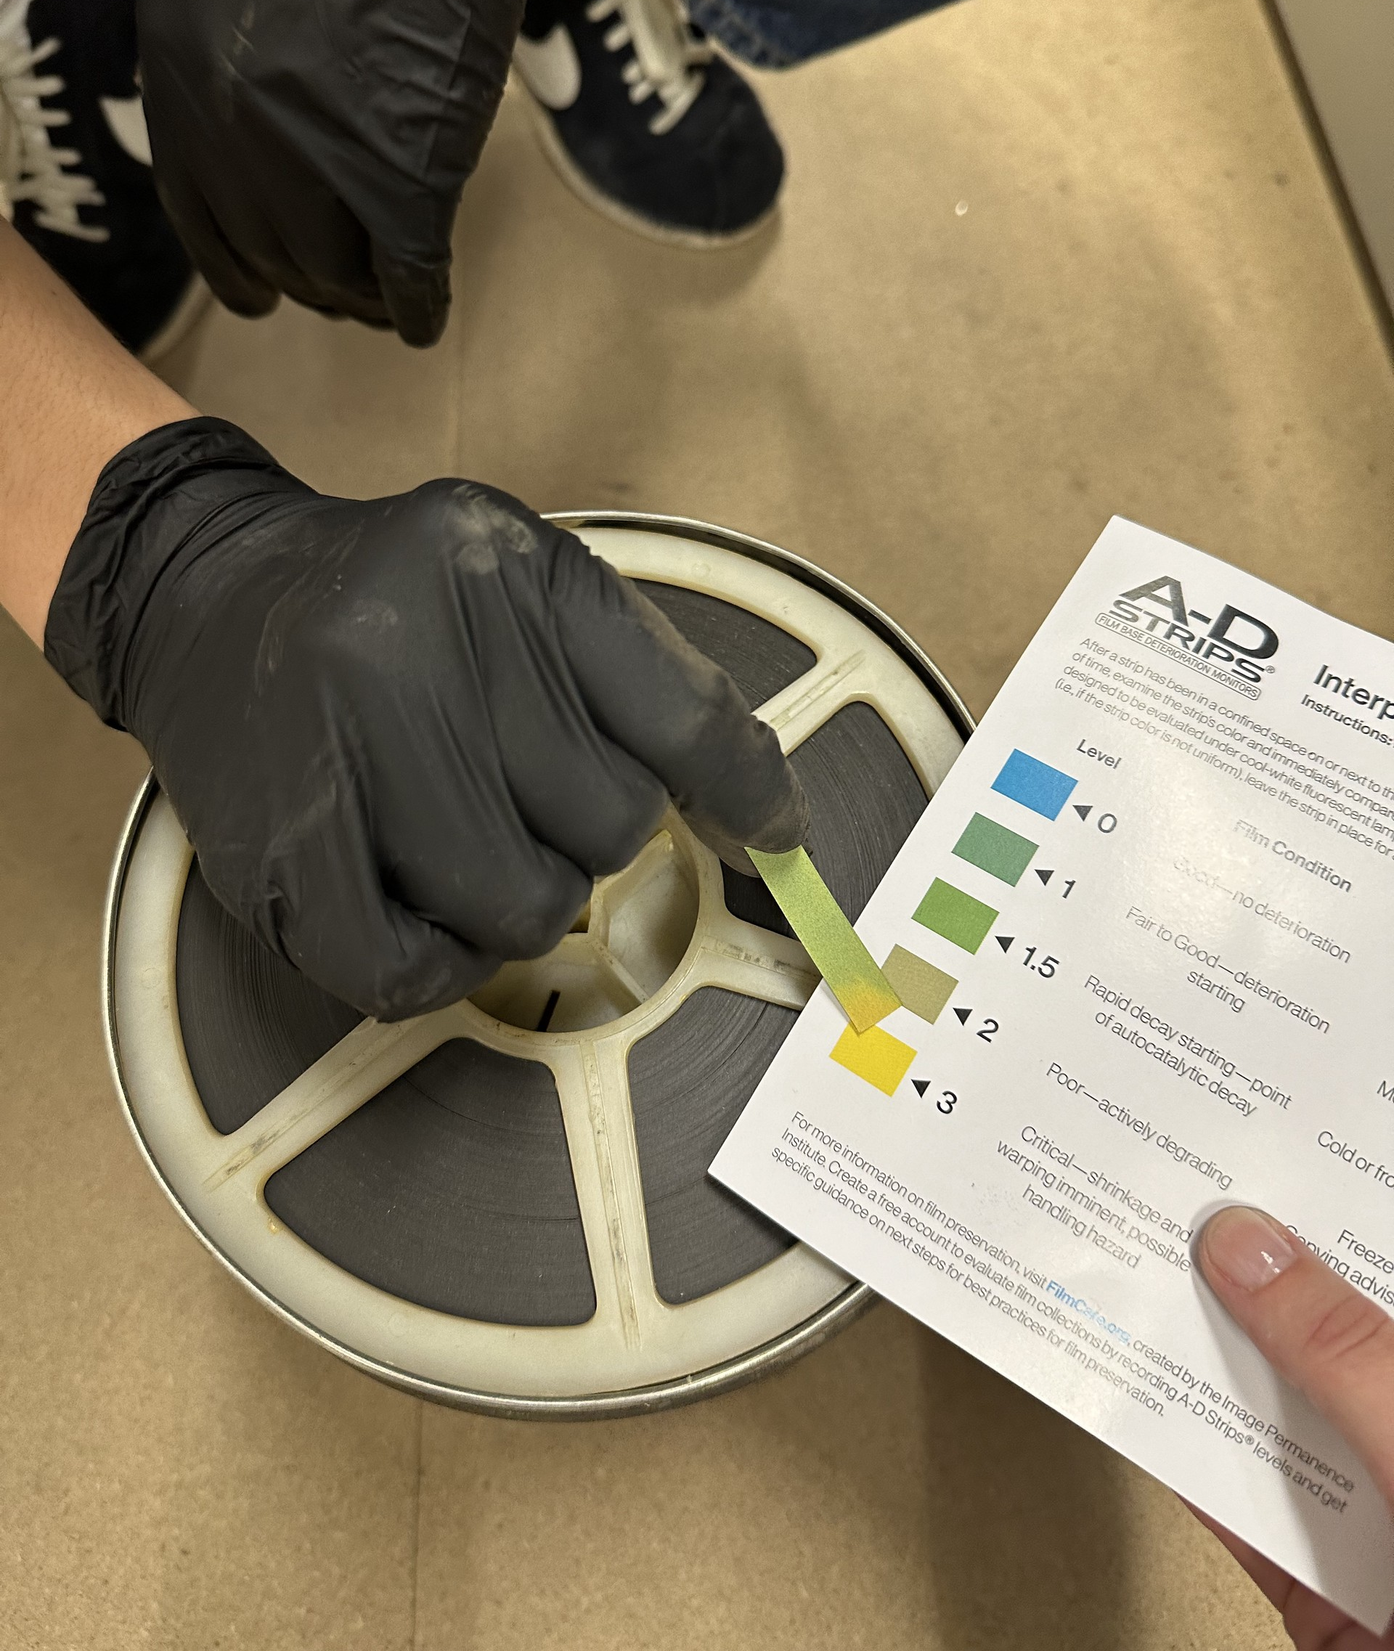
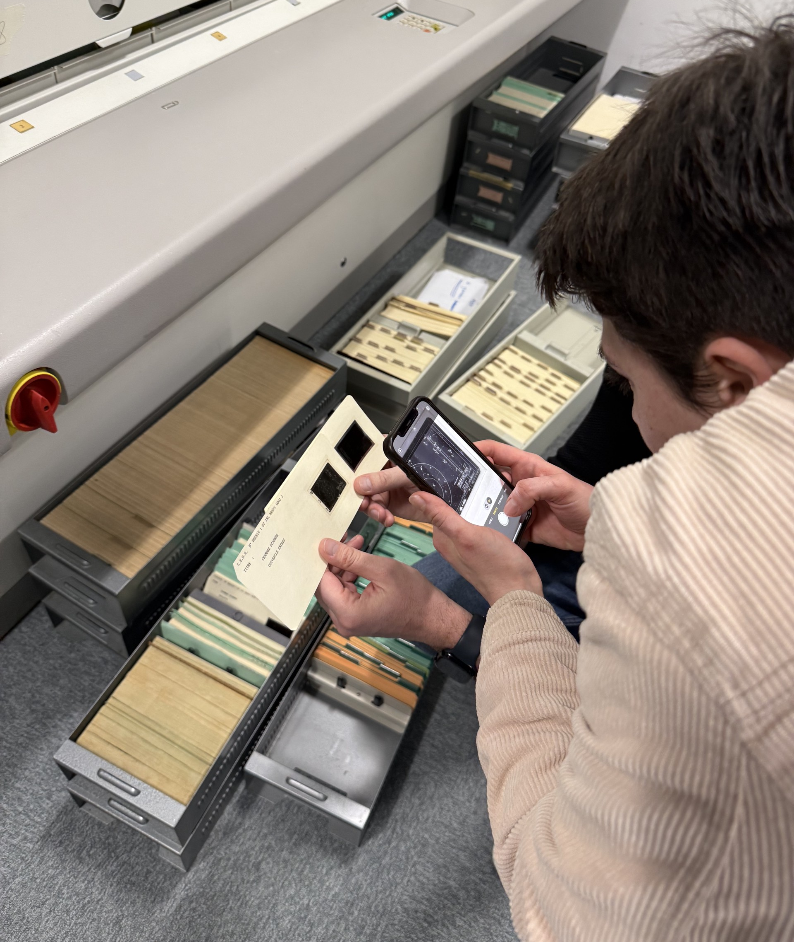
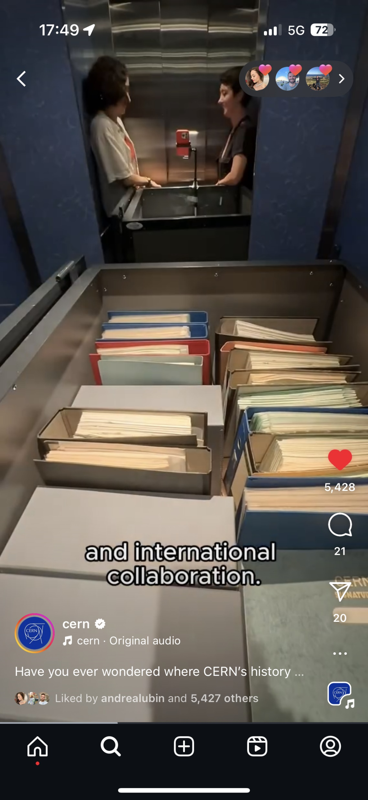
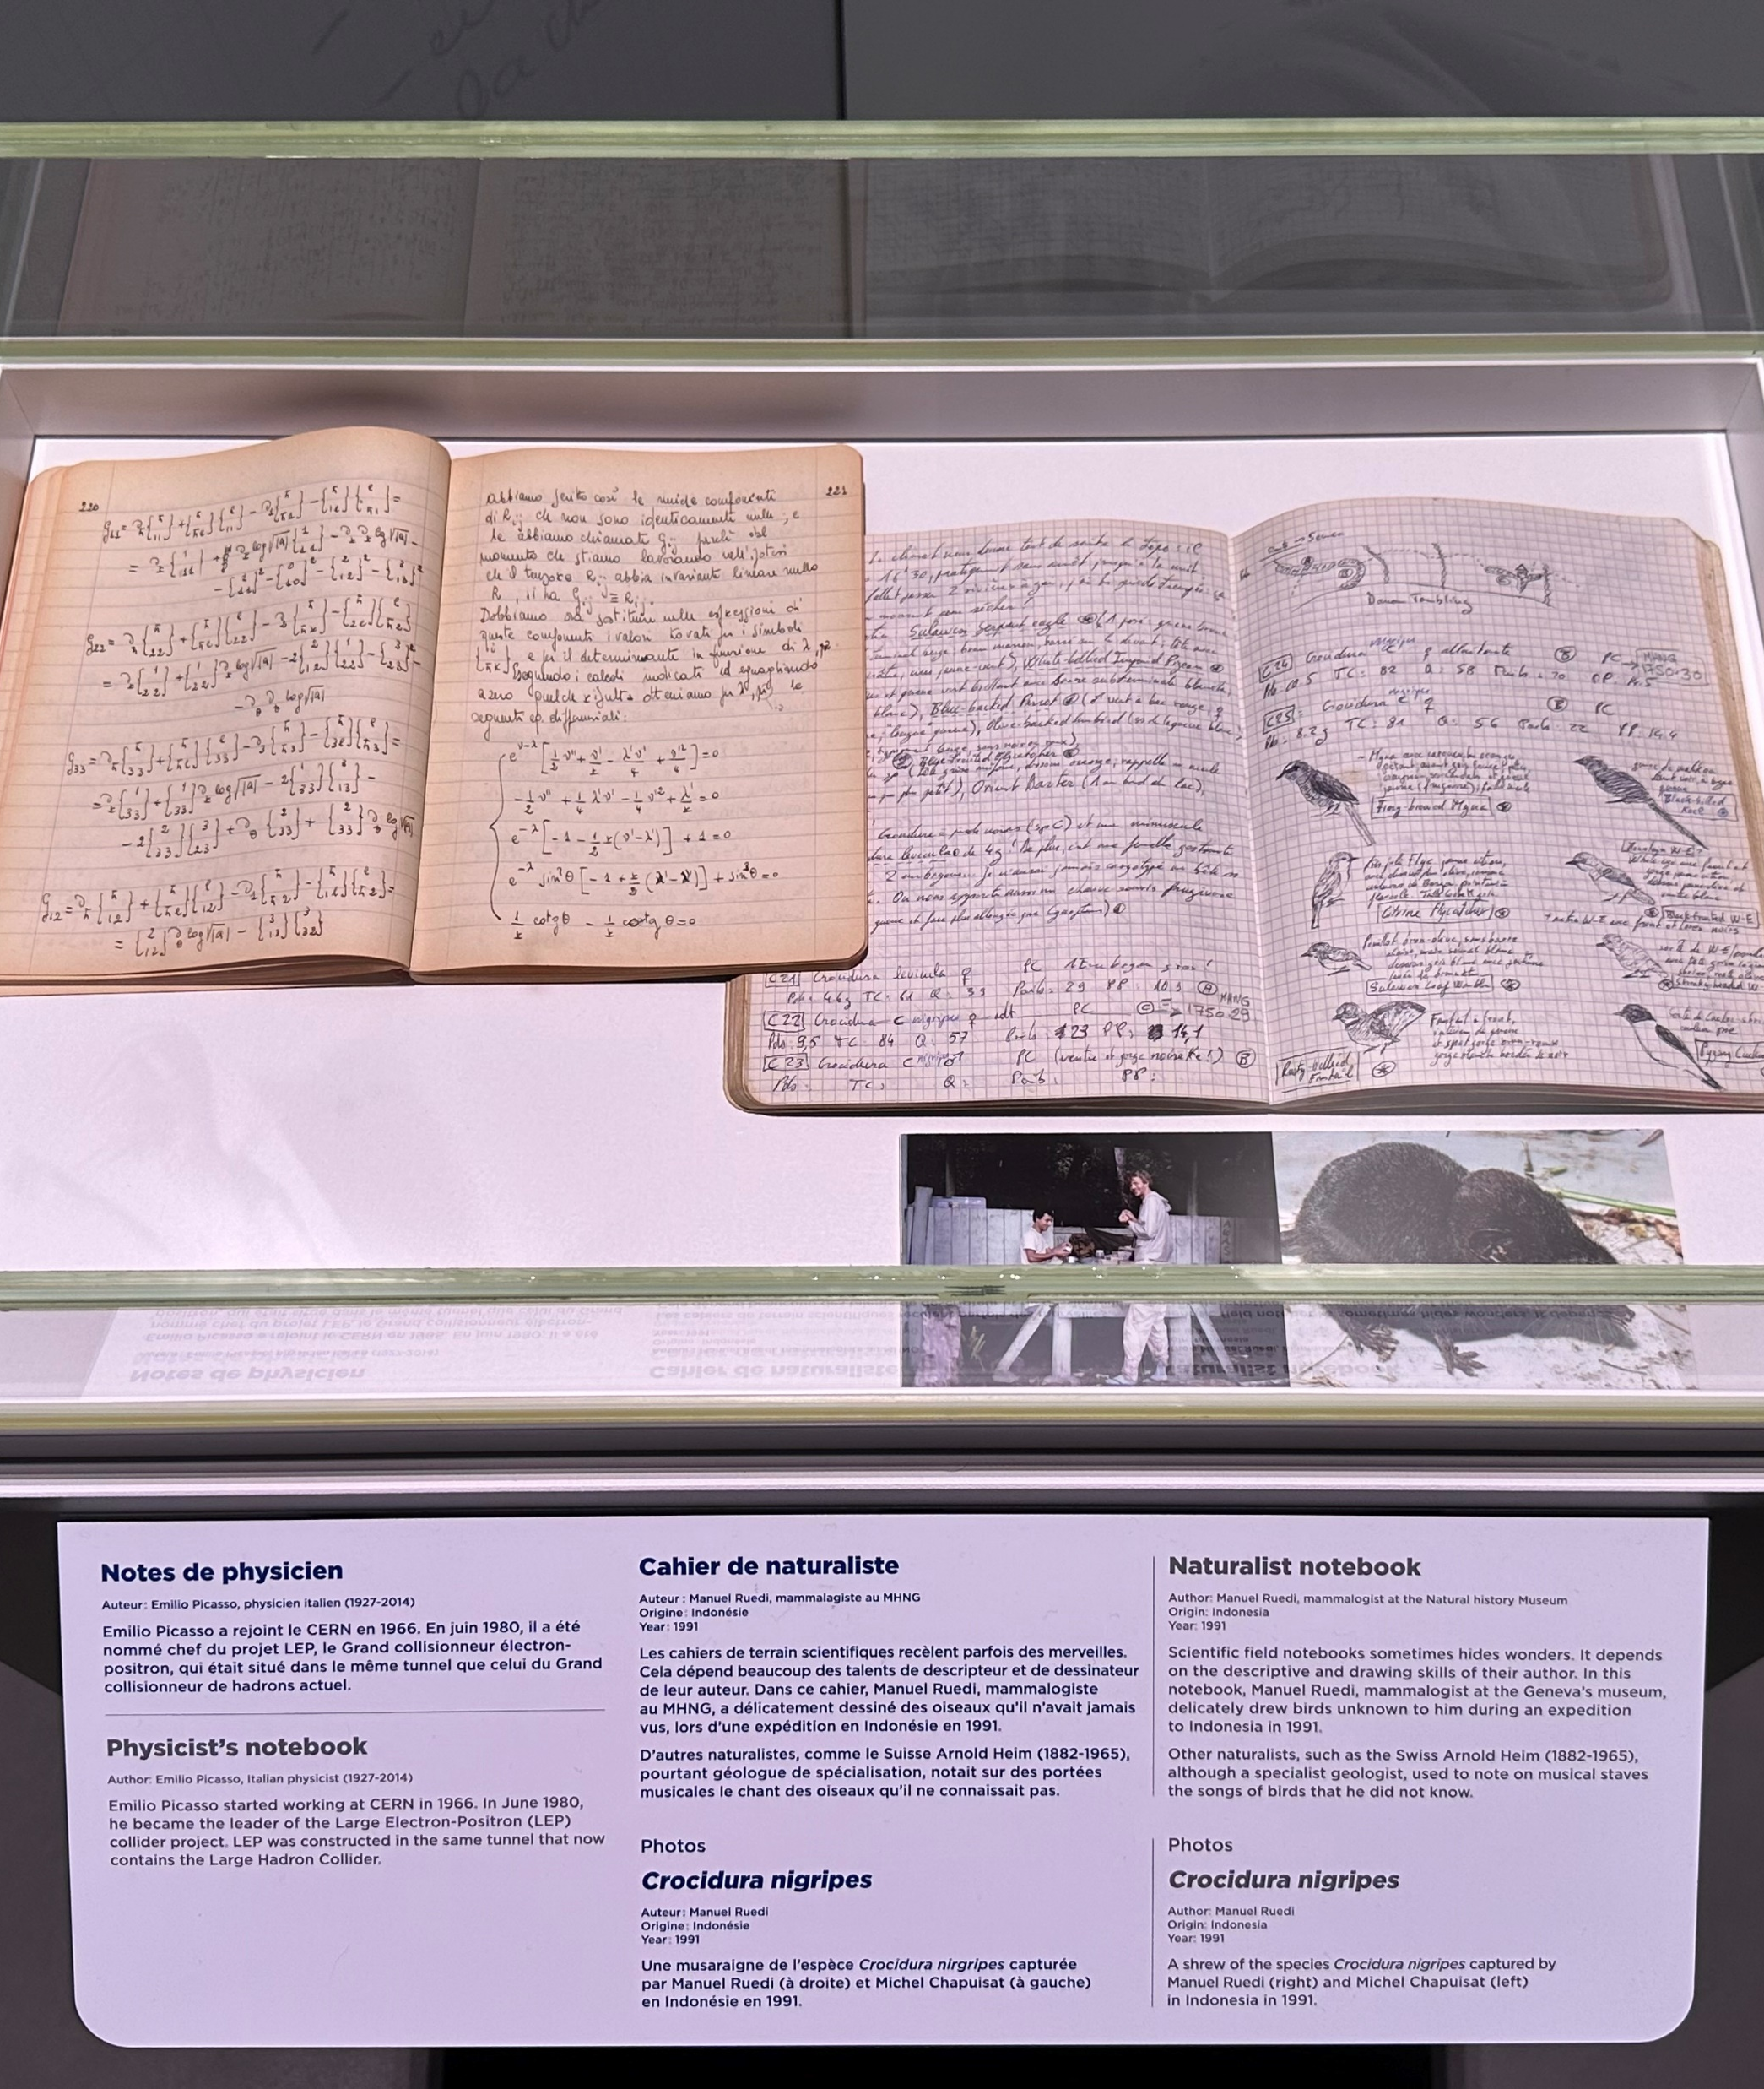
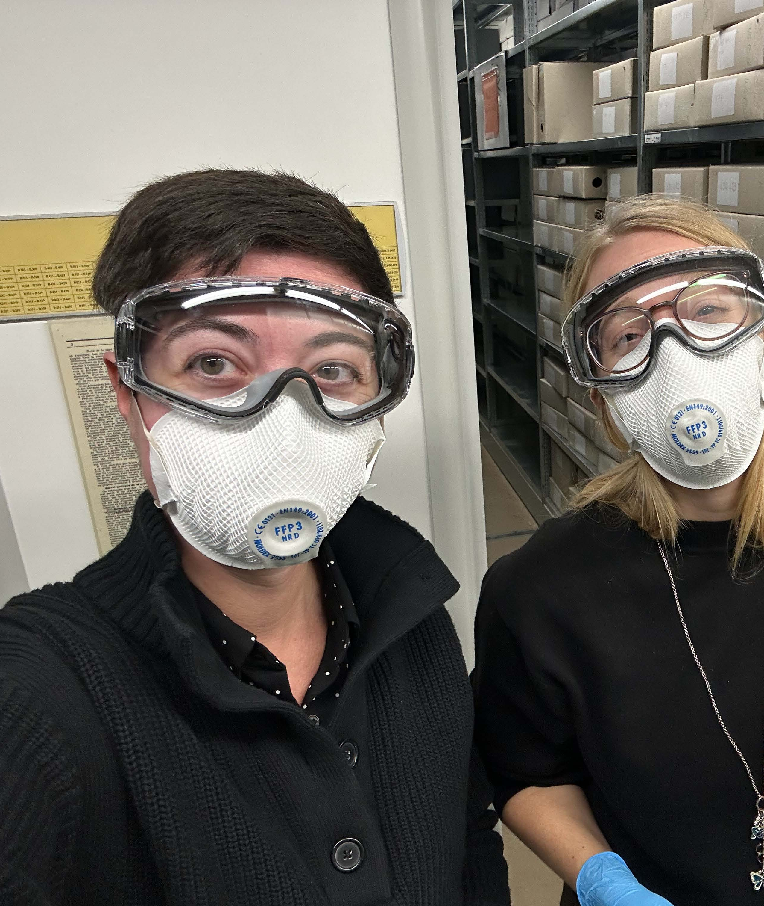
A day in the life
Answer reference requests, host researchers
Outreach activities (social media, exhibitions)
Update policies
Process collections
Accession materials
Physical care of collections
(re-boxing, etc.)

Slide 11
https://scientific-info.cern

