Slide 1





Muon Collider
D. Schulte
On behalf of the International Muon Collider Collaboration
LDG Review, February, 2025
Funded by the European Union (EU). Views and opinions expressed are however those of the author(s) only and do not necessarily reflect those of the EU or European Research Executive Agency (REA). Neither the EU nor the REA can be held responsible for them.

Slide 2
Overall Goals and Roadmap Deliverables
IMCC, International Muon Collider Collaboration
Currently hosted at CERN
Collaboration goal:
Develop high-energy muon collider as option for particle physics:
Focus on 10 TeV feasibility
Initial stage as option by ~2050 as strongly recommended by Steering Board and Advisory Committee, with required compromises
Could later consider other energies
LDG Roadmap deliverables (2026-2027):
A Project Evaluation Report that assesses key issues to motivate that investment into a CDR is justified;
An R&D Plan that describes a path towards the collider;
An Interim Report by the end of 2023 that documents progress and allows the wider community to update their view of the concept and to give feedback to the collaboration (has been delivered)
Will deliver a tentative Project Evaluation Report and a tentative R&D Plan on March 31, 2025
Final versions at the end of MuCol February 2027

Slide 3

Muon Collider Roadmap CTEs
Protons produce pions which decay into muons which are captured
Short, intense proton bunch
Ionisation cooling of muon in matter
Acceleration to collision energy
Collision
- Proton driver
bunch compression
- Graphite target
- Target solenoid
- Muon cooling design
- 6D cooling solenoids
- 6D cooling RF cavities
- Final cooling solenoids
- Pulsed magnets and
power converters
- RCS RF system
Identified and prioritized with community
Other areas need now also to be addressed
(some work started)
- Collider ring dipoles
- Final focus quadrupoles
2
D. Schulte Muon Collider, LDG Review, February 2025
3

Slide 4
Roadmap Workpackages
Acronym | Workpackage | Leader(s)
SITE | Site considerations/layout | Christian Carli, Claudia Ahdida, John Osborn
NF | Neutrino flux mitigation syst. | Roberto Losito, Christian Carli
MDI | Machine-detector interface | Anton Lechner
ACC | Accelerator design Proton combination complex Muon cooling RCSs Collider ring Collective effects Long. beam. dynamics in acceleration | Natalia Milas Chris Rogers Antoine Chance Christian Carli Elias Metral Heiko Damerau
HFM | High-field magnet technology | Luca Bottura
FR | Fast-ramping magnets | Fulvio Boattini
RF | Radio frequency technologies | Alexej Grudiev, Dario Giove
TAR | Target facility and technology | Chris Rogers
MOD | Muon cooling cell module | Lucio Rossi
DEM | Muon cooling demonstrator | Roberto Losito
INT | Integration | John Osborn, Carlo Rossi, Daniel Schulte
CC members:
Daniel Schulte (study leader)
Andrea Wulzer (deputy physics)
Donatella Luccesi (dep. detector)
Chris Rogers (dep. machine)
Luca Bottura
Christian Carli
Antoine Chance
Dario Giove
Alexej Grudiev
Anton Lechner
Roberto Losito
Elias Metral
Natalia Milas
Lucio Rossi
Diktys Stratakis
Sergo Jindiariani
Mark Palmer
Steinar Stapnes (SB chair)
Nadia Pastron (ICB chair)

Slide 5
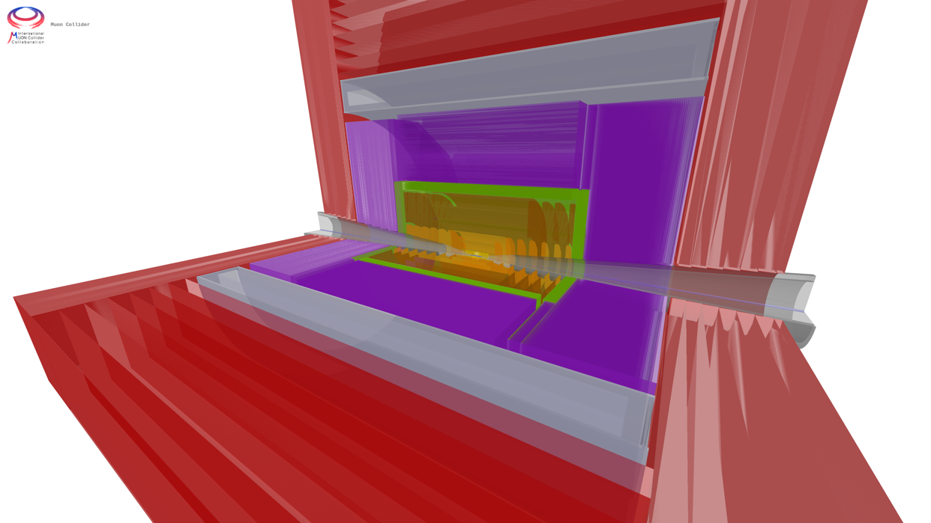
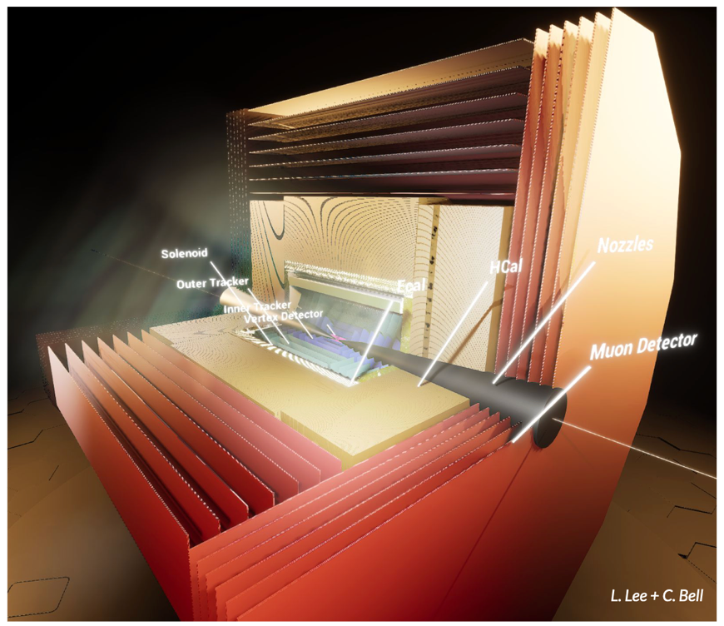
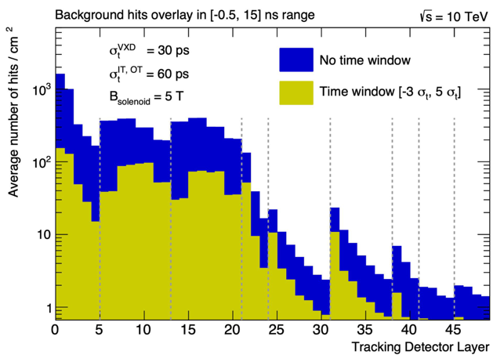
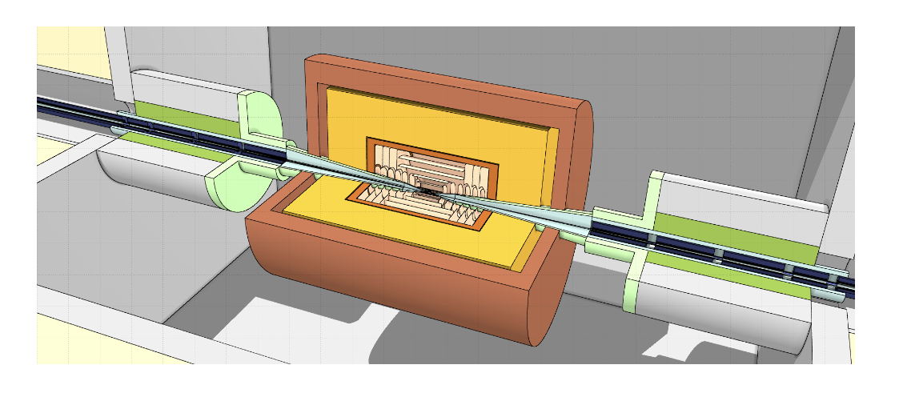
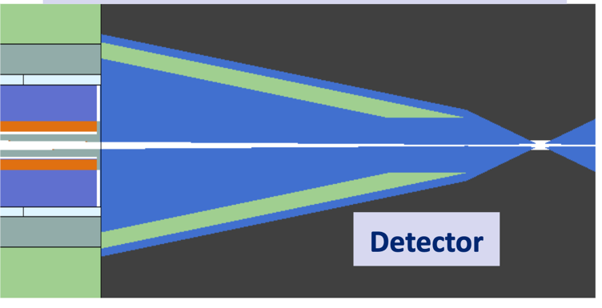
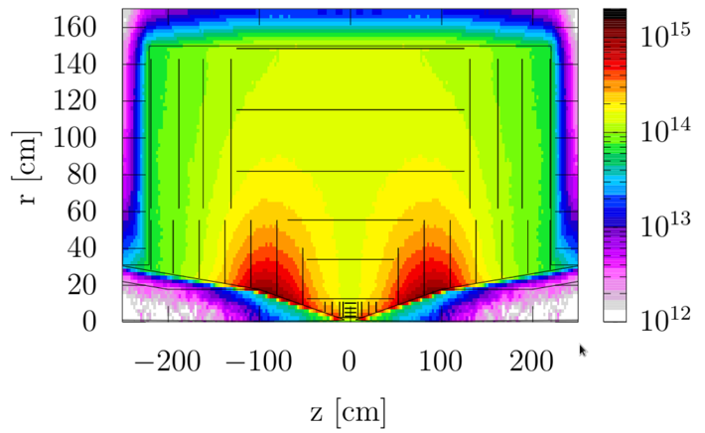
Beam-induced Background (MDI)
MUSIC
(MUon System for Interesting Collisions)
MAIA
(Muon Accelerator Instrumented Aperatus)
Goal:
Develop tools and provide required input for detector background studies and improve mask
Achieved:
All software tools are in place, mask optimized and background data delivered to experiment, now iterating with detector experts
Key conclusions:
Can do the important physics with near-term technology also thanks to HL-LHC developments
Radiation levels similar to HL-LHC

Slide 6
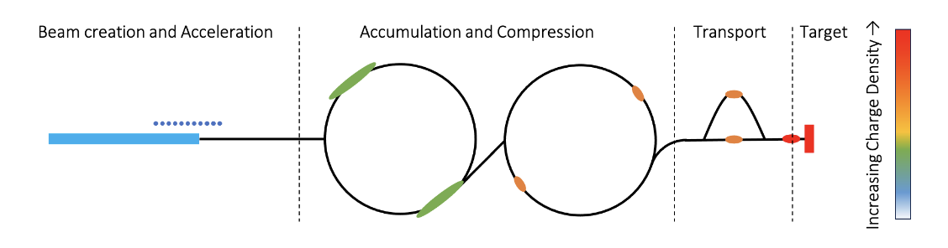
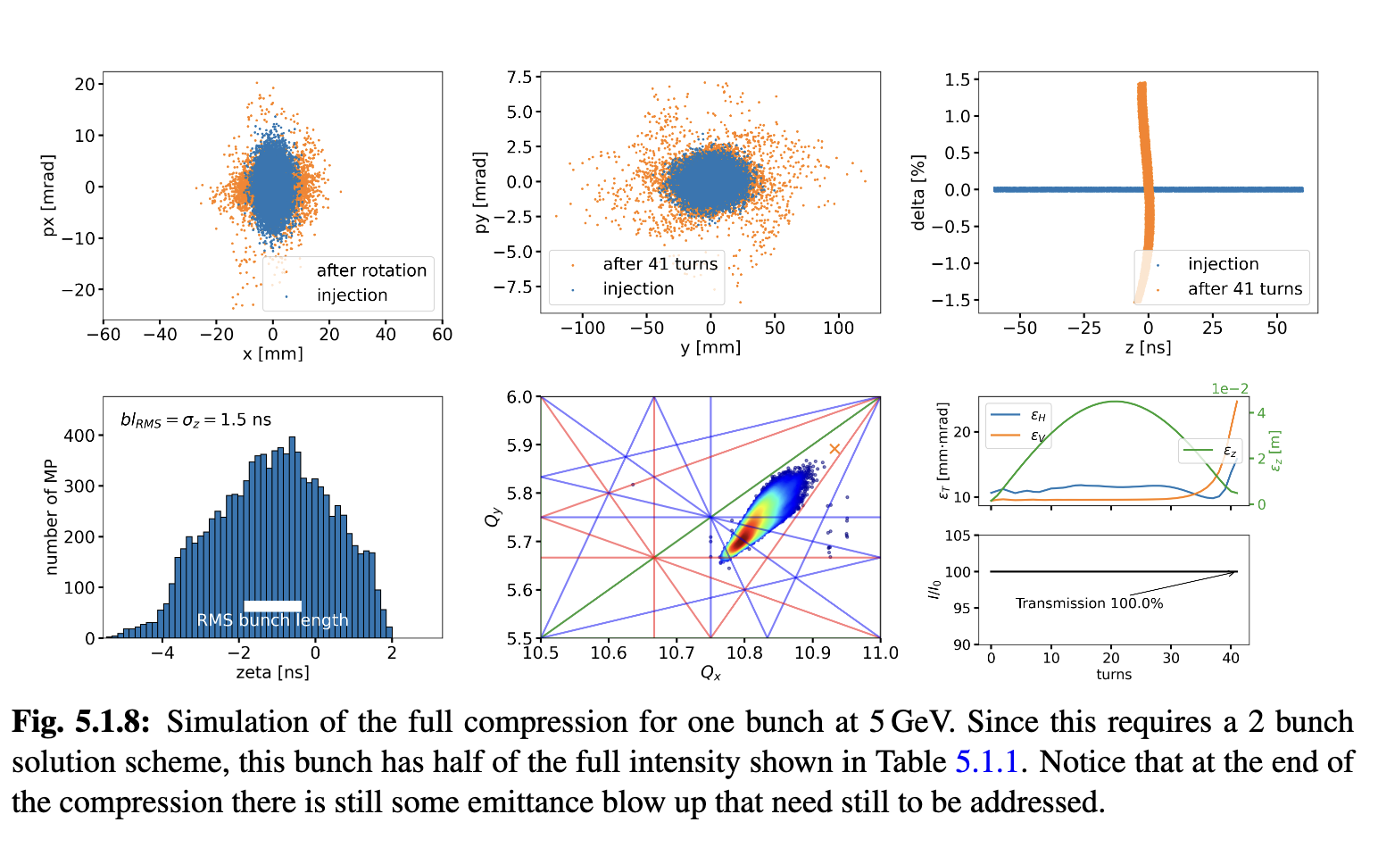
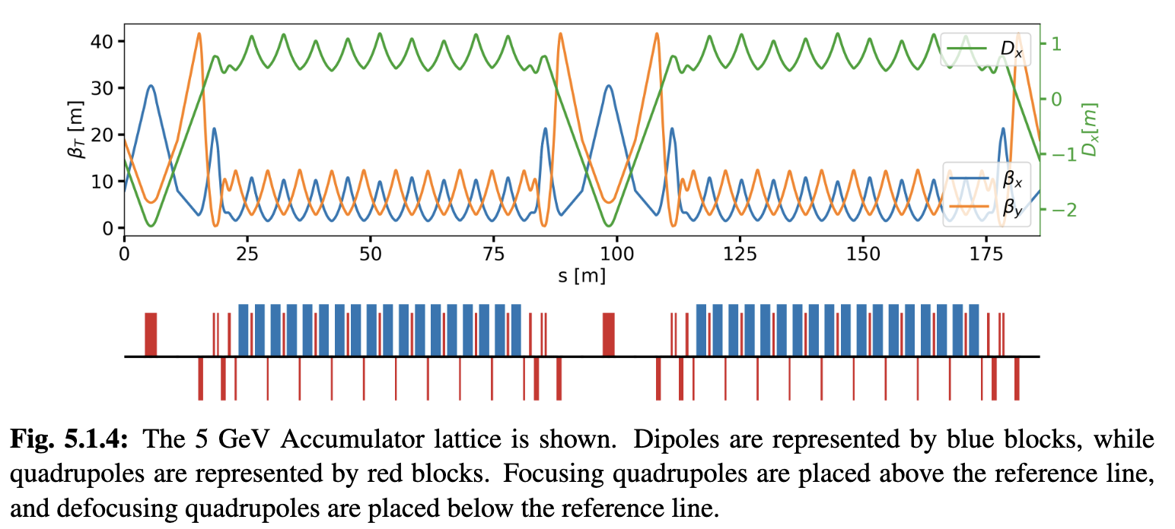
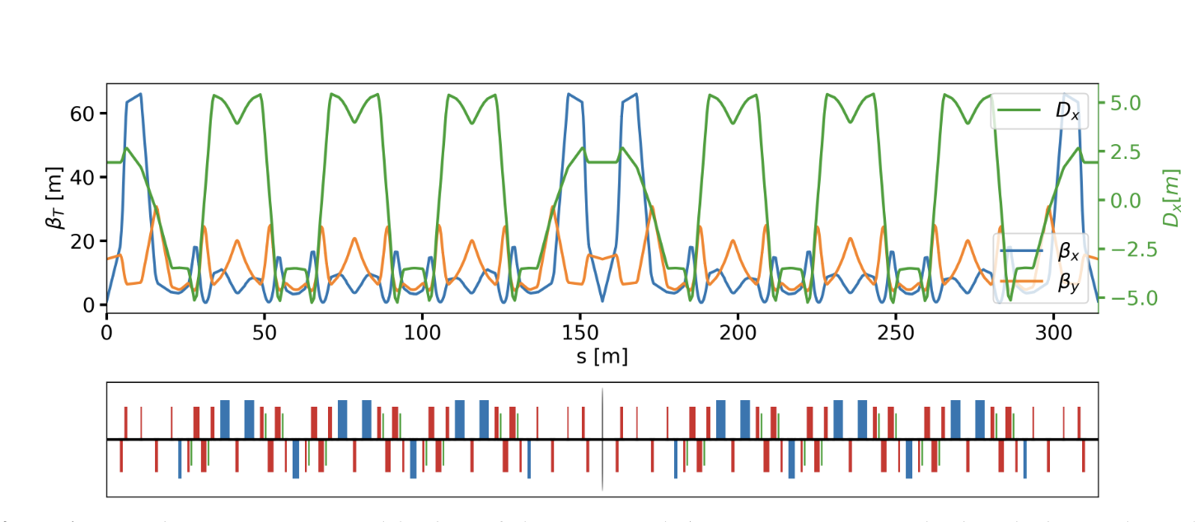
Proton Complex (ACC)
Goal:
Concept of proton pulse combination complex (accumulator and compressor rings)
Achieved:
Lattices exist for accumulator and combiner rings, first collective effects studies promising
Key conclusions:
Can compress 2 MW, 5 GeV proton beam to two 2 ns bunches, then merge them
  Optimisation in compressor ring for collective effects ongoing
4 MW requires beam energy of 10 GeV

Slide 7
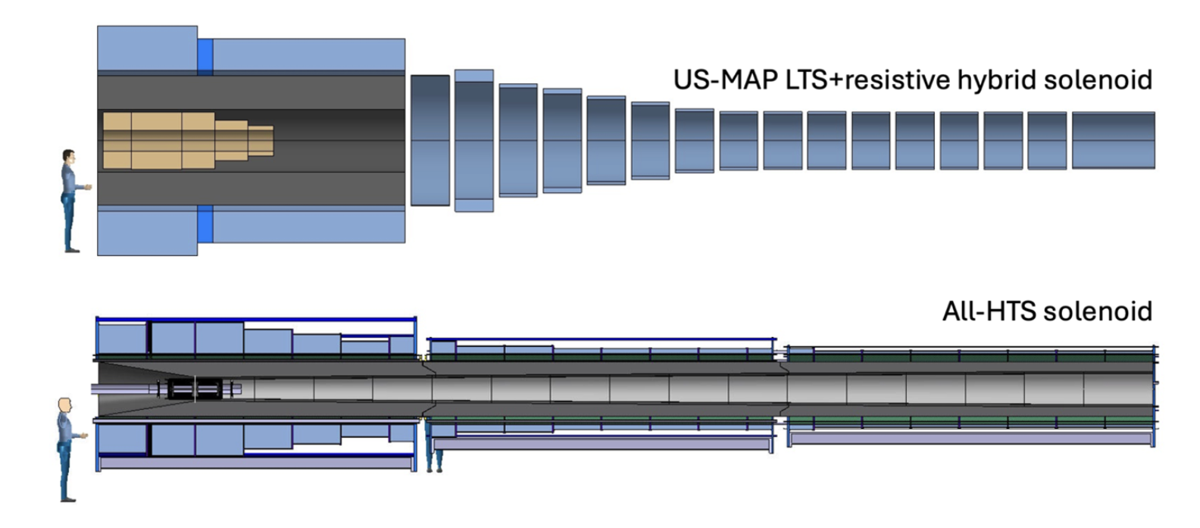
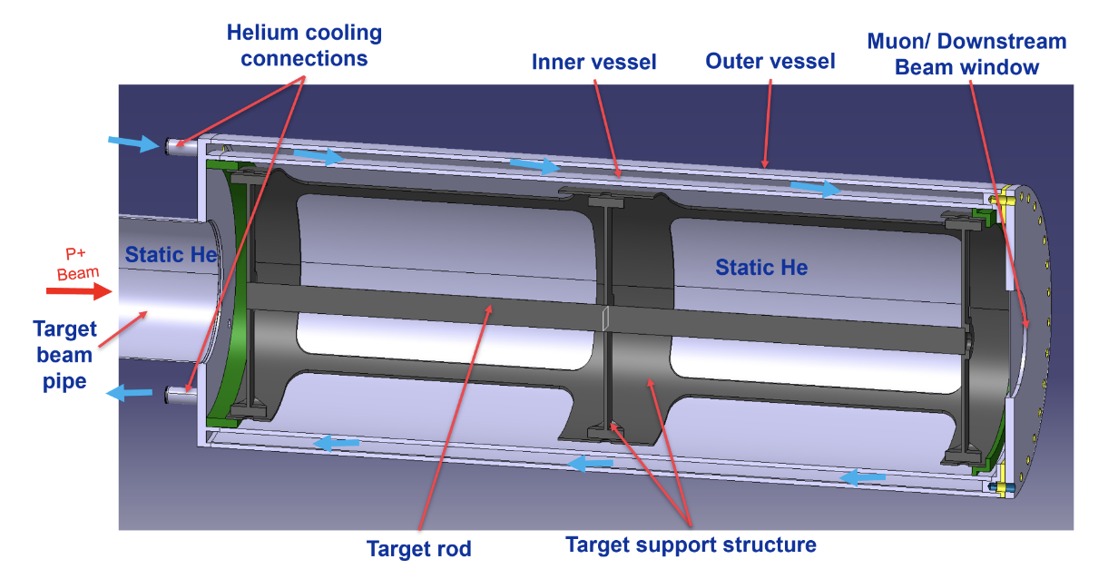
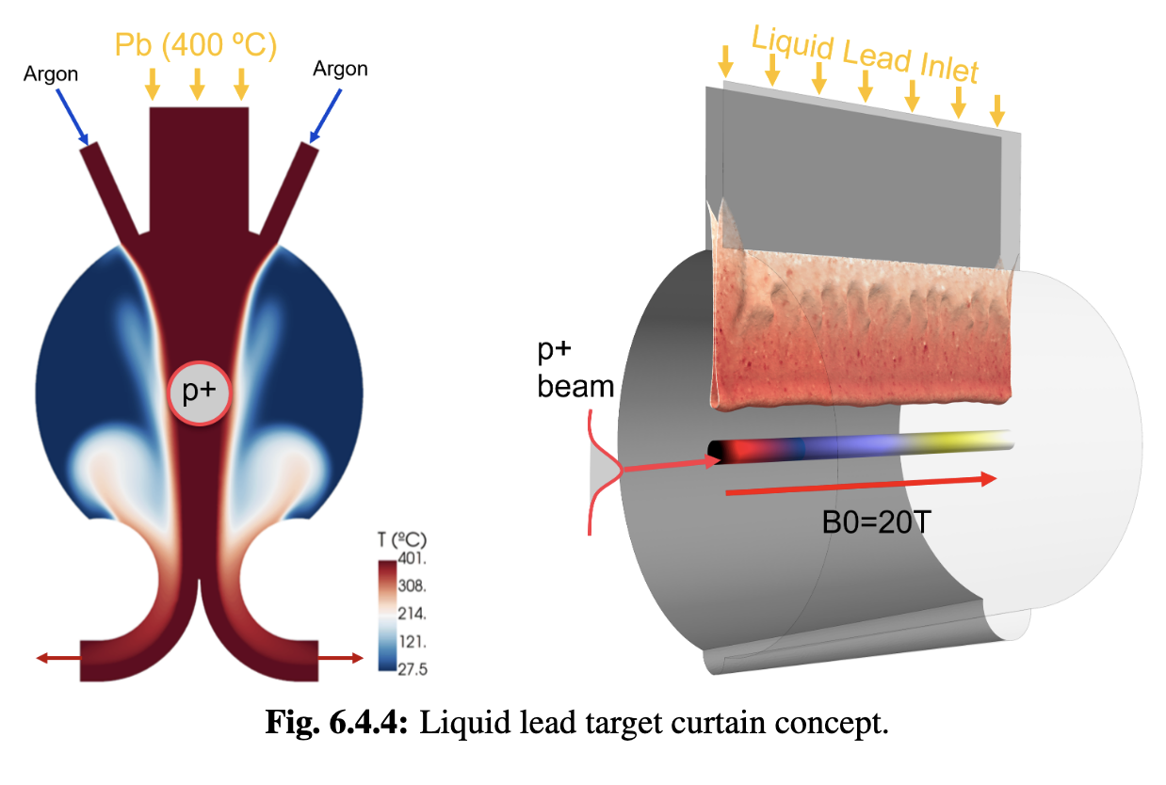
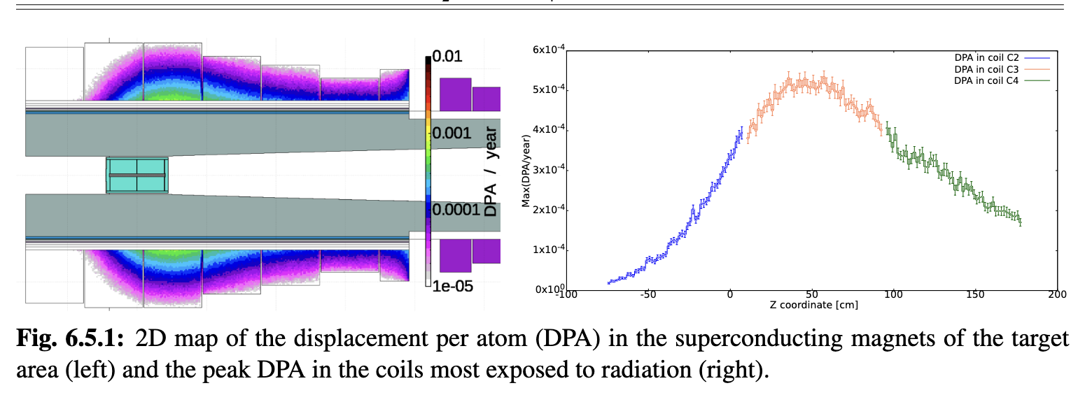
Target (TAR/HFM)
Goal:
Assessment of feasibility of 2 MW target
Can we replace mercury with graphite?
Achieved:
Initial 2 MW/400kJ target conceptual design
Can use graphite target instead of mercury
HTS solenoid and shielding concept developed
First pion yield optimization performed
Study of proton removal ongoing
Key conclusions:
Cooling, stress, radiation are OK
Cooling by natural convection is OK
Components survive 2 MW beam
Alternative, higher power liquid metal target to be studied

Slide 8
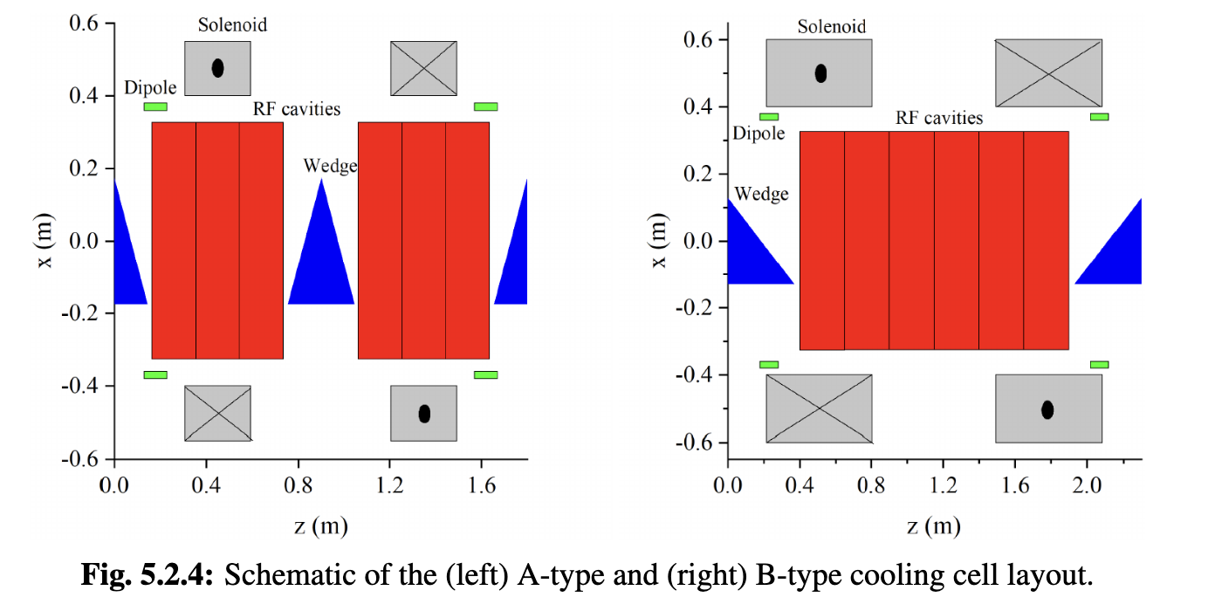
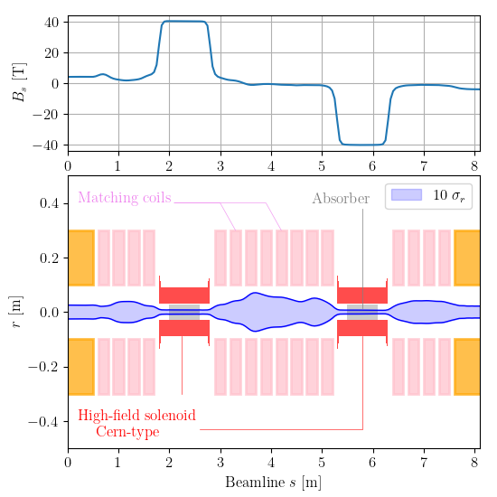
Muon Cooling (ACC)
Goal:
Improve the 6D muon cooling design
Improve the final muon cooling design
Achieved:
Improved 6D cooling lattice developed
Improved final cooling lattices developed
Identified final cooling absorbers as CTE
  Use of hydrogen gas to mitigate
RF design started

Slide 9
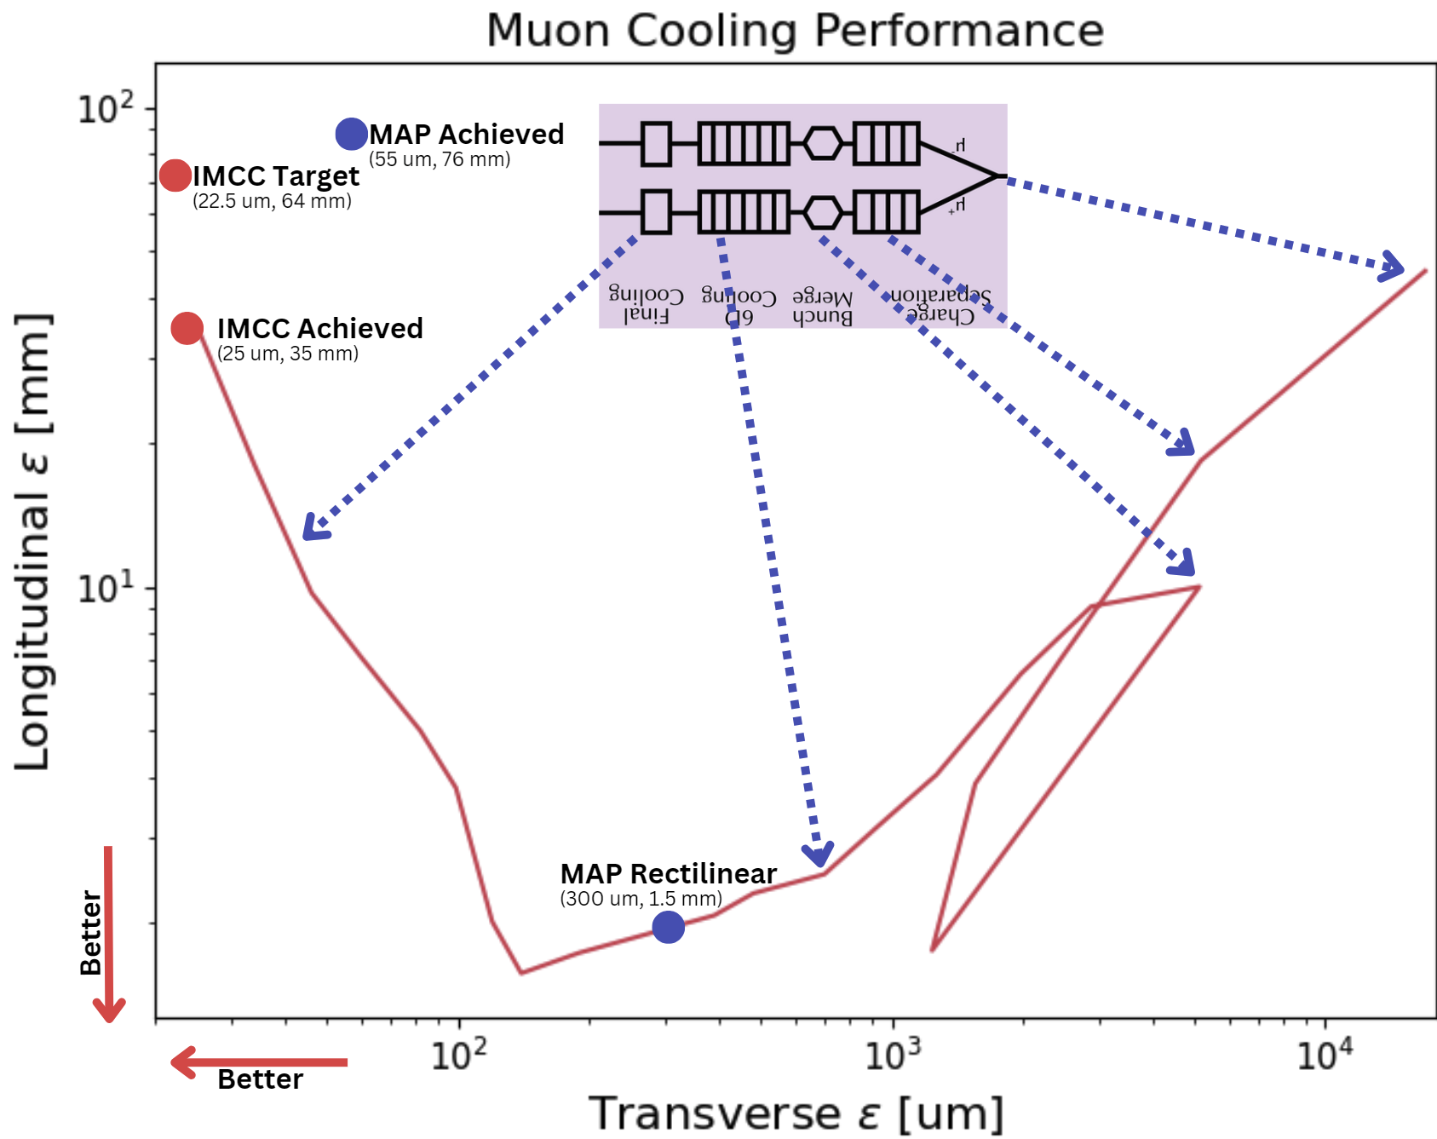
Muon Cooling (ACC)
Key conclusions:
Muon cooling is much improved
Muon transmission should be improved
  (Compensated by high-energy complex, could increase target power, mu+ could be 30% more)
Identified final cooling absorber as CTE, solved by using hydrogen gas
Collective effects and imperfections need to be addressed
Old MAP design
Parameter | MAP | goal | est.
Long. emitt [meVs] | 26.7 | <22.5 | 12.3
Transv. emitt [um] | 55 | <22.5 | 24
Target
Achieved
System | goal | estim.
End of cooling | 4x10¹² | 2.8x10¹²
Collider | 1.8x10¹² | 1.5x10¹²
better
better

Slide 10
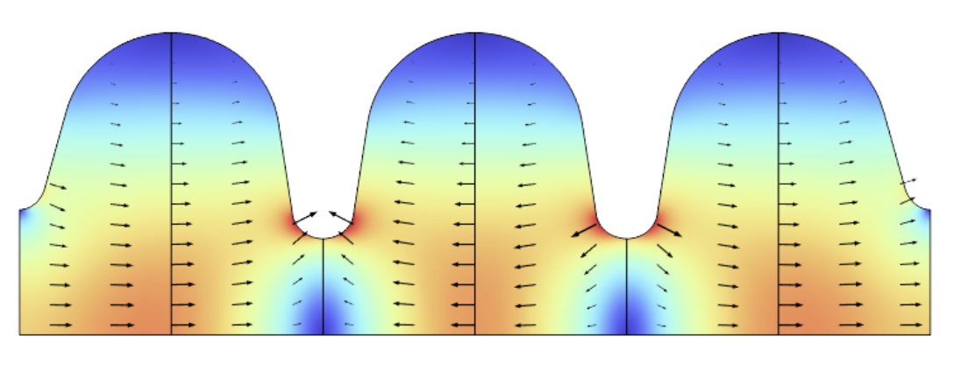
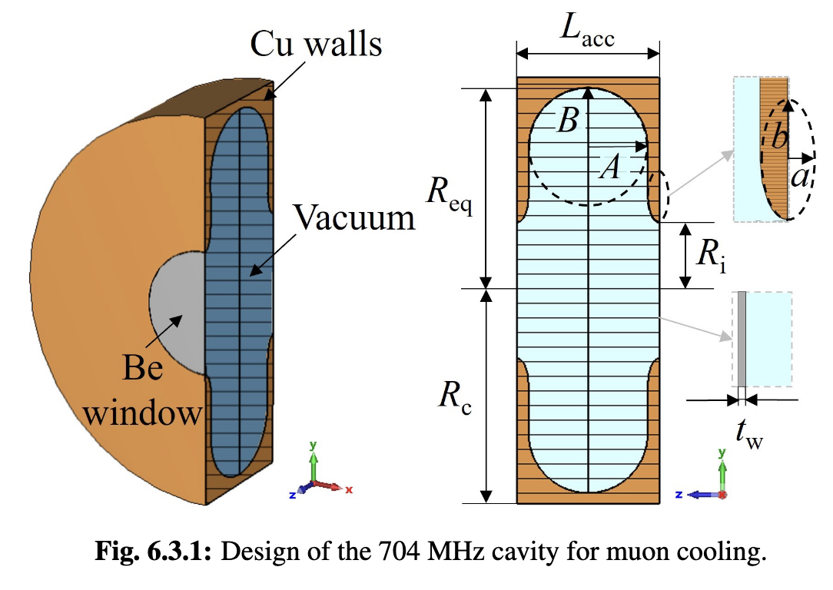
Muon Cooling RF Technology (RF/MOD)
Goal:
A concept for the normal-conducting accelerating cavities of the muon cooling complex considering beam loading
Achieved:
Frequencies selected
Started RF cavity designs
  Two options considered (magnetic and electric coupling)
  Beam loading needs to be controlled
Gradients along cooling complex defined
Cavity design for cooling module test exists and is being updated
Key conclusions:
High-field RF gradients in solenoid field have been demonstrated at FNAL, test stand no longer exists
Need new RF test stand urgently
  INFN started some funding
  SLAC is preparing test stand for 3 to 1.3 GHz
Key conclusions:
Some improvement for space charge in some 6D cooling cells required (ongoing)

Slide 11
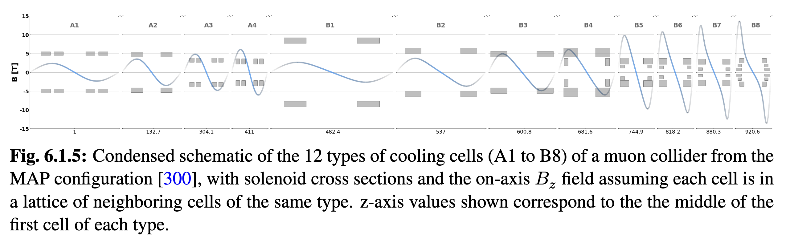
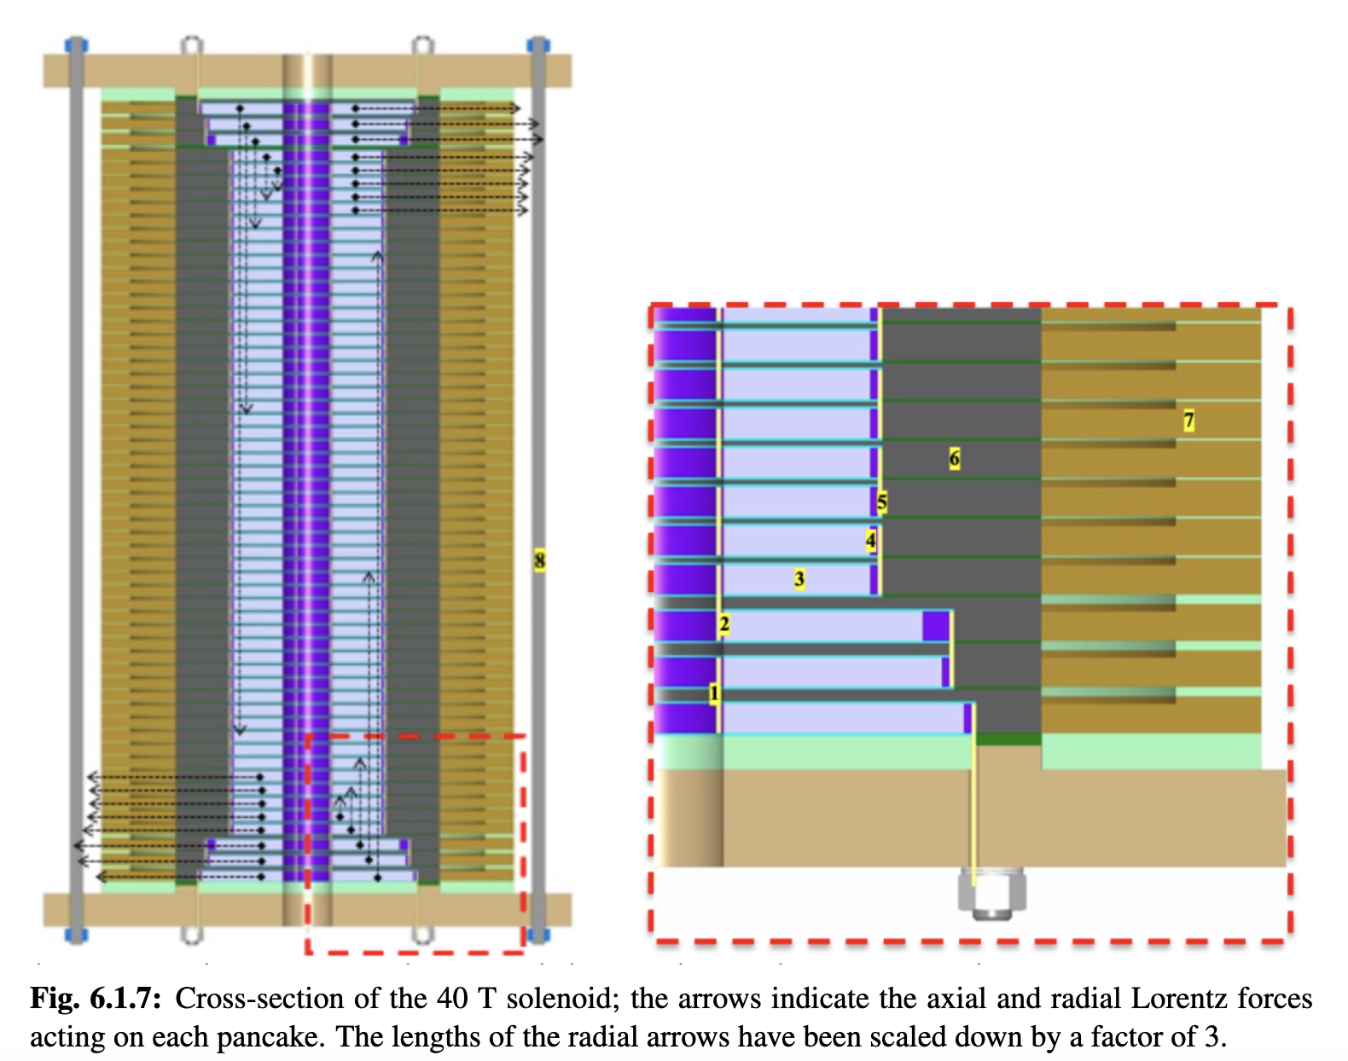
Muon Cooling Solenoids (HFM)
Goal:
Establish realistic performance goals for the different 6D muon cooling solenoids
40+ T small aperture solenoid concept for final cooling
Achieved:
Developed tool to generate realistic 6D HTS cooling solenoid configurations
  Used in beam dynamics
A concept a 40 T HTS-based cooling solenoid has been developed
Key conclusions:
Split 6D cooling solenoids need to be demonstrated in compact module
40 T final cooling solenoid appears feasible (32 T all HTS has been demonstrated by LNCMI, 45 T HTS insert by NHMFL, note: Ultimate limit may be 55 T)
Experiments now required

Slide 12
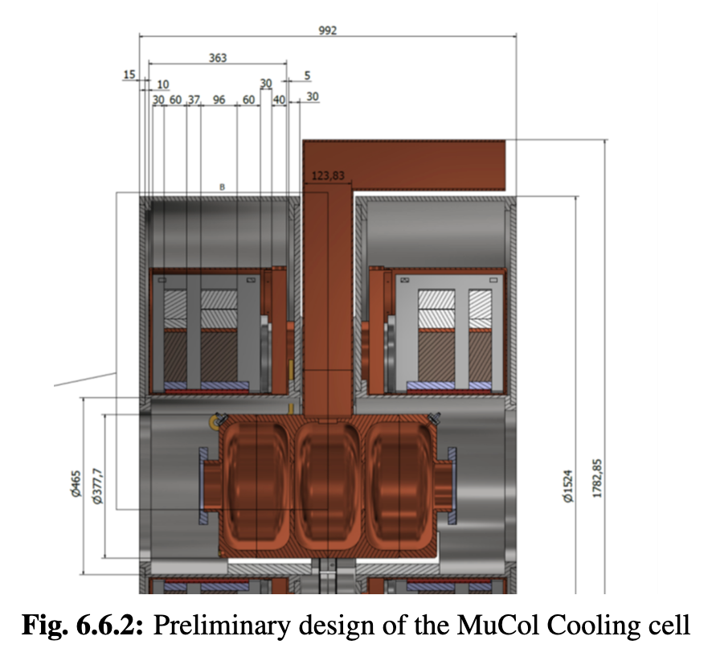
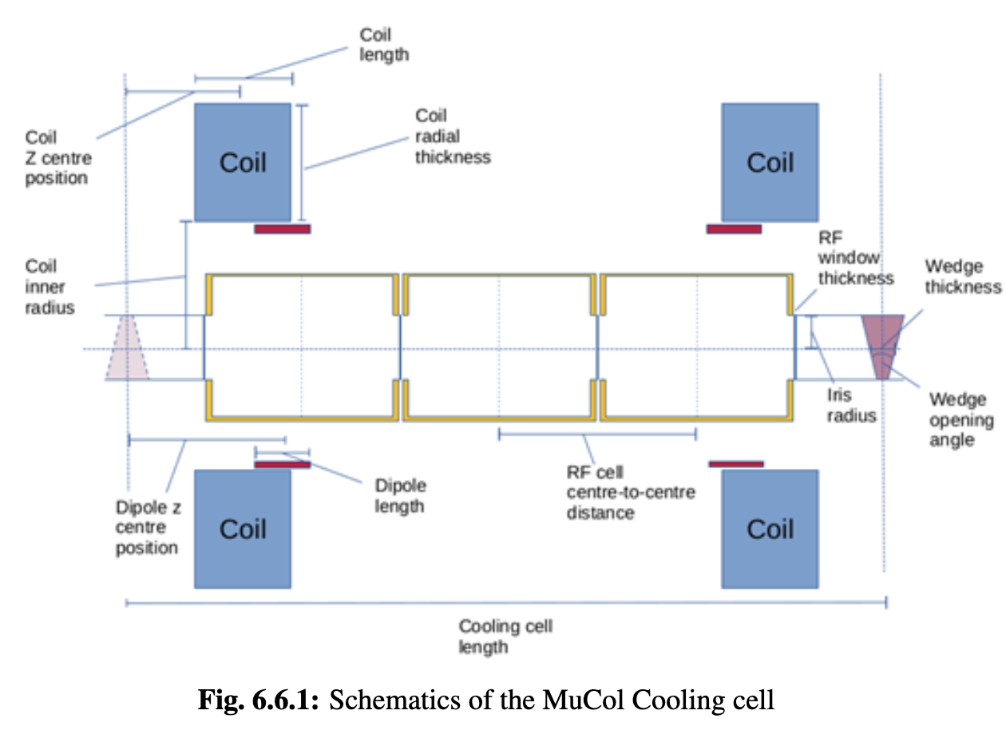
Muon 6D Cooling Cell (MOD)
Goal:
Assess the engineering challenges of an integrated 6D cooling cell
Achieved:
Preliminary design of a cooling cell will be ready in few months
  Solenoid
  Cavity
  Integrated model
Identified challenges of cell assembly and connections to next cells
Key conclusions:
Key challenge is force from magnetic field
Concept to connect flanges developed
Iterations to improve overall and components design also considering beam dynamics is required/ongoing
Conceptual design ready in a few months

Slide 13
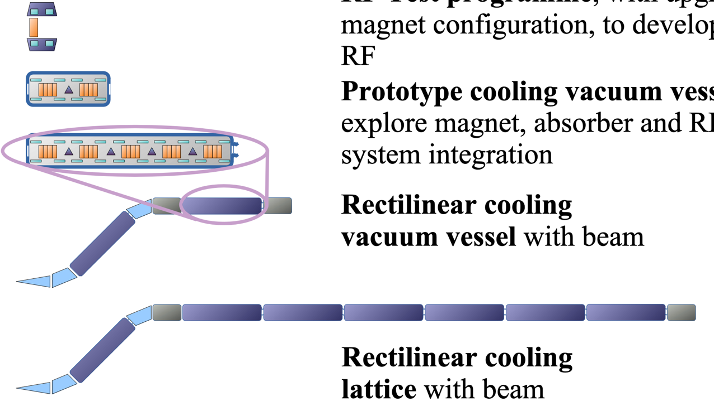
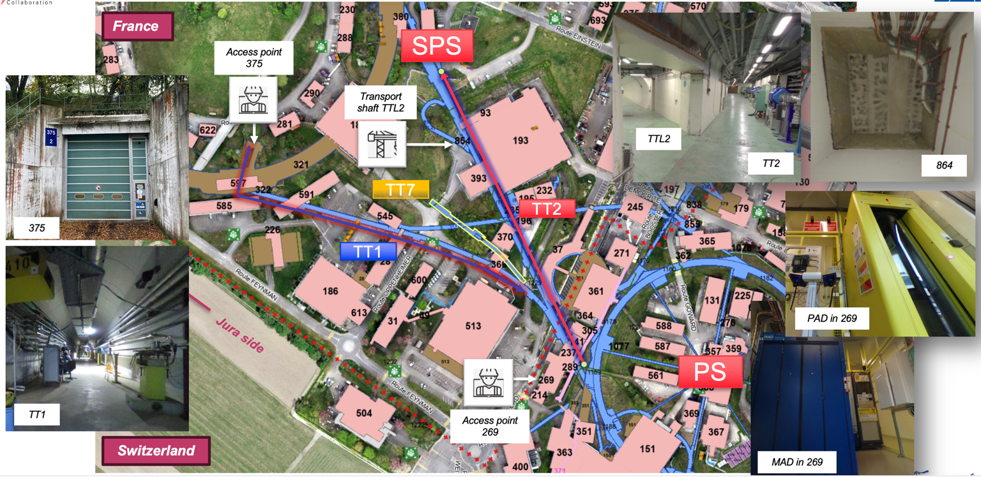
Muon Cooling Demonstrator (DEM)
Goal:
Identify scope and potential location of facility to demonstrate cooling cell technology with beam
Staged implementation
Components
RF model test stands
700 MHz cell test infrastructure
Module test with beam
Improved module string
Achieved:
Defined the scope and concept, made initial cost estimate, investigated three promising locations at CERN, funding for study of demonstrator at FNAL exists.
Staged timeline to implement demonstrator
Key conclusions:
Two locations at CERN appear possible with limited cost
RF test stand is critical to verify cavity performance in time
High-power 704 MHz klystron needs to be developed now

Slide 14
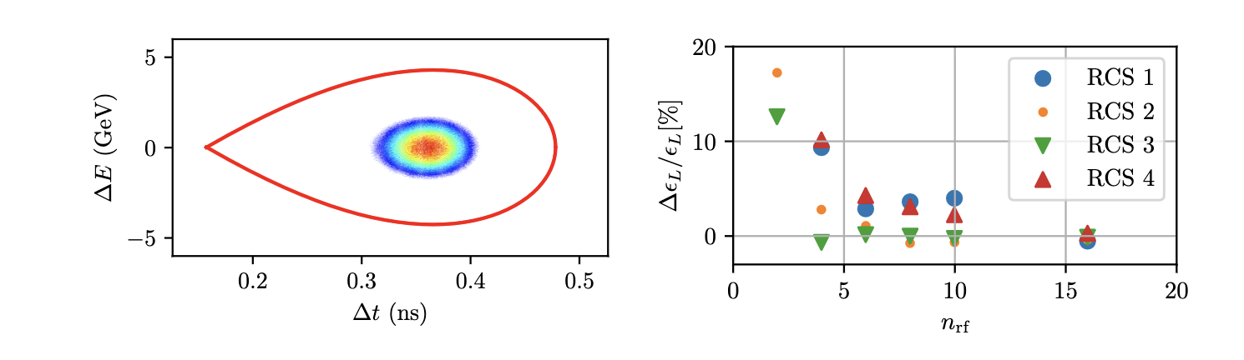
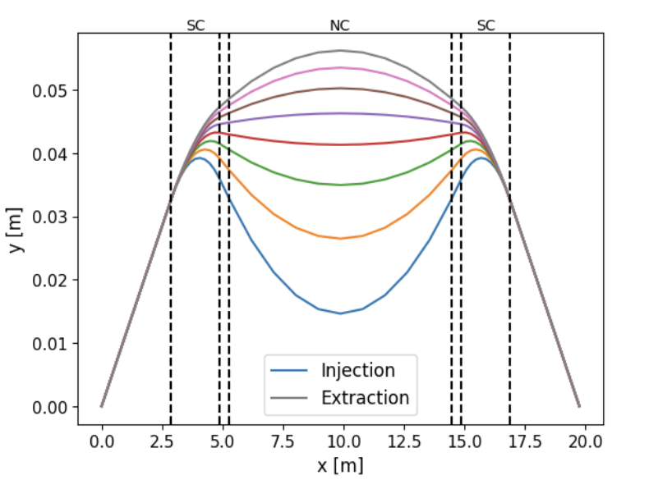
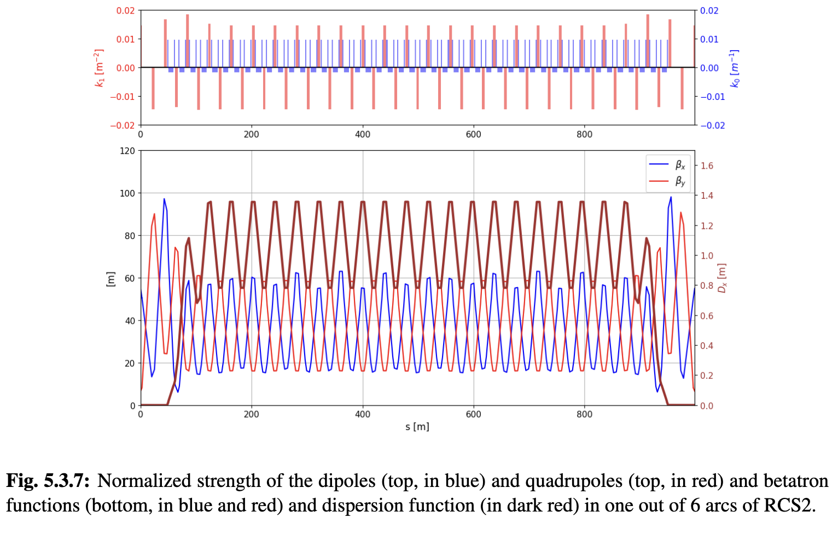
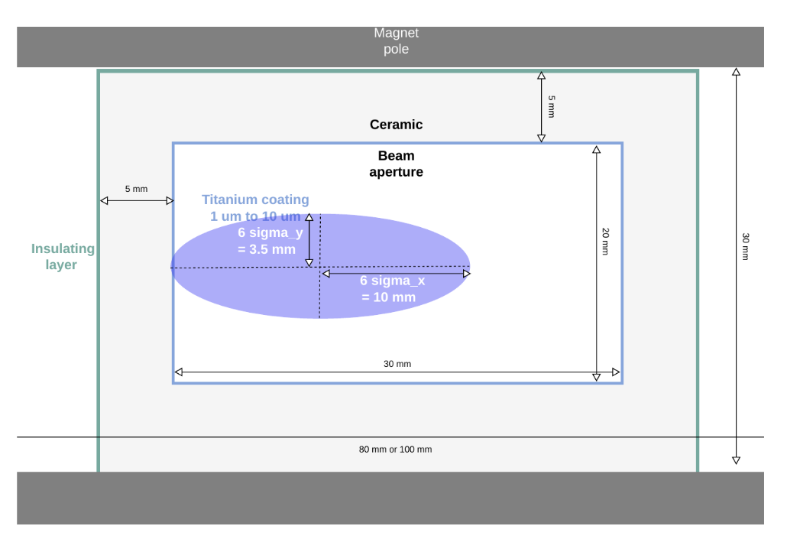
RCS Design (ACC)
Goal:
Design concept for RCS
Choice of RF configuration
Achieved:
Lattices for all site independent RCSs exist
Key performance specifications for magnets, beam pipe and RF exists
Longitudinal beam dynamics studied in each RCS
Initial concept for matching from one RCS to the next is being developed
Key conclusions:
1.3 GHz TESLA-type cavities could be used
  Design HOM removal
Need coated ceramic chamber
Dimensions of magnet apertures known and reasonable
Very likely can use simple transfer lines between RCSs

Slide 15
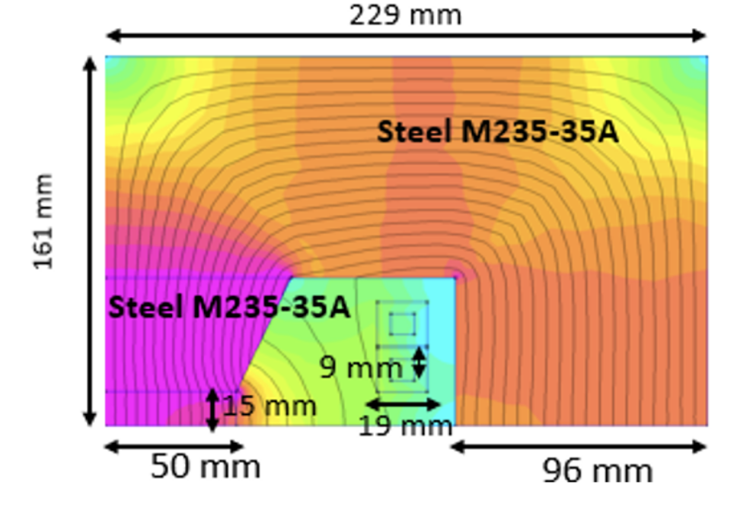
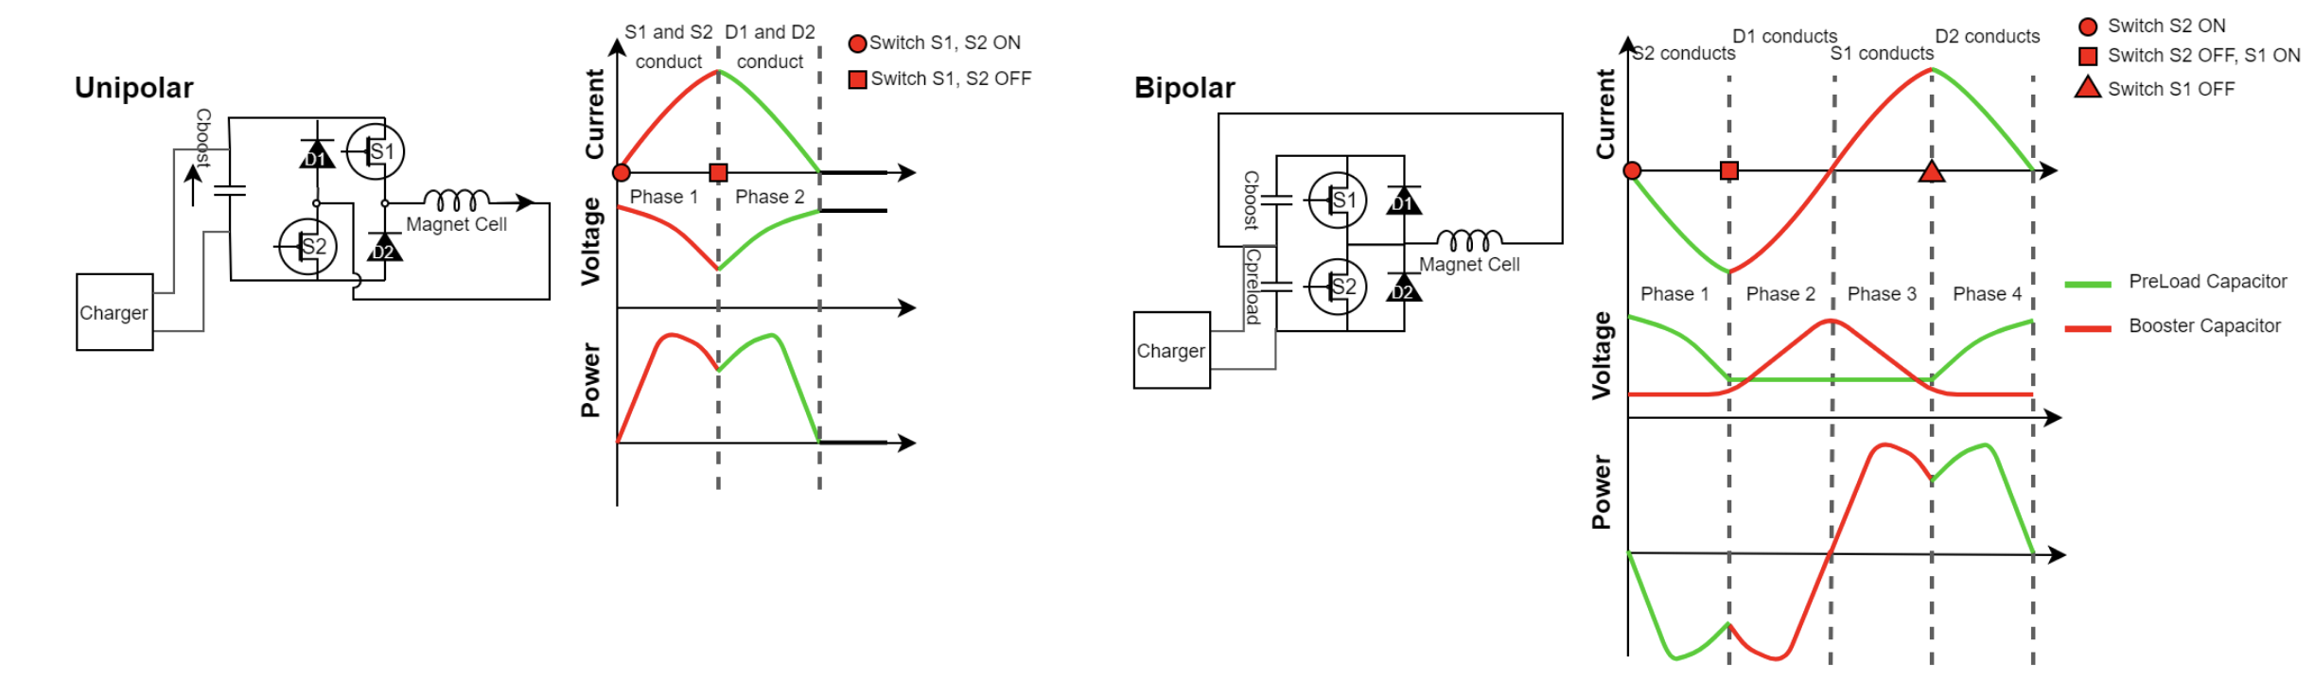
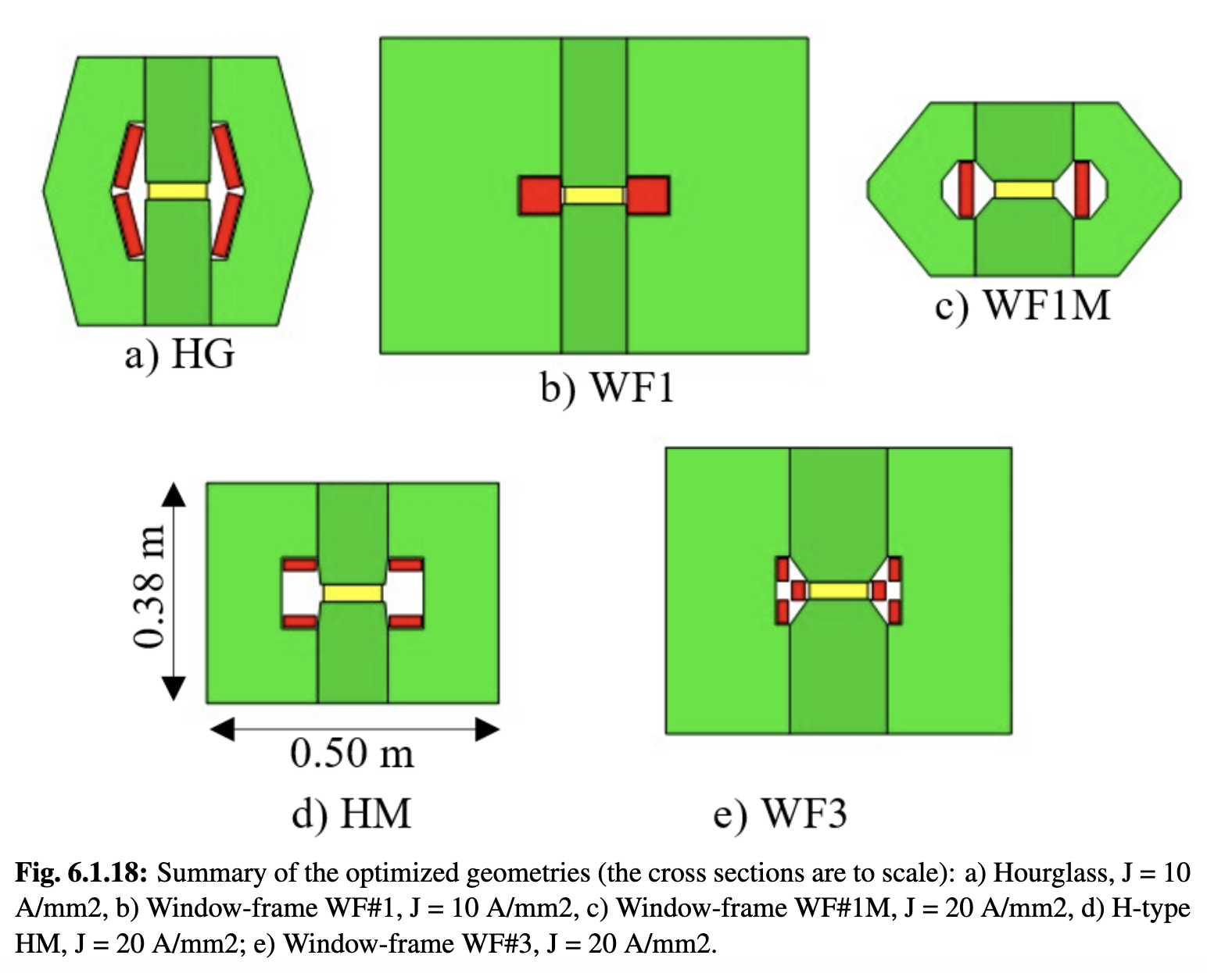
Fast-ramping RCD Dipoles (FR)
Goal:
RCS dipoles and power converter (PC) concept
LHC 2 RCS is hybrid
Achieved:
Codes benchmarked
Best of several magnet concepts chosen
Power converter conceptual design developed
  Does not require to switch capacitor voltage to switch PC voltage
Optimisation tool developed to match magnet and RF ramps
Key conclusions:
Magnet codes agree (20%)
Dipole energy about 5.5 kJ/m (200 MJ total)
High recovery efficiency for RCSs
Ready for experimental optimization/models/protoypes
RCS | E [J/m] | E_{iron} [J/m] | E_{copper} [J/m] | Loss [%] | P [MW]
SPS 1 | 5447 | 10 | 52 | 1.1 | 1.9
LHC 1 | 5678 | 9.2 | 80.6 | 1.6 | 12.8
LHC 2 | 5752 | 63.4 | 298 | 6.3/2 | 26.6
Energy in magnets, losses per cycle and total power at 5 Hz including cooling

Slide 16
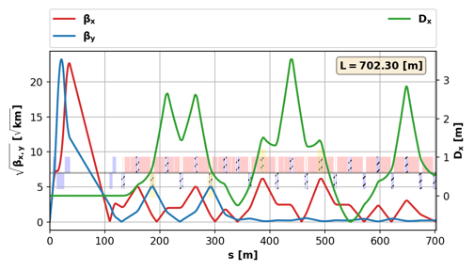
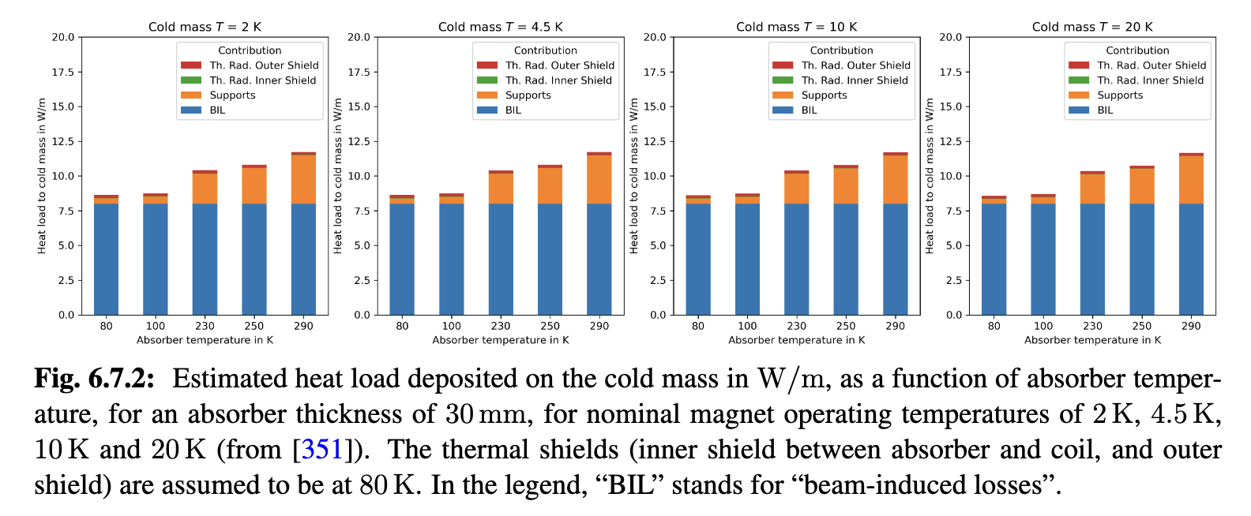
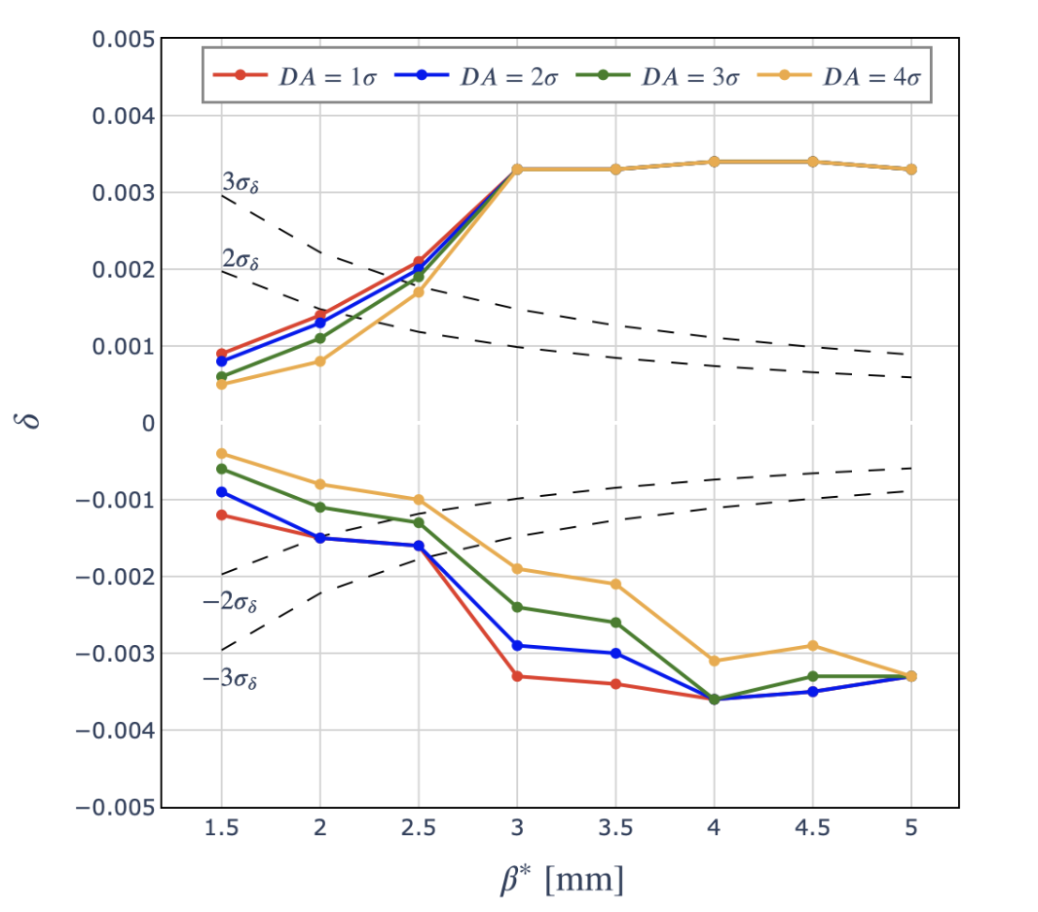
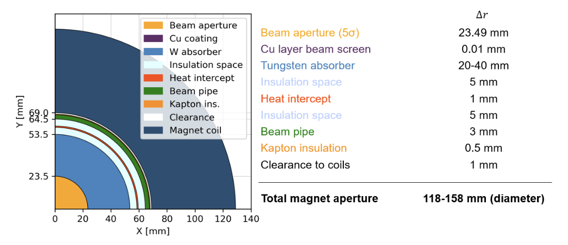
Collider Ring (ACC)
Goal:
Design concept collider ring lattice
Achieved:
Apertures defined based on magnet protection from muon decay debris
Lattice reaches target beta-functions but not yet target energy acceptance
Key conclusions:
Need to further improve energy acceptance
  New final cooling lattice reduces energy spread to 60%
  Some further improvement beneficial, need start-to-end study to estimate precisely
Slight adjustment to new magnet performance specifications is required
  Small impact on design expected
Need to address the impact of the neutrino flux mitigation movers on beam operation

Slide 17
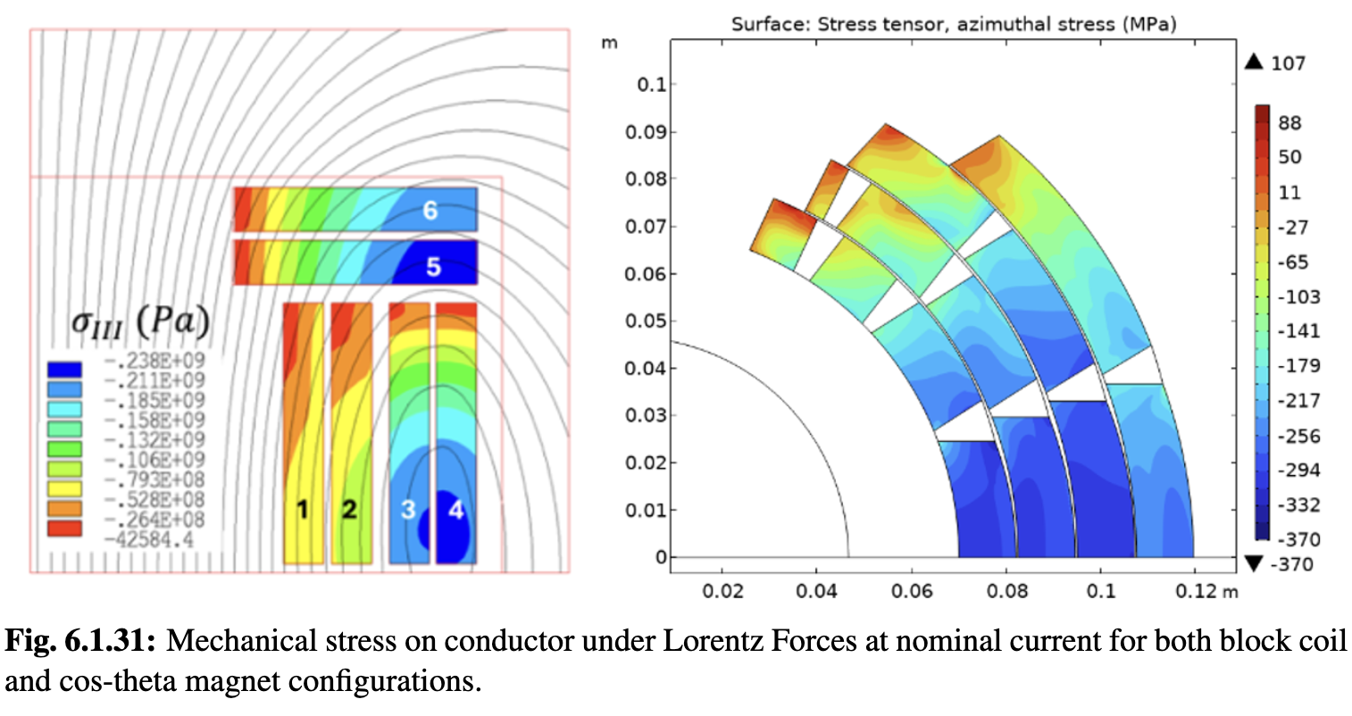
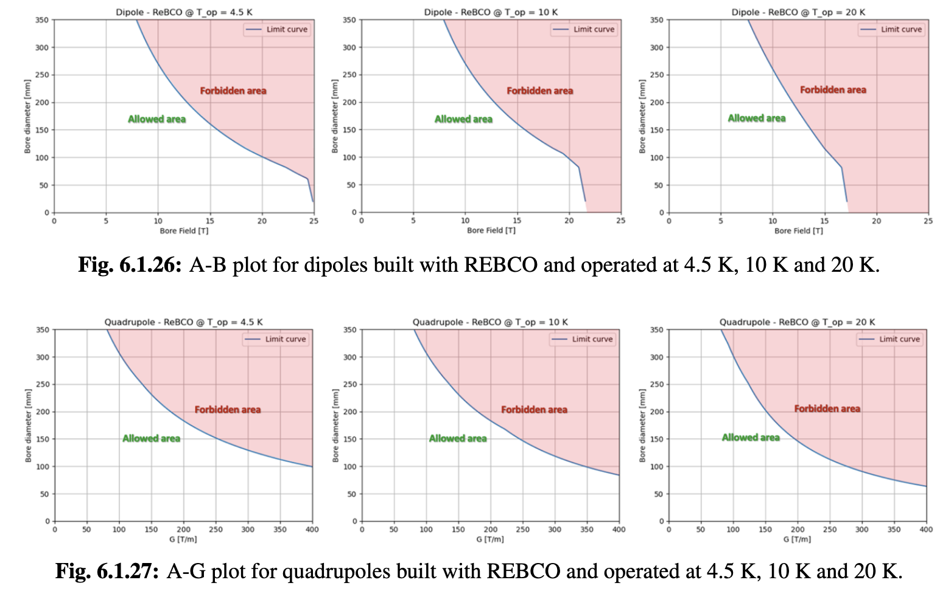
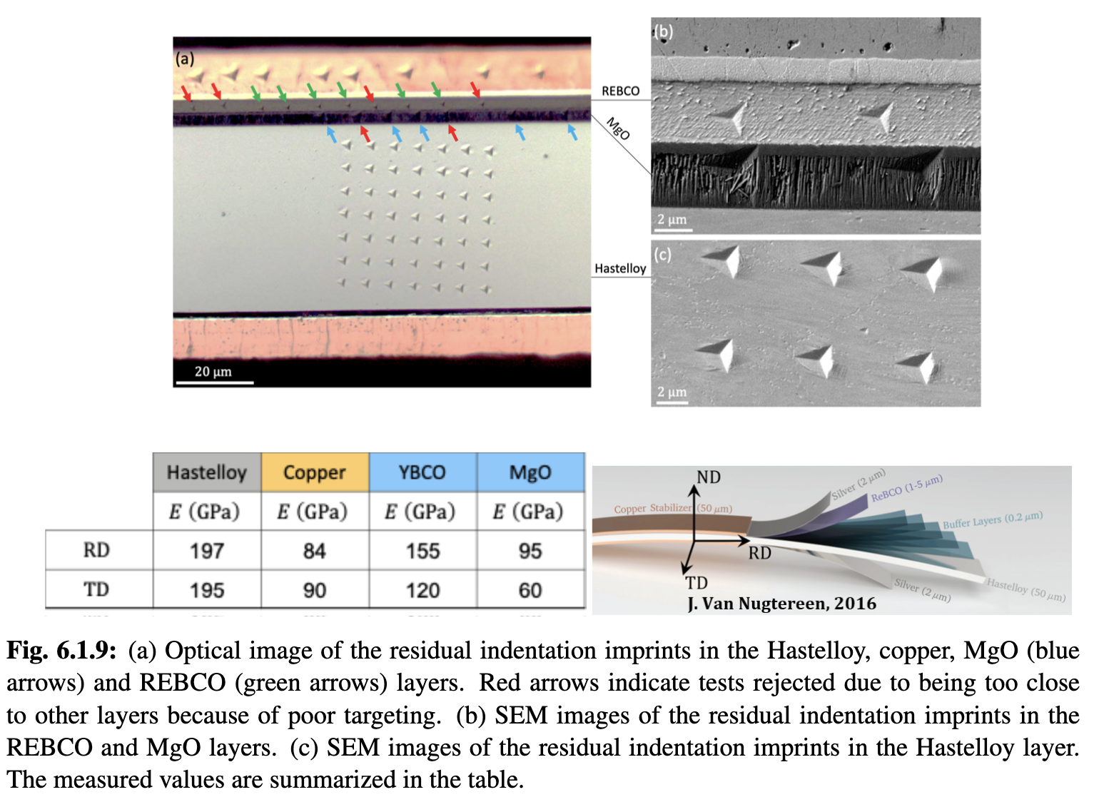
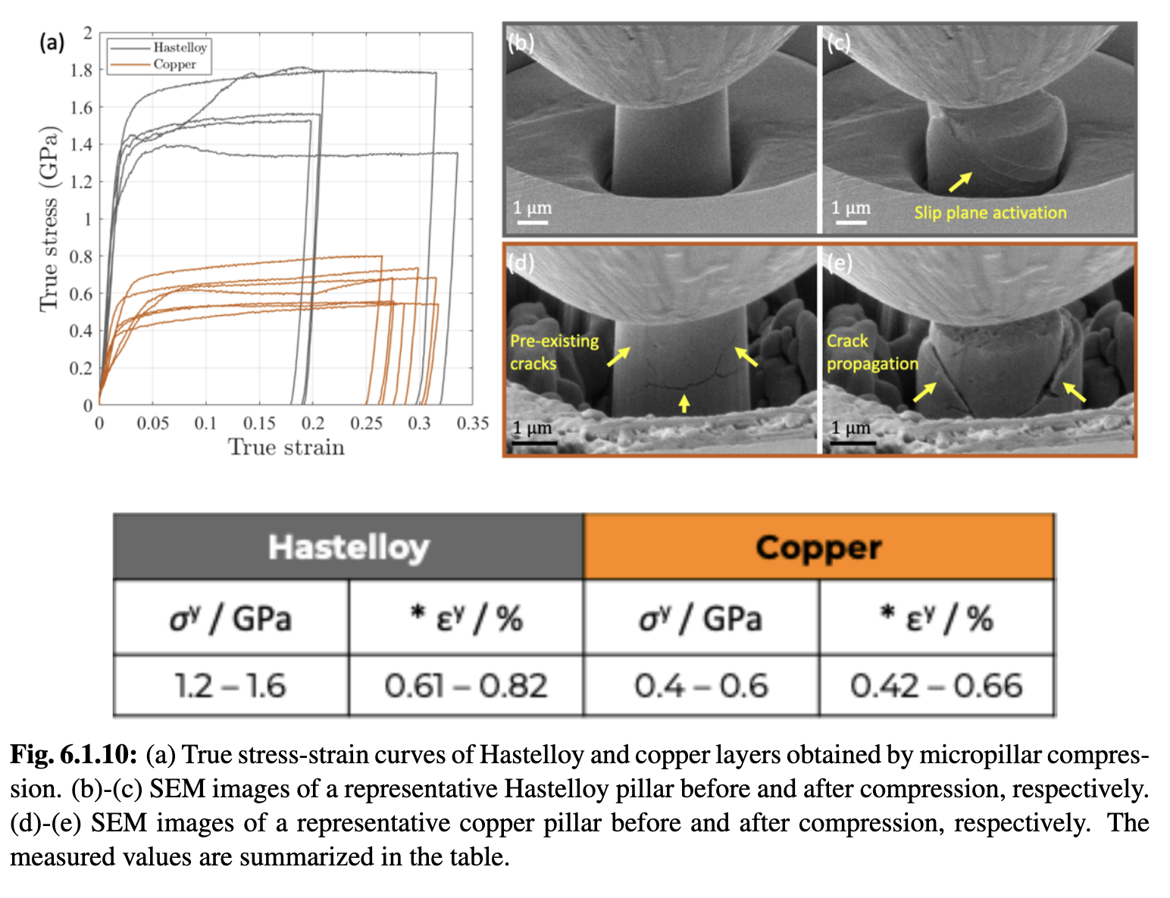
Collider Ring Magnets (HFM)
Goal:
Define realistic target parameters for collider ring magnets
Achieved:
New method developed to identify field limit, depending on technology, cost, aperture, considering current, stress and protection (quadrupoles, dipoles, combined function magnets)
Two conceptual dipole designs ongoing
Combined function design ongoing
Key conclusions:
Lattice design requires limited adjustments, expect almost no impact on performance
Dipoles appear feasible:
  NbTi at 4 K, 4.8 T, 16 cm aperture
  Nb3Sn at 4, 11 T, 16 cm aperture
  HTS at 20 K, 14 T, 14 cm aperture
Quad in dipole best combined solution
Experimental programme is now essential

Slide 18
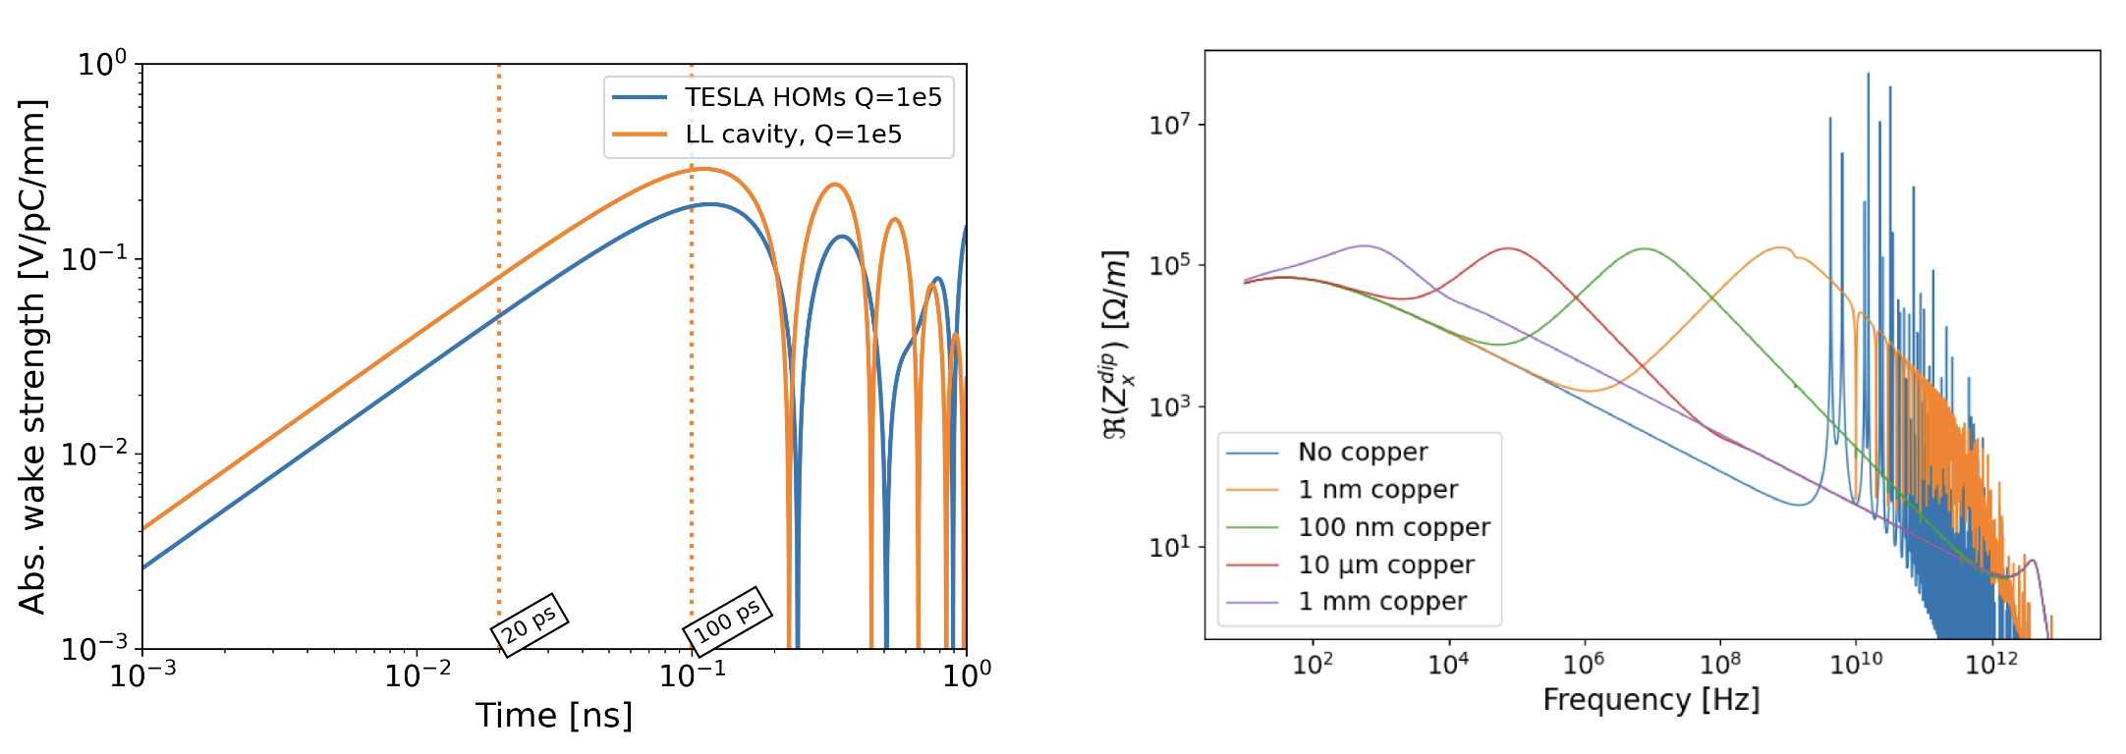
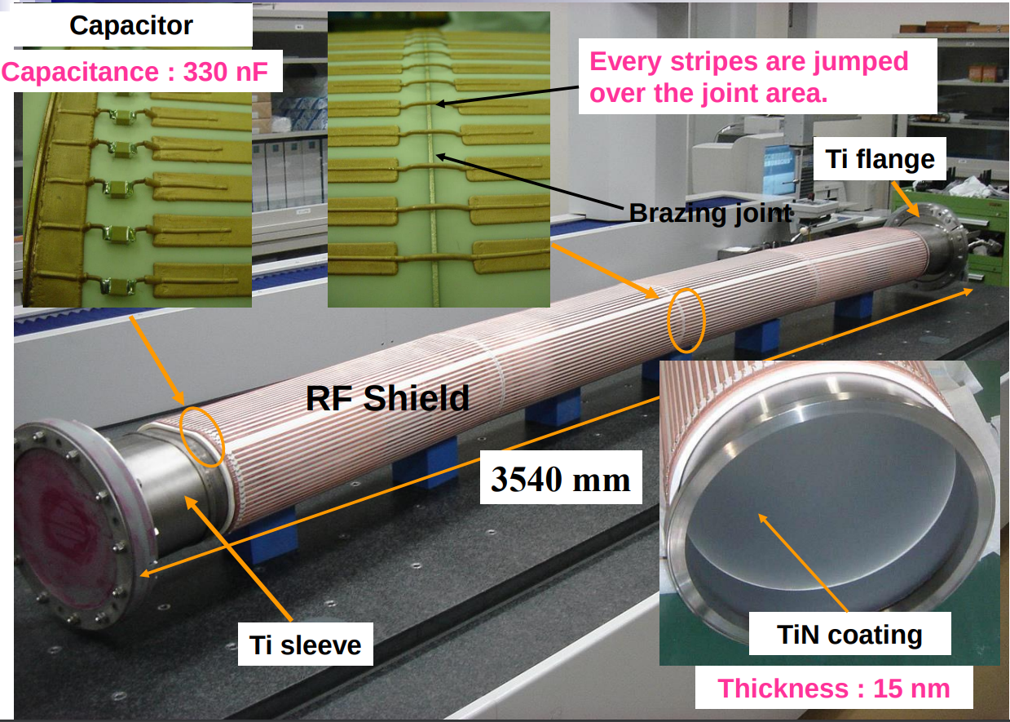
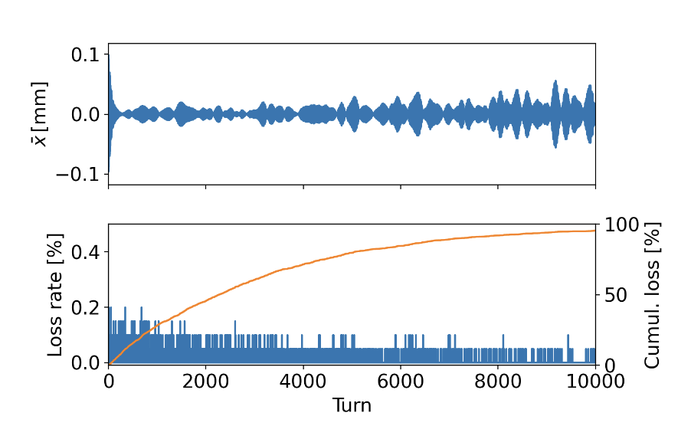
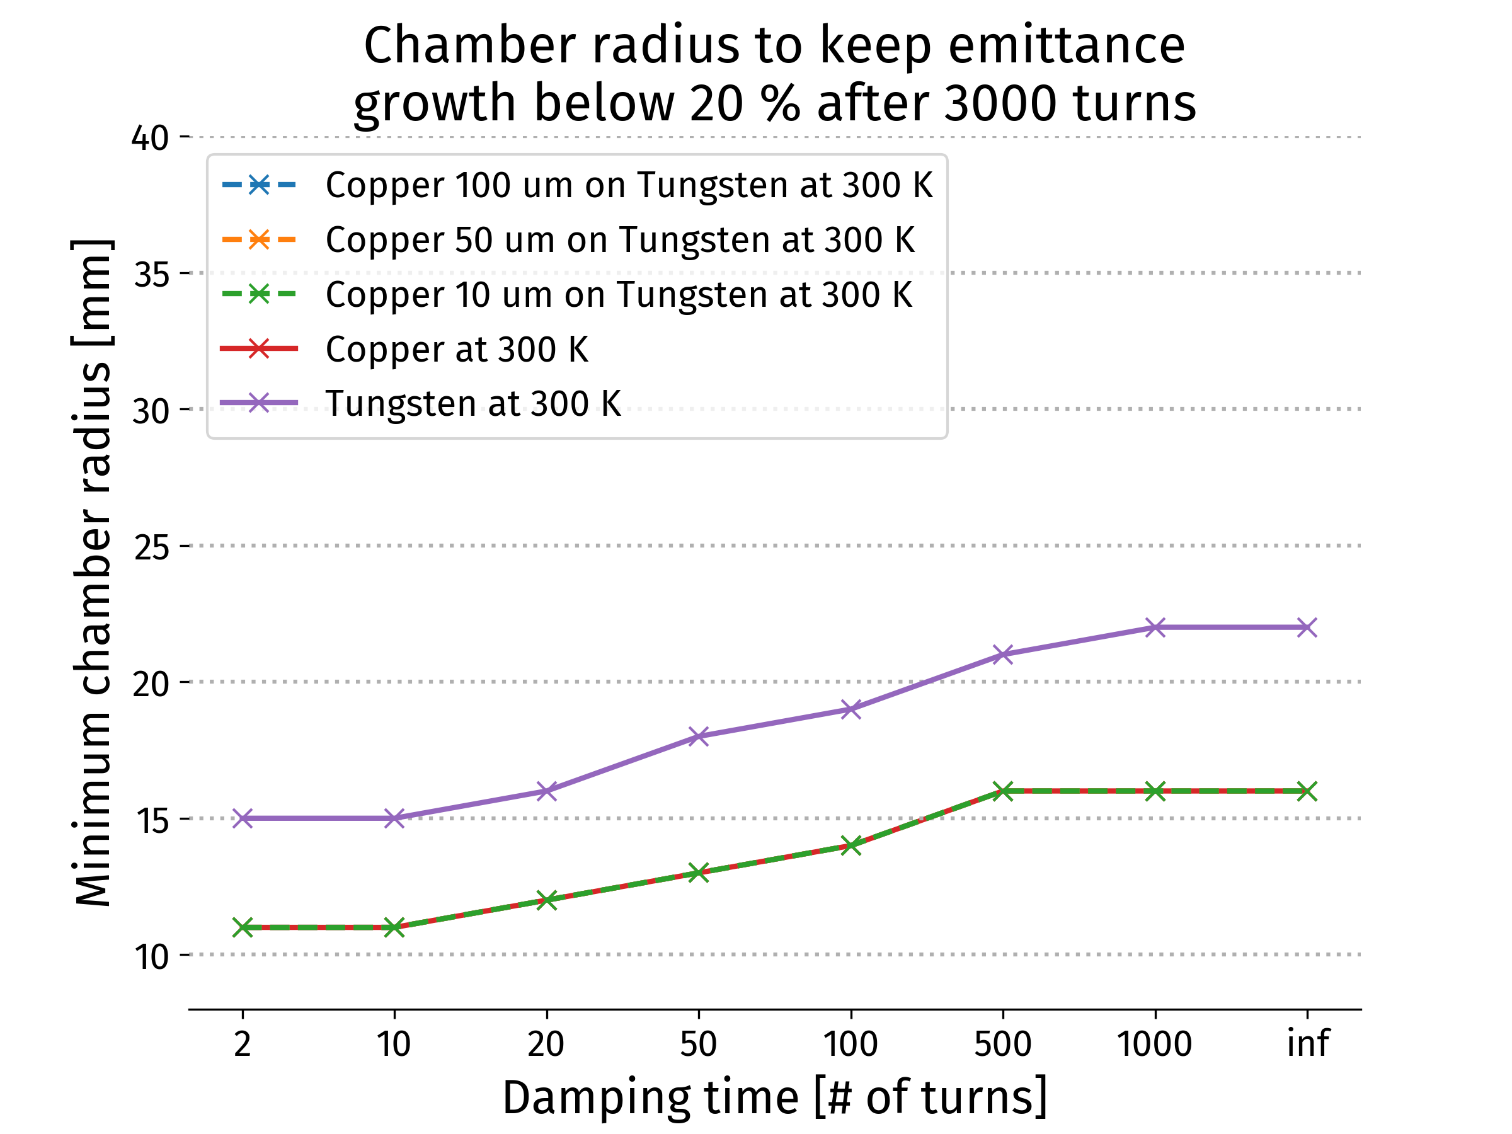
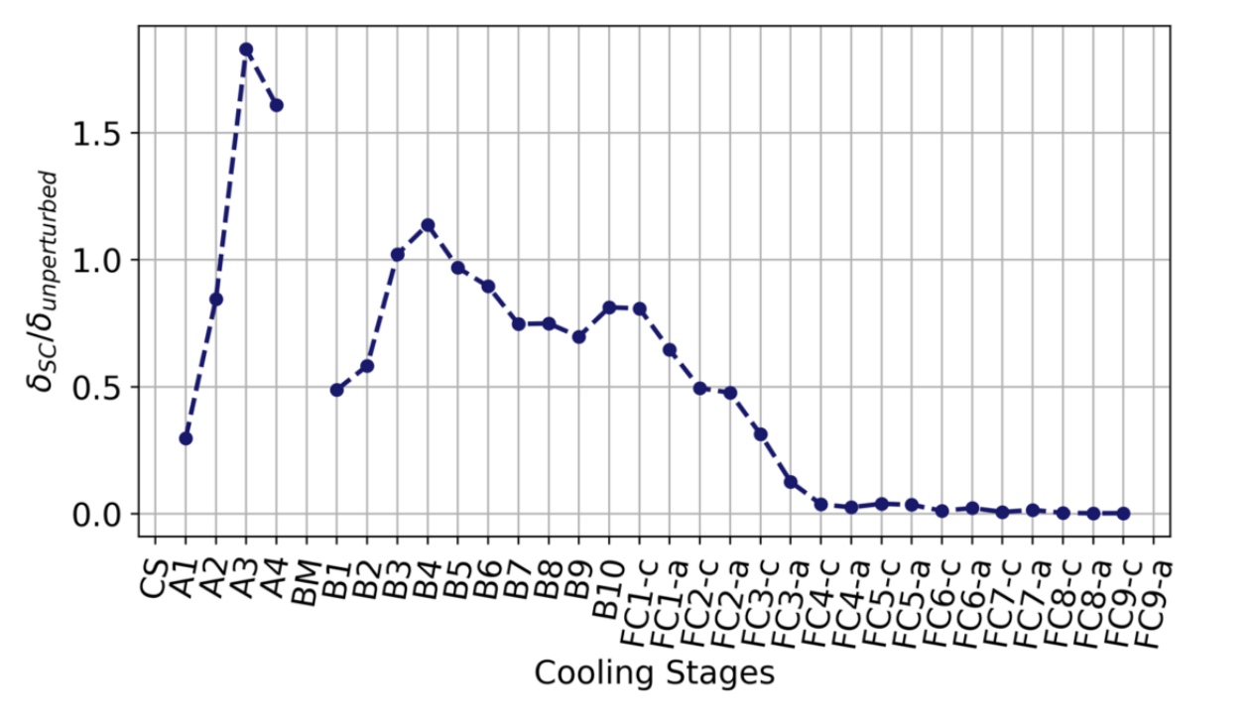
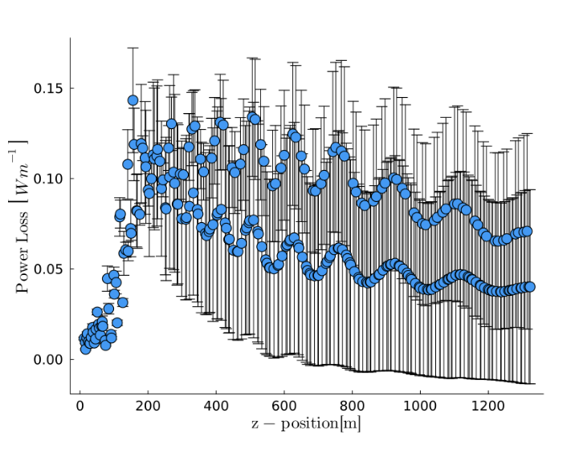
Collective Effects (ACC)
Goal:
Identify collective effects intensity bottlenecks
Achieved:
Assessed impedances (beam screen and RF cavities) in RCSs and collider ring
Counter-rotating beam impedance studied
Key bottlenecks identified in muon cooling
Initial studies for proton complex
Key conclusions:
Impedances in high-energy complex can be taken care of by design
Beam-beam can be handled by 20 turn feedback
Resistive wall in muon cooling is OK
Identified further key detailed studies: beam loading, longitudinal and transverse space charge in 6D cooling, impedance of cooling absorbers

Slide 19
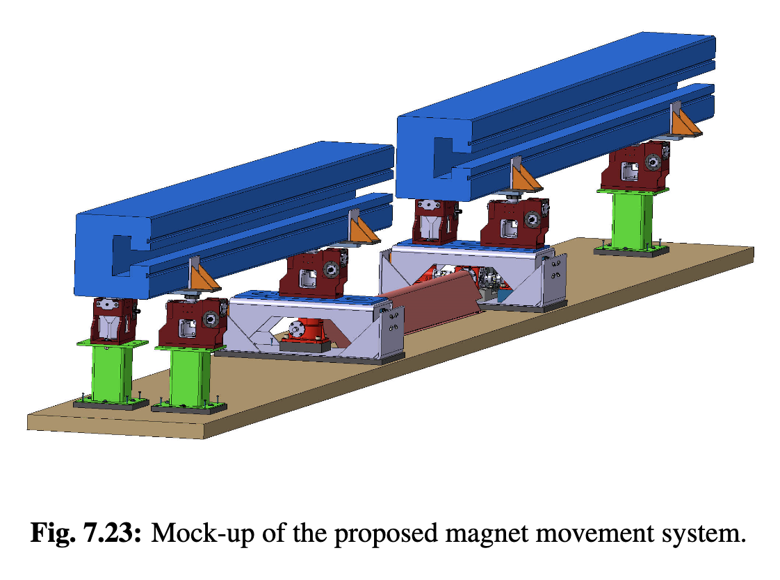
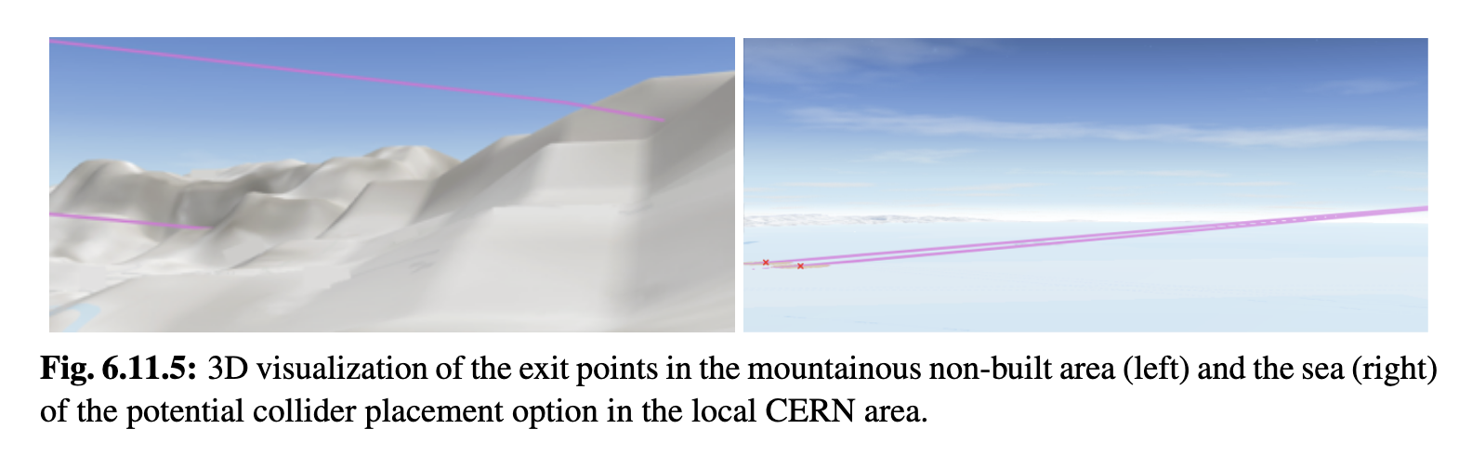
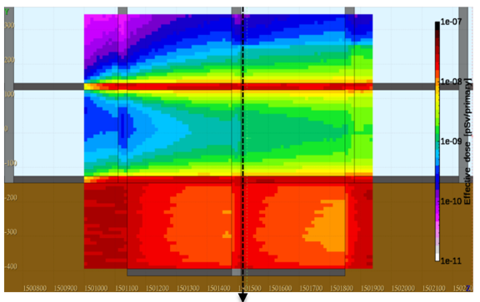
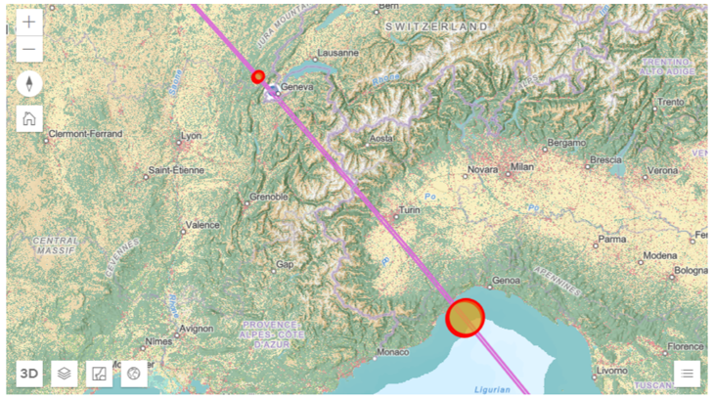

Site (SITE/NF/INT)
Goal:
Assess if collider ring is possible next to CERN or elsewhere, with focus on neutrino flux (<O(10uSv/year) is negligible, CERN aims at <20uSv/year)
t₁
Achieved:
Strategy: use mover system for arcs (every few hours, +/- 1 mradian), positioning for experimental straights
Radiation Protection developed detailed models and tools with FLUKA
Extended CERN geoprofiling tool to identify surface sites with neutrinos (next optimization with AI)
Specifications defined for mover system
Identified first ring placement to retire risk from experimental insertion neutrino flux
t₂
Key conclusions:
Experimental straights are OK if we can get two sites on a downhill slope in the Jura
Average neutrino flux from arcs is about negligible for 7.6 TeV (more detailed evaluation required)
Need to identify real limits of mitigation
Need to define concept for interconnects
Further site improvement could be possible

Slide 20

Site (SITE/INT)
Goal:
Can the collider be implemented at CERN
Muon production, cooling, initial acceleration
Achieved:
Tentative assessment of parameters and layout using SPS and LHC tunnels
Collider ring (10 TeV)
Key conclusions:
Collider ring could be connected to LHC
Potential RCSs (tentative):
  SPS-1 normal RCS
  LHC-1 1.6 TeV, normal RCS
  LHC-2 3.8 TeV, hybrid RCS
LHC tunnel should be large enough
  Alcoves to be looked at
Construction (almost) exclusively on CERN land
Civil engineering cost O(1GCHF)
Motivates detailed study!
Two RCSs in LHC tunnel
Injector similar to SPL
SPS and LHC used for RCSs
Transferline maximum slope 6%

Slide 21
Staging (CERN-specific)
Expect to be ready for implementation in 15 years
Detector
Muon cooling technology
HTS solenoid technology
NbTi or Nb3Sn collider ring magnets
Param. | Unit | 3 TeV (SI) | 10 TeV (SI) | 3.2 TeV (1) | 7.6 TeV (1 or 2) | 3 TeV small ring
L/IP | 10³⁴ cm⁻²s⁻¹ | 1.8 | 17.5 | 0.74 | 7.9 | 1.8
N | 10¹² | 2.2 | 1.8 | 2.2 | 1.8 | 2.2
f_{r} | Hz | 5 | 5 | 5 | 5 | 5
P_{beam} | MW | 5.3 | 14.4 | 5.3 | 11 | 5.3
C | km | 4.5 | 11.4 | 11 | 11 | 4.5
B_{dipole} | T | 11 | 14 | 4.8 | 11 | 11
Collider techn. |  | Nb3Sn | HTS | NbTi | Nb3Sn or HTS | Nb3Sn
Likely need longer for
HTS collider ring magnets
Fast-ramping HTS RCS magnets
Example options
Site Independent (SI)
Using SPS and LHC tunnels
  First 3.2, then 7.6 TeV (could use Nb3Sn or HTS in second step; power and cost optimisation)
  Or 7.6 TeV in one step
Smaller longitudinal emittance may allow 50% more luminosity at 3 TeV
Can explore 4.5 km 3 TeV tunnel for higher luminosity
With improved RCS technology it might be possible to reach more then 7.6 TeV
Take with a grain of salt, this is to motivate the studies
21

Slide 22
Summary
Neutrino flux mitigation and site studies are progressing
Study of movers in collider ring and at a later stage extension to full complex required
Machine-induced background can be mitigated
Realistic performance specifications for the key high-field magnets have been developed with magnet experts
Models and prototypes required to progress
Design for the fast-ramping magnets and power converter exists
Models and prototypes required to progress
RF design is progressing, well advanced for RCS
Test of cooling cavities required to verify performance limits => needs an RF test stand
Important lattice design progress for the key systems (proton bunch compression, 6D cooling, final cooling, RCSs, collider ring)
Some improvement required, connecting lattices need to be designed (not in original scope)
Cooling cell engineering design progressing
Experimental programme needed
Demonstrator design is progressing to test cooling cells with beam
Further optimisation of whole collider will be required

Slide 23
IMCC/MuCol Partners
IEIO | CERN
FR | CEA-IRFU
 | CNRS-LNCMI
 | Ecoles des Mines St-Etienne
DE | DESY
 | Technical University of Darmstadt
 | University of Rostock
 | KIT
UK | RAL
 | UK Research and Innovation
 | University of Lancaster
 | University of Southampton
 | University of Strathclyde
 | University of Sussex
 | Imperial College London
 | Royal Holloway
 | University of Huddersfield
 | University of Oxford
 | University of Warwick
 | University of Durham
 | University of Birmingham
 | University of Cambridge
NL | University of Twente
IT | INFN
 | INFN, Univ., Polit. Torino
 | INFN, LASA, Univ. Milano
 | INFN, Univ. Padova
 | INFN, Univ. Pavia
 | INFN, Univ. Bologna
 | INFN Trieste
 | INFN, Univ. Bari
 | INFN, Univ. Roma 1
 | ENEA
 | INFN Frascati
 | INFN, Univ. Ferrara
 | INFN, Univ. Roma 3
 | INFN Legnaro
 | INFN, Univ. Milano Bicocca
 | INFN Genova
 | INFN Laboratori del Sud
 | INFN Napoli
Mal | Univ. of Malta
EST | Tartu University
PT | LIP
SE | ESS
 | University of Uppsala
FI | Tampere University
 | HIP, University of Helsinki
LAT | Riga Technical University
CH | PSI
 | University of Geneva
 | EPFL
 | HEIA-FR
BE | Univ. Louvain
AU | HEPHY
 | TU Wien
ES | I3M
 | CIEMAT
 | ICMAB
China | Sun Yat-sen University
 | IHEP
 | Peking University
 | Inst. Of Mod. Physics, CAS
 | University of CAS
KO | Kyungpook National University
 | Yonsei University
 | Seoul National University
India | CHEP
Ty
CA | Université Laval
US | Iowa State University
 | University of Iowa
 | Wisconsin-Madison
 | University of Pittsburgh
 | Old Dominion
 | Chicago University
 | Florida State University
 | RICE University
 | Tennessee University
 | MIT Plasma science center
 | Pittsburgh PAC
 | Yale
 | Princeton
 | Stony Brook
 | Stanford/SLAC
 | …
DoE labs | FNAL
 | LBNL
 | JLAB
 | BNL
Brazil | CNPEM
23
Signed MoC (58), requested MoC, contributor

Slide 24
Roadmap Workpackages
Acr. | Workpackage | %* | Achieved | In progress
SITE/NF | Site, neutrino flux | 80 | Mitigation of flux from experimental insertions and average arc, integration at CERN | Mover impact on beam, interconnects, optimisation
MDI | Machine-detector interface | 90 | Important physics can be done | Optimisation
ACC | Accelerator design Proton combination complex Muon cooling RCSs Collider ring Collective effects Long. beam. dynamics in acceleration | 80 70 80 70 60 80 | Accumulator and compressor ring design, initial collective effects 6D and final cooling lattice designs close to performance goal Lattice designs exist with realistic performance specifications 10 TeV lattice design reaches beta-functions High-energy complex design consistent with collective effects For each RCS RF specified, concept for matching between RCSs | Bunch merger, optimisation 6D RF design Optimisation Energy bandwidth, mover impact Cooling system Optimisation
HFM | High-field magnet technology | 90 | Feasible performance specification targets for all magnets | Optimisation
FR | Fast-ramping magnets | 90 | Design | Optimisation
RF | Radio frequency technologies | 70 | 1.3 GHz for RCS | 6D Cooling RF design/space charge
TAR | Target facility and technology | 80 | Target survives, shielding possible, solenoid | Spent beam
MOD | Muon cooling cell module | 80 | Initial design | Optimisation
DEM | Muon cooling demonstrator | 70 | Initial concept, site exploration | Optimisation
INT | Integration | 70 | Overall parameters, staged approach, key cost and power | Optimisation
*Percent readiness to launch CDR phase

Slide 25

IMCC Organisation and Resources
Started almost from scratch after last European Strategy
LDG suggested formation of IMCC
Now 58 full members plus several contributing partners
Addendum to CERN-DoE agreement in preparation for DoE labs
Muon Collider Roadmap had not been based on existing resources
Started with budget at CERN and elsewhere (e.g. INFN) as well as US contributions during Snowmass
First secured resources
Contributions of the partners
EU co-funding via MuCol has been essential
US contributed through Snowmass and now starts contributing
  Demonstrator at FNAL study, RF test stand at SLAC, funding at BNL
  University funding for detector and to bring young particle physicists into accelerators
Total accelerator resources used until end 2024: 169 FTEy
Available 2025+26: 90 – 130 FTEy (secured - prospect)

Slide 26
Reserve

Slide 27
Technically Limited Timeline for Development Phase
R&D required to prepare approval and launch of project
Decision process and further optimization/project preparation
Initial programme to keep potential for ambitious starting point
As requested by ESPPU
All budget available
Full commitment
All R&D successful

Slide 28
For Reference: Organisation
IMCC, International Muon Collider Collaboration
Can be joined by signing MoC
Currently hosted at CERN, but can be modified
Resources
Voluntary contributions of the partners
The European Union via MuCol and iFast
Non-member contributions
Study reports to
The members and other contributors
CERN Council (represents European Particle Physics)
  Via Lab Directors Group (LDG)
  Via ESPPU
European Union because they co-fund MuCol
Addendum to CERN-DoE agreement in preparation
  Actually, collaboration is already starting in practice
  Will revise organization once US is fully joining
Collaboration Board (ICB), elected chair: Nadia Pastrone
Steering Board (ISB), Chair Steinar Stapnes
International Advisory Committee (IAC), Chair Ursula Basler
Coordination committee (CC)
Study Leader: Daniel Schulte
Deputies: Andrea Wulzer, Donatella Lucchesi, Chris Rogers

