Slide 1






Beam Loading of Windowed RF Cavities
Dillon Merenich¹, Tianhuan Luo², Xueying Lu^{1,3}
Northern Illinois University¹
Lawrence Berkeley National Lab²
Argonne National Lab³
March 18, 2025

Slide 2
Outline
Introduction
  Beam loading for Muon Collider
Beam loading with CST Wakefield Solver
  Pillbox with no windows
  Pillbox with windows
Beam loading with CST PIC Solver
Conclusions

Slide 3
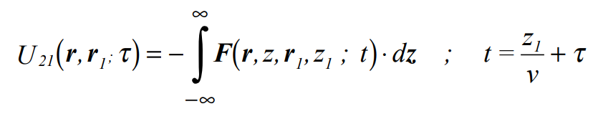
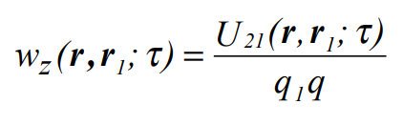
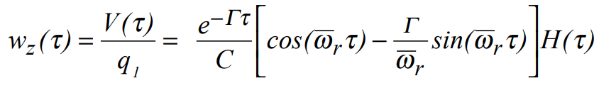
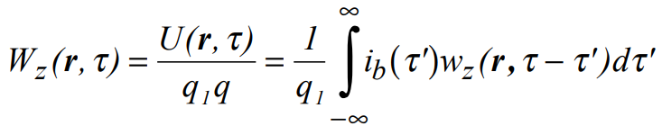
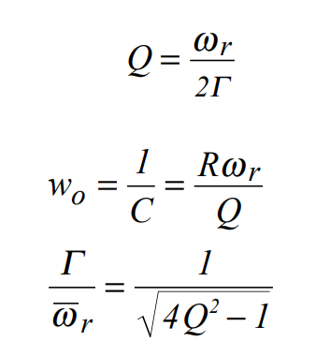
Beamloading Overview
Single Particle
Wake potential describes the energy loss per trailing charge per bunch charge
  Couples to high R/Q modes
  Combination of cavity modes and space charge effects
Mode Wake
Particle Bunch
https://arxiv.org/pdf/physics/0309023

Slide 4
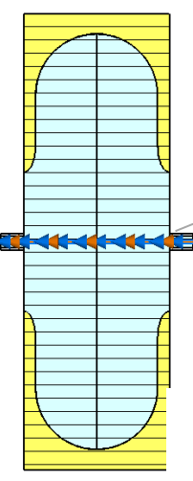
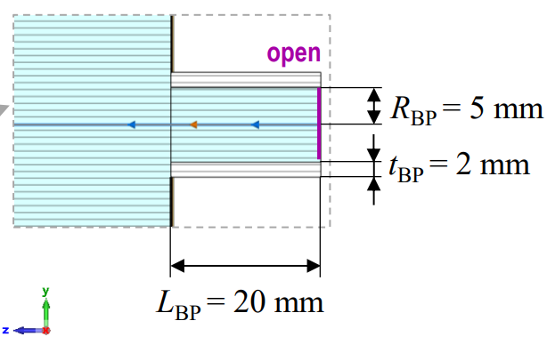
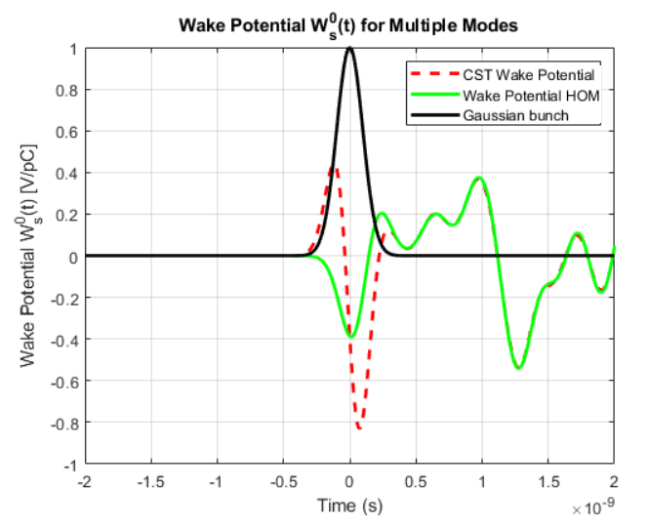
Motivation
Previous studies* (right) to extract wake potentials introduce a beam pipe to CST Wakefield simulations, modifying the more realistic windowed geometry of the MuC cavities
Questions arise:
  How does the introduction of a pipe impact the fields excited by the bunch? Scattering effects from the beam passing through the aperture?
  Are the field changes significant enough to the wake calculation?
  Can there be a way to use CST to resolve the wakefield without a pipe?
*Design Studies of cavities for muon cooling

Slide 5
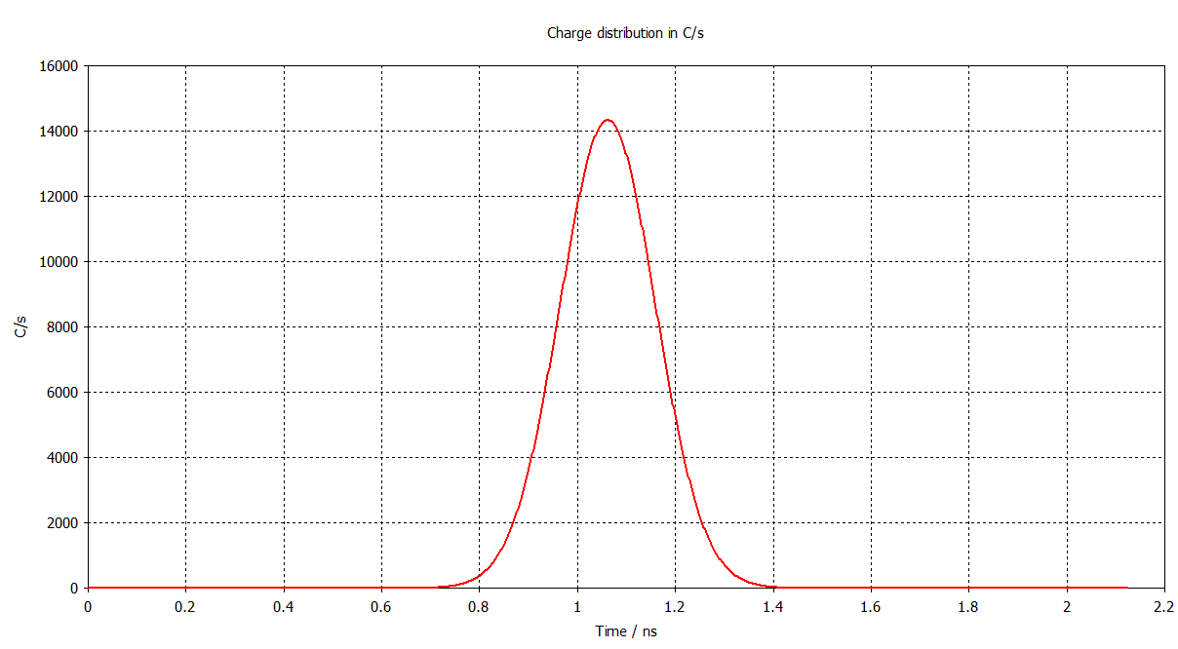
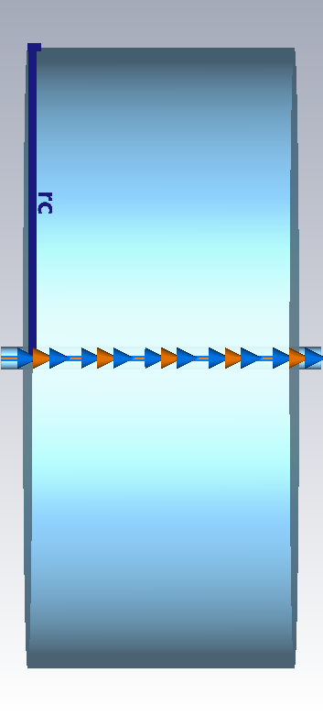
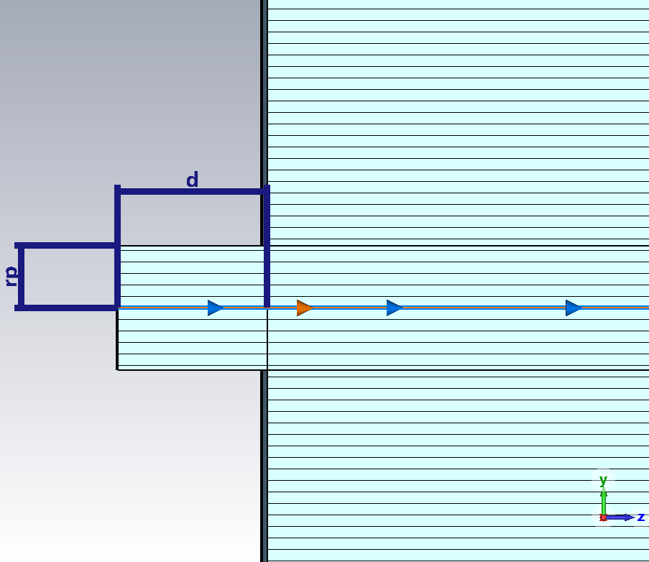
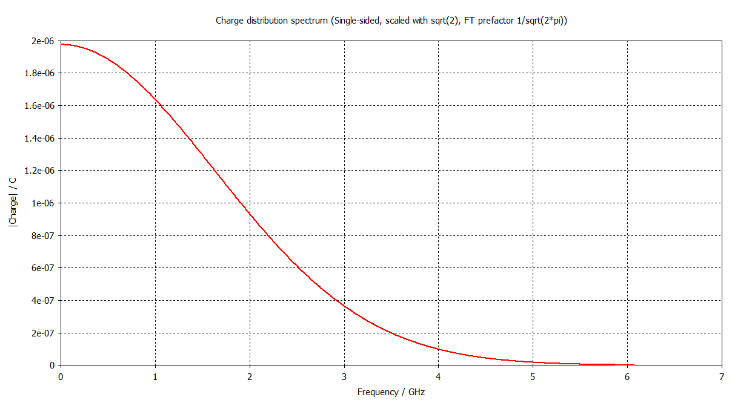
Wakefield Simulations in a Simple Pillbox with Beam Pipe
σ_{z} (mm) | Q_{tot} (μC) | β | I_{ave} (A)
26.3 | 3.5 | 0.9 | 660
Bunch current
Wakefield model
Cavity radius = 140 mm
f010 ~ 820 MHz
Bunch Spectrum

Slide 6
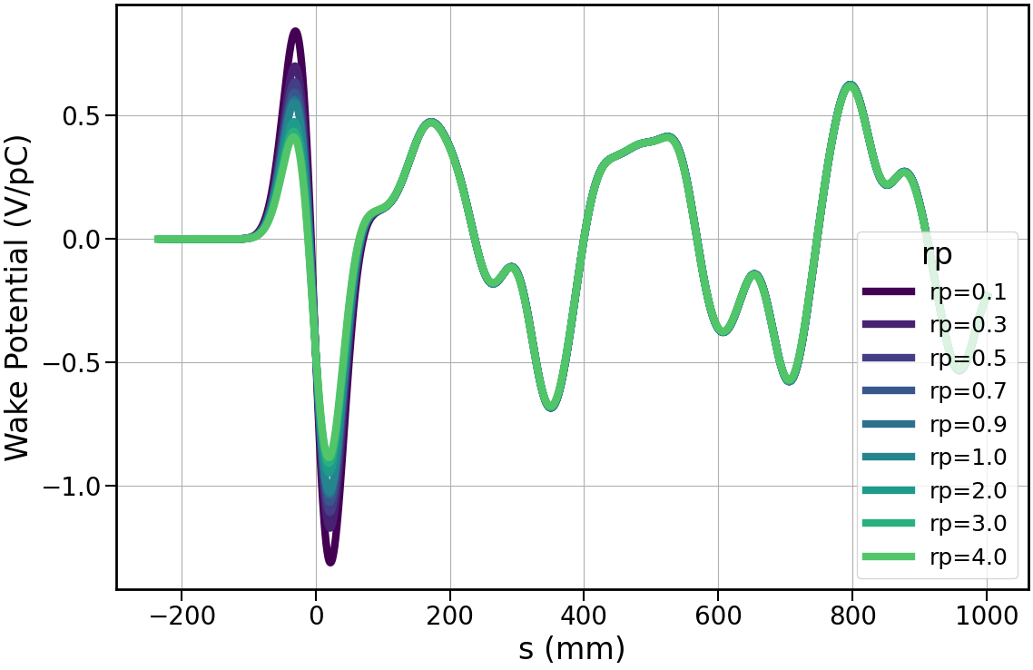
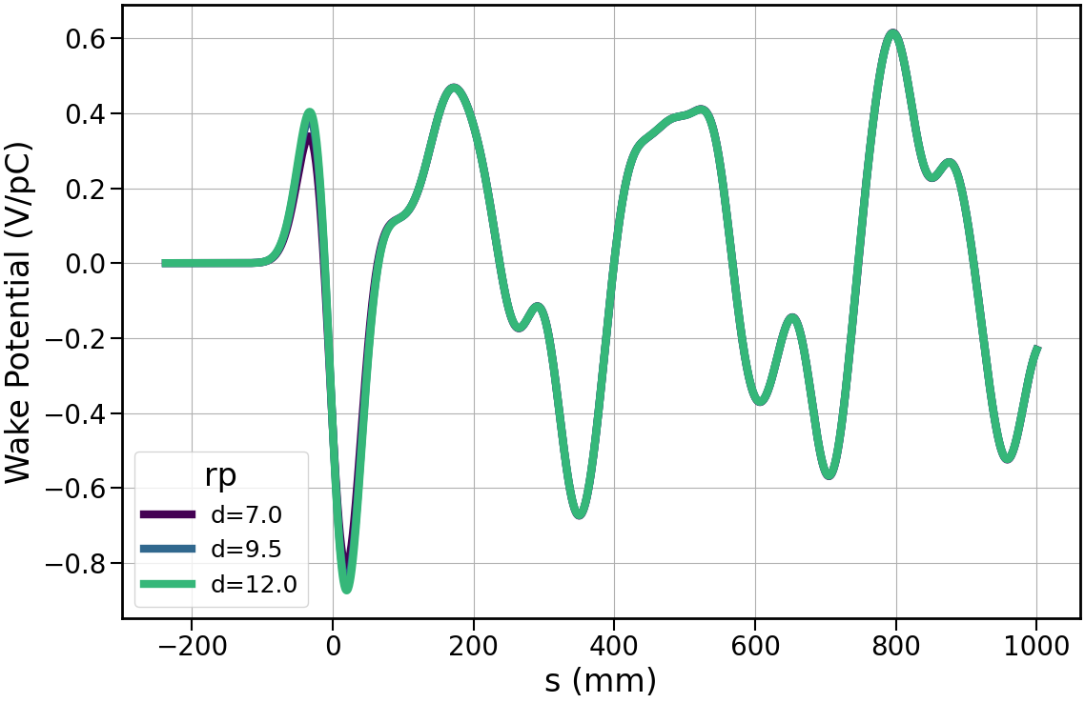
Wakefields in a Simple Pillbox with Beam Pipe
Wake potential variation with rp
Simulations fix d=12 mm and vary rp
Clear impact of the pipe radius on the wake potential
Simulations fix r=5 mm and vary d
Minimal impact on wake potential
Wake potential variation with d
Pipe insertion does impact the resulting beam loading effects

Slide 7
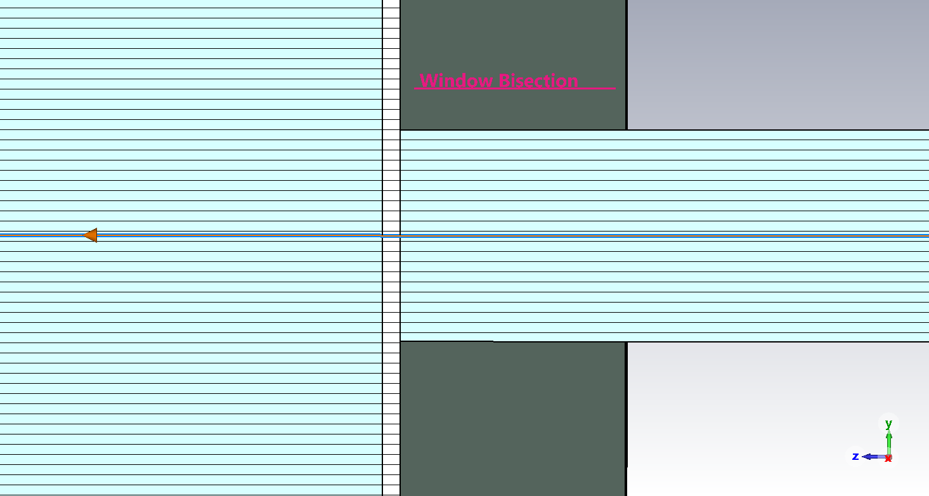
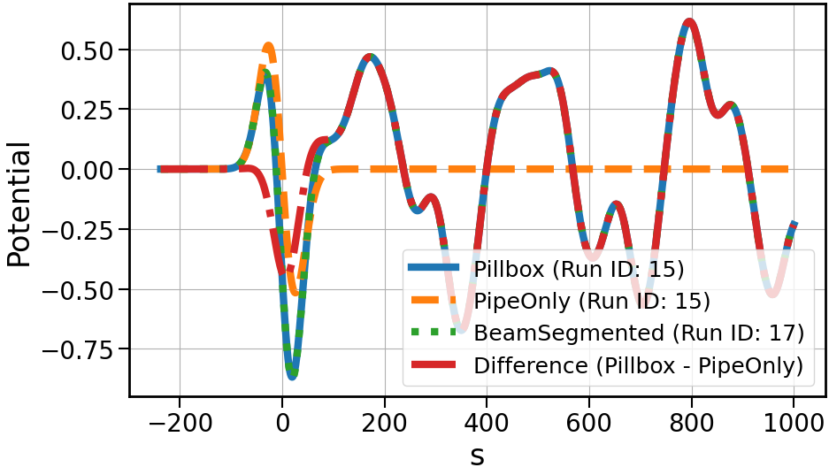
Wakefields in a Segmented Pillbox with Beam Pip, rp=5mm,d=12mm
Segment the pipe to see how CST treats a beam passing through the windows
  5 mesh cells across window → 150μm
  Material is Be → penetration depth ~2.2μm
Results for a given pipe radius and length result in the same for the segmented and non-segmented cases
CST seems to not be acknowledging the windows → as pipe radius approaches zero, the wake should differ

Slide 8
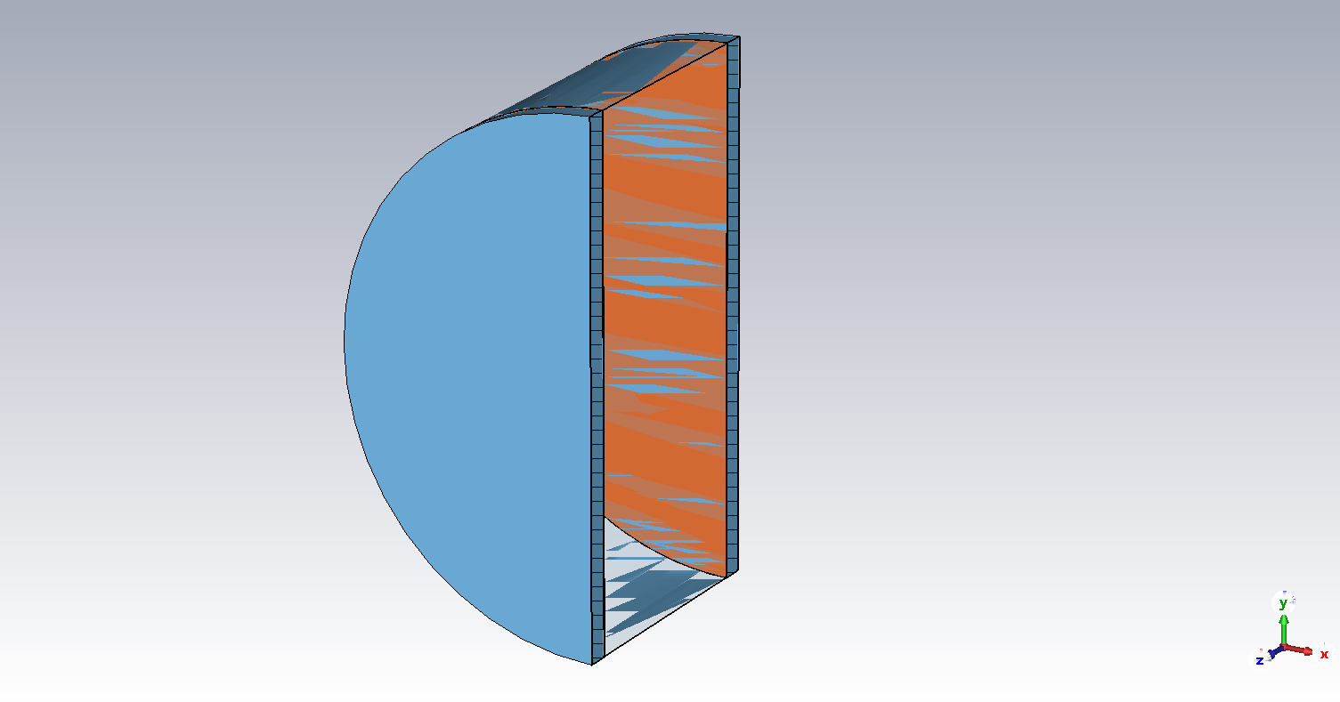
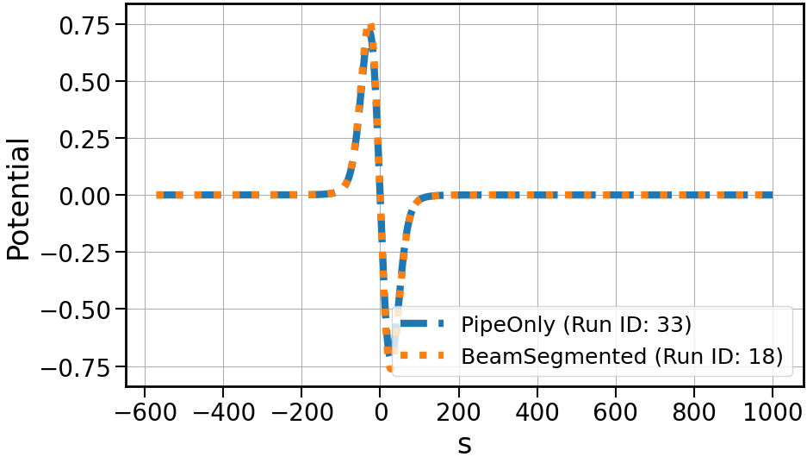
Wakefields in a Segmented Pillbox with Beam Pipe, rp=rc,d=12mm
rp = rc →Wake resembles that of a smooth pipe
Validates CST is not acknowledging the windows in this geometry
CST cannot properly resolve windowed wake

Slide 9
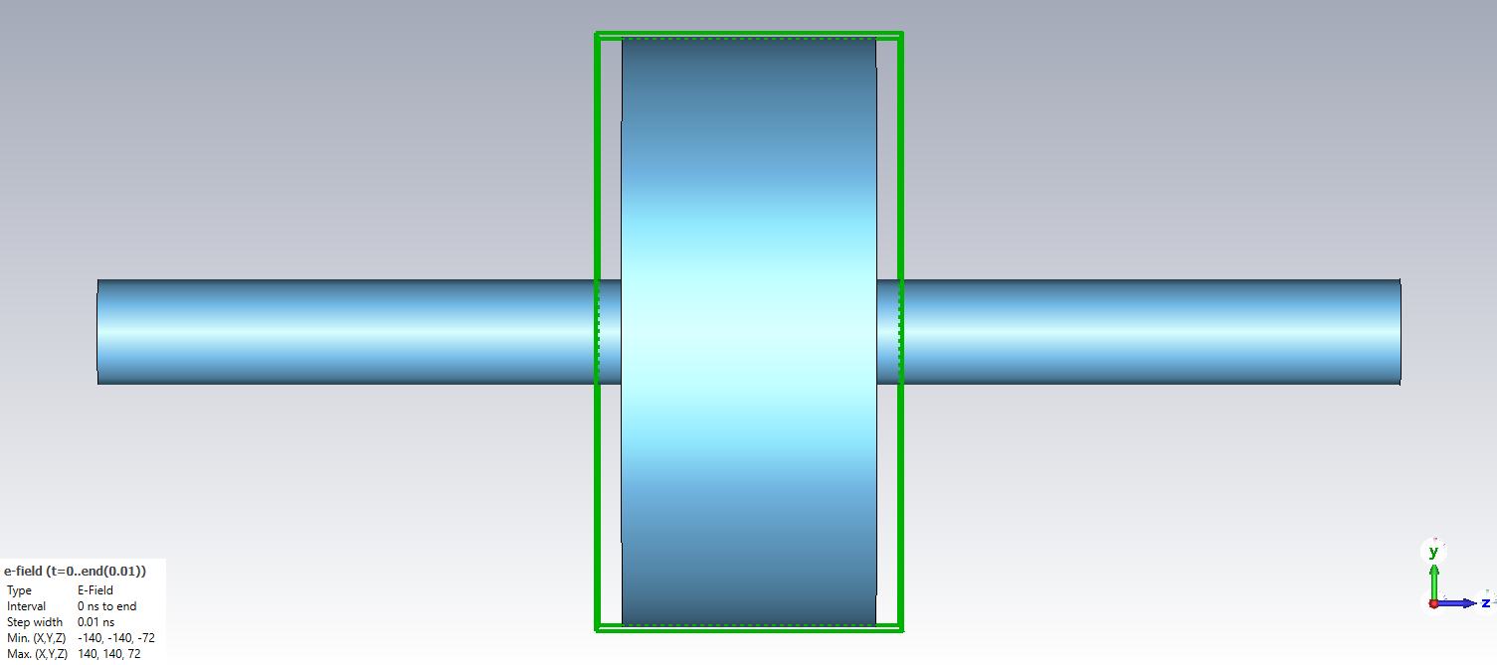
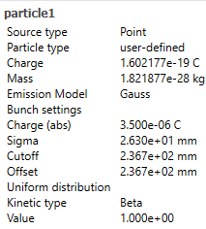
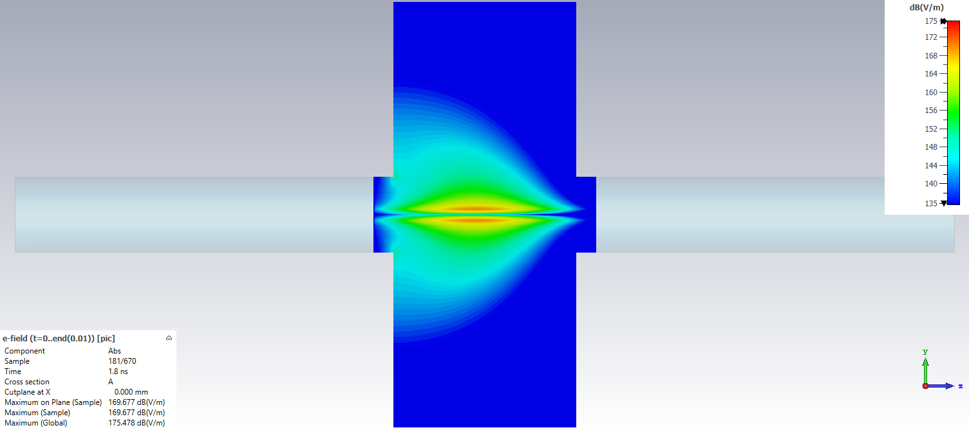
CST PIC Solver - Setup
PIC model
Mimic bunch charge from wakefield solver
Extend pipe to remove edge effects, valid since wakefield solver uses open bounds
Reduce time stability factor in CST → higher resolution of fields
Resolve fields and export
Calculate wake potential in post processing w/ Python
Beam center

Slide 10
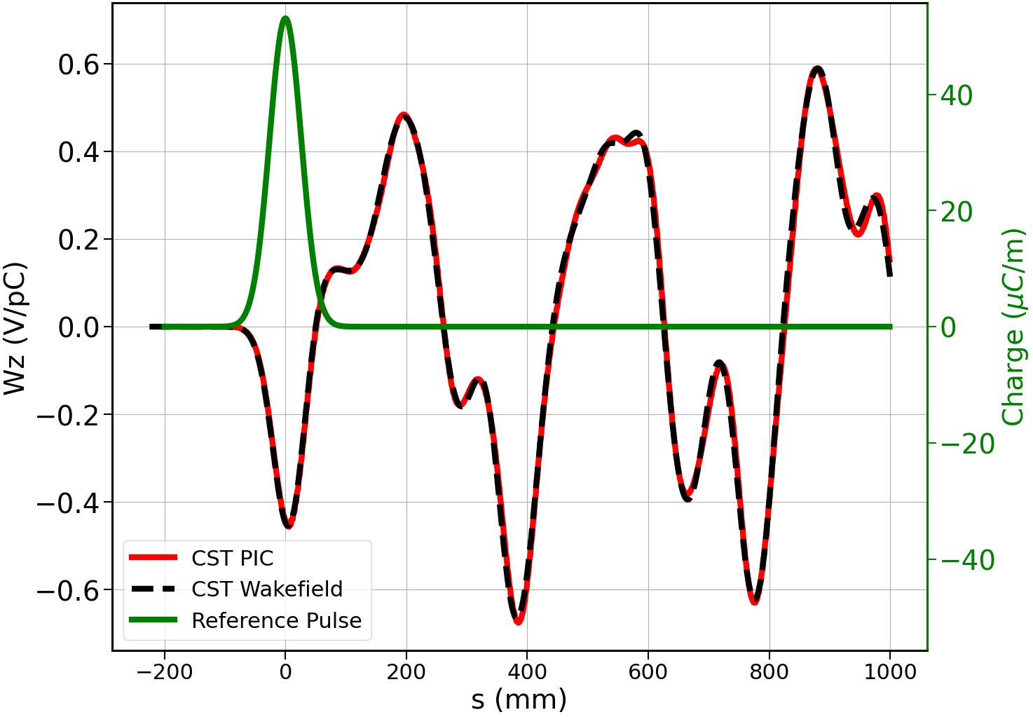
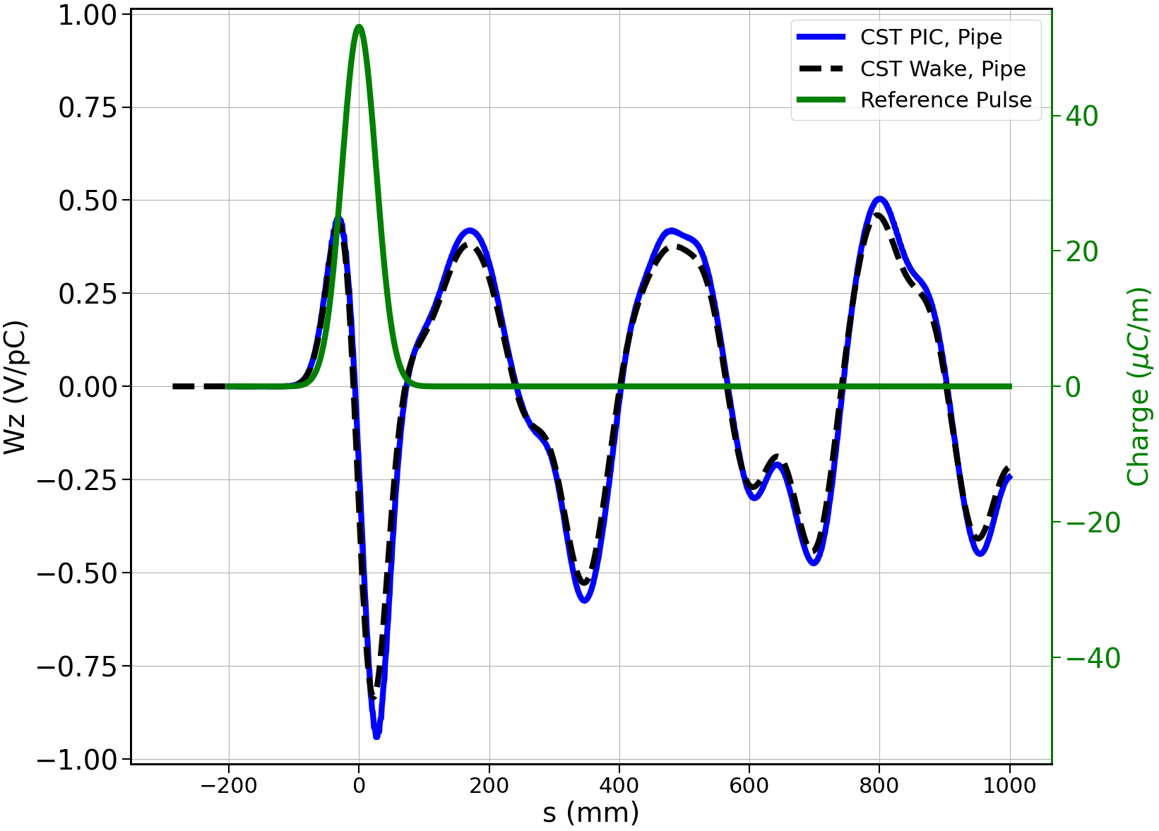
Wakefield Results Using CST PIC – Pillbox with a Pipe
Wakefield model
β=1
rp=25mm, d=12mm
β=0.9
Perfect agreement between postprocessing and Wakefield Solver

Slide 11
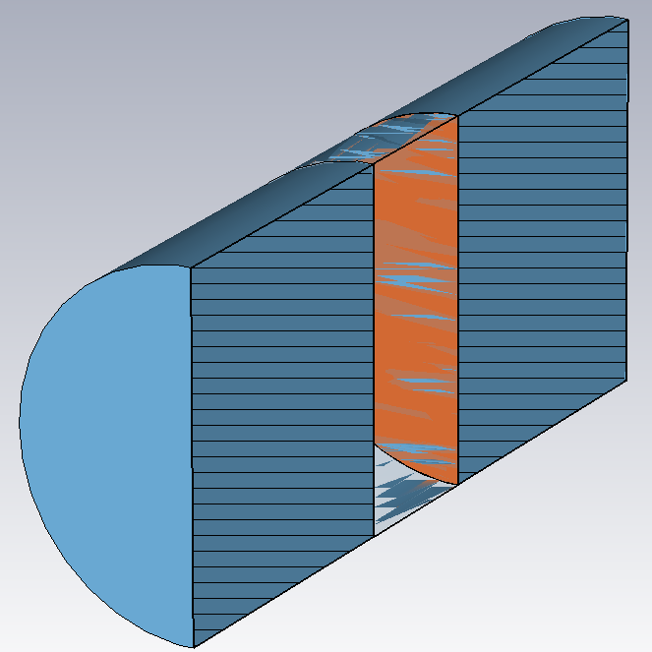
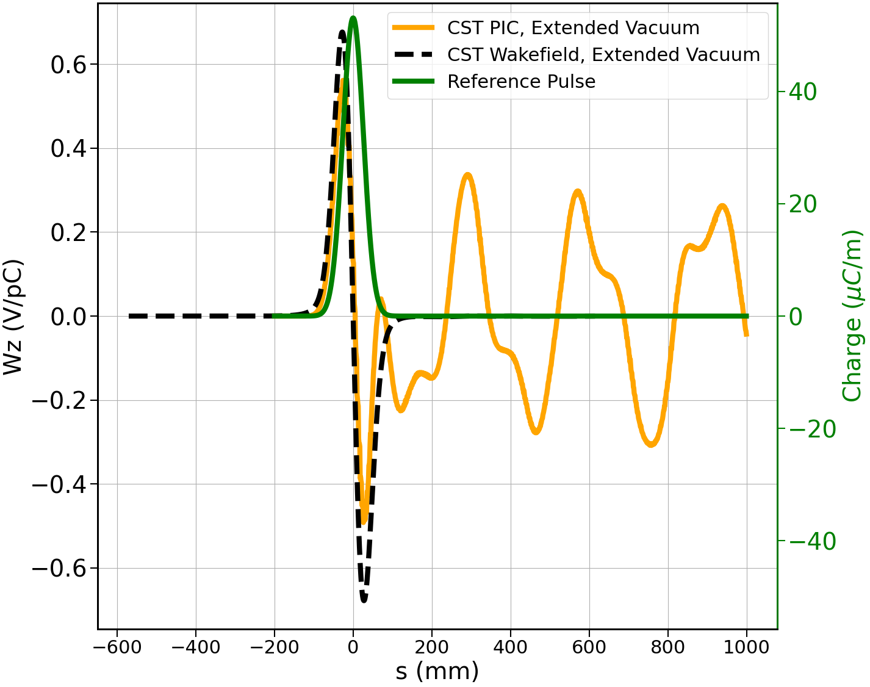
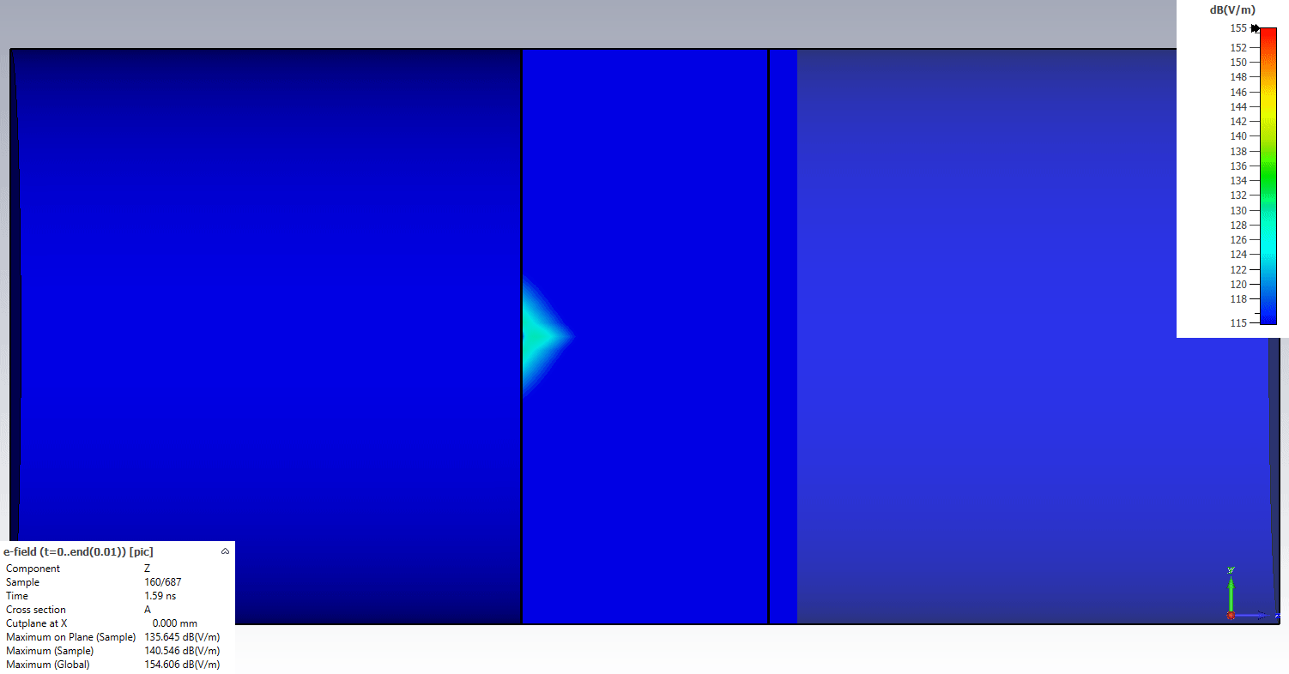
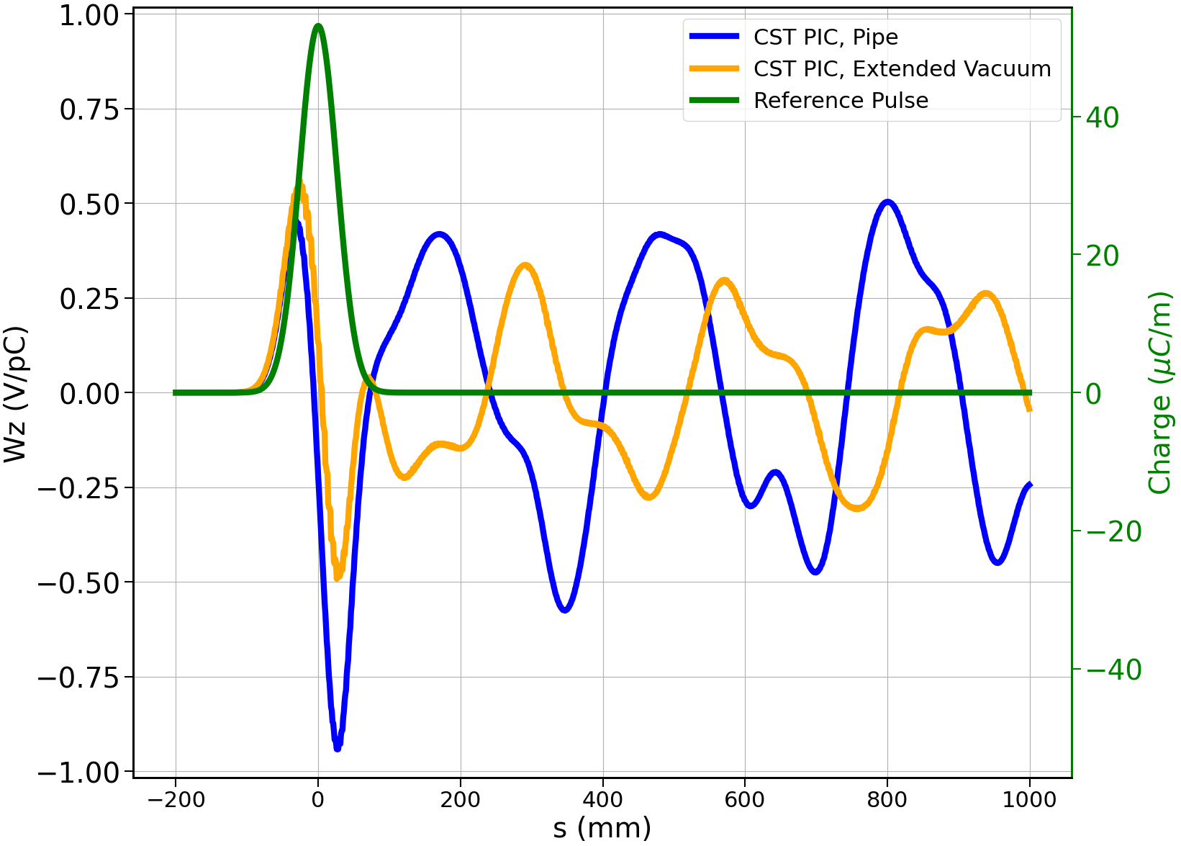
Wakefields Results CST PIC Solver
Deviation due to vacuum extension
Extended pipe
Pipe
PIC Wakefield w pipe incision vs PIC
extended Vacuum
Wakefield vs PIC
Both extended Vacuum
For μC bunches, impact ~ O(MV)

Slide 12
Conclusions and Takeaways
CST Wakefield Solver is not suitable to handle windowed geometry – does not acknowledge the windows, regardless of mesh
  Pipe insertion has significant impact on the wake
CST PIC solver can be used with postprocessing wakefield calculations
  Valid for large bunches, need to make sure solver time step is small enough, windows must be transparent to particles, and simulation time must be long enough to propagate all trailing charges
  Short bunches not valid outside of frequency range of mesh
  Ignores beam scattering effects
PIC Solver results indicate CST Wakefield Solver providers a slight overestimate in the near-field wake, but the wake is still significant enough to impact operation (O(MV) )
Studies ignore multiple scattering effects, which may be significant at later stages (B7-B10)
Need to assess effects on wakes from fields in the extended vacuum

Slide 13

Thank you
for attention
Dillon Merenich
Northern Illinois University
March 18, 2025

Slide 14
Backup

Slide 15
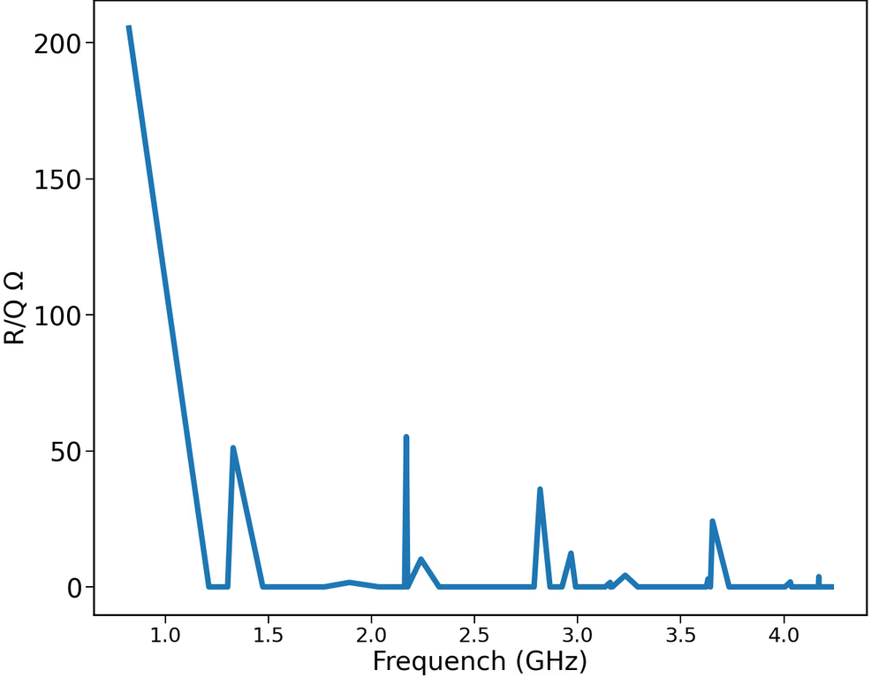
Cavity R/Q vs Freq
rp=25mm, d=12mm

Slide 16
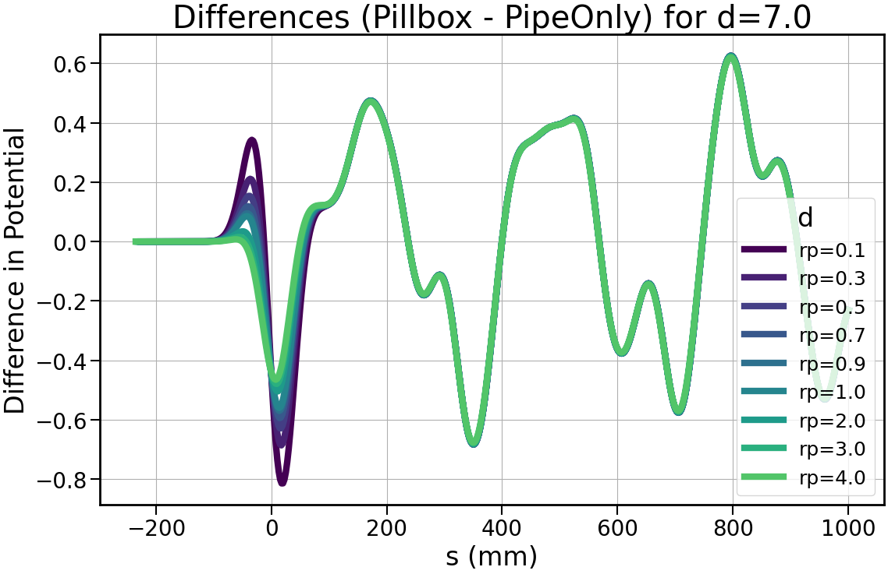
Wakefield Solver – HOM Wake from Subtraction

Slide 17
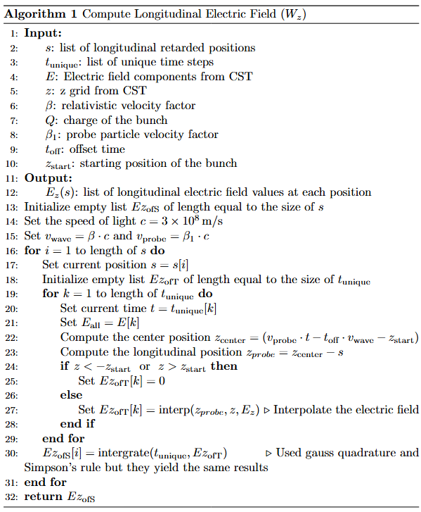
Pseudo code

Slide 18
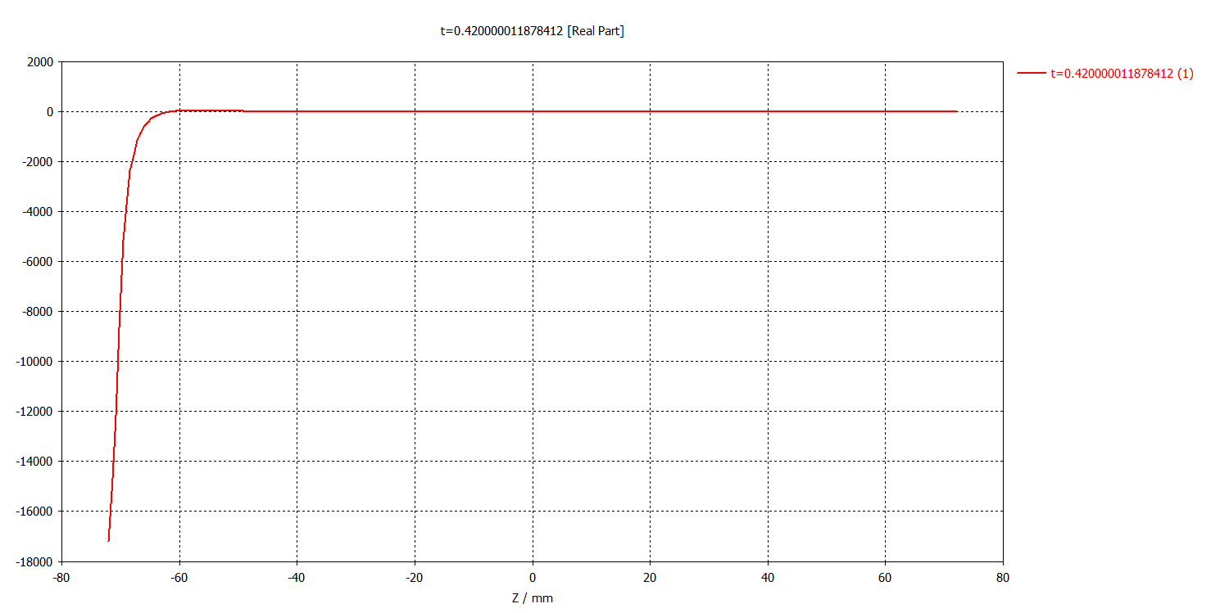
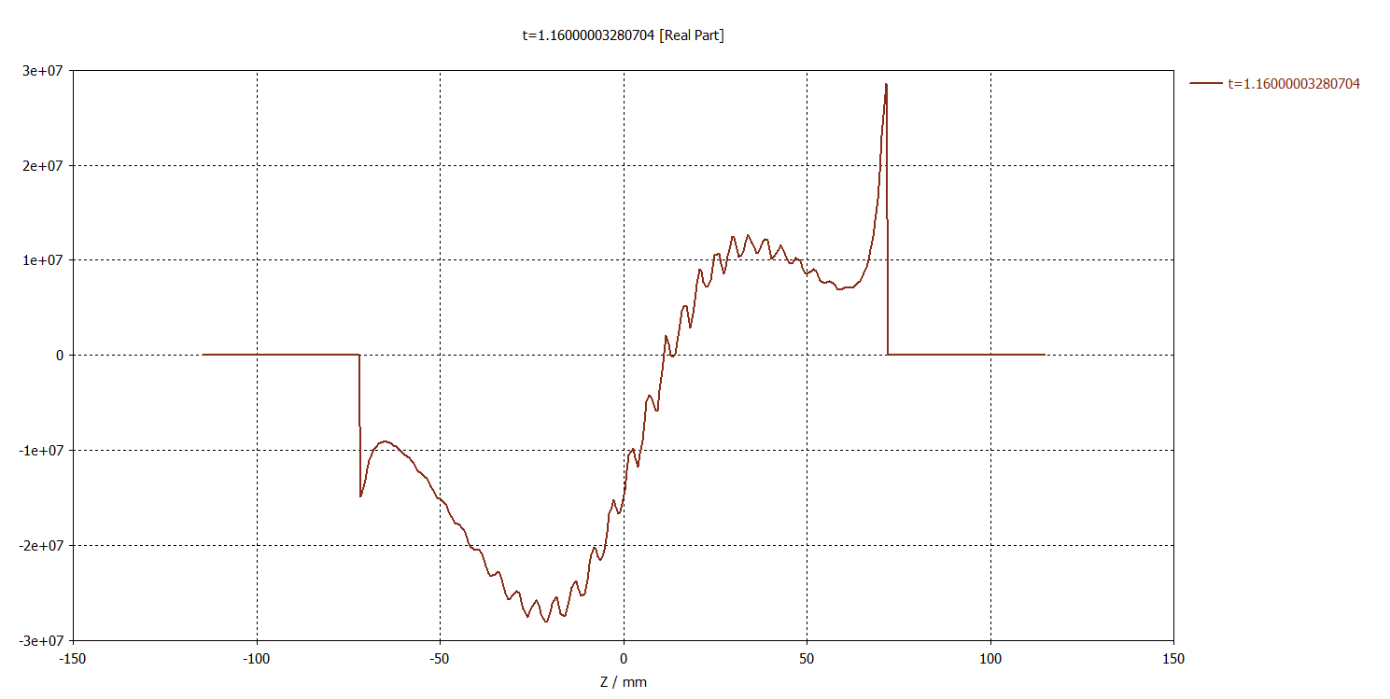
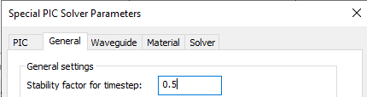
Nuances with CST PIC Solver
Need drift space before the desired calculation domain to remove edge effects → larger mesh domain → longer simulations
Need a small time constant in CST to resolve fields → quite lengthy simulations
Not useful for small particle bunches, high frequency noise, would need very dense mesh to resolve frequencies for small pulses
Simulation time must be long enough for s_{max} to propagate through entire structure
On axiz Ez, edge effect
On axiz Ez, large time constant

Slide 19
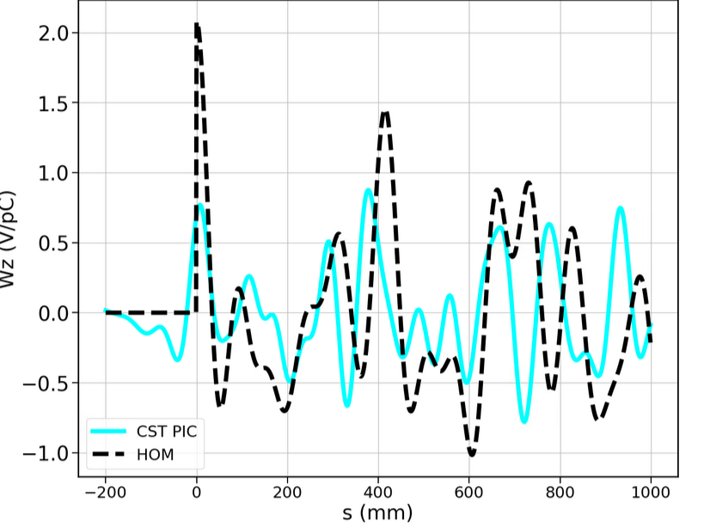
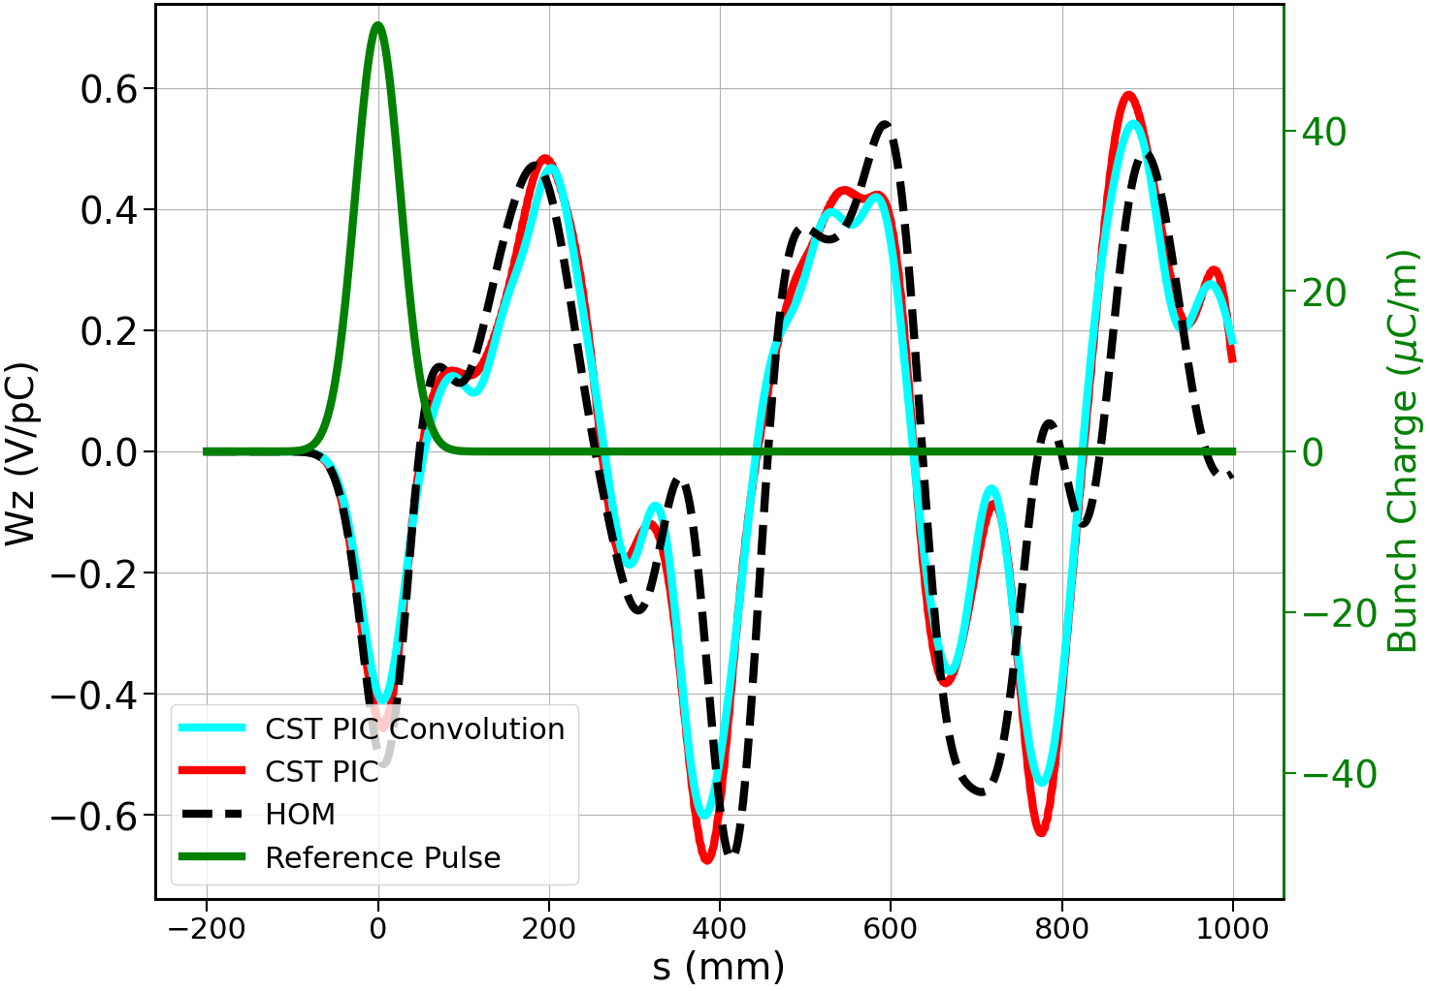
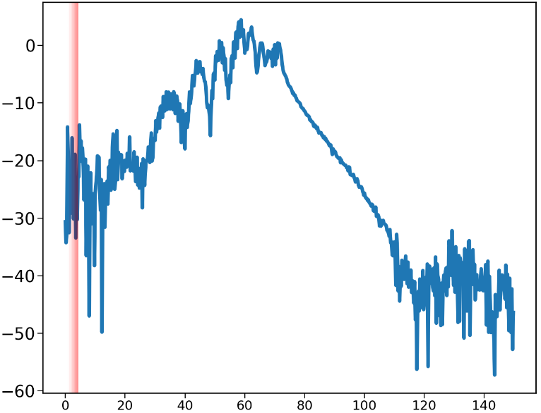
Wakefunction Trade Study – Single Particle
Filtered pic wake function
Wake potentials
Pillbox modes
Unfiltered pic wake function spectrum

