Slide 1
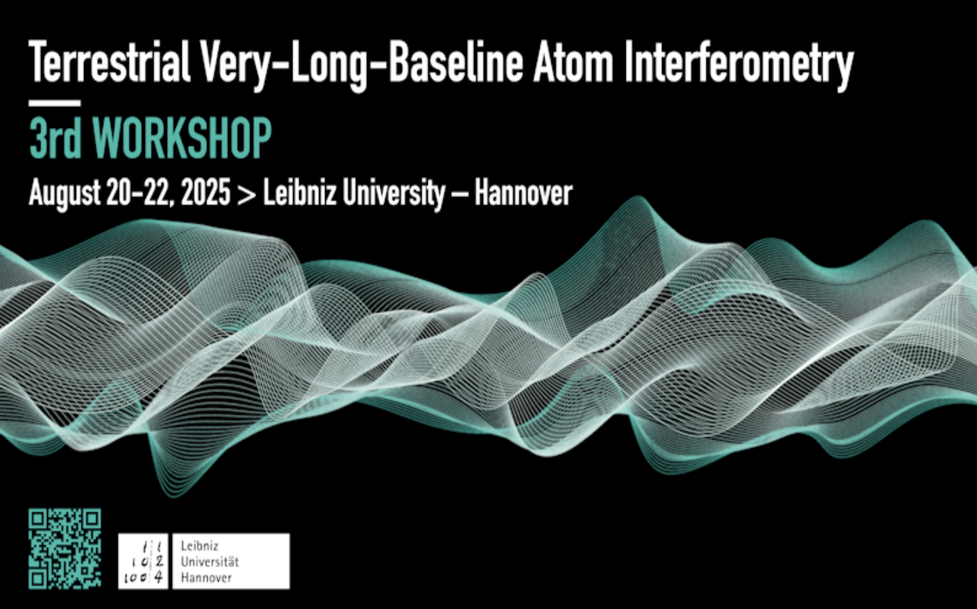
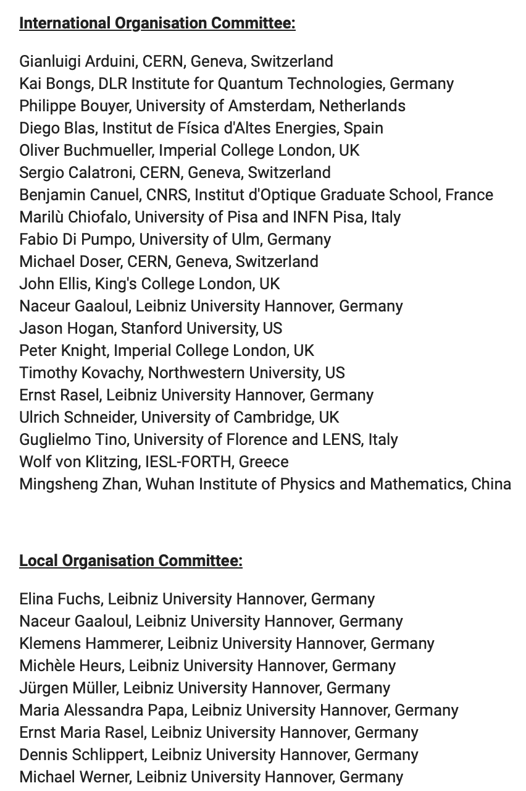
The 3rd TVLBAl workshop follows the formation of the TVLBAI Proto-Collaboration and will focus on discussing] the technology and physics drivers for large-scale Atom Interferometry as well as establishing a comprehensive roadmap. The primary objectives are to bring together researchers from diverse institutions, foster strategic discussions, and develop a pathway towards funding for Terrestrial Very-Long Baseline Atom Interferometer projects
expected to become operational in the mid-2030s.

Slide 2
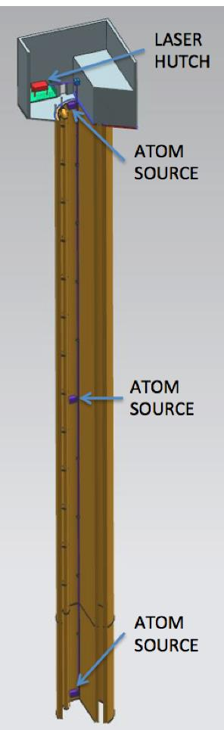
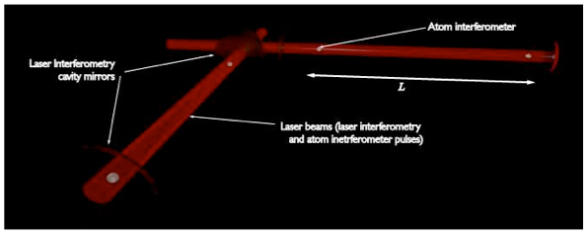
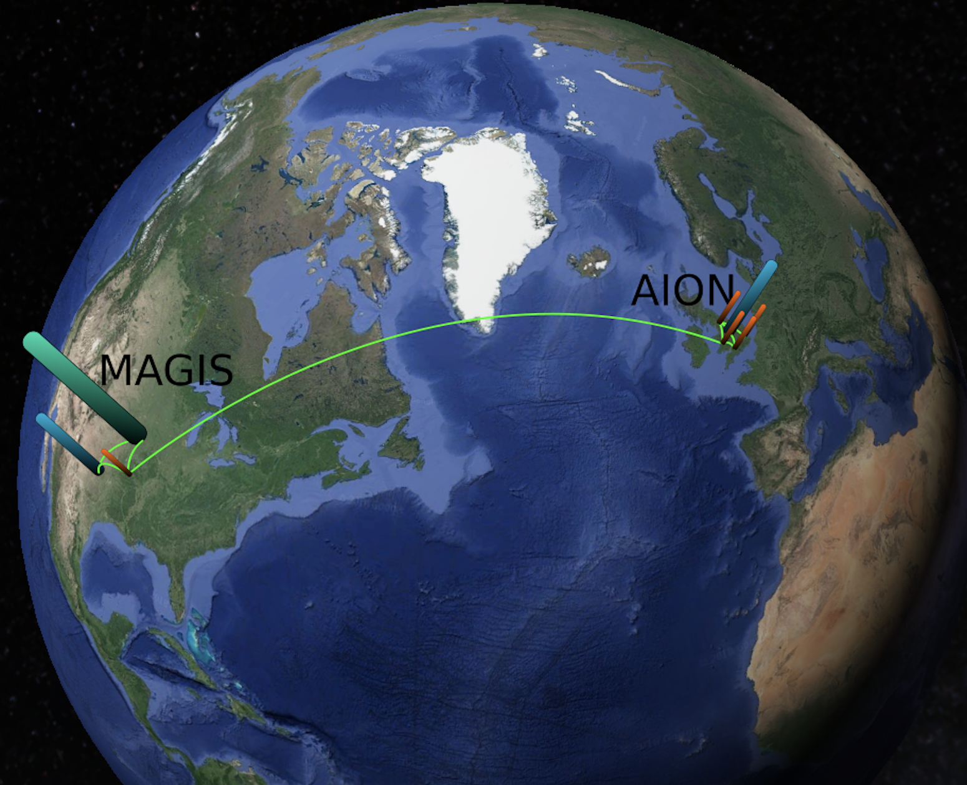
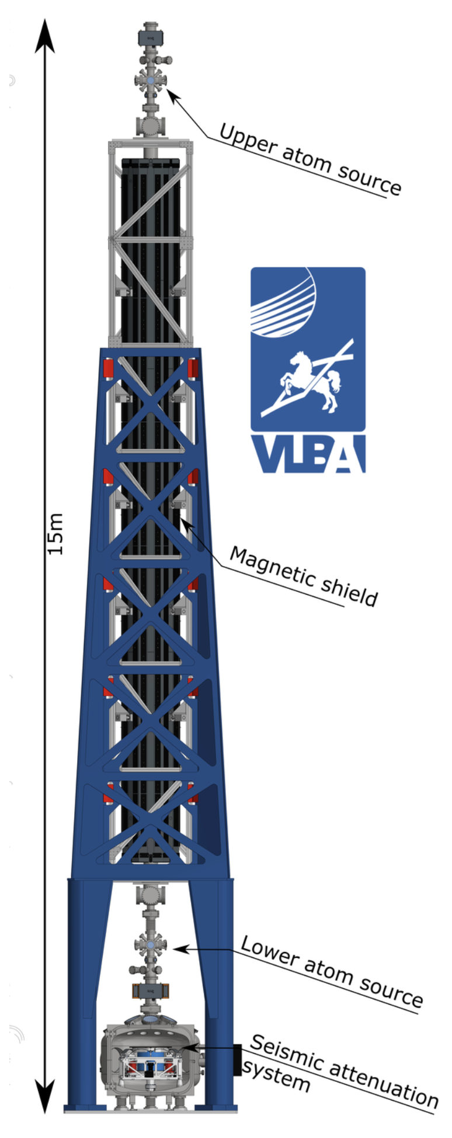
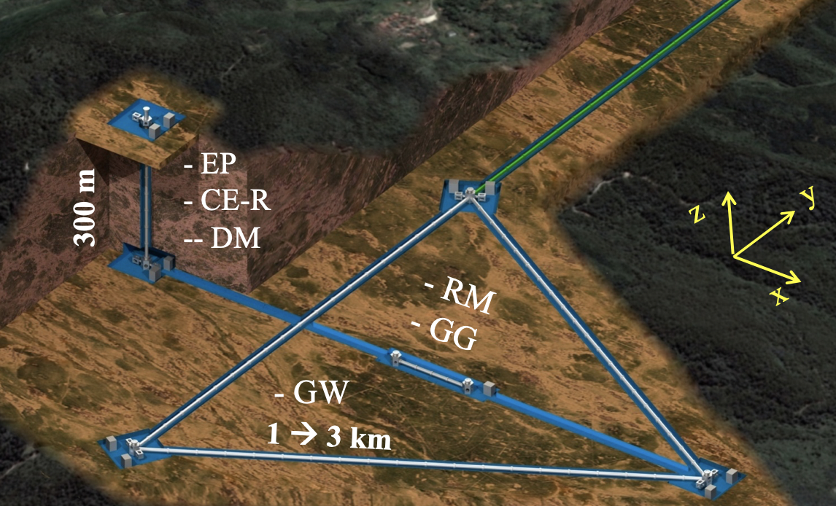
Ground Based Large Scale O(100m) Projects
MIGA: Terrestrial detector using atom interferometer at O(100m)
(France)
AION: Terrestrial shaft detector using atom interferometer at 10m – O(100m) planned
(UK)
VLBAI: Terrestrial tower using atom interferometer O(10m)
(Germany)
ZAIGA: Terrestrial detector for large scale atomic interferometers, gyros and clocks at O(100m)
(China)
MAGIS: Terrestrial shaft detector using atom interferometer at O(100m)
(US)
Planned network operation

Slide 3
Ground Based Large Scale O(100m) Projects
MIGA: Terrestrial detector using atom interferometer at O(100m)
(France)
AION: Terrestrial shaft detector using atom interferometer at 10m – O(100m) planned
(UK)
VLBAI: Terrestrial tower using atom interferometer O(10m)
(Germany)
Examples of large-scale CA projects that act as demonstrators for
GW mid-frequency band and ULDM detectors.
All these projects are represented in the TVLBAI Community.
Each project requires an investment of O(10M+) currency units.
All projects (AION, MAGIS, MIGA, VLBAI, ZAIGA)
are funded by national funding agencies and foundations.
Timeline 2020 to 2030ish
ZAIGA: Terrestrial detector for large scale atomic interferometers, gyros and clocks at O(100m)
(China)
MAGIS: Terrestrial shaft detector using atom interferometer at O(100m)
(US)
Planned network operation

Slide 4
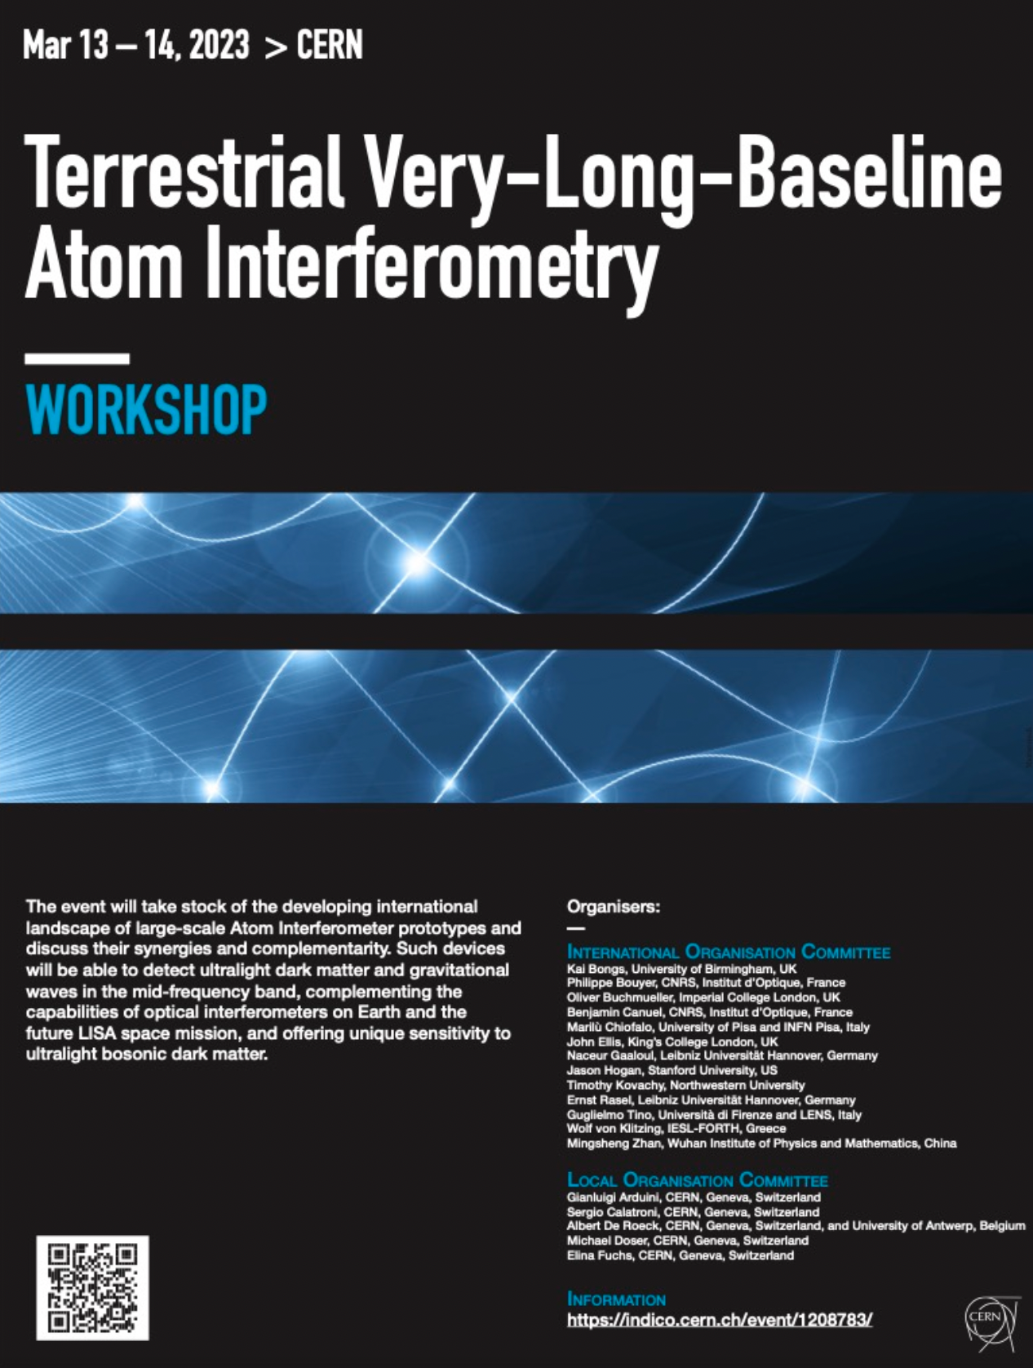
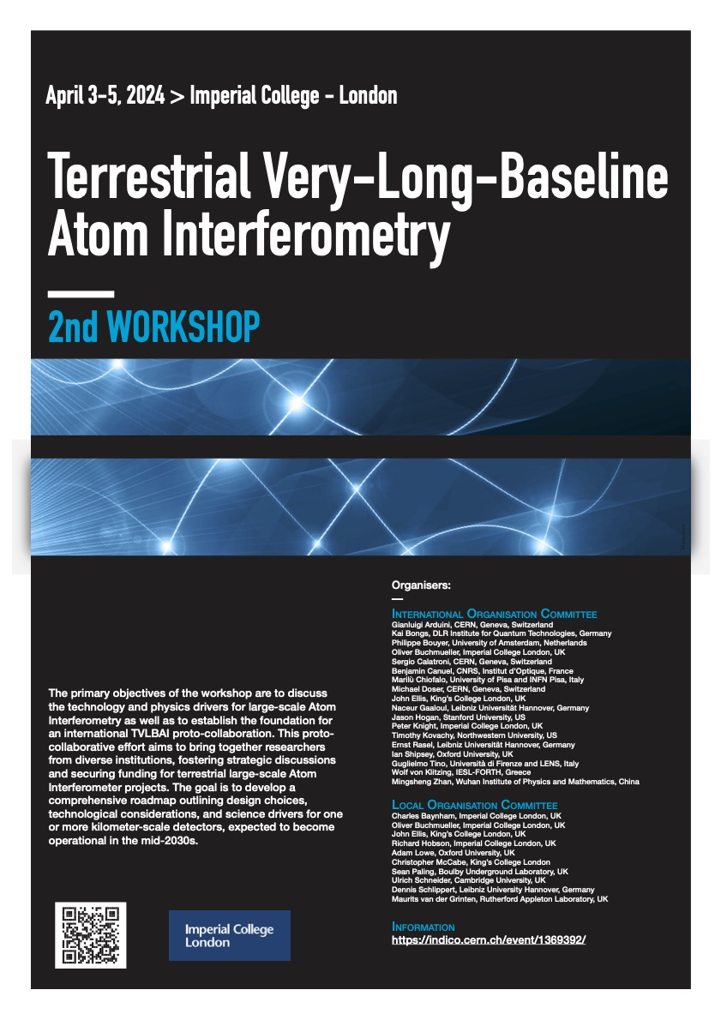

Slide 5
1st Workshop Summary now published with more 200 co-authors:
EPJ Quantum Technology, 12, 42. https://epjquantumtechnology.springeropen.com/articles/10.1140/epjqt/s40507-025-00344-3

Slide 6
1st Workshop Summary now published with more 200 co-authors:
EPJ Quantum Technology, 12, 42. https://epjquantumtechnology.springeropen.com/articles/10.1140/epjqt/s40507-025-00344-3
2nd Workshop Summary now published with more than 250 co-authors:
AVS Quantum Science (Vol. 6, Issue 2
https://doi.org/10.1116/5.0185291
DOI: 10.1116/5.0185291

Slide 7
1st Workshop Summary now published with more 200 co-authors:
EPJ Quantum Technology, 12, 42. https://epjquantumtechnology.springeropen.com/articles/10.1140/epjqt/s40507-025-00344-3
2nd Workshop Summary now published with more than 250 co-authors:
AVS Quantum Science (Vol. 6, Issue 2
https://doi.org/10.1116/5.0185291
DOI: 10.1116/5.0185291
2nd TVLBAI Workshop was held in LONDON in APRIL with the goal of forming a proto -collaboration.

Slide 8
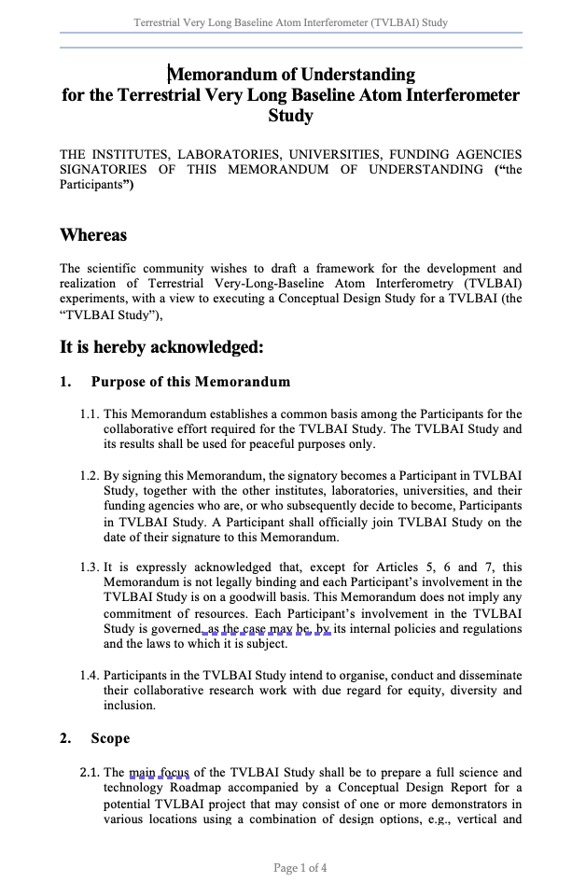
Workshop Summary now published with more than 250 co-authors:
AVS Quantum Science (Vol. 6, Issue 2
https://doi.org/10.1116/5.0185291
DOI: 10.1116/5.0185291
2nd TVLBAI Workshop was held in LONDON in APRIL with the goal of forming a proto -collaboration.

Slide 9
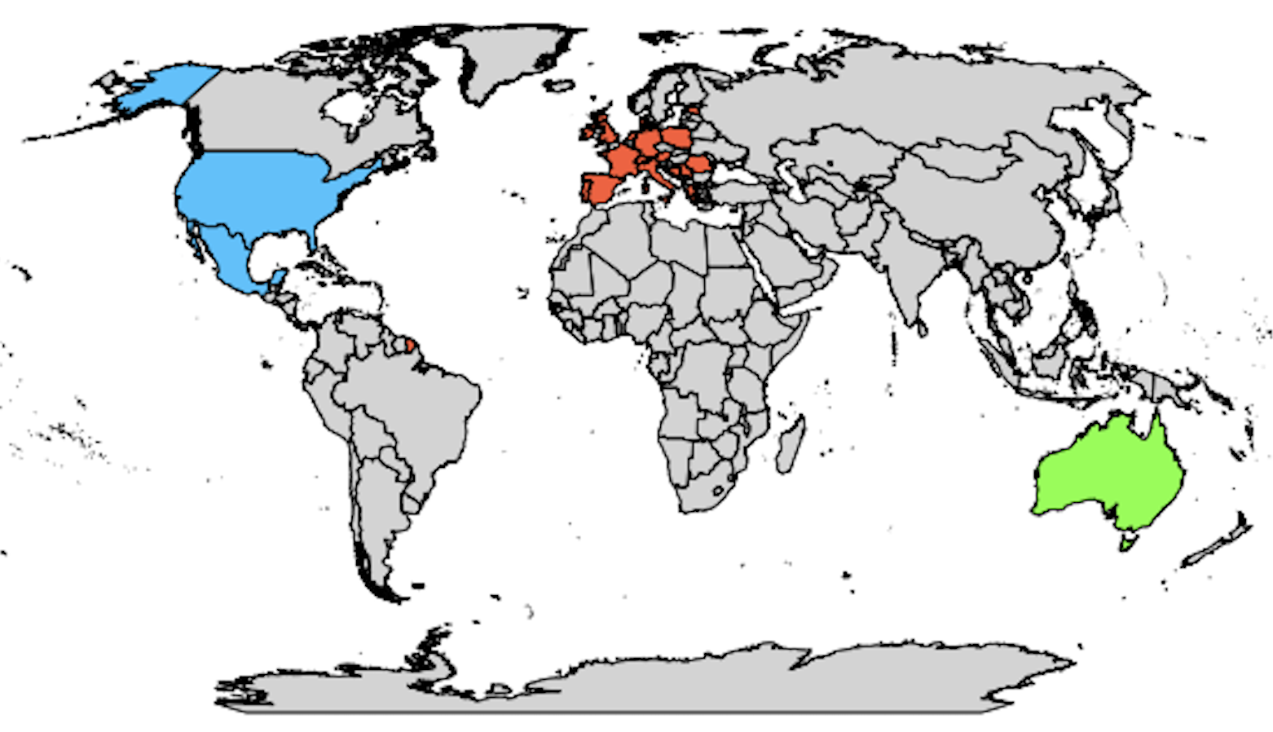
TVLBAI Proto-Collaboration
Austria
Institute of Science and Technology Austria
Bosnia and Herzegovina
University of Sarajevo - Faculty of Science
Denmark
Aarhus University - Department of Physics and Astronomy
Estonia
National Institute of Chemical Physics and Biophysics (KBFI)
France
University of Toulouse III – Paul Sabatier
École Normale Supérieure
Germany
Technische Universität Darmstadt
Leibniz University Hannover
Ulm University
Greece
Laboratory of Theoretical and Computational Physics, National Technical University of Athens (LThCP)
Foundation for Research and Technology – Hellas (FORTH)
Laboratory of Astronomy, Aristotle University of Thessaloniki (AUTH)
Ireland
Tyndall National Institute
Italy
University of Florence – DFA
LENS Laboratory
University of Pisa
Malta
University of Malta
Netherlands
University of Amsterdam
Poland
Space Technology Centre, AGH University of Science and Technology, Krakow
Center for Theoretical Physics, Polish Academy of Sciences (CTP PAS)
University of Warsaw
Portugal
Instituto de Telecomunicações
Romania
Institute of Space Science
Serbia
Institute of Physics Belgrade (IPB)
South East European Network for Mathematical and Theoretical Physics (SEENET-MTP) Centre
Spain
Institute of Theoretical Physics (IFT UAM-CSIC)
Institute of Corpuscular Physics (IFIC), Valencia
Autonomous University of Madrid (UAM)
Institut de Fisica d'Altes Energies (IFAE)
United States
University of Arizona
Johns Hopkins University
Stanford University
Northwestern University
University of Delaware
University of Kentucky
Bates College, Maine
Switzerland
University of Geneva
CERN
University of Neuchâtel
University of Zurich
Fachhochschule Graubünden
United Kingdom
Imperial College London
King's College London
University College London (UCL)
University of Birmingham
University of Cambridge
University of Liverpool
University of Manchester
University of Oxford
University of Southampton
University of Sussex
University of Warwick
UKRI-STFC RAL
Mexico
Autonomous University of Aguascalientes (UAA)
Observers (Under Evaluation)
Germany
German Aerospace Center (DLR)
Iran
Isfahan University of Technology
United States
Fermi National Accelerator Laboratory (Fermilab)
Jet Propulsion Laboratory (JPL)
55 institutions from 21 countries
TVLBAI Chair: Prof. O. Buchmueller
Australia
University of Western Australia

Slide 10
TVLBAI Proto-Collaboration
Austria
Institute of Science and Technology Austria
Bosnia and Herzegovina
University of Sarajevo - Faculty of Science
Denmark
Aarhus University - Department of Physics and Astronomy
Estonia
National Institute of Chemical Physics and Biophysics (KBFI)
France
University of Toulouse III – Paul Sabatier
École Normale Supérieure
Germany
Technische Universität Darmstadt
Leibniz University Hannover
Ulm University
Greece
Laboratory of Theoretical and Computational Physics, National Technical University of Athens (LThCP)
Foundation for Research and Technology – Hellas (FORTH)
Laboratory of Astronomy, Aristotle University of Thessaloniki (AUTH)
Ireland
Tyndall National Institute
Italy
University of Florence – DFA
LENS Laboratory
University of Pisa
Malta
University of Malta
Netherlands
University of Amsterdam
Poland
Space Technology Centre, AGH University of Science and Technology, Krakow
Center for Theoretical Physics, Polish Academy of Sciences (CTP PAS)
University of Warsaw
Portugal
Instituto de Telecomunicações
Romania
Institute of Space Science
Serbia
Institute of Physics Belgrade (IPB)
South East European Network for Mathematical and Theoretical Physics (SEENET-MTP) Centre
Spain
Institute of Theoretical Physics (IFT UAM-CSIC)
Institute of Corpuscular Physics (IFIC), Valencia
Autonomous University of Madrid (UAM)
Institut de Fisica d'Altes Energies (IFAE)
United States
University of Arizona
Johns Hopkins University
Stanford University
Northwestern University
University of Delaware
University of Kentucky
Bates College, Maine
This is an open science collaboration, and we welcome applications from other institutions at any time.
Switzerland
University of Geneva
CERN
University of Neuchâtel
University of Zurich
Fachhochschule Graubünden
United Kingdom
Imperial College London
King's College London
University College London (UCL)
University of Birmingham
University of Cambridge
University of Liverpool
University of Manchester
University of Oxford
University of Southampton
University of Sussex
University of Warwick
UKRI-STFC RAL
Mexico
Autonomous University of Aguascalientes (UAA)
Observers (Under Evaluation)
Germany
German Aerospace Center (DLR)
Iran
Isfahan University of Technology
United States
Fermi National Accelerator Laboratory (Fermilab)
Jet Propulsion Laboratory (JPL)
55 institutions from 21 countries
TVLBAI Chair: Prof. O. Buchmueller
Australia
University of Western Australia

Slide 11
Work Packages (Proposal adopted by ICB)
TVLBAI
WP-1
Scientific Foundations and Physics Goals
Theory Development
WP-2
Advanced Atom Interferometry Techniques
WP-4
Network Integration and Synergies
WP-5
Data Analysis and Interpretation
Laser Stability and Noise Mitigation
Workshops and Conferences
Simulation and Modelling
Synergies with Existing GW and DM Experiments
WP-3
Site Options and Engineering & Infrastructure
Atom Source Development
Atom Species
Site Selection and Evaluation:
Engineering Requirements:
Infrastructure Readiness:
Horizontal and Vertical Network Design
Training, Diversity, Education
Public and Industry Engagement
Collaborative Experimentation
Data Sharing Protocolsl
Signal Processing Algorithms
Systematic Error Mitigation
Data Analysis
WP-6 Community Building and Outreach

Slide 12
Work Packages (Proposal adopted by ICB)
TVLBAI
WP-1
Scientific Foundations and Physics Goals
Theory Development
WP-2
Advanced Atom Interferometry Techniques
WP-4
Network Integration and Synergies
WP-5
Data Analysis and Interpretation
Laser Stability and Noise Mitigation
Workshops and Conferences
Simulation and Modelling
Synergies with Existing GW and DM Experiments
WP-3
Site Options and Engineering & Infrastructure
Atom Source Development
Atom Species
Site Selection and Evaluation:
Engineering Requirements:
Infrastructure Readiness:
Horizontal and Vertical Network Design
Training, Diversity, Education
Public and Industry Engagement
Collaborative Experimentation
Data Sharing Protocolsl
Signal Processing Algorithms
Systematic Error Mitigation
Data Analysis
WP-6 Community Building and Outreach
We are appointing co-conveners for each WP. If your institution is part of TVLBAI and you are interested or wish to propose candidates, please send nominations to:
Oliver.Buchmueller@cern.ch, John.Ellis@cern.ch, Sergio.Calatroni@cern.ch.

Slide 13
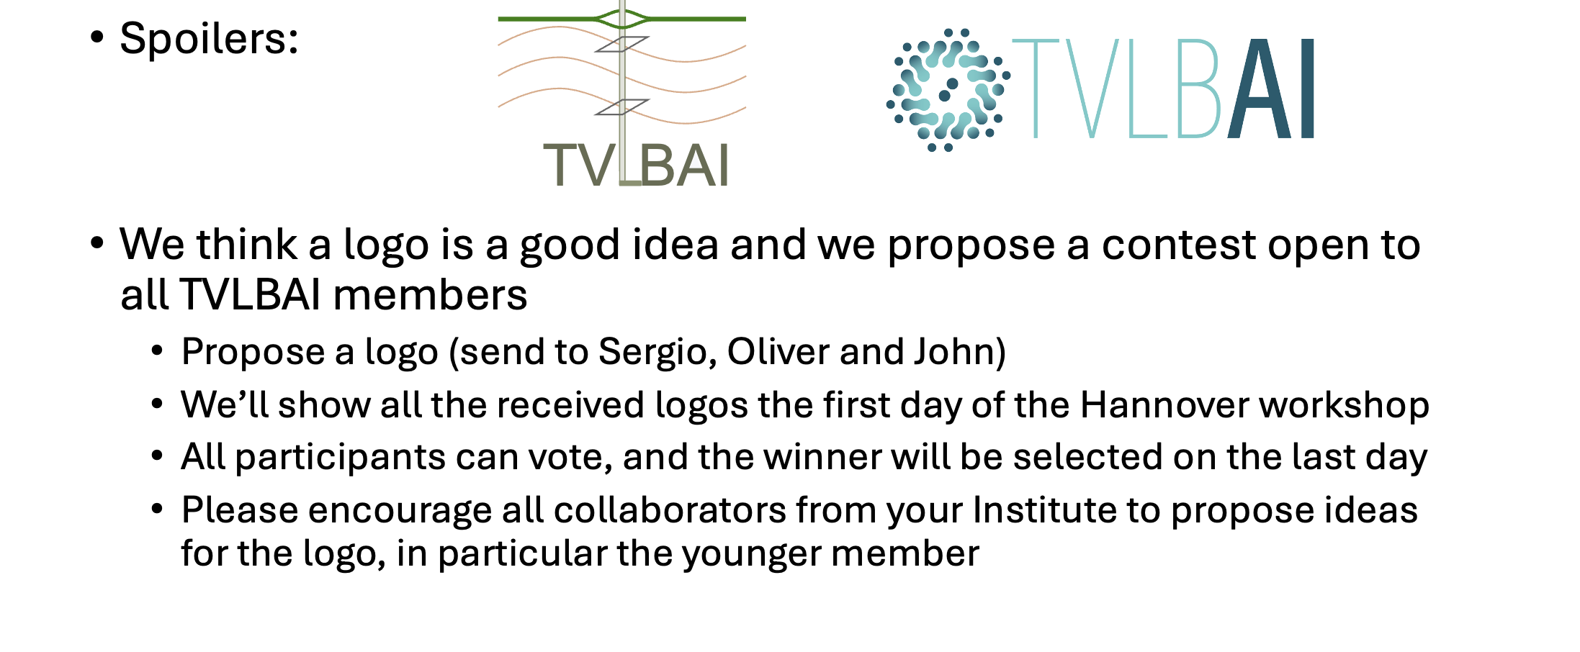
TVLBAI Logo Contest – slide from Sergio
Send to: Oliver.Buchmueller@cern.ch, John.Ellis@cern.ch, Sergio.Calatroni@cern.ch.

Slide 14
TVLBAI Proto-Collaboration
Austria
Institute of Science and Technology Austria
Bosnia and Herzegovina
University of Sarajevo - Faculty of Science
Denmark
Aarhus University - Department of Physics and Astronomy
Estonia
National Institute of Chemical Physics and Biophysics (KBFI)
France
University of Toulouse III – Paul Sabatier
École Normale Supérieure
Germany
Technische Universität Darmstadt
Leibniz University Hannover
Ulm University
Greece
Laboratory of Theoretical and Computational Physics, National Technical University of Athens (LThCP)
Foundation for Research and Technology – Hellas (FORTH)
Laboratory of Astronomy, Aristotle University of Thessaloniki (AUTH)
Ireland
Tyndall National Institute
Italy
University of Florence – DFA
LENS Laboratory
University of Pisa
Malta
University of Malta
Netherlands
University of Amsterdam
Poland
Space Technology Centre, AGH University of Science and Technology, Krakow
Center for Theoretical Physics, Polish Academy of Sciences (CTP PAS)
University of Warsaw
Portugal
Instituto de Telecomunicações
Romania
Institute of Space Science
Serbia
Institute of Physics Belgrade (IPB)
South East European Network for Mathematical and Theoretical Physics (SEENET-MTP) Centre
Spain
Institute of Theoretical Physics (IFT UAM-CSIC)
Institute of Corpuscular Physics (IFIC), Valencia
Autonomous University of Madrid (UAM)
Institut de Fisica d'Altes Energies (IFAE)
United States
University of Arizona
Johns Hopkins University
Stanford University
Northwestern University
University of Delaware
University of Kentucky
Bates College, Maine
Switzerland
University of Geneva
CERN
University of Neuchâtel
University of Zurich
Fachhochschule Graubünden
United Kingdom
Imperial College London
King's College London
University College London (UCL)
University of Birmingham
University of Cambridge
University of Liverpool
University of Manchester
University of Oxford
University of Southampton
University of Sussex
University of Warwick
UKRI-STFC RAL
Mexico
Autonomous University of Aguascalientes (UAA)
Observers (Under Evaluation)
Germany
German Aerospace Center (DLR)
Iran
Isfahan University of Technology
United States
Fermi National Accelerator Laboratory (Fermilab)
Jet Propulsion Laboratory (JPL)
55 institutions from 21 countries
TVLBAI Chair: Prof. O. Buchmueller
Australia
University of Western Australia

Slide 15
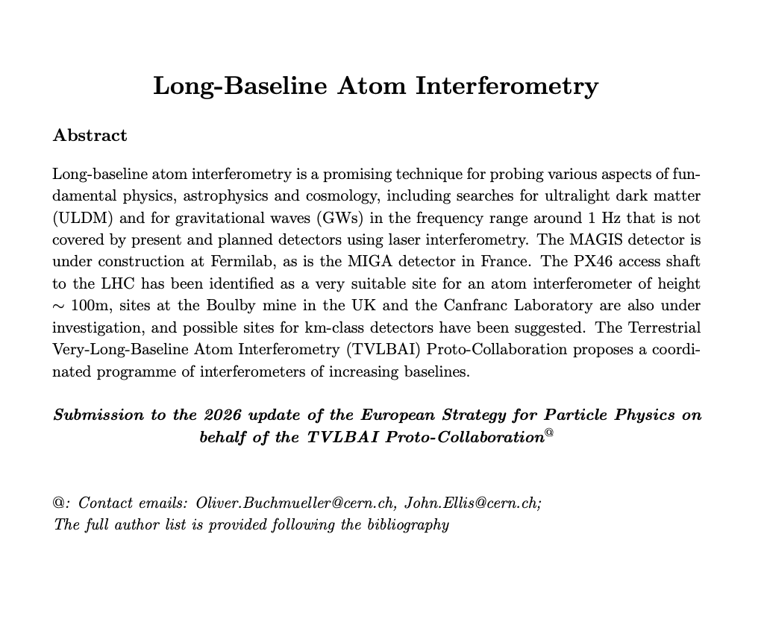
TVLBAI Proto-Collaboration
Austria
Institute of Science and Technology Austria
Bosnia and Herzegovina
University of Sarajevo - Faculty of Science
Denmark
Aarhus University - Department of Physics and Astronomy
Estonia
National Institute of Chemical Physics and Biophysics (KBFI)
France
University of Toulouse III – Paul Sabatier
École Normale Supérieure
Germany
Technische Universität Darmstadt
Leibniz University Hannover
Ulm University
Greece
Laboratory of Theoretical and Computational Physics, National Technical University of Athens (LThCP)
Foundation for Research and Technology – Hellas (FORTH)
Laboratory of Astronomy, Aristotle University of Thessaloniki (AUTH)
Ireland
Tyndall National Institute
Italy
University of Florence – DFA
LENS Laboratory
University of Pisa
Malta
University of Malta
Netherlands
University of Amsterdam
Poland
Space Technology Centre, AGH University of Science and Technology, Krakow
Center for Theoretical Physics, Polish Academy of Sciences (CTP PAS)
University of Warsaw
Portugal
Instituto de Telecomunicações
Romania
Institute of Space Science
Serbia
Institute of Physics Belgrade (IPB)
South East European Network for Mathematical and Theoretical Physics (SEENET-MTP) Centre
Spain
Institute of Theoretical Physics (IFT UAM-CSIC)
Institute of Corpuscular Physics (IFIC), Valencia
Autonomous University of Madrid (UAM)
Institut de Fisica d'Altes Energies (IFAE)
United States
University of Arizona
Johns Hopkins University
Stanford University
Northwestern University
University of Delaware
University of Kentucky
Bates College, Maine
Switzerland
University of Geneva
CERN
University of Neuchâtel
University of Zurich
United Kingdom
Imperial College London
King's College London
University College London (UCL)
University of Birmingham
University of Liverpool
University of Manchester
University of Oxford
University of Southampton
University of Sussex
University of Warwick
UKRI-STFC RAL
Mexico
Autonomous University of Aguascalientes (UAA)
Observers (Under Evaluation)
Germany
German Aerospace Center (DLR)
Iran
Isfahan University of Technology
United States
Fermi National Accelerator Laboratory (Fermilab)
Jet Propulsion Laboratory (JPL)
55 institutions from 21 countries
TVLBAI Chair: Prof. O. Buchmueller
Australia
University of Western Australia

Slide 16
TVLBAI Proto-Collaboration
Austria
Institute of Science and Technology Austria
Bosnia and Herzegovina
University of Sarajevo - Faculty of Science
Denmark
Aarhus University - Department of Physics and Astronomy
Estonia
National Institute of Chemical Physics and Biophysics (KBFI)
France
University of Toulouse III – Paul Sabatier
École Normale Supérieure
Germany
Technische Universität Darmstadt
Leibniz University Hannover
Ulm University
Greece
Laboratory of Theoretical and Computational Physics, National Technical University of Athens (LThCP)
Foundation for Research and Technology – Hellas (FORTH)
Laboratory of Astronomy, Aristotle University of Thessaloniki (AUTH)
Ireland
Tyndall National Institute
Italy
University of Florence – DFA
LENS Laboratory
University of Pisa
Malta
University of Malta
Netherlands
University of Amsterdam
Poland
Space Technology Centre, AGH University of Science and Technology, Krakow
Center for Theoretical Physics, Polish Academy of Sciences (CTP PAS)
University of Warsaw
Portugal
Instituto de Telecomunicações
Romania
Institute of Space Science
Serbia
Institute of Physics Belgrade (IPB)
South East European Network for Mathematical and Theoretical Physics (SEENET-MTP) Centre
Spain
Institute of Theoretical Physics (IFT UAM-CSIC)
Institute of Corpuscular Physics (IFIC), Valencia
Autonomous University of Madrid (UAM)
Institut de Fisica d'Altes Energies (IFAE)
United States
University of Arizona
Johns Hopkins University
Stanford University
Northwestern University
University of Delaware
University of Kentucky
Bates College, Maine
Switzerland
University of Geneva
CERN
University of Neuchâtel
University of Zurich
United Kingdom
Imperial College London
King's College London
University College London (UCL)
University of Birmingham
University of Liverpool
University of Manchester
University of Oxford
University of Southampton
University of Sussex
University of Warwick
UKRI-STFC RAL
Mexico
Autonomous University of Aguascalientes (UAA)
Observers (Under Evaluation)
Germany
German Aerospace Center (DLR)
Iran
Isfahan University of Technology
United States
Fermi National Accelerator Laboratory (Fermilab)
Jet Propulsion Laboratory (JPL)
55 institutions from 21 countries
TVLBAI Chair: Prof. O. Buchmueller
Australia
University of Western Australia

Slide 17
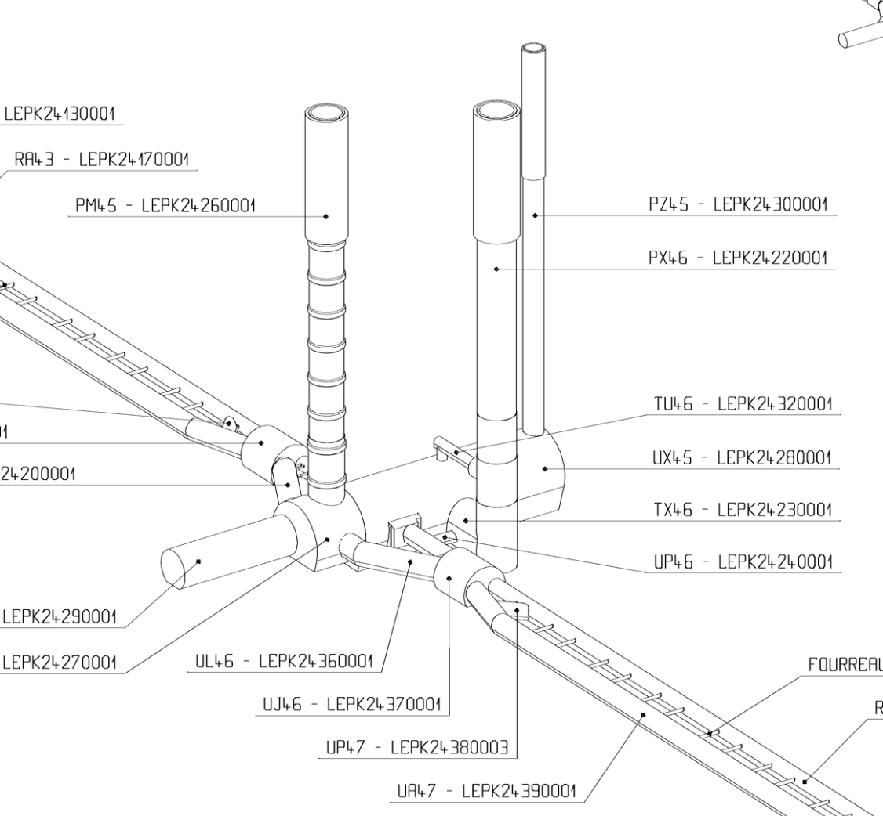
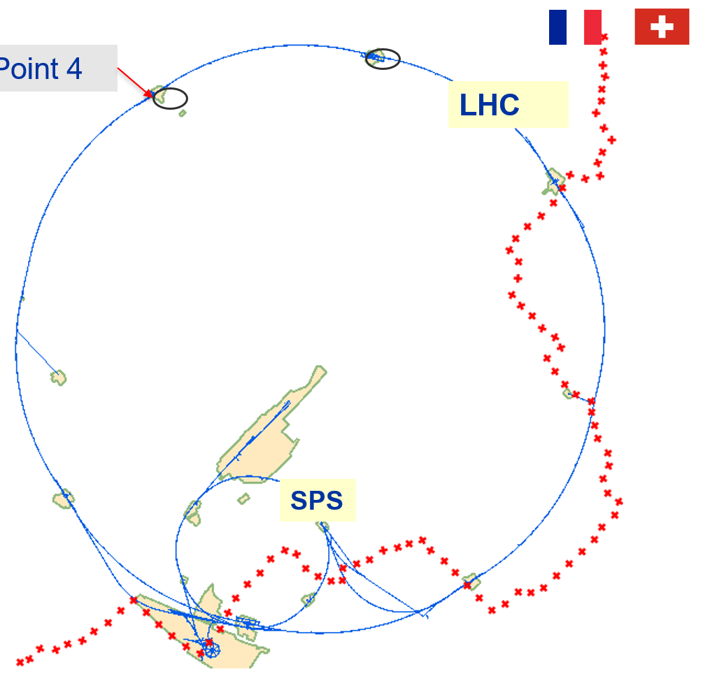
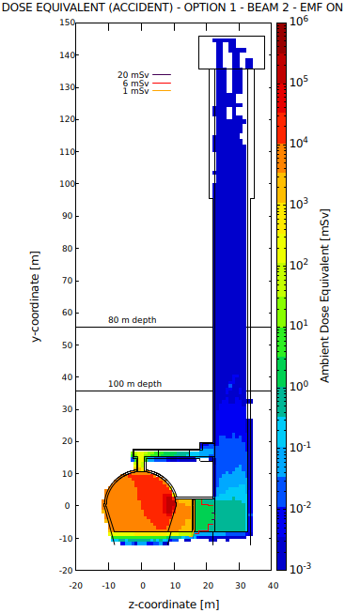
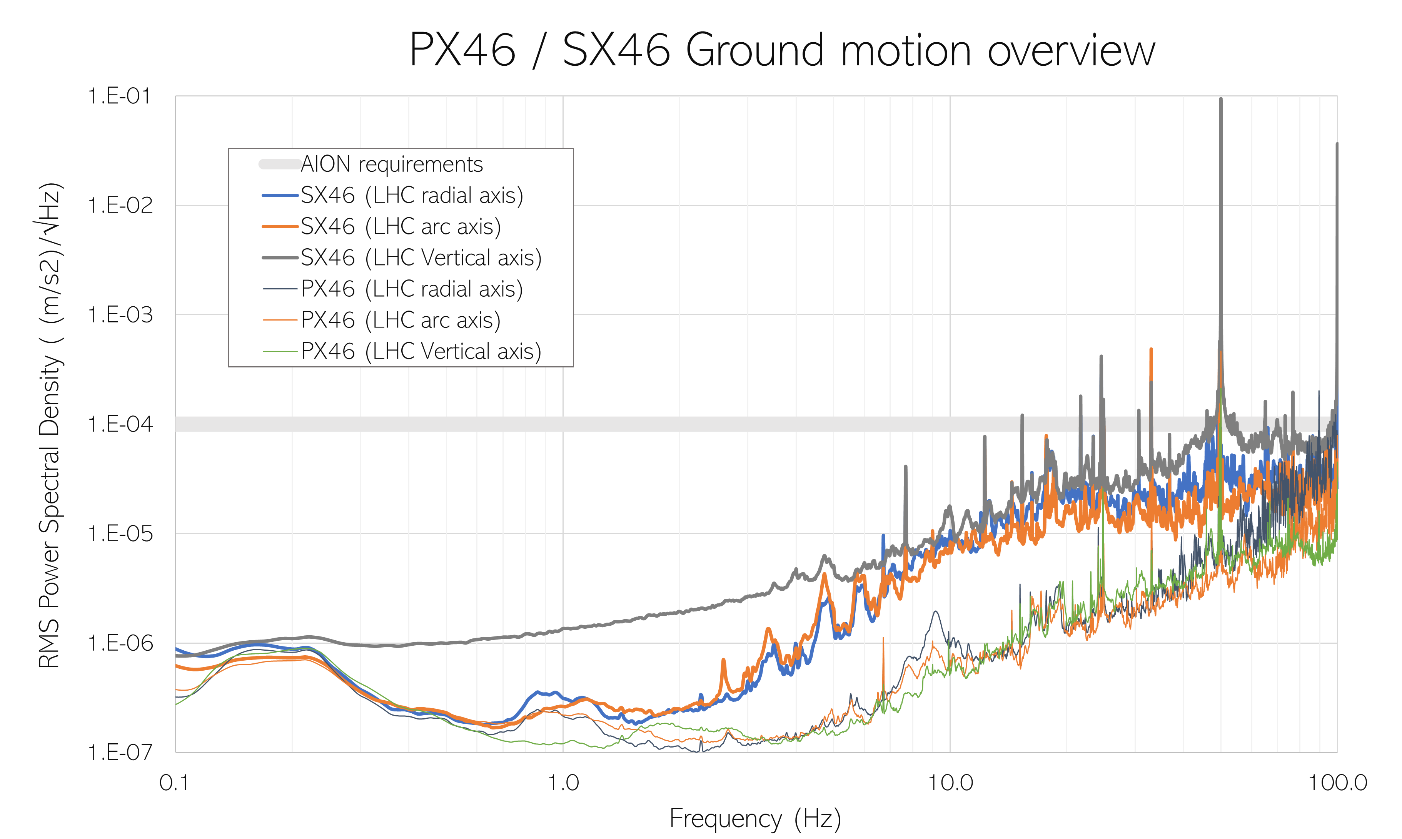
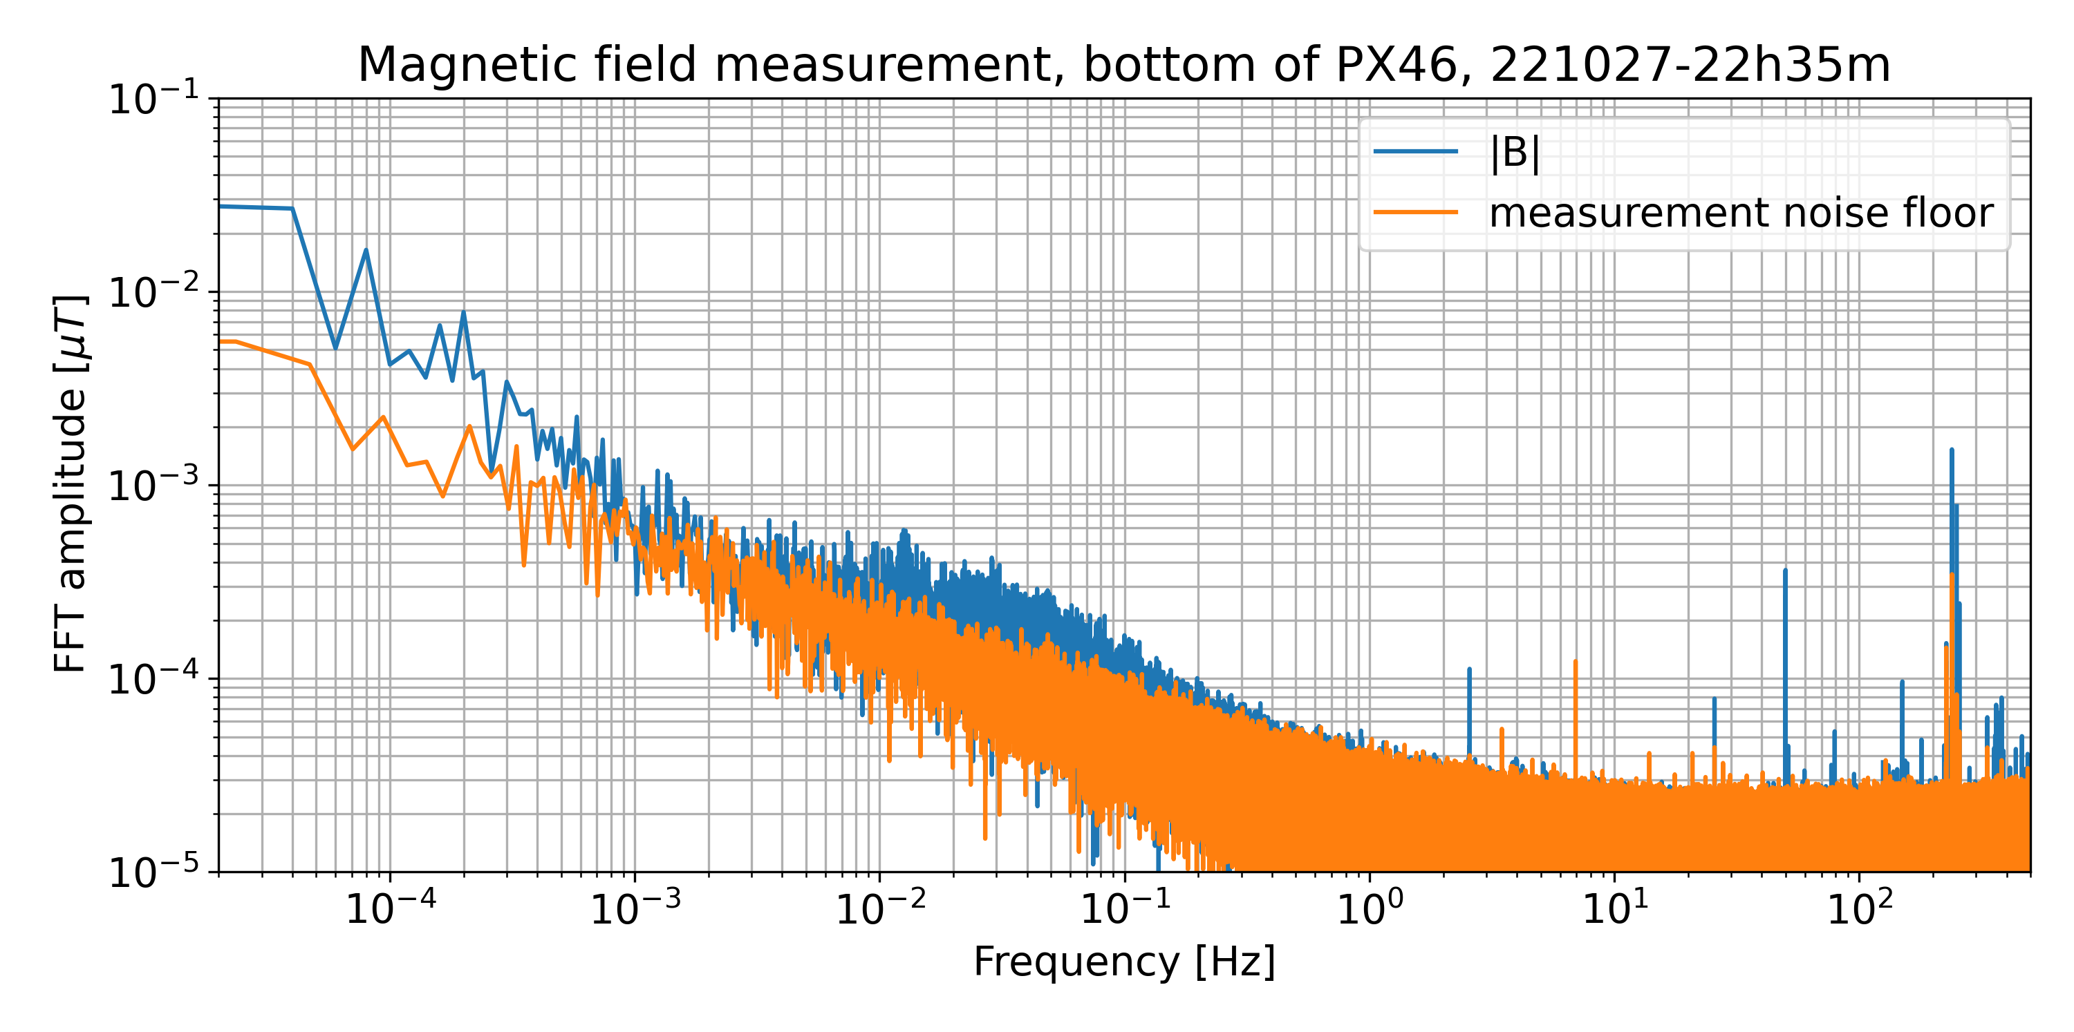

Possible site for a vertical VLBAI at CERN: 140 m deep pit at LHC Pt 4
PX46 – P4 Support shaft
Depth 143m, diameter 10.10m
Dose equivalent – case of beam loss
Shielding wall at the bottom of TX46
LHC beam on
Safety, access, evacuation, etc.: demonstrated feasibility for 365d/y 24h24 access and AION operation, also when the LHC beam is on

Slide 18
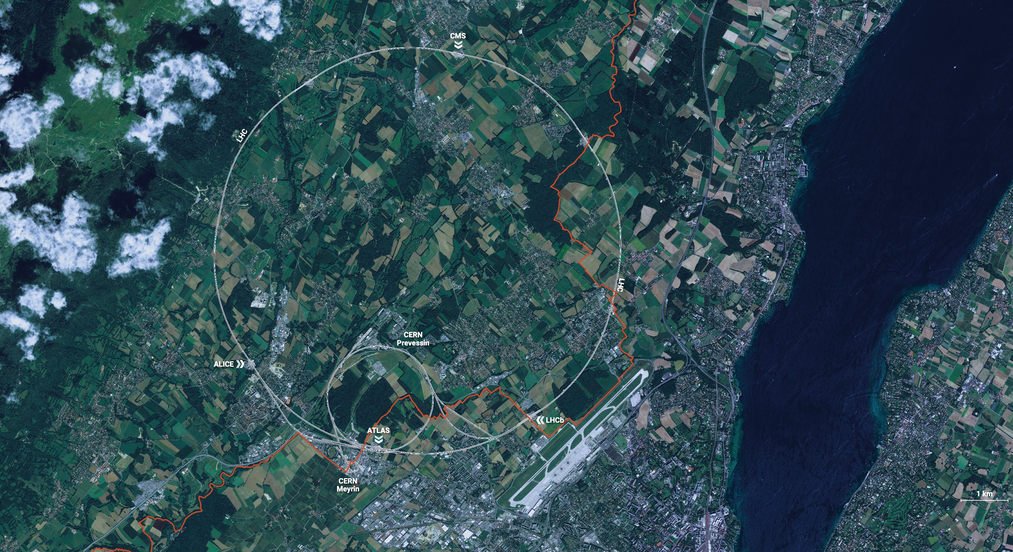
CERN is the world’s biggest laboratory for particle physics.
CERN:
Conseil Européen pour la Recherche Nucléaire", or European Council for Nuclear Research
The goal is to understand the most fundamental particles and laws of the universe.

Slide 19

CERN in a Nutshell
CERN was founded in 1954 with 12 European Member States
CERN’s annual budget is 1200 MCHF (equivalent to a medium-sized European university)
23 Member States
Austria – Belgium – Bulgaria – Czech Republic Denmark – Finland – France – Germany – Greece Hungary – Israel – Italy – Netherlands – Norway Poland – Portugal – Romania – Serbia – Slovakia Spain – Sweden – Switzerland – United Kingdom
As of 31 December 2020
Employees:
2635 staff, 756 fellows
Associates:
11 399 users, 1687 others
3 Associates Member States
in the pre-stage to membership
Cyprus – Estonia – Slovenia
7 Associate Member States
Croatia – India – Latvia – Lithuania – Pakistan Turkey – Ukraine
6 Observers
Japan – Russia – USA
European Union – JINR – UNESCO
More than 50 Cooperation Agreements with non-Member States and Territories
Albania – Algeria – Argentina – Armenia – Australia – Azerbaijan – Bangladesh – Belarus – Bolivia Bosnia and Herzegovina – Brazil – Canada – Chile – Colombia – Costa Rica – Ecuador – Egypt – Georgia – Iceland
Iran – Jordan – Kazakhstan – Lebanon – Malta – Mexico – Mongolia – Montenegro – Morocco – Nepal
New Zealand – North Macedonia – Palestine – Paraguay – People's Republic of China – Peru – Philippines – Qatar
Republic of Korea – Saudi Arabia – Sri Lanka – South Africa – Thailand – Tunisia – United Arab Emirates – Vietnam
Notes:
The speaker can highlight CERN’s second mission as stated when it was established: to foster peaceful collaborations between nations that had recently been at war.
Additional information (OPTIONAL)
More than 40% of CERN’s budget is returned to industry through materials, utilities and services

Slide 20
A laboratory for people around the world
Distribution of all CERN Users by the country of their home institutes as of 31 December 2020
Geographical & cultural diversity
Users of 110 nationalities
~ 23% women
Member States 6632
Austria 82 – Belgium 122 – Bulgaria 37 – Czech Republic 221 Denmark 35 – Finland 79 – France 794 – Germany 1185 Greece 138 – Hungary 67 – Israel 63 – Italy 1388
Netherlands 166 – Norway 78 – Poland 272 – Portugal 80 Romania 99 – Serbia 35 – Slovakia 66 – Spain 325 Sweden 96 – Switzerland 329 – United Kingdom 875
Associate Member States 27
in the pre-stage to membership
Cyprus 11 – Slovenia 16
Associate Member States 390
Croatia 38 – India 151 – Lithuania 13 – Pakistan 35
Turkey 124 – Ukraine 29
Observers 3071
Japan 211 – Russia 1021 – United States of America 1839
Non-Member States and Territories 1279
Algeria 2 – Argentina 15 – Armenia 10 – Australia 23 – Azerbaijan 2 – Bahrain 2 – Belarus 26 – Brazil 108 Canada 196 – Chile 22 – Colombia 15 – Cuba 3 – Ecuador 4 – Egypt 14 – Estonia 26 – Georgia 35
Hong Kong 20 – Iceland 3 – Indonesia 7 – Iran 13 – Ireland 6 Kuwait 2 – Latvia 6 – Lebanon 17
Malaysia 4 – Malta 3 – Mexico 49 – Montenegro 5 – Morocco 18 – New Zealand 11 – Oman 1 People’s Republic of China 334 – Peru 2 – Puerto Rico 2 – Republic of Korea 132 – Singapore 3
South Africa 57 – Sri Lanka 8 – Taiwan 50 – Thailand 16 – United Arab Emirates 2
Notes:
THIS SLIDE WILL INCLUDE THE NUMBER OF MEMBERS OF PERSONNEL OF THE VISITORS’ COUNTRY OF ORIGIN

Slide 21
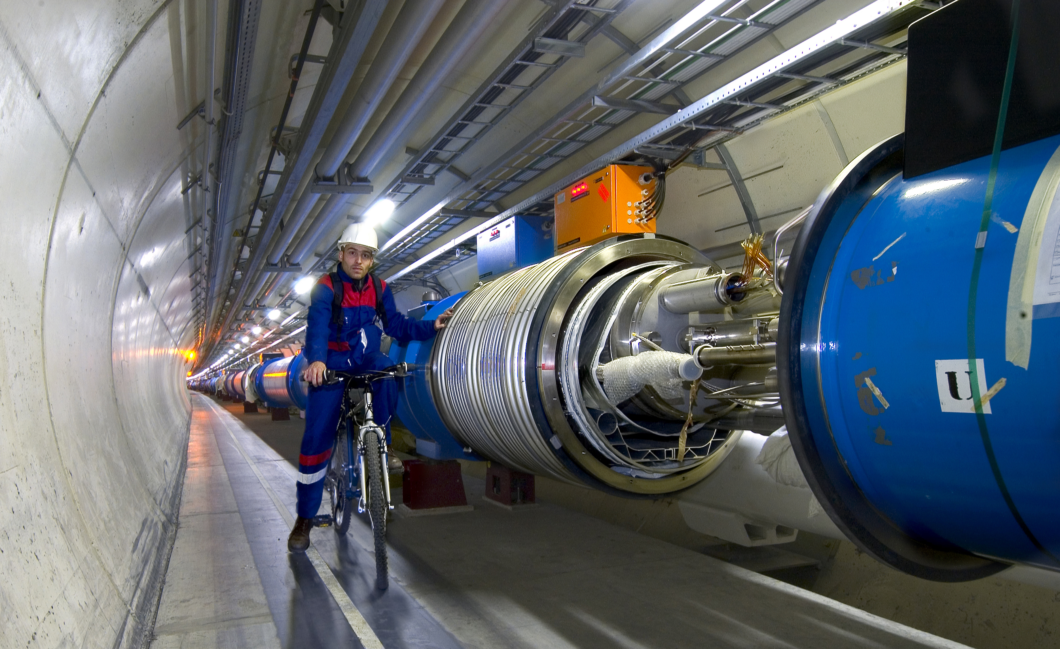
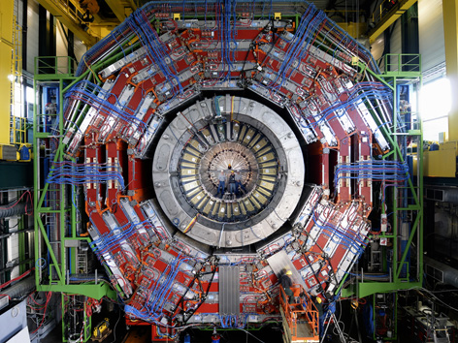
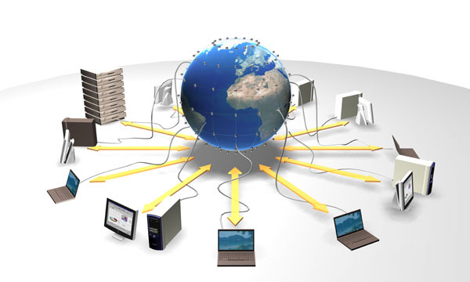
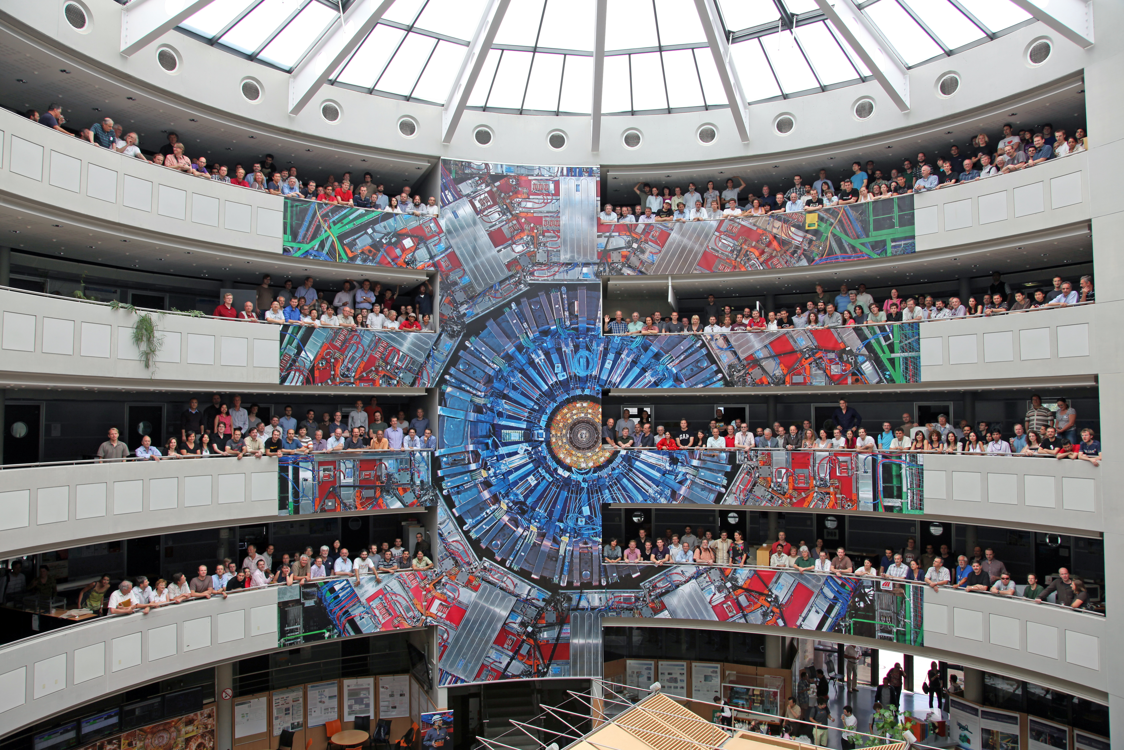
This Study Requires…….
1. Accelerators: powerful machines that accelerate particles to extremely high energies and bring them into collision with other particles
2. Detectors: gigantic instruments that record the resulting particles as they “stream” out from the point of collision.
3. Computing: to collect, store, distribute and analyse the vast amount of data produced by these detectors
4. Collaborative Science on a worldwide scale: thousands of scientists, engineers, technicians and support staff to design, build and operate these complex “machines”.

Slide 22
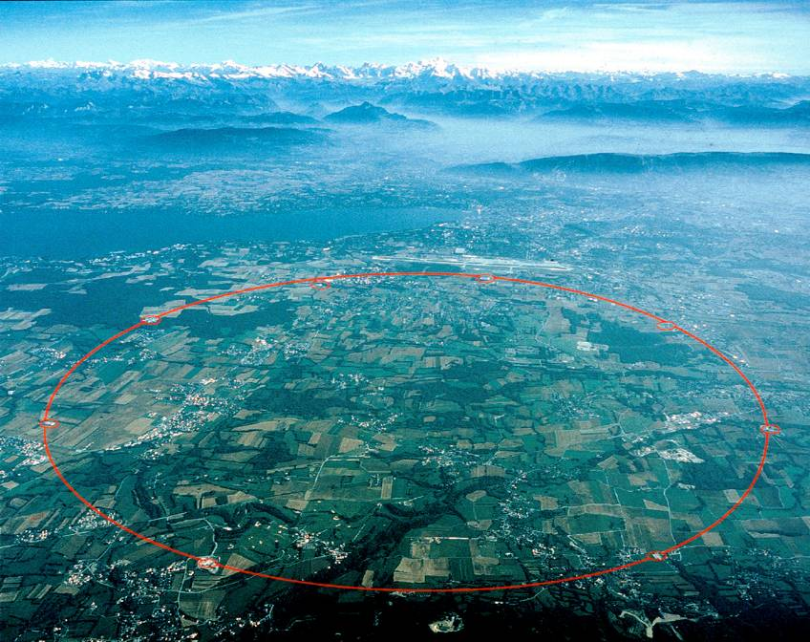
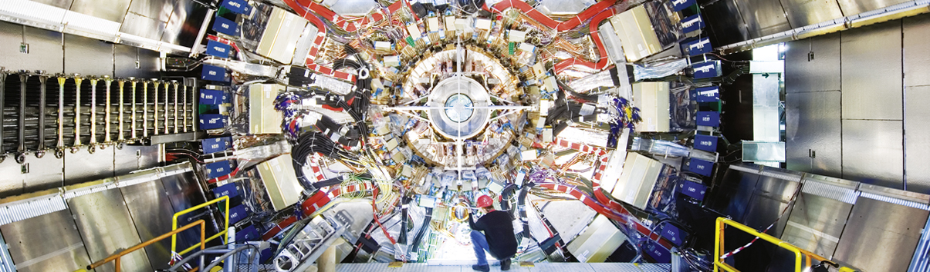

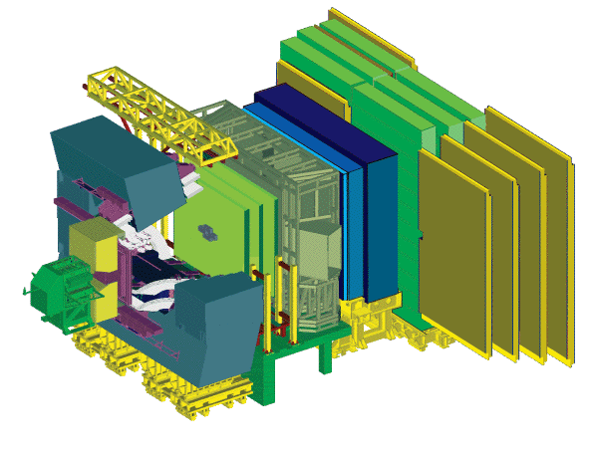
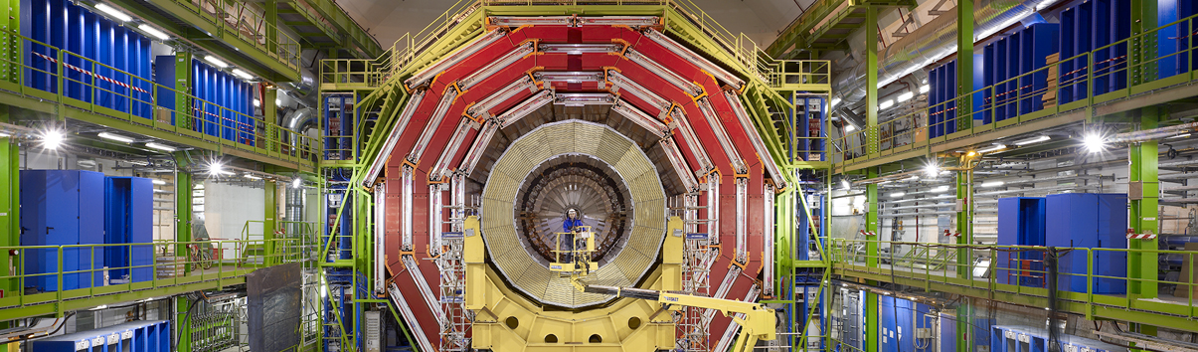
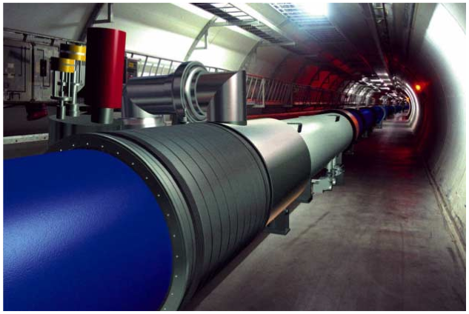
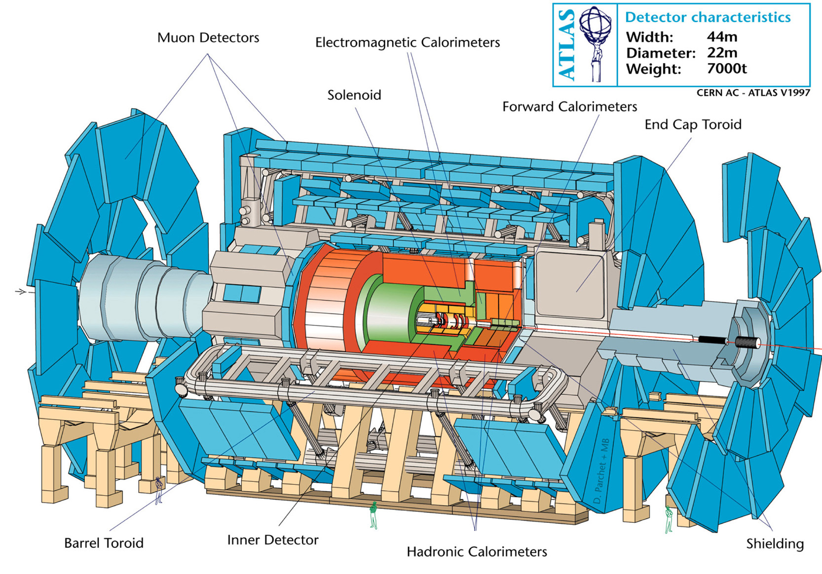
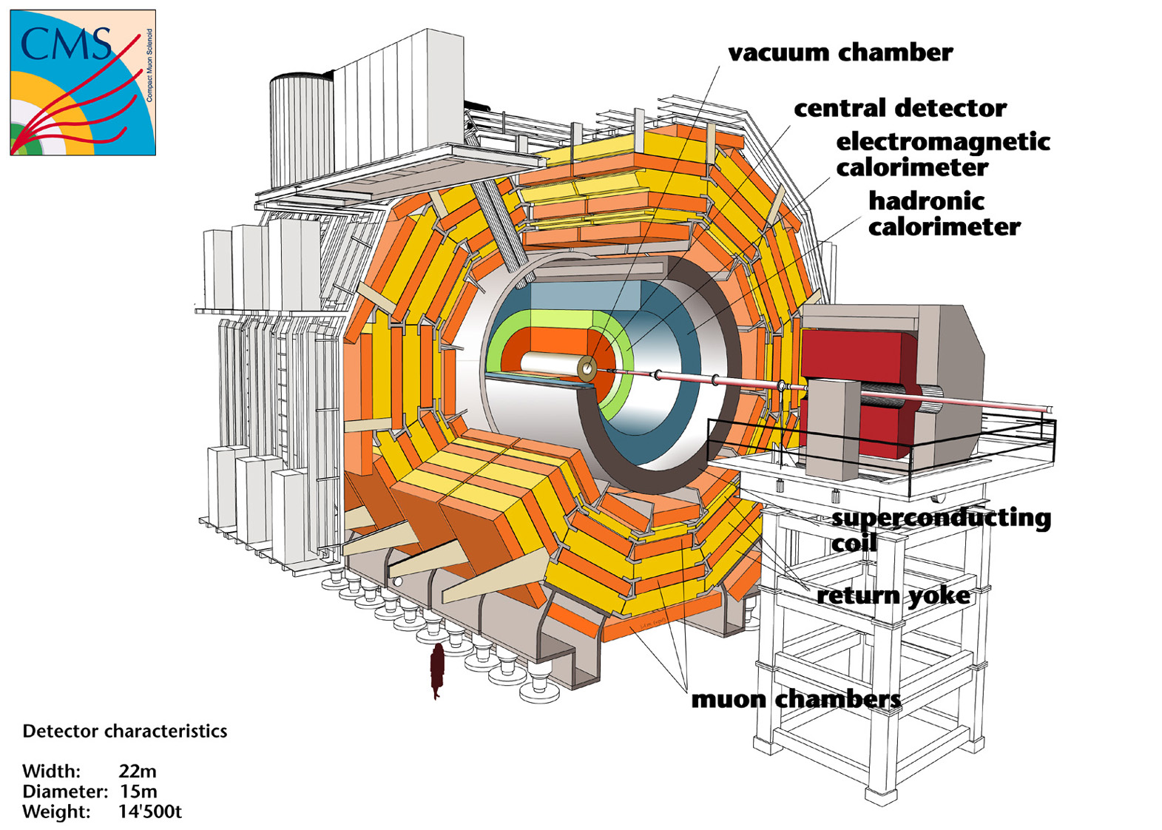
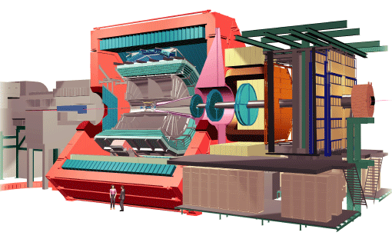
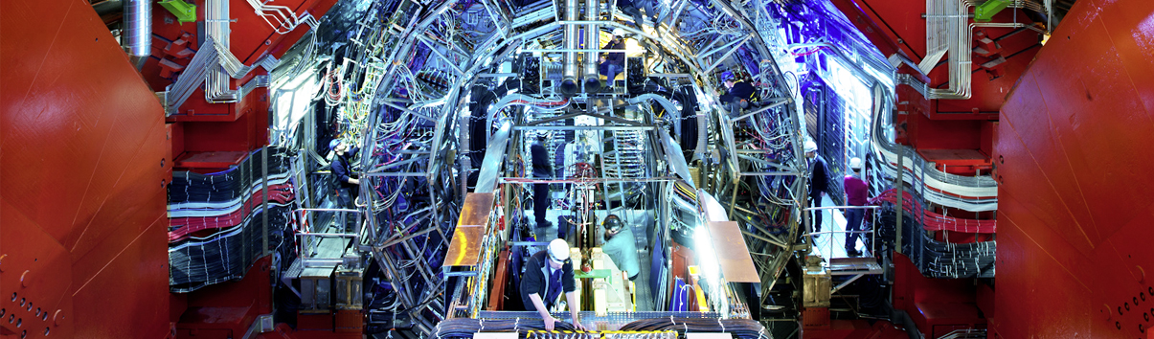

The Large Hadron Collider (LHC) – CERN’s Flagship Science Programme
pp, B-Physics, CP Violation
LHC : 27 km long
100m underground
ATLAS
CMS
ATLAS
General Purpose, pp, heavy ions
LHCb
Heavy ions, pp
ALICE
ALICE
CMS

Slide 23
Possible site for a vertical VLBAI at CERN: 140 m deep pit at LHC pt.4
PX46 – P4 Support shaft
Depth 143m, diameter 10.10m
Dose equivalent – case of beam loss
Shielding wall at the bottom of TX46
LHC beam on
Safety, access, evacuation, etc.: demonstrated feasibility for 365d/y 24h24 access and AION operation, also when the LHC beam is on

Slide 24
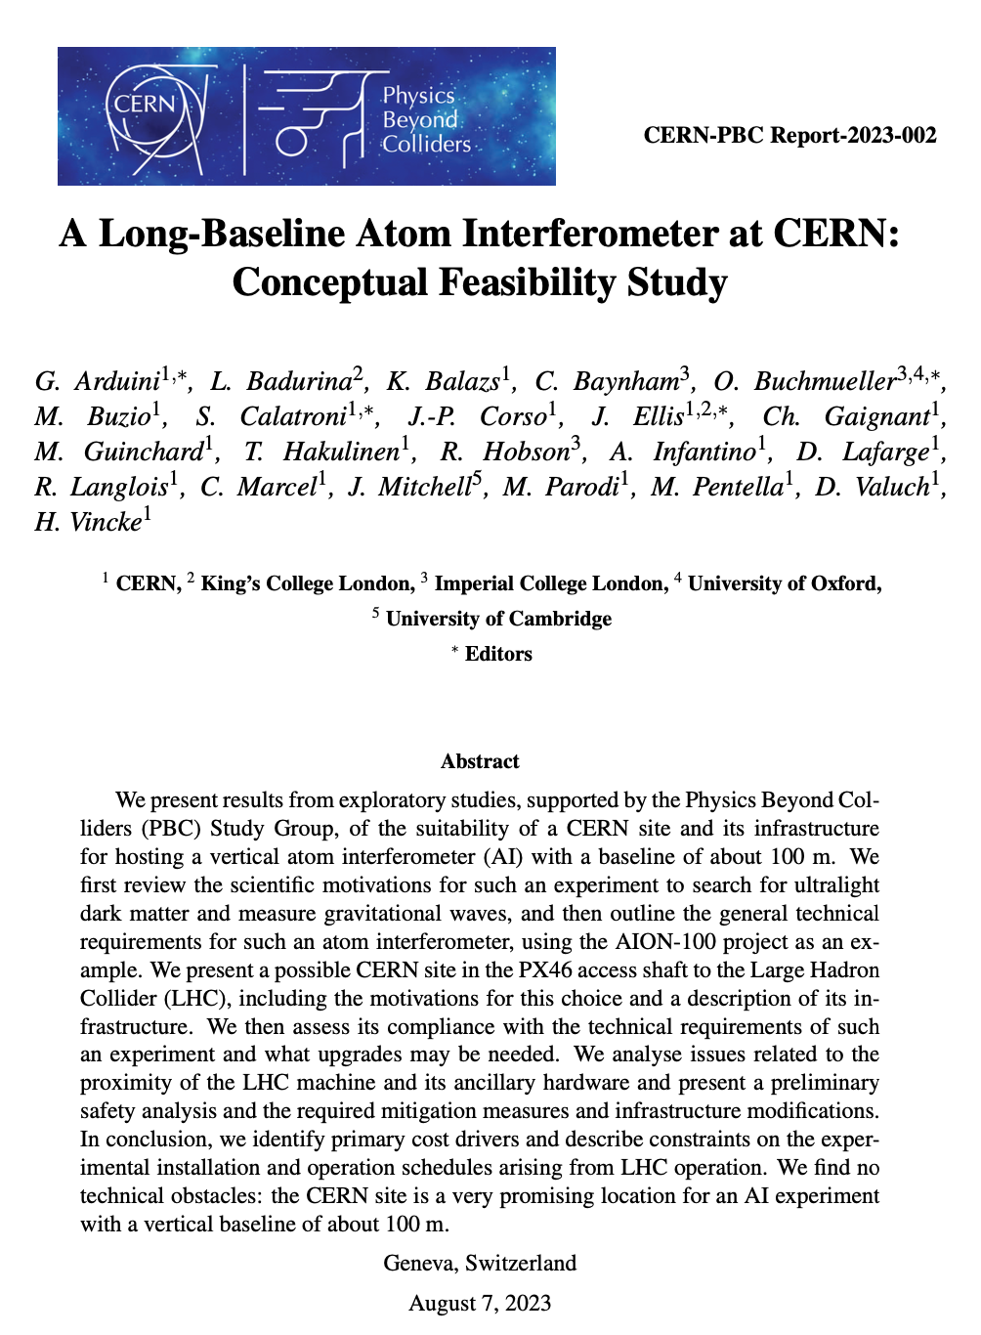
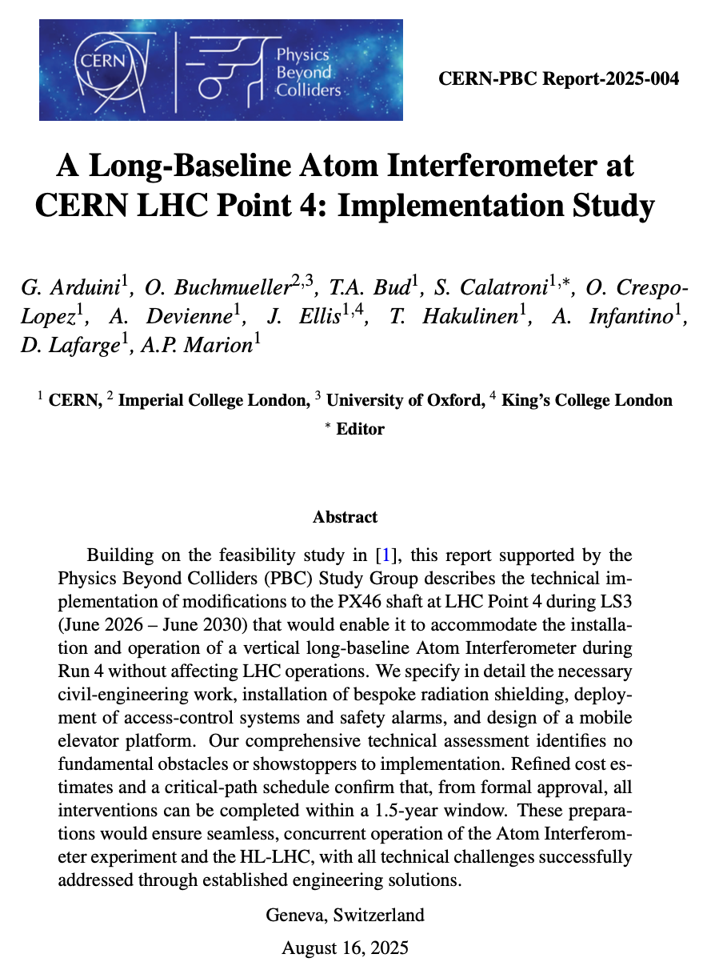
Possible site for a vertical VLBAI at CERN: 140 m deep pit at LHC pt.4
PX46 – P4 Support shaft
Depth 143m, diameter 10.10m
Dose equivalent – case of beam loss
Shielding wall at the bottom of TX46
2025: https://www.arxiv.org/abs/2508.09694
2023: https://arxiv.org/abs/2304.00614
LHC beam on
Safety, access, evacuation, etc.: demonstrated feasibility for 365d/y 24h24 access and AION operation, also when the LHC beam is on

Slide 25
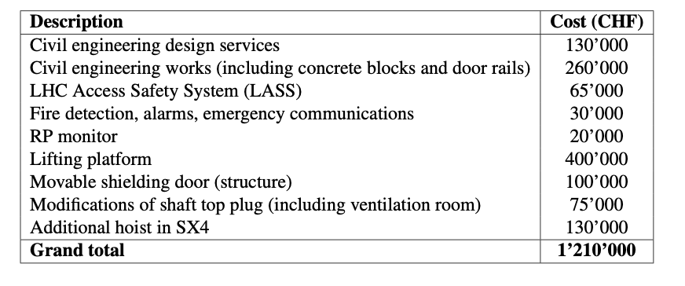
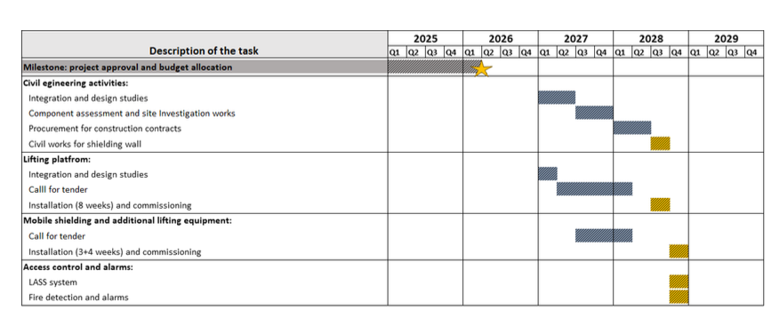
Possible site for a vertical VLBAI at CERN: 140 m deep pit at LHC pt.4
PX46 – P4 Support shaft
Depth 143m, diameter 10.10m
Dose equivalent – case of beam loss
Shielding wall at the bottom of TX46
LHC beam on
Safety, access, evacuation, etc.: demonstrated feasibility for 365d/y 24h24 access and AION operation, also when the LHC beam is on
We have defined a reliable budget and timeline to make the shaft ready for a vertical 100 m atom interferometer project

Slide 26
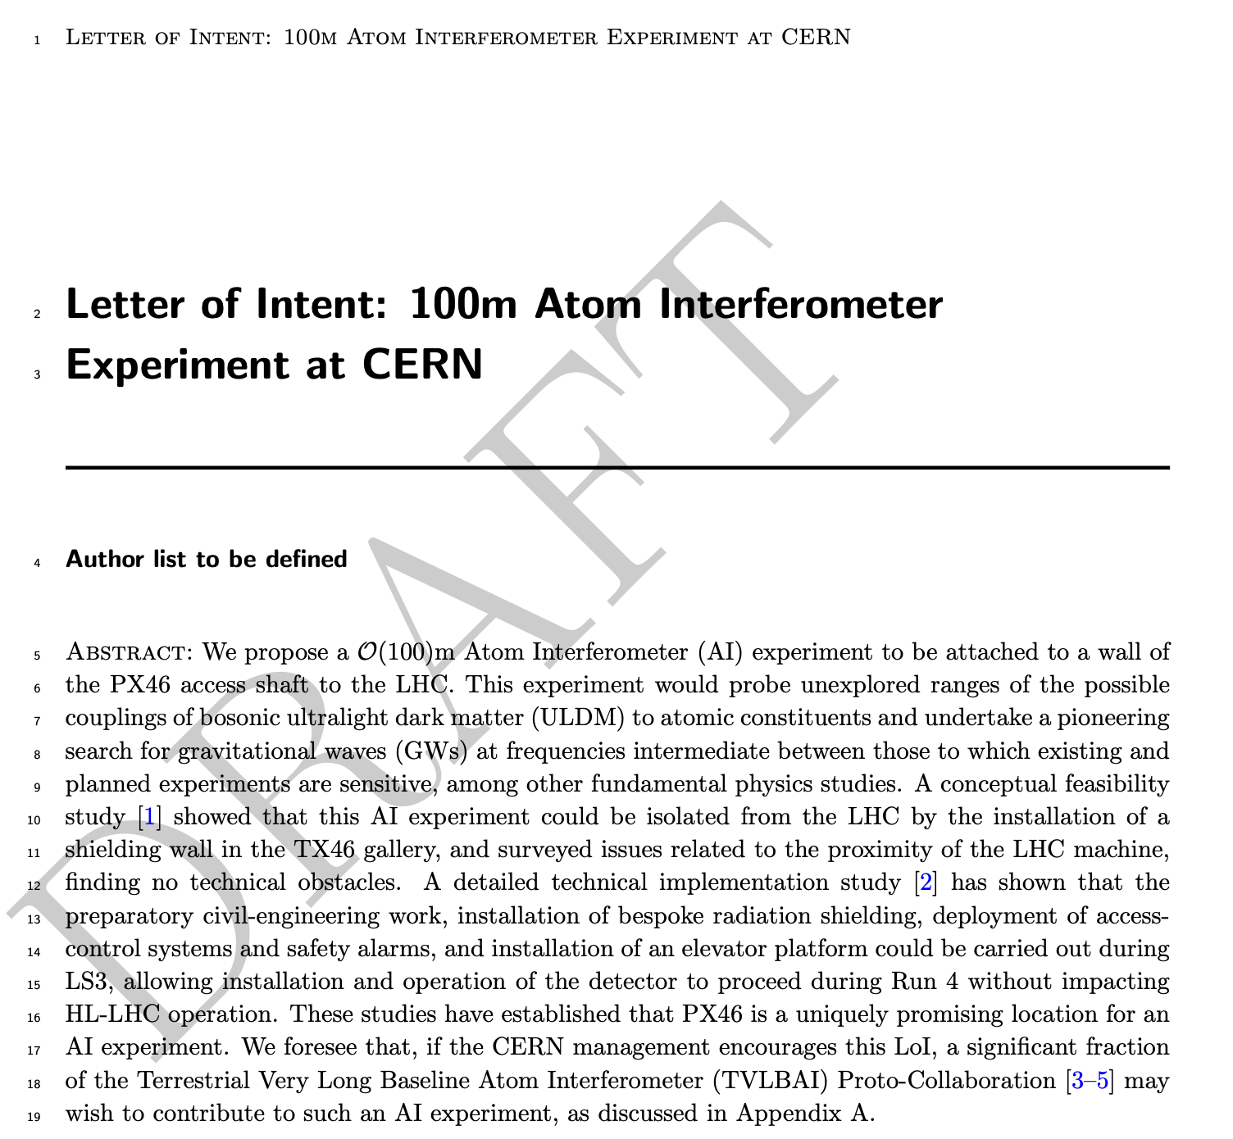
Preparing Letter of Intent for CERN
Feasibility & implementation studies confirm PX46 can host the experiment at ~1.2 M CHF (within CERN’s infrastructure mandate).
LoI launches CERN approval — strong European institutional support as signatories is essential.
Urgency: civil-engineering work must be included in LS3 (2026–2028) planning this year.
Signing the LoI: no resource commitment, but signals interest, builds community support, and positions us for future national funding.
More in Sergio Calatroni’s talk

Slide 27
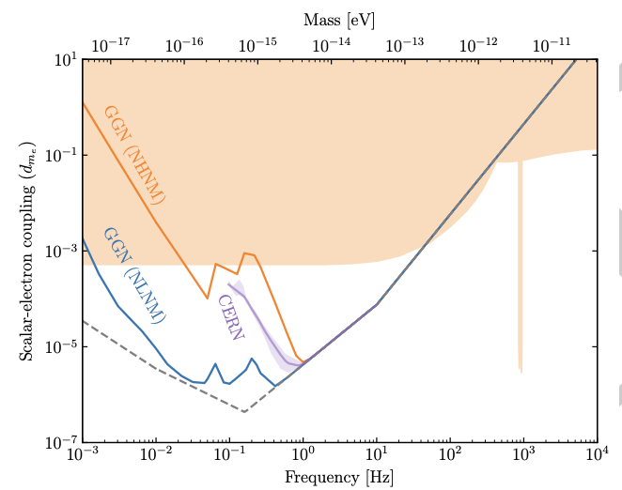
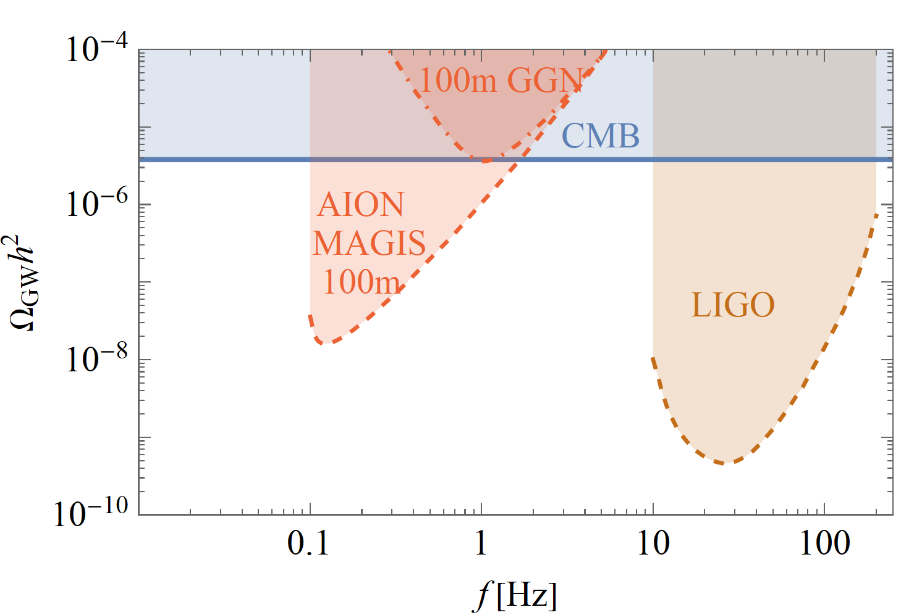
Physics Potential in a Nutshell
Besides probing a large range of new Ultra-Light DM parameter space, a ~100m experiment could also explore new territory for gravitational waves in a yet unexplored frequency range.

Slide 28
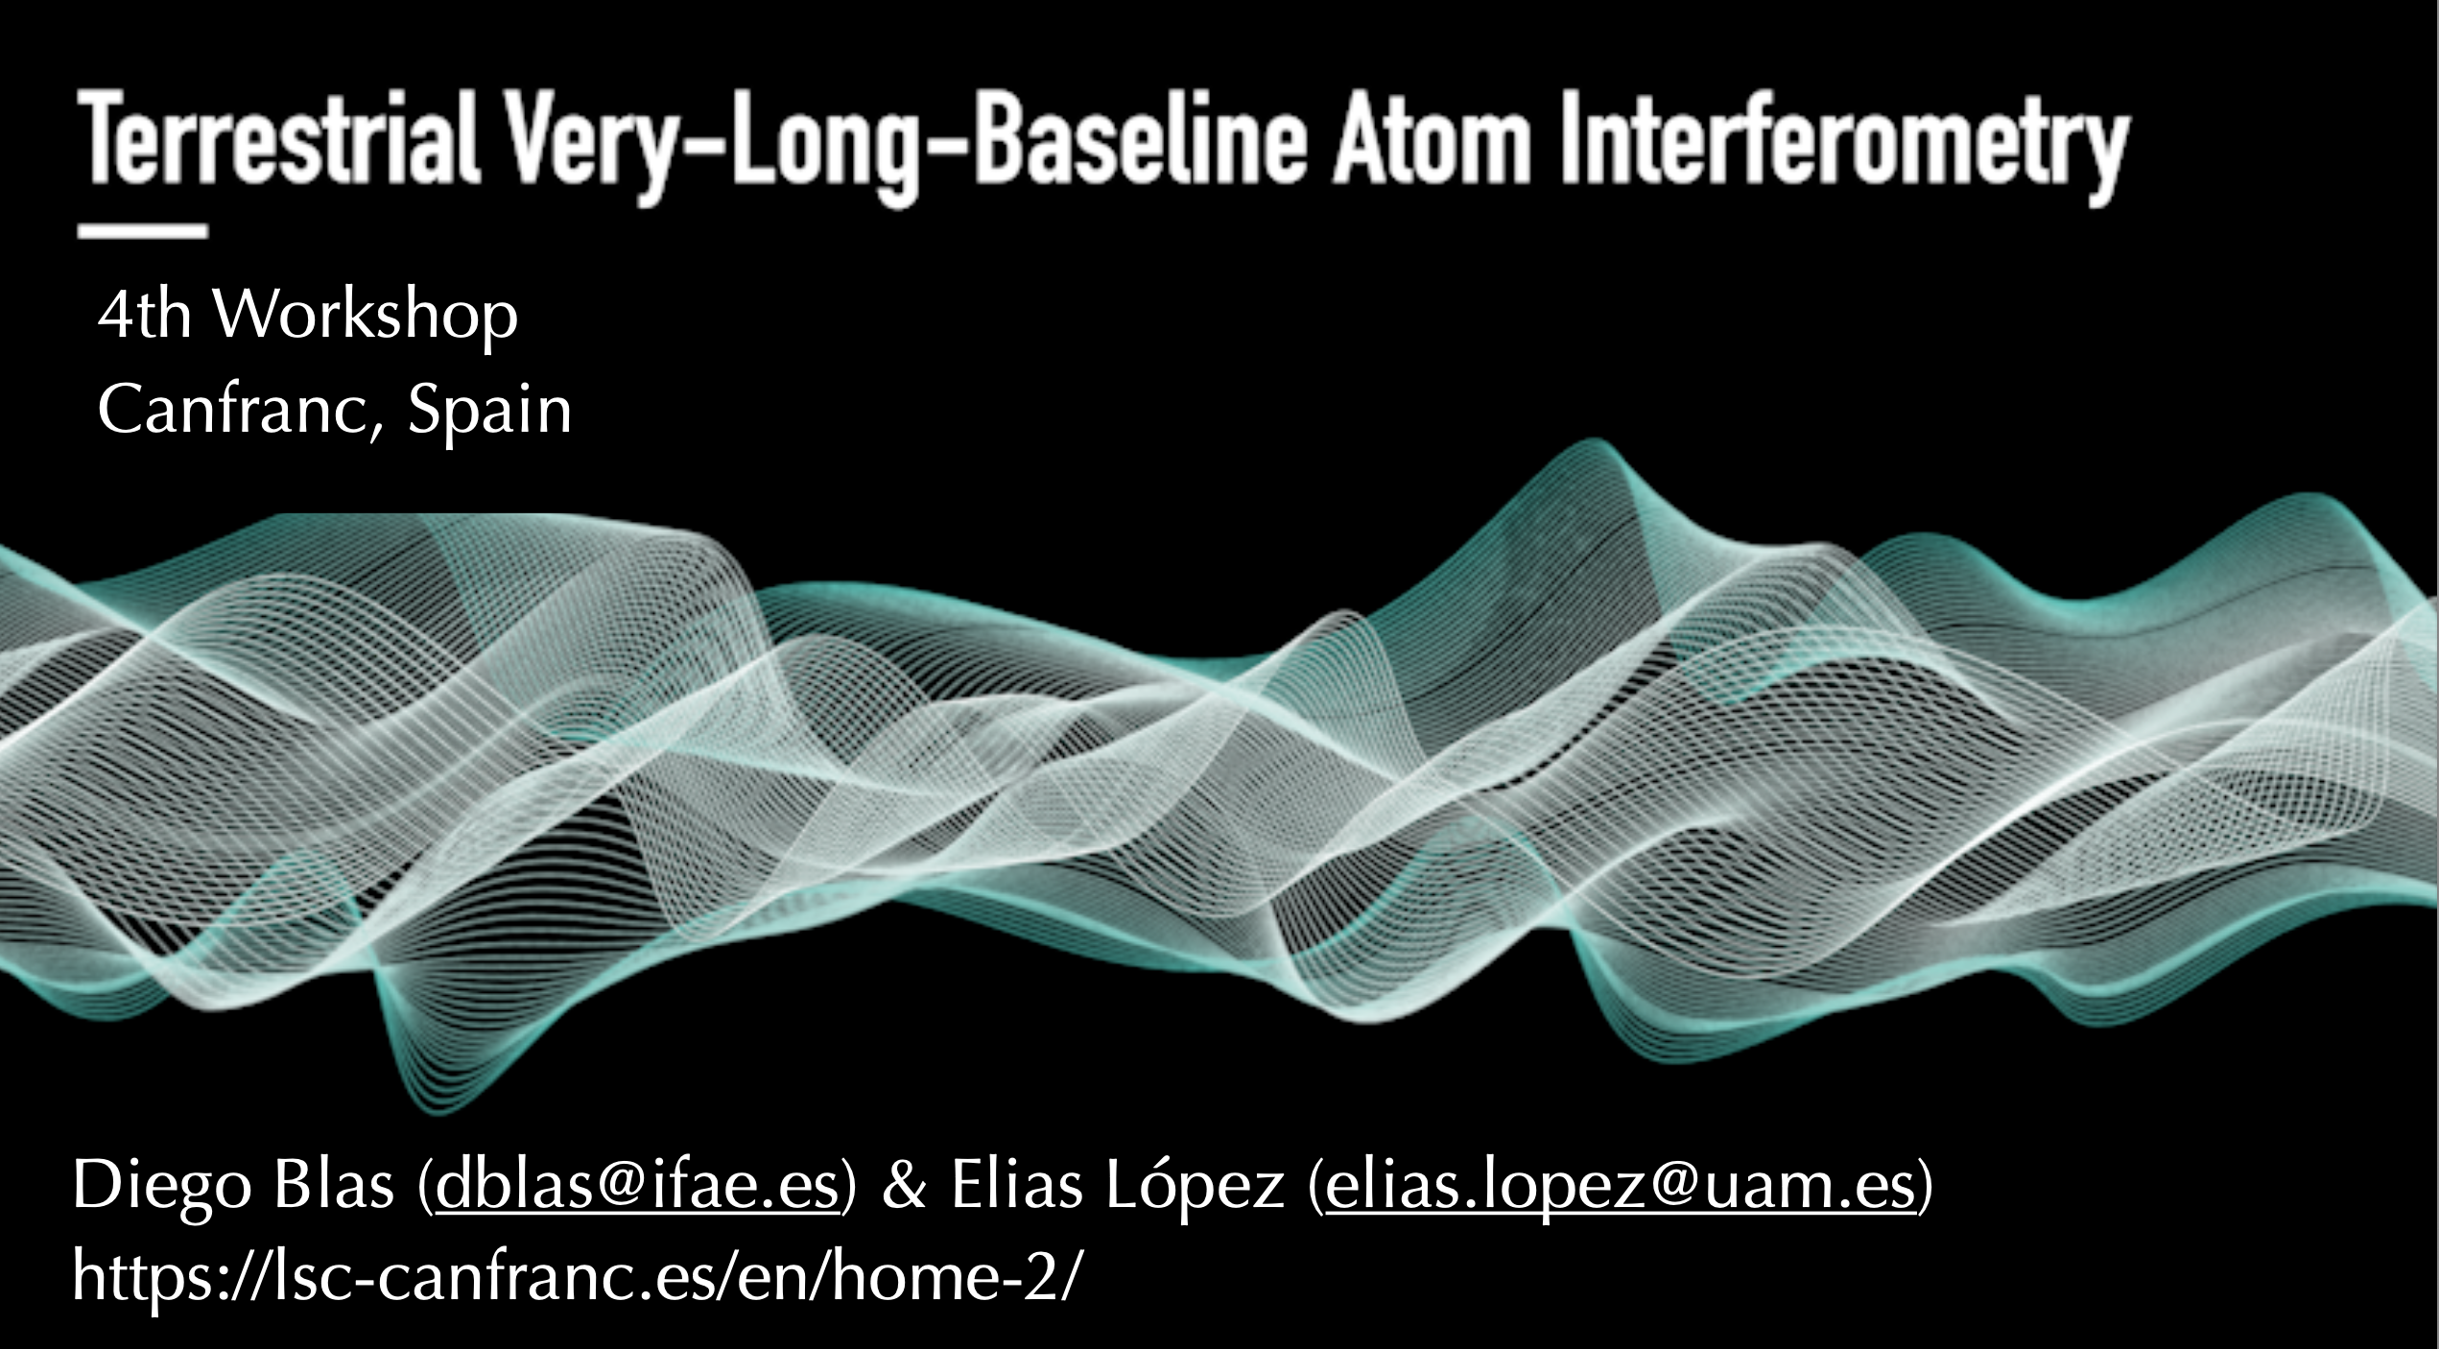
Next Workshop in Spain
Slides from Diego

Slide 29
Next Workshop in Spain
More about it at the end of our
workshop by Elias
Slides from Diego

Slide 30
3rd TVLBAI Workshop

