Slide 1



Long-baseline LMT Clock Atom Interferometry
TVLBAI Workshop 2025
Hannover, Germany
Jan Rudolph
Stanford University & Fermilab

Slide 2
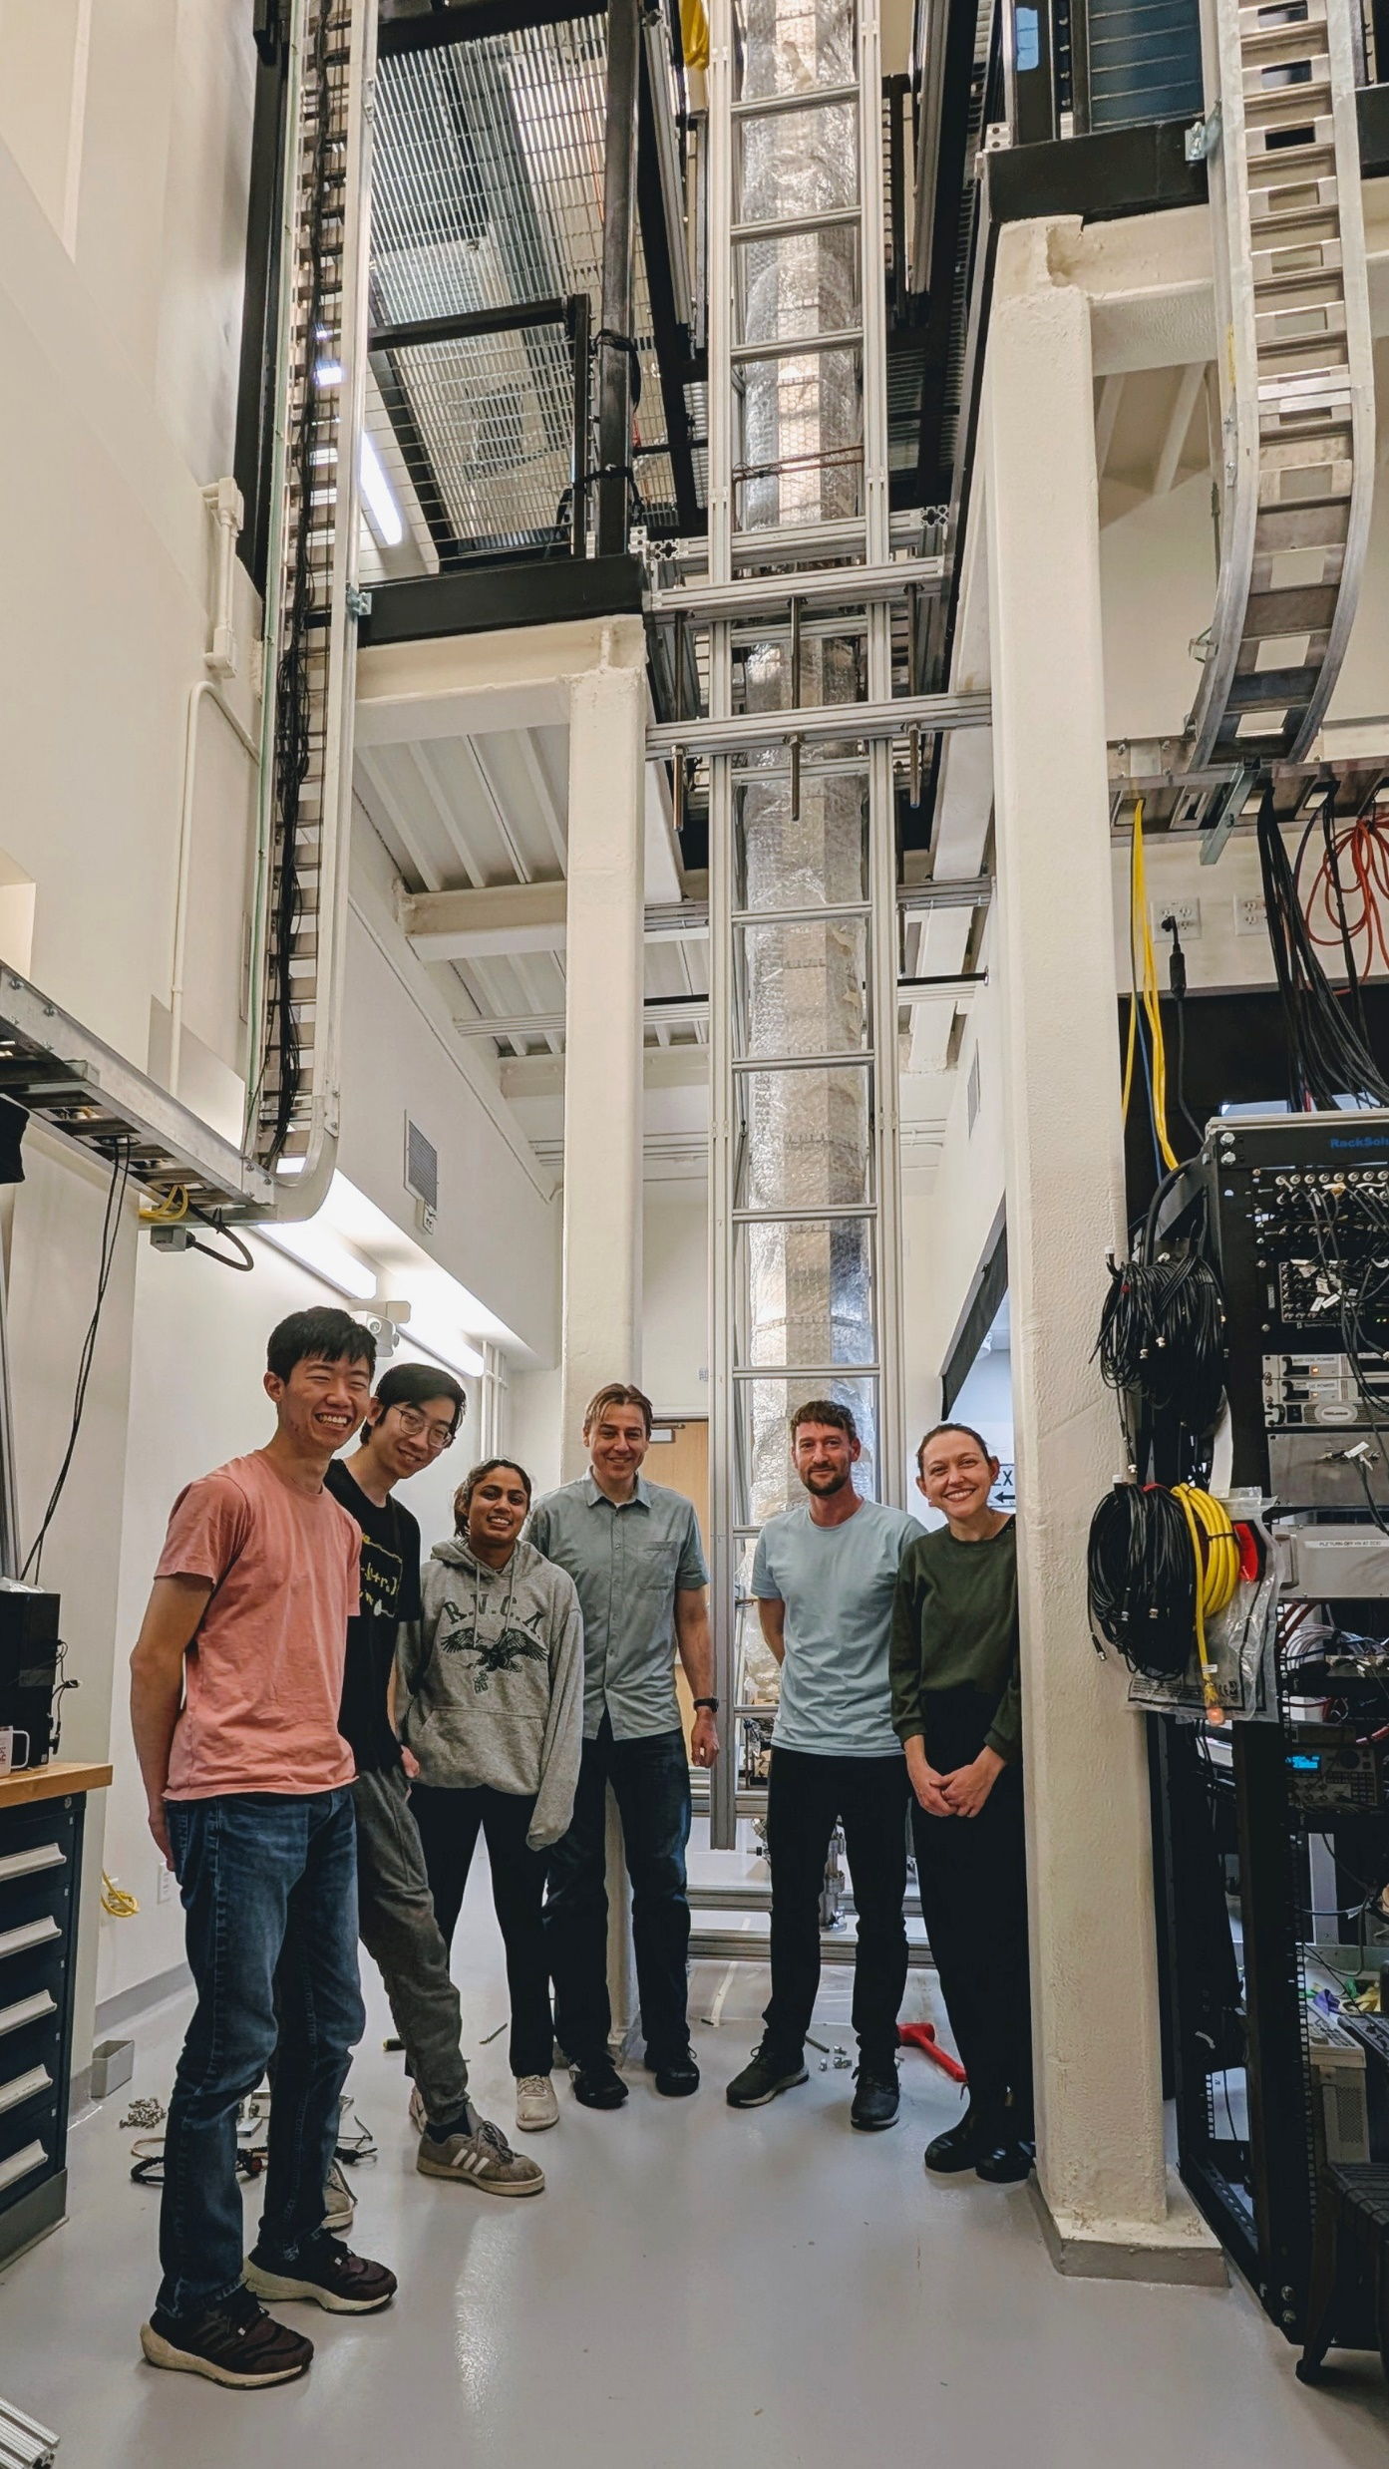

Stanford Strontium Gradiometer
Stack of two ~5m-scale atomic fountains
Support free-fall times of 1.5 s each
Full complexity of MAGIS-100 (and more)
Most hardware is designed, built, and tested
Vertical since spring 2025
Final assembly ongoing
MAGIS pathfinder
State-of-the-art gravity gradiometry
Tests of fundamental physics with clock AI

Slide 3

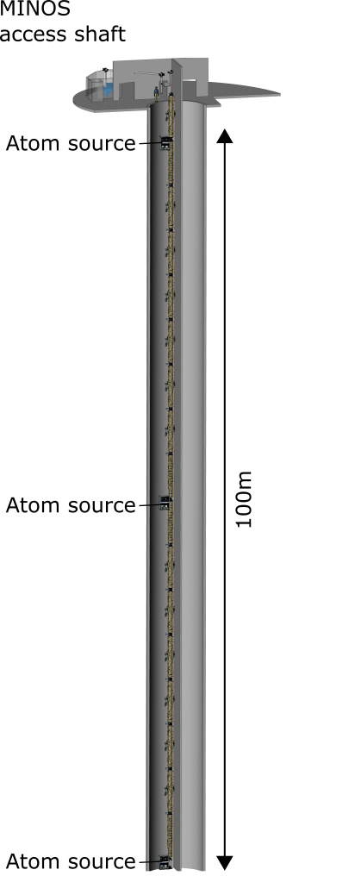
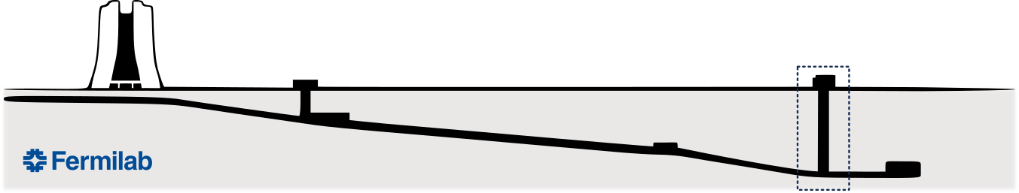









Detector Facility at FNAL
Wilson Hall
MINOS Building
Matter wave Atomic Gradiometer Interferometric Sensor [1]
100-meter baseline atom interferometer currently under construction
Prototype gravitational wave detector in the mid-band (0.03 – 3 Hz)
Intermediate step to full-scale detector (terrestrial or space)
Probes for ultralight wave-like dark matter beyond current limits
Tests of quantum mechanics on unprecedented scales
[1] Abe, et al. - Quantum Sci. Technol. 6, 044003 (2021)

Slide 4
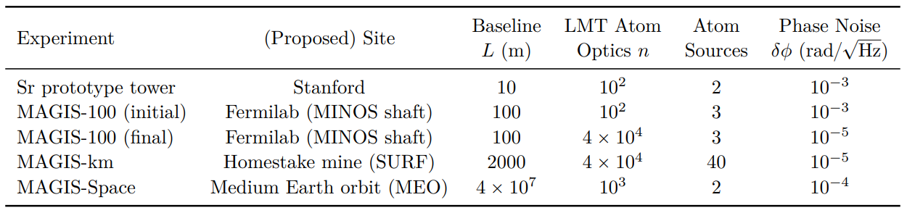
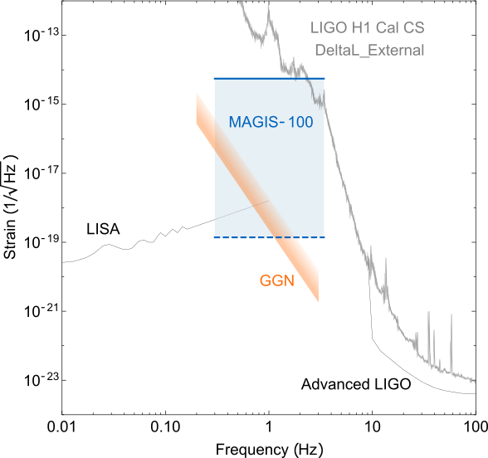
MAGIS Roadmap
Design parameter targets for MAGIS-100 and follow-on detectors [1]
Main areas of technology development:
Larger detectors (baseline length)
Atom number (phase resolution)
LMT atom optics
Terrestrial detectors rely on thousandfold enhancement through LMT
Clock atom interferometry can support such a large number of pulses
[1] M. Abe et al., Quantum Sci. Technol. 6, 044003 (2021)

Slide 5
Outline
  Major challenges for LMT enhancement
Mitigation strategies
Practical limits for LMT enhancement

Slide 6
Challenges for Long-Baseline AI
How do I increase my baseline without sacrificing LMT enhancement?
What are and what aren’t major challenges?
  Low Rabi frequency/laser power?
  Laser noise?
  COM dynamics, Coriolis deflection?
  Atom cloud collimation/temperature?
⟶ Can I increase my LMT order by extending the baseline?

Slide 7
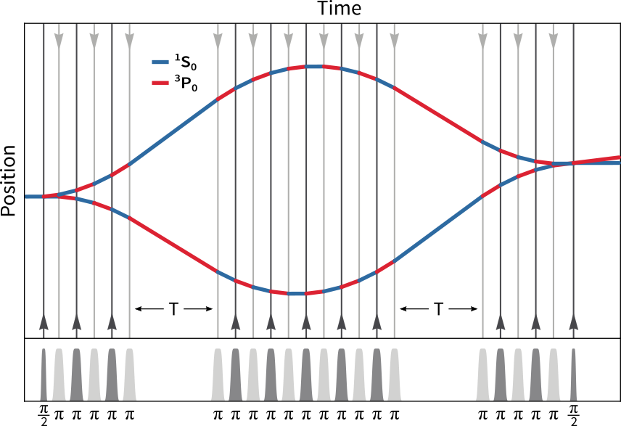
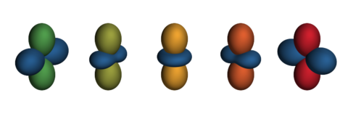
Case Study: Narrowband Clock AI using ⁸⁷Sr at 698nm
Every mode (atom/isotope/transition) requires a completely different optimization
Narrow transition (mHz) ⟶ low Rabi frequency (kHz)
Pulse durations are long, always pulsing (T ⟶ 0)
Double diffraction (two laser frequencies)
2
1
0
Singlet state
³P_{J}
698 nm
¹S₀
Triplet states
There are compelling alternatives, like multi-photon transitions that work for any isotope!
[2] S. Carman, JR, B. E. Garber, et al. to appear in PRX 10.1103/qk3v-46y8

Slide 8
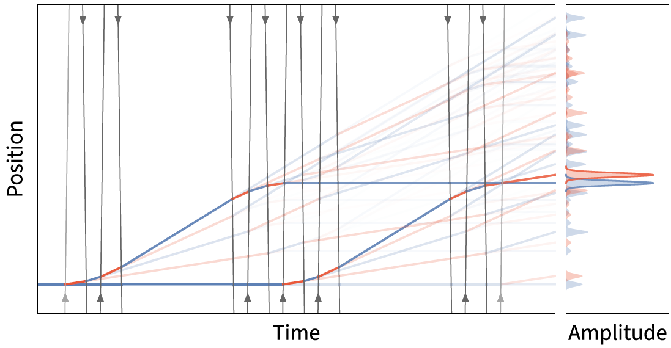
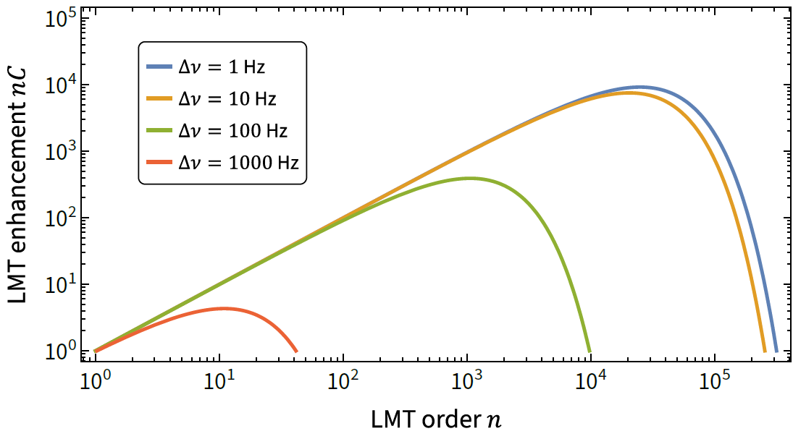
Laser Noise
Due to narrow linewidth, laser noise has been suspected to be a major concern
Pulse infidelity of n consecutive pulses scales linearly with n
Number of relevant parasitic paths is small
Not a limiting source of error for RMS laser noise of 10 Hz or better [3]
[3] Y. Jiang, JR, J.M. Hogan - arXiv:2508.10288

Slide 9
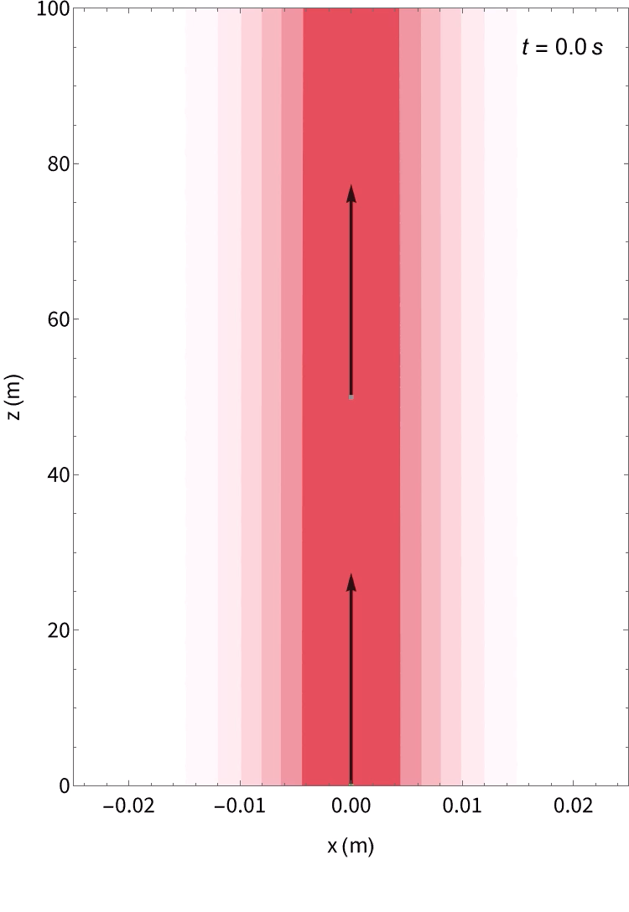

COM Dynamics in a 100m Gradiometer

Slide 10
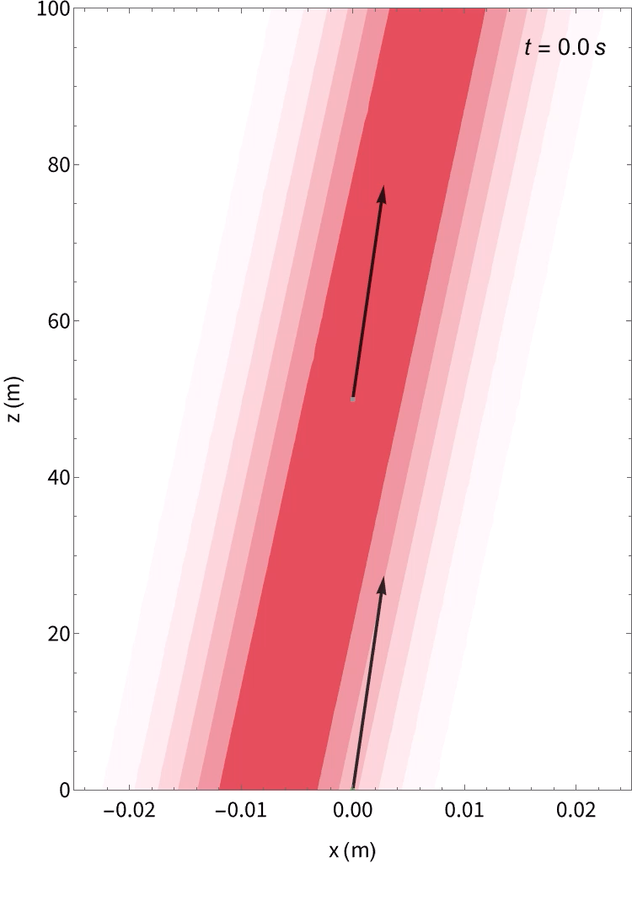
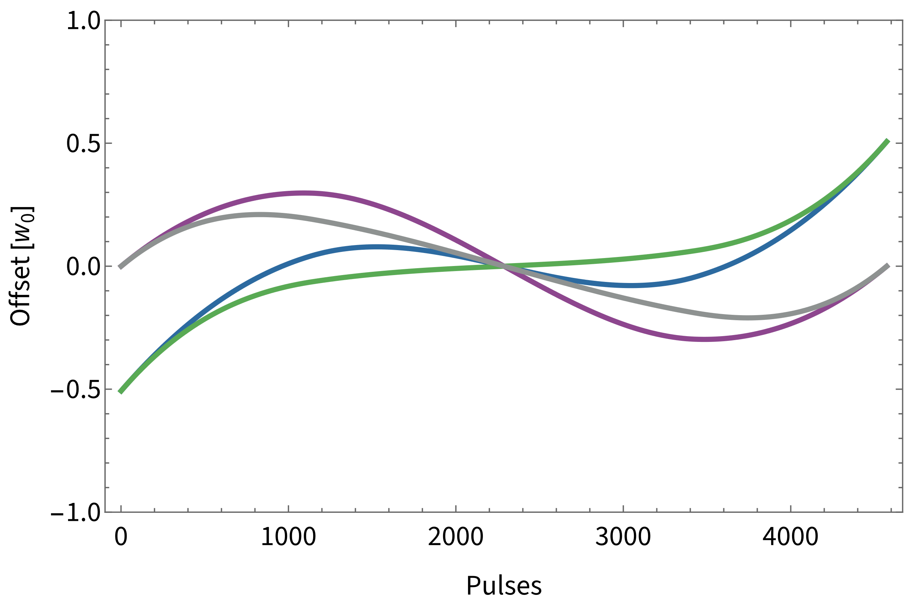
Coriolis Compensation: Counterrotation
Counterrotating the beams closes the interferometer
Starting at half angle and pivoting at midpoint minimizes displacement
Displacement grows linearly with duration and baseline length

Slide 11
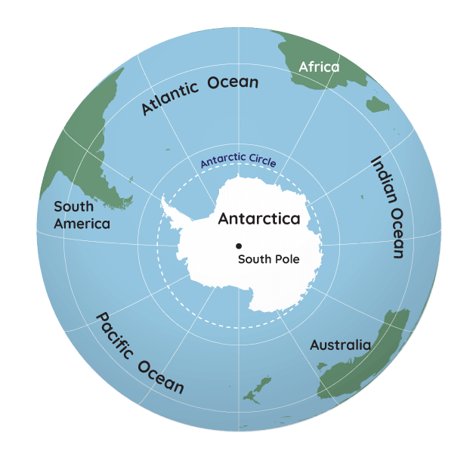
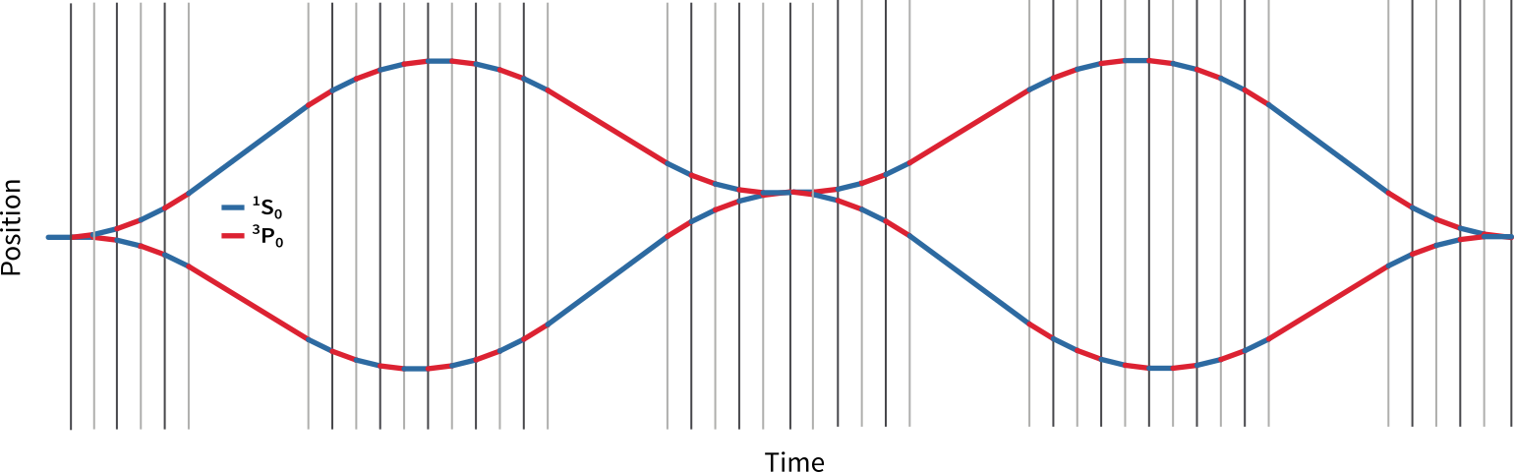
Counterrotation of the Beams for 1km Baseline Detector
Running the exact same sequence (5.6 s) over a 1km baseline:
  ~10cm displacement
  Need 10x larger beam ⟶ 100x more laser power
  Requires >10x wider instrument
  ⟶ leads to overall sensitivity loss
Practical solution: build your detector at the south pole
Alternative strategy: multi-loop sequences!

Slide 12

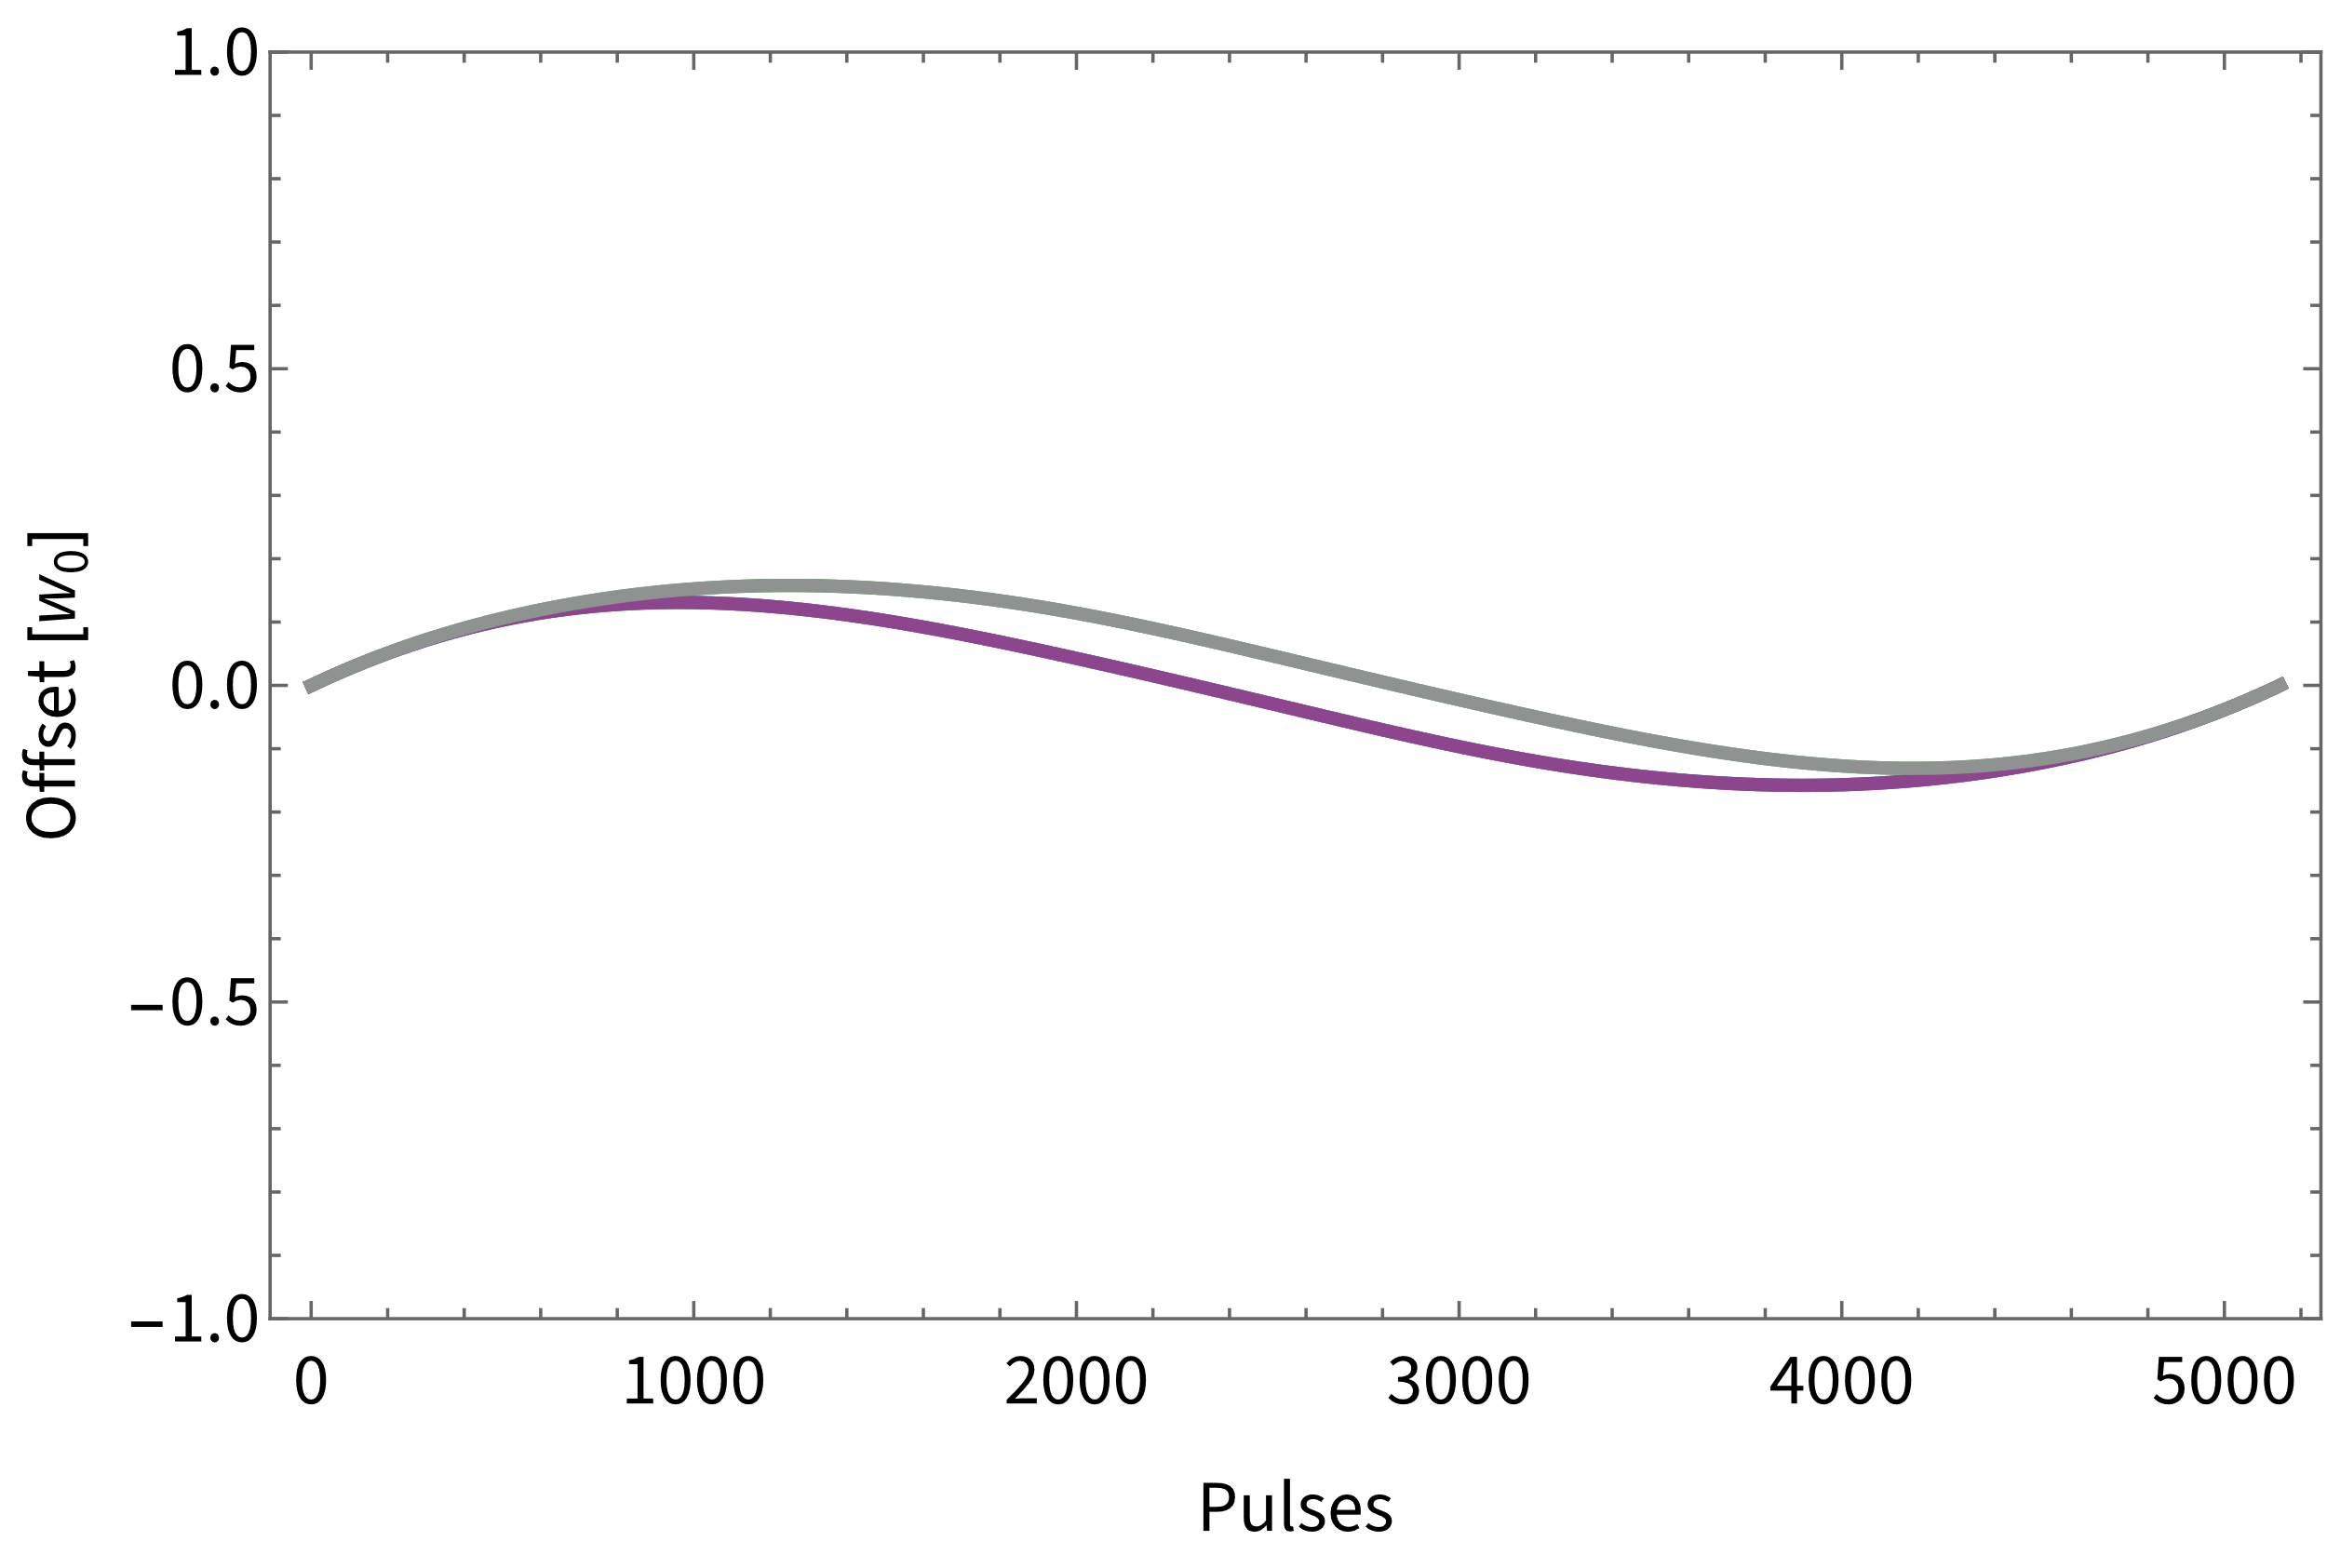
Double Loop Sequence – No Rotation
Double (even) loop sequence cancels (constant) inertial effects
Interferometer closes with static beams
No dynamic rotation required
Displacement manageable!

Slide 13
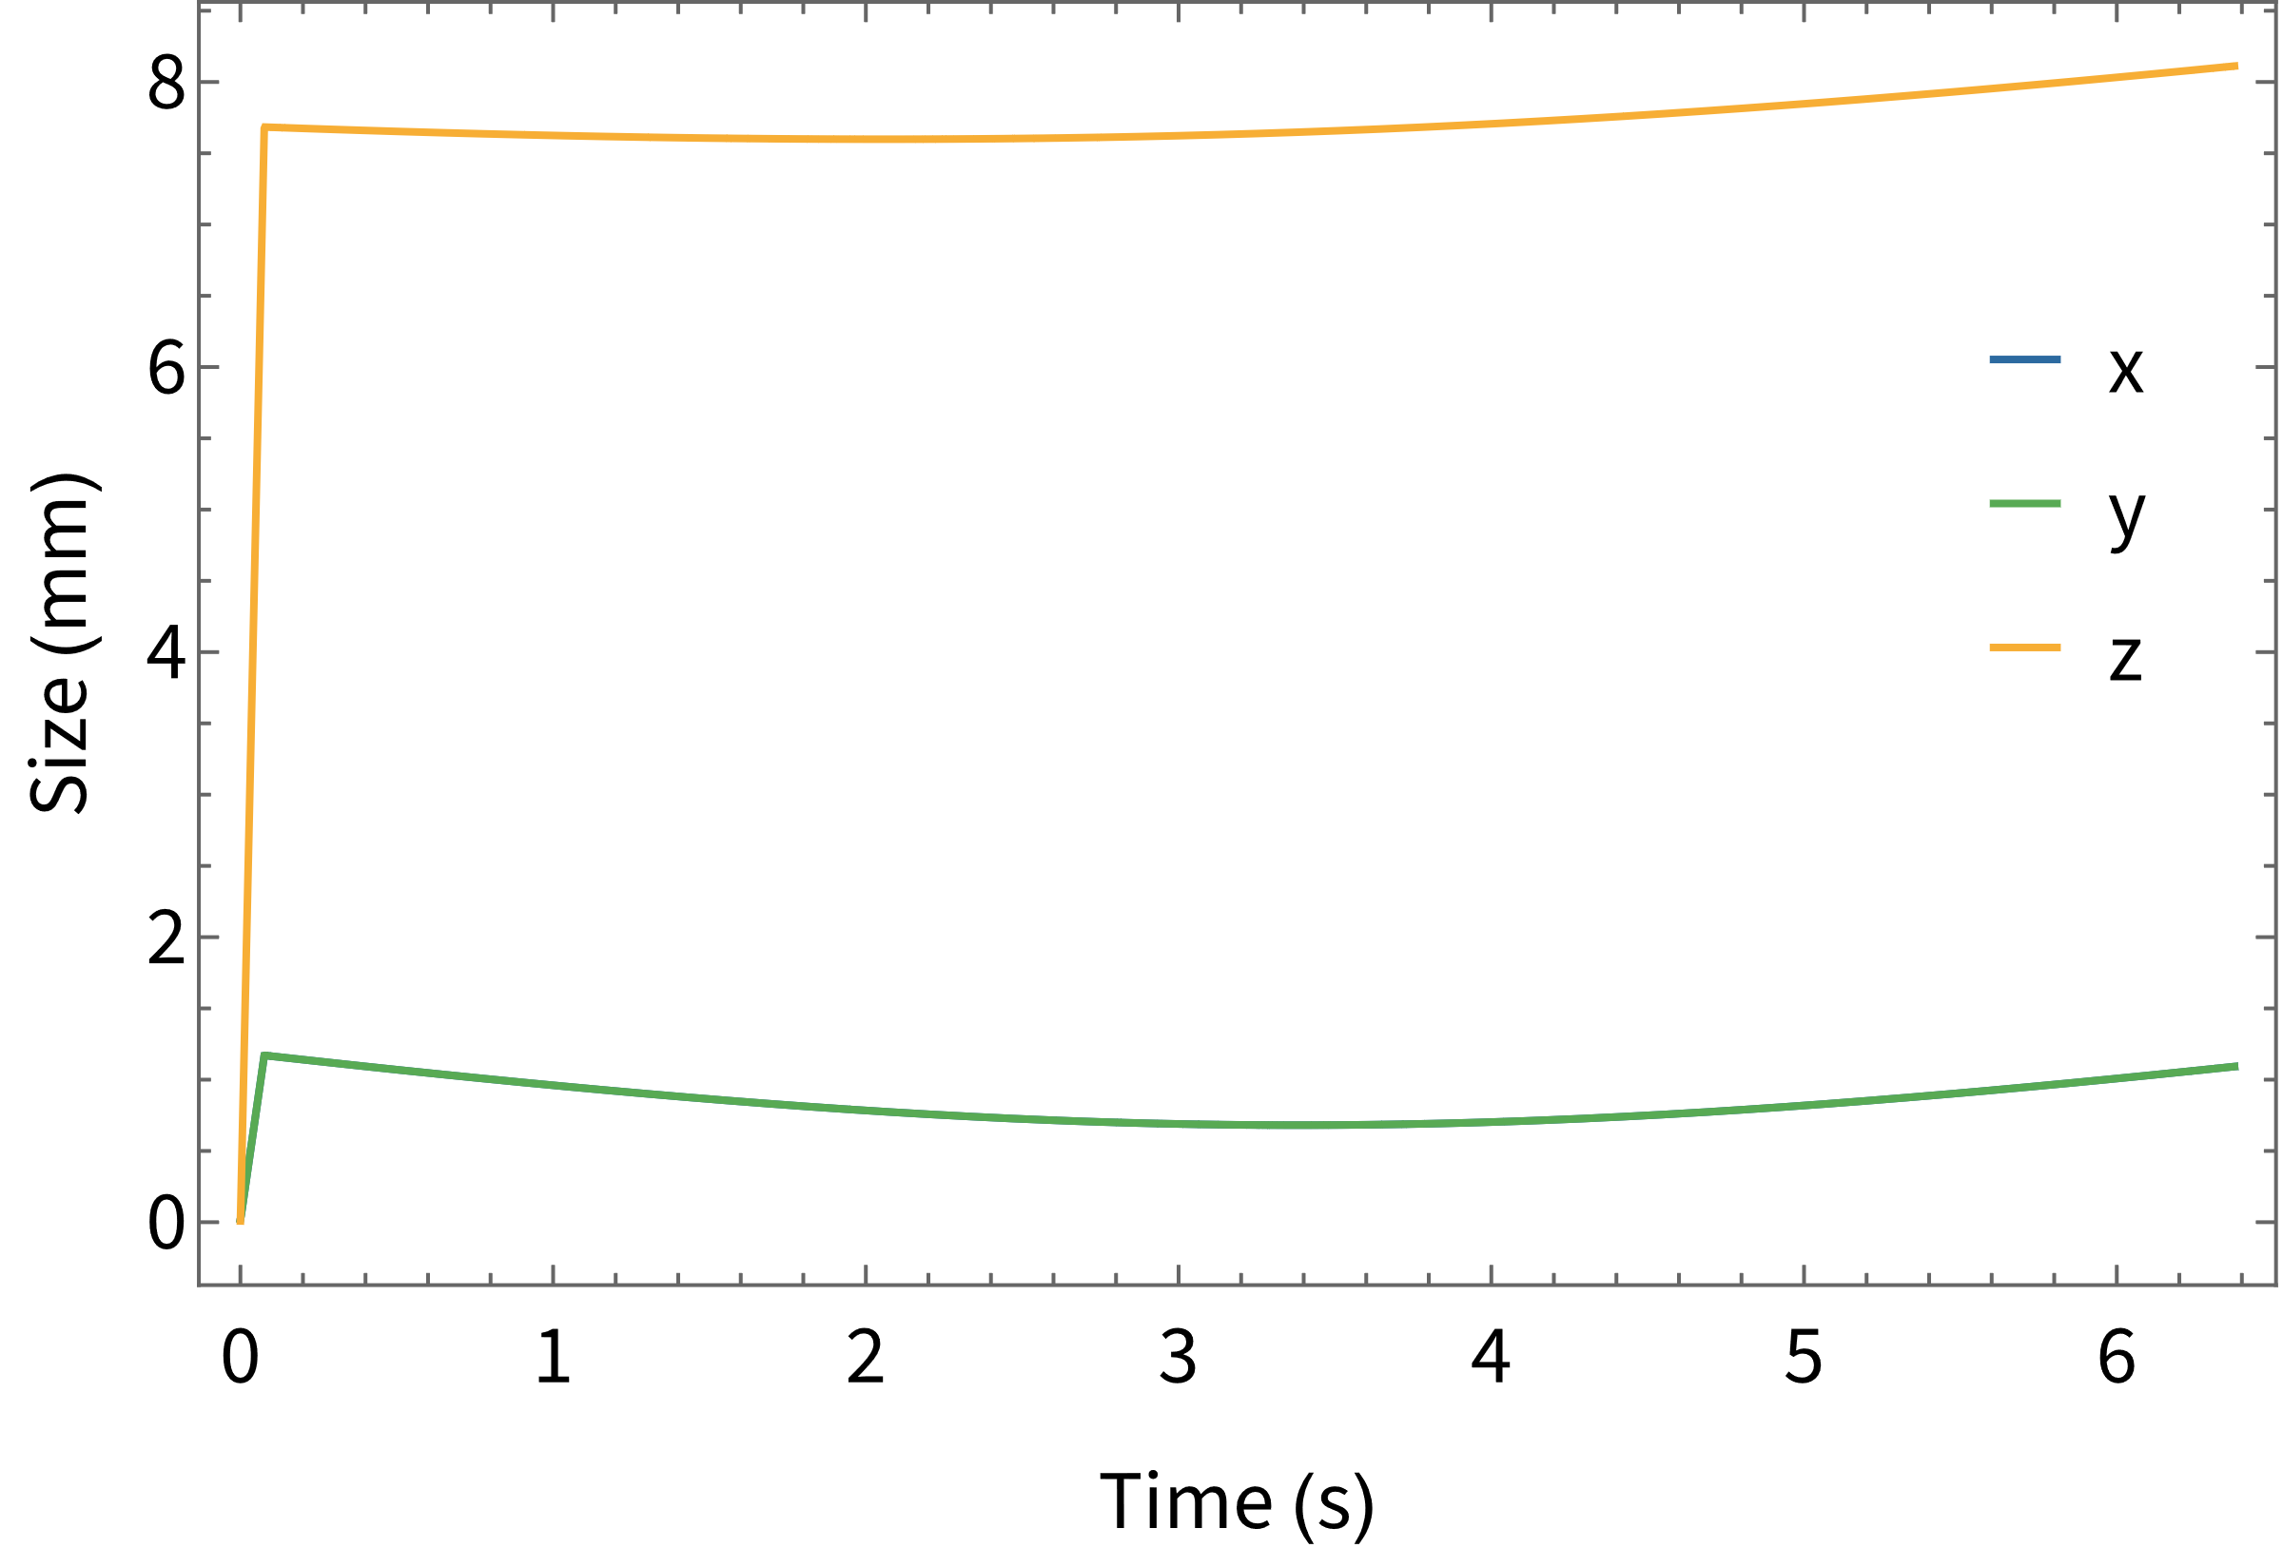
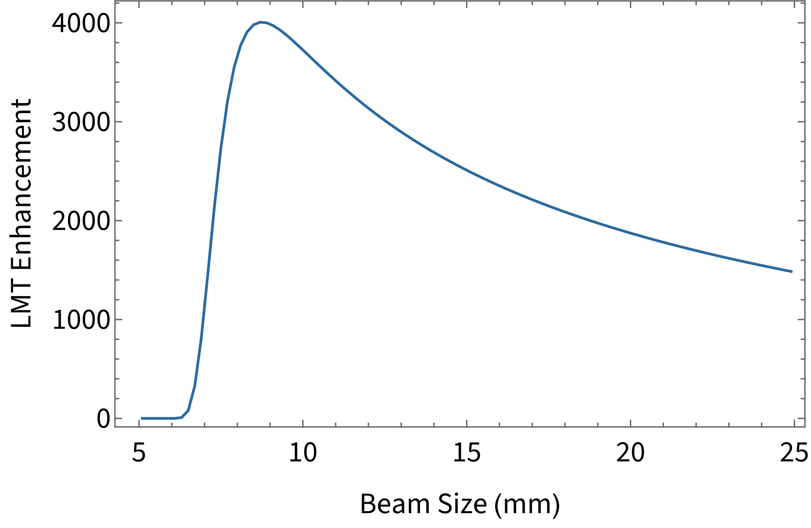
Size Dynamics & Pulse Strategy
10⁷ ⁸⁷Sr atoms at 180 pK (axial)
Need to find a lensing and pulse strategy combination to address:
  Spontaneous emission
  Off-resonant scattering
  Intensity inhomogeneity/displacement
  Doppler broadening (temperature, laser noise, …)
Very large LMT enhancement with current lasers
Sequence fidelity ~90%, most atoms survive
More laser power ⟶ larger optimal beam size
>10k enhancement requires ~ 2 x 100 W
Many practical constraints: free aperture, lensing volume, detection volume, …
P = 2 x 10 W, 1 Hz RMS noise

Slide 14
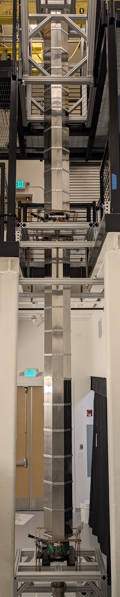
Summary
10 m and 100 m-scale instruments under construction (Stanford & Fermilab)
Have developed and modeled different modes/atom optics
  Narrowband composite clock AI with fermions
  Collinear three-photon clock AI with bosons
Laser noise not a practical constraint for LMT AI
Coriolis compensation through multi-loop sequences
Designed practical sequences for substantial LMT enhancement
Exploring practical LMT limits, at 100 m baseline and beyond

Slide 15




Collaborators & Funding
Mahiro Abe
Rachel Barcklay
Samuel Carman
Nicholas Entin
Benjamin Garber
Yijun Jiang
Yi Lu
Megan Nantel
Indra Periwal
Hunter Swan
Dhruv Tandon
Michael Van de Graaff
and Jason Hogan
Mahiro Abe
Philip Adamson
Evan Angelico
Rachel Barcklay
Marcel Borcean
Daniela Bortoletto
Kieran Bridges
Samuel Carman
Steve Chappa
Swapan Chattopadhyay
Zilin Chen
Jonathon Coleman
Noah Curfman
Kenneth DeRose
Tejas Deshpande
Savas Dimopoulos
Mike Dinnon
Bill Dymond
Nicholas Entin
Gedminas Elertas
Christopher Foot
Josef Frisch
Benjamin Garber
Steve Geer
Valerie Gibson
Jonah Glick
Peter Graham
Steve Hahn
Cecilia Hanna
Roni Harnik
Leonie Hawkins
Sam Hindley
Jason Hogan
Henry Hunt
Dirk Hurd
Yijun Jiang
Michael Kagan
Mark Kasevich
Ronald Kellett
Mandy Kiburg
Tim Kovachy
Jim Kowalkowski
Yi Lu
Joseph Lykken
John March-Russell
Jeremiah Mitchell
Martin Murphy
Sergei Nagaitsev
Megan Nantel
Lucy Nobrega
Chris Overstreet
Alyssa Payleitner
Indra Periwal
Robert Plunkett
Surjeet Rajendran
Roger Romani
Natasha Sachdeva
Murtaza Safdari
Sharika Saraf
James Santucci
Jesse Schelfhout
Ariel Schwartzman
Ian Shipsey
Hunter Swan
Dhruv Tandon
Dylan Temples
Henry Throssell
Linda Valerio
Michael Van de Graaff
Arvydas Vasonis
Maxine Vandegar
Erik Voirin
Yiping Wang
Daniel Weatherill
Daniel Wood
Stanford Team
GBMF7945
NSF QLCI 2016244
UK STFC

