Slide 1


Prospects for squeezed clock interferometry
Richard Hobson, Imperial College London, AION collaboration

Slide 2
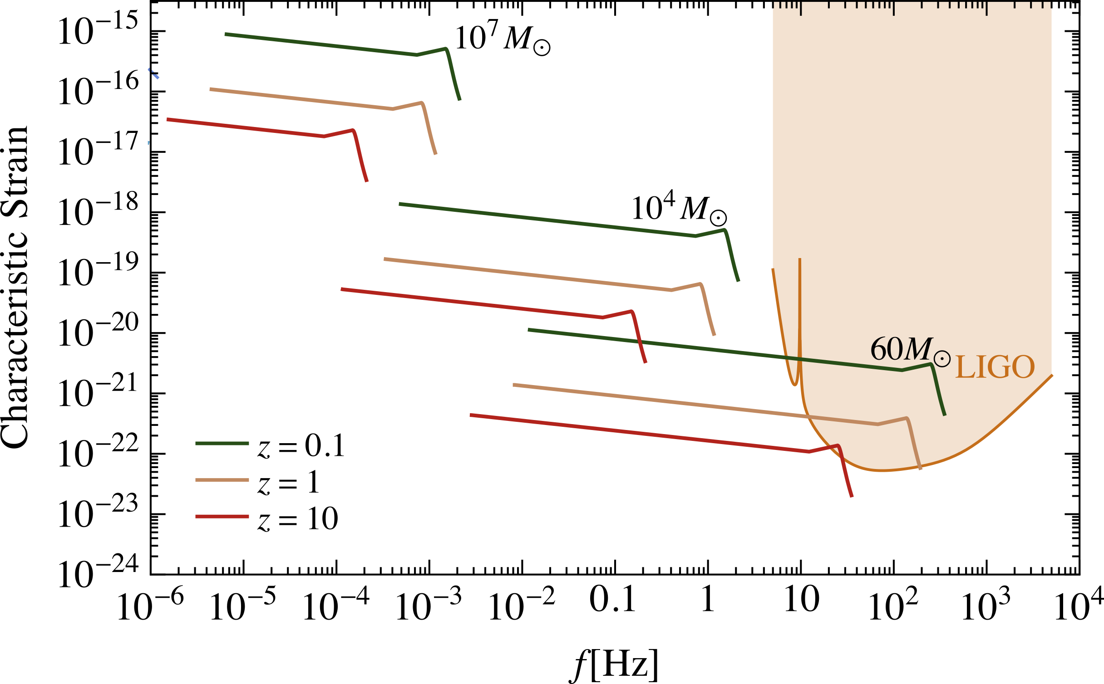
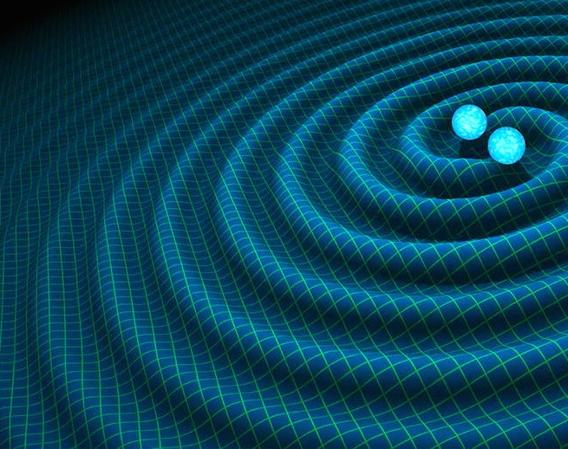
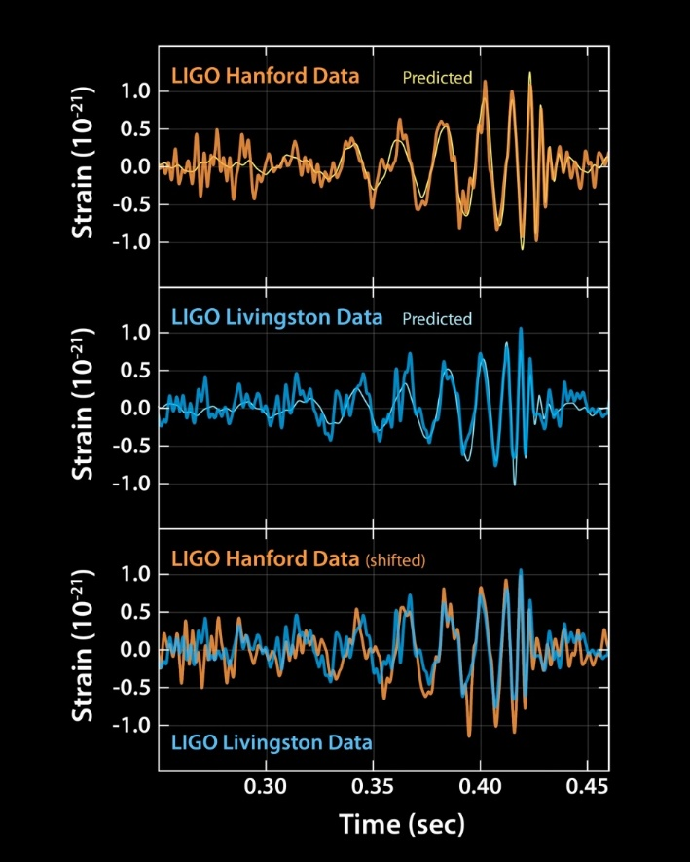
Motivation: Gravitational waves
https://www.ligo.caltech.edu/image/ligo20160211a
https://sservi.nasa.gov/articles/scientists-detect-first-gravitational-waves/
Time
Notes:
Minimum sensitivity plot – shaded regions
Merger events depicted as lines
Merger evolves from left to right
LIGO first signal in 2015 – yellow star

Slide 3

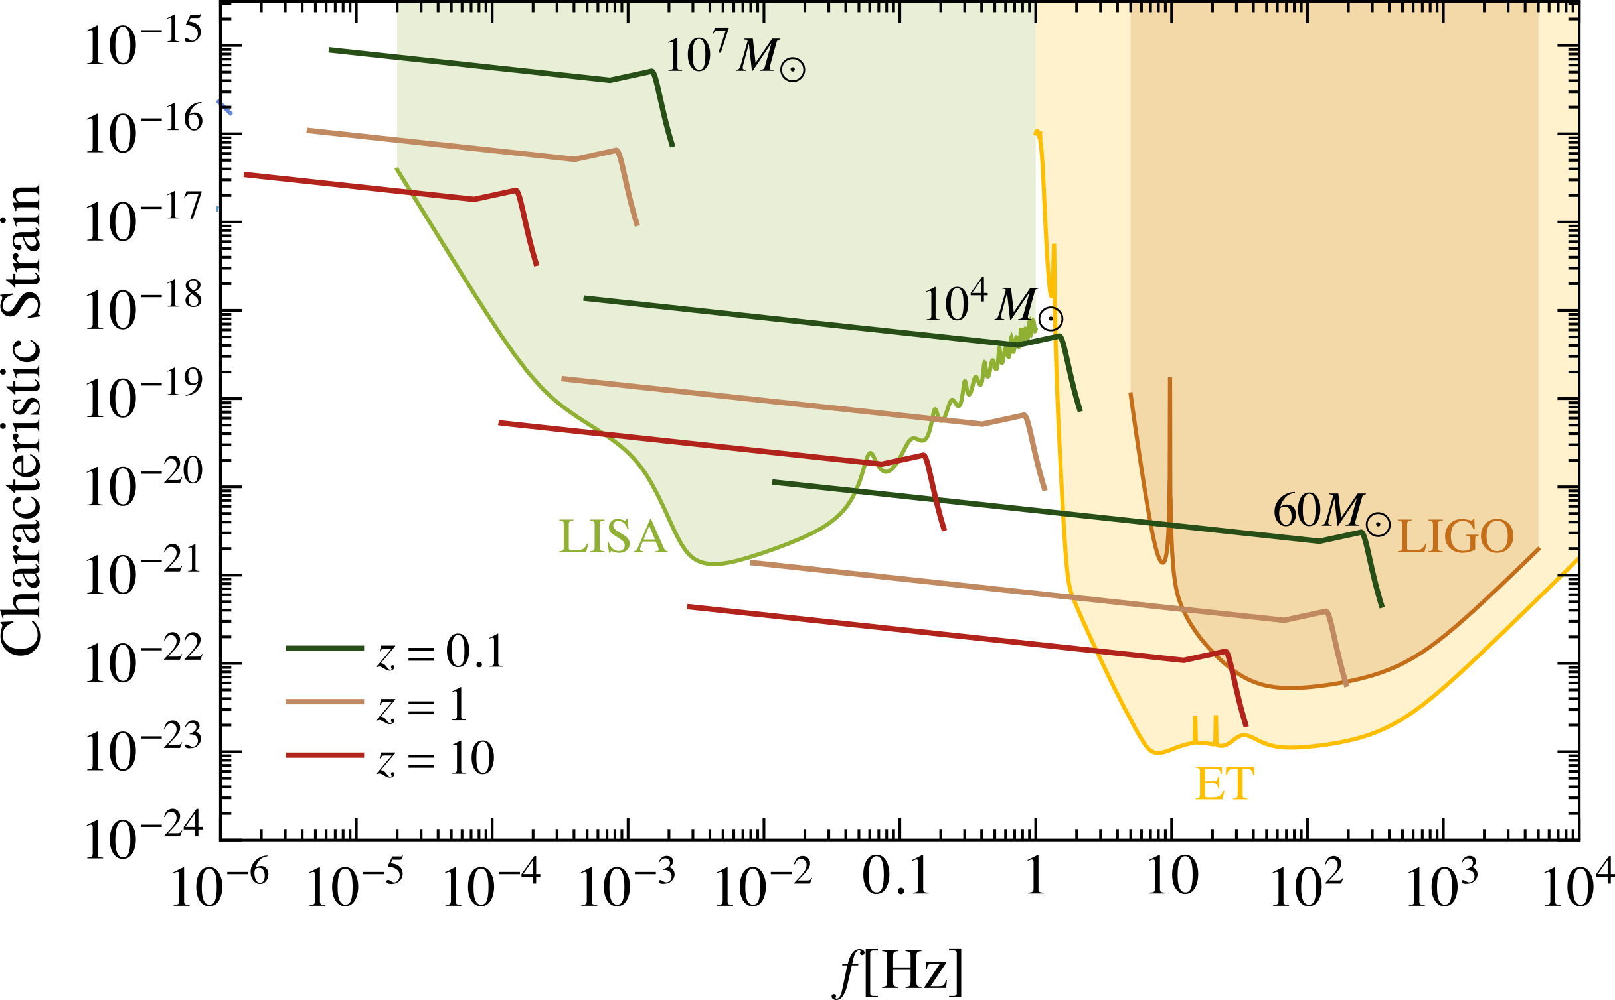
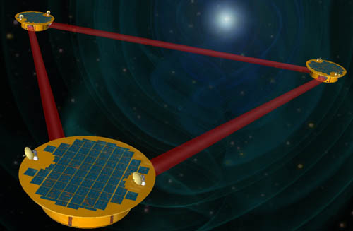
Motivation: Gravitational waves
https://lisa.nasa.gov/archive2011/
Notes:
Future laser interferometer detectors: LISA (space), ET (bigger, longer)
Mind the gap!

Slide 4
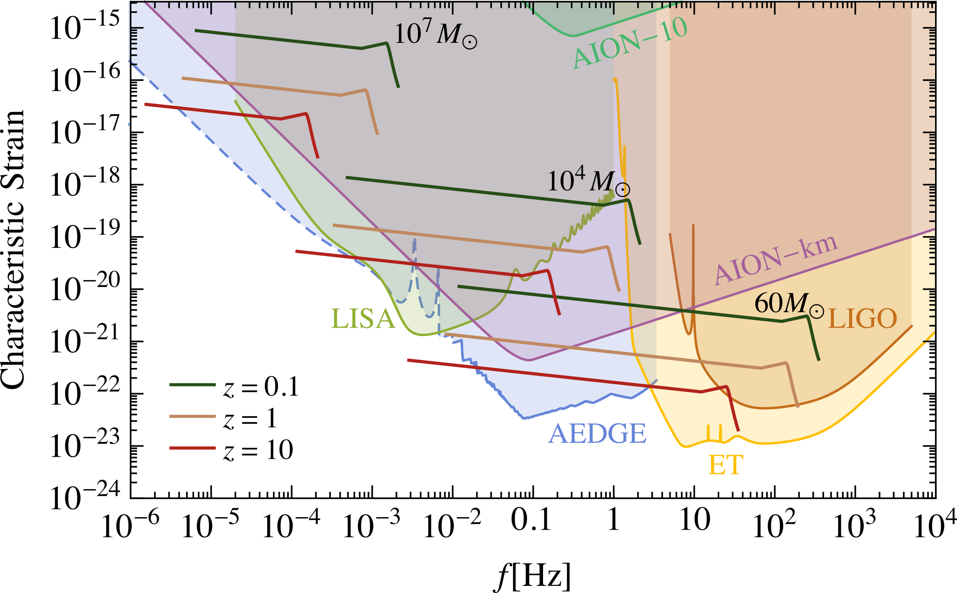
Motivation: Gravitational waves
https://lisa.nasa.gov/archive2011/
Notes:
Here is where my tech comes in: AION-km and AEDGE

Slide 5



Motivation: Gravitational waves
https://lisa.nasa.gov/archive2011/
$$δφ \sim {10}^{−5}/\sqrt{Hz}$$

Slide 6

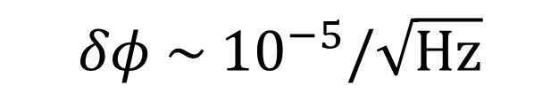
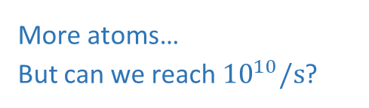
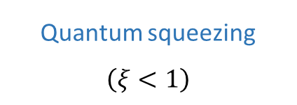
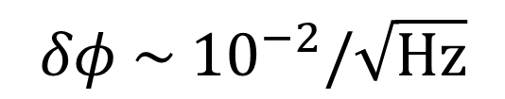
Roadmap to low phase noise
$$δφ \sim {10}^{−2}/\sqrt{Hz}$$
$$δφ \sim {10}^{−5}/\sqrt{Hz}$$
$$δφ=ξ×\frac{1}{\sqrt{N_{atoms}}}$$
Quantum squeezing $\left(ξ<1\right)$
More atoms…
But can we reach${10}^{10}/s$?

Slide 7
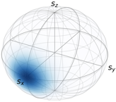
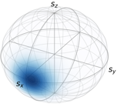
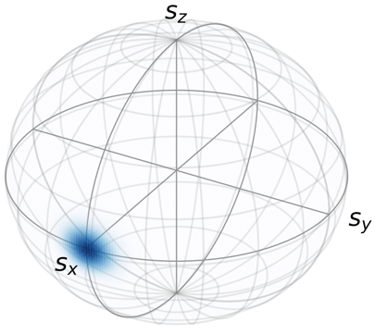
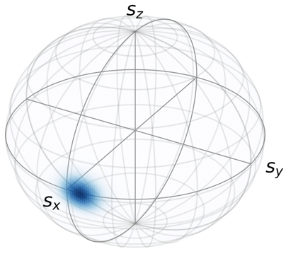
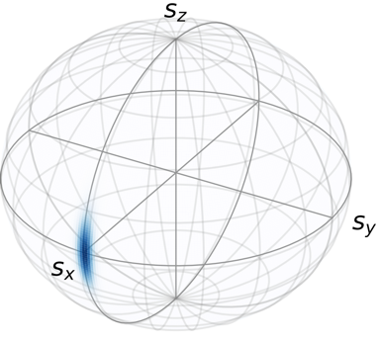
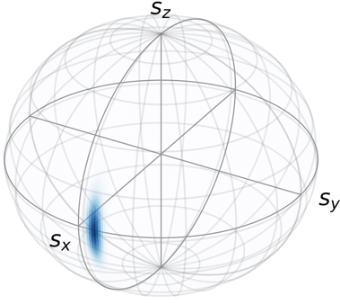

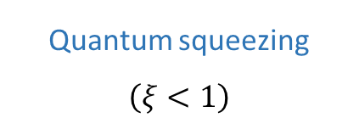
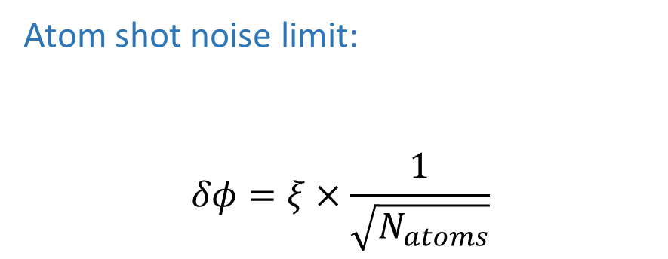



Why squeezed states?
$$δφ \sim {10}^{−2}$$
$$δφ \sim {10}^{−5}$$
$$δφ=0.1 rad$$
Low N:
Atom shot noise limit:
$$δφ=ξ×\frac{1}{\sqrt{N_{atoms}}}$$
High N:
$φ$resolution
High N Squeezed:
Quantum squeezing $\left(ξ<1\right)$
More atoms

Slide 8
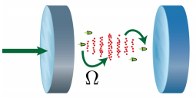
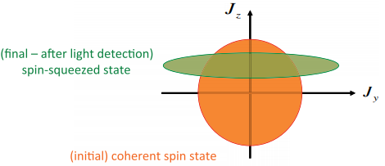
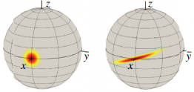



Cavity squeezing – Intro
Method: Place atoms inside a cavity
1. Quantum nondemolition (QND) measurement of ${\hat{S}}_{z}$
2. Nonlinear “twisting” Hamiltonian
$$H∝{\hat{S}}_{z}^{2}$$
$${\hat{S}}_{z}$$
$${\hat{S}}_{y}$$
Figures from Luca Pezze: https://link.aps.org/doi/10.1103/RevModPhys.90.035005

Slide 9
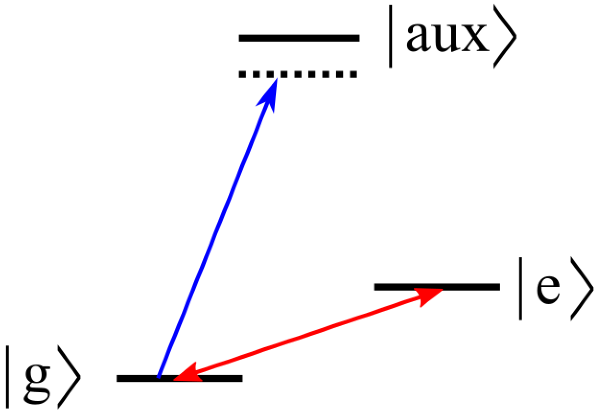
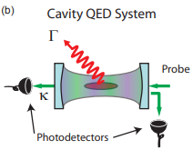
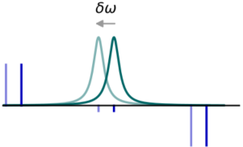
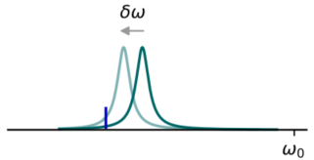



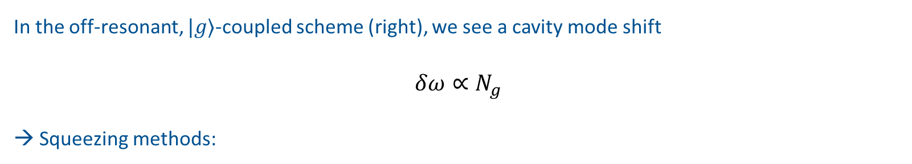
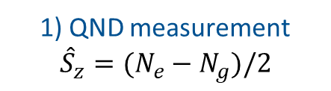
Cavity squeezing – Intro
$$δ_{c}$$
In the off-resonant, $|g⟩$-coupled scheme (right), we see a cavity mode shift
$${δω∝N}_{g}$$
→ Squeezing methods:
Probe
Clock
1) QND measurement ${\hat{S}}_{z}=(N_{e}−N_{g})/2$
Or 2) Twisting: $H∝{\hat{S}}_{z}^{2}$
$${\overset{⃑}{E}}_{c} (r)$$
Figure from Zilong Chen et al: https://link.aps.org/doi/10.1103/PhysRevA.89.043837

Slide 10
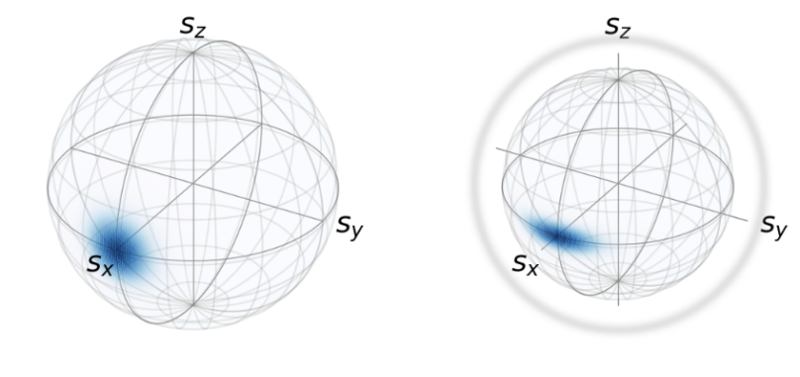
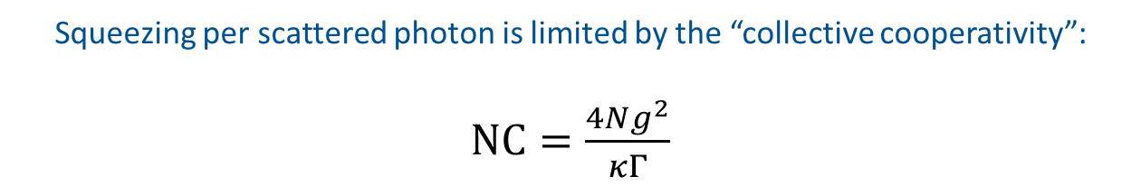
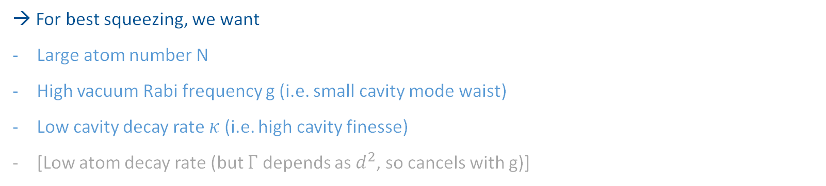
Cavity squeezing – limits
$$δ_{c}$$
As you squeeze, some atoms scatter photons → effectively smaller atom number N
Probe
→
Clock
Squeezing per scattered photon is limited by the “collective cooperativity”:
$NC=\frac{4Ng^{2}}{κΓ}$
→ For best squeezing, we want
Large atom number N
High vacuum Rabi frequency g (i.e. small cavity mode waist)
Low cavity decay rate $κ$ (i.e. high cavity finesse)
[Low atom decay rate (but $Γ$ depends as $d^{2}$, so cancels with g)]
$${\overset{⃑}{E}}_{c} (r)$$
Figure from Chen paper: https://link.aps.org/doi/10.1103/PhysRevA.89.043837

Slide 11
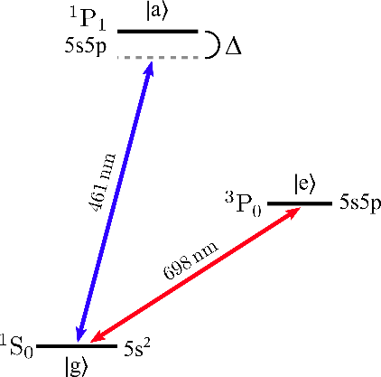
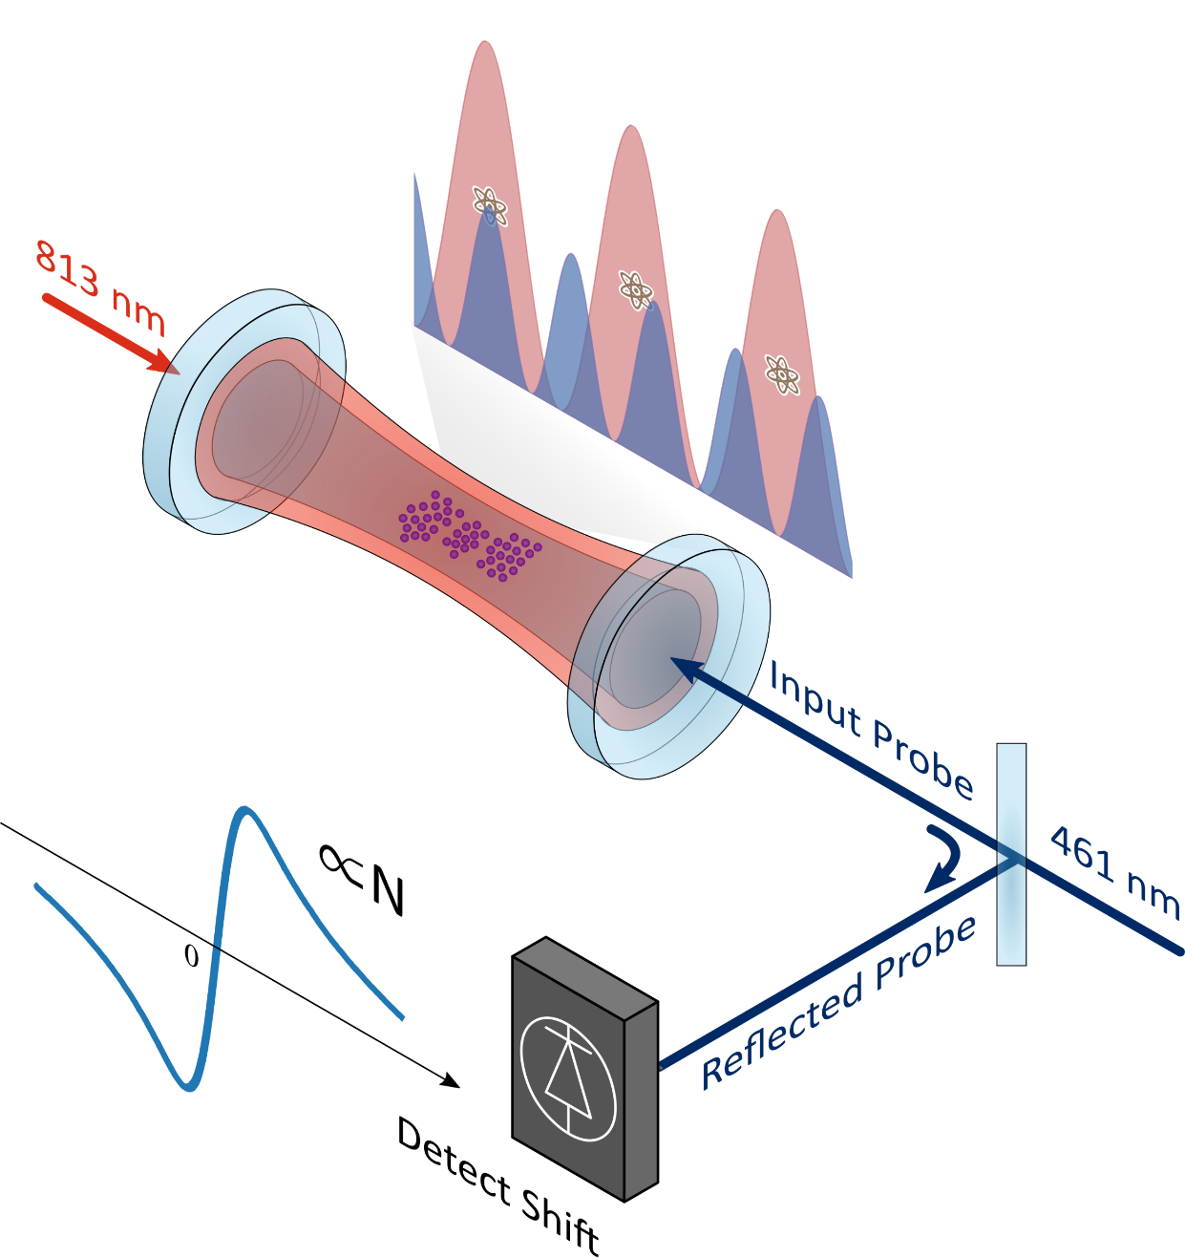
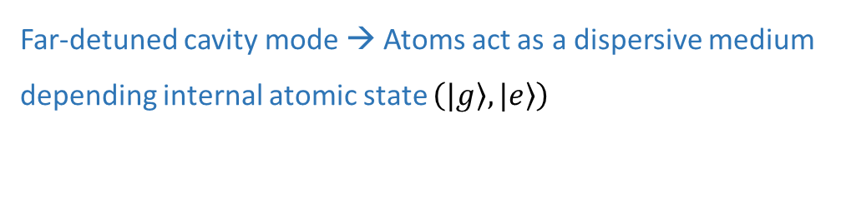
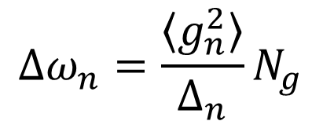
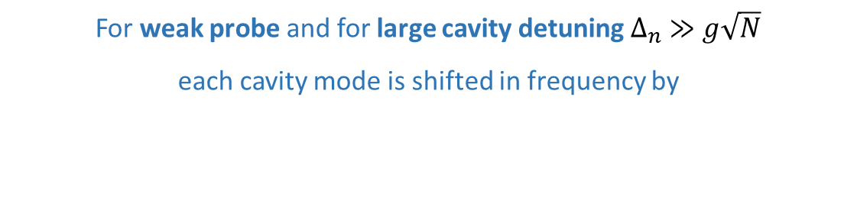
Cavity squeezing – NPL Sr clock
Far-detuned cavity mode → Atoms act as a dispersive medium depending internal atomic state $\left(\left.|g\right\rangle ,\left.|e\right\rangle \right)$
For weak probe and for large cavity detuning $∆_{n} ≫g\sqrt{N}$
each cavity mode is shifted in frequency by
$$Δω_{n}=\frac{\left\langle g_{n}^{2}\right\rangle }{Δ_{n}}N_{g}$$
1 atom = 55 Hz shift

Slide 12
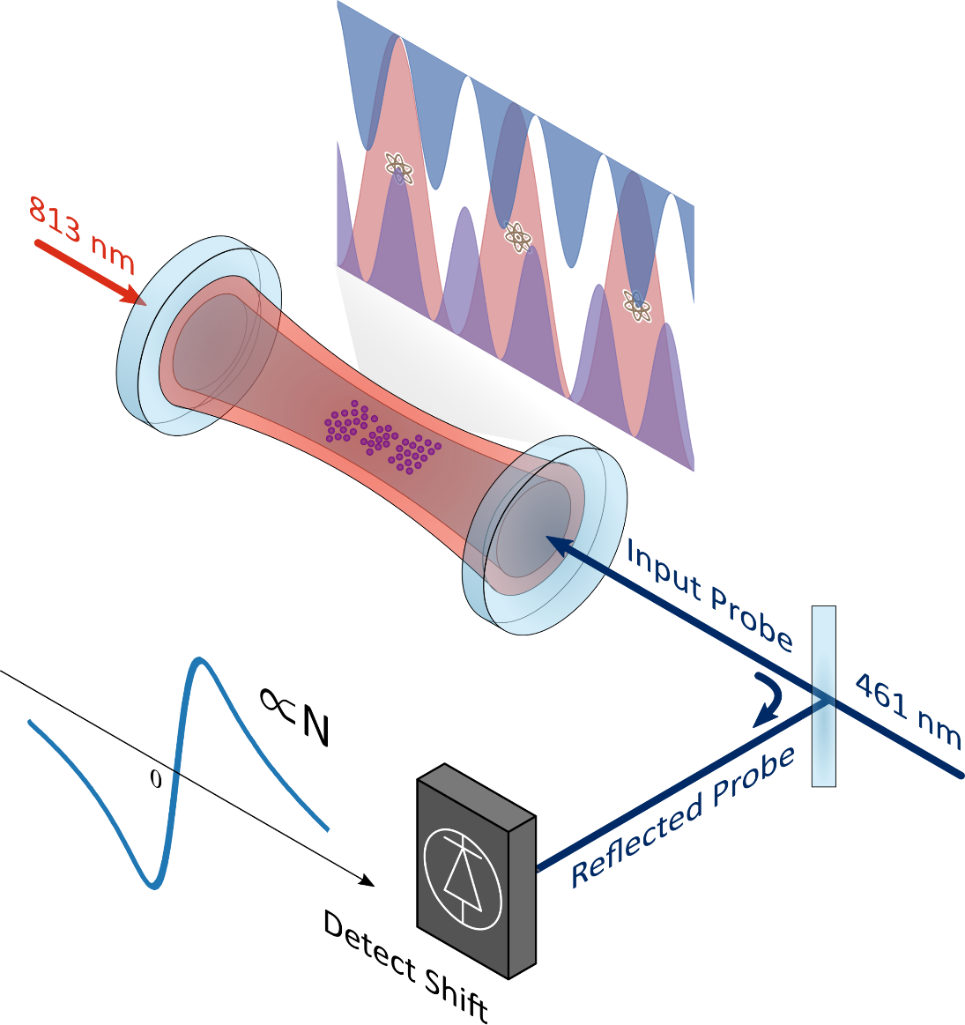
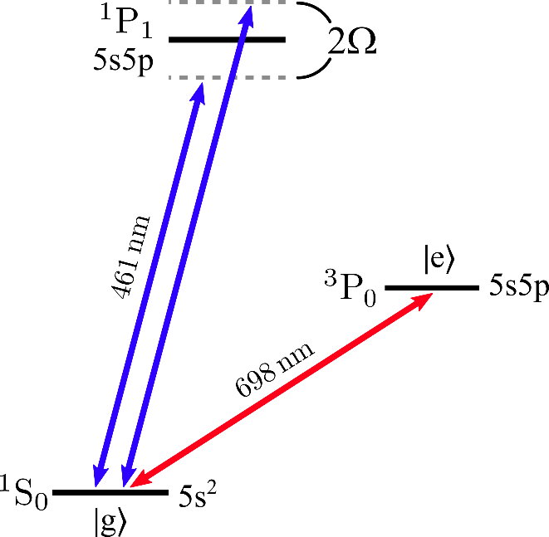


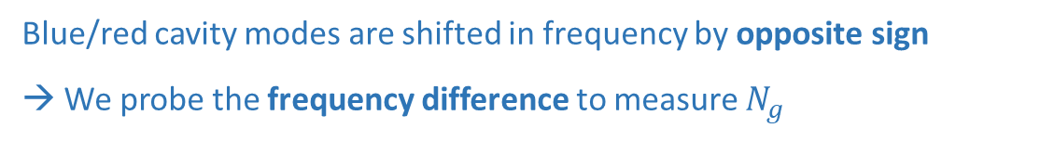
Cavity squeezing – NPL Sr clock
In detail: Two cavity modes probed with red- and blue-detuned QND light:
Blue/red cavity modes are shifted in frequency by opposite sign
→ We probe the frequency difference to measure $N_{g}$
$$Δω_{n}=\frac{\left\langle g_{n}^{2}\right\rangle }{Δ_{n}}N_{g}$$
1 atom = $±$55 Hz shift
R Hobson et al. Optics Express 27, 26, 37099-37110 (2019)

Slide 13
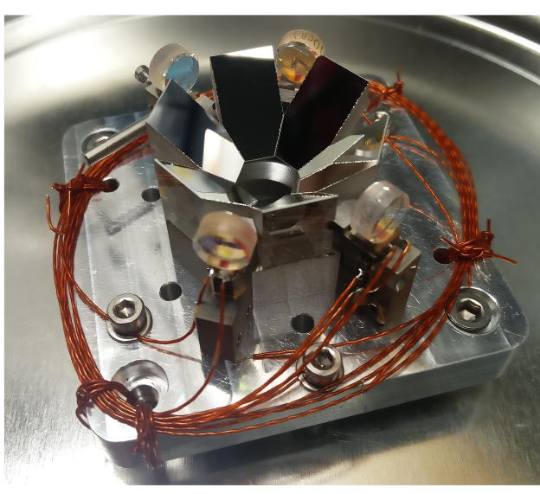
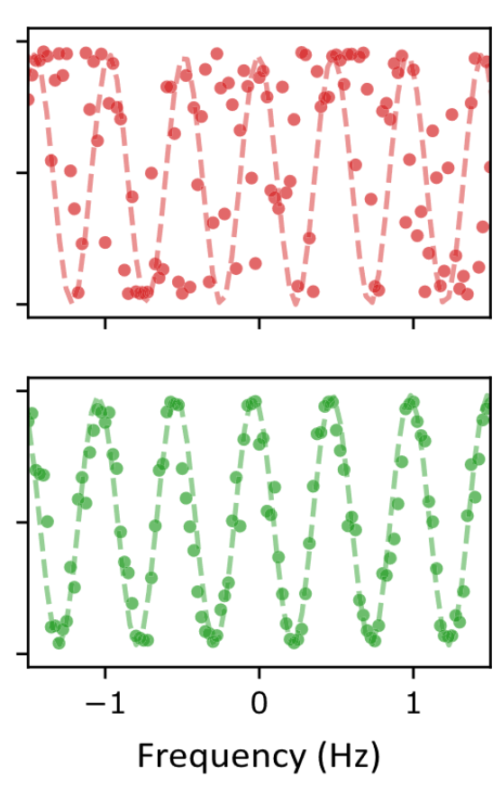
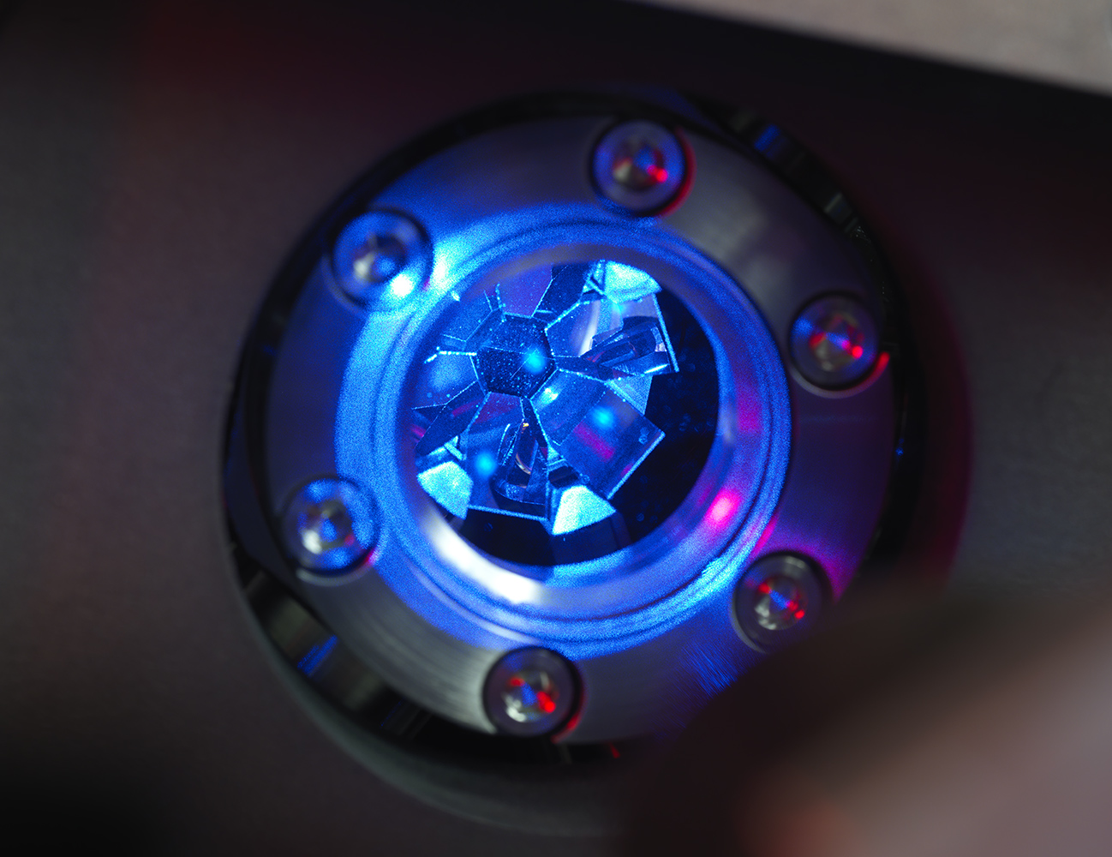
Cavity squeezing – NPL Sr clock
We achieved quantum non-demolition measurement, and could improve the clock
E.g. 2-second Ramsey clock (in clock 2) using an atom phase lock (to clock 1)
No atom phase lock:
With atom phase lock:
R Hobson et al. Optics Express 27, 26, 37099-37110 (2019)
W. Bowden et al. PRX 10, 4, 041052 (2020)
W. Bowden et al. Scientific Reports 9, 11704 (2019)

Slide 14
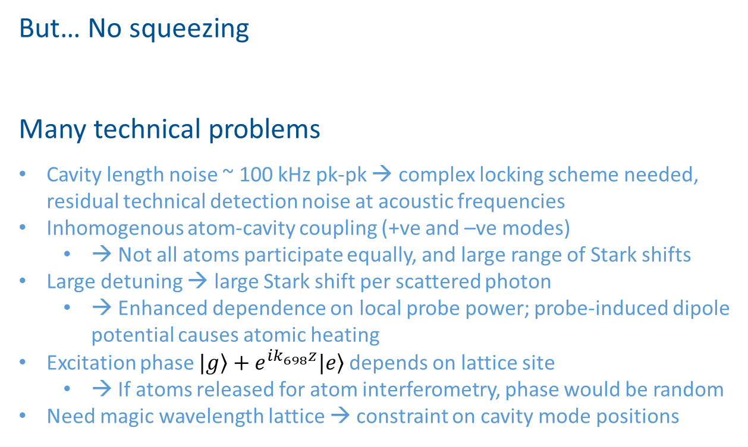
Cavity squeezing – NPL Sr clock
But… No squeezing
Many technical problems
Cavity length noise ~ 100 kHz pk-pk → complex locking scheme needed, residual technical detection noise at acoustic frequencies
Inhomogenous atom-cavity coupling (+ve and –ve modes)
  → Not all atoms participate equally, and large range of Stark shifts
Large detuning → large Stark shift per scattered photon
  → Enhanced dependence on local probe power; probe-induced dipole potential causes atomic heating
Excitation phase $\left.|g\right\rangle +e^{ik_{698}z}\left.|e\right\rangle$ depends on lattice site
  → If atoms released for atom interferometry, phase would be random
Need magic wavelength lattice → constraint on cavity mode positions

Slide 15
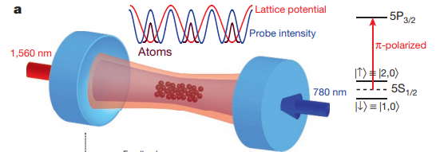
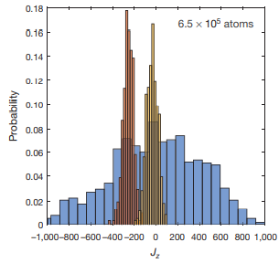
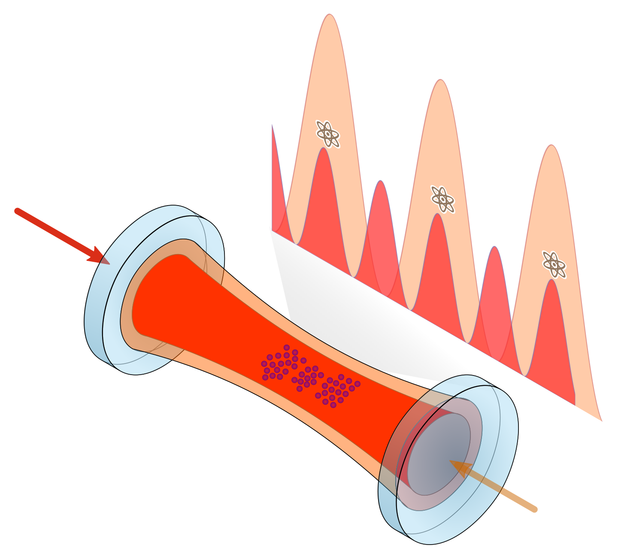
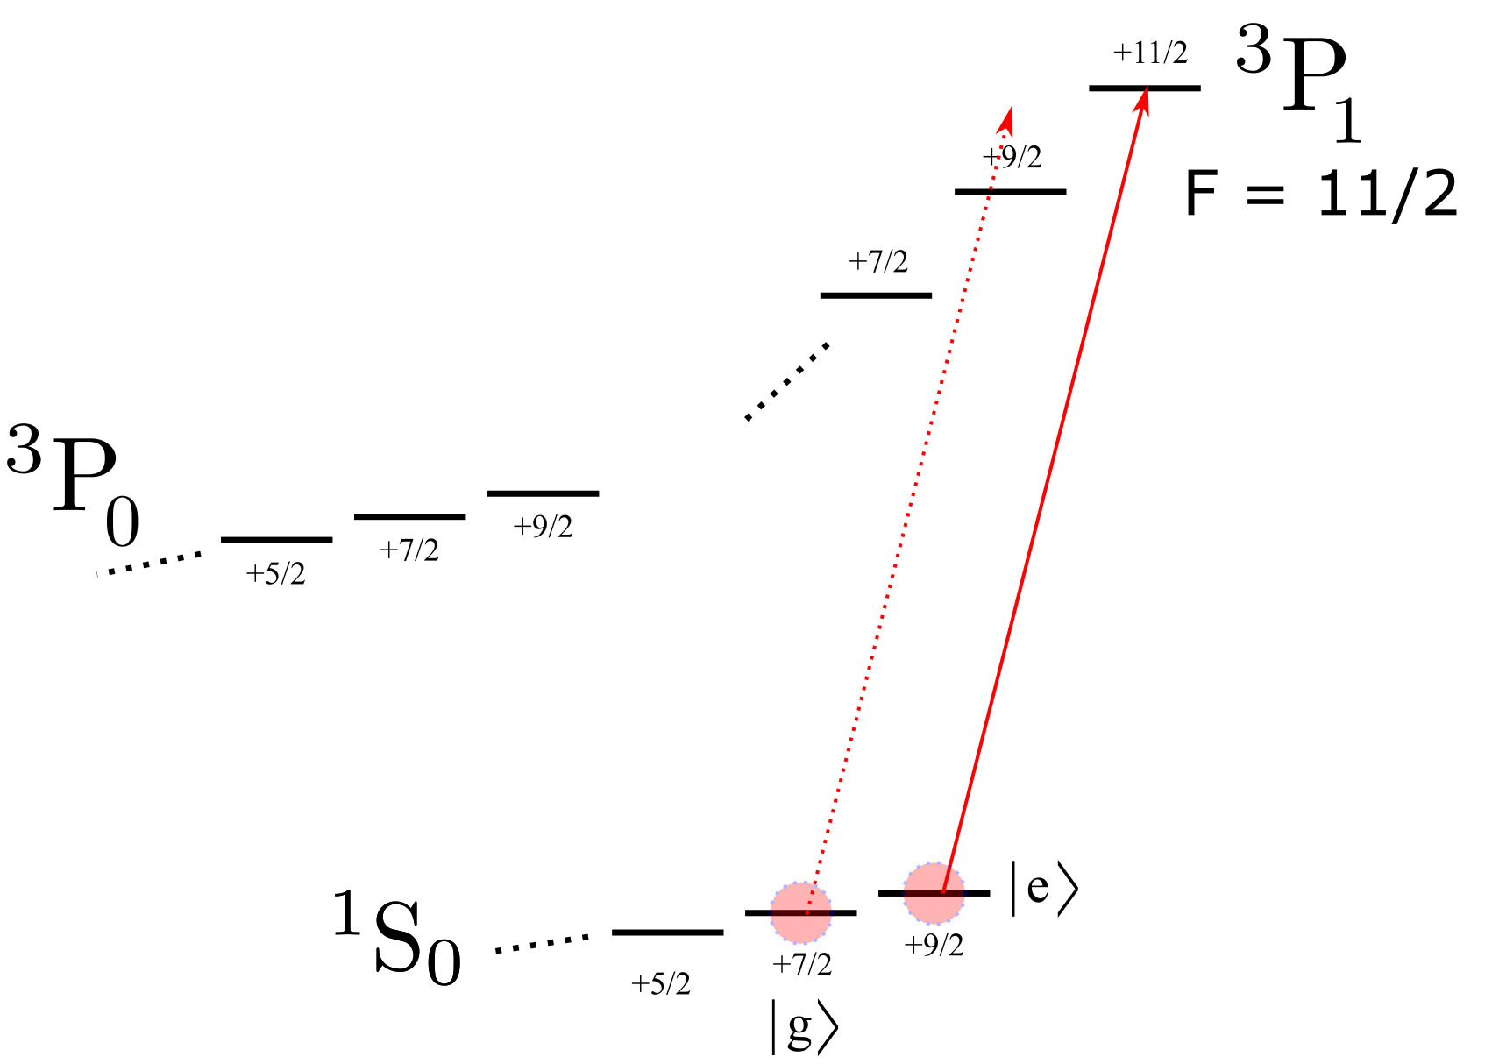
Cavity squeezing – Imperial AION plan
Neat trick from Onur Hosten/Mark Kasevich group:
Overlap lattice/probe modes line up → uniform, high coupling
→ World record squeezing factor: 100
Imperial plan for Sr – squeeze internal states, then map to momentum
689 nm
Figures from Hosten/Kasevich (Stanford): https://www.nature.com/articles/nature16176
1379 nm

Slide 16
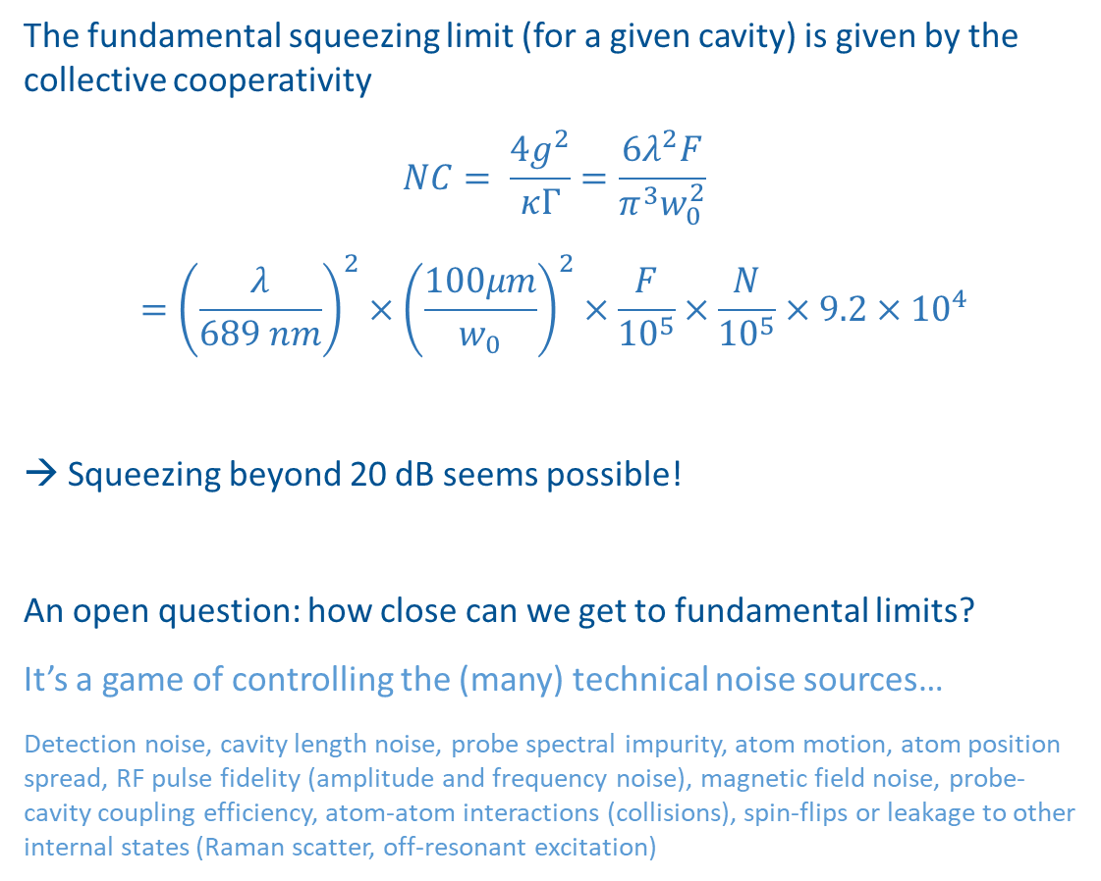
Cavity squeezing – Imperial AION plan
The fundamental squeezing limit (for a given cavity) is given by the collective cooperativity
$$NC= \frac{4g^{2}}{κΓ}=\frac{6λ^{2}F}{π^{3}w_{0}^{2}}$$
$$={\left(\frac{λ}{689 nm}\right)}^{2}×{\left(\frac{100μm}{w_{0}}\right)}^{2}×\frac{F}{{10}^{5}}×\frac{N}{{10}^{5}}×9.2×{10}^{4}$$
→ Squeezing beyond 20 dB seems possible!
An open question: how close can we get to fundamental limits?
It’s a game of controlling the (many) technical noise sources…
Detection noise, cavity length noise, probe spectral impurity, atom motion, atom position spread, RF pulse fidelity (amplitude and frequency noise), magnetic field noise, probe-cavity coupling efficiency, atom-atom interactions (collisions), spin-flips or leakage to other internal states (Raman scatter, off-resonant excitation)
689 nm
1379 nm

Slide 17
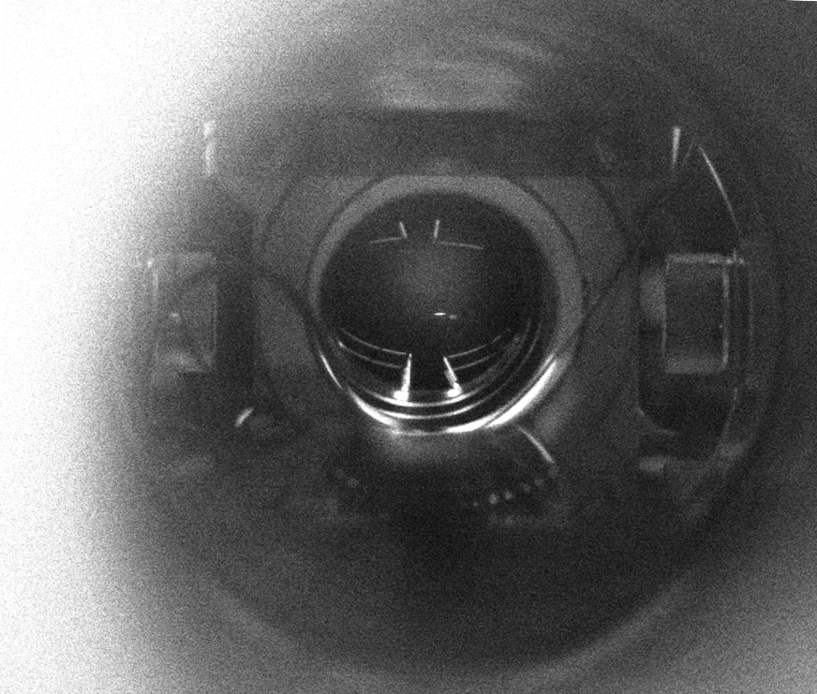
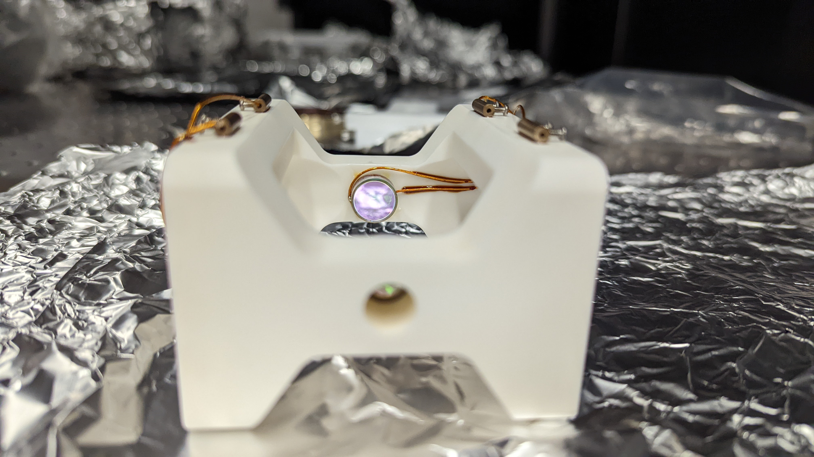




Experimental progress – ⁸⁷Sr clock interferometer
⁸⁷Sr
Squeezing cavity
For more, see “Differential, single-photon interferometry with the ⁸⁷Sr clock transition for AION” - Charles Baynham

Slide 18



The ultracold Sr group
Leonie, Ludo, Charles, Richard, David, Elizabeth, Alice, Tom, Dillen, and Oliver

