Slide 1
ATCA shelf procurement
EP-ESE - PS & Crate service

Slide 2
Reminder on the ATCA chassis frame-contract with nVent (Schroff)
–
Procurement and maintenance

Slide 3
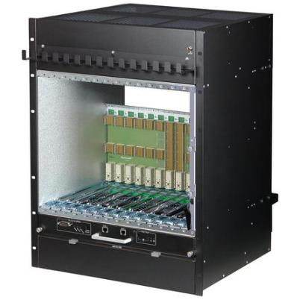


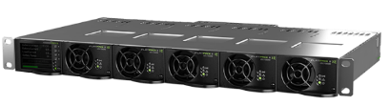
Outcome of the IT-4604 (shelf) and DO-32713 (rectifier)
Reminder, presented during previous ATCA IG meetings
Selected companies
ATCA shelf: nVent (Schroff)
  Power rectifier: Eltek
  DCS integration
ATCA shelf: Remote control via the Schroff shelf manager (ShMM 700 based)
  Power rectifier: Remote control via “smartpack” control module over snmp
  (warning: no On/Off capabilities)
Schroff/nVent ATCA shelf
Eltek - 48Vdc rectifier system

Slide 4
ATCA shelf specification summary
Reminder, presented during previous ATCA IG meetings
Physical shelf baseline:
  19” rack system compatible card cage
  14 ATCA blade slots with RTM
  2 shelf manager slots
  2 redundant power entry module (PEM) slots (-48Vdc input)
  Removable cable management trays (front and rear)
  Hot-swappable cooling units
  Cooling variants:
      Variant 1: Shelf compatible with in-rack vertical air flow
      Variant 2: Shelf compatible with PICMG standard front to back air flow
  Shelf maximum height: 14U with variant 1; 16U with variant 2
Backplane requirements:
  Topology 1: Dual star
  Topology 2: Full mesh
  Fabric lane bit rate: 40Gbase-KR4
  Option: 100Gbase-KR4 (for phase 2)
Module location and accessibility:
  Front access:
    14 ATCA blades
    2 shelf managers
    Air filter
  Rear access:
    14 RTM
    2 PEM

Slide 5
Procurement framework for ATCA shelf and - 48V rectifier
Reminder, presented during previous ATCA IG meetings
Procurement framework
Based on blanket framework contracts
  Ok for large quantities over long term (10+ years)
Purchase orders placed in common at the end of every quarter
  Requests to be submitted via dedicated online DB
  Fixed negotiated prices (subject to yearly price indexation linked to local cost of living)
  TID (money transfer) to a common account prior to common PO (DAI)
  Equipment tracked in the DB from common PO on
Note: Same procedure as for ordering VME crates today
User issues request via DB
TID (money transfer) by ESE
ESE issues Common PO (once TID is signed, quarterly)
User can pickup its units from the ePool reception
PO: purchase order

Slide 6
Procurement framework for ATCA shelf (and - 48V rectifier)
Reminder, presented during previous ATCA IG meetings
Main contractual conditions
Delivery lead-time: 10 weeks from ordering date*
Warranty duration: 2 years from delivery date
Long term maintenance:
  Fixed repair prices for every type of equipment (independent from the failure reason)
  Subject to a 3 months repair warranty
  Fixed verification prices for every type of equipment
  Mostly applied in case of «no fault found»
  Verification by the PS & Crate service : free of charge
Maintenance requests: «fault report» (and verification requests) to be registered in the DB prior to equipment return at the ePool reception
  Subject to budget code registration. But DAI is issued only if equipment is out of warranty
* : Delivery lead-times subject to increase.
  Technical DB: https://aismisc.cern.ch/aismisc/f?p=117

Slide 7
Availability of nVent (Schroff) ATCA chassis

Slide 8
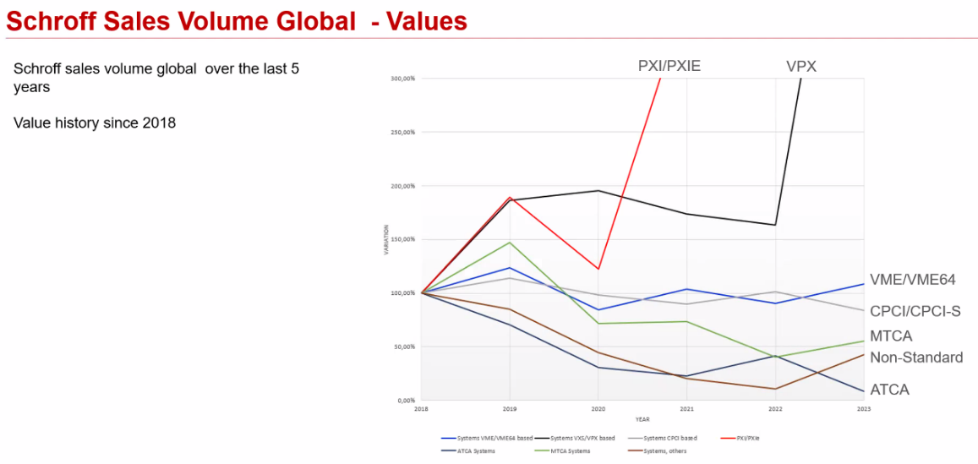
ATCA availability
ATCA market situation and nVent product roadmap – nVent presentation of May 2023 during the 18th ATCA IG
Screenshot from Ralf Waldt’s nVent presentation @ 18th xTCA Interest Group Meeting, May 23

Slide 9
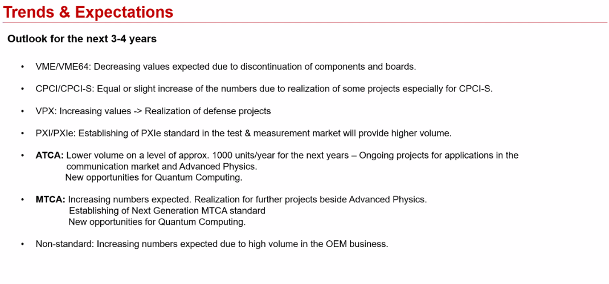
ATCA availability
ATCA market situation and nVent product roadmap – nVent presentation of May 2023 during the 18th ATCA IG
Screenshot from Ralf Waldt’s nVent presentation @ 18th xTCA Interest Group Meeting, May 23
The sooner your ATCA chassis are ordered the better…
“ Telecom is using OCP => Dedicated standard (not running well). Now telecom is going into server solutions, in accordance with OCP Telco standard, SW as a service. No dedicated HW anymore. “

Slide 10
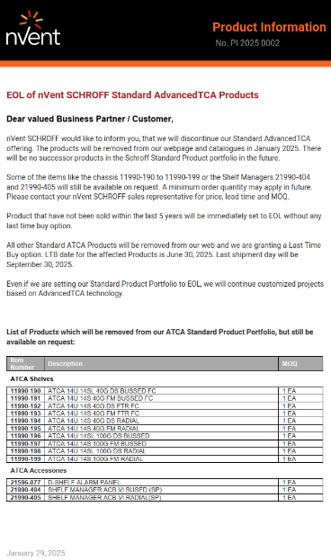
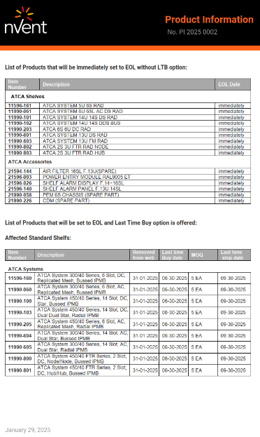
ATCA EOL notification from nVent
Announced end of January
Summary:
nVent has EOL its ATCA product line. Some chassis can still be ordered on request.
The CERN procurement frame-contract is part of the exception.

Slide 11
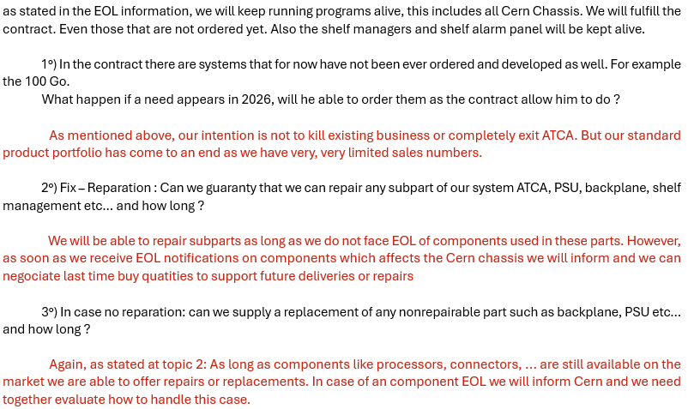
ATCA EOL notification from nVent
Replies from nVent “global product manager systems” for procurement and maintenance contract B1660:

Slide 12
ATCA EOL notification from nVent
Some considerations
Place your ATCA chassis orders (request in the tech DB) as soon as possible !
  https://aismisc.cern.ch/aismisc/f?p=117
Consider increased spare quantities, in particular for modules (Shelf Man, cooling units, PEM)
Order other ATCA components asap : Filer-panels and air filters (available at the CERN stores), mechanical latches, connectors, other COTS ATCA blades, etc.

Slide 13
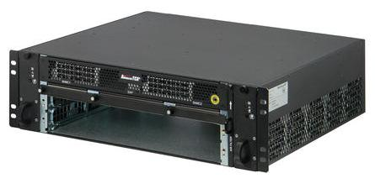
ATCA 2-slots pizza-box chassis from nVent
Available from the electronics pool catalogue but currently out of stock
Not part of the frame-contract with nVent
Purchase option requested a user a few weeks ago
nVent reply
  Production still possible but…
  MOQ 30 units
  Long delivery lead-time (6 months)
  Estimated unit price: 3.4 kCHF
        Atlas and CMS contacted to check their overall needs (leading to 14 units)
        Any additional interest ?

Slide 14
Thanks for your attention

Slide 15
Backup slides

Slide 16
ATCA shelf and - 48V rectifier specification summary
Other requirements:
Electrical
  Shelf power distribution for minimum: 400W (front blade) + 50W (RTM) to each slot
Shelf manager
  Based on Pigeon Point Systems ShMM700 or newer
  Support the following protocols and interfaces: RMCP, SNMP, SSH
  Support for HPM.1 and HPM.3
Standards, Rules and Regulations:
  PICMG standard:
    AdvancedTCA base specification PICMG-3.0 Revision-3.0
    AdvancedTCA base extensions specification PICMG-3.7 Revision-1.0 section 5 for cooling aspects
  Intel specification: IPMI v2.0
  EMC compliance: CISPR22 and CISPR24 Class A and IEC/EN 61000-6-3
  Safety standard: IEC/EN 60950-1 and CERN IS-23 and IS-41
  Ethernet standard: IEEE standard 802.3
  ROHS compliance: WEEE Directive 2012/19/EU
  CE compliance and related regulations

Slide 17
Additional info from the Power
Supply and Crate service

Slide 18
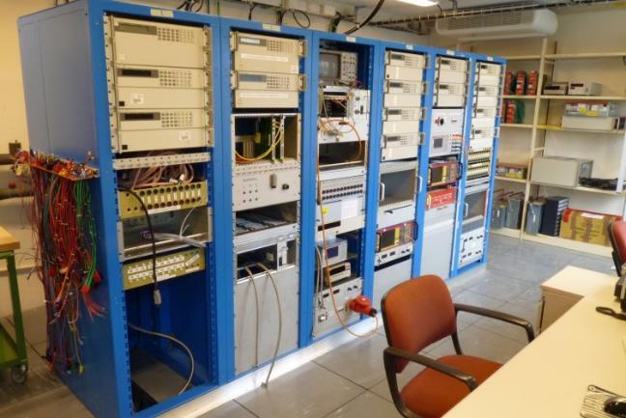
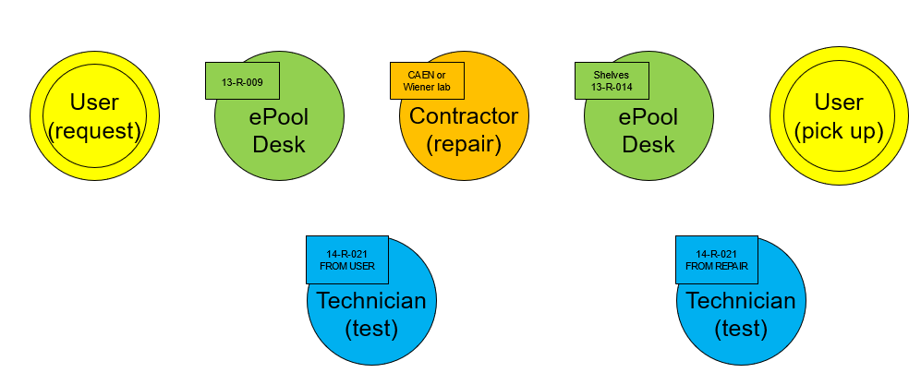
Current service for LHC PS & VME crates (reminder)
Support and maintenance service main tasks
For low and high voltage power supply and crate equipment in use in the LHC experiments at CERN.
Preliminary technical evaluation of new equipment
Common procurement framework (existing contracts)
Testing, support and maintenance (preventive and corrective) with manufacturers on-site service
Test rig development and maintenance
Central tracking of equipment units during its lifetime (online DB)
Communication path: Electronics Coordination Board (ECB)
LVPS and crate service test rigs
Key numbers
4 manufacturers (Wiener, Caen, Eltek and Schroff)
1500 chassis (or crates)
1700 PS modules
Over 1000 bulk PS and PFCs
Over 1000 test/year by the service (20 tests/wk)
About 1000 CAN PSU equipment
DB tracking and maintenance workflow

Slide 19
Current service for LHC PS & VME crates (reminder)
Reminder
Existing procurement and maintenance frame-contracts
Launched 2005 for procurement and 2009 for maintenance
Selected list of Wiener and Caen equipment, now also Schroff and Eltek
Fixed repair and verification prices
Valid until 31st of December 2019 but extended since then until end 2024
8 weeks (56 days) repair turnaround time (Optional accelerated service, Wiener only : 4 weeks)
Yearly purchase option for on-site service (Wiener and Caen only)
Repair warranty duration :
        Wiener, Eltek, Schroff: 3 months
        Caen: 4 months

Slide 20
Integration of nVent (Schroff) and Eltek equipment
What remains unchanged (LHC PS)
The LHC PS equipment support will continue as today…
… and so will the current service contributions, tracking DB, test rigs, etc.
Integration of nVent and Eltek contracts
New equipment procurement is made through common PO as it is the case today for Wiener and Caen equipment (requests issued with the tech DB: https://aismisc.cern.ch/aismisc/f?p=117 )
Service level unchanged:
Baseline: Status quo for the LHC PS & crates and same level of service for the new equipment (ATCA)
On-site service: Service provides tracking DB and logistics. Possible annual fee for the vendor on-site option (not for Schroff and Eltek).
Test rig: Service develops, maintains and operates a test rig facility and offers testing service free of charge. Annual fee for test equipment rental and maintenance.

Slide 21
Backplane qualification
Presented during ACES 2020

Slide 22
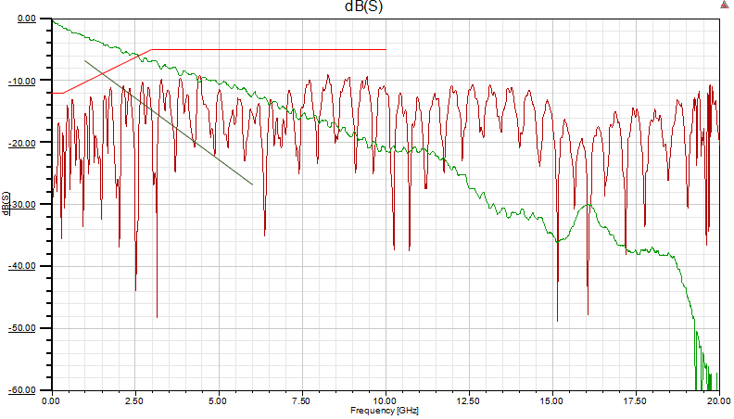
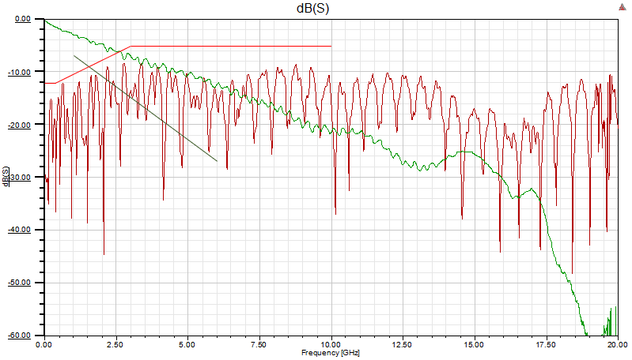
ATCA Schroff 40G backplane – VNA measurements
Measurements performed on the dual star 40G backplane for Schroff standard airflow shelves
Measurements between distant slots
Slot 1 to Slot 14
Reference lines:
  IEEE 802.3 40Gbase-KR4
RX0
TX0

Slide 23
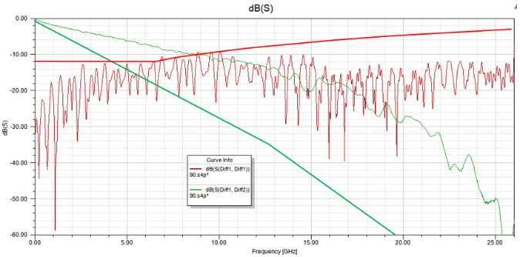
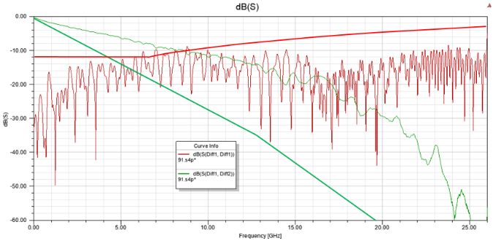
ATCA Schroff 100G backplane – VNA measurements
Measurements performed on the dual star 100G backplane for Schroff standard airflow shelves
Measurements between adjacent slots
Slot 1 to Slot 2
Reference lines:
  IEEE 802.3 100Gbase-KR4
RX0
TX0

Slide 24
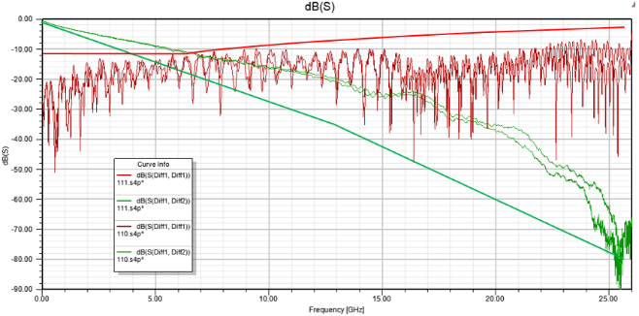
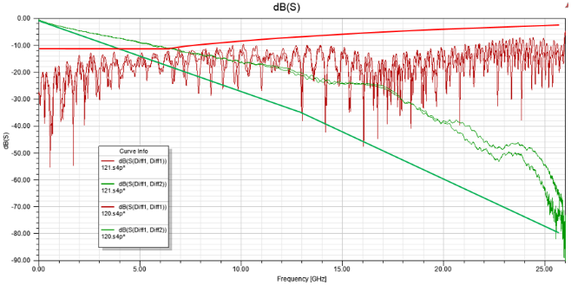
ATCA Schroff 100G backplane – VNA measurements
Measurements performed on the dual star 100G backplane for Schroff standard airflow shelves
Measurements between distant slots
Slot 1 to Slot 14
Reference lines:
  IEEE 802.3 100Gbase-KR4
RX0 TX0
RX2 TX2

Slide 25
ATCA Schroff 100G backplane – VNA measurements
Backplane is compliant with IEEE 802.3 100Gbase-KR4
Few very minor reflection peaks on adjacent slots might be induced by the test setup (adapter cards)
In comparison the Comtel 100G backplane has slightly worst results
Measurements tools:
Keysight N5225A PNA 50 GHz
Comtel ATCA adapter cards with coaxial cables

