Slide 1
CERN IPMC: Update
On behalf of the CERN xTCA/IPMC Team

Slide 2
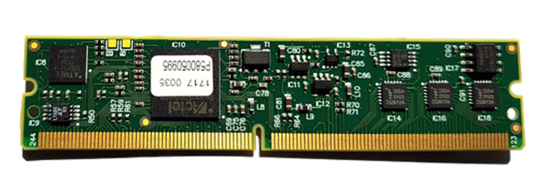
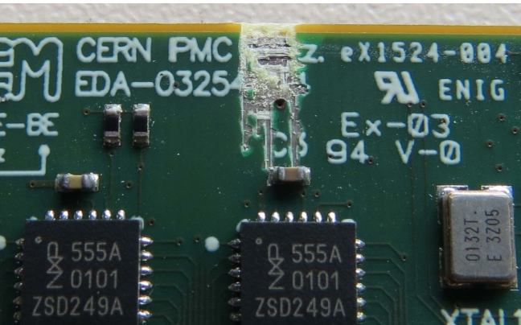
IPMC Cards
IPMC:
Current availability:
IPMC Version V3 (two UARTs): ~50
IPMC Version V4 (three UARTs): ~200
New production:
In 2023 a batch of 500 cards (V4) was manufactured
In early 2024 ATLAS and CMS have provided their requirements (including spares) for CERN IPMCs
To satisfy the communicated needs until 2028 we have placed an order for another 1050 cards
  100 cards were already delivered
  Some had mechanical issues. These cards were identified and rejected. The remaining ones carefully tested; the company was notified, and they promised to correct the error in the next batch.
  We are awaiting the delivery of the final 950 cards
No further production batches are currently foreseen, the on-going production covers the needs of ATLAS and CMS for their respective Run-4 upgrade plans

Slide 3
IPMC Cards - 2
Test coverage
  In the meantime, the production test system is being improved
  IPM_IO pins (16), all AMC pins, UARTs, and hardware address pins are fully tested
Producing more IPMC tester cards as spares in case the mezzanine connector wears out during the test
  Completing the IPMC performance test setup, which consists of an ATCA shelf fully populated with IPMC tester blades
Pigeon Point S/W support:
  Contract valid until end 2025, will be renewed
Purchasing procedure:
  Send an email to epesebe-ipmc-purchase@cern.ch, containing experiment, project name, number and version of IPMCs, and budget code: 1 IPMC = 200 CHF.

Slide 4
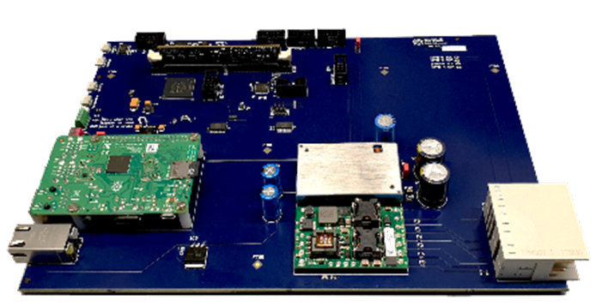
IPMC Tester
IPMC Tester:
For desk-top testing
(this is how we test the IPMC cards)
For in-shelf tests
As a development kit
Current availability:
CERN has a few IPMC Testers for sale.
You can buy one for 1500 CHF
Final production:
Another 20 IPMC Testers were built (for EP/ESE internal use)
Plan to run full-crate tests: stress tests of IPMC software and ShelfManager, investigate system aspects.
Documentation:
  https://cernbox.cern.ch/pdf-viewer/eos/project/c/cern-ipmc-support/public/CERN-IPMC%20DevKit%20-%20v.4.0.pdf

Slide 5
IPMC Support
Web site (https://cern-ipmc.web.cern.ch):
  Documentation, software, remote compilation (requires login, now also works with 2FA), link to Discourse
Documentation:
  https://cern-ipmc.web.cern.ch/doc
  Coming soon: HOW-TO on Platform Event Filtering
The IPMC firmware remote compilation page
  It is now possible to upload and compile a directory with all the files. Select “Project directory mode" here: https://cern-ipmc.web.cern.ch/compile
Discourse forum (https://cern-ipmc-forum.web.cern.ch):
Check/read the existing topics.
If you cannot find anything on your issue, create a new topic.
Alternatively, send an email to epesebe-xtca-support@cern.ch:
The email should also create a new topic in Discourse.
Support team: Markus Joos, Stefan Haas, Ralf Spiwoks
CERN has a support contract with PigeonPoint Systems (PPS):
We escalate issues to PPS, if we cannot solve them ourselves.

Slide 6
Questions?
Contact: epesebe-xtca-support@cern.ch

