Slide 1


Challenges from collective effects in the design and modelling of Muon Colliders
D. Amorim, E. Métral
Thanks to S. Albright, F. Batsch, J. S. Berg, F. Boattini, C. Barbagallo, L. Bottura, X. Buffat,
C. Carli, A. Chancé, H. Damerau, E. de la Fuente, M. Gast, A. Grudiev, I. Karpov, E. Kvikne,
E. Lamb, N. Mounet, T. Pieloni, C. Rogers, G. Rumolo, M. Seidel, D. Schulte,
L. Soubirou, K. Skoufaris, R. Taylor, L. Thiele, M. Vanwelde
BE seminar, 14th March 2025
This work was performed under the auspices and with support from the Swiss Accelerator Research and Technology (CHART) program (www.chart.ch).

Slide 2
Overview of the Muon Collider
Some examples of collective effects
Collective effects in the Muon Collider

Slide 3
Overview of the Muon Collider
Some examples of collective effects
Collective effects in the Muon Collider

Slide 4
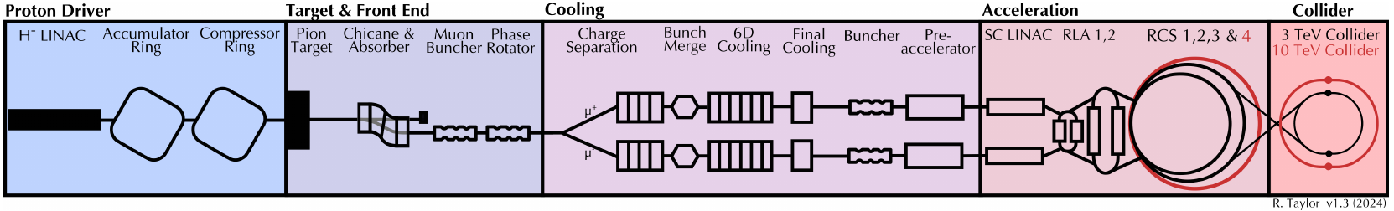
Overview of the Muon Collider complex
Muon decay with a lifetime of 𝝉₀=𝟐.𝟐𝝁𝒔 but thanks to special relativity, the lifetime in the laboratory frame becomes 𝝉=𝛾𝜏₀=47323⋅2.2𝜇𝑠=𝟏𝟎𝟒 𝒎𝒔 at 5 TeV
The challenge is to generate muon bunches with low emittance and accelerate them quickly enough to a high luminosity experiment
High power proton driver to generate high intensity muon beams
6D muon cooling to reach target emittances
Fast acceleration in Recirculating Linacs and Rapid Cycling Synchrotrons to counter-balance
the muon decay
In the collider ring, small β* are needed to reach the luminosity target

Slide 5
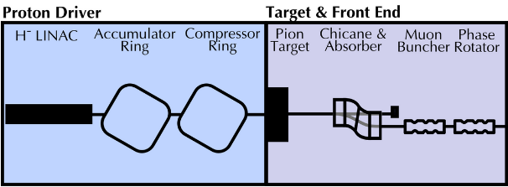
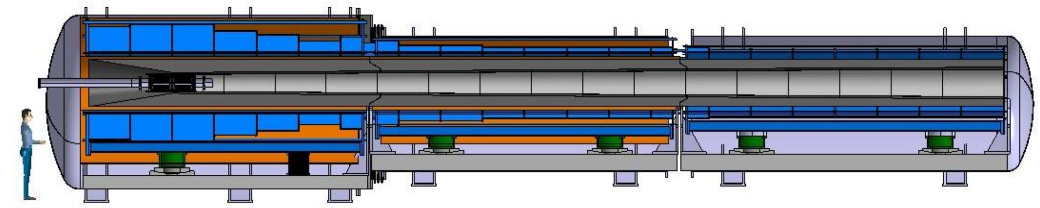
Proton driver and target
Generate high power proton beam, two options at 2 MW or 4 MW
  5 GeV or 10 GeV, 5⋅10¹⁴ protons on target, 2 ns bunch length, 5 Hz repetition rate
  Comparable to ESS: 5MW, 2 GeV, 14 Hz
Graphite target, surrounded by a tungsten shield and immerged in a strong solenoid field generated by High Temperature Superconductors
  Must withstand radiation flux and dissipate generated heat load
Tungsten shield
HTS solenoid
Graphite target
p⁺
µ⁺, µ⁻, π⁺, π⁻
C. Accettura et al.
Notes:
https://ieeexplore.ieee.org/document/10443443
https://indico.cern.ch/event/1325963/contributions/5792975/attachments/2818936/4922081/IMCC_March2024.pdf

Slide 6
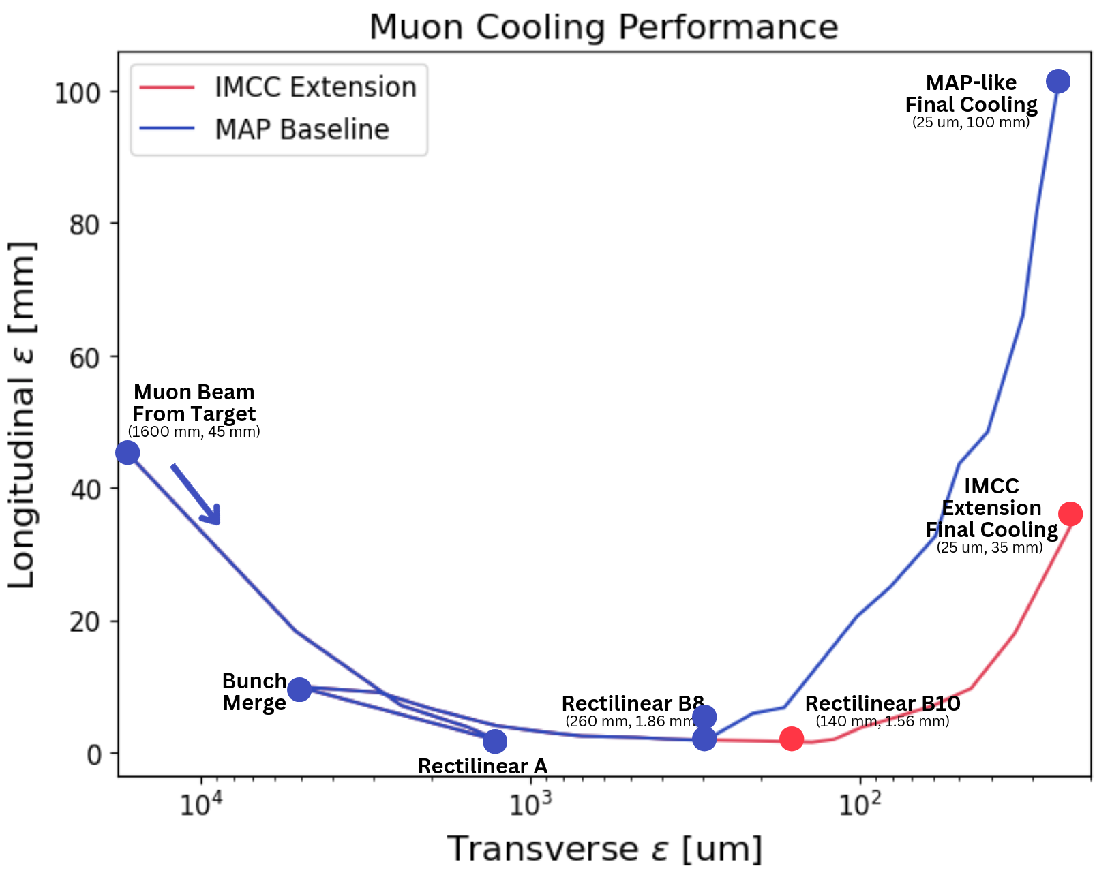
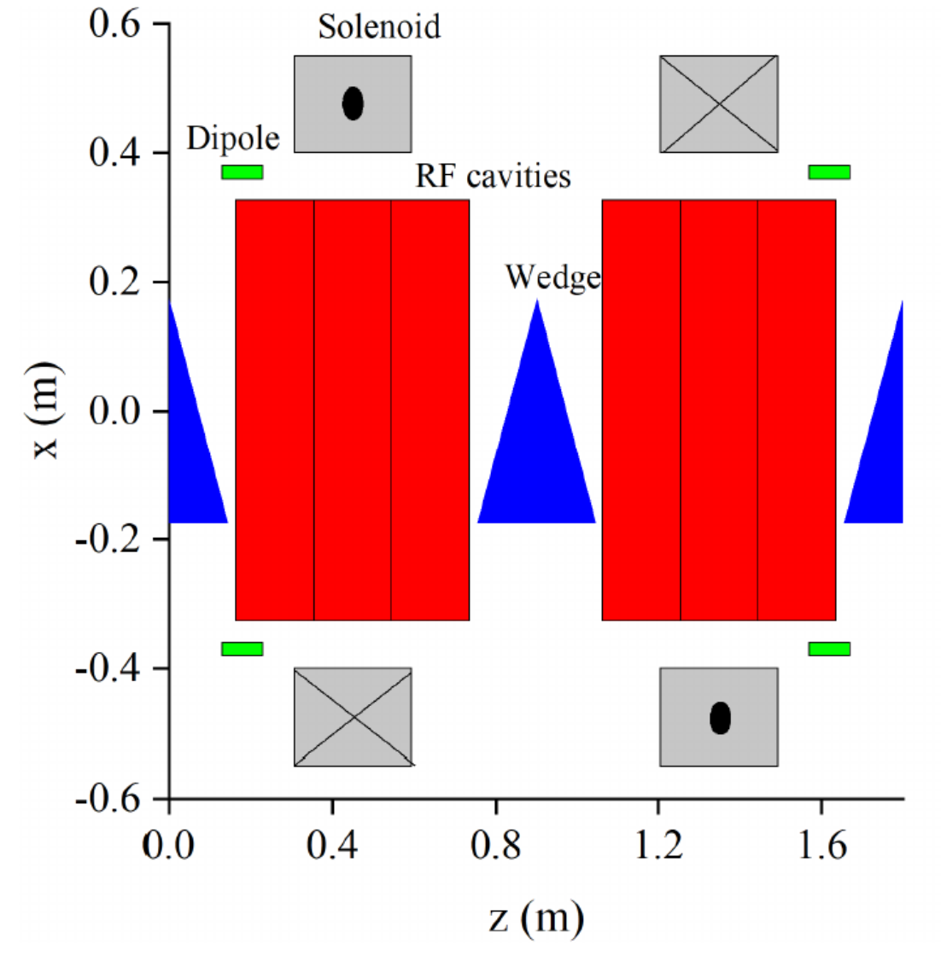
Muon Cooling
Ionization cooling provided by Liquid Hydrogen wedge absorbers
Warm RF cavities to restore the beam longitudinal momentum
Solenoid magnet to focus the beam at the absorber location
From Interim Report
R. Taylor
Notes:
From Interim report: https://arxiv.org/abs/2407.12450
Chris Rogers prensetation?

Slide 7
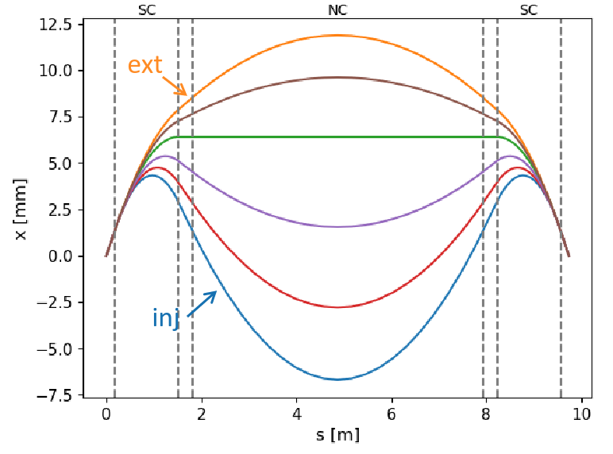
Rapid Cycling Synchrotrons (RCS)
Large RF voltage are required to accelerate the beams: many RF cavities in each machine. E.g., 90 GV and 3000 cavities in RCS 4
  Fast ramping magnets are needed: e.g., 4200 T/s in RCS 1
Hybrid synchrotrons for RCS 2, 3 and 4: alternate fixed-field 10 T superconducting dipoles and pulsed 1.8T normal conducting dipoles to increase the energy swing
  This creates large orbit excursion in the dipole magnets
L. Soubirou
Machine parameters | RCS 1 | RCS 2 | RCS 3 | RCS 4
Circumference [km] | 6 | 6 | 10.7 | 35
Injection energy [GeV] | 63 | 313.8 | 750 | 1500
Energy increase per turn [GeV] | 14.7 | 7.9 | 11.3 | 63.6
Bunch intensity at injection [10¹² muons] | 2.7 | 2.4 | 2.2 | 2.0
ε_{t} [µm rad] / ε_{l} [eV s] | 25 / 0.025
Notes:
Lisa Soubirou annual meeting: https://indico.cern.ch/event/1325963/contributions/5806746/attachments/2817648/4921129/Status_RCS_geometry_LSoubirou.pdf

Slide 8
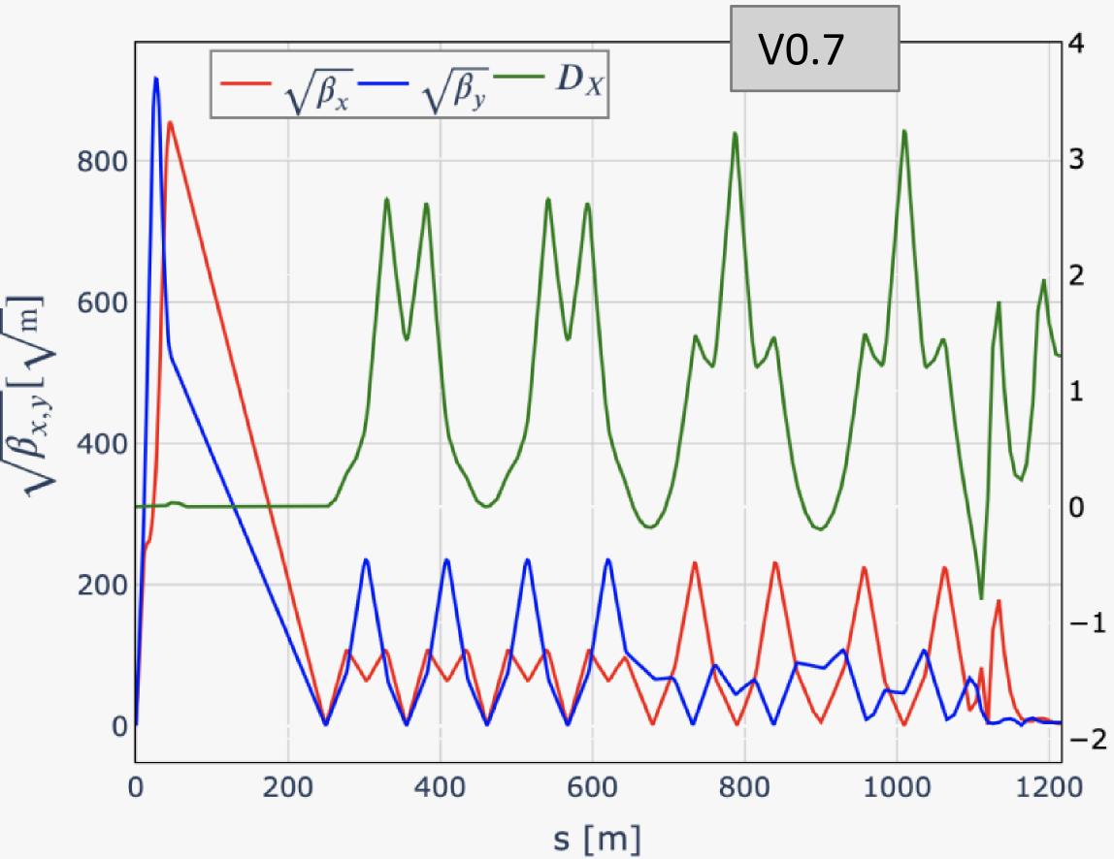
Collider
Achieve high luminosity, both instantaneous and integrated
  Small β* (1.5 mm), high bunch intensity 1.8·10¹², 5 Hz repetition rate
Must minimize intensity losses per turn from muon decay
  Compact ring with high average dipole field
Challenging lattice design with strong final focus magnets
creating large chromatic aberrations
Parameters | Stage 1 Collider 3 TeV | Stage 2 Collider 10 TeV
Circumference [km] | 4.5 | 10
Beam energy [TeV] | 1.5 | 5
Instantaneous luminosity [10³⁴ cm⁻²s⁻¹] | 2.1 | 21
Bunch intensity at injection [10¹² muons] | 2.2 | 1.8
Repetition rate [Hz] | 5 | 5
Bunch length at IP [mm] | 5 | 1.5
β* at IP [mm] | 5 | 1.5
ε_{t} [µm rad] / ε_{l} [eV s] | 25 / 0.025
K. Skoufaris, M. Vanwelde
Notes:
Marion presentation: https://indico.cern.ch/event/1325963/contributions/5806746/attachments/2817648/4921129/Status_RCS_geometry_LSoubirou.pdf
Kyriacos:

Slide 9
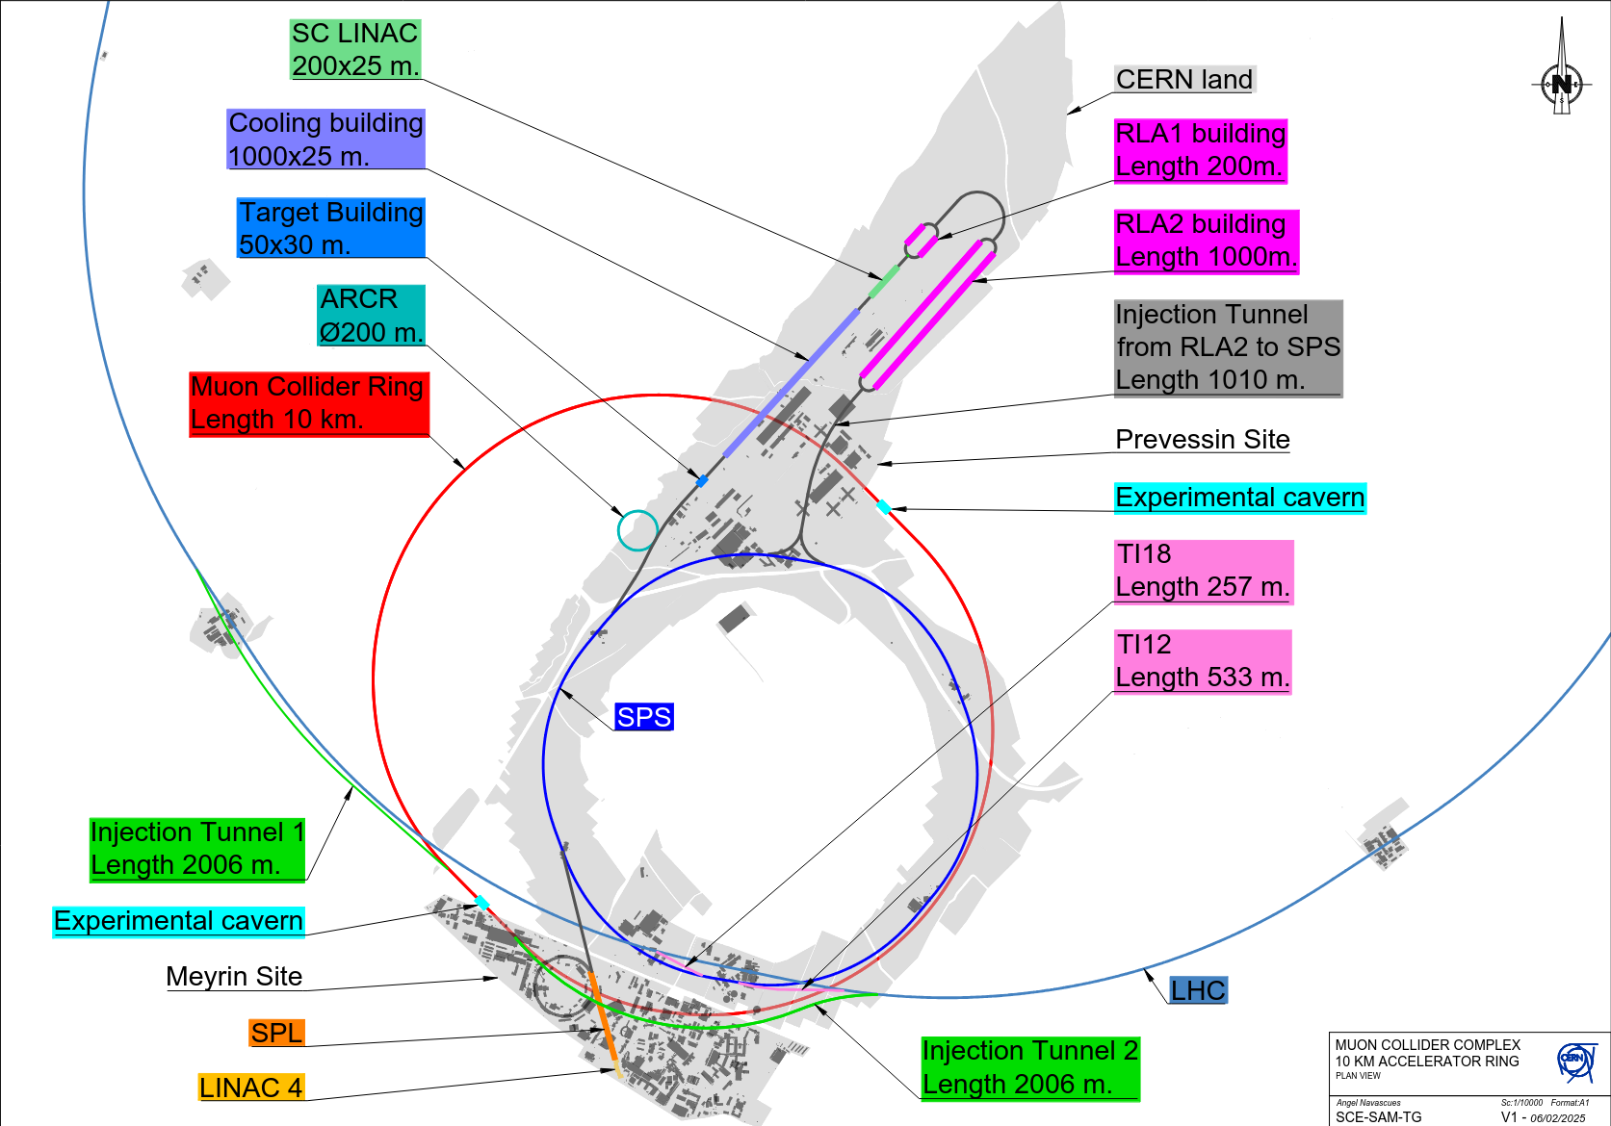
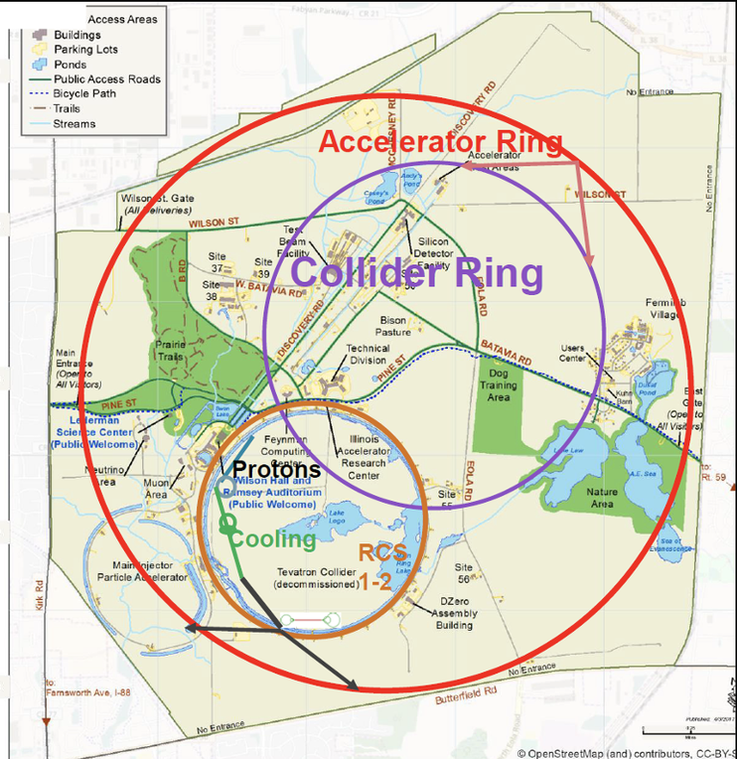
Implementation studies
Muon Collider collaboration is based on a “Greenfield” facility
Studies have been started to implement a Muon Collider on CERN site or Fermilab site
  Could reuse existing tunnels and fit most of
  the facility on CERN lands
  Collider placement need to be carefully
  assessed to mitigate neutrino flux
Implementation of a
muon cooling test facility
at CERN is also studied

Slide 10
Overview of the Muon Collider
Some examples of collective effects
Collective effects in the Muon Collider

Slide 11
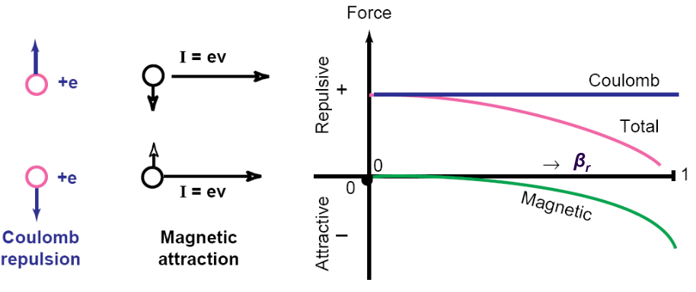
Direct space charge
In a bunch, particles are subject to Coulomb repulsion
Once in motion, the induced magnetic field creates an attractive force
But at low energies this force does not sufficiently compensate the Coulomb force
This force depends on the transverse distribution of the particles and is non-linear for Gaussian bunches
K. Schindl, Space Charge

Slide 12
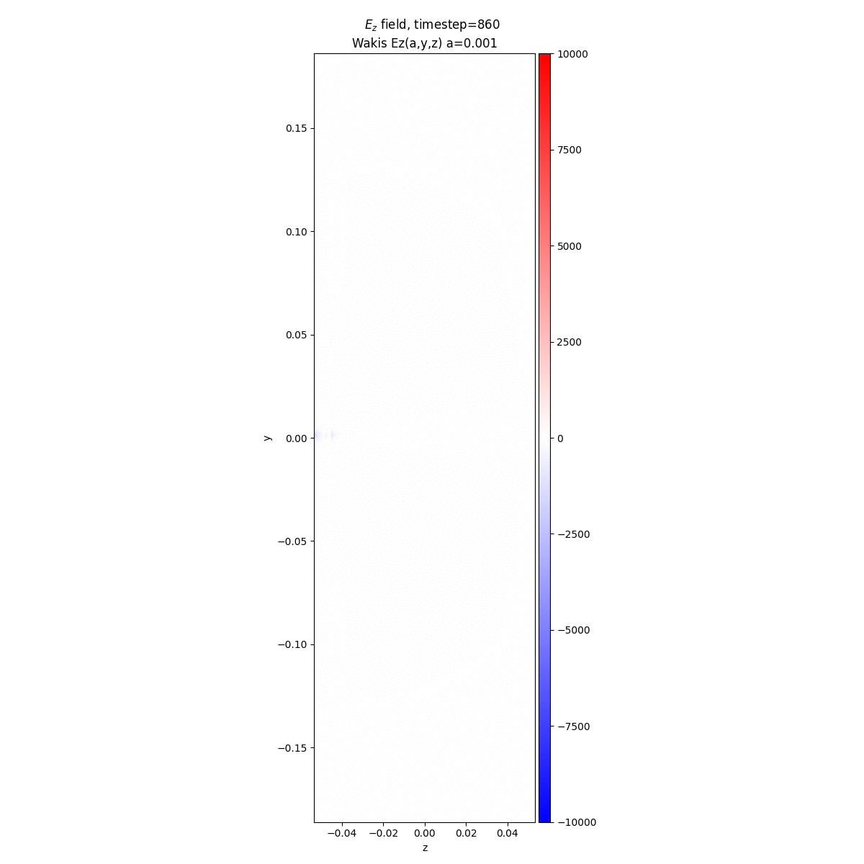

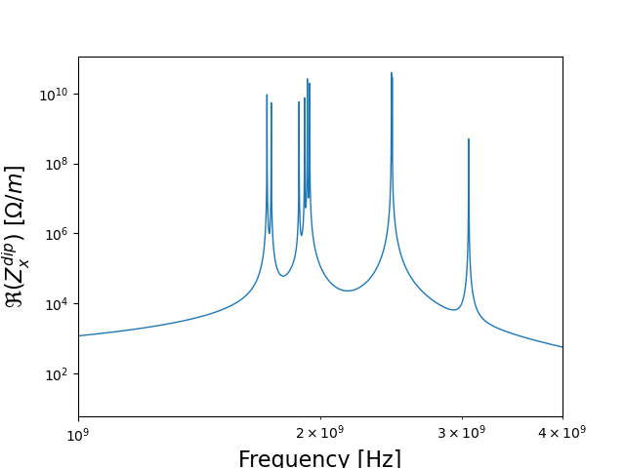

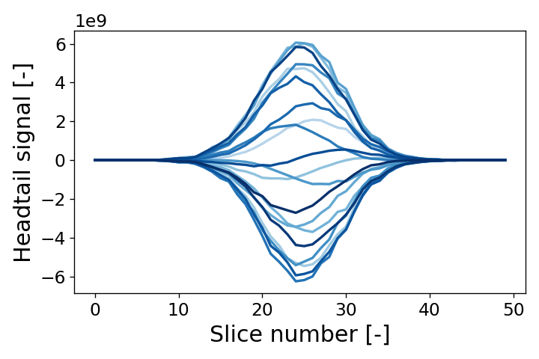
Impedance / Wakefields
The charged bunches interact electromagnetically with their environment: vacuum chamber, RF cavities, flanges etc.
Impedance (frequency domain)/wakefields (time domain) characterize these interactions
  They can be computed with 3D electromagnetic simulations or analytical models
These fields can perturb the following bunch, or the bunch itself
Careful design of the accelerator equipment can reduce these parasitic fields
Cavity transverse impedance model
E. de la Fuente
Turn-by-turn headtail signal
Notes:
Add

Slide 13
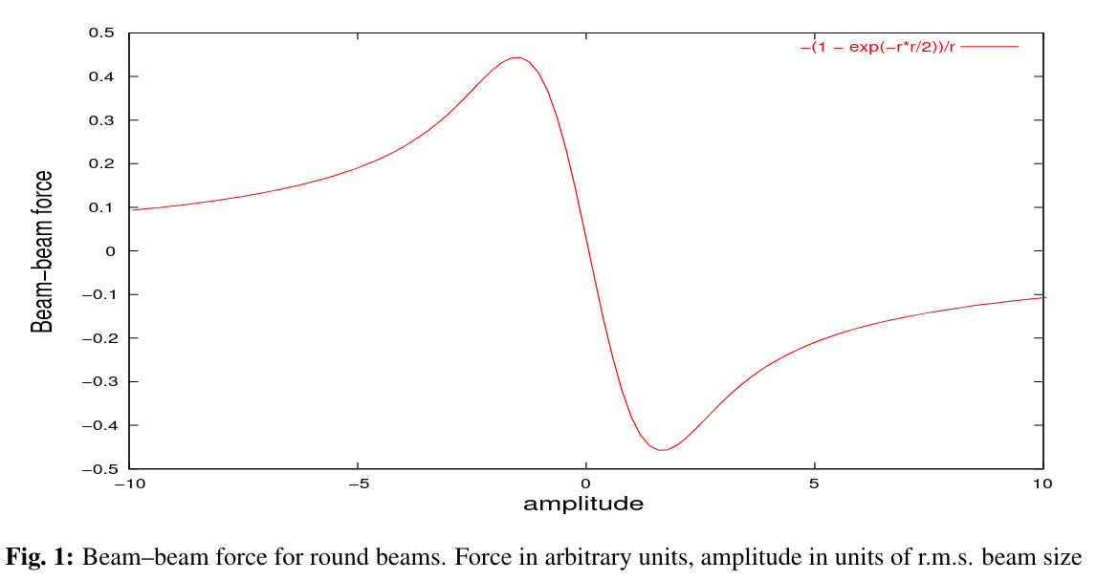




Beam-beam interactions
W. Herr and T. Pieloni, Beam-beam effects
Interaction Point
Muons $μ^{−}$
Antimuons $μ^{+}$
$${\vec{F}}_{beam on particle}$$
Amplitude
$${\vec{F}}_{beam on particle}$$
Bunches generate an electromagnetic field
When two bunches cross each other, the fields generated by one bunch perturb the other bunch
These effects are non-linear, and depend on the particle distribution, the number of bunches etc.

Slide 14
Overview of the Muon Collider
Some examples of collective effects
Collective effects in the Muon Collider

Slide 15
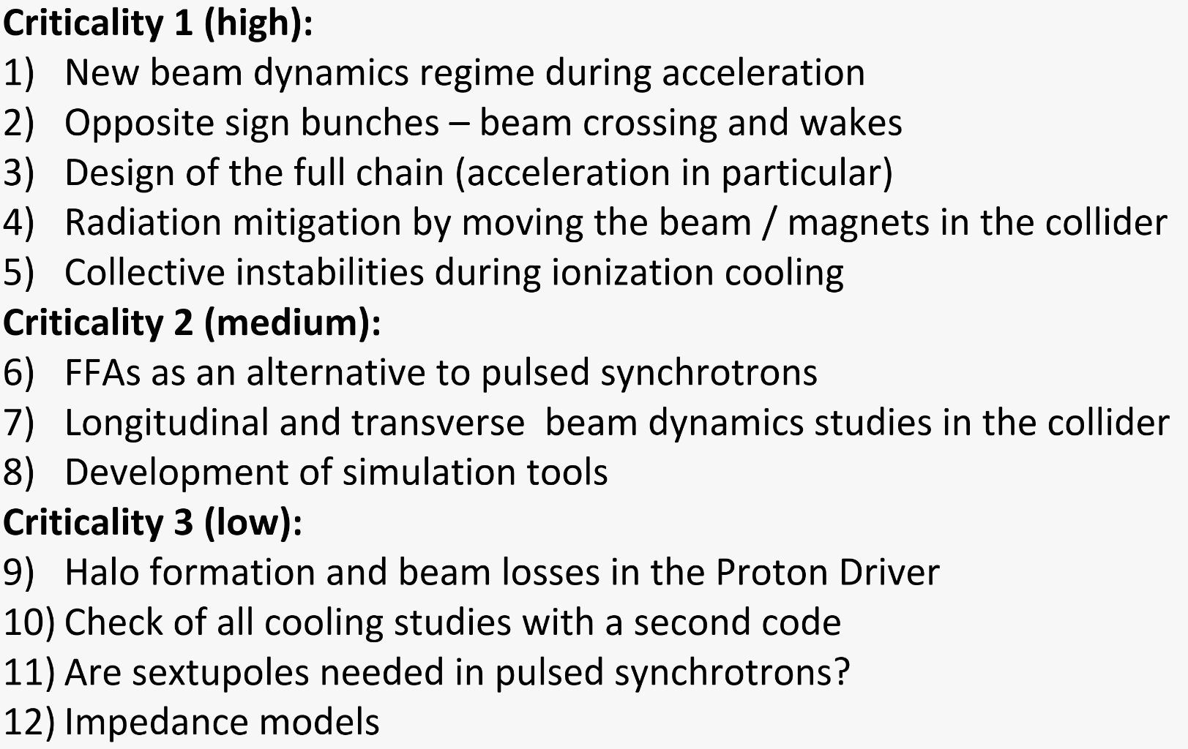
Collective effect challenges identified for the Muon Collider
Collaboration roadmap in 2021 identified twelve items for beam dynamics and collective effects, based on studies previously done by the US Muon Accelerator Program
R. Ryne, T. Raubenheimer, E. Métral

Slide 16
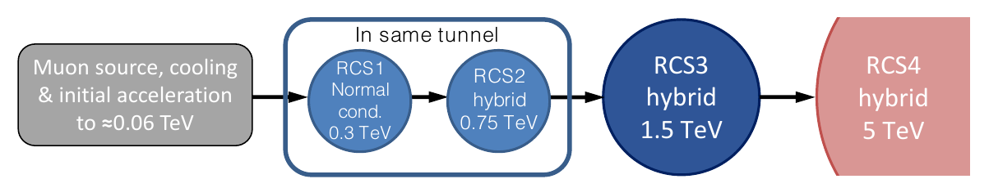

Collective effects challenges in the Rapid Cycling Synchrotrons (RCS)
Large RF voltage are required to accelerate the beams: many RF cavities in each machine. E.g., 90 GV and 3000 cavities in RCS 4
  Synchrotron tune $Q_{s}=1.5≫1/π$ in RCS 1 at injection, well above the longitudinal phase space stability criteria
  The cavities must be distributed along the ring to preserve longitudinal focusing
Fast ramping magnets are needed: e.g., 4200 T/s in RCS 1
  The vacuum chamber must be designed to both minimize eddy current effects and beam coupling impedance

Slide 17
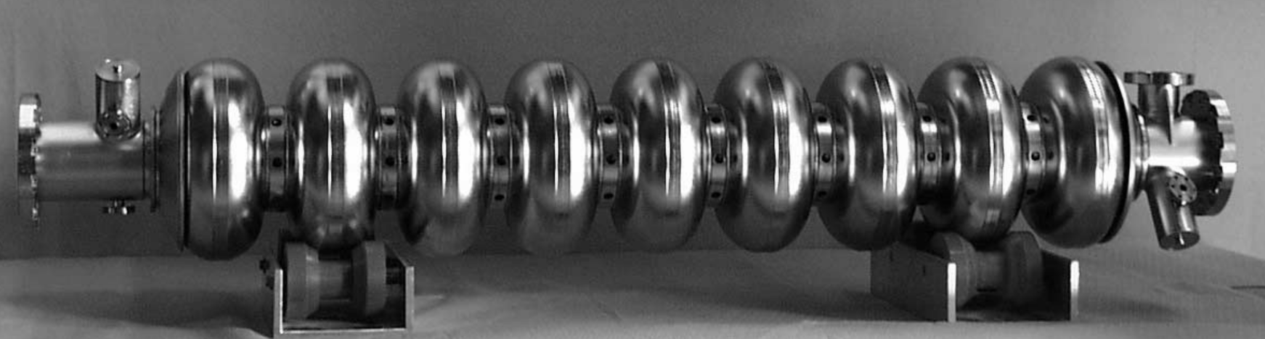
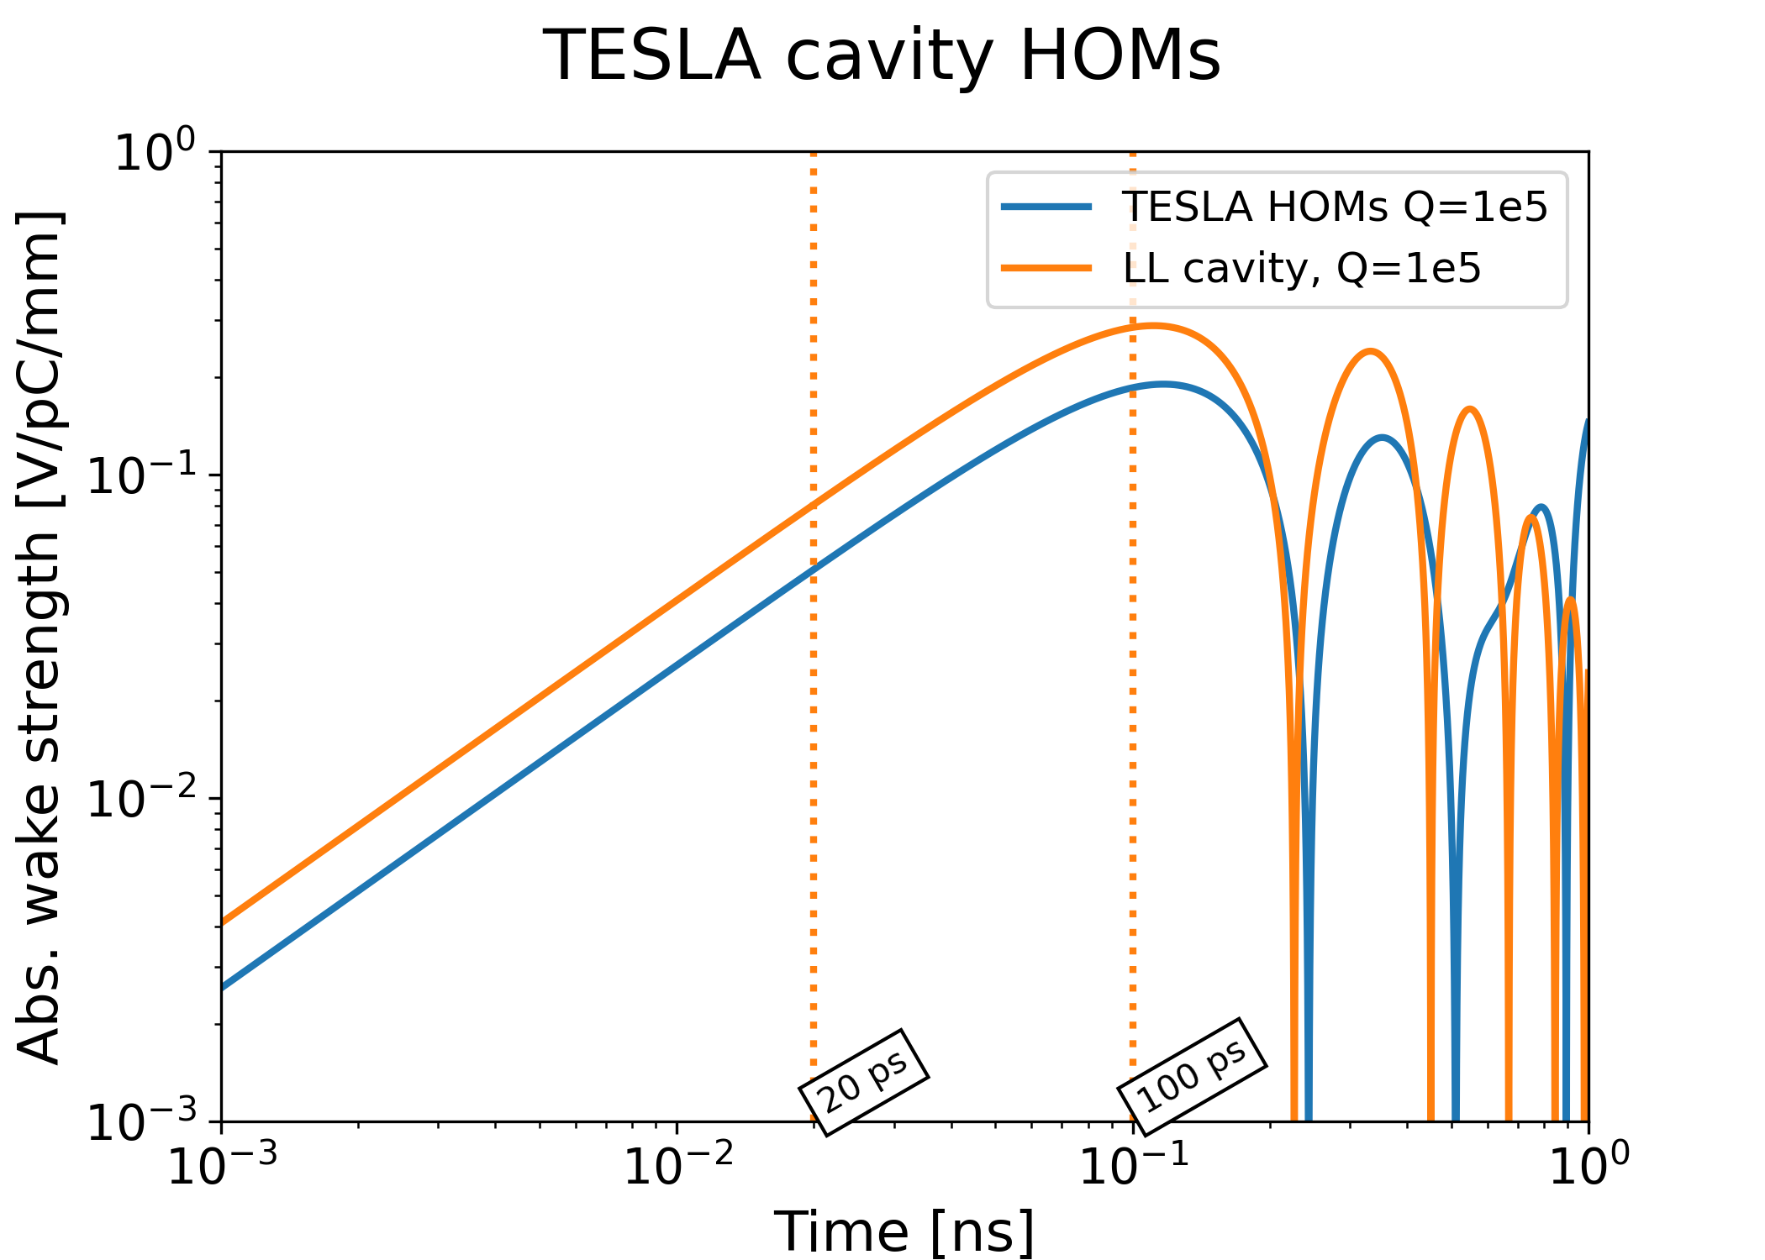
Impedance model for the RF cavities
1.3GHz superconducting TESLA cavity has been considered for the studies for their high gradient (30 MV/m per cavity is assumed)
The High Order Modes (HOMs) of the cavities are the main concern for transverse stability
Two variants of this cavity have been studied: the classic TESLA and the Low Loss type
  TESLA cavities are used at European
  XFEL and are ILC baseline
  Low Loss type have been studied to
  reach higher accelerating gradient,
  at the cost of stronger HOMs
Impedance function for the Low Loss cavity HOMs
Wake function for the two types of cavity studied
1 σ_{z}
Notes:
TESLA cavity: https://journals.aps.org/prab/abstract/10.1103/PhysRevSTAB.3.092001

Slide 18
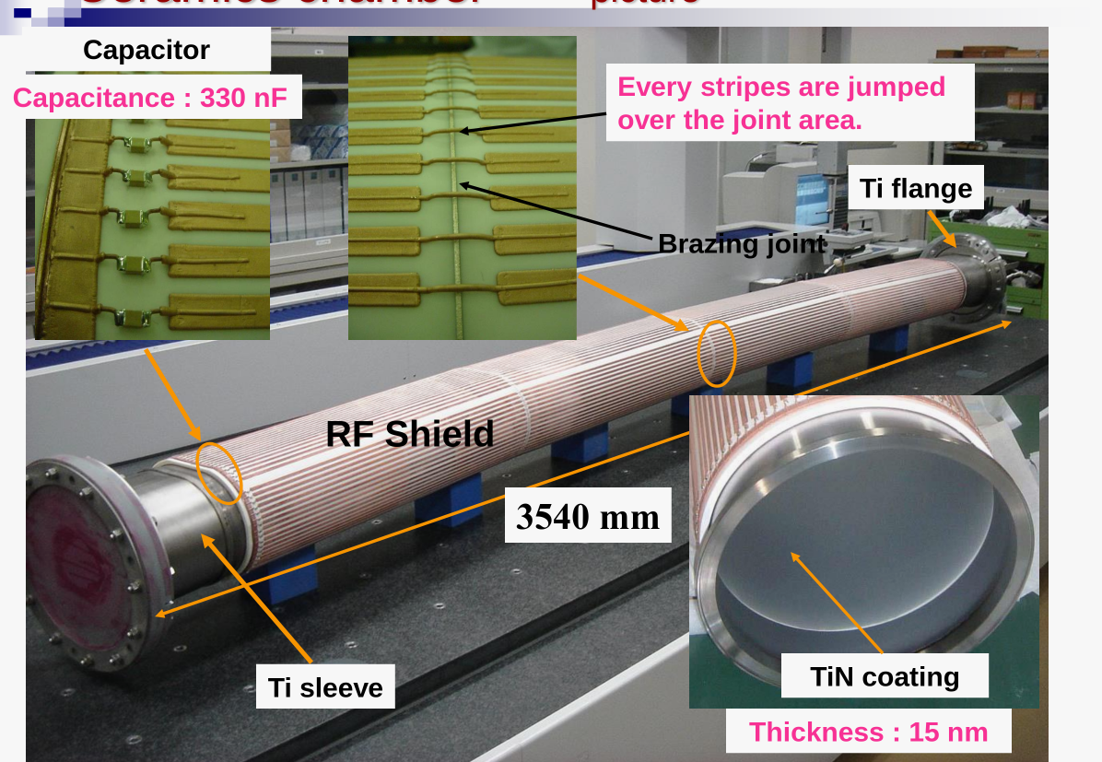
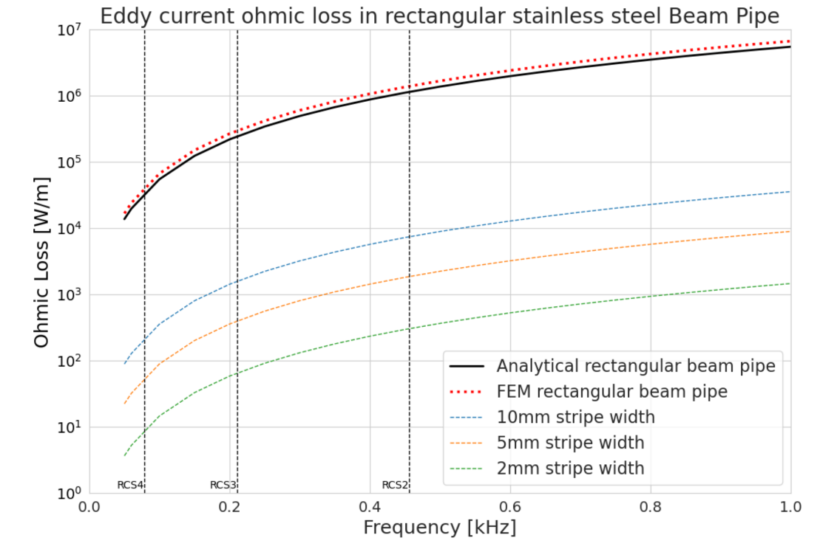

Vacuum chamber design constraints for the pulsed magnets
Ramp rate $\dot{B}$ are large e.g. 4200 T/s in RCS 1, therefore, large eddy current losses would appear in a classic metallic vacuum chamber
A ceramic chamber must be used, with longitudinal stripes to maintain continuity for the beam image current
Eddy current losses are drastically reduced and become acceptable for thinner stripes
E. Kvikne
M. Kinsho, J-PARC
Notes:
Erik Kvikne: https://indico.cern.ch/event/1437002/contributions/6061674/attachments/2903847/5093368/Wrap-up_on_Eddy_Current_E
JPARC: https://indico.fnal.gov/event/16269/contributions/36516/attachments/22688/28130/J-PARC-RCS-Vacuum-Chambers.pdfffects_in_the_NC_RCS_Vacuum_Chamber.pdf

Slide 19
Impedance model for the RCS vacuum chamber
Iron yoke
Ceramic
Impedance and its impact on transverse beam stability must be assessed
Provide the magnet and vacuum team with design input such as metallic coating thickness or minimum chamber radius
Chamber impedance is computed with ImpedanceWake2D
Example study to check the impact of a metallic coating.
  Radius constant at 10mm, ceramic thickness set to 5mm
30mm
RF shield
100mm
Impedance model
Ceramic
Copper
5mm
10mm
Notes:
Ref: Erik presentation annual meeting
Ref: IW2D

Slide 20
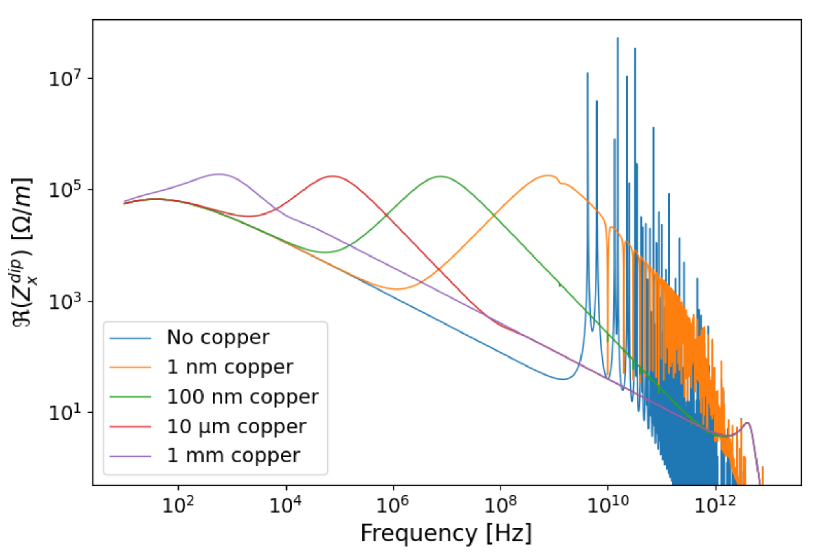
Impedance model for the RCS vacuum chamber
Transverse dipolar impedance for 1m of chamber
E. Kvikne
An uncoated ceramic (blue curve) created strong resonances: detrimental for impedance
Adding a 100 nm inner metallic coating (green curve) damps these resonances

Slide 21
Tracking simulations for the
RCS chain
We must ensure that bunch intensity and transverse emittance are preserved through the acceleration chain
Macroparticle tracking simulations are performed using the Xsuite framework
  A single muon bunch is tracked through the chain of four accelerators
  The RF cavities (700 in RCS 1, 3000 in RCS 4) and their wakefield elements are regularly placed in 32 stations along the ring
Beam monitor
66 turns
55 turns
RF station and
Impedance
17 turns
55 turns
RCS 3
750 -1500 GeV
RCS 4
1.5 -5.0 TeV
Transverse
damper
RCS 1
63 – 313 GeV
RCS 2
313 - 750 GeV
Notes:
Ref xsuite

Slide 22
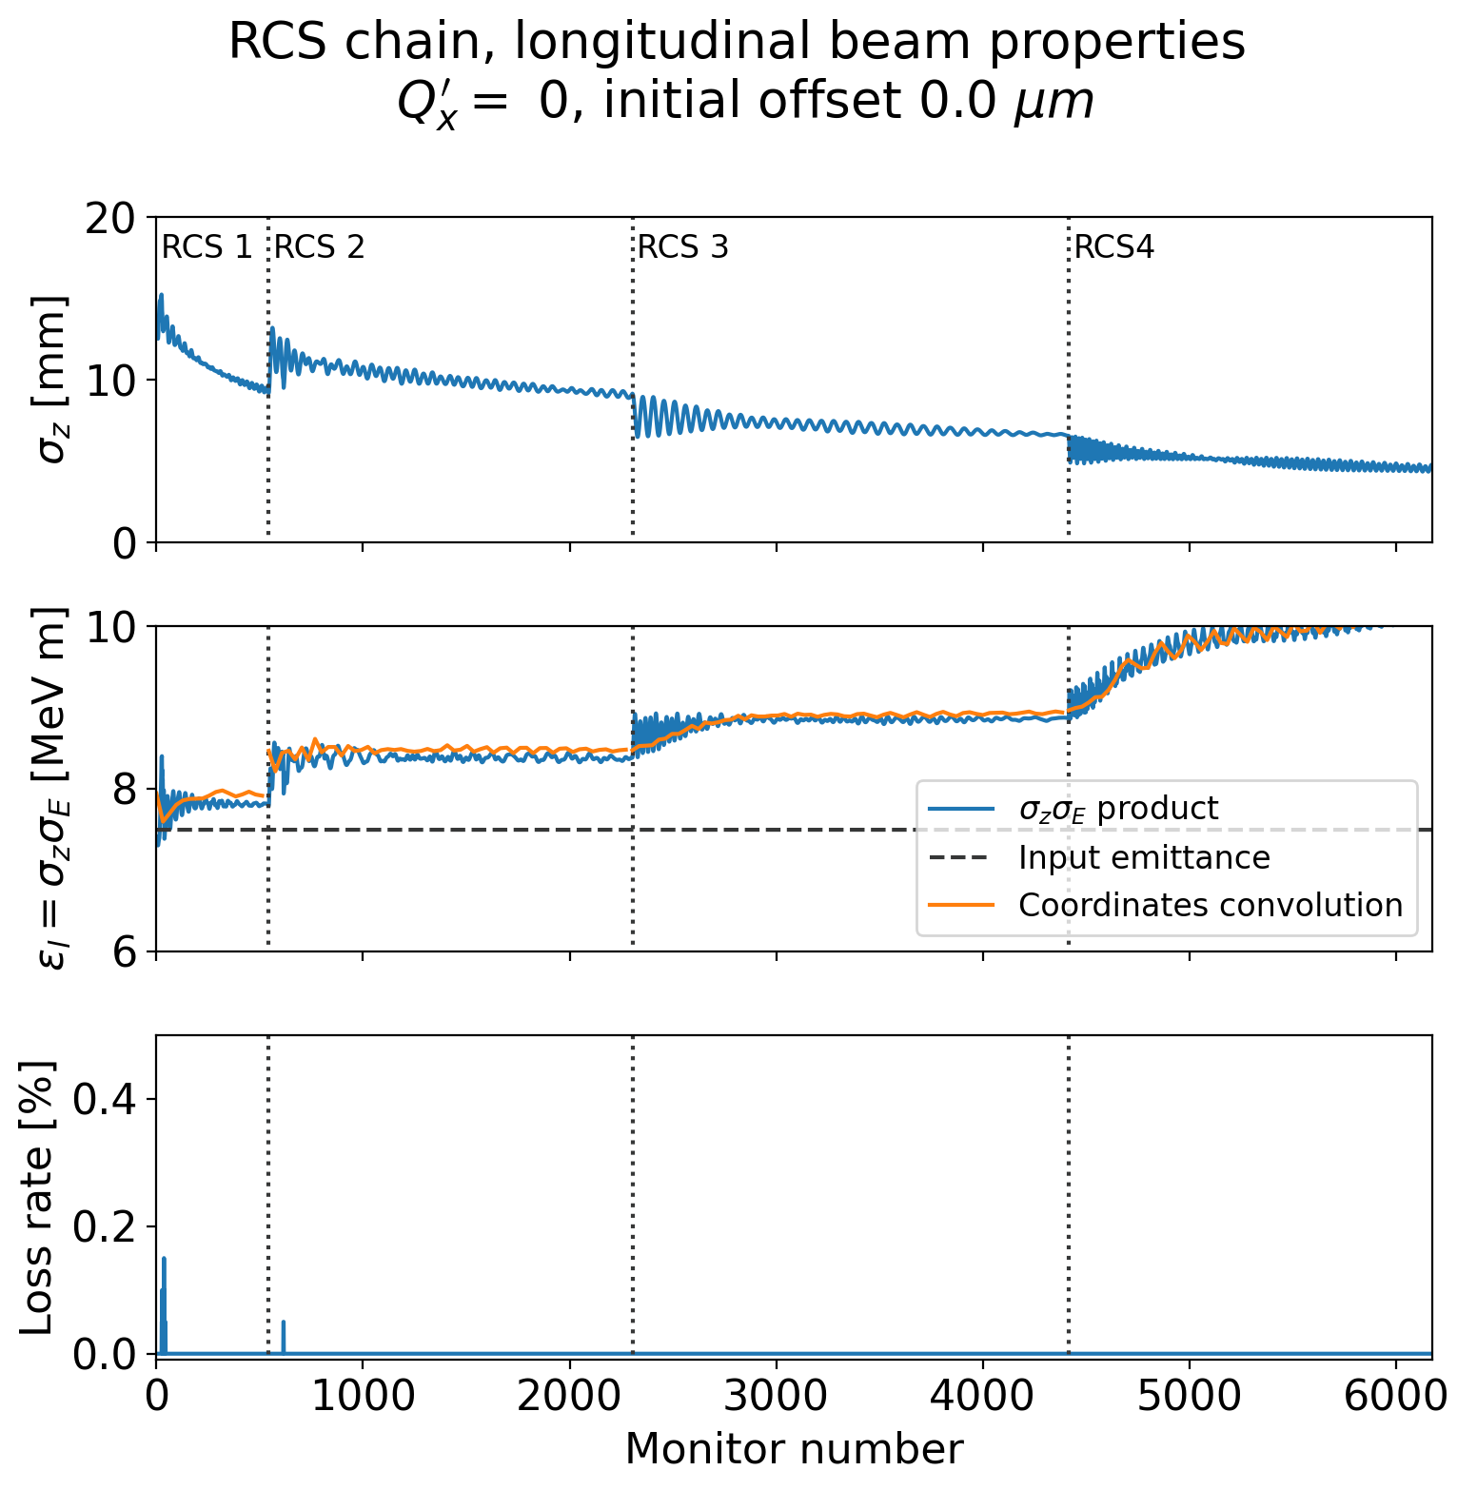
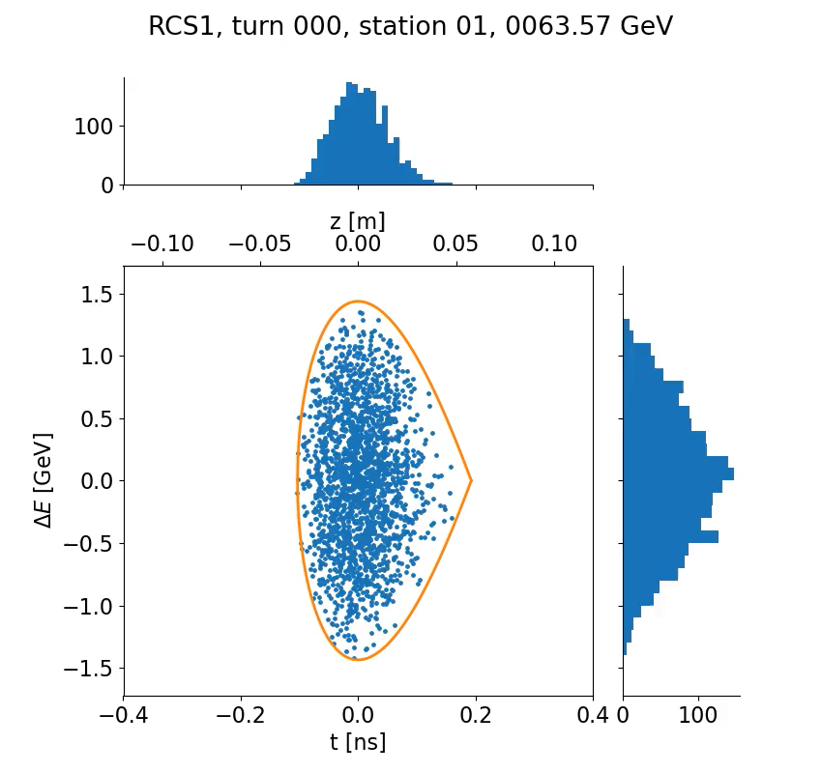
Particle tracking simulations for the RCS chain
Macroparticle tracking allows to simulate the effect of the RF cavities wakefield on the beam
  Simulations showed here only include the RF cavity wakefield

Slide 23
Particle tracking simulations for the RCS chain
Macroparticle tracking allows to simulate the effect of the RF cavities wakefield on the beam
  Simulations showed here only include the RF cavity wakefield
Bunch is matched longitudinally at injection into RCS 1
There is longitudinal emittance blow-up
Some particles are lost in the first turns after injection

Slide 24
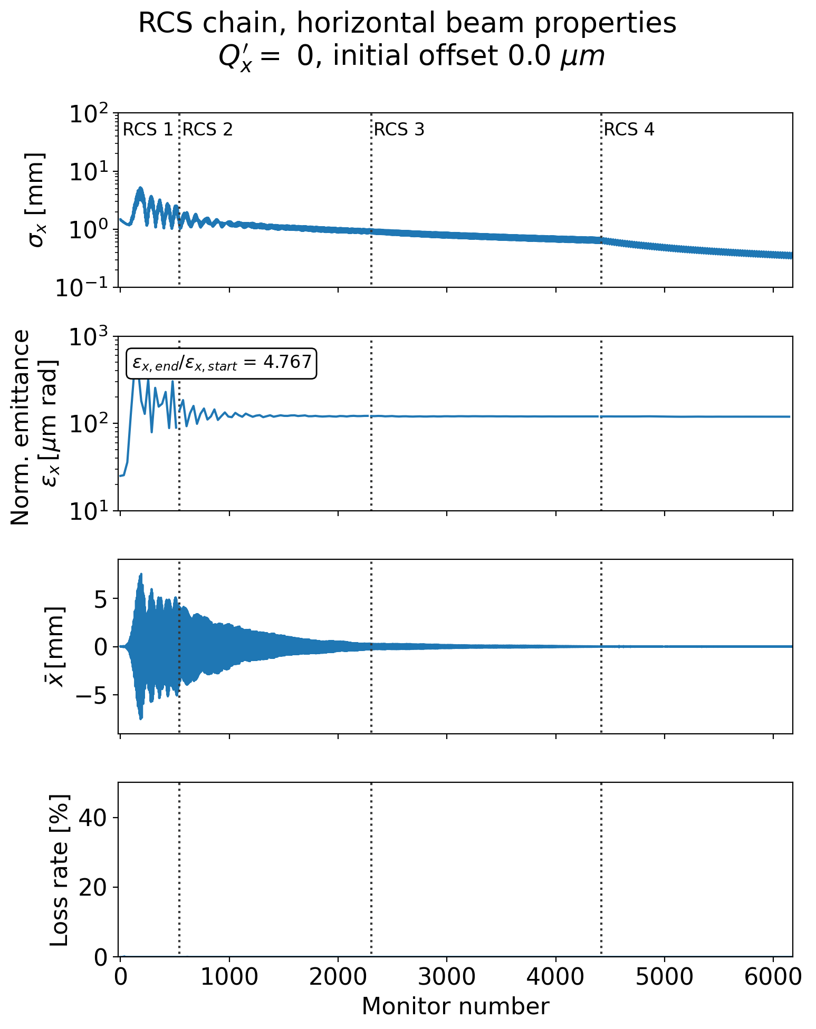
Particle tracking simulations for the RCS chain
Macroparticle tracking allows to simulate the effect of the RF cavities wakefield on the beam
  Simulations showed here only include the RF cavity wakefield
The large number of RF cavities create strong, short range wakefields
A fast transverse instability can develop in the RCS and generate emittance blow-up and beam losses
Transverse emittance blow-up in RCS 1
Large horizontal bunch oscillation

Slide 25
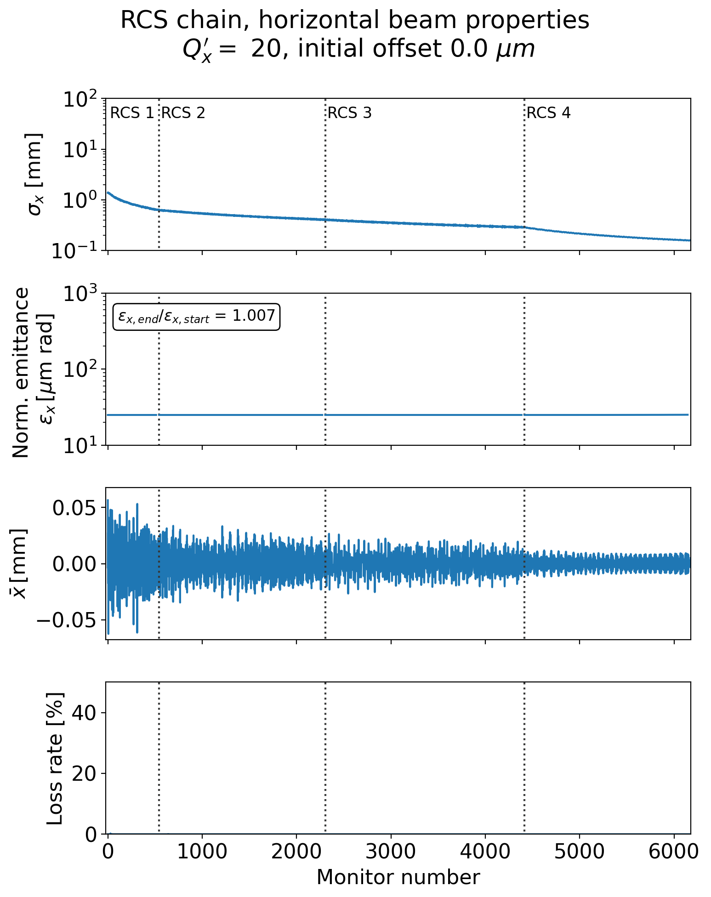
Particle tracking simulations for the RCS chain
The large number of RF cavities create strong, short range wakefields
A fast transverse instability can develop in the RCS and generate emittance blow-up and beam losses
Introducing positive chromaticity and a transverse damper can mitigate the instability
No emittance blow-up
Transverse oscillations are damped

Slide 26
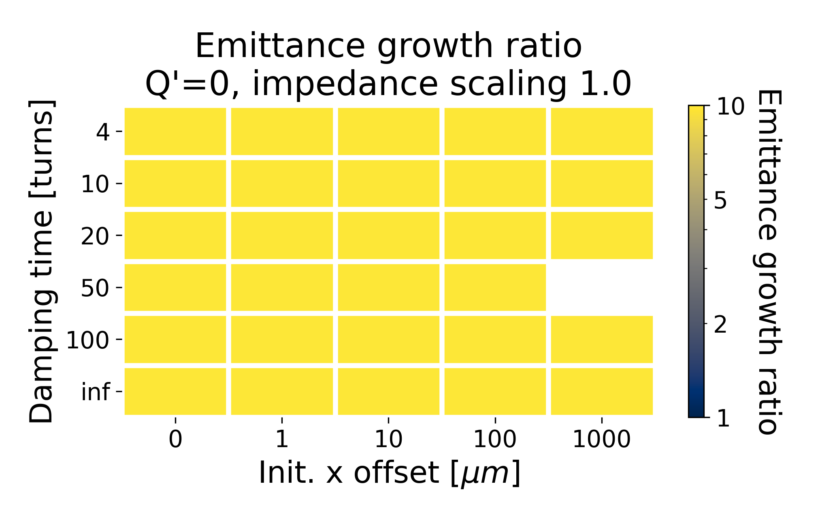
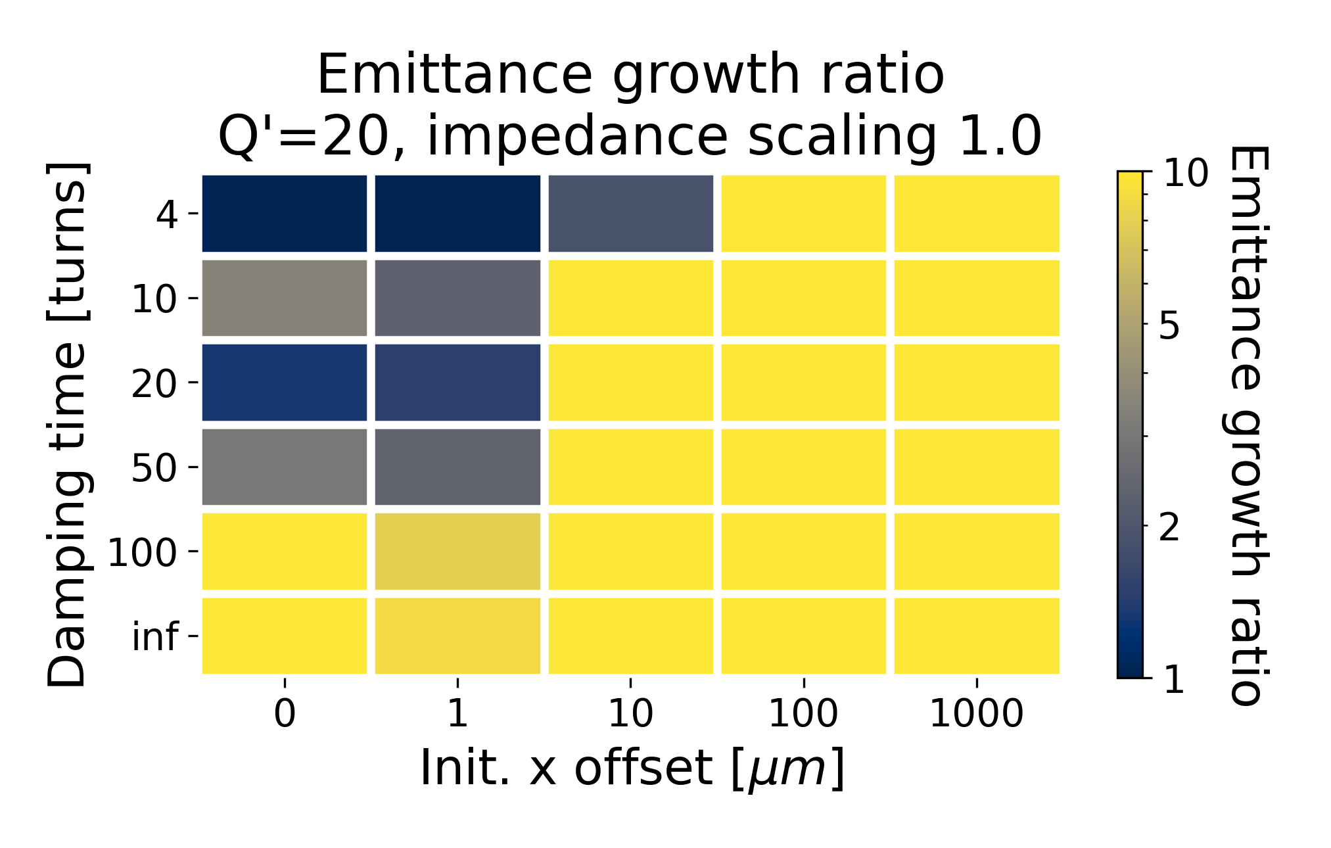
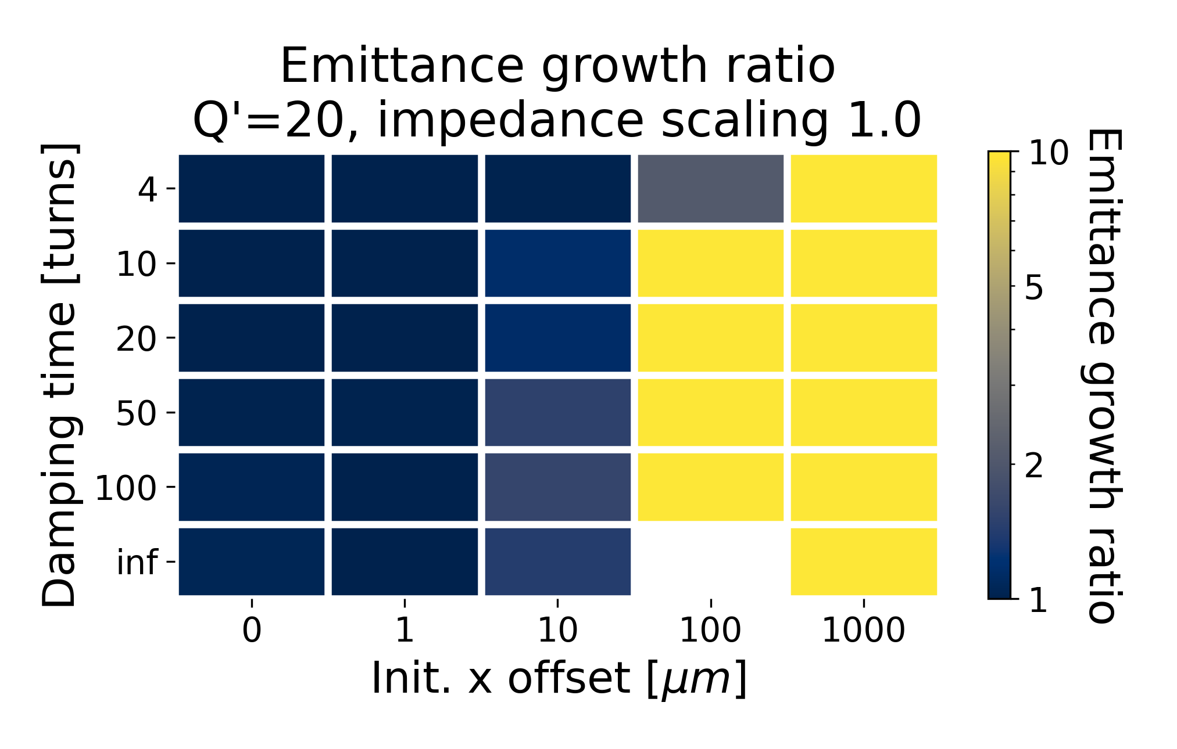
Impact of the different type of
RF cavities
The large number of RF cavities create strong, short range wakefields
A fast transverse instability can develop in the RCS and generate emittance blow-up and beam losses
Introducing positive chromaticity and a transverse damper can mitigate the instability
Parametric tracking simulations were performed, investigating the impact of transverse damper, chromaticity, initial beam offset or RF cavity type
Chromaticity Q’=0
Chromaticity Q’=+20
Low Loss cavity
Heatmap of emittance growth through the RCS chain, scanning transverse damping time and bunch offset
TESLA cavity

Slide 27
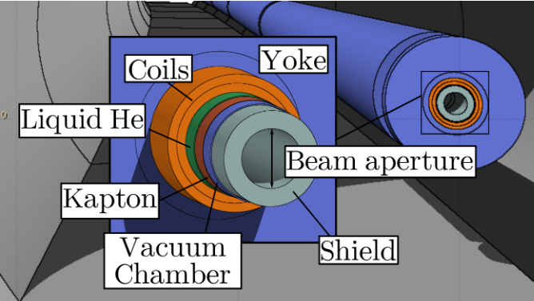
Collective effects challenges for the 10 TeV collider
Short bunch length σ_{z}=1.5 mm and large Δp/p₀ = 10⁻³
  Very large RF voltage would be needed, even with small slippage factor (GV range with η ~ 10⁻⁶)
  → unpractical
  Operation with minimal RF (to compensate synchrotron radiation losses) is foreseen. It implies correcting
  η to zero to obtain an isochronous ring
Resistive wall would be the main contributor to transverse impedance
Tungsten liner is required to shield the superconducting coils from muon decay products
D. Calzolari

Slide 28
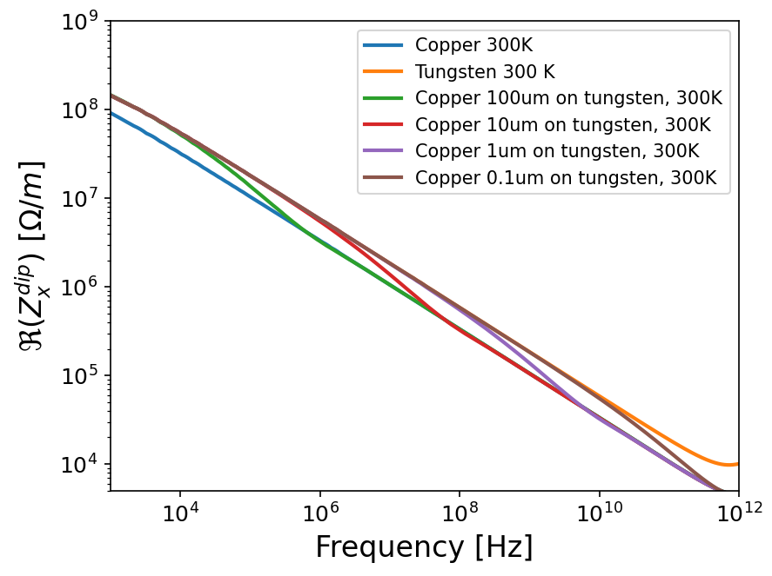
10 TeV collider impedance model
Assume 10 km resistive wall impedance for the collider
Scan the chamber radius and the copper coating thickness
Goal: find the minimum chamber radius and coating thickness admissible for transverse coherent stability
 | Tungsten 300K | Copper 300 K
Resistivity [nΩ m] | 54.4 | 17.9
40 mm
23 mm chamber radius
Different copper coating thickness
Scan
Tungsten
Copper

Slide 29
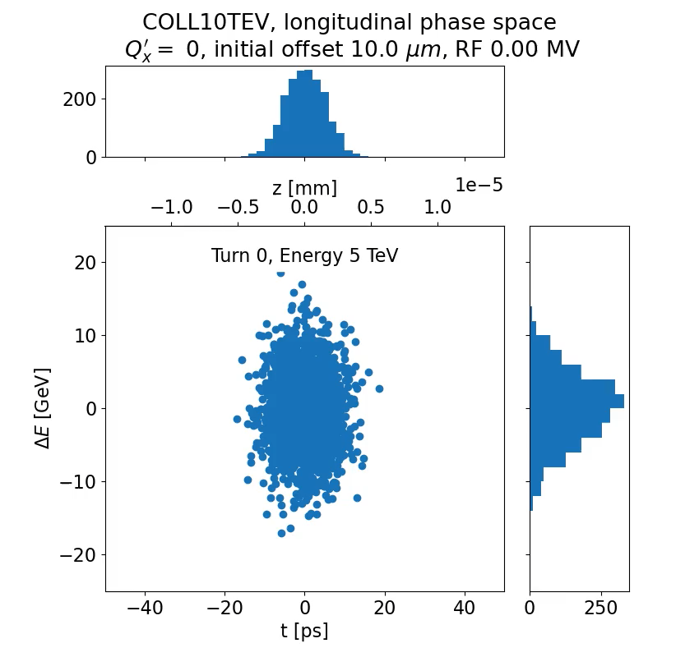
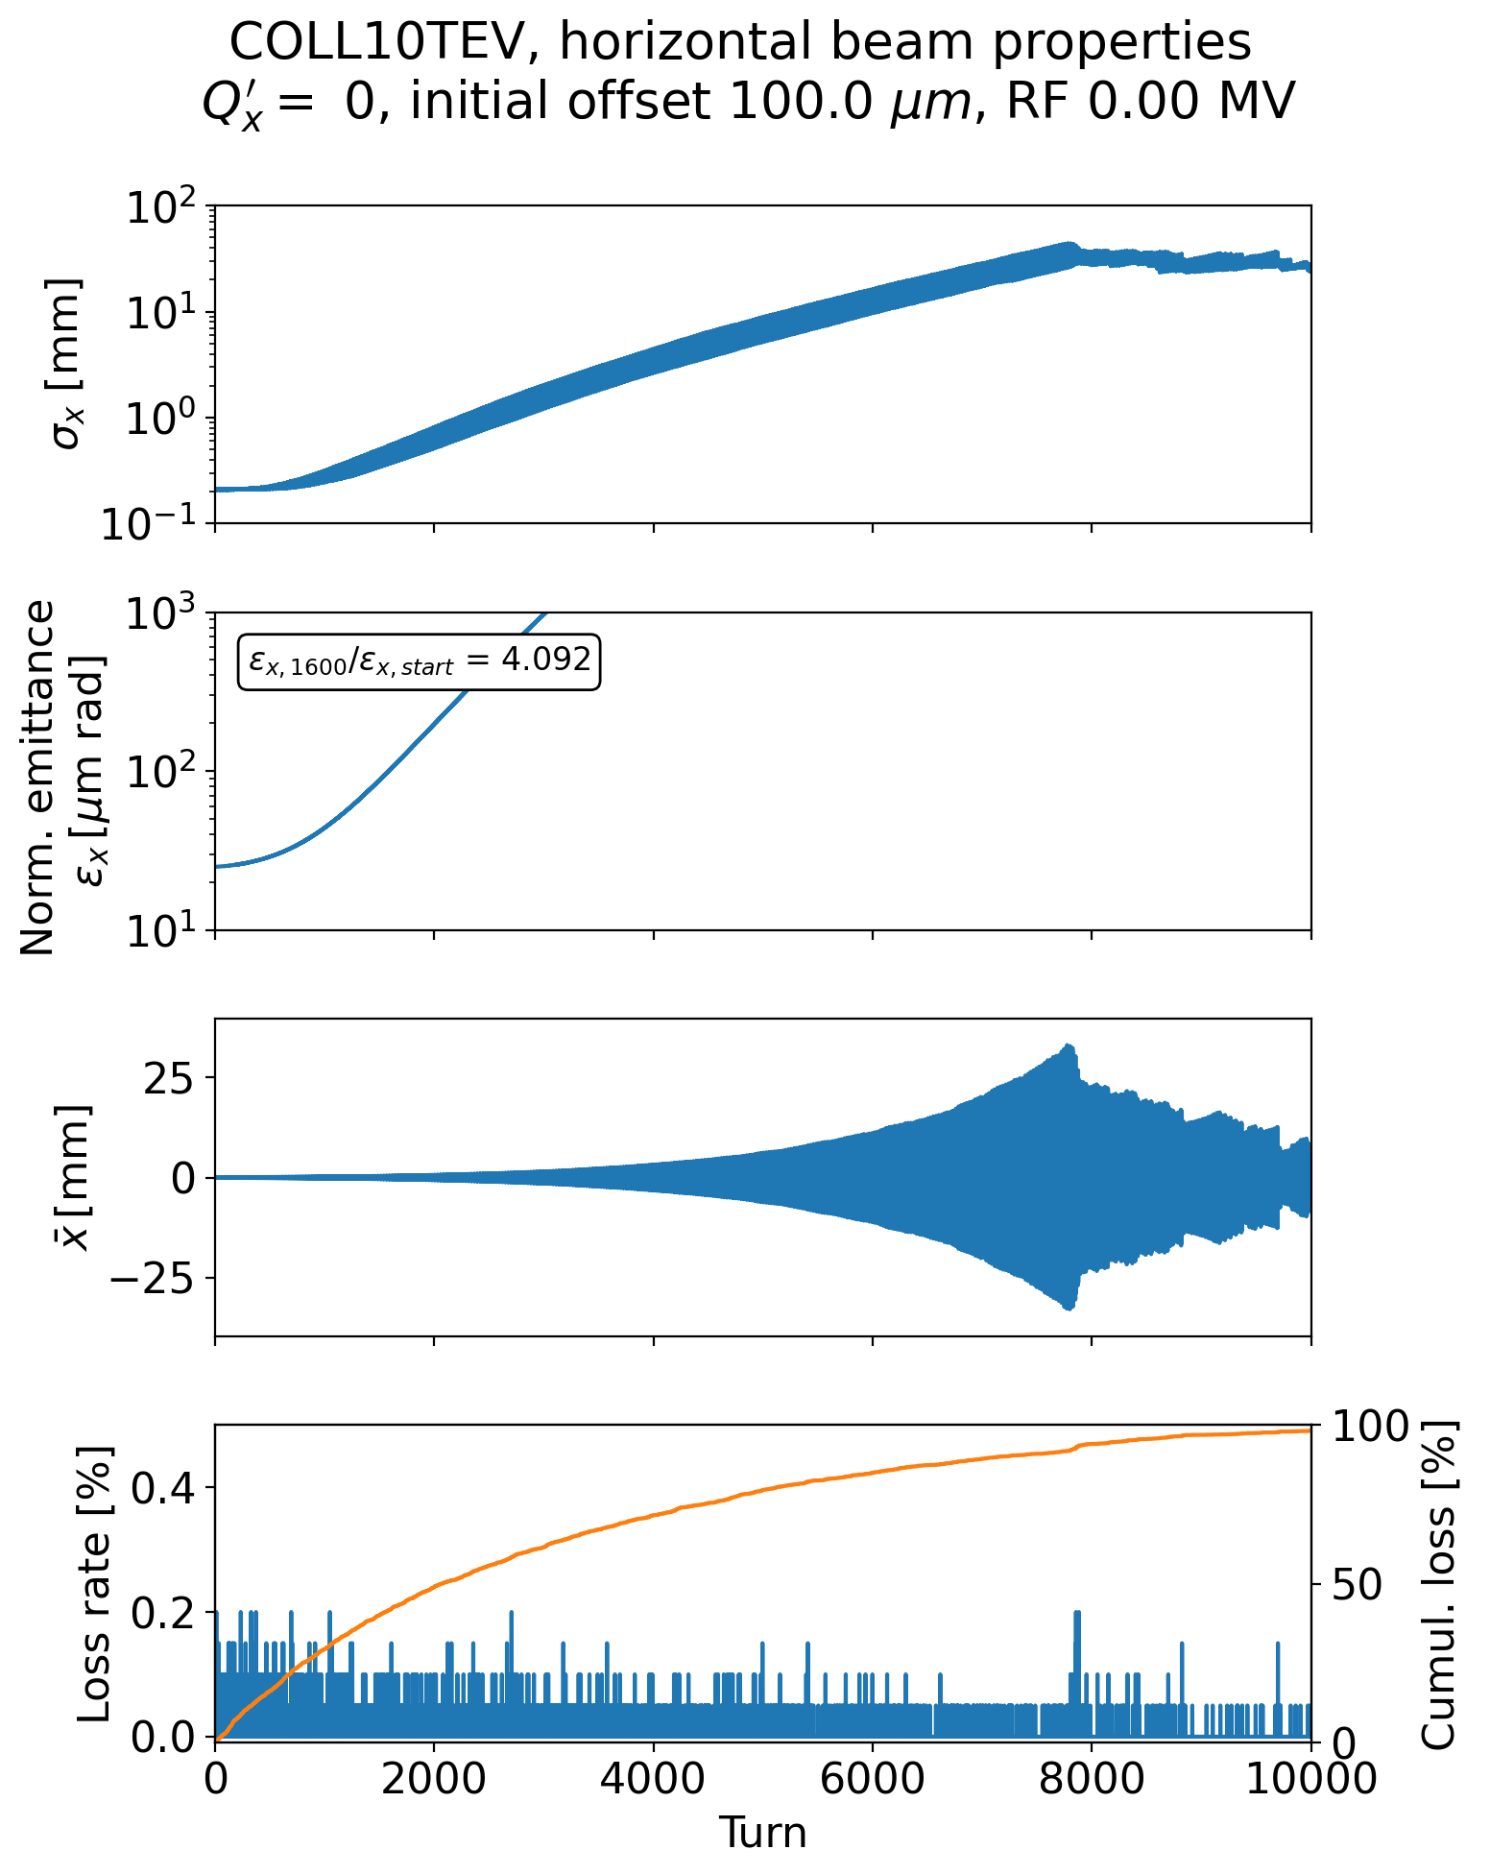
Particle tracking simulation for the collider
Muon half-life at 5 TeV is t_{1/2} = ln(2)·ɣ·τ₀ = ln(2)·47323·2.2μs = 72 ms
  In the 10 km collider ring, this corresponds to ~2200 turns
  The luminosity quickly decreases after the bunch injection
The muon decay effect was added to transverse stability simulations
It is essential to preserve the transverse emittance to maximize luminosity at the interaction points
Despite the bunch intensity reduction over time, a beam break-up instability can appear
Example here with a 23 mm radius, copper coated tungsten chamber

Slide 30
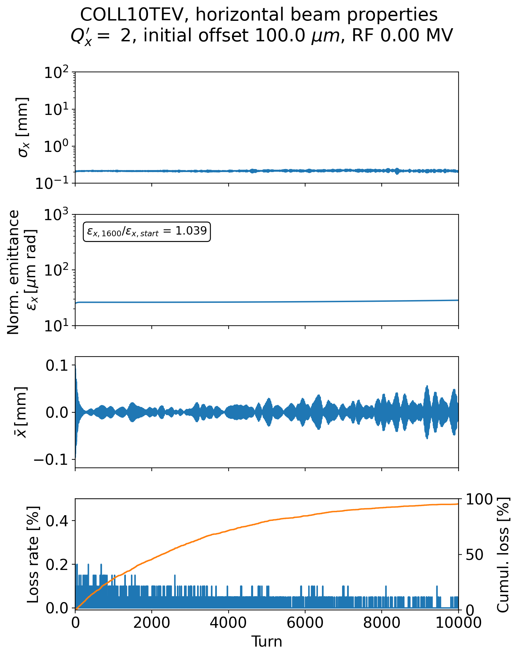
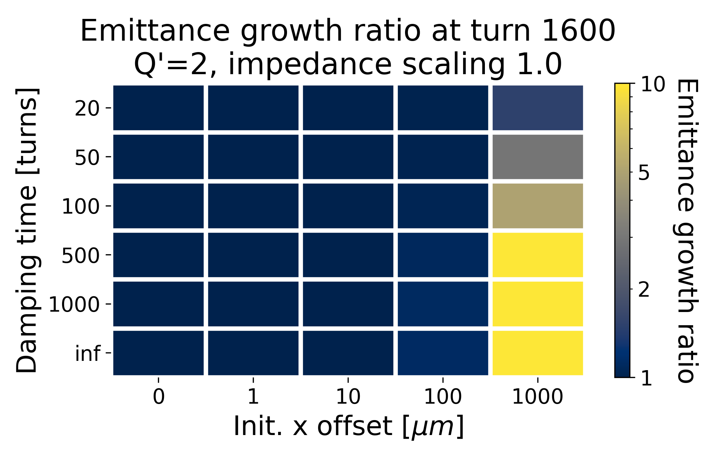
Particle tracking simulation for the collider
Introducing some small, positive or negative chromaticity helps mitigate the instability by introducing some tune spread
Parametric tracking simulations were performed to evaluate the impact of different chromaticities, transverse damper strength or initial bunch offset
Heatmap of emittance growth through after 1600 turns in the collider, scanning transverse damping time and bunch offset
Notes:
See p. 561 of K.Y. Ng book, https://doi.org/10.1142/5835

Slide 31
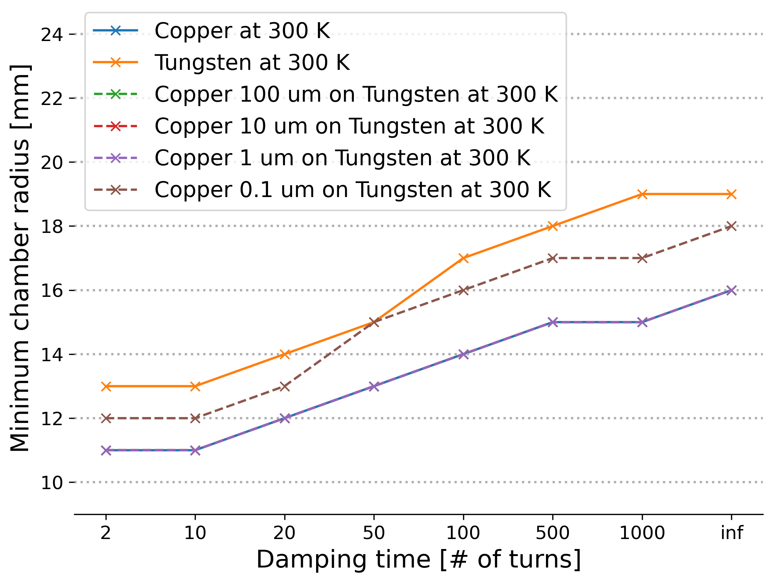
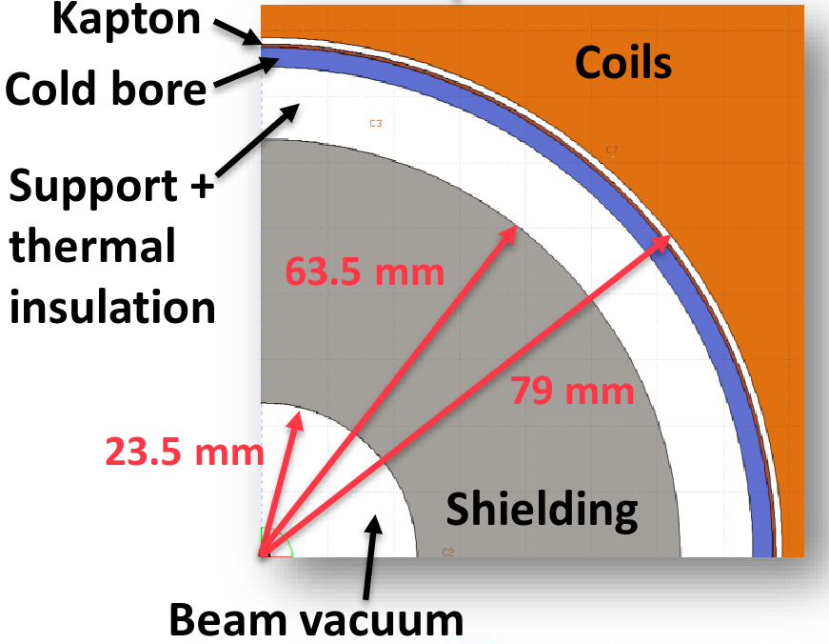
Minimum vacuum chamber radius admissible in the collider
Use tracking simulations to assess transverse stability limitation versus chamber radius and coating thickness
With 10 μm copper coating, the chamber radius
must be at least 16 mm (without damper)
Requirement from optics
A. Lechner et al., Design meeting 09/2023
It is below the 23.5 mm assumed in the dipole magnet radial build, constrained by the lattice design

Slide 32
Collective effect challenges identified for the Muon Collider
Collaboration roadmap in 2021 identified twelve items on beam dynamics and collective effects
R. Ryne, T. Raubenheimer, E. Métral
Items showed in this presentation
Impedance models and beam dynamic simulations available at gitlab.cern.ch/muon-collider-bd/muc-impedance
Mitigation measures: sextupoles and damper are needed in the RCS

Slide 33
Collective effect challenges identified for the Muon Collider
Collaboration roadmap in 2021 identified twelve items on beam dynamics and collective effects
R. Ryne, T. Raubenheimer, E. Métral
Other items addressed
Initial beam-beam studies for the 10 TeV collider
RCS chain parameter optimization: python package developed with RF, powering and optics team available at gitlab.cern.ch/muon-collider-bd/rcsparameters and web tool at rcsparameters.web.cern.ch
Comparison of different approaches for analytical coherent space charge estimation in the proton driver (IPAC 25 proceeding to be published)

Slide 34
Collective effect challenges identified for the Muon Collider
Collaboration roadmap in 2021 identified twelve items on beam dynamics and collective effects
R. Ryne, T. Raubenheimer, E. Métral
Items currently investigated
Collective effects in the ionization cooling
  High bunch intensity up to 40·10¹² muons/anti-muons at start of cooling
  Many RF cavities to maintain the beam energy
  Wakefield effects in the liquid hydrogen absorbers
Two beam wakefield in the RCS, with multiple RF stations

Slide 35
Conclusion and outlook
The Muon Collider complex hosts a variety of accelerators with different beam dynamics regime
  The high bunch intensity, the cooling and the quick acceleration pose unique challenges for the high-energy part of the chain
Collective effects studies are critical to ensure that the collider performance can be reached
  Providing input for the RF, magnet, vacuum and optics design teams
  With the proper mitigation measures and careful design choices, transverse beam stability can be ensured in the RCS chain and the 10 TeV collider
  Still a lot of effects to be investigated in the high energy part: beam-beam in the RCS, two beam wakefield etc.
Collective effects in the muon cooling are now the focus: high bunch intensity, low energy (β~0.9), large number of cavities, wakefield effect inside absorbers

Slide 36
References
Transverse impedance and beam stability studies for the muon collider ring, IPAC 23
Transverse impedance and beam stability studies for the muon collider Rapid Cycling Synchrotrons, IPAC 23
Transverse Coherent Instability Studies for the High-Energy Part of the Muon Collider Complex, HB 2023
Transverse Collective Effects studies for a Muon Collider, ICHEP 2024
Coherent Beam-Beam effects in a Muon Collider, Beam Beam workshop 2024
IMCC and MuCol annual meeting 2024
IMCC annual meeting 2023
IMCC annual meeting 2022
Interim report for the International Muon Collider Collaboration (IMCC)
MuCol Milestone Report 5: Preliminary parameters

Slide 38
Beam and machine parameters for the RCS
Machine parameters | Unit | RCS 1 | RCS 2 | RCS 3 | RCS 4
Circumference | m | 5990 | 5990 | 10700 | 35000
NC magnet length | m | 3655 | 2539 | 4366 | 20376
Bunch intensity | 10¹² | 2.7 | 2.7 | 2.7 | 2.7
Beam momentum | GeV/c | 63 | 313.8 | 750 | 1500
Energy increase per turn | GeV | 14.7 | 7.9 | 11.3 | 63.6
Rev. frequency | kHz | 50 | 50 | 28 | 8.6
RF frequency | MHz | 1300 | 1300 | 1300 | 1300
Harmonic number |  | 25957 | 25957 | 46295 | 151433
RF voltage | GV | 20.9 | 11.22 | 16.1 | 90.0
Number of RF stations |  | 32 | 32 | 32 | 32
αp |  | 0.0024 | 0.0024 | 0.001 | 0.001
Avg. beta x/y | m | 50 / 50 | 50 / 50 | 50 / 50 | 50 / 50
Chromaticity Q’x/Q’y |  | scan | scan | scan | scan
Detuning from octupoles x/y | m⁻¹ | 0 / 0 | 0 / 0 | 0 / 0 | 0 / 0
Beam parameters | Unit | Value
Bunch length 1σ | mm | 5.7
Bunch intensity | Particles per bunch | 2.7e12
εx / εy | μm rad | 25
# of macropaticles |  | 400k
# of turns wakefield |  | 5
# of slices wakefield |  | 2000
Parameters from F. Batsch RCS tables

Slide 39
Beam and machine parameters for the Collider
Machine parameters | Unit | Collider 10 TeV
Circumference | m | 10000
Bunch intensity | 10¹² | 1.8
Beam momentum | GeV/c | 5000.0
Energy increase per turn | GeV | 0
Rev. frequency | kHz | 30
RF frequency | MHz | 1300
Harmonic number | - | 43478
RF voltage | GV | 0
αp | - | 0.0
Avg. beta x/y | m | 85 / 51
Chromaticity Q’x/Q’y |  | Scan Q’x/Q’y=0
Detuning from octupoles x/y | m⁻¹ | 0 / 0
Beam parameters | Unit | Value
Bunch length 1σ | mm | 1.5
Bunch Δp/p0 1σ | - | 1e-3
Bunch intensity at inejction | Particles per bunch | 1.8e12
Longitudinal emittance εl = σzσE | MeV m | 7.5
Transverse emittance εx / εy | μm rad | 25
# of macropaticles | - | 200k
# of turns wakefield | - | 5
# of slices wakefield | - | 2000
Not relevant since RF voltage is set to zero

Slide 40
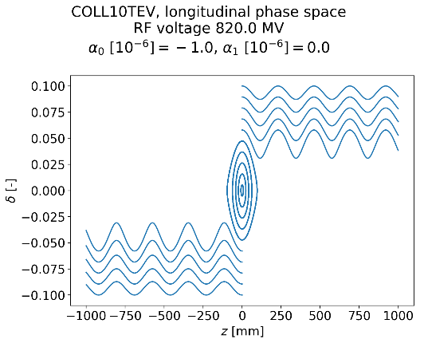
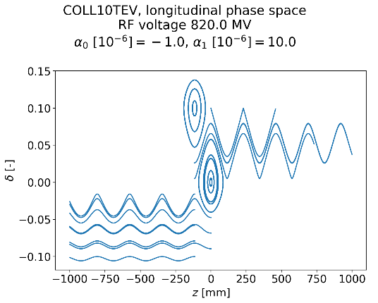
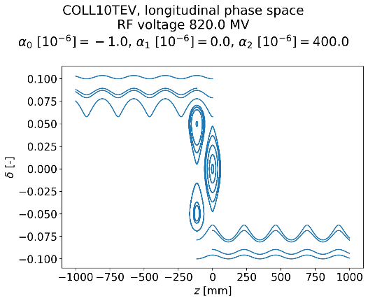
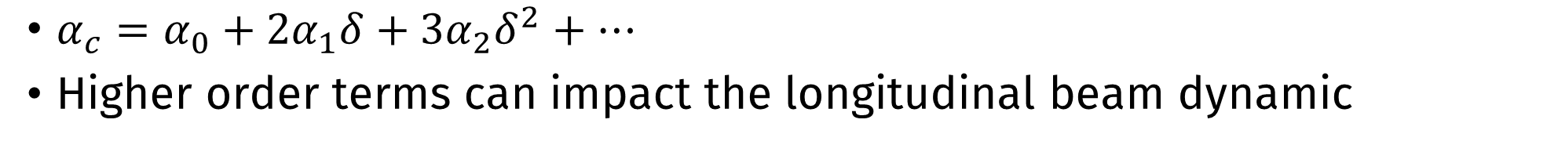
High order momentum compaction
$α_{c}=α_{0}+2α_{1}δ+3α_{2}δ^{2}+…$
Higher order terms can impact the longitudinal beam dynamic
Example effect of higher order momentum compaction factor on RF bucket (with RF votage)

Slide 41
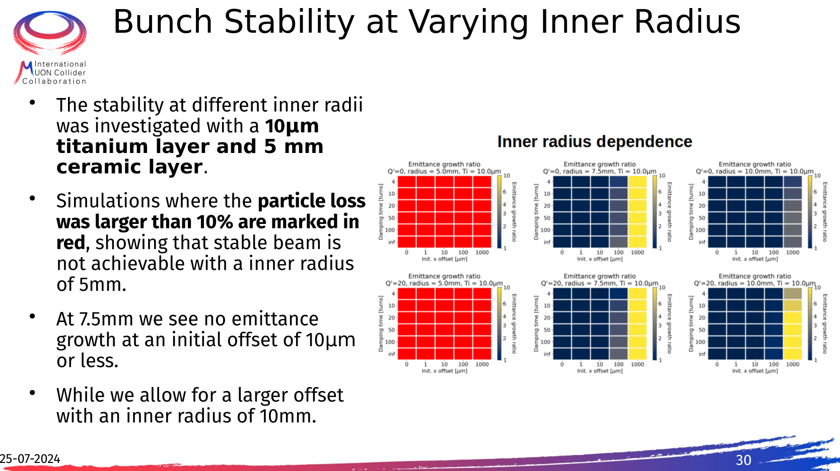

Slide 42
