Slide 1
Computational Accelerator Physics (CAP)
section meeting
Giovanni Iadarola
28 Mar 2024

Slide 2
Information
IPAC25:
  Light Peer Review approved at GL level.
  Other papers: deadlines 25 April SL, 02 May 2025 to GL and 16 May 2025 to DH​
  Confluence page to be used for upload: https://confluence.cern.ch/display/IC/IPAC+2025+-+Taipei
HB2025 workshop will take at IMP Huizhou, China, from October 19 to 24, 2025. Proposals received:
  Riccardo: “Xsuite for high brightness and high intensity hadron rings”
  Andrea: “RF-Track for high brightness and high intensity hadron linacs”
FCC Week (Vienna):
  Gianni: “Xsuite evolution for FCC studies”
  Andrea: “RFTrack development and simulations for the FCC injector linacs”

Slide 3
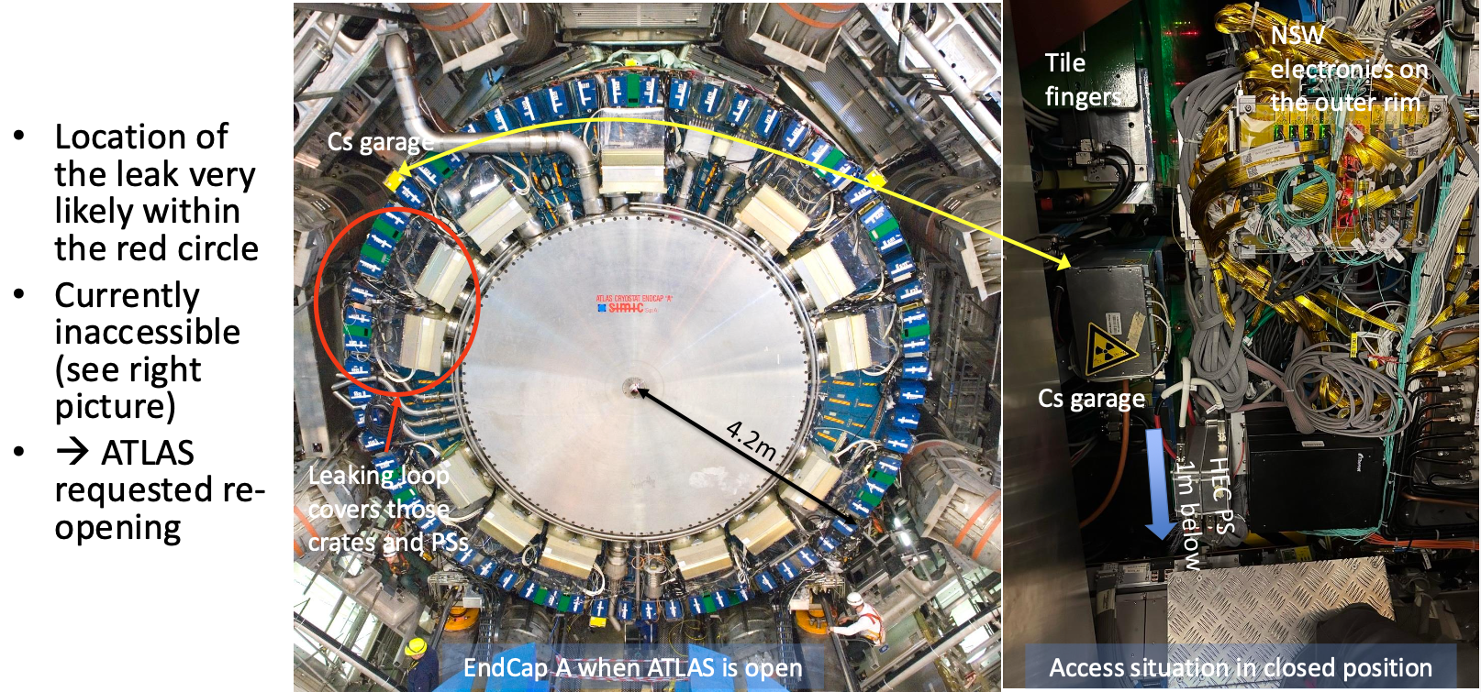
Information – LHC startup
ATLAS announced earlier this week a leak in the cooling system of their Liquid Argon calorimeter, which requires re-opening the detector..

Slide 4
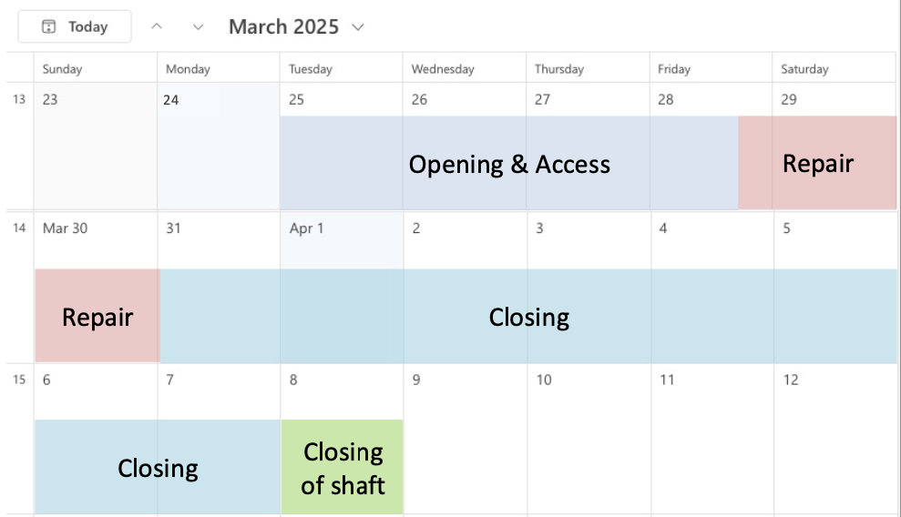
Information – LHC startup
Presentation from ATLAS at LMC meeting
  After optimizing the planning and assuming working in two shifts and over the weekends + availability of vacuum and survey teams when needed, the intervention may only last until 7-8 April (i.e., 2 weeks instead of the 3-4 weeks initially envisaged)
  Under this assumption first beam to LHC would be on 9 April, i.e., only two days later than previously planned
  However, current beam commissioning plan still shows one week delay and won’t be updated for now, as there’s too much uncertainty to further detail it at this stage
  This means that the activities during commissioning, and in particular, over the Easter weekend, can only be defined more
  precisely once the delay is better known

