Slide 1
Medipix
Benedikt Bergmann on behalf of the Medipix team

Slide 2
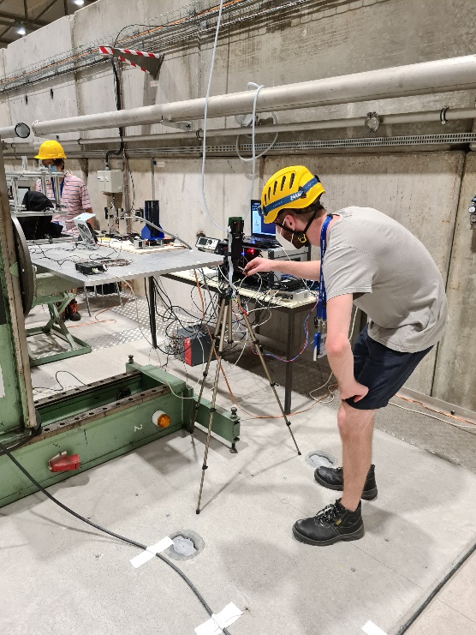
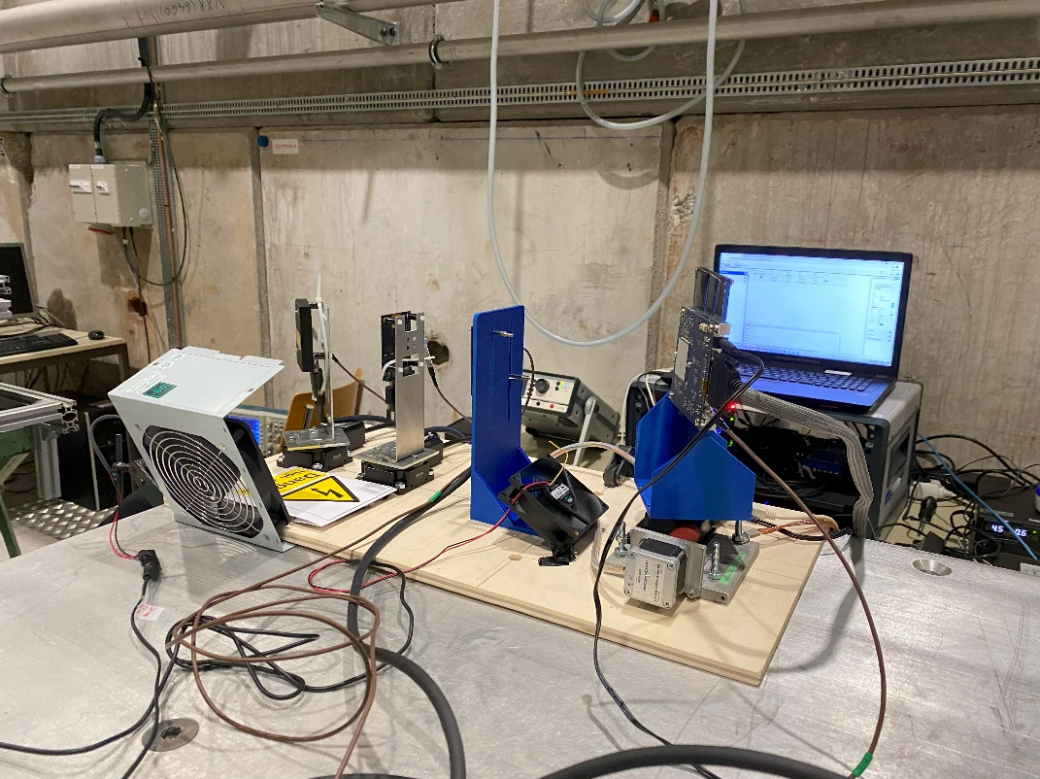
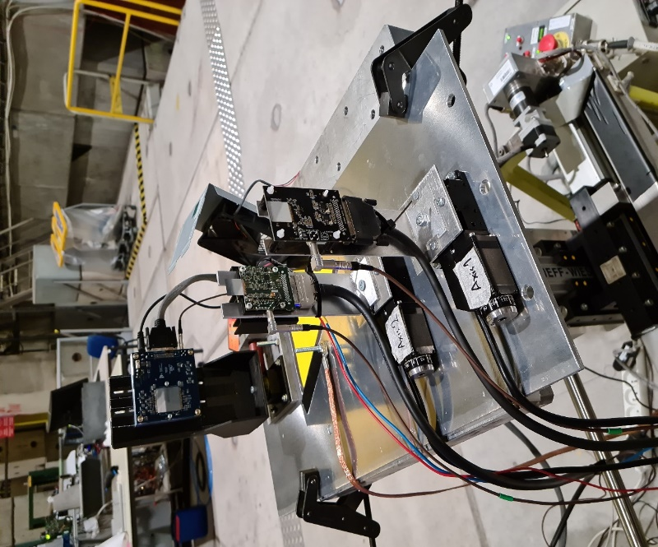
Schematic of the installation
Timepix4 R/O system
Characterization of the response of ATLAS-Timepix3
Test of software for real-time analysis and data compression
Test of the HardPix space radiation monitor including on-board processing
SPS Setup August
SPS 2021 - Setup September

Slide 3
Beam Condition
Please enter all the beams condition required.
If multiple beam time with different beam condition, please detail the run number under the corresponding column.
Particle | Polarity | Energy (0.1 to 15 GeV/c (T09) | High purity | Intensity per spill | Beam size (Ømm) | Run number (if applicable
Anything but electrons | Positive/Negative/does not matter | 0.5, 2, 5, 12 | NO | 0.1-1E6 | 20-40 mm

Slide 4
Services needed
Tables
  Fix table : YES (1)
  Moving table : ideally YES (1)
  Purpose for the moving table: alignment in the beam.
  Size (0.3 m x 0.5 m) and weight (5 kg) of setup on the table
GAS : NO (detail type)
High Voltage : NO (detail voltage)
Instrumentation: (not strictly required)
  Wire Chamber : NO
  Cherenkov signal : NO
  Scintillator signal : NO
Infrastructure
  Electronics rack in zone : NO
  Any other : (detail)

Slide 5
Contact during the run
Contact :
Benedikt Bergmann + benedikt.Bergmann@utef.cvut.cz + (+420) 775 868 794 (I am not able to join but will be available remotely)
The final on-site contact will be defined…

