Slide 1
ALICE ITS3

Slide 2
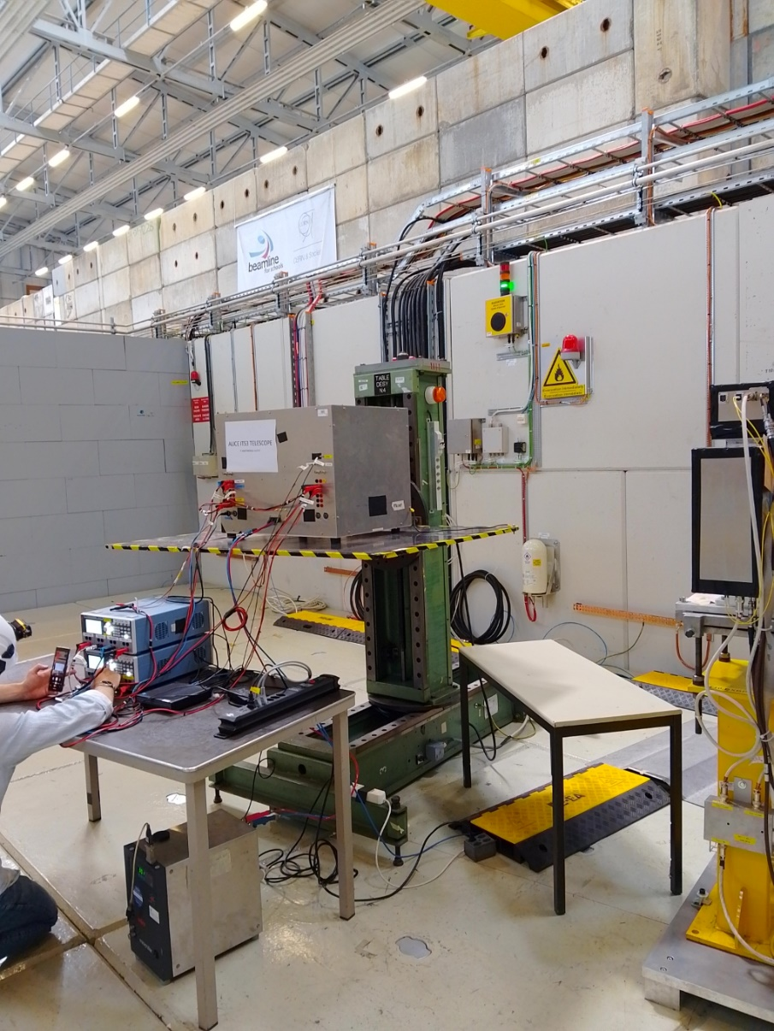
Schematic of the installation
Total length : “1” m
Total width : “1” m
Height of beam : ”1.4” m

Slide 3
Beam Condition
Please enter all the beams condition required.
If multiple beam time with different beam condition, please detail the run number under the corresponding column.
Particle | Polarity | Energy (0.1 to 15 GeV/c (T09) | High purity | Intensity | Beam size (Ømm) | Run number (if applicable
Pion/Muons/Electrons/Any | Positive/Negative/does not matter | xx | YES/NO | 1E2 to 8E6 | 1 to 40 | 1/2/.. all
pions | Most of the time negative | 8-11 GeV/c | NO | 1E4 to 8E6 | 1 to 20

Slide 4
Services needed
Tables
  Fix table : NO (how many)
  Moving table : YES (1)
  Purpose for the moving table: Scanning
  Size (0.7 x 0.7 m) and 20 (kg) of setup on the table
GAS : NO (detail type)
High Voltage : NO (detail voltage)
Instrumentation :
  Wire Chamber : NO
  Cherenkov signal : NO
  Scintillator signal : NO
Infrastructure
  Electronics rack in zone : NO (how many)
  Any other : (detail)

Slide 5
Contact during the run
Contact :
Paolo Martinengo + Paolo.Martinengo@cern.ch + 163757
Hartmut Hillemanns + Hartmut.Hillemanns@cern.ch + 165464

