Slide 1
Straw test in T10
Robert Garbrecht Larsen

Slide 2
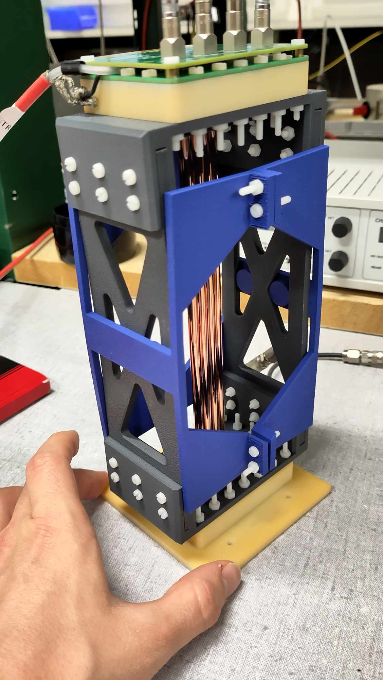
Schematic of the installation
The setup is a small straw detector with 4 straws.
6cm
PCB
Beam
Support with straw
12.5cm
Table/platform
Total length : 6 cm
Total width : 10 cm
Height of beam : 12.5 cm

Slide 3
Beam Condition
We want to scan the energy and intensity of the beam, in order to benchmark simulations of the signals generated in the straws.
Particle | Polarity | Energy (0.1 to 15 GeV/c (T09) | High purity | Intensity | Beam size (Ømm) | Run number (if applicable
Any | Positive | 1 to 11.5 | NO | 1e5 | 5 | 10 points
Any | Positive | 11.5 | NO | 1e2 to 7e6 | 5 | 10 points

Slide 4
Services needed
Tables
  Fix table : YES, One
  Moving table : NO
  Purpose for the moving table: None
  Size (0.1 m x 0.1 m) weight: 1kg
GAS : YES (Ar/CO2 50/50, we are in contact with gas team)
High Voltage : YES (Operated with between 1650V and 1900V)
Instrumentation :
  Wire Chamber : NO
  Cherenkov signal : NO
  Scintillator signal : NO
Infrastructure
  Electronics rack in zone : NO
  Any other : All electronics will be placed in barracks

Slide 5
Contact during the run
Contact :
Robert Garbrecht Larsen+ robert.garbrecht.Larsen@cern.ch + 60034
Inaki Ortega Ruiz+ inaki.ortega@cern.ch + 63501

