Slide 1
Return on experience: chair's perspective
Hector Garcia Gavela
26th March 2025

Slide 2
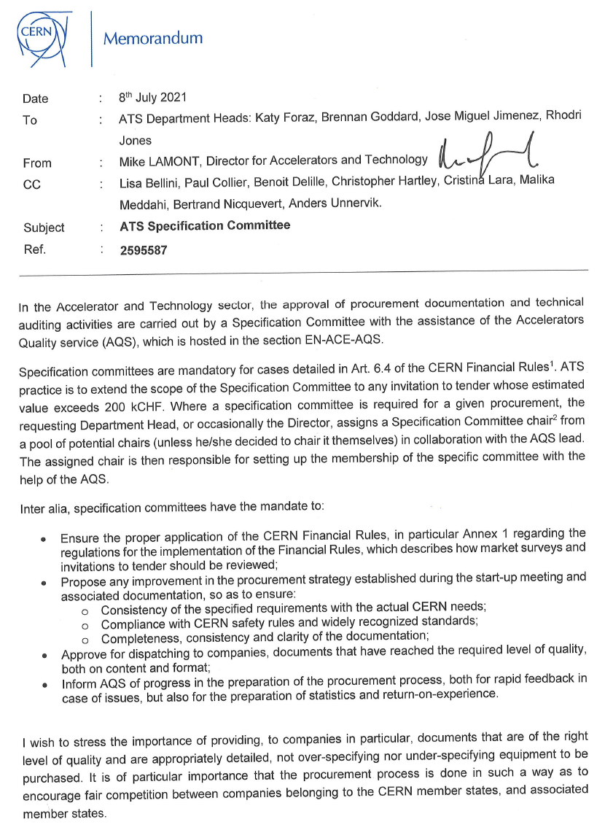
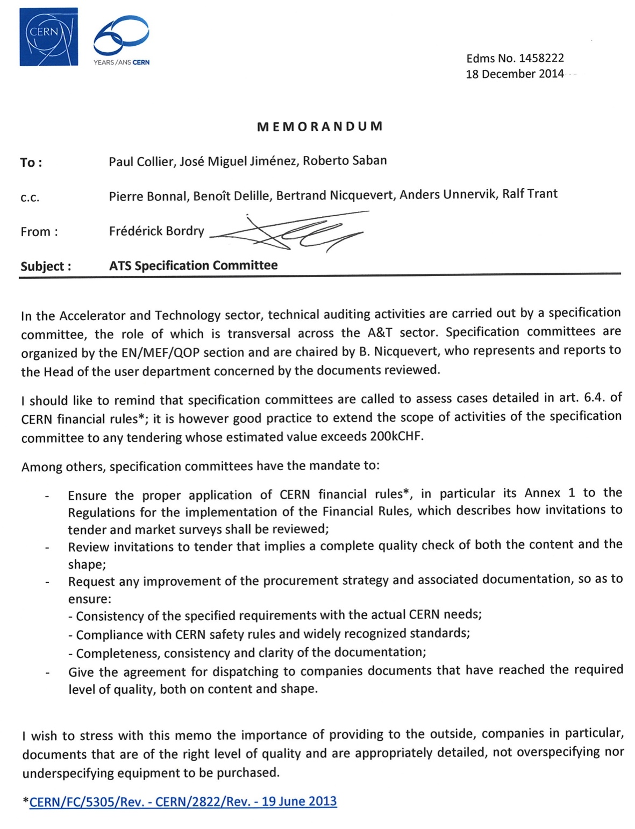
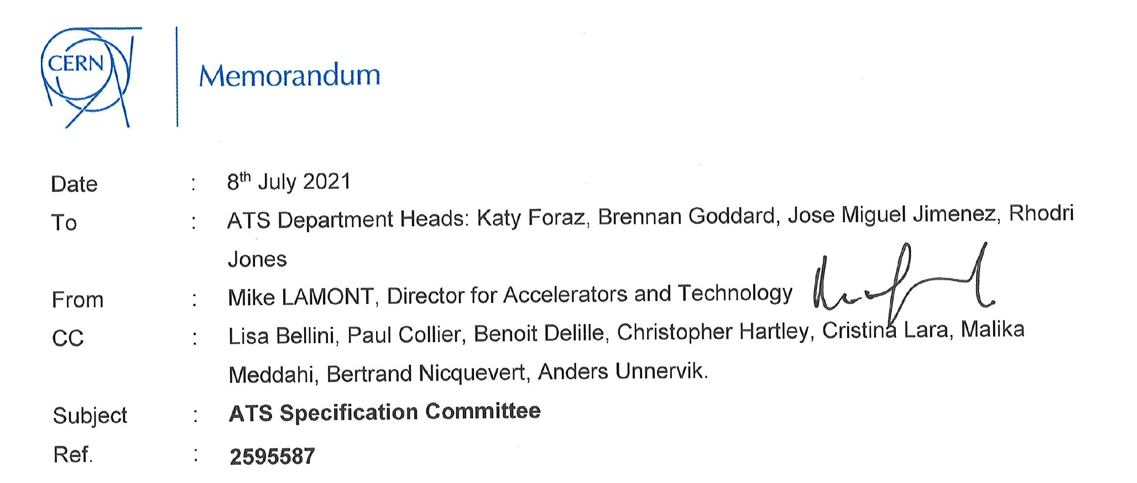

Slide 3
ATS Specification Committees
Since 2014 (officially mandated) in the Accelerator and Technology sector, the approval of procurement documentation and technical auditing activities are carried out by a Specification Committee. This was mandated by the ATS Director
Since June 2024 (following the change in the procurement rules), Technical audit is mandatory all Market Survey and Invitation to Tender whose estimated value exceeds 400 kCHF (for any procurement of any sector)
Where a specification committee is required for a given procurement, A Specification Committee chair from a pool of potential chairs is nominated by the IPT Head. The chairperson is then responsible for setting up the membership of the Specific Committee with the help of the technical audit team

Slide 4
ATS Specification Committees
Specification Committees have the mandate to:
  Ensure the proper application of the CERN Financial Rules, in particular Annex 1 regarding the regulations for the implementation of the Financial Rules, which describes how market surveys and Invitations to Tender should be reviewed;
  Propose any improvement in the procurement strategy established during the
  start-up meeting and associated documentation, so as to ensure:
    Consistency of the specified requirements with the actual CERN needs;
    Compliance with CERN safety rules and widely recognized standards;
    Completeness, consistency and clarity of the documentation;
Approve for dispatching to companies, documents that have reached the required level of quality, both on content and format (documents sent out are also representing the image of CERN)

Slide 5
ATS SC Chair
The role of the SC Chair implicates professional responsibility as you are the one giving the ok to go ahead with a process in which there are financial, schedule and image implications for the Organization…
However, do not panic!.... And the role should be seen as a contribution to the Organization in order to succeed, and not as an individual risk in case things go wrong. The ultimate responsibility for the specification is with the TO and not the Chair
We all are busy with our daily duties, but taking such role implies to find time to accommodate the activity – I see sometimes very little reaction to Wim’s call for chairs or large time to hold the SC
Each case has its own particularities but try to implement the return of experience from previous ones (or your own experience dealing with procurement activities)
These slides do not intend to serve as guideline for anybody, but to share my return of experience from the process itself, and some personal considerations…

Slide 6
SC Phases
  Preparation: from start-up meeting with IPT to the OK for circulation, with « good enough » documents deemed final and Chair assignment
  Verification*: until the Spec Committee meeting, where both content and form are discussed and agreed upon by all stakeholders
  Validation*: check that all changes agreed are correctly implemented, until green light
  Dispatch: until dispatch to potential bidders (or Firms in the case of MS)
  *: phases where Chairs are involved

Slide 7
SC Phases
  Preparation: from start-up meeting with IPT to the OK for circulation, with « good enough » documents deemed final and Chair assignment
    This is most likely the most important phase of the process. Documents that have been properly discussed and checked by all the stakeholders arrive to the SC with a very good level of maturity and makes life easier to everyone.
    In this phase, I recommend to reach the good-to-go. Final tweaks and discussions will take place at the SC.
    GL to go for the SC stays at the IPT level.
    I would find useful to warn the chairperson that will take over the SC in advance, so she/he can already start looking for potential slots. However, this means that there is a commitment to send the documents for circulation by a certain date.
    The time between the circulation and the SC has been streamlined, which I believe it is very much appreciated by the teams

Slide 8
SC Phases
  Verification (aka SC): until the Spec Committee meeting, where both content and form are discussed and agreed upon by all stakeholders
    Do not hesitate to get in touch with other colleagues that are involved in order to get additional information from third parties
    We must rely on the assigned technical experts appointed to the SC (do not hesitate to send proposals to the technical-audit-team). We are not fully knowleagble in the very broad of technologies passing through and all the specificities of each procurement. Likewise, we must rely on the PO for commercial aspects of the procurement
    If they can not attend the SC, at least to get their comments during the circulation (Today is the case for IT but there are no experts for MS)
    Formatting can already be done prior to the SC. I don’t personally think that SC are meant to discuss about commas, semi-colon or justified text (do the formatting as necessary and keep it in-track changes, so the TO and PO can implement it later easily)

Slide 9
SC Phases
  Verification (aka SC): until the Spec Committee meeting, where both content and form are discussed and agreed upon by all stakeholders
  For MS:
    They are not intended to be technical specifications!
    Technical Description should be kept rather light.
    Qualification Questionnaire is definitely a key document and in 95% of the cases the only way to either qualify or disqualify Firms
    Single Firms vs Group of Firms – We should stick to the discussion held in the Start up Meeting
    Questions for information – It will help to prepare the IT based on the return from the Firms

Slide 10
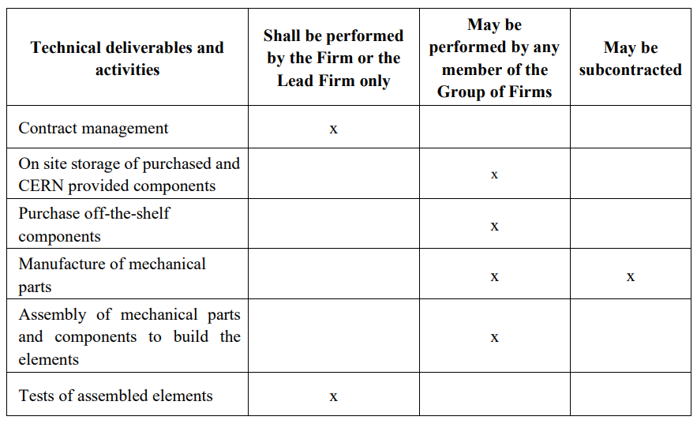
SC Phases
  Verification (aka SC): until the Spec Committee meeting, where both content and form are discussed and agreed upon by all stakeholders
In many cases it is a source of misunderstandings
  The document (QQ) is based on the content of the table so perhaps a clear guideline in the template could help to clarify some basics
  Likewise to include as an option that even for subcontracted activities, the Firm/Lead Firm GoF/GoF collectivelly will need to have also knowledge about the activity or to follow the activity if done by a subcontractor
  Make clear that the Companies cannot modify the table

Slide 11
SC Phases
  Verification (aka SC): until the Spec Committee meeting, where both content and form are discussed and agreed upon by all stakeholders
  For ITs:
    The SC should focus on the content of the documents. Are they clear and fully understandable? Are all requirements clearly specified, measurable and realistic? Is it the foreseen strategy fully reflected in the documents? Is it the delivery schedule realistic and compatible with the needs? Is there any risky point to be clarified? Based on the information provided, think ahead of what could go wrong later at the Contract execution trying to anticipate those issues.
    How the validation is done, by whom and at which stage (this usually triggers payments)
    SC are also meant for an open discussion among all the involved parties, try to foster such discussion to make sure everyone is aligned

Slide 12
SC Phases
  Verification (aka SC): until the Spec Committee meeting, where both content and form are discussed and agreed upon by all stakeholders
  For ITs:
    Feedback from HSE – to be improved
    List of Qualified and selected Firms not always available at the time of the SC - I understand that in some cases, additional inputs are required but I guess a preliminary overview (if not final outcome is available at that time) should be revised in the SC (Strategic considerations depending on the final number of qualfied Firms)

Slide 13
SC Phases
  Validation*: check that all changes agreed are correctly implemented, until green light
    Make sure that all changes have been implemented, otherwise get in touch with the TO and PO to get additional explanations (if not already given)
    Technical audit team to be involved in the process (CC) so they can kindly take care of the versioning/traceability

Slide 14
Summary
The process is well established since many years at ATS, and the pool of chairs was increased to cope with the very intense activity in the last years
The process has been streamlined, which is much appreciated by all the teams
Main focus on the content during the SC and help with the editing during the circulation
As far as I know, this is the only sector at CERN with a clear mandate. Any feedback from other technical audits held in other sectors to improve ATS SCs?
How to close the loop with the Chairs? Return of experience at the adjudication and at the closure of the Contract (claims, litigations, etc.)
Thanks to everyone involved in the technical audit process (technical audit team, TOs, POs, Chairs, IPT mgmt., Dispatching team, etc)

Slide 15

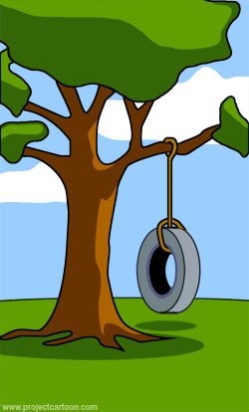

What was explained
by the user
By the way, wouldn’t
in-sourcing
solve the situation?
What was actually
wished by the user

