Slide 1
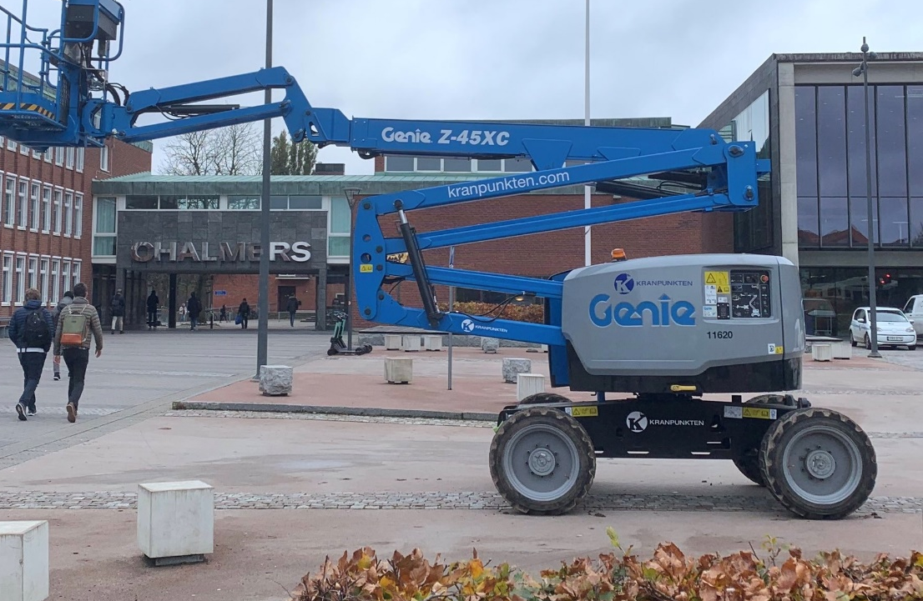
Gender Equality in the academy: Gender Initiative for Excellence at CHALMERS
Maria Saline
Coordinator Genie
2025-11-19
Photo: Pernilla Wittung-Stafshede

Slide 2
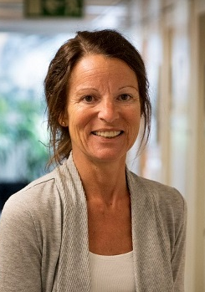
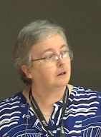
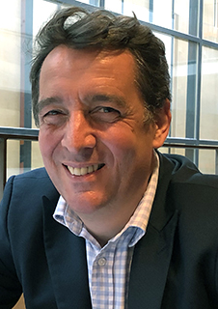
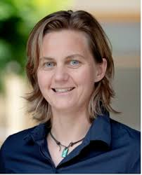
What is GENIe
…strategy to increase success and excellence at Chalmers!
LEADERSHIP 2019-2022;
Background
Pernilla Wittung-Stafshede, Prof. Rice Univ. Houston, TX, USA
Mary Sheeran, Prof. CSE. emerita
Money 300 MSEK (30 MEuro)
Long term 10 years, 2019-2028
Initiated and lead by faculty
2022-2023;
Goals
Paul Walton, Prof. Chemistry, York Univ, UK
Visiting Prof. Chalmers
Increased female faculty
Eliminate structural and cultural barriers that hamper women's careers
Create an workenvironment, which is inclusive, diverse and supports excellence in research and education
2025 -
Remodeled to Network-based Initiative,
Chair of the network: Hana Dobsicek Trefna, Prof. E2
Notes:
Genie

Slide 3
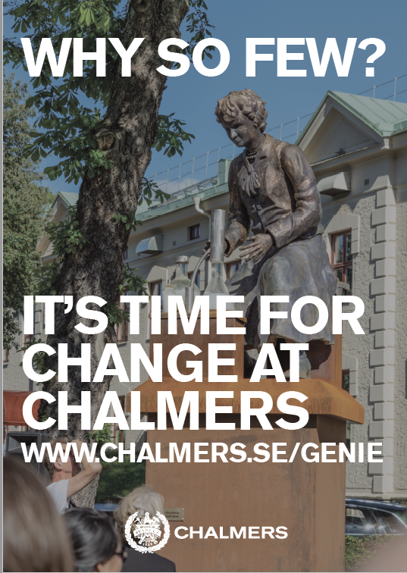
Genie organization
Steering group
Maria Elmquist, Deputy president (Equality and leadership)
Ragne Ernadsson (Head of Dept. rep.)
Anders Johansson (Faculty rep.)
Angela Hillemyr (Head of HR)
Advisory group
Paul Walton, (York University) Interim leader sept 2023-feb 2024
Lena Gustafsson (Umeå Univ. Chalmers)
Liisa Husu, (Örebro University)
Peter Sestoft (IT Univ. Copenhagen)
Genie representatives group
Faculty representative from each department
DrGenie representatives group
PhD student representative arom each department

Slide 4
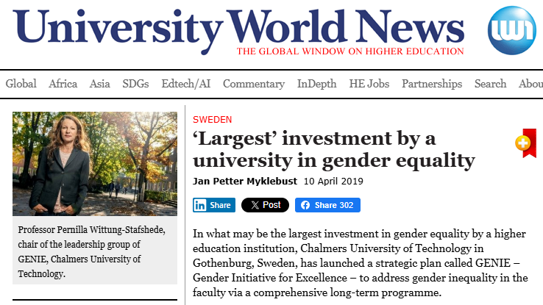
GENIe 2019 - 2024
…strategy to increase success and excellence at Chalmers!
Initial phase
Listened listened listened…
Brought on advisors and experts
Created actions based on needs
Based all work in trust
Trained ambassadors/Genie representatives
April 10, 2029, https://www.universityworldnews.com/post.php?story=20190410073042444
Notes:
Genie

Slide 5
Activity structure 2019-2024
GENIE
Meassure/analyze
Activities at the departments
Central actions
Notes:
No particular focus on parenthood – but big part of the life and many people get emplyed permanantly in the time of life when becoming a parent or not is current. Discuss parentleave, and work-regulations as well as evaluations connected to parenthood.
Economically heavy, hard to find the right person even if ok (disucced keep a postdoc who is experienced – often regulations limiting the process.)

Slide 6
Activity structure 2019-2024
GENIE
Meassure/analyze
Gender divided data 2018-2023
Bibliomentry gender divided​
Added questions about belonging and academic culture to the empoyee-survey
Collect and share good examples
Notes:
No particular focus on parenthood – but big part of the life and many people get emplyed permanantly in the time of life when becoming a parent or not is current. Discuss parentleave, and work-regulations as well as evaluations connected to parenthood.
Economically heavy, hard to find the right person even if ok (disucced keep a postdoc who is experienced – often regulations limiting the process.)

Slide 7
Activity structure 2019-2024
GENIE
Activities at the departments
Each institution received 2MSek for local actions
Genie representative/inst. (13)
Connected to Chalmers Rules of Procedure: ‘academic household work’ (ACE)
Network of PhD students – DrGenie
Plans and goals for GE work into yearly Operational Plan ​
“Why women leave – Chemistry” (non-events)​
Toolbox with ideas on what to do + reference and links
Notes:
No particular focus on parenthood – but big part of the life and many people get emplyed permanantly in the time of life when becoming a parent or not is current. Discuss parentleave, and work-regulations as well as evaluations connected to parenthood.
Economically heavy, hard to find the right person even if ok (disucced keep a postdoc who is experienced – often regulations limiting the process.)

Slide 8
Activity structure 2019-2024
GENIE
Central actions
Education ​
Culture change course, ​
DEI in undergraduate edu. ​
Male leaders “walk the talk” - course​
Female leadership program + build community​
Leadership program: “inclusive outstanding research environments”​
New Recruitments
3 Full Professor ​
1 Professor ​
1 Associate professor​
6 Assistant professors​
15 Postdocs ​
3 PhD-students ​
3 internal support ​
16 Visiting researchers​
Support to existing faculty
Support to 15 female PI​​
30 project (Gender+excellence) ​​
Mentorship, student networks (CWA) ​
Seminars and outreach​​
Articles, events, podd and seminars​

Slide 9
Accountable effects on central level
40% of those hired for positions requiring a doctoral degree in 2025 are women.
45% of those hired or promoted to professor in 2025 are women
Women | 2018 | 2025
Professor | 17% | 24%
Assistant Proff | 33% | 48%
Post-doc | 33% | 35%
PhD student | 34% | 38%
Genie effect: mindset and awareness in recruitments
money (170 MSEK invested)
Notes:
Change of thinking and processes by genie. Provided funding for some of the newly hired.

Slide 10
Intern open call project 2020-2022
Funding excellence coupled to gender
30 projects sharing 23 MKr
All 13 dept. represented
Categories:
Gender perspective of research
Education
Support to research
Facilities
Notes:
No particular focus on parenthood – but big part of the life and many people get emplyed permanantly in the time of life when becoming a parent or not is current. Discuss parentleave, and work-regulations as well as evaluations connected to parenthood.
Economically heavy, hard to find the right person even if ok (disucced keep a postdoc who is experienced – often regulations limiting the process.)

Slide 11
MENTORSHIP PROGRAM
Rationale
“If you are a woman, it is difficult to feel that you belong in that environment when you see that all professors are men. We need role models, people to identify with, share experiences with and have trusting, open discussions with,”
Julia Järlebark
Mentorship program for female PhD students / Post-docs
Initiative aiming to provide support to young female scientists by creating opportunities to exchange ideas, discuss challenges, receive career coaching, and, when needed, report difficulties or concerns.
Organizers WISE – Workforce for Inclusive Science
Equality, diversity, and inclusion in WACQT
Details: 25-30 mentee-mentor pairs each year (6 years)
mentees: mainly from two depts, mentors: female faculty
Ongoing: stepwise extend to entire Chalmers
https://www.chalmers.se/en/current/news/mentoring-to-break-down-gender-barriers-in-academia/​

Slide 12


Why women leave – Chemistry
Key findings:
academic chemistry progress was linked with personal skills and significant support.
While the obstacles were more connected with the academic organization and culture.
  Identified Non-events:
  Faculty women were not invited to participate in groups and celebrations with colleagues.
  Not invited to be in decision-making at the Department
  Faculty women needs were ignored and there was lack of support in their daily job tasks
  Women were not heard about their projects, ideas, previous experiences, recommendations, needs
“Non-events” also depicted; “Carrying a ton of feathers”
www.publicdomainpictures.net/
Notes:
No particular focus on parenthood – but big part of the life and many people get emplyed permanantly in the time of life when becoming a parent or not is current. Discuss parentleave, and work-regulations as well as evaluations connected to parenthood.
Economically heavy, hard to find the right person even if ok (disucced keep a postdoc who is experienced – often regulations limiting the process.)

Slide 13
Invisible Labour
“Valuable Labour: Academic Citizenship in Promotion and Tenure”
Posed the following research questions:
  1. What academic service-related tasks are being done, and by whom?
  2. What are the tradeoffs involved in participating?
  3. How can we make academic citizenship visible and valued?
  Tasks being done: academic leadership, institutional service, and collegiality
  External institutional service is more likely to be formalized and therefore valued more than internal service
  Internal service takes the most time and is the least visible
Notes:
Pilot from one dept – tested at SE and Physics – will be brought further

Slide 14
Genie 2.0: Integration
Translation of the best practices to academic structure
Chalmers
Deputy President for leadership and equality
Meassure/analyze
Activities at the departments
Central actions
Equality office + HR
Equality group
Genie & Dr Genie reps
Support for taylored departmental actions
GENIE council
Chalmers women network
Guestresearcher/professor program
Academic culture projects

Slide 15
Lessons learnt
Learning
Successes
Limited faculty growth
Hard to put Gender Equality aspects in work processes
Hard to value equality work/academic citizenship
Resistance from majority groups
Not easy to convert theory to implementation
Female faculty has increased
Hired great women to faculty
Academic agenda in focus
  Deputy President for leadership and equality
  Higher awareness of gender in-equality
  Increased engagement
Built structure for equality work
Built trust for Genie
Visibility is positive for Chalmers reputation

Slide 16
Logotype
Thank you!
genie@chalmers.se
Chalmers.se/genie

