Slide 1
UR55L – WCC installation follow-up
Pauline Laurent – Matheus Marreiros (EN-EL-CS)
06/03/2025

Slide 2
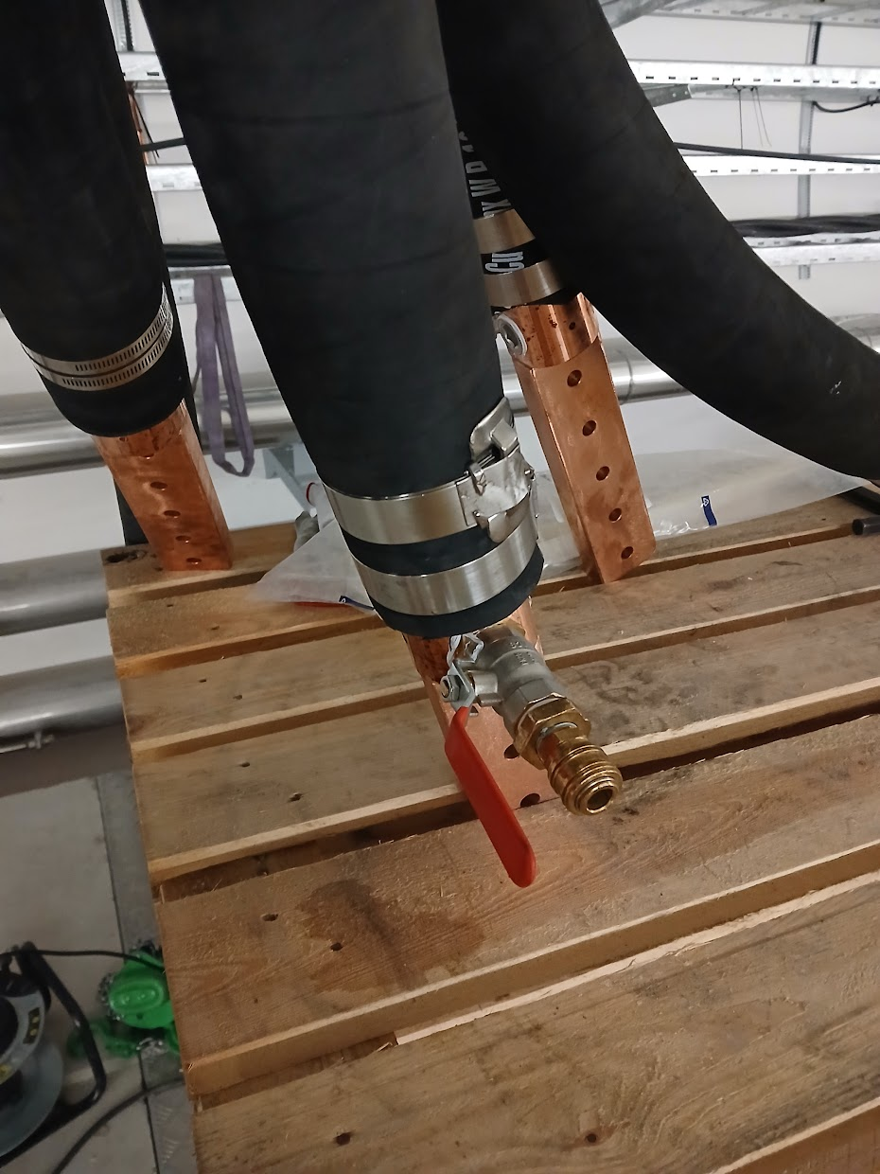
Schedule
First cable pulled 4 days after FLOHE’s team arrival due to trainings and worksite preparation
  This time will be reduced for the next works (same team, no trainings, better management of transport)
Next installations schedules will be detailed by phase (preparation and pulling, lug orientation and pressure tests) and not only by areas
  Lug orientation and installation of definitive collars take more time than expected
  Better management of coactivity, especially for the pressure tests

Slide 3
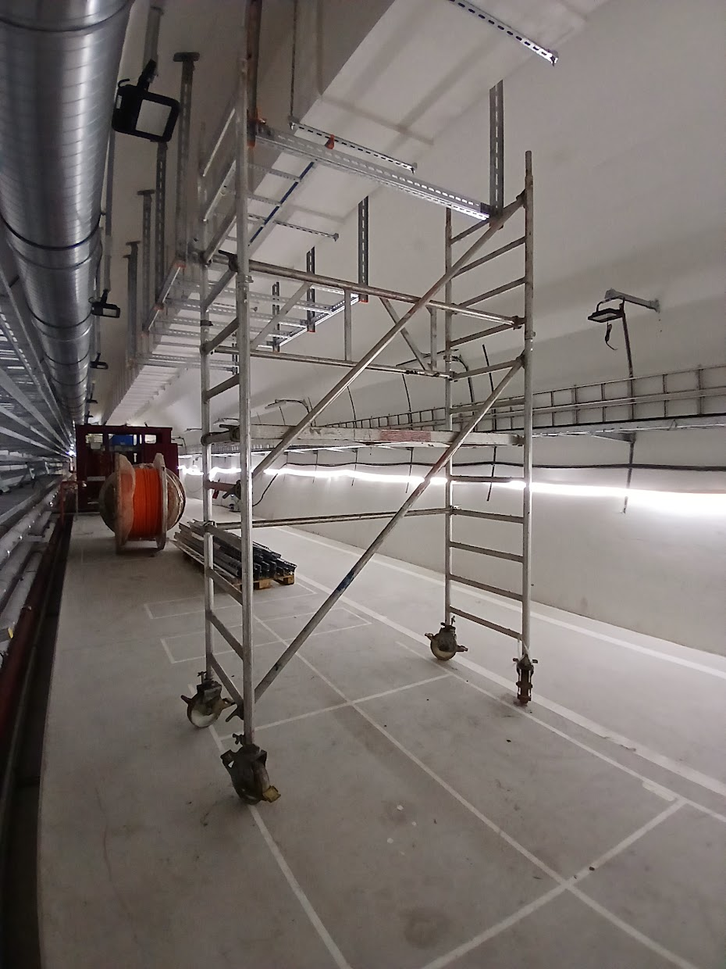
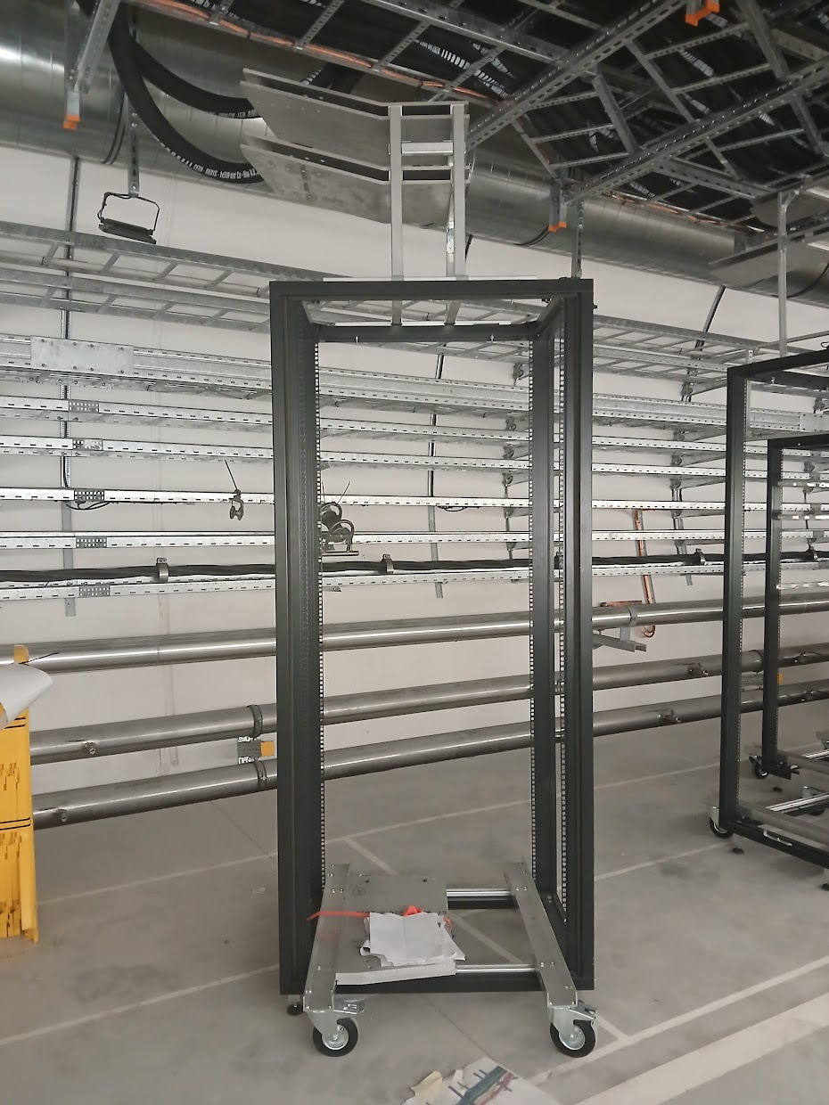
Material, tools and mockups
FLOHE’s scaffolding was too high and not appropriate for the works
Some pulling material was borrowed from CERN (chaussette de tirage, tourillon…), FLOHE will acquire their own
Some mockups are too light/unbalanced, weights need to be added at the bottom for stabilization

Slide 4
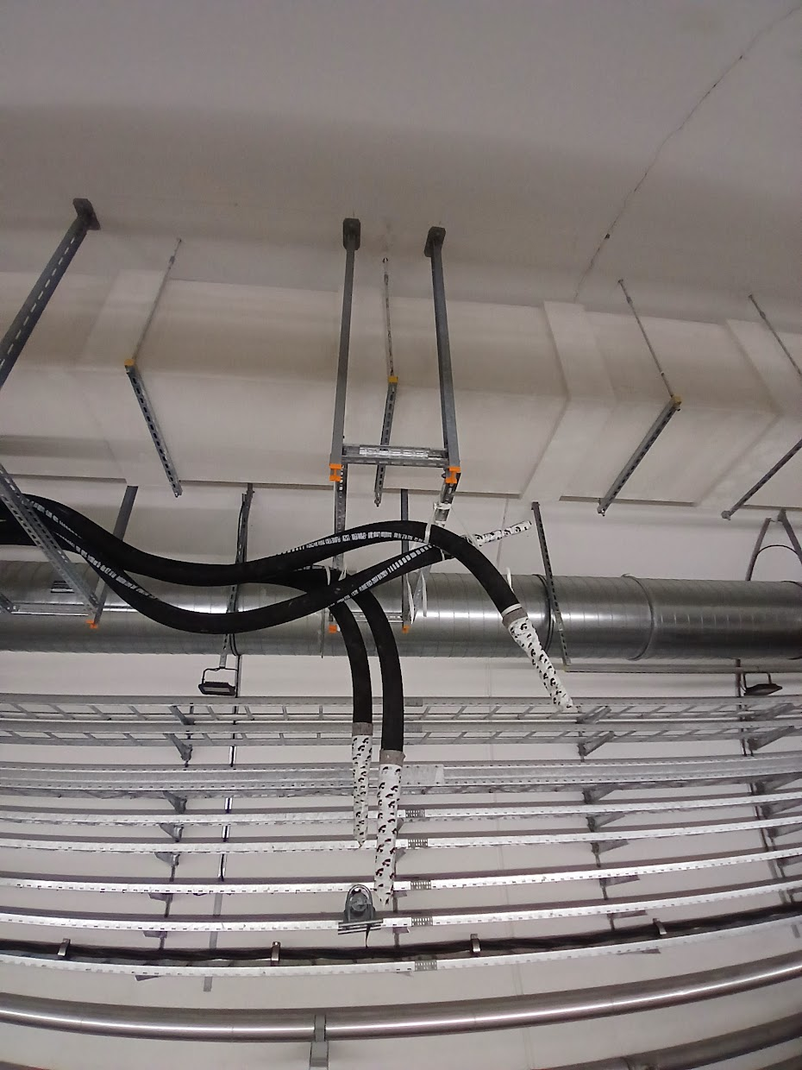
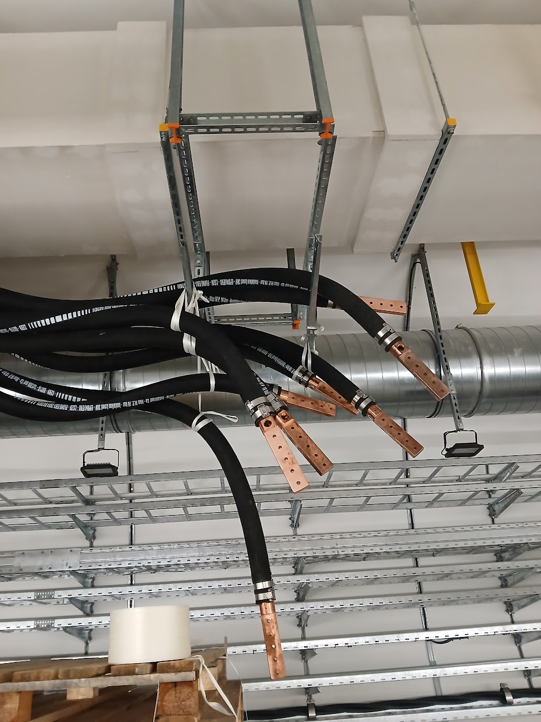
Other points
Integration drawings of the mechanical structures will be modified to include the horizontal reinforcement added on the temporary supports

Slide 5
Thank you!

