Slide 1


Social protection at CERN

Slide 2
Everything you ever wanted to know about the CERN Health Insurance Scheme
SA Seminar, April 1st 2025
V. Brillault & J. Lahaye

Slide 3
Outline
Creation of the CHIS and CHIS Board
CERN Health Insurance Scheme (CHIS) in number
  Basic principles of the CHIS
  Nature of the CHIS
  Scheme administration
  Periodical actuarial studies
Health Insurance Scheme
  Reasons of changes in 2012
  General aspects
  General rule
  Benefits
Long Term Care
  Nature
  Benefits
  Financing
  Advantages
Conclusions

Slide 4
Creation of the CHIS & CHIS Board
First contract with a Swiss insurer 1954 (Swiss LAMA)
1970 CERN extension to France territory (needs of an international HIS)
1971 Austria & AGF as CERN HIS insurer (Austria’s office at CERN in 1973)
1977 Austria doesn’t act as insurer but as a third part administrator with a fix remuneration proportional to reimbursement
1991 renew of the Austria’s contract with no significant changes
End of 1992 CHISB (CERN Health Insurance Supervisory Board) was born
1995 following the Hoffmann report CERN contributes for the retirees
1998 new call for tender (60 compagnies) – Austria wins the contract
2000 Austria changes its name to UNIQA
2001 Introduction of the LTC (Long Term Care)
2005 – 2007 HIS cost explosion due to medical inflation and doubly deductible
2010 HIS complete reforms with abolition of the deductible
2011 – 2015 Contribution increase by step 8% first year and 4% following years
2022 Integration of the new graduate in the scheme
Driven by the SA

Slide 5
CHIS Board
Joint Committee
  Strategic Advisor to the DG and Chairperson
  4 representatives from the Management (including Chairperson)
  4 representatives from the Members: 2 from the SA, 2 from the pensioneers (seats let by SA)
  Invited: legal & medical services
Sub-group of the Standing Concertation Committee
  Annual reporting & preparing changes for discussion at the SCC
  Does not handle individual cases
Notes:
Comité paritaire

Slide 6
CHIS historical motto
Everyone pays according to their means; everyone benefits according to their needs
Notes:
Devise historique: Chacun paie selon ses moyens, chacun utilise selon ses besoins

Slide 7
CERN Health Insurance Scheme (1)
Basic principles of the CHIS
  Obligatory, everyone must participate
  Contributions are based on salaries only, independent of age of beneficiaries and
  of number of beneficiaries
  in the household
  All members of the family (spouse & dependent children are covered).
It is compulsory
It is a mutual scheme

Slide 8
CERN Health Insurance Scheme (2)
  Freedom of choice of health
  care providers &
  world-wide coverage
  Responsibility of each CHIS member
  the level of reimbursement
  shall not exceed the level
  of contributions
Freedom of choice
Collective responsibility
CHIS ≠ External Insurance

Slide 9
CERN Health Insurance Scheme (3)
Nature of the CHIS
  HIS: budgeted (+ reserves), LTC: capitalised
  Funding of the CHIS & LTC
  Contribution of active staff – share between Staff & Organisation : 4.06% + 0.8% & 7.71% of basic salary
  Contribution of pensioners – share between pensioners & Organisation : 4.06% +0.8% & 7.71% + 0.8% of the last indexed monthly basic salary
  Contribution of spouses when they receive an income (EDH → SHIPID) when CHIS used as primary insurance

Slide 10
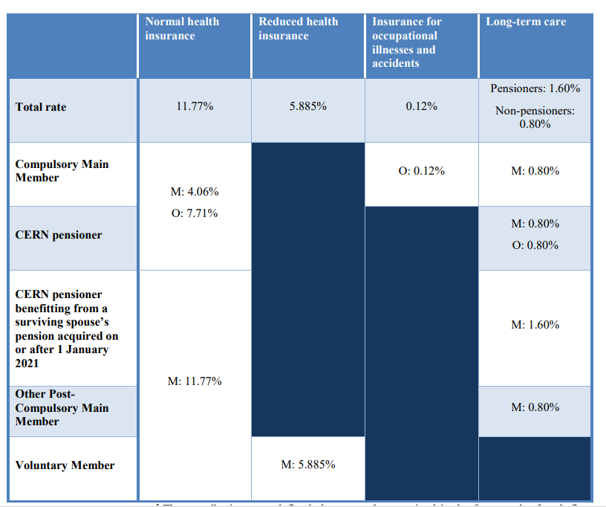
Contribution rates

Slide 11
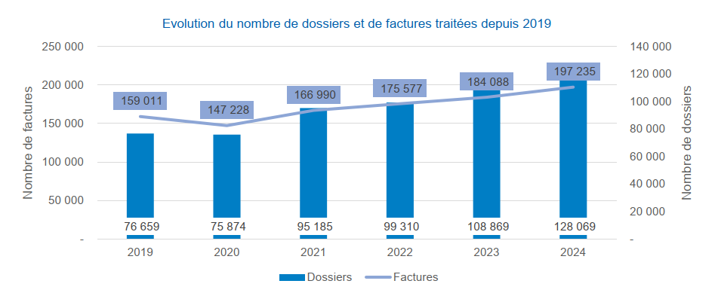
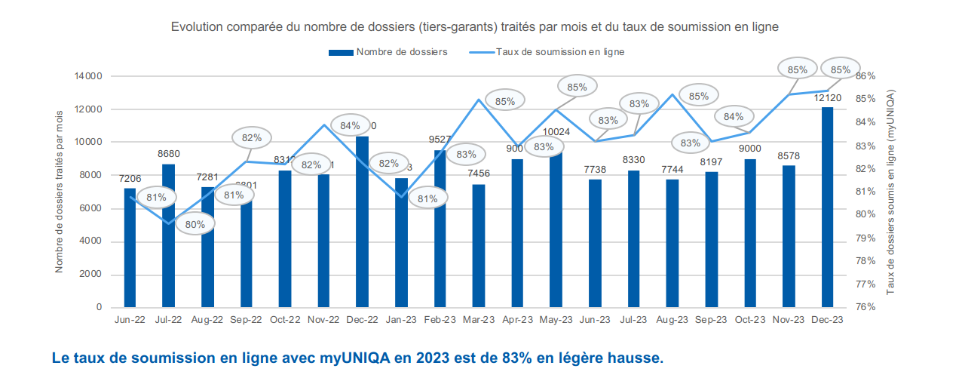
CERN / UNIQA
Scheme administration & responsibilities
  CERN has the full control of the scheme
  CERN monitors the scheme
  CERN lays down the policies & proposes modifications as needed
  UNIQA acts as a daily administrator of the scheme
    Possibility to submit claims electronically since 2020 (great success)
  UNIQA implements the policies & applies the CHIS rules
  UNIQA produces statistics and gives feedback
  UNIQA receives a fixed amount as remuneration
  UNIQA gives support during tariff negotiations
+7%
+18%
UNIQA ≠ External Insurance

Slide 12
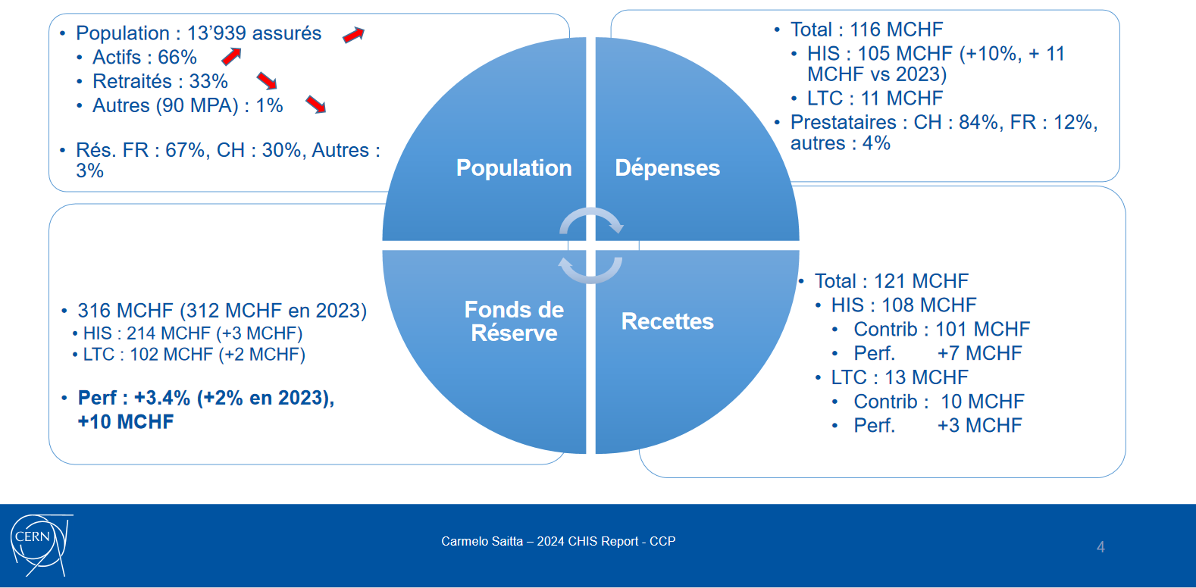
CHIS end of 2024

Slide 13
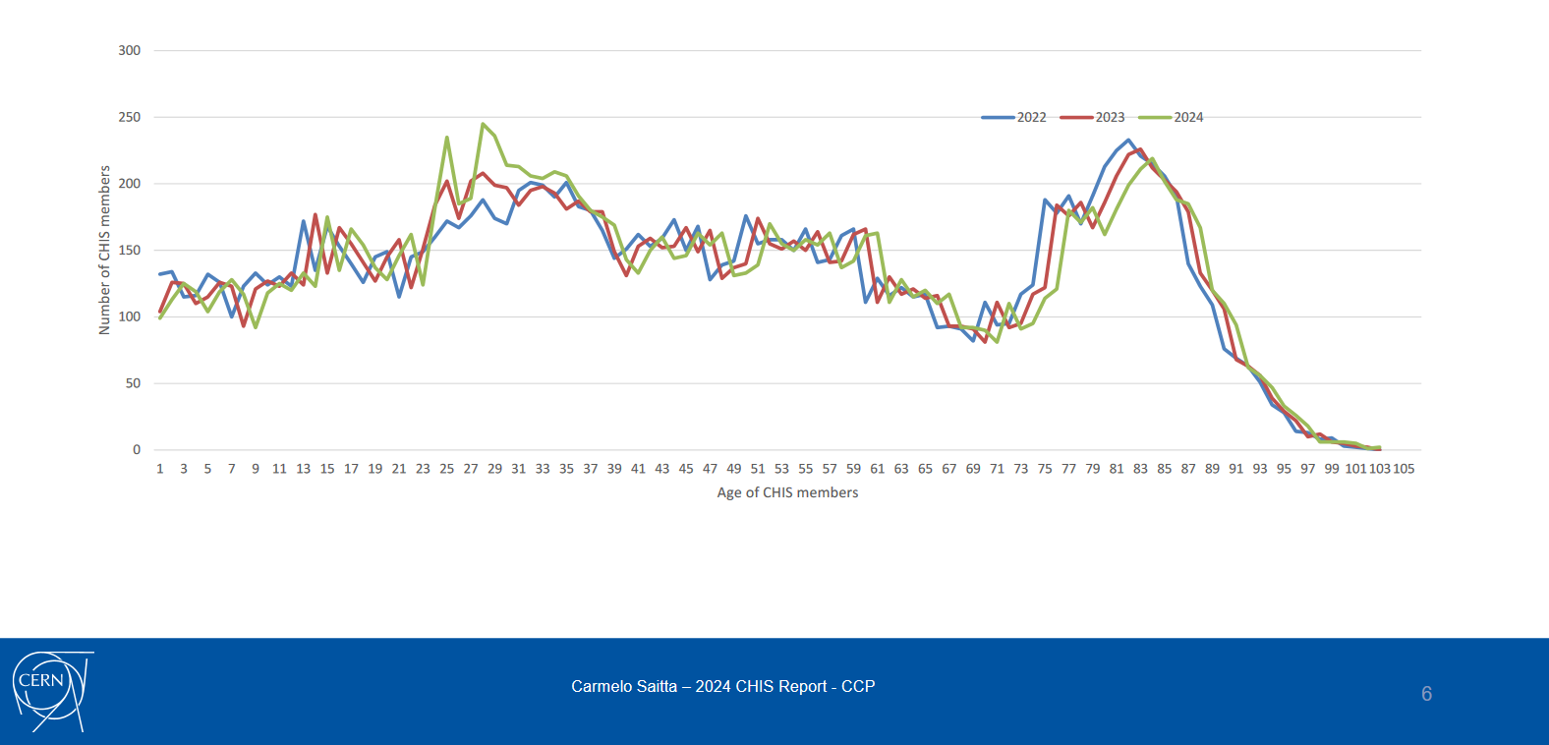
Demographics – Age (end 2024)
CHIS Members
2022: 13823
2023: 13853
(+110 staffs, - 80 retirees)
2024: 13939
(+199 staffs, - 109 retirees)

Slide 14
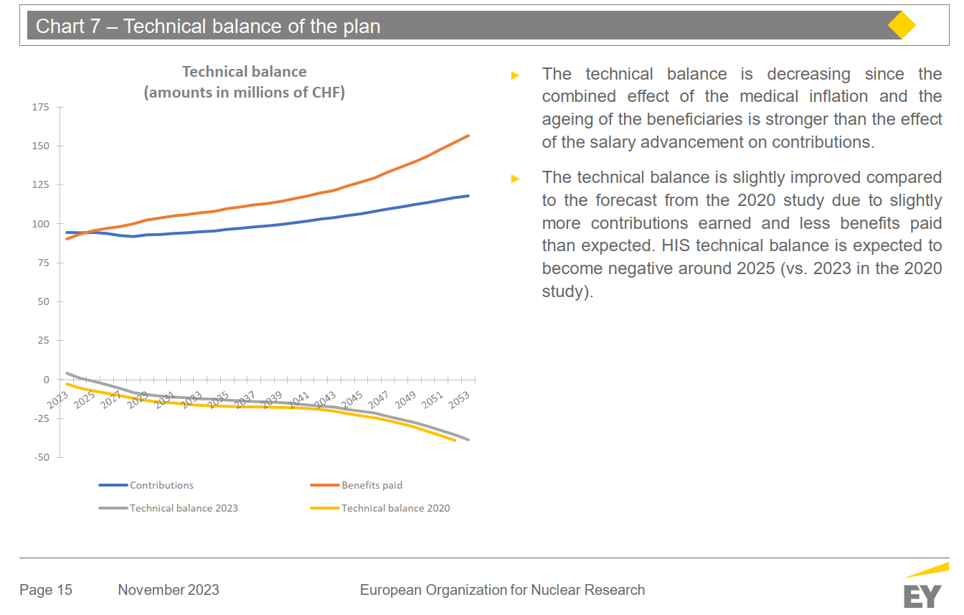
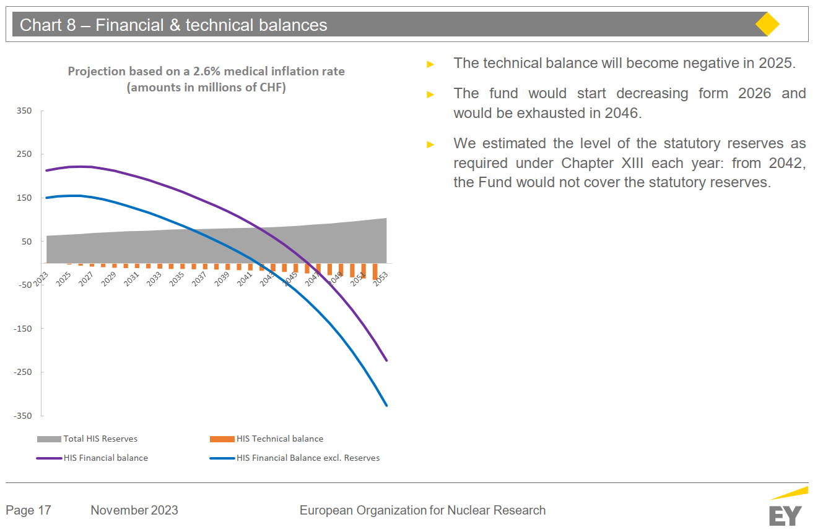
Periodical actuarial study – HIS 2023

Slide 15
CHIS changes in 2012 / Why change?
  Modernize CERN Health Insurance Scheme (CHIS)
  Simplify the system (easier to understand)
  Display an initial reimbursement rate of 80% (e.g. other IO), without changing global reimbursement rate
  Reimburse preventive treatment fully (100%)
  Ensure a better cover for expensive cases
  Show greater fairness between young and less young members of the scheme

Slide 16
General aspects (1)
General rule (by year)
  80%, 90% & 100% for each CHIS member : adults & children
  FCA (frais à la charge de l’assuré) expenses borne by insured member
    Hospitalization & out-patient treatment are both included
FCA | Expenses* | Reimbursement rate
≤ 500 CHF | ≤ 2500 CHF | 80 %
500 CHF < FCA ≤ 3000 CHF | 2500 CHF < Exp ≤ 27500 CHF | 90 %
3000 CHF | > 27500 CHF | 100 %
!! *Several expenses are not eligible for inclusion in the FCA calculation !!

Slide 17
General aspects (2)
Ceilings
  Reimbursement of certain treatments subject to ceilings
  Ceiling on expenses (before January 2012 on reimbursements)
  Ceilings increased by 10 % in 2012
  Expenses above 80 k CHF for a given single case (B1 to B5) during one’s lifetime → reimbursement 100%
  Reimbursements at 100 % or expenses above ceilings are not considered for the FCA calculation
  For certain treatments, the ceilings are cumulative over 2 or 3 years

Slide 18
General aspects (3)
Bonus (B1 to B6 & B8.e)
    Bonus system introduced in January 2012
        Additional 5 % on reimbursement rate in certain countries (limited to 100%)
        Most Member States satisfy condition to get bonus (list reviewed annually)
    Reference state for calculation: most expensive host state
        Member states with health cost (OECD tables) 20% cheaper than in the reference state generate a bonus of 5 %
    Since 2012
        Reference state is Switzerland → no bonus
        Expenses incurred in Norway and Denmark have no bonus

Slide 19
General rule
Case 3
Case | Expenses in CHF
1 | 2500
2 | 25000
3 | 27500
Case 2
Current system
Hospitalization included
80%
90%
100%
Adult &
Child
Case 1
500
3000
Expenses borne by the insured member
cost neutral to CHIS balance

Slide 20
Benefits (1)
Hospitalization
  Public Hospital !! excluding semi-private or private ward !!
    100 % not taken into account for the FCA calculation
  Private Hospital (no CHIS approved establishment)
    80% not taken into account for the FCA calculation
  Other
    General rule
    CHIS approves non-public establishments outside CH implicitly if either:
  tariff agreement exists with national social security system in that country; or
  rates applied to CHIS members are “similar” to public local rates
!! The surcharge for accommodation and board in a private room (ward) is paid exclusively by the Member !!
Notes:
Etablissement Agree, avec convention

Slide 21
Benefits (2)
Optics
  Corrective lenses for spectacles, contact lenses, disposable contact lenses, spectacle frames
    General rule
    Ceiling 500 CHF per year, cumulative over 3 years
    On prescription
Dental care
  All treatments
    General rule
    Ceiling 3300 CHF per year, cumulative over 3 years
Other
  Hire or purchase of auxiliary appliances designed to foster personal autonomy in the case of recognized disability, reduced earning capacity or dependence
    Modifications to a vehicle to allow the member to move around
    Ceiling of 11’000 CHF, cumulative over 2 years

Slide 22
Benefits introduced in the last 10 years
UAT (Unité d’Accueil Temporaire) temporary placement unit & UAP (Unité d’Attente de Placement) unit awaiting placement
  General rule
Refractive surgery
  General rule, 2000 CHF per eye once in a lifetime
  Waiting time : 12 months as CHIS member before reimbursement
Prevention
  100 % according to list : vaccine papillomavirus, mammography, hemoccult.
Infertility treatments
  General rule
  Such reimbursements are subject to: 1) prior approval by the third‑party administrator, UNIQA, upon presentation of a medical prescription and other relevant information; and 2) to a life‑time ceiling for expenses of 30,000 CHF.
Oral contraception
  General rule
Psychologist/psychotherapists for adults
  General rule, 6000 CHF / year ceiling

Slide 23
Long-Term Care scheme (1)
Driven by the SA
Nature of the LTC
  All CHIS members are insured, regardless of their age and medical history
  Three levels of dependency
    Low level (3 dependencies)
    Medium level (4 dependencies)
    High level (5 dependencies and more)
According to the member’s degree of ability to perform some life essential actions
Getting up, sitting down, getting into bed
Mobility
Washing & grooming
Dressing & undressing
Taking food & drink
Going to the lavatory
Coherence & ability to communicate
Orientation in space & time

Slide 24
Long-Term Care scheme (2)
Benefits
* Not paid during hospitalization
 | Low level | Medium level | High level
Medical treatment | No change
Paramedical treatment: B6c, B6d, B6e | Up to 1’100 CHF per month | Up to 1’650 CHF per month | Up to 2’750 CHF per month
Home care* allowance | 48 CHF per day | 72 CHF per day | 120 CHF per day
50% of standard full-board Swiss cost
70% of standard full-board French cost

Slide 25
Long-Term Care scheme (3)
Financing of the LTC
  Affiliation and contribution are compulsory for CHIS members
  Contribution rate of 0.8% for all staff contributors
  Enlargement of the basis of contribution for the pensioners
  (0.8% corresponds to 1.1% of pension)
  Capitalized LTC Fund to pay the home care allowance over time
Proposed by the SA
Staff members of the scheme are the single contributors
But the Organization pays a contribution for pensioners (0.8 %)

Slide 26
Long-Term Care scheme (4)
Advantages of the LTC
  Cost reduction of increasing hospital bills
  Improved the long-term financial balance of the Organization’s health insurance scheme
  Better cover for dependent persons
  Keep the CHIS equivalent to the LAMAL scheme

Slide 27
Conclusions
Great benefits to be maintained while following the evolution with the addition of new benefits and at the same time trying to constrain the cost increase.
This is not an easy task, and everybody’s help is needed to win the challenge and keep our very good health insurance system alive and sustainable in the long run.
LTC is a very good system with benefits really appreciated and fully financed with a capitalized fund

Slide 28
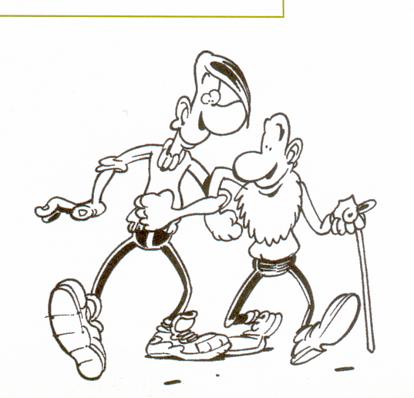
END
Thank you for your attention
(Further reading: Special Proton 2024)

