Slide 1


Current design status of the
Synchrotron Radiation Absorber of the FCC-ee
Stefania Grozavu, Marco Morrone
TE-VSC Seminar
17th June 2025

Slide 2



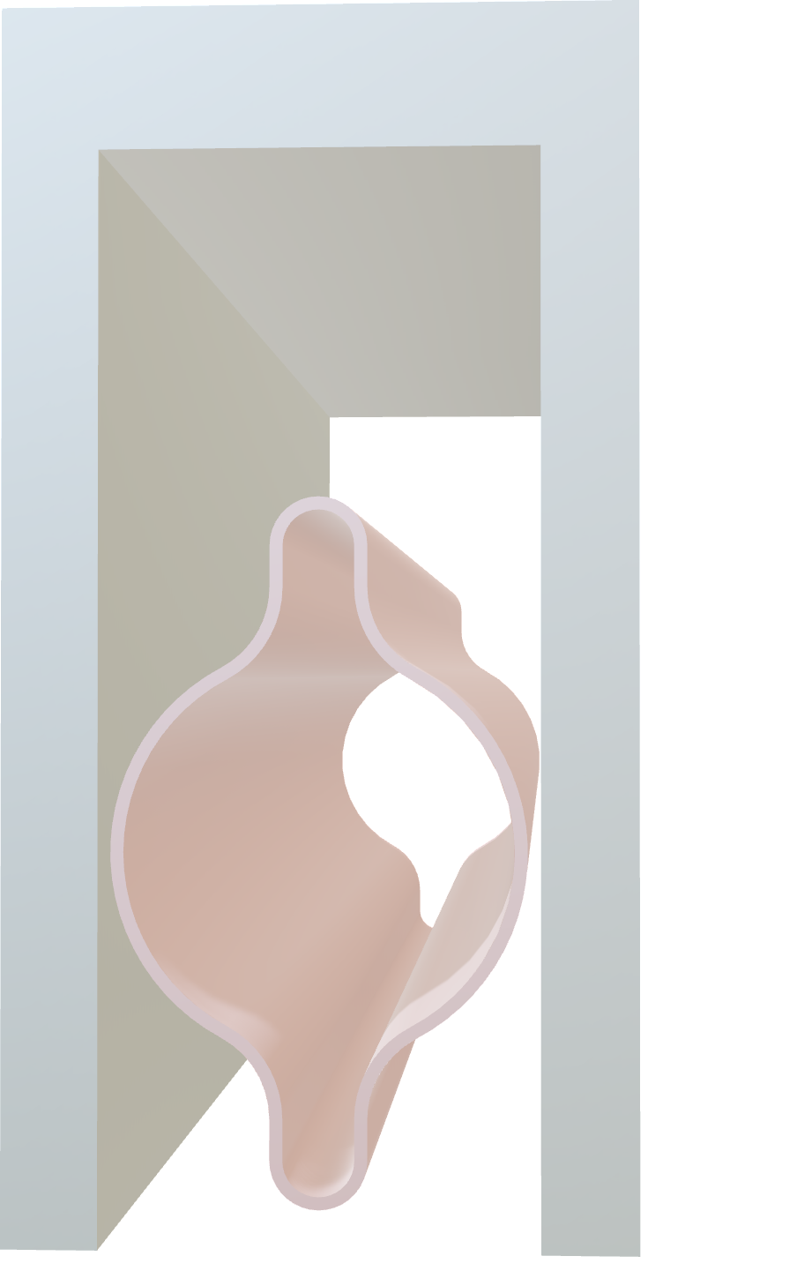

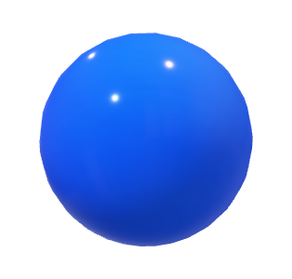


FCC-ee: Synchrotron Radiation
accelerator center
N↓
dipole
S↓
γ
$$e^{−}$$

Slide 3

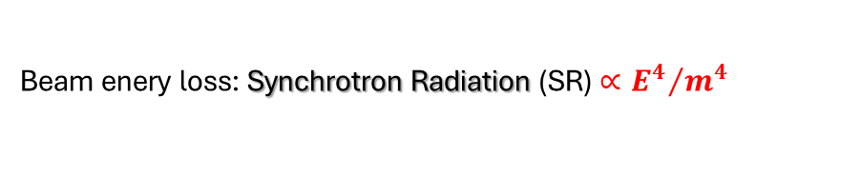






FCC-ee: Synchrotron Radiation
Beam enery loss: Synchrotron Radiation (SR) $∝{E^{4}}/{m^{4}}$
accelerator center
N↓
dipole
S↓
γ
$$e^{−}$$

Slide 4
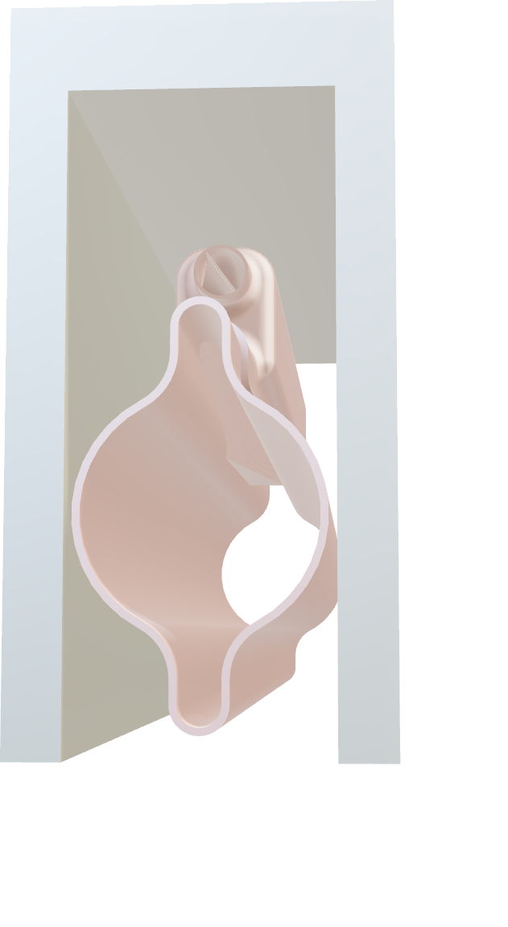
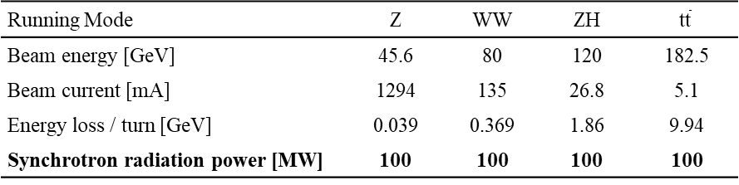
FCC-ee: Synchrotron Radiation
Beam enery loss: Synchrotron Radiation (SR) $∝{E^{4}}/{m^{4}}$
Running Mode | Z | WW | ZH | $$\text{t}\overline{\text{t}}$$
Beam energy [GeV] | 45.6 | 80 | 120 | 182.5
Beam current [mA] | 1294 | 135 | 26.8 | 5.1
Energy loss / turn [GeV] | 0.039 | 0.369 | 1.86 | 9.94
Synchrotron radiation power [MW] | 100 | 100 | 100 | 100
γ
$$e^{−}$$

Slide 5



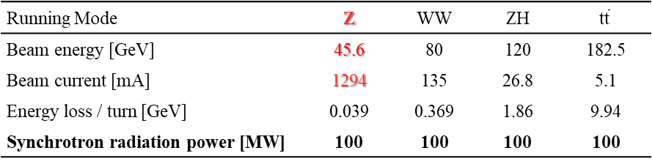
FCC-ee: Synchrotron Radiation
Beam enery loss: Synchrotron Radiation (SR) $∝{E^{4}}/{m^{4}}$
Running Mode | Z | WW | ZH | $$\text{t}\overline{\text{t}}$$
Beam energy [GeV] | 45.6 | 80 | 120 | 182.5
Beam current [mA] | 1294 | 135 | 26.8 | 5.1
Energy loss / turn [GeV] | 0.039 | 0.369 | 1.86 | 9.94
Synchrotron radiation power [MW] | 100 | 100 | 100 | 100
Running Mode | Z | WW | ZH | $$\text{t}\overline{\text{t}}$$
Beam energy [GeV] | 45.6 | 80 | 120 | 182.5
Beam current [mA] | 1294 | 135 | 26.8 | 5.1
Energy loss / turn [GeV] | 0.039 | 0.369 | 1.86 | 9.94
Synchrotron radiation power [MW] | 100 | 100 | 100 | 100
highest SR surface power density
_______
γ
$$e^{−}$$

Slide 6

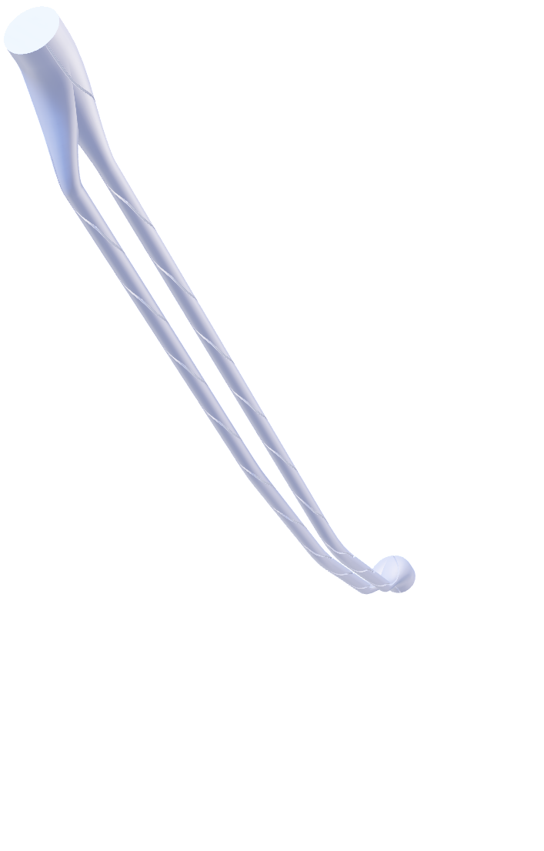
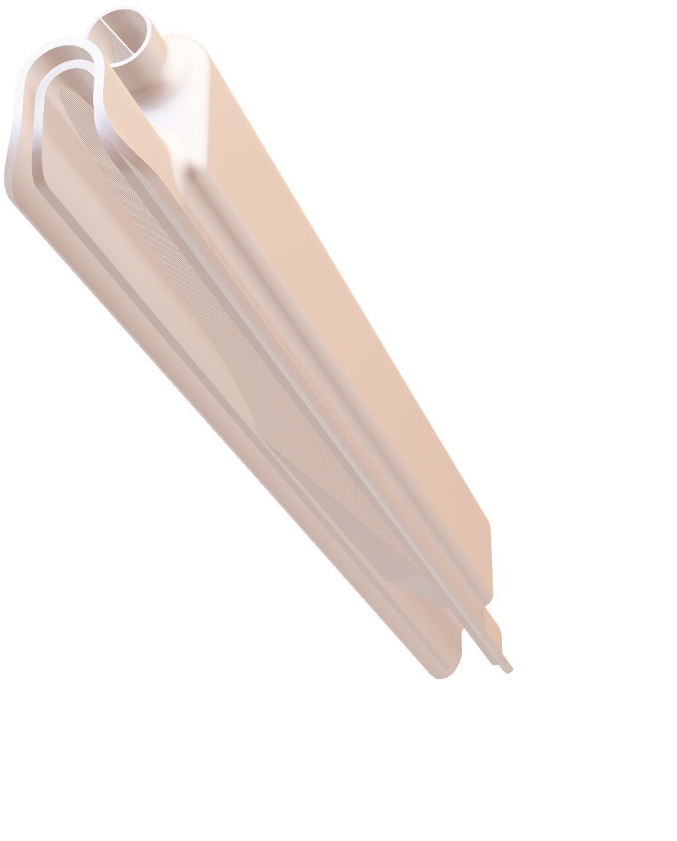
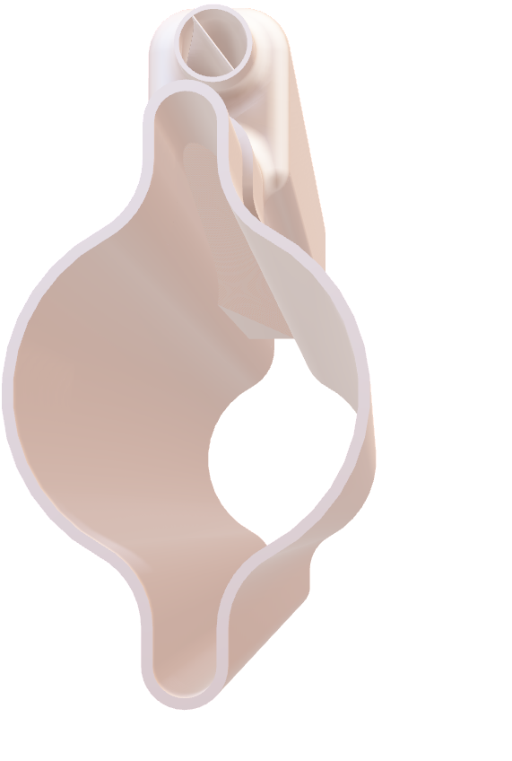
Synchrotron Radiation Absorber (SRA)
Conceptual design of the SRA:
Placement | localized absorber placed in the external winglet of the VC
Integration | laser welding of SRA into dedicated aperture
Design | slanted SR impinging surface with saw tooth profile
Manufacturing | Powder Bed Fusion 3D Printing
Material | CuCrZr
Cooling | water circuit
water cooling circuit
390 mm
SRA
vacuum chamber (VC)
⌀ 14 mm
saw tooth profile
⌀ 60 mm
0.2 mm
γ

Slide 7
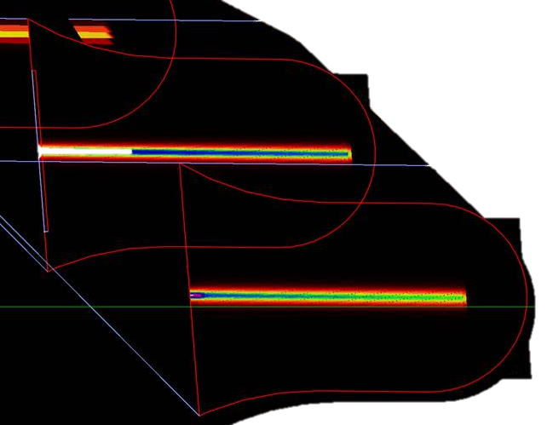
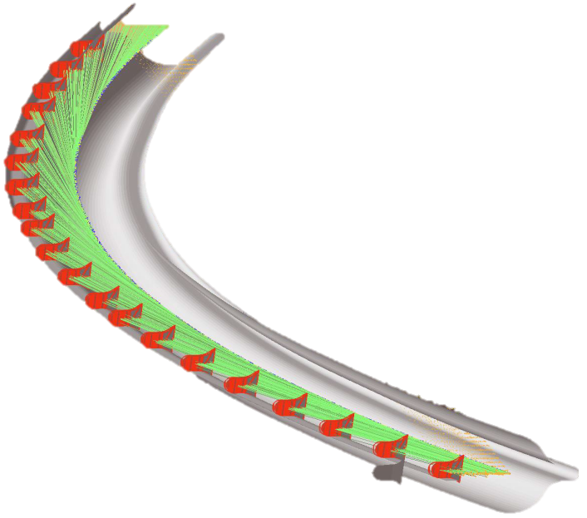
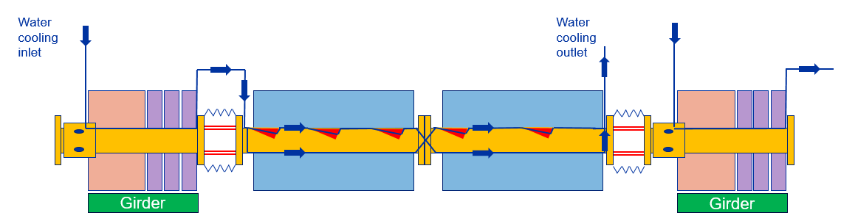


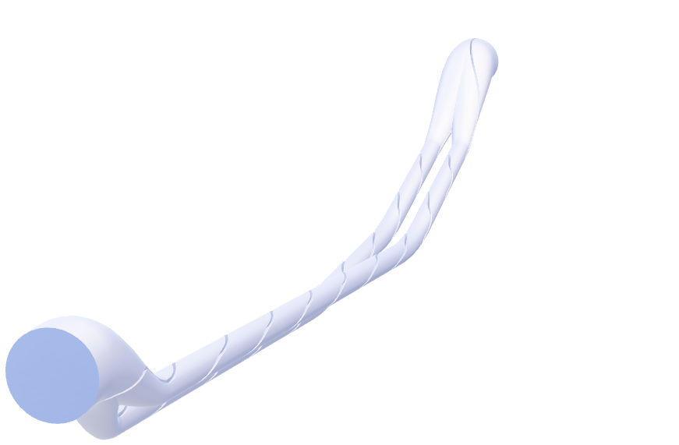
Cooling Circuit Design
SRAs Locations
Arc Half-Cell Layout
SR power deposition [W/mm²]
SynRad+ Simulations
SRA geometry and cooling circuit design
SRA geometrical model
Temperature and stress ($σ_{max}$)
SRA Thermo-mechanical characterization with FEM simulations
Real performance
Experimental validation
SF ·$σ_{max}$ < 500 MPa
Yield Strength ~ 500 MPa
Material Properties of CuCrZr
Synchrotron Radiation
Absorber (SRA)
Quad & Correctors
Dipole
Dipole

Slide 8
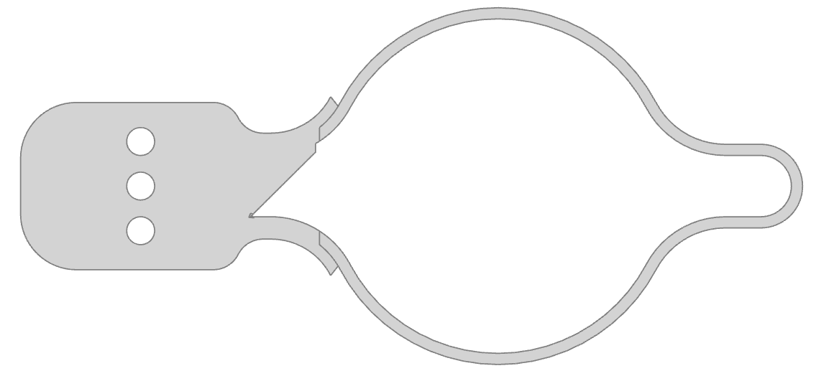
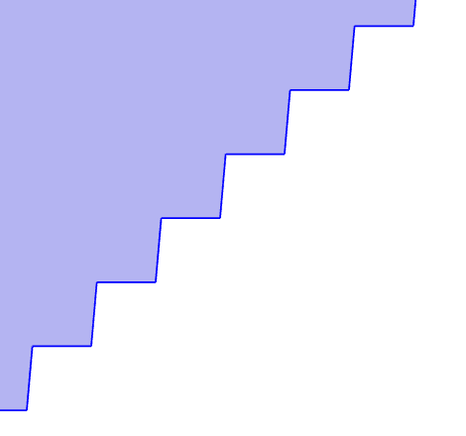

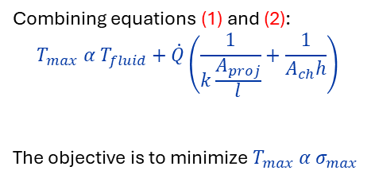

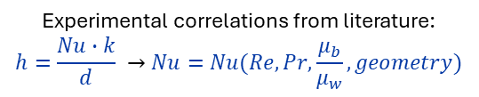
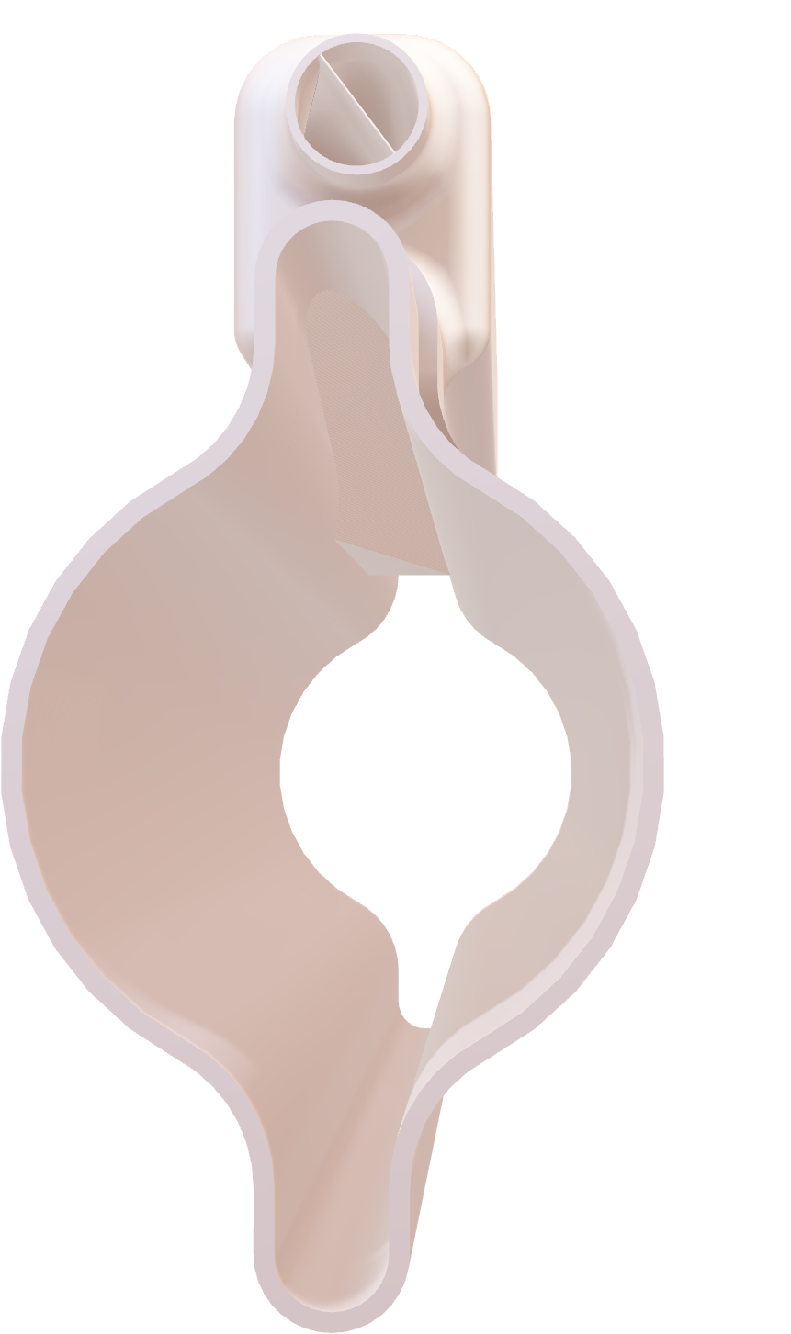

2D Thermo-Mechanical Simulation
Experimental correlations from literature:
$$h=\frac{Nu∙k}{d} →Nu=Nu(Re, Pr, \frac{μ_{b}}{μ_{w}},geometry)$$
Copper
Heat convection: heat transfer coefficient, h [W/(m²K)]
(1) $\dot{Q}=hA_{ch} (T_{wall}−T_{fluid})$
Heat conduction
(2) $\dot{Q}=kA_{proj}∇T$
CuCrZr
k = 360 W/(m*K) - thermal conductivity
α = 20.3e-6 1/K - thermal expansion
Combining equations (1) and (2):
$$T_{max} α T_{fluid}+\dot{Q}\left(\frac{1}{k\frac{A_{proj}}{l}}+\frac{1}{A_{ch}h}\right)$$
The objective is to minimize $T_{max} α σ_{max}$
SR Power $\dot{Q}/L$ [W/m]
conduction term
convection term

Slide 9
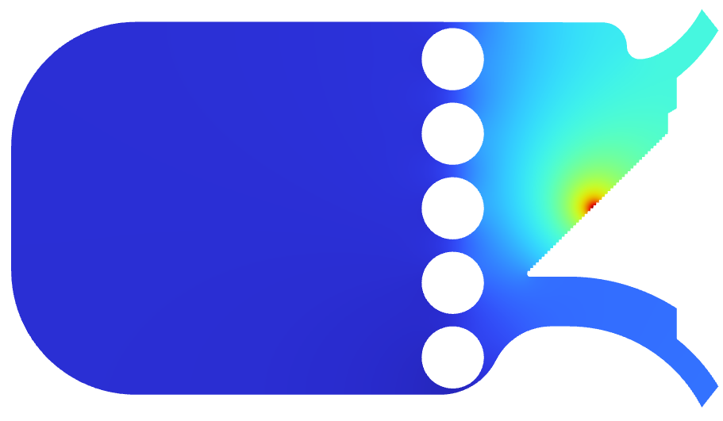
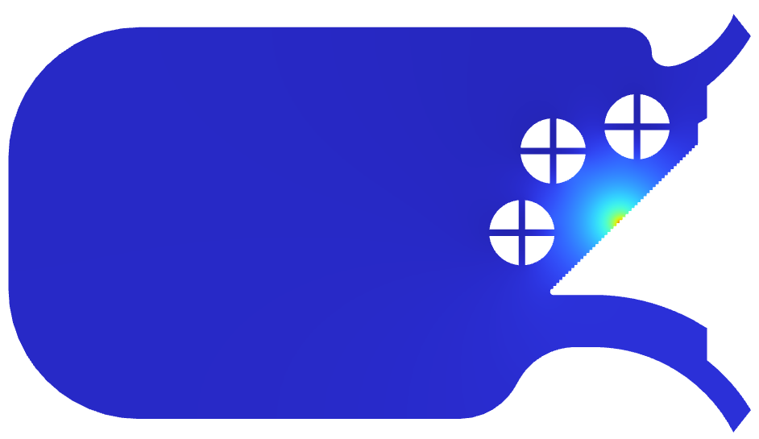
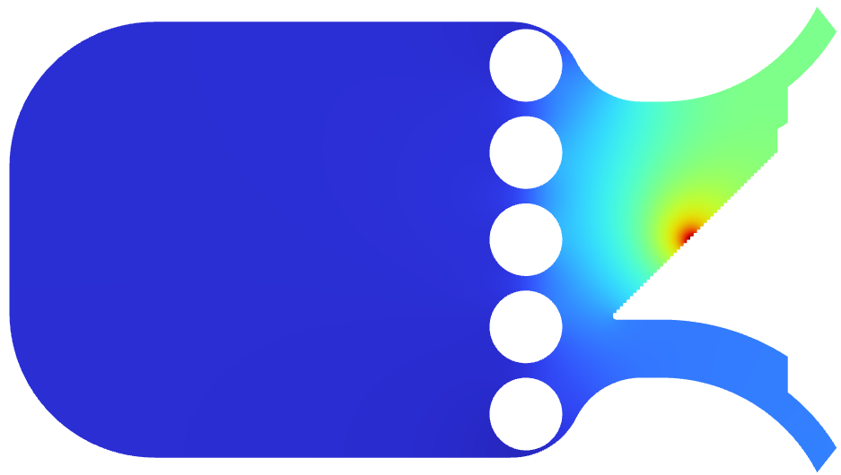
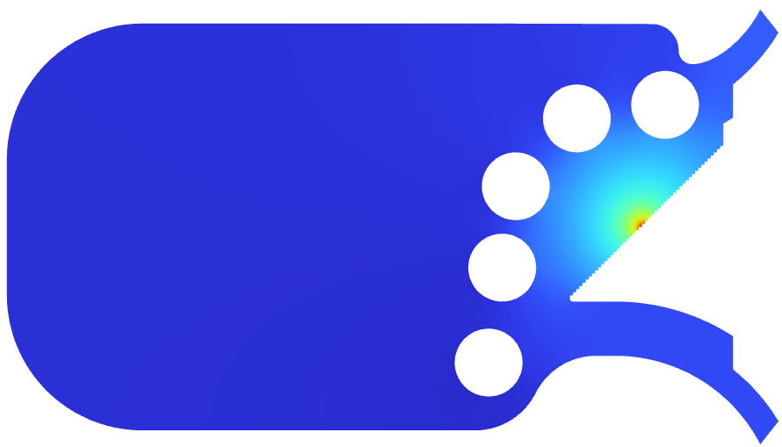
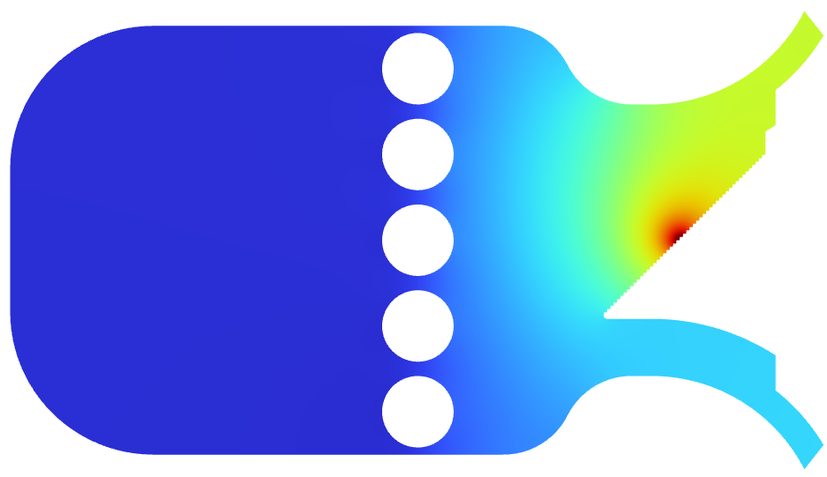
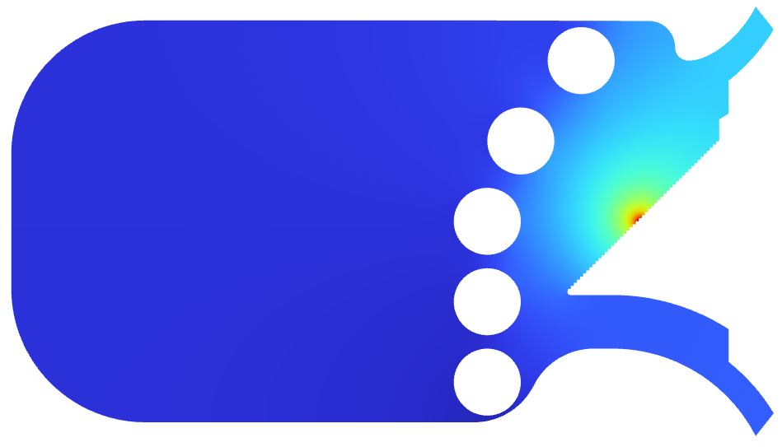
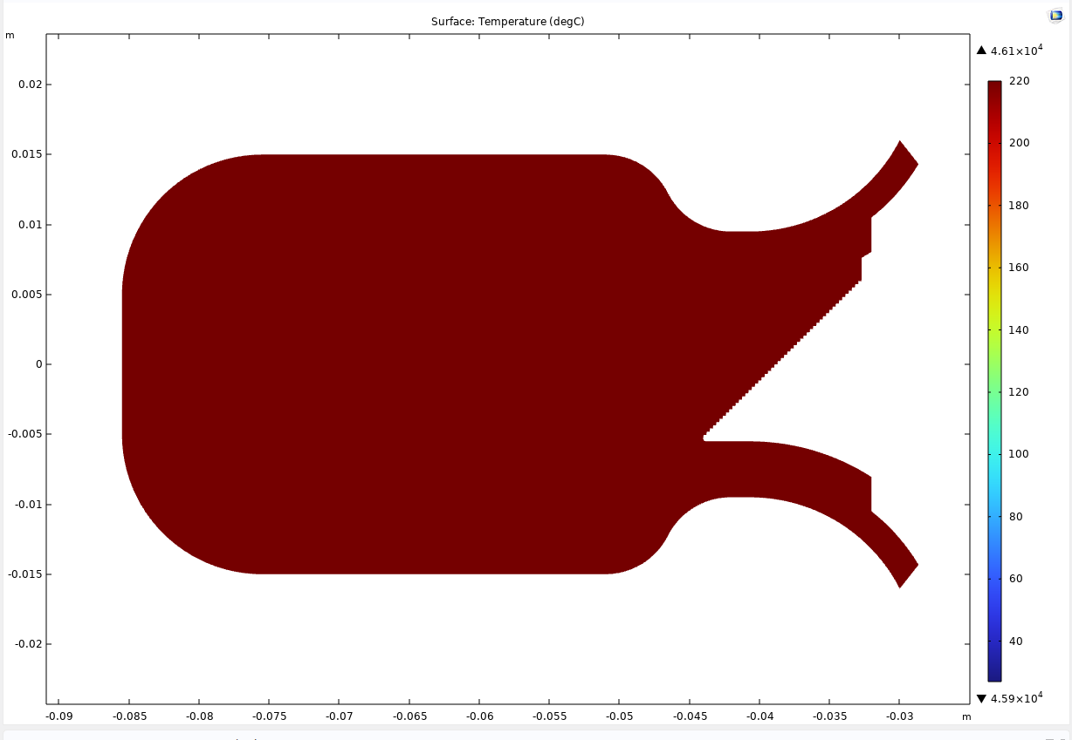
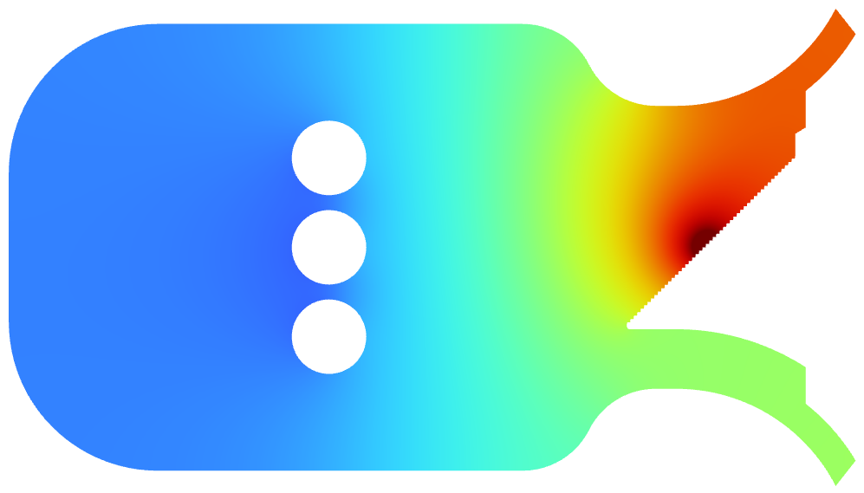
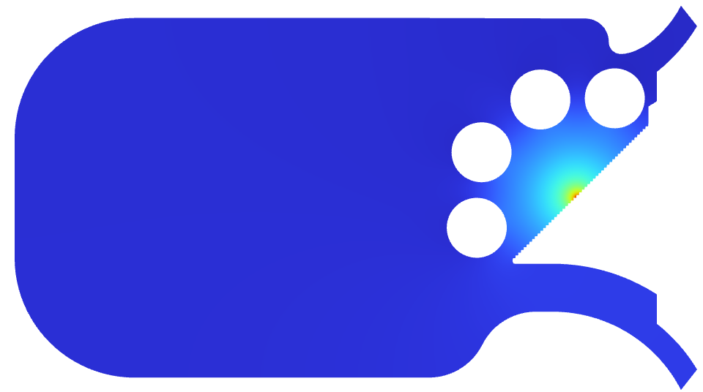
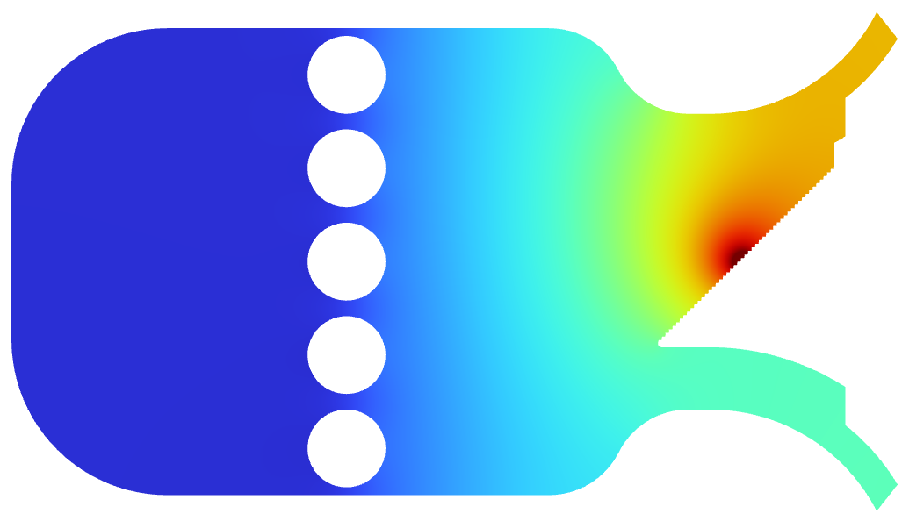

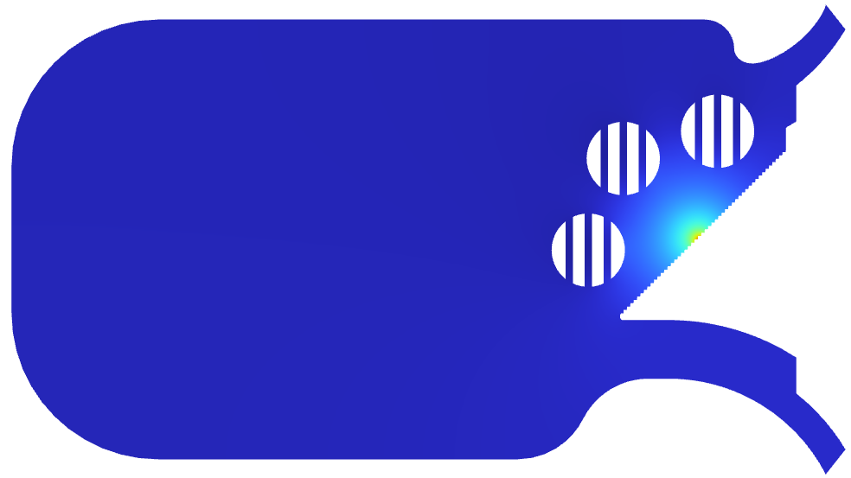
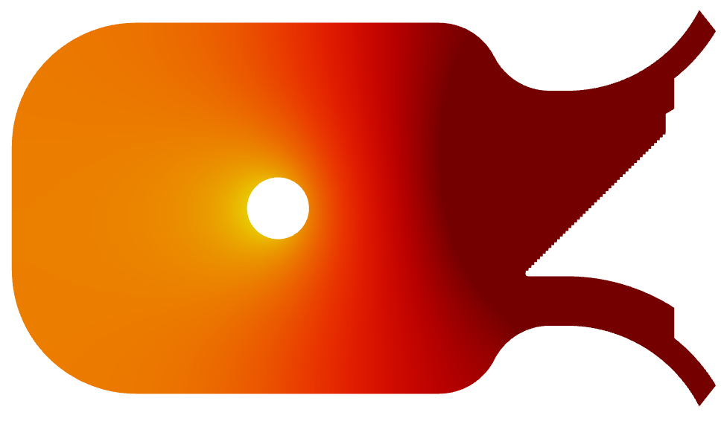
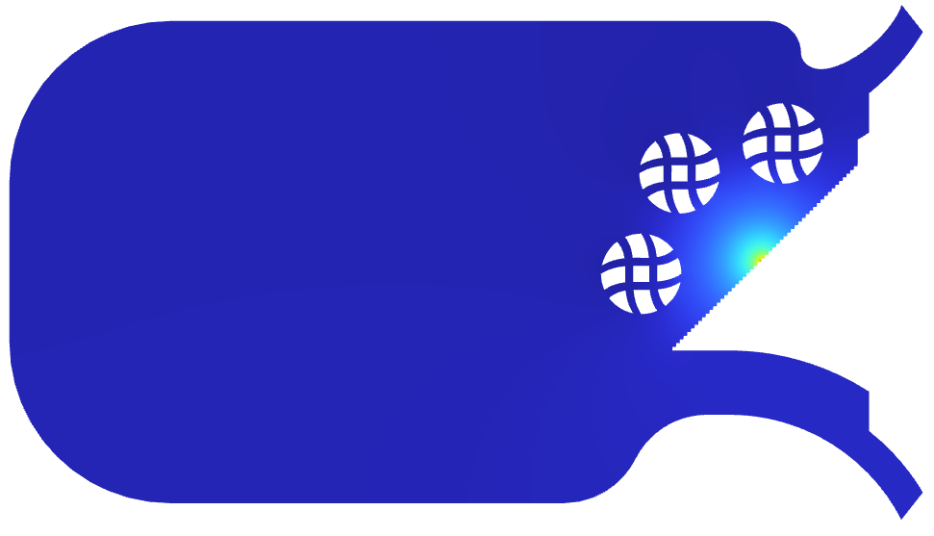
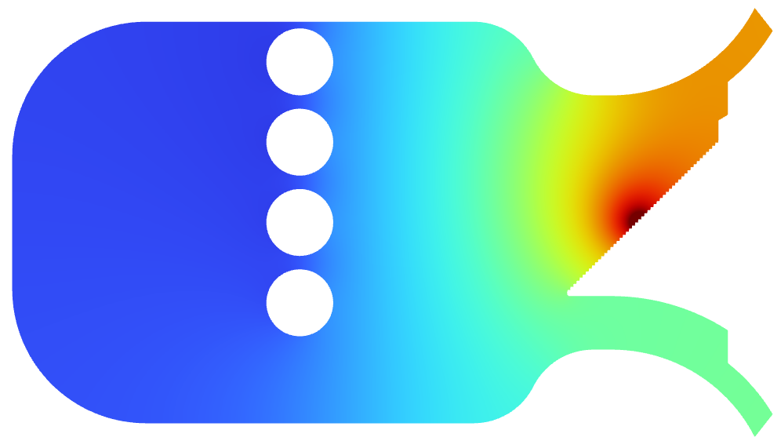
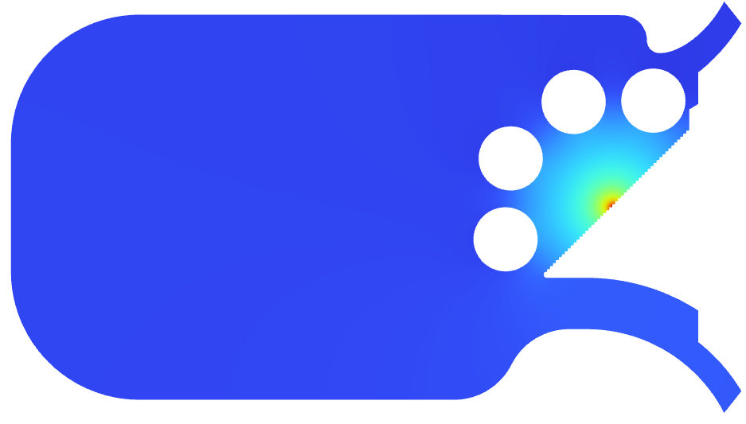
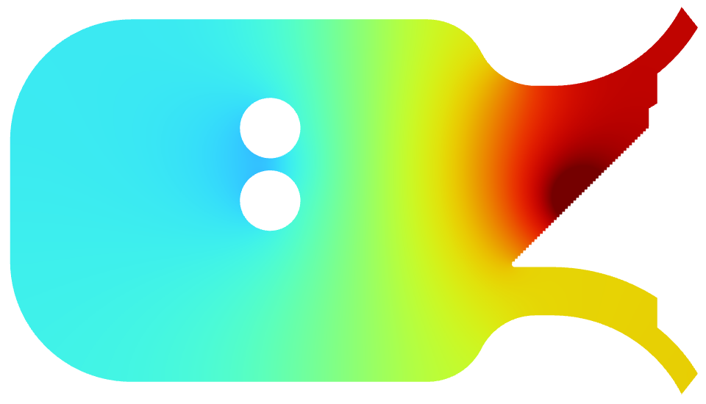
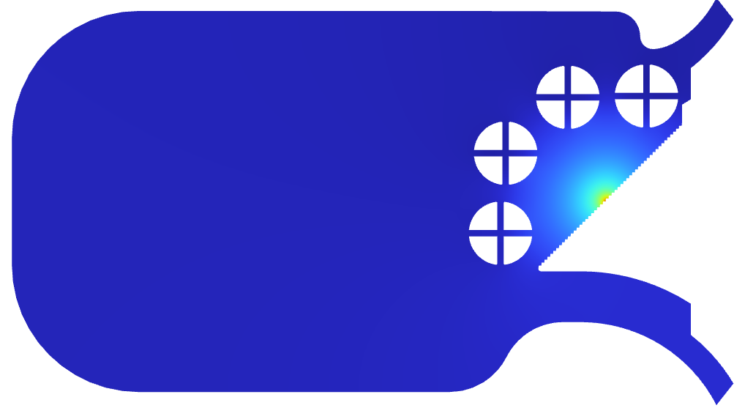
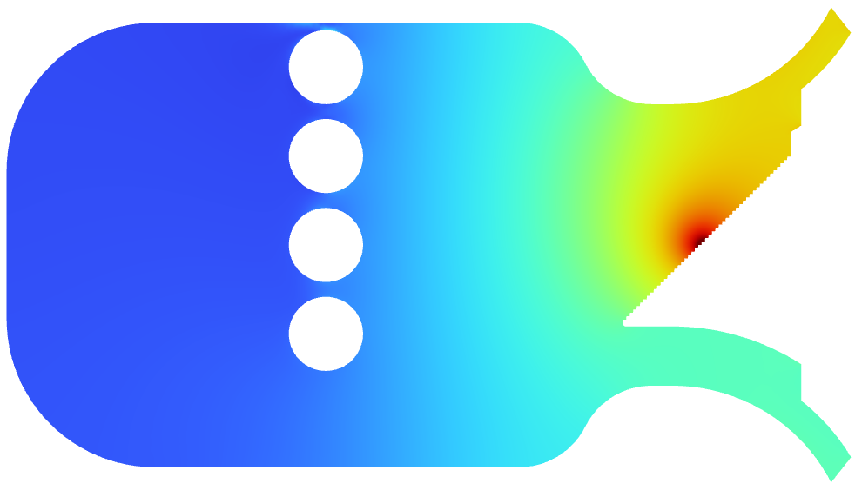
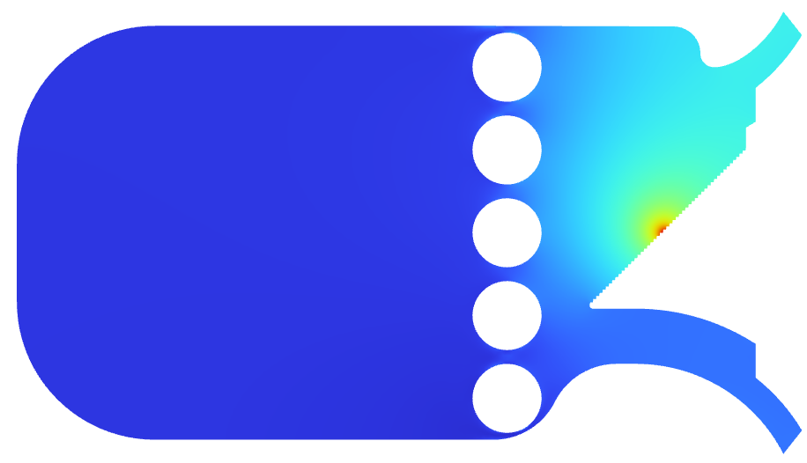
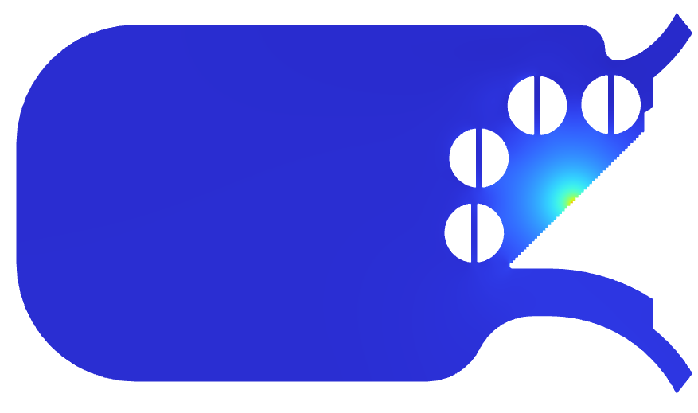
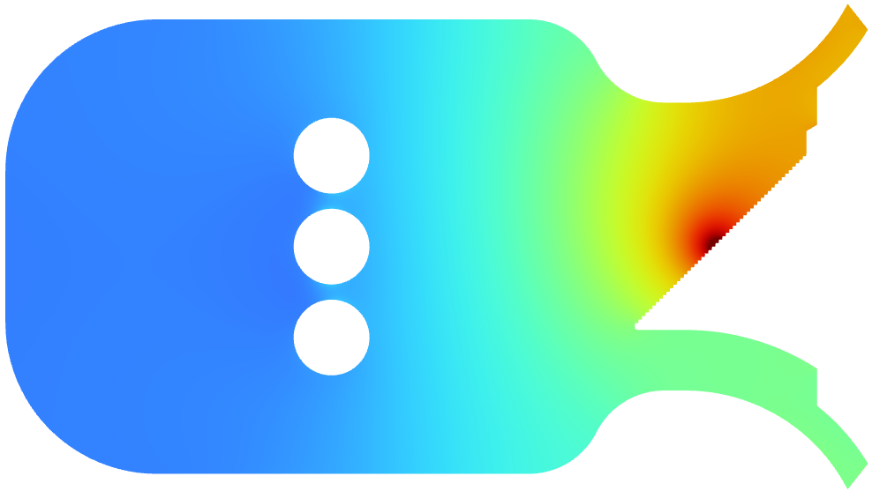
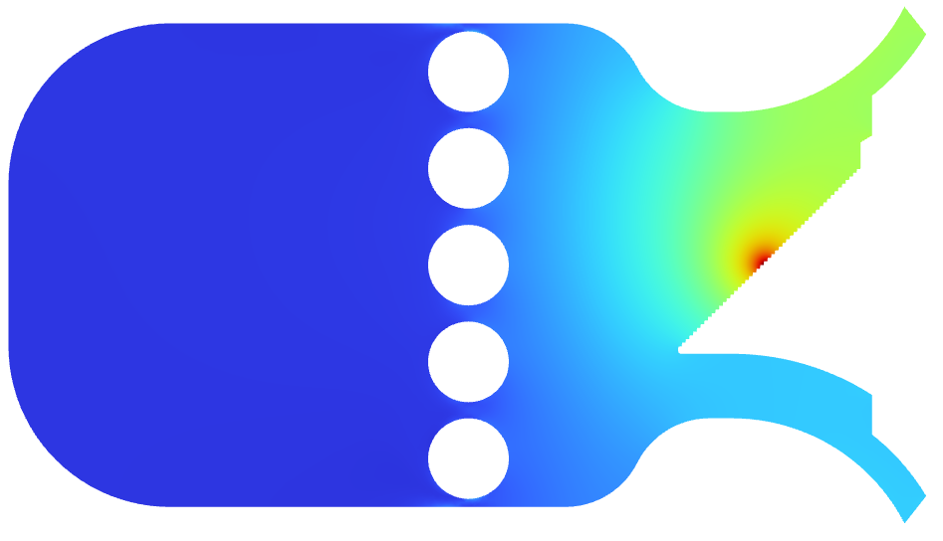
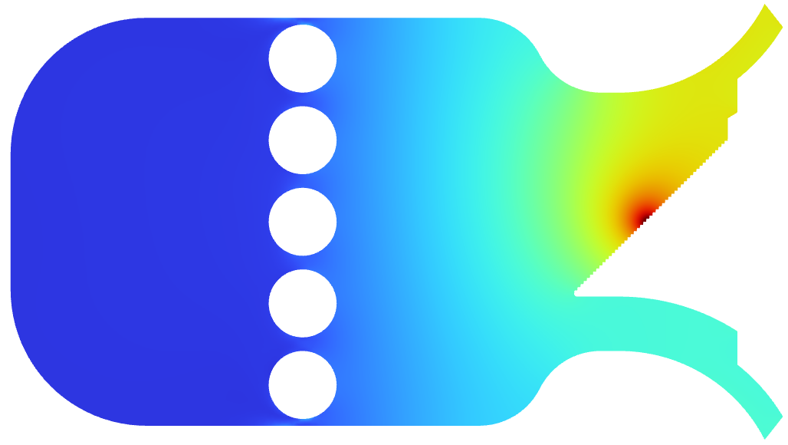
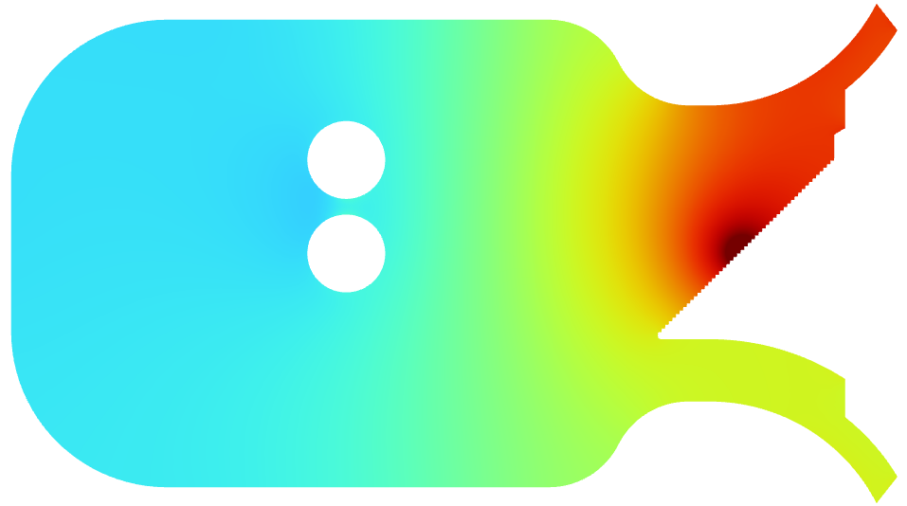
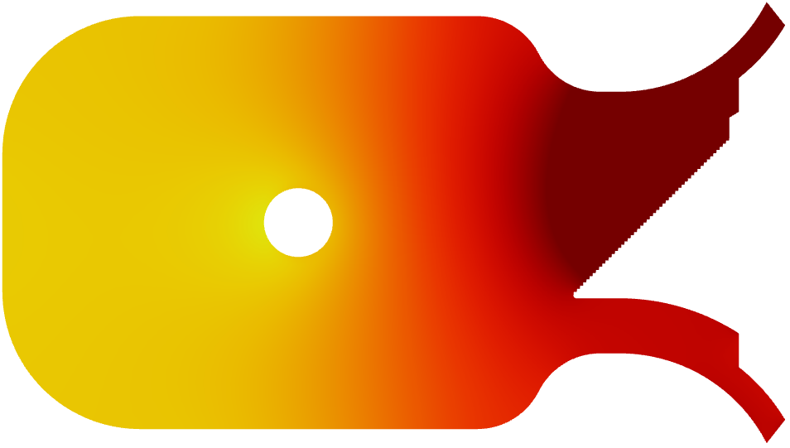
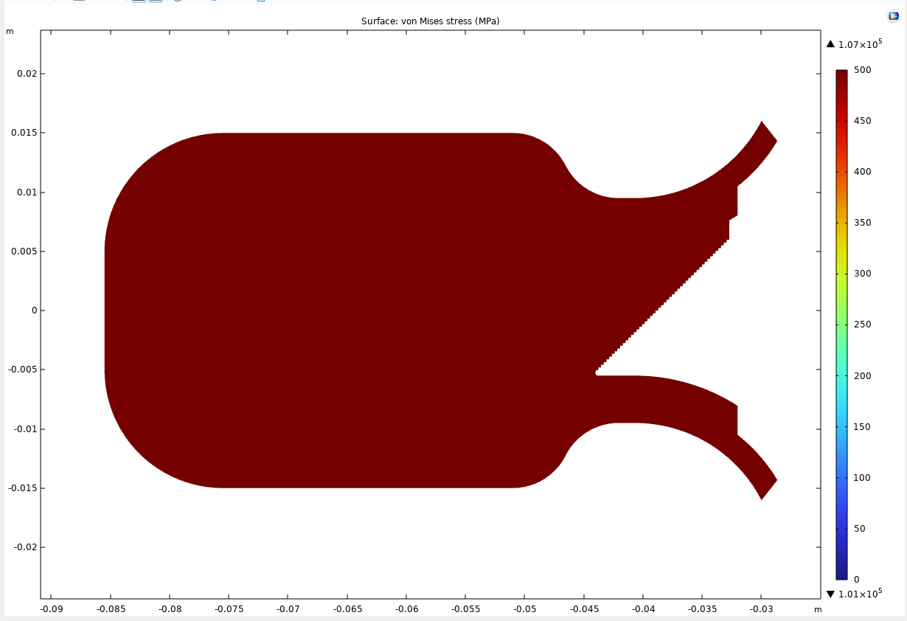
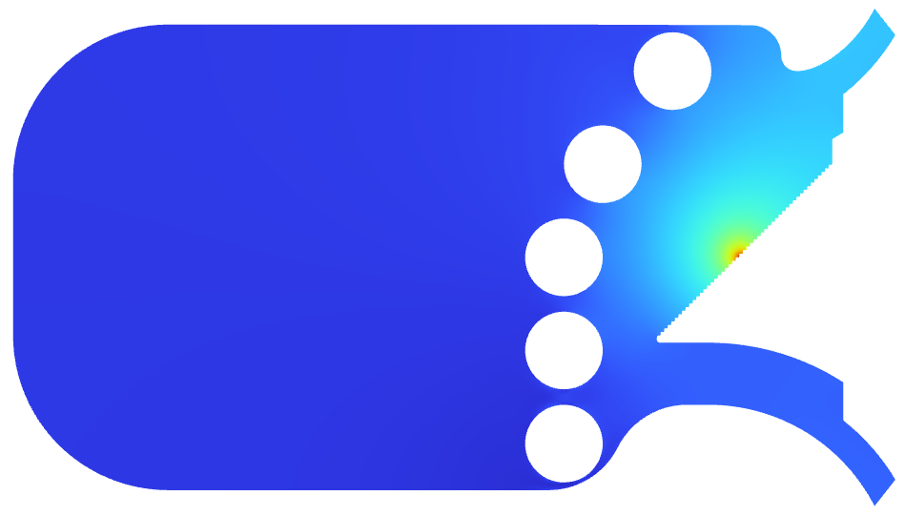

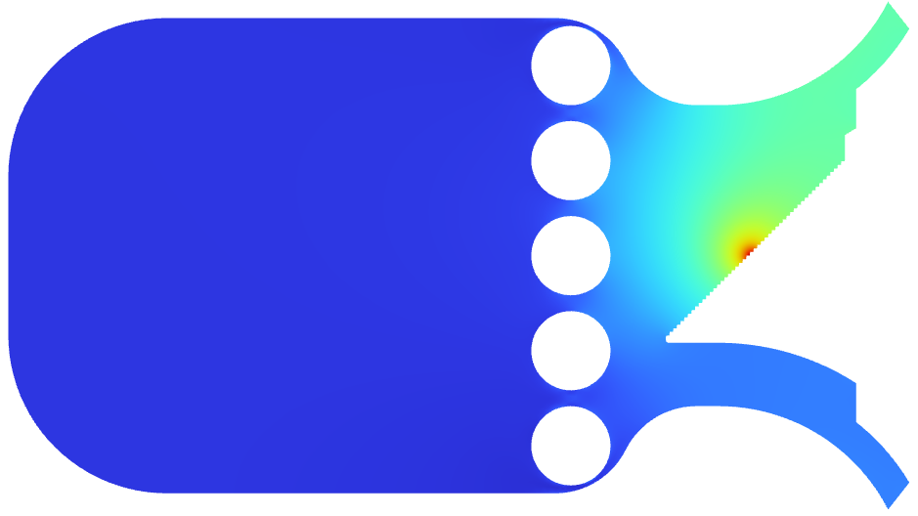
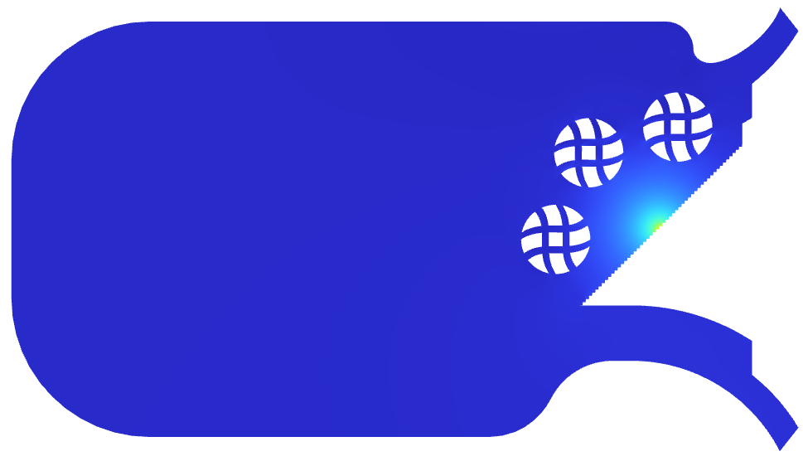
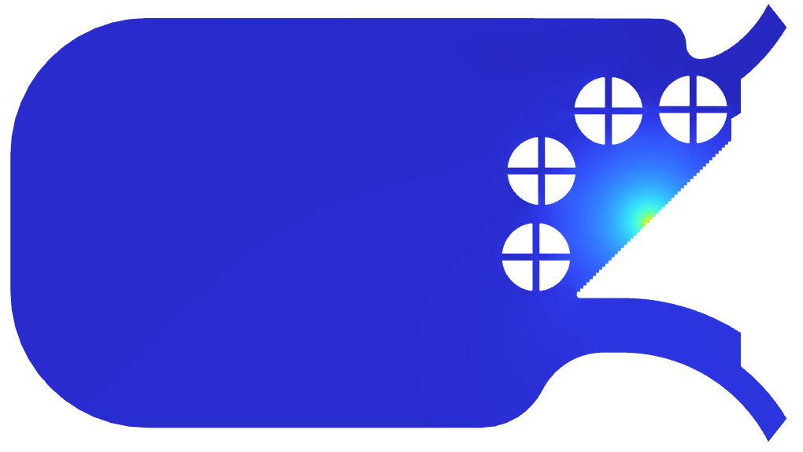
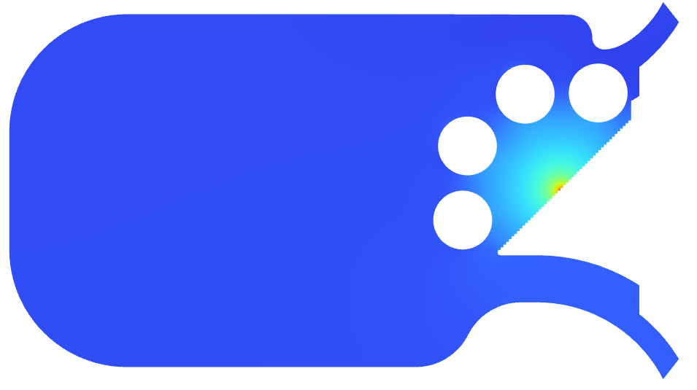
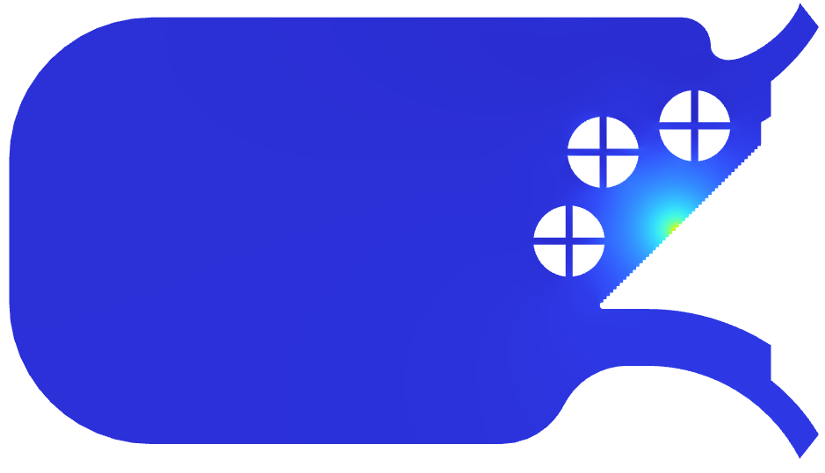















220
180
140
100
60
27 = $T_{fluid}$
2D Thermo-Mechanical Simulation
Temperature [°C]
$σ_{max}$
[MPa]
Circular channels with d = 5 mm
800
500 = ${YS}_{CuCrZr}$
450
400
350
300
250
200
150
100
0
adding channels
700
SF
600
Asymptotic limit
Von Mises stress [MPa]
1.00
500
remove channel
improving positioning
1.25
400
remove channel
h↑
1.50
adding fins
adding tapes
300
$${σ_{max} α T}_{max} α T_{fluid}+\dot{Q}\left(\frac{1}{k\frac{A_{proj}}{l}}+\frac{1}{A_{ch}h}\right)$$
$${σ_{max} α T}_{max} α T_{fluid}+\dot{Q}\left(\frac{1}{k\frac{A_{proj}}{l}}+\frac{1}{A_{ch}h}\right)$$
$${σ_{max} α T}_{max} α T_{fluid}+\dot{Q}\left(\frac{1}{k\frac{A_{proj}}{l}}+\frac{1}{A_{ch}h}\right)$$
$${σ_{max} α T}_{max} α T_{fluid}+\dot{Q}\left(\frac{1}{k\frac{A_{proj}}{l}}+\frac{1}{A_{ch}h}\right)$$
$${σ_{max} α T}_{max} α T_{fluid}+\dot{Q}\left(\frac{1}{k\frac{A_{proj}}{l}}+\frac{1}{A_{ch}h}\right)$$
200
$h_{D\&B}$ = 15500 W/(m²K)
100
$h_{M\&B}$ = 22000 W/(m²K)
Dittus and Boelter correlation: smooth channel
$$Nu=0.024{Re}^{0.8}{Pr}^{0.4}$$
$\dot{m}$ [gr/s]
Manglik and Bergles correlation: twisted tape insert
0
0
58.7
117.4
176.1
234.8
293.5
$$Nu=\left(1+\frac{0.769}{x_{L}}\right)0.023{Re}^{0.8}{Pr}^{0.4}{\left(\frac{π}{π−4δ/d}\right)}^{0.8}{\left(\frac{π+2−2δ/d}{π−4δ/d}\right)}^{0.2}{\left(\frac{μ_{b}}{μ_{w}}\right)}^{0.3}$$
0 1 2 3 4 5
n. of channels

Slide 10












Fluid Thermo-Dynamics Simulations
Computational Fluid Dynamics (CFD)
Heat transfer coefficient:
$h=\frac{Nu∙k}{d} →Nu=Nu(geometry, fluid regime)$
Nusselt number:
$Nu= {\left.\frac{ ∂T^{∗}}{ ∂y^{∗}}\right|}_{y^{∗}=0}$ where $y^{∗}=\frac{y}{d}$ and $T^{∗}=\frac{T−T_{w}}{T_{b}−T_{w}}$
hydrodynamic field
thermal field

Slide 11





Fluid Thermo-Dynamics Simulations
CFD potential for the SRA design:
Hydrodynamic characterization:
  Pressure and velocity distribution
  Developing flow regions (bends and cross-section variations)
  Backflow or stagnant fluid (source of vibrations)
Thermal characterization:
  Temperature distribution
  Heat transfer coefficient (substituting empirical correlations)

Slide 12







Fluid Thermo-Dynamics Simulations
Smooth Circular Channel
Mesh Sensitivity Study
Perform simulation on ≥ 3 levels of mesh refinement
Extract value of a representative variable for comparison
Extrapolate the exact asymptotic CFD Solution
Asses the error committed for each refinement level
Decide the adequate mesh size
mesh refinement
coarse
fine
26000
60.0% error
CFD results
24000
$$\dot{Q}$$
near-wall region
22000
$$h$$
20000
Heat Transfer coefficient, h [W/m²K]
12.6% error
18000
5.1% error
fluid domain
2.0% error
0.8% error
16000
Exact Asymptotic CFD Solution
14000
Element size:
12000
0
1
2
3
4
5
6
Mesh size [Million Elements]
Refinement ratio: 1.25

Slide 13












Experimental Validation
Measurement capabilities of the test setup:
Pressure drop:
$∆P={(P}_{out}−P_{in})$
Heat power absorption:
$\dot{Q}=\dot{V}ρc_{p}(T_{f,out}−T_{f,in})$
Heat transfer coefficient:
$\overline{h}=\frac{\dot{Q}}{{A(\overline{T_{w}}}_{ }−\overline{T_{f}})}$
convergence
T
temperature sensor
P
pressure sensor
$$T_{w,1}$$
$$T_{w,2}$$
$$T_{w,3}$$
$$T_{w,4}$$
$$T_{f,in}$$
$$P_{in}$$
$$P_{out}$$
$$T_{f,out}$$
water tank
test specimen
mixing section
control valve
pump
$$\dot{V}$$
flow meter

Slide 14






Experimental Validation
After mastering the experimental validation for the benchmark case…
Experimental Validation Goals:
Asses cooling performance of different channels geometry
Asses thermo-mechanical performance of locally heated SRA
waves
lattice
thermal bridge
double twisted-tape
4 x 1kW cartridges
twisted-tape

Slide 15




Key Takeaways
Current design status:
Cooling circuit current design: 3 cooling channels of 5-mm-diameter with twisted-tape
  Maximum mean velocity: 3 m/s (due to copper erosion limitation)
  Flow rate: 176 g/s /absorber → 352 g/s /cooling line
  Cooling water inlet temperature: 27°C
  Mean fluid temperature increase: 4.75°C /absorber
Thermo-mechanical results:
  Maximum temperature: 184°C
  Maximum Von Misses Stress: 360 MPa (Safety Factor of 1.4) (highly localized)
  Pressure drop: 0.7 bar /absorber
Work in progress:
CFD simulations on the different geometries
Coupled simulations of fluid and solid domain on the SRA
Upgrade and fine tunning of the test setup
Experimental characterization of different geometries of the cooling channels
Experimental characterization of the heated absorber
$T_{max}$ = 184°C
$σ_{max}$ = 360 MPa

Slide 16
Thank you for your attention!

