Slide 1

In-situ SEY determination with the LHC Vacuum Pilot Sector and PyECLOUD
Quentin DUONG
TE – VSC – VSM
Dr. Vincent BAGLIN (CERN) CERN supervisor
Dr. Gaël SATTONNAY (IJCLab-Paris Saclay University) Doctoral supervisor
quentin.duong@cern.ch
01/07/2025

Slide 2

Outline
Experimental description
Electron-cloud simulation with the PyECLOUD program
$δ_{max}$ determination using the number of bunches at injection
TE – VSC – VSM

Slide 3
Experimental Description
TE – VSC – VSM

Slide 4
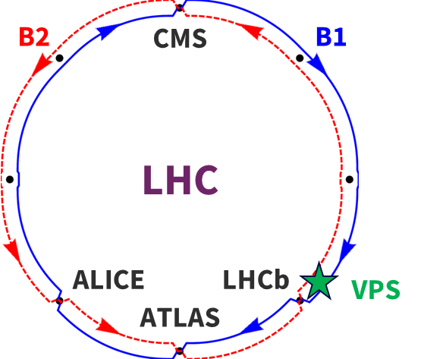
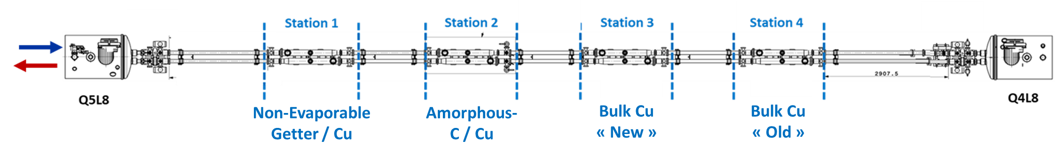
General VPS layout
  Vacuum Pilot Sector (VPS)
  Location: close to LHCb
  2 beamlines physically separated
  Installed in 2015 in its latest version:
    1.4 m-long NEG coating
    1.4 m-long thick a-C coating ~500 nm
    1.4 m-long bulk Cu « New »
    1.4 m-long bulk Cu « Old » (installed in 2014)
TE – VSC – VSM

Slide 5
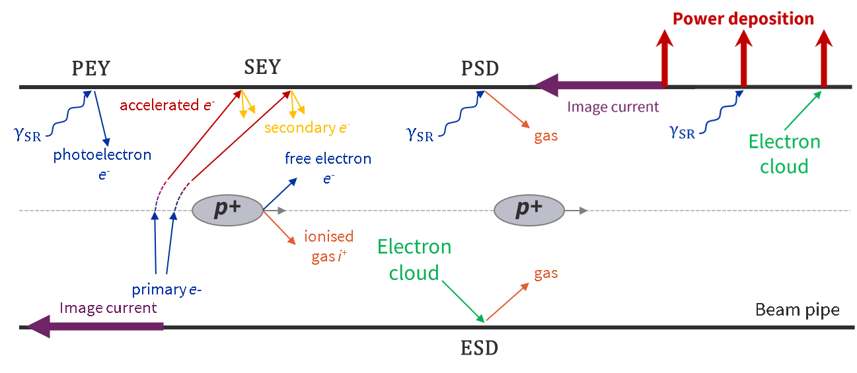
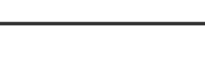
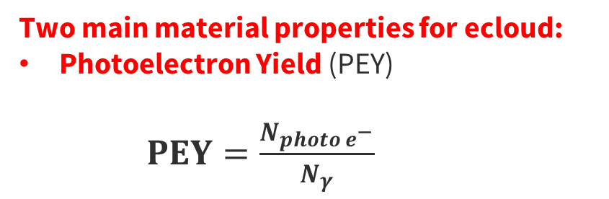
Electron cloud build-up
  Electron cloud = Primary + Secondary electrons
  Primary electrons:
    Photoelectrons induced by photoelectric effect
    Free electrons induced by residual gas ionisation (bunch, photons, or electrons induced)
  Two main material properties for ecloud:
  Photoelectron Yield (PEY)
  $PEY=\frac{N_{{photo e}^{−}}}{N_{γ}}$
TE – VSC – VSM

Slide 6
Electron cloud build-up
  Electron cloud = Primary + Secondary electrons
  Primary electrons:
    Photoelectrons induced by photoelectric effect
    Free electrons induced by residual gas ionisation (bunch, photons, or electrons induced)
  Two main material properties for ecloud:
  Photoelectron Yield (PEY)
  $PEY=\frac{N_{{photo e}^{−}}}{N_{γ}}$
TE – VSC – VSM

Slide 7
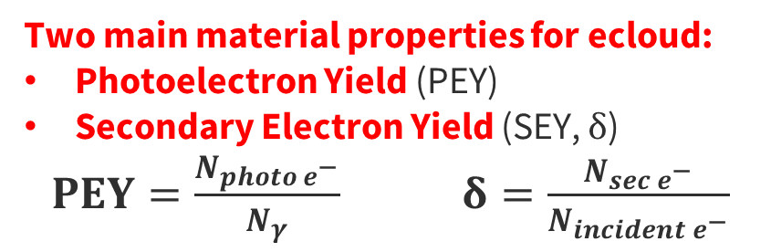
Electron cloud build-up
  Electron cloud = Primary + Secondary electrons
  Primary electrons:
    Photoelectrons induced by photoelectric effect
    Free electrons induced by residual gas ionisation (bunch, photons, or electrons induced)
  Secondary electrons: induced by primary electrons, accelerated by successive bunches, hitting the surface
  Two main material properties for ecloud:
  Photoelectron Yield (PEY)
  Secondary Electron Yield (SEY, $δ$)
  $PEY=\frac{N_{{photo e}^{−}}}{N_{γ}}$ $δ=\frac{N_{{sec e}^{−}}}{N_{incident e^{−}}}$
TE – VSC – VSM

Slide 8
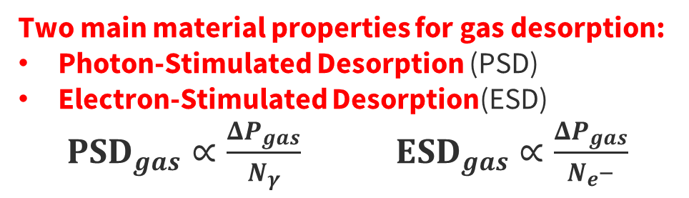
Electron cloud build-up
  Electron cloud = Primary + Secondary electrons
  Primary electrons:
    Photoelectrons induced by photoelectric effect
    Free electrons induced by residual gas ionisation (bunch, photons, or electrons induced)
  Secondary electrons: induced by primary electrons, accelerated by successive bunches, hitting the surface
  Two main material properties for ecloud:
  Photoelectron Yield (PEY)
  Secondary Electron Yield (SEY, $δ$)
  $PEY=\frac{N_{{photo e}^{−}}}{N_{γ}}$ $δ=\frac{N_{{sec e}^{−}}}{N_{incident e^{−}}}$
  Two main material properties for gas desorption:
  Photon-Stimulated Desorption (PSD)
  Electron-Stimulated Desorption(ESD)
  ${PSD}_{gas}∝\frac{{ΔP}_{gas}}{N_{γ}}$ ${ESD}_{gas}∝\frac{{ΔP}_{gas}}{N_{e^{−}}}$
TE – VSC – VSM

Slide 9
Electron cloud build-up
  Electron cloud = Primary + Secondary electrons
  Primary electrons:
    Photoelectrons induced by photoelectric effect
    Free electrons induced by residual gas ionisation (bunch, photons, or electrons induced)
  Secondary electrons: induced by primary electrons, accelerated by successive bunches, hitting the surface
  Two main material properties for ecloud:
  Photoelectron Yield (PEY)
  Secondary Electron Yield (SEY, $δ$)
  $PEY=\frac{N_{{photo e}^{−}}}{N_{γ}}$ $δ=\frac{N_{{sec e}^{−}}}{N_{incident e^{−}}}$
  Two main material properties for gas desorption:
  Photon-Stimulated Desorption (PSD)
  Electron-Stimulated Desorption(ESD)
  ${PSD}_{gas}∝\frac{{ΔP}_{gas}}{N_{γ}}$ ${ESD}_{gas}∝\frac{{ΔP}_{gas}}{N_{e^{−}}}$
TE – VSC – VSM

Slide 10
Electron cloud build-up
  Electron cloud = Primary + Secondary electrons
  Primary electrons:
    Photoelectrons induced by photoelectric effect
    Free electrons induced by residual gas ionisation (bunch, photons, or electrons induced)
  Secondary electrons: induced by primary electrons, accelerated by successive bunches, hitting the surface
  Two main material properties for ecloud:
  Photoelectron Yield (PEY)
  Secondary Electron Yield (SEY, $δ$)
  $PEY=\frac{N_{{photo e}^{−}}}{N_{γ}}$ $δ=\frac{N_{{sec e}^{−}}}{N_{incident e^{−}}}$
  Two main material properties for gas desorption:
  Photon-Stimulated Desorption (PSD)
  Electron-Stimulated Desorption(ESD)
  ${PSD}_{gas}∝\frac{{ΔP}_{gas}}{N_{γ}}$ ${ESD}_{gas}∝\frac{{ΔP}_{gas}}{N_{e^{−}}}$
  Side effects observable with VPS: electron density & pressure rise, and heat load
TE – VSC – VSM

Slide 11
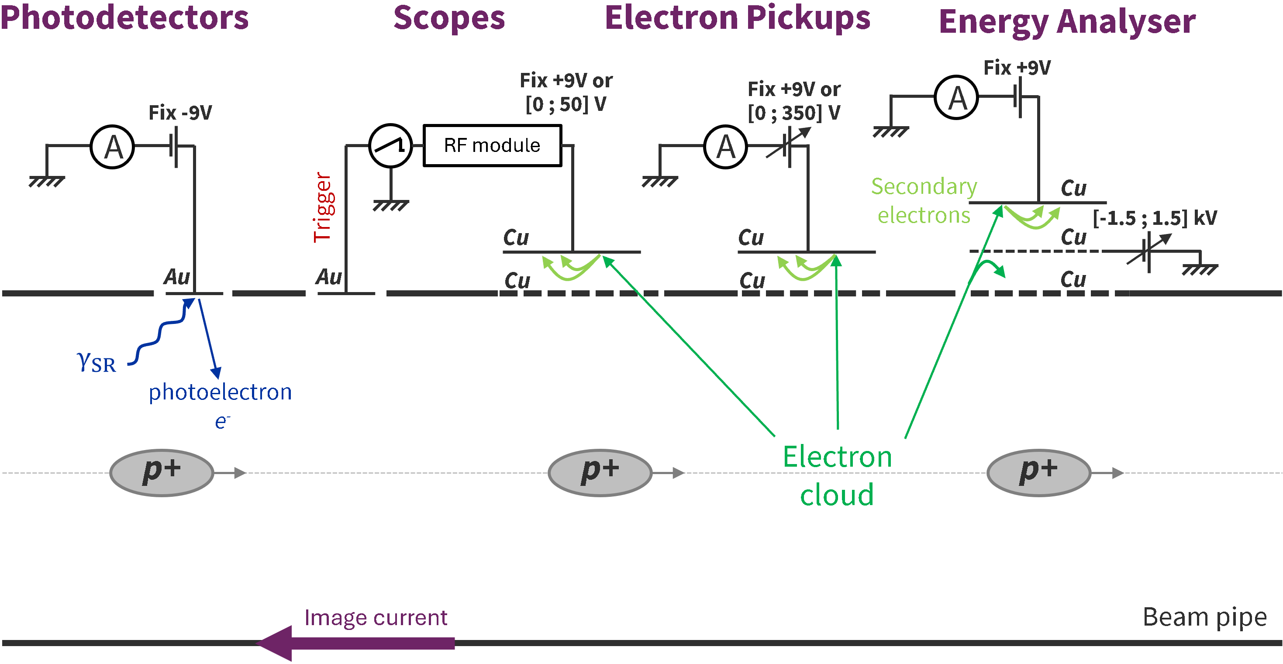
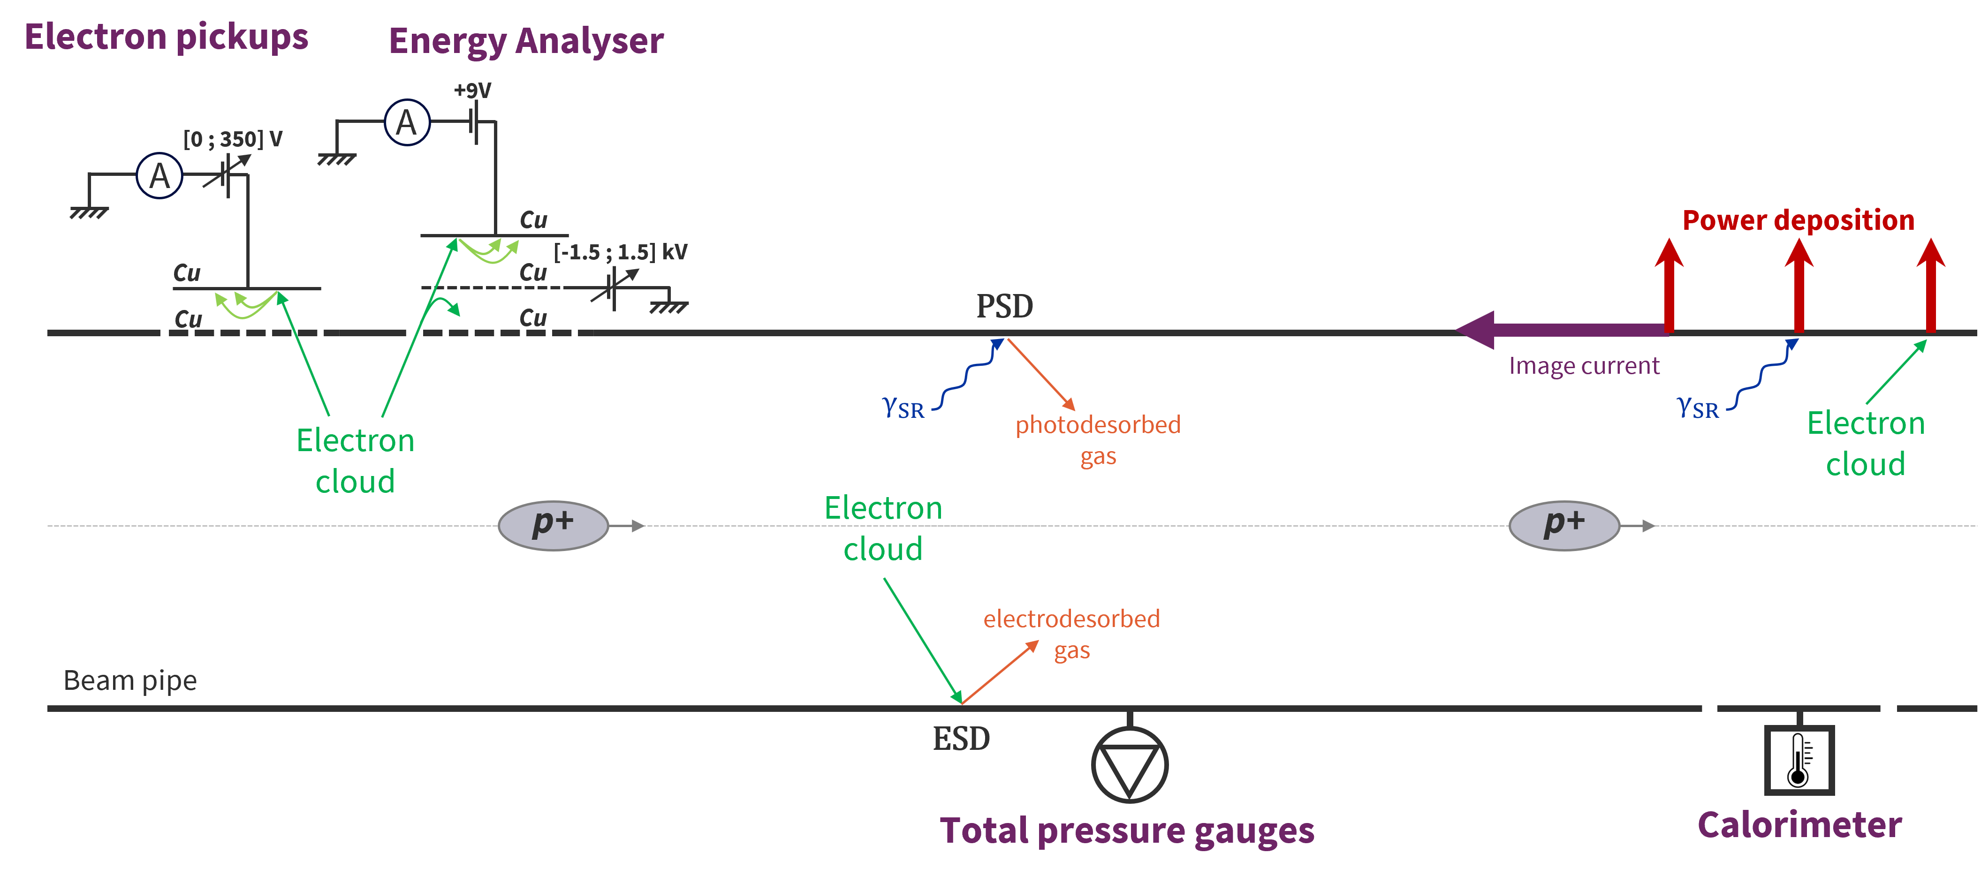
VPS instrumentation overview
  Direct e-cloud measurement
  Electron currents
  Electron energy
  Indirect e-cloud measurement
  Pressure rise
  Temperature rise
gas
RGA
  Total & partial pressure gauges
TE – VSC – VSM

Slide 12
VPS instrumentation overview
  Direct e-cloud measurement
  Electron currents
  For this presentation, only electron pickups are used.
gas
RGA
  Total & partial pressure gauges
TE – VSC – VSM

Slide 13
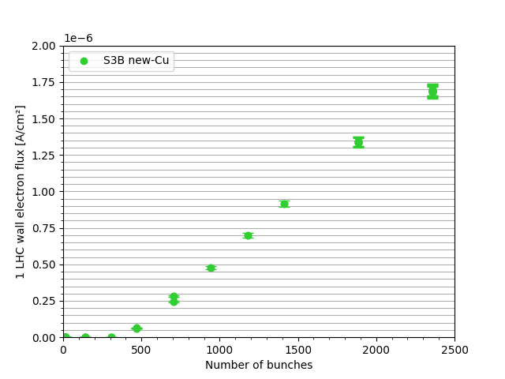
Electron cloud response of copper during injection
Fill 8872 (04/06/2022, 13:42)
  At injection, the intensity seems to follow a linear evolution after a certain number of bunches are injected.
TE – VSC – VSM

Slide 14
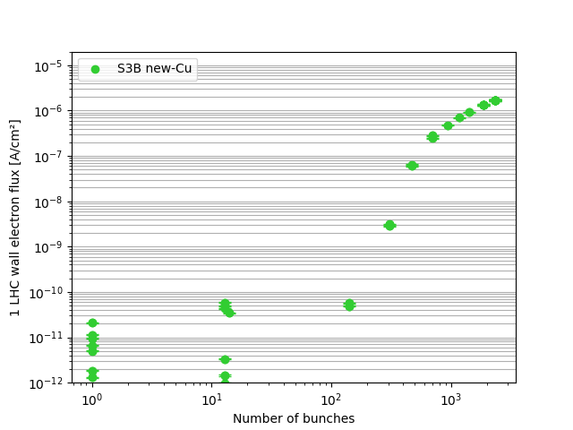
Electron cloud response of copper during injection
Fill 8872 (04/06/2022, 13:42)
  At injection, the intensity seems to follow a linear evolution after a certain number of bunches are injected.
TE – VSC – VSM

Slide 15
Electron cloud response of copper during injection
Fill 8872 (04/06/2022, 13:42)
Transitory
regime
Linear
regime
Transitory
regime
Linear
regime
  At injection, the intensity seems to follow a linear evolution after a certain number of bunches are injected.
TE – VSC – VSM

Slide 16

Electron cloud response of copper during injection
Fill 8872 (04/06/2022, 13:42)
Transitory
regime
Linear
regime
Transitory
regime
Linear
regime
$$α$$
  At injection, the intensity seems to follow a linear evolution after a certain number of bunches are injected.
  Two interesting parameters: linear coefficient $α$
TE – VSC – VSM

Slide 17

Electron cloud response of copper during injection
Fill 8872 (04/06/2022, 13:42)
Transitory
regime
Linear
regime
Transitory
regime
Linear
regime
$$α$$
$$N_{th}$$
  At injection, the intensity seems to follow a linear evolution after a certain number of bunches are injected.
  Two interesting parameters: linear coefficient $α$ and the linear regime threshold $N_{th}$
TE – VSC – VSM

Slide 18
Electron cloud response of copper during injection
Fill 8872 (04/06/2022, 13:42)
Transitory
regime
Linear
regime
Transitory
regime
Linear
regime
$$α$$
$$N_{th}$$
How do $α$ and $N_{th}$ change with $δ_{max}$?
TE – VSC – VSM

Slide 19
Electron-cloud simulation with the PyECLOUD program
TE – VSC – VSM

Slide 20
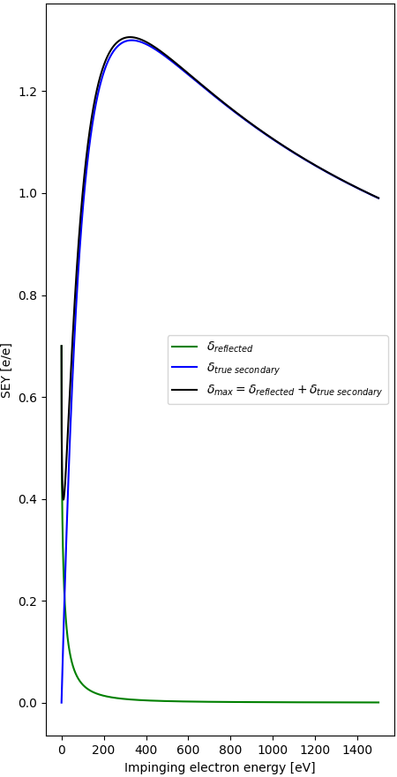
SEY curve modelisation
e-
Reflected e-
TSE
Beam pipe
  SEY = Reflected + True Secondary Electrons (TSE)
TE – VSC – VSM

Slide 21








SEY curve modelisation
$δ_{max}$
e-
Reflected e-
TSE
$s$
Beam pipe
$R_{0}$
define the decrease
  SEY = Reflected + True Secondary Electrons (TSE)
  $$f(R_{0},E_{0})$$
  $$f(δ_{max},E_{max}, s)$$
$$δ_{max}=1.3$$
$$E_{max}=332$$
$$s=1.35$$
$$R_{0}=0.7$$
$$E_{0}=150$$
$E_{0}$
$E_{max}$
TE – VSC – VSM

Slide 22
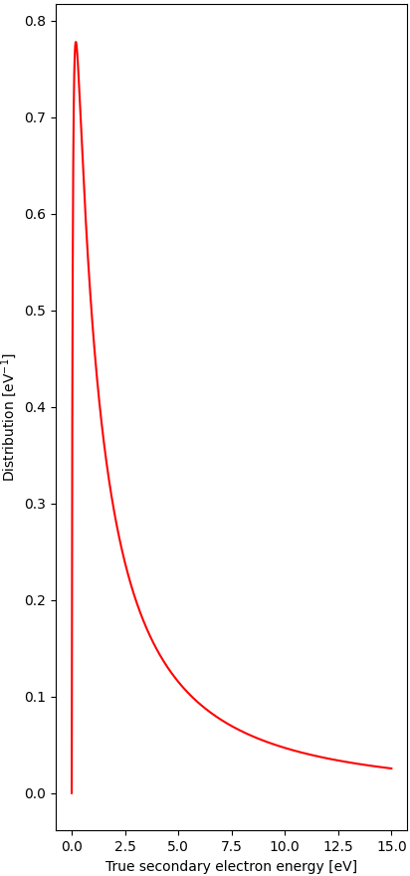


SEY curve modelisation
$δ_{max}$
e-
Reflected e-
TSE
$s$
Beam pipe
$R_{0}$
define the decrease
~mediane
  SEY = Reflected + True Secondary Electrons (TSE)
  TSE energy distribution modelled by a lognormal function:
  $$f\left(E\right)=\frac{1}{Eσ\sqrt{2π}}exp\left(\frac{{\left(\ln{E}−μ\right)}^{2}}{σ^{2}}\right)$$
$$μ=1.0828$$
$$σ=1.6636$$
  $$f(R_{0},E_{0})$$
  $$f(δ_{max},E_{max}, s)$$
$$δ_{max}=1.3$$
$$E_{max}=332$$
$$s=1.35$$
$$R_{0}=0.7$$
$$E_{0}=150$$
~width
$E_{0}$
$E_{max}$
TE – VSC – VSM

Slide 23
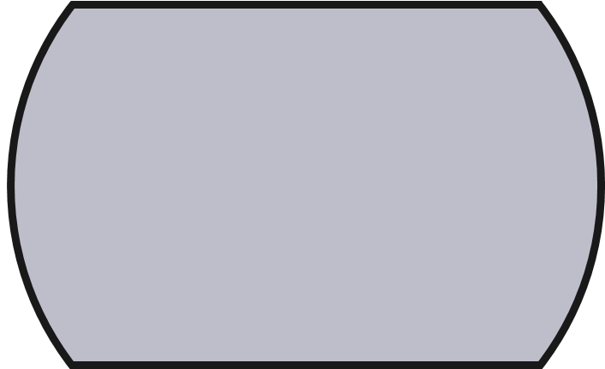


PyECLOUD simulation principle
$$t$$
Bunch
p+
Beam Intensity Estimation
Primary Electron Generation
Beam pipe
Electric Field Computation
  2D time-iterative electron density algorithm
Macroparticle Motion
Secondary Electron Generation
$$t+Δt$$
[G. Iadarola, ECLOUD’12, 2012]
TE – VSC – VSM

Slide 24
PyECLOUD simulation principle
e-
$$t$$
Photo-electrons
p+
Ionisation electrons
Beam Intensity Estimation
(for E_{beam} > 2 TeV)
Primary Electron Generation
Beam pipe
Electric Field Computation
  2D time-iterative electron density algorithm
Macroparticle Motion
Secondary Electron Generation
$$t+Δt$$
[G. Iadarola, ECLOUD’12, 2012]
TE – VSC – VSM

Slide 25
PyECLOUD simulation principle
« Macroparticle »
$$t$$
Photo-electrons
p+
Ionisation electrons
Beam Intensity Estimation
(for E_{beam} > 2 TeV)
Primary Electron Generation
Beam pipe
Electric Field Computation
  2D time-iterative electron density algorithm
Macroparticle Motion
Secondary Electron Generation
$$t+Δt$$
[G. Iadarola, ECLOUD’12, 2012]
TE – VSC – VSM

Slide 26
PyECLOUD simulation principle
$$t$$
p+
Beam Intensity Estimation
Primary Electron Generation
Beam pipe
Electric Field Computation
  2D time-iterative electron density algorithm
Macroparticle Motion
Secondary Electron Generation
$$t+Δt$$
[G. Iadarola, ECLOUD’12, 2012]
TE – VSC – VSM

Slide 27
PyECLOUD simulation principle
$$t$$
Beam Intensity Estimation
Primary Electron Generation
Beam pipe
Electric Field Computation
  2D time-iterative electron density algorithm
Macroparticle Motion
Secondary Electron Generation
$$t+Δt$$
[G. Iadarola, ECLOUD’12, 2012]
TE – VSC – VSM

Slide 28
PyECLOUD simulation principle
$$t$$
Beam Intensity Estimation
Primary Electron Generation
Beam pipe
Electric Field Computation
  2D time-iterative electron density algorithm
Macroparticle Motion
Secondary Electron Generation
$$t+Δt$$
[G. Iadarola, ECLOUD’12, 2012]
TE – VSC – VSM

Slide 29
PyECLOUD simulation principle
$$t$$
Beam Intensity Estimation
Primary Electron Generation
Beam pipe
Electric Field Computation
  2D time-iterative electron density algorithm
Macroparticle Motion
Secondary Electron Generation
$$t+Δt$$
[G. Iadarola, ECLOUD’12, 2012]
TE – VSC – VSM

Slide 30
PyECLOUD simulation principle
$$t$$
Secondary electrons
Beam Intensity Estimation
Primary Electron Generation
Beam pipe
Electric Field Computation
  2D time-iterative electron density algorithm
Macroparticle Motion
Secondary Electron Generation
$$t+Δt$$
[G. Iadarola, ECLOUD’12, 2012]
TE – VSC – VSM

Slide 31
PyECLOUD simulation principle
$$t$$
Secondary electrons
Beam Intensity Estimation
Primary Electron Generation
Beam pipe
Electric Field Computation
  2D time-iterative electron density algorithm
  Main results to extract:
  Energy distribution at the beam pipe wall
  Electron-cloud build-up at the nanosecond scale
  Electron-induced power deposition at the nanosecond scale
Macroparticle Motion
Secondary Electron Generation
$$t+Δt$$
[G. Iadarola, ECLOUD’12, 2012]
TE – VSC – VSM

Slide 32

$δ_{max}$determination using the number of bunches at injection
TE – VSC – VSM

Slide 33
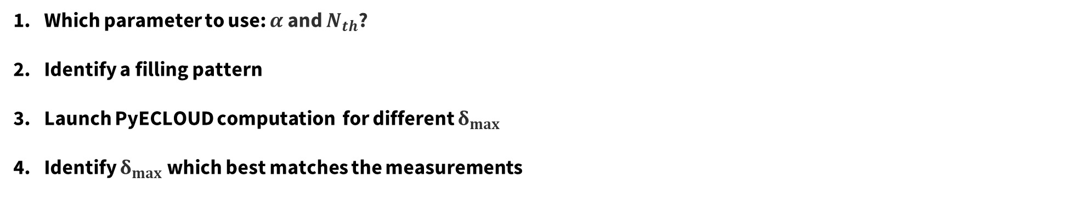
$δ_{max}$assessment methodology
Which parameter to use: $α$ and $N_{th}$?
Identify a filling pattern
Launch PyECLOUD computation for different $δ_{max}$
Identify $δ_{max}$ which best matches the measurements
At injection (450 GeV), there’s no photoelectron.
Electron-cloud = Electrons from gas ionisation + Secondary electrons
TE – VSC – VSM

Slide 34
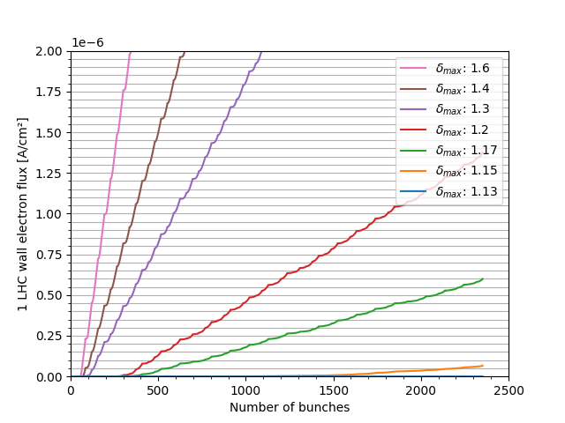
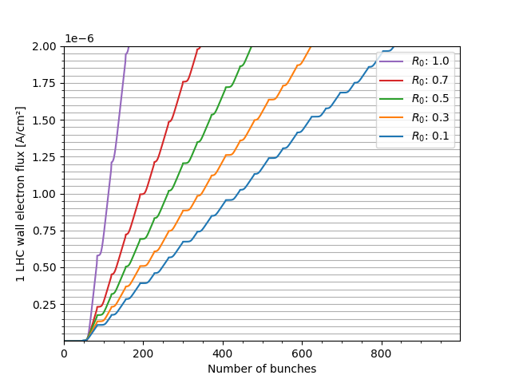
Which parameter to use? Case of $α$
TE – VSC – VSM

Slide 35












Which parameter to use? Case of $α$
$$α$$
$$α$$
$$α$$
$$α$$
$$α$$
$$α$$
$$α$$
$$α$$
$$α$$
$$α$$
$$α$$
  $$α=f\left(δ_{max},R_{0},E_{max},E_{0},…\right)$$
TE – VSC – VSM

Slide 36
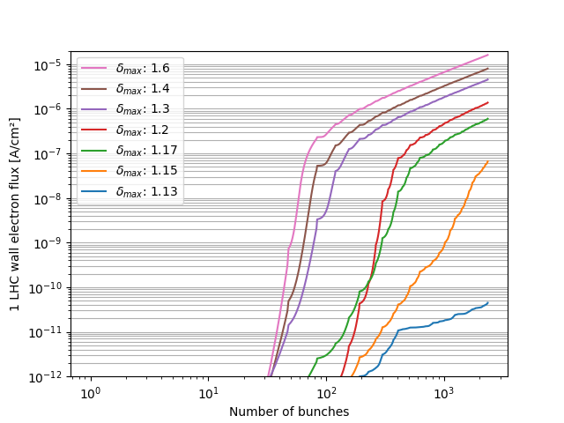
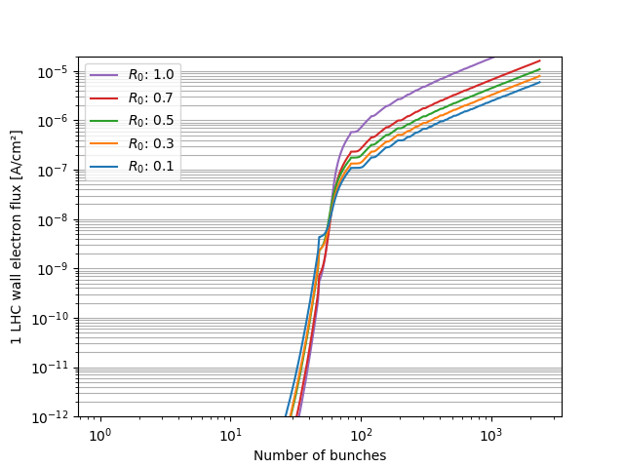
Which parameter to use? Case of $N_{th}$
  $$α=f\left(δ_{max},R_{0},E_{max},E_{0},…\right)$$
TE – VSC – VSM

Slide 37




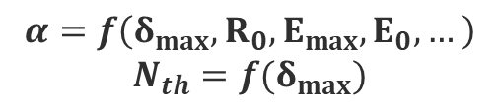
Which parameter to use? Case of $N_{th}$
$$N_{th}$$
$$N_{th}$$
$$N_{th}$$
$$N_{th}$$
  $$α=f\left(δ_{max},R_{0},E_{max},E_{0},…\right)$$
  $$N_{th}=f(δ_{max})$$
TE – VSC – VSM

Slide 38

Which parameter to use? Case of $N_{th}$
$$N_{th}$$
$$N_{th}$$
$$N_{th}$$
$$N_{th}$$
  $$α=f\left(δ_{max},R_{0},E_{max},E_{0},…\right)$$
  $$N_{th}=f(δ_{max})$$
  $N_{th}$ is to be used to assess $δ_{max}$!
TE – VSC – VSM

Slide 39
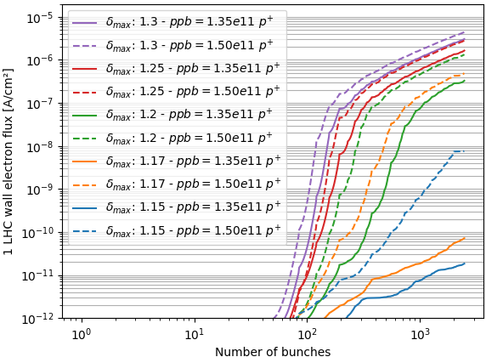


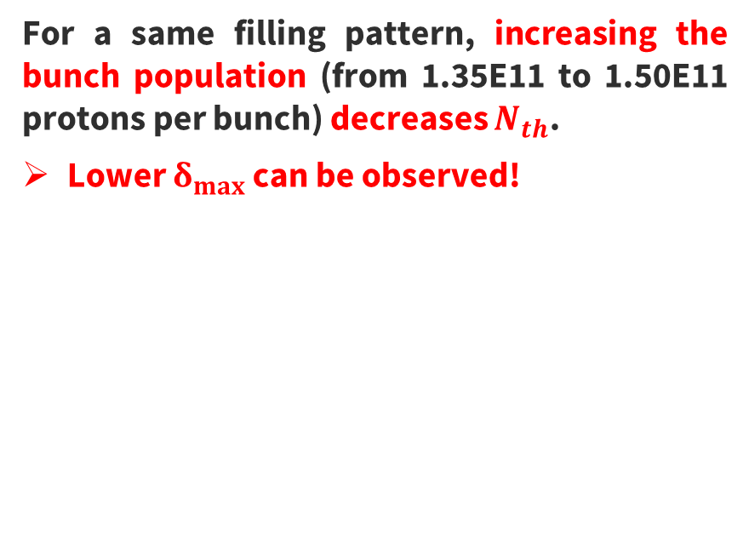








Identify a filling pattern
ppb = protons per bunch
$$ppb$$
$$[1E11 p^{+}]$$
$$1.35$$
$$1.50$$
  For a same filling pattern, increasing the bunch population (from 1.35E11 to 1.50E11 protons per bunch) decreases $N_{th}$.
  Lower $δ_{max}$ can be observed!
$$δ_{max}$$
$$1.15$$
$$1.17$$
$$1.20$$
$$1.25$$
$$1.30$$
TE – VSC – VSM

Slide 40

Identify a filling pattern
ppb = protons per bunch
$$ppb$$
$$[1E11 p^{+}]$$
$$1.35$$
$$1.50$$
  For a same filling pattern, increasing the bunch population (from 1.35E11 to 1.50E11 protons per bunch) decreases $N_{th}$.
  Lower $δ_{max}$ can be observed!
  Filling patterns used to obtain the next results:
  > 1000 bunches
  > 1.05 x 10¹¹ protons per bunch (ppb)
  Used many times in 2022
$$δ_{max}$$
$$1.15$$
$$1.17$$
$$1.20$$
$$1.25$$
$$1.30$$
TE – VSC – VSM

Slide 41
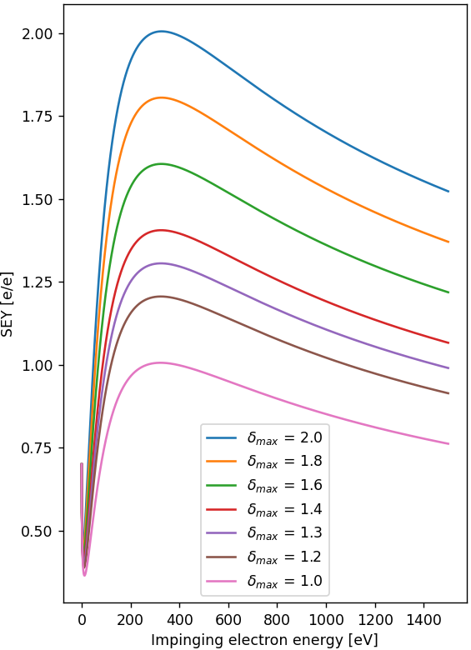
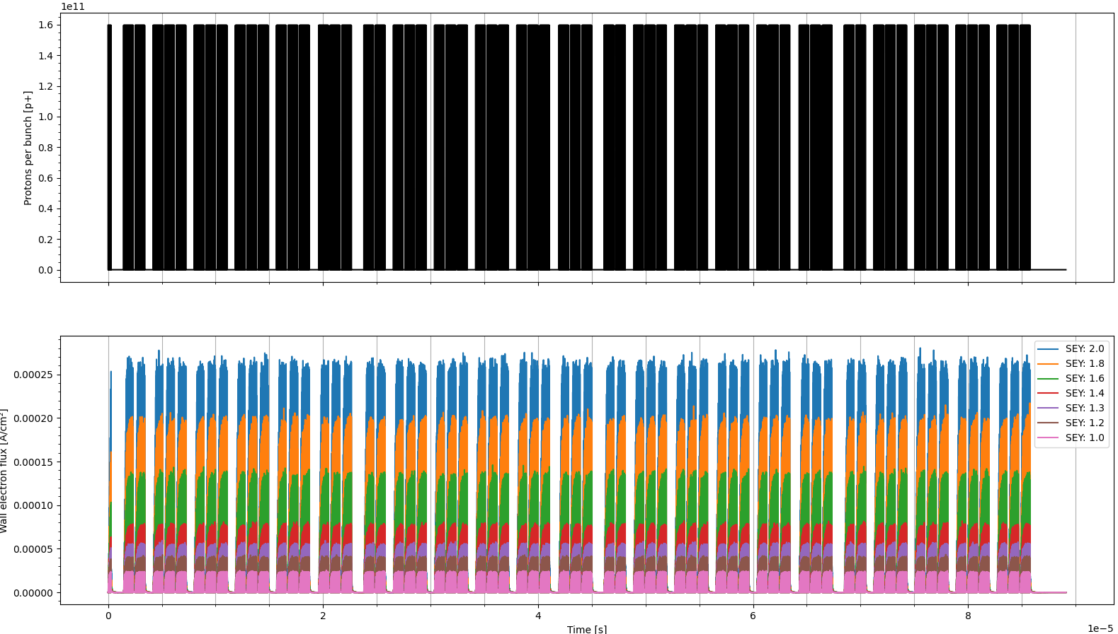

Launch PyECLOUD computation for different $δ_{max}$
1 LHC revolution: ${Δt}_{LHC}=88.9 µs$
Bunches
Wall linear electron density
$$N_{e}$$
TE – VSC – VSM

Slide 42
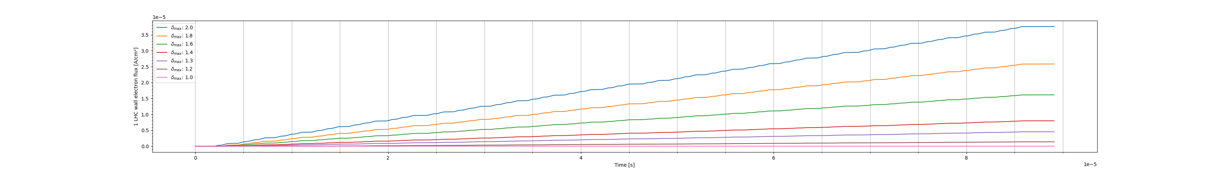
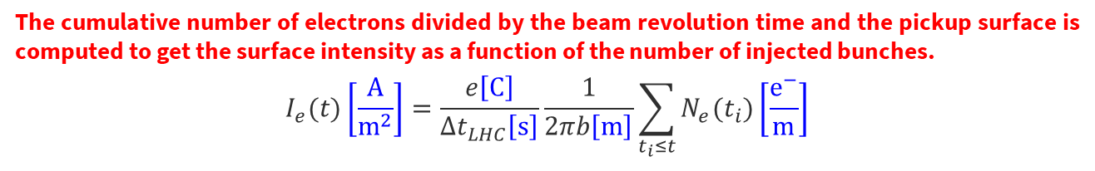

Launch PyECLOUD computation for different $δ_{max}$
1 LHC revolution: ${Δt}_{LHC}=88.9 µs$
Bunches
Wall linear electron density
$$N_{e}$$
$$I_{e}$$
Wall surface electron intensity
  The cumulative number of electrons divided by the beam revolution time and the pickup surface is computed to get the surface intensity as a function of the number of injected bunches.
  $$I_{e}(t)\left[\frac{A}{m^{2}}\right]=\frac{e\left[C\right]}{{Δt}_{LHC}\left[s\right]}\frac{1}{2πb\left[m\right]}\sum_{t_{i}≤t}{N_{e}(t_{i})\left[\frac{e^{−}}{m}\right]}$$
beam pipe radius
TE – VSC – VSM

Slide 43
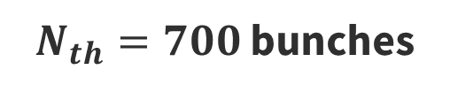
Identify $δ_{max}$ which best matches $N_{th}$
$N_{th}=700$ bunches
TE – VSC – VSM

Slide 44
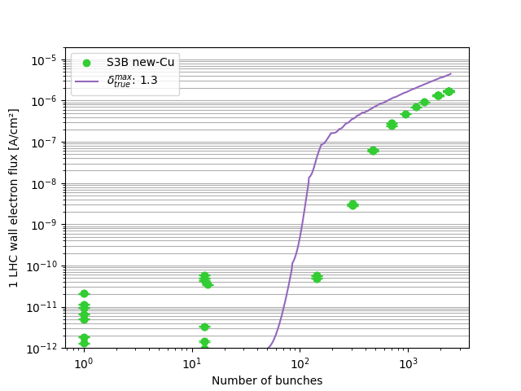
Identify $δ_{max}$ which best matches $N_{th}$
$N_{th}=700$ bunches
TE – VSC – VSM

Slide 45
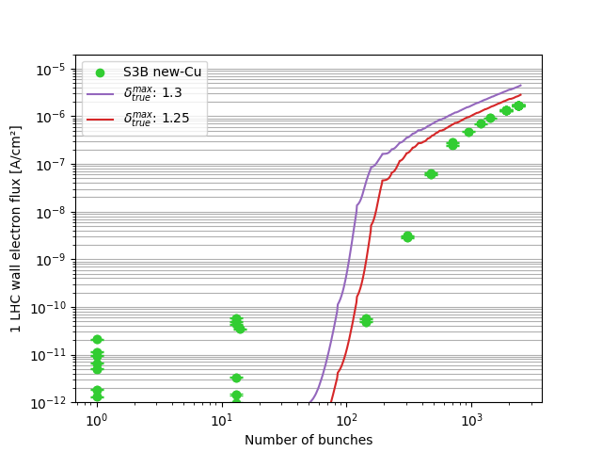
Identify $δ_{max}$ which best matches $N_{th}$
$N_{th}=700$ bunches
TE – VSC – VSM

Slide 46
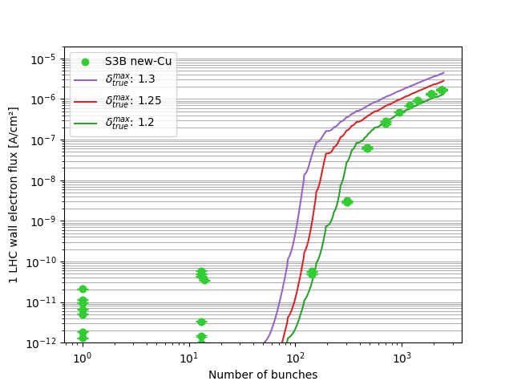
Identify $δ_{max}$ which best matches $N_{th}$
$N_{th}=700$ bunches
TE – VSC – VSM

Slide 47
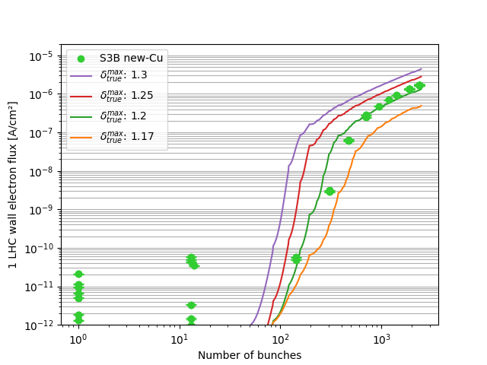
Identify $δ_{max}$ which best matches $N_{th}$
$N_{th}=700$ bunches
TE – VSC – VSM

Slide 48
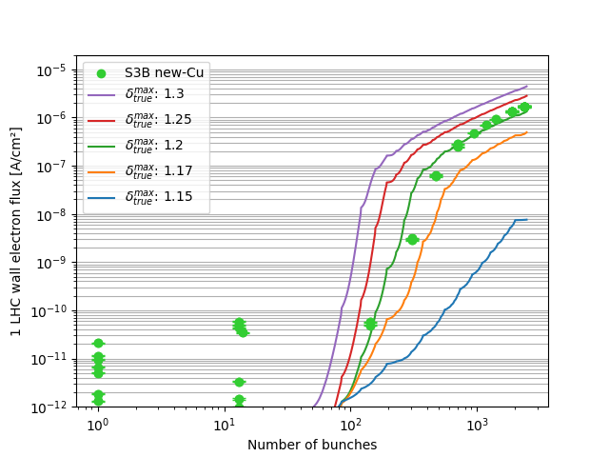
Identify $δ_{max}$ which best matches $N_{th}$
$N_{th}=700$ bunches
TE – VSC – VSM

Slide 49
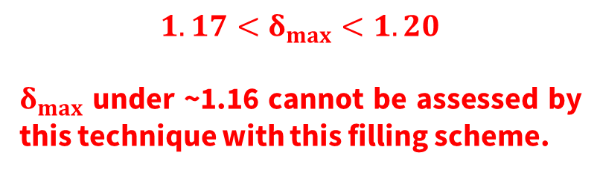
Identify $δ_{max}$ which best matches $N_{th}$
$N_{th}=700$ bunches
  $$1.17<δ_{max}<1.20$$
  $δ_{max}$ under ~1.16 cannot be assessed by this technique with this filling scheme.
limit
TE – VSC – VSM

Slide 50
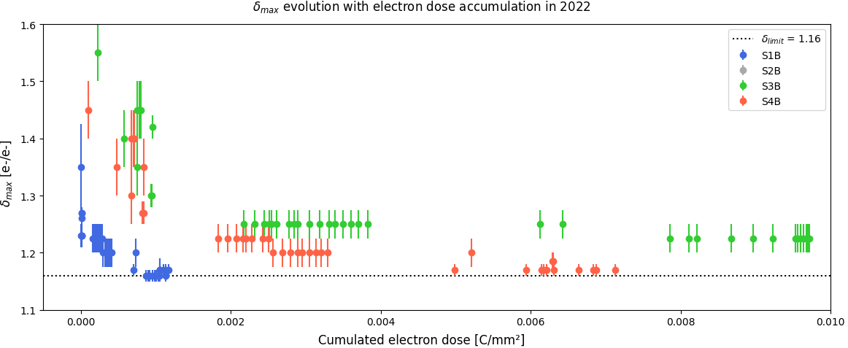
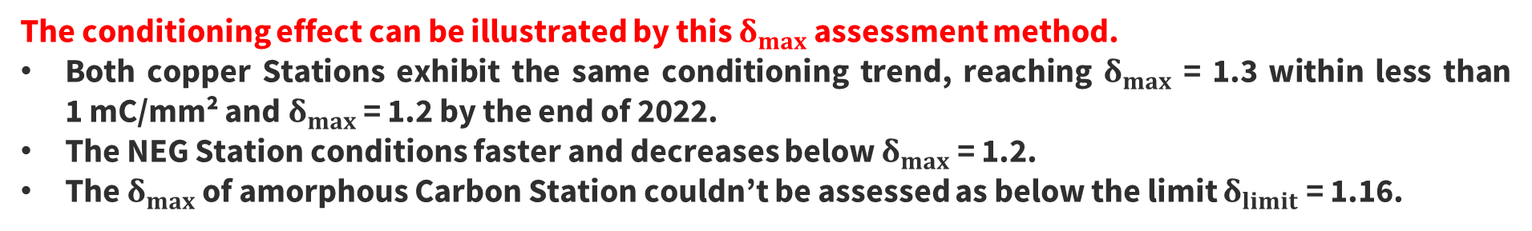
SEY dose dependence after LS2 (long deconditioning time)
  The conditioning effect can be illustrated by this $δ_{max}$ assessment method.
  Both copper Stations exhibit the same conditioning trend, reaching $δ_{max}$ = 1.3 within less than 1 mC/mm² and $δ_{max}$ = 1.2 by the end of 2022.
  The NEG Station conditions faster and decreases below $δ_{max}$ = 1.2.
  The $δ_{max}$ of amorphous Carbon Station couldn’t be assessed as below the limit $δ_{limit}$ = 1.16.
TE – VSC – VSM

Slide 51
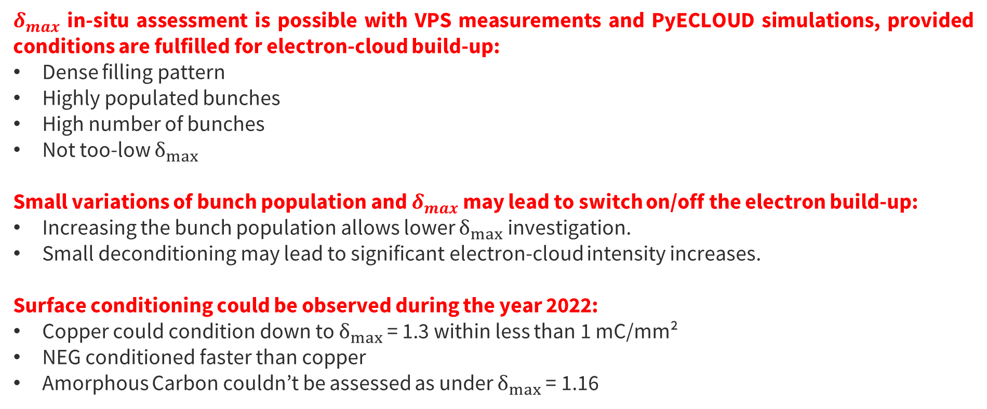
Conclusion
  $δ_{max}$ in-situ assessment is possible with VPS measurements and PyECLOUD simulations, provided conditions are fulfilled for electron-cloud build-up:
  Dense filling pattern
  Highly populated bunches
  High number of bunches
  Not too-low $δ_{max}$
  Small variations of bunch population and $δ_{max}$ may lead to switch on/off the electron build-up:
  Increasing the bunch population allows lower $δ_{max}$ investigation.
  Small deconditioning may lead to significant electron-cloud intensity increases.
  Surface conditioning could be observed during the year 2022:
  Copper could condition down to $δ_{max}$ = 1.3 within less than 1 mC/mm²
  NEG conditioned faster than copper
  Amorphous Carbon couldn’t be assessed as under $δ_{max}$ = 1.16
TE – VSC – VSM

