Slide 1
Influence of humidity and temperature on Penning gauge measurement
Iker LOBATO SOLA (TE-VSC-ICM)
TE-VSC Seminar
25/11/2025

Slide 2
Outlook
Pfeiffer IKR070 Penning gauge
Found issues or inconsistencies
First findings and actions
Investigation
Solutions
Conclusion

Slide 3
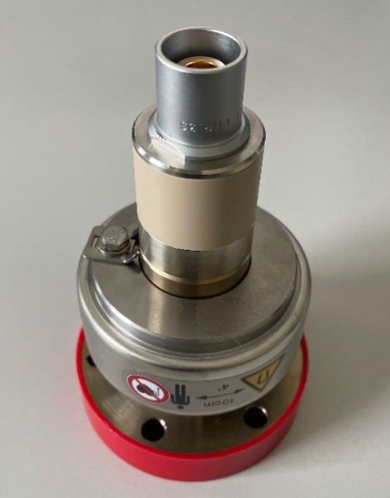
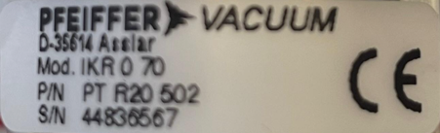
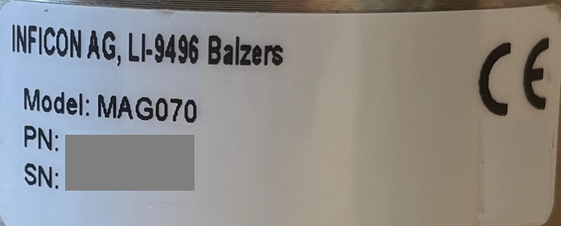
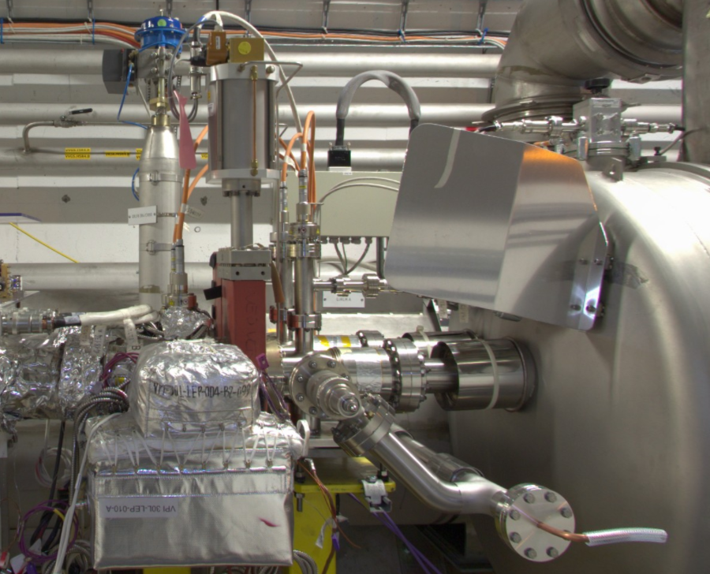
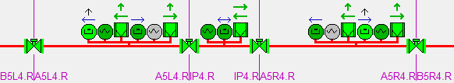
Pfeiffer IKR070 Penning gauge
What it is?
The Penning gauge or cold cathode ionization vacuum gauge (VGP) is a vacuum pressure measurement instrument which provides measurements in the range of 10E-4 to 10E-11 mbar
Who is the manufacturer?
Distributed by Pfeiffer Vacuum
Designed and produced by INFICON AG (former Balzers)
What do we use them for?
To monitor the vacuum in our setups and accelerators
To give interlock to users and sector valves
How many are used at CERN?
More than 1000 units installed at:
cPS, SPS, LHC, experiments, etc.
Pfeiffer IKR 070
INFICON MAG 070
LHC P4 vacuum application synoptic example

Slide 4
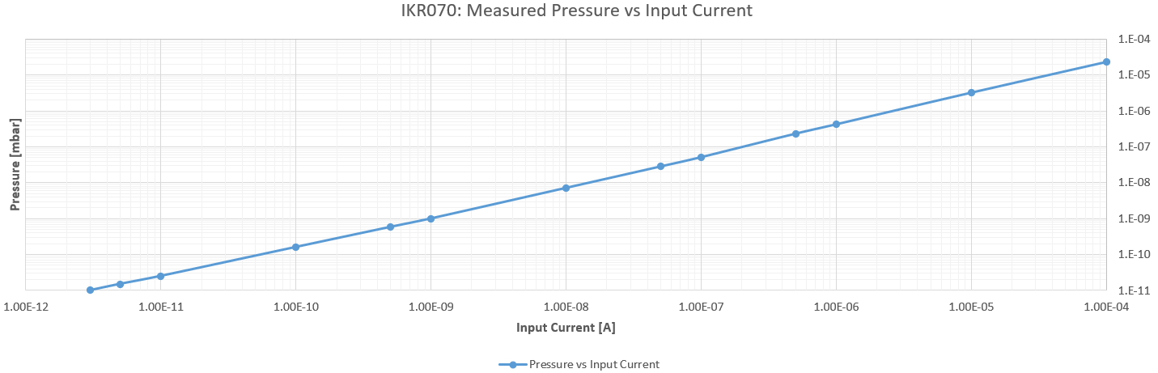
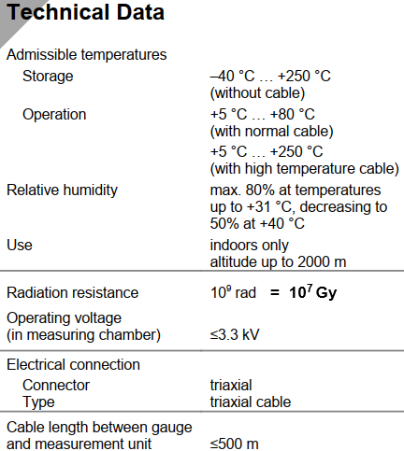
Pfeiffer IKR070 Penning gauge
3.3 kV
Cathode
Magnet
How it works?
Consists of two electrodes, an anode and a cathode, between which a high voltage (3.3 kV DC) is applied. When the negatively charged electrons leave the cathode at high velocity toward the anode, they ionize the neutral gas molecules in the chamber, igniting a gas discharge. This gas discharge current is proportional to the pressure
Pressure vs current transfer function
+
-
N
N
A
B
S
S
Anode
0,1mA = 2.3E-05mbar
3pA = 1.0E-11mbar
3pA ≤ uR (Under range)
IKR070 transfer function P-I (courtesy of N. Chatzigeorgiou)
IKR070 Specs

Slide 5
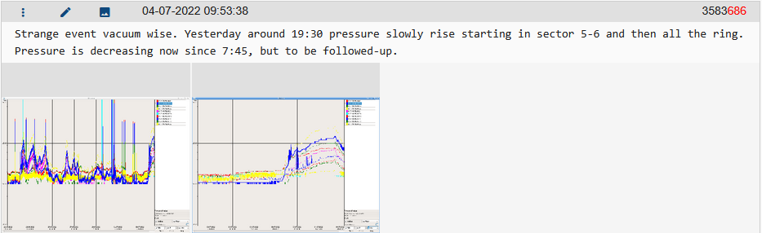
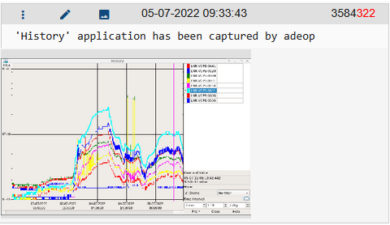
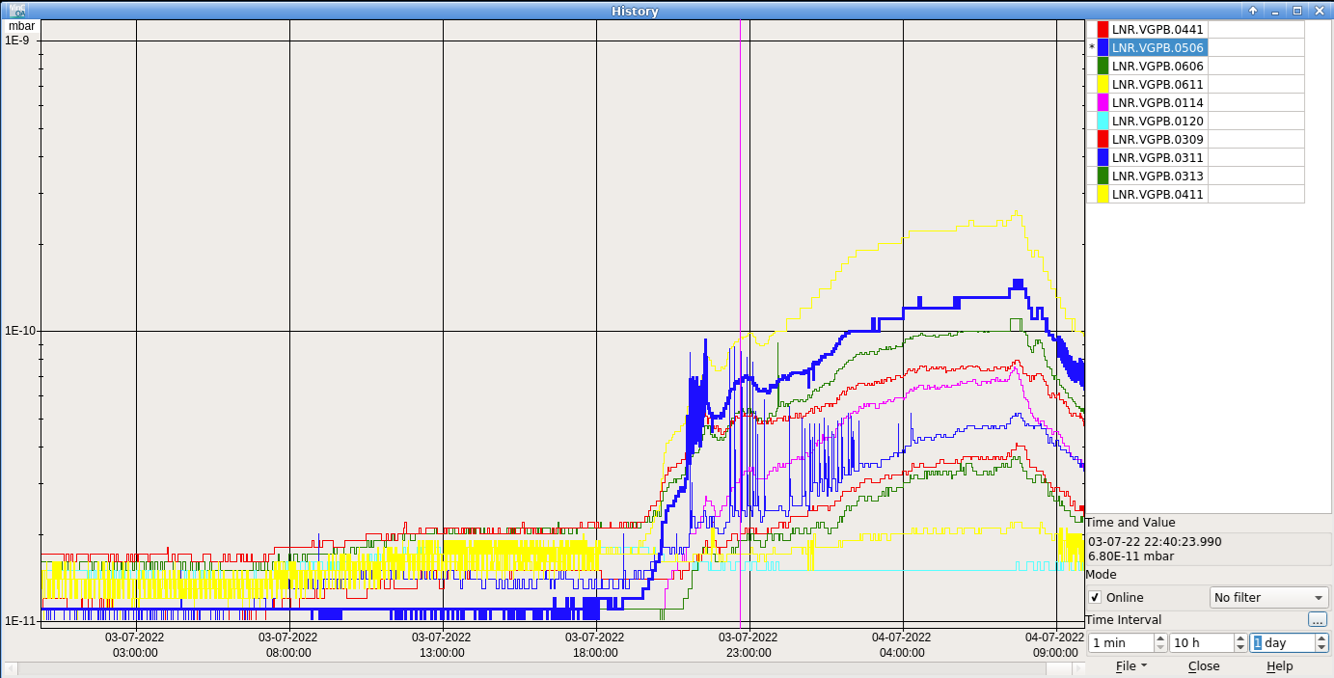
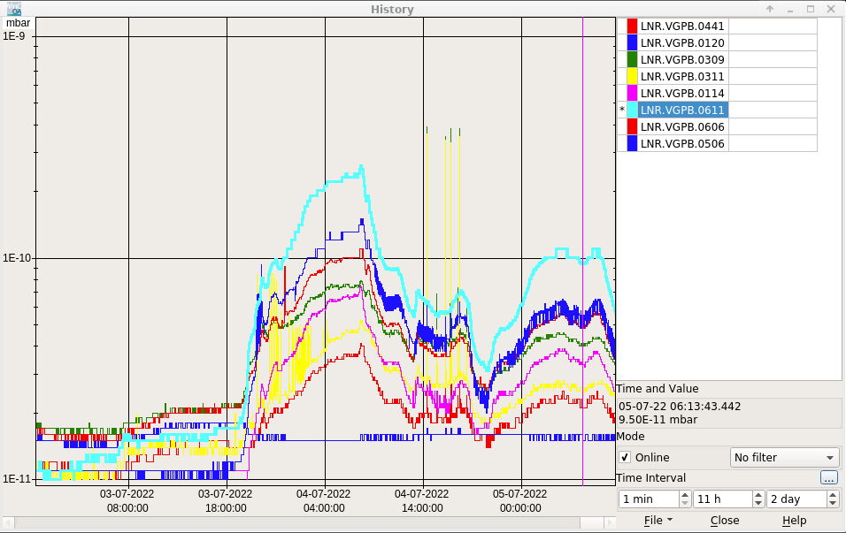
The issue
First observation
AD and ELENA OP observed an abnormal pressure fluctuation in the ELENA ring
AD Logbook screenshot
ELENA Logbook screenshot

Slide 6
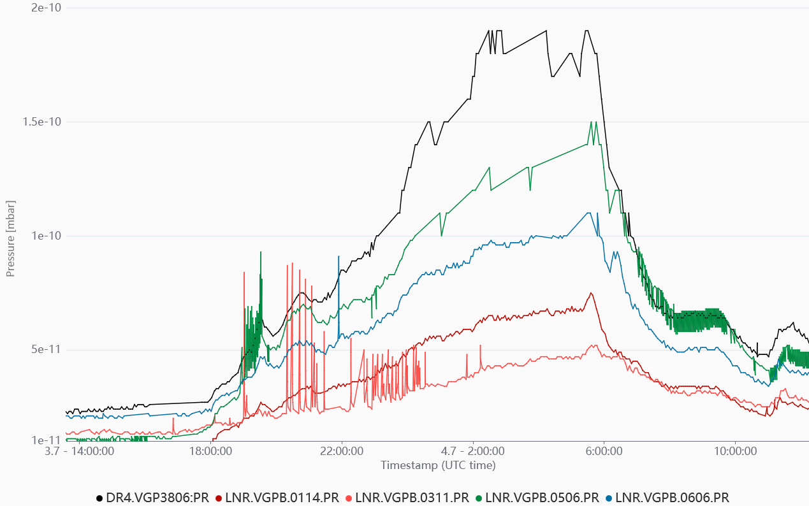
The issue
Our first observation
We noticed that an AD ring gauge showed the same behaviour
AD VGP
ELENA VGP
Timber plot of the AD and ELENA VGP readouts, July 2022

Slide 7
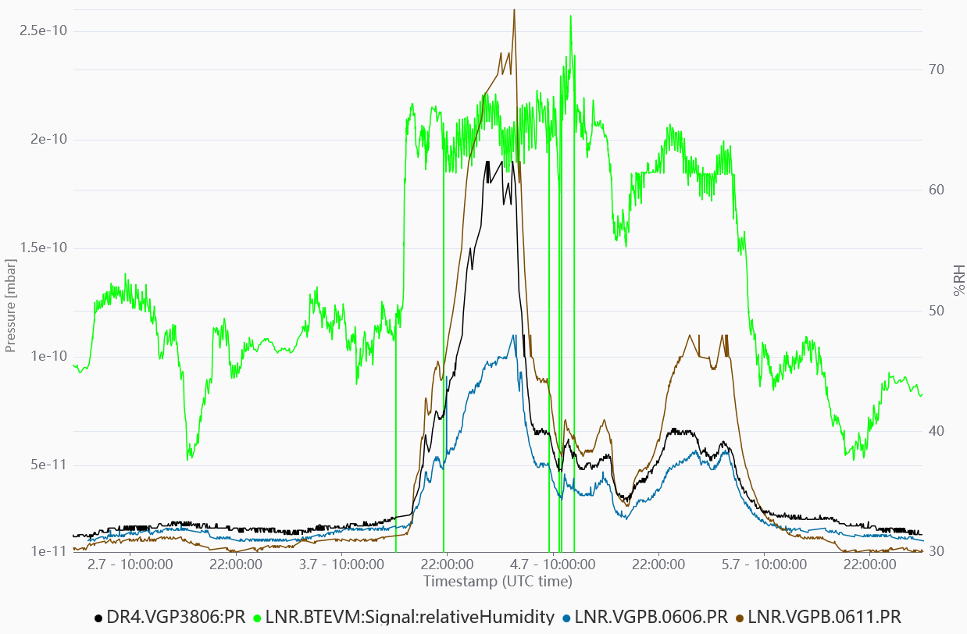
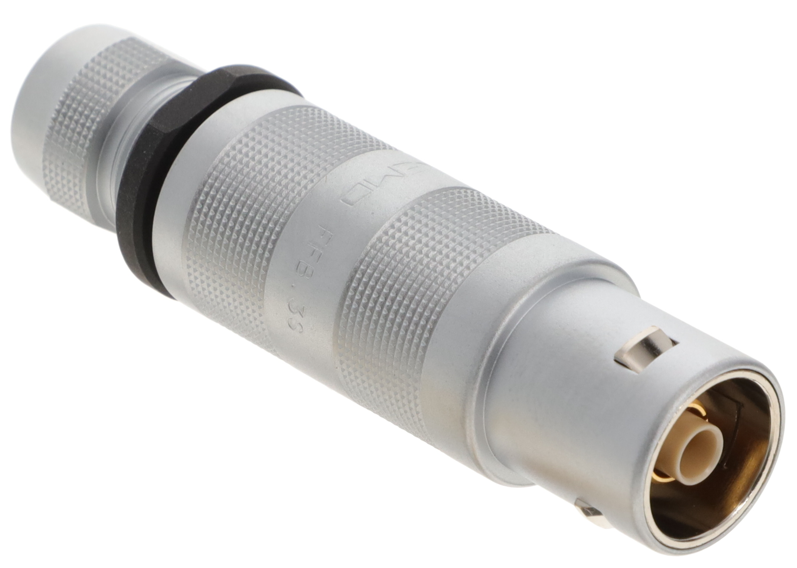
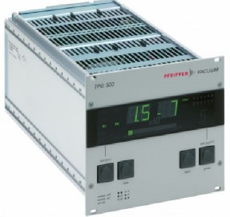

The issue
First hypothesis
Controller, equipment or cabling issue or malfunction
First lead
Certain correlation between a %RH signal at the LNR and the pressure
Timber plot of the AD and ELENA VGP readouts and LNR %RH sensor, July 2022

Slide 8
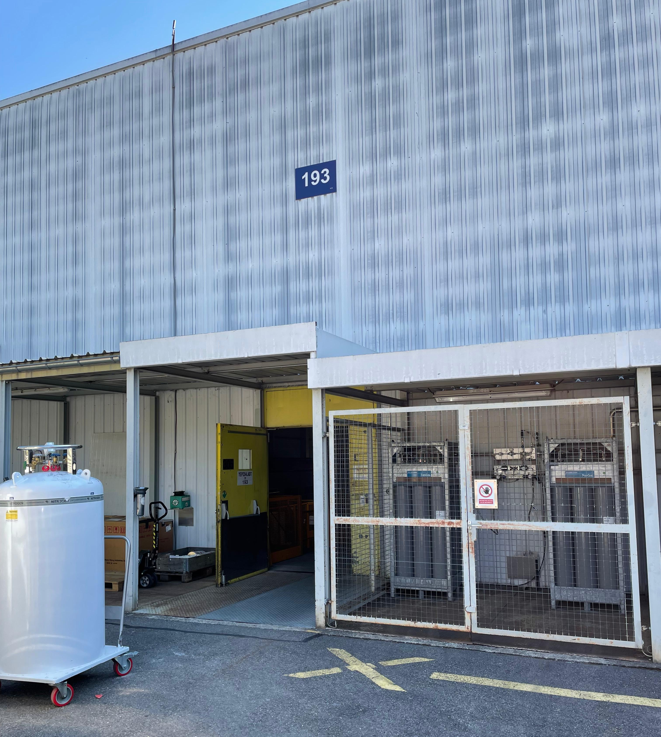
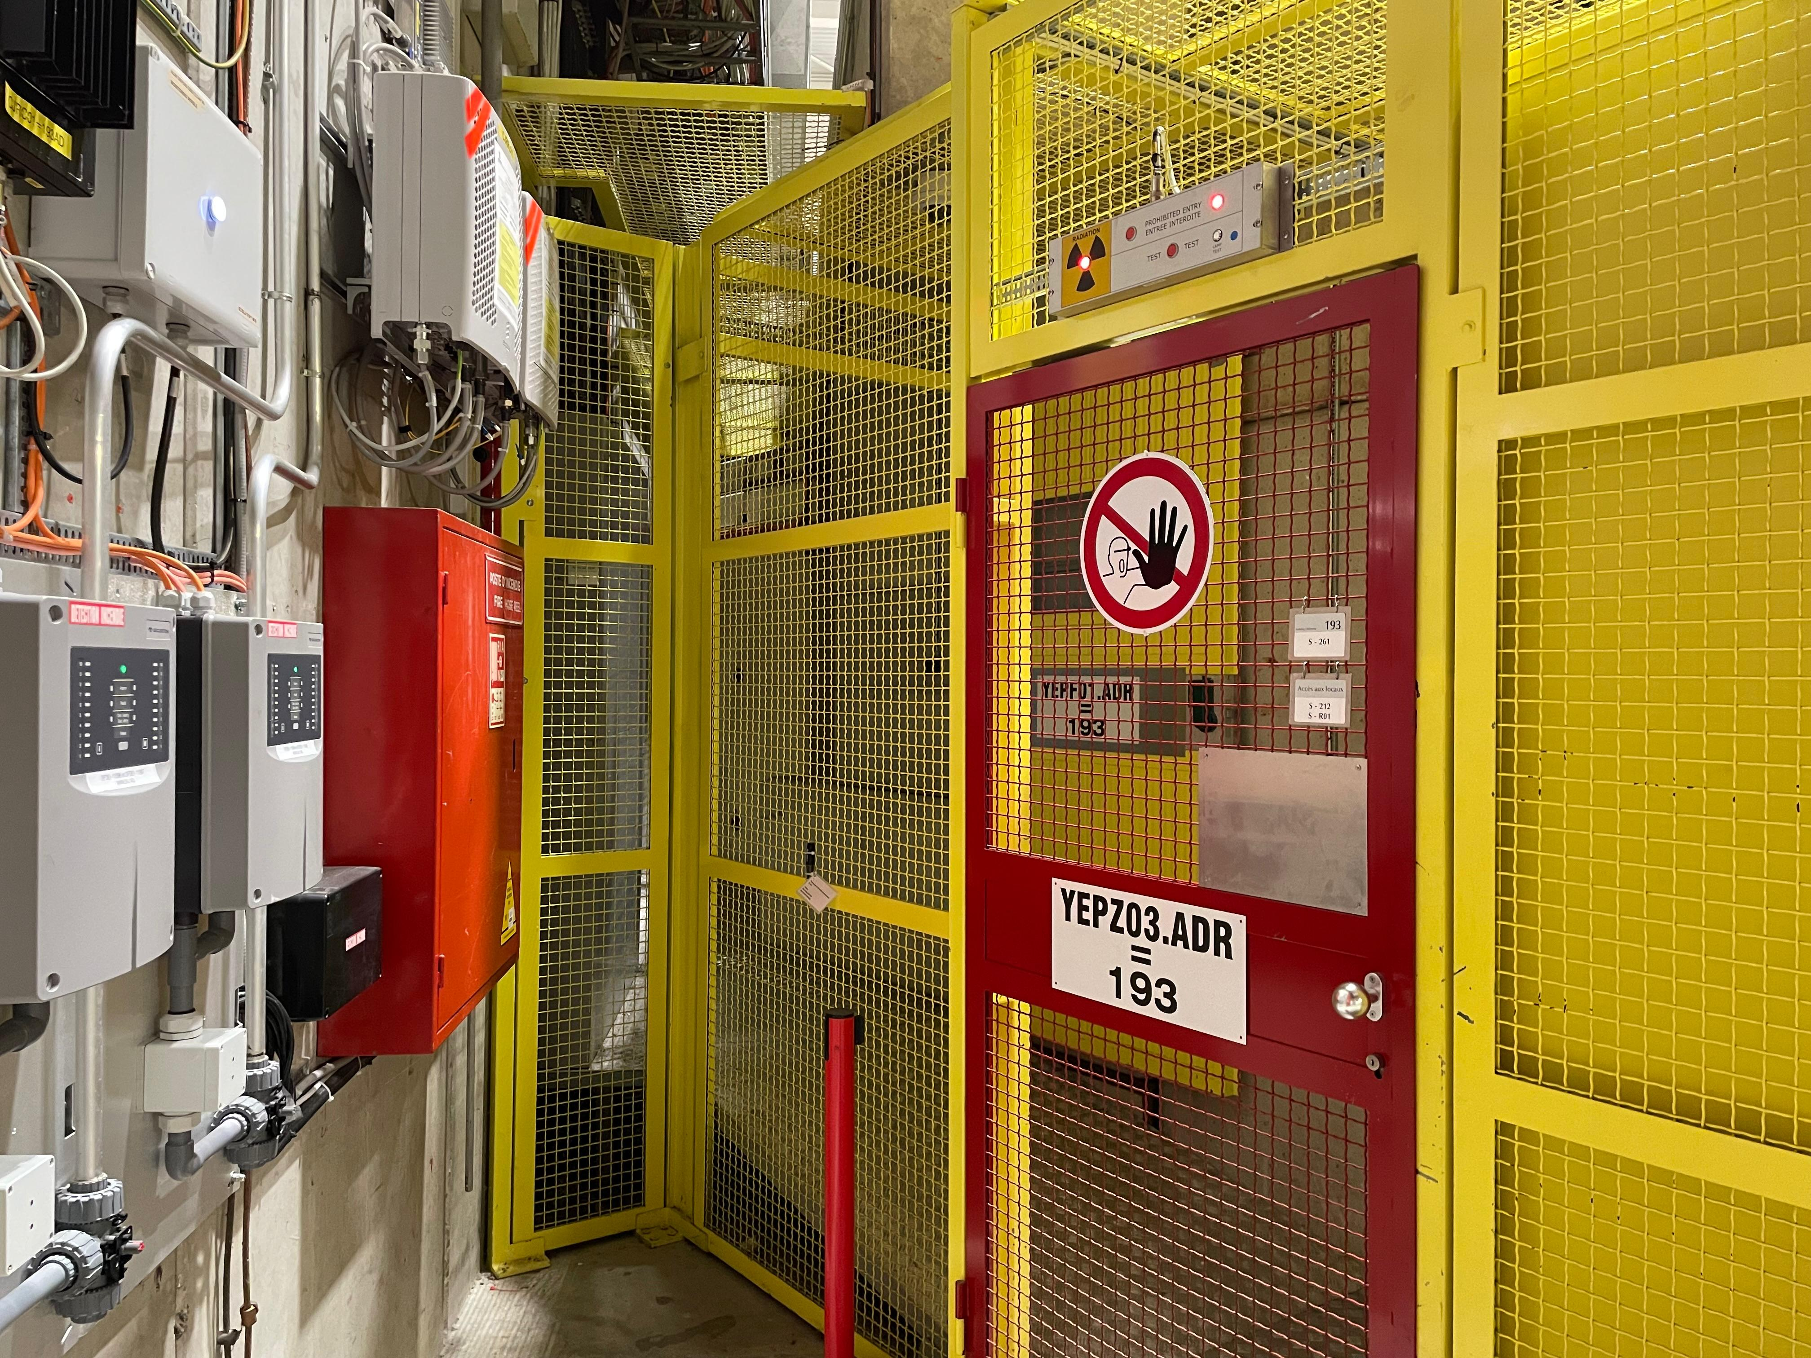
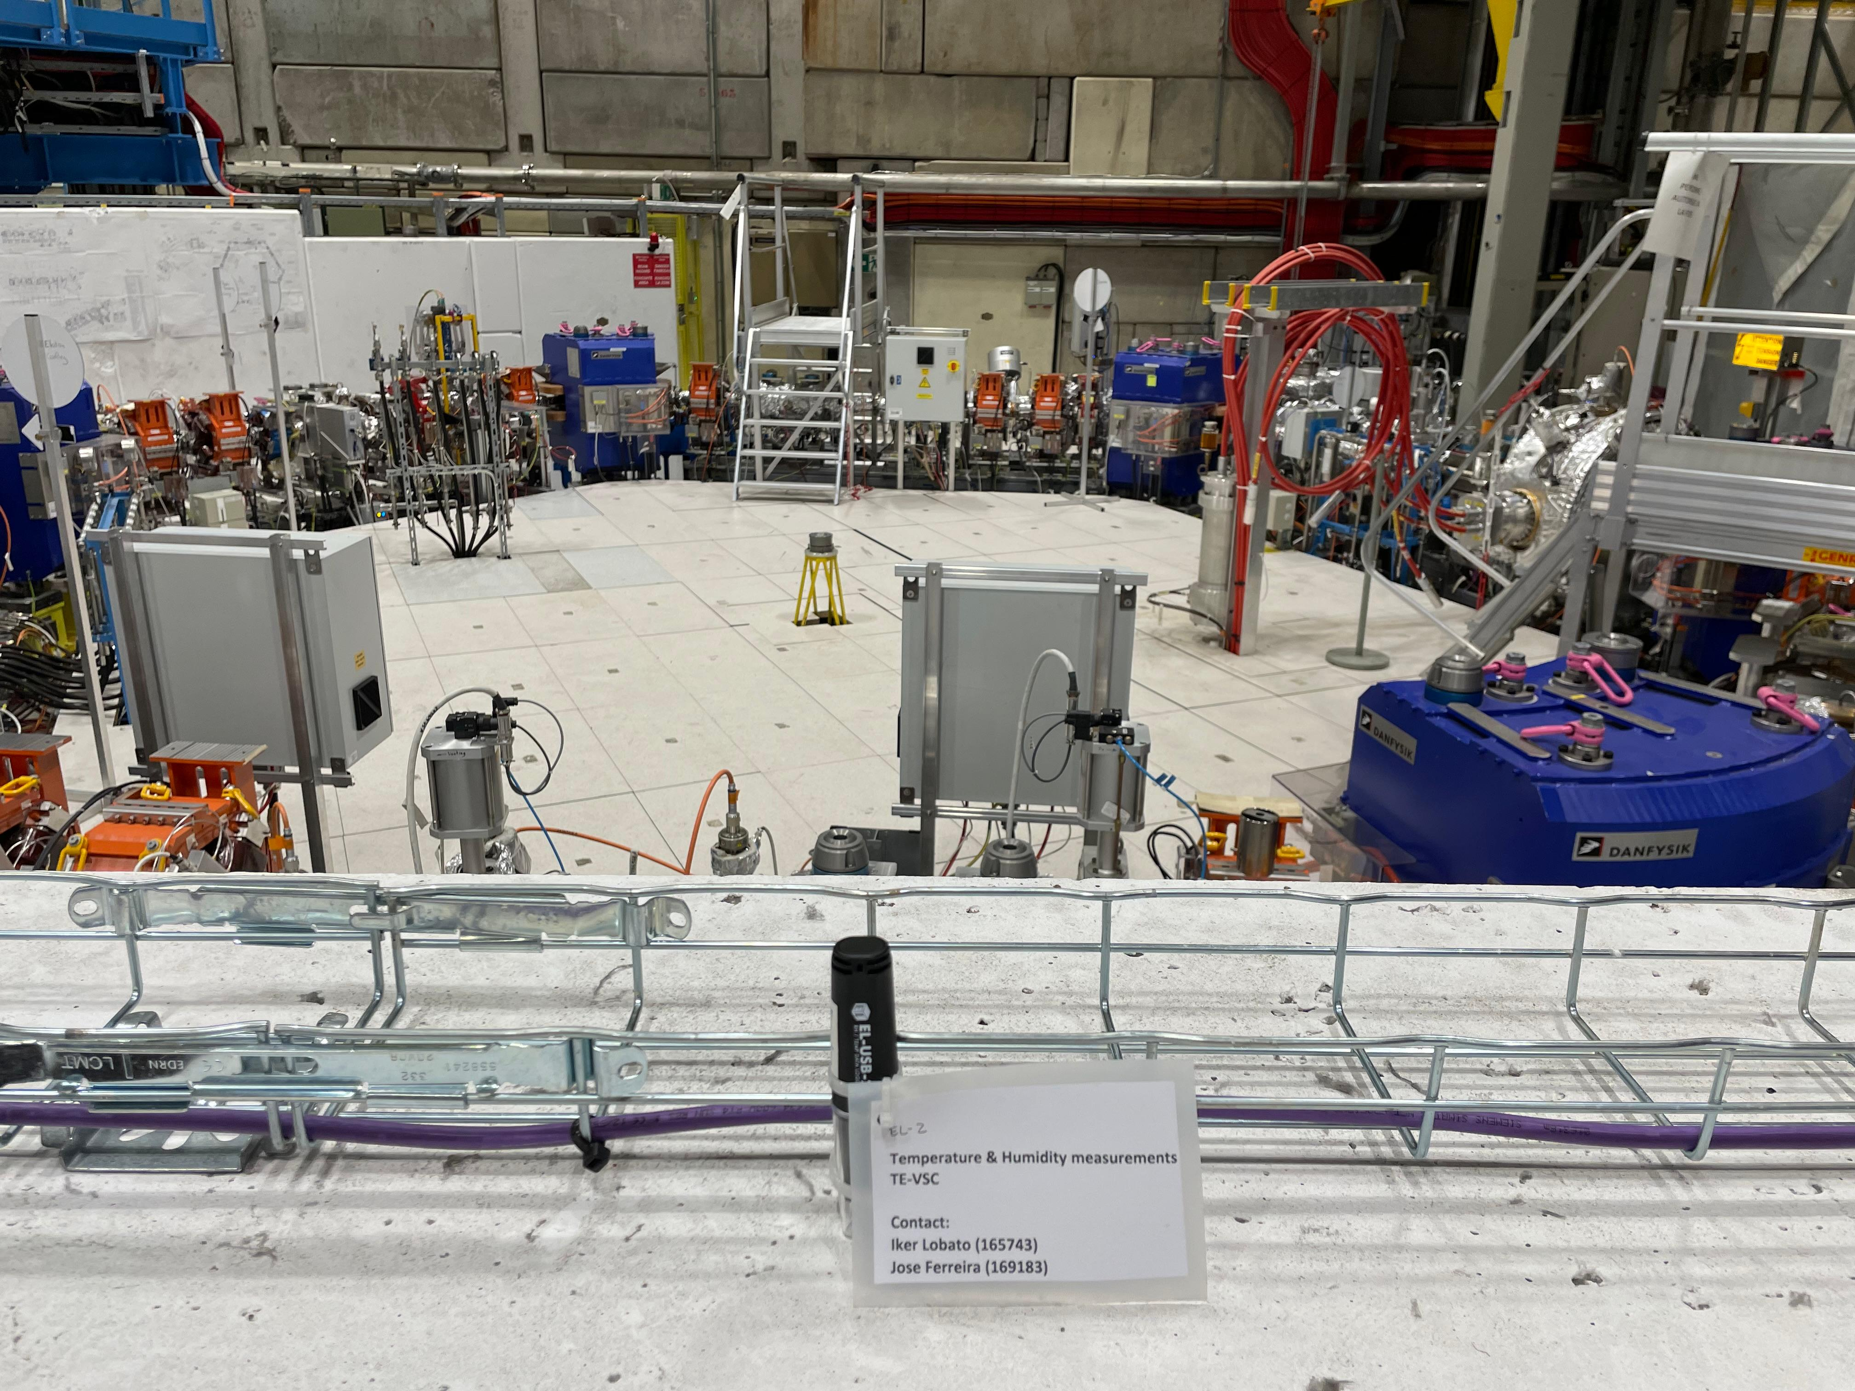
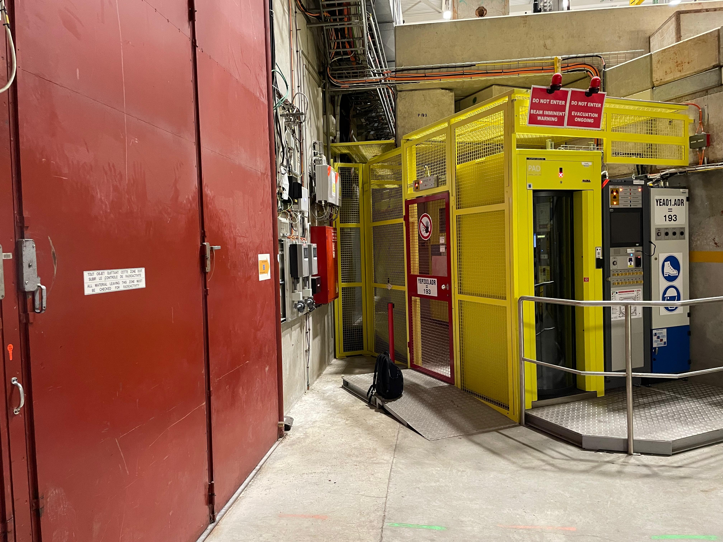
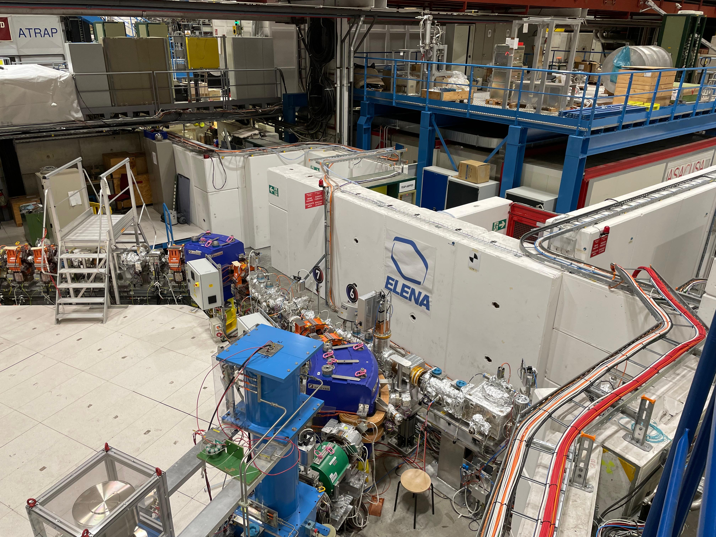
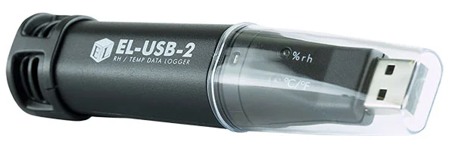
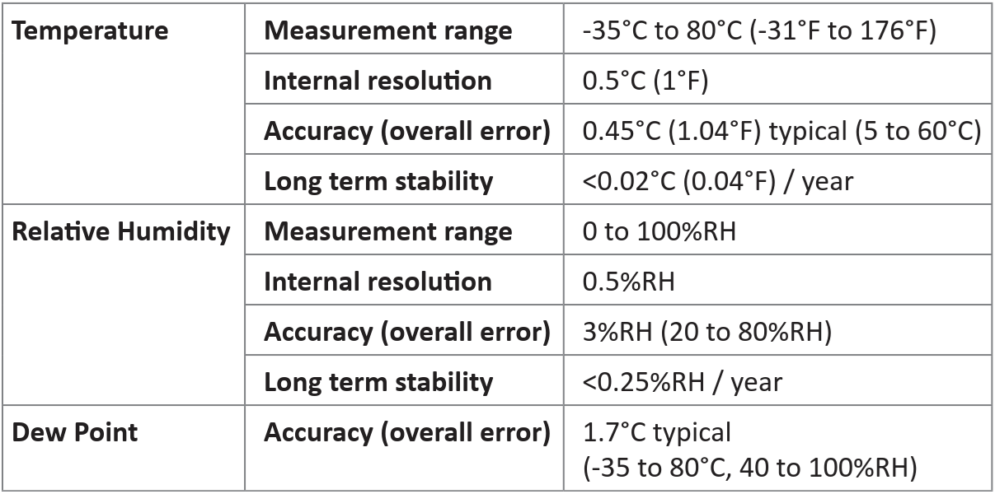
Logging hygrometry data
First action
We placed our own humidity and temperature Data Loggers “close” to the affected gauges
AD/ELENA b.193
EL-USB-2 specs
AD ring access PAD area
ELENA ring

Slide 9
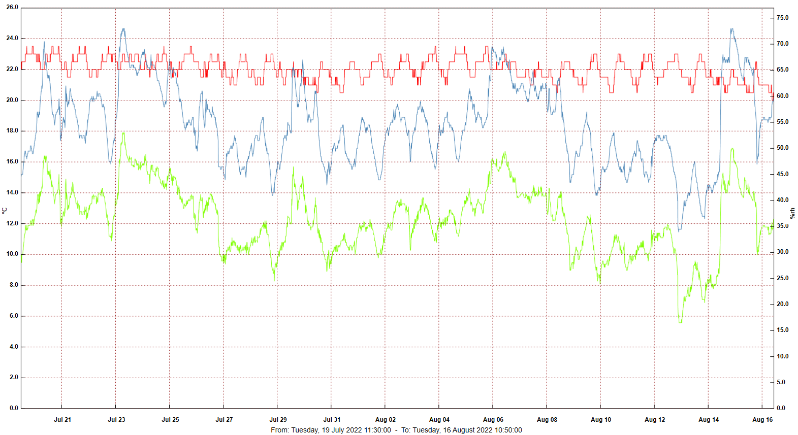
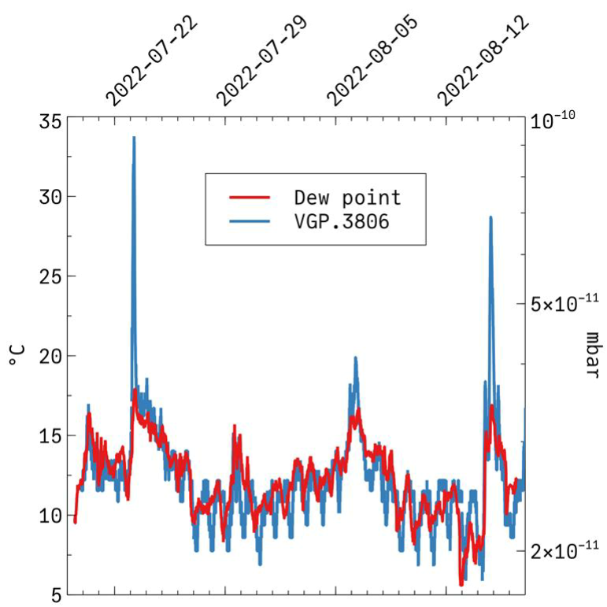



Logging hygrometry data
Logged Data
The warm weather, in addition to storms, affected the humidity and temperature levels in the hall, which affected the VGP readouts
AD DR4.VGP3806 and dew point
comparison (plot by J.A. Ferreira)
AD hygrometry data from July and August 2022

Slide 10
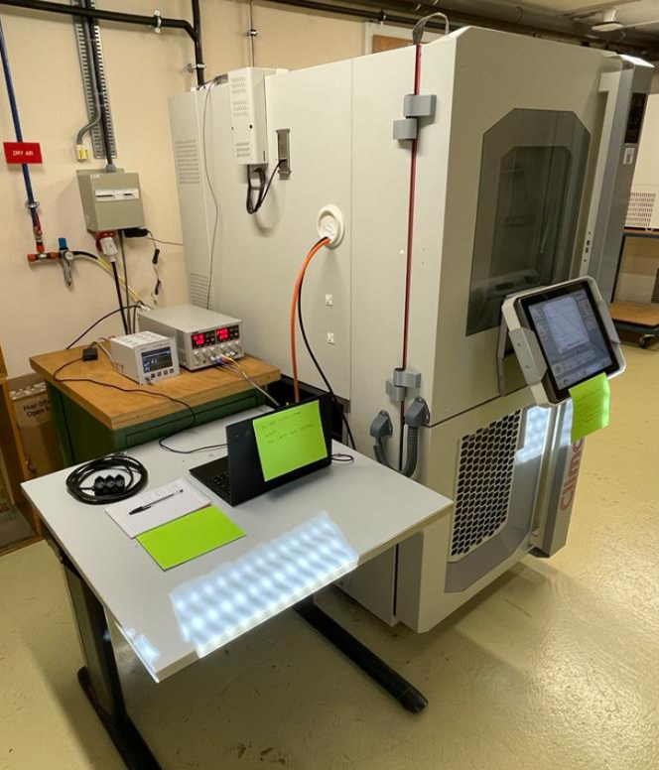
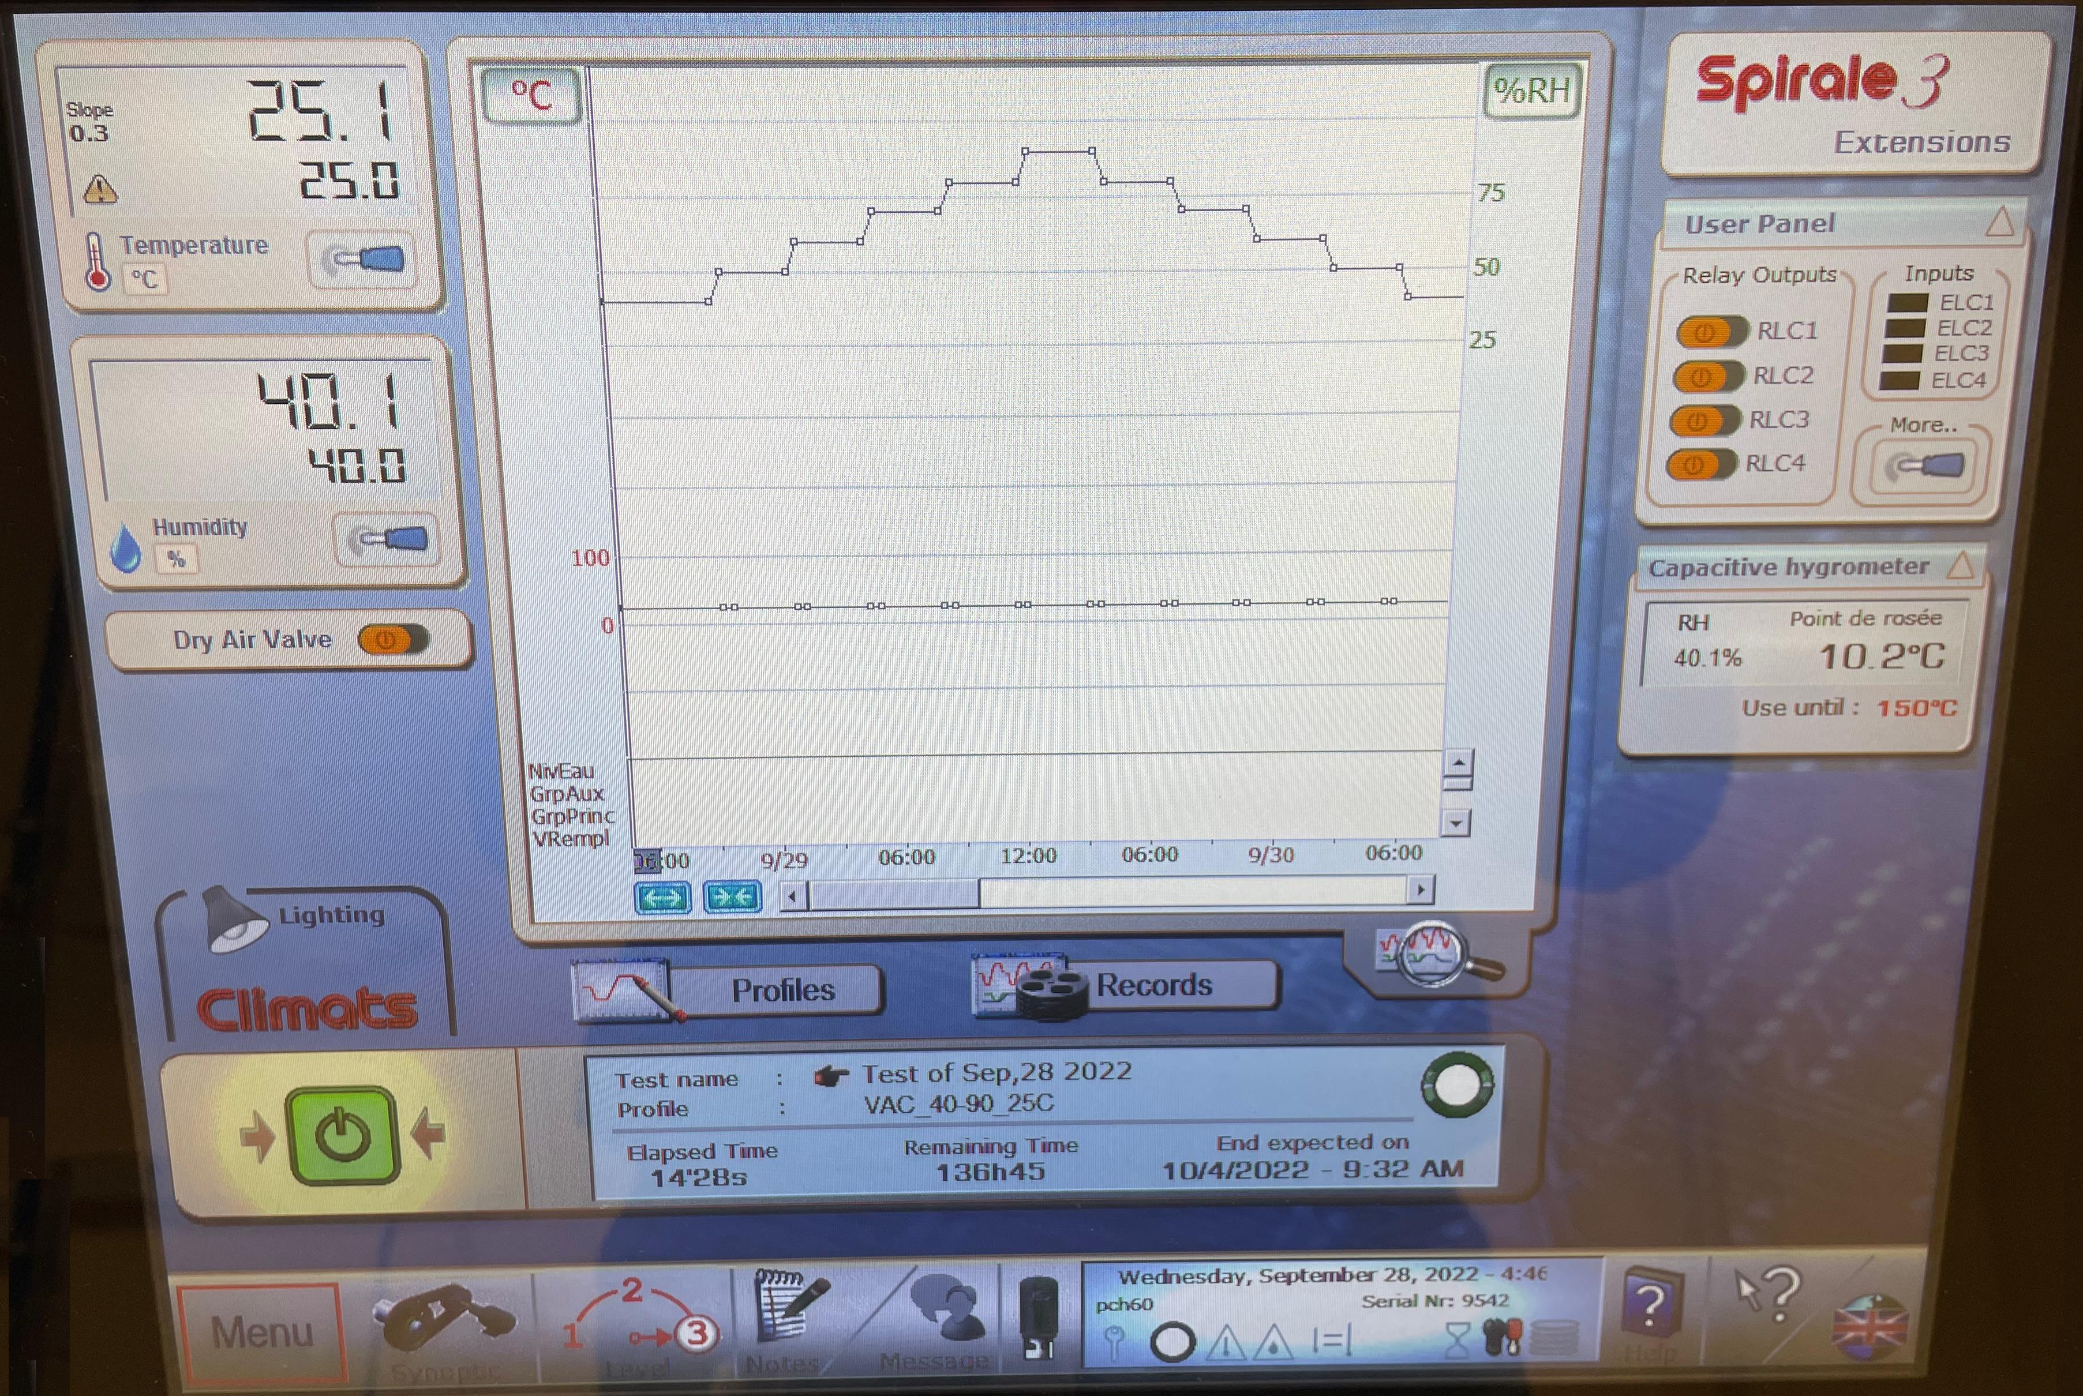
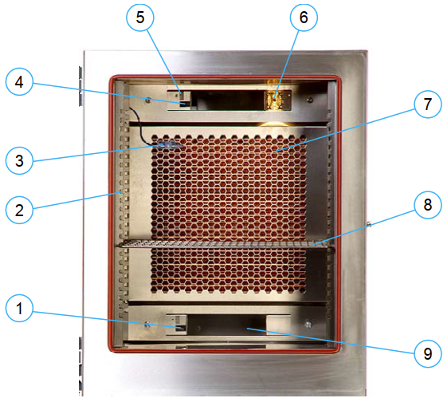
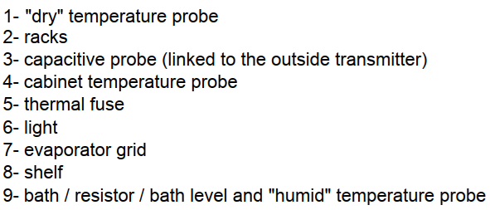
Climatic Chamber
Climats EXCAL 1423-HA (2013)
  Temperature control from -70°C to +180°C
  Humidity control from 10 to 98%
  138L (550 x 500 x 500 mm)
  Admissible dissipation at 20°C = 2.5kW
  Location : b.13-S-011
  EP-ESE
EXCAL 1423-HA touch panel and program
Climats EXCAL 1423-HA climatic chamber
  Room controlled ambient conditions:
  ~ 20°C
  ~ 40%RH

Slide 11
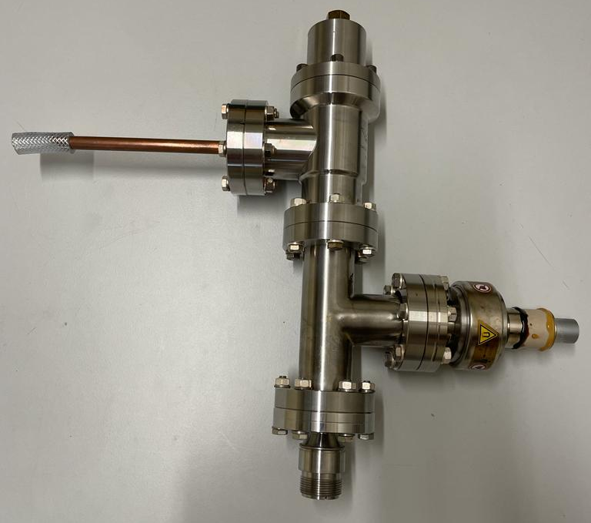
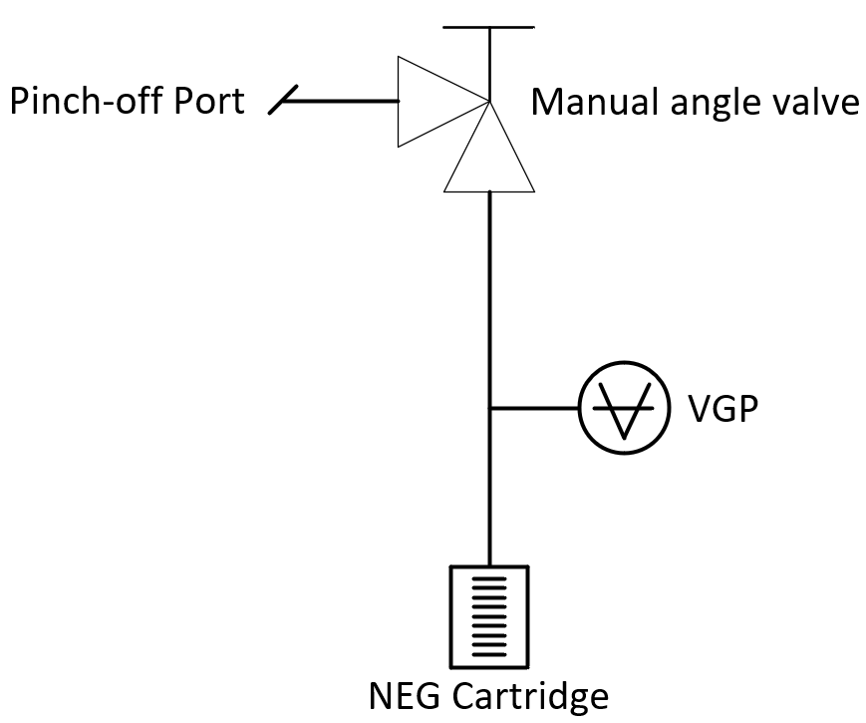
Setup
Experimental setup prepared for the tests
Objective to be fitted into the EXCAL machine
  Penning gauge (Pfeiffer IKR070)
  NEG cartridge
  Manual valve
  Pinch-off port
Features
  Baked-out
  Very low vacuum pressure
    E-12mbar range
    Penning reading under range (uR)
  Powered NEG cartridge
    Increase the temperature to ignite the gauge
VGP testing setup

Slide 12
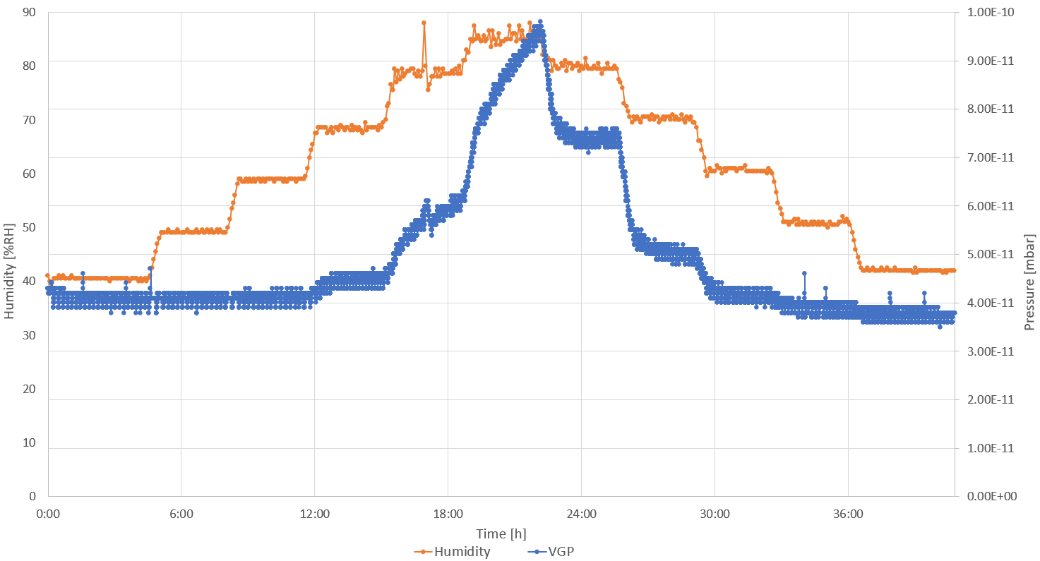
First test
Test performed by increasing 10% humidity every 3h. Fixed 25°C starting at 40%RH up to 90%RH and back
ΔI ~40pA
Δ𝑃 ~6.0E-11 mbar
Standard IKR070 VGP measurements at the EXCAL machine

Slide 13
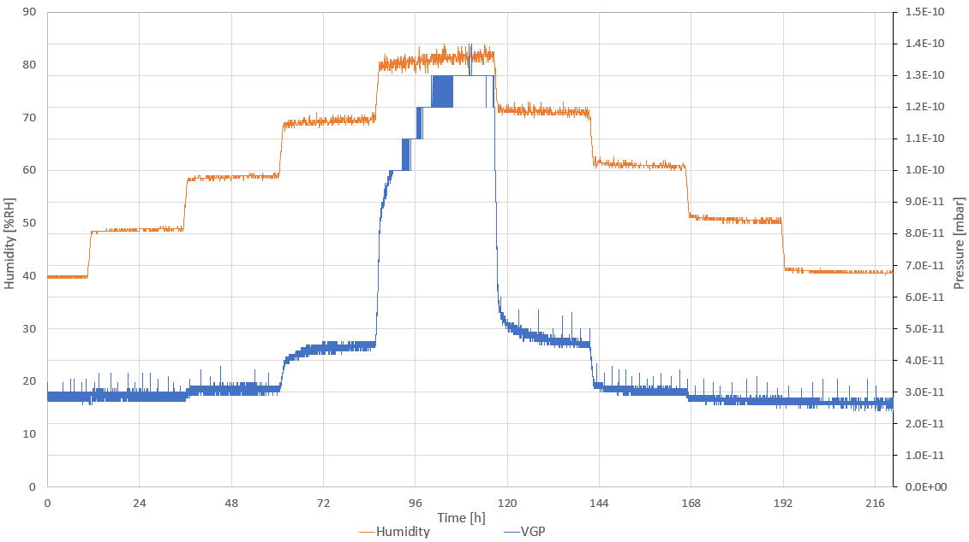
Second test
Test performed by increasing 10% humidity every 24h. Fixed 25°C starting at 40%RH up to 80%RH and back
ΔI ~200pA
Δ𝑃 ~1.0E-10 mbar
Standard IKR070 VGP measurements at the EXCAL machine

Slide 14
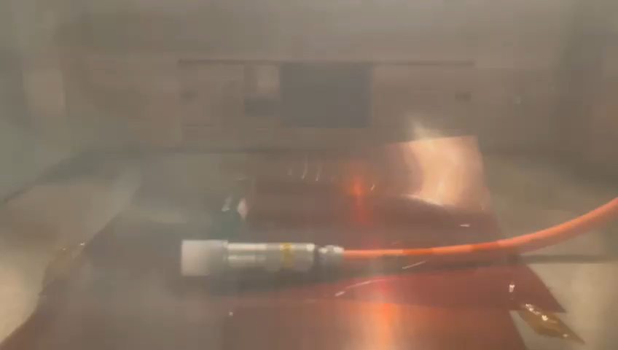
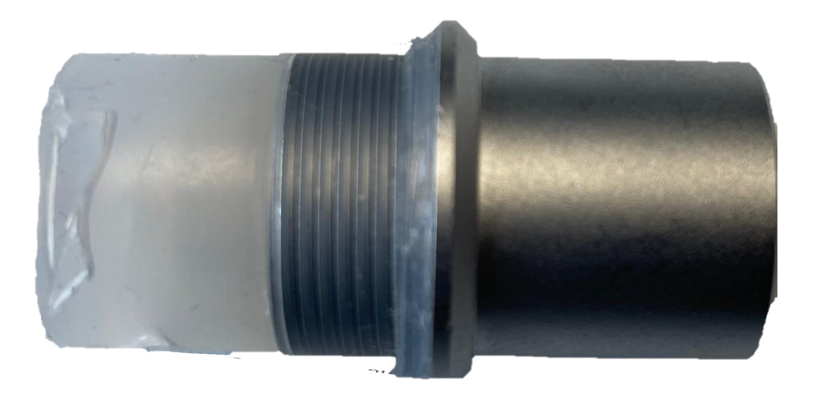
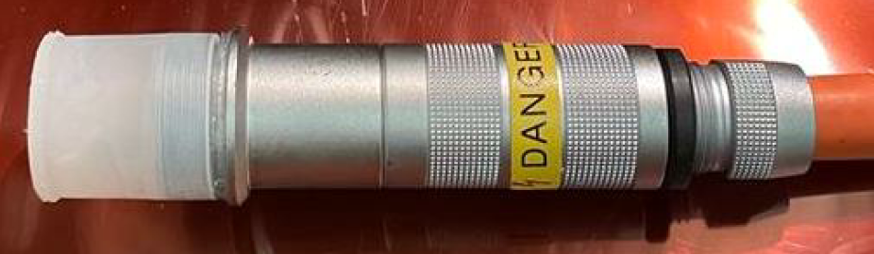
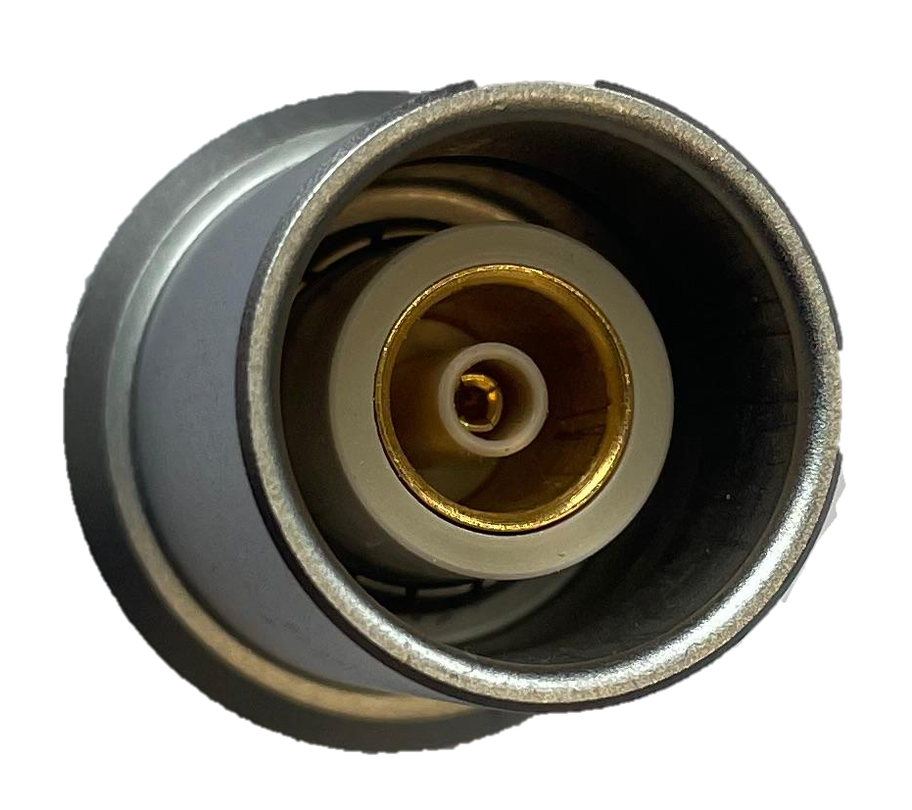
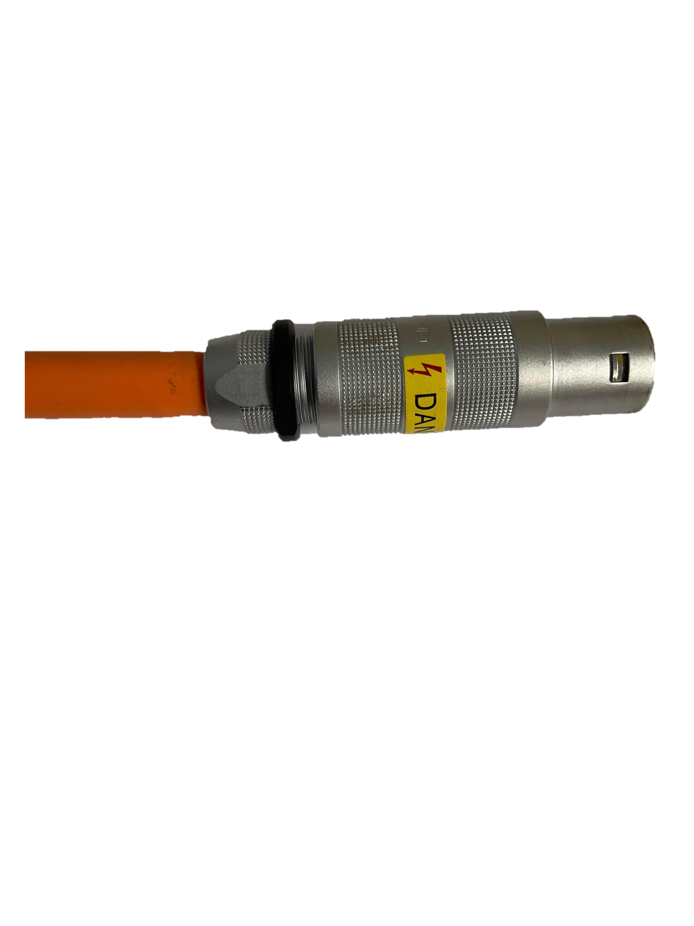
LEMO connector and HV cable
  LEMO connectors
  Plug ref.: FFB.3S.460.CLAC10
  Socket ref.: EHP.3S.460.CLL
  Operation thresholds:
  Temp.: -55 °C to 250 °C
  Hum.: 95 %RH at 60 °C
  TFA3 cable – Triaxial FRNC
  Operation thresholds:
  Temp.: -20 °C to 60 °C
  Hum.: no information
LEMO socket on the left and plug on the right
Insulated LEMO socket and TFA3 cable with a LEMO plug
at the EXCAL chamber at %80RH and 25 °C

Slide 15
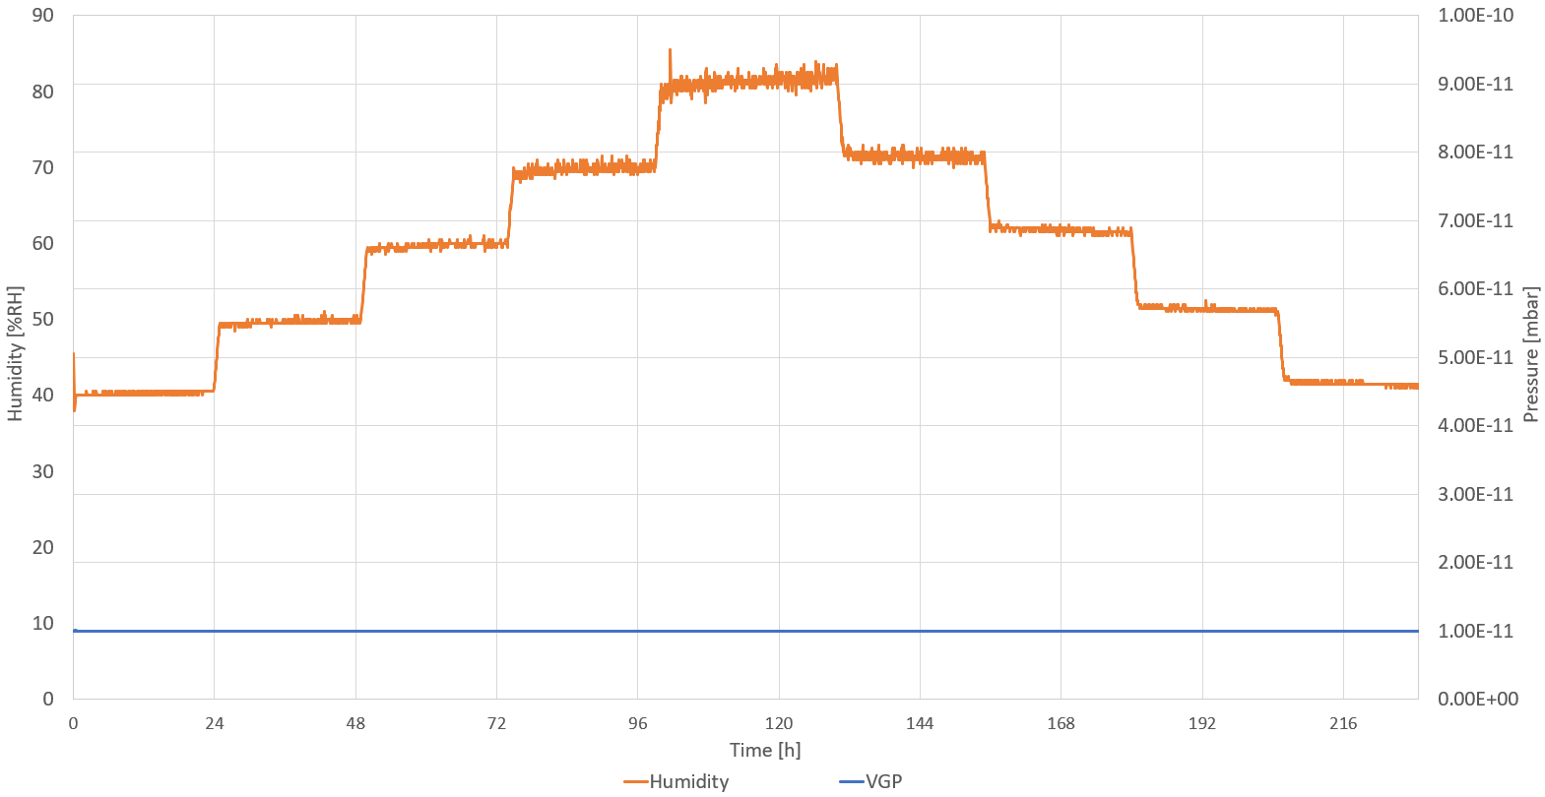
LEMO connector and HV cable test
Test performed by increasing 10% humidity every 24h. Fixed 25°C starting at 40%RH up to 80%RH and back
← uR
Insulated LEMO connector measurements at the EXCAL machine

Slide 16
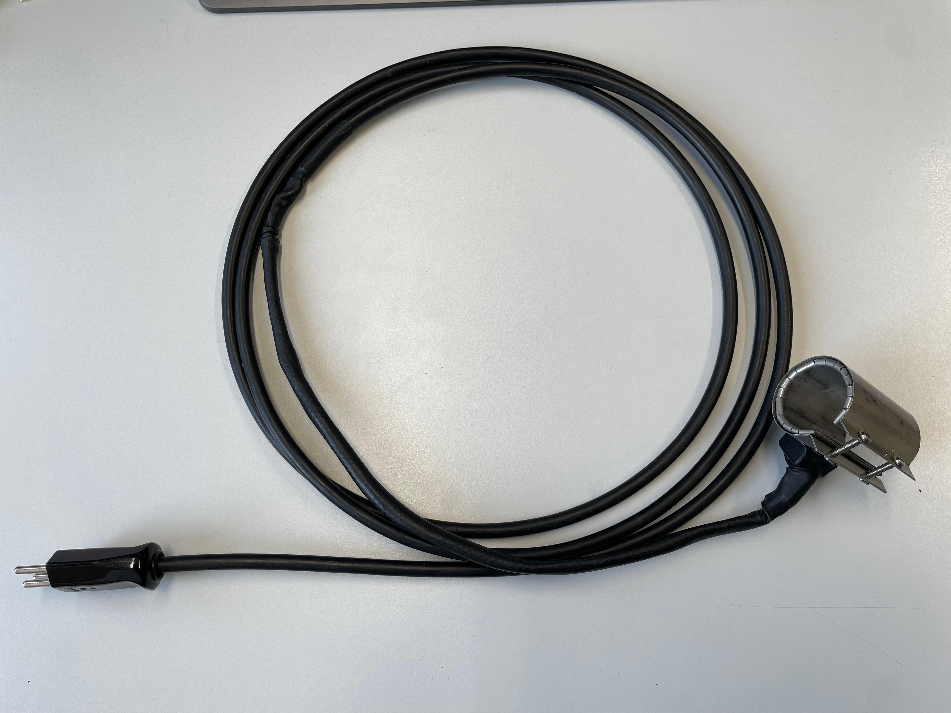
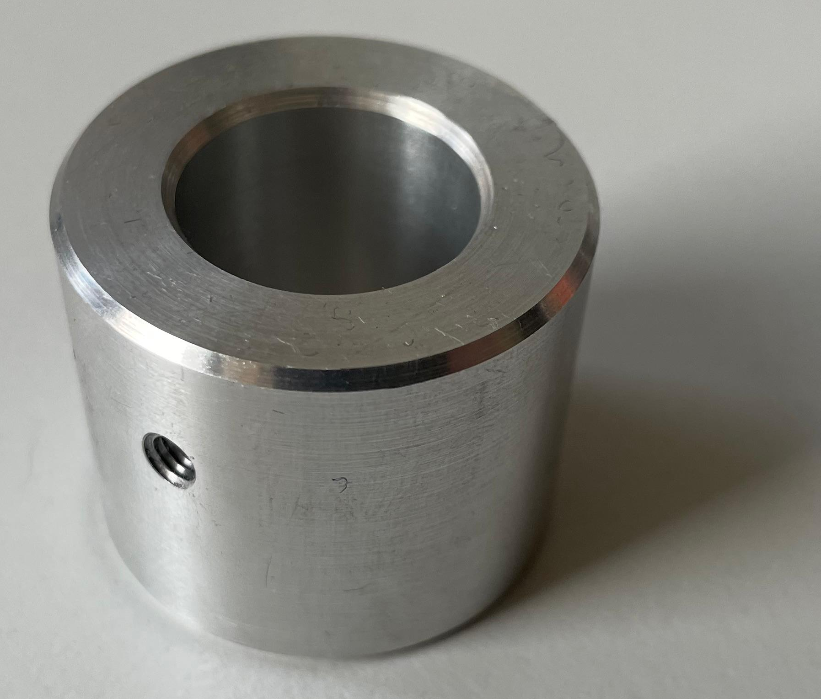
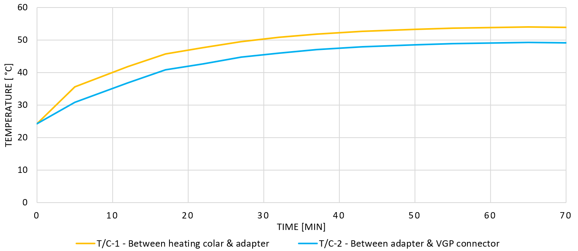
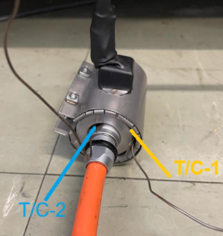
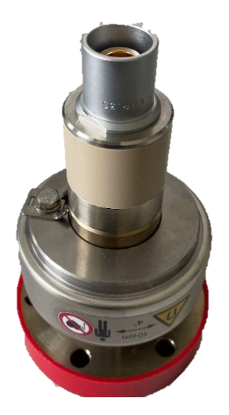
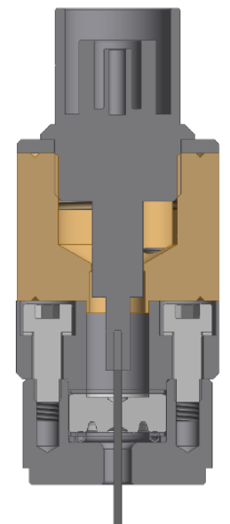
Heating collar
  Heating collar: DIMECA (F) 034 H60 230V 5W
    Adapter to ensure close contact
    Tested at room temperature
Heating collar with cable
Aluminum adapter
Heating collar temperature measurement versus time plot and setup photo

Slide 17
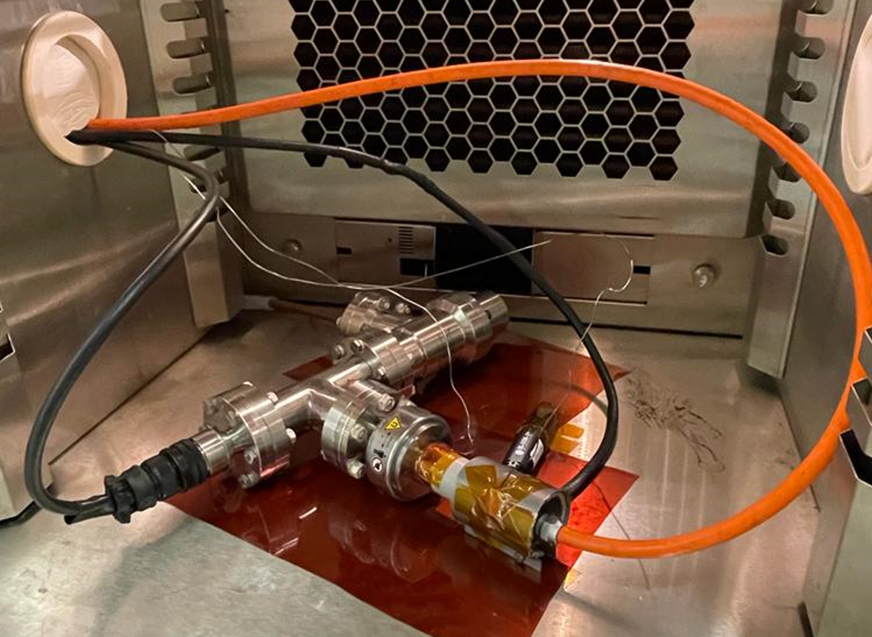
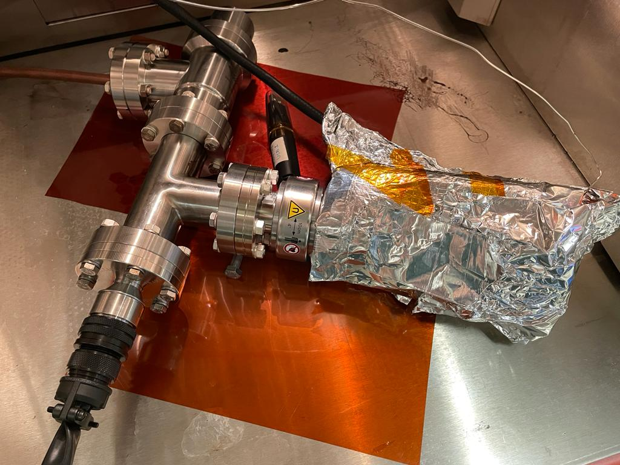
Setup with the heating collar
VGP testing setup with the heating collar at the EXCAL climatic chamber

Slide 18
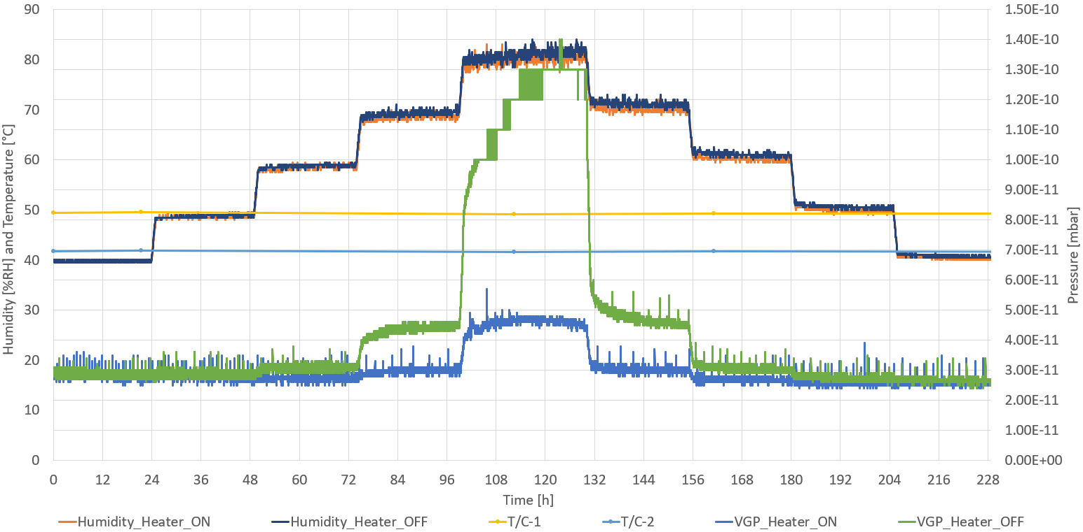
Tests with and without the heating collar
Test performed by increasing 10% humidity every 24h. Fixed 25°C starting at 40%RH up to 80%RH
ΔI ~200pA
Δ𝑃 ~1.0E-10 mbar
ΔI ~10pA
Δ𝑃 ~2.3E-11 mbar
Standard IKR070 VGP with heating collar on/off comparison measurements at the EXCAL machine

Slide 19
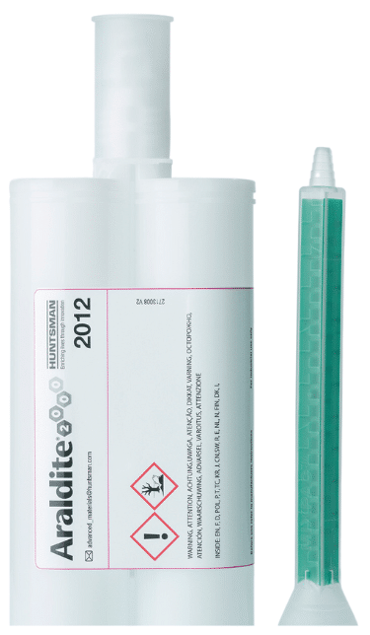
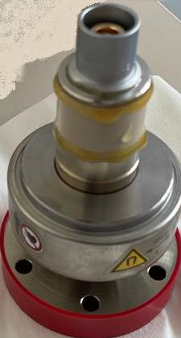
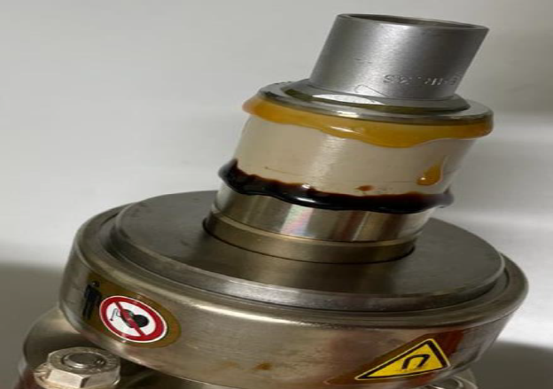

Araldite® 2012 adhesive
Characteristics and features
Two-component epoxy adhesive (mix ratio 1 : 1)
Bonds a wide variety of metals and plastics
Rapid cure at room temperature (pot life approx. 5-8 min, fixture in ~20 min)
High strength and toughness
Self-levelling
Cons:
Maximum continuous operating temperature ~70 °C
Impossible to remove and to reopen the connector
Not easy to apply with precision
Applying the Araldite® 2012 adhesive at the VGP PEEK and LEMO socket connector
VGP with freshly applied adhesive on the left, and after the bake-out on the right

Slide 20

Araldite® 2012 tests
Test performed at high (>80%RH) humidity and fixed 25°C during 14 days with pre and after drying periods
Standard IKR070 VGP with the Araldite® 2012 adhesive measurements at the EXCAL machine

Slide 21





Conclusion/actions after the first set of tests
  Conclusion
  Leakage current correlation with humidity level confirmed
    IKR070 not according to the specs
  Actions
  Heating collar installed at ELENA ring VGP
    Significantly reduces the leakage current
  Findings summarized on a Technical Note (EDMS3126377)
    Manufacturer (Inficon) contacted
ELENA LNR.VGPB.0606 with heating collar

Slide 22

Investigation by Inficon
  Inficon confirmed our findings
  They concluded that the humidity condensates at the atmospheric side of the ceramic feedthrough, generating a conductive layer at the surface level
Inficon slide (courtesy of R. Salemme)

Slide 23


Solution proposed by Inficon
  Main requirements
  To seal mechanically the inner volume of the HV feedthrough
  Solution to be installed without the need of breaking vacuum
  Mounting should be possible at any gauge mounting orientation
  Proposed solution
  O-rings to seal the critical feedthrough volume
  Modified PEEK part to host the O-rings and a ferrule to guide
  Pros
  Easy replacement / installation
  No need to break vacuum
  LEMO wall socket connector untouched
  Cons (due to the FKM O-ring)
  Continuous max. bakeout temperature reduced to 200°C resp. 250°C
  Radiation tolerance reduced to 10⁵ Gy resp. 10⁷ Gy
O-rings
Ferrule
(cone)
Standard IKR070 on the left, modified PEEK solution on the right
Modified PEEK solution parts

Slide 24


Modified setup with the PEEK solution
VGP testing setup with two IKR070 gauges; Inficon modified PEEK on the left, standard PEEK with 1mm drilled hole on the right
VGP testing setup with two IKR070 gauges at the EXCAL

Slide 25

Modified PEEK solution tests
Test performed at high (>80%RH) humidity and fixed 25°C during 14 days with pre and after drying periods
ΔI ~210pA
Δ𝑃 ~1.1E-10 mbar
VGP setup measurements at the EXCAL machine with two IKR070 gauges; Inficon modified PEEK and standard PEEK with 1mm drilled hole

Slide 26
Conclusion and future work
  What now?
  10 modified PEEK units to be received soon
    To be installed at AD, ELENA and LEIR during YETS25/26
  Upon CERN acceptance*
    A part number will be assigned by INFICON for ordering the modified PEEK part solution
    A part number will be assigned by INFICON to order the MAG070 Penning gauge with the assembled modified PEEK
    *We need to acknowledge the max. bakeout temperature of 200°C and the radiation tolerance of 10⁵ Gy
  Leakage current correlation with humidity level confirmed at the VGP
  Pfeiffer IKR070 / Inficon MAG070 not according to the specs
  Conditions to see the Leakage Current effect at the standard IKR070 measurements
  Very low vacuum pressure (E-11mbar range)
  High humidity (>60%RH)
    Machines on the surface with openings (e.g. AD/ELENA, LEIR)
    Gauges close to cooling circuits and no ventilation (e.g. LHC P5 – CMS yoke)
  CERN in-house solution – heating collar
  Requires 230VAC near the VGP
  Significantly decreases the leakage current
  INFICON solution – modified PEEK with O-rings
  Seals the HV feedthrough internal volume
  Easy installation
    Including retrofitting on installed gauges

Slide 27
Acknowledgments
Thanks to the main contributors; A. Sinturel, J.A. Ferreira, G. Pigny and ICM colleagues
Especial thanks to other colleagues for the productive conversations, shared knowledge, and collaboration;
TE-VSC
    IVO
    BVO
    VSM (S. Meunier)
    SCC (B. Teissandier)
    DLM (H. Rambeau)
BE-OP-AD
EP-ESE (C. Richard)
BE-CEM-EPR (S. Fiore)
INFICON AG (Roberto, Oskar and Tim)
...and many others

Slide 28
Thank you for your attention !
Any questions ?

Slide 29



NEG cartridge
  NEG was heated during the EXCAL climatic chamber tests
    Powered with ~10.12W (5.06V / 2.00A)

Slide 30

IKR 070 disassembled

Slide 31

MAG 070 gauge model with new PEEK adapter
  A groove milled around the external surface of new PEEK adapter allows visually recognising and distinguishing the new part
CAD model courtesy of R. Salemme

Slide 32

Modified PEEK solution tests
Test performed at the b.30 ICM electronics lab under natural room conditions for both the controller and the gauges
VGP setup measurements at the b.30 lab with two IKR070 gauges; Inficon modified PEEK and standard PEEK with 1mm drilled hole

Slide 33





VFDS shrink tube test
Test performed at high (>80%RH) humidity and fixed 25°C during 14 days with pre and after drying periods
Standard IKR070 VGP covered with the Raytronics VFDS shrink tube measurements at the EXCAL machine

