Slide 1

Present LHC triplet magnets
H. Prin

Slide 2
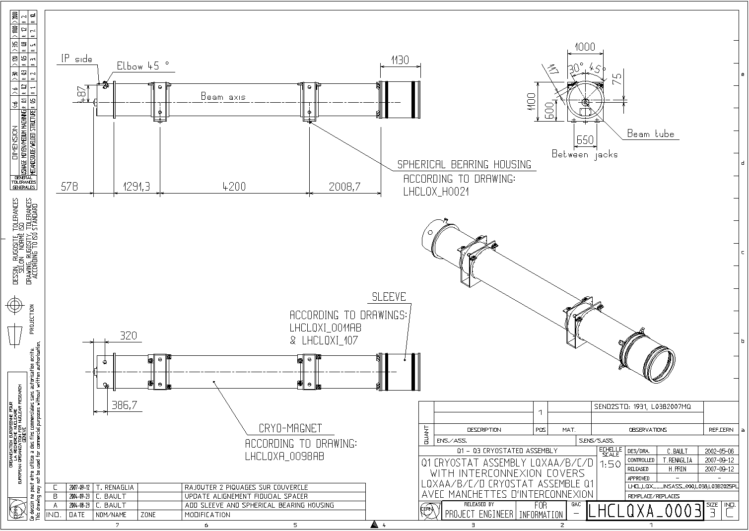
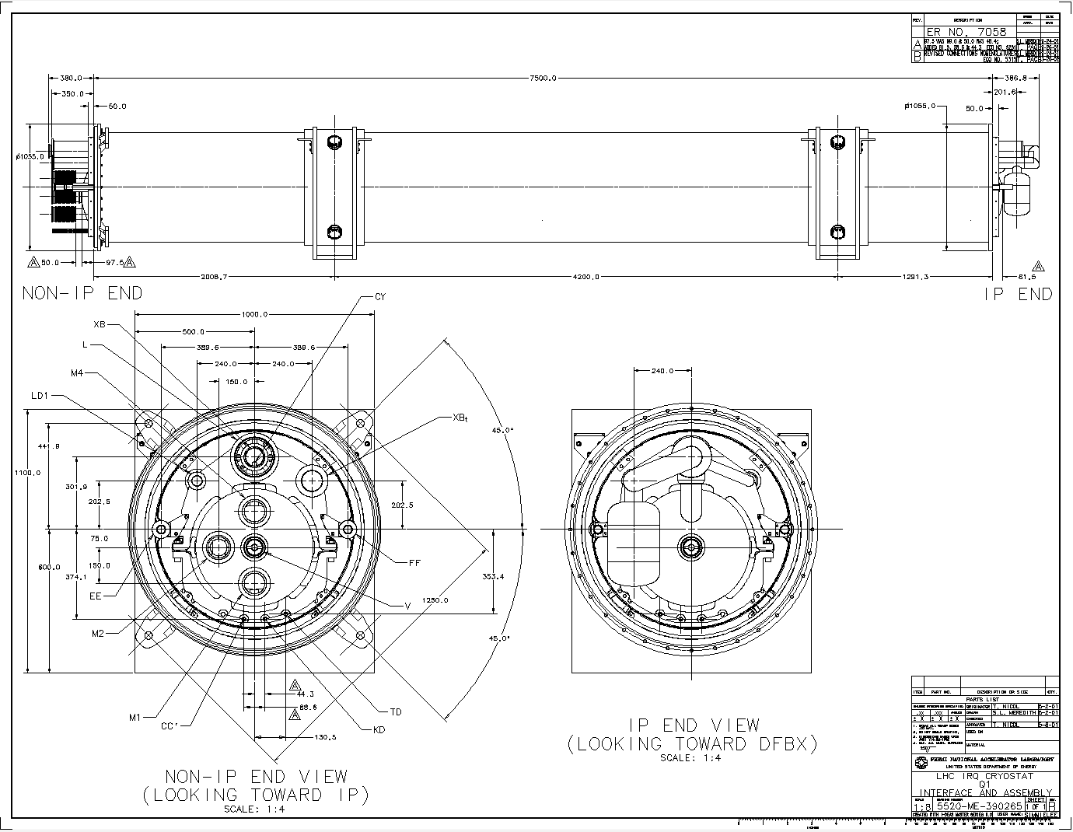
Q1 - LQXA
9208
More details in LHCLQXA_0161

Slide 3
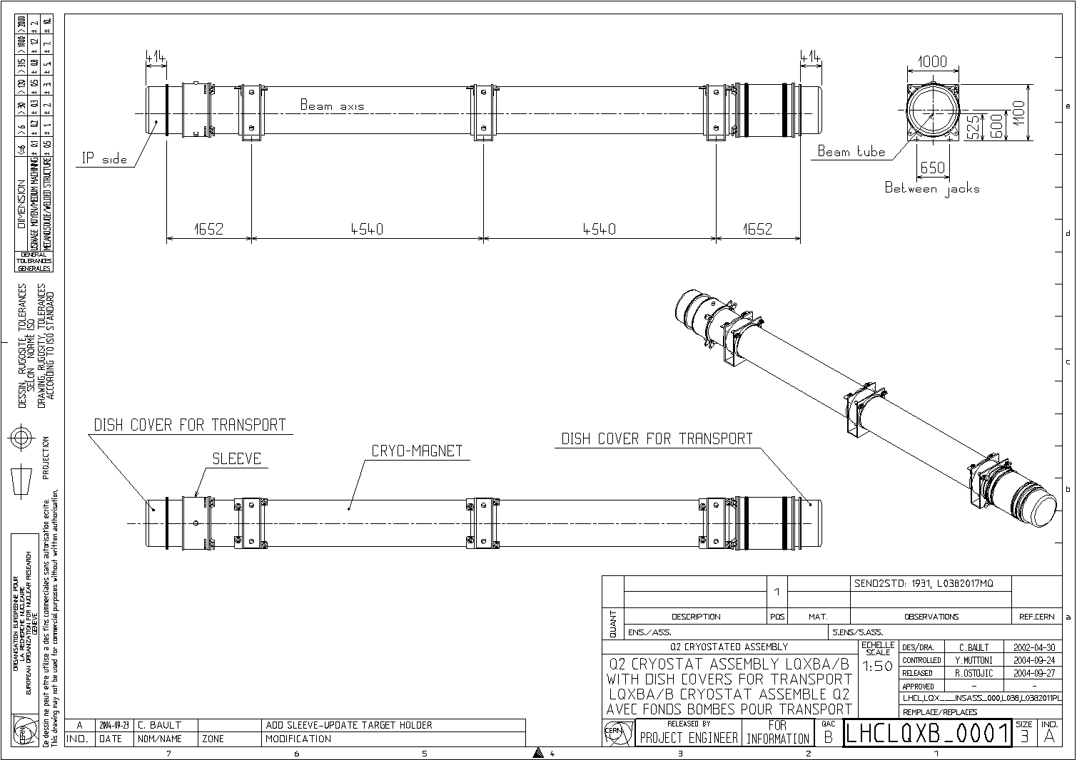
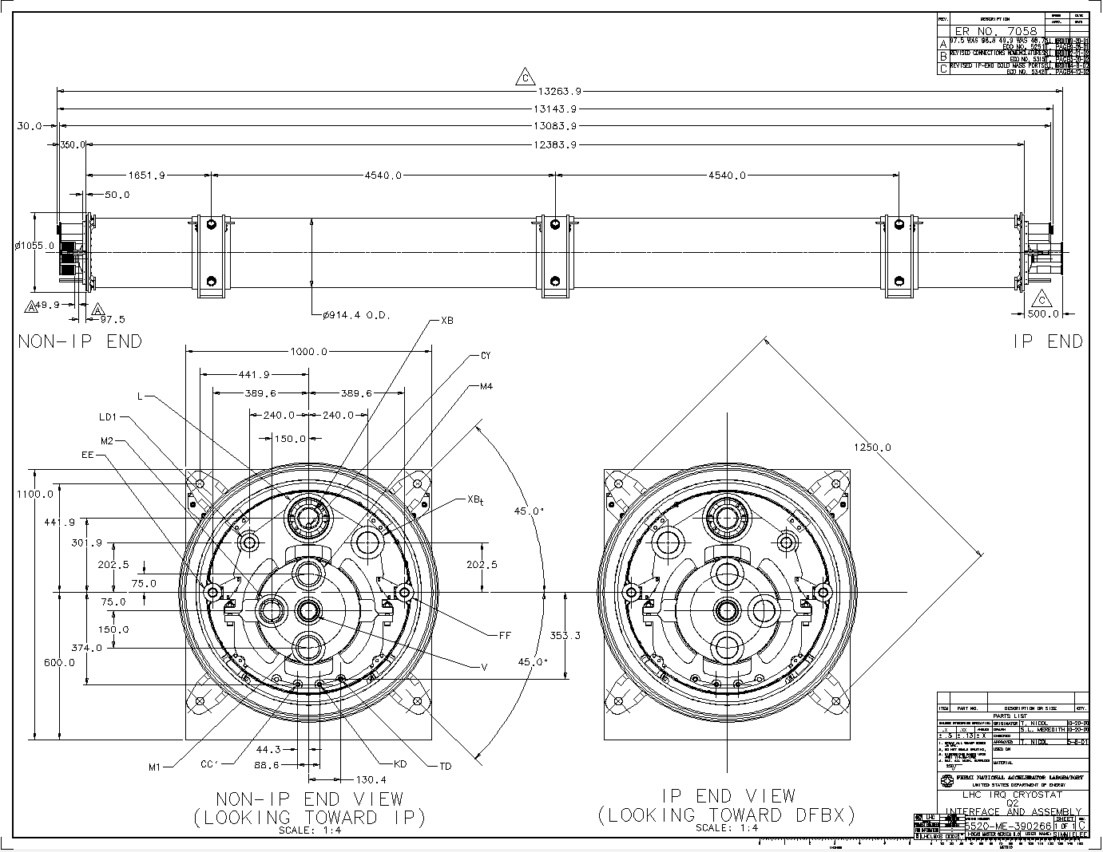
Q2 - LQXB
13212
More details in LHCLQXB_0002

Slide 4
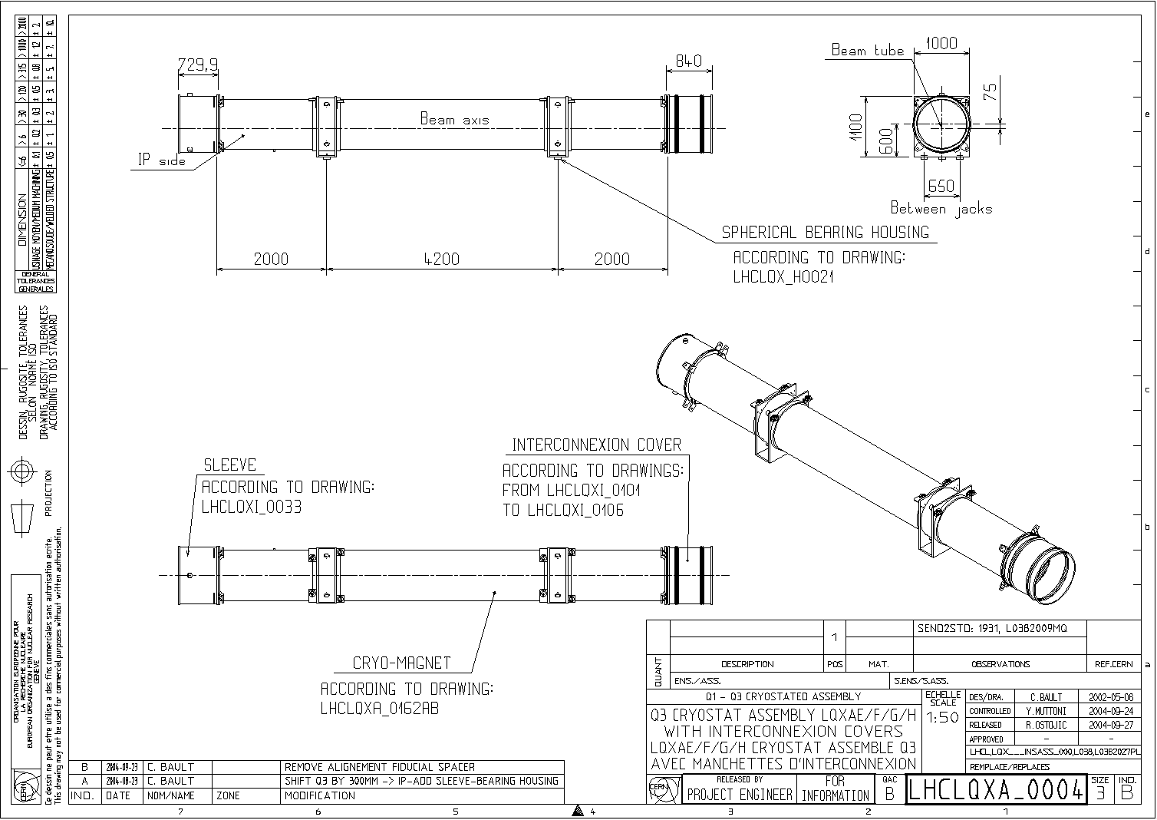
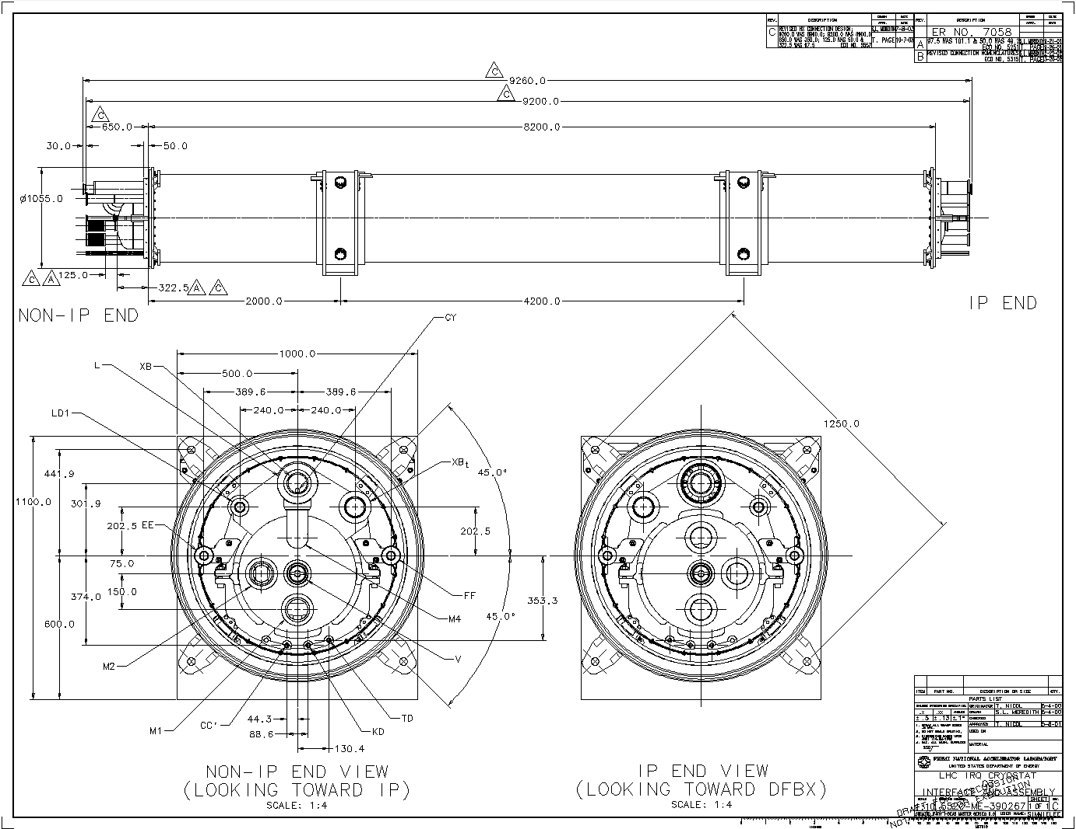
Q3 - LQXC
9770
More details in LHCLQXA_0162

Slide 5
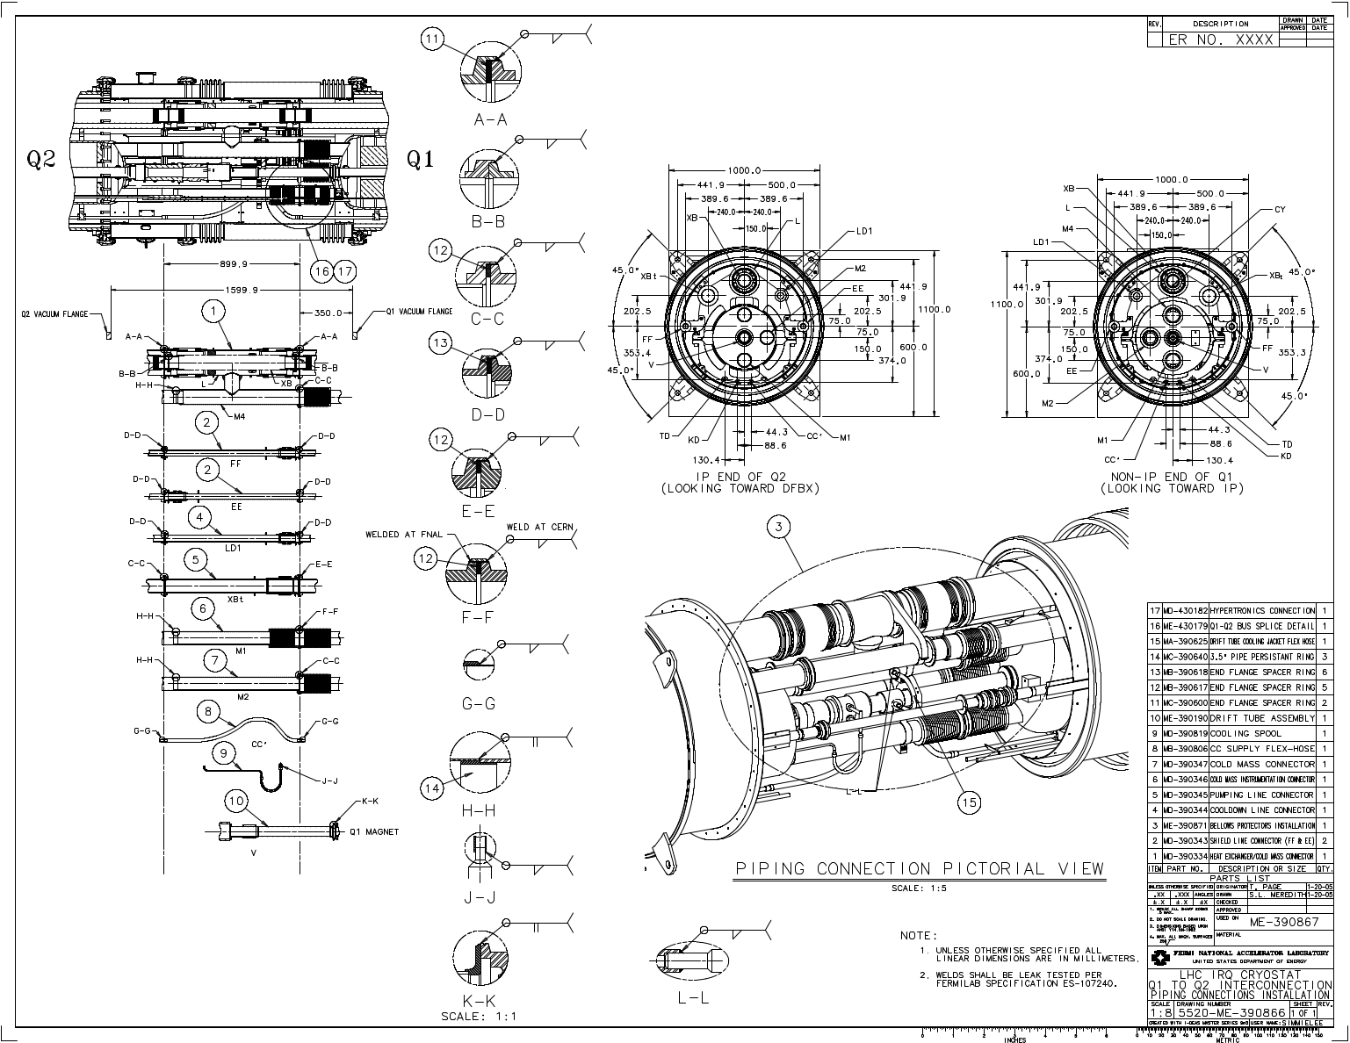
Initial Q1-Q2 Interconnection design

Slide 6
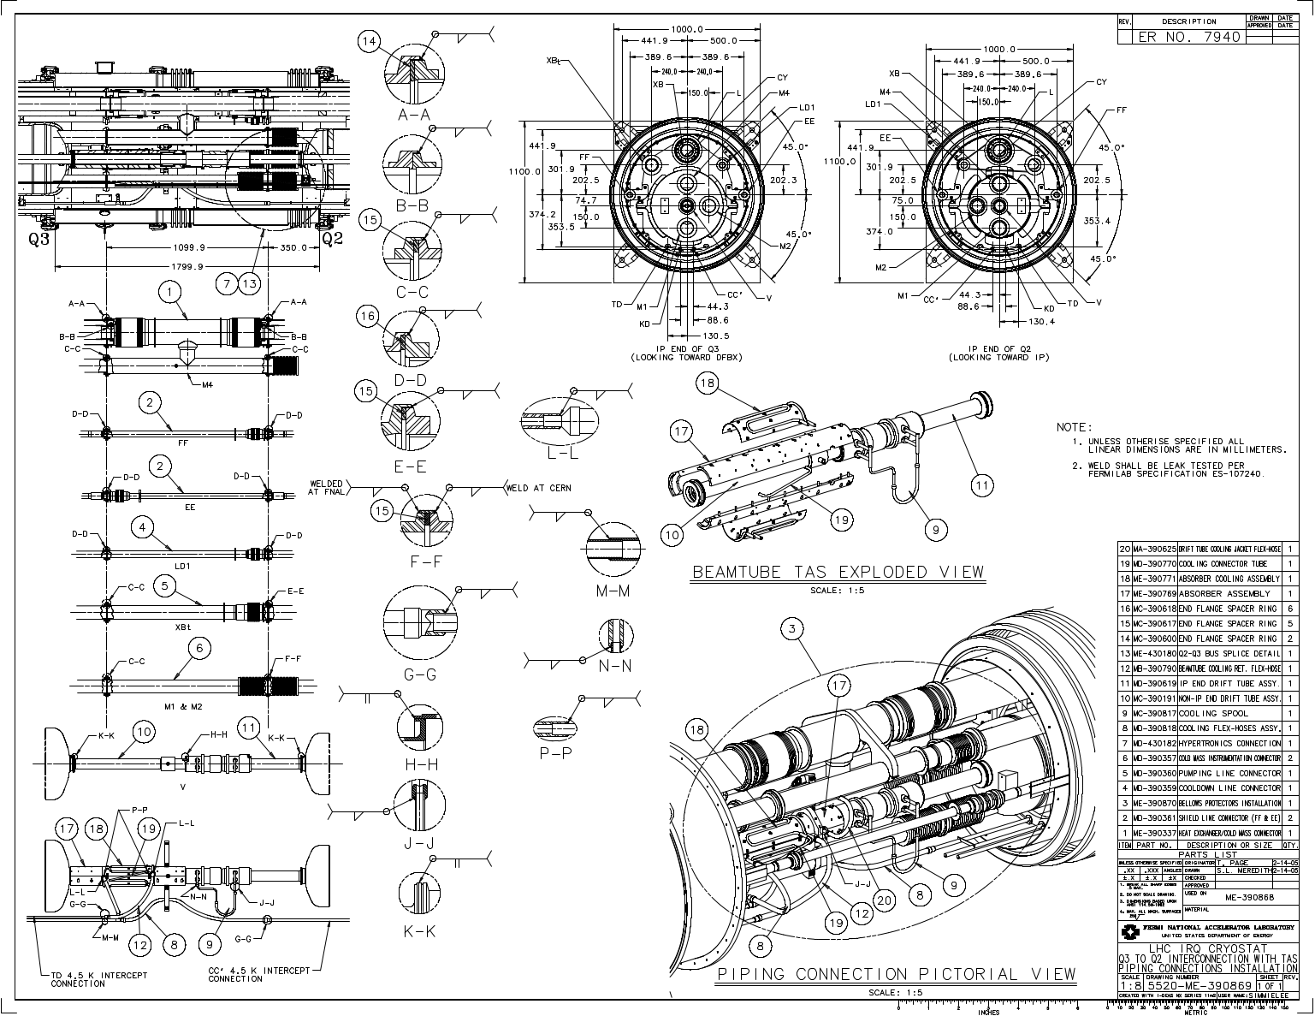
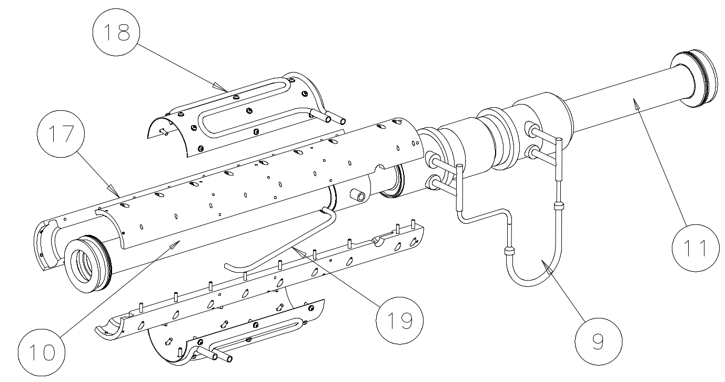
Initial Q2-Q3 Interconnection design (with TAS)
TASB
TASB cooler

Slide 7
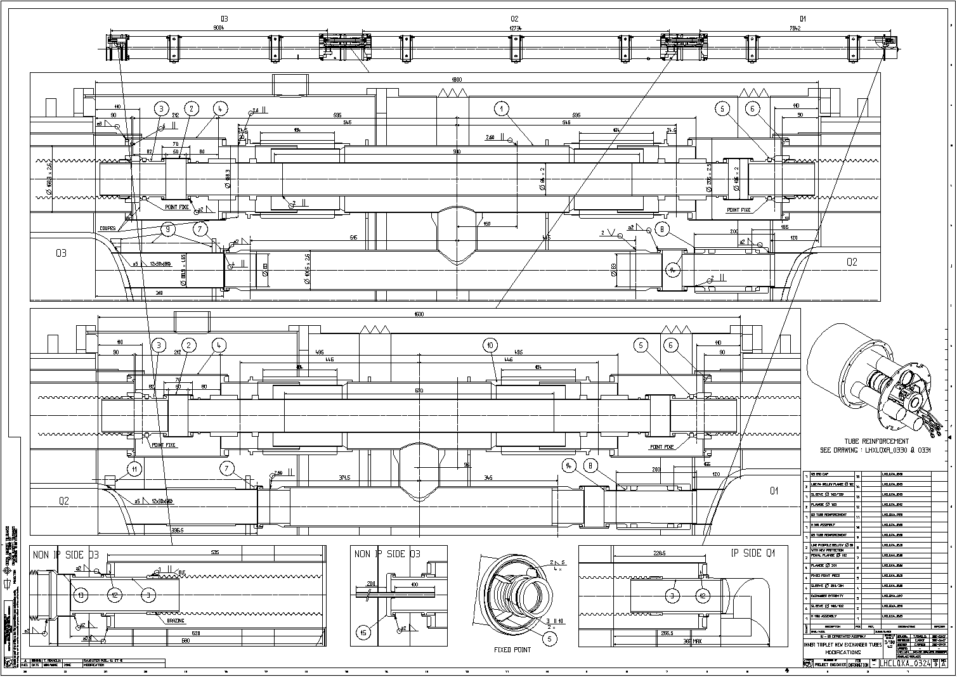
Interconnections after consolidation in 2007

