Slide 1
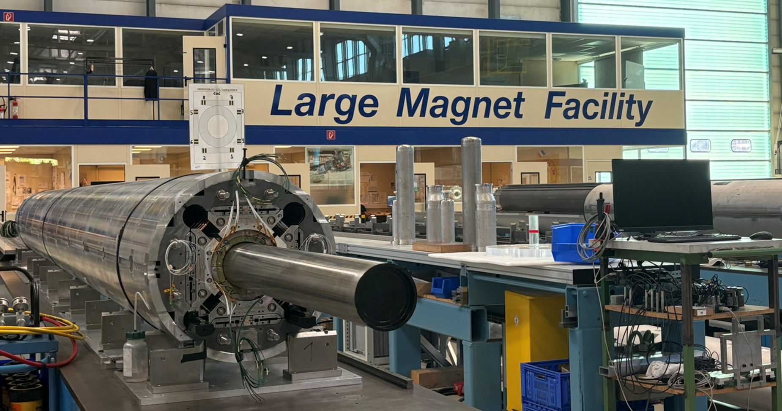

Assembly of the Nb₃Sn MQXFB Quadrupole for HL-LHC
Penelope Matilde Quassolo
Acknowledgements: Susana Izquierdo Bermudez, Nicholas Lusa, Stephane Triquet, Sylvain Mugnier, Paolo Ferracin, Jose Ferradas Troitino

Slide 2
Outline
Introduction
MQXFB assembly
  Yoke-shell sub-assembly
  Coil pack sub-assembly
  Magnet loading
    Azimuthal preload
    Axial preload
Conclusion

Slide 3
Outline
Introduction
MQXFB assembly
  Yoke-shell sub-assembly
  Coil pack sub-assembly
  Magnet loading
    Azimuthal preload
    Axial preload
Conclusion

Slide 4
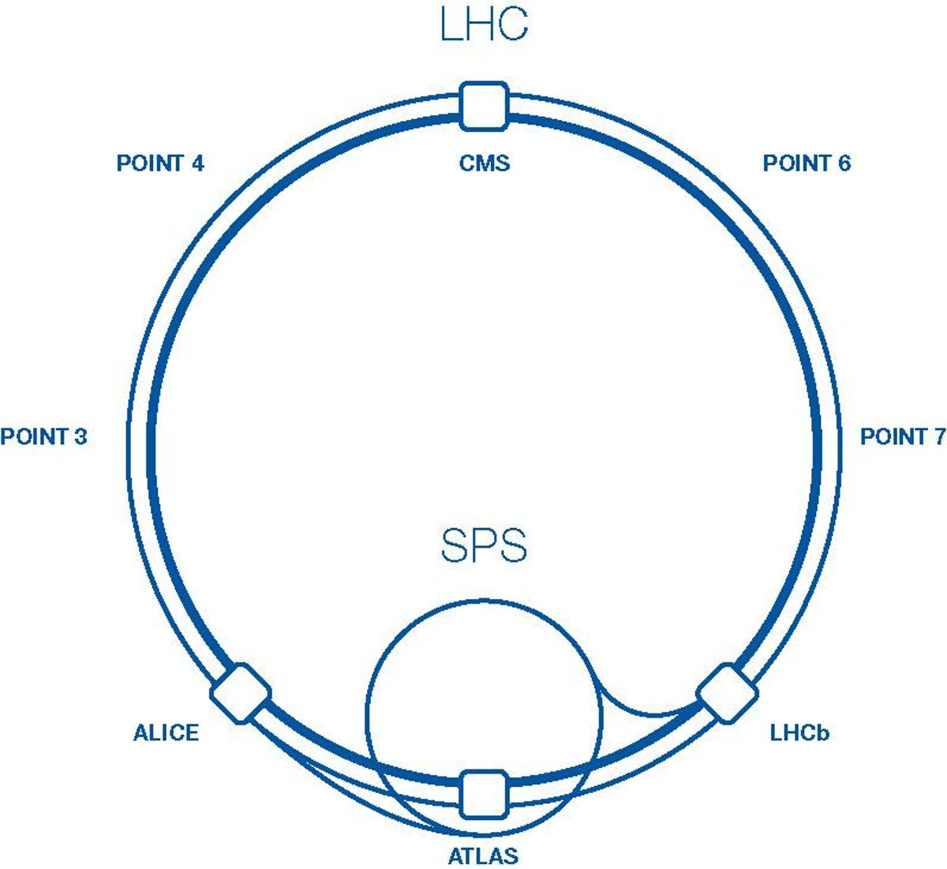
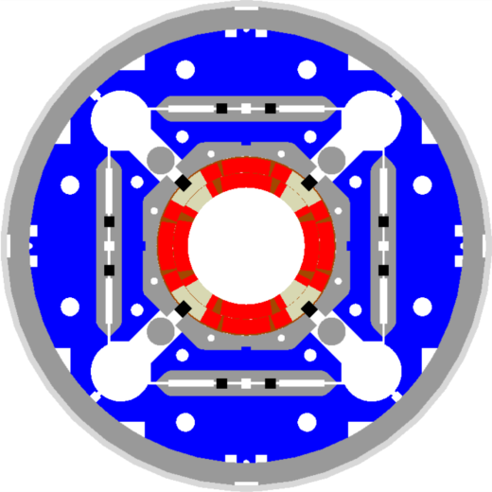
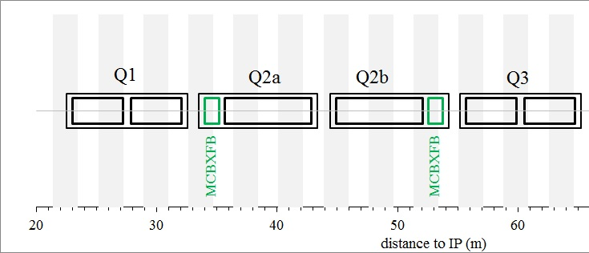
HL–LHC Nb₃SN magnets
The High Luminosity Large Hadron Collider project (HL-LHC) aims at upgrading the existing LHC machine to increase its integrated luminosity by a factor of ten in about a dozen years after commissioning. An important part of this upgrade is focused in the LHC insertion regions (near Point 1 – ATLAS and Point 5 – CMS): upgrade of the inner triplets → New MQXF low-β quadrupole magnets (Nb₃Sn, 20 MQXFA + 10 MQXFB).
Construction of pre-series and series magnets on-going, joint effort between CERN and US-AUP.
MQXF
E. Todesco

Slide 5
HL–LHC Nb₃SN magnets challenges
LHC MB
NbTi, B_{p} = 8.6 T
Eq. coil width: 27 mm
J_{strand} = 475/616 A/mm²
HL-LHC MQXF
Nb₃Sn, B_{p} = 11.3 T
Eq. coil width: 36 mm
J_{strand} = 715 A/mm²

Slide 6
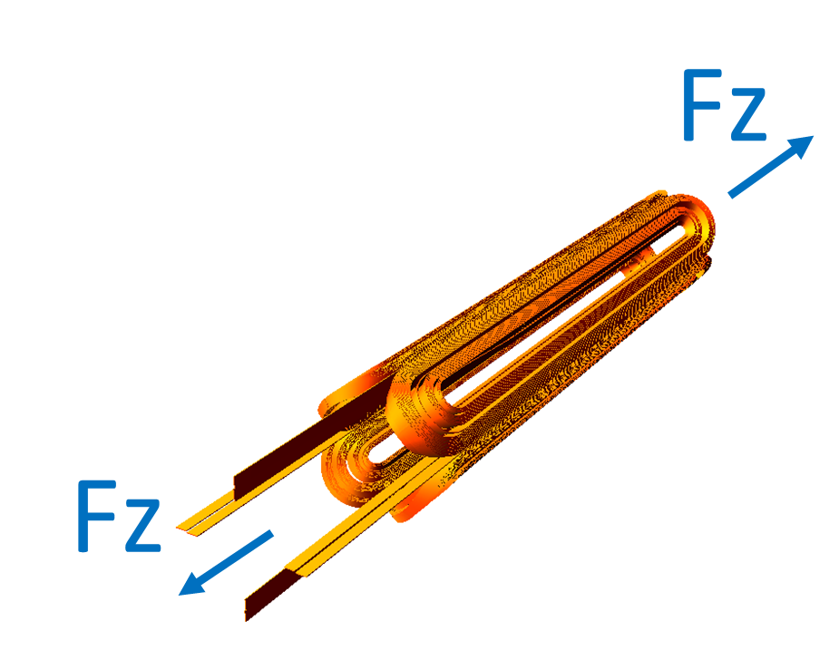
HL–LHC Nb₃SN magnets challenges
≈ 2 times more force/stress than in the LHC-MB dipoles, in a brittle conductor
LHC MB
NbTi, B_{p} = 8.6 T
F_{x} = 3.4 MN/m
σ_{θ,em} = 50-60 MPa
F_{z} = 265 kN
HL-LHC MQXF
Nb₃Sn, B_{p} = 11.3 T
F_{x} = 6.8 MN/m
σ_{θ,em} = 100-110 MPa
F_{z} = 1200 kN
F_{x} per half magnet; F_{z} per aperture

Slide 7
HL–LHC Nb₃SN magnets challenges
Large electromagnetic forces in a brittle conductor calls for an innovative structure.

Slide 8
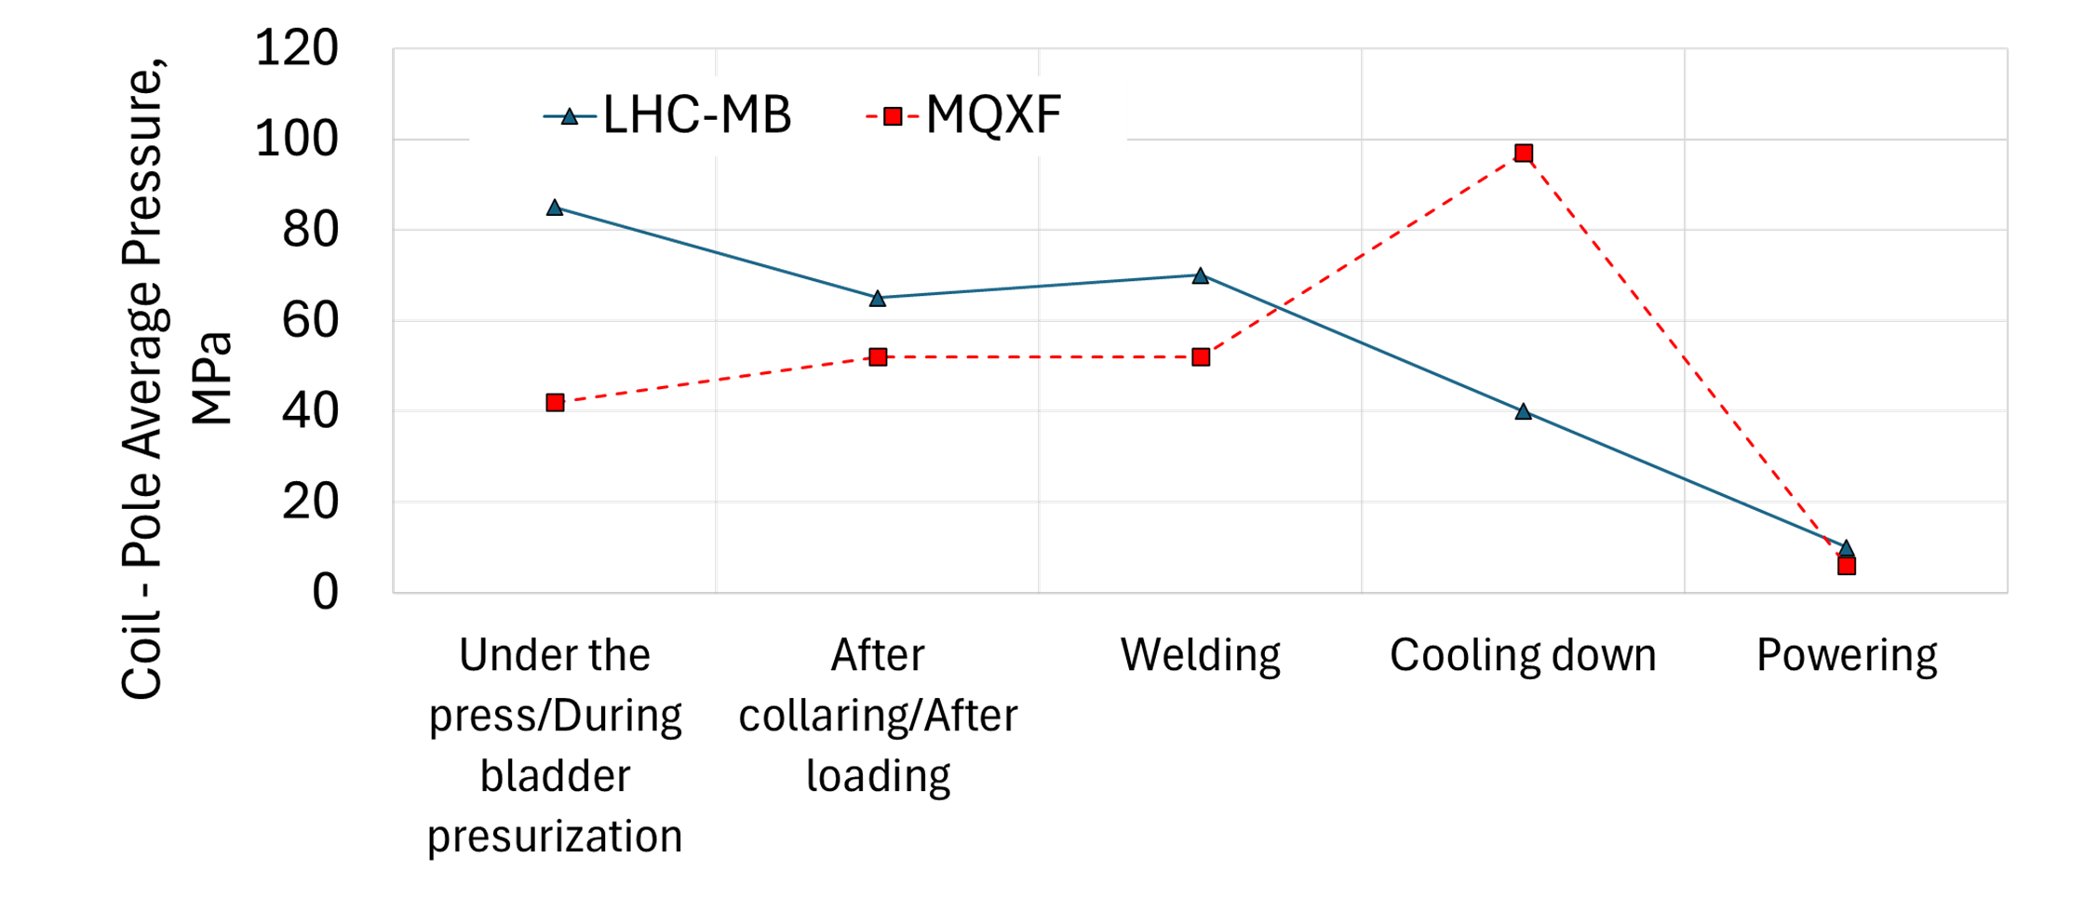
MQXF structure
MQXF structure is based on an aluminium shell pre-loaded with bladders and keys
  ≈ 50 % of the pre-load during room temperature assembly (bladder pressurisation and key insertion)
  ≈ 50 % increase in pre-load during cool down due to the difference in thermal contraction between the outer aluminium shell and the rest of the magnet
LHC MB components shrink differently, and there is a significant reduction of pre-load during cool down
P. Ferracin, et al., “Modeling of coil pre-stress loss during cool-down in the main dipoles of the Large Hadron Collider,"
in IEEE Transactions on Applied Superconductivity, vol. 12, no. 1, pp. 1705-1708, March 2002, doi: 10.1109/TASC.2002.1018736

Slide 9
Objective
A superconducting magnet is a complex electromagnetic-mechanical system, and the HL-LHC MQXF marks the first time magnets with this innovative structure, utilising Nb₃Sn conductors, are being installed in an accelerator.
Objective: Can we monitor production with simple tools while ensuring the required preload?

Slide 10
Outline
Introduction
MQXFB assembly
  Yoke-shell sub-assembly
  Coil pack sub-assembly
  Magnet loading
    Azimuthal preload
    Axial preload
Conclusion

Slide 11
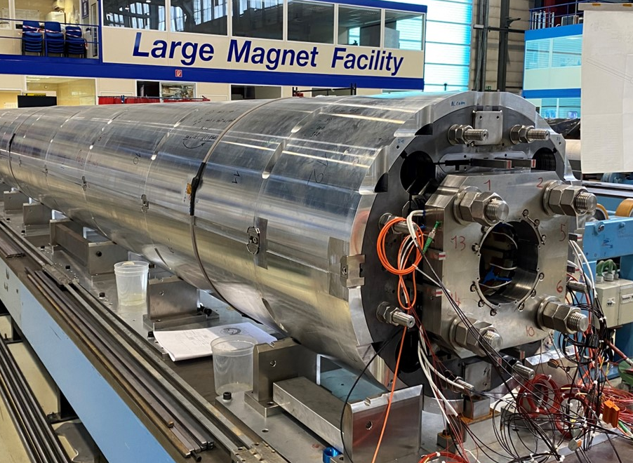
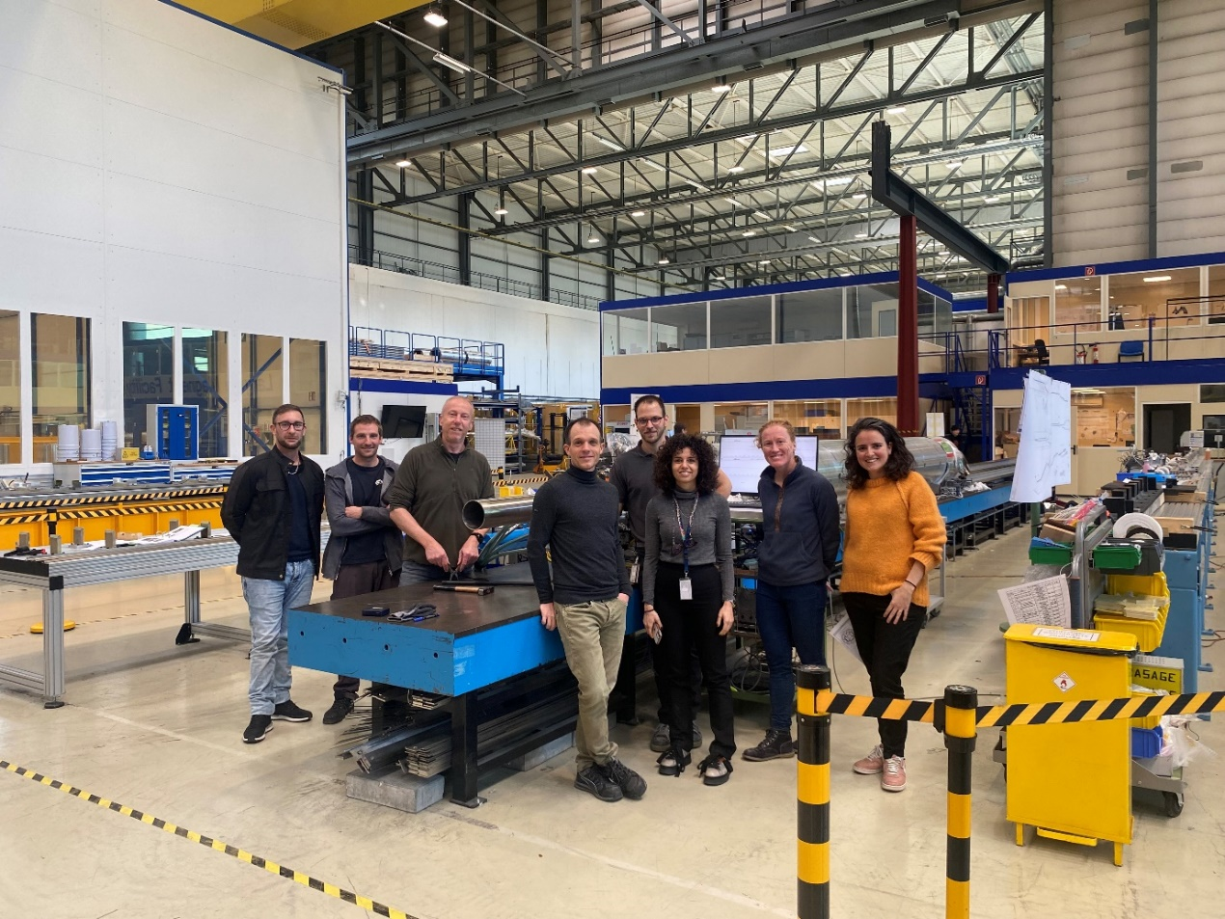
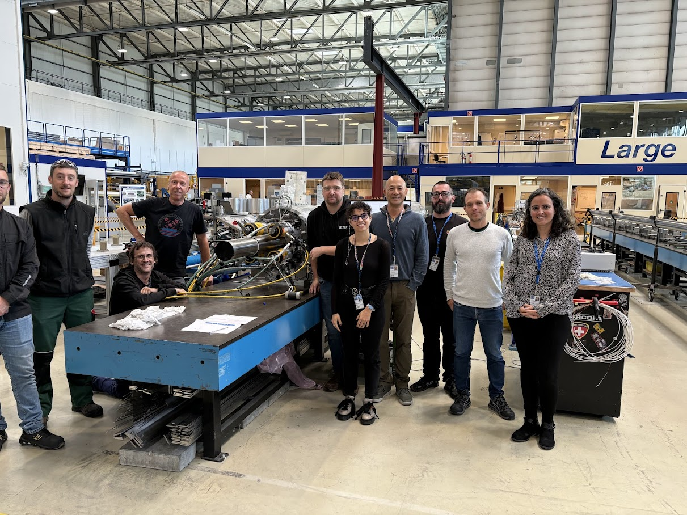
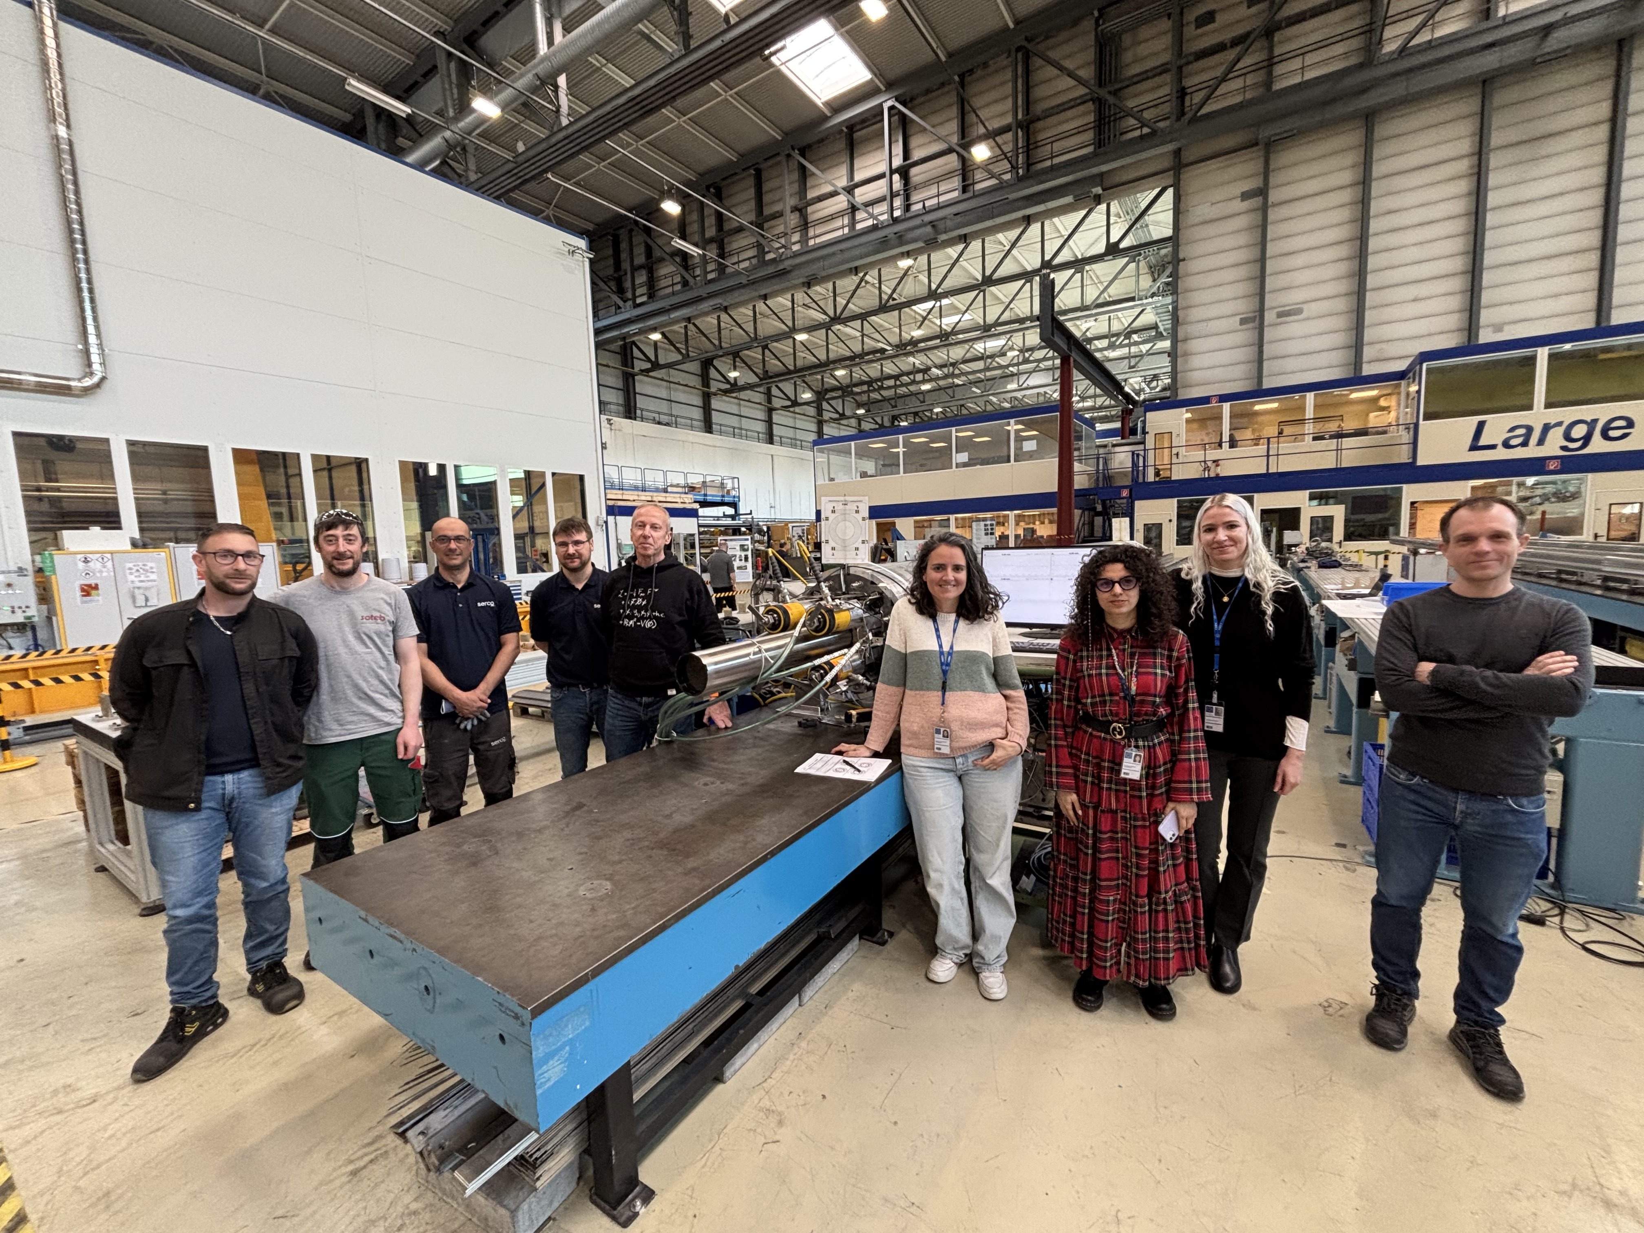
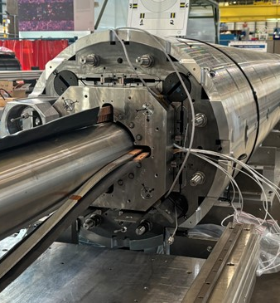
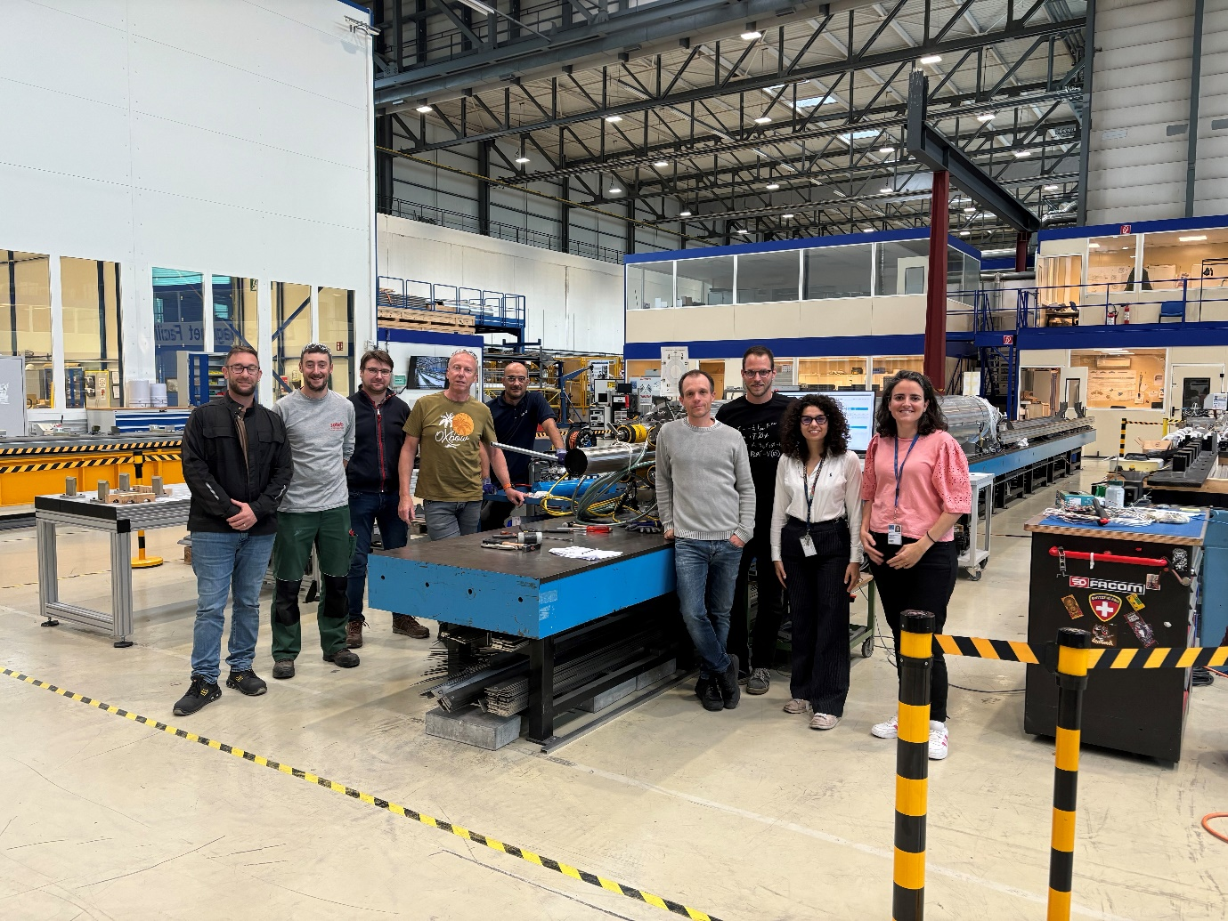
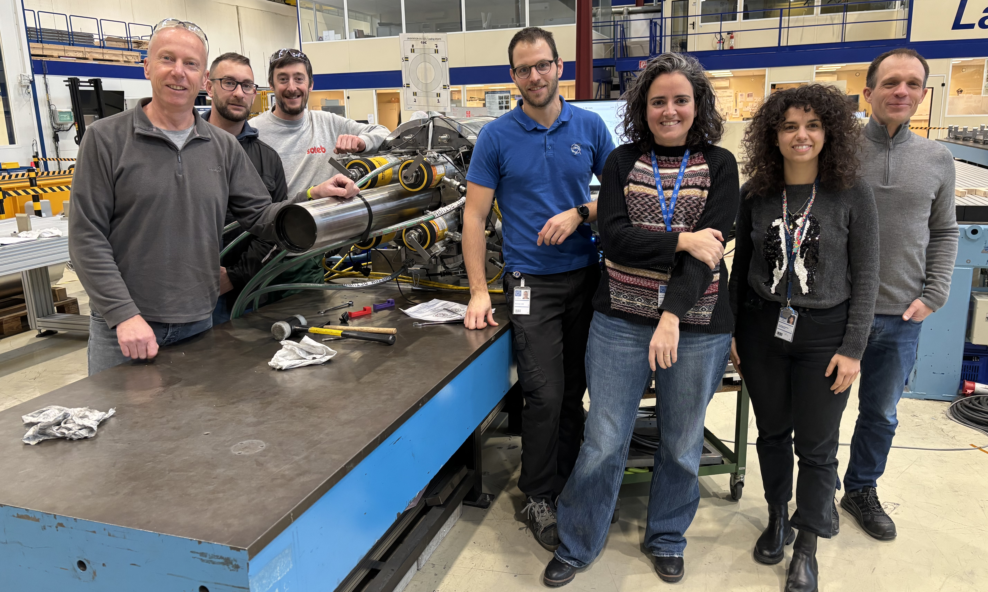
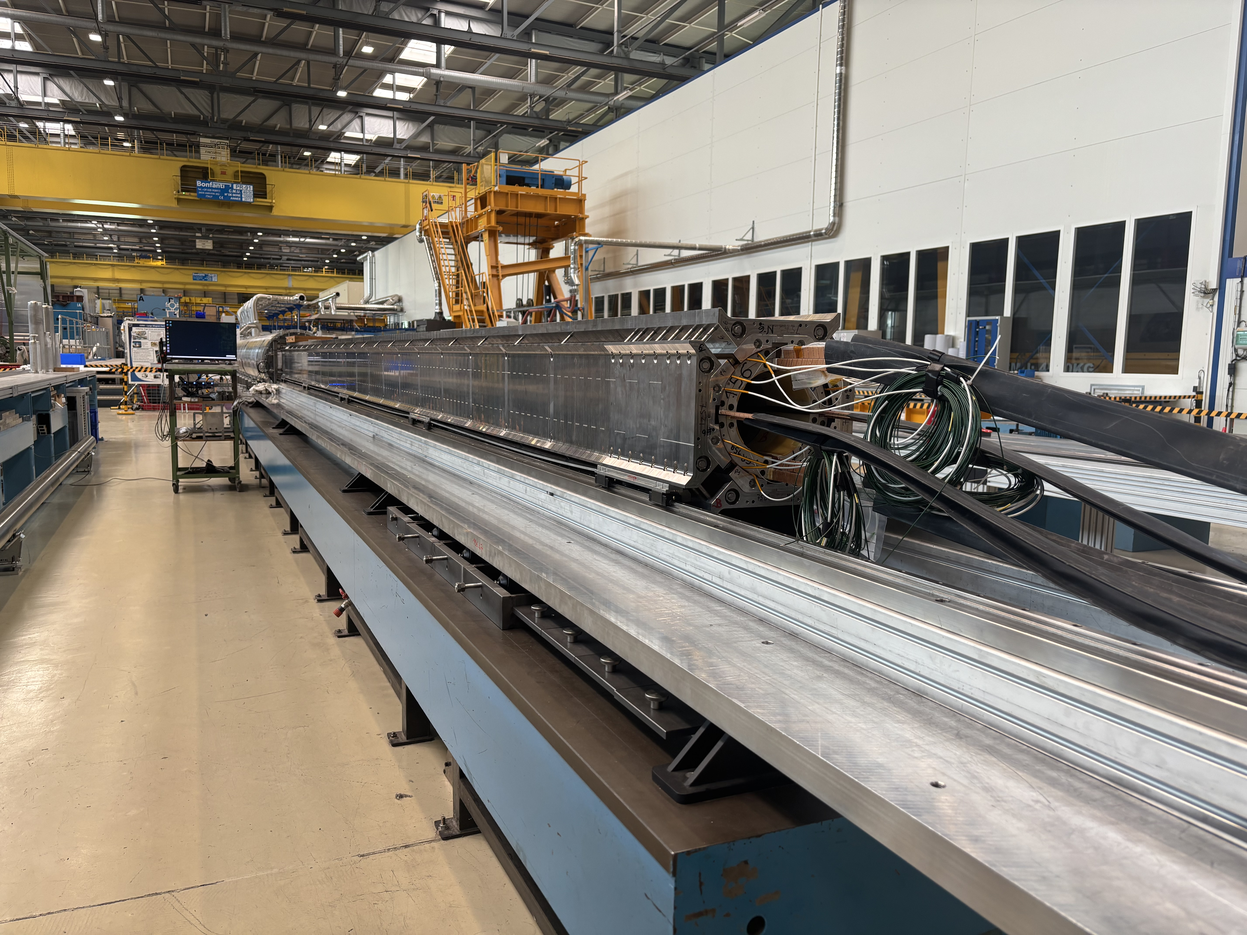
MQXFB assembly
One magnet is assembled every ≈ 3.5 months
The assembly of the last magnet for installation (MQXFB10) is ongoing. Two more magnets (spare) are needed to complete production. We expect to finish in spring 2026
MQXFB03
MQXFB04
MQXFB05
MQXFB06
May-June 2023
Sept-Oct 2023
Feb-March 2024
MQXFB08
May-June 2024
MQXFB07
Sept-Oct. 2024
MQXFB09
Feb-March 2025
MQXFB10
May-June 2025
Nov-Dec. 2024

Slide 12
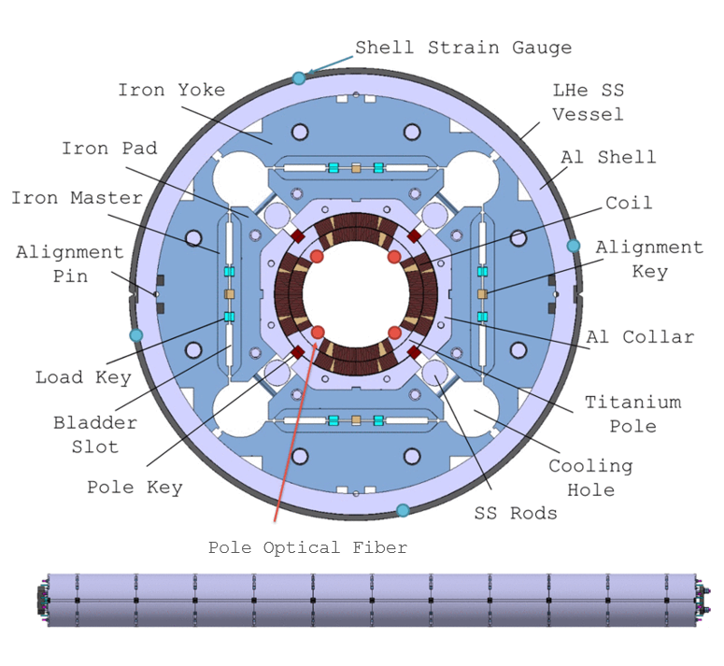
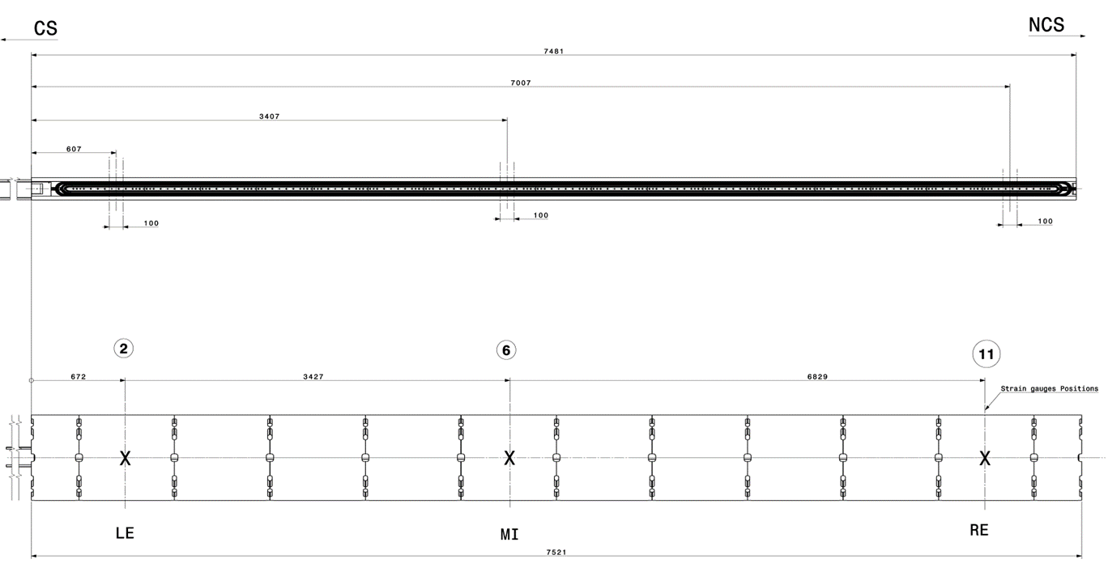
MQXFB assembly
Magnet assembly can be divided into 3 steps:
Coil pack assembly
Yoke-shell assembly
Loading
Different measurements are performed and compared with the established acceptable ranges during the assembly process.
How do we measure?
Pole optical fibres
Shell strain gauges
Rod strain gauges
LVDT (dimensions, rod displacement, etc)
Pressure sensors ( bladders, rod hydraulic system, etc)
Others

Slide 13
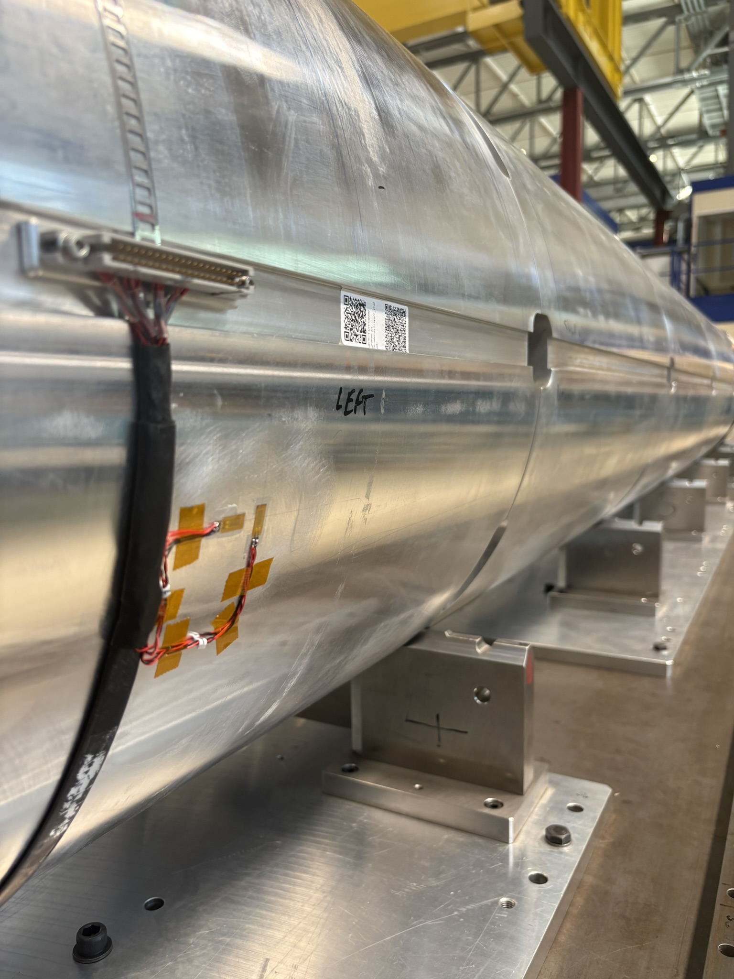

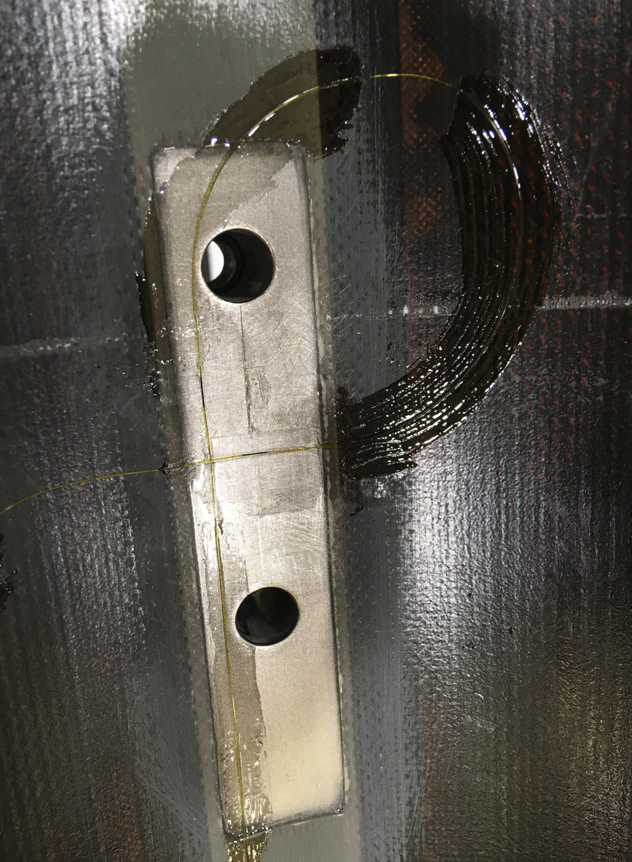
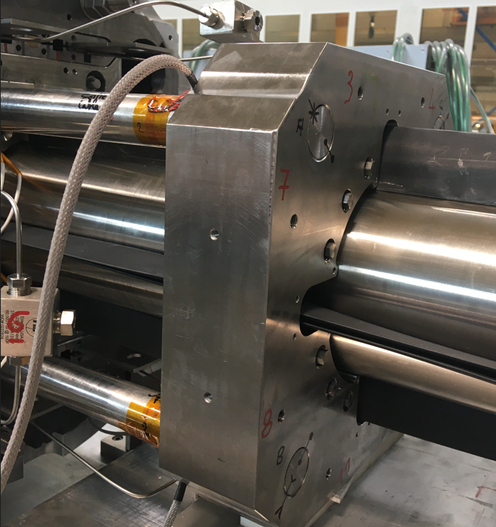
Mechanical instrumentation overview
Coil: titanium winding poles are equipped with optical fibres, measuring the azimuthal and axial strain in the LE, MI, and RE.
Shell: strain gauges positioned in each quadrant to measure both axial and azimuthal strains in the LE, MI, and RE.
Rods: strain gauges to measure the axial strain, in one longitudinal position for each tie-rod.
Measuring points on the coil titanium inner pole (FBG)
Al-shell
equipped with SG
Tie rods equipped with SG
S. MUGNIER, EN-MME Mechanical Measurement Lab https://edms.cern.ch/document/2506543/1

Slide 14
Outline
Introduction
MQXFB assembly
  Yoke-shell sub-assembly
  Coil pack sub-assembly
  Magnet loading
    Azimuthal preload
    Axial preload
Conclusion

Slide 15
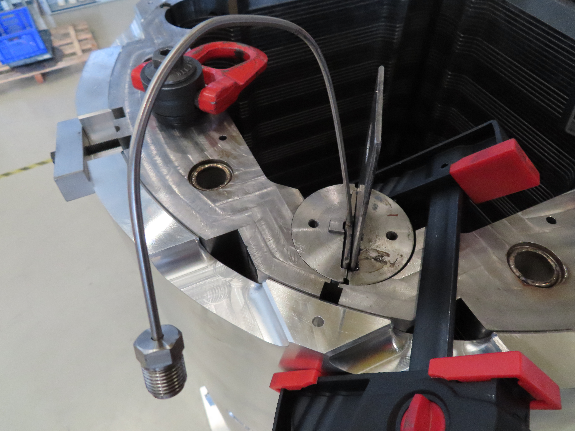
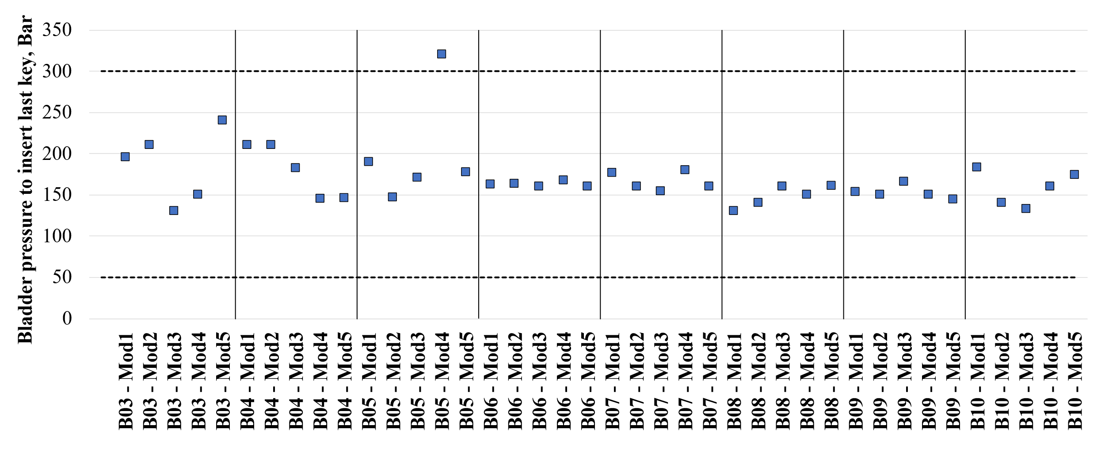
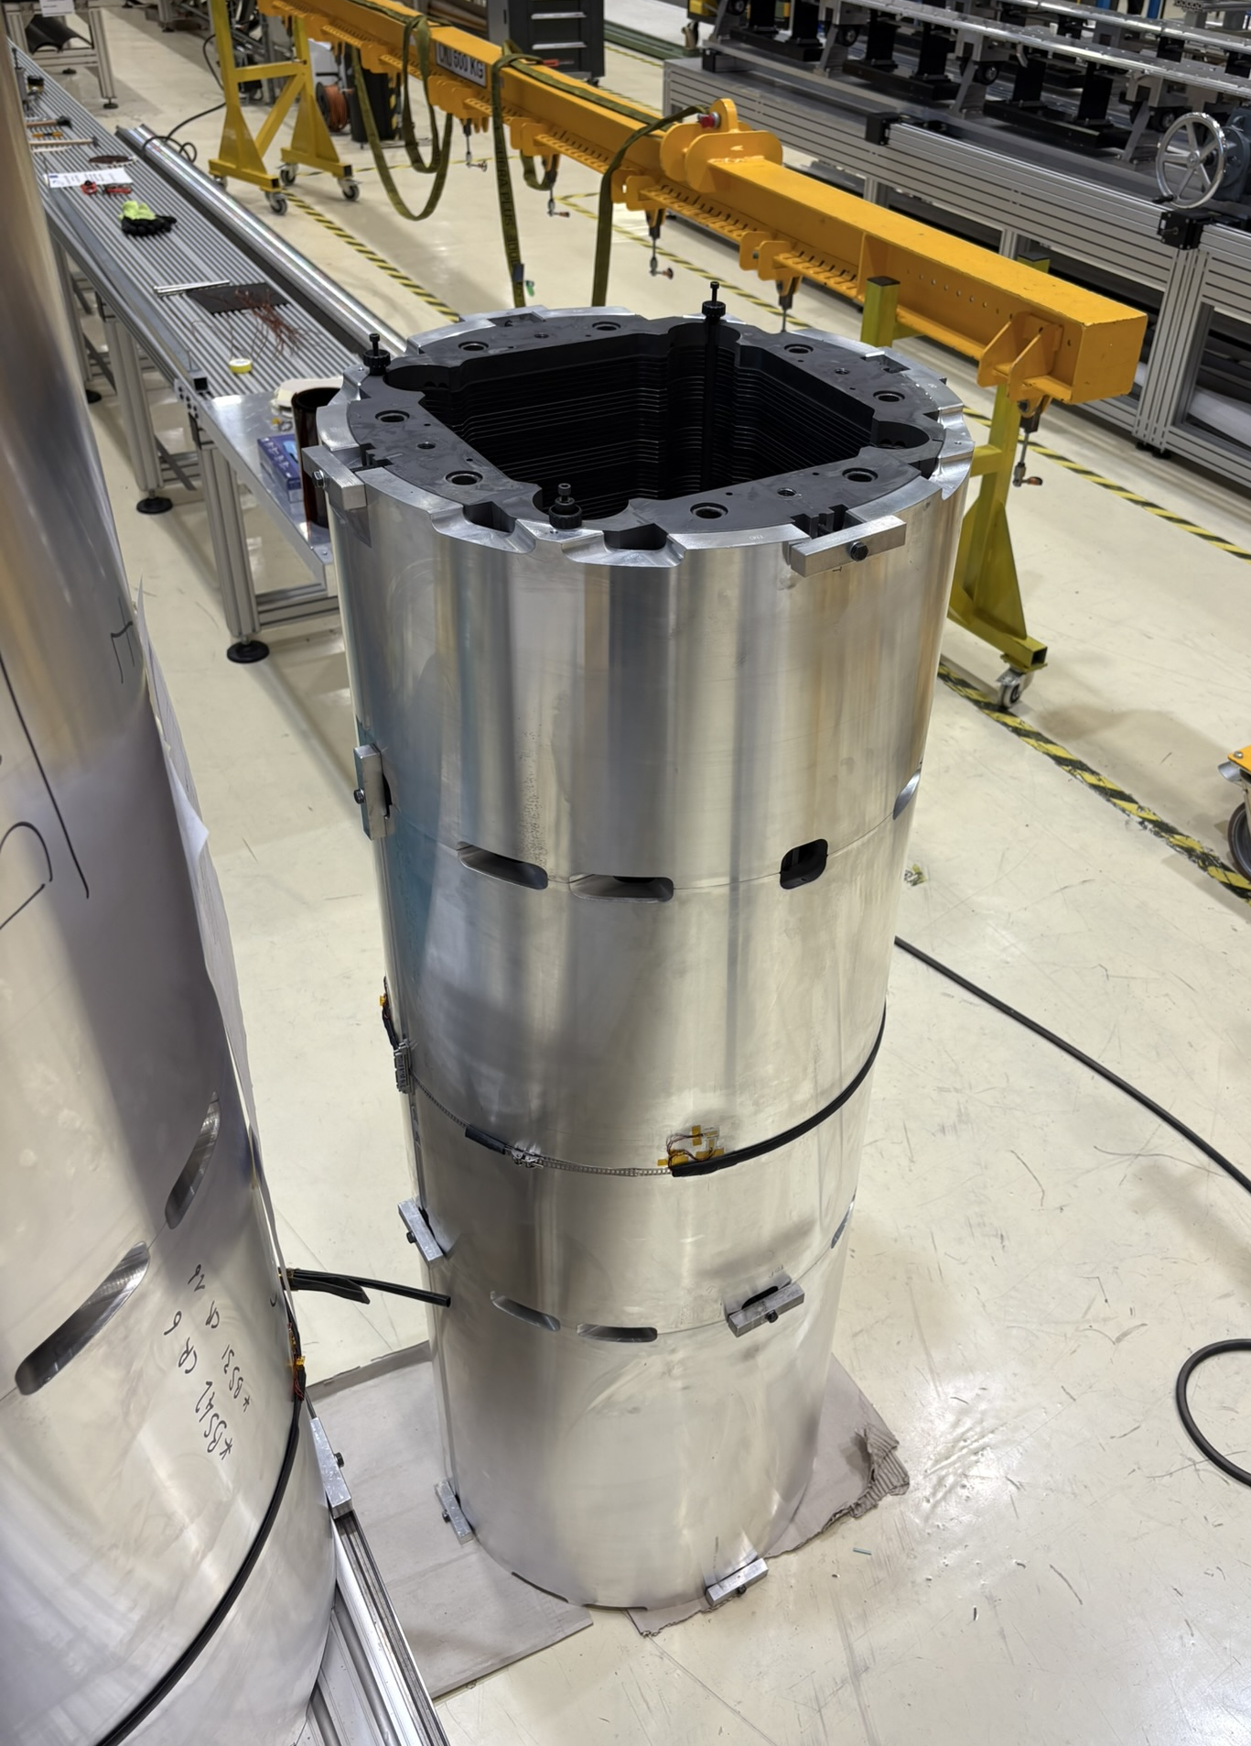
Yoke-shell vertical sub-assembly
Initially, four yoke stacks are then inserted vertically inside the shells.
A bladder operation is performed to insert the interference keys (12.1 mm), to constrain the yokes against the shells. The cooling holes in the yokes are used as the bladder locations to open the gaps. The required bladder pressure to insert the last yoke key is monitored via pressure sensors

Slide 16
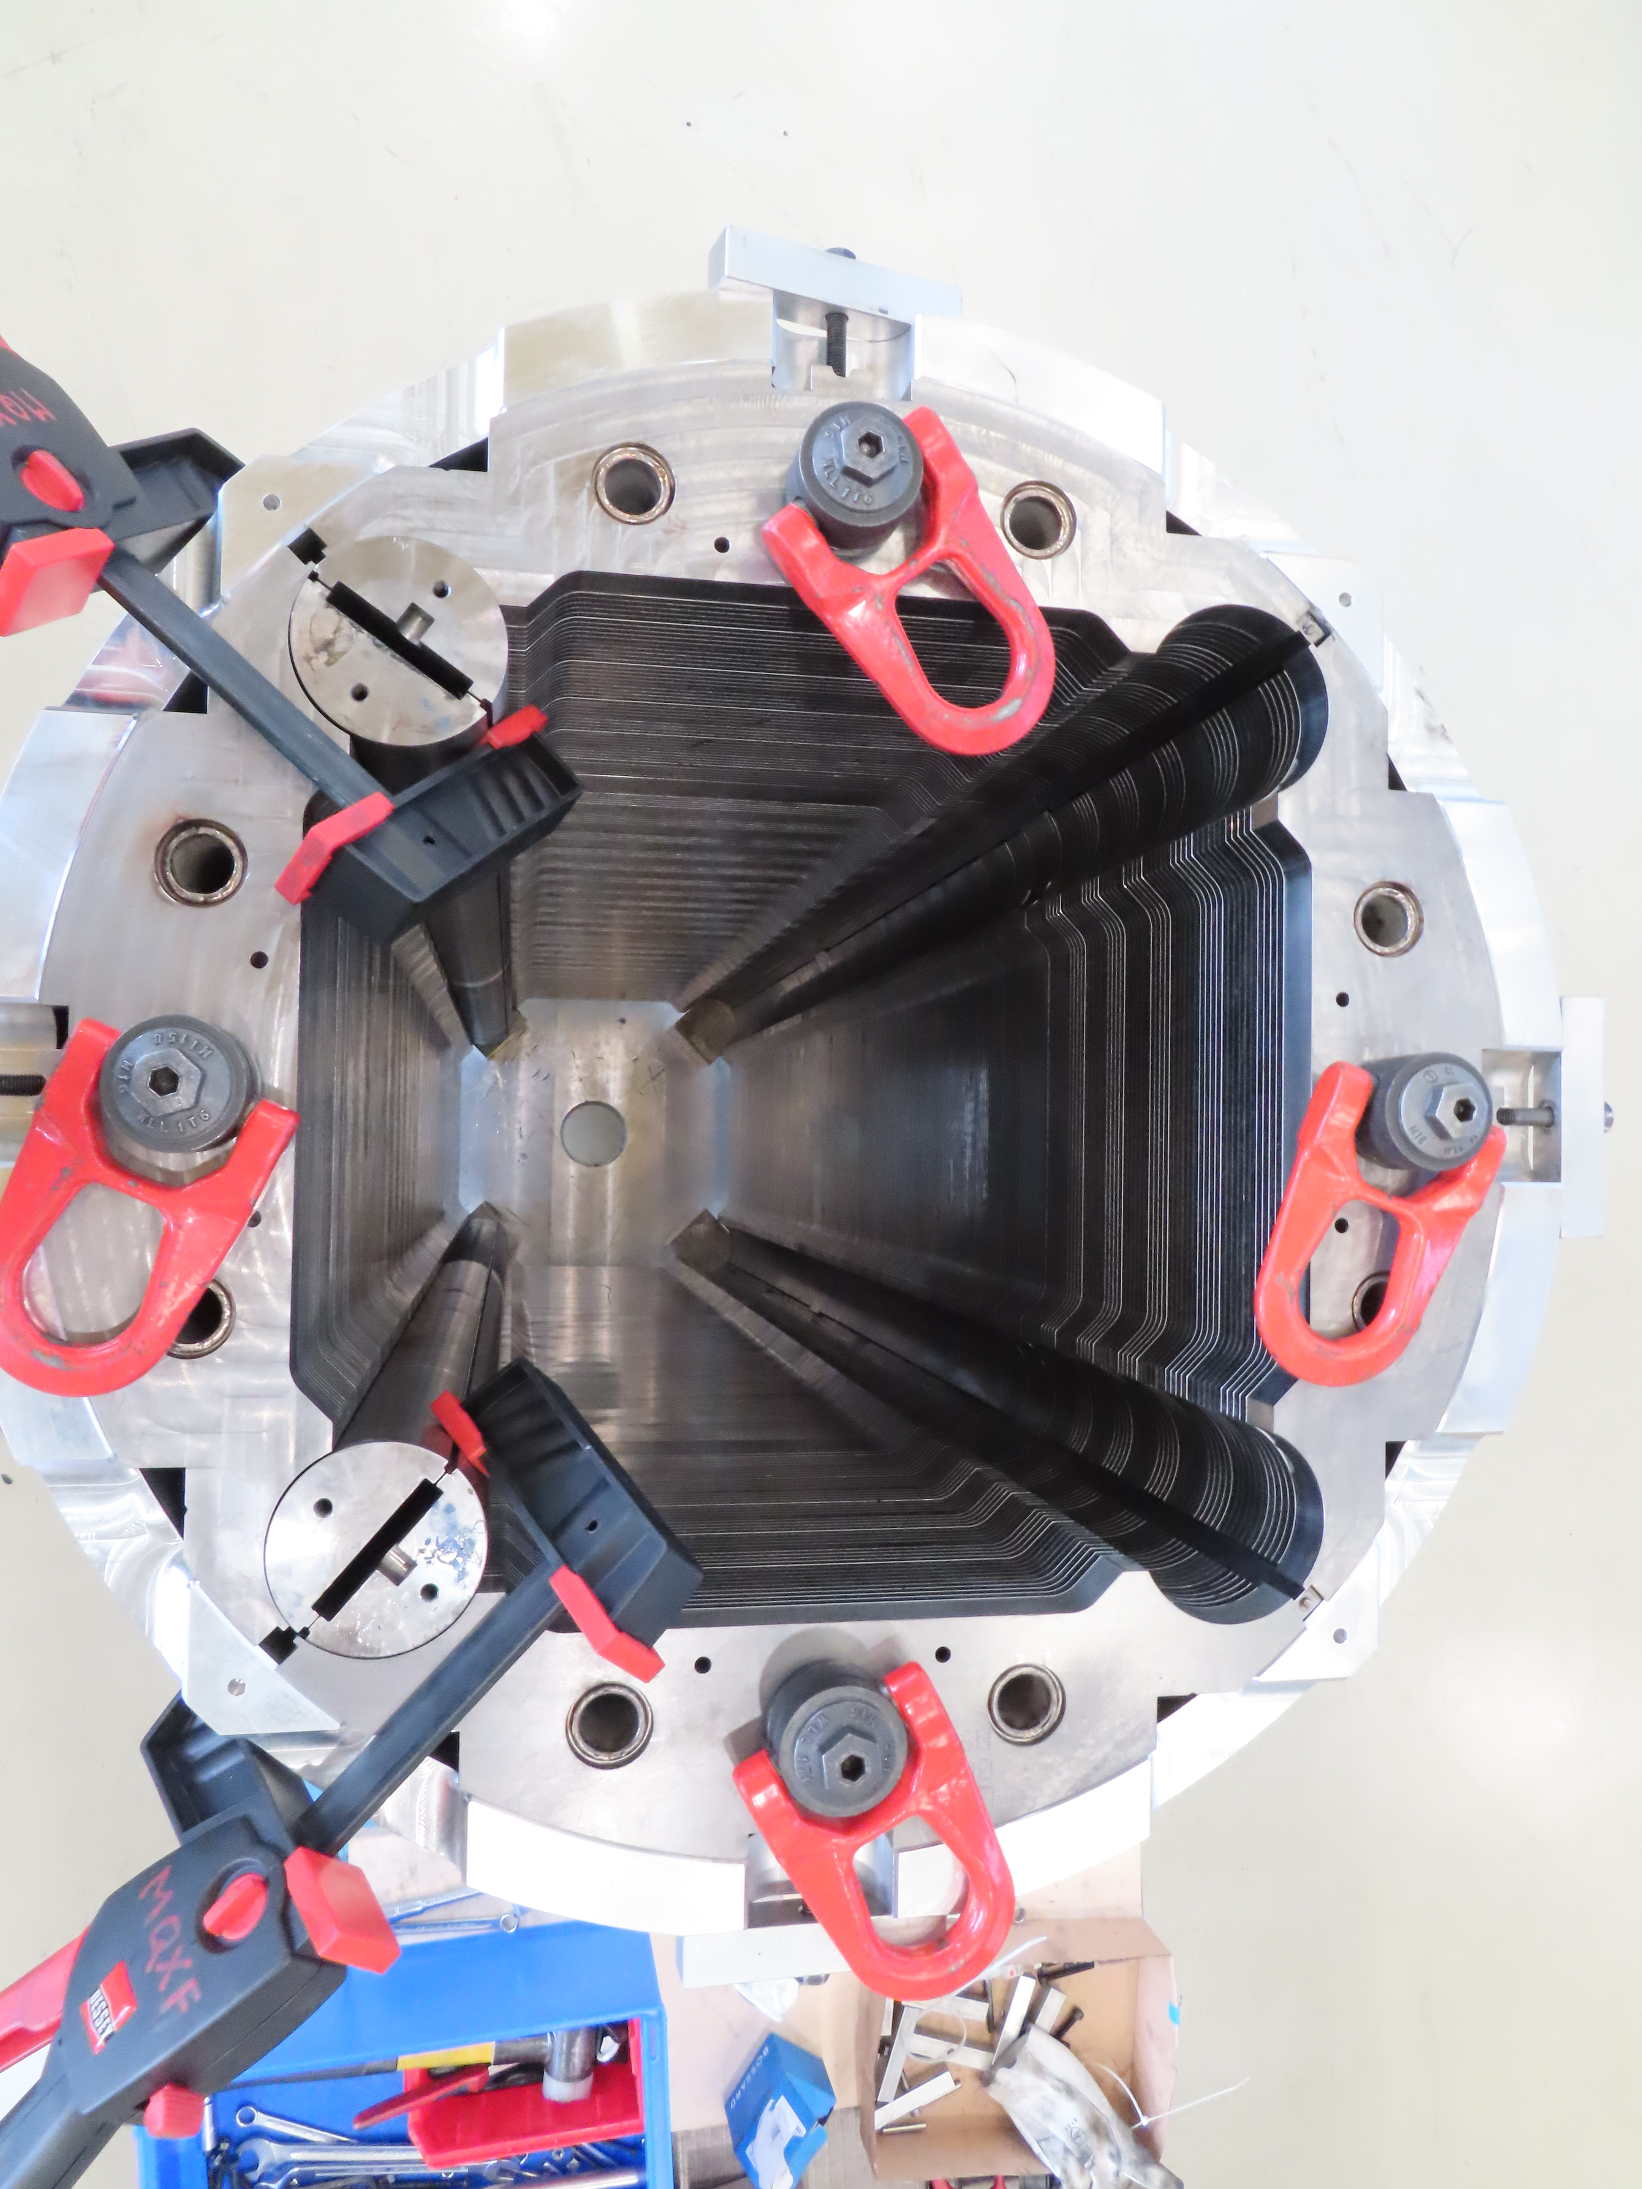
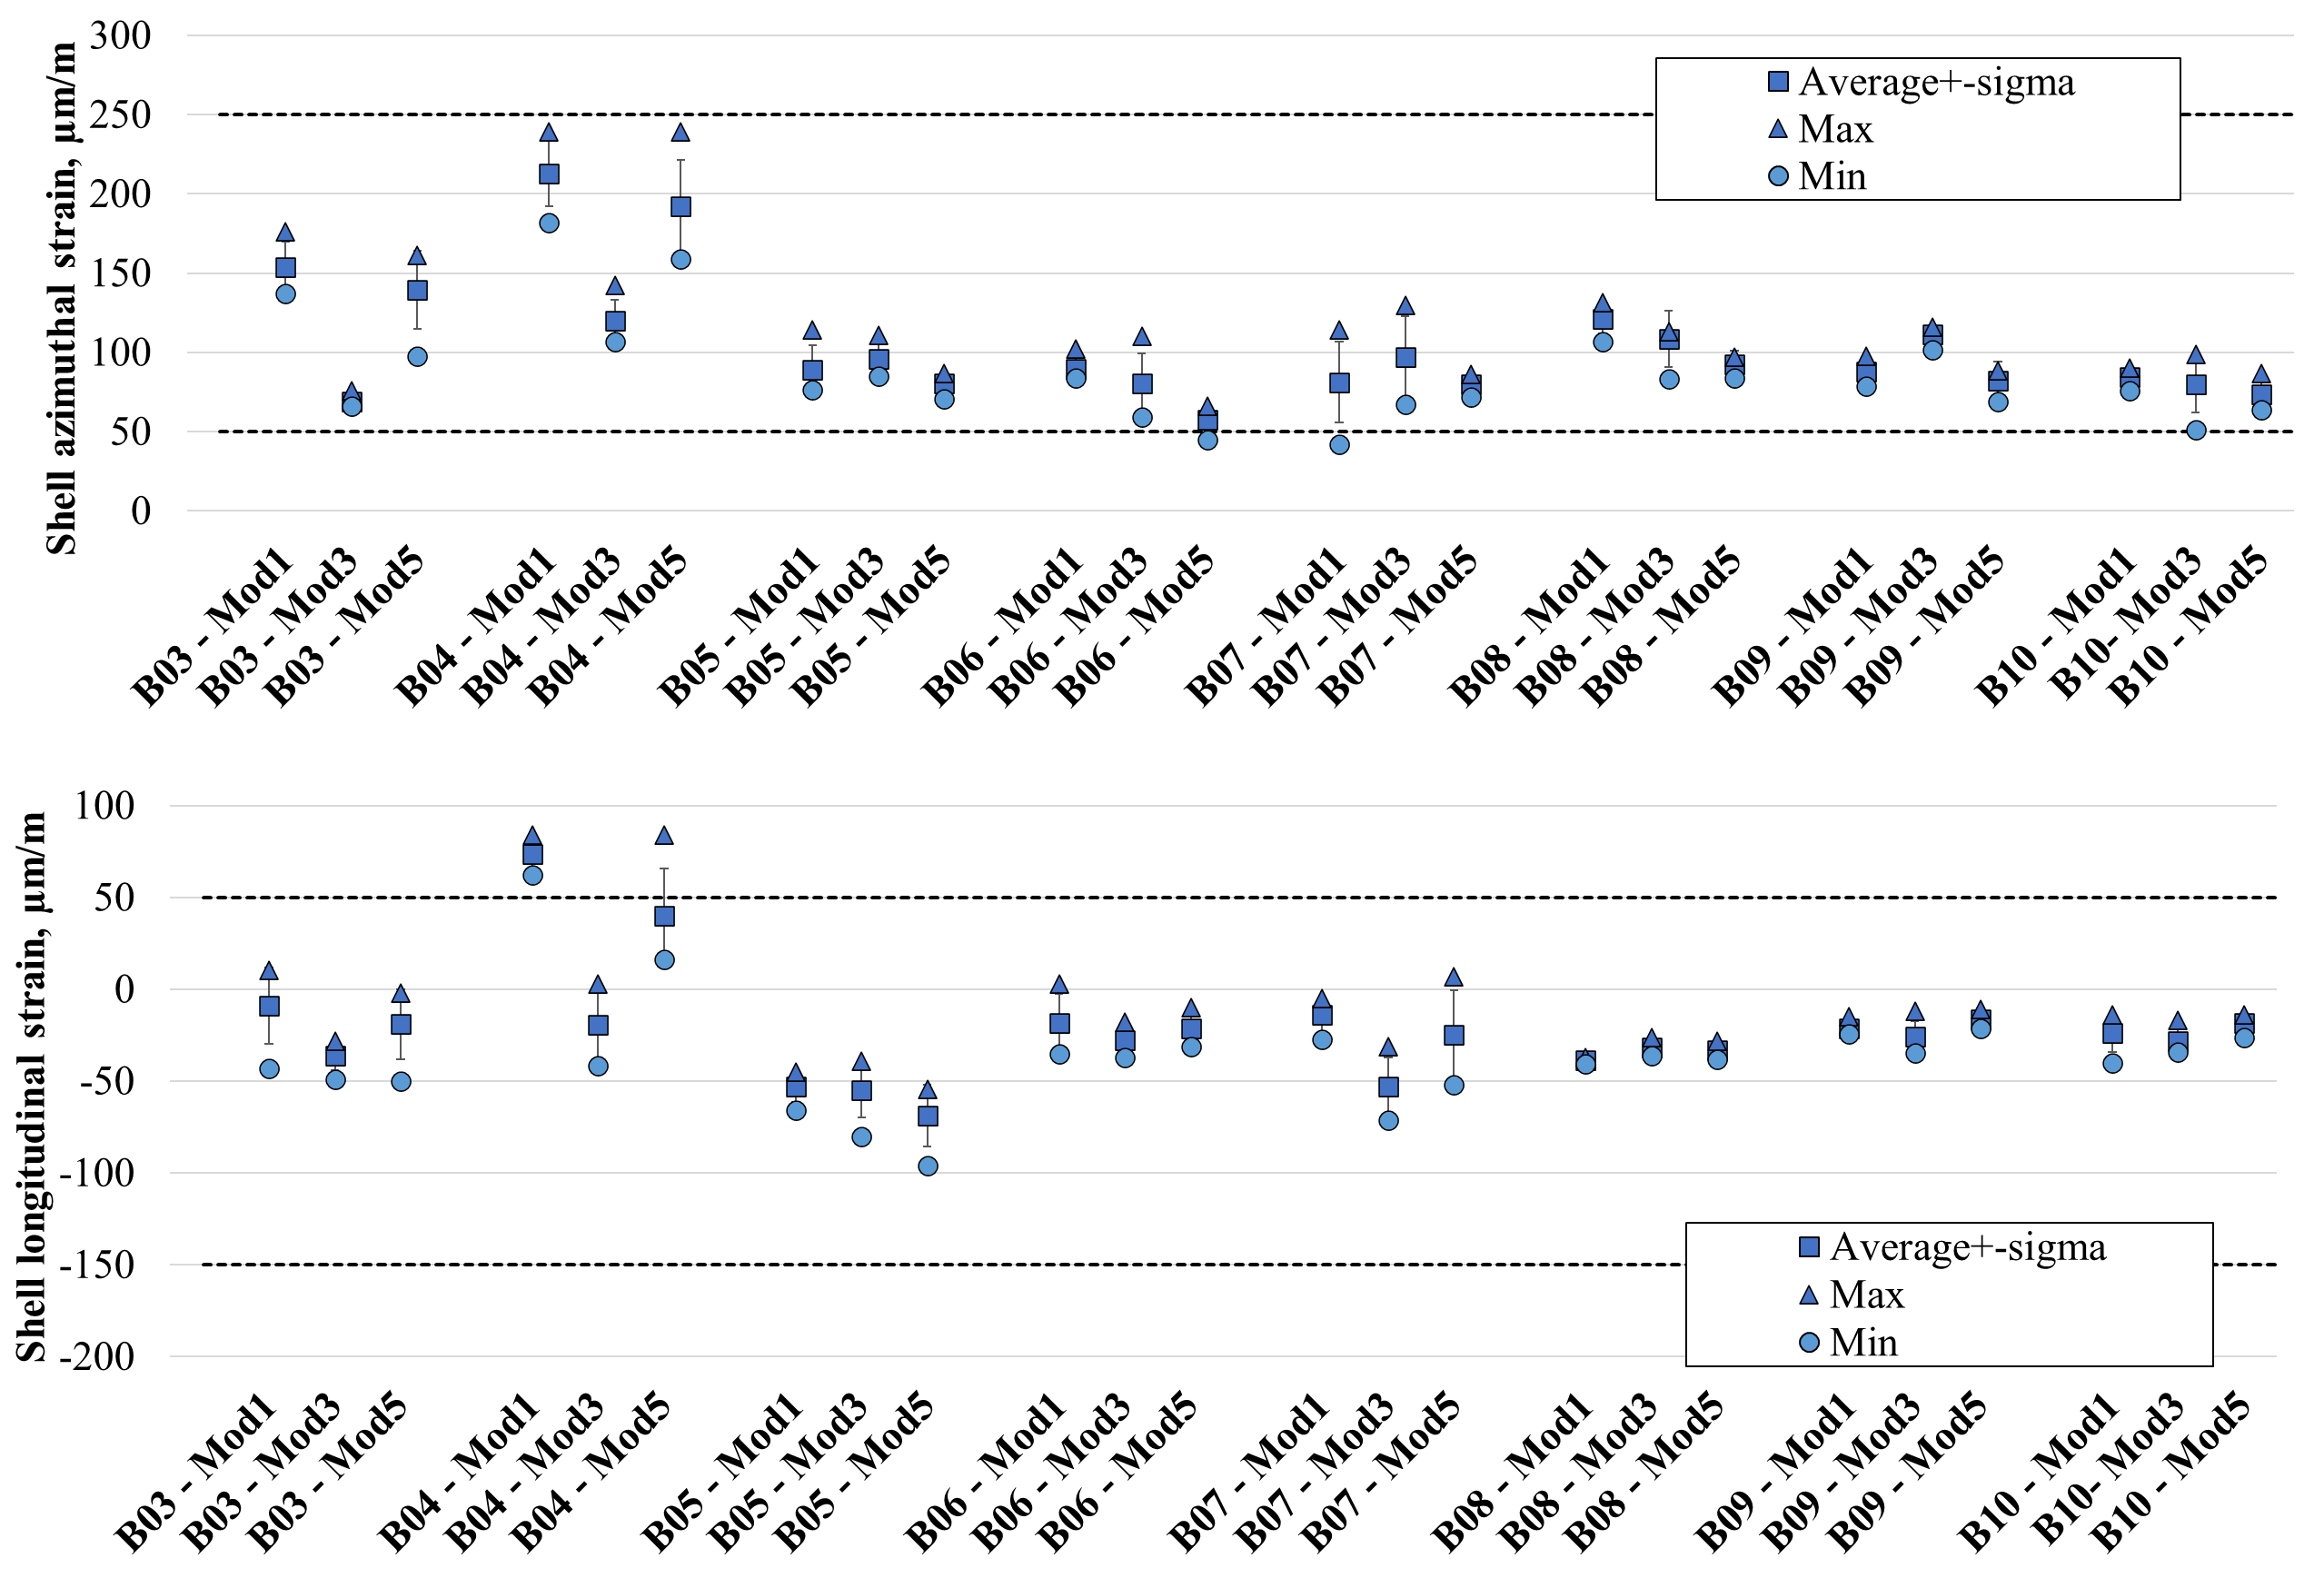
Yoke-shell vertical sub-assembly
The resulting interference produces an azimuthal tension in the shells, which is measured by strain gauges mounted on the outer surface of the shells in four angular locations.

Slide 17
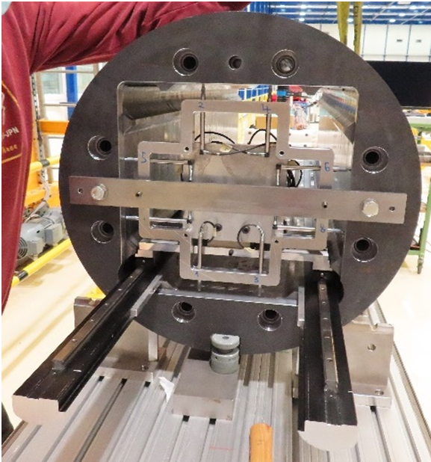
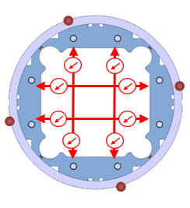
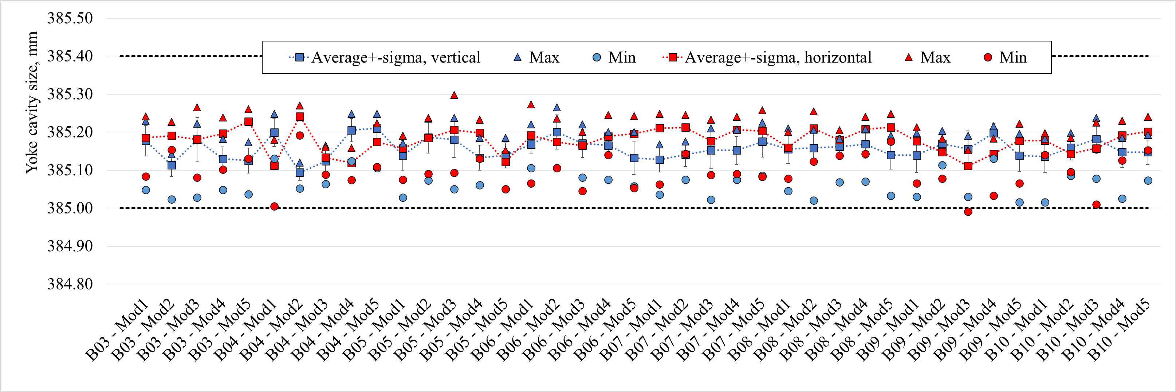
Yoke-shell vertical sub-assembly
Once the module is assembled, the dimensional check of yoke cavity is carried out by performing two horizontal and two vertical measurements along the length of the structure, using a system based on LVDTs
  The difference between the vertical and horizontal measurements is consistently less than 100μm along the length

Slide 18
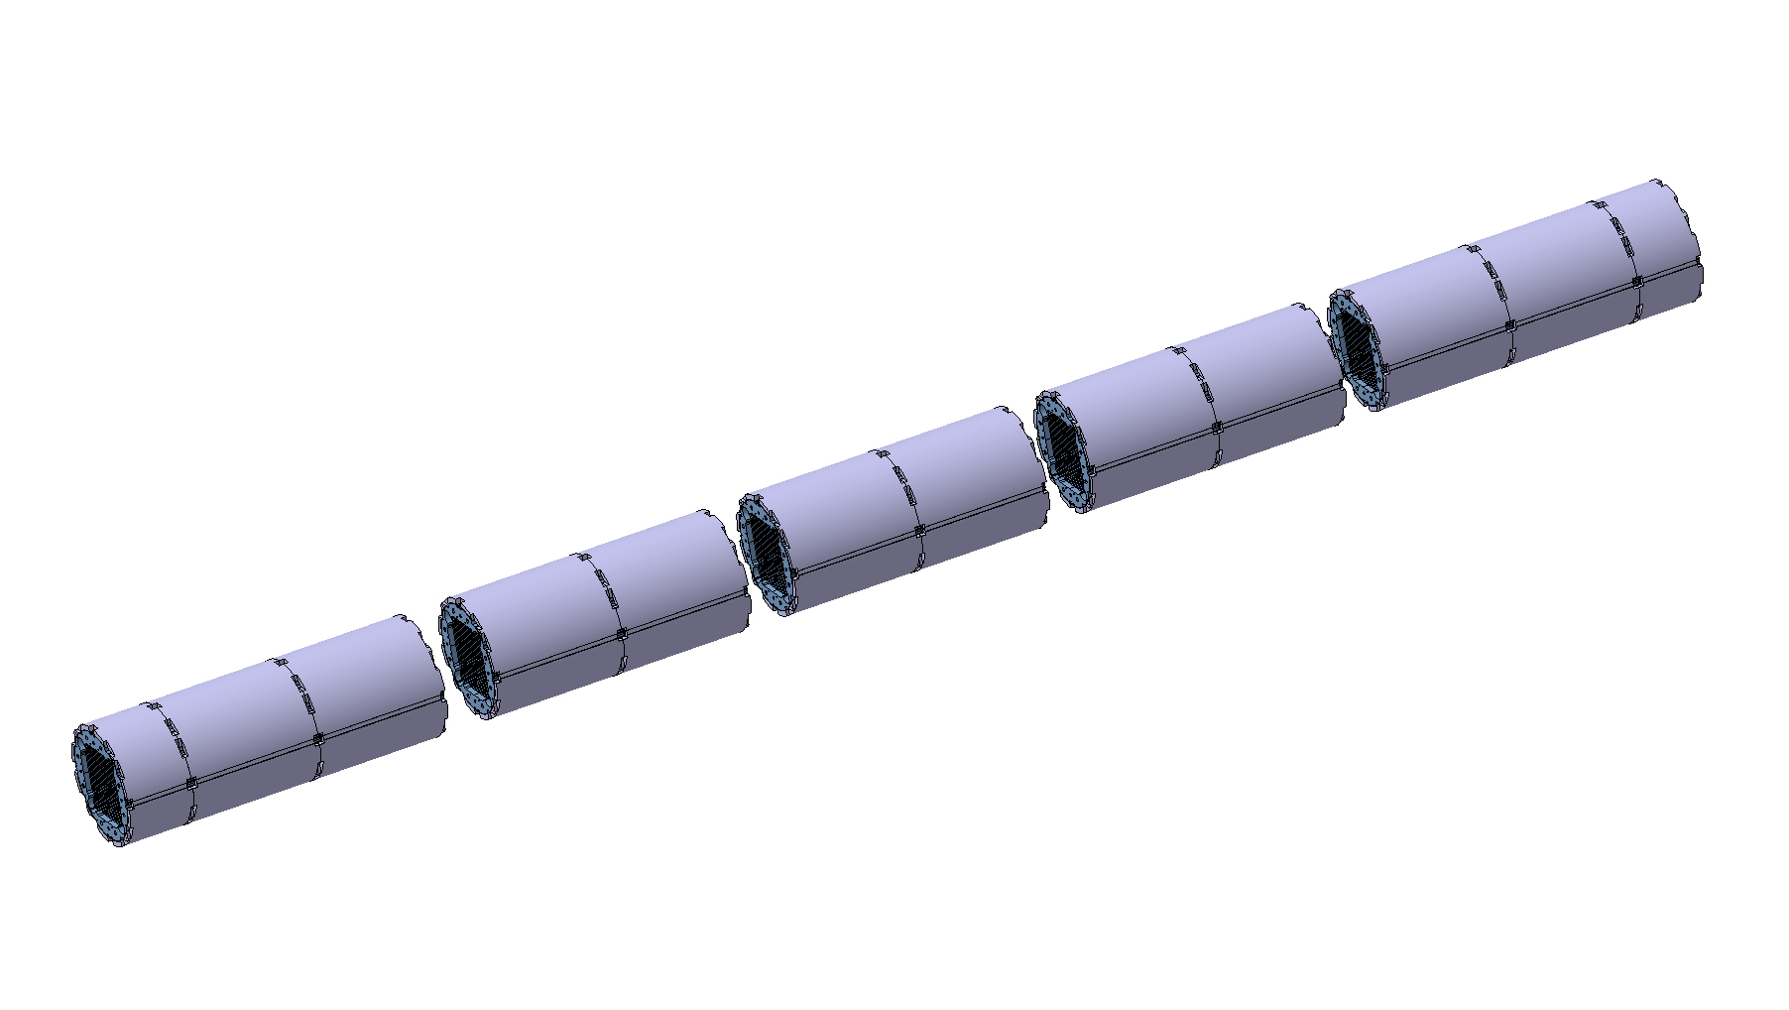
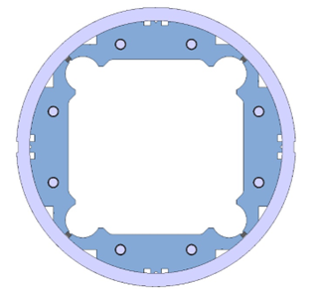
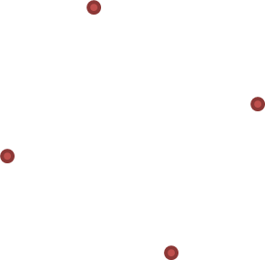

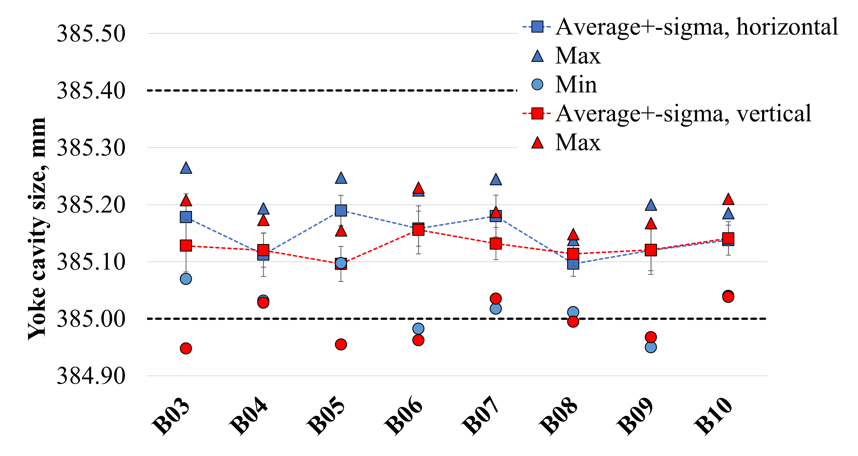
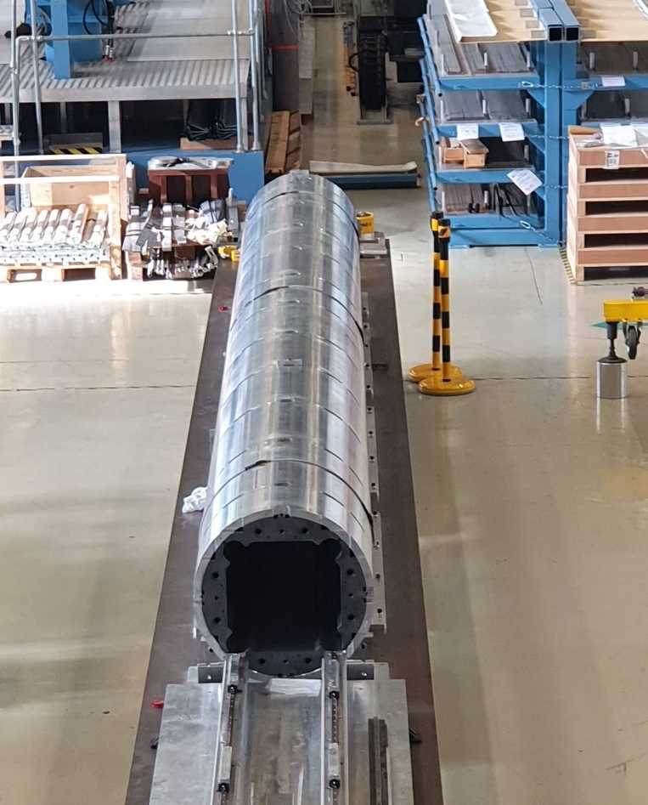
Yoke-shell horizontal sub-assembly
The yoke and shells, initially assembled in modules, are joined to form a single horizontal structure.
The shell external diameter is measured with the Pi-tape
The cavity dimensions are measured again with LVDT, along the length for a total of 76 measurements.
  The difference between the vertical and horizontal measurements is consistently less than 100μm along the length

Slide 19
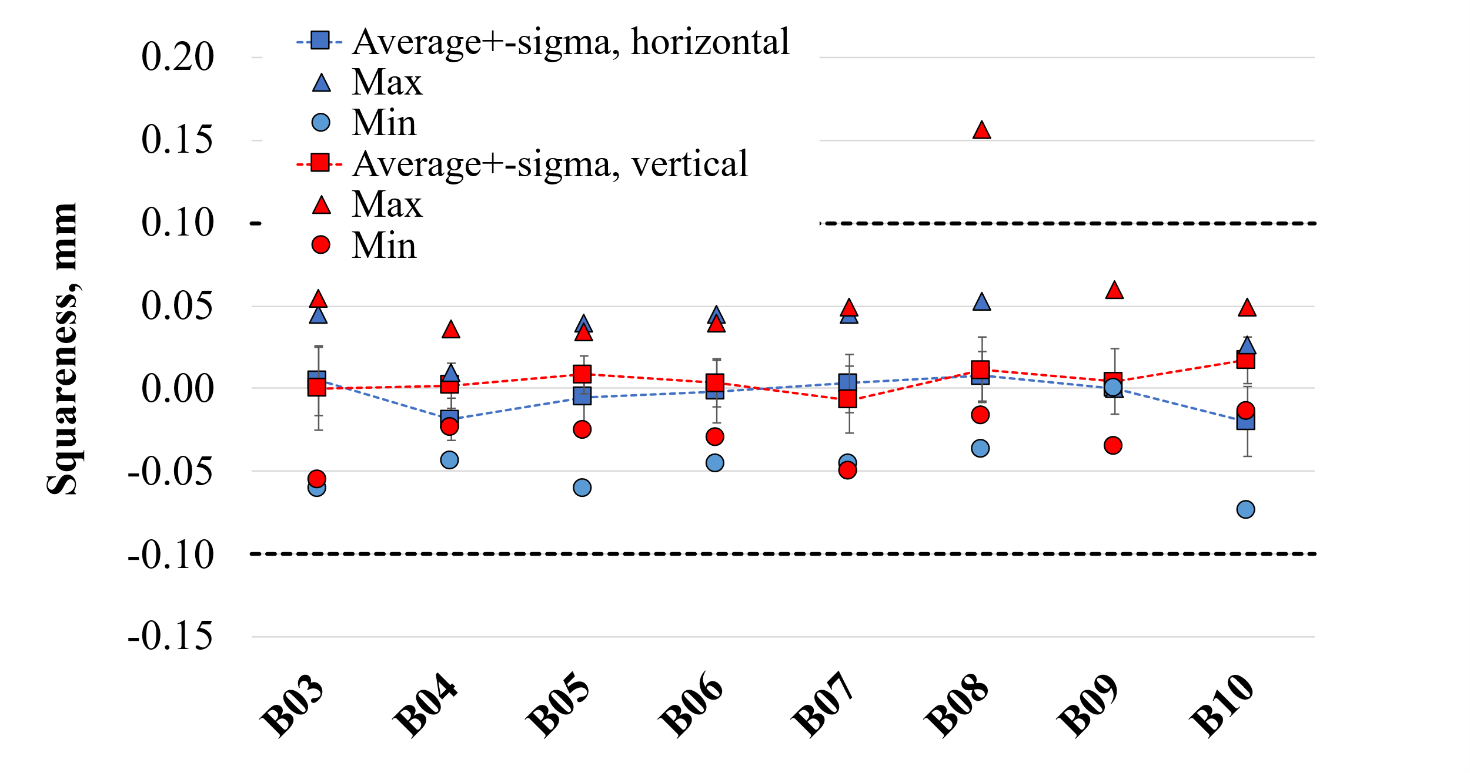
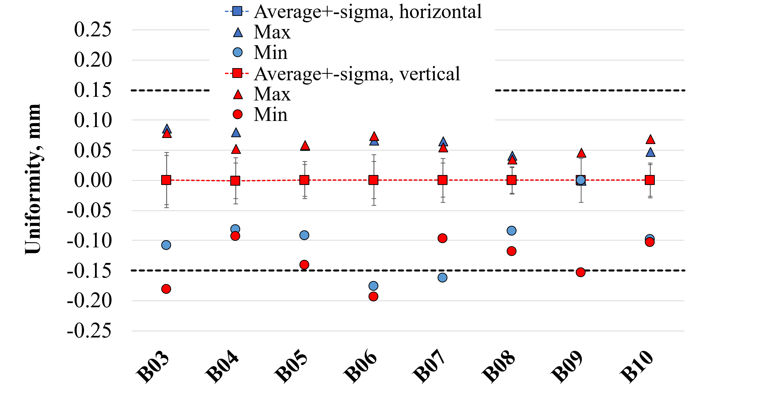
Yoke-shell sub-assembly
Squareness (DH1-DH2 or DV1-DV2) and uniformity (average of the vertical or horizontal cavity dimension in each cross-section with respect to the measured average vertical or horizontal dimension of the entire yoke shell structure) are derived from the cavity sizes.
  Squareness is controlled up to 100 μm
  Uniformity is controlled up to 150 μm

Slide 20
Outline
Introduction
MQXFB assembly
  Yoke-shell sub-assembly
  Coil pack sub-assembly
  Magnet loading
    Azimuthal preload
    Axial preload
Conclusion

Slide 21
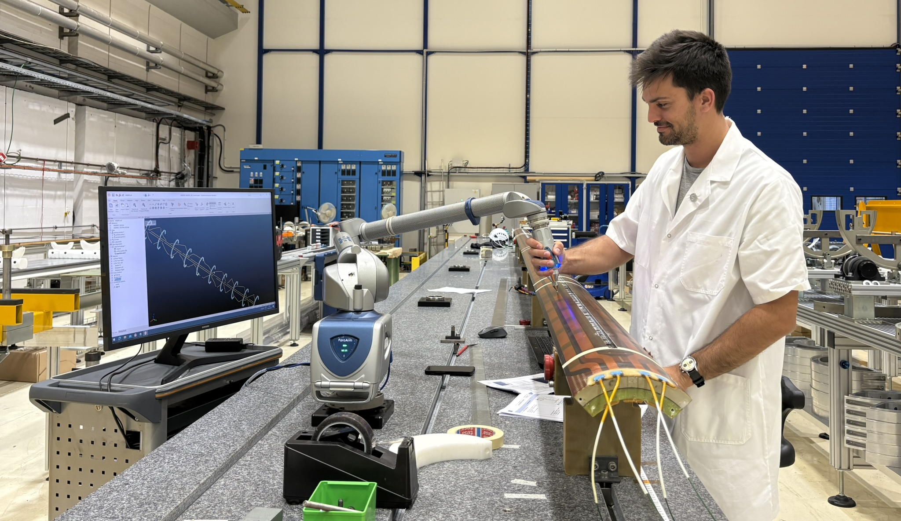
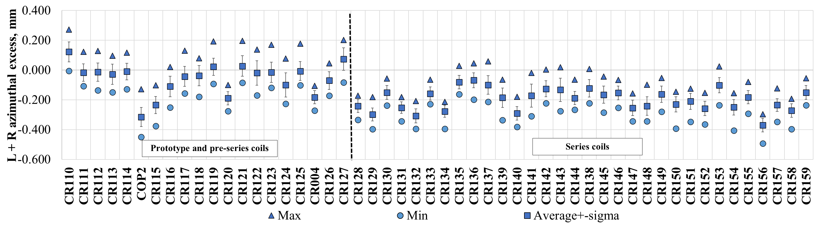
Coil geometry
Before the assembly, the coils are measured using a FARO® arm portable Coordinate Measurement Machine
  Series production coils are, on average, 200 μm smaller than nominal in the azimuthal direction with a typical spread along the length of ± 100 μm.
A. Vieitez Suarez, S. Straarup, N. Lusa

Slide 22
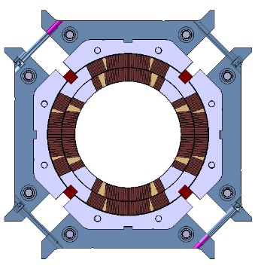
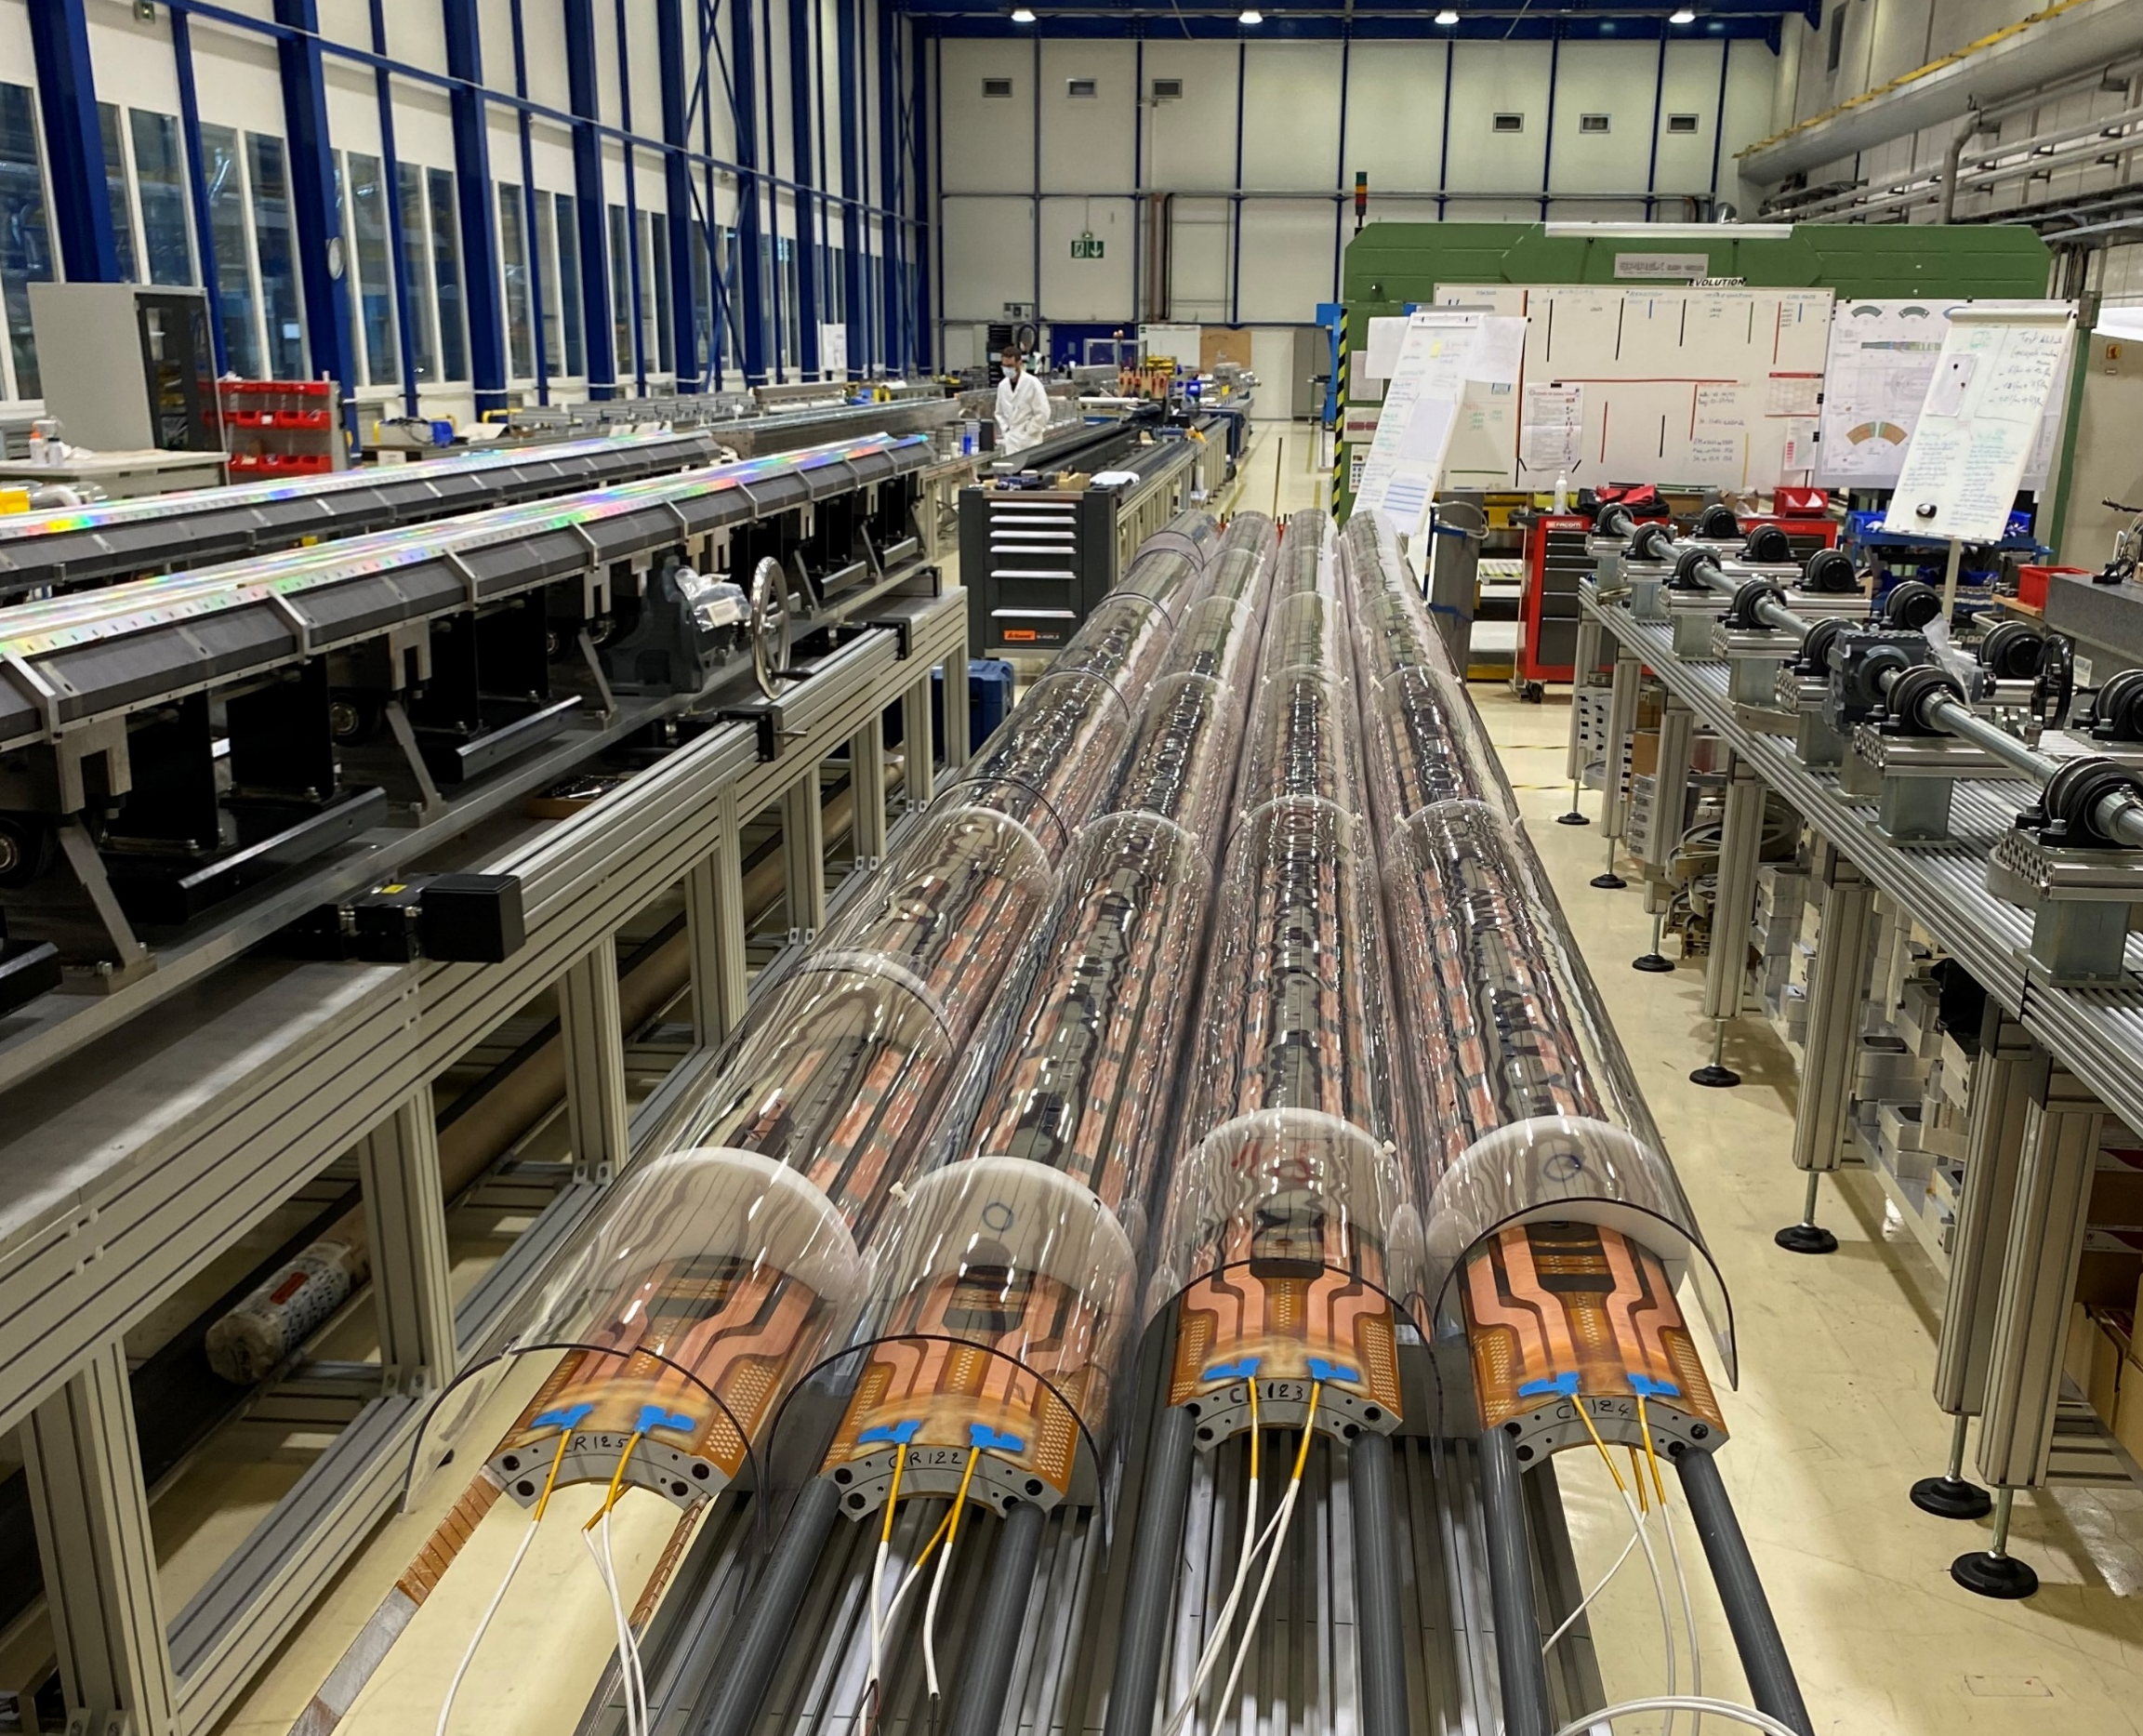
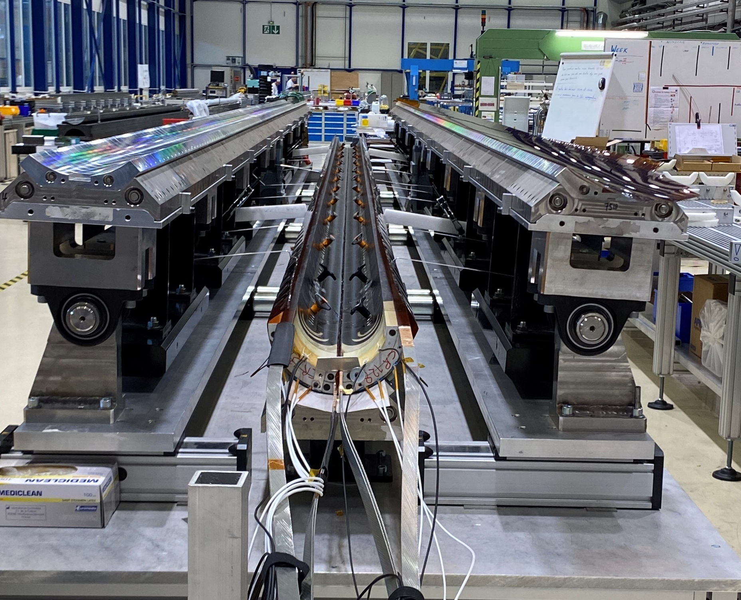
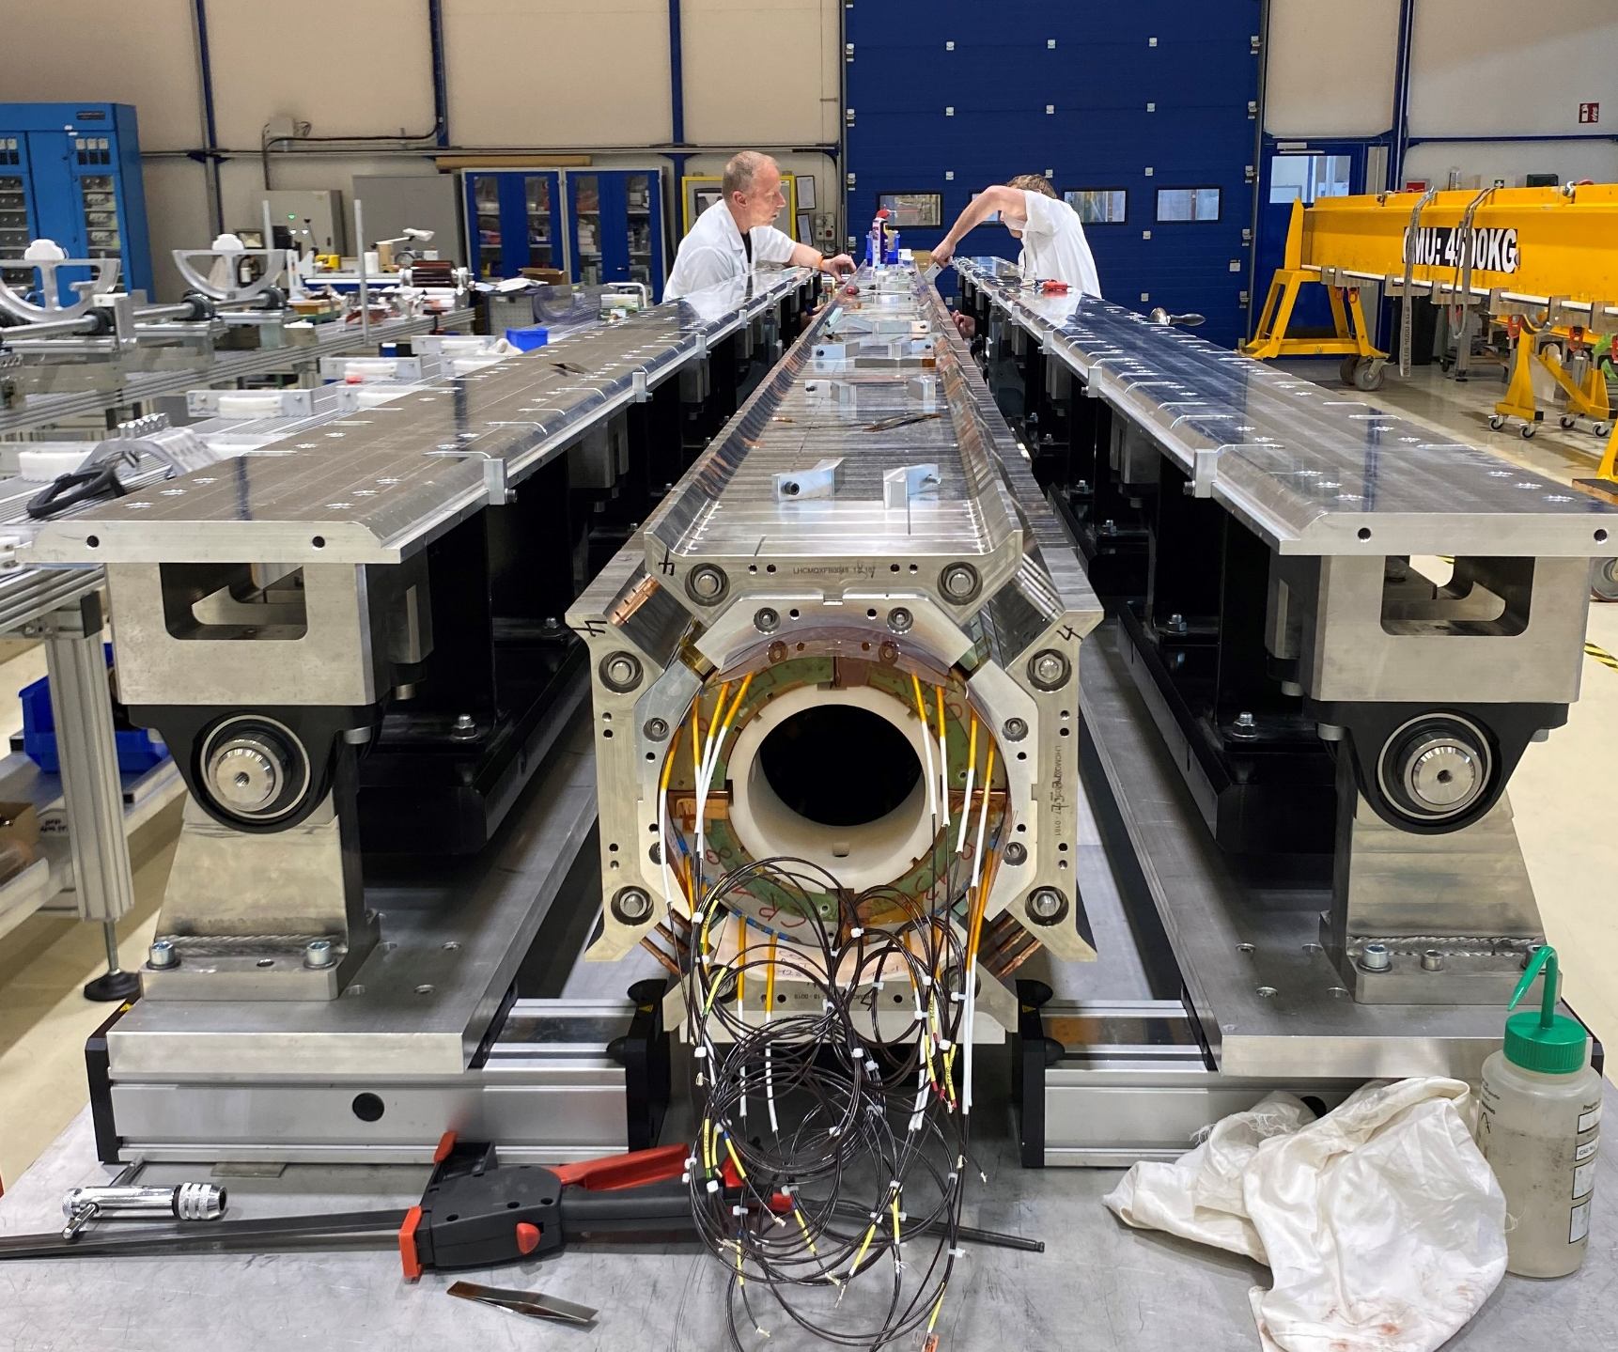
Coil pack sub-assembly
During the coil pack assembly, four coils are surrounded by aluminium collars and iron pads bolted around them.
Polyimide shims are used to compensate for coil size differences. They are placed at the coils’ mid-plane to adjust the azimuthal direction and on the inner surface of the collars to correct the radial direction.
The collars do not have a mechanical function; they act as a spacer
Mid-plane shims
Radial shims

Slide 23
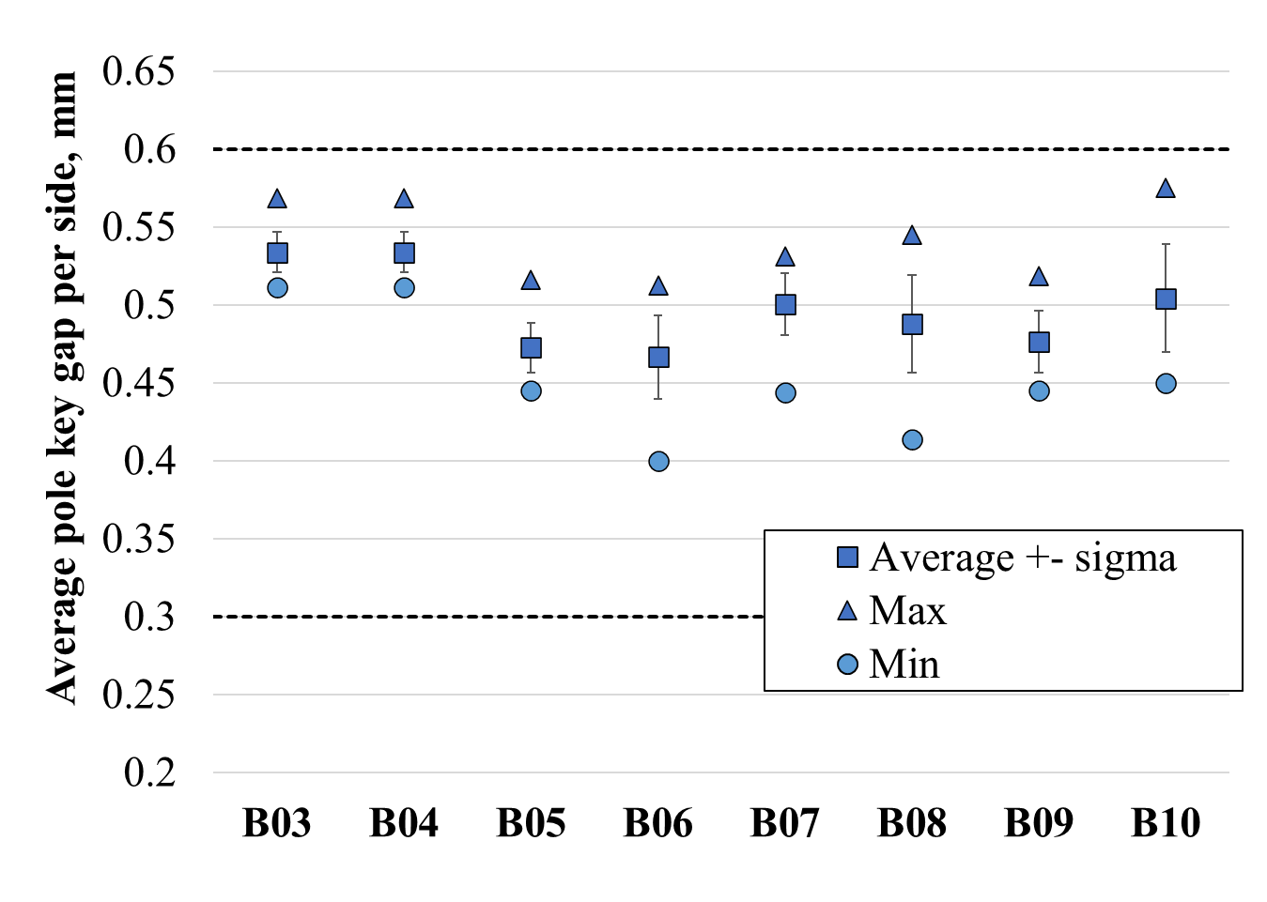
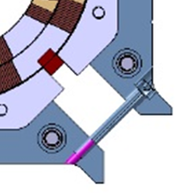
Coil pack sub-assembly
The pole key is inserted in the pole slot without being in contact with the collars. To verify that, the pole key gap per side is derived from the pad-to –pad distance, measured during the coil pack assembly.
Pad to pad distance

Slide 24
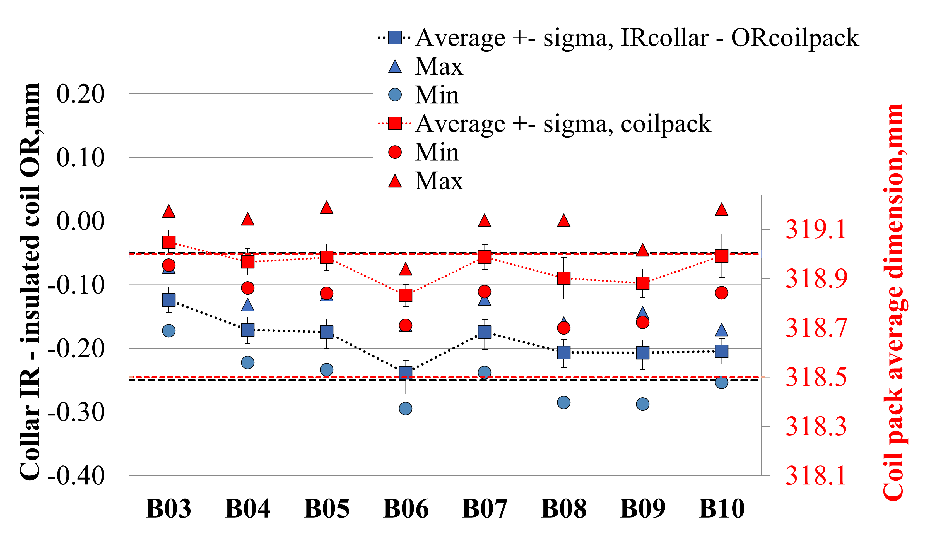
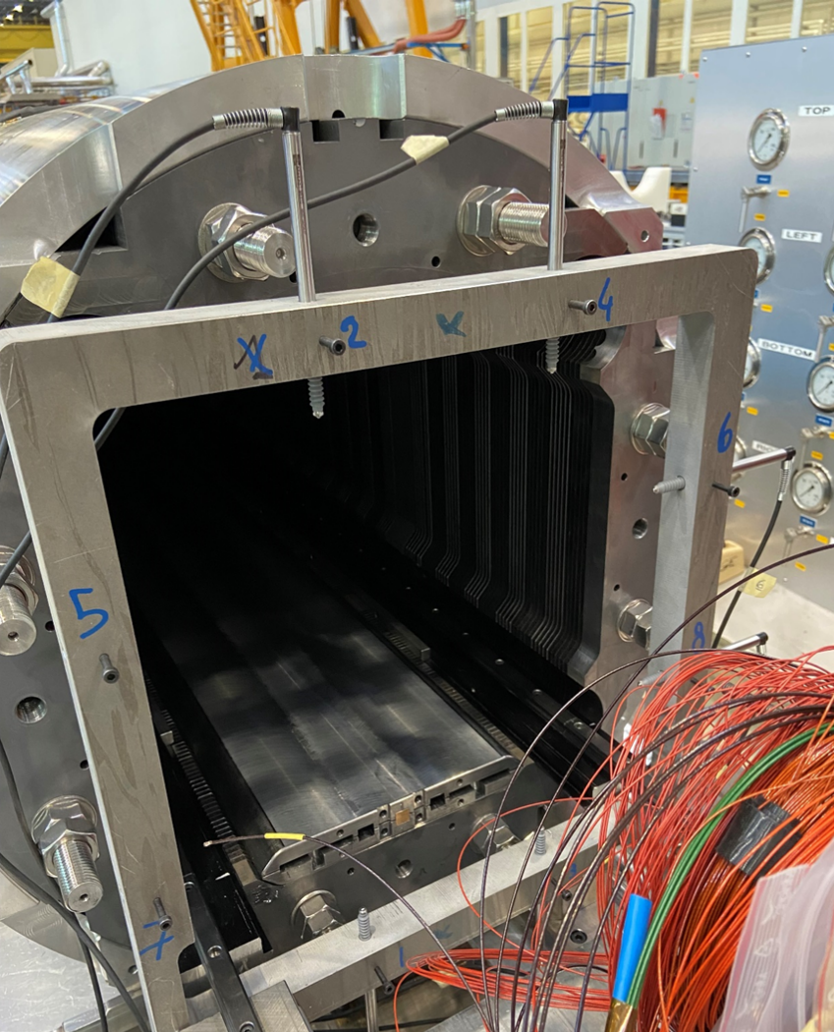
Coil pack sub-assembly
The radial gap between the outer radius of the impregnated coil and the inner radius of the collar is derived from the coil measurements
The external dimension of the coil pack is measured with LVDTs.
An average offset of 100 μm is observed between the measured coil pack average dimension and the expected value based on coil CMM measurements and the shimming plan
The two independent measurements present very good agreement, confirming the reliability and repeatability of the fabrication

Slide 25
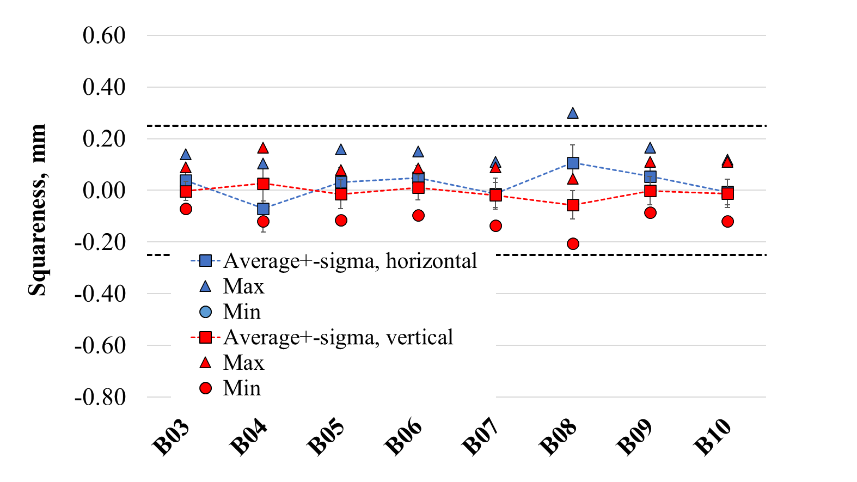
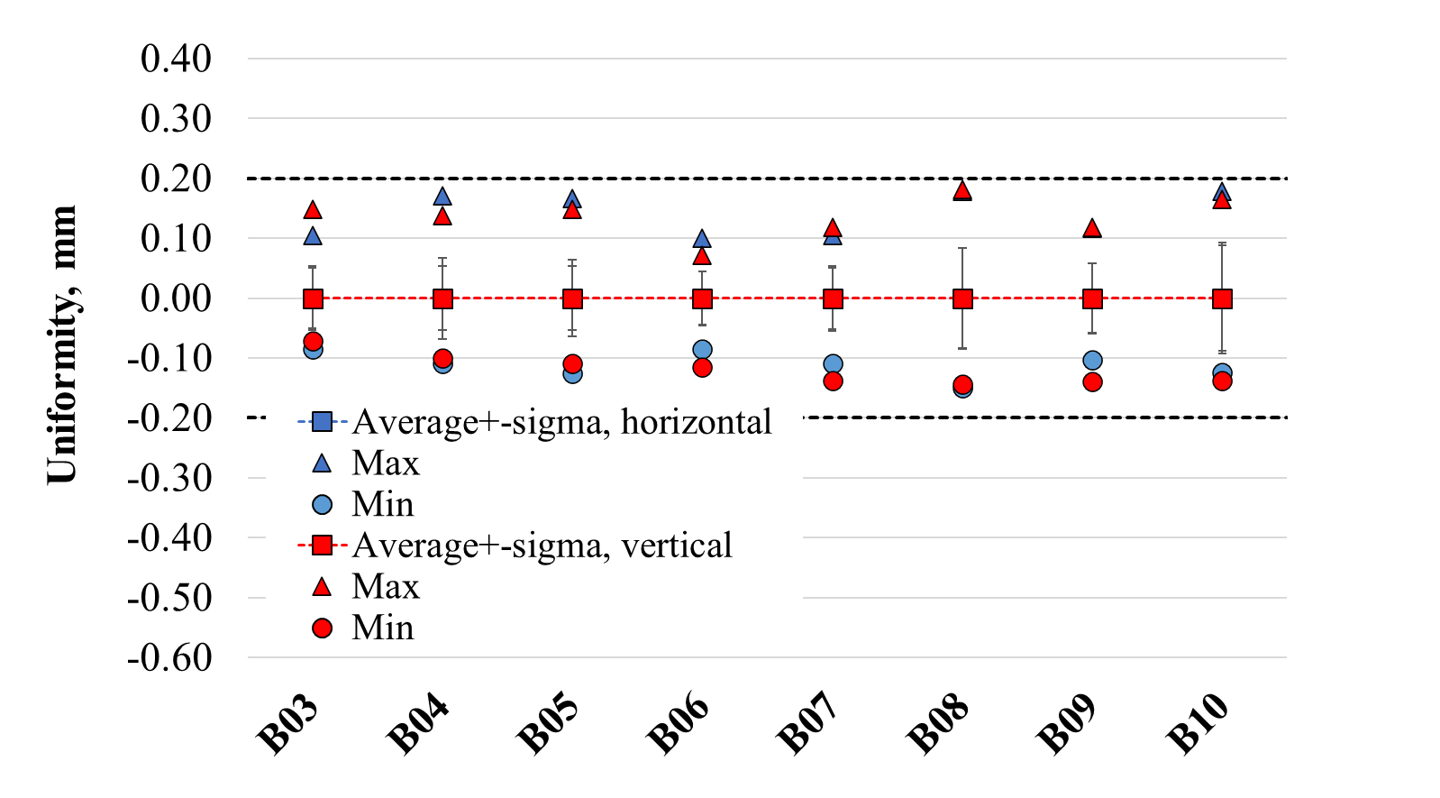
Coil pack sub-assembly
Squareness (DH1-DH2 or DV1-DV2) and uniformity (average of the vertical or horizontal dimension in each cross-section, concerning the measured average vertical or horizontal dimension of the entire coil pack) are derived from the external coil pack size.
  Squareness is controlled up to 200 μm
  Uniformity is controlled up to 150 μm

Slide 26
Outline
Introduction
MQXFB assembly
  Yoke-shell sub-assembly
  Coil pack sub-assembly
  Magnet loading
    Azimuthal preload
    Axial preload
Conclusion

Slide 27
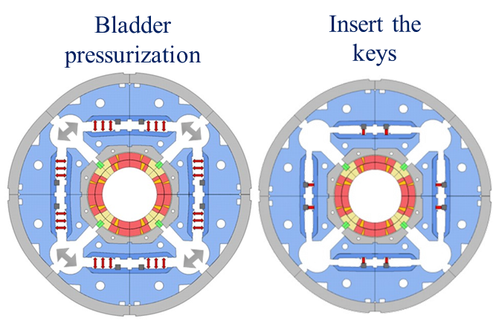
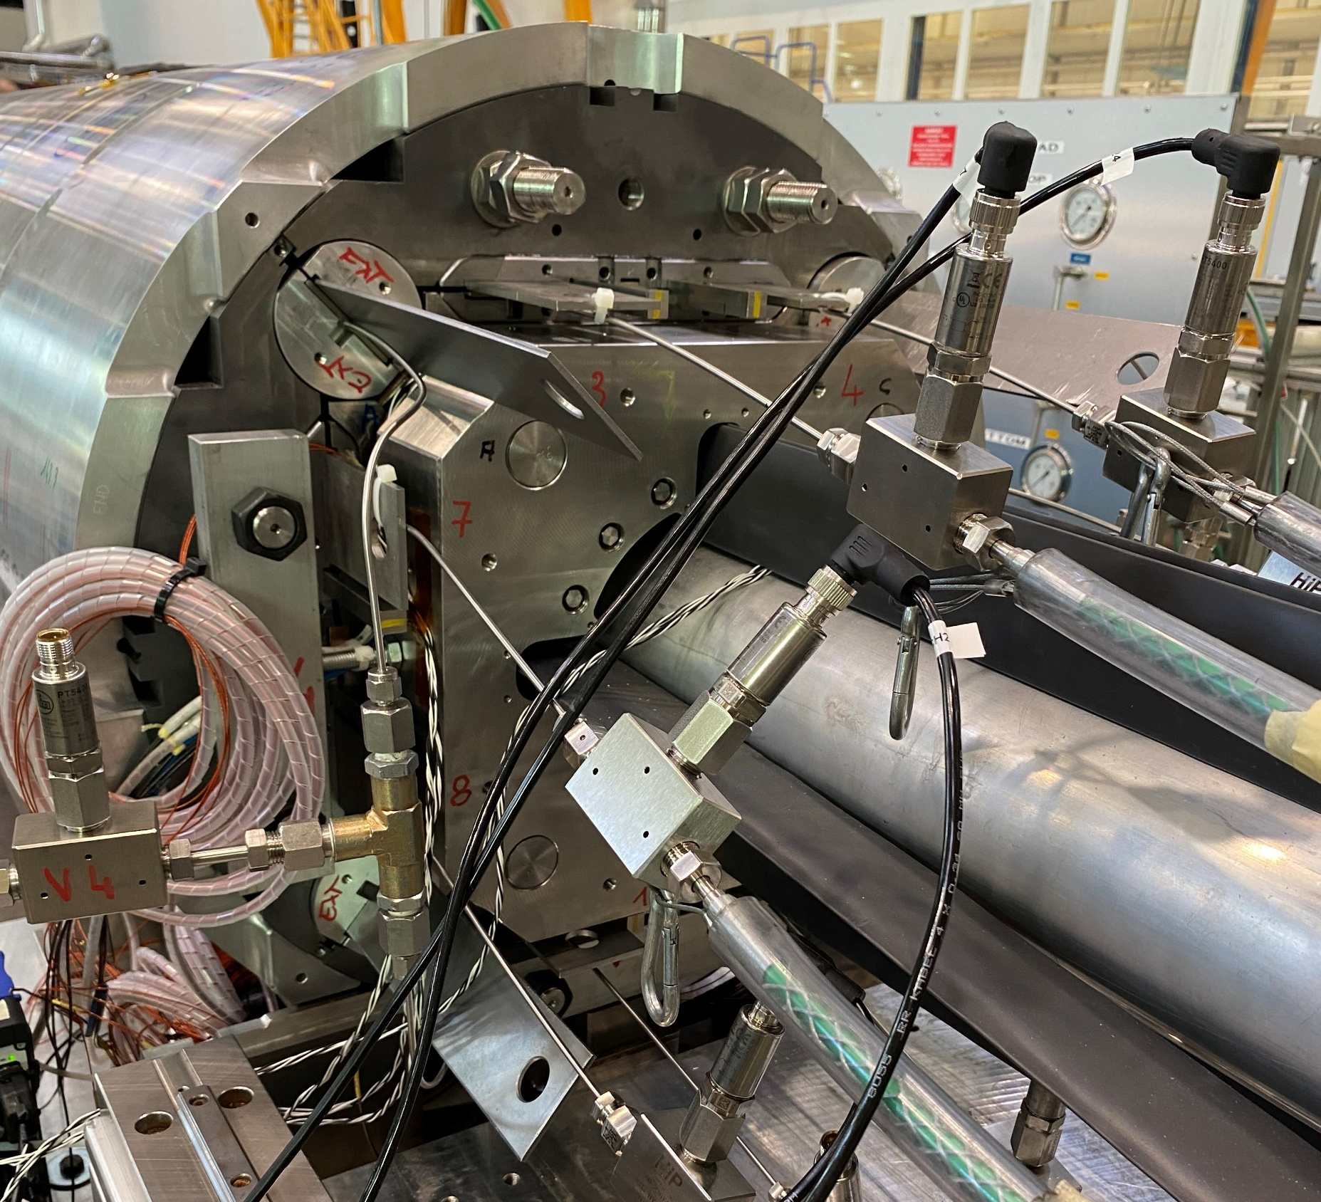
Loading – azimuthal loading
Loading procedure provides the required pre-stress to the coil after cool-down to reduce conductor motion.
The coil pack sub-assembly is inserted into the yoke-shell structure.
Azimuthally, the magnet is pre-loaded using the bladder and key procedure. This technique pre-tensions the shell and pre-compresses the coil.
Instrumentation during azimuthal loading:
  Shell → Strain gauges
  Coil → Optical fibres

Slide 28
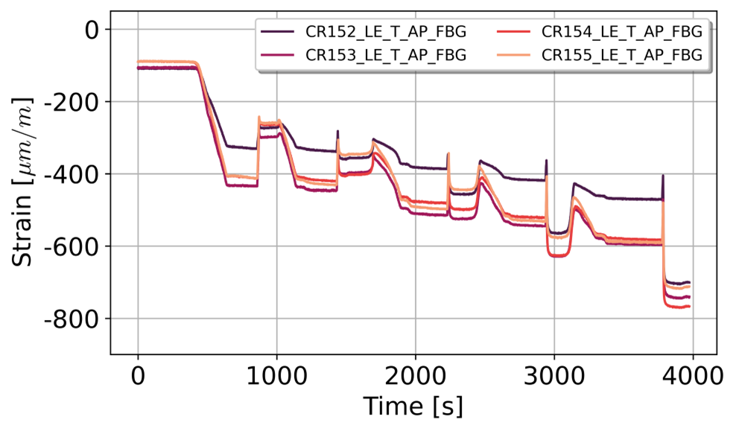

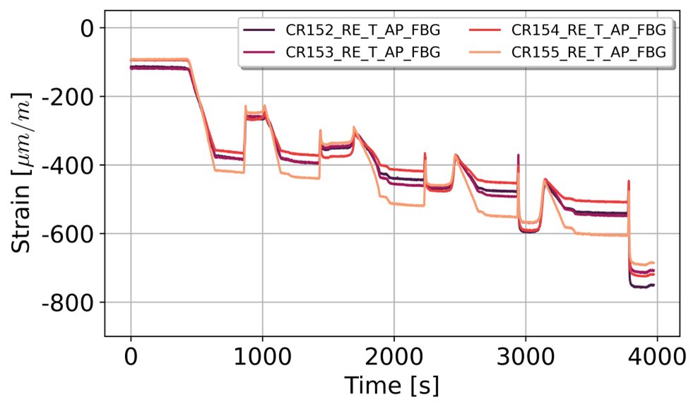



Loading – azimuthal loading
LE - ε_{θ}
MI - ε_{θ}
RE - ε_{θ}
Coil
LE - ε_{θ}
MI - ε_{θ}
RE - ε_{θ}
Shell

Slide 29

Loading – azimuthal loading
A two-dimensional Finite Element (FE) model used for general mechanical analyses in the MQXF magnet.
The mechanical simulation is performed based on a steady-state analysis type.
Any time-dependent load will be approximated as a series of static loads, which will be applied through multiple (chronologically ordered) solution steps.
Thanks to the model, it is possible to:
compute the expected preload condition
assess the sensitivity to the geometrical variability of the components
  + 100 μm of total coil arc length translates to*:
    13 MPa in azimuthal compression at the winding pole
    8 MPa in the azimuthal tension at the Al shell
Symmetry B.C.
Symmetry B.C.
J. Ferradas Troitino, P.M. Quassolo https://edms.cern.ch/document/2783610/1
P. M. Quassolo https://edms.cern.ch/document/3191744/1
*assuming that only the average coil size plays a role in the coil stress, and knowing that the model presents assumptions and approximations (described in the technical notes)

Slide 30



Loading – azimuthal loading
Coil stress for target pre-load
S. Izquierdo Bermudez, ‘Feedback of HL-LHC Magnets to HFM’

Slide 31

Loading – azimuthal loading
The azimuthal preload is monitored via the transfer function (TF) that describes the increase of stress in the pole as a function of the increase of stress in the shell.
The measurements are compared with the FE model.
The measured stress typically deviates by less than 10 MPa from the FE predictions.
B03 and B04 are deliberately assembled with a 15 MPa lower preload.
LE (circles), MI(squares) and RE (triangles)

Slide 32
Loading – azimuthal loading
Objective: Can we monitor production with simple tools while ensuring the required preload?

Slide 33



Loading – azimuthal loading
Based on the measurements collected during production, two geometric parameters are used to assess the level of pre-load:
Increase in the aluminium shell developed length during loading (measured with Pi-tape)
$$Δ_{l_{shell}}=l_{shell_{after loading}}−{l_{shell}}_{before loading}$$
Variation of the radial dimension of the coil (which includes the coil pack dimensions (considering coil dimensions and the shimming plan) and the applied interference during loading)
$$Δ_{r_{coil}}=\left(r_{i_{collar}}−r_{o_{insulated coil}}\right)+interf_{loading}+c$$
c is a calibration constant applied to ensure consistency between experimental measurements and finite element model predictions, c = 0.156 mm

Slide 34

Loading – azimuthal loading
The target coil stress at the end of the loading (80 ± 8 MPa) is reached for a ∆l_{shell}= (1/1.3 mm) and ∆r_{coil}= (-0.36/-0.47 mm), in good agreement with FE predictions.
  Excludes the LE end of magnet MQXFB06, outlier under investigation
LE (circles), MI(squares) and RE (triangles)

Slide 35


Loading – azimuthal preload
It is possible to derive the coil/shell stress based on geometrical measurements and the FE model $k=209 MPa/mm$ .
$$Δ_{σ_{coil,DERIVRD}}=kΔ_{r_{coil}}$$
The derived coil stress form geometrical measurements (∆σ_{θ,coil, DERIVED}) is within 10 MPa of the measured value with mechanical instrumentation (∆σ_{θ,coil}).
LE (circles), MI(squares) and RE (triangles)

Slide 36
Outline
Introduction
MQXFB assembly
  Yoke-shell sub-assembly
  Coil pack sub-assembly
  Magnet loading
    Azimuthal preload
    Axial preload
Conclusion

Slide 37

Loading – axial preload
Axial pre-load concept
  Axial force (1.2 MN, compared to 265 kN/aperture in the LHC-MB Dipoles)
  Two parameters
    Structure stiffness
    Axial preload with the rods putting ~50% of the force (0.54 MN)

Slide 38



Loading – axial preload
Axial loading in the MQXFB magnet assembly is achieved by applying a controlled tensile force to the support rods using a hydraulic piston system. It is monitored using strain gauges on the rods.
The strain target for the rods: 650 ± 50 µstrain after loading for MQXFB.

Slide 39
Loading – axial loading
Objective: Can we monitor production with simple tools while ensuring the required preload?

Slide 40


Loading – axial preload
The equivalent targets for pressure and displacement to have 650 ± 50 µstrain are:
Pressure target: 300 ± 25 bar
Displacement target: -5.33 ± 0.4 mm
From magnet B08, strain gauges are not installed in the rods, and axial preload is done based on piston pressure and axial rod elongation measurements.
In B03 and B04, the LVDTs were accidentally moved during the loading, so the data are not 100% reliable

Slide 41
Outline
Introduction
MQXFB assembly
  Yoke-shell sub-assembly
  Coil pack sub-assembly
  Magnet loading
    Azimuthal preload
    Axial preload
Conclusion

Slide 42
Conclusion
The MQXFB magnet series production exhibits high reproducibility and precision across all assembly stages.
Key geometrical parameters (coil pack size, aluminium shell developed length, applied interference, piston pressure, rod elongation) are effective indicators for quality control and monitoring of magnet pre-load.
Azimuthal coil pre-stress is achieved within a 10 MPa variation, specifically within:
  ∆lshell = 1.0–1.3 mm
  ∆rcoil = −0.36 to −0.47 mm
Axial pre-load is reliably ensured by:
  Piston pressure: 300 ± 25 bars
  Rod elongation: 5.33 ± 0.40 mm
With 80% of the MQXFB magnets assembled, results confirm that simple geometrical measurements can effectively ensure pre-load specifications are met throughout the production

Slide 43


Thank you

