Slide 1




RPC and (M)RPC:
an historical-conceptual approach
Marcello Abbrescia
University and INFN Bari, Italy
DRD1 gaseous detector school
FTD, University of Bonn, Germany, September 17-24, 2025

Slide 2
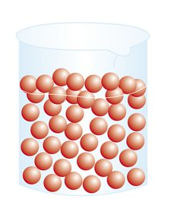
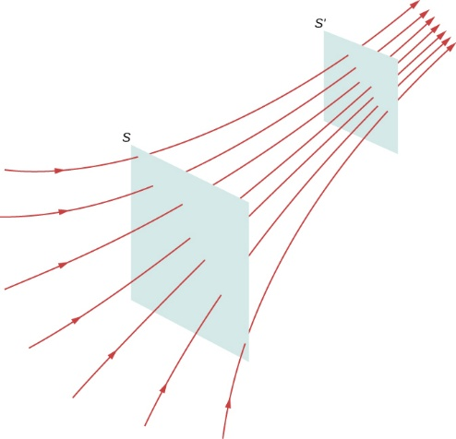
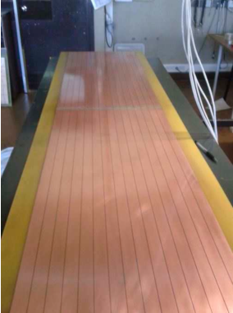
Ingredients for a gaseous detector
1. A gas volume:
where (almost) everything takes place;
in principle can have arbitrary shape.
2. An electric field:
ion-electron recombination in its absence;
must be intense enough (order of 1 MV/m) to allow multiplication processes;
multiplication processes are necessary because number of primary ion-electron pairs is just few tens/mm (to be compared with 23400 electrons-hole pairs in 300 μm of Si).
3. Suitable readout electrodes:
readout electrodes sometimes coincide with high voltage electrodes, but they are conceptually different.
Marcello Abbrescia
DRD1 school 2025
2

Slide 3
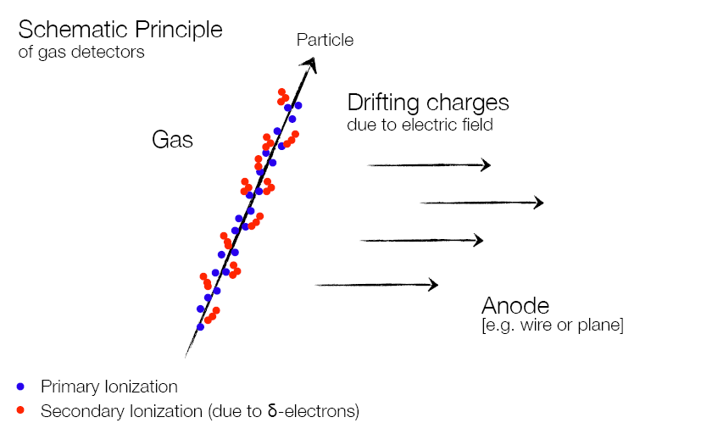
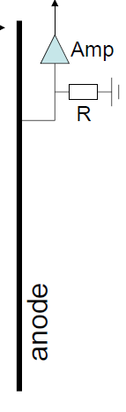
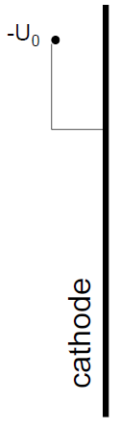
Working principles of gaseous detectors
Drift and amplification
due to electric field
Detection of an impinging particle takes place because this ionizes the gas, generating ion-electron pairs.
Marcello Abbrescia
DRD1 school 2025
3

Slide 4
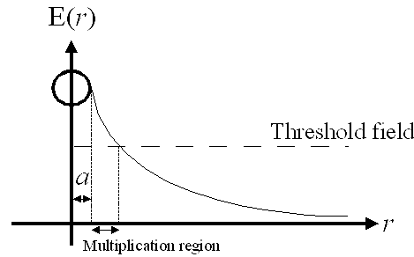
First gaseous detectors
From the historical point of view, the first gaseous detector had a cylindrical shape.
Using «typical» parameters
A = 80 μm
B = 10 cm
HV = 2000 V
Indeed you can manufacture a detector like this
E(a)=5.18 x 10 ⁶ V/m
Multiplication takes place essentially close to the central wire
only the region with a distance from it less then 400 μm, namely around 0.2% of the detector volume, is active for multiplication.
Marcello Abbrescia
DRD1 school 2025
4

Slide 5
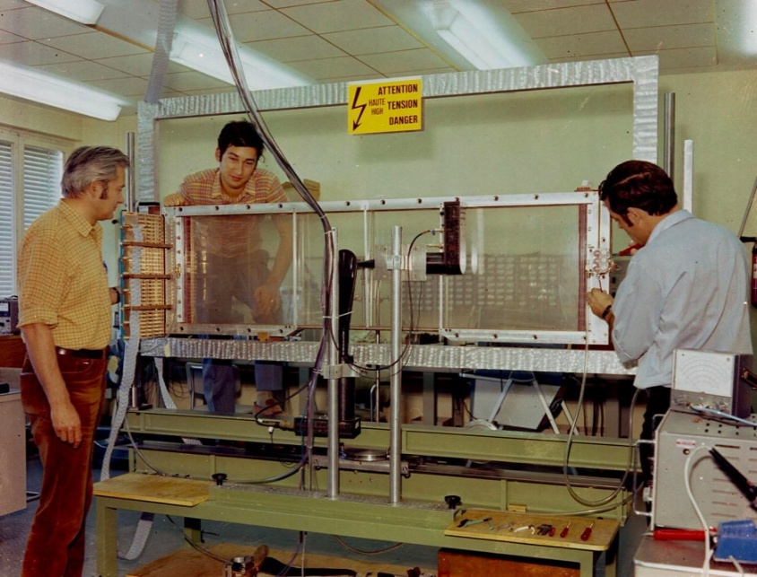
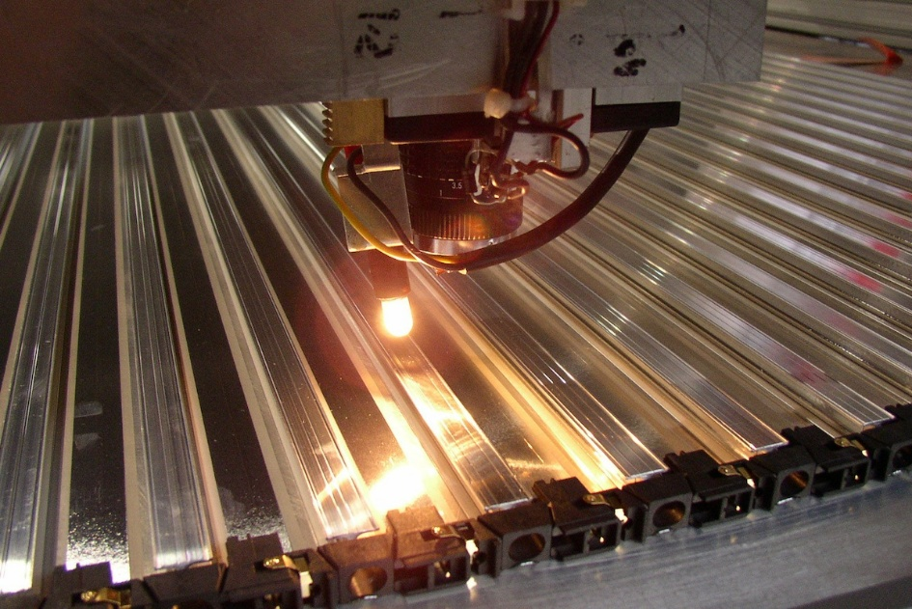
Cylindrical gaseous detector
Cylindrical gaseous detectors, with a central wire, immediately had a tremendous success, and are widely used nowdays.
- A variation of this principle was the invention of the Multi-Wire Propotional Chamber, worth the Nobel prize to George Charpak.
Drift chambers used in the CMS experiment (with a squared section).
Marcello Abbrescia
DRD1 school 2025
5

Slide 6
Limitations of cylindrical gaseous detectors
Time resolution in cylindrical gaseous detectors is limited by the variable amount of time the electrons need to drift from the points where they are produced to the region where multiplication takes place.
Electrons drift and arrive at the wire, one after another, depending on drift distance.
The signal on the wire comprises a series of signals (and typically the first is used for timing)
A 1 cm drift length variability, considering a drift velocity v_{d} ≈ 5 cm/μs, implies a time uncertainty of around 200 ns.
Marcello Abbrescia
DRD1 school 2025
6

Slide 7
Using a uniform electric field
It was clear from the beginning that the way to increase time resolution was using a uniform electric field.
HV electrodes
If the electric field is intense enough everywhere, avalanches can grow everywhere
All clusters drift toward the anode with the same velocity and simultaneosly originate avalanches.
Marcello Abbrescia
DRD1 school 2025
7

Slide 8
REMIND
In ANY detector the signal is NOT generated when the charges are collected by the readout electrodes.
The signal is generated when the charges drift in the detector volume: when they are collected by the readout electrodes, everything is OVER.
V_{d}
O V
1 V
O V
Since avalanches develop at the same time, the total signal is the SUM of the signal generated by multiple avalanches.
Marcello Abbrescia
DRD1 school 2025
8

Slide 9
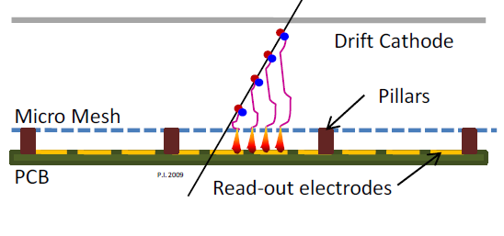
An important difference
In a planar gaseous detector the whole detector volume is at the SAME time drift region and multiplication region
In wire chambers and MPGD drift region and multiplication region are separated.
First change of paradygm:
passing from 1/r electric fields to uniform electric fields.
From cylindrical gaseous detectors → planar gaseous detectors
Marcello Abbrescia
DRD1 school 2025
9

Slide 10
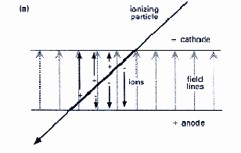



Let’s dimension such a detector
Using a 1 cm gap, in order to reach an electric field around 5.18 x 10 ⁶ V/m, we would need 51.8 kV
A problem even for nowdays power suppliers.
Therefore a suitable solution is to reduce the gap thickness
Typically down to 1-2 mm
1 mm gas gap → ≈ 5 kV of applied voltage
Primary ionization follows Poisson statistics, therefore the probability of NOT having any primary ion-electron pair in a thickness g (intrinsic inefficiency) is:
$${1−ε=e}^{−λg}$$
Where λ is the number of primaries per unit lenght (around 5-6/mm for the gas typically used in these devices).
For 1 mm, $1−ε=0.6 \%$
For 0.5 mm, $1−ε=8 \%$
(!!!)
Marcello Abbrescia
DRD1 school 2025
10

Slide 11
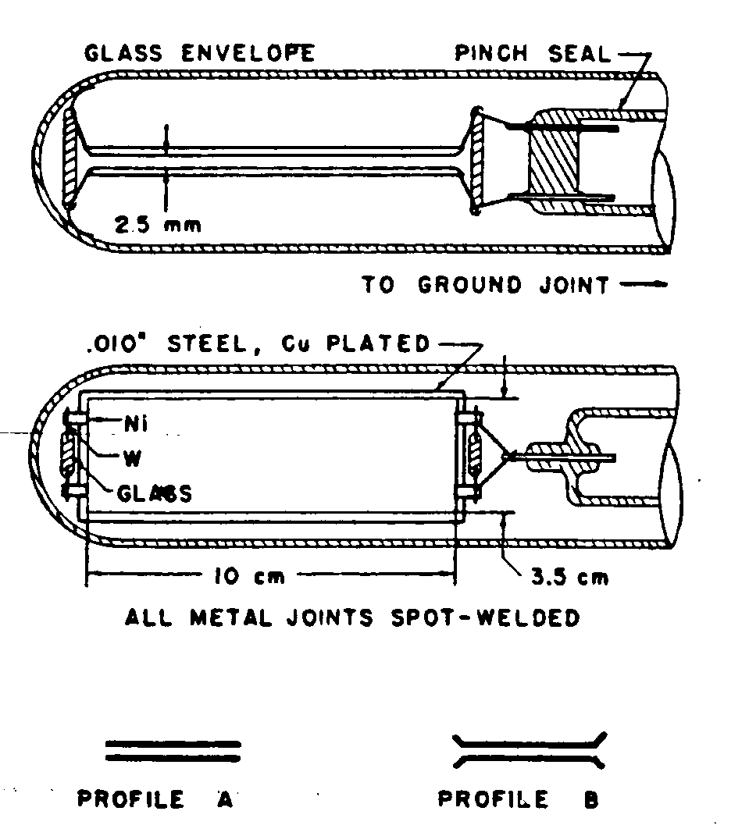
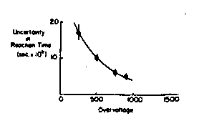
Keuffel’s PPC
Built for the first time in 1949. Quite similar to planar capacitors.
First prototype: two Molibdenium disks separated by 3 mm and with an area of 31 cm²
Subsequently, Keuffel used two Copper plates (or iron/copper plated plates): d=2.5 mm, A=35 cm²
Gas mixture: xilene (C₆H₁₂(CH₃)₂) p_{parz} = 6 mmHg
argon p_{tot} = 0.5 Atm
World record time resolution for gaseous detectors
Marcello Abbrescia
DRD1 school 2025
11

Slide 12
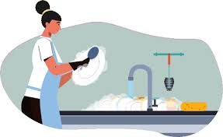
Pros and conts of Keuffel’s PPC
Problems:
To get intense electric fields, the electrodes are at few mm distance
Characteristics of Keuffel’s PPC:
large signals ≈ 100 V (on 50 Ω)
time resolution ≈ 5 × 10⁻⁹ s
efficiency ≈ 90%
plateau from 0.9 to 3 kV
Detector lifetime: few months
Limited because of the formation of a (micro) point on the electrodes where a discharge always originates
Extremely laborious surface preparation
cleaning of the electrodes with increasingly fine sandpaper;
washing with xylene
vacuum tube assembly
re-washing with xylene, alcohol, and distilled water;
evacuation of the tube under vacuum and heating for two hours at 200 °C
introduction of hydrogen (to reduce any oxides)
evacuation down to 10⁻⁵ mm Hg (or better)
cooling
filling with the active mixture: first xylene and then Ar, to form a layer of xylene on the electrodes
Marcello Abbrescia
DRD1 school 2025
12

Slide 13
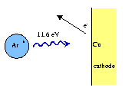
Choice of the gas filling
Noble gases are preferentially used due to the absence of vibrational and rotational states ➔ionization dominates.
Possible electron multiplication at low electric field
Choose cheap noble gases with low ionization potential
New avalanches
Continuos discharge
De-excitation of noble gases can happen via photo-emission; for instance, Ar produces 11.6 eV photons.
This can be large then the extraction energy for many metals: Cu - 7.7 eV
Marcello Abbrescia
DRD1 school 2025
13

Slide 14
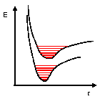
Quencher gases
Solution: add poly-atomic gases as “quenchers”
Because of the presence of many vibrational and rotational levels, these gases absorb photons in a wide range of energy.
Methane: absorption band between 7.9 and 14.5 eV
The result is that photons are prevented from covering long distances, and electron photo-production is reduced.
Marcello Abbrescia
DRD1 school 2025
14

Slide 15
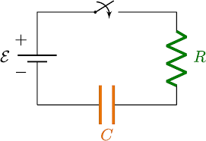
A game of Switch on and off
A typical PPC is a planar capacitor: hence the equivalent circuit is an RC circuit.
A discharge in the gas volume behaves like a short circuit connecting anode and cathode of the capacitor.
Differently to what happens in cylindrical gaseous detectors, in planar gaseous detectors a discharge continues until the applied HV is removed.
PPC
After the passage of an ionizing particle, the applied HV was removed for a certain time (0.01-0.05 s) → suitable switch-off electronic circuits (Franzinetti e Bella, Focardi, Torelli, Rubbia ...)
The time needed to charge up again a capacitor is related to the time constant of the circuit τ=RC
The maximum frequency of particle detection (rate capability) is limited.
Marcello Abbrescia
DRD1 school 2025
15

Slide 16
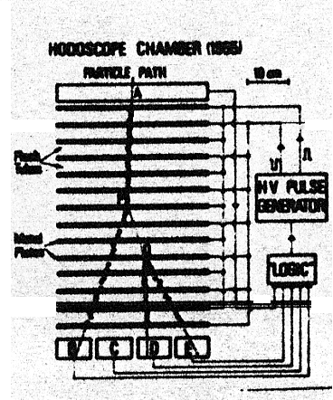
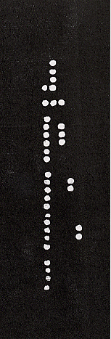
Conversi’s flash chambers
Planar gaseous detector had an incredible success. Here one curious example (1955).
μ
HV electrodes
=
Shielding
Wireless tubes filled with Ne
γ→e⁺e⁻
Since Ne produces fluorescence photons during a discharge it was possible directly visualize the particles
Marcello Abbrescia
DRD1 school 2025
16

Slide 17
OK, this is really nice.
BUT
Is there a smarter way than continuously switching OFF and ON the detectors
Marcello Abbrescia
DRD1 school 2025
17

Slide 18
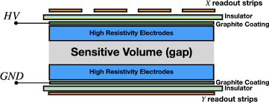
Include resistive elements in gaseous detectors
Put in front of the HV metallic planar electrodes, resistive plates of suitable material.
In this configuration, the detector is still a planar capacitor, but partially filled with a resistive material.
Marcello Abbrescia
DRD1 school 2025
18

Slide 19
As usual, put some numbers
The electrical equivalent of an RPC is the following:
Once that the capacitor representing the gas gap is discharged because of the passage of an ionizing particle and subseguent discharge, its re-charging time is related to the time constant of this circuit:
d is the thickness of the resistive plates
g is the thickness of the gas gap
For d=g=2 mm and ρ = 10 ¹¹ Ωcm, τ is few ms (milliseconds)!
Electrons are collected on the anode in times of the order of few tens of ns
Ions are collected on the anode in times of the order of few tens of μs
Marcello Abbrescia
DRD1 school 2025
19

Slide 20

From the practical point of view
This means that during the discharge, and well after even the ions are collected, the resistive material behaves like an insulator.
There is no more a short circuit between anode and cathod.
No need to switch ON and OFF the applied HV voltage.
Also, after the electrons are collected on the anode, they remain there for «ages» before they are neutralized by the current flowing from the HV electrodes.
Locally, the electric field goes to zero.
If another ionizing particle passes close the «dead» area, it cannot be revealed because the electric field is under threshold for multiplication
Marcello Abbrescia
DRD1 school 2025
20

Slide 21
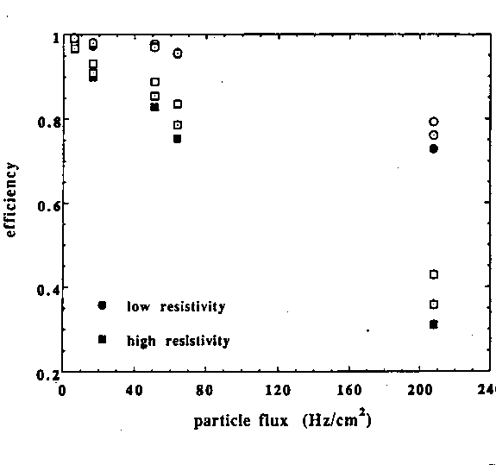
Limitation in rate capability
In a Parallel Plate Detector, with metallic electrodes, the whole electrodes as discharged as a consequence of the development of a discharge.
In a Resistive Plate Chamber (RPC), only a localized region is discharged, with dimensions close to the avalanche disk size.
BUT it remains discharged for much longer time, because the resistive component of the time constant τ is much (MUCH) larger.
Net result is a decrease of the efficiency vs. rate of impinging particles, depending on the resistivity value.
Low resistivity
High resistivity
Note: this is a result of the beginning of 1990s: now we can do much better!
Marcello Abbrescia
DRD1 school 2025
21

Slide 22
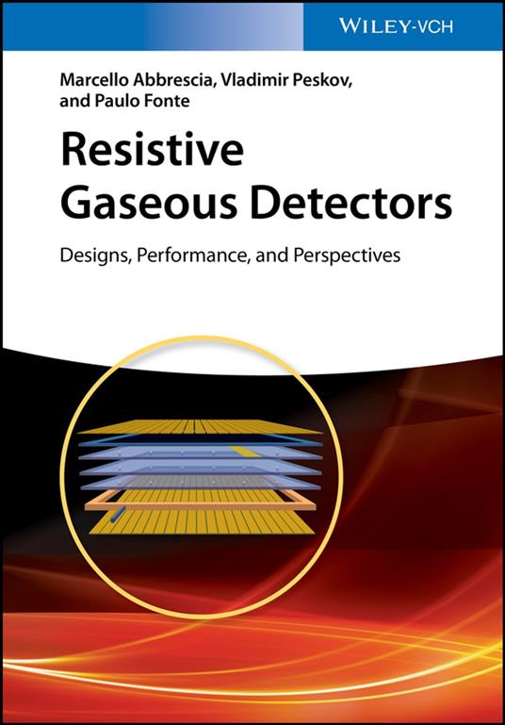

Inclusion of resistive elements
in gaseous detectors
Including resistive elements in gaseous detectors was (and is) a major breakthrough in GD R&D
Crazy guys even wanted to write a book on this revolutionary concept.
THANKS Paulo and Vladimir: writing this book was the most exciting, instructive and rewarding experience in my entire academic life!
Disclaimer: this is NOT advertising. The book is available for FREE at the CERN library.
Marcello Abbrescia
DRD1 school 2025
22

Slide 23
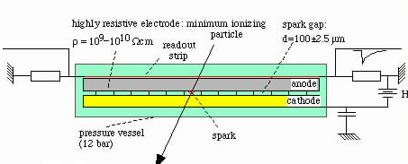
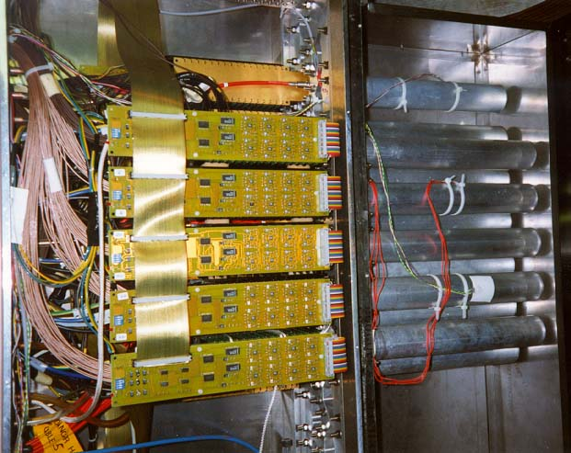
Pestov’s Planar Spark Chambers (PSC)
They were the first (1970) implementation of a planar gaseous detector with ONE resistive (glass) plate.
100 μm gap «compensated» by the use of a Ar/Ne/quencher gas mixture at 10 Atm
Exceptional time resolution!
Used in NA49 with limited lifetime
Marcello Abbrescia
DRD1 school 2025
23

Slide 24
Signals in planar gaseous detectors
Ionization probabilty (and gain) are not the only parameters to be optimized in gaseous detectors: time resolution is quite relevant.
Given the fact that the electric field is uniform in the gas gap of a planar gaseous detector (at least at low rate), semi-analytical description of its behaviour can be found. Signals developed can be approximated like follows:
Here, we neglect saturation effects (correct if we consider the initial stages of the avalanches), and:
v_{d} is the electron drift velocity (assumed constant with time);
E_{w} is the weighting field (assumed uniform in space);
η is the first effective Townsend coefficient
M_{j} is the avalanche fluctuation coefficient
t is the time elapsed since the passage of the ionizing particle
Marcello Abbrescia
DRD1 school 2025
24

Slide 25

Time resolution in RPCs
Inverting the previous equation (with some approximations), one can deduce an estimate for the time resolution of an RPC:
Factors under the square root depend on the specific gas or statistic and little can be done.
Here it is clear what an experimentalist can do to improve time resolution:
Improve drift velocity v_{d}
(choose the suitable gas, since it tends to saturate at high fields)
Increase first Townsend coefficient → high electric fields
The applied HV is somehow limited by technological reasons, so the way that Pestov choose was to use a very narrow gap with a quite intense electric field.
Results do NOT come by chance!
Marcello Abbrescia
DRD1 school 2025
25

Slide 26
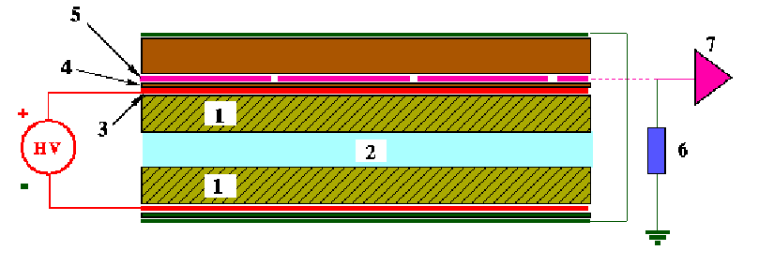
Finally… the RPCs
They are made by two plates of «bakelite» (HPL, high pressure phenolic laminates), a plastic material widely used, obtained impregnating paper with phenolic resins.
Later on glass was used
Bakelite plates were coated from one side with graphite, to manufacture the HV electrodes.
On the side toward the gas gap they were coated with linseed oil
They were typically readout by means of copper readout strips or pads.
Readout strips
Copper strips
HV electrodes
Bakelite of resistivity 10 ¹⁰- 10 ¹² Ωcm
Marcello Abbrescia
DRD1 school 2025
26

Slide 27
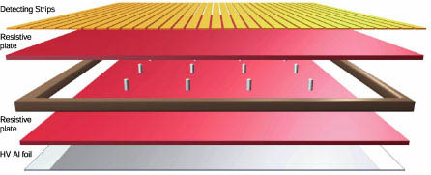
Finally… the RPCs
Invented at the beginning of the ‘90s by R. Santonico and R. Cardarelli.
Easy to build and not expensive
2 mm gap, 8-10 HV applied
Ar/isobutane/CF₃Br mixture
Full efficiency
Time resolution around 1-2 ns
Made planar gaseous detectors very «democratic», i.e. easy to build
Immediately used in many experiments, both at accelerators and for cosmic rays.
Marcello Abbrescia
DRD1 school 2025
27

Slide 28

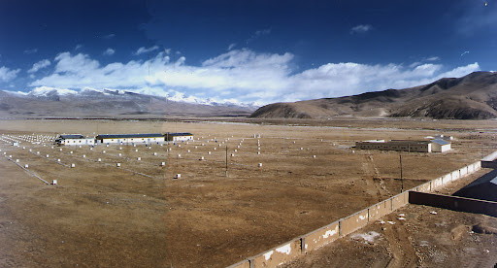
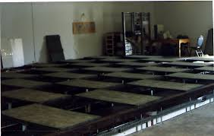
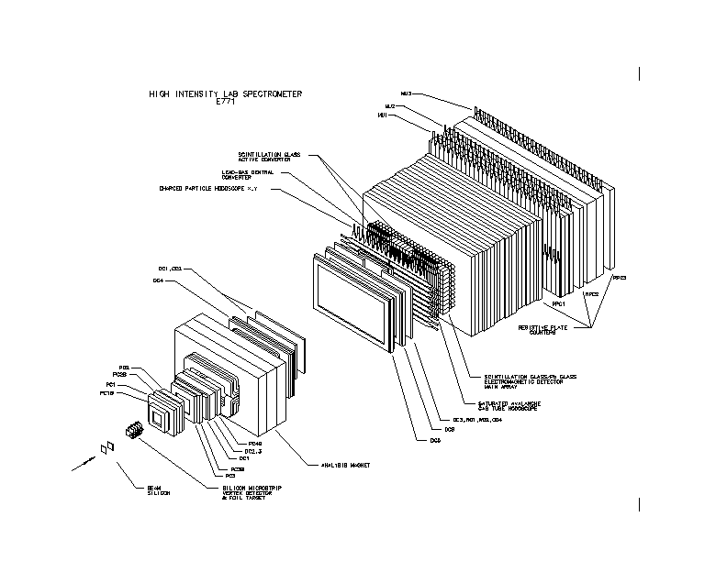
Some experiment of the past using RPCs
Argo-YBJ experiment, on the Tibet, fully implemented with RPCs
E771
E771 at Fermilab
Three planes of RPCs
Used for trigger and simple reconstruction
Marcello Abbrescia
DRD1 school 2025
28

Slide 29
Avalanche and discharge processes in RPCs
Avalanche: it grows because of subsequent ionization processes due to the drifting electrons.
Streamer: because of space charge effects, secondary avalanches are created via photo-ionization
Spark: short circuit between anode and cathode
The separation between avalanche and streamers decreases as the voltage increases.
Marcello Abbrescia
DRD1 school 2025
29

Slide 30
The problem of the rate capability
At the beginning of ‘90s it was urgent to design the experiment for the (future) LHC. Given the expected fluxes, the limitation in rate capability of RPCs was relevant. RPC were NOT a «fast» detector.
RPCs represented an attractive solution for the muon system of the LHC experiments, but they were to be operated at fluxes around hundred(s) Hz/cm².
The limitation in the time constant of an RPC canNOT be overcome (in principle):
Reduce resistivity
On the AVERAGE, the voltage drop in the resistive plates is given by:
Marcello Abbrescia
DRD1 school 2025
30

Slide 31
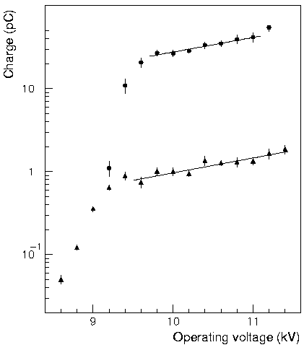
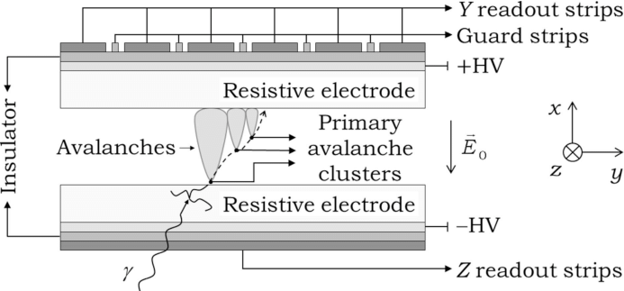
The solution: another change of paradygm
The localized voltage drop in and RPC is proportional to the size of the avalanche/streamer developed.
Note: an RPC is NOT a proportional counter: the final size of the avalanches depend on the distance from the anode the are originated.
The solution was reducing as much as possible the percentage of streamers, and reducing the size of the avalanches. In practise:
Reduce the operating voltage
Transfer the needed amplification from the gas to the front-end electronics.
Marcello Abbrescia
DRD1 school 2025
31

Slide 32
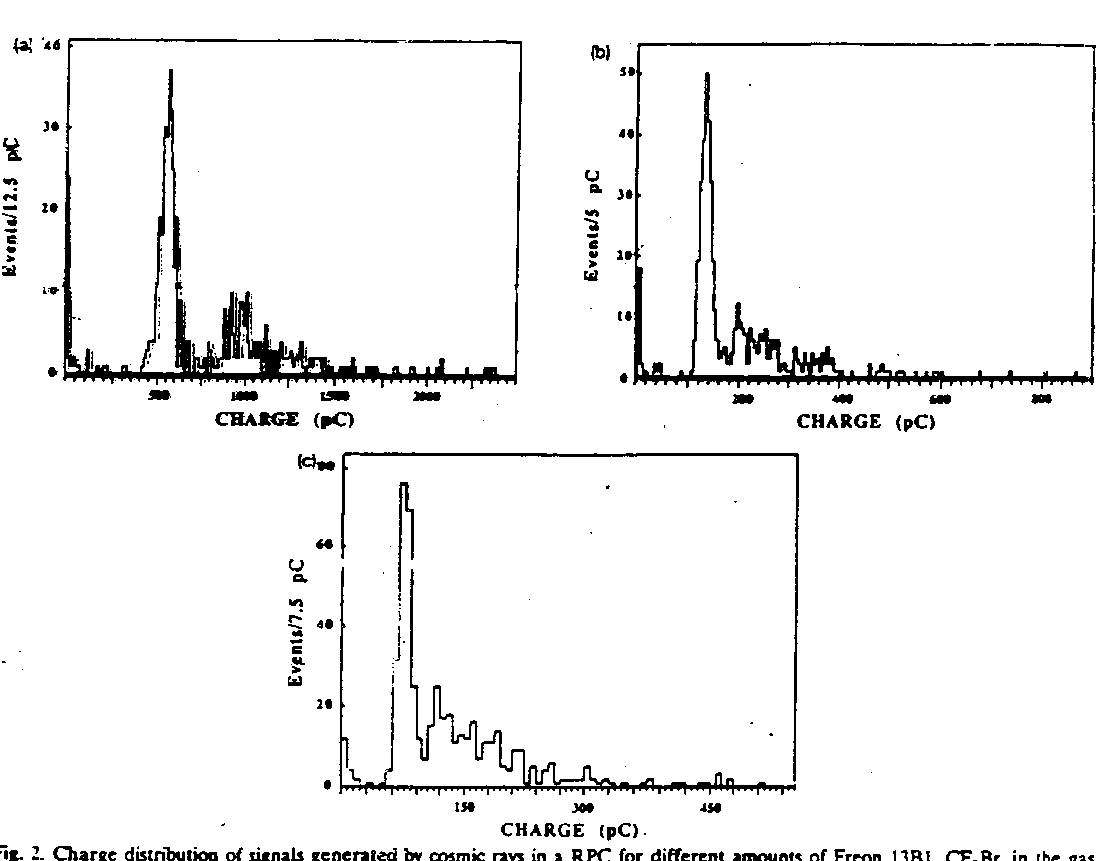
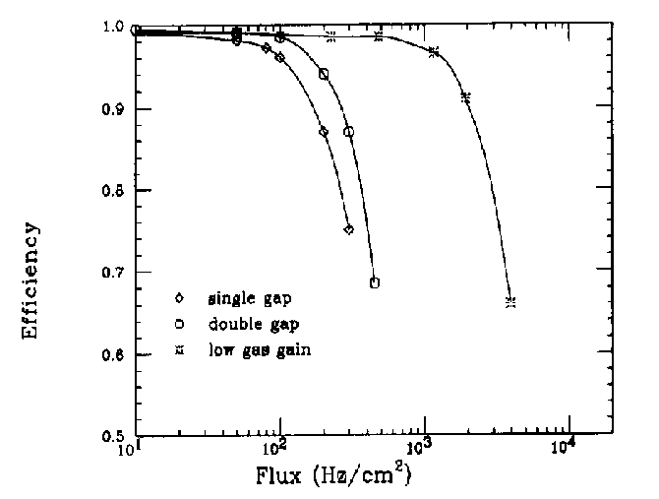
The role of “Freon”
It was found that using strongly quenching gas mixtures helped in obtaining a «Pure avalanche» mode of operation.
Increasing fractions of CF₃Br
Then replaced with mixtures made almost all of C₂H₂F₄ (tetrafluoroethane)
CF₃Br 0%
Increase of the rate of a factor more than 10
<q_{ind}>=500pC
CF₃Br 8%
<q_{ind}>=60pC
Passing from 100 Hz/cm² to 1-2 kHz/cm²
Marcello Abbrescia
DRD1 school 2025
32

Slide 33
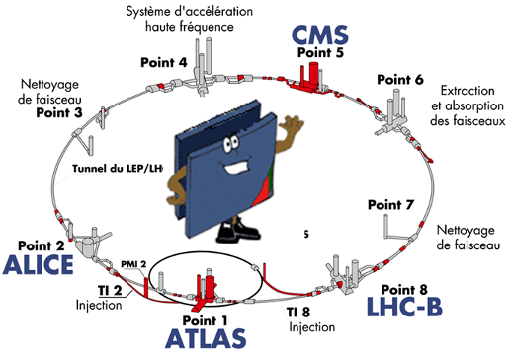
Summarizing…
The idea was to pass from «streamer» mode of operation to «avalanche» mode of operation (or «saturated avalanche»).
The term «saturated avalanche» derives from the fact that the size of the avalanche in RPCs is such that space charge effects are not negligible → the avalanche growth is no more exponential.
This passage implied the use of more sophisticated electronics (widely available in the 90’s)
Marcello Abbrescia
DRD1 school 2025
33

Slide 34
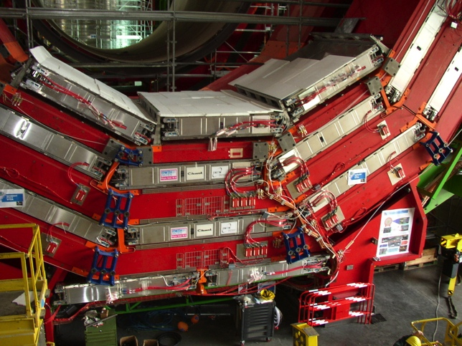
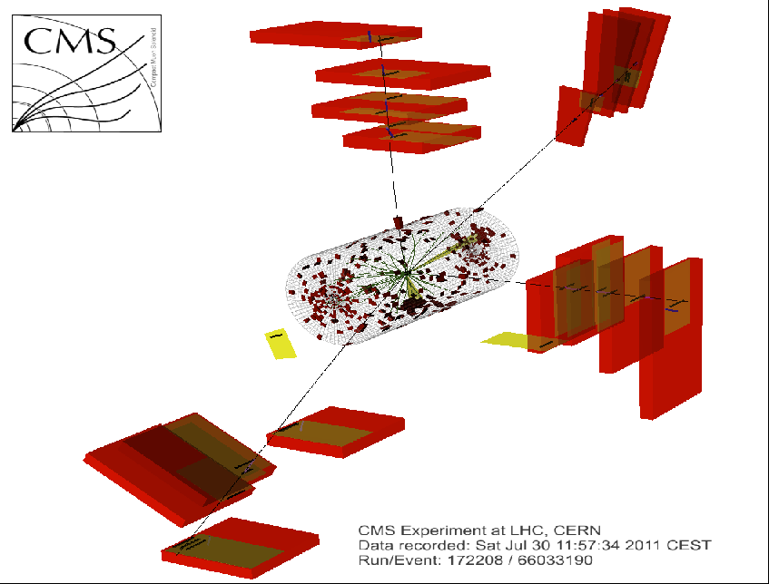
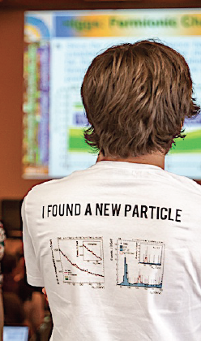
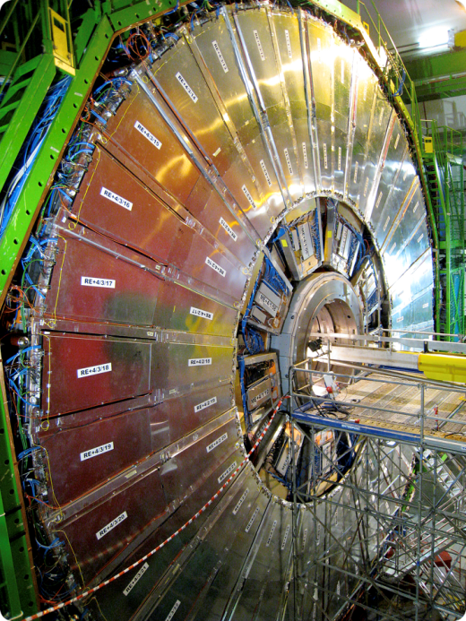
RPCs at the LHC experiments: CMS
The RPCs at the LHC experiments have contributed to the discovery of the Higgs boson.
Marcello Abbrescia
DRD1 school 2025
34

Slide 35
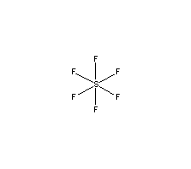
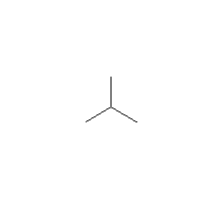

Problems to be addressed: Aging effects in RPCs
When you install RPC at the LHC experiments you want them to last the experiment lifetime (≈30 years)
unreacted molecules
e⁻ ; γ ; UV ; etc.
+
+
+ HF
avalanche
R134a
C₄H₁₀
SF₆
+ radiolytic products
R134a
The gas used in RPCs, and specifically tetrafluoroethane, can partially dissociate because of avalanche processes and UV production.
Isobutane
SF₆
H₂0
Chromatogram of the INPUT gas to an RPC
Marcello Abbrescia
DRD1 school 2025
35

Slide 36
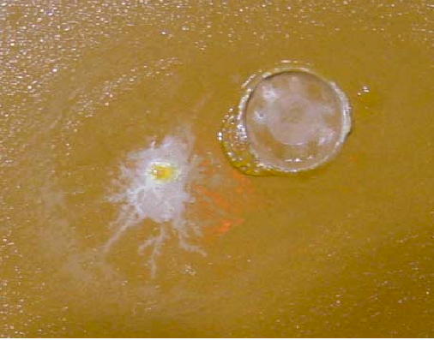
Aging effects in RPCs
Many stange compounds appear, the most dangerous being hydrofluoric acid (HF), whose production resulted to be roughly proportional to the average avalanche charge.
Chromatogram of the OUTPUT gas from an RPC
Marcello Abbrescia
DRD1 school 2025
36

Slide 37
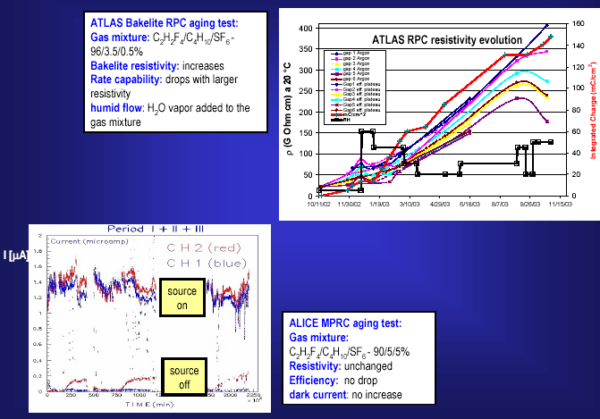
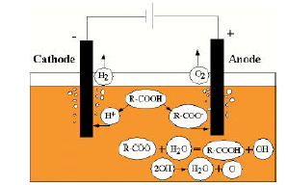
Conductive processes in bakelite
Experimentally, bakelite resitivity seems to increase with time.
This is increase can be controlled by enriching with H₂O vapor the gas mixture used.
Time when H₂0 vapor was added
Current conduction in bakelite is ionic, and therefore requires H₂O to be sustained (J. Va’Vra, who cited a young M. Abbrescia in his diaries(.
Marcello Abbrescia
DRD1 school 2025
37
Marcello Abbrescia - Universitá di Bari, Italy

Slide 38
The advent
OF
Multigap Resistive Plate Chambers (MRPCs)
Marcello Abbrescia
DRD1 school 2025
38

Slide 39
The huge dynamic range of RPCs
TRUE: in RPCs, ALL electron avalanche processes start immediately: the induced signal (due to movement of charge) is the sum of all avalanches: thus all ionisation produced in chamber plays a role.
However the avalanches grows across the full gap width.
This is an exponential process, depending on the distance from the anode.
The avalanches originating close to the anode might not grow large enough to give rise to a detectable signal.
Marcello Abbrescia
DRD1 school 2025
39

Slide 40
The introduction of Multigap-RPCs
To get all these avalanches to produce EACH a detectable signal, the gain (namely the electric field) is set very high.
This implies production of streamers or sparks from the avalanches starting close to the cathode.
Solution: add barriers within the gas gap to stop the development of the avalanche.
Reduce the dynamic range
Since the gap is narrow, the gain can be set very (VERY) high.
Marcello Abbrescia
DRD1 school 2025
40

Slide 41
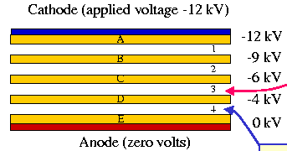
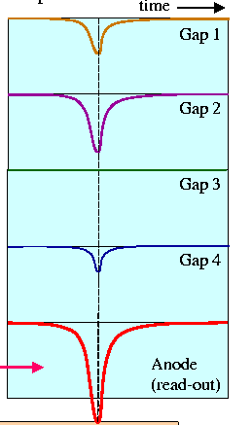
Structure of a Multigap-RPC
Stack of equally-spaced resistive plates with voltage applied to external surfaces (all internal plates electrically floating)
Pickup electrodes on external surfaces (resistive plates transparent to fast signal)
Internal plates take correct voltage - initially due to electrostatics but kept at correct voltage by flow of electrons and positive ions – feedback principle that dictates equal gain in all gas gaps
The signal is the analogic SUM of the signals from all the gaps.
Marcello Abbrescia
DRD1 school 2025
41

Slide 42
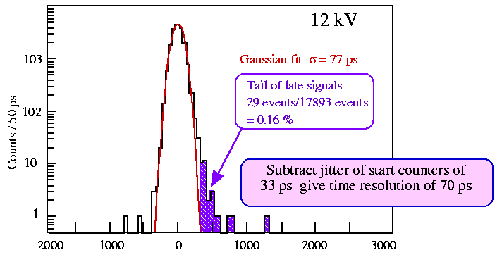
Performance of MRPCs
250 μm gas gaps (10 gaps in ALICE-TOF)
Using tiny gap, the electric field can be increased quite high
The first Townsend coefficient is really (REALLY) high.
Excellent time resolution
Marcello Abbrescia
DRD1 school 2025
42

Slide 43
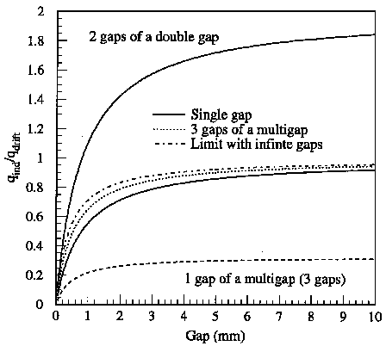
The importance of the configuration
It might seem that increasing the number of gaps to infinte we would get the perfect detector. Actually the contribution of each gap to the induced signal reduces increasing the number of gap.
Single gap
Ramo theorem
ΔV_{w}=1V
Ratio between induced and drifting charges
Double gap
ΔV_{w}=1V
ΔV_{w}=1V
Multigap (3 gaps)
ΔV_{w}=1/3V
ΔV_{w}=1/3V
ΔV_{w}=1/3V
Marcello Abbrescia
DRD1 school 2025
43

Slide 44

And now…
What’s next???
Marcello Abbrescia
DRD1 school 2025
44

Slide 45
Use of GreenHouse Gases in HEP
GHGs are used in several gaseous particle detectors due to their characteristics suitable for optimal detector performance AND long term operation
30 years ago we had to get rid of Ozone Depletion gases
Now we have to get rid of GHGs
Marcello Abbrescia
DRD1 school 2025
45

Slide 46

The replacement of GHGs with eco-friendly gas
We need to replace:
C₂H₂F₄ = R134a = TFE mainly used in RPCs
SF₆ mainly used in RPCs
CF₄ used in CSCs, GEMs, RICH, etc.
with more ecological gases, namely with a much lower Global Warming Potential.
Difficult problem: gases are the core of gas-filled detectors.
We also need:
to get the same performance
not to change the electronics and HV (for existing systems)
It’s not a problem concerning just the RPC community
HEP experiments, present and future, last several (dozens) of year
→ A good performance must be mantained for an adequate period of time
→ Aging tests are needed as well.
Of course we can also re-circulate
the gases used, after purifying them,
and reduce leaks
Marcello Abbrescia
DRD1 school 2025
46

Slide 47
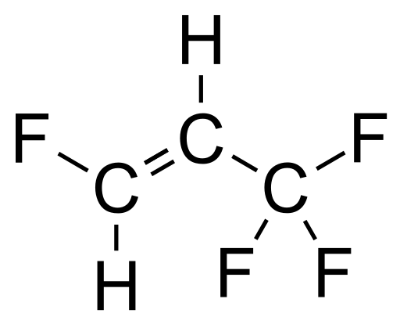
The importance of collaborative effort
All high energy experiments (ALICE, ATLAS, CMS, LHCb, etc.) and the CERN gas group (CERN EP-DT) started, already several years ago, an intense R&D program to find suitable gas mixtures.
Practically all research trendlines concentrate around the idea of replacing:
C₂H₂F₄ (GWP=1430)→ C₃H₂F₄ze (GWP=4)
+ CO₂ (GWP=1) or He
EEE
C₃H₂F₄ (here indicated as HFO for short) is the molecule most similar to TFE but with low GWP
CO₂ (or He) are essentially added to reduce the operating voltage.
The RPC EcoGas@GIF++ is a Collaboration transversal to ALICE, ATLAS, CERN EP-DT, CMS, and LHCb willing to put together expertise and resources in order to test potential candidates of eco-friendly gas mixtures with different detectors and electronics.
47
Marcello Abbrescia
DRD1 school 2025
47

Slide 48

Yeah…
But what about the REAL future???
Marcello Abbrescia
DRD1 school 2025
48

Slide 49
Recent and future trendlines
We are now in a phase similar to the ‘90s, namely we need to develop detectors suitable for the next generation accelerators (FCC, ILC, Muon Collider…)
- Much larger energy and luminosity wrt. LHC
In general, one wants to push the detector perfomance forward in terms of:
Rate capability
Time resolution
(spatial resolution)
Longevity
What would you do?
Suggestions are welcome!
Here I have some considerations about what the community is doing: but let us hear what would YOU do!
Marcello Abbrescia
DRD1 school 2025
49

Slide 50

Conclusions
Using a planar geometry in gaseous detectors, in place of using cylindrical or more geometries, is a change of paradygm: it has advantages and drawbacks, but it was something NEW.
The introduction of resistive elements in gaseous detectors was a breakthrough, which rapidly expanded beyond the realm of planar gaseous detectors: again, it was something NEW.
Further refinements came: passing from streamer to avalanche mode, the introduction of MRPCs: again, NEW IDEAS.
Marcello Abbrescia
DRD1 school 2025
50

Slide 51

Lesson to be learnt
A particle detector is not made by putting together pieces of hardware.
A particle detector is made by putting together IDEAS: chose them well, assemble them in the right way, and it will go like wind.
Marcello Abbrescia
DRD1 school 2025
51

