Slide 1
Status and News
CERN & Experiments
Plenary RRB 60th Meeting
Joachim Mnich
April 28th, 2025

Slide 2
Main Discussion Points 60th LHC RRB
M&O budget requests for 2026
Status & Progress Phase II Upgrades ATLAS and CMS
  Schedule and cost developments
  Start planning installation and commissioning phase
Phase IIb upgrades ALICE and LHCb
  Scoping documents evaluated by the LHCC and discussed in the CERN Research Board
  Main conclusions and next steps to match technical and scientific assessment with the expected available resources

Slide 3
News from CERN

Slide 4
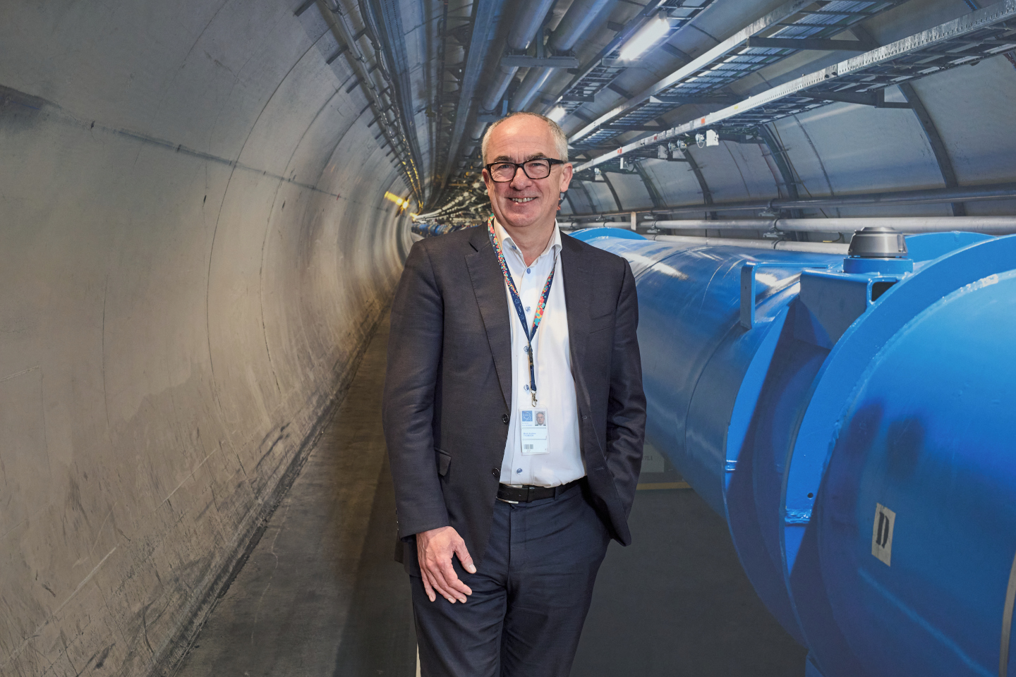
News from Council
Mark Thomson elected as next
Director General of CERN
starting January 1st, 2026
Council accepted Slovenia as 25th CERN Member State
  Formal steps in Slovenia proceeding
  Flag raising ceremony expected in June 2025 with
  Prime Minister present
Council approved the admission of Chile and Ireland as Associate Member States,
  Subject to completion of the necessary accession and ratification processes in the countries
  Signatures of Agreements With ministers scheduled for May

Slide 5
Progress Update European Strategy for Particle Physics
March 2024: CERN Council started the process
March 2025: Deadline for community input
263 documents submitted, see
https://indico.cern.ch/event/1439855/contributions/
1st half 2026: Council discussions and decision
Monte Verità
1–5.12.2025
Venice

Slide 6
RRB Scrutiny Group Composition 2025
Frey, Ariane University of Göttingen, DE (Chairperson)
Schmidt, Burkhard CERN EP Dep. (Scientific Secretary)
Cochran, James Iowa State University, US
d'Hose, Nicole CEA-IRFU, FR
Ferro-Luzzi, Massi CERN EP Dep.
De Groot, Nicolo NIKHEF, NL
Marshall, Philipp SLAC, US
Pepe, Monica INFN Perugia, IT
Trocme, Benjamin IN2P3, FR
Rozycka, Agata CERN FAP Dep.
Troska, Jan CERN EP Dep.
Vossebeld, Joost University of Liverpool, UK
Suggestions for new candidates from the smaller CERN Member States are very welcome for the 2025 Scrutiny cycle

Slide 7
Status of the Experiments

Slide 8
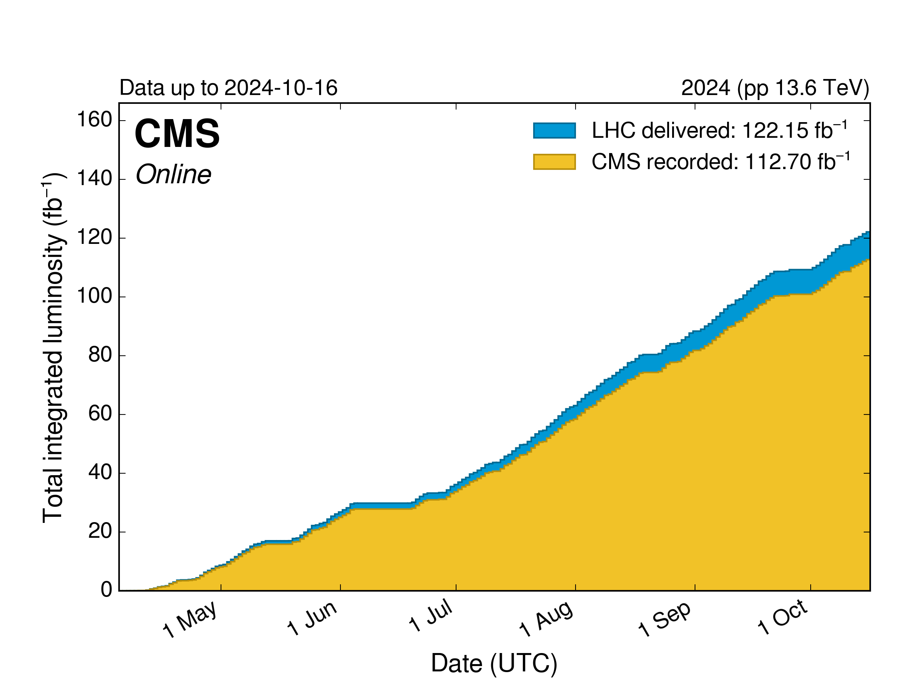
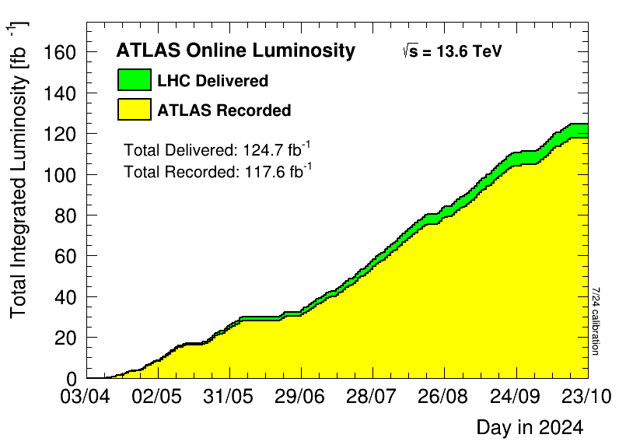
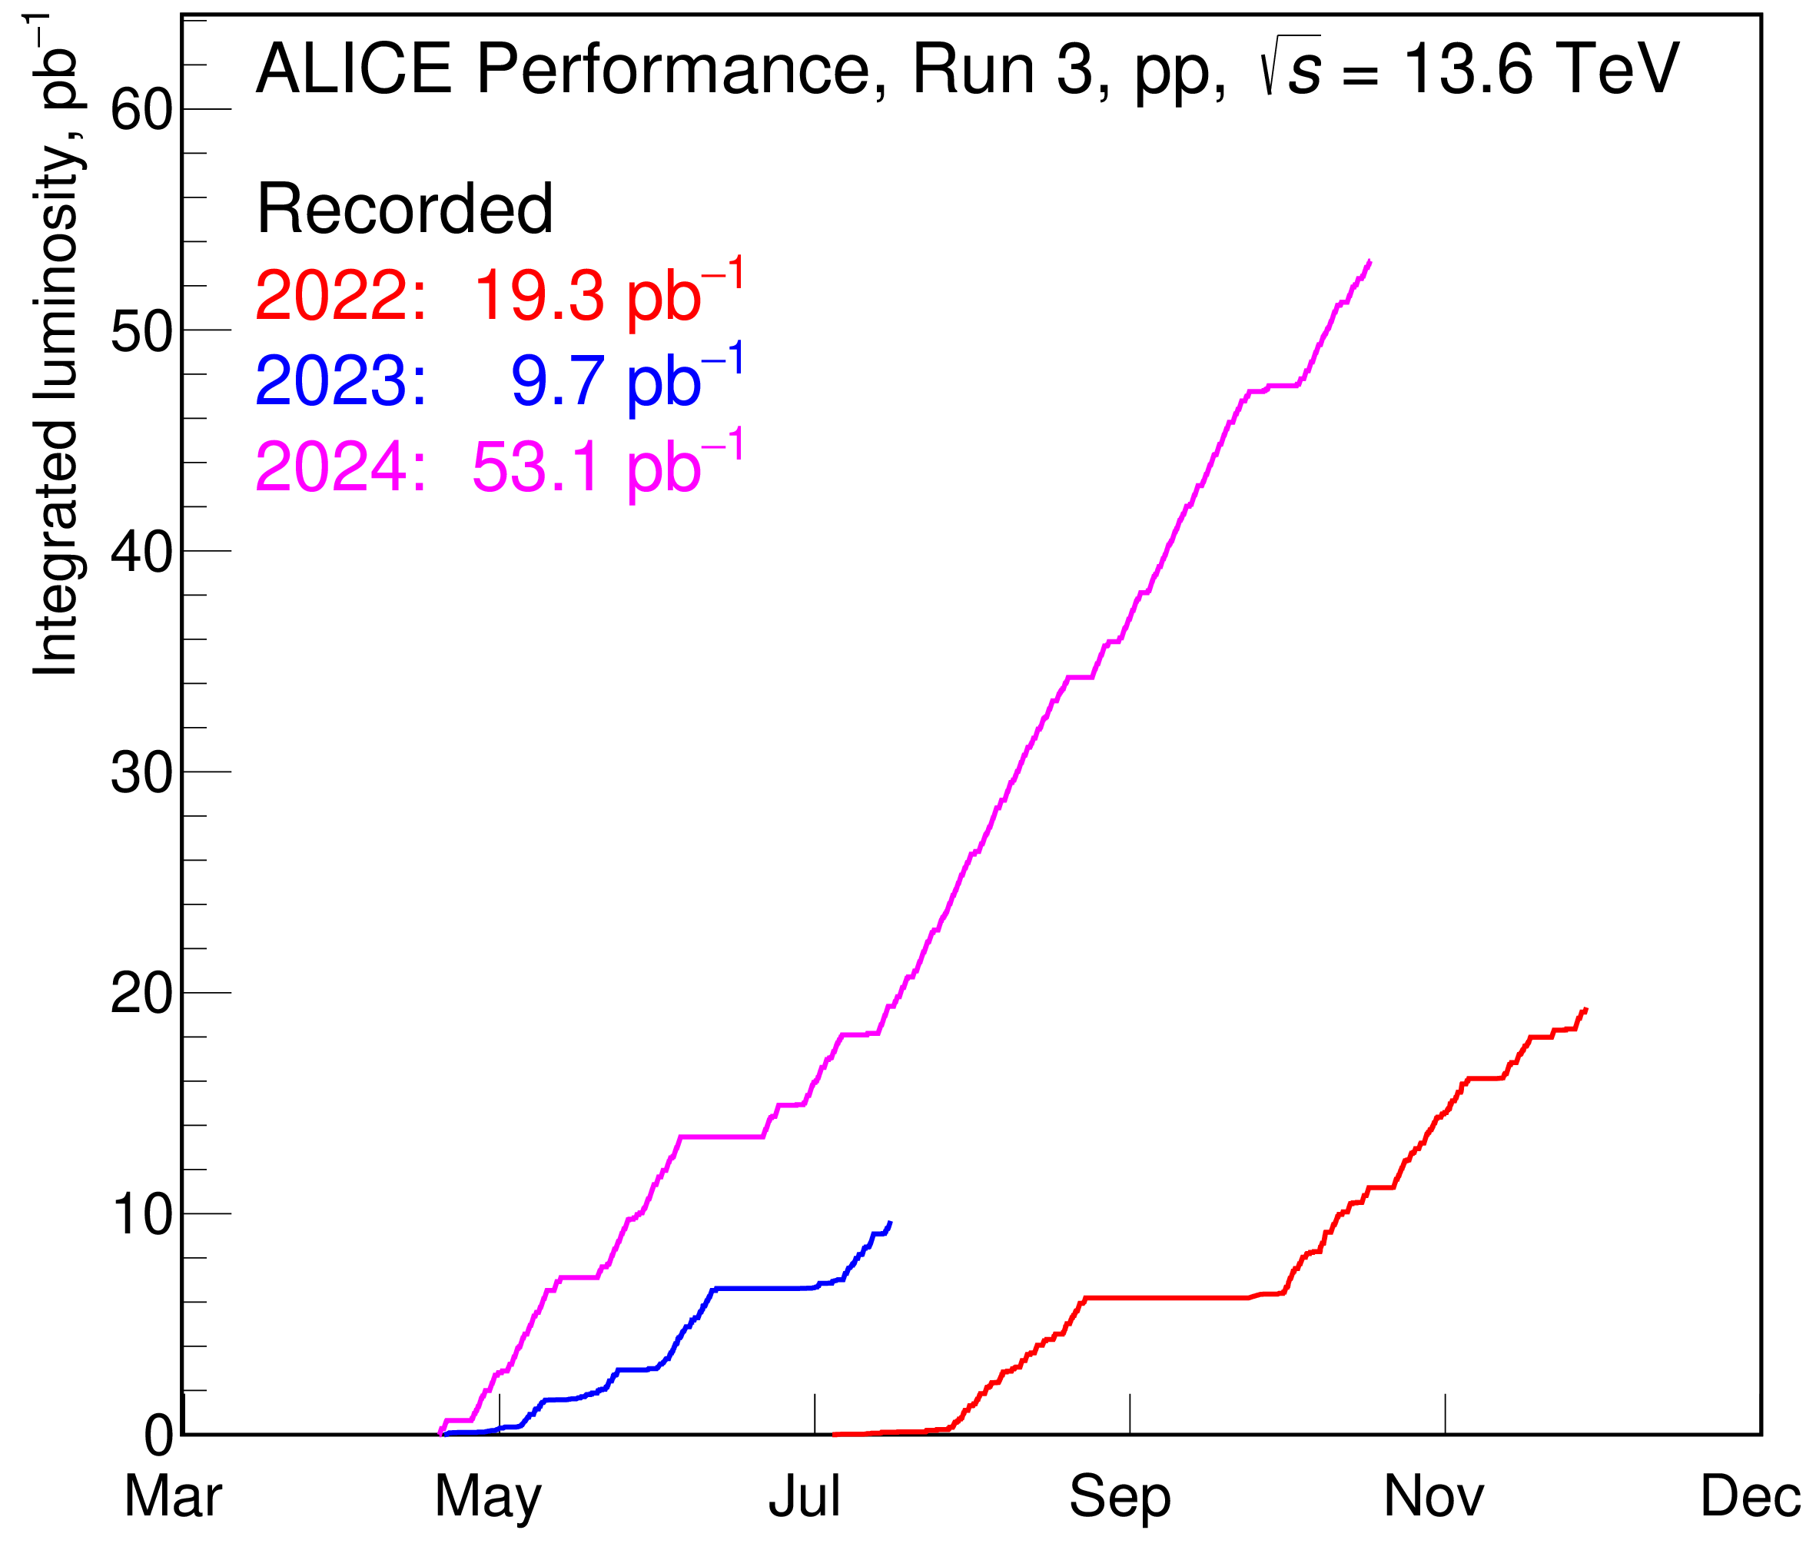
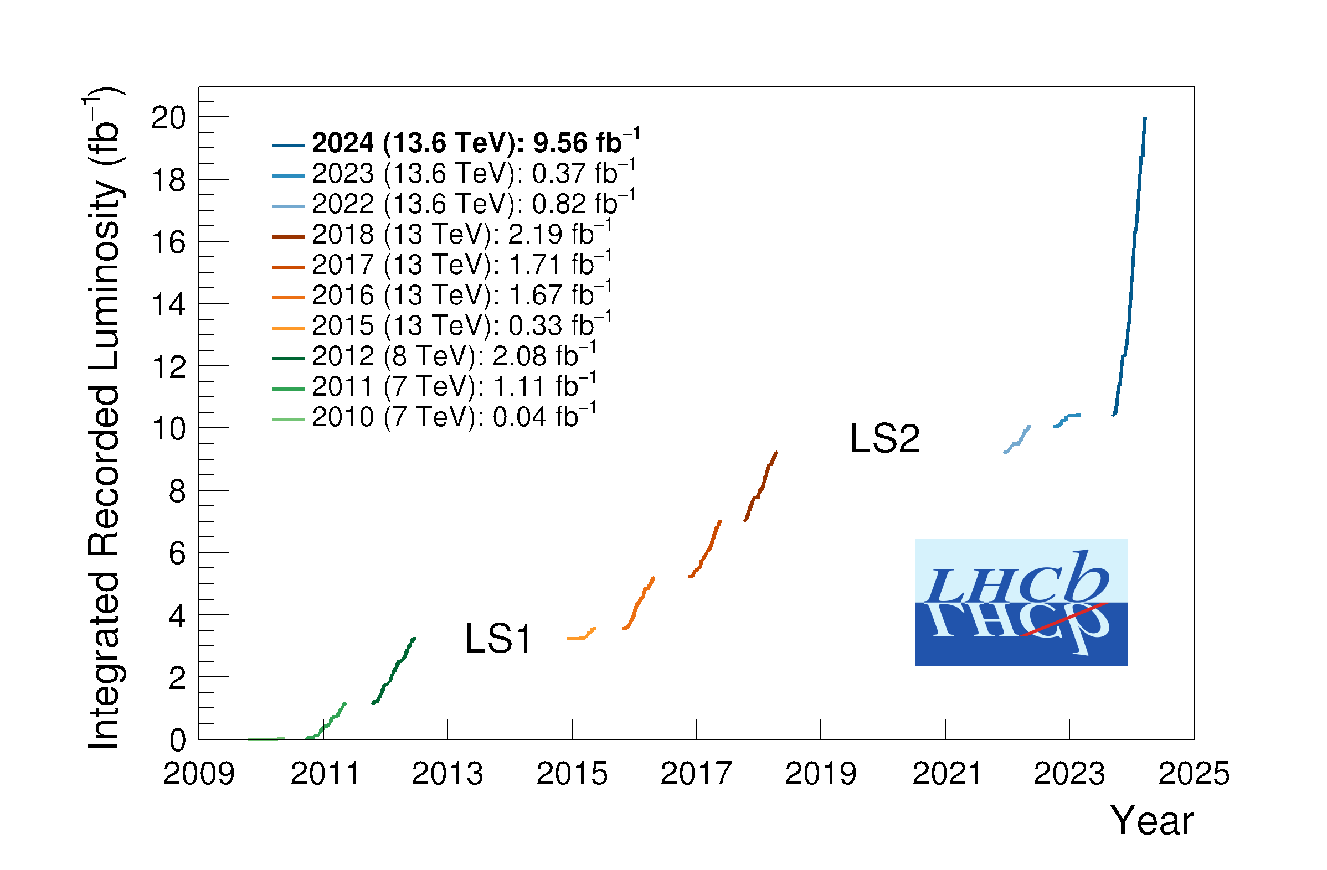
Recall 2024 LHC Run
Fantastic LHC performance
> 120 fb⁻¹ pp luminosity delivered to ATLAS & CMS
LHCb and ALICE doubled their pp luminosity in 2024
With all Phase I upgrades fully commissioned, e.g.
  ATLAS & CMS run at pileup µ > 60
  initial detectors designed for µ ≈ 20
  ALICE 1000 times more minimum bias events in central barrel because of continuous readout
Notes:
Wir schauen uns Observablen an, die man online nicht triggern kann. Ein Beispiel ist die Produktion von low-pT B-Mesonen (siehe Anhang). Wir können so die gesamte Anzahl an b-quarks bestimmen, die produziert werden (total bb-bar cross-section). Das testet einerseits pQCD und ist andererseits eine Referenzmessung für Pb-Pb, wo man untersucht wie die schweren b-quarks mit den leichteren u,d-quarks im QGP interagieren. Neben B-Mesonen schauen wir uns aber noch viele andere seltene Teilchen an, die wir nicht triggern können (anti-alpha, hypertriton, Omega aus charm Zerfällen).

Slide 9
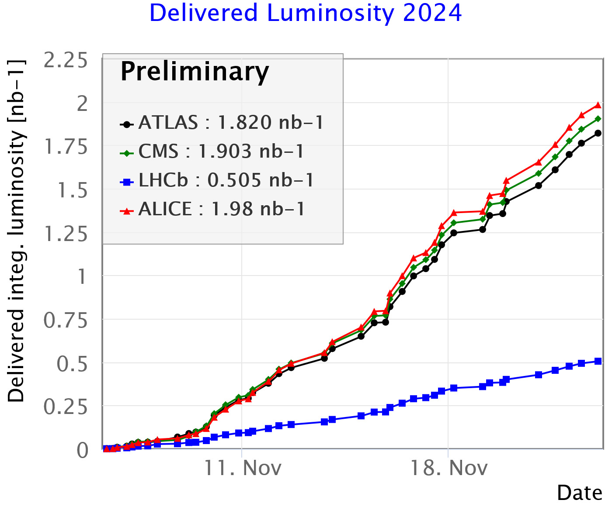
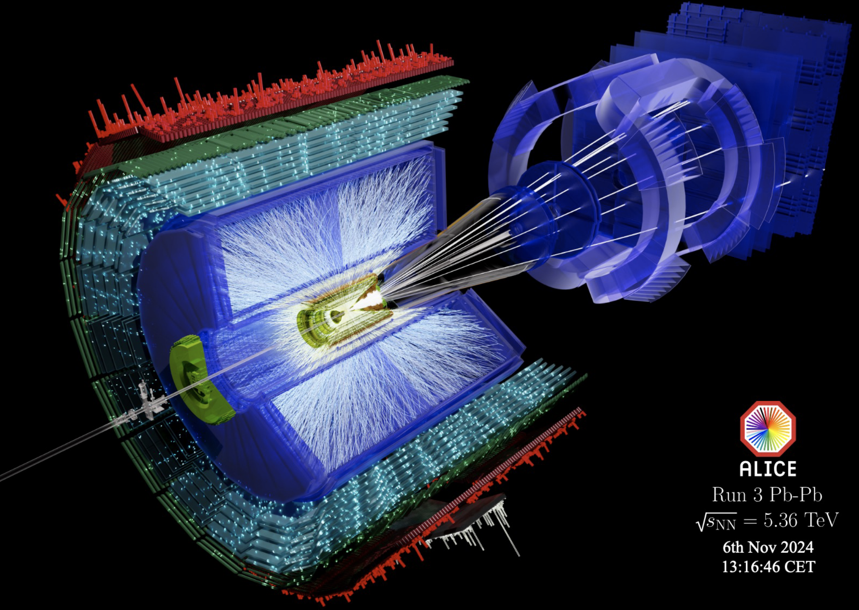
2024 LHC Heavy Ion Run
Target luminosity delivered:
≈ 1.9 nb⁻¹ to ATLAS/ALICE/CMS and
0.5 nb⁻¹ to LHCb

Slide 10

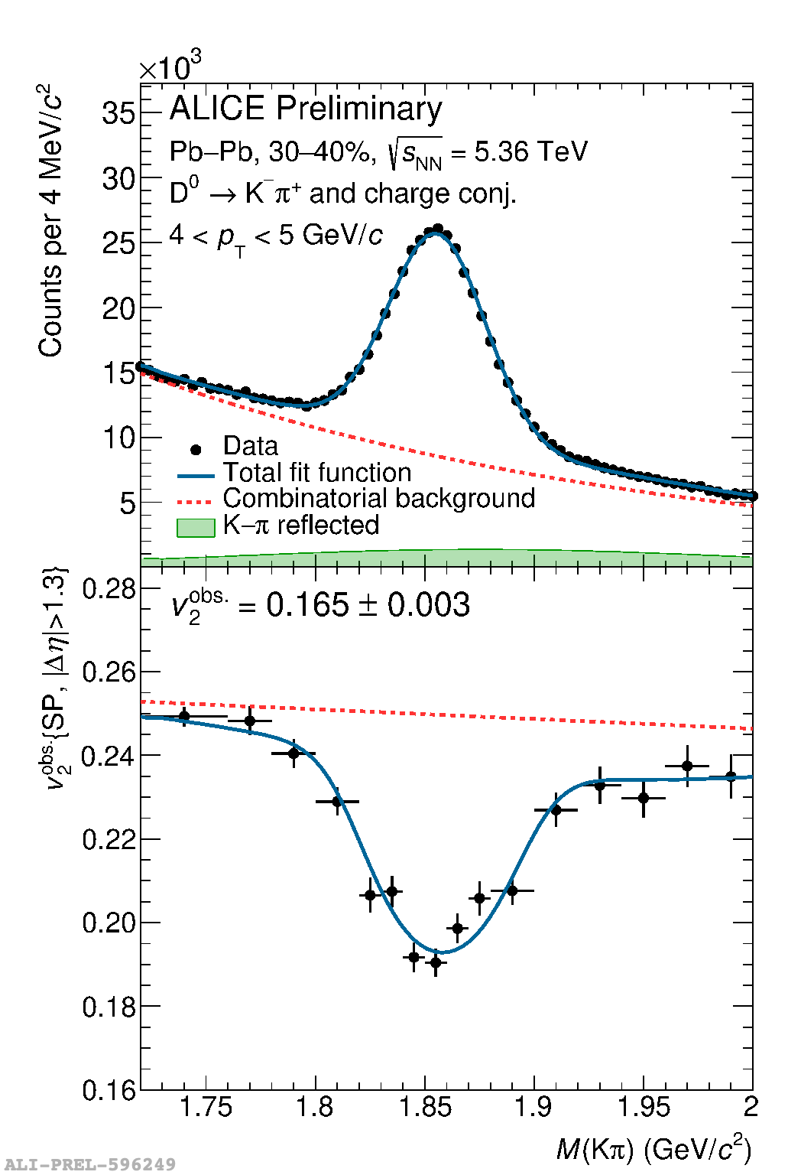
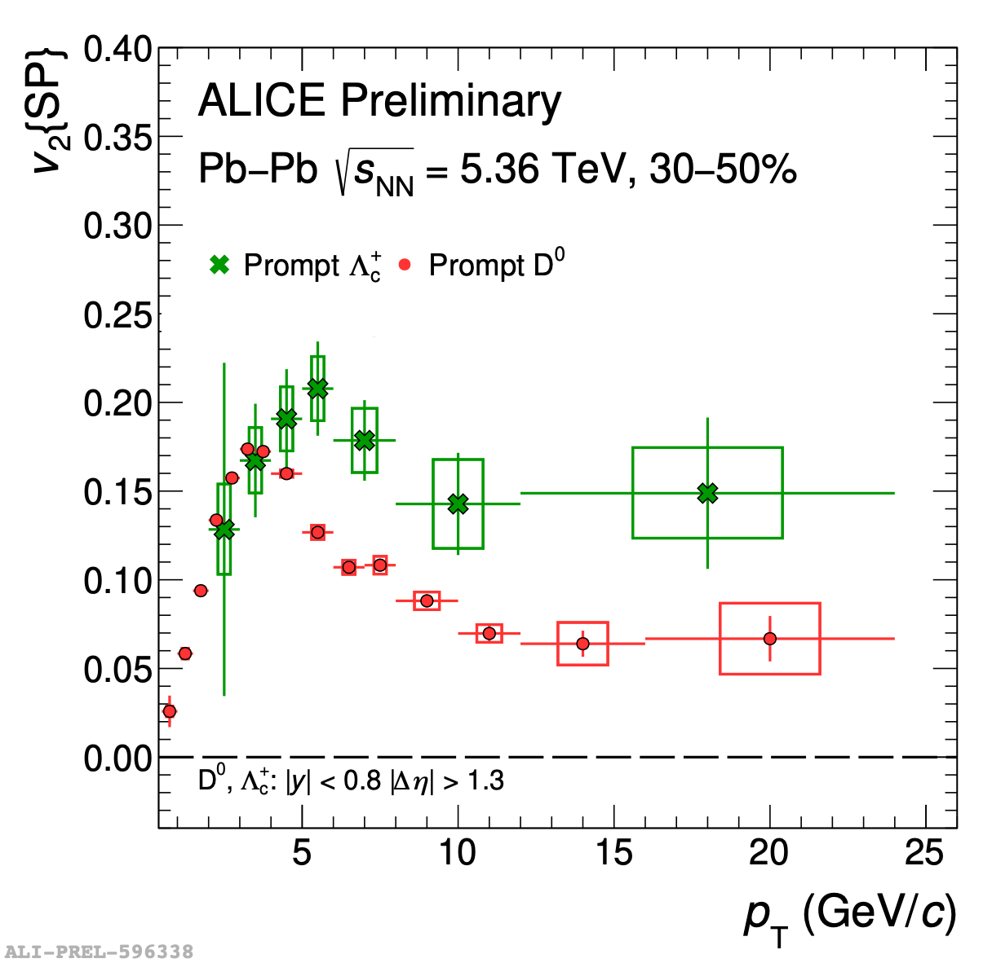
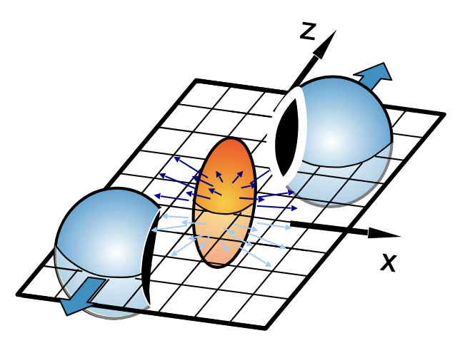



Recent Physics Results: ALICE
Elliptic flow v² of charm hadrons
Key result from Run 3 Pb-Pb (full 2023 statistics):
heavy flavour elliptic flow
  Lambda_c is a first measurement one of the LoI goals for ALICE 2
  Physics interest:
  baryon formation/coalescence
  (3 versus 2 quarks)
  Presented at Quark Matter
  April 2025 in Frankfurt
$Λ_{c}^{+}$: c + 2 light quarks
$D^{0}$: c + 1 light quark
Baryon v₂ approx. 3/2 times meson v₂: hadronisation by quark coalescence
$$\frac{dN}{dφ}∝1+v_{2}cos(φ−Ψ_{2})$$

Slide 11

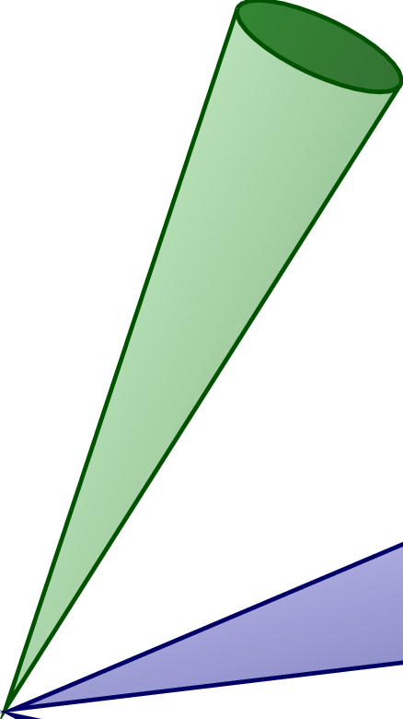
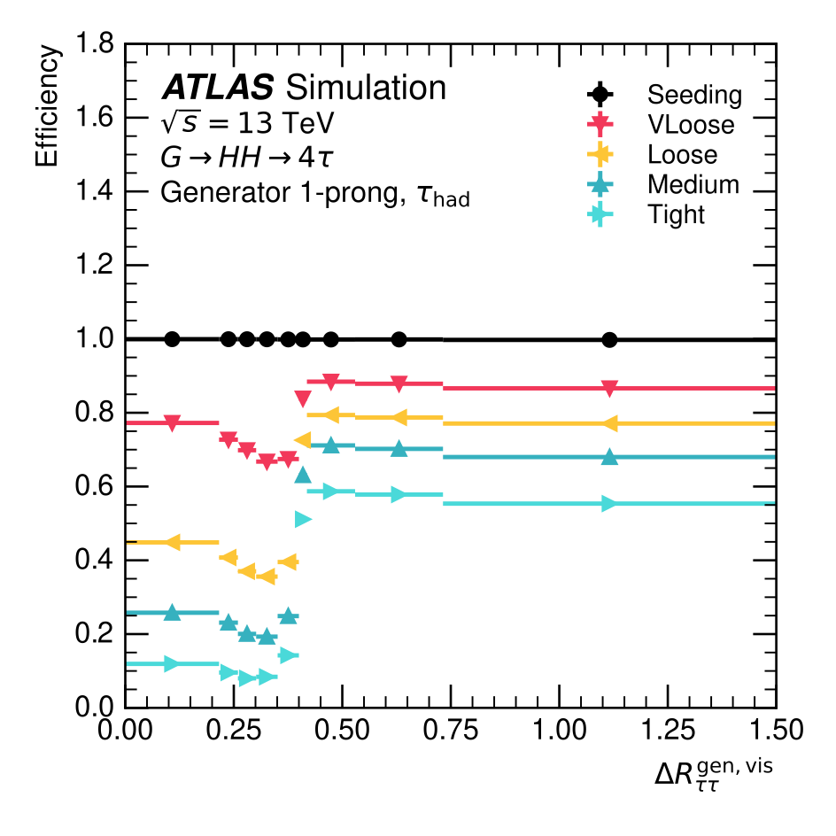
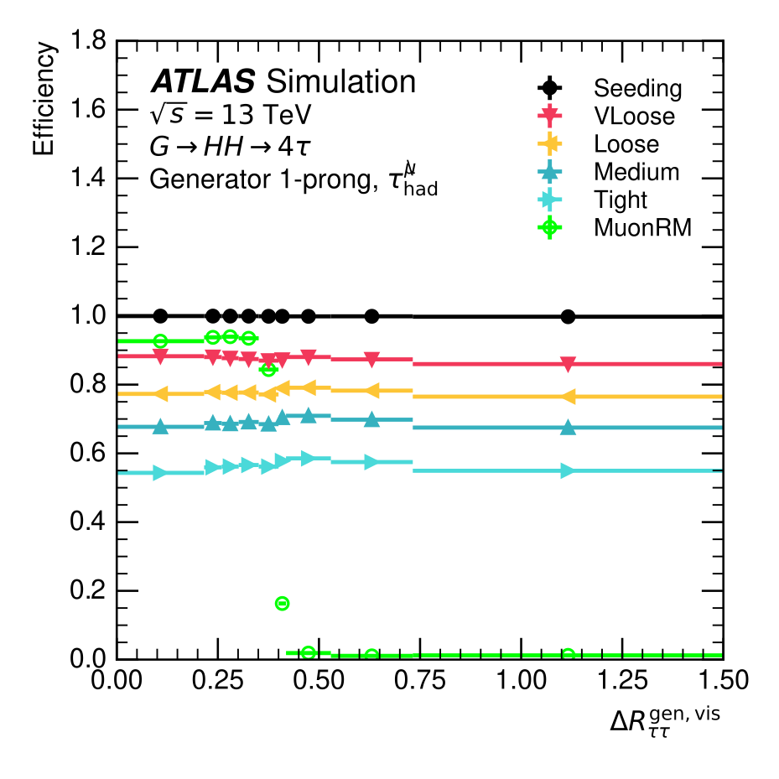

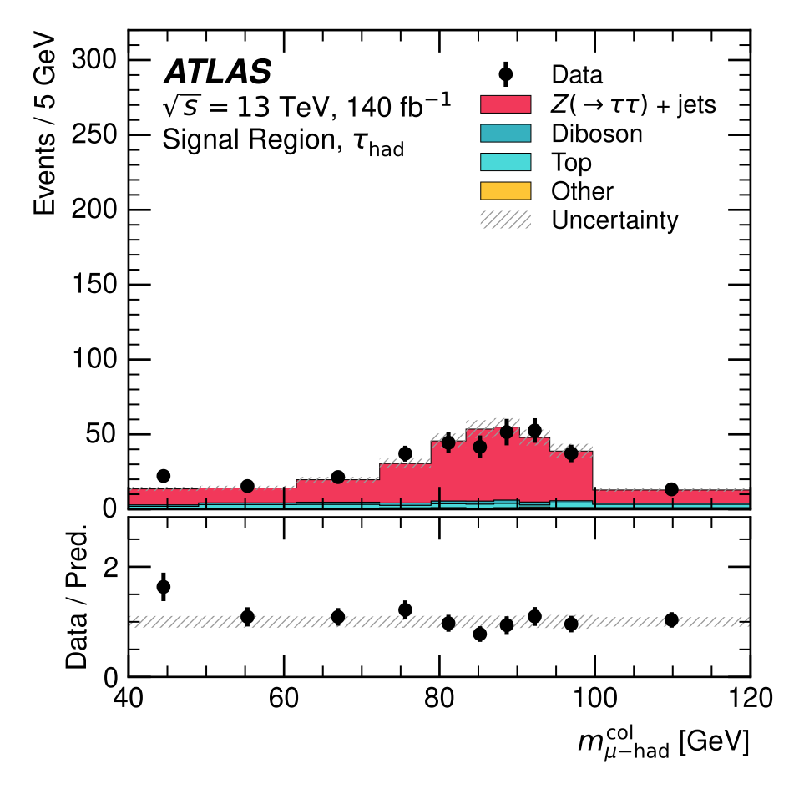
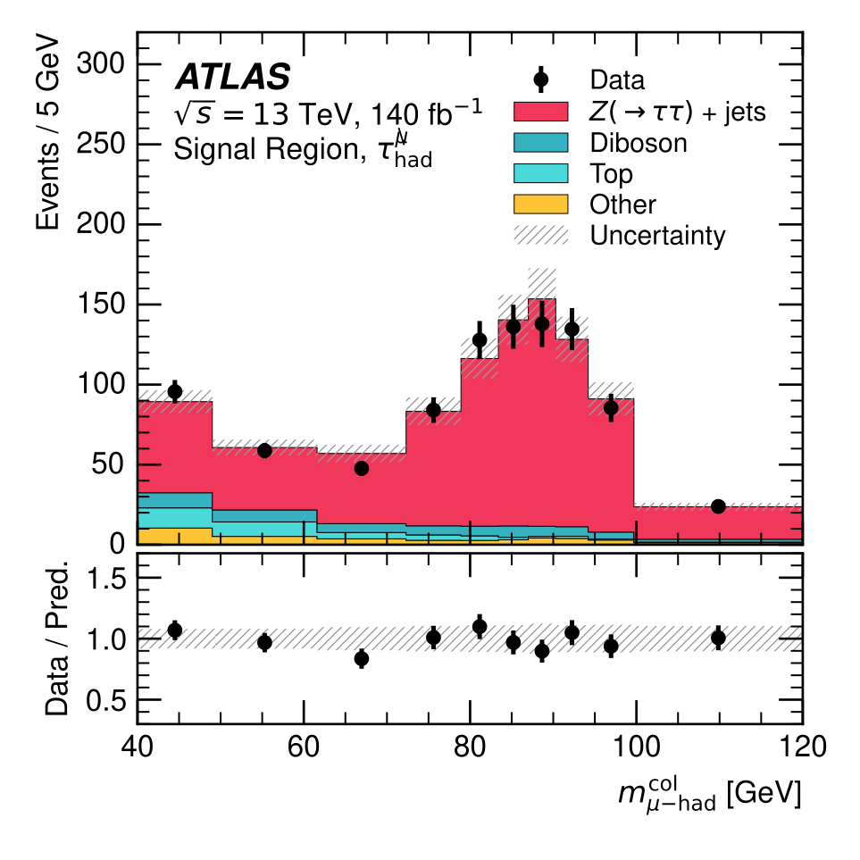







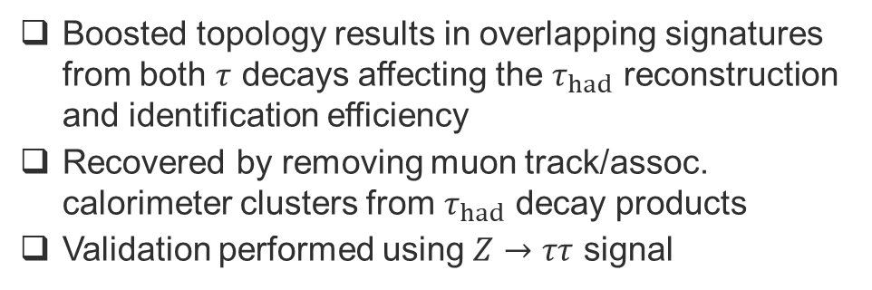

ATLAS: Highly Boosted Tau-Pairs
$$ν_{τ}$$
$$τ^{−}$$
$$W^{−}$$
$$ΔR<0.4$$
$$μ^{+}$$
Reco & ID efficiency recovered at low $ΔR$
$$τ^{+}$$
$$W^{+}$$
$$ν_{μ}$$
$${\overline{ν}}_{τ}$$
Boosted topology results in overlapping signatures from both $τ$ decays affecting the $τ_{had}$ reconstruction and identification efficiency
Recovered by removing muon track/assoc. calorimeter clusters from $τ_{had}$ decay products
Validation performed using $Z→ττ$ signal
x4-5 signal acceptance increase

Slide 12

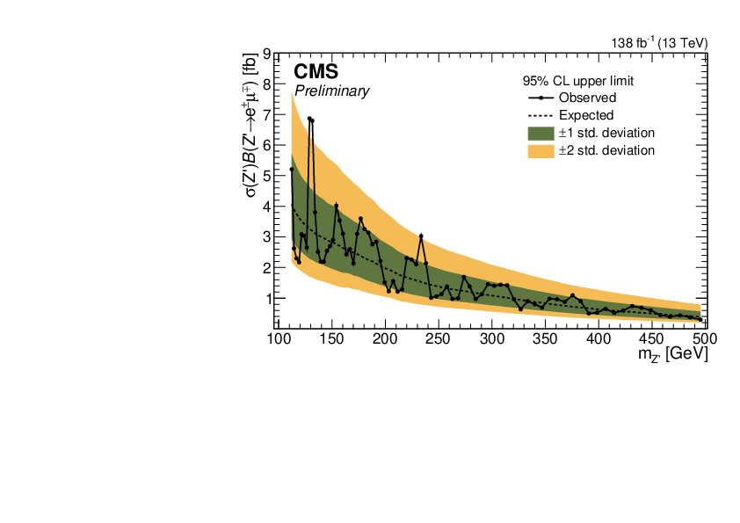
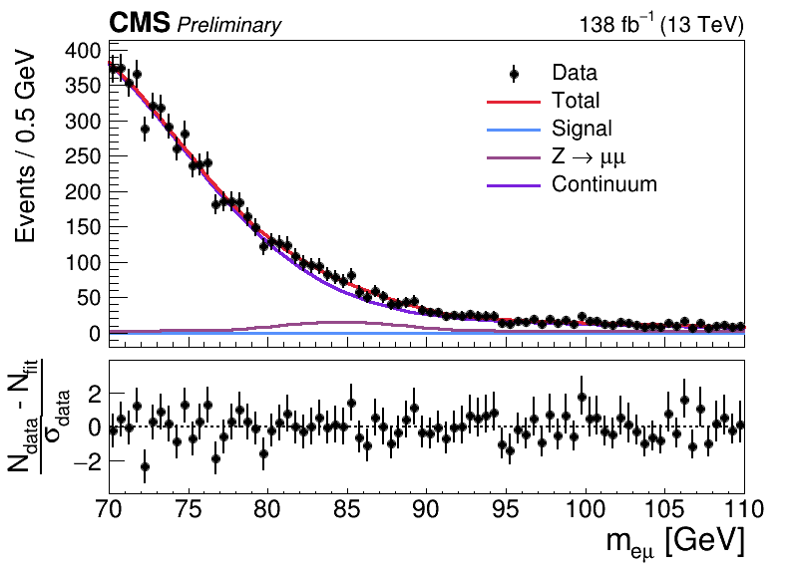
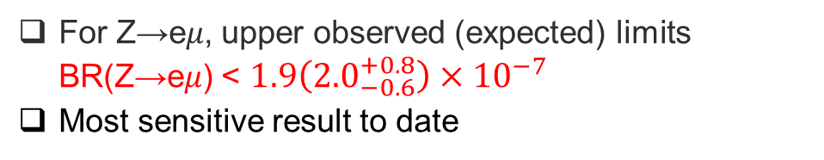
CMS: Search for Charged Lepton-Flavour Violating Z and Z´ Decays
Search for Z→e𝜇, Z→e𝜏, Z→𝜇𝜏
Search for a heavier Z’→e𝜇
Z→e𝜇
Z’→e𝜇
For Z→e𝜇, upper observed (expected) limits BR(Z→e𝜇) < $1.9\left({2.0}_{−0.6}^{+0.8}\right)×{10}^{−7}$
Most sensitive result to date
For Z’→e𝜇, upper limits cross section times BFs range from 0.3 to 7 fb in the Z’ mass range of 110-500 GeV

Slide 13
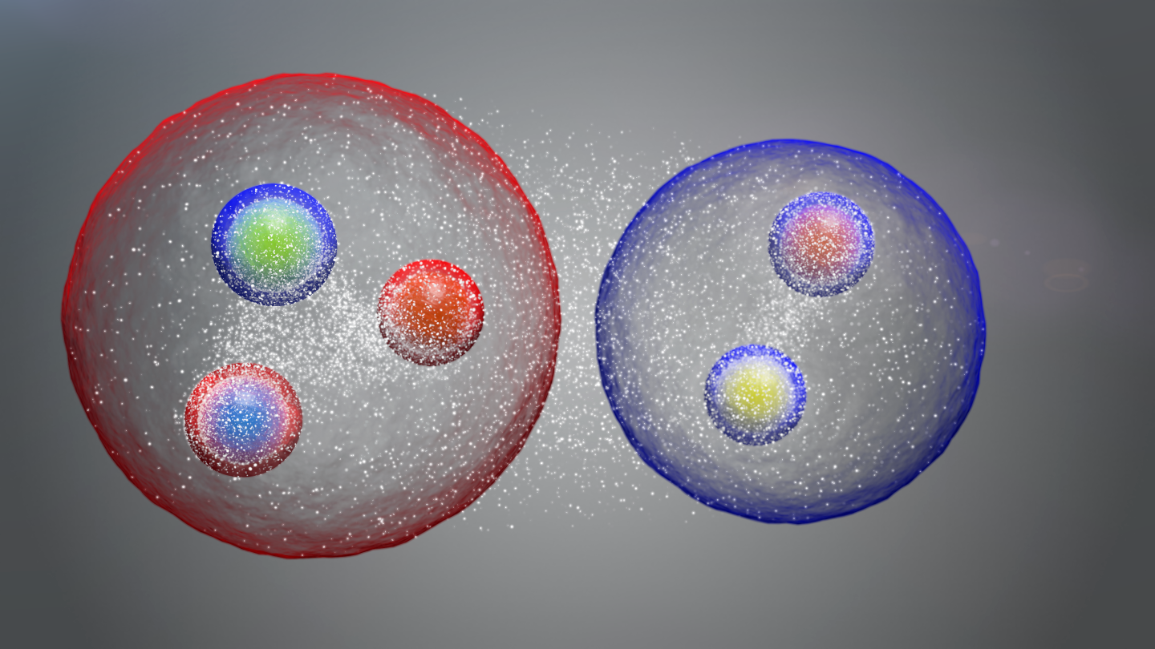
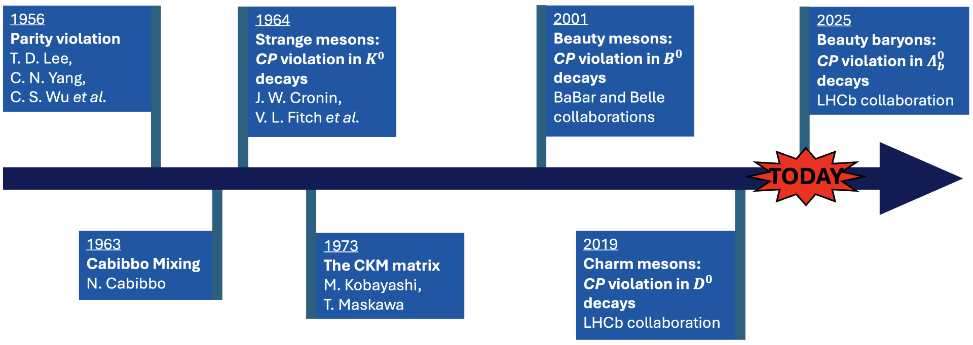
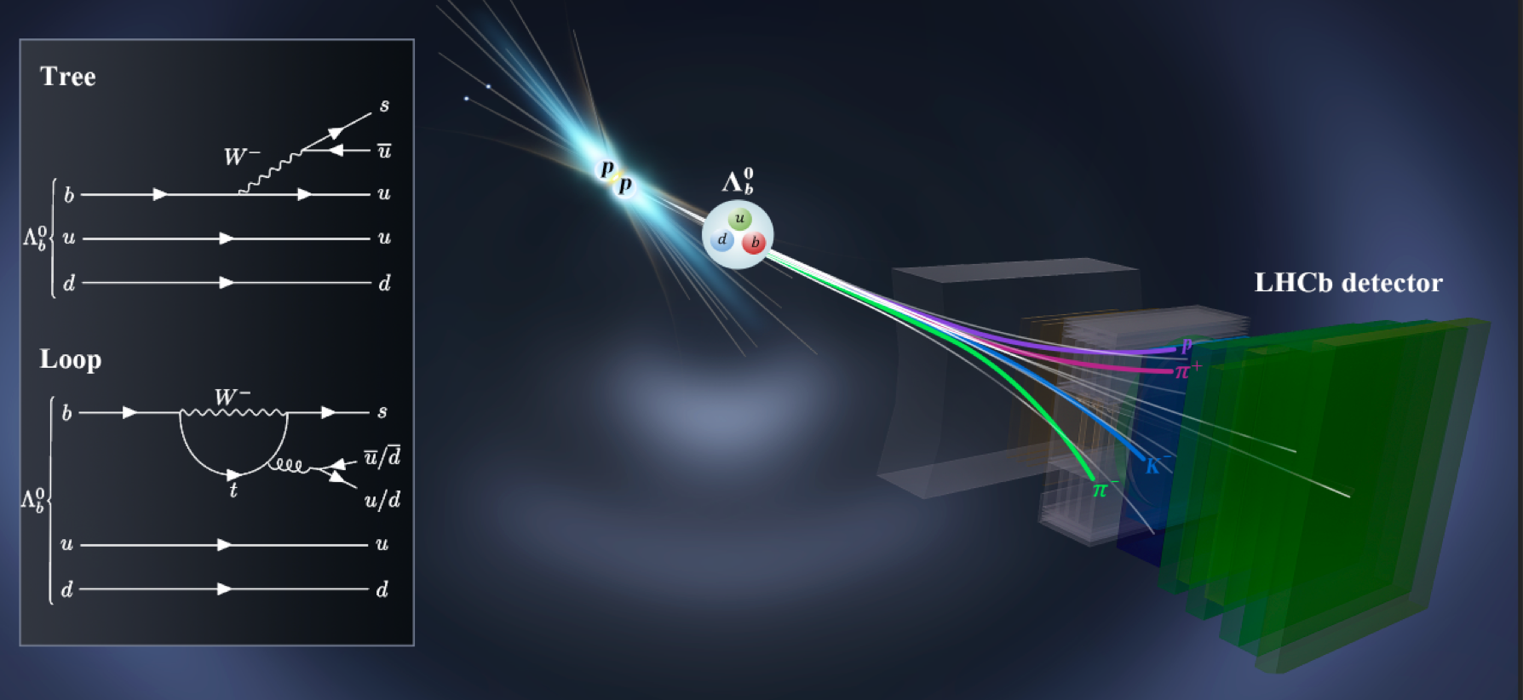
LHCb: Observation of CP Violation in Baryon Decays
Meson
Baryon
So far CP violation was only observed in processes involving mesons
LHCb reports the first observation of CP violation in baryon decays
This observation opens a new avenue in the studies of the Standard Model and its extensions

Slide 14

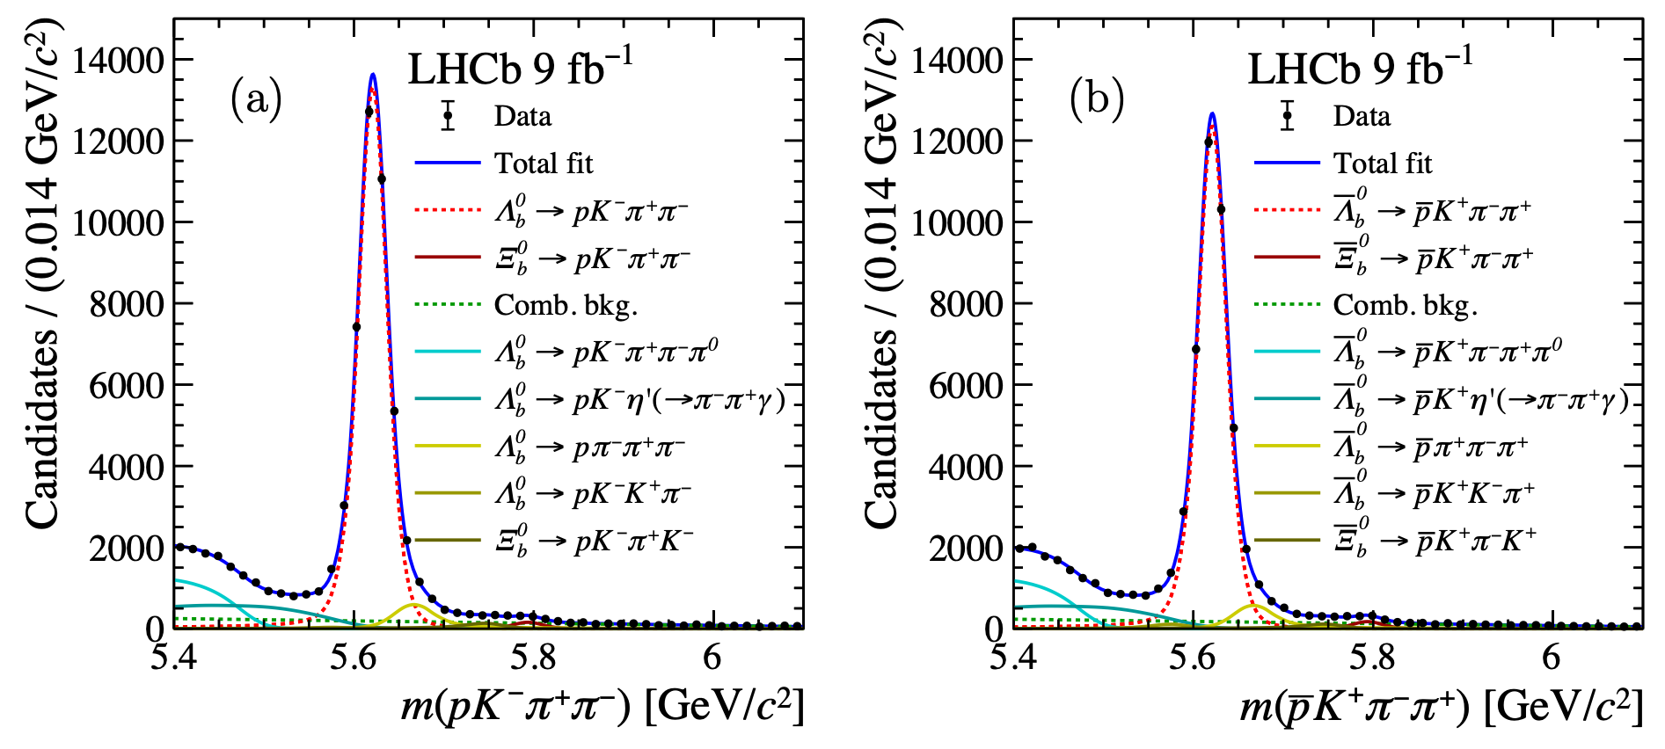

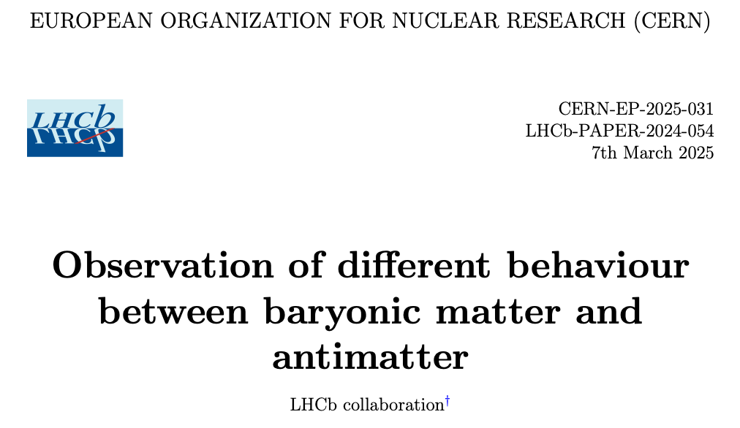

LHCb: Observation of CP Violation in Baryon Decays
LHCb studied the decay rates of the $Λ_{b}^{0}$ baryon and ${\overline{Λ}}_{b}^{0}$anti-baryon into the pKππ final state
Measured a small but significant difference in the decay rates
CERN press release
$5.2σ$ difference from zero
LHCb-PAPER-2024-054
Submitted to Nature

Slide 15
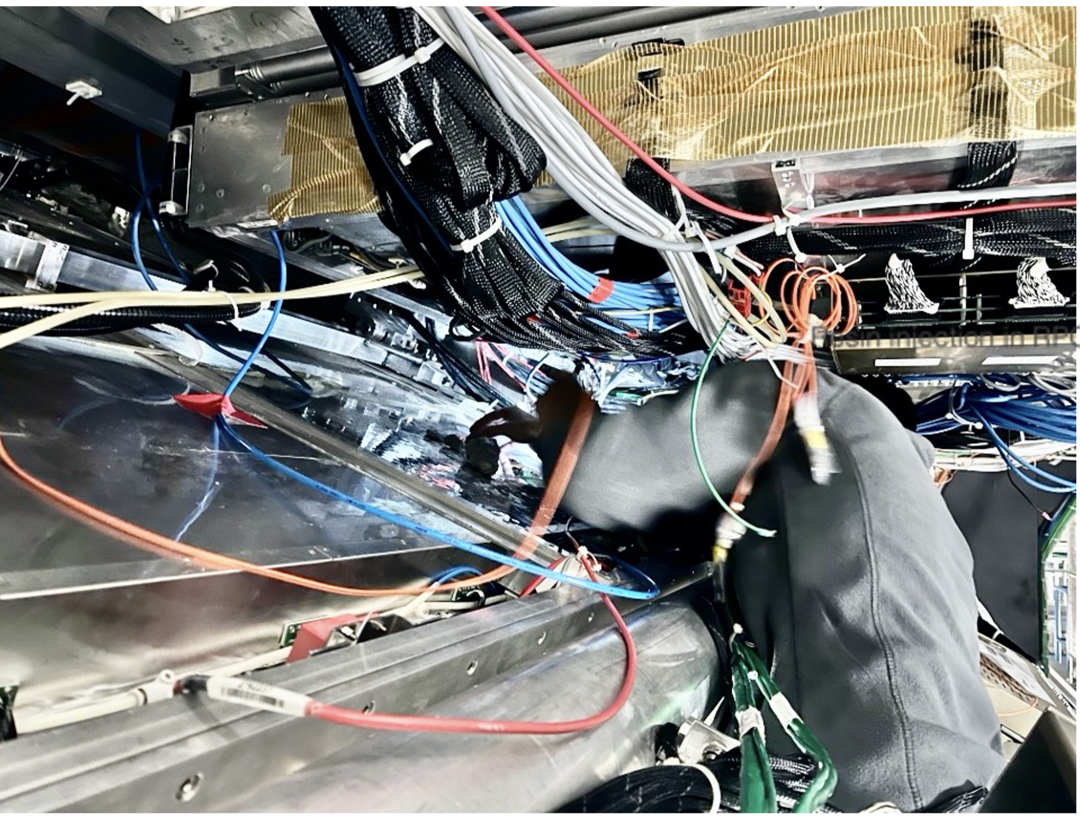
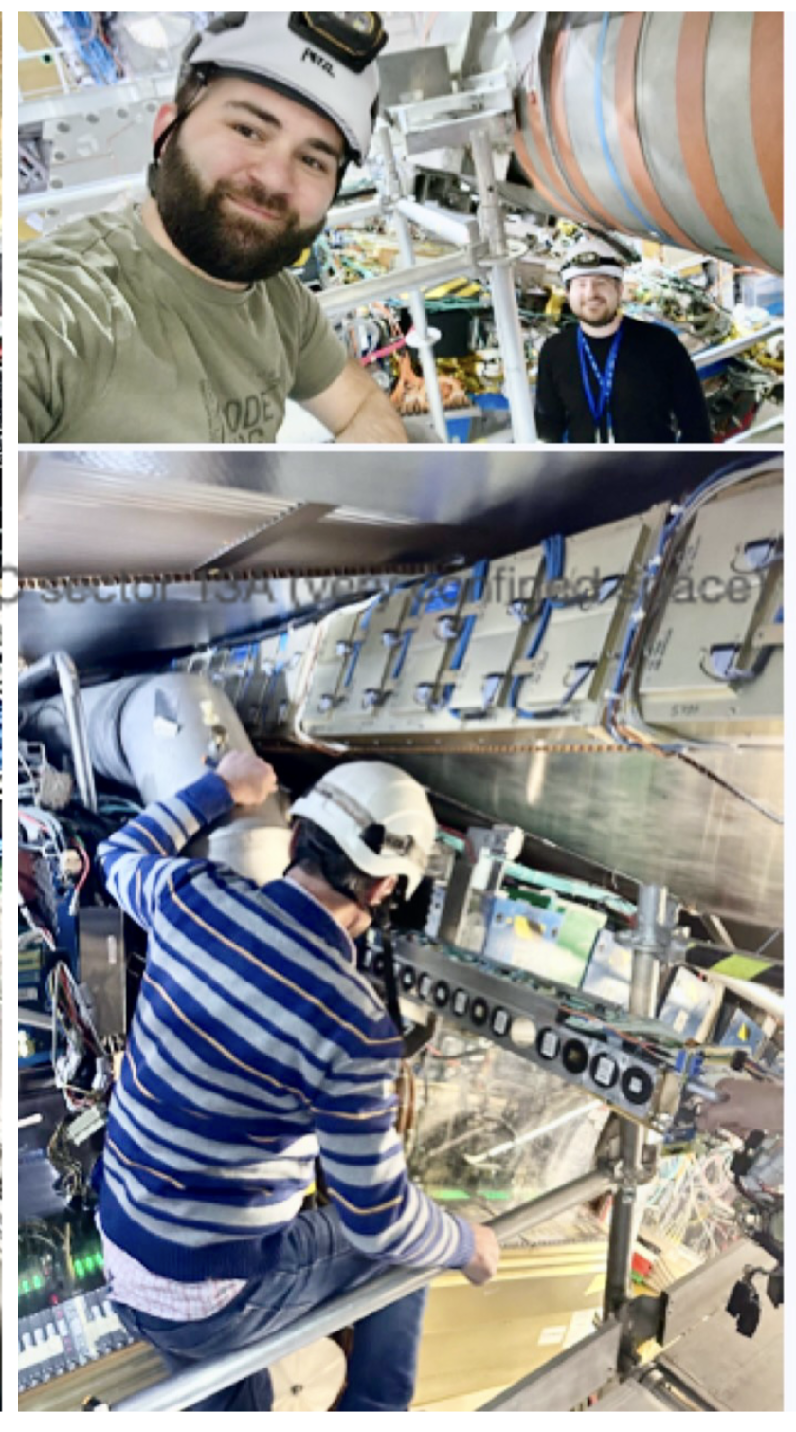
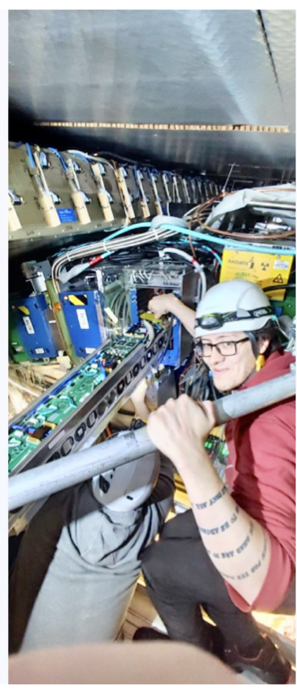
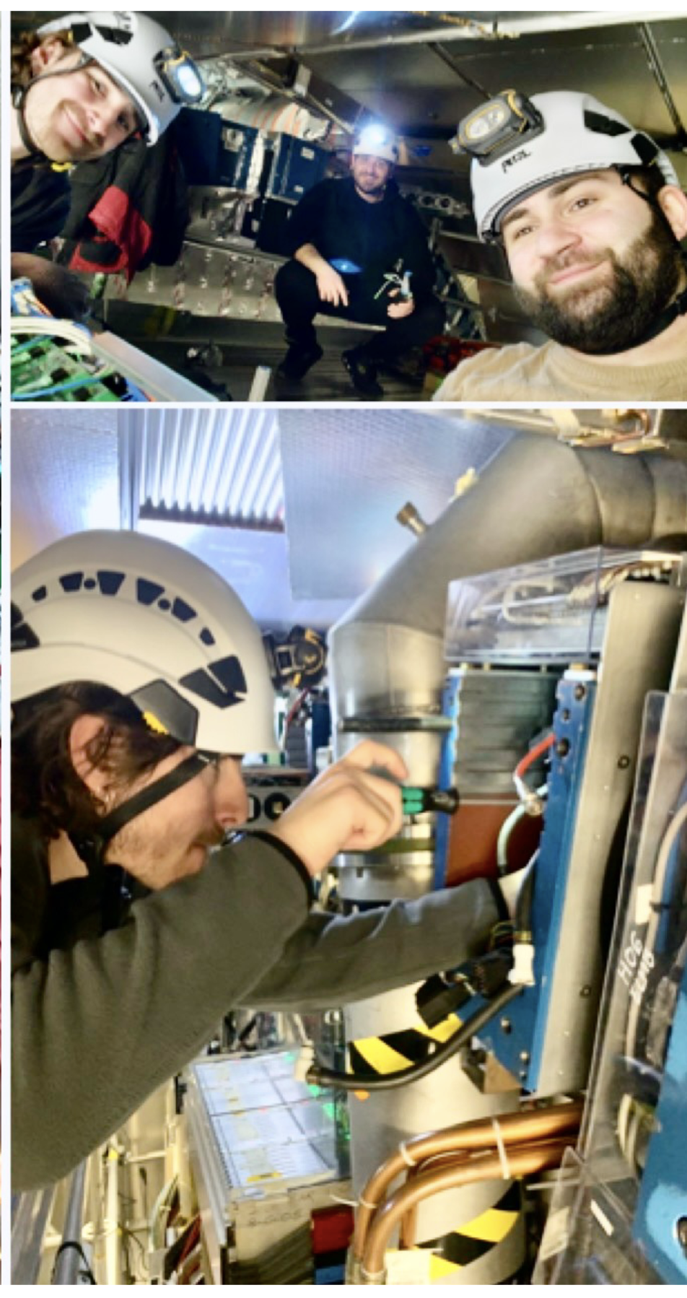
YETS Activities: Impressions from ATLAS
Resin injection in RPC sector13A (very confined space!)
to fix gas leaks
TileCal maintenance team exchanging valves in cavern

Slide 16
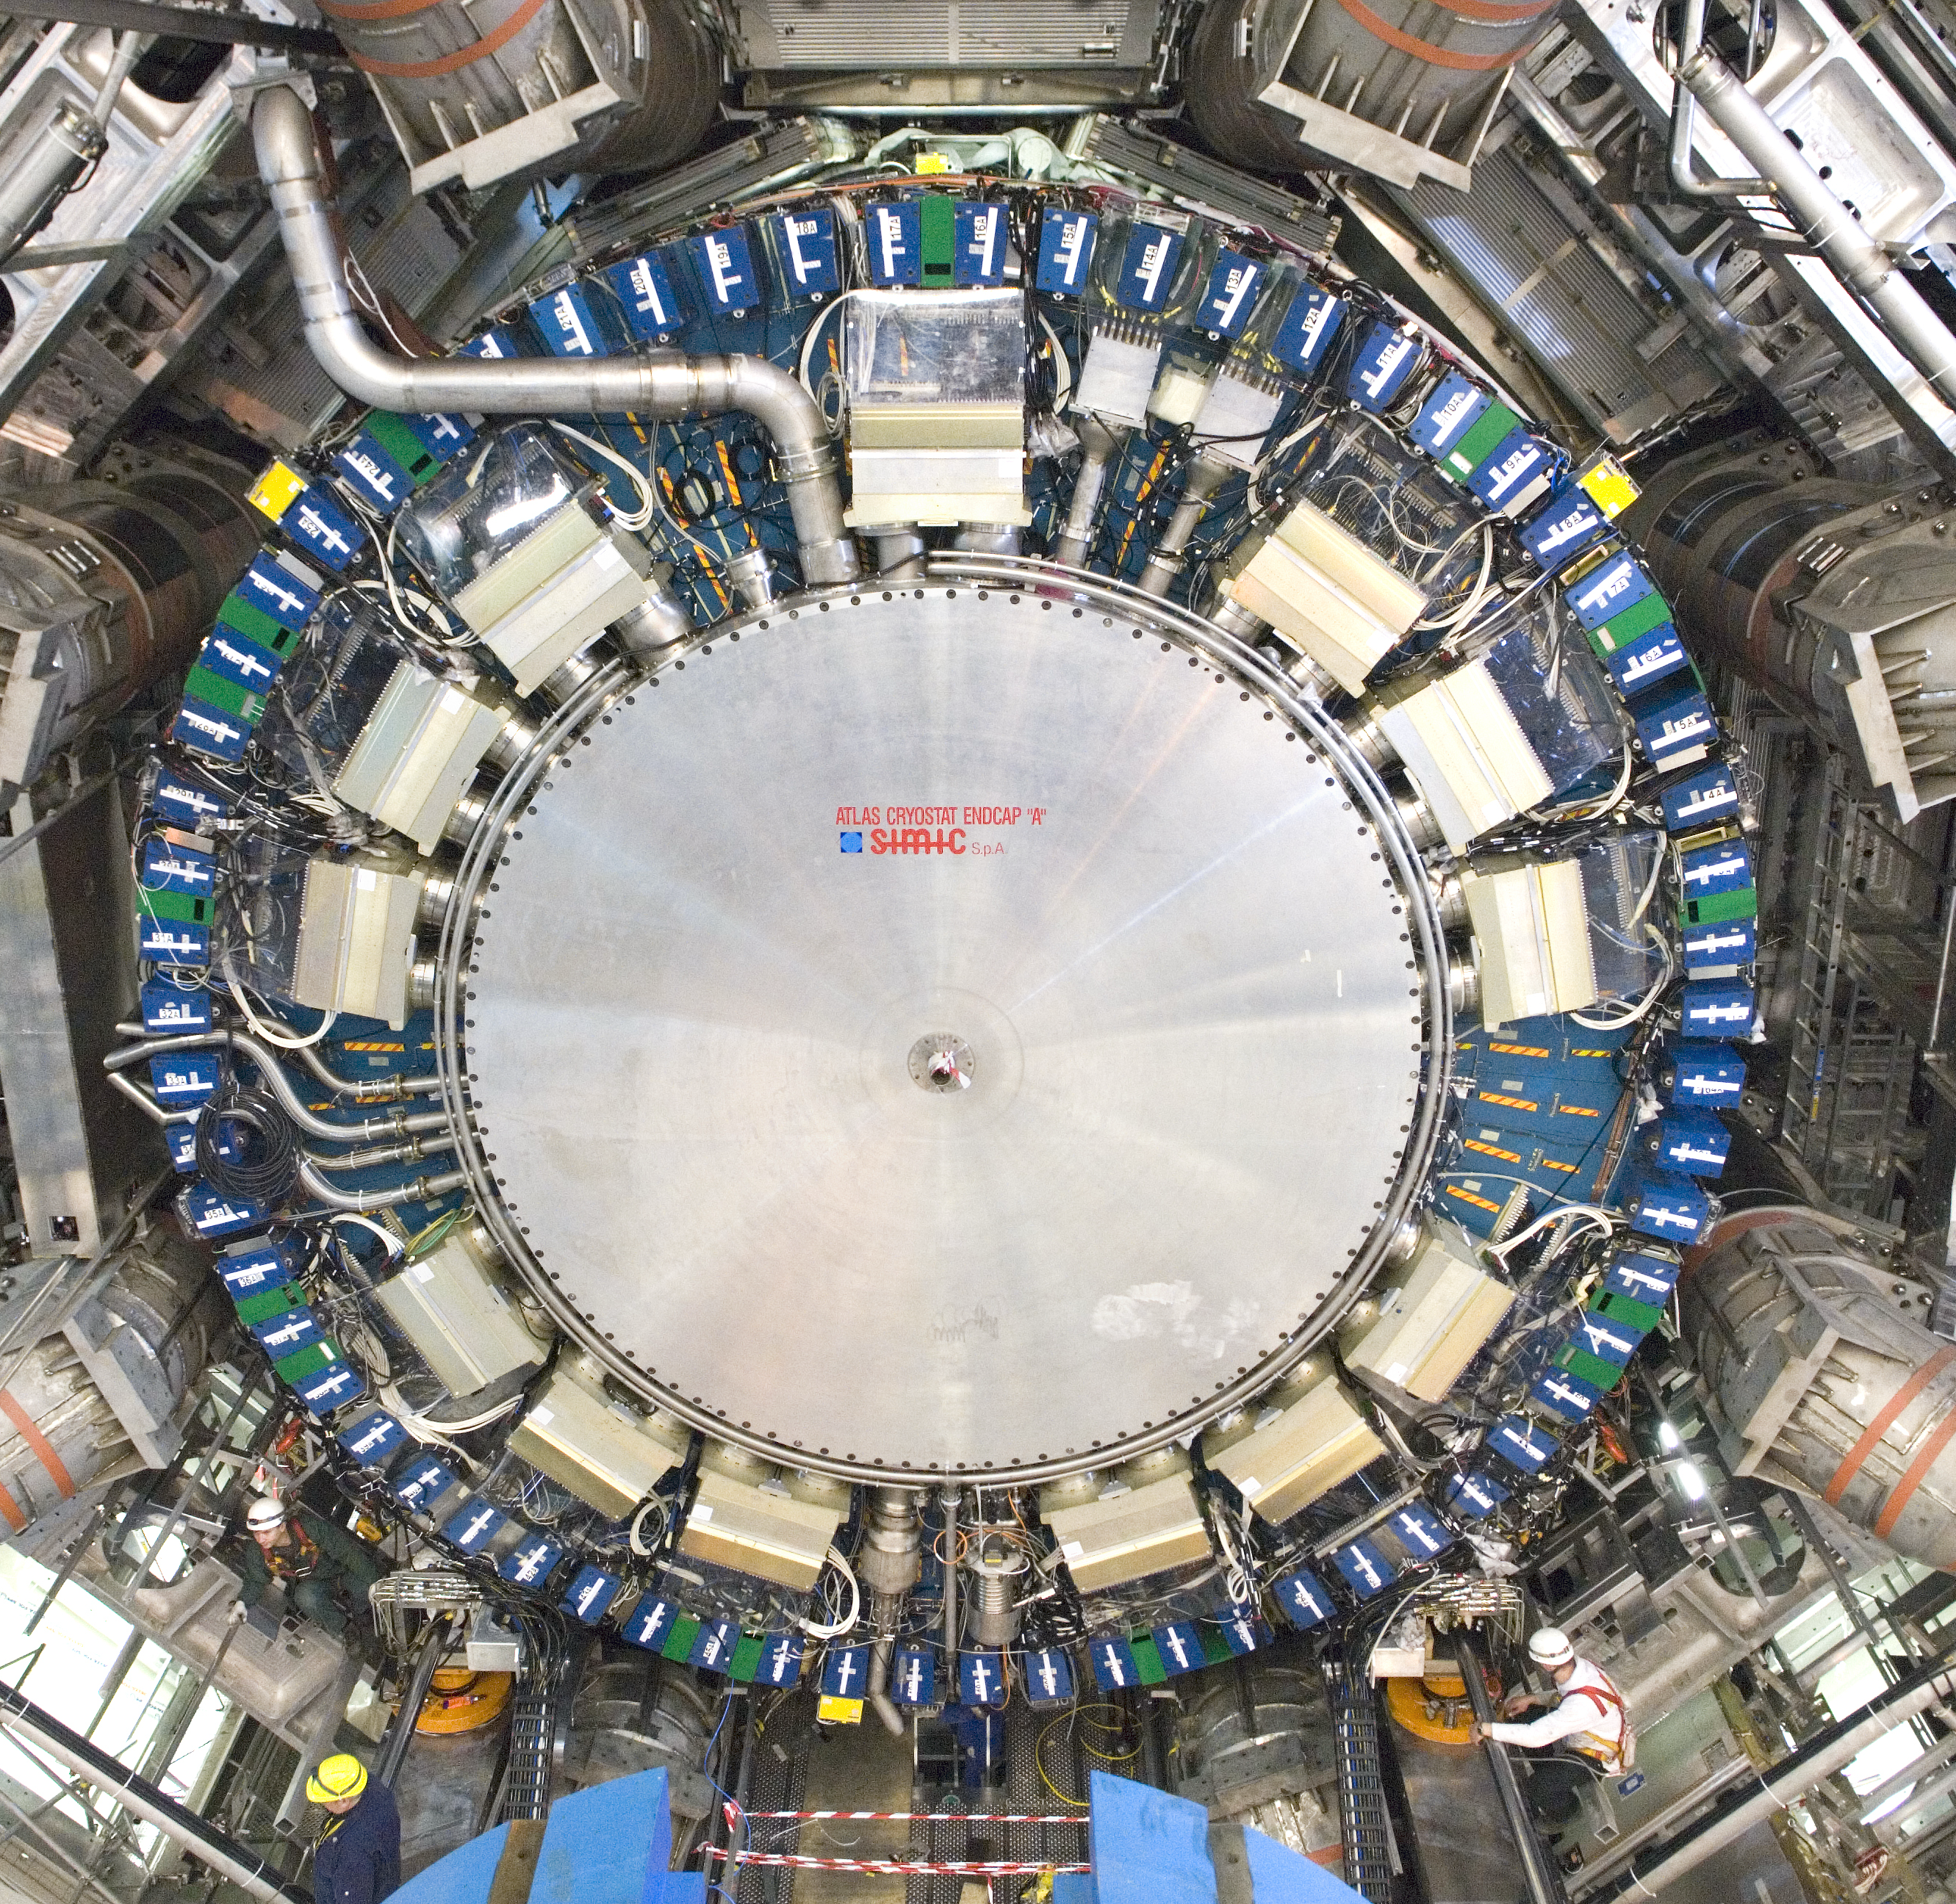
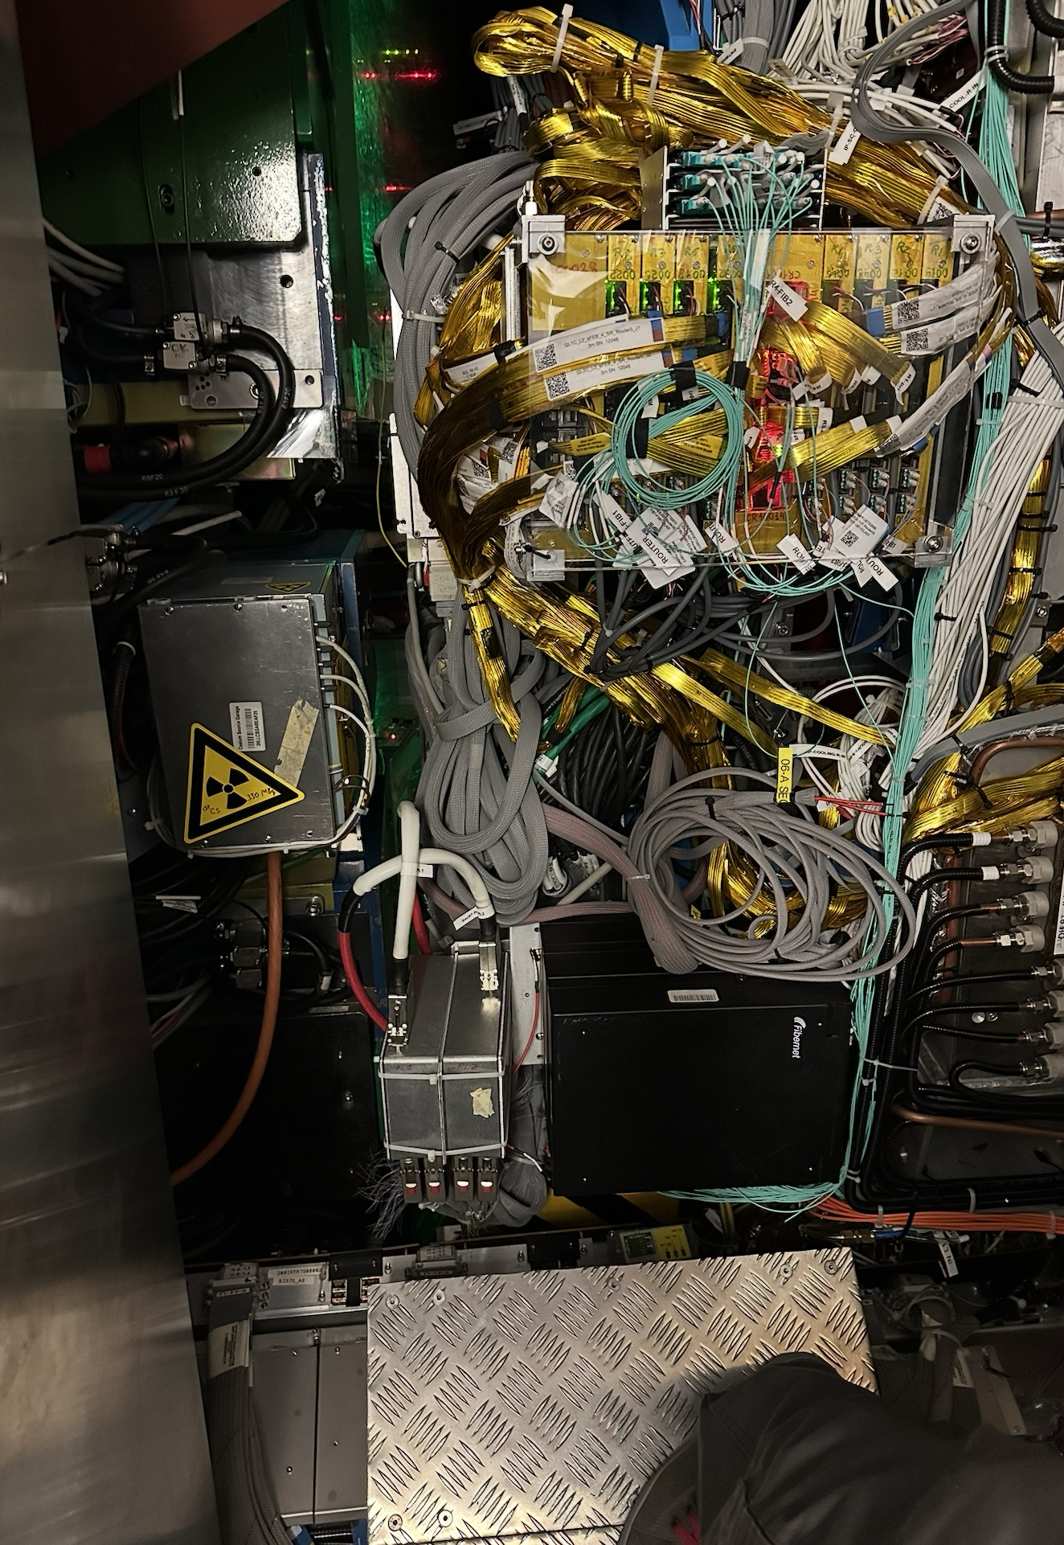
ATLAS LAr FE Cooling Leak
Just before closing the detector at the end of March:
Leak of the LAr front-end (FE) under-pressure water cooling system detected
Two FE crates had to be switched off during the weekend
  Reduced LAr endcap A acceptance significantly
      Very difficult access
    Immediate action taken:
      Moving of NSW to allow access
      Thanks to big efforts by ATLAS and support by teams from the LHC and other experiments, delay could be limited to a couple of days
Tile fingers
NSW outer rim
Cs garage
Leaking loop covers those crates and PSs
Access when ATLAS is open
Access situation now

Slide 17
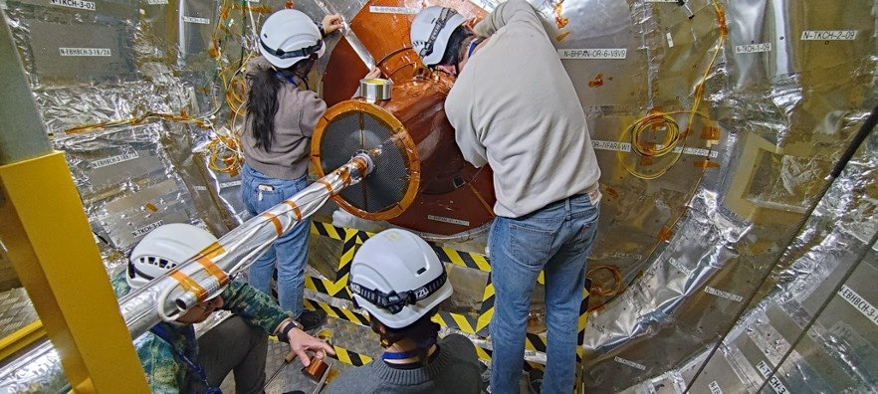
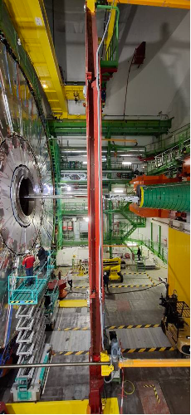
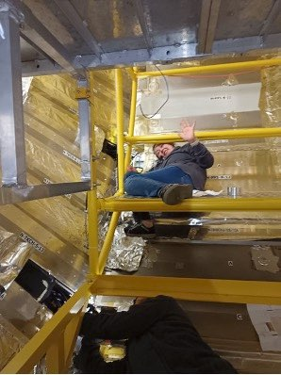
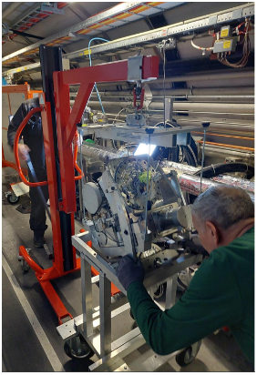
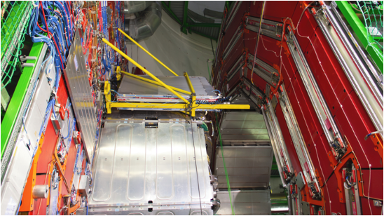
YETS Activities: Impressions from CMS
Tracker: opening of the bulkhead and cleaning of Pixel fibers
RPC (Barrel)
Leak Repair
Opening with push back system for
Installation of RE-4/1 chamber
HCAL-HO
Electronics maintenance
PPS in tunnel

Slide 18
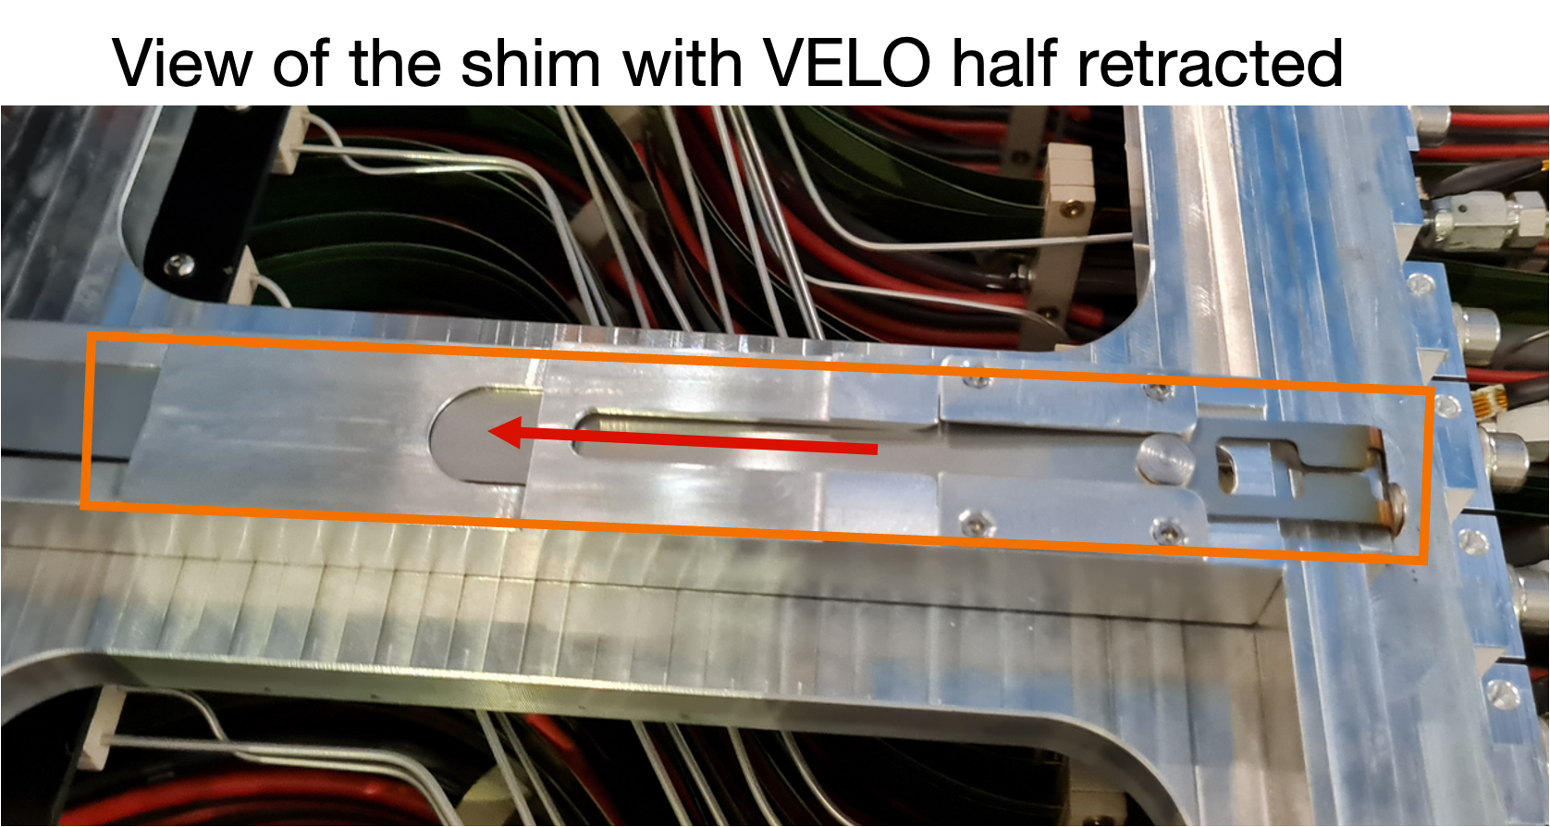
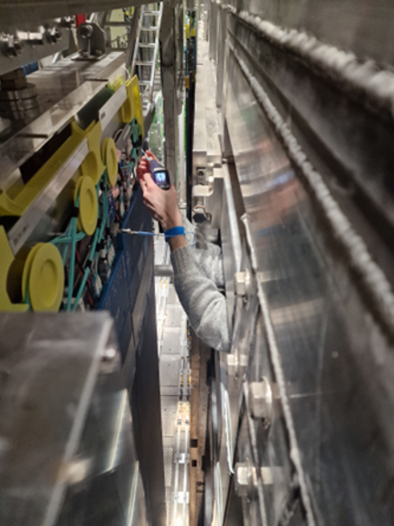
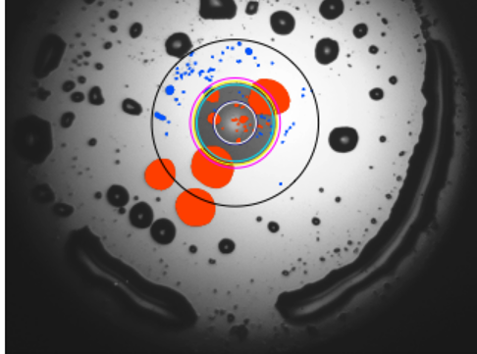
LHCb & ALICE YETS Activities
LHCb:
  VELO: removal of shims allows the VELO sensors to move 0.5 mm closer to the beam line. Expect an improvement in IP resolution of around 10%
  Change of an O-ring to fix minor leak of the secondary vacuum detected in 2024.
  SciFi tracker: changing the SiPM cooling liquid from C₆F₁₄ to NOVEC 7100, 30 times lower greenhouse warming potential
  SciFi & RICH: Huge campaign to clean fibres: performance degradation due to outgassing of VTRx
ALICE:
  Magnet: cooling leak fixed
  TPC: cooling leak in field cage rod fixed
  General maintenance of all detectors
  Stains from outgassing of VTRx
All 4 detectors are ready and eagerly waiting for stable beams at 6.8 TeV

Slide 19
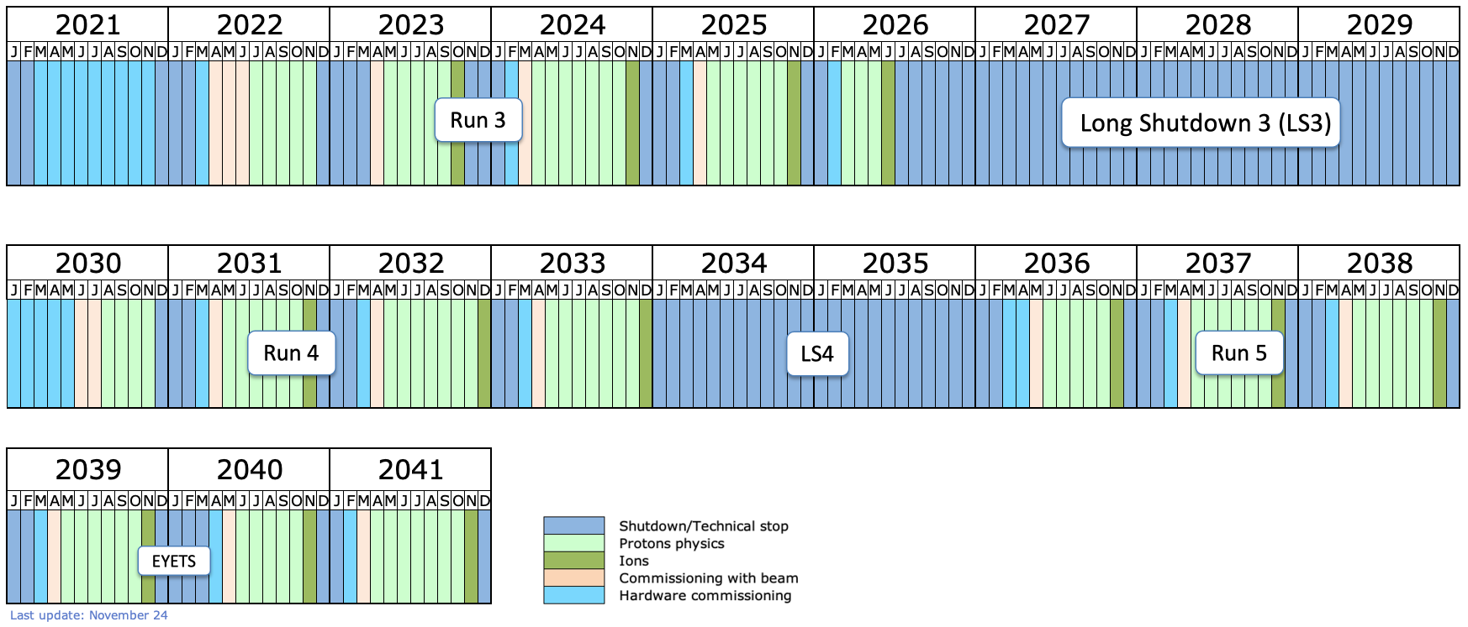
Detector Upgrades: LHC Timeline
today
LS2: Upgrade of accelerator and detectors (Phase I)
LS3: Upgrade HL-LHC and Phase II ATLAS&CMS
North Area Upgrade (SHiP)
start HL-LHC
LS4: Upgrade
Phase IIb ALICE&LHCb

Slide 20
Phase II Upgrades
High-level summary:
ATLAS and CMS are making good progress in many areas, more details below
But schedule remains tight even after moving start of HL-LHC as several technical risks remain

Slide 21
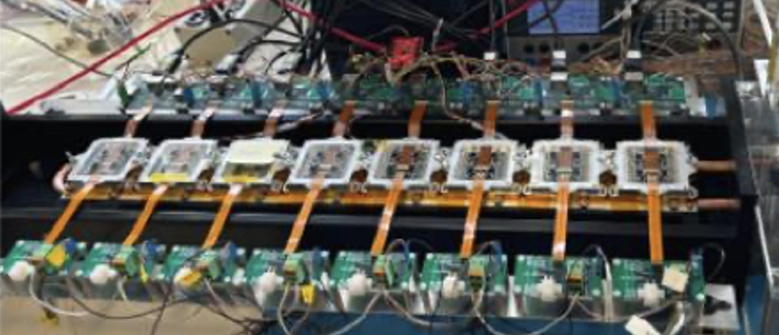
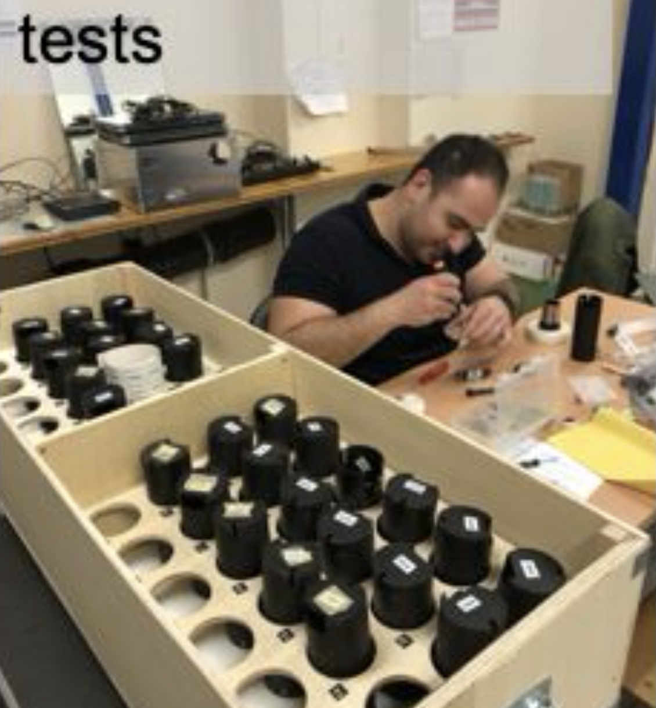
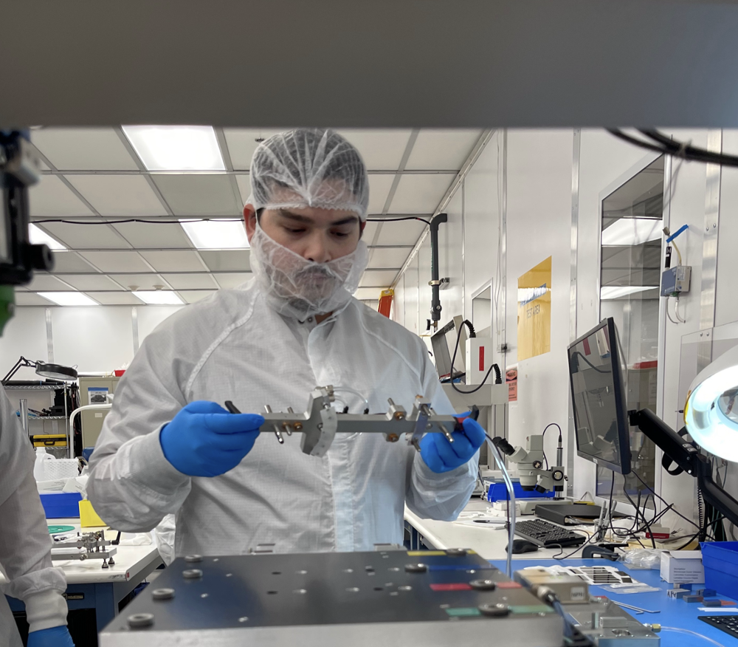
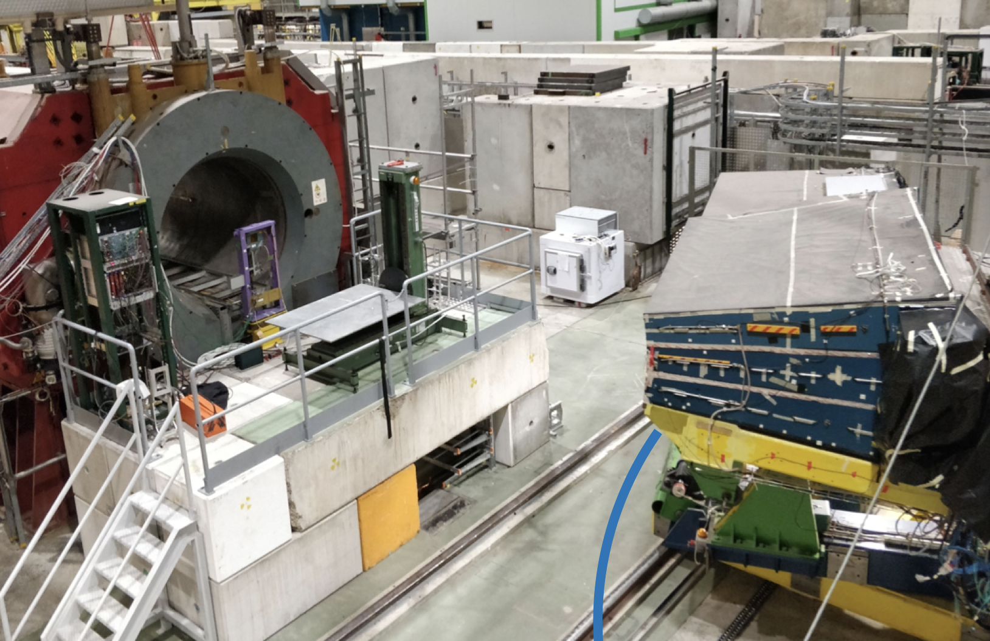
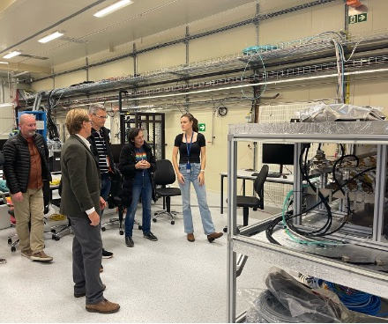
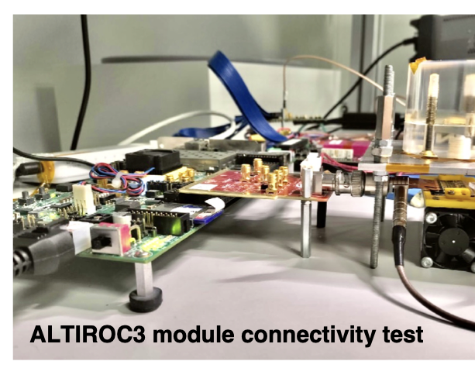
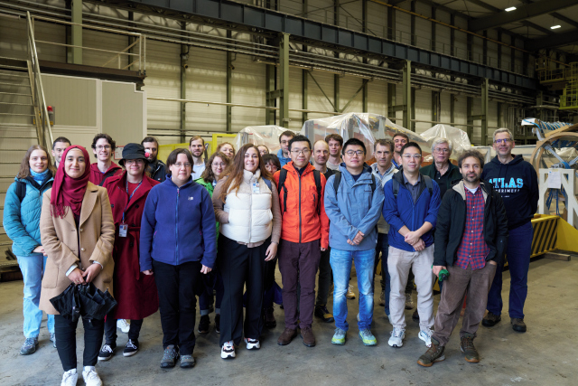
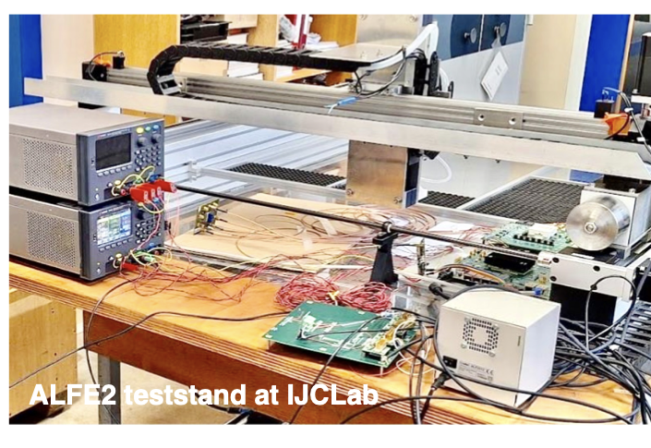
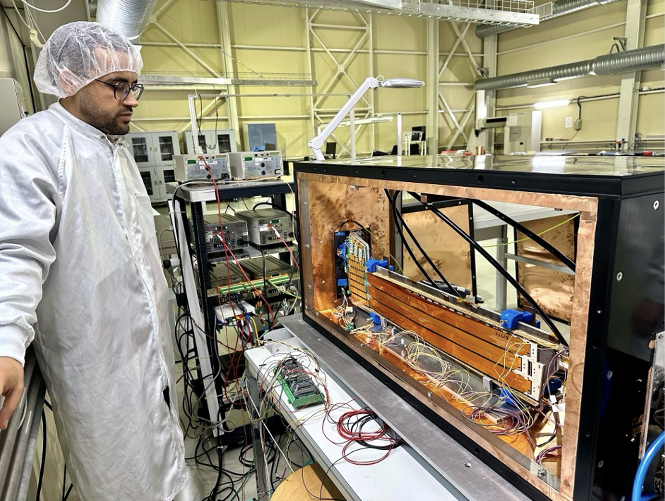
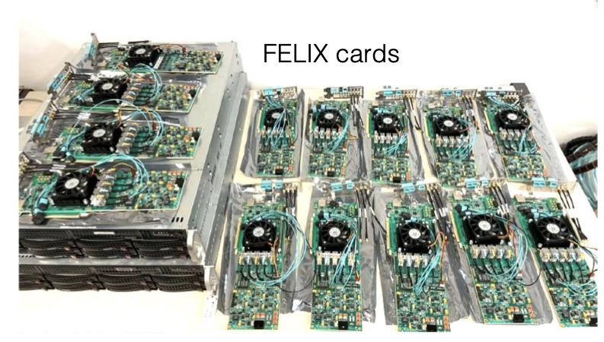
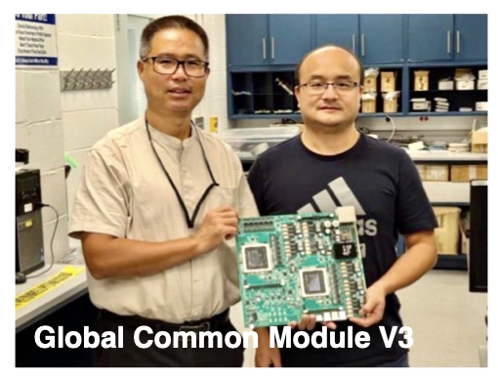

ATLAS Phase II Highlights
ITk serial powering
Tile PMT tests
ITk module production
ITk system tests
Main objectives for 2025:
Complete ITk sensor/FE chip fabrication
Produce strip barrel staves/endcap petals and pixel modules at nominal speed
Tile modules in test beam
Visit to Phase-II upgrade sites
HGTD module connectivity testing
LAr preamp/shaper testing
HGTD demonstrator
FELIX cards
Front-end electronics testing for Muon RPCs
Muon RPC readout panels
Muon RPC production
L0 global trigger prototype testing

Slide 22





CMS Phase II Highlights
For the first time two silicon Low and two High Density trains on a cooling plate
Big step towards integration and system evaluation
Outer Tracker modules
in pre-production
Starting Pixel module production
Main objectives for 2025:
All designs finalised
Tracker module & ladder, HGCAL module & cassette production started
Stacking of back-flange and back-disk
with attachment of wedges and support cylinder
BTL-Tracker Support Tube heating foil gluing
Ready for BTL installation early March
Machining of full set of one CE-H endcap absorber completed in Pakistan
Pre-assembly of absorber stack underway

Slide 23
Phase II: High-Level Summary
Since October 2024:
Good progress in many areas
But some delays occurred: mainly due to faulty lpGBT ASIC, Samtec Firefly, HGROC ASIC (CMS), establishing a solution for ITk (endcap) sensor cracking (ATLAS)
Corrected lpGBT v2 ASIC is now available, much earlier than anticipated, thanks to huge efforts of CERN EP-ESE group,no further delays expected due to this issue, is now a question of money, e.g. reproducing ITk end-of-stave cards
Risks of cash and cashflow problems
outstanding contributions from some countries, also still outstanding compensation for Russia
Main risks/issues of concern:
ATLAS:
ITk pixel has still contingency but almost all sub-items on critical path
ITk strip production delay caused by interposer (solution to the sensor cracking) has still to be assessed
CMS:
Hybrids for outer tracker
HGCAL 98% of design finished but many small things to be achieved to start cassette production this autumn

Slide 24
Risk Mitigation
Are there ways to mitigate these known (and also unknown) risks on the schedule?
Any further slippage would require even more resources and reputationally be very detrimental
Measures where Funding Agencies could help:
More flexibility across sub-projects, for both money and person power, rather than taking rigid definitions from the MoUs
More flexibility in common resources
Mechanism to socialize cost overruns in big items with savings in others (compensation mechanism)
Prioritise Phase II wrt. other LHC related requests
Help to spread and raise the awareness among the collaboration members that Phase II is the highest priority project and must be completed on schedule
Help to avoid cash flow problems in the collaborations
e.g. 50% of the CMS Detector Upgrade Fund (DUF) is still missing
Strong support (physicists, engineers, technicians) will be required also during the detector installation in LS3 and after that for commissioning
Now is the time to start planning

Slide 25
Phase IIb: ALICE and LHCb
Both experiments submitted scoping documents
Scenarios with different core costs and physics performance & reach
In March 2025 the LHCC provided a detailed scientific and technical review
  Frank Simon will report on this in more detail in the ALICE and LHCb sessions
Followed by discussions in the CERN Research Board, see below
Goal is to define the scopes of the upgrades by the end of this year
  Based on discussions with Funding Agencies to define realistic funding envelopes
Then start to work on TDRs
Detector improvements during LS3:
ALICE: ITS3 and FoCal: TDRs are completed and endorsed by Research Board
LHCb: ECAL, RICH; endorsed by RB; DAQ Enhancement TDR; LHCC recommended for approval

Slide 26

ALICE & LHCb Scoping Options
CERN-LHCC-2024-010
CERN-LHCC-2025-002
Scoping options:
Without ECAL
Reduced field (2 T → 1T)
Reduced acceptance |η| < 2.5
Estimated core cost range: 116 - 170 MCHF
Estimated core costs [MCHF]:
182 156 125

Slide 27
CERN Research Board 19.03.2025:
The Research Board thanks the LHCC for their thorough review and endorses the setting up of the two expert reviews recommended by the LHCC, on the installation schedules and ASIC production for the ALICE and LHCb upgrades, noting that these should proceed in parallel while the scope of the upgrades is decided. The timeframe is for detailed discussion to take place with the funding agencies at the Resources Review Board (RRB) in April to take stock of the available resources, and then approval of the chosen scope for each experiment to be made later this year following the October RRB, based on an updated assessment of the available resources. The CERN Council and its subordinate bodies will be kept informed and input from the SPC on the scoping scenarios will be sought.
The Research Board recommends that ALICE concentrate on the scoping options without the ECal, and with acceptance that can be afforded with the resources available. The need for a new superconducting magnet, whose technology is not yet fully mastered, is a significant concern, as it provides a potential single point of failure for the upgrade; until the feasibility of producing a new magnet in a timely manner has been confirmed, the possibility of reuse of the CDF magnet should be seriously investigated. A convincing solution to the provision of a suitable magnet, including realistic plans for its construction and installation that are compatible with the HL-LHC schedule, is a pre-requisite for the approval of the ALICE3 upgrade. The prospects for the proposed new technology for time-of-flight should be further scrutinised, and until established, the use of existing technology should be considered in the resource requirements.
The Research Board recommends that LHCb concentrates on the Middle scoping scenario, as the challenging higher peak luminosity of the Baseline scenario would only be relevant at the start of fills so the gain in integrated luminosity would be modest, while the Low scenario would see reduction in physics potential with the removal of some detectors; the Middle scenario also appears to be well adapted to the expected resources. Effort on new ASIC designs should continue to focus on the essential developments.

Slide 28
Reminder Russia
Termination of ICA with the Russian Federation became effective Nov 30, 2024
Russian institutions and people affiliated to them ceased to be member of the collaborations
Note: does not apply to JINR
There are 3.2 MCHF outstanding contributions to M&O and upgrade Common Funds from Russian institutions
Little hope to ever receive them…

Slide 29

Computing: Data Production by CERN Experiments
CERN will reach the Exabyte mark a few weeks after the LHC restart

Slide 30



LHC Compute Resources
The LHC experiments continue leveraging all CPU capacity at WLCG sites (30% above pledge) and extra opportunistic resources from HLTs and HPCs (another +30%)
# of cores
WLCG pledges
02/2025
The plot accounts for all CPU resources available to the experiments (WLCG sites, HPCs, HLT farms)

Slide 31

WLCG Resource Needs for 2025 & 2026
Extra resources are needed to match the increased luminosity expectations for 2025 and the run in 2026 decided in December 2024
Top priority for WLCG is to ensure that experiments can successfully collect and archive data, with a particular focus on storage, especially tape. This might come at the cost of CPUs and possibly disk space
RRB in April 2025 will decide the level of resources for 2026
Sites are being asked to prepare deployment very early (~Feb 2026) as the run will start earlier than usual
In 2025:
ALICE will need additional 22 PB on tape (14.5 PB at Tier-0, 7.5 PB at Tier-1)
ATLAS will need additional 20 PB on tape (10 PB at Tier-0, 10 PB at Tier-1)
CMS will need additional 34 PB on tape (25 PB at Tier-0, 9 PB at Tier-1) plus 4 PB on disk at Tier-0
(no additional resources needed by LHCb)

Slide 32
Summary
New Member and Associate Member States are about to join the CERN family
LHC experiments:
  Experiments continue to produce many excellent results
  2024/25 YETS: maintenance work accomplished
Upgrade of LHC experiments:
  ATLAS and CMS are progressing but schedule remains tight
  Impact of the lpGBT problem could be limited, corrected version of the ASIC available
  ALICE and LHCb scoping documents reviewed by LHCC:
  Reduction of upgrade plans are recommended
  Concerns remain on construction & installation schedules, and ALICE superconducting magnet
  Need to define financial framework by the end of 2025
Computing
  Well prepared for 2025/26 run, expected LHC luminosity and change of LS3 schedule pose resource challenges

Slide 33
Thank you for your attention!

Slide 34
Backup

Slide 35
Status ATLAS Phase II
ITk Pixel
Parts production proceeding well; solution defined to cope with lpGBT issue (ubiquitously used ASIC for optical links)
Module production started in a few sites; qualification of hybridisation vendors advancing (2/4, third one being qualified)
Local support loading pre-production proceeding
Main challenge: most tasks near the critical path (limited headroom for further schedule optimisation)
ITk Strip
Production of most parts nearly completed
Most sites qualified for module production
Module production started for Barrel after decision on module cracking solution; decision taken for Endcap – production starting
Main challenge: limited schedule contingency
HGTD
LGAD sensor production started
Modules Final Design Review passed
Full size detector element demonstrator (54 modules) assembled and operated
Main challenge: resource limitations for ASIC probing
Muon
sMDT and TGC chamber and electronics production progressing well;
RPC chamber production restarted after addressing gas leak issue (including refurbishment of initial production)
Main challenge: finalisation of complete readout electronics chain for RPC on critical path
LAr:
FE Board finalised – integration tests started
Tile:
Pre-production of on-detector and off-detector electronics progressing well; very comfortable contingency
Main objectives for 2025:
Complete ITk sensor/FE chip fabrication
Produce strip barrel staves/endcap petals and pixel modules at nominal speed

Slide 36
Status CMS Phase II
L1-Trigger (and other back-end-boards): designs ready, waiting for final optics (SAMTEC firefly)
Muons: second 50% of RPC installed and CSC almost done, DT and ME0 in production
Barrel Calorimeter: designs finished, starting production soon
DAQ: pre-production of boards done
Barrel Timing Layer: >30% modules done, will refurbish ~20% of boards due to lpGBT
Endcap Timing Layer: on track, sensors and ASIC design finished, next electronics and mechanics
Outer Tracker: designs finished, first pre-production modules, delays in modules due to lpGBT and slow hybrid delivery
Inner Tracker: designs finished, module production starting, about 5% bare modules in hand
HGCAL: last touches/evaluation on designs, module production starting, mechanics progressing, results from system testing encouraging
Surprises still possible, last bottlenecks being resolved
Majority of ingredient items in production
lpGBT issues caused delays but version 2 now in hand, saturating production
Main objectives for 2025:
All designs finalised
Tracker module & ladder, HGCAL module & cassette production started

Slide 37
Key Dates of New HL-LHC Schedule
As decided by the CERN directorate:
Delay start of HL-LHC by 1 year, composed roughly by 1/2 year extension of Run 3 in 2026 and 1/2 year extension of LS3 as required by the LHC and by CMS
Operation in 2026:
short YETS 2025/26
run LHC until end of June with possibly HI run taking place in June
run injectors until September
Restart in 2030
start hardware commissioning in January 2030
closure of experimental caverns mid-May
beam in the machine as of June
restart of injectors to be defined
Post-LS3:
LS4 moved by one year: from 2033/34 to 2034/35
LS5 will become an EYETS
Details still to be worked out, optimization to be performed
Note: this delay of HL-LHC start will incur additional costs to CERN and the Funding Agencies

