Slide 1
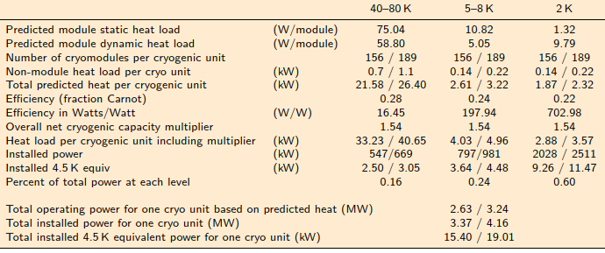
RF cryoplant approximation
Does not include:
  Different loads due to different HOM power
  Gets extracted at cold → significantly higher
  Cryogenic load due to muon-decay
Based on ILC cryo loads from ILC-TDR [1] →
Dynamic load scaled to MuCol duty factors
Scaled unit consumption to 1 cavity equivalent
Calculated room temperature equivalent
  With partial Carnot efficiency
1 unit = 13 strings x 4 main linac units = 52 ML units
1 ML unit = 3 cryomodules with 25 cavities
MuCol Parameter | RCS1 | RCS2 | RCS3 | RCS4
Per cavity dynamic loss [kW] | 0.6 | 0.9 | 1.9 | 5.4
Per cavity static loss [W] | 700 | 700 | 700 | 700
Installed cryo plant size [MW] | 1.3 | 0.9 | 2.0 | 27.1
[1] ILC-TDR table 3.11 https://linearcollider.org/files/images/pdf/Accelerator.pdf

