Slide 1
General information
L. Mether, T. Pieloni
FCC electron cloud meeting
18 March 2025

Slide 2
Feasibility Study Final Report
FCC electron cloud meeting / 18 March 2025
Report scheduled to be finalised by end of March, in time for submission to the update of the European Strategy for Particle Physics (ESPP)
Volume 2: Accelerators, Technical Infrastructures, Safety Concepts
Our contributions:
  Electron cloud section in ”Collective effects” chapter in ”FCC-ee Collider” part
  Paragraphs for “Vacuum system, electron-cloud mitigation and radiation shielding” section in “Technical Systems” in “FCC-ee Booster” part
  I hope that you received the request and have registered as authors
The volume was closed for editing on Feb 9th
  Unclear if we still get to read/comment before submission
  No up-to-date information on when the report will be available

Slide 3
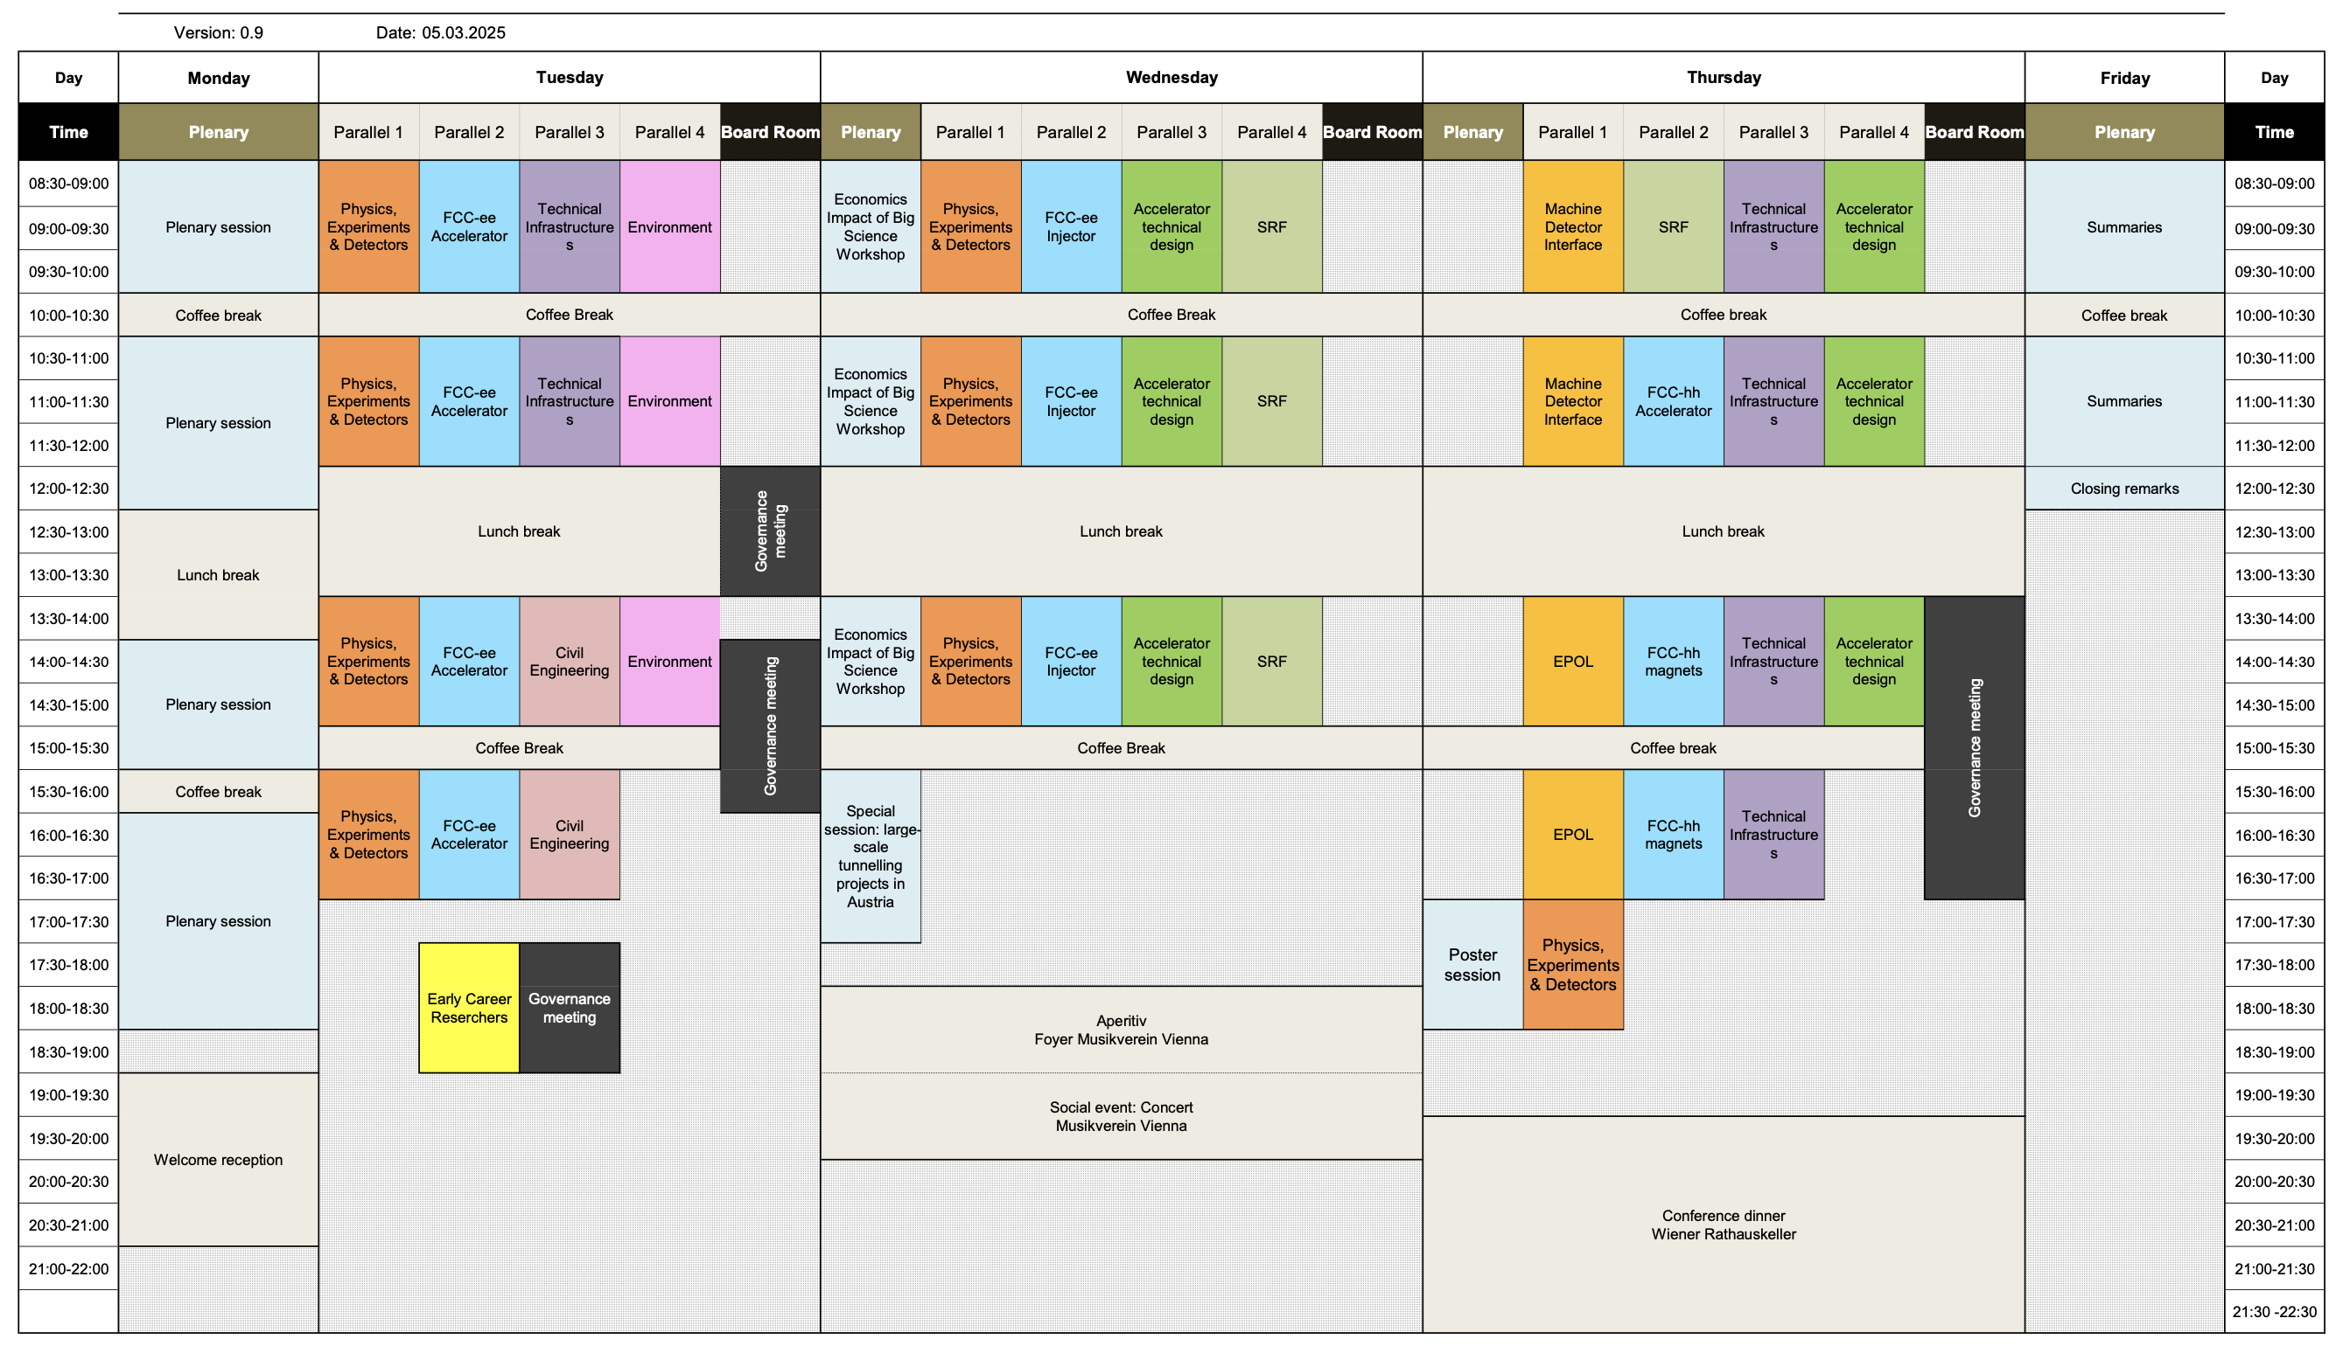
FCC Week 2025
FCC electron cloud meeting / 18 March 2025
19–23 May 2025, Vienna
Planning one talk on
electron cloud, covering
collider and booster
studies

Slide 4
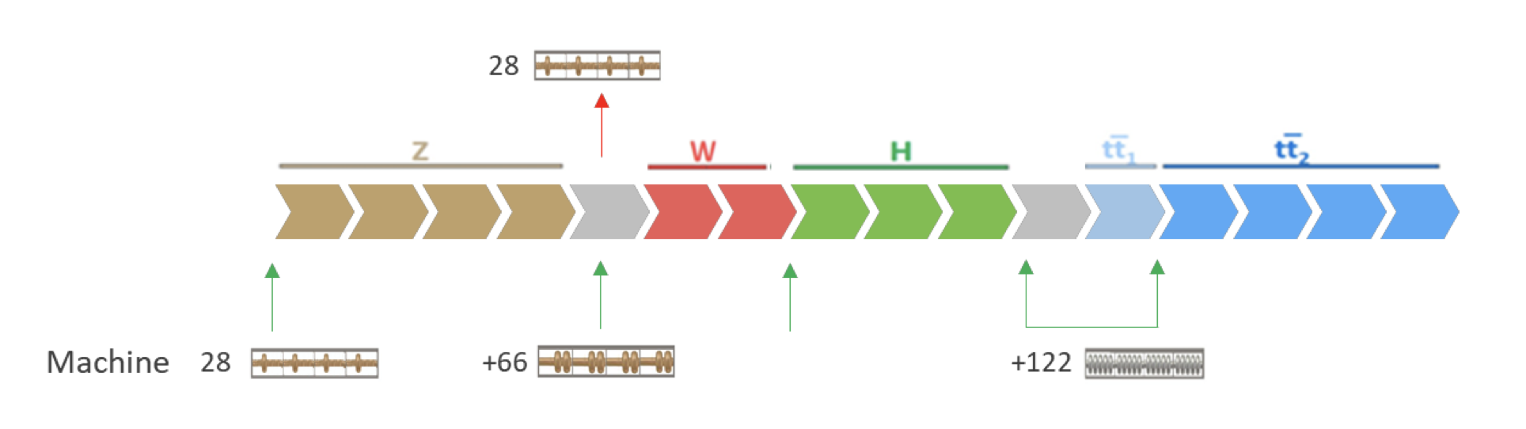
Design updates
FCC electron cloud meeting / 18 March 2025
New baseline assumes a common RF system for Z, W, and ZH modes
  Previously, single-cell cavities for Z mode, to be replaced when switching to W
  Requires Reverse Phase Operation (RPO, Y. Morita et al., 2009) mode for Z
RPO leads to significant variation of effective RF voltage along bunch trains due to beam loading
  Can be reduced with higher RF voltage and shorter gaps between trains
O. Brunner

Slide 5
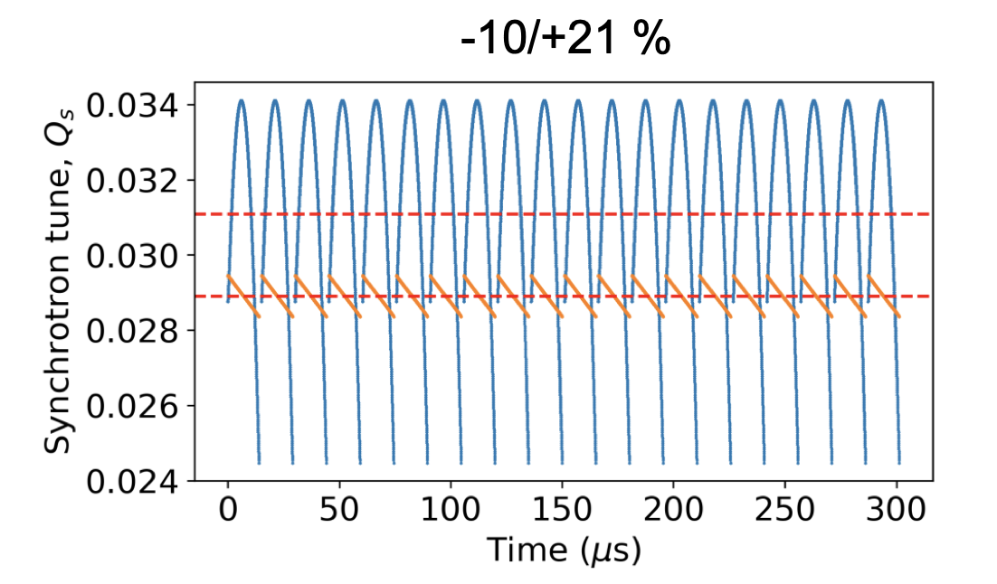
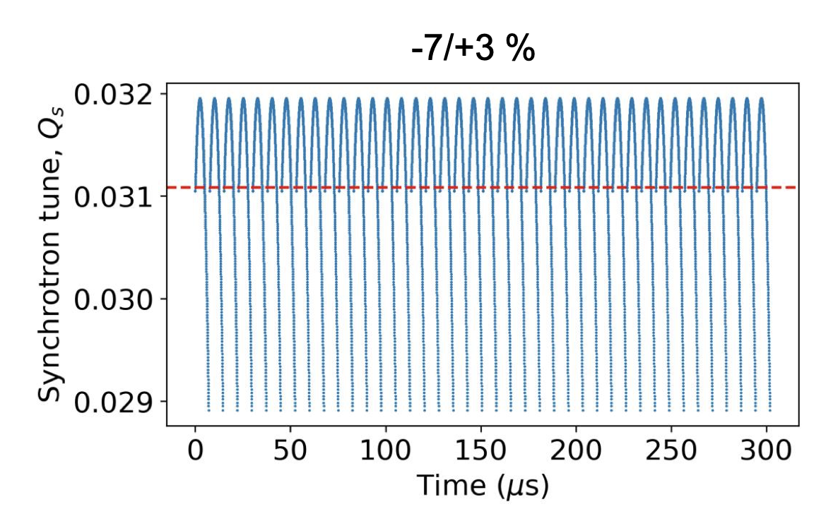
Design updates
FCC electron cloud meeting / 18 March 2025
Several studies and considerations since November to evaluate viability for RF, beam lifetime, beam stability and electron cloud
  High RF voltage gives too poor lifetime and poor stability
  A reduction in bunch intensity and correlated reduction in bunch spacing excluded by e-cloud
  Converged on reduction of train and gap length by 2: 20 x 560b + 48e → 40 x 280b + 24e, reduces variation from up to ~30% to ~10%
I. Karpov, FCC-ee design meeting, Nov 6th

Slide 6
Pending electron cloud studies
FCC electron cloud meeting / 18 March 2025
Multipacting thresholds
  Evaluate impact of change to bunch train structure
  Evaluate impact of low-intensity witness bunches in bunch train gaps
  Continue studies with Furman-Pivi model, e.g. for various mitigation techniques?
Photoemission
  Photoelectron yield studies with up-to-date photon flux data for collider and booster
  (new results from photon tracking estimated around the FCC Week)
  3D simulations to study longitudinal spread?
Beam stability
  Stability studies with saved realistic electron densities instead of uniform distributions to confirm stability thresholds
  Study impact of chromaticity, beam-beam, impedance on stability

Slide 7
6

