Slide 1




Electron Cloud Mitigation Using Non-Uniform Bunch Spacing
Sabato Luca¹
Mether Lotta², Tatiana Pieloni¹, Zimmermann Frank², Zobov Mikhail³
¹ ² ³
FCC-ee Electron Cloud Meeting
18th March 2025
This work was performed under the auspices and with support from the Swiss Accelerator Research and Technology (CHART) program (www.chart.ch).

Slide 2
Outline
Introduction
Mitigation Techniques
Conclusions and Outlooks

Slide 3
Outline
Introduction
Mitigation Techniques
Conclusions and Outlooks

Slide 4
Analysed Filling Schemes
Filling schemes (with constant beam current)
From Tor Raubenheimer (private communication 06/2023)
Filling Scheme Number​ | Bunch Intensity​ [x10¹¹ ppb]​ | Bunch Spacing​ [ns]​ | Number bunches / Train​ | Number Trains​ | Gap Length [ns]​ (gap/bunch spacing)​
1​ | 1.51​ | 15​ | 320​ | 50​ | 1275 (85)​
2​ | 2.15​ | 20​ | 280​ | 40​ | 1980 (99)​
3​ | 2.15​ | 25​ | 560​ | 20​ | 1175 (47)​
4​ | 2.43​ | 25​ | 255​ | 40​ | 1225 (49)​
Important to understand the impact of lower bunch intensity (we will need to fill the ring)
The bunches are gradually filled from the booster at collision energy (top-up injection)
E-cloud becomes too severe with bunch spacing < 25 ns, more details in:
  L. Sabato, “Electron cloud studies”, FCC week 2023
  L. Sabato, “Update on the Electron CloudStudies for FCC-ee”, FCC e-cloud meeting 12/09/2023
Limit on higher nominal bunch intensity values due to other collective effects (e.g., beam-beam, beam-coupling impedance), more details in:
  M. Migliorati, “FCC-ee single beam collective effects”, FCC week 2024
  R. Soos, “Xsuite simulations of beam-beam effects with impedance contribution”, FCC week 2024

Slide 5
Analysed Filling Schemes
Bunch Intensity [x10¹¹ ppb] | Bunch Spacing [ns] | Number bunches / Train | Number Trains | Gap Length [ns] (gap/bunch spacing)
2.15 | 25 | 560 | 20 | 1175 (47)
The following analysis is only on the filling scheme
  with 25 ns bunch spacing
  nominal bunch intensity 2.15 x 10¹¹ ppb

Slide 6
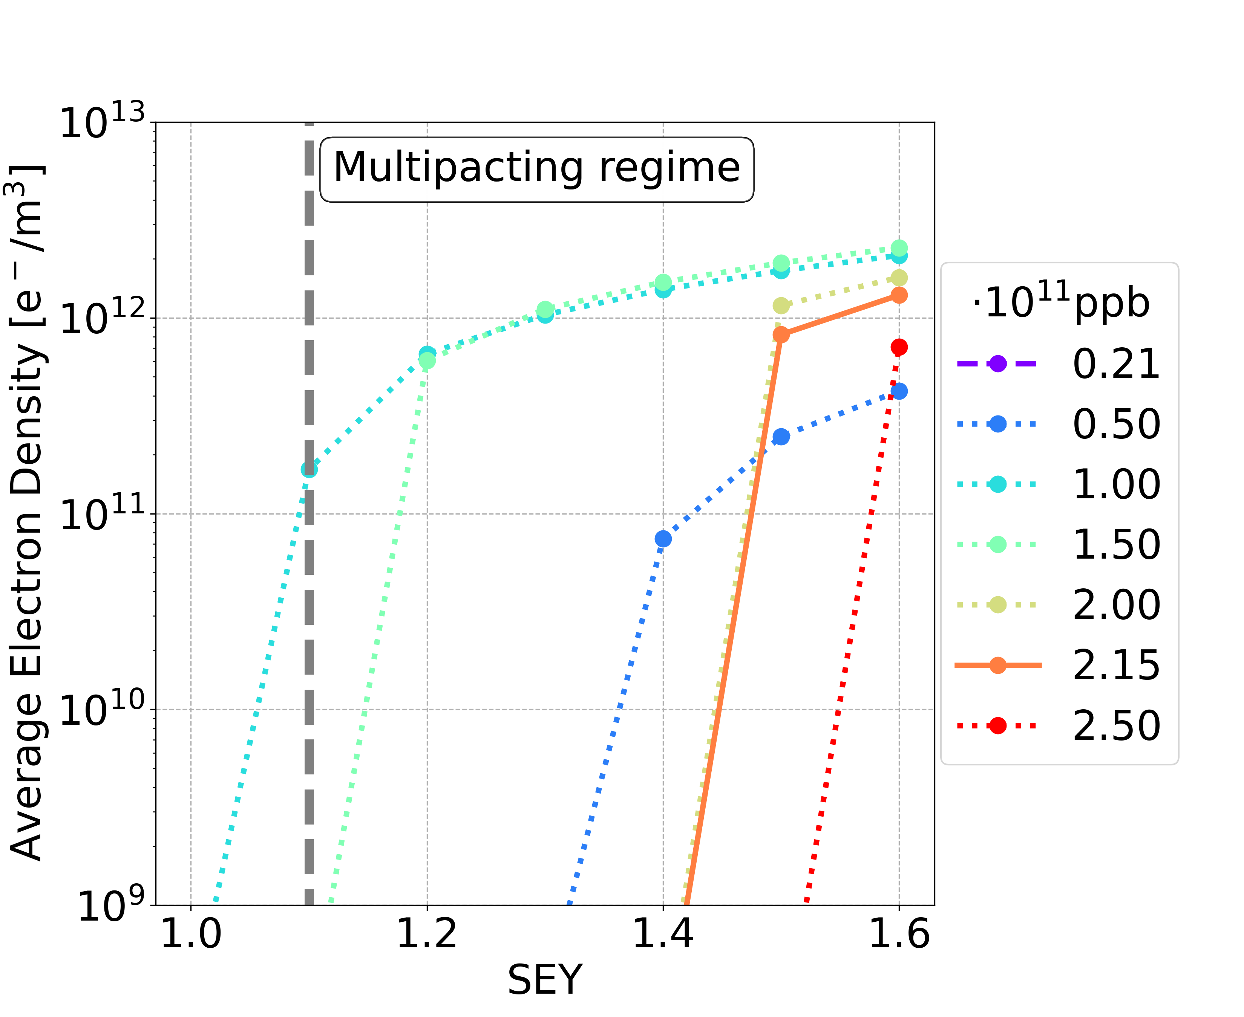
E-Cloud Build-Up Studies: Dipole
The bunch intensities 1.00 and 1.50 x 10¹¹ ppb are the most critical cases
Bunch population | SEY multipacting thresholds
nominal | 1.4
below nominal | 1.0

Slide 7
Motivation
The SEY multipacting thresholds are extremely tight for baseline parameters
Quadrupoles and sextupoles have the lowest SEY multipacting thresholds
Bunch intensities 1.00 and 1.50 x 10¹¹ ppb are the most critical cases
Element | Field | Bunch population | Thresholds
Drift Space | - | nominal | 1.4
 |  | below nominal | 1.2
Dipole | 15.2 mT | nominal | 1.4
 |  | below nominal | 1.0
Quadrupole | 1.45 T/m | nominal | 1.1
 |  | below nominal | 1.0
Sextupole | 72.5 T/m² | nominal | 1.1
 |  | below nominal | 1.0

Slide 8
Outline
Introduction
Mitigation Techniques
Conclusions and Outlooks

Slide 9
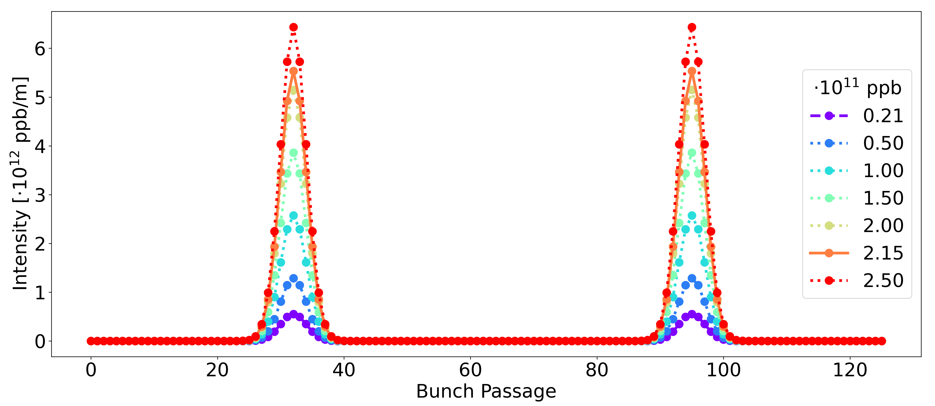
Mitigation: Charge Accumulation Phase
bunch intensities increase uniformly
100
101
The bunch intensities 1.00 and 1.50 x 10¹¹ ppb are the most critical cases
During the charge accumulation phase: do not fill the bunches of the train uniformly
  (Now it is possible because the injection scheme from booster changed from full ring to 1/10)
In this way the critical bunch intensities will be reached with a larger bunch spacing

Slide 10
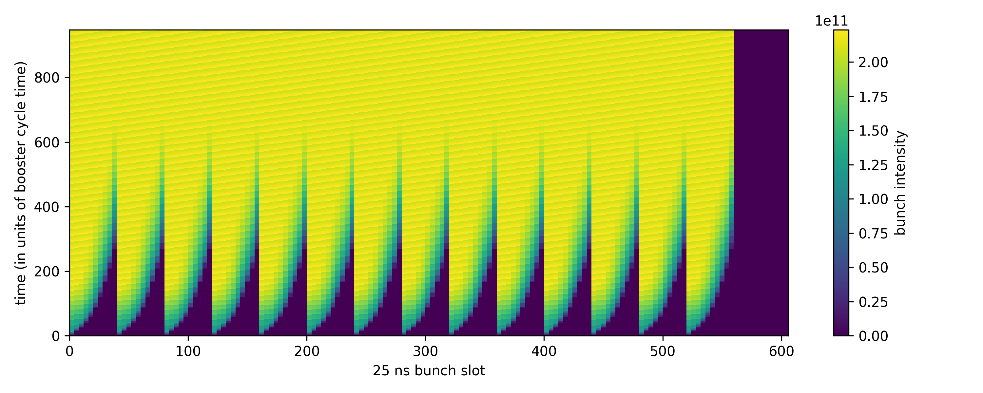
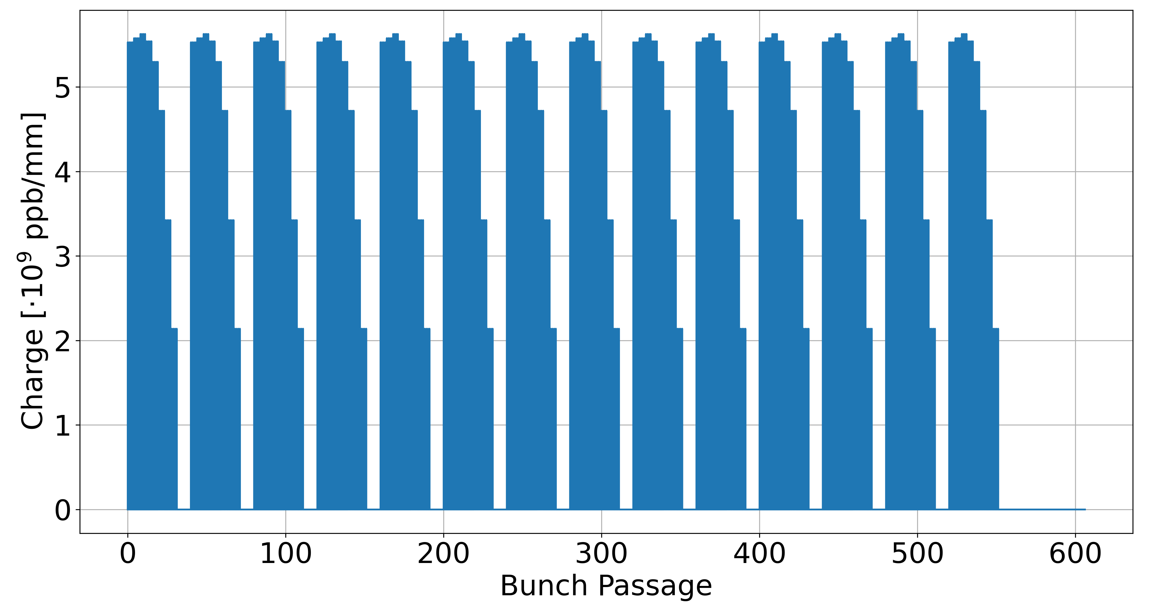

Charge Accumulation Phase
Option 1
Option 2
Option: 1 Booster Cycle: 200
Courtesy of Hannes Bartosik (FCC week 2024)

Slide 11
Charge Accumulation Phase
Option 1
Option 2
750
Analysed range (step 25 booster cycles)
50
750
Analysed range (step 25 booster cycles)
50

Slide 12
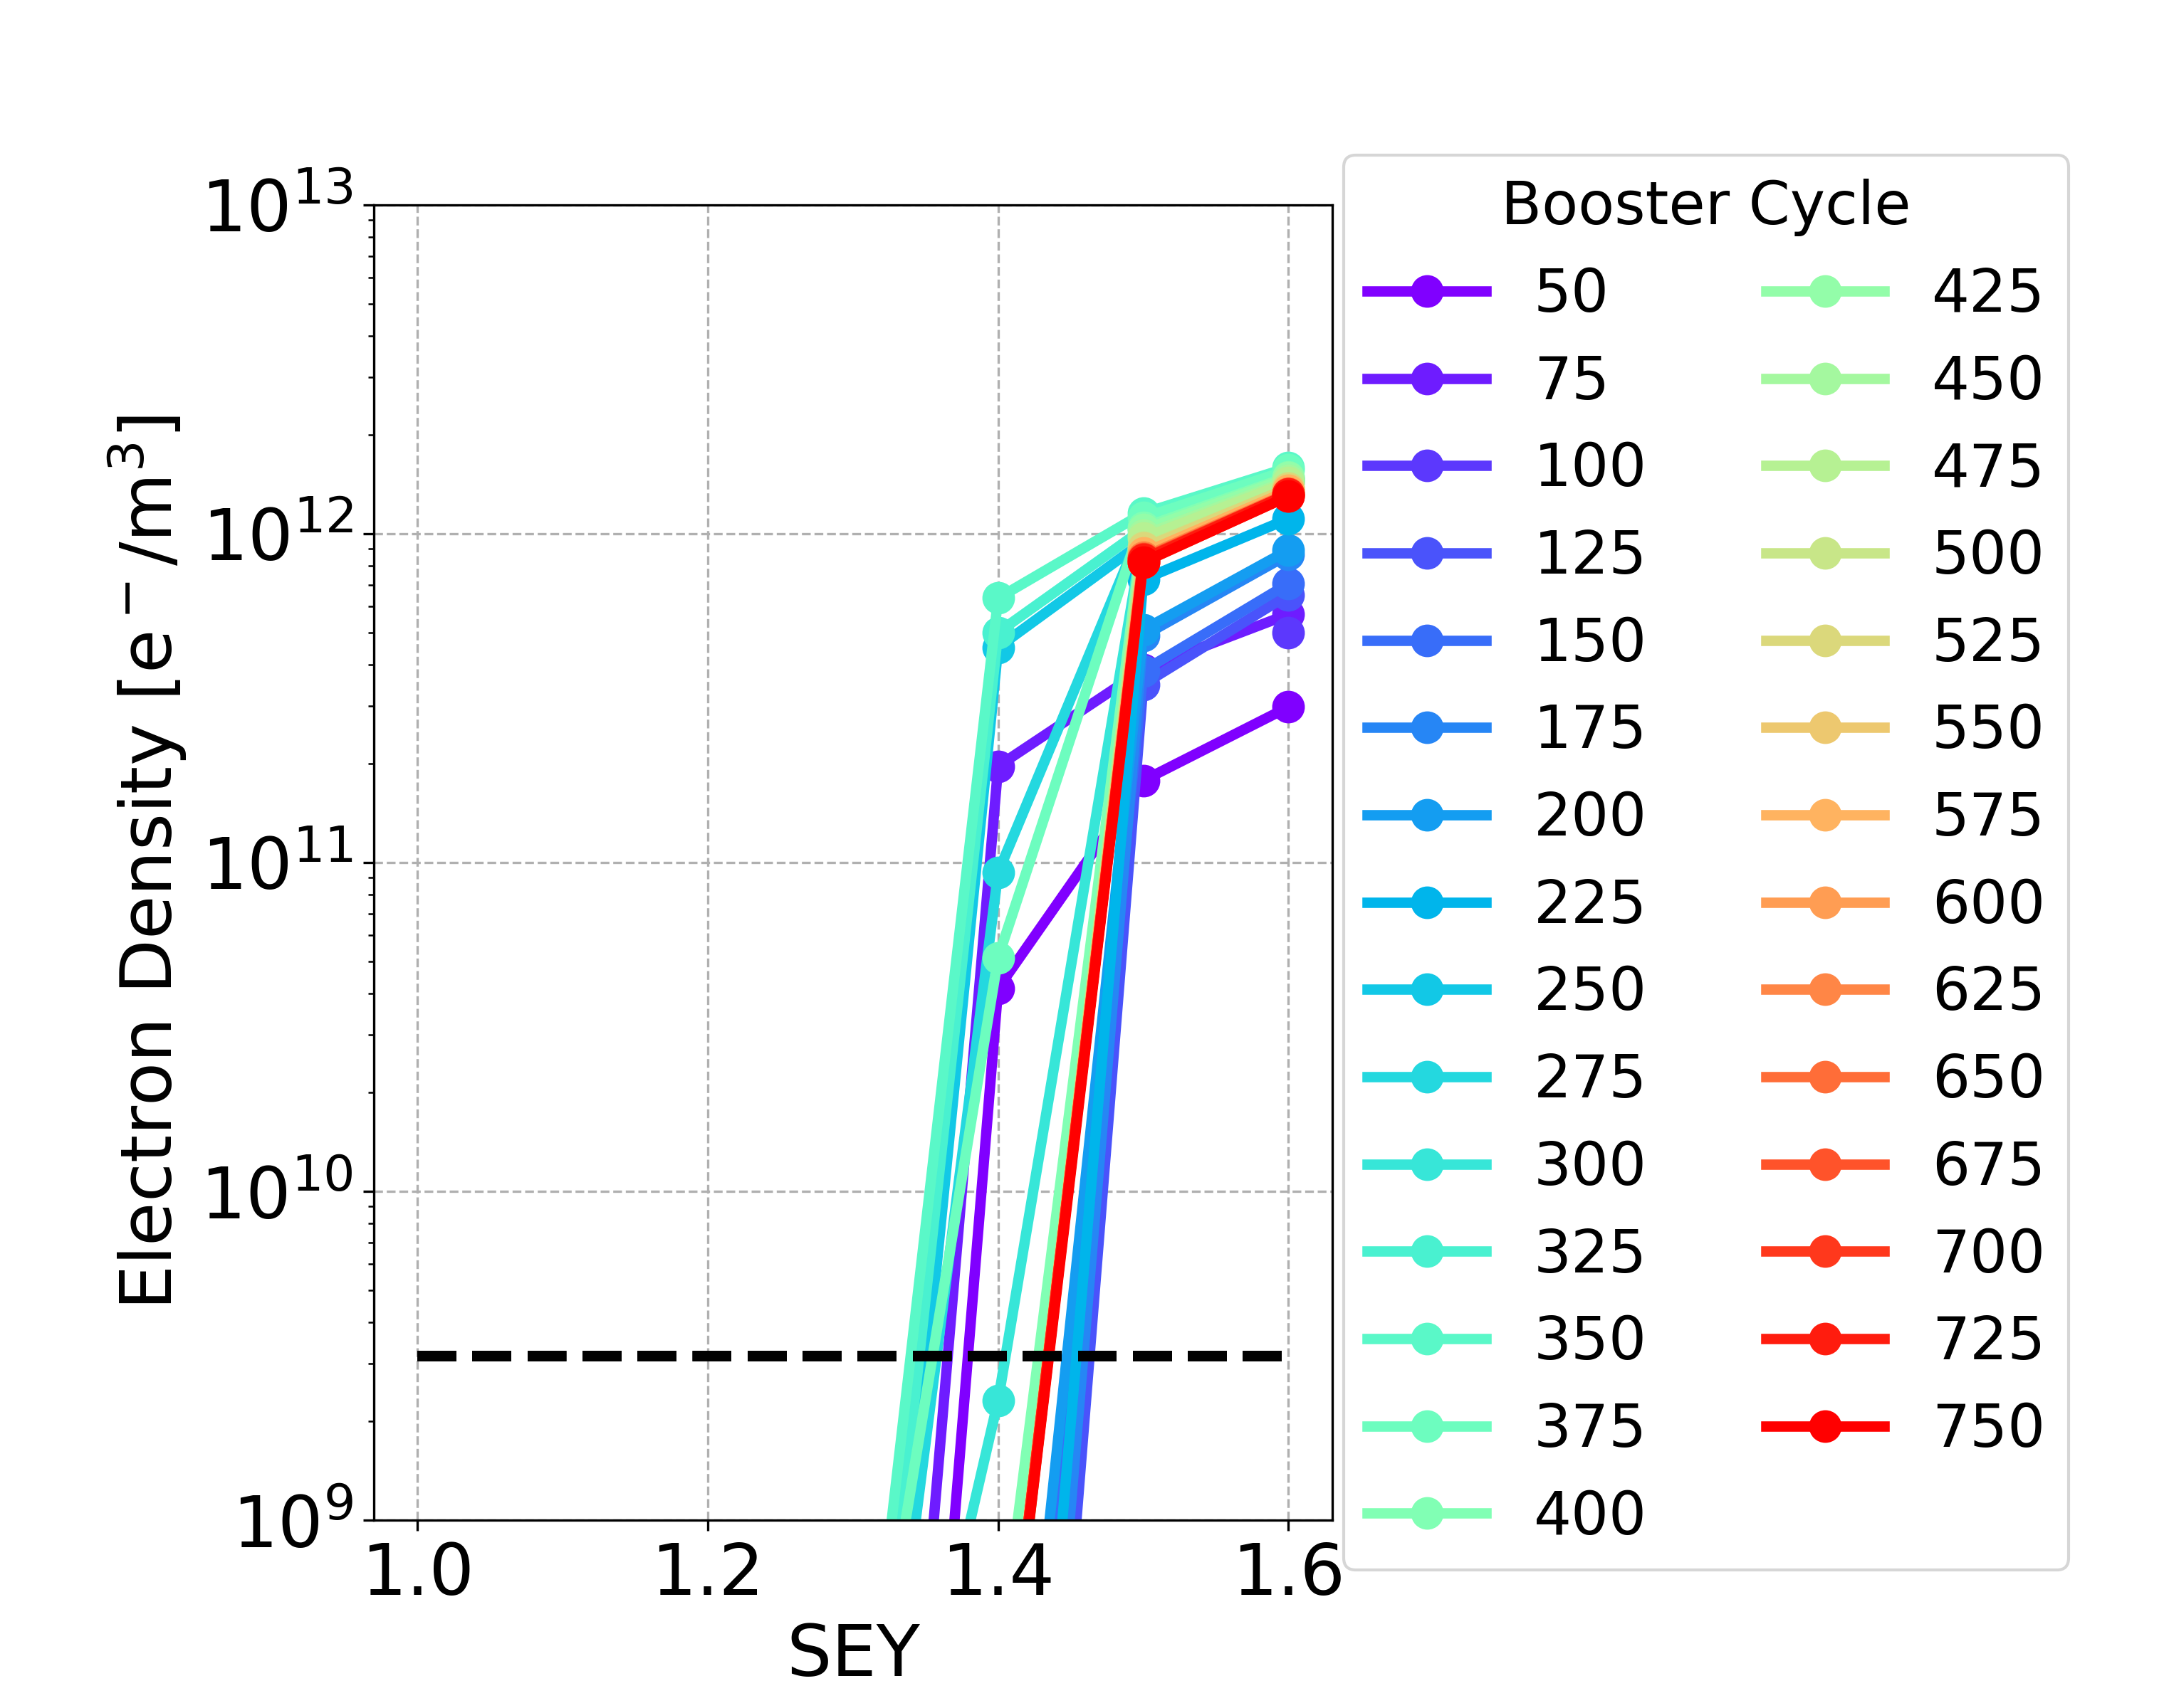
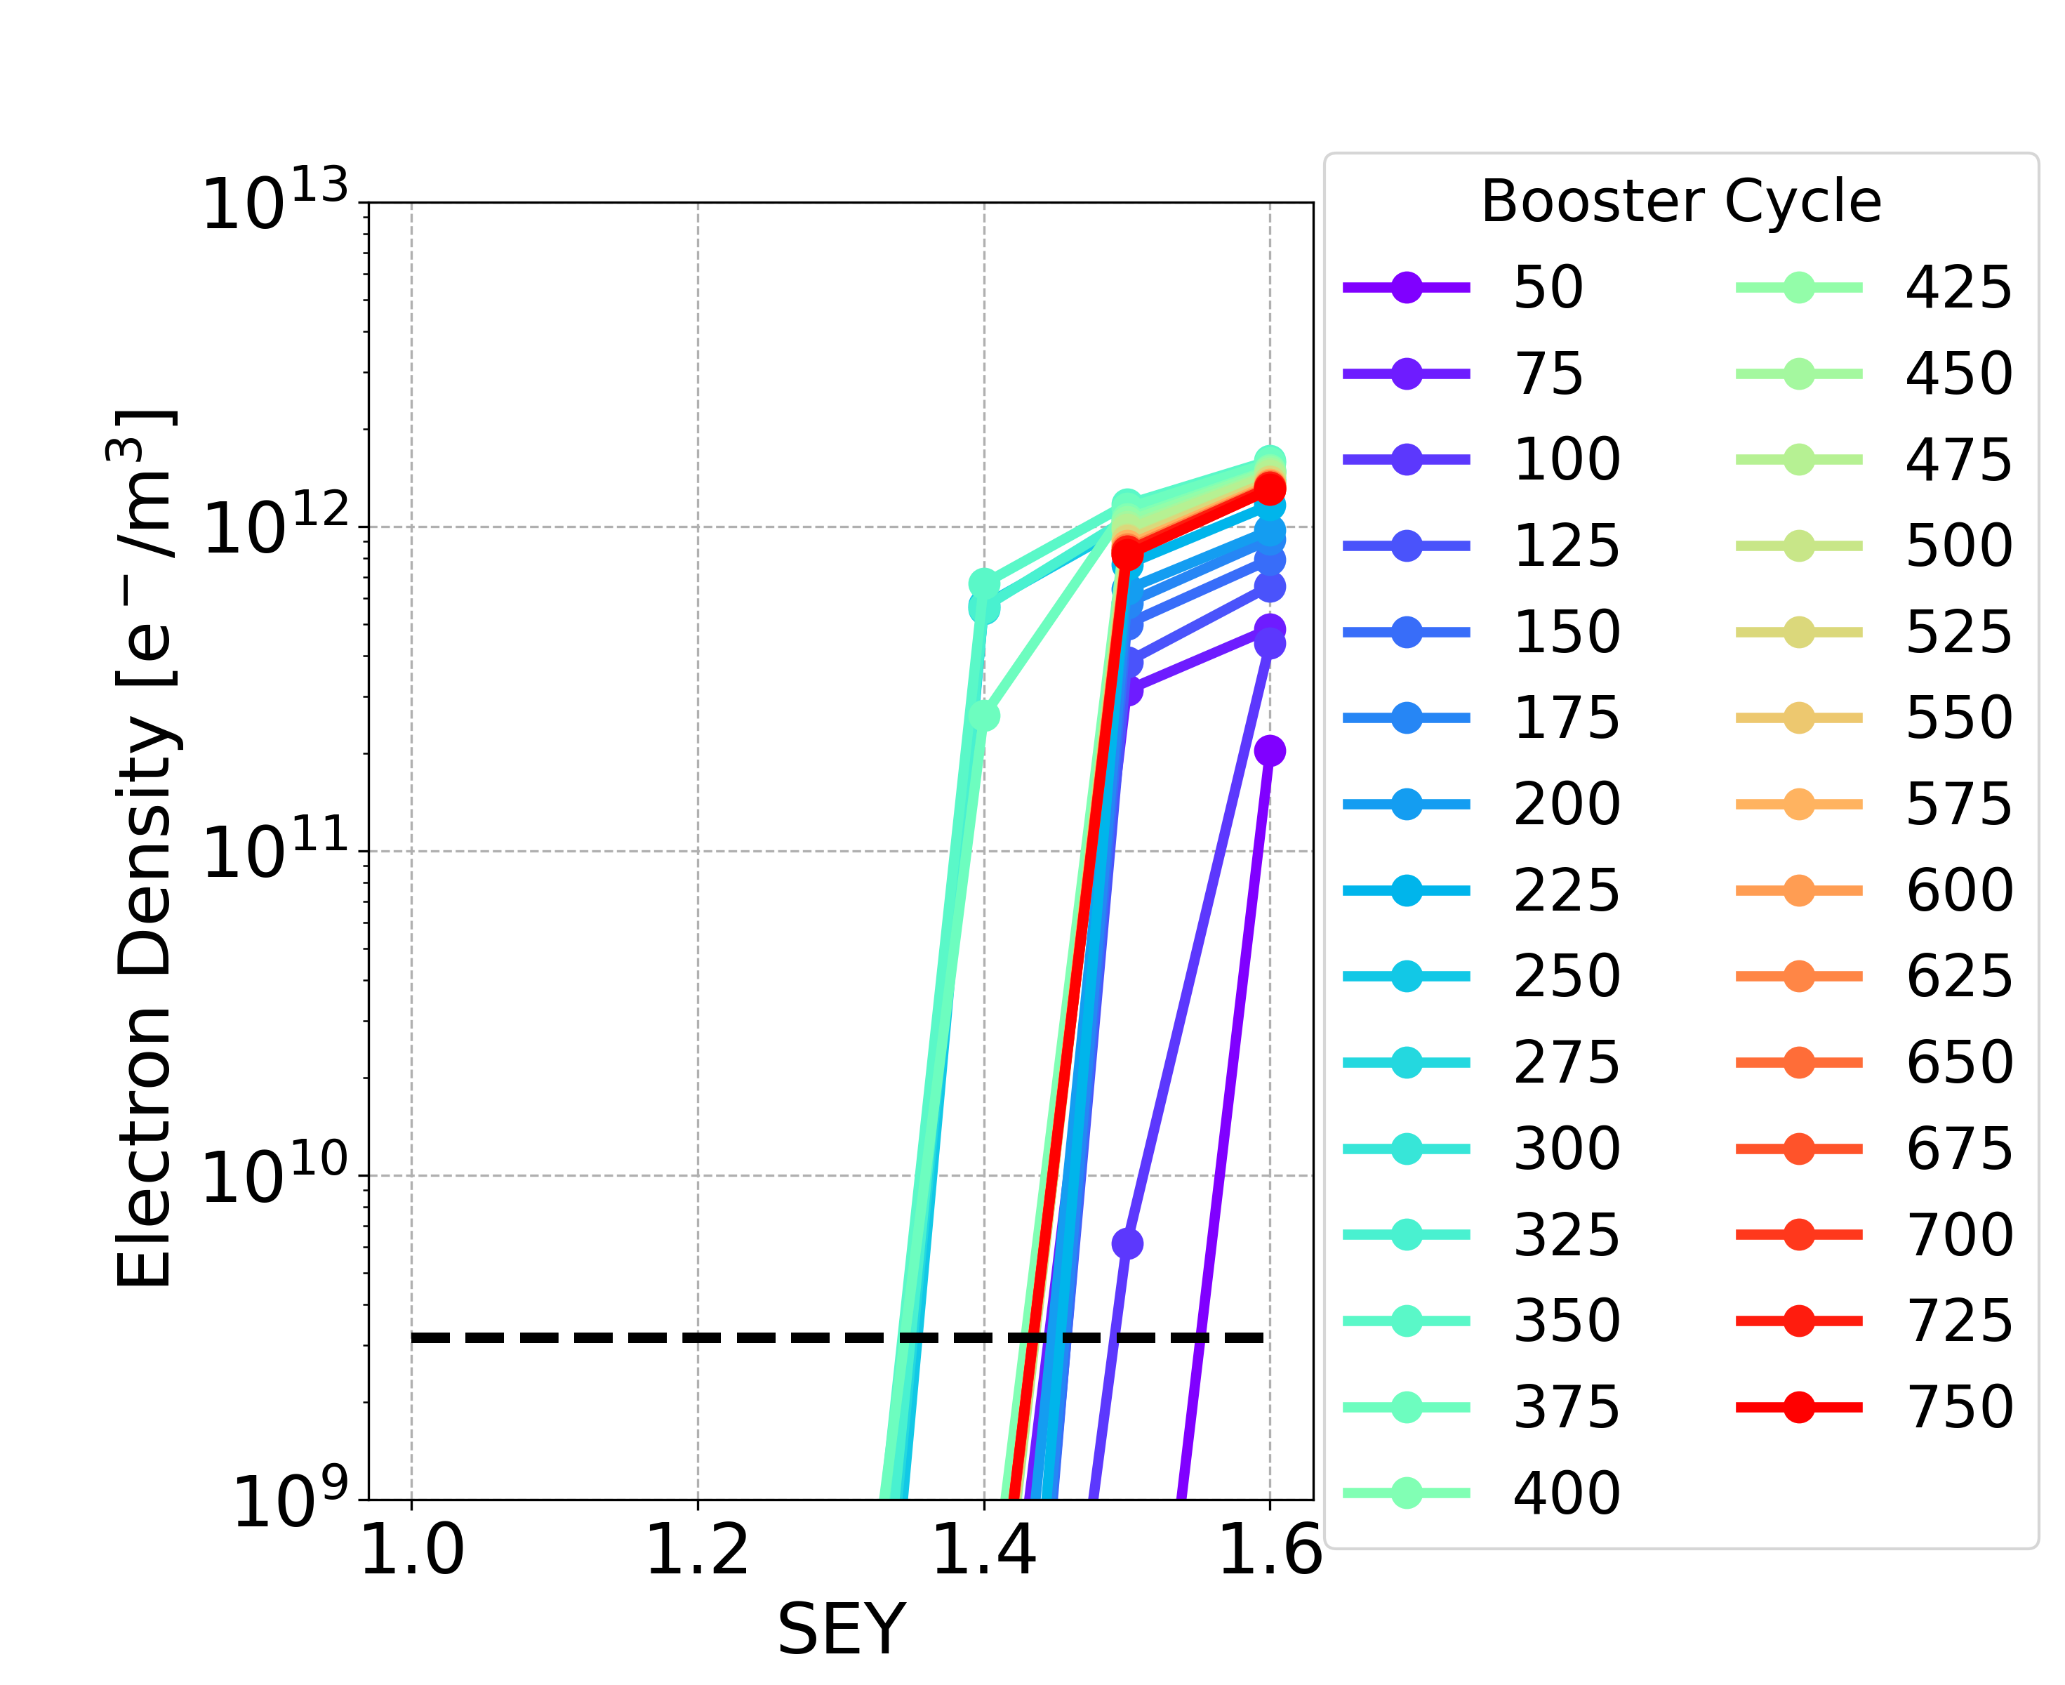
Charge Accumulation Phase: Dipole
Option 1 Option 2
Bunch population | SEY multipacting thresholds
nominal | 1.4
below nominal | 1.0
 | SEY multipacting thresholds
During charge accumulation | 1.3
Using the two options with special filling schemes during the charge accumulation phase, the SEY mutipacting thresholds are higher and they tend to the SEY multipacting thresholds in the case of the nominal bunch intensity

Slide 13
Charge Accumulation Phase: Summary
The two options with special filling schemes are also effective for the other analysed elements
Quadrupoles and sextupoles have the lowest SEY multipacting thresholds
Element | Field | Special filling schemes during charge accumulation phase | Uniform 25 ns
Drift Space | - | 1.4 | nominal | 1.4
 |  |  | below nominal | 1.2
Dipole | 15.2 mT | 1.3 | nominal | 1.4
 |  |  | below nominal | 1.0
Quadrupole | 1.45 T/m | 1.1 | nominal | 1.1
 |  |  | below nominal | 1.0
Sextupole | 72.5 T/m² | 1.1 | nominal | 1.1
 |  |  | below nominal | 1.0

Slide 14
Trains with Non-Uniform Bunch Spacing
Analysed trains with uniform bunch spacing
Trains with 25 ns bunch spacing
Trains with smaller bunch spacing and with small gaps in order to mitigate the e-cloud (keeping the same train duration):
Trains with 10 ns bunch spacing (2 bunches + 3 empty bunches)
1 2 3 560
...
Time [ns]
0 25 50
1 2 3 560
...
e e e
Time [ns]
0 10 20 30 40 50

Slide 15
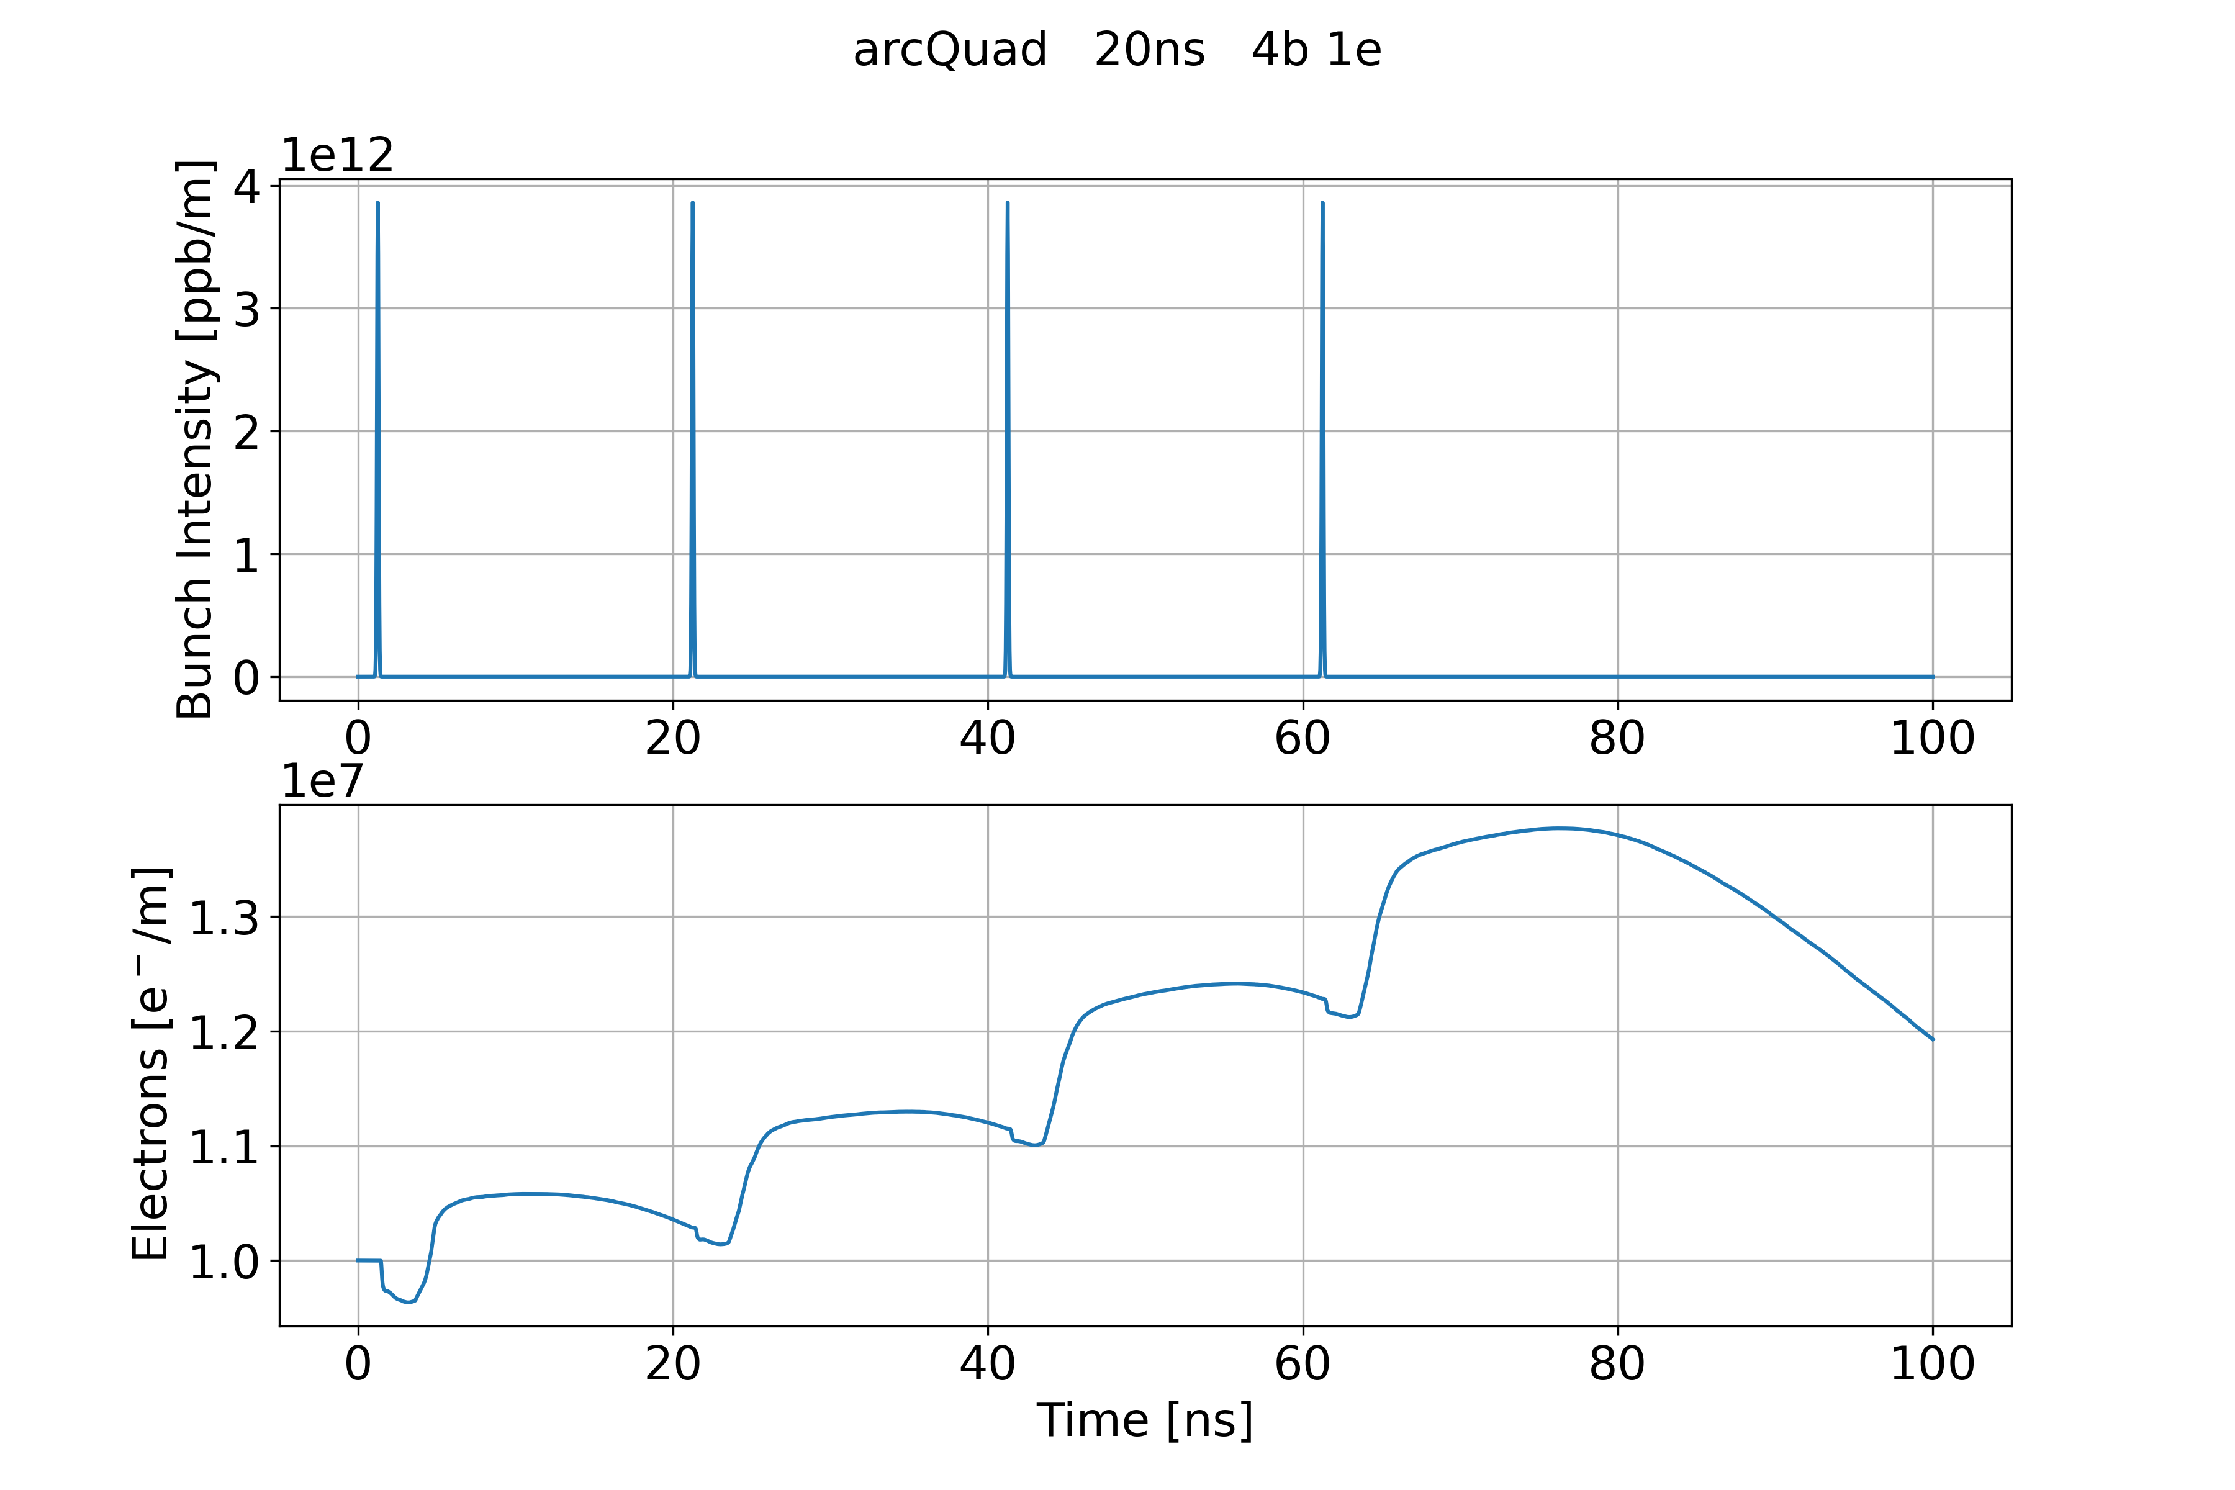
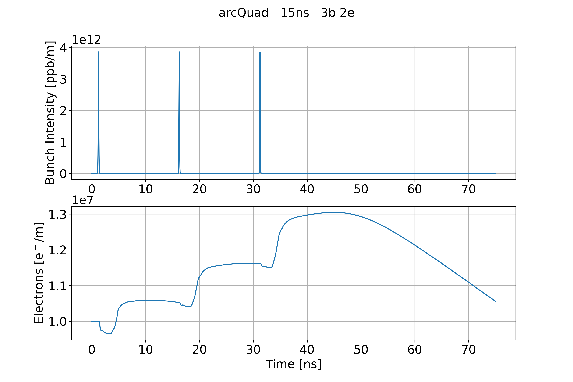
Long Bunch Spacing
Analysed some cases with few bunch passages and a small gap
Considering larger bunch spacing (20 ns and 15 ns), the small gap is not long enough to mitigate the e-cloud
  e-cloud after the bunch passages and the small gap is larger than the initial e-cloud density
Bunch spacing 20 ns with 4 bunches and 1 empty
Bunch spacing 15 ns with 3 bunches and 2 empty

Slide 16
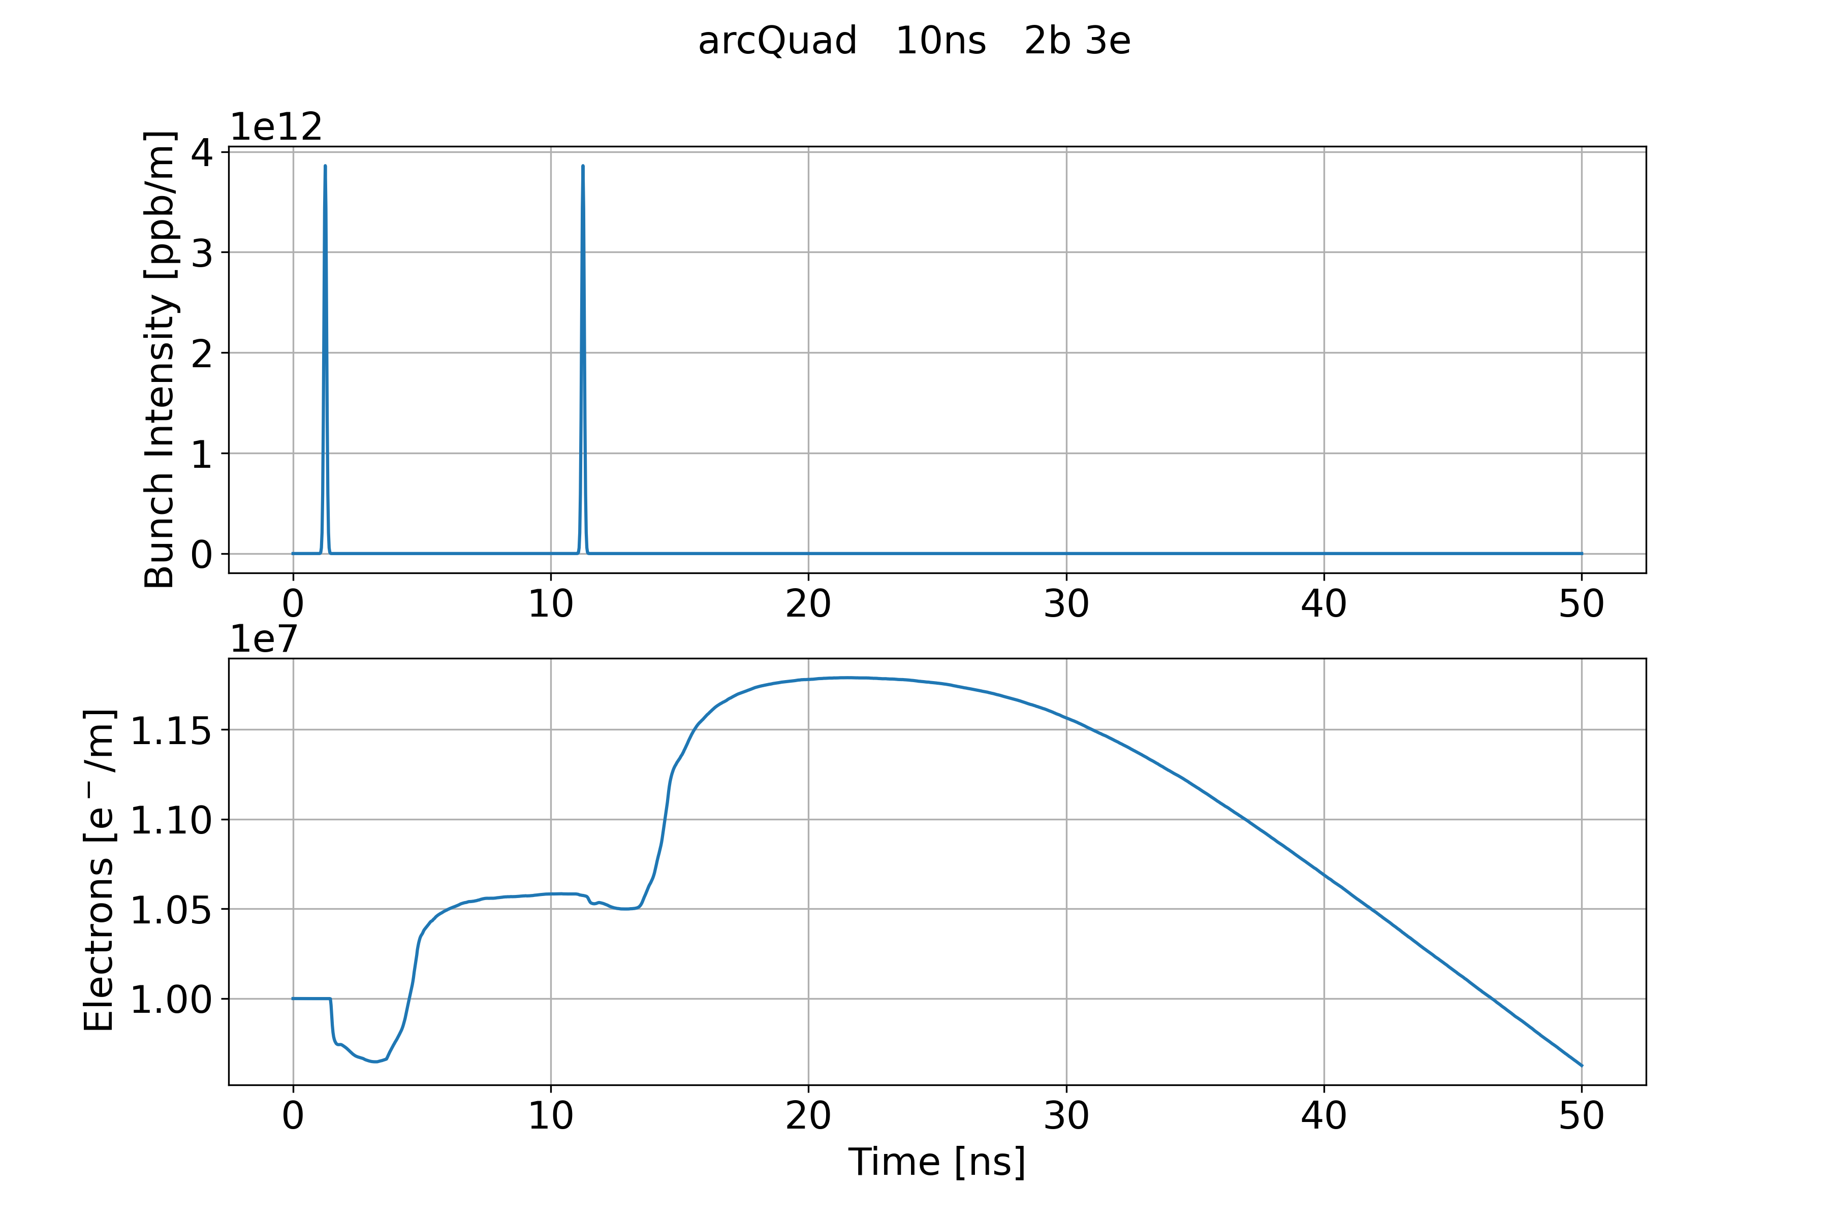
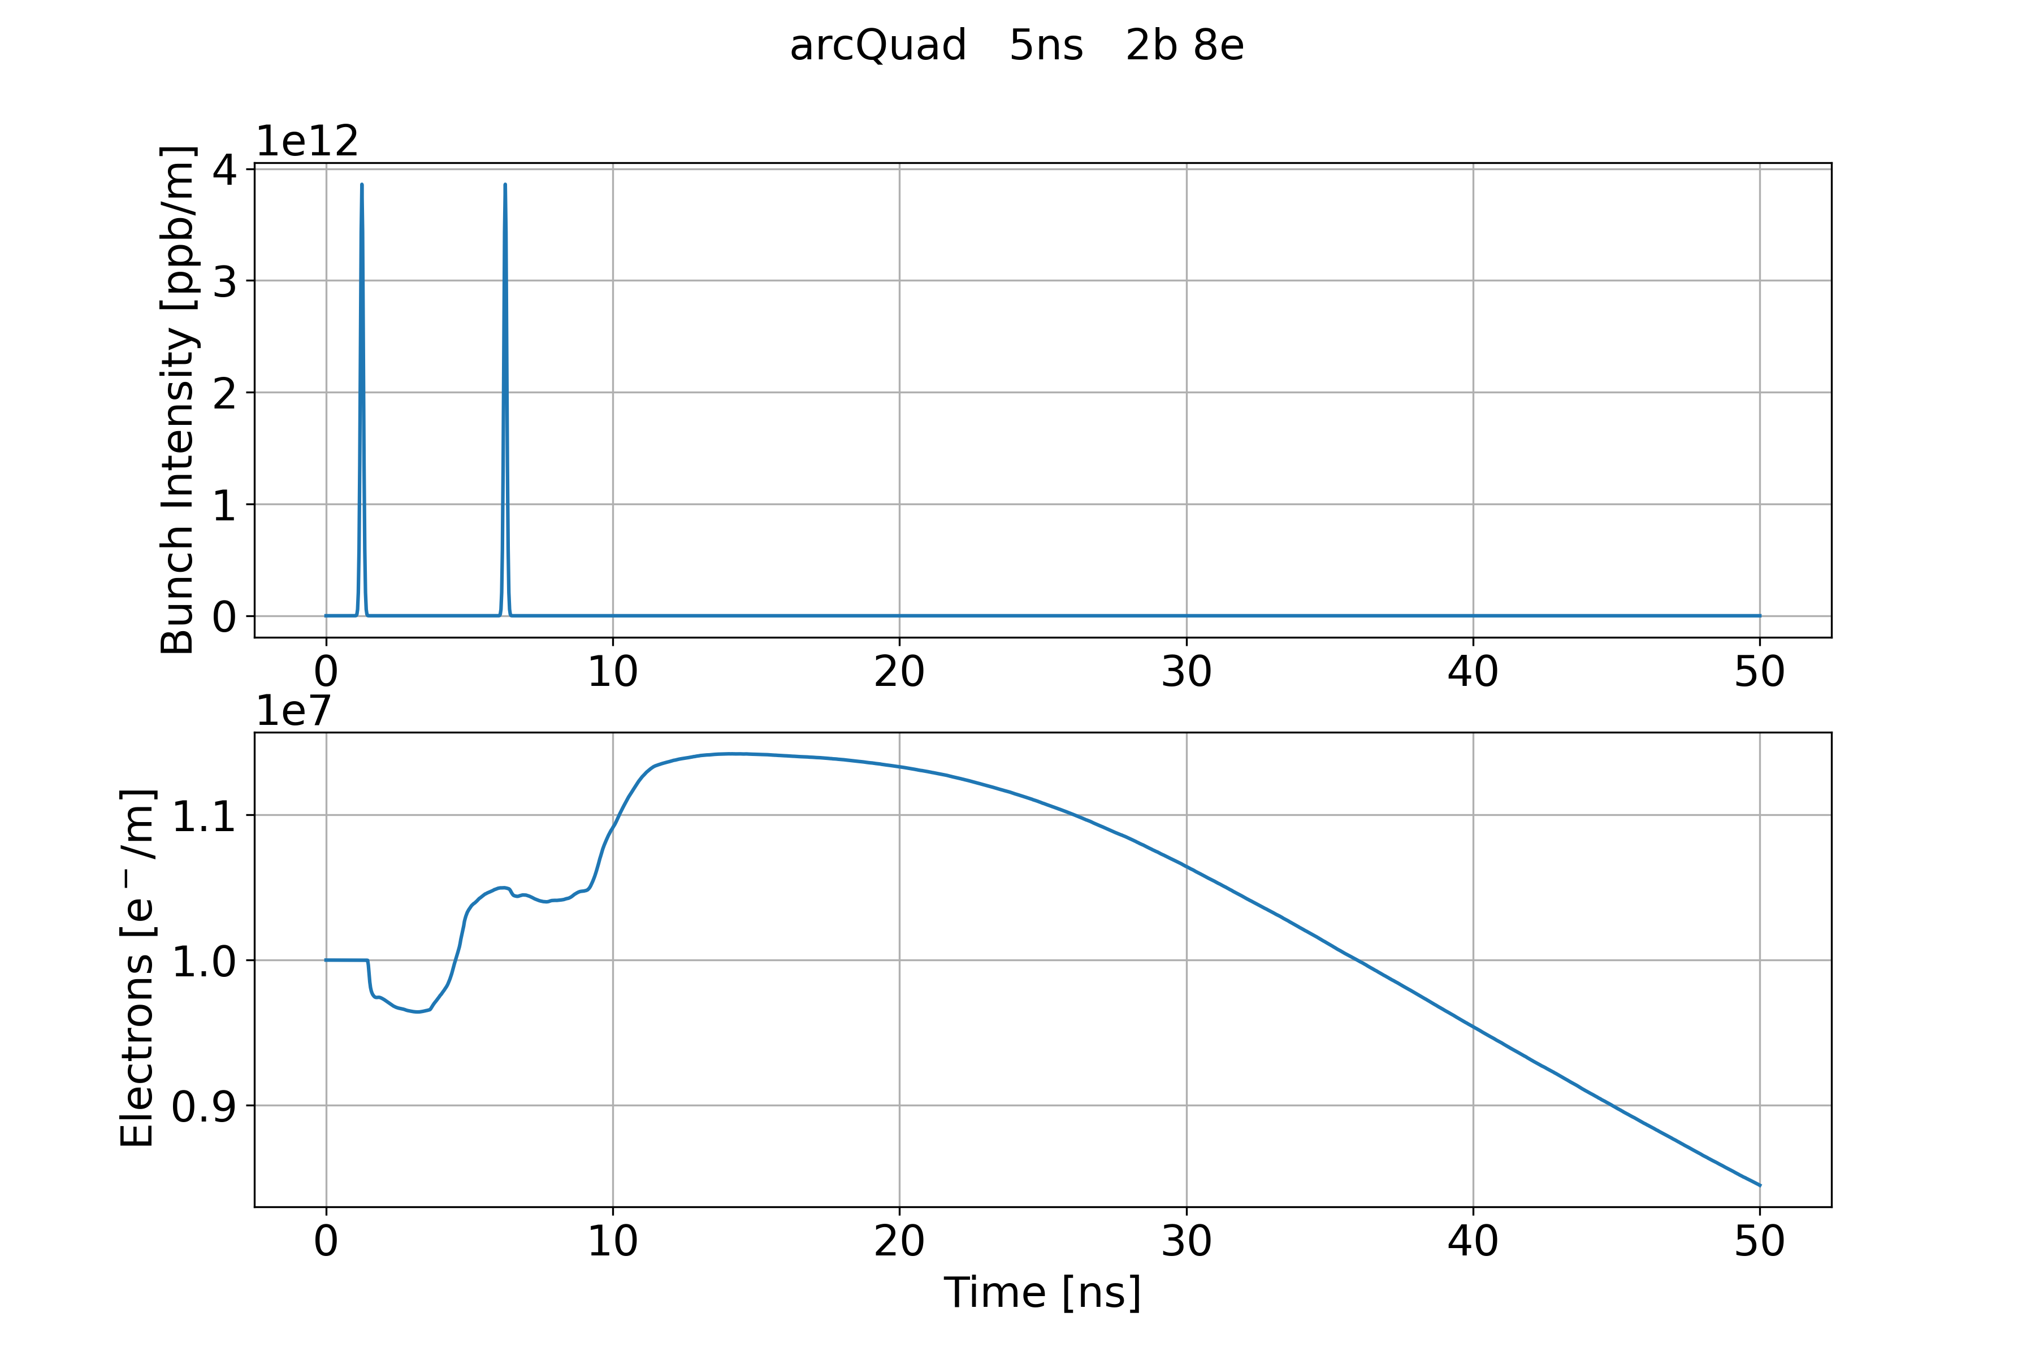
Short Bunch Spacing
Considering very small bunch spacing (10 ns and 5 ns), the small gap is long enough to mitigate the e-cloud
  e-cloud after the bunch passages and the small gap is smaller than the initial e-cloud density
Bunch spacing 10 ns with 2 bunches and 3 empty
Bunch spacing 5 ns with 2 bunches and 8 empty

Slide 17
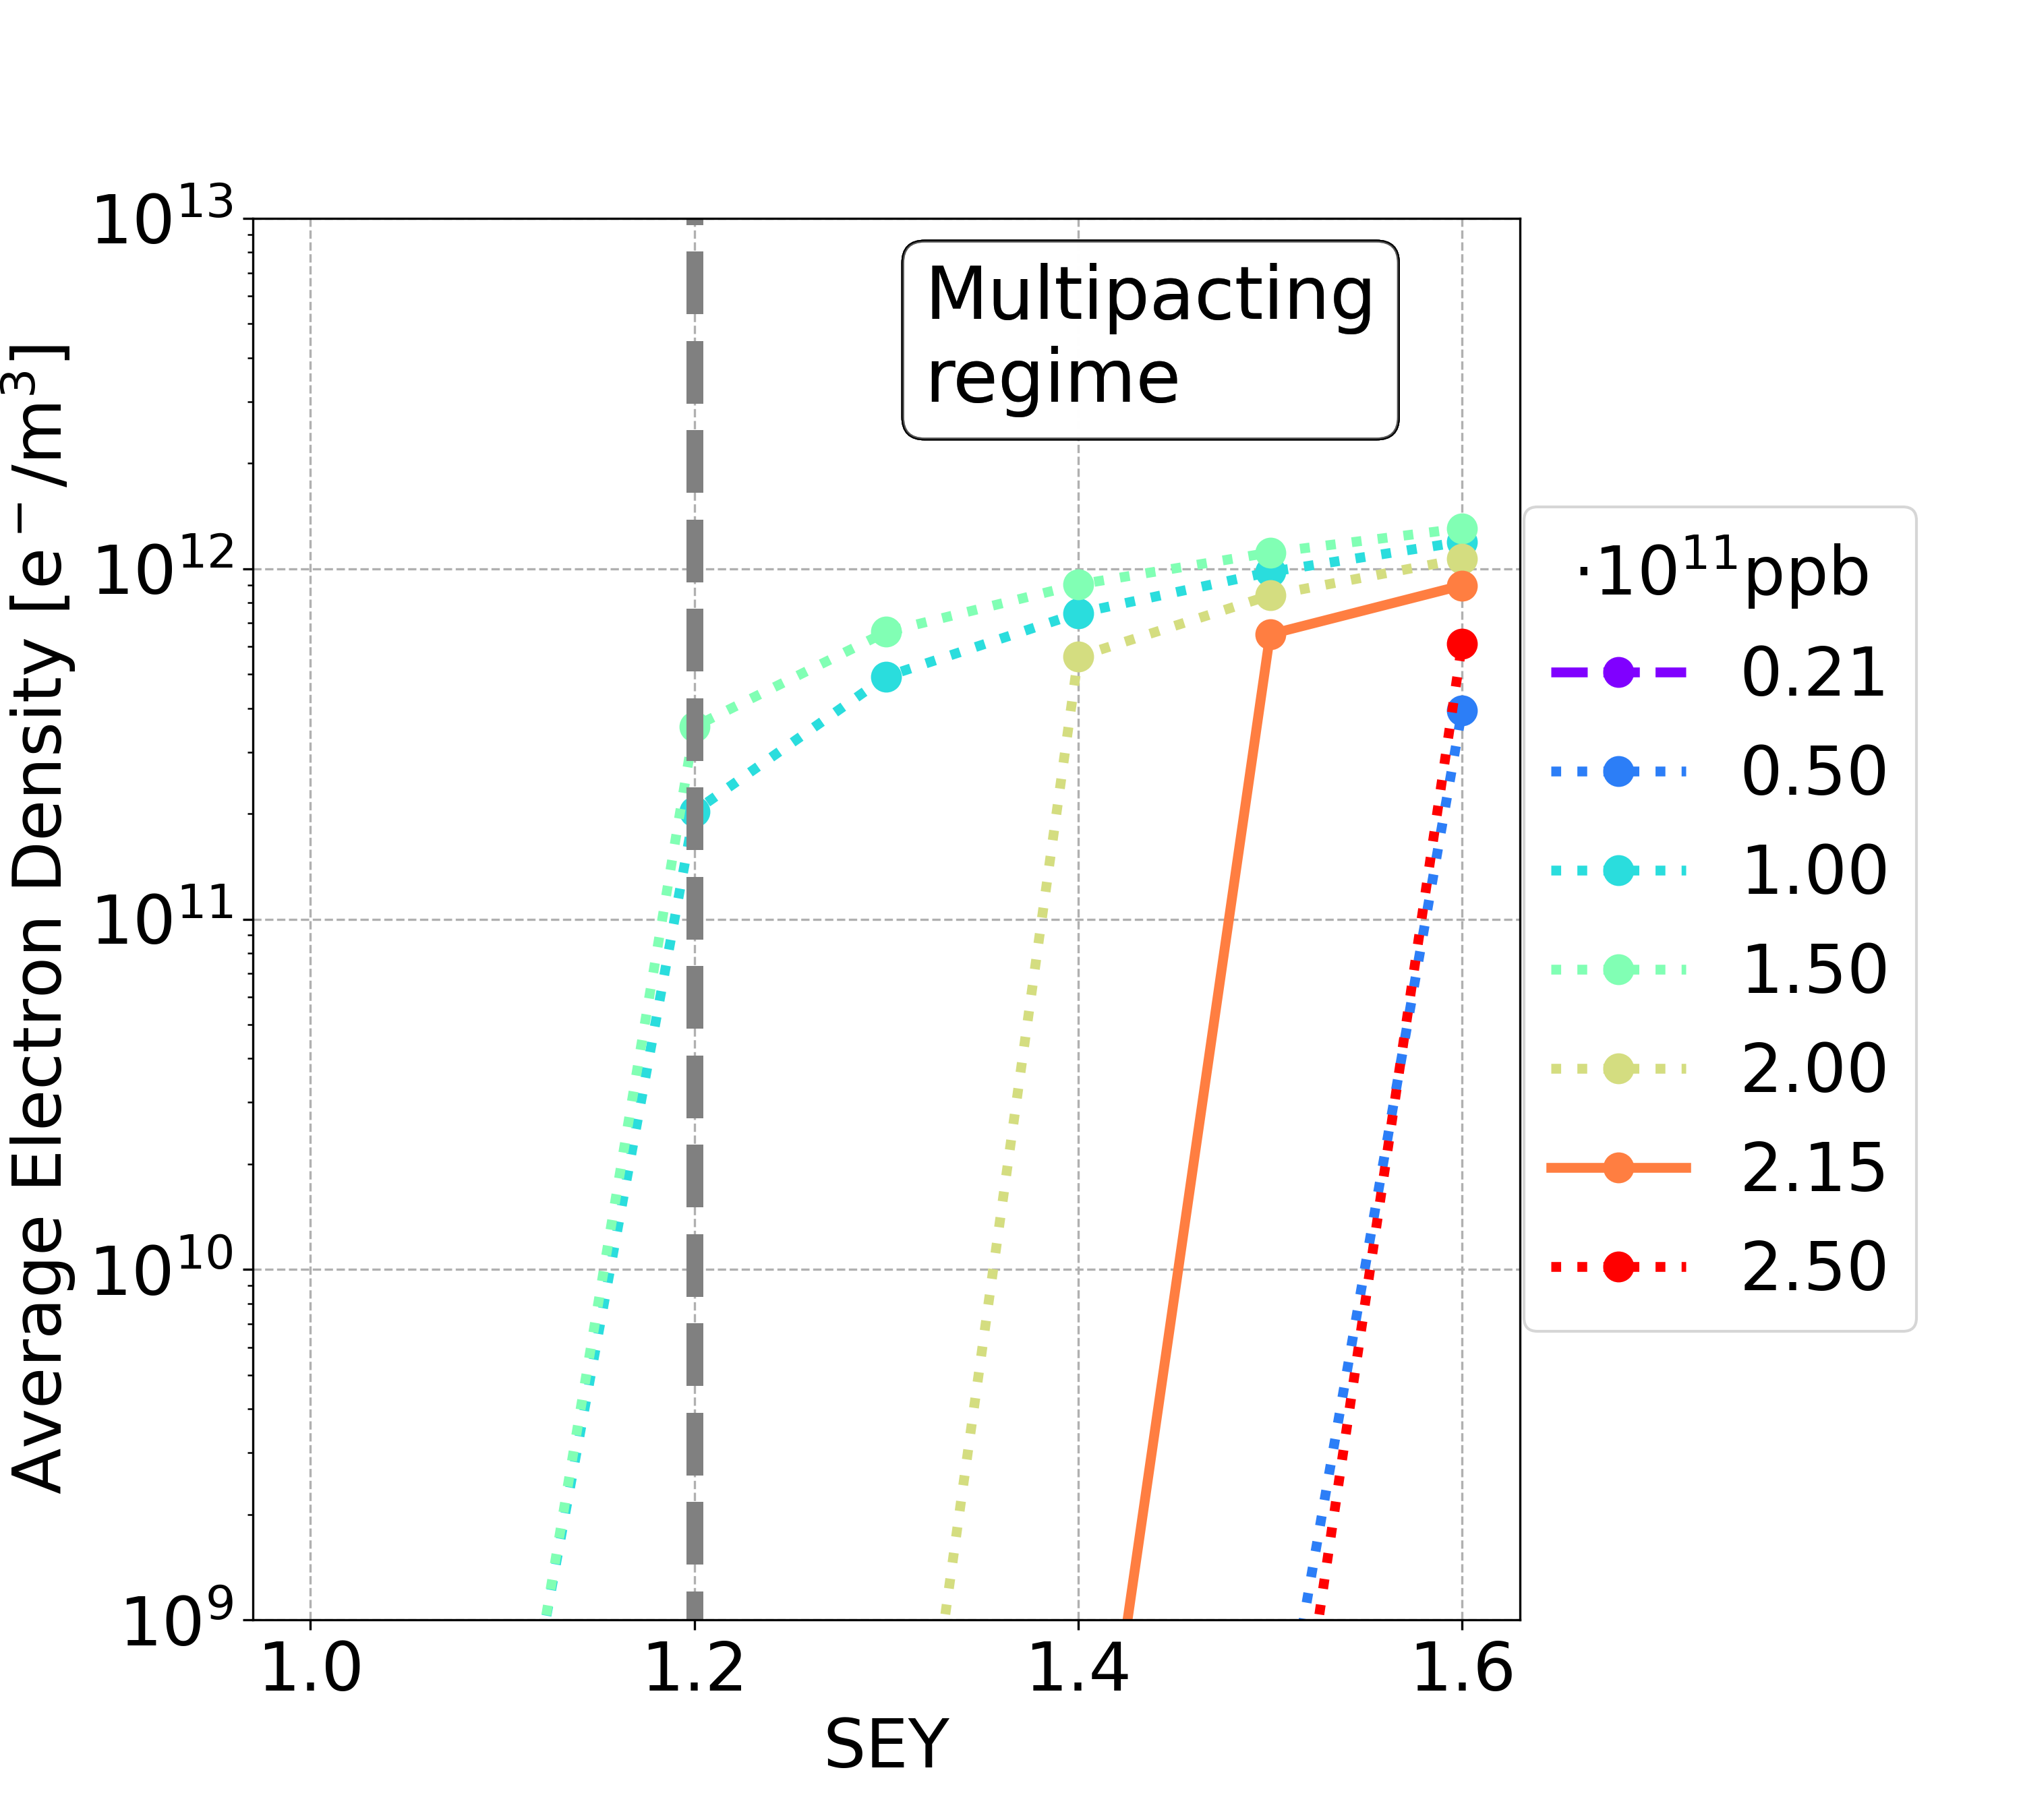
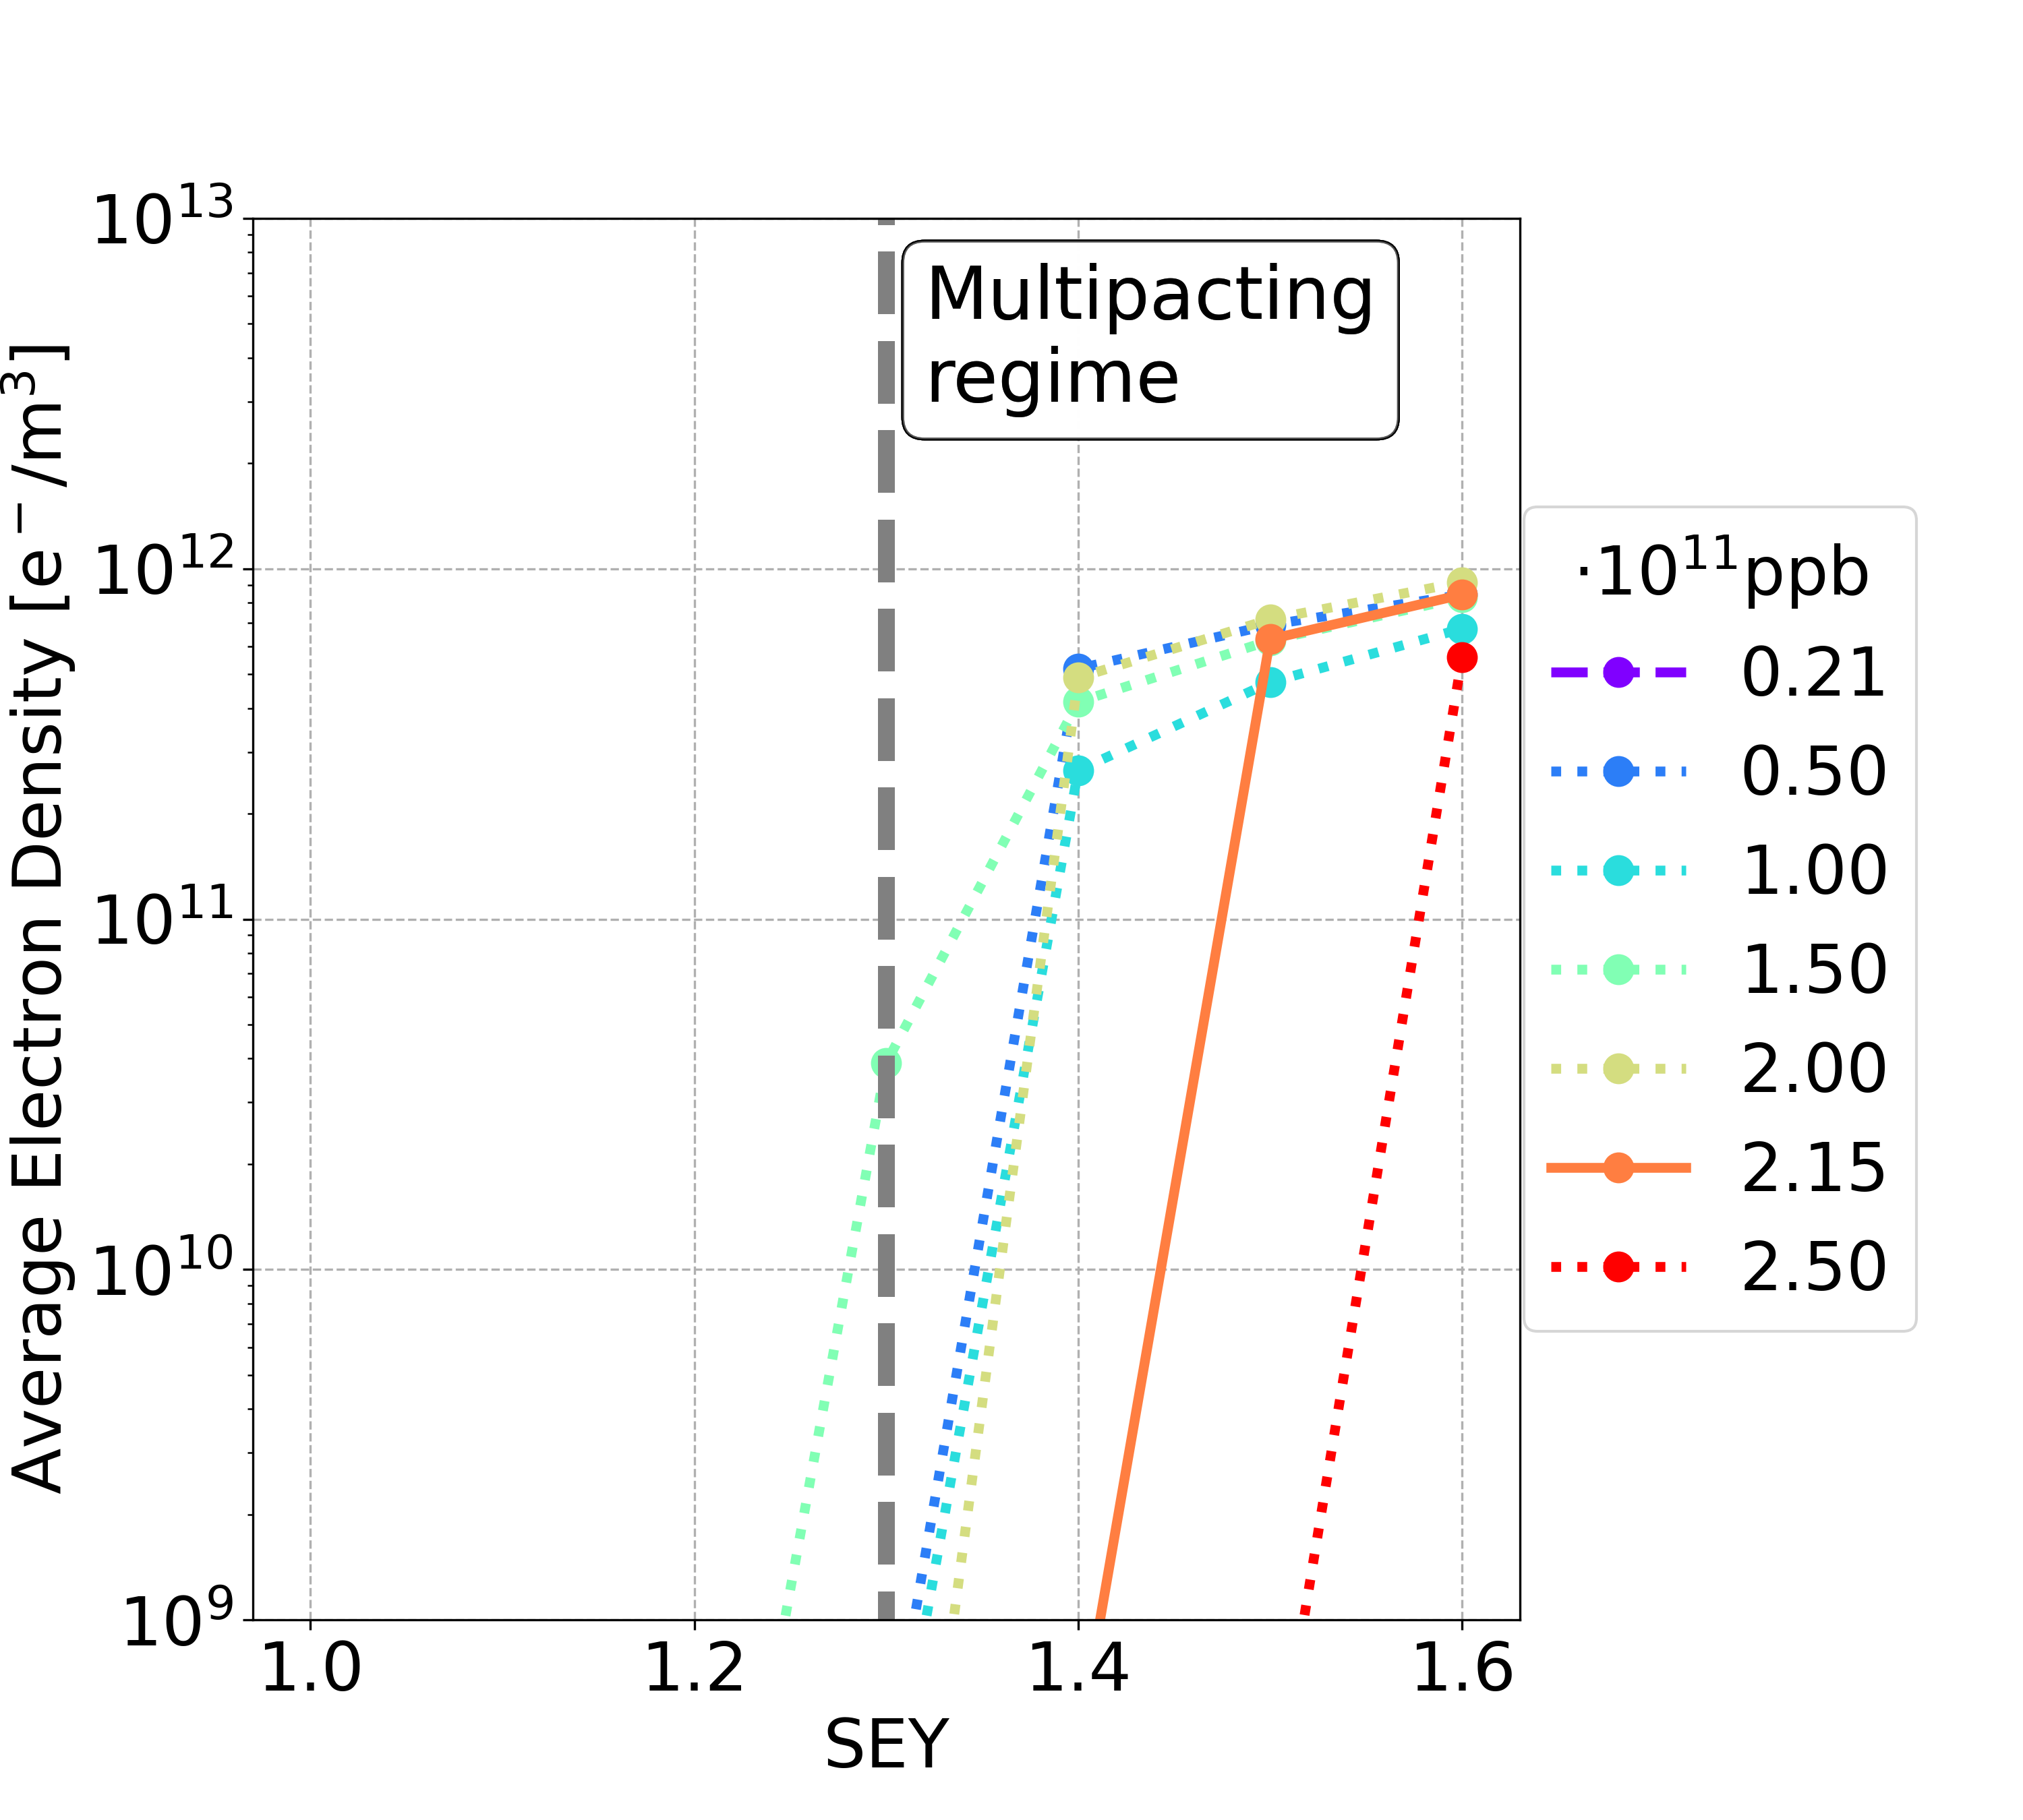
Short Bunch Spacing: 10 ns vs 5 ns
Considering the passage a full train of 560 bunches and the following train gap
A better e-cloud mitigation is obtained using filling schemes with 5 ns bunch spacing
Bunch spacing 10 ns with 2 bunches and 3 empty
Bunch spacing 5 ns with 2 bunches and 8 empty

Slide 18
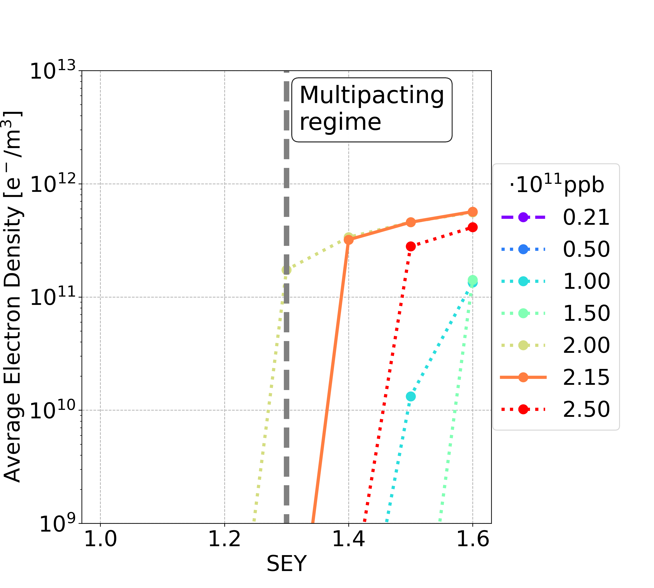
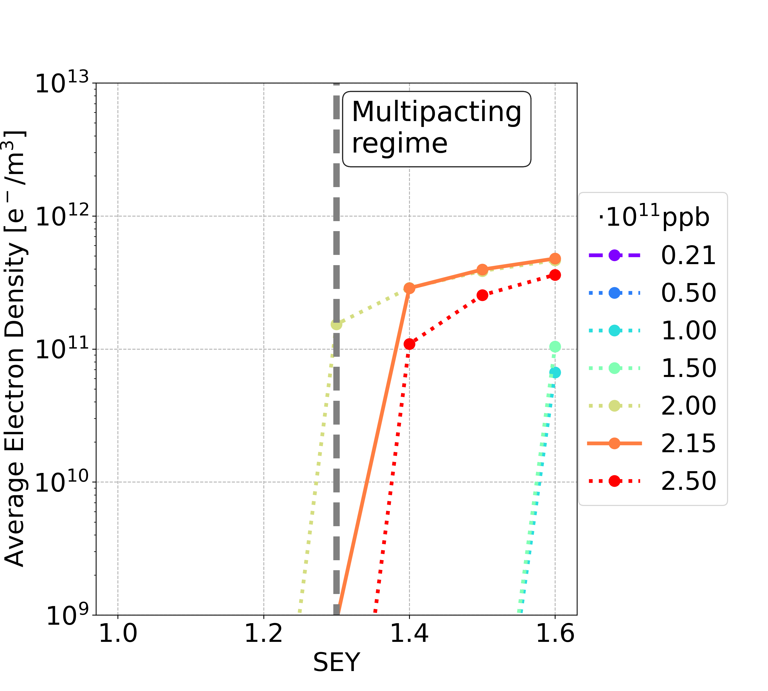
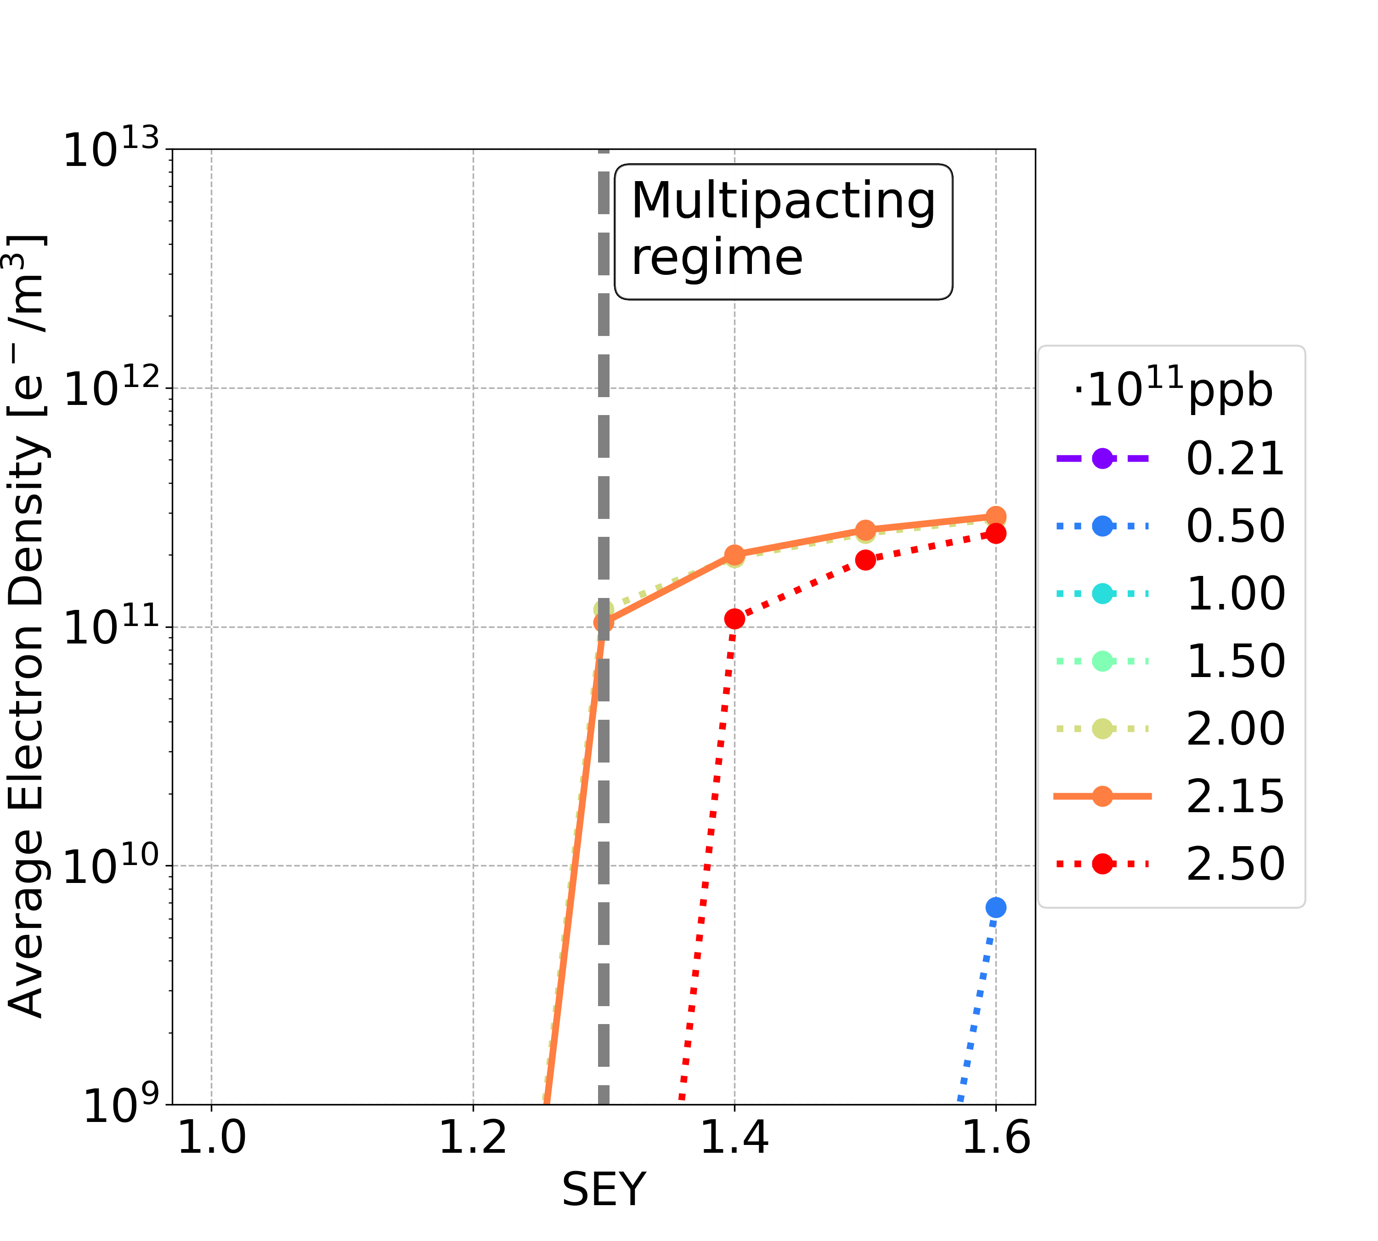
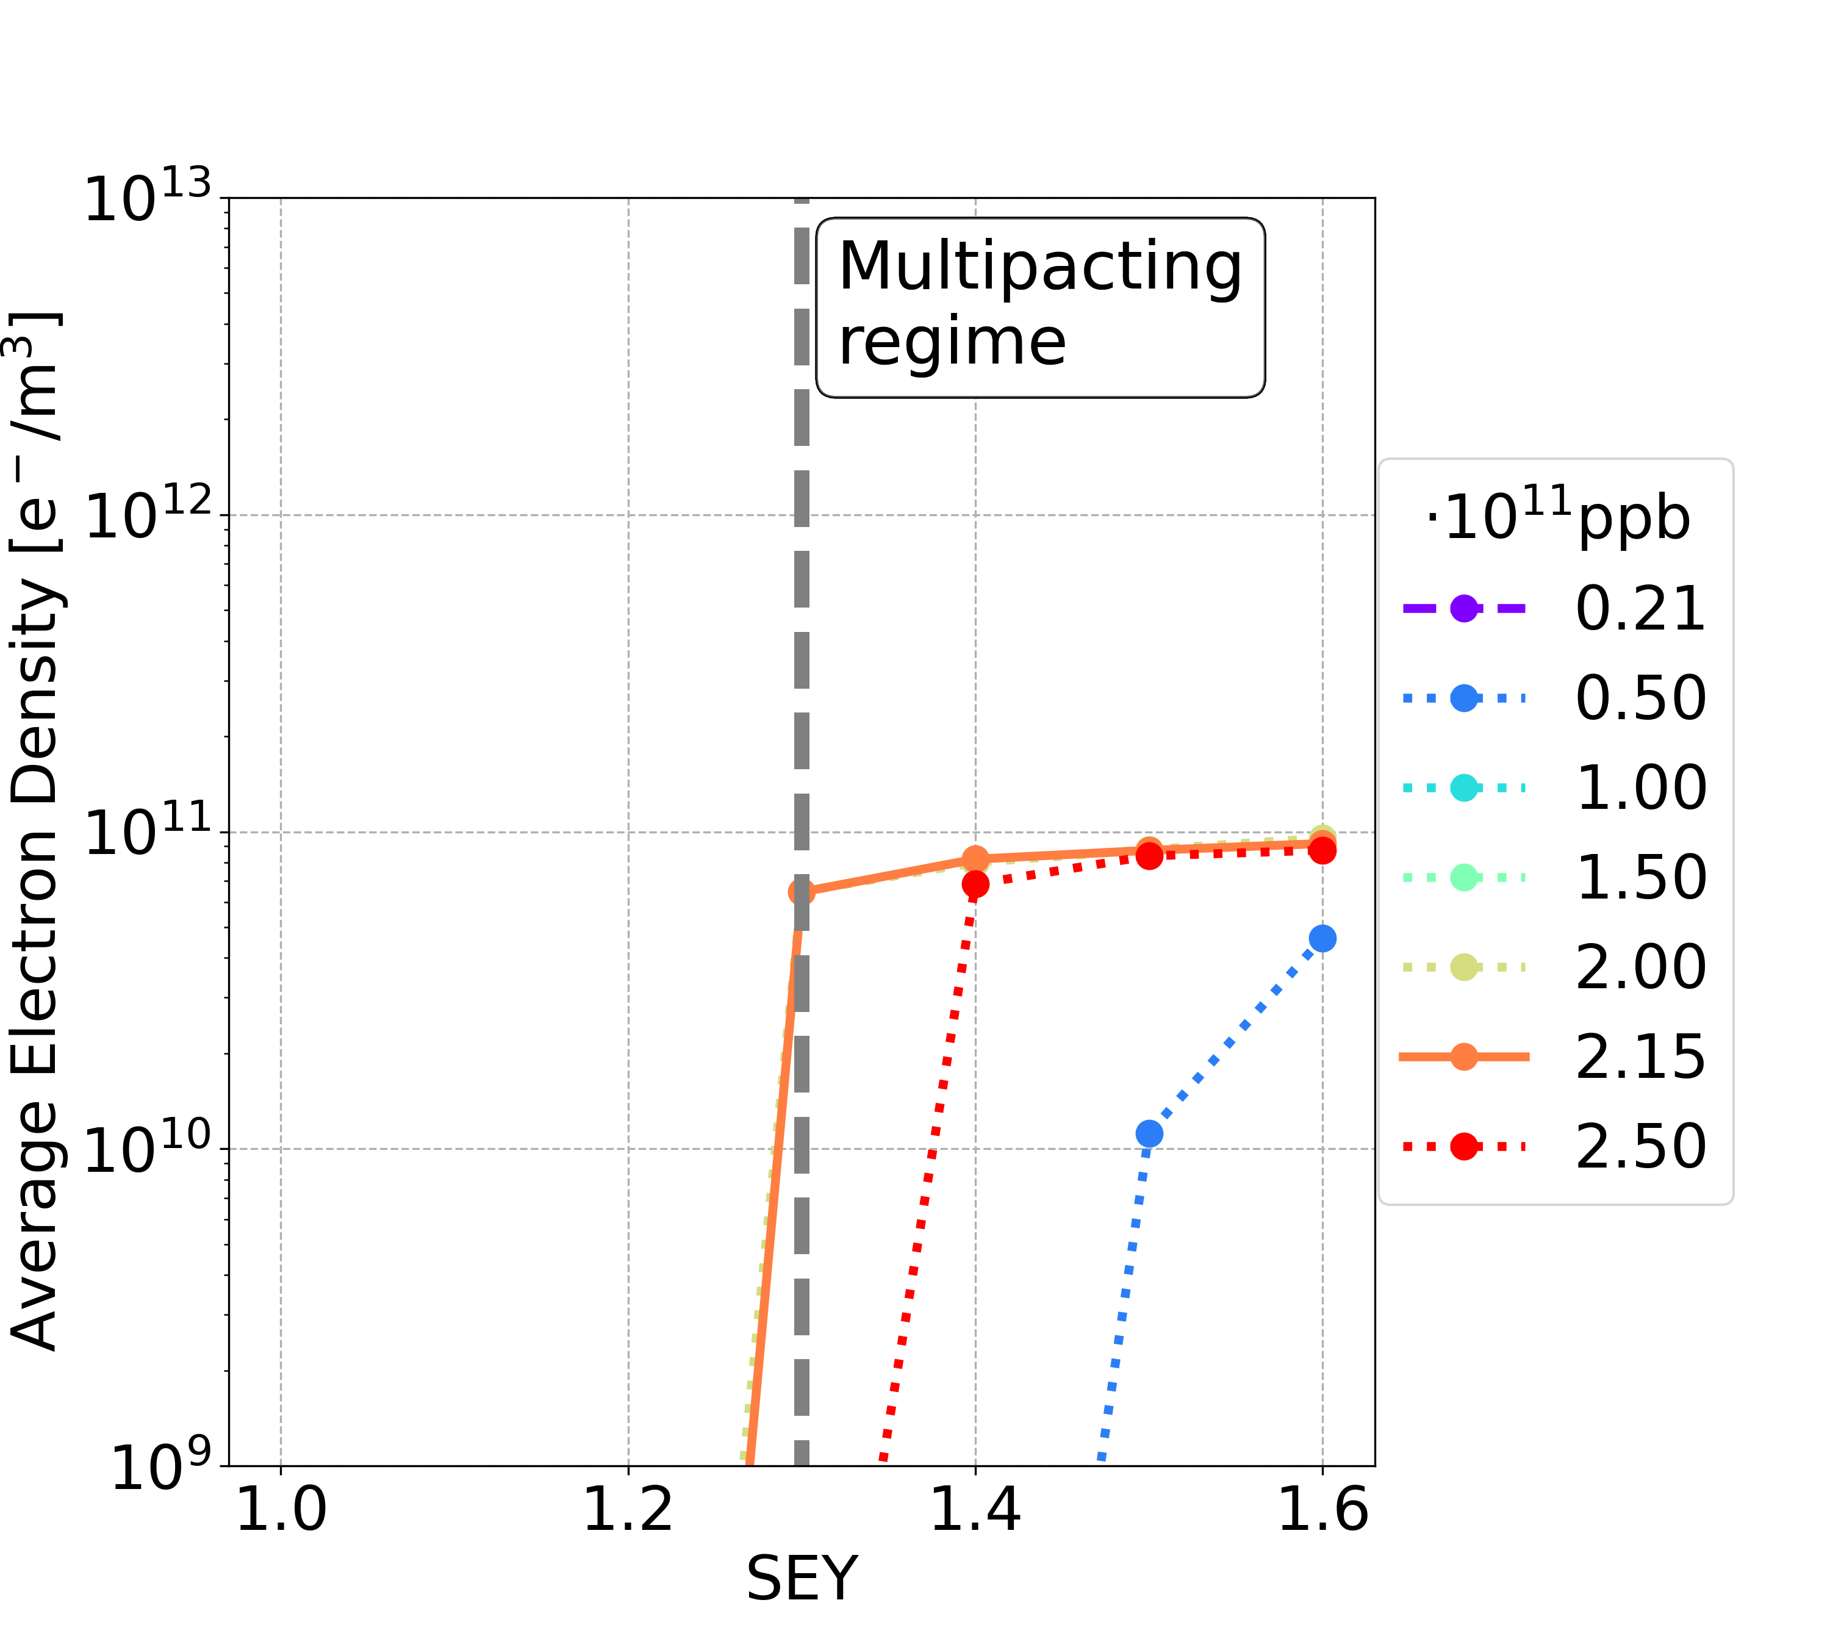
Short Bunch Spacing 5 ns: Dipole
Considering different filling patterns
4b+16e
5b+20e
8b+32e
16b+64e
Bunch population | Uniform 25 ns | 2b+8e | 4b+16e
nominal | 1.4 | 1.4 | 1.3
below nominal | 1.0 | 1.2 | 1.2
Bunch population | Uniform 25 ns | 2b+8e
nominal | 1.4 | 1.4
below nominal | 1.0 | 1.2
Bunch population | Uniform 25 ns | 2b+8e | 4b+16e | 5b+20e | 8b+32e | 16b+64e
nominal | 1.4 | 1.4 | 1.3 | 1.3 | 1.2 | 1.2
below nominal | 1.0 | 1.2 | 1.2 | 1.2 | 1.2 | 1.2
Using filling schemes with non-uniform bunch spacing, the strict constraint on the SEY multipacting thresholds for critical bunch intensities could be mitigated

Slide 19
Short Bunch Spacing 5 ns: Summary
Element | Field | Bunch population | Uniform 25 ns | 2b+8e | 4b+16e | 5b+20e | 8b+32e | 16b+64e
Drift Space | - | nominal | 1.4 | 1.4 | 1.4 | 1.4 | 1.3 | 1.2
 |  | below nominal | 1.2 | 1.4 | 1.4 | 1.4 | 1.3 | 1.2
Dipole | 15.2 mT | nominal | 1.4 | 1.4 | 1.3 | 1.3 | 1.2 | 1.2
 |  | below nominal | 1.0 | 1.2 | 1.2 | 1.2 | 1.2 | 1.2
Quadrupole | 1.45 T/m | nominal | 1.1 | 1.3 | 1.3 | 1.3 | 1.3 | 1.2
 |  | below nominal | 1.0 | 1.2 | 1.3 | 1.3 | 1.3 | 1.2
Sextupole | 72.5 T/m² | nominal | 1.1 | 1.4 | 1.5 | 1.5 | 1.4 | 1.2
 |  | below nominal | 1.0 | 1.2 | 1.5 | 1.5 | 1.4 | 1.2
Using filling schemes with non-uniform bunch spacing, the strict constraint on the SEY multipacting thresholds could be mitigated, for all the analysed magnetic elements
The filling schemes with the patterns 4b16e and 5b20e are the most promising

Slide 20
Higher Total Bunches
Having a larger number of bunches
  allows for a reduction in nominal bunch intensity while maintaining the same beam current
  reducing the severity of other collective effects (beam-coupling impedance and beam-beam)
The filling schemes with the patterns 4b16e has been analysed
Additional bunches are added, reducing the number of empty bunches that form the gap
Train 1
1
2
3
4
5
6
7
8
5
6
7
8
560
...
Train gap
0
10
20
30
40
50
60
70
80
90
100
110
120
Time [ns]
Filling pattern | 4b+16e | 5b+15e | 6b+14e | 7b+13e | 8b+12e
Total bunches | 11,200 | 14,000 | 16,800 | 19,600 | 22,400
Nominal bunch intensity [x10¹¹ ppb]​ | 2.15 | 1.72 | 1.43 | 1.23 | 1.07
Filling pattern | 4b+16e | 5b+15e
Total bunches | 11,200 | 14,000
Nominal bunch intensity [x10¹¹ ppb]​ | 2.15 | 1.72
Filling pattern | 4b+16e
Total bunches | 11,200
Nominal bunch intensity [x10¹¹ ppb]​ | 2.15

Slide 21
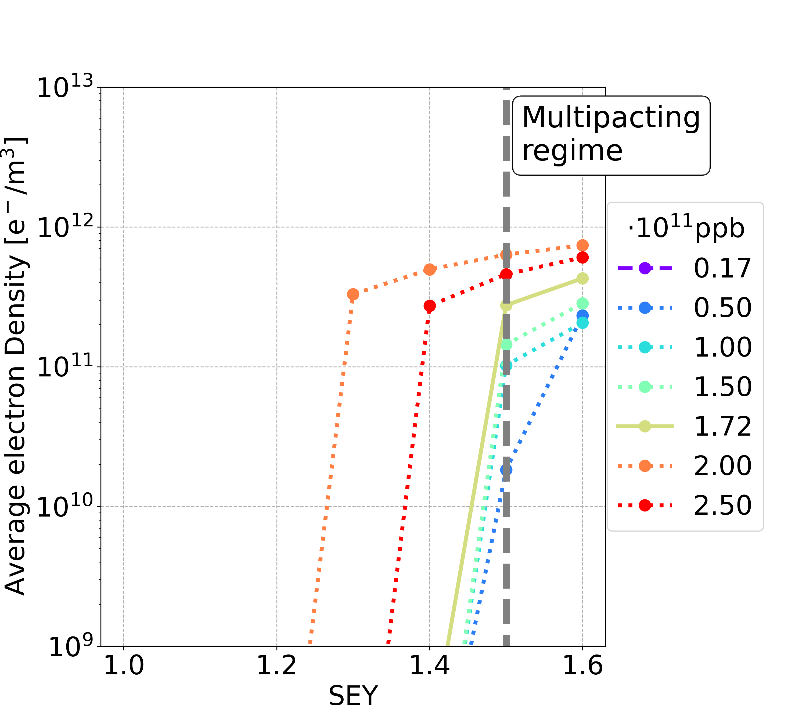
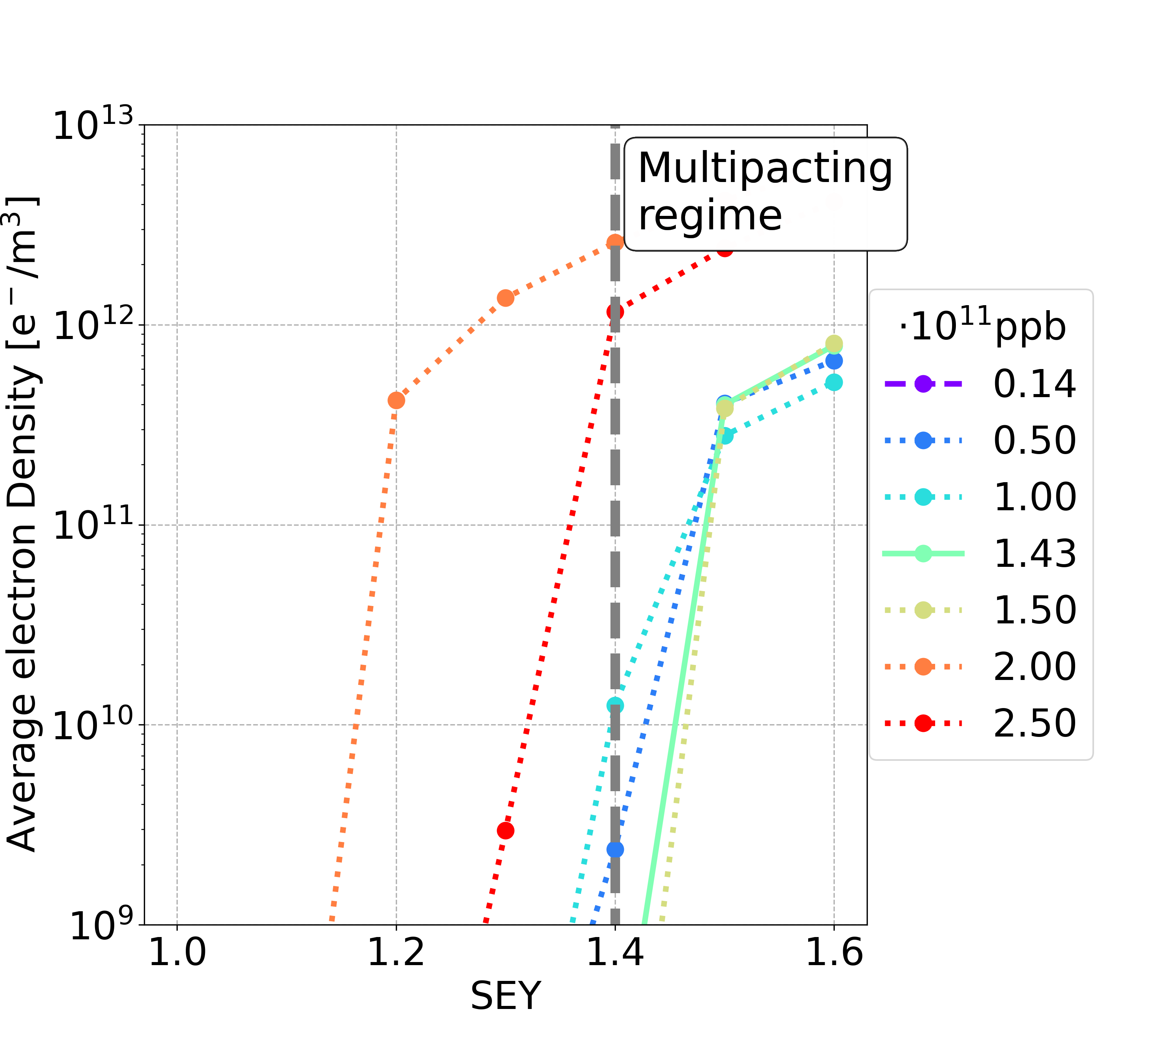
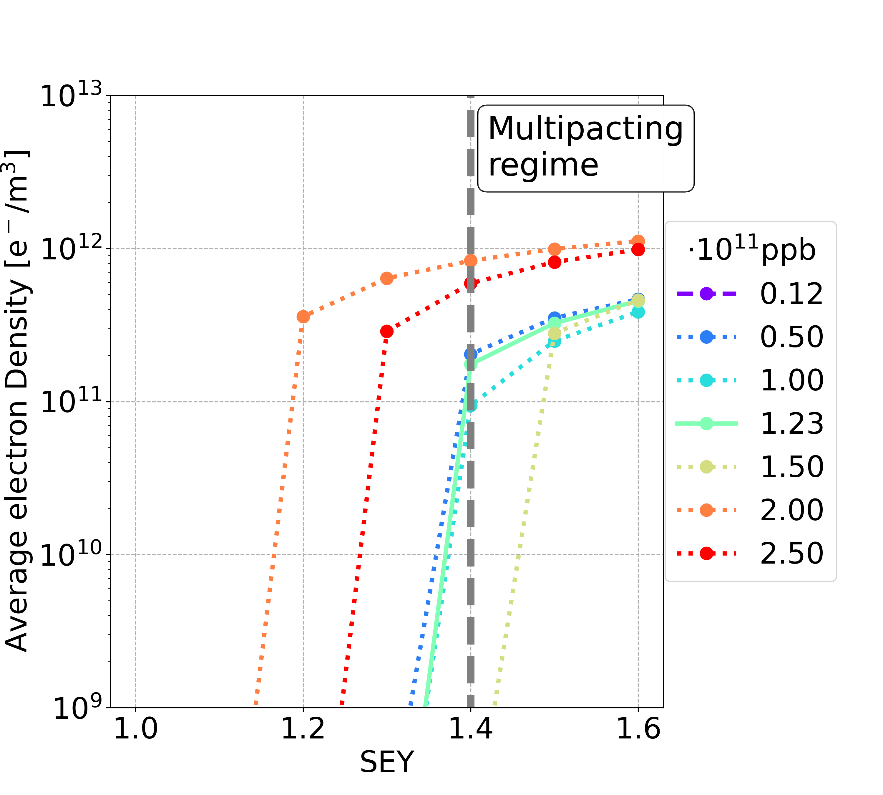
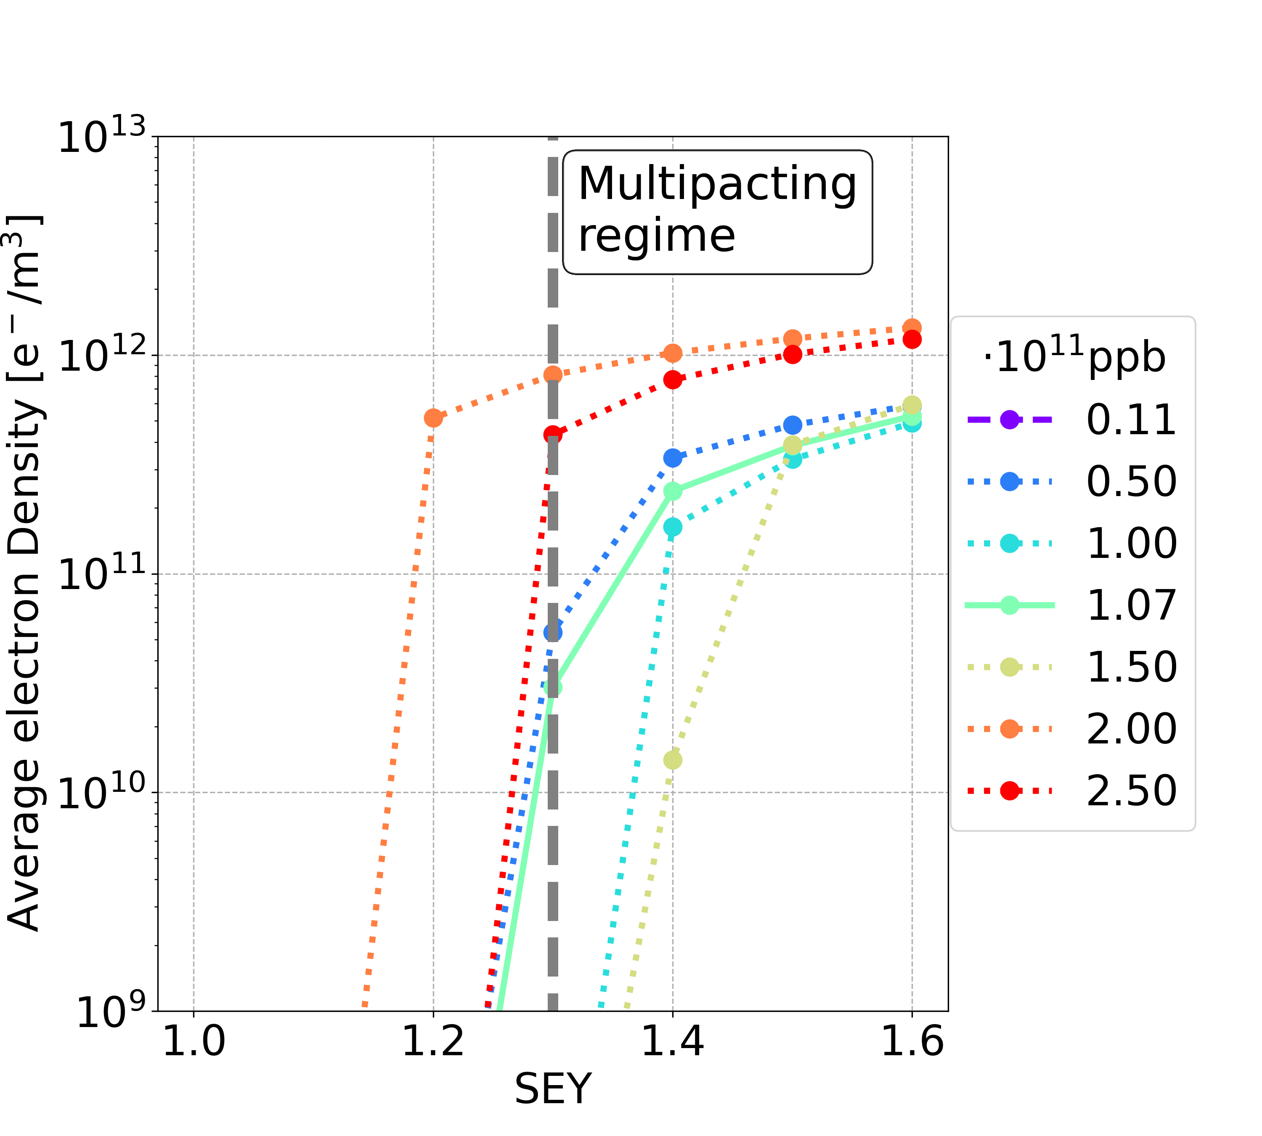
Higher Total Bunches: Dipole
Considering different filling patterns with a larger number of bunches
5b+15e
6b+14e
7b+13e
8b+12e
Bunch population | Uniform 25 ns | 4b+16e | 5b+15e | 6b+14e | 7b+13e | 8b+12e
nominal | 1.4 | 1.3 | 1.4 | 1.4 | 1.3 | 1.2
below nominal | 1.0 | 1.2 | 1.4 | 1.3 | 1.3 | 1.2
Bunch population | Uniform 25 ns | 4b+16e | 5b+15e
nominal | 1.4 | 1.3 | 1.4
below nominal | 1.0 | 1.2 | 1.4
Bunch population | Uniform 25 ns | 4b+16e
nominal | 1.4 | 1.3
below nominal | 1.0 | 1.2
Filling schemes with non-uniform bunch spacing and a higher total number of bunches remain effective in alleviating the stringent requirements on the internal surface material of the vacuum chamber

Slide 22
Higher Total Bunches: Summary
Element | Field | Bunch population | 4b+16e 11,200 2.15x10¹¹ ppb | 5b+15e 14,000 1.72x10¹¹ ppb | 6b+14e 16,800 1.43x10¹¹ ppb | 7b+13e 19,600 1.23x10¹¹ ppb | 8b+12e 22,400 1.07x10¹¹ ppb
Drift Space | - | nominal | 1.4 | >1.6 | >1.6 | 1.5 | 1.4
 |  | below nominal | 1.4 | >1.6 | >1.6 | 1.5 | 1.4
Dipole | 15.2 mT | nominal | 1.3 | 1.4 | 1.4 | 1.3 | 1.2
 |  | below nominal | 1.2 | 1.4 | 1.3 | 1.3 | 1.2
Quadrupole | 1.45 T/m | nominal | 1.3 | 1.2 | 1.1 | 1.1 | 1.2
 |  | below nominal | 1.3 | 1.2 | 1.1 | 1.1 | 1.1
Sextupole | 72.5 T/m² | nominal | 1.5 | 1.4 | 1.3 | 1.2 | 1.2
 |  | below nominal | 1.5 | 1.4 | 1.3 | 1.2 | 1.2
Filling schemes with non-uniform bunch spacing and a higher total number of bunches remain effective in alleviating the stringent requirements on the internal surface material of the vacuum chamber

Slide 23
Outline
Introduction
Mitigation Techniques
Conclusions and Outlooks

Slide 24
Conclusions
The material constraints in order to avoid e-cloud avalanche multiplication are extremely tight for baseline parameters
Using filling schemes with non-uniform bunch spacing
  the e-cloud formation process could be mitigated
  the total number of bunches could be increased, with a corresponding decrease of the bunch population, while keeping the surface requirements achievable
    reducing the severity of other collective effects (beam-coupling impedance and beam-beam)

Slide 25
Outlooks
A new filling scheme has been proposed to reduce the transient beam loading
Less bunches per train
  better for the e-cloud
Shorter gap length
  critical from the e-cloud point of view
  is the train gap long enough to clear the vacuum chamber of the e-cloud after the train passage?
The mitigation technique, based on filling schemes with non-uniform bunch spacing, should be effective, as the small gaps within the train can remain unchanged
Bunch Intensity [x10¹¹ ppb] | Bunch Spacing [ns] | Number bunches / Train | Number Trains
2.15 | 25 | 280 | 40
2.15 | 25 | 560 | 20
Bunch Intensity [x10¹¹ ppb] | Bunch Spacing [ns] | Number bunches / Train | Number Trains | Gap Length [ns] (gap/bunch spacing)
2.15 | 25 | 280 | 40 | 575 (23)
2.15 | 25 | 560 | 20 | 1175 (47)
From Ivan Karpov
(private communication 03/2025)
From Tor Raubenheimer
(private communication 06/2023)

Slide 26
Thanks for your attention

