Slide 1
Update from the Run Coordination
63rd AWAKE Technical board
12/03/2025
Michele Bergamaschi

Slide 2
Contents
2025 Schedule overview
Activities at AWAKE since last TB
Program before proton run 2025
Measurement during proton run
General remarks for 2025 proton run

Slide 3
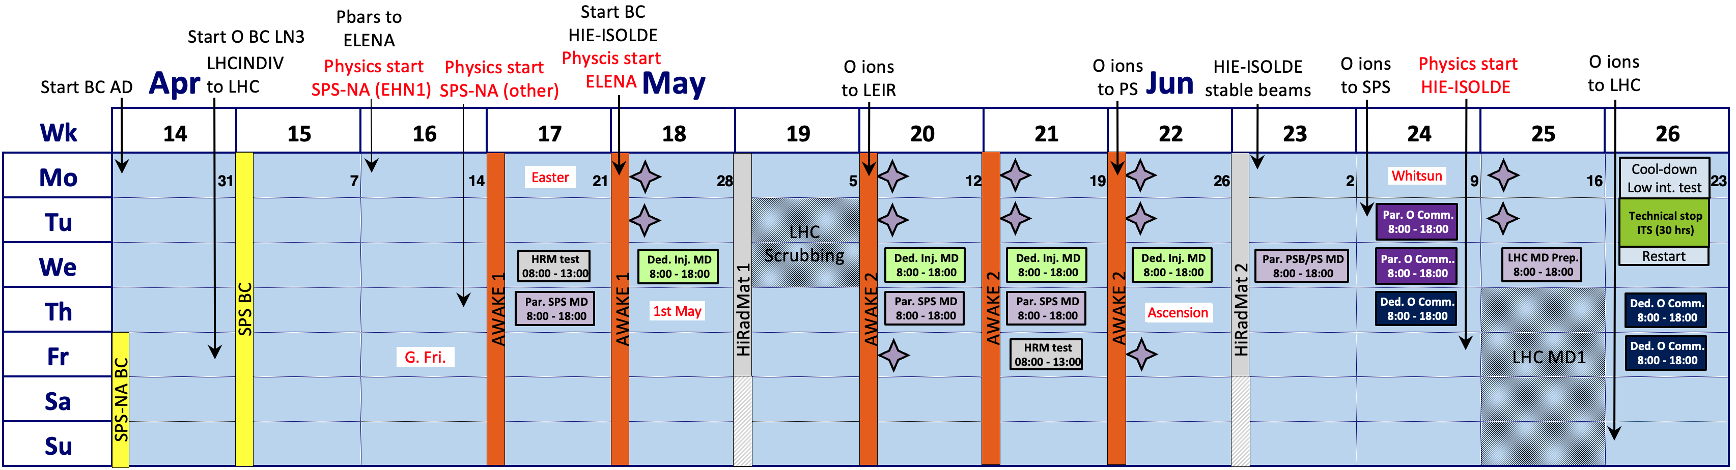
2025 Schedule Overview
Proton runs:
5 weeks, spaced in 2 runs. 1 Week between them
After proton run:
1 week copper photocathode test
Then decommissioning of AWAKE starts

Slide 4


Activities at AWAKE since last TB
Replacement of LBDP2 and LBDP3 -> done on 24/01
Pump-down of proton and vapor source sections -> done on 31/01
E-beam maintenance -> done on week 5
Electron and laser DSO test on -> performed 6/02, got the beam permit on 12/02
Laser interlock test -> done 06/02, but high-power mode missing
Vapor source replacement of faulty probe (bath spare) -> happened 10/02
Fiber communication for camera servers with AWAKE tunnel - > Re-established 11/02
Replacement of UPS in TSG4 -> happened 11/02

Slide 5
Activities at AWAKE since last TB
Installation of new Exp Volume switches-> happened 11/02. Speed 2x then before
HeNe alignment - > done on 12/02
RF conditioning -> done on 13/02
Photocathode QE measurements-> done twice (UV realigned in between ), see next talk by Edu
E-beam -> restarted on week 7
Replacement of faulty turbo pump VPGR.VVG.412401 -> done on 18/02

Slide 6

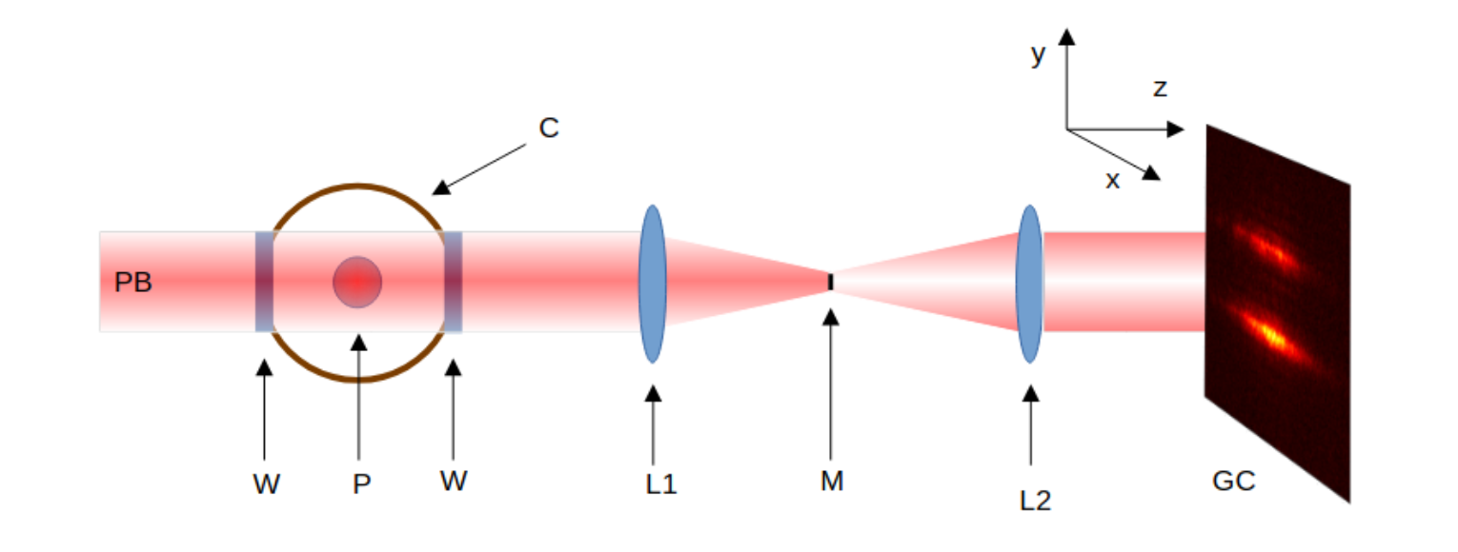
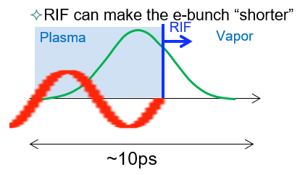
Proposed studies before 2025 proton run
Laser propagation and ionization: measurements of plasma column:
  Continue collaboration with Wigner team
  Transverse measurement: Schlieren imaging study evolution of plasma radius, ready for proton run for wakefield effect (2025), new MPP student (Jedd Page) joined from December 2024
  Longitudinal measurements: back-propagating blue light
  -> requires two vacuum installation: 1 at BTV354 done, 1 at laser merging point missing
  Simultaneous measurement of plasma light, laser envelop/calibration with step See Jan’s talk at last PEB
Electron beam :
  Further e⁻ beam characterization studies, e⁻ beam alignment preparation for seeding/hosing studies
  e⁻ beam propagation in Rb-vapor to measure the scattering effect for Run2c injection
  Experiment with e⁻ beam in plasma, including Relativistic Ionization Front (RIF) in e⁻ beam. Monitor plasma light (for e-beam seed level) function of laser/ e⁻ beam delay + e⁻ beam deceleration:
    As started during 2024 proton run, but should be done systematically and for different densities (2-4-7 e14 1/cc)

Slide 7
Program during the YETS
Laser propagation and ioniziation: measurements of plasma column (from Lucas):
Offline schlieren alignments in EHN1
Setup will integrated in the tunnel
Adapt system to new conditions -> integrate with plasma density measurements
Retrieve schlieren performances of last year
Prepare for better remote control during Proton run
Finish and prepare for the blue laser experiment (ionization studies)

Slide 8
Program during the YETS
Electron beam :
Setup/restart (Time frame 2-3days)
Optics and Operation (Time frame ~ 1week/10 days)
E-beam in Rb-vapor -> first set of measurements already taken more next week
E-beam in plasma

Slide 9
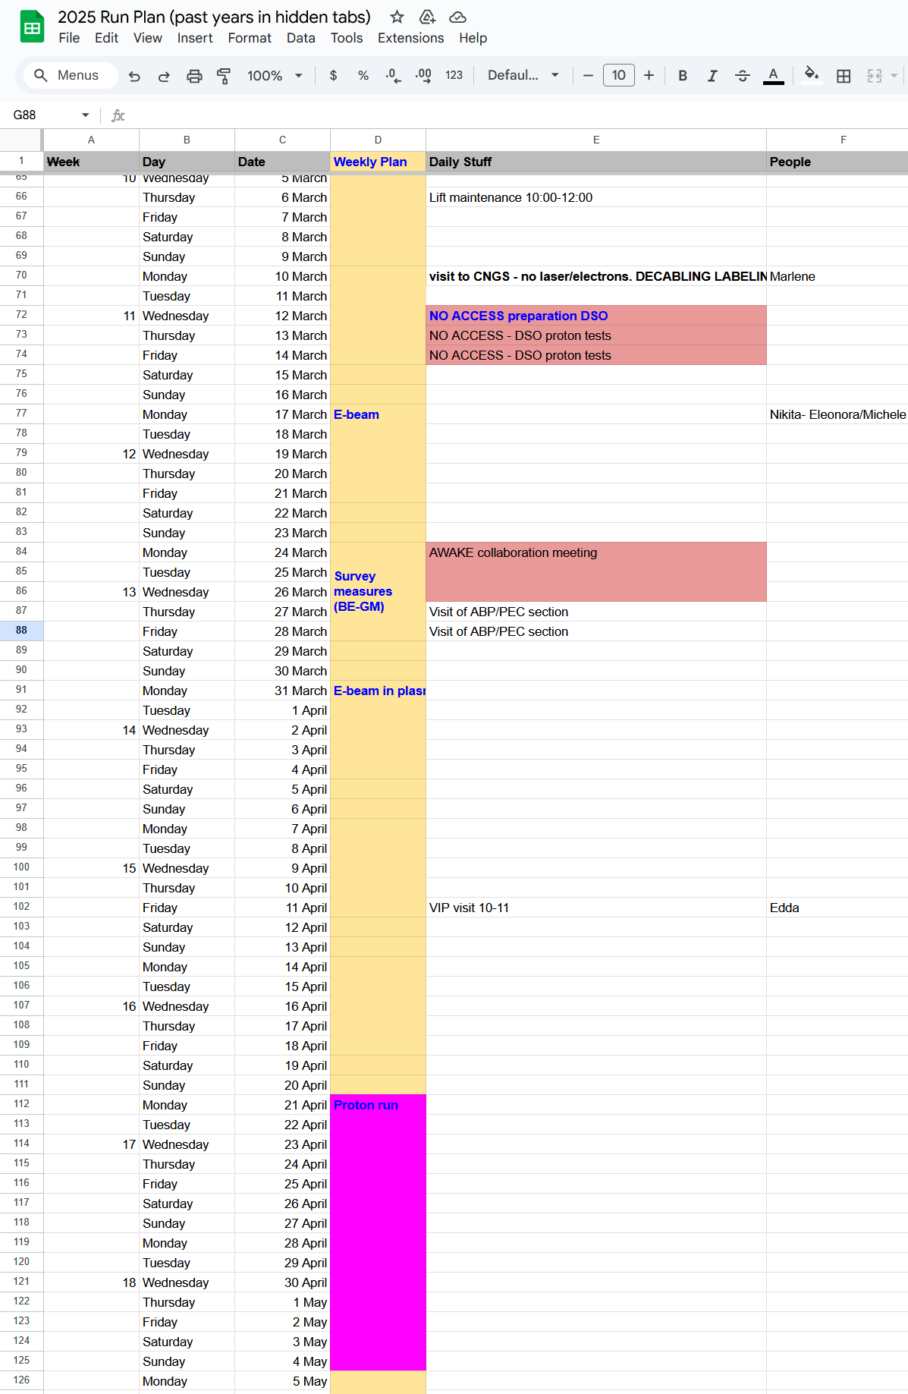
Program during the YETS
Laser studies-> dedicated 3 weeks 17/02 to 09/03
E-beam commissioning/setup> already started
E-beam dedicated studies -> 17/03 to 21/03
E-beam in plasma -> 31/03 to 04/04
We have a calendar maintained by Eloise and me that you can access here: https://docs.google.com/spreadsheets/d/1Ek3OMETumKdAzUGEjctXiAJwTj3HUyb98da67mfmzn8/edit?gid=407551030#gid=407551030

Slide 10
Run2b: 2025 Measurements
  Programmatic points to address for Run2c :
    e⁻ beam seeding at high density without hosing and high p⁺ bunch population
    Sensitivity to misalignment of hosing
    Emittance measurements, effect of plasma density ramp at plasma end
  Physics studies for plasma acceleration:
    Asymmetry in Self-Modulation suppression with plasma density gradient
    Plasma e⁻ filament formation in density ramp
    Growth of Self-Modulation versus plasma length
    Growth of hosing versus plasma length

Slide 11
Commissioning Status: Instrumentation
 | Hardware | Software | Electron/laser beam | Proton beam | Who?
eBPM | Ok | Ok | Ok |  | Nikita and Eleonora
pBPM and BCT | SPS responsibility
BTV Screens | Ok | Ok | Ok |  | Arthur
BTV Cameras | Ok | Ok | Ok |  | Arthur
XMPP Streak | To be re-started |  |  |  | Arthur
Upstream Streak | Removed | Removed | Removed | Removed
YMPP Streak | To be re-started |  |  |  | Arthur
Faraday Cup | Ok | Ok | Ok |  | Nikita and Eleonora
Spectrometer | To be re-started |  |  |  | Fern
Rb Density | US+MS, DS | US+MS, DS | US+MS, DS |  | Michele
Plasma PMTs | 1 scope need to be replaced |  |  |  | Jan
Photodiode @ CTR | Not powered |  |  |  | Michele

Slide 12
Commissioning Status: Beams
 | Beam Created | Aligned and Propagated | Optics/Size | Intensity/Charge | Who?
Electrons | Ok | Ok |  |  | Nikita and Eleonora
Laser (IR) | Ok now, but flash lamps to be replaced before the run | Ok | Ok | Ok | Lucas
Laser (UV) | Ok | Ok | Ok | Ok | Lucas
Laser (Marker) | to be checked |  |  |  | Lucas
Electron Controls
Laser Controls
 | Hardware | Software | Beam | Who?
Magnets | Ok | Yasp issue | Ok | Nikita and Eleonora
Spectrometer Magnets | To be tested |  |  | Fern
 | Hardware | Software | Beam | Who?
Picomotors | Ok | Update for power cycled foresee | Ok | Lucas
Filter wheels | Ok | Ok | Ok | Lucas

Slide 13
Commissioning Status: Alignment and DAQ
Alignment: optical lines, timing, synchronization
Reference image showing screen markings on all BTV | With e-beam and hene, not 54 and exp. Reference with protons
Photocathode UV translation stage photocatode: effect on e⁻ trajectory | To be done, next week
Streak optical lines: align with HeNe or reference | To be checked
Streak absolute time: find signal (electrons, IR or Marker) in all time windows | To be done, next week
Beam synchronization: synch Marker+IR on Downstream streak | To be done
Beam synchronization: synch Electrons+Marker on downstream streak | To be done
Align old spectrometer camera to see entire screen | To be done
Data Acquisition and Data Quality
Run Event Builder at 1Hz | Works at 1 Hz, cannot read PMTs scopes, Michele and Lucas
Run Event Builder with SPS calibration trigger | To be done
Use Event Builder GUI to check which devices are not sending data | To be checked
Start DQM and verify that all data is processed | To be done

Slide 14
General remarks for 2025 proton run
On-call requirements
Usual teams: Timing, Instrumentation, Vacuum, Controls
RP: foresee access every Wednesday,
RPE: now we have only 3 (Ans/Eloïse/David) aim to cover every weekend, please fill the calendar
During 2024 run we continued the daily meeting for control room team to assess daily program and prepare for next day: most of the time done in dead time (ex LHC fill) for effectiveness

Slide 15
Thank you for your attention

