Slide 1
DRD1 H4(PPE134) 2024 Test Beam​
DRD1 R&D Collaboration
Development of Gaseous Detectors Technologies
Physics scope ​
Beam requirements ​
Infrastructure needs
Web sites: https://drd1.web.cern.ch/ https://drd1.web.cern.ch/activities-wg7
WG7 (Common Test Facilities) Conveners:
Karl Floethner, Roberto Guida, Katerina Kuznetsova, Yorgos Tsipolitis
H4/PPE134 Contact Persons: Yorgos Tsipolitis, Karl Flöthner
12th March 2024

Slide 2
Physics Scope (as of today)
Generic and Application driven R&D
  Muon/Tracking: GEM, mm and μRWELL, μRGroove, Straw, RPC
  TPC: Twin GEM TPC (Beam monitoring), high pressure optical TPC
  Timing: PICOSEC micromegas, MINICACTUS, RPC
  Calorimetry: MPGD-based HCAL
  Readout: Capacitive Coupling, Resistive Sharing
Project driven R&D
  EIC: MPGDs
FE electronics and DAQ
  Multi-channel Front End: e.g. VMM3a-SRS, TIGER-GEMROC
  Fast timing electronics (discrete and digitizers, ASICs)
Beam time @ GIF++, not covered here… members will contact GIF++ coordinators if needed.

Slide 3
Beam Requirements (as of today)
mu: highest rate as possible. Polarity and momentum not important (the configuration offering the highest rate is the preferred one).
pi: highest rate as possible. Polarity and momentum not important (the configuration offering the highest rate is the preferred one). Shifts with rate scan =<24h of interest (to be discussed and agreed with GIF++ colleagues)
e- (no interest yet): 20-100 (tbd) GeV/c low intensity (to be discussed and agreed with GIF++ colleagues).
GOLIATH
Different requests from 0.5T to 1.5T (4 groups)
→ to be discussed and agreed with GIF++ colleagues
We would need to change from muons to pions several times during the beam period as we did in the past (informing GIF++ in advance).

Slide 4
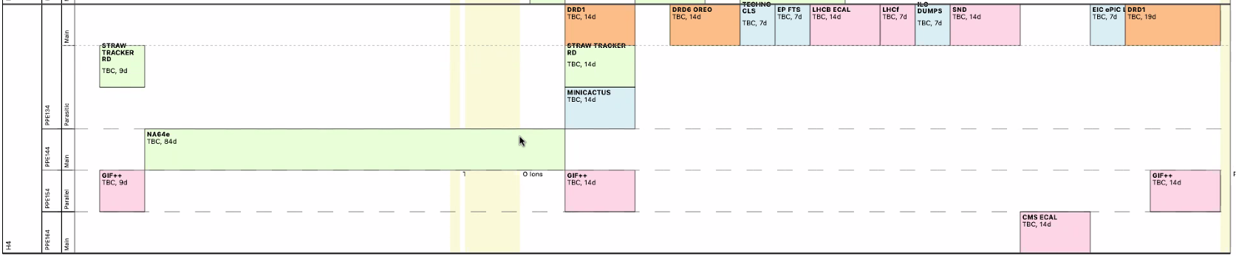
Infrastructure Needs (as of today)
Infrastructure Needs (NA)
PPE 134 Installations | Upstream/inside/Downstream Goliath (beam pipe to be removed from all area)
GAS zone (887/R-C47) | Installation of several non-flammable cylinders
Flammable Gas Operation | YES (to be seen with new Gas System and David Jaillet)
Desy Table | 3-4
XSCA Table (**) | 1-2
Blue LAPP Table | 1
Survey (detector alignment) | Yes
GOLIATH | YES (limited number of time / to be discussed/agreed with GIF++)
Jul
Nov

Slide 5
Expression of interest
(as of today 13 groups with 8-11 per period)
availability of “satellite” control room?
Team/Institute |  | Period of Interest | Beam requirements | Magnetic Field | Required gas | Involved institutes/collaborations
Optical HP TPC |  | summer, most likely fall. | muons and pions, ideally around 2.5GeV, | 0.5T, if possible. | Ar/CF4 (99/1) | IGFAE, UVigo, IFIC, Liverpool
USTC |  | All | muon and pion(for high rate test) | 1T magnetic field for 2 shifts | Ar:CO2:CF4/45:15:40 and Ar:iC4H10/98:2 | USTC and LICP(Lanzhou Institute of Chemical Physics)
LMU Munich |  | Summer, 2 weeks | Muons | No magnetic field. | Ar:CO2 93:7 and Ar:CO2:iC4H10 | LMU
BES III |  | November | Muons | No
GEM-TPCs |  | All | Muons and pions and scan | No | Mixer: He/CO2 and Ar/CO2 | HIP, PSI Czech Technical University CERN
JLAB: PICOSEC |  | November 2025 | Muons | No | Ar/CO2 70/30, Ne/CF4/C2H6 | Jefferson Lab, Florida Tech, U. of Virginia, Stony Brook U. Univ. of South Carolina
JLAB: EIC ePIC MPGDs |  | November 2025 | pions and muons | Yes | Ar-CO2 (80/20), Ar-CO2-iso (90/7/3),Ar-Iso (95/5), Ar-CO2-CF4 (45,10,45) | Jefferson Lab, CEA Saclay, INFN Roma II
Thomas Jefferson National Accelerator Facility, USA |  | November, 2025 | pions and muons | 1.5 T GOLIATH magnet is important requirement | ArCO2(80:20) Ar-CO2-iC4H10 (95:3:2) Ar-CO2-CF4 | Jefferson Lab, Florida Institute of Technology, University of Virginia
MPGD-HCAL |  | Summer and/or summer/fall | pions and muons | Not needed | Ar:CO2:C4H10(93:5:2) Ar:CO2:CF4 (45:15:40) | CERN INFN & University of Bari INFN RM3 INFN Naples Weizmann
CMS RPC group |  | Unclear | pions and muons | no | Unclear | University of Bari
PICOSEC |  | All | Muons | no | Ar/CO2 70/30, Ne/CF4/C2H6 | PICOSEC Coll.
DRD1 telescope |  | All | Muons and Pions | No | Ar/CO2 70/30 | GDD

