Slide 1

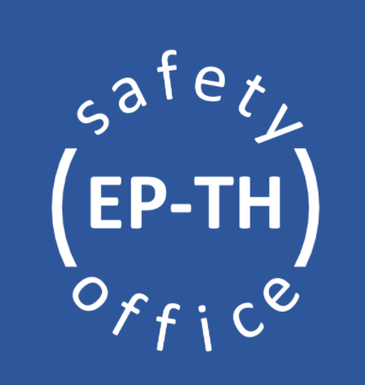
General Safety for
EHN1 users

Slide 2

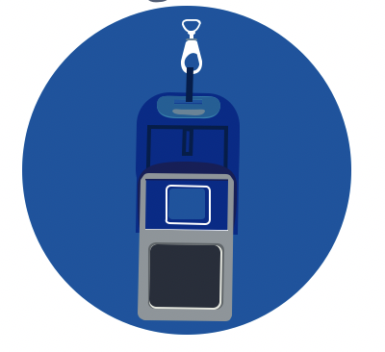
General Safety in EHN1
Necessary PPEs (Personal Protective Equipment) mandatory to enter the EHN1 Beam Facility are:
  personal dosimeter
  helmet, safety shoes (can be taken from counting rooms as soon as entering the building, if stored there – must enter the building from the door closer to the counting room)
Every experimental area is equipped with safety installations, as fire extinguishers and AUG (General Emergency Stop – cut the power in the entire building). Please, take some time to familiarise with their position the first time you enter the building!
Any accidents or incidents shall be declared via: https://edh.cern.ch/Document/General/IncidentDeclaration
Additional PPEs might be required, depending on the activities to be performed.

Slide 3
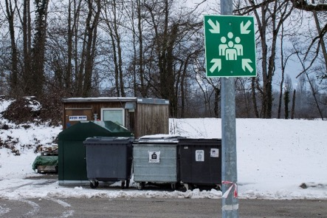
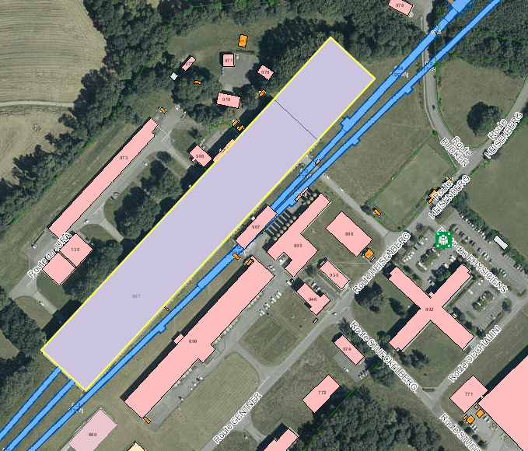
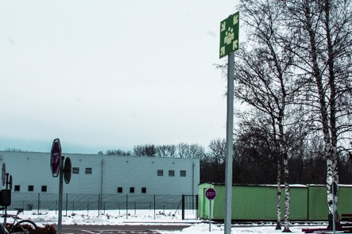
Assembly points in EHN1
There are two assembly points, located at the sides of EHN1. Please, take some time familiarise with their location!
NP Hall
EHN1
Jura side: close to picnic area
In case of evacuation alarm, leave immediately the building and go to the assembly point!
Salève side: car park by the ramp, close to building 892

Slide 4
Early Safety Instructions for Temporary Experiments
The information contained in EP Safety Office web pages shall be considered as early as possible in the design of the experiment to facilitate the safety validation process. You will find details about:
  List of materials allowed and forbidden at CERN;
  Instructions and recommendations to be followed for specific hazards and risks brought by the experiment to CERN;
  Best safety practices for installation and operations of detectors at CERN;
  Safety contacts for any additional questions.
This process should start no later than 1 week prior to the installation of your experiment at CERN. If your experiment introduces hazards or risk implications (including but not limited to the use of flammable gas, mechanical equipment, cryogenics or lasers), the EP Safety Office must be contacted as early as possible, in advance of the submission of your ISIEC.
Every set-up must undergo this safety process, before operations. This includes:
Main user set-ups, parasitic users, returning setups coming back with the same installation as last time

Slide 5
ISIEC Form & Safety Clearance process
Go on the website: https://ep-th-safety.web.cern.ch/isiec-safety-clearance (you must Sign In to access the ISIEC form)
Submit the ISIEC (Initial Safety Information for Experiments at CERN) form with the details related to your experiment (description, hazards, etc) at least 1 week before the operation
You will receive a confirmation email and you will be contacted by the EP Safety Office to organise the inspection visit on site (once the installation of the set-up is completed!)
After the inspection, the remarks (if any) will be communicated to you. If no major remarks are present, you will receive the Safety Clearance form via email. If present, minor remarks will be listed in this form. Make sure they are all resolved before taking beam!
The Safety Clearance is valid for an operation time of 3 weeks. Please, contact the EP Safety Office if your beam time is extended.
ISIEC inspections slots:
Wednesday afternoon 3PM – 5PM

Slide 6
Safety contacts
In case of any safety related questions, different safety actors will be available:
TSO – Territorial Safety Officer
Contact: EHN1-TSO@cern.ch
DSO – Department Safety Officer
Contact: ep-safety-office@cern.ch

Slide 7

Thank you!
Questions?

