Slide 1


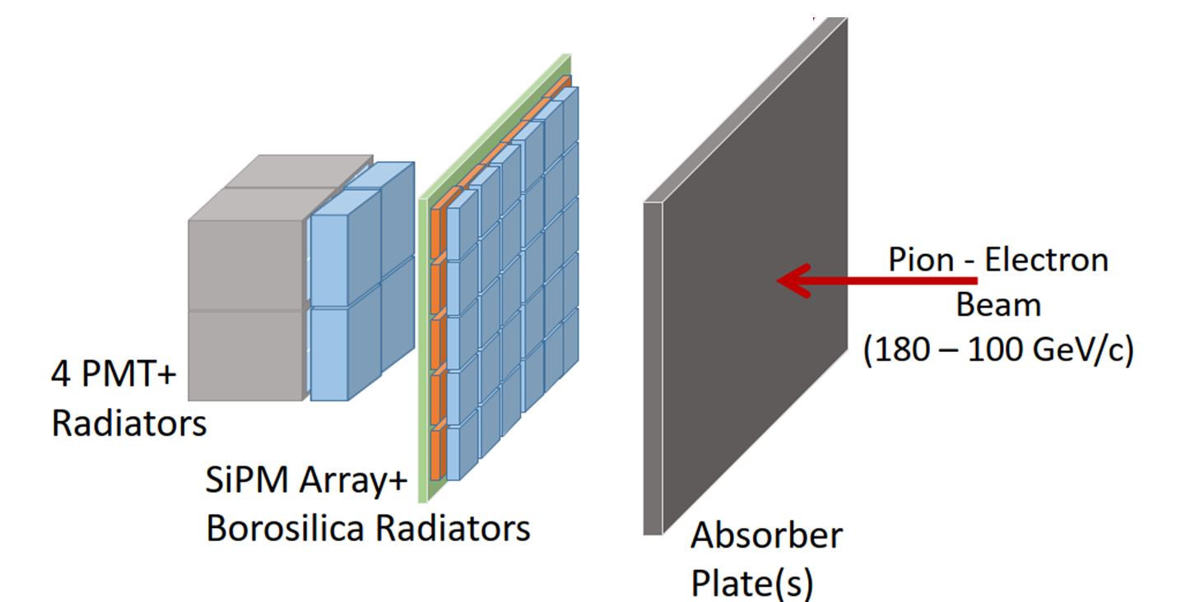


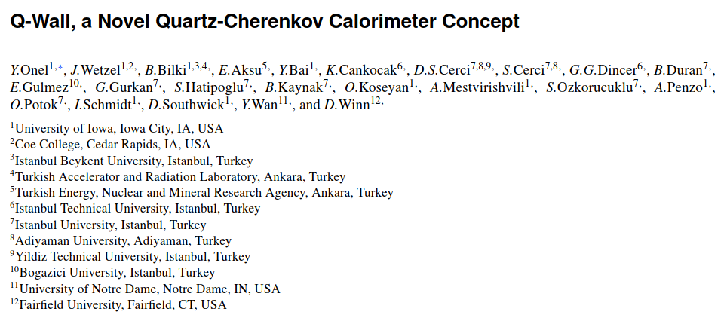


Test Beam 2025 – Line H2
UoI: Y. Onel, A. Mestvirishvili, A. Penzo, J. Wetzel,....
Turkey : S.Ozkorucuklu, D.S.Cerci, S.Cerci, B.Kaynak, O. Potok, ....
Q-Wall : Highly Segmented Quartz Tile Calorimeter
Forward Calorimetry (η > 3)
HL-LHC / FCC
High rate, pileup, radiation
Fast, segmented, rad hard
2025 TB:
Multilayer arrays
Pulse digitizing DAQ
Shower timing
Energy clustering
1

Slide 2
Test Beam 2025 – Line H2
Name of test beam activity CMS HF Wall
Purpose of test beam activity Detector R&D
Area Requested North Area (SPS)
Beam Line, Zone H2 (PPE172 - H2B)
Beam Requirements:
Particle type: electrons
  momentum (GeV/c): 50 – 150
Number of days : 4
Particle type: hadrons
momentum (GeV/c): 50 -180
Number of days : 3
Optimal beam size: ≈ 1cm²
Beam purity? < 10%,
Momentum precision? <10%
Intensity [Hz]: 1k ; polarity does not matter
Run Coordinator: Dragoslav Lazic
Contact User: Alexi Mestvirishvili
Time constraints:
Preferred dates
• From: 2025-07-01
To: 2025-08-15
Reason of Preference:
Manufacture of equipment
• From: 2025-05-20
To: 2025-06-30
Reason of Preference:
Teaching obligations
Excluded dates
• From: 2025-08-16
To: 2025-12-10
Reason of Preference:
Teaching obligations
2

Slide 3
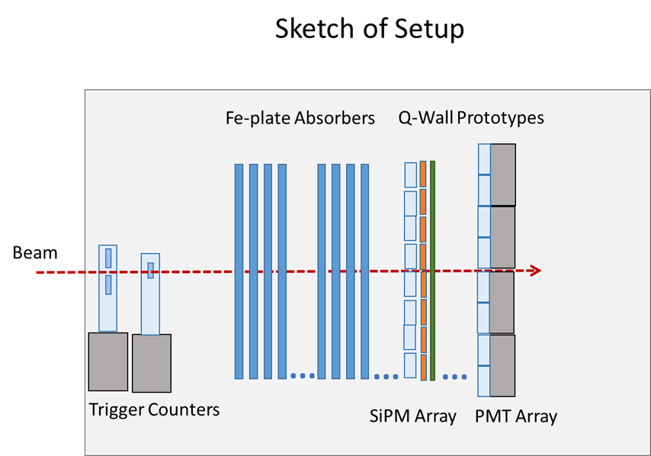
Q-Wall Equipment and Installation
Type Calorimeter (Absorber plates will be added as needed)
Length 0.5[m]
Width 0.5[m]
Height 0.5[m]
Weight 50[kg]
Required floor space:
Length 1[m]
Width 1[m]
Beam instrumentation: MWPC
Installation: 8[h]
De-Installation: 8[h]
Top of support height : 2.5[m]
Space in control room: 2[m²]
Power requirements: 2[kW]
Laser No
Irradiated materials and sources No
Cooling / Pressure / vacuum / cryogenics : No
Gas Requirements No (no flammable/poisonous gas)
Moveable table : Existing LV-229 table in PPE172
3

