Slide 1

SPS-BGI Model to LHC Tunnel
Impedance Investigation
SY-RF-BR
10/03/2025
H. Bursali on behalf of Impedance Team
hikmet.bursali@cern.ch

Slide 2
Outline
First Result
  Model with 1 kΩ NEG coated ceramic cathode
Studied Options
  Decreased NEG coating resistivity on ceramic cathode
  Model with/without cathode
  Model with ferrites
  Model with beam screen
Conclusion
1

Slide 3
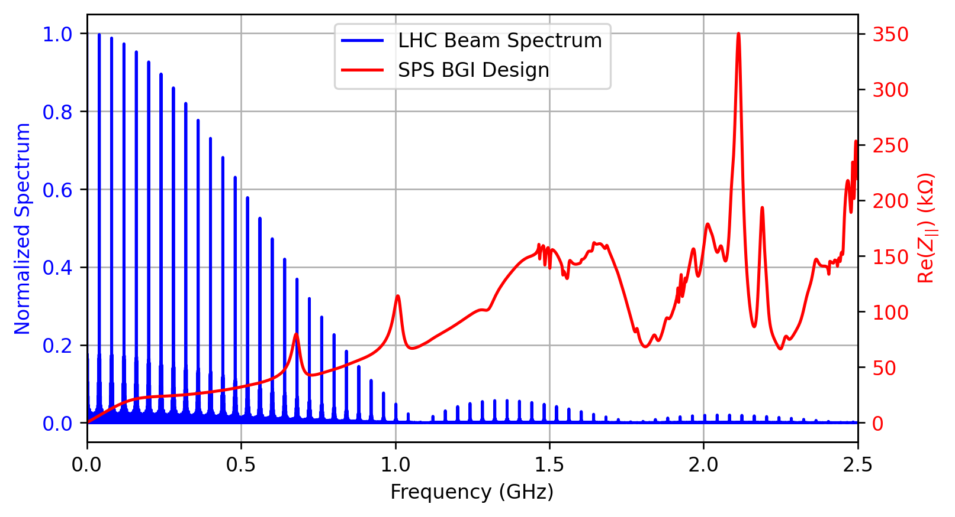
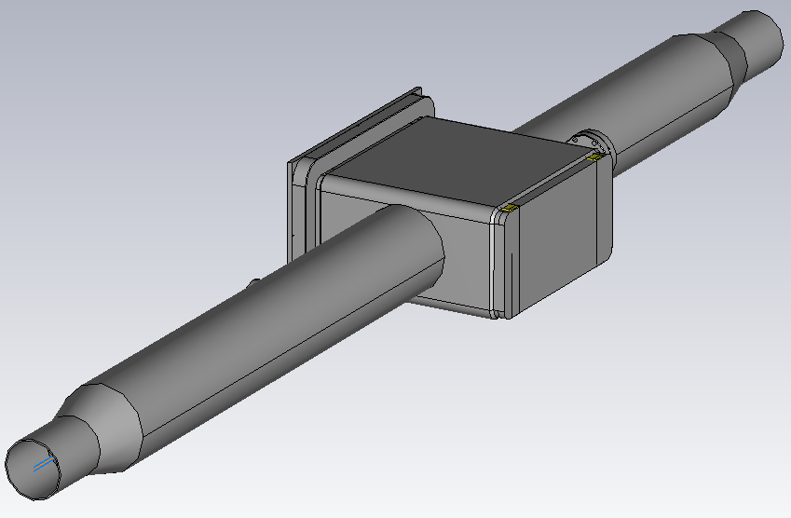

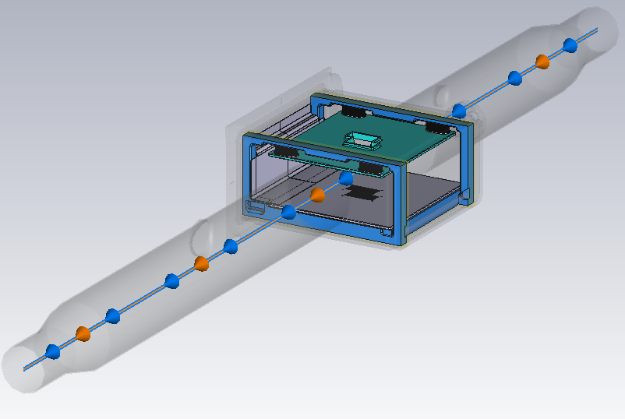
First Result
SPS - BGI with tapers (120 mm to 80 mm diameter)
Tank
393 W
Internal View
Broadband contribution
1 kΩ NEG coated ceramic cathode
2

Slide 4
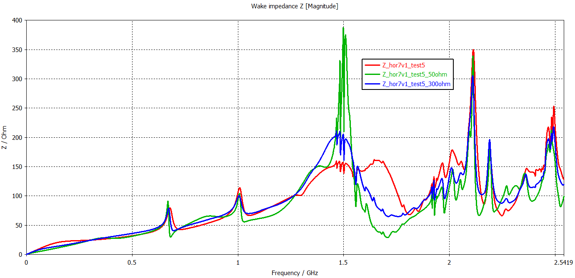
Studied Options
Different Coating Resistivities
Coating Resistivity
1 kΩ
300 Ω
50 Ω
Coating resistivity | Beam-induced RF power loss
1 kΩ | 393 W
300 Ω | 298 W
50 Ω | 203 W
Tapers
Broadband contribution
3

Slide 5
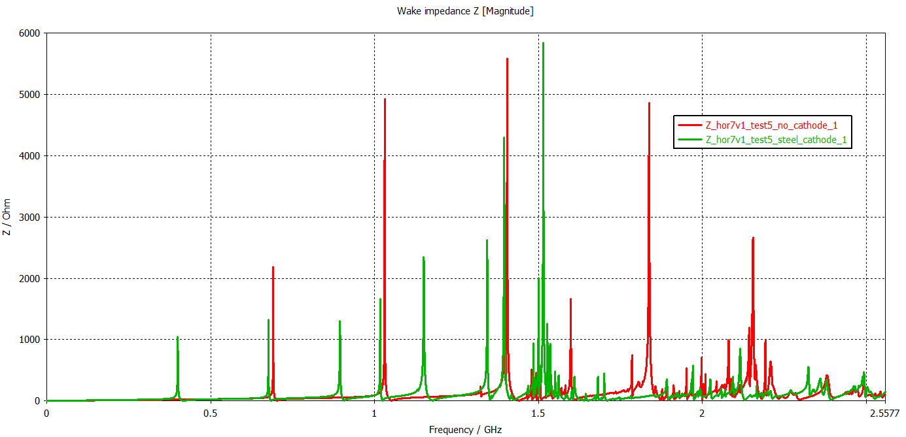
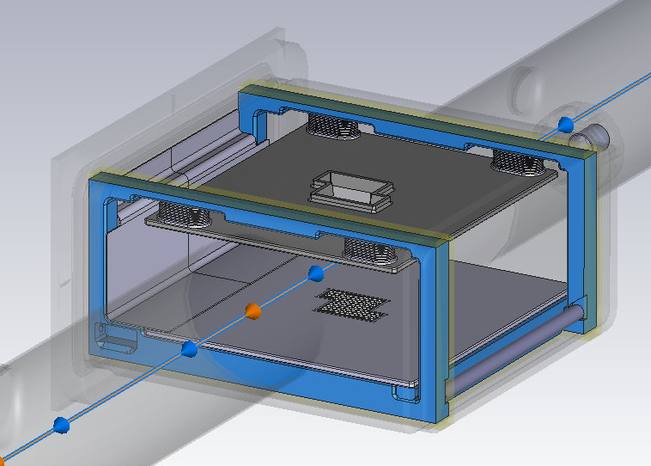
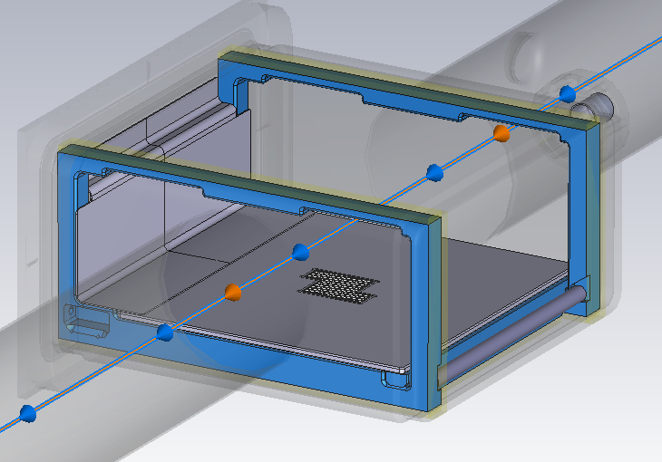
Studied Options
With/without Steel Cathode
Beam aperture
Ø -> 120 mm
Resonances from chamber itself
Model with cathode
Model without cathode
-> RF absorbers can be studied!
4

Slide 6
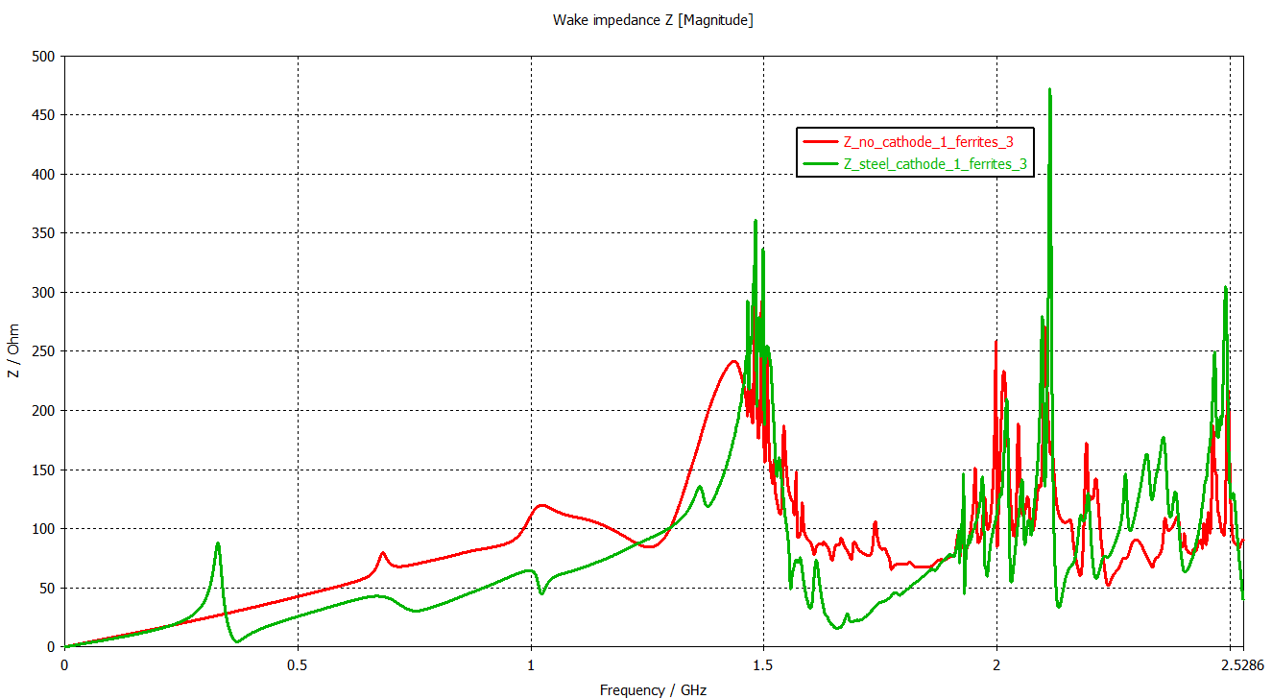
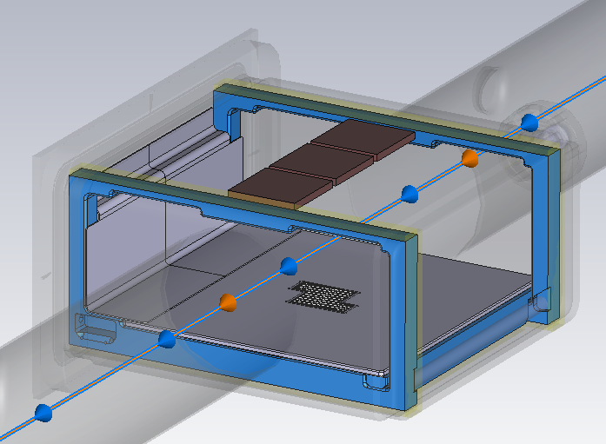
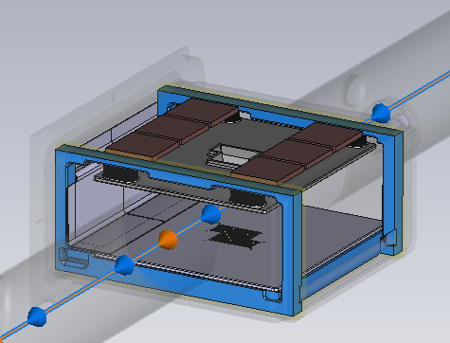
Studied Options
Ferrite usage
TT2-111R
May break due to the high intensity beam!
With cathode
Without cathode
115 W
170 W
5

Slide 7
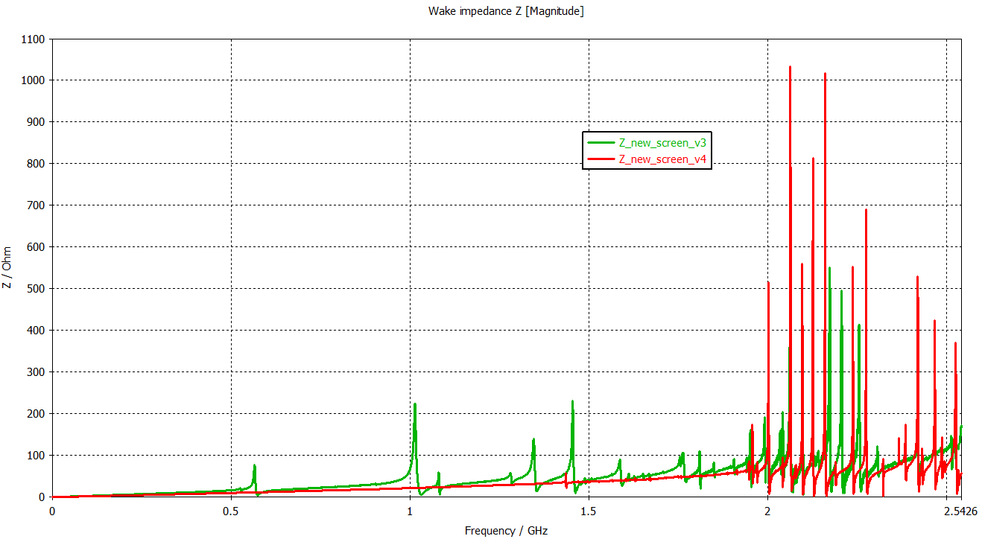
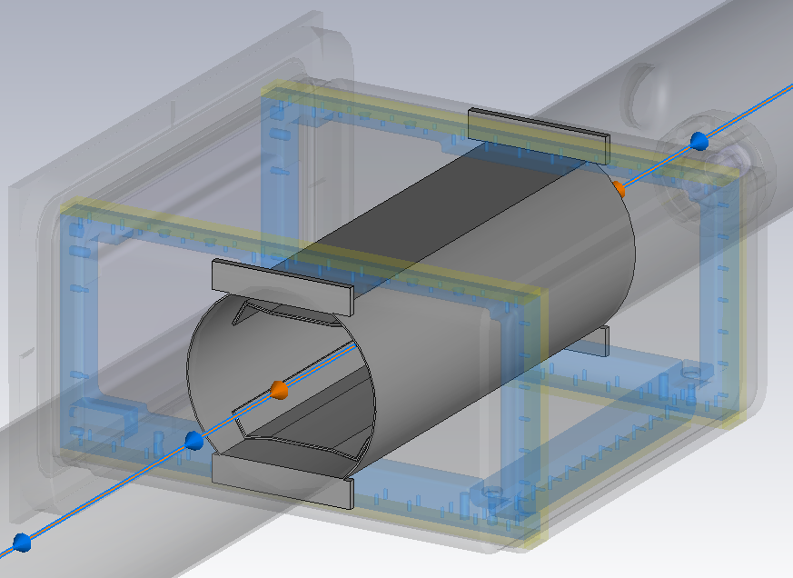
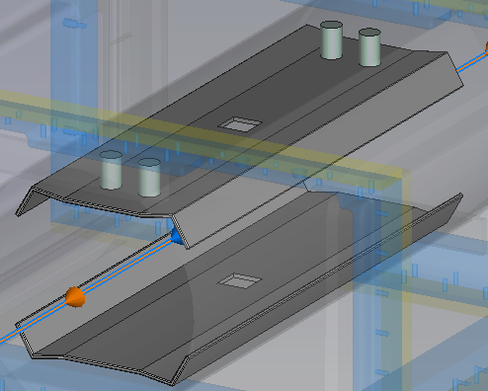
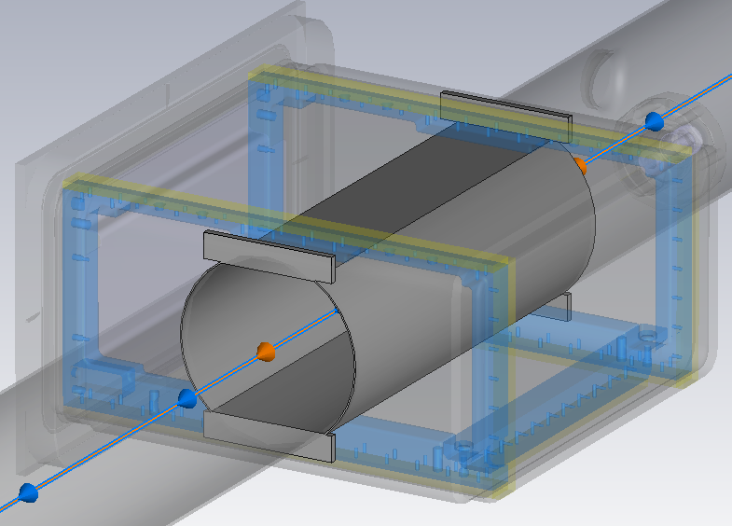
Studied Options
Model with Beam Screen
With cathode
Without cathode
1.01 GHz
1.45 GHz
565 MHz
6

Slide 8
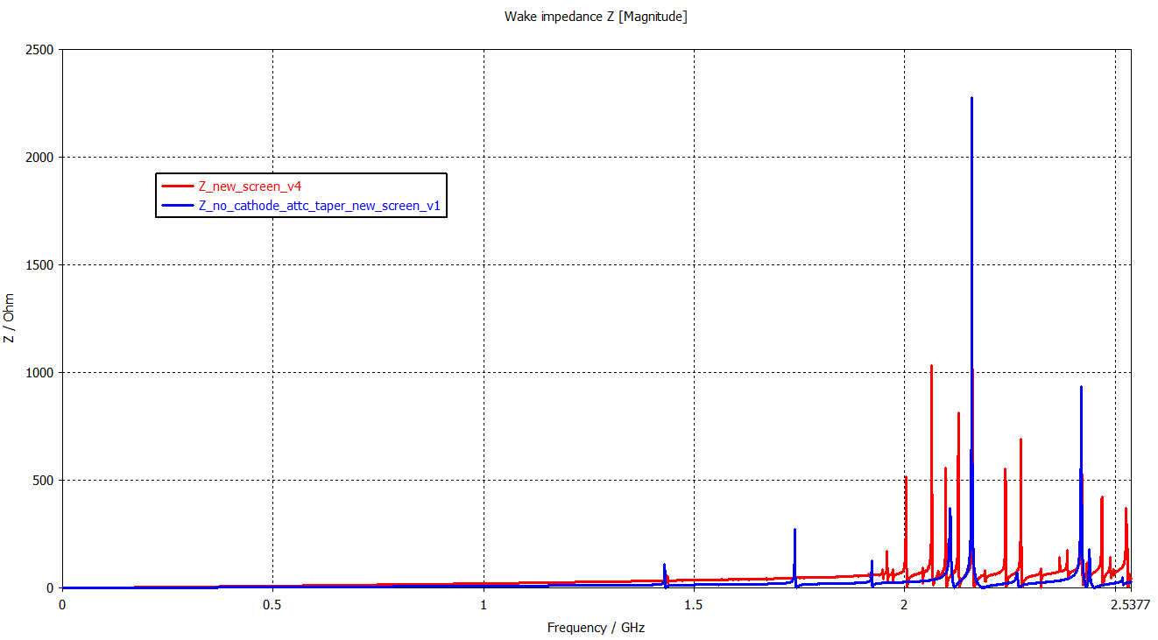
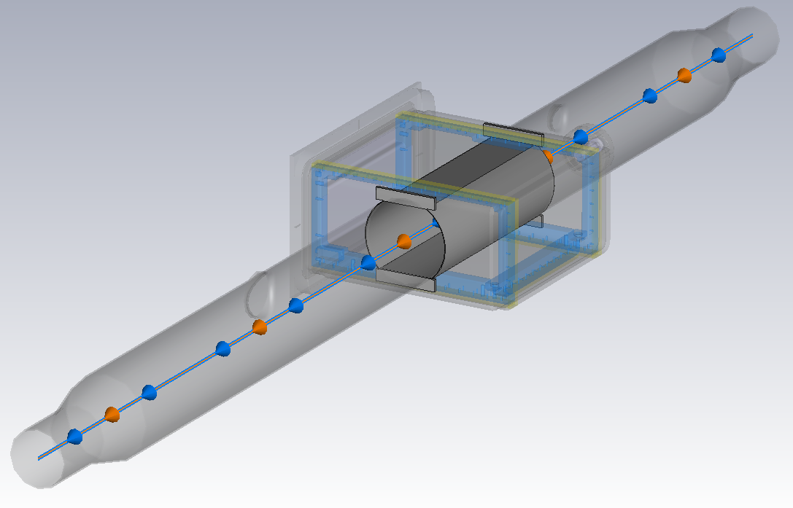
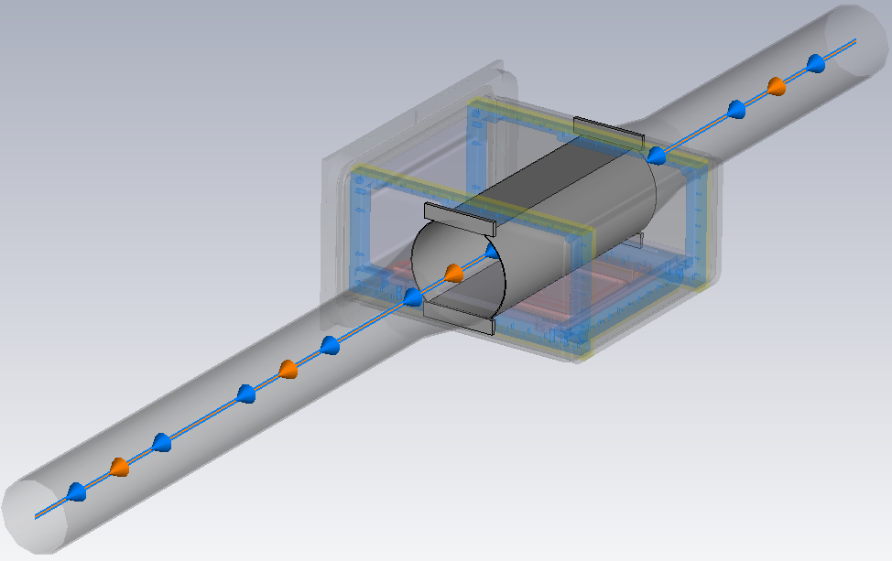
Studied Options
Model with Beam Screen
Tapers attached to the tank
Tapers at the end
7

Slide 9
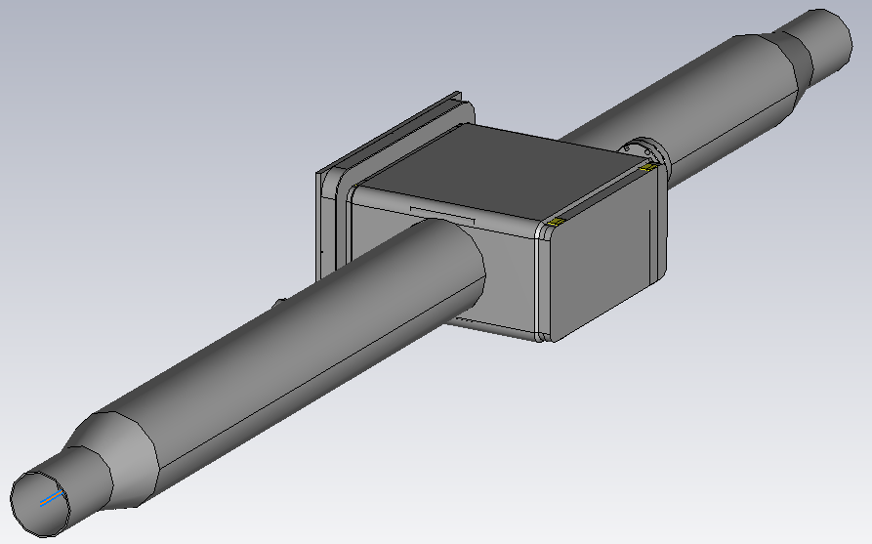
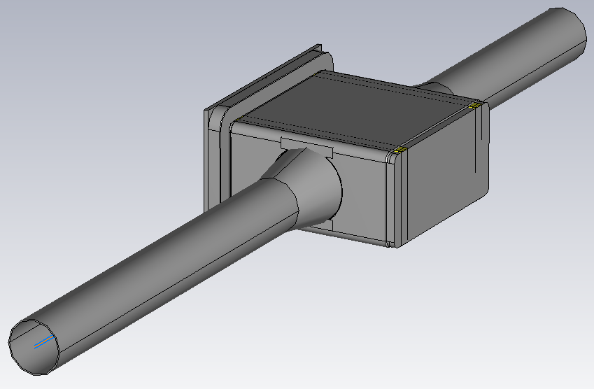
Conclusion
Decreased resistivity on cathode coating is still causing the broadband impedance, thus excessive power loss.
Ferrites may break due to the high intensity beam.
Best option till now is the model with beam screen and no cathode.
  Power loss is low for both models with different taper locations.
8

Slide 10
Thanks for your attention!
SY-RF-BR

Slide 11
Backup Slides

Slide 12
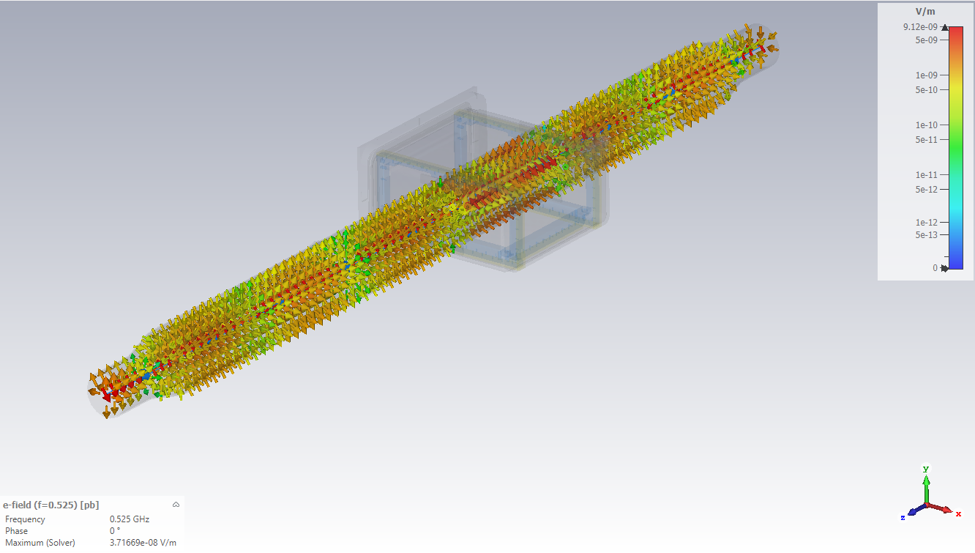
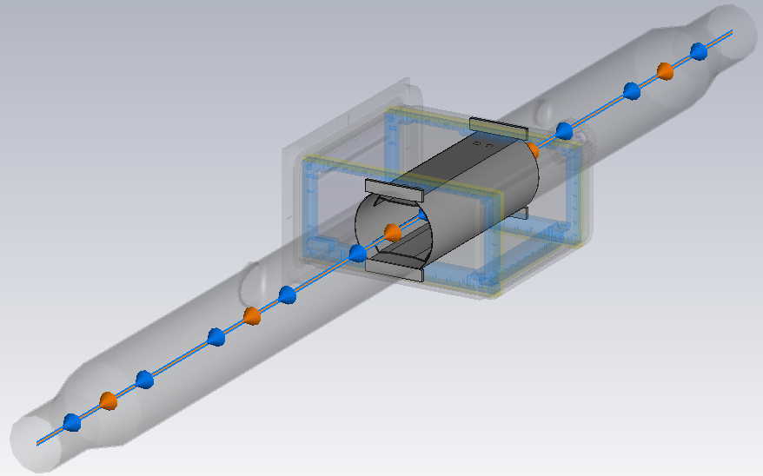

Slide 13
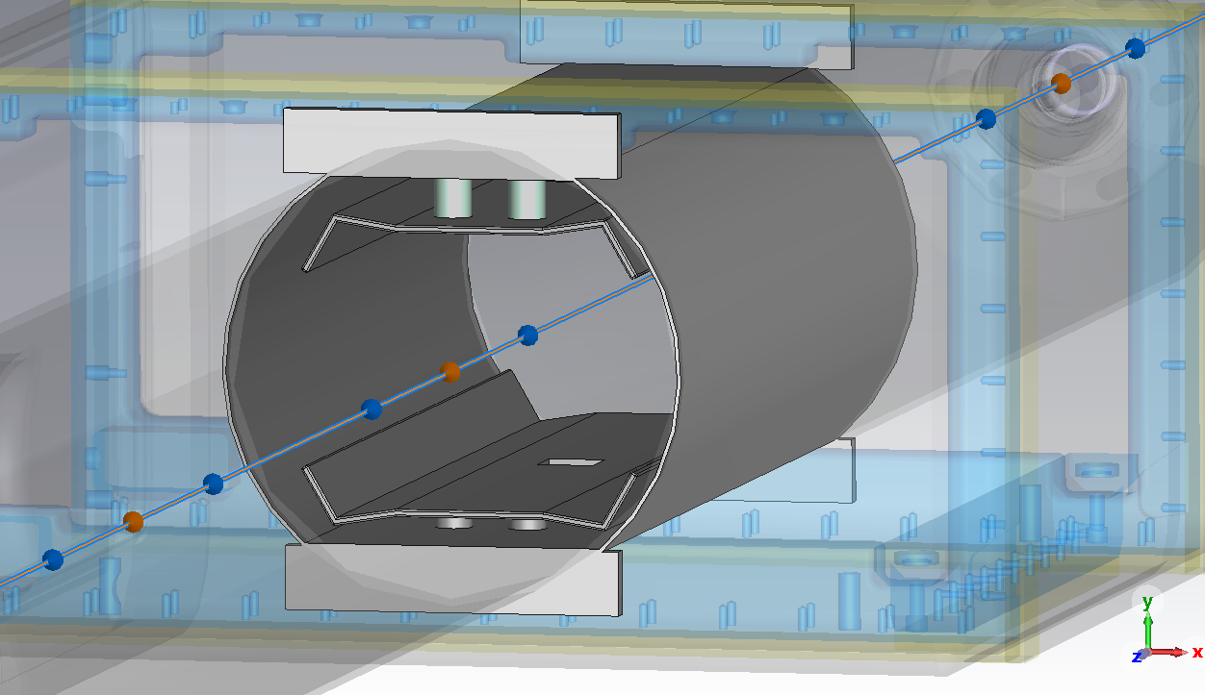
Beam Screen and Cathode

Slide 14
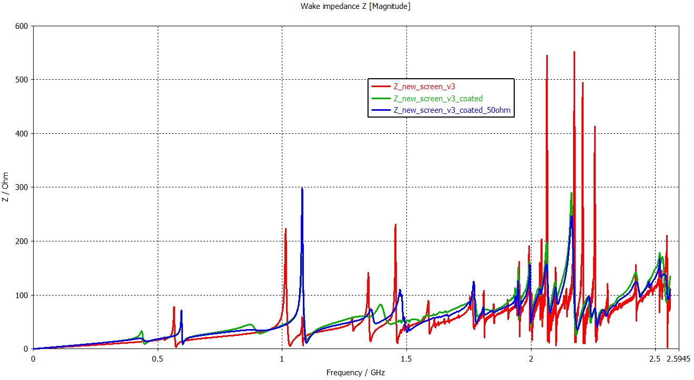
Model with Beam Screen and Cathode
RF power loss
15.8 W
51.9 W
48.2 W
Steel Cathode
1 kΩ NEG coated ceramic cathode
50 Ω NEG coated cathode

Slide 15
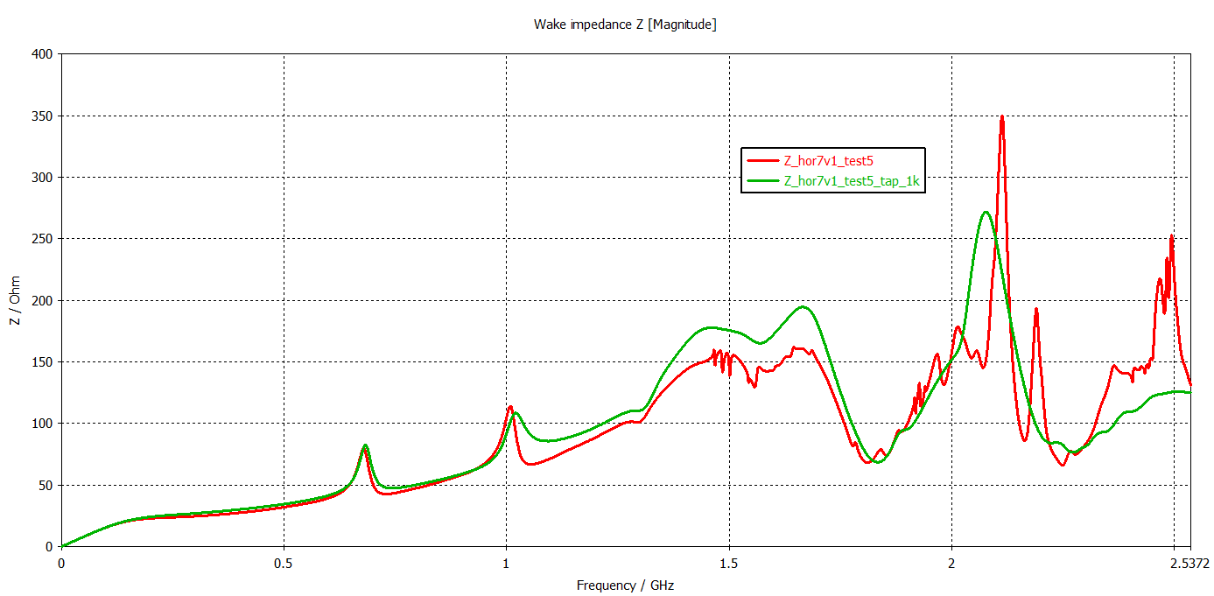
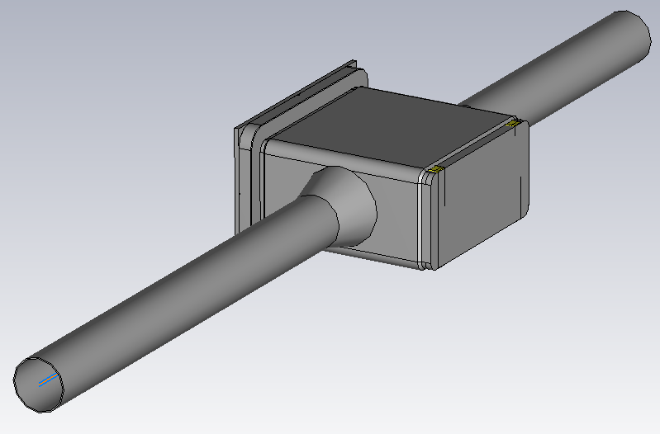
Comparison of Taper Locations
Tapers at the end
Tapers attached to the tank

Slide 16
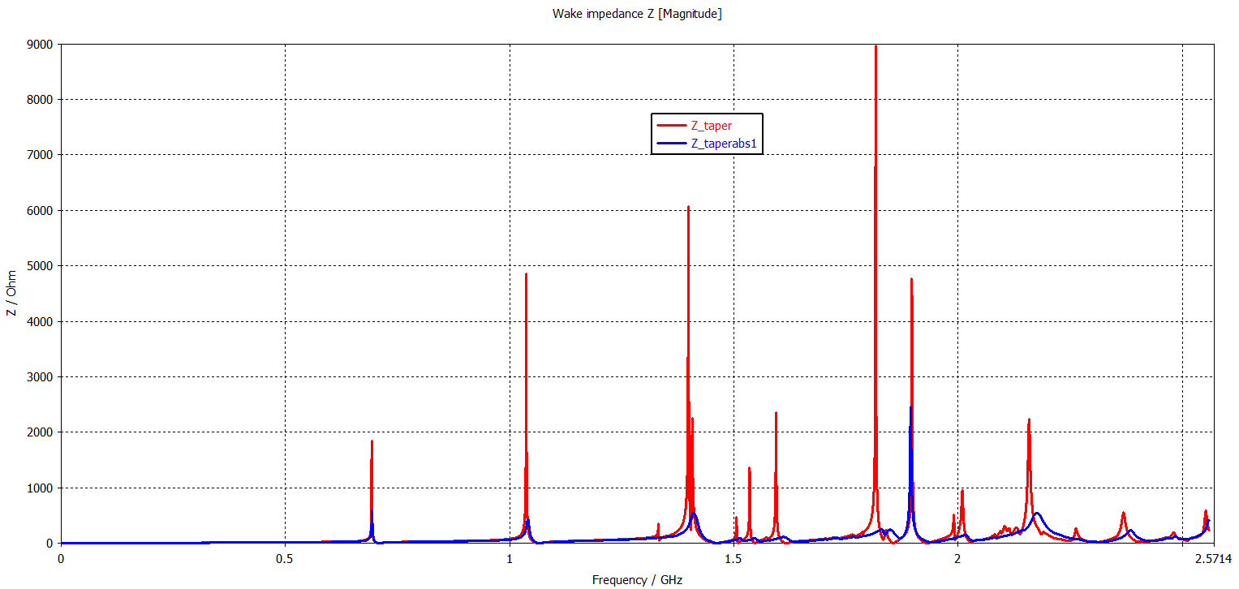
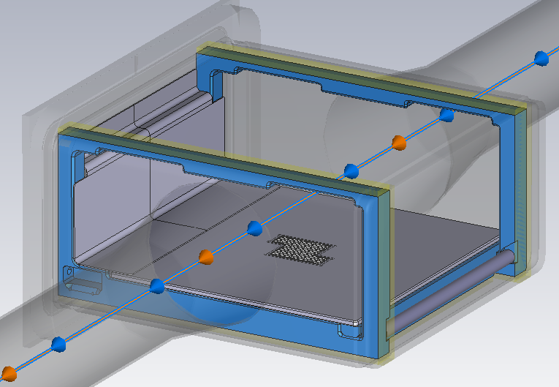
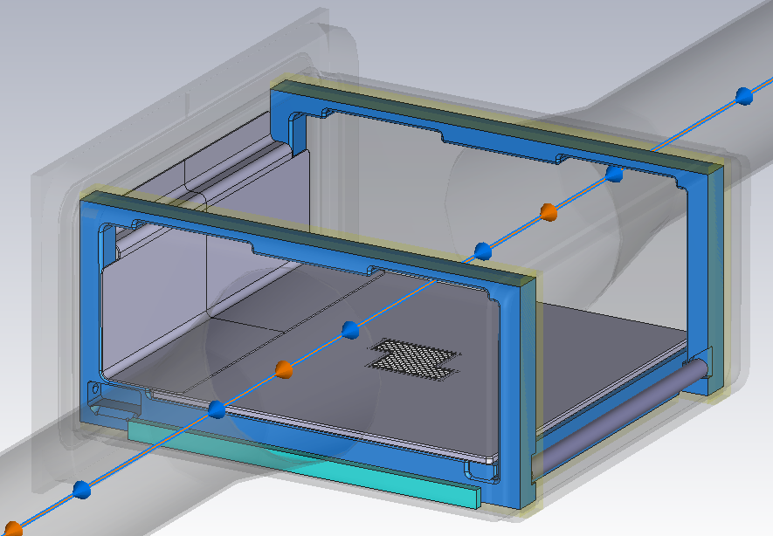
Studied Options
SPS-BGI design (tapers attached to the tank)
Beam aperture
Ø -> 80 mm
No cathode
No cathode + RF absorbers on sides
50 Ω NEG coated macor

Slide 17
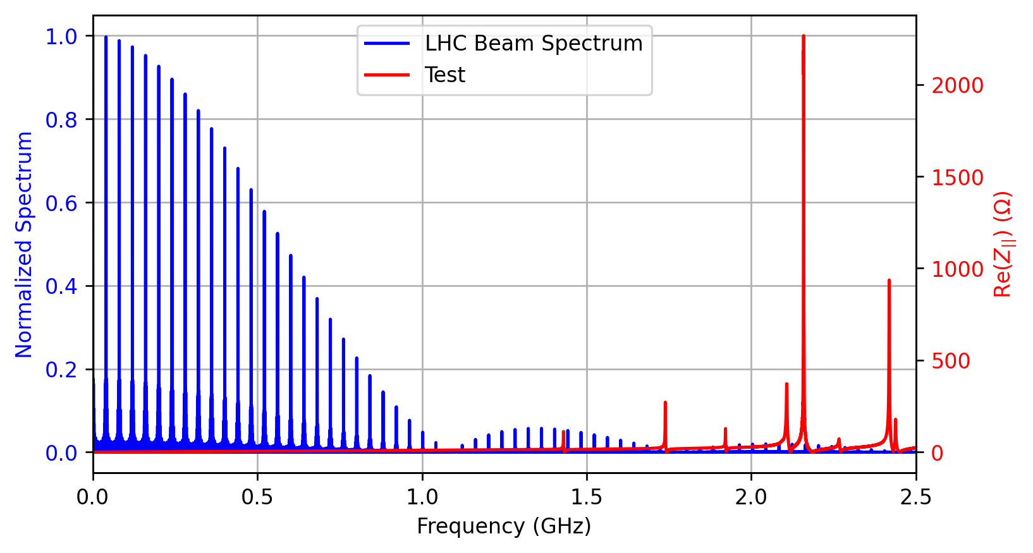
Possible Options
Model with beam screen and no cathode (tapers attached to the tank)

Slide 18
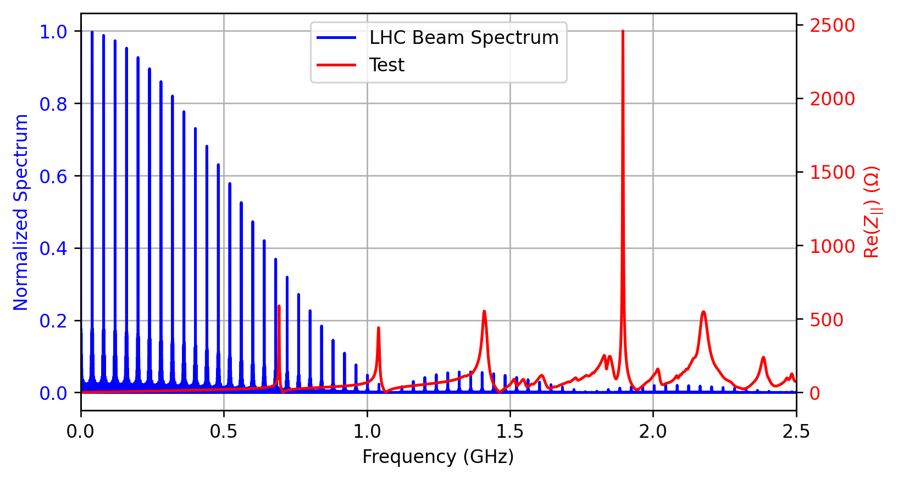
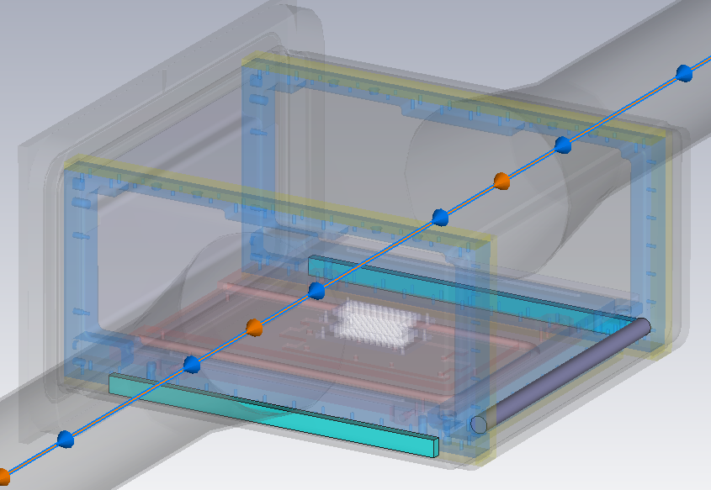
Possible Options
Model without cathode (tapers attached to the tank) + RF absorbers
698 MHz

Slide 19
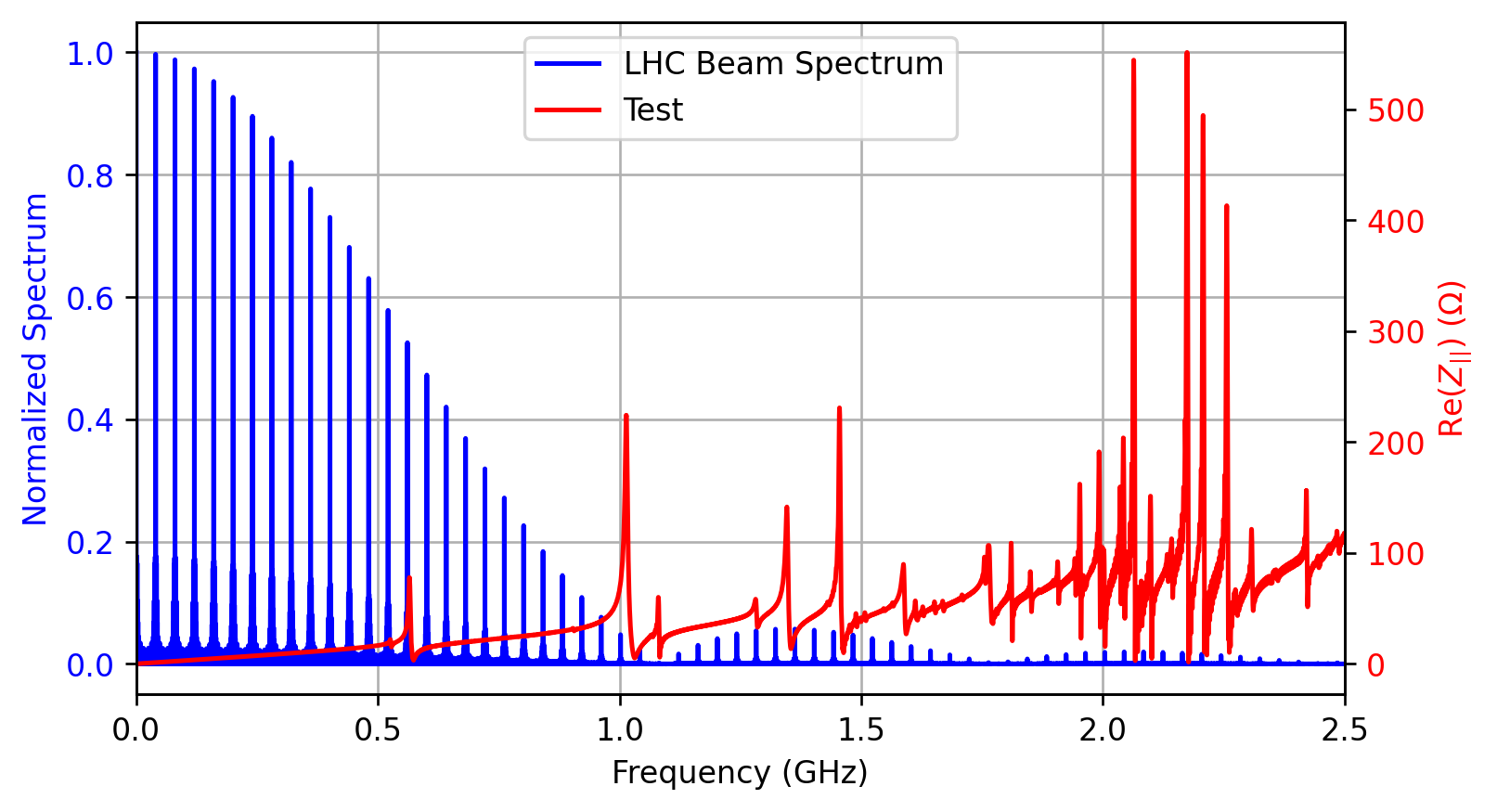
Possible Options
Model with beam screen and steel cathode (tapers at the end)
1.014 GHz
565 MHz

Slide 20
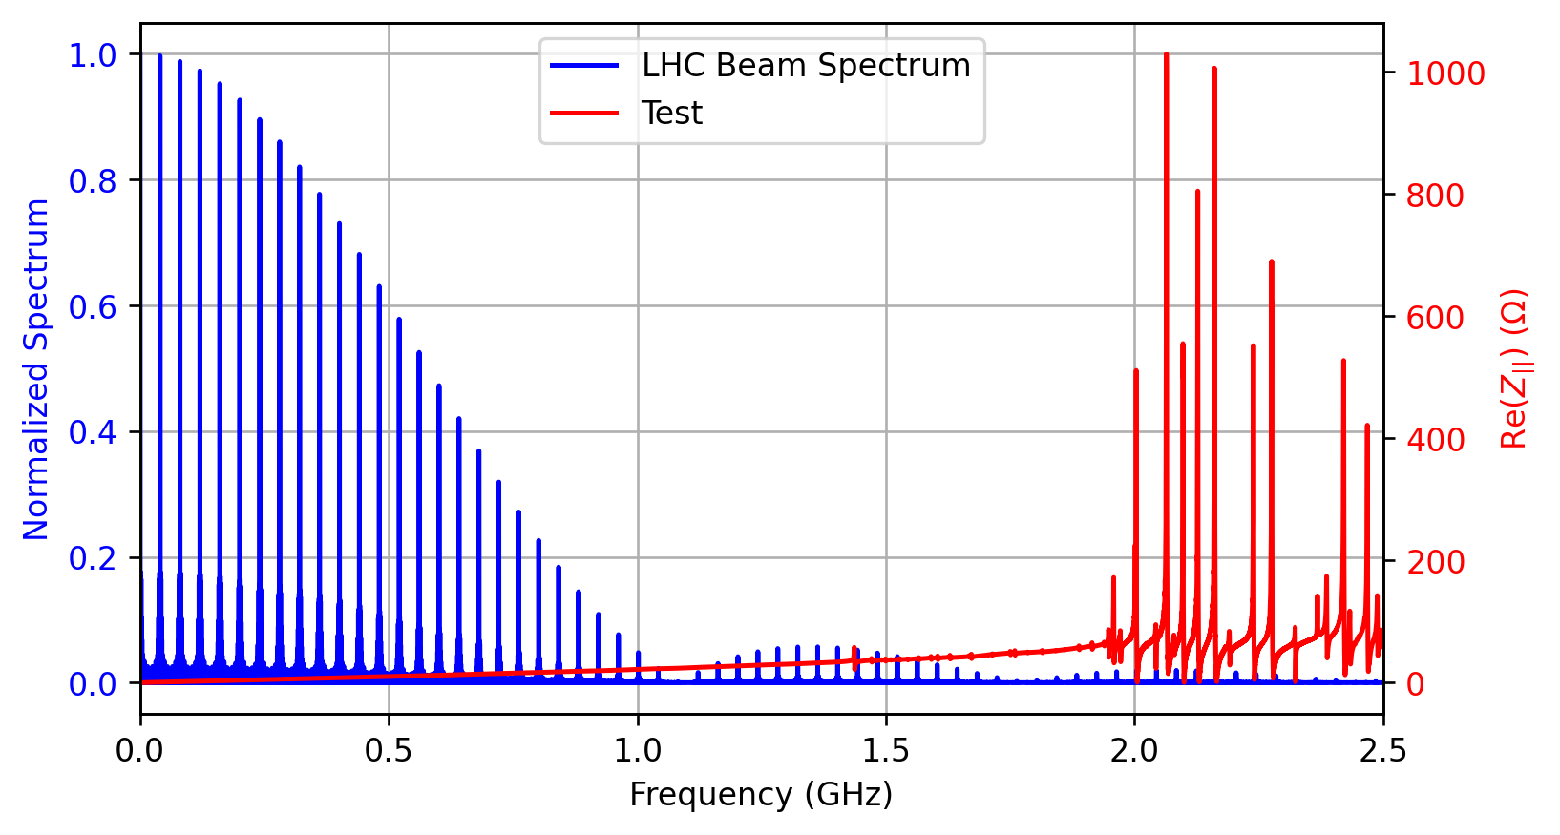
Possible Options
6.14 W

