Slide 1
Planning of the SPS scrubbing run
L. Mether
with the SPS scrubbing team

Slide 2
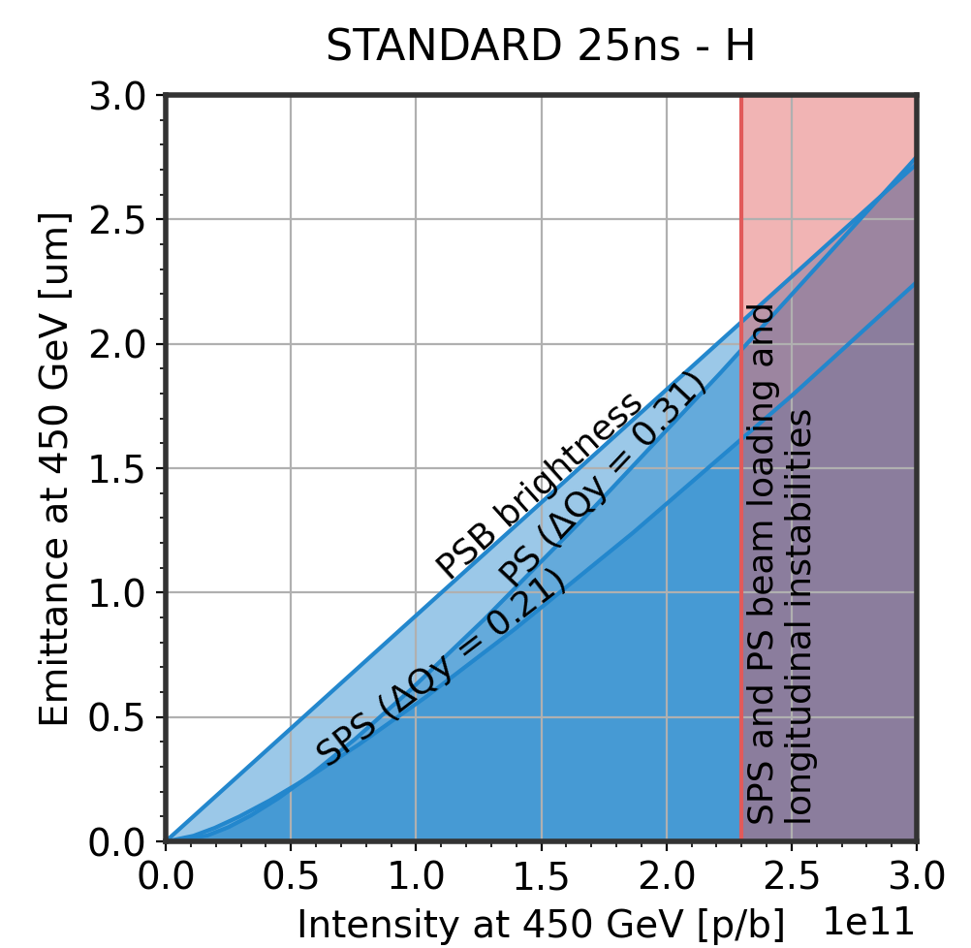
Scrubbing goals
Condition new and vented devices and areas
  No critical new equipment installed (see next slides) – major bottlenecks not expected
Restore operation with the standard LIU beam
  Recover 4x72b with 2.3e11 p/b and 1.65 ns ±10% at flat top
  Possible limitation from pressure spikes in RF cavities, as in 2024
  No other major bottlenecks expected
Work on further optimising the standard LIU beam
  Emittance/brightness characterisation and optimisation towards LIU target
  Tail characterisation?
Dedicated studies
🤞

Slide 3
Vacuum activities during the YETS
No critical new equipment installed
A few critical sectors opened: ZS, RF Cavity 3
  Opened for less than 24 hours, under N₂ controlled atmosphere
Several sectors close to critical equipment opened:
  A magnet exchanged close to the MKPs
  Vacuum sector 520 (BGI) opened to air for > 4 weeks – ‘buffer sector’ redcues impact on MKDV
  TECS crystal exchange next to MKDH – opened for less than 24 hours
Arc 3 opened for ~5 days for ion pump consolidation (these were outgassing a fair bit in previous years)

Slide 4
Vacuum activities during the YETS
Complete list, see presentation by A. Harrison at SPS MPC
Sextant | Sector | Position | Intervention
BA1 | 120 | 10101 - 10701 | Magnet exchange Corroded vacuum chamber exchange
 | 134 | 11692 – 11699 | Access chambers
 | 135 | 11699 – 11759 | E-Cloud Ion pump modification
 | 136 | 11759 – 11832 | Scraper installation
 | 150 | 11960 - 12301 | Magnet exchange
 | 162 | 13101 - 20101 | Magnet exchange
BA2 | 212 | 20501 – 21301 | Magnet exchange Ion pump and gauge non-conformities
 | 231 | 21603 – 21699 | Leak on ZS HV feedthrough
 | 240 | 21880 – 21903 | Access chambers
 | 262 | 21301 - 30101 | Magnet exchange (x2)
Sextant | Sector | Position | Intervention
BA3 | 334 | 31740 – 31797 | RF Cavity #3 HOM exchange
 | 351 | 31998 – 32301 | Ion pump consolidation
 | 361 | 32301 – 33101 | Ion pump consolidation
 | 362 | 33101 – 40101 | Ion pump consolidation Magnet exchange Endoscopy Sector valve exchange
BA4 | 411 | 40101 – 40701 | Magnet exchange
 | 420 | 41301 – 41620 | Magnet exchange
BA5 | 520 | 51301 – 51678 | BGI – 3rd magnet Wire Scanners TECS crystal exchange
 | 532 | 51759 – 51859 | TECS crystal exchange
BA6 | 633 | 61731 – 61757 | Crab Cavities
 | 640 | 61880 – 61903 | Access chambers
 | 651 | 61903 – 62301 | Gamma Factory laser pillar installation
Open to air >24h

Slide 5
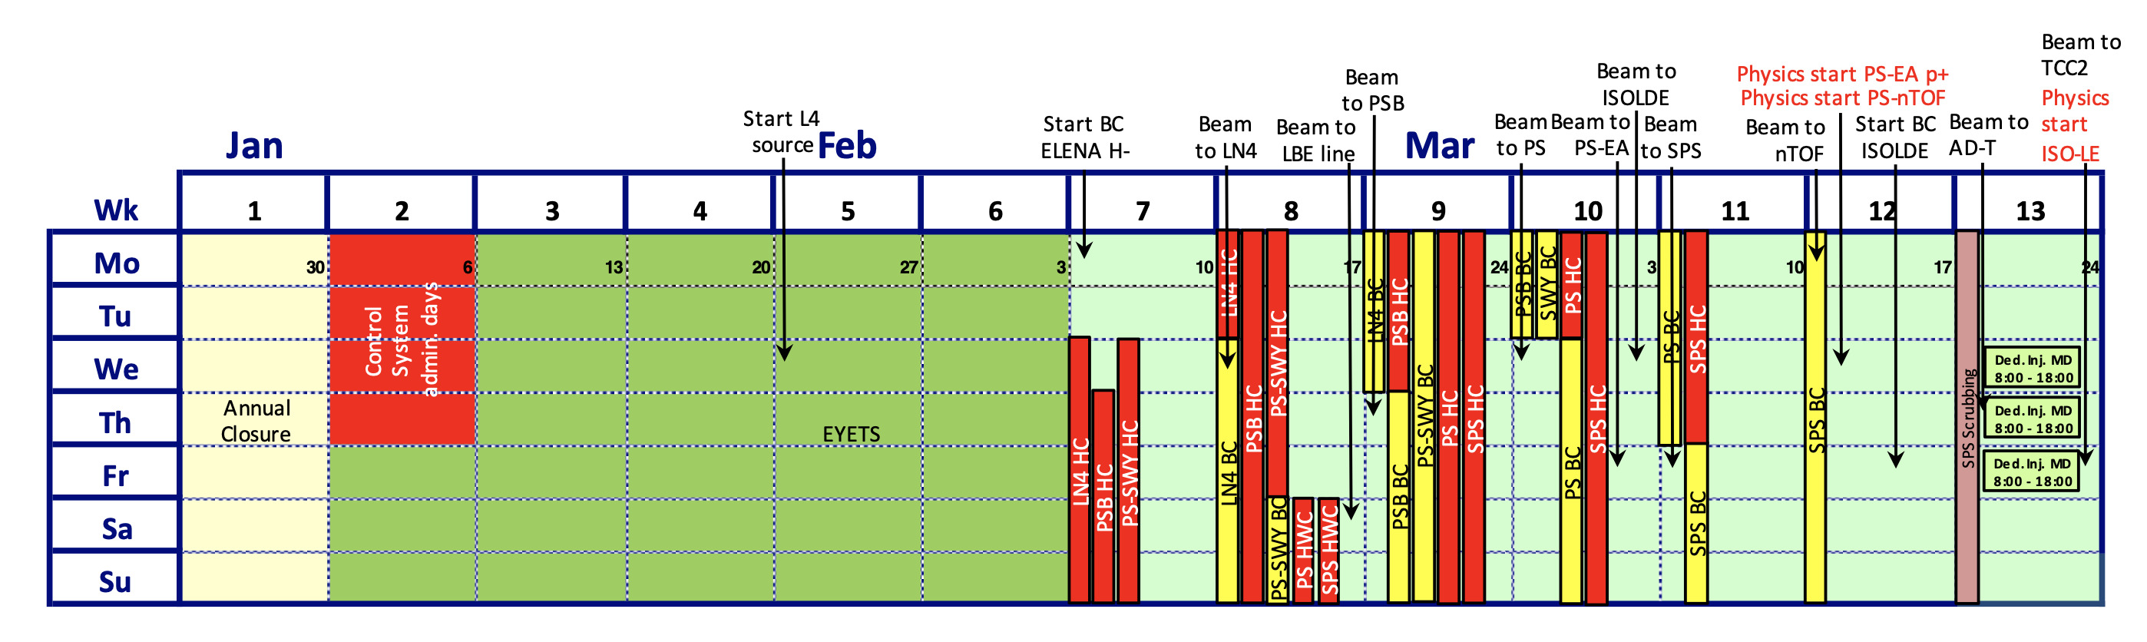
Scrubbing schedule
Scrubbing is scheduled for next week (W13)
Similarly to last year, scrubbing could start partially already this week, from Thursday afternoon/evening
  Any updates to the commissioning schedule? Can we continue scrubbing during Friday daytime?
Start
scrubbing

Slide 6
Scrubbing schedule
Scrubbing is scheduled for next week (W13)
Several dedicated MDs scheduled in the middle of the scrubbing week
  Initially 4 days occupied: three dedicated MDs + HiRadMat commissioning
  Changed to two dedicated MDs
    Wed 26.3, Francesco & Matthew for SHiP – scrubbing in parallel possible?
    Thu 27.3, Massimo and Dora for stable island studies with collimators – no scrubbing in parallel
Start
scrubbing

Slide 7
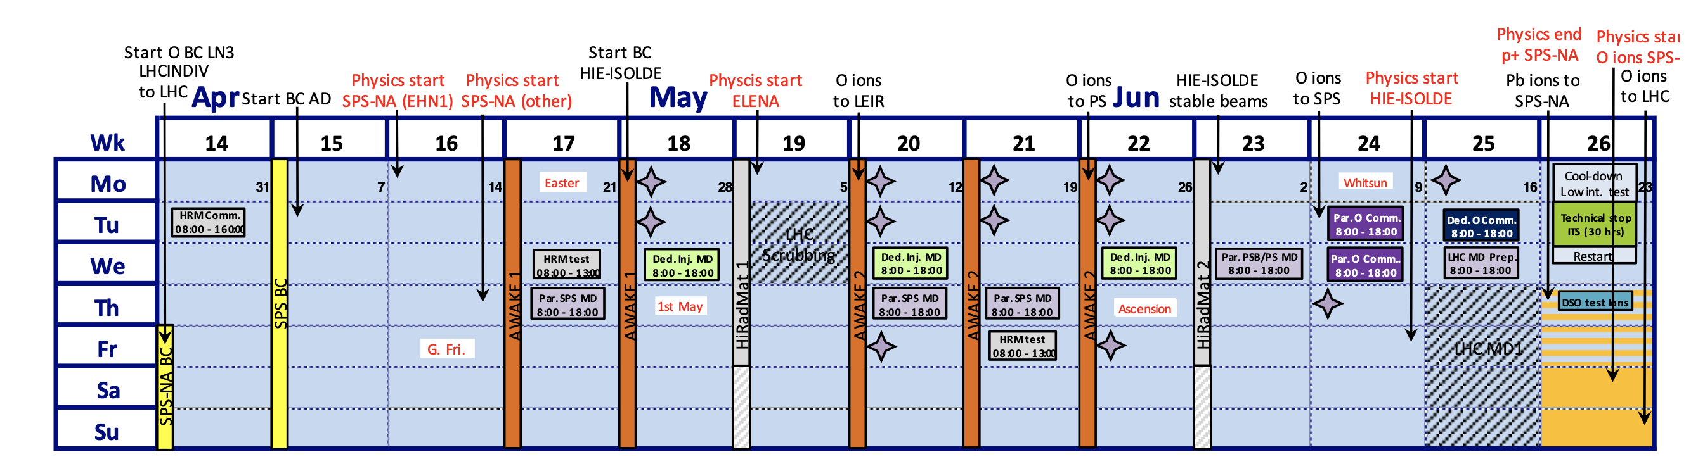
Scrubbing schedule
Scrubbing is scheduled for next week (W13)
Possibly some room for scrubbing, if needed, also in W14 and W15?

Slide 8
Tentative planning: W12
Intensity ramp-up at flat bottom
  Ramp up number of bunches, number of batches and bunch intensity, starting from moderate intensity ~1.2e11 p/b and going up to 2.5-2.7e11 p/b with trains of 4x72 bunches
Settings
  Long flat bottom cycle
  Can be dedicated scrubbing, if no other activities take place

Slide 9
Tentative planning: W13
Intensity ramp-up on the accelerating cycle
  Ramp up number of bunches, number of batches and bunch intensity, starting with moderate intensity ~1.2e11 p/b and going up to 2.3e11 p/b with 4x72 bunches
    Gradually reduce bunch length at flat top down to 1.65 ns for the highest intensities
Settings
  Nominal 450 GeV/c flat top cycle
    Keep the 400 GeV/c long flat top cycle as backup in case of unexpected bottlenecks
  Extraction bumps in & extraction septa on to condition the extraction region
  for LHC operation
  Do we want to always keep SFTPRO in the supercycle to reduce heating in MKP-S?

Slide 10
Dedicated studies
Consolidation of LIU intensity with standard beam
  Optimization in transverse and longitudinal plane
Exploration of intensity margins
  Study transverse stability at injection energy with intensities slightly higher than 2.6e11 p/b
MKP-S beam-induced heating with orbit bump
  Interesting mainly if injection bump for operation will be removed/reduced
Monitor the SPS QD/QF current at different intensities
  Follow-up with SY/EPC regarding the current overshoot when applying Laslett
Start investigation of the PS-SPS optics matching
  Measurements can be done in parallel with scrubbing
See full presentation by Ingrid at SPS MPC
Start
scrubbing

Slide 11
Specific guidelines
The ZS should be pulsed without beam during scrubbing
  Step back in scrubbing during NA commissioning, monitoring ZS behaviour
MKP-S heating
  Temperature threshold set at 60 degrees
  We need to ensure sufficient margin for scrubbing during allocated slots
    Do we want to keep SFTPRO in the supercycle on the ramp to reduce the heating?
What are the bunch intensity limitations?
  Will the bunch intensity be limited to 2.3e11 ppb at the end of flat top (including scraping?), for 4x72b?
  Intensity limitation with a single batch?
  Achieved during 2024 scrubbing:
    Flat bottom: 2.7e11 p/b injected, 2.55e11 p/b with 4x72b
    Single batch at flat top: 2.35e11 p/b at 400 GeV/c, with 1.7 ns
    Full beam, 4x72b, at flat top: 2.3e11 p/b, with 1.65 ns

Slide 12
Specific guidelines
ECLOUD and BGI magnets always ON
  Interlocked (no action should be required on our part)
Crab cavities should be in from the start of scrubbing (TBC)
The “fast valves” are always blocked open since a few years and essentially obsolete
  Removal from machine under consideration

Slide 13
Vacuum interlock thresholds
 | HW [mbar] | SIS [mbar]
MKP-L | 4e-7 | 2e-7
MKP-S | 4e-7 | 2e-7
MKDH/V | 6e-7 | 6e-7
Kickers
In the MKPs, the thresholds will be set to “scrubbing” values
In MKDH/V an increase could be done, but would limit the supercycle
  Allowed thresholds determined by the highest energy in the supercycle
  Requires SY-ABT & TE-VSC expert action
Arcs
Normally at 1e-6 mbar
Possibility to go to 1e-5 if limited during scrubbing
  VSC considering going to 1e-5 mbar by default during scrubbing
MKDH/V | HW [mbar]
Nominal | 6e-7
E ≤ 400 GeV | 1e-6
E ≤ 26 GeV | 5e-6
Arcs | HW [mbar]
Nominal | 1e-6
Scrubbing | 1e-5

Slide 14
Shift plans
Aim to keep scrubbing “shifts” flexible, as in 2023-2024
  Weekdays: Presence from morning to evening (when there is a need)
  Weekdays: Leave scrubbing to operators for the nights with clear tasks, guidelines
  Weekends: Mostly monitoring from afar, updating guidelines for operators, and specific studies in CCC
Worked very well previously, but we may be more limited with time this year
  Let’s see how it goes!

Slide 15
Organisation & resources
Daily scrubbing updates on Zoom to discuss progress and plans, at 10 am?
  https://cern.zoom.us/j/67103030864?pwd=dXo5MjJ3TXY2WlR0em91cEY0bjhmdz09
Daily scrubbing summaries in SPS MD logbook
Further updates and discussions on the e-cloud Mattermost
  https://mattermost.web.cern.ch/be-dep/channels/ecloud
Resources
Various instructions on scrubbing CodiMD (still being updated):
  https://codimd.web.cern.ch/q9LHfY7lR7q2_6VDF4-6IQ

