Slide 1
SPS’ E-cloud monitor configuration 2025
Plans for data taking campaigns
Holger Neupert, TE-VSC, e-cloud meeting #88, 03.09.2024

Slide 2
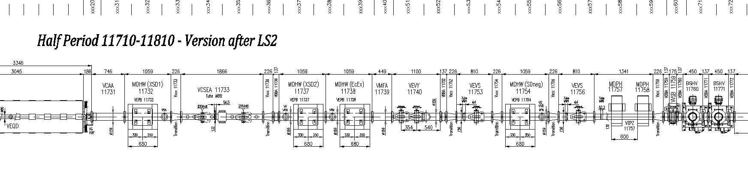
E-cloud monitor layout in SPS-BA1
Drawing number: SPSLNINS0142
E-cloud monitors
SEY drum
Mobile sample, can be transferred under vacuum for SEY and surface Analysis (XPS)
RGA

Slide 3
E-cloud monitors 2024
Liner configuration with new name
VECM11732 is the new name in NXCALS to unify with the naming of the magnet
Installation 17.01.2024
To be discussed:
VECM11732: second LIPSS on Cu from Leipzig
VECM11737: new copper liner to compare to ECM1
VECM11738: CNe13 long term stability a-C coating
VECM11754: a new Stainless Steel (304) liner to compare to SPS’ vacuum chambers
BESCLD_
VECM11732
BESCLD_
VECM11737
BESCLD_
VECM11738
BESCLD_
VECM11754
Cu LIPSS 2
fresh
Cu MBB
Profile, fresh
CNe13 since 2008 in SPS
SS MBB
Profile fresh
14/03/2025
Holger Neupert TE/VSC

Slide 4
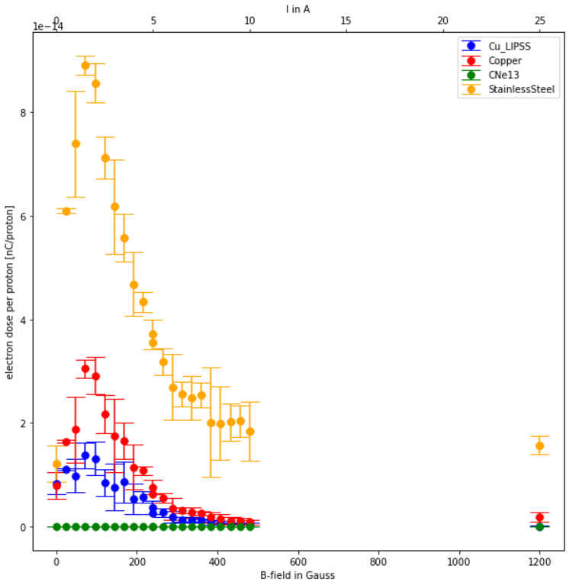
Scan B field from 0G to 1200G
My email from 05.02.2025:
As discussed after my presentation at the injector MD days beginning this week we would like to use LHC filling cycles to scan the magnetic field in MDHW magnets(MDHW11732, MDHW11737, MDHW11738, MDHW11754). This would allow us to have good statistics on e-cloud monitor results.
If I count on 250 proton physics fills (not sure here, estimation from https://bpt.web.cern.ch/lhc/supertable/2024/) as in 2024 with 24injections each we could make at least about 6000 data points for about 30 different magnetic fields ranging from 0G to 1200G with really stable conditions. I think a part of the scattering of the data I’ve showed came from adjustments to the beam during our data taking. It was a parallel MD.

Slide 5
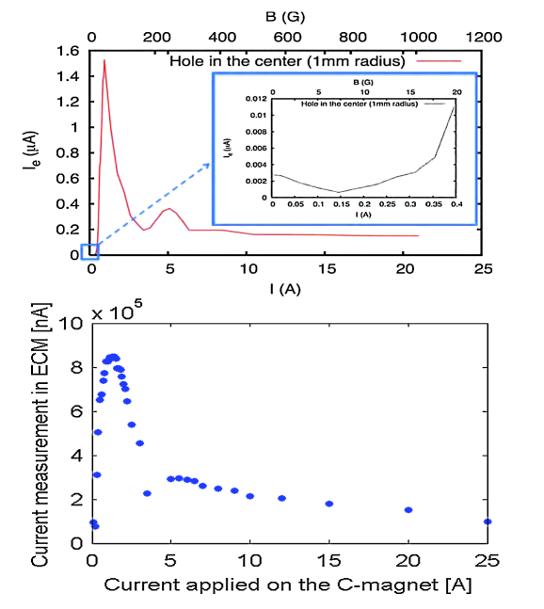
Old data from 2010/2011
https://journals.aps.org/prab/pdf/10.1103/PhysRevSTAB.14.071001

