Slide 1
Overview on progress of Scattering Amplitudes
Queen Mary, University of London
Nov. 9, 2011
Congkao Wen

Slide 2
Progress

Slide 3
Progress
In the past several years there have been enormous progress in unraveling the structure of scattering amplitudes in gauge theory and gravity.

Slide 4
Progress
In the past several years there have been enormous progress in unraveling the structure of scattering amplitudes in gauge theory and gravity.
Conceptually, it leads beautiful mathematic structure of scattering amplitudes.

Slide 5
Progress
In the past several years there have been enormous progress in unraveling the structure of scattering amplitudes in gauge theory and gravity.
Conceptually, it leads beautiful mathematic structure of scattering amplitudes.
Practically, it makes some previous impossible calculations trivial, in particular precision calculations in QCD.

Slide 6
Feynman diagram
Inefficiency of traditional Feynman diagram calculation:

Slide 7

Feynman diagram
Inefficiency of traditional Feynman diagram calculation:

Slide 8
Feynman diagram
Inefficiency of traditional Feynman diagram calculation:
Gauge redundancy in every Feynman diagram.

Slide 9
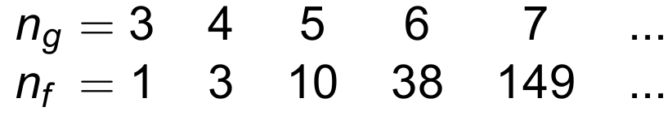
Feynman diagram
Inefficiency of traditional Feynman diagram calculation:
Gauge redundancy in every Feynman diagram.
Fast-growing of # of Feynman diagrams:

Slide 10
Feynman diagram
Inefficiency of traditional Feynman diagram calculation:
Gauge redundancy in every Feynman diagram.
Fast-growing of Feynman diagrams:
Very complicated Feynman diagram calculations lead to very simple results.

Slide 11
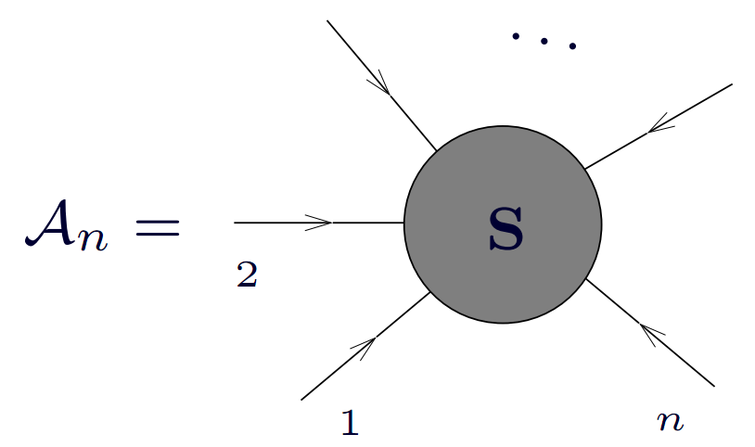
Scattering Amplitudes

Slide 12
Scattering Amplitudes
The amplitudes with no/one negative helicity gluon/graviton vanish!

Slide 13
Scattering Amplitudes
The amplitudes with no/one negative helicity gluon/graviton vanish!
The first non-trivial one is called MHV amplitude with two negative helicity gluons/gravitons.

Slide 14
Scattering Amplitudes
The amplitudes with no/one negative helicity gluon/graviton vanish!
The first non-trivial one is called MHV amplitude with two negative helicity gluons/gravitons.
NMHV, NNMHV, and so on.

Slide 15
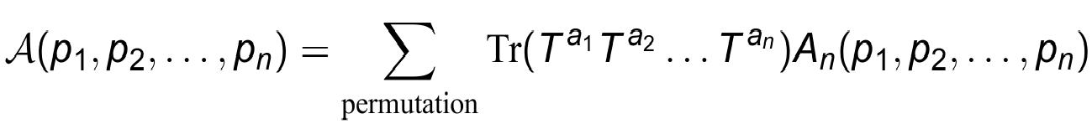
Introduction to notation
Only color-ordered partial amplitudes will be considered,

Slide 16


Introduction to notation
Only color-ordered partial amplitudes will be considered,
Spinor helicity formalism:
by using the on-shell condition

Slide 17
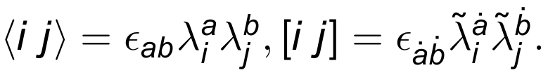
Introduction to notation
Only color-ordered partial amplitudes will be considered,
Spinor helicity formalism:
by using the on-shell condition
Lorentz invariants are defined as

Slide 18
Example of Hidden structure
Five-gluon tree-level amplitude of QCD

Slide 19
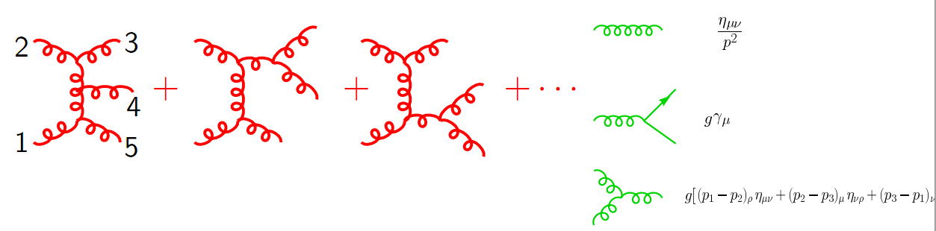
Example of Hidden structure
Five-gluon tree-level amplitude of QCD

Slide 20
Example of Hidden structure
Five-gluon tree-level amplitude of QCD
The result obtained from traditional methods

Slide 21
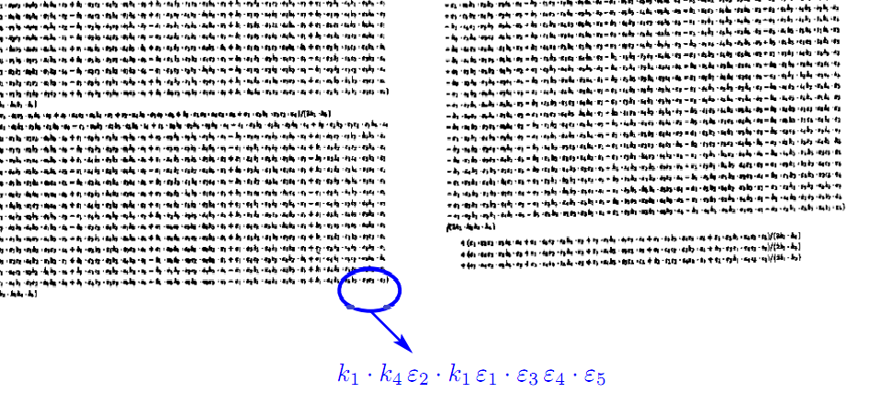
Example of Hidden structure

Slide 22
Example of Hidden structure
The following contains all the physical content as the above formula:

Slide 23
Example of Hidden structure
The partial amplitudes:

Slide 24
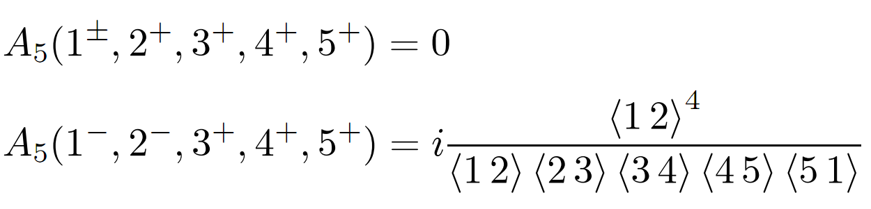
Example of Hidden structure
The partial amplitudes:

Slide 25
Example of Hidden structure
The partial amplitudes:
Dress it up with colors and sum over permutations to obtain the full answer

Slide 26
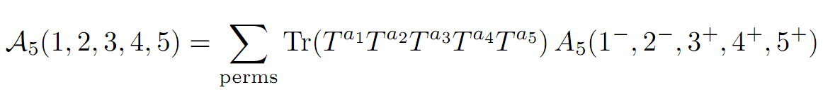
Example of Hidden structure
The partial amplitudes:
Dress it up with colors and sum over permutations to obtain the full answer

Slide 27
SUSY is helpful

Slide 28
SUSY is helpful
The ideas and techniques are best understood with SUSY.

Slide 29
SUSY is helpful
The ideas and techniques are best understood with SUSY.
BCFW recursion relations for N=4 & N=8 were solved, which can be used as solutions of QCD and gravity.

Slide 30
SUSY is helpful
The ideas and techniques are best understood with SUSY.
BCFW recursion relations for N=4 & N=8 were solved, which can be used as solutions of QCD and gravity.
QCD amplitudes can be decomposed into simpler ones

Slide 31
BCFW recursion relations
Recursion relations:[Britto, Cachazo, Feng & Witten, 04’, 05’]

Slide 32
BCFW recursion relations
Recursion relations:[Britto, Cachazo, Feng & Witten, 04’, 05’]
Reduce higher-point amplitudes into lower-point ones

Slide 33
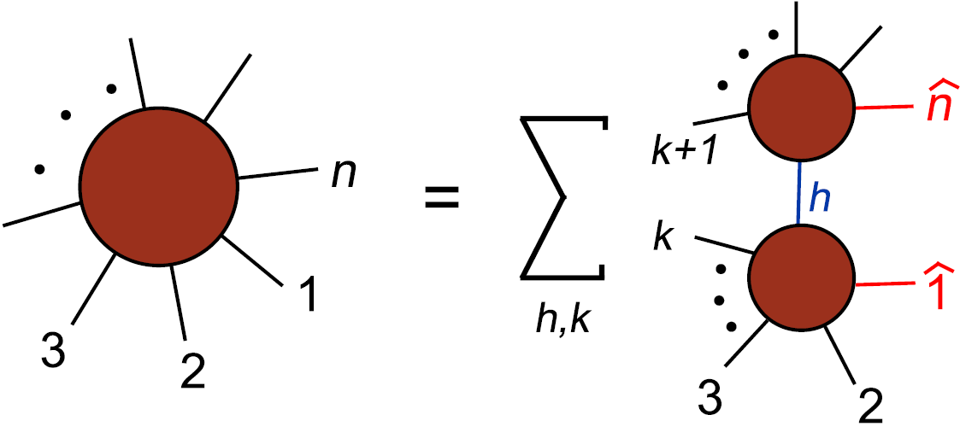
BCFW recursion relations
Recursion relations:[Britto, Cachazo, Feng & Witten, 04’, 05’]
Reduce higher-point amplitudes into lower-point ones
A_{n-k+1}
A_{n}
A_{k+1}

Slide 34
BCFW recursion relations
Recursion relations:[Britto, Cachazo, Feng & Witten, 04’, 05’]
Reduce higher-point amplitudes into lower-point ones
Recursion is great, having solution is even better.
A_{n-k+1}
A_{n}
A_{k+1}

Slide 35
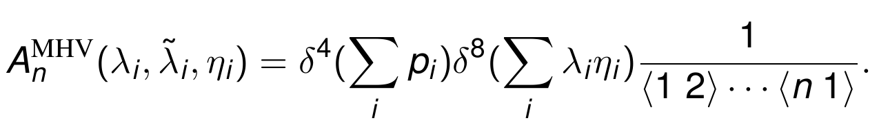
Solutions to BCFW
First non-trivial case, MHV amplitude[Parke Taylor,86’]

Slide 36
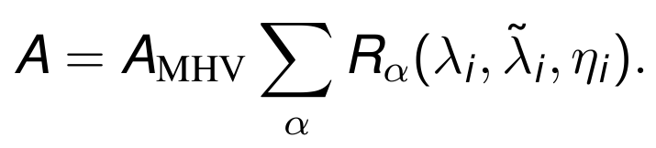
Solutions to BCFW
First non-trivial case, MHV amplitude[Parke Taylor,86’]
All Non-MHV amplitudes [Drummond, Henn 08’]

Slide 37
Solutions to BCFW
First non-trivial case, MHV amplitude[Parke Taylor,86]
All Non-MHV amplitudes [Drummond, Henn 08’]
N=8 SUGRA was also solved similarly
[Drummond, Spradlin, Volovich, CW, ’09]

Slide 38
BCFW at loop-level
BCFW recursion relation can be generalized to loop-level to obtain the loop integrand
[Arkani-Hamed, Bourjaily, Cachazo, Caron-Huot, Trnka, 10’]

Slide 39
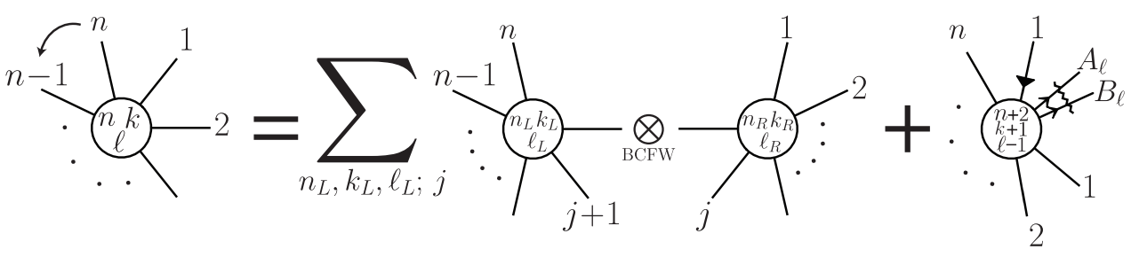
BCFW at loop-level
BCFW recursion relation can be generalized to loop-level to obtain the loop integrand
[Arkani-Hamed, Bourjaily, Cachazo, Caron-Huot, Trnka, 10’]

Slide 40
CSW rules
CSW rule is a Witten's twistor-string theory inspired technique of "sewing" MHV amplitudes together to build arbitrarily tree amplitudes: [Cachazo, Svrcek, Witten, 04’]

Slide 41
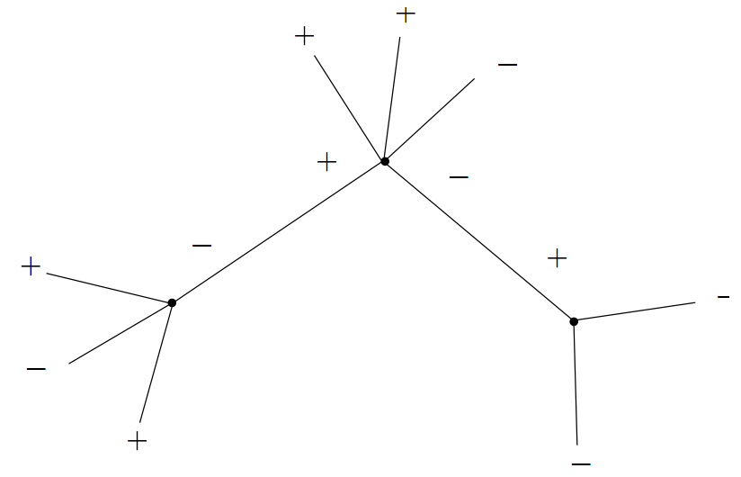
CSW rules
CSW rule is a Witten's twistor-string theory inspired technique of "sewing" MHV amplitudes together to build arbitrarily tree amplitudes: [Cachazo, Svrcek, Witten, 04’]

Slide 42
CSW rules at loop-level
Nothing prevents us to form a loop in CSW diagrams: [Brandhuber, Spence, Travaglini, 04’]

Slide 43
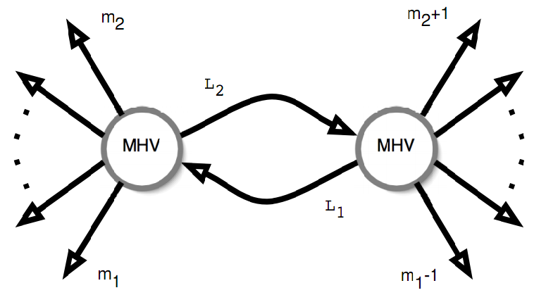
CSW rules at loop-level
Nothing prevents us to form a loop in CSW diagrams: [Brandhuber, Spence, Travaglini, 04’]

Slide 44
[Black Hat collaborators] Black Hat
Amplitudes decomposed into coefficients multiplying scalar integrals and rational terms:

Slide 45
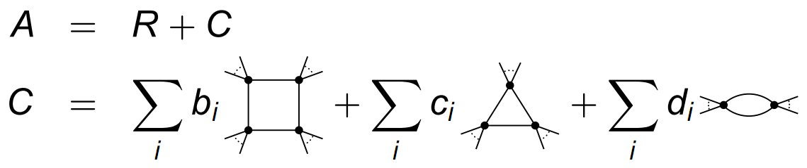
[Black Hat collaborators] Black Hat
Amplitudes decomposed into coefficients multiplying scalar integrals and rational terms:

Slide 46
[Black Hat collaborators] Black Hat
Amplitudes decomposed into coefficients multiplying scalar integrals and rational terms:
The coefficients can be determined by unitarity cuts.

Slide 47
[Black Hat collaborators] Black Hat
Amplitudes decomposed into coefficients multiplying scalar integrals and rational terms:
The coefficients can be determined by unitarity cuts.
The rational part can be compute by recursion relations.

Slide 48
New Symmetries in N=4 SYM

Slide 49
New Symmetries in N=4 SYM
Abstract Symmetries are often helpful in practical calculations.

Slide 50
New Symmetries in N=4 SYM
Abstract Symmetries are often helpful in practical calculations.
Dual (super)conformal symmetry exists at planar limit, which is invisible in Lagrangian.

Slide 51

New Symmetries in N=4 SYM
Abstract Symmetries are often helpful in practical calculations.
Dual (super)conformal symmetry exists at planar limit, which is invisible in Lagrangian.
The symmetry acts on dual coordinates

Slide 52
New Symmetries in N=4 SYM
Abstract Symmetries are often helpful in practical calculations.
Dual (super)conformal symmetry exists at planar limit, which is invisible in Lagrangian.
The symmetry acts on dual coordinates
Conformal symmetry and dual conformal symmetry comprise two lowest levels of a Yangian symmetry.
[Drummond, et al, 08’][Drummond et al, 09’][Arkani-Hamed, 10’]

Slide 53
The use of the Symmetries

Slide 54
The use of the Symmetries
Dual conformal symmetry has anomaly at loop level.

Slide 55
The use of the Symmetries
Dual conformal symmetry has anomaly at loop level.
Anomaly equation allows us to determine 4 and 5-point amplitudes to all loop order. [Drummond, Henn, Korchemsky, E.Sokatchev, 08’]

Slide 56
The use of the Symmetries
Dual conformal symmetry has anomaly at loop level.
Anomaly equation allows us to determine 4 and 5-point amplitudes to all loop order. [Drummond, Henn, Korchemsky, E.Sokatchev, 08’]
All-loop amplitudes can be written as
[Bern, Dixon, Smirnov, 05’]
BDS ansatz + Remainder function.

Slide 57
Wilson loop/Correlation/Amplitude

Slide 58
Wilson loop/Correlation/Amplitude
Expectation value of Light-like Wilson loop in dual space is equivalent to scattering amplitudes. [Alday, Maldacena, 07’] [Drummond et al, 08’] [Brandhuber, Heslop, Travaglini, 08’] [BHT & Spence, 09’]

Slide 59
Wilson loop/Correlation/Amplitude
Expectation value of Light-like Wilson loop in dual space is equivalent to scattering amplitudes. [Alday, Maldacena, 07’] [Drummond et al, 08’] [Brandhuber, Heslop, Travaglini, 08’] [BHT & Spence, 09’]
Correlation function of some operators with Light-like limit is equivalent to scattering amplitudes. [Alday, et al 10’]

Slide 60
Wilson loop/Correlation/Amplitude
Expectation value of Light-like Wilson loop in dual space is equivalent to scattering amplitudes. [Alday, Maldacena, 07’][Drummond et al, 08’] [Brandhuber, Heslop, Travaglini, 08’] [BHT & Spence, 09’]
Correlation function of some operators with Light-like limit is equivalent to scattering amplitudes. [Alday et al, 10’]
It helps computing the scattering amplitudes: OPE of Wilson loop [Alday, Gaiotto, Maldacena, Sever, Vieria]

Slide 61
Dual formalism of S-matrix
Witten’s twistor string theory: [Witten, 03’]

Slide 62
Dual formalism of S-matrix
Witten’s twistor string theory: [Witten, 03’]
Scattering amplitudes are related to the curves in (super)twistor space.

Slide 63
Dual formalism of S-matrix
Witten’s twistor string theory: [Witten, 03’]
Scattering amplitudes are related to the curves in (super)twistor space.
Arkani-Hamed et al’s Grassmannian formalism: [Arkani-Hamed, Cachazo, Chueng, Kaplan, 09’]

Slide 64
Dual formalism of S-matrix
Witten’s twistor string theory: [Witten, 03’]
Scattering amplitudes are related to the curves in (super)twistor space.
Arkani-Hamed et al’s Grassmannian formalism: [Arkani-Hamed, Cachazo, Chueng, Kaplan, 09’]
All-loop Planar amplitudes are associated with an contour integral defined with Grassmannian.

Slide 65
Dual formalism of S-matrix
Witten’s twistor string theory: [Witten, 03’]
Scattering amplitudes are related to the curves in (super)twistor space.
Arkani-Hamed et al’s Grassmannian formalism: [Arkani-Hamed, Cachazo, Chueng, Kaplan, 09’]
All-loop Planar amplitudes are associated with an contour integral defined with Grassmannian.
Twistor string theory and Grassmannian formulation are closely related to each other. [Bourjaily, Trnka, Volovich, CW, 10’]

Slide 66
Summary

Slide 67
Summary
BCFW recursion relations and CSW rules make some previous impossible calculations trivial.

Slide 68
Summary
BCFW recursion relations and CSW rules make some previous impossible calculations trivial.
Numerical calculations on QCD.

Slide 69
Summary
BCFW recursion relations and CSW rules make some previous impossible calculations trivial.
Numerical calculations on QCD.
New symmetries in N=4 SYM.

Slide 70
Summary
BCFW recursion relations and CSW rules make some previous impossible calculations trivial.
Numerical calculations on QCD.
New symmetries in N=4 SYM.
Wilson loop/Correlation/Amplitude duality.

Slide 71
Summary
BCFW recursion relations and CSW rules make some previous impossible calculations trivial.
Numerical calculations on QCD.
New symmetries in N=4 SYM.
Wilson loop/Correlation/Amplitude duality.
Dual of S-matrix: Twistor string theory & Grassmannian formulation.

Slide 72
Summary
BCFW recursion relations and CSW rules make some previous impossible calculations trivial.
Numerical calculations on QCD.
New symmetries in N=4 SYM.
Wilson loop/Correlation/Amplitude duality.
Dual of S-matrix: Twistor string theory &
Grassmannian formulation.
Much more to uncover.

Slide 73
Thank you!

