Slide 1
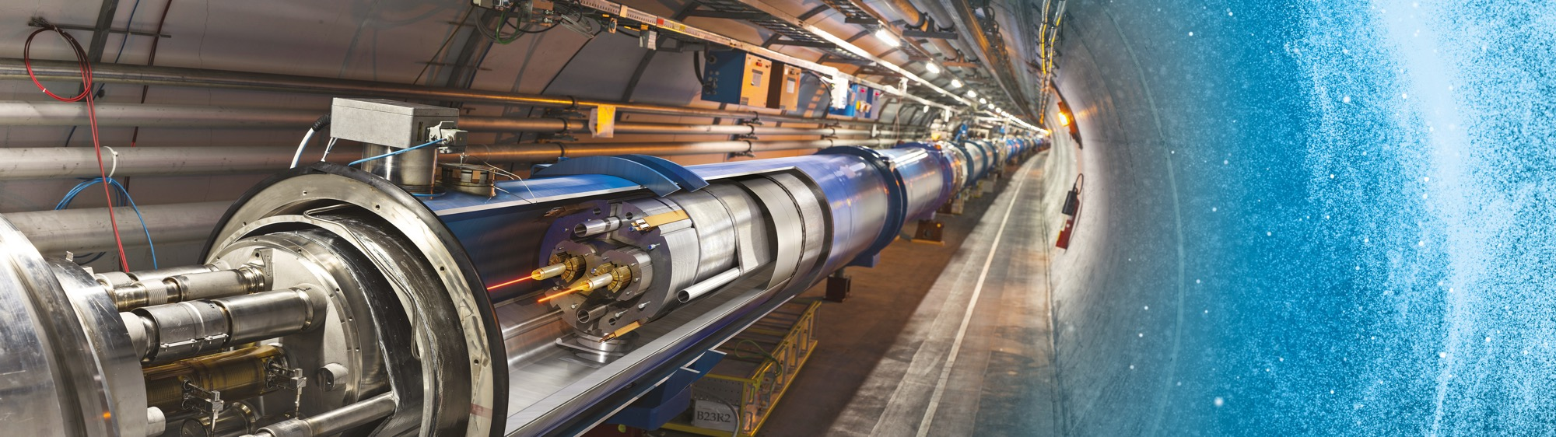
Doing Business with CERN
Thematic Industry Day 6 May 2025
Floris Bonthond
Procurement Officer

Slide 2
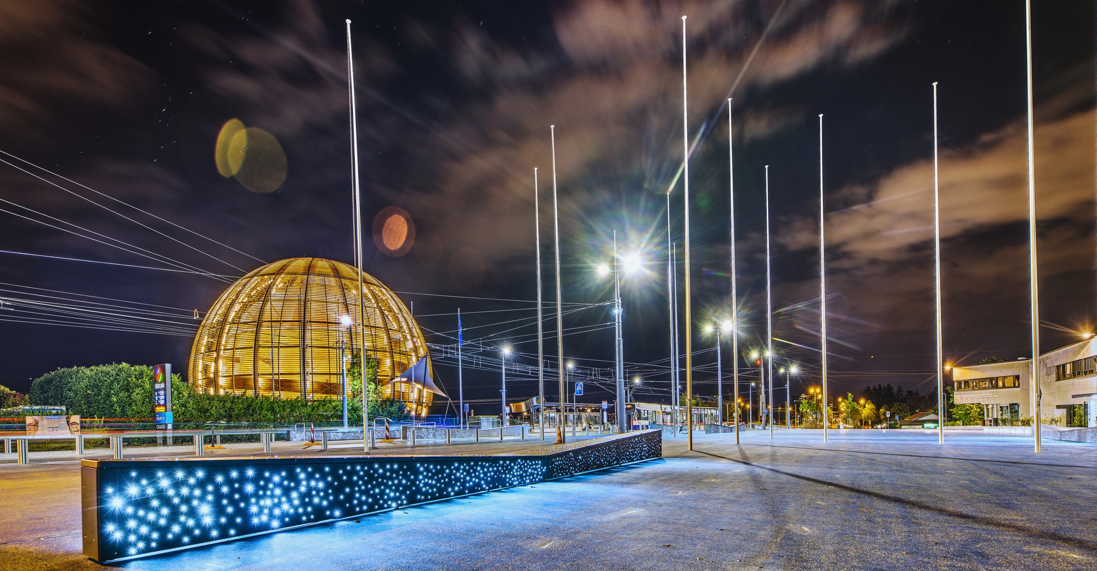
AGENDA
Introduction
    Legal Framework
    Budget
    Statistics
    What does CERN buy
    CERN’s future projects
Procurement@CERN
    Procurement Service
    Procedures
    Website
Impact of doing business with CERN
6 May 2025 – Floris Bonthond

Slide 3

INTRODUCTION
6 May 2025 – Floris Bonthond

Slide 4

CERN - the world’s largest laboratory for particle physics
International Organization
established on 1 July 1953 -
“Science for Peace”
Immunity of jurisdiction
and execution
6 May 2025 – Floris Bonthond
Notes:
This slide addresses two questions:
“Where are we?”
Use the map to indicate the location of CERN, headquartered in Geneva, straddling the Franco-Swiss border
“What is CERN?”
CERN is one of the world’s leading laboratories for particle physics
CERN’s vision (long-term goal) is to understand the fundamental particles and laws of the Universe (This is the Vision statement that features in CERN’s communication strategy)
Thus, CERN is first and foremost a research laboratory

Slide 5
In 1954, CERN had 12 Member States
Today, CERN has:
24 Member States
2 Associate Member States in the pre-stage to membership
8 Associate Member States
4 Observers
Geographical & cultural diversity
110 nationalities,
from 77 countries
~ 2,676 Staff members
~ 2,000 Contractors’ employees
~ 13,000 Physicists / users
6 May 2025 – Floris Bonthond
Notes:
The speaker can highlight CERN’s second mission as stated when it was established: to foster peaceful collaborations between nations that had recently been at war.
This slide will have information on the country of the visiting delegation:
Location on the world map
Date of accession (if Member State or Associate Member State)
For information:
Member States – Austria, Belgium, Bulgaria, Czech Republic, Denmark, Estonia, Finland, France, Germany, Greece, Hungary, Israel, Italy, Netherlands, Norway, Poland, Portugal, Romania, Serbia, Slovak Republic, Spain, Sweden, Switzerland, United Kingdom
Associate Member States in the pre-stage to membership – Cyprus, Slovenia
Associate Member States – Croatia, India, Latvia, Lithuania, Pakistan, Turkey, Ukraine
Observers – USA, Russia (SUSPENDED), Japan, (EU, JINR, UNESCO)

Slide 6

CERN is entitled to establish its own internal rules necessary for its proper functioning, including:
Procurement Rules
Safety Rules
Staff Regulations of its own personnel
6 May 2025 – Floris Bonthond

Slide 7

Four pillars underpin CERN’s mission
RESEARCH
EDUCATION
& TRAINING
COLLABORATION
INNOVATION
6 May 2025 – Floris Bonthond

Slide 8

Budget & Expenditure
6 May 2025 – Floris Bonthond

Slide 9


































2025 Member State contributions (1.3 B CHF)
Country | Percentage | Amount (CHF)
Germany | 20.10% | 254 713 750
United Kingdom | 14.63% | 185 443 700
France | 12.38% | 156 880 600
Italy | 9.43% | 119 487 150
Spain | 6.62% | 83 864 950
Netherlands | 4.72% | 59 771 700
Switzerland | 3.72% | 47 108 400
Poland | 3.09% | 39 196 050
Belgium | .2.71% | 34 355 300
Sweden | 2.61% | 33 069 950
Norway | 2.43% | 30 748 450
Israel | 2.28% | 28 901 850
Austria | 2.15% | 27 217 900
Denmark | 1.87% | 23 653 250
India | 1.45% | 18 348 250
Romania | 1.32% | 16 710 000
Finland | 1.29% | 16 346 850
Country | Percentage | Amount (CHF)
Czech Republic | 1.17% | 14 807 450
Portugal | 1.06% | 13 424 700
Greece | 0.97% | 12 225 600
Brazil | 0.81% | 10 232 950
Hungary | 0.71% | 8 982 550
Slovak Republic | 0.52% | 6 552 450
Türkiye | 0.39% | 4 955 250
Bulgaria | 0.39% | 4 888 400
Serbia | 0.28% | 3 596 450
Slovenia | 0.21% | 2 654 050
Pakistan | 0.16% | 2 053 850
Estonia | 0.16% | 2 045 150
Cyprus | 0.09% | 1 119 450
Latvia | 0.08% | 1 066 250
Ukraine | 0.08% | 1 034 000
Croatia | 0.08% | 1 000 000
Lithuania | 0.08% | 1 000 000
6 May 2025 – Floris Bonthond

Slide 10
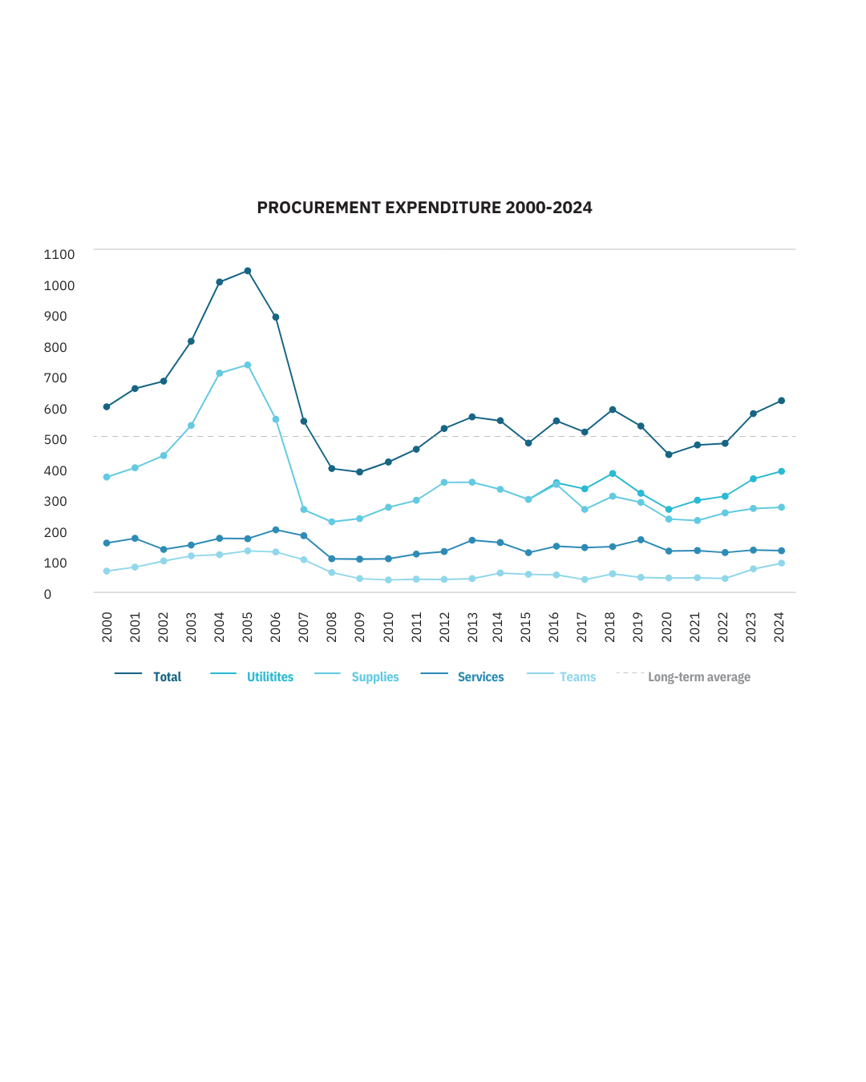
Procurement Expenditure
613M CHF
6 May 2025 – Floris Bonthond

Slide 11

What does CERN buy?
6 May 2025 – Floris Bonthond

Slide 12
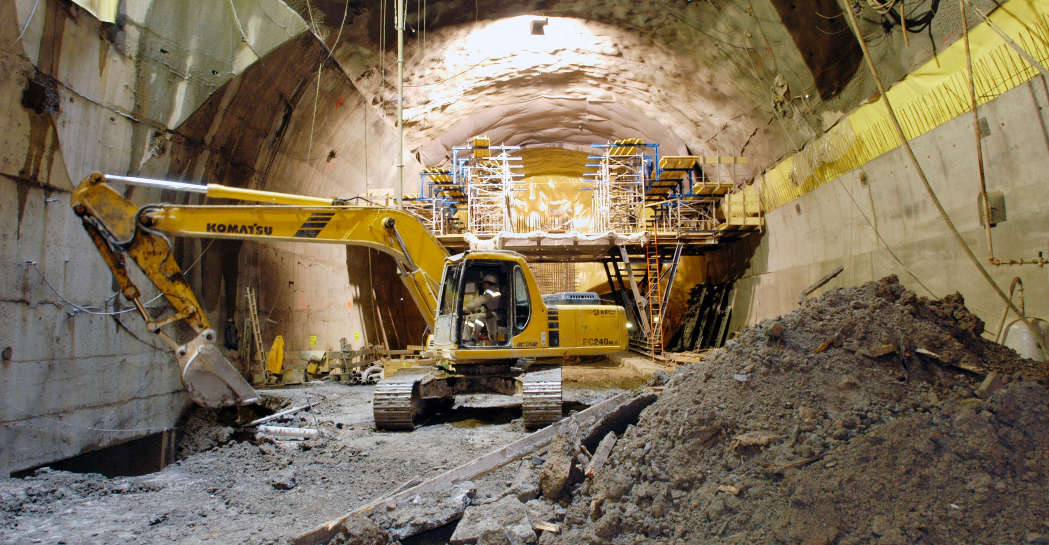
Civil engineering
  Construction
  Renovation of buildings
  Metallic structures
  Earthworks
  Roads
6 May 2025 – Floris Bonthond

Slide 13
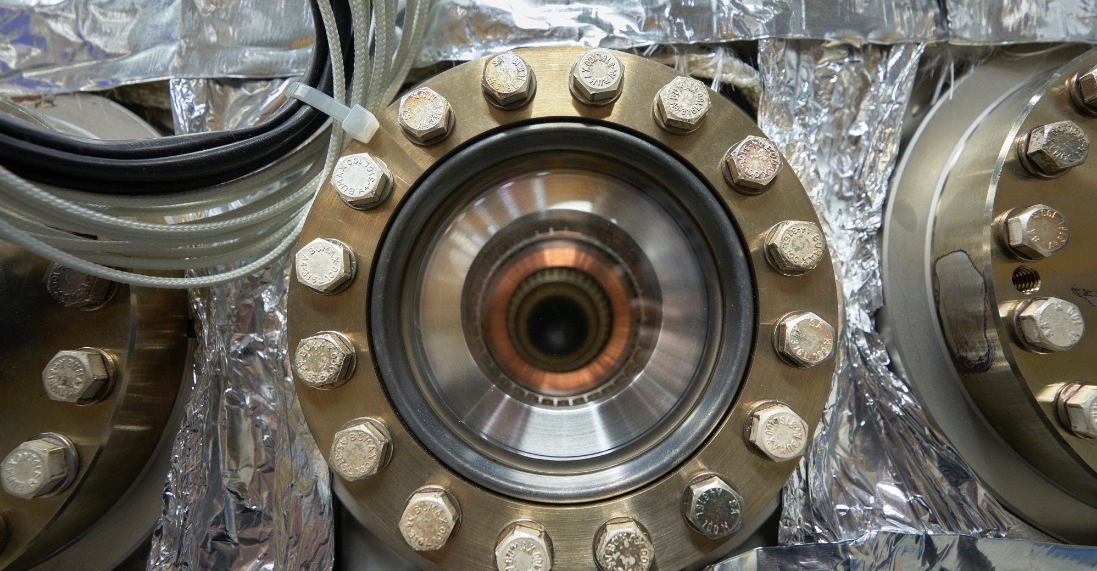
Electrical engineering and magnets
  Transformers
  Switchboards and switchgears
  Cables
  Automation
  Power supplies
  Magnets
6 May 2025 – Floris Bonthond

Slide 14
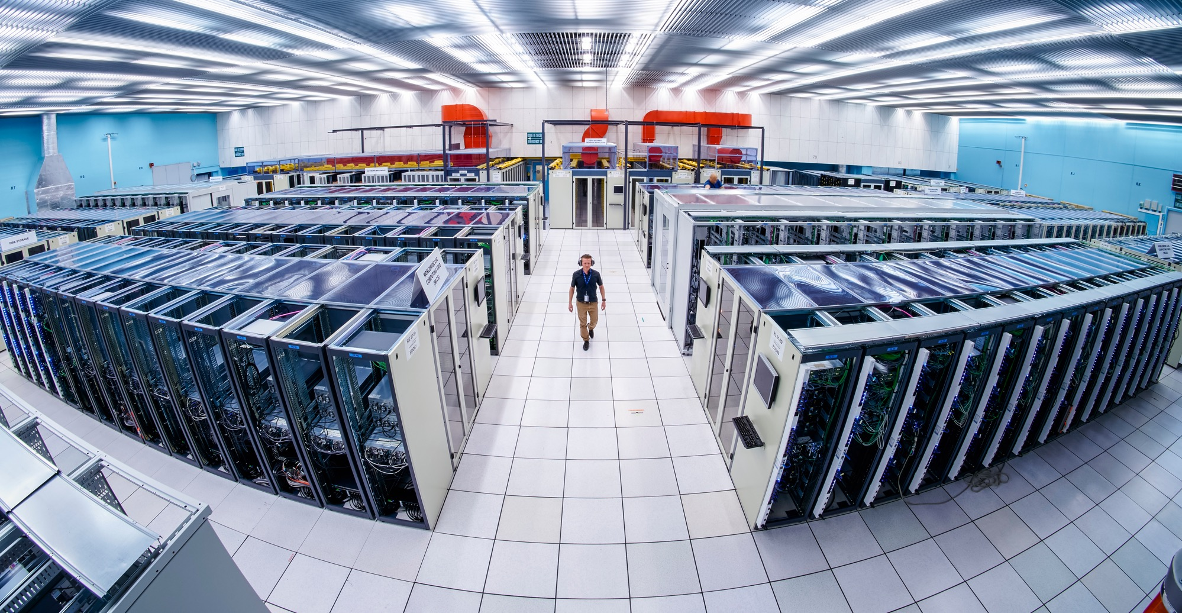
Information Technology
  Computing systems
  Servers
  Software
  Network equipment
  Personal computer equipment
6 May 2025 – Floris Bonthond

Slide 15
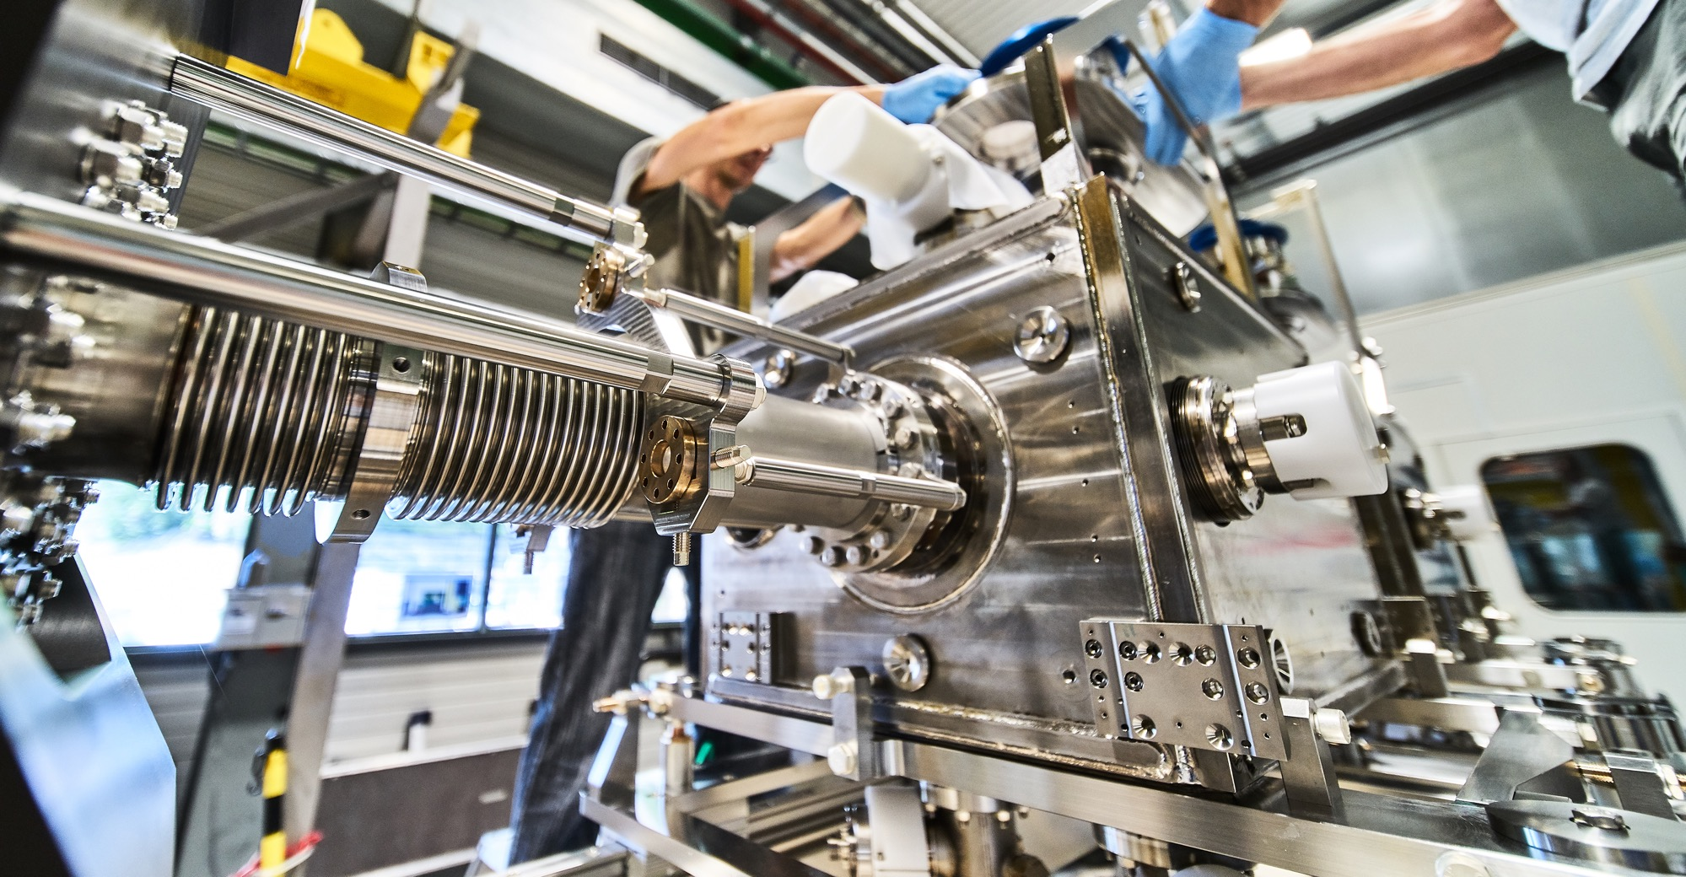
Mechanical engineering and raw materials
  Machining
  Sheet metal work
  Welding (arc, MIG, TIG, EBW)
  Special fabrication techniques
  Raw materials, finished and semi-finished products (plates, pipes, etc.)
  Offsite engineering and testing
6 May 2025 – Floris Bonthond

Slide 16
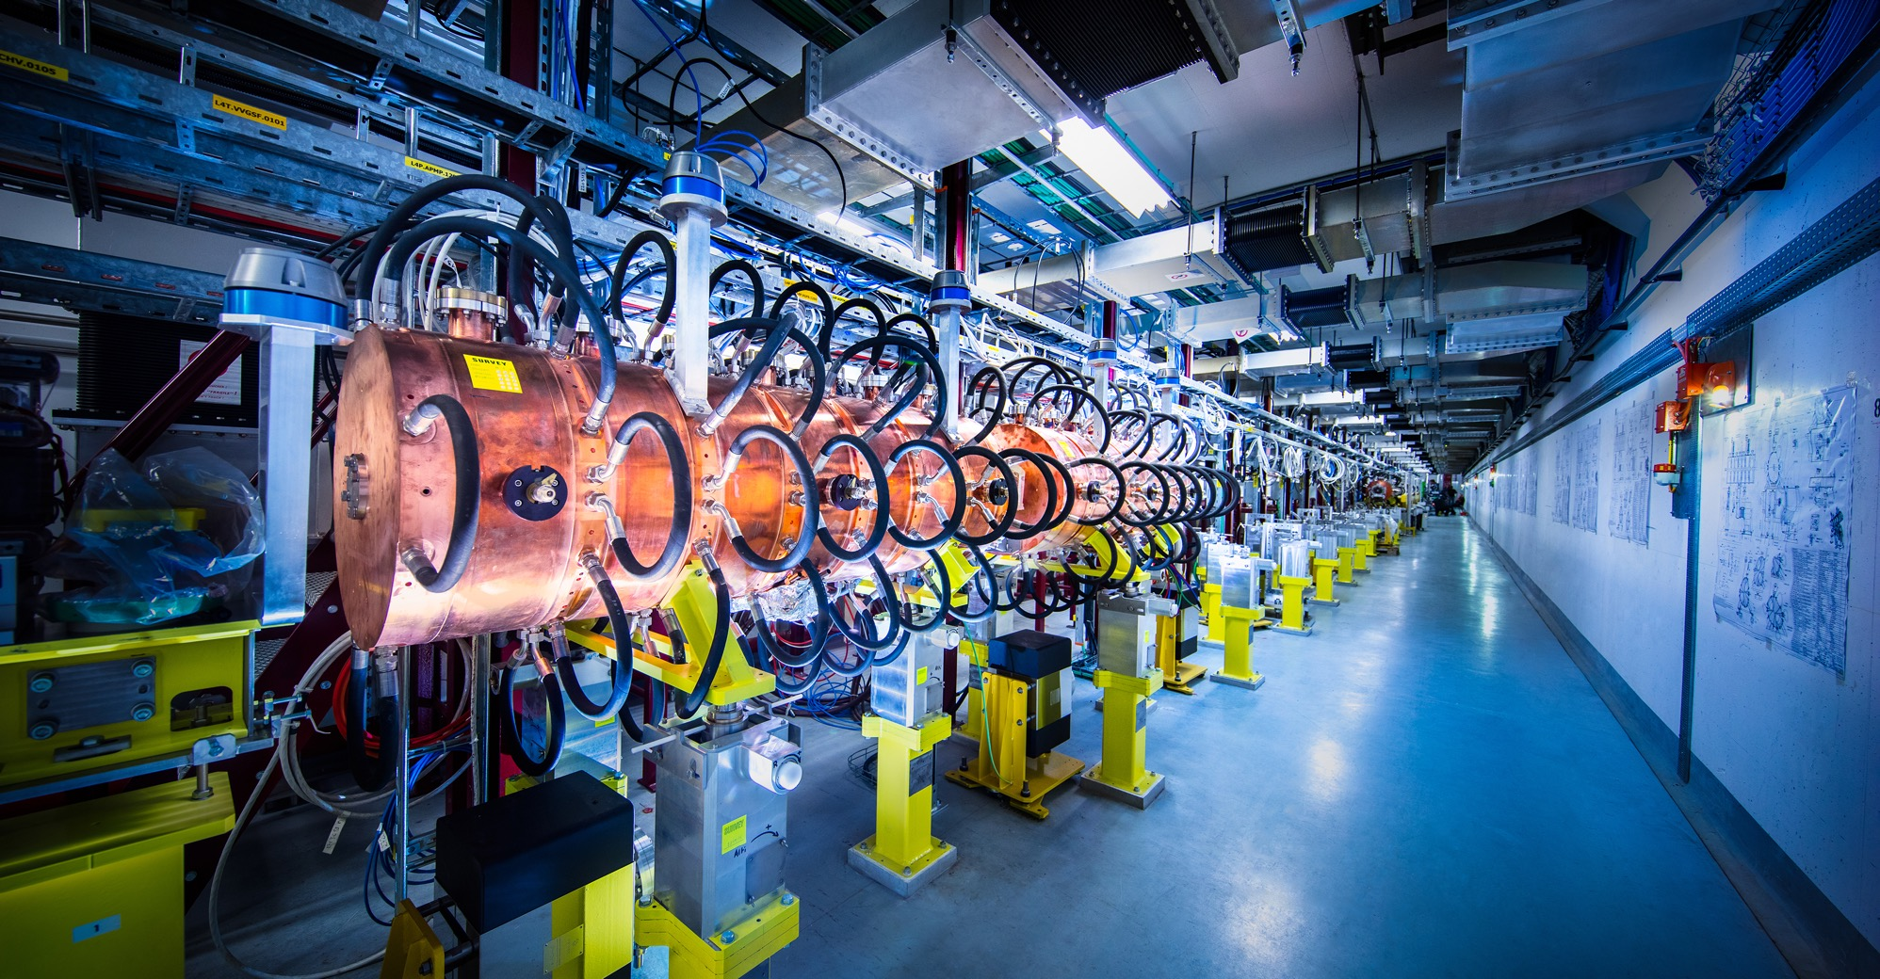
Electronics and radio frequency
  Electronic components (active, passive)
  PCBs and assembled boards
  LV and HV power supplies
  Radio frequency plants
  Amplifiers
6 May 2025 – Floris Bonthond

Slide 17
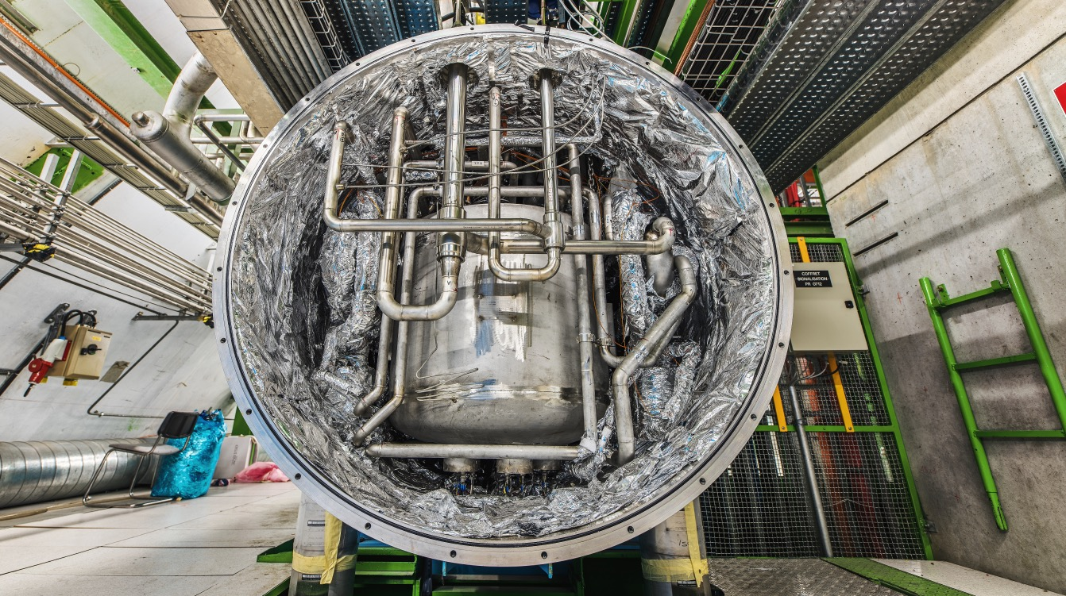
As well as
  Cryogenic and vacuum equipment
  Optics and photonics
  Particle and photon detectors
  Health and safety equipment
  Transport and handling equipment
  Office supply, furniture
  Industrial services on the CERN Site
6 May 2025 – Floris Bonthond

Slide 18
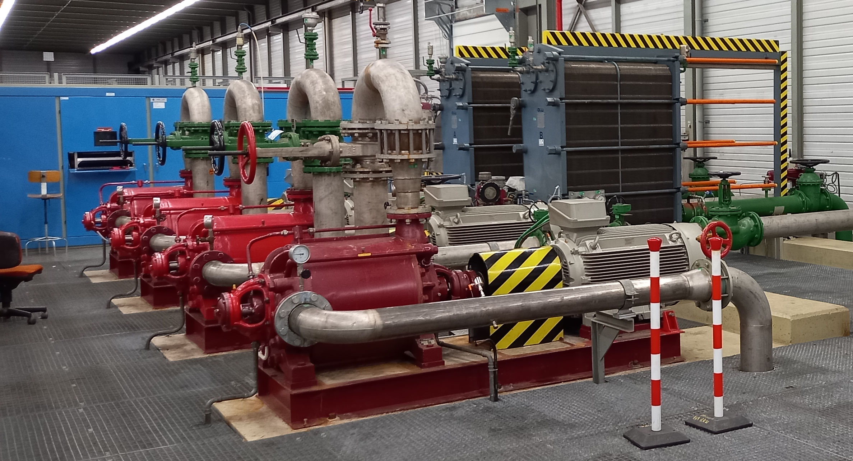
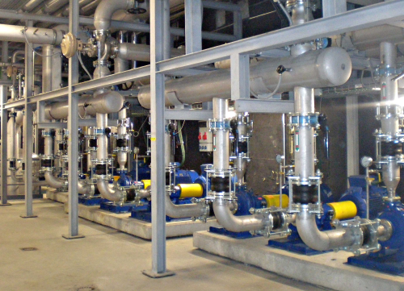
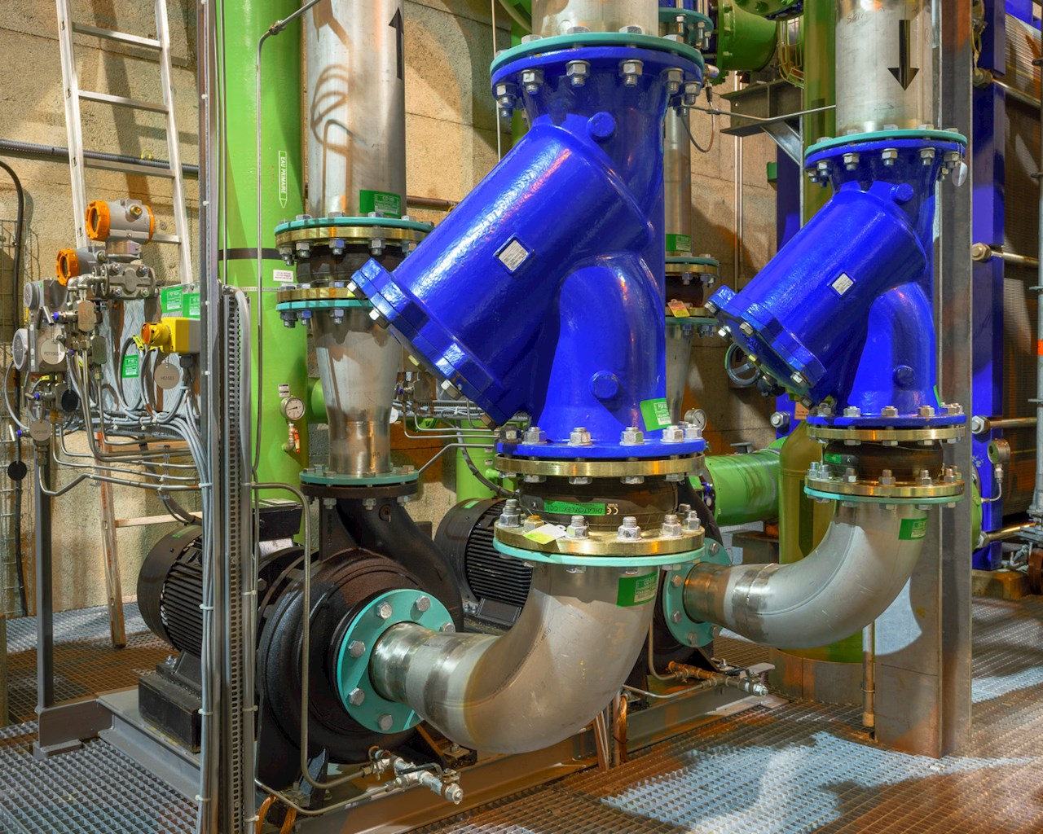
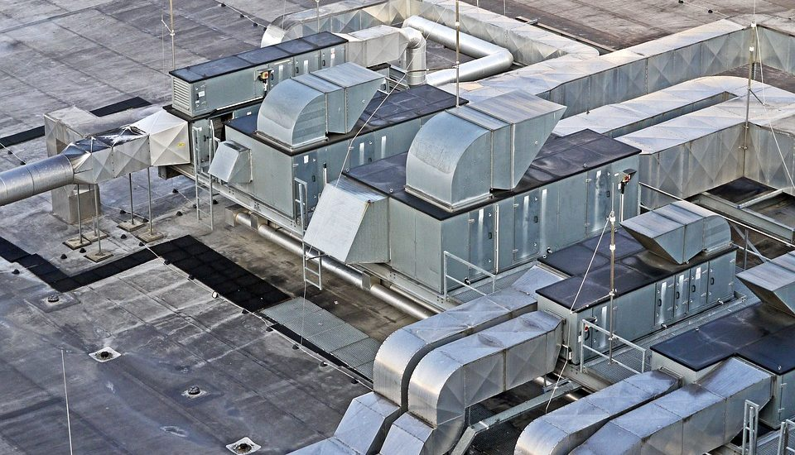
And finally, last but certainly not least:
HVAC equipment:
  Cooling towers
  Raw water distribution stations
  Ventilation systems
  Compressed air stations
  Heat pumps
  Chillers
  CO2 cooling systems
  Water treatment plants
  HVAC units
6 May 2025 – Floris Bonthond

Slide 19
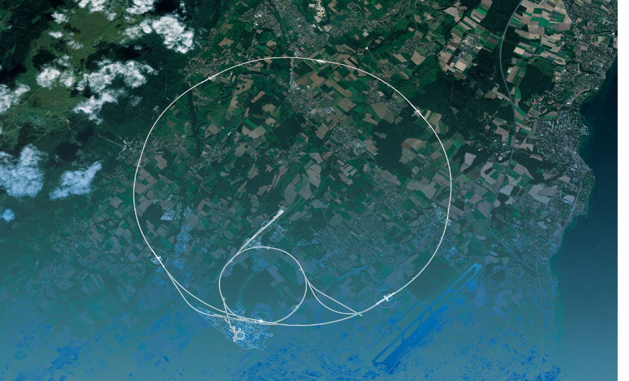
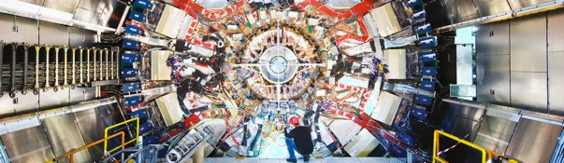
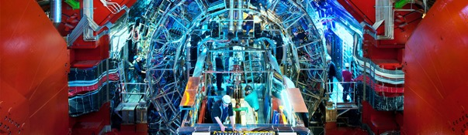
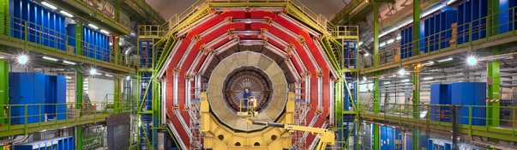
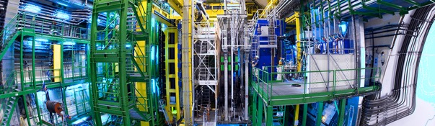
CERN also buys for the LHC experiments
The Compact Muon Solenoid (CMS) is a general-purpose detector.
It has a broad physics programme ranging from studying the Standard Model
(including the Higgs boson) to searching for extra dimensions and particles
that could make up dark matter.
CMS
ALICE (A Large Ion Collider Experiment) is a detector dedicated
to heavy-ion physics. It is designed to study the physics of strongly
interacting matter at extreme energy densities, where a phase of
matter called quark-gluon plasma forms..
ALICE
ATLAS
LHCb
The ATLAS experiment (short for "A Toroidal LHC Apparatus") detects
the tiny subatomic particles created after beams of particles smash into
each other at near light speed.
The Large Hadron Collider beauty (LHCb) experiment
specialises in investigating the slight differences between
matter and antimatter by studying a type of particle called
the "beauty quark", or "b quark".
6 May 2025 – Floris Bonthond

Slide 20
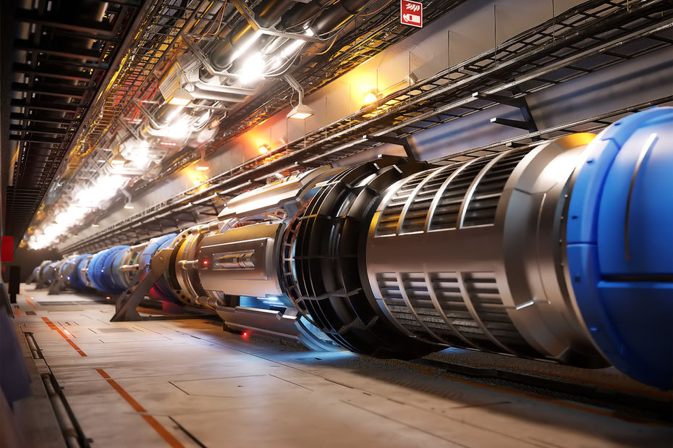
CERN’S FUTURE
The Compact Muon Solenoid (CMS) is a general-purpose detector.
It has a broad physics programme ranging from studying the Standard Model
(including the Higgs boson) to searching for extra dimensions and particles
that could make up dark matter.
CMS
ALICE (A Large Ion Collider Experiment) is a detector dedicated
to heavy-ion physics. It is designed to study the physics of strongly
interacting matter at extreme energy densities, where a phase of
matter called quark-gluon plasma forms..
ALICE
ATLAS
The ATLAS experiment (short for "A Toroidal LHC Apparatus") detects
the tiny subatomic particles created after beams of particles smash into
each other at near light speed.
6 May 2025 – Floris Bonthond

Slide 21
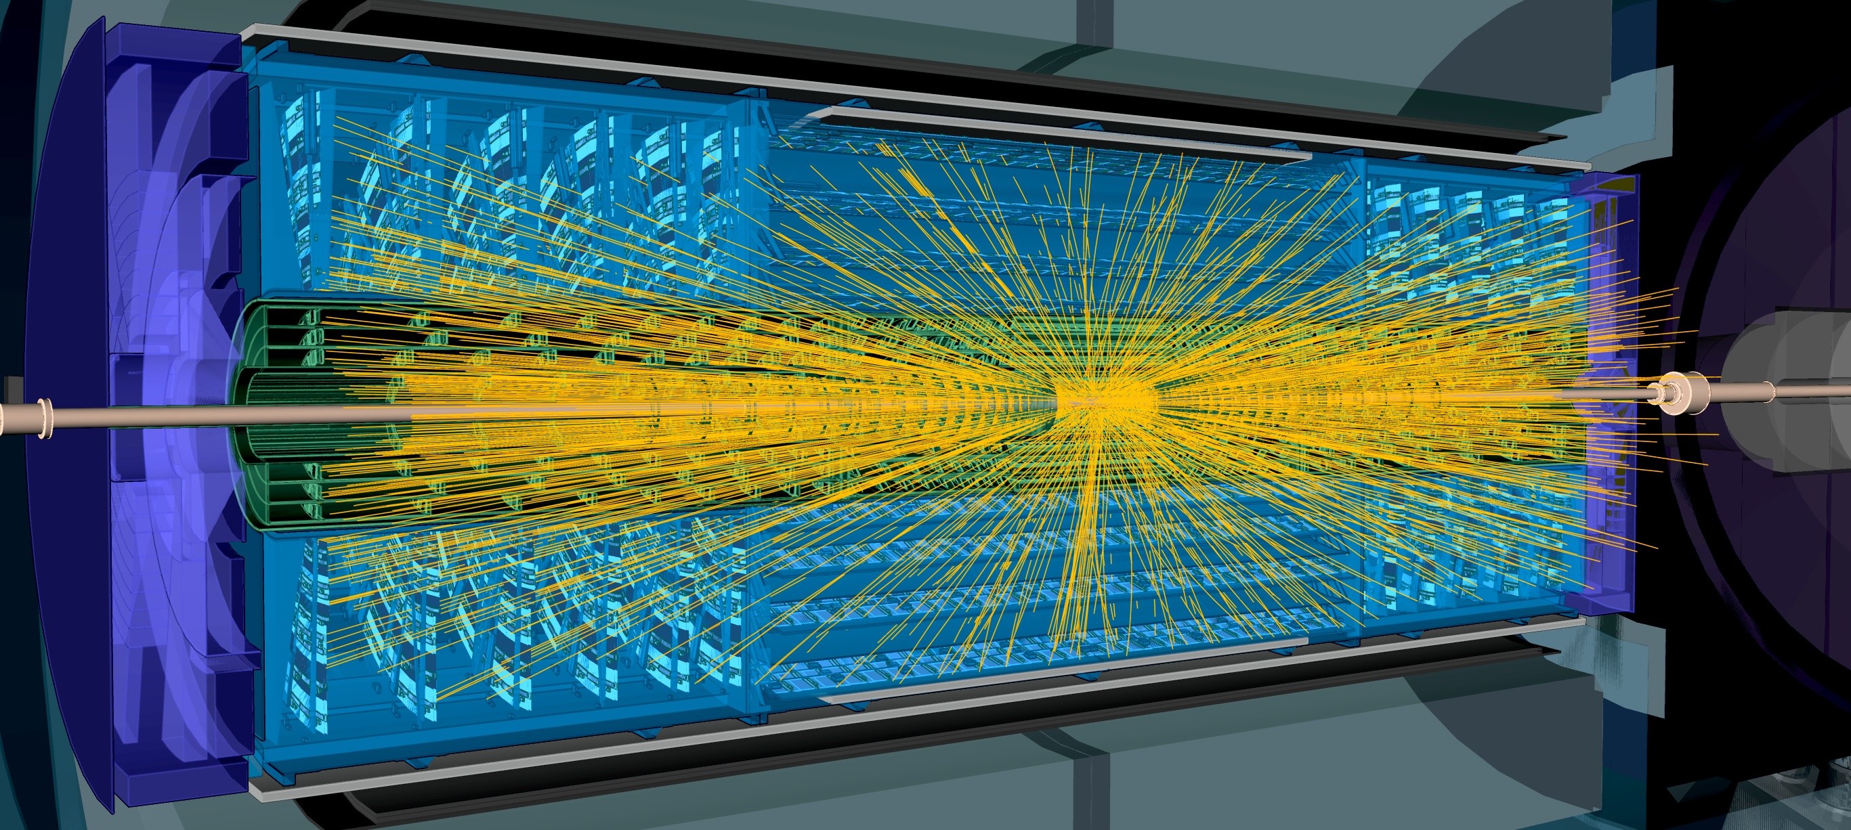
Current project - upgrade of the LHC to
High Luminosity* LHC
Hi-Lumi will provide greater precision and discovery potential, up to 10× more collisions. More collisions = better chances to observe rare or subtle phenomena
Hi-Lumi will start operating in 2026, and run until 2035
CERN is already looking beyond 2035, with several projects in R&D or study stages
Luminosity = a measure of how many collisions occur per second
6 May 2025 – Floris Bonthond

Slide 22
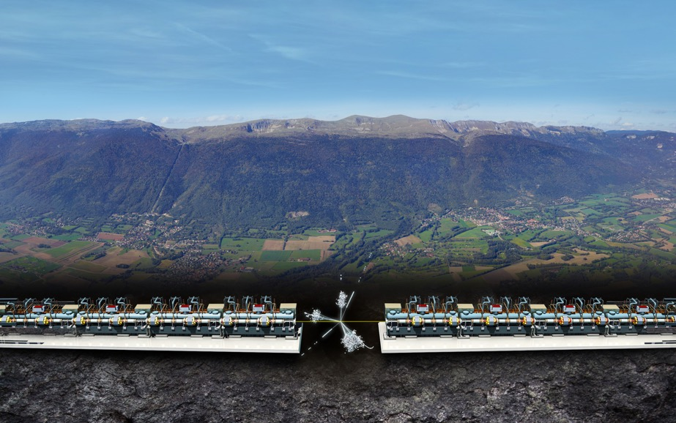
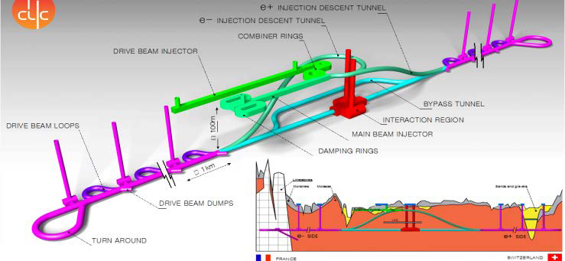

Compact LInear Collider (CLIC)
Explore physics beyond the Standard Model with extreme precision, especially by studying the Higgs boson, the top quark, and searching for new particles — in a way that complements the LHC and FCC. Located 100m underground.
First stage (380 GeV center of mass energy): 11.4 km (CLIC380)
Second stage (1.5 TeV): 29 km (CLIC1500)
Final stage (3 TeV): 50.1 km (CLIC3000)
6 May 2025 – Floris Bonthond

Slide 23
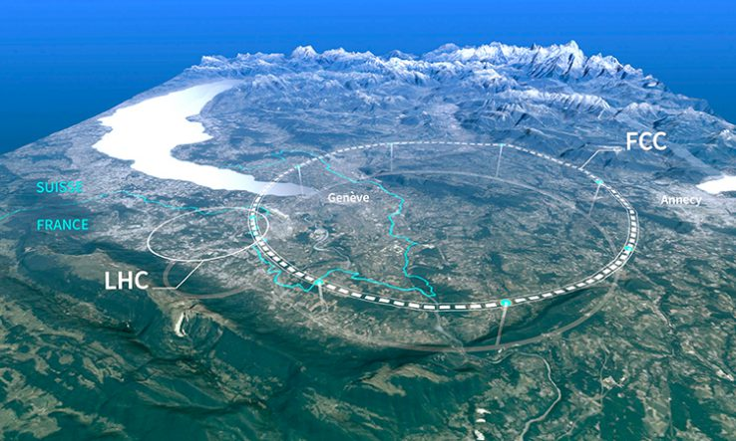
Future Circular Collider (FCC)
6 May 2025 – Floris Bonthond

Slide 24
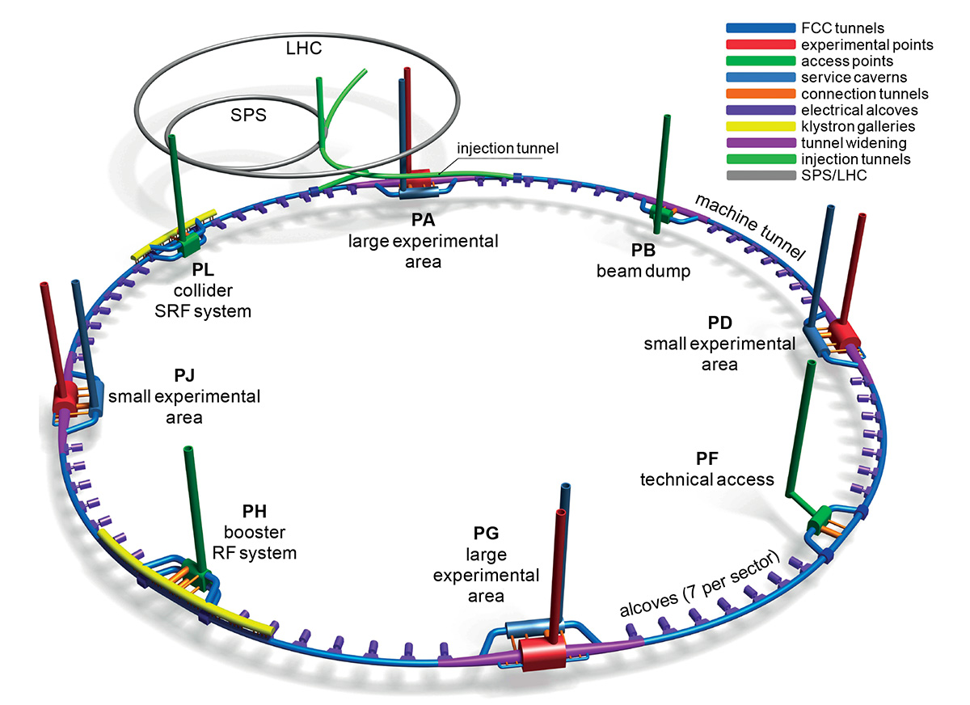
Now – 2025
Feasibility study (completed)
Final technical concepts for FCC-ee, FCC-hh, and tunnel infrastructure
Engagement with member states and stakeholders
2028–2030
Decision by CERN Council on whether to proceed
Final design approval and initial funding commitments
2030s
Construction of FCC-ee (electron-positron collider)
  Includes excavation of the 91 km tunnel, between 100 and 200 m underground
  Installation of civil infrastructure, cryogenics, and low-field magnets
Late 2040s
Start of FCC-ee operations
  High-precision Higgs, Z, and top quark studies
  Runs for ~15–20 years
2060s–2070s
Upgrade to FCC-hh (proton-proton collider)
  Installation of high-field (16 T) magnets
  Target energy: up to 100 TeV
6 May 2025 – Floris Bonthond

Slide 25
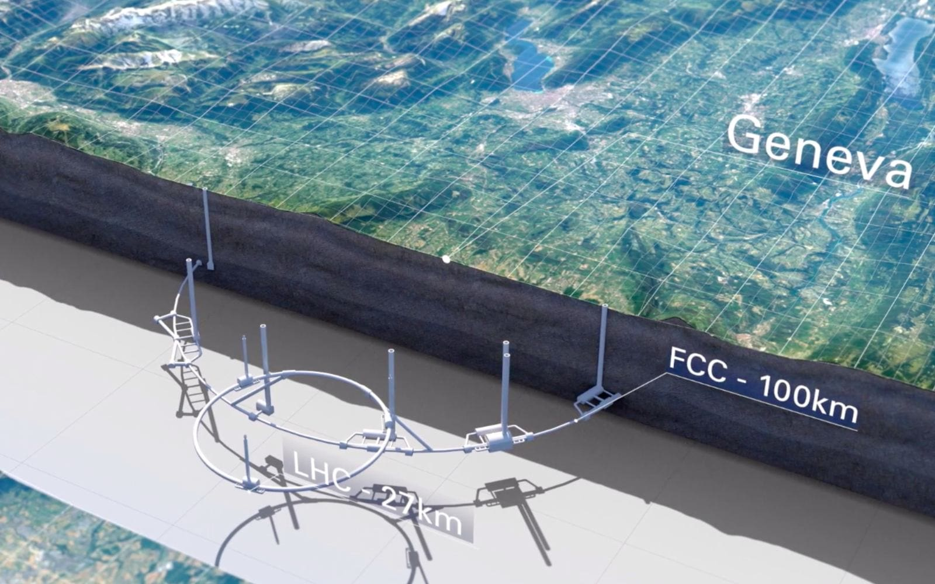
1. Understand the Higgs Boson in Depth
  Perform ultra-precise measurements of the Higgs boson’s properties
  Study Higgs self-interaction and coupling to other particles
  Detect possible deviations from Standard Model predictions
  The FCC-ee (electron-positron stage) is a "Higgs factory" designed for this purpose.
2. Search for New Physics Beyond the Standard Model
Explore phenomena like:
  Dark matter candidates
  Supersymmetry (SUSY)
  Extra dimensions
  Hidden particles not detectable at the LHC
The FCC-hh (proton-proton stage) will collide particles at up to 100 TeV, offering ~7× the energy of the LHC.
3. Explore the Top Quark, W, Z and Electroweak Forces
  Conduct ultra-high-precision studies of the heaviest known fundamental particle (the top quark)
  Refine the understanding of electroweak interactions
4. Enable Technological and Industrial Innovation
  Develop advanced superconducting magnets, cryogenics, computing, and materials science
  Spur innovation in fields like medical imaging, data processing, and energy systems
5. Lay the Foundation for a Unified Theory
By collecting the most precise data and exploring new energy regimes, the FCC aims to reveal hints
toward a more fundamental theory unifying gravity, quantum mechanics, and particle physics.
6 May 2025 – Floris Bonthond

Slide 26


PROCUREMENT @CERN
6 May 2025 – Floris Bonthond

Slide 27

How does CERN buy?
  Off-the shelf or non-standard products which can be produced with existing manufacturing techniques or technologies:
  Functional specification
  Non-standard products where industry has neither the required know-how nor the interest to develop and design the products:
  Build-to-Print specification
Prototypes and or Pre-series might be required.
Floris.Bonthond@cern.ch
27
6 May 2025 – Floris Bonthond

Slide 28
The Procurement Service
The mission of the Procurement Service is to procure all supplies and services for CERN
Meeting all requirements:
Technical, performance, delivery,
legal and commercial
At the lowest possible overall cost
While :
Achieving balanced industrial return for CERN Member States
Respecting CERN Procurement Rules
Floris.Bonthond@cern.ch
6 May 2025 – Floris Bonthond

Slide 29
Principles of the Procurement Rules (1/4)
1
Transparency and Impartiality
2
Tenders open to Member States only
3
Objectivity and equal treatment: tendering packages are objective and impartial
6 May 2025 – Floris Bonthond

Slide 30
Principles of the Procurement Rules (2/4)
Selective tendering procedures: CERN’s tendering procedures are not open to any interested firm
Confidentiality: Opening and evaluation of bids as well as negotiations are not public
6 May 2025 – Floris Bonthond

Slide 31
Principles of the Procurement Rules (3/4)
Award on a Lowest compliant bid basis
Most commonly used for Supply contracts
Technical
Financial
2
Delivery
6 May 2025 – Floris Bonthond

Slide 32
Principles of the Procurement Rules (4/4)
Award on a Best Value For Money basis
Most commonly used for industrial service contracts
2
No alignment rule
6 May 2025 – Floris Bonthond

Slide 33

Enquiries between 10,000 and 400,000 CHF
Price enquiry (Demande d’Offre - DO)
Submission deadline: 4-6 weeks from date of dispatch
All price enquiries above 50,000 CHF are also sent to the
Industrial Liaison Officers (ILOs) for information
Price enquiries consist of:
  Technical specification and annexes
  Technical Questionnaire (optional)
  Tender form
  CERN’s General Conditions (contracts, invitations to tender, safety, etc.)
Price enquiries between 200,000 – 400,000 CHF announced on CERN’s procurement website, see “Business Opportunities”
Bids shall be submitted via CERN’s e-tendering interface
6 May 2025 – Floris Bonthond

Slide 34

Enquiries exceeding 400’000 CHF (1/2)
Market Survey (MS)
Prior announcement on CERN’s procurement website, see
“Business Opportunities”
  At this stage, interested firms are encouraged to contact CERN in
  order to have a clear understanding of the requirement, allowing
  them to begin their organisation ahead of the tendering process
Market surveys consist of:
  Technical Description
  Qualification Questionnaire (technical and financial criteria)
Submission deadline: 4 weeks, or more if the MS is still online
Enables CERN to define a list of selected firms
6 May 2025 – Floris Bonthond

Slide 35

Enquiries exceeding 400’000 CHF (2/2)
Invitation to Tender (IT)
Sent to selected firms only
Submission deadline: 4 weeks from date of dispatch (with a longer period for more complex requirements)
Firms can ask all questions in writing to understand all requirements and prepare a bid that best matches CERN’s needs
All invitations to tender are sent to the Industrial Liaison Officers (ILOs) for information
Invitations to Tender consist of:
  Technical specification and annexes
  Technical Questionnaire (optional)
  Tender form
  CERN’s General Conditions (contracts, invitations to tender, safety, etc.)
Bids shall be submitted via CERN’s e-tendering interface
6 May 2025 – Floris Bonthond
Notes:
Invitations to tender consist of:
Technical specification and annexes;
Tender form (and a technical annex - optional);
General Conditions of CERN (contracts, invitations to tender, Safety, etc.)

Slide 36


Clarification process
To help bidders to fully understand CERN’s needs and allow preparation of best suited bid
During Price Enquiry and Invitation to Tender phases
Concerns all technical, commercial and legal aspects
To be sent to the Procurement Officer in charge
Questions and Answers will be provided to all Bidders
6 May 2025 – Floris Bonthond

Slide 37


Industrial Return Coefficient
The Industrial Return Coefficient (IRC) of a Member State is defined as the ratio between that Member State's percentage share of the value of all Supply contracts and that Member State's percentage contribution to the CERN Budget over the same period
Well balanced Member States: IRC ≥ 1
Poorly balanced Member States: IRC < 1
6 May 2025 – Floris Bonthond

Slide 38
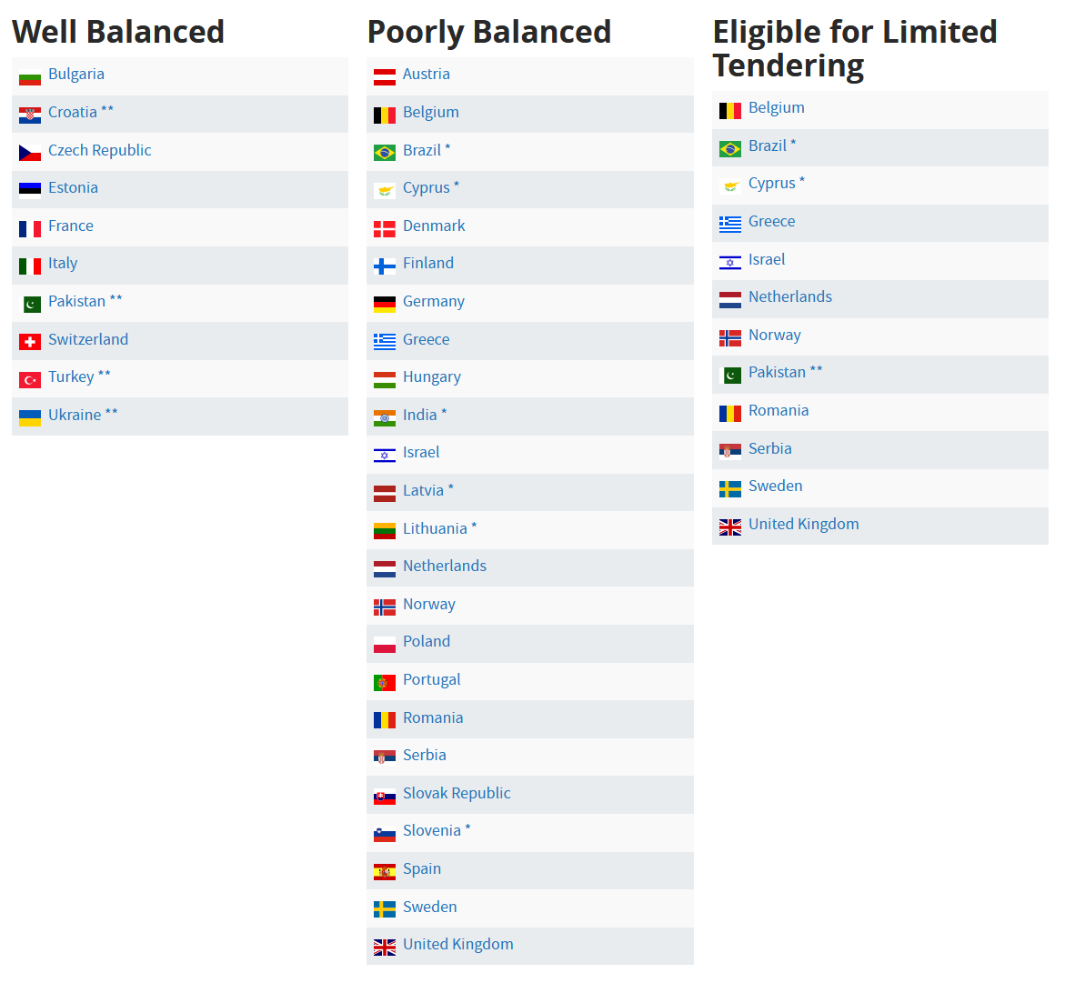
Industrial Returns for CERN Member States
Between 1 March 2025 and 28 February 2026
6 May 2025 – Floris Bonthond

Slide 39
Country of Origin of a bid
SUPPLIES
“Country(ies) where the supplies (including their components and sub-assemblies) are manufactured or undergo the last major transformation by the contractor or its sub-contractor(s)”
If at least 60% of the total amount of the bid comes from a poorly balanced MS, then the whole bid will be treated as that from a bidder in a poorly balanced MS
SERVICES
“Country in which the bidder is established”
If at least 40% of the total amount of the bid comes from a poorly balanced MS, then the whole bid will be treated as that from a bidder in a poorly balanced MS
6 May 2025 – Floris Bonthond

Slide 40
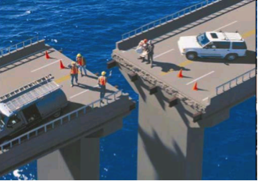
Alignment Rule*
Under certain conditions as defined in CERN’s Procurement Rules,
a bidder offering goods originating in poorly balanced Member States is allowed to align his price to that of the lowest bidder and thereby be awarded the contract
RULE
1
Supplies Contract only, adjudicated on
Lowest Compliant Basis
2
With a total amount exceeding
100’000 CHF
3
Price difference shall not exceed 20%
* Only applies to fully compliant bids
6 May 2025 – Floris Bonthond

Slide 41
Alignment rule (Scenario 1)
Lowest bid from a PB MS
Bid (CHF)
Contract
Well balanced MS
Poorly balanced MS
6 May 2025 – Floris Bonthond

Slide 42
Alignment rule (Scenario 2)
Lowest bid from a WB MS
  (a) 1st bidder from PB MS aligns
Bid (CHF)
<20%
Contract
Well balanced MS
Poorly balanced MS
6 May 2025 – Floris Bonthond

Slide 43
Alignment rule (Scenario 2)
Lowest bid from a WB MS
  (b) if not, 2nd lowest bidder from PB MS aligns
Bid (CHF)
<20%
Contract
Well balanced MS
Poorly balanced MS
6 May 2025 – Floris Bonthond

Slide 44
Alignment rule (Scenario 2)
Lowest bid from a WB MS
  (c) if no alignment of second two bids from PB MS, contract placed with lowest bidder from WB MS
Bid (CHF)
<20%
Contract
Well balanced MS
Poorly balanced MS
6 May 2025 – Floris Bonthond

Slide 45
Alignment rule with splitting (Scenario 3)
  Lowest bid from a PB MS and another bid from a PB MS within 20% of the lowest
  Bidder from PB MS aligns contracts placed with the 2 lowest bidders from PB MS
Bid (CHF)
<20%
Contract
Well balanced MS
Poorly balanced MS
6 May 2025 – Floris Bonthond

Slide 46
Alignment rule with splitting (Scenario 4)
  Lowest bid from a WB MS and two bids from PB MS within 20% of the lowest
  Both bidders from PB MS align contracts placed with both bidders from PB MS
Bid (CHF)
<20%
Contract
Well balanced MS
Poorly balanced MS
6 May 2025 – Floris Bonthond

Slide 47
Alignment rule with splitting (Scenario 5)
  Lowest bid from a WB MS and a bid from a PB MS within 20% of the lowest
  Lowest bidder from PB MS aligns contracts placed with the lowest bidder and the bidder from PB MS
Bid (CHF)
<20%
Contract
Well balanced MS
Poorly balanced MS
6 May 2025 – Floris Bonthond

Slide 48
Limited Tendering
Countries eligible for LT
Belgium
Brazil
Cyprus
Denmark
Greece
Israel
Netherlands
Norway
Pakistan
Romania
Serbia
Sweden
United Kingdom
«Limited tendering is foreseen by the CERN Procurement Rules to improve the industrial return of Poorly Balanced Member States»
Conditions
Twelve Member States with the lowest Industrial Return Coefficient for Supply Contracts
Used in case where there is sufficient competition
ILOs can ask to add firms, provided they are established in one of the eligible countries
Bids will only be considered where a minimum of 60% of their value originates in any combination of the twelve Member States communicated by CERN
6 May 2025 – Floris Bonthond

Slide 49

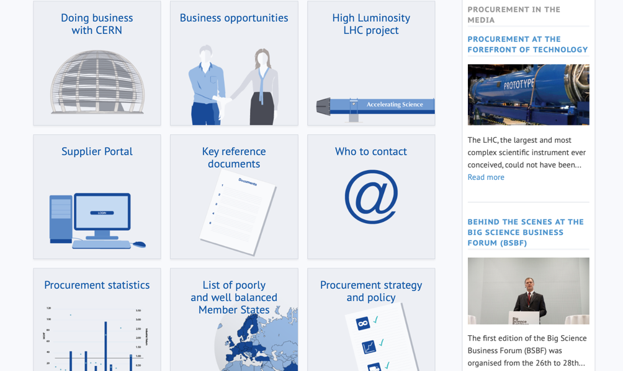
PROCUREMENT WEBSITE
6 May 2025 – Floris Bonthond

Slide 50
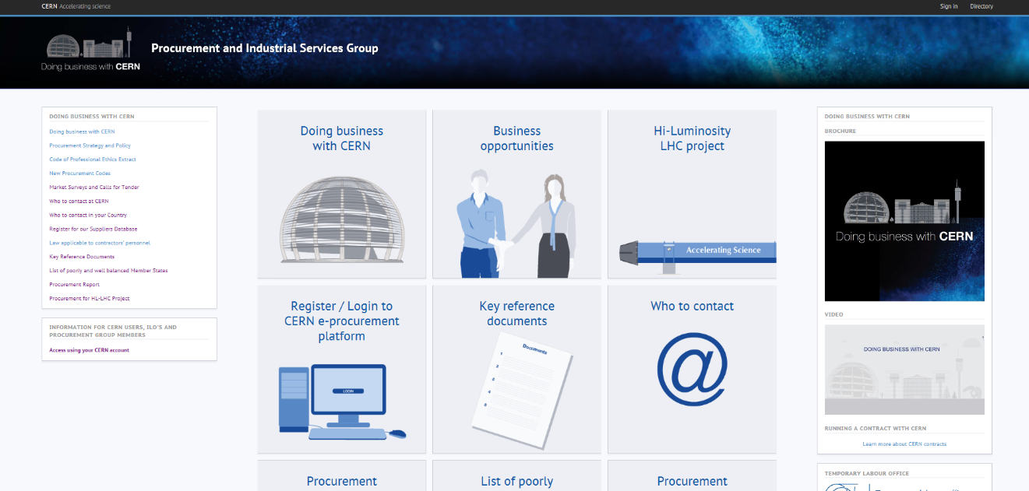
Procurement Website
http://procurement.web.cern.ch
6 May 2025 – Floris Bonthond

Slide 51
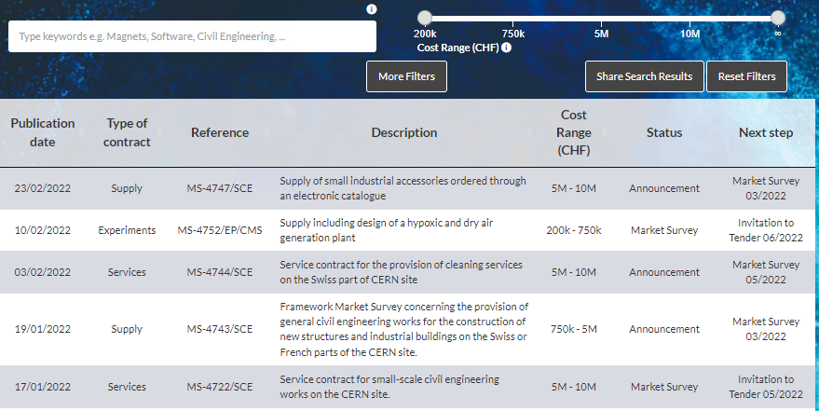
Business opportunities at CERN
https://forthcoming-ms.app.cern.ch/#!/
6 May 2025 – Floris Bonthond

Slide 52
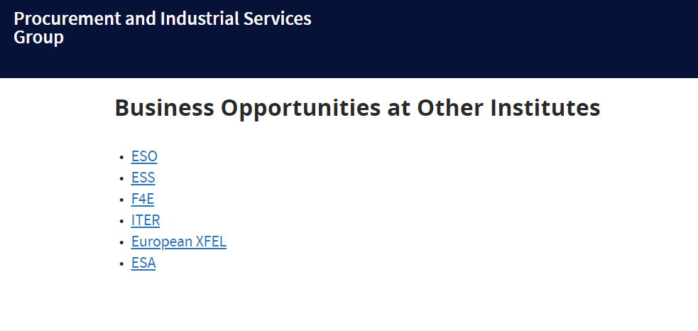
Opportunities at Other Institutes
https://procurement.web.cern.ch/home/business-opportunities-other-institutes
6 May 2025 – Floris Bonthond

Slide 53
Procurement Website
http://procurement.web.cern.ch
6 May 2025 – Floris Bonthond

Slide 54
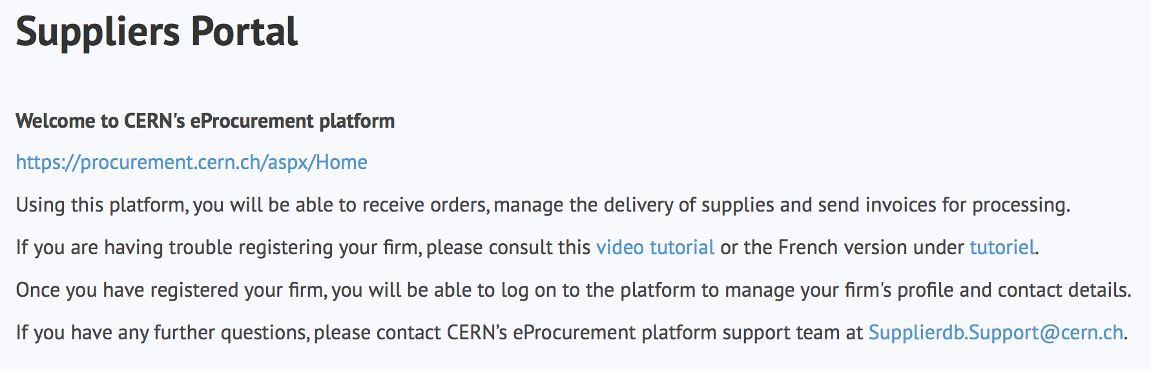
Register in the Suppliers Portal
For all exchanges with CERN, to:
Be visible for future opportunities
(with the procurement codes you have indicated)
Receive and follow-up orders
Send invoices
MANDATORY
6 May 2025 – Floris Bonthond

Slide 55
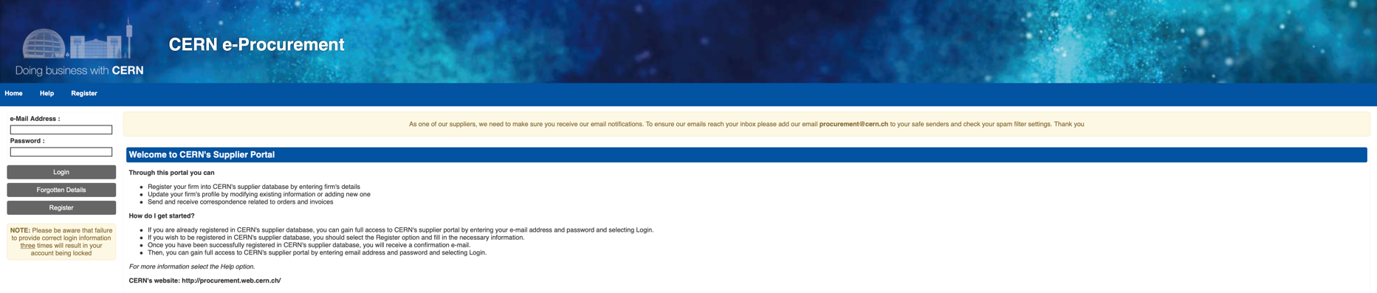
CERN e-Procurement
To ensure our emails reach your inbox, please add our email procurement@cern.ch to your safe senders and check your spam filter settings
6 May 2025 – Floris Bonthond

Slide 56
Procurement Website
http://procurement.web.cern.ch
6 May 2025 – Floris Bonthond

Slide 57
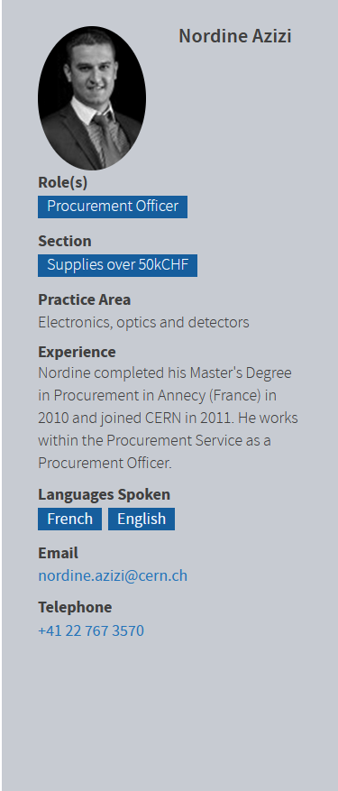

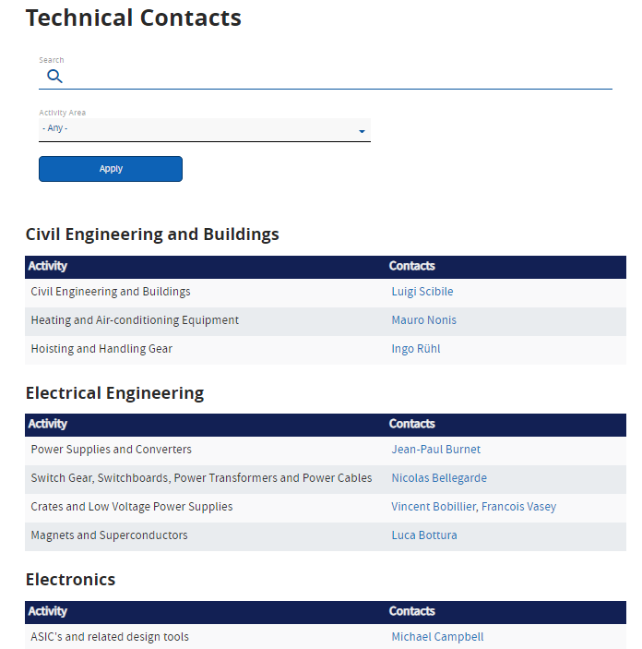
Contacts at CERN
Procurement Officers
Technical Officers
6 May 2025 – Floris Bonthond

Slide 58
Contacts in your country
ILO: Industrial Liaison Officer
ILOs are appointed by CERN's Member States to facilitate the flow of communication between CERN and its suppliers. ILOs can provide advice on the opportunities available for doing business with CERN and the support available to firms in their local regions
ILOs are essential to:
Increase competition in bidding
Balance Industrial Return
Raise awareness
Transmit information to potential suppliers
Advise CERN about potential suppliers
Support contractors & suppliers on any general technical, organisational and procedural aspects of CERN
Promote registration in suppliers DB
Encourage long-term participation of industry in CERN’s mission
6 May 2025 – Floris Bonthond

Slide 59

Impact of
Doing business with CERN
6 May 2025 – Floris Bonthond

Slide 60
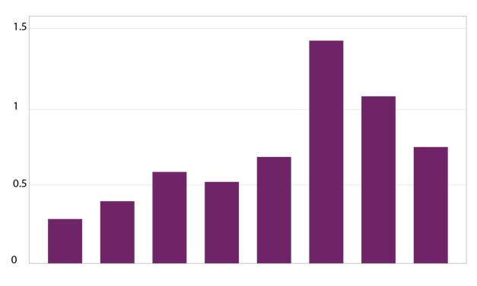
The economical impact of CERN Procurement on supplier’s performance (Castelnovo et al, 2018)
Empirical studies (by the analysis of financial data from 1995 to 2008 from 365 CERN suppliers for the LHC) show that after working with CERN on high-tech contracts, CERN suppliers
out-performed their peers by:
Investing more in R&D and filing more patents
Higher productivity, revenue and profitability
Order/contract received from CERN
Increase in R&D
Innovation
Productivity growth
increase revenues & profitability
Patents per firm
More than
2 years before
2-1 years before
Date of order
1,2 years later
3,4 years later
5,6 years later
7,8 years later
More than
8 years later
6 May 2025 – Floris Bonthond
Notes:
Average number of patents filed before and after the beginning of the procurement relationship with CERN
The X-axis shows the «relative years», that are the difference between a given year and the year the first order is received. Therefore, CERN(0) is, for each company, the year of beginning of the procurement relationship.

Slide 61
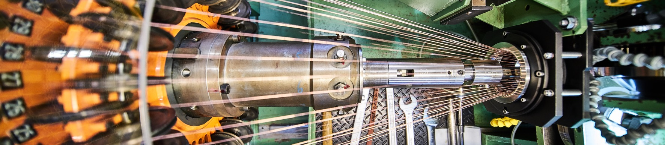
Doing business with CERN: the facts
Supplier Survey (500+ respondents in 34 countries, 2024)
4.53/5
average rating
98%
of suppliers would recommend CERN as a client
1 out of 4
hired new personnel
71%
had positive impact on their sales
63%
used CERN as a marketing reference
66%
improved products or services
47%
developed new products
70%
improved technical knowledge in their field
52%
found or opened a new market to address
6 May 2025 – Floris Bonthond
Notes:
The key message here is that CERN is an open institution: open to its neighbours, and open to citizens from across the globe. We welcome them to CERN and go out to meet them
This slides summarises the outreach activities carried out by CERN.
It also includes a mention of CERN’s fundraising activities, for projects that are not part of CERN’s core activity. These fall into three categories: education & outreach, culture and creativity, innovation and knowledge exchange

Slide 62
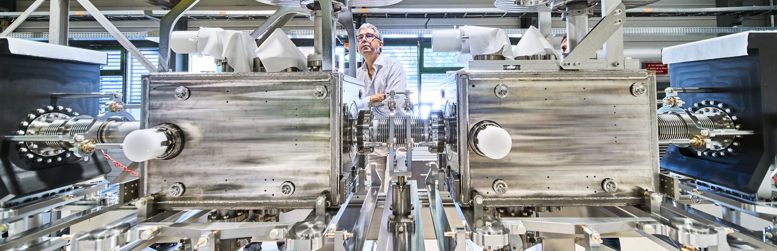
Doing business with CERN: the facts
Using CERN as a marketing reference* improves the supplier’s reputation
* Conditions apply
6 May 2025 – Floris Bonthond

Slide 63
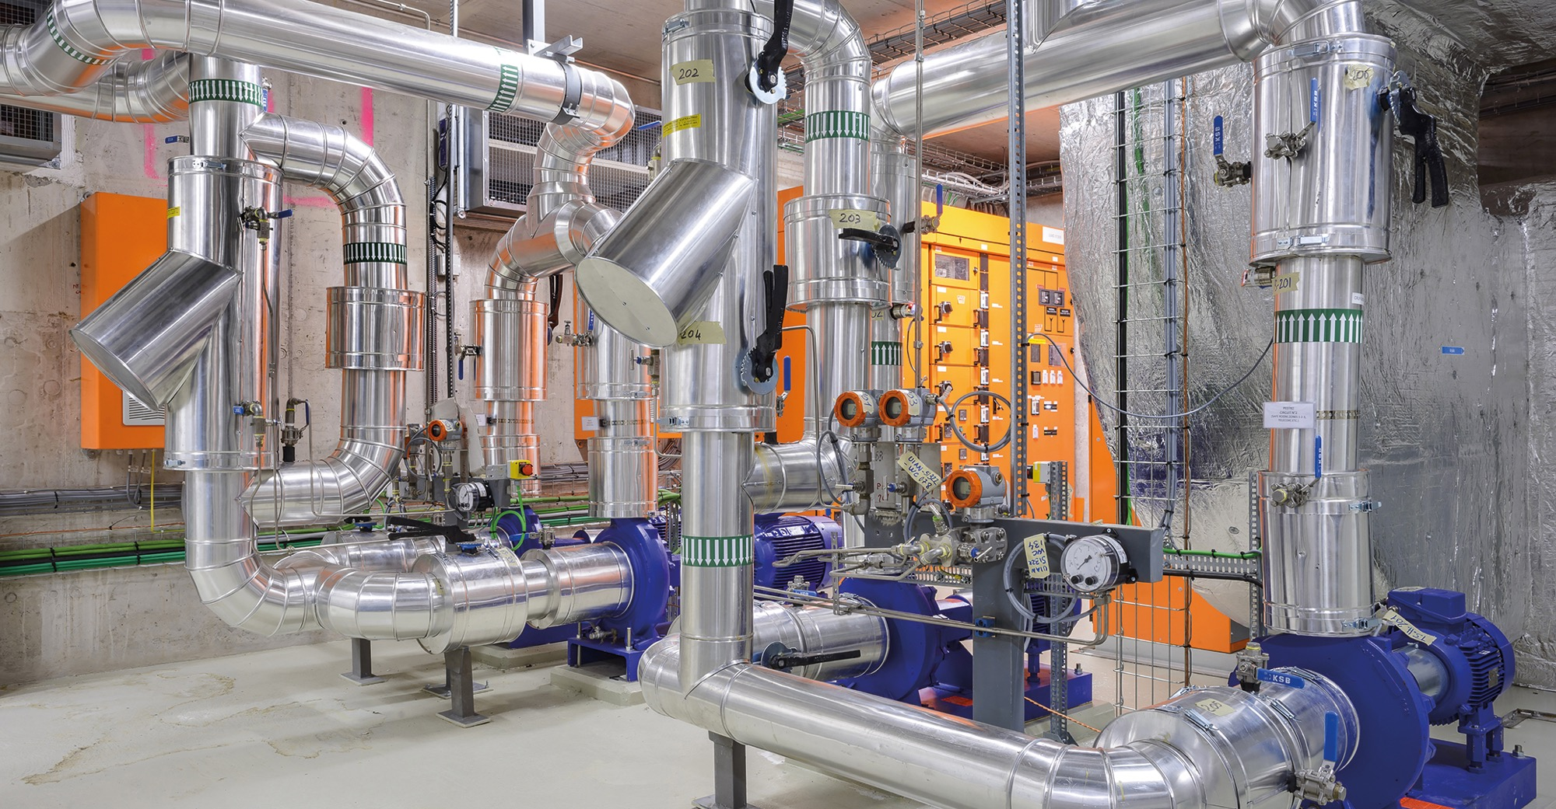
Social
Cost-Benefit Analysis (CBA) calculated by the University of Milan
“Each CHF invested in
HL-LHC project pays back approximately 1.8 CHF on societal benefits, including scientific, economic and cultural value (development of innovative technologies, industrial spillovers, skills acquired by students, etc.).”
6 May 2025 – Floris Bonthond

Slide 64
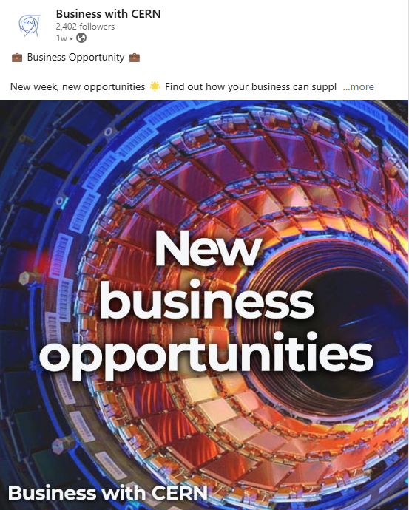
Follow us on LinkedIn
6 May 2025 – Floris Bonthond

Slide 65

Thank you
Thank you

