Slide 1
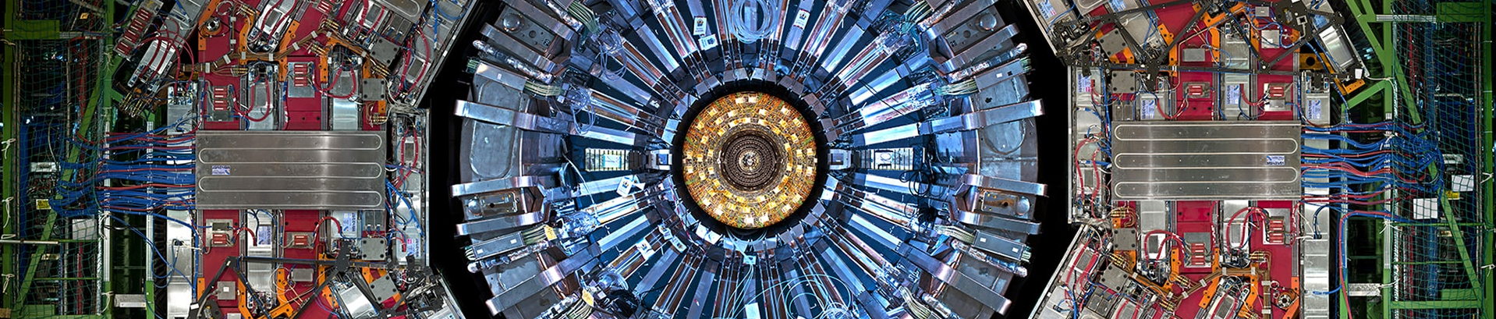


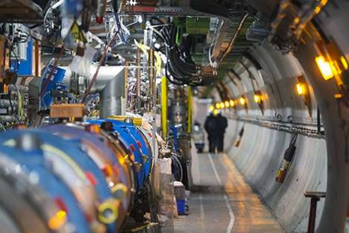
Unbinned measurements with refinable systematics
Lisa Benato, Cristina Giordano, Claudius Krause, Ang Li, Robert Schöfbeck, Dennis Schwarz, Maryam Shooshtari, Daohan Wang HEPHY Vienna, May 19th, 2025

Slide 2
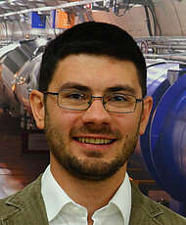


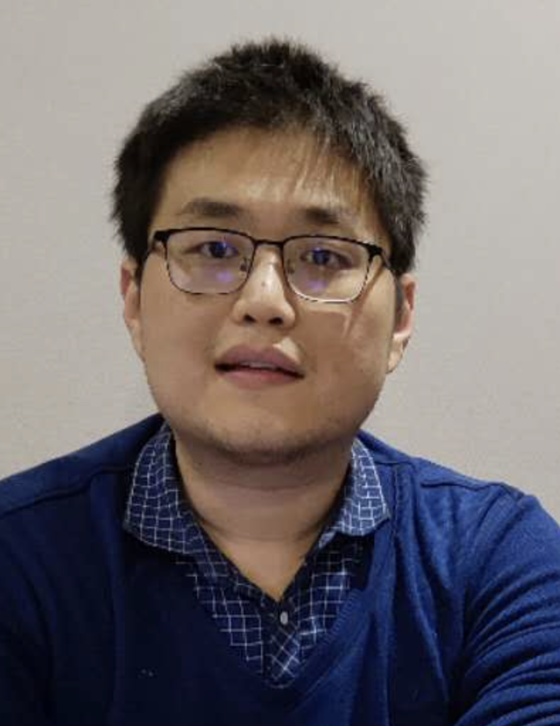

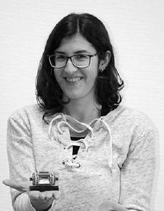
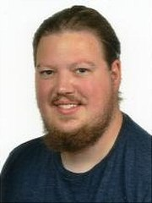

Who we are & where we come from
Joint venture of the [CMS Data Analysis] group & [Machine learning] group @ HEPHY (Vienna)
”You should use that unbinned method for this new challenge … ”
” … ”
ML
CMS
CMS
Two open
Postdoc positions:
[link1] [link2]
ML
CMS
CMS
CMS
CMS

Slide 3
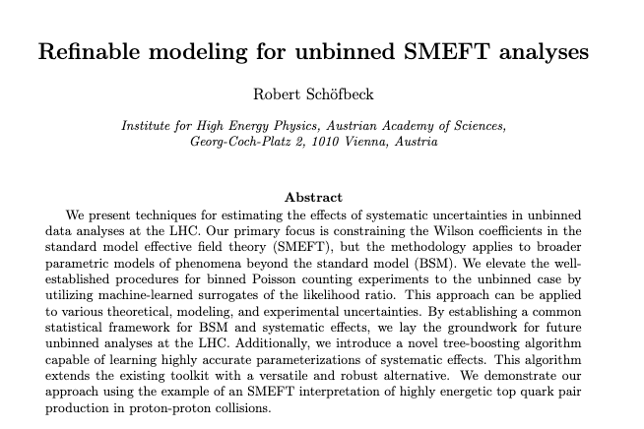
Starting point
``Refinable modeling for unbinned SMEFT analyses``
[RS, MLST 6 015007 (2025)]
    Statistical footing of “systematics recipes”
    Recepies for stage-wise unbinned model building
    Dissect the effect of (groups of) systematics & POIs
    Machine-learn the components
    (Not used for the challenge): SMEFT specification;
    Parametric Tree Algorithm
Our strategy for FAIR-HUC
  Divide & Conquer: go piece by piece
    Build all known dependencies into the profiled test statistic
    Arbitrarily accurate models for systematics
”Domain experts” using/developing ML tools
  HEPHY was strongly involved in H→𝝉𝝉 observation in CMS
  Preprint on Challenge: [ 2505.05544 ]
[Mach. Learn. Sci. Technol. 6 015007 (2025)]

Slide 4
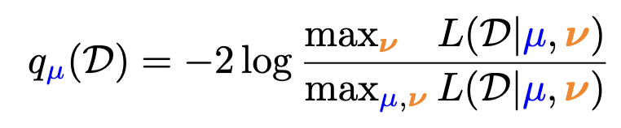
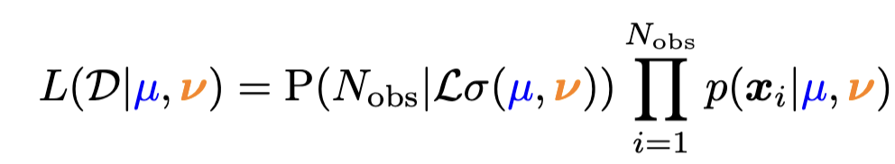
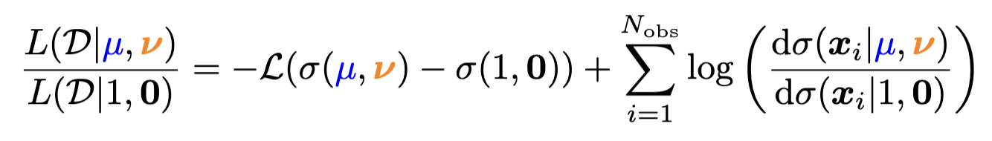

Test statistic
Profile log-likelihood test statistic
Extended likelihood (for one selection)
  … and its (log-) ratio
  Need to evaluate the differential cross section ratio (DCR) and the inclusive cross section
  for new observed data ( 𝓓 ) and as a function of the model parameters.
    (μ, 𝜈) = (1,0) is the “nominal” parameter point

Slide 5
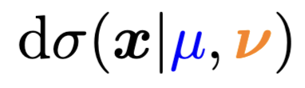

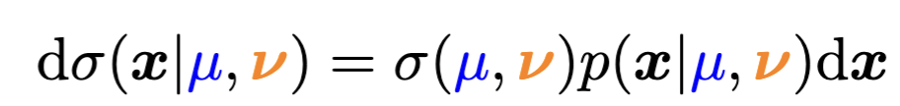
Modeling across the fields
Mathematical statistics: dσ(x| μ,𝛎)
A measure on a probability space
  Random variable x takes values
  in a “set” (continous / discrete parts)
  dσ maps unions and intersactions of subsets of this space (σ-field) to ℝ
  Here: Continous variables + overflows
  DCR = Radon-Nikodym derivative
Technically relevant for overflow bins,
Fisher information, etc.
  And when you ask yourself “can I do this?”
What is ?
Physics: dσ(x| μ,𝛎)/dx
Unbinned differential cross section
(detector-level, fiducial, total)
Access to dσ(x| μ,𝛎) via expensive sampling
Machine-learning: dσ(x| μ,𝛎) defines a pdf
  The inclusive model is not particularly useful.
μ … POI ∊ ℝ
𝛎 … nuisance parameters ∊ ℝ^{M}
x … observation (1 event)

Slide 6


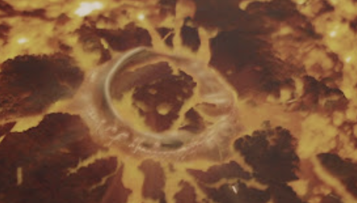

What to do with
dσ(x| μ,𝛎) encodes the
field’s knowledge about how
phenomena depend on model
parameters.
  Extract from the bottom of a river (of wikis)
Wield its power to our advantage:
Expand dσ(x| μ,𝛎) into sub-processes
and encode analytic dependencies,
as if you had the power to evaluate
  Can’t keep it, though.
Get rid of dσ(x| μ,𝛎)
by forming ratios, which we do evaluate
with ML surrogates

Slide 7
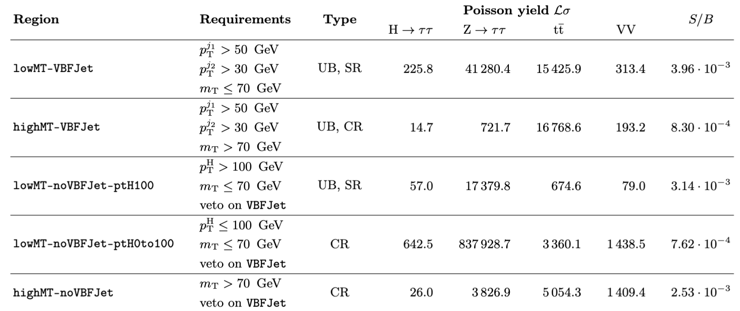
analysis regions
FAIR-HUC Challenge: H→𝝉𝝉 inclusive cross section measurement in 𝝉_{lep}𝝉_{had} channel
  Overwhelming backgrounds: Z →𝝉𝝉, top quark pairs, diboson (VV), [no fakes, non-prompt]
We split into five regions: two signal regions and three control regions
  lowMT-VBFJet vector boson fusion (VBF) with about 90% of sensitivity
  lowMT-noVBFJet-ptH100 ggH (no label for production mode)
Main SR for VBF (90% sensitivity)
Unbinned CR
SR for ggH
90% of data → One bin for bkg norm
Split off tt and VV CR (2 bins)

Slide 8
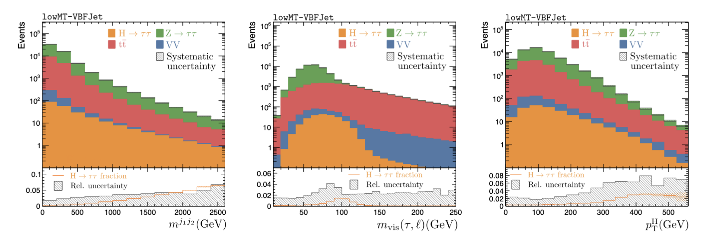
Challenge data set
28 features but no silver bullet
  NB: We re-reconstructed a variant of m_{𝝉𝝉}^{MMC} but it didn’t help
  Tight constraints on systematics are needed
    Three “normalization-type” effects: 0.1% bkg (on everything), 2% ttbar, and 25% diboson(VV)
    Three “calibration-type” effects: jes, tes, met. Those modify x
  7 paramaters: 1 POI μ, 6 nuisances 𝜈 and a subset 𝜈_{calib} that refers to jes, tes, met
Good design!
Doable - but challenging

Slide 9
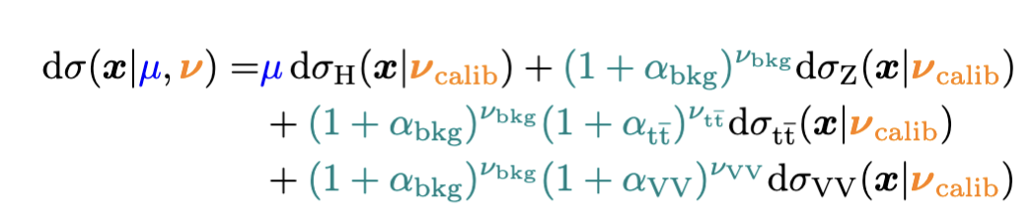
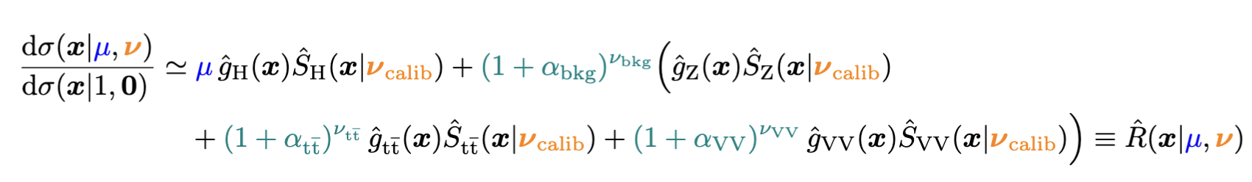
There and back again …
Additive expansion with analytic dependence for normalization uncertainties
Relate to reference model and factorize the calibration-type systematics
Repeat for Z, tt, VV & put it together:
NB1: Still avalid measure
NB2: The additive ansatz
facilitates to refinable modeling.
Form ratio wrt total
nominal (a choice)
model systematics per-process
(another choice)
ML surrogate
for systematics
Likelihood-ratio
trick
DCR =
= surrogate

Slide 10

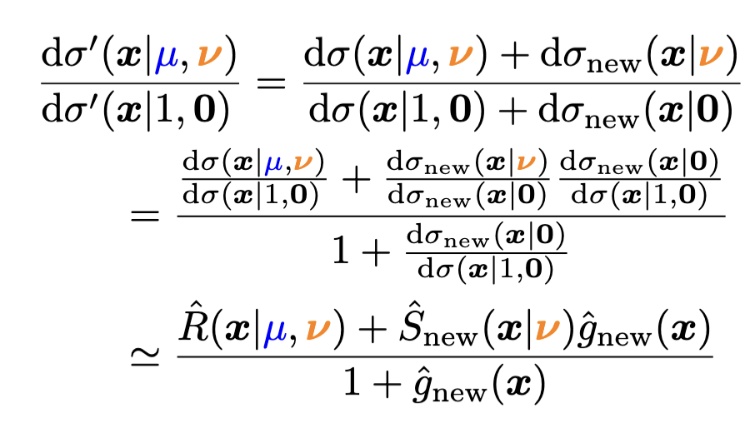
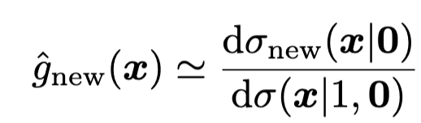
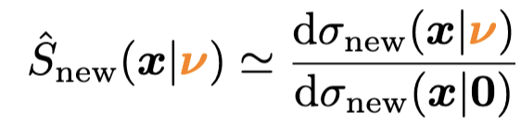
Refining the model
Why build the model this way? Because we’ll never be quite done.
Add a new background
These steps can be iterated and combined. No element of the partial model is invalidated
One new piece is needed:
Learn with likelihood-ratio trick
One more piece is needed:

Slide 11
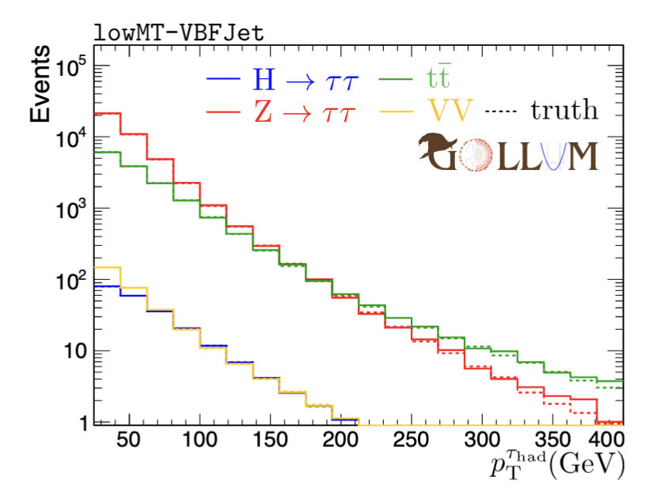
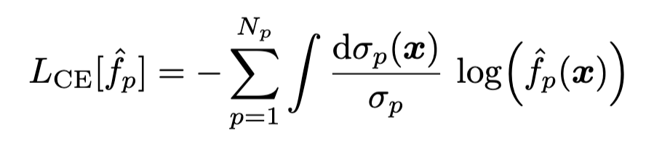
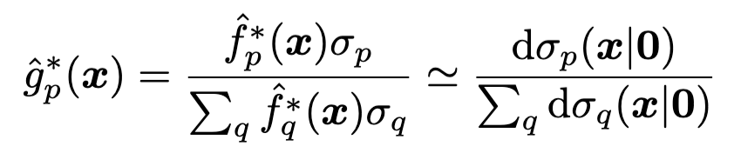
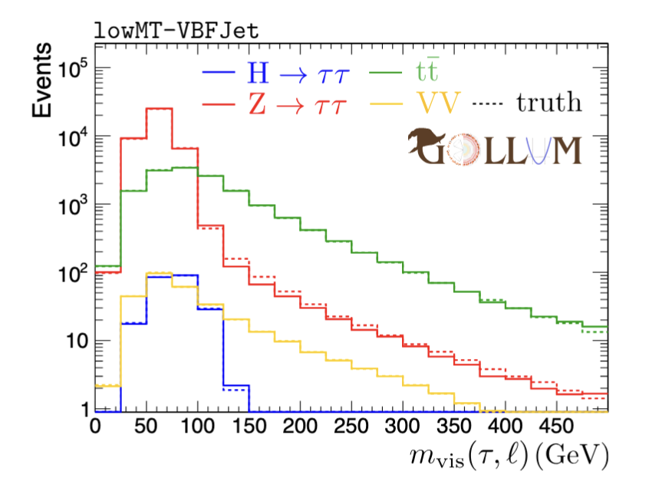
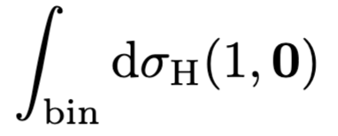
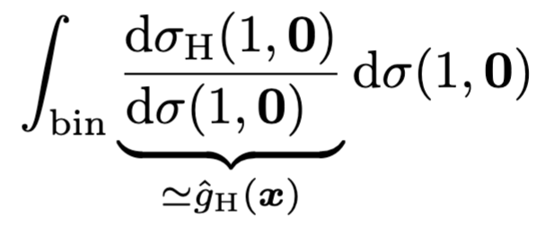
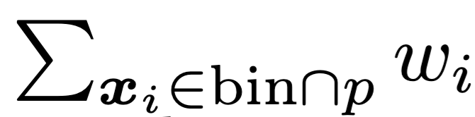
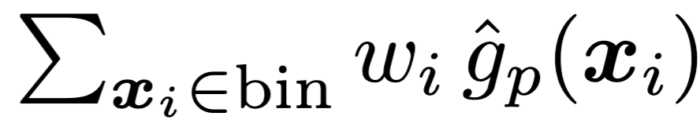
multiClassifier training
Multiclassifier output is proportional to the class probability
Here, we use “probability weighting” that we convert to
cross-section weighting as
Tensorflow NN with 28/128/128/4
  Softmax output; Adam opt., moderate L1/L2 reg.
Each bin compares with
or, empirically, with

Slide 12
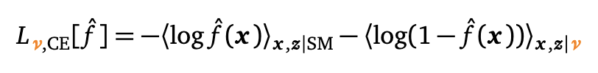
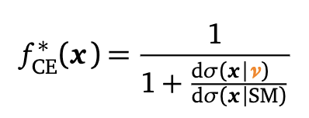
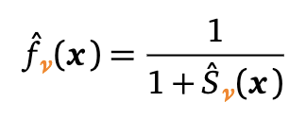

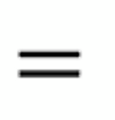
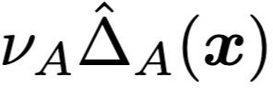
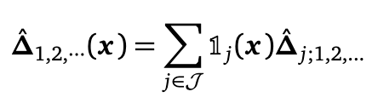
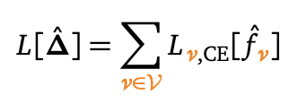
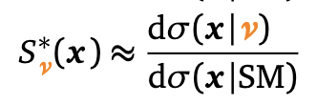

learning parameterizations (Generic)
“Likelihood ratio trick”
Parametric ansatz:
Implement coefficient functions Δ(x) as NNs or trees:
Sum over more data sets than independent. :
enough to learn
non-parametric DCR

Slide 13
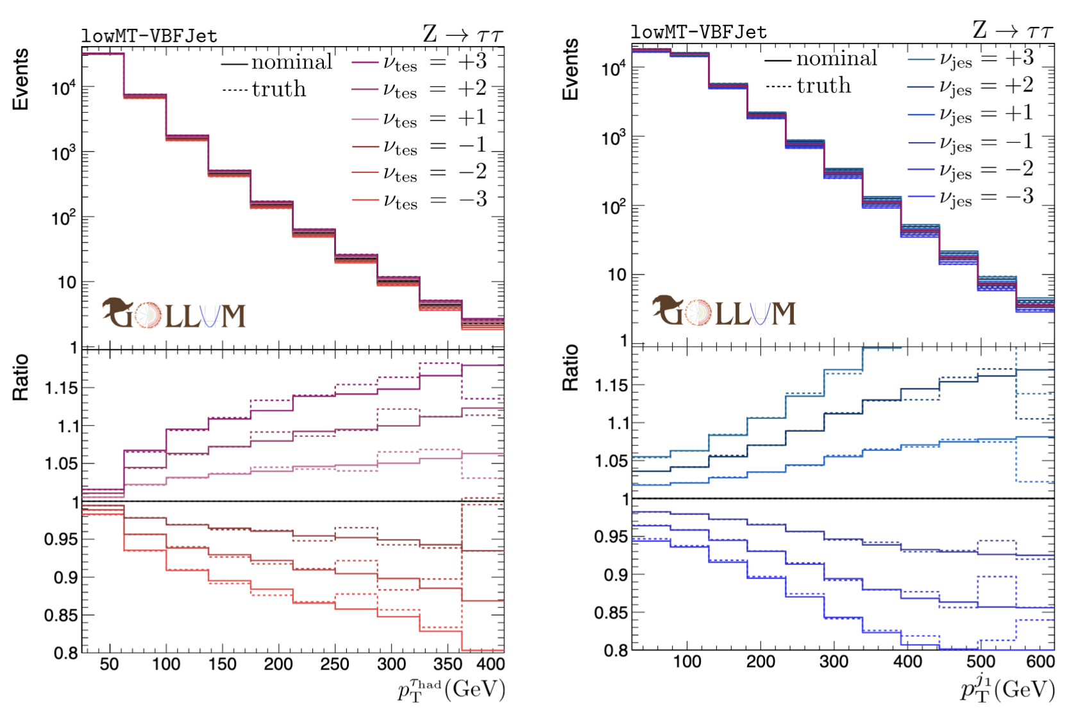
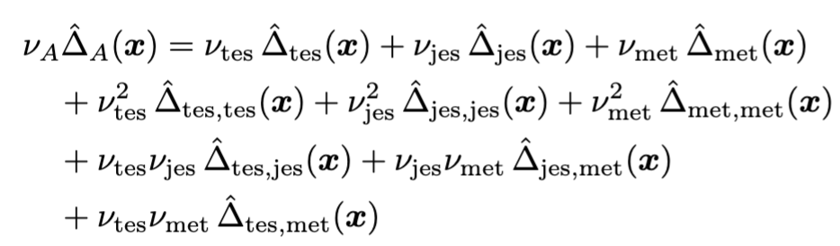
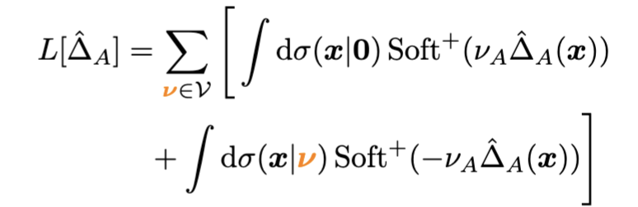
Example systematics
Per region, train up to
(log-) quadratic order
The CE loss can be written as
Tensorflow; 28/256/256/9; Adam
Training data: All systematic
samples with |𝜈_{jes}|+ |𝜈_{jes}|+ |𝜈_{met}| ≤ 2

Slide 14
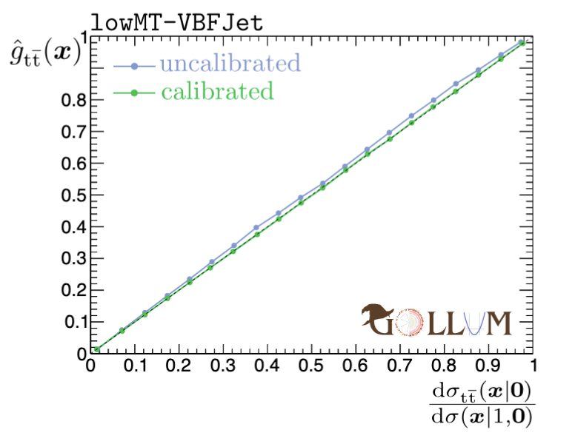
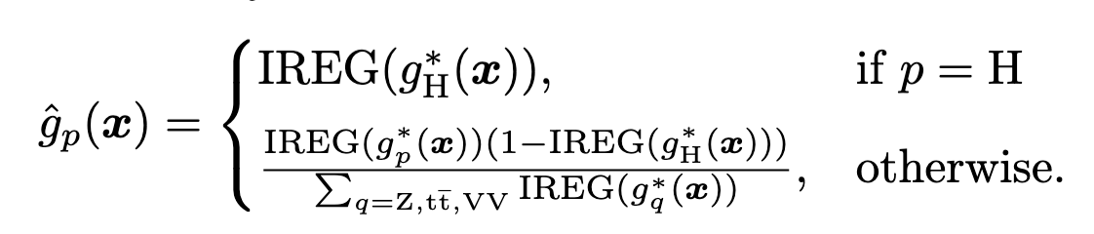
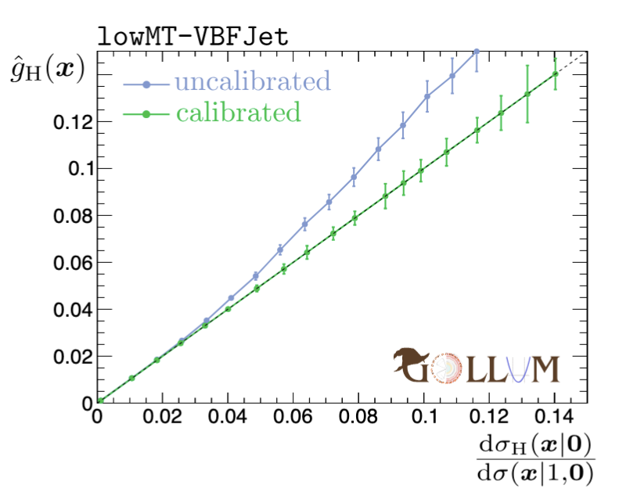
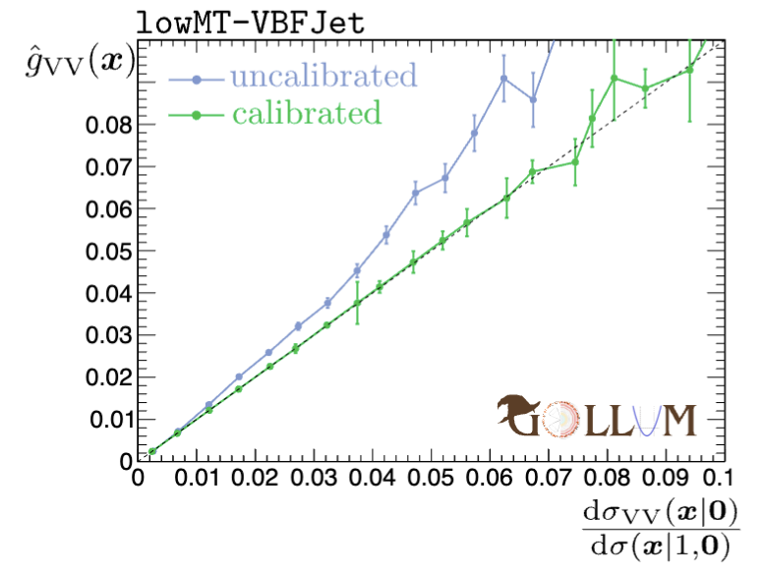
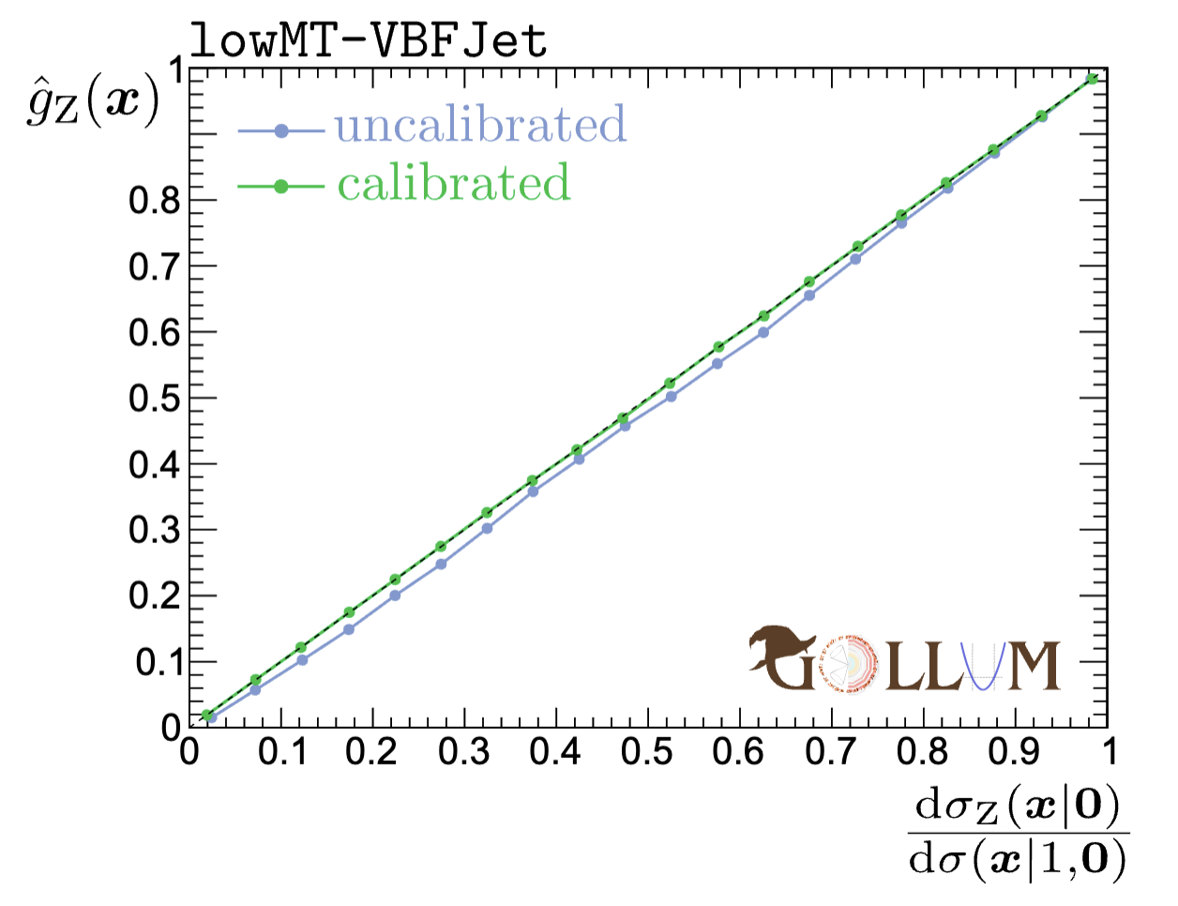
Calibration
And then, it fails! Problem: Multiclassifer is not well calibrated
Events in the bin 0.19<g_{Z}(x)<0.21 need to ~20% fraction of Z
  g_{H} is off by ~7%, g_{Z} is off by a -2% (x10-x100!) → drastic impact
Staged isotonic regression provides excellent calibration

Slide 15
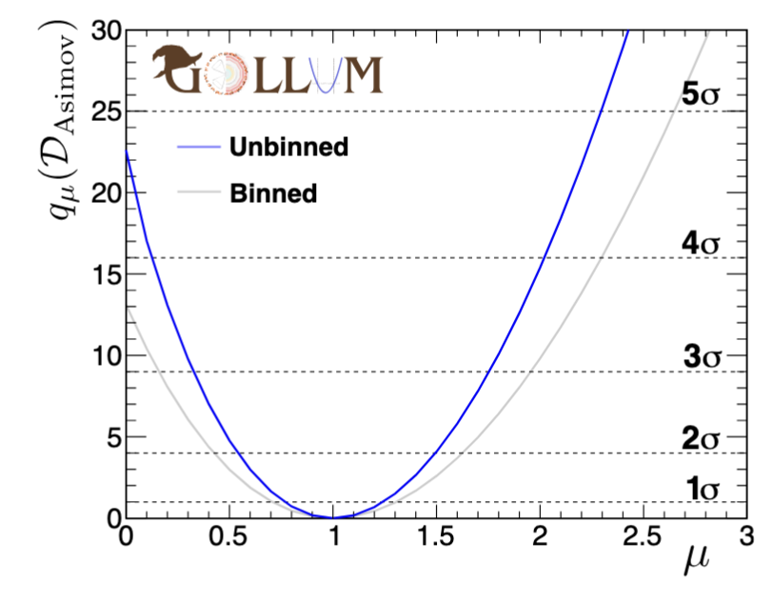
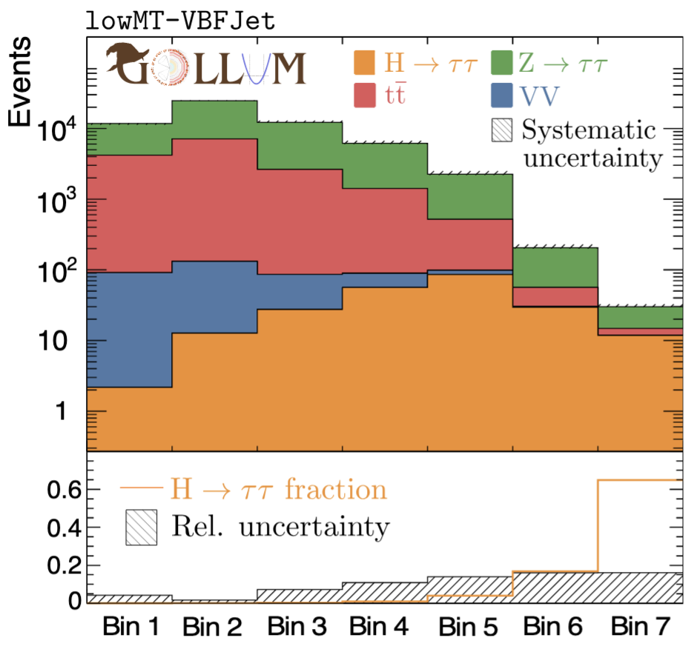
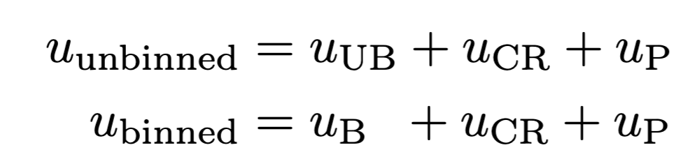
Asimov results
Add likelihood from:
  unbinned (UB, 3 regions), control regions (CR), penalties (P)
Define a binned reference
Bin in signal node of multiclassifier
Results rather stable wrt
the details of the binning

Slide 16
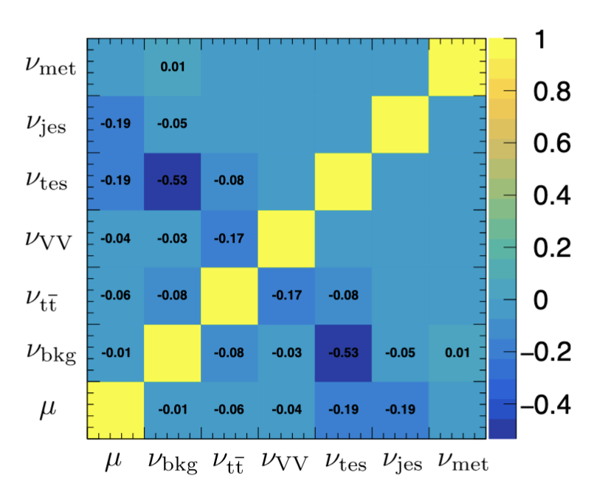
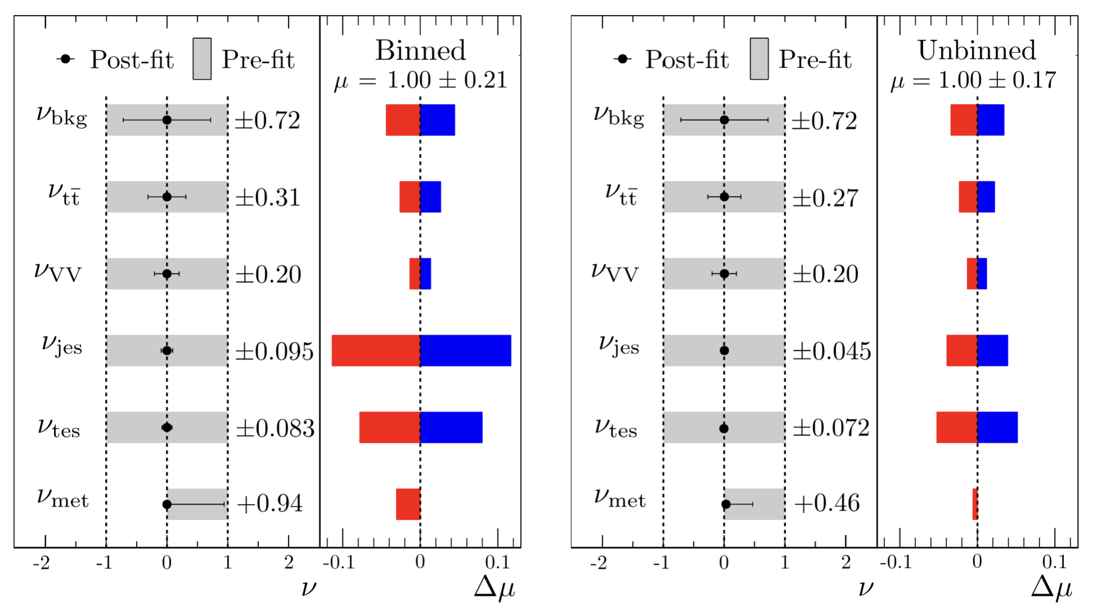
Impacts
Post-fit, the measurement is statistically dominated.
Post-fit impacts are below ~5%!

Slide 17
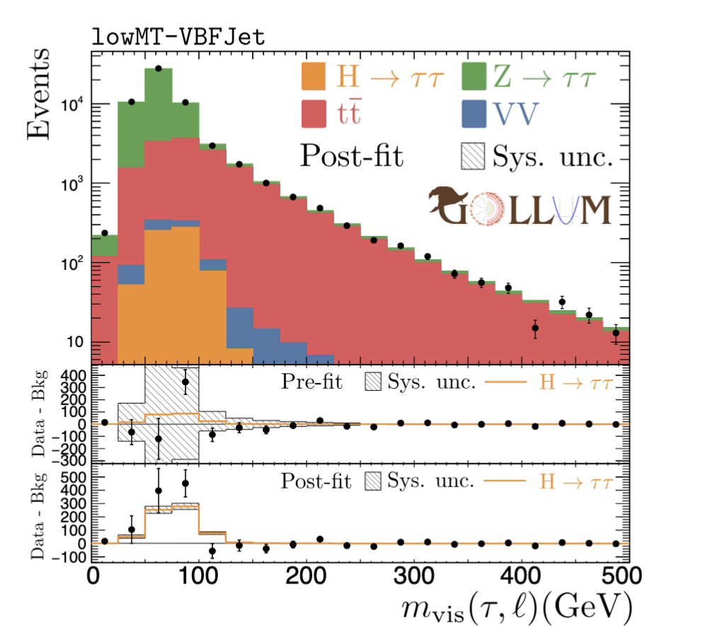


Postfit distributions
μ ^{true} = 3, μ^{MLE} = 3.24

Slide 18


Toy studies
50k toys, sampling the distribution from the challenge paper

Slide 19

Interval size and coverage
Interval size grows with μ_{true}. Coverage is excellent.
Note to the organizers: Our submitted model fits the MLE but does not re-minimize the nuisances when scanning to find the interval boundaries. This solves the timing problem that appears only at the remote cluster [see email]. The simplification causes a flat deficiency of 4.5% in the interval width which we calibrated by inflating the interval. Apparently, this inflation factor is slightly imperfect, hence our imperfect coverage in the last submitted model. Results in the plots are fully profiled.

Slide 20

What did we learn?
This was a great challenge!
  Doable but challenging & realistic
Lessons learned:
  Calibrated classifiers are key; otherwise,
  ML part was straightforward
  Numerics! Instead of multiplying exp,
  must accumulate logs
  Numerics! Likeihood ratios have dramatic
  cancellations away from the minimum;
  6-7 digits must be accurately modeled
  Numerics! The constant piece in the extended likelihood, ℒσ (μ𝜈), is CPU intensive and demanding
We’re now more ready than we were before thanks to your efforts ☺
today

