Slide 1
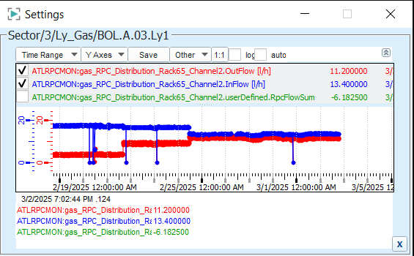
Leaky lines check
1 potential trigger hole BOL5A03.CO. DZ2 was before, extra valve was installed by Enrico ?

Slide 2
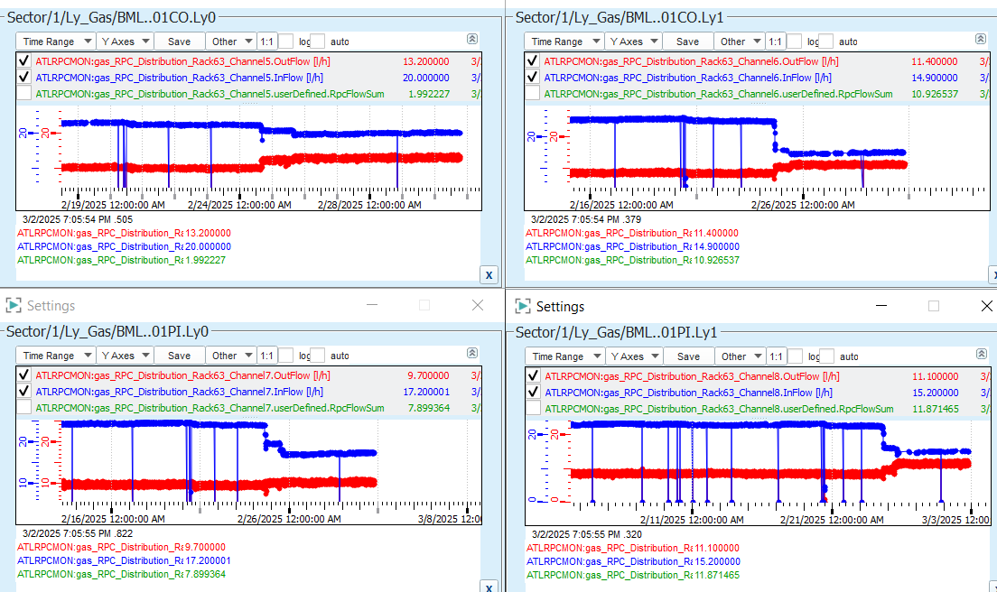
Leaky lines check
4 potential trigger holes

Slide 3
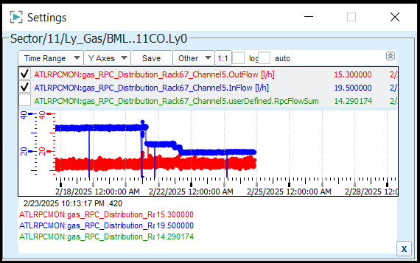
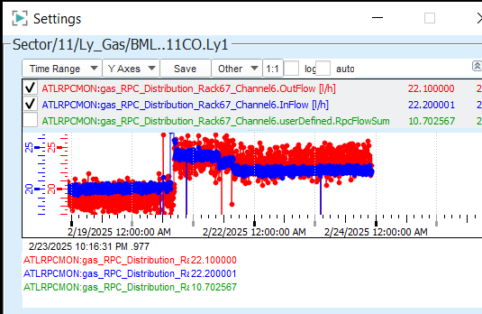
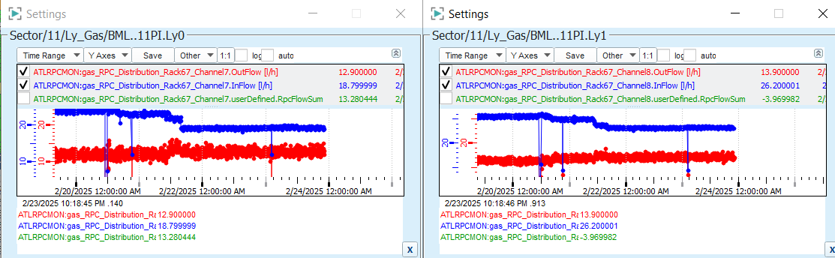
Leaky lines check BM-11 25.02.2025
6 potential trigger holes

Slide 4
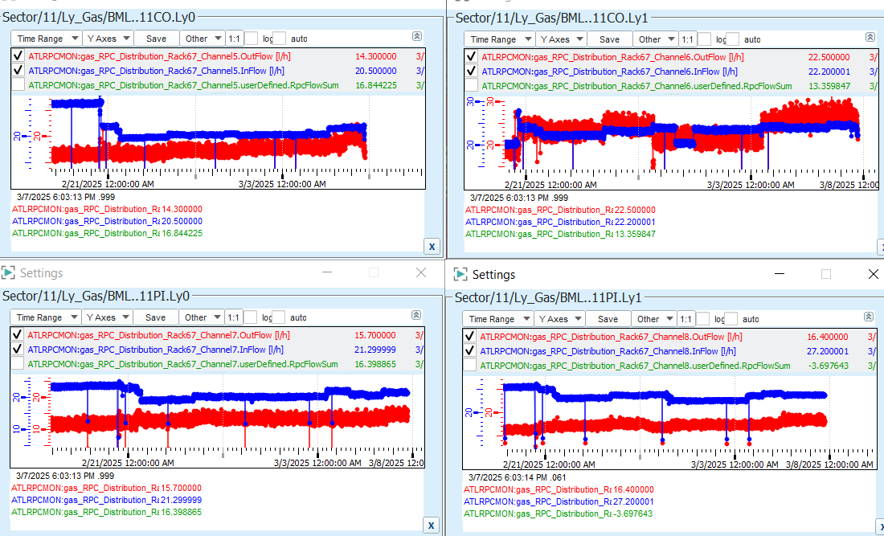
Leaky lines check BM-11 07.03.2025
0 potential trigger holes

Slide 5
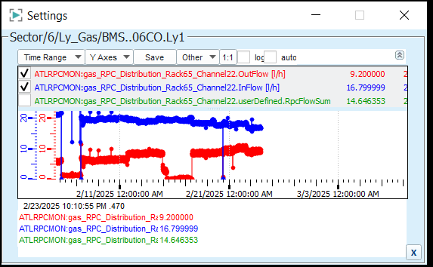
Leaky lines check
1 potential trigger hole

Slide 6
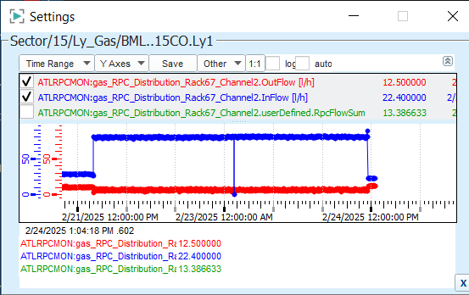
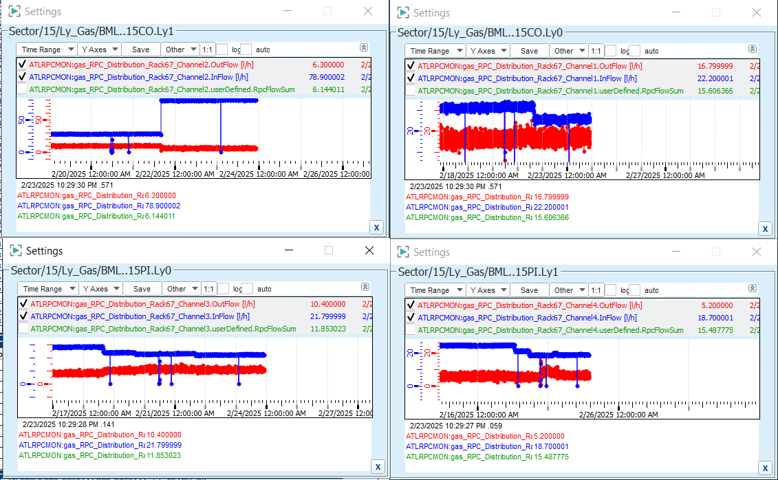
Leaky lines check
X potential trigger holes

