Slide 1



ATLAS RPC
FOAM TECHNIQUE STUDIES
Weekly Report
presenter: Ahmet Renklİoğlu
On behalf of atlas rpc FOAM team
10.03.2025

Slide 2
GENERAL STATUS
LAST WEEK REPORT
The number of teams working in the Cavern last week:
3
Total CLAYING
Total INJECTION
325
289
The total number of 'Clay’
last week:
  72
Plan for this week
The total number of Injection
last week:
91
The number of teams working in the Cavern this week:
3
In which sectors did the Foam Teams work last week?
The total number of 'Clay’
this week:
75
BOF.12.PI
BOF.14.PI
BOS.06.CO
The total number of Injection
this week:
90
In which sectors will the Foam Teams work this week?
BOS.04.CO*
BML.11.CO*
BML.15.CO*
BML.C.07.CO
BMS.06.PI
10.03.2025
*The sectors in which we have worked in the past YETS.
Relatively easier sectors.

Slide 3
General status week by week
10.03.2025

Slide 4
Status of earlıer ınjectıon
Results and Analysis of Gas Tests
Detailed Inspection Results: (16 Dec. – 19 Dec.)
Total No. Of
4 Corners Repaired Layers | 161
Application Failures (Excluded) | 12
Valid Layers for Statistics | 149
Still OK Layers | 136
New Big Leaks | 3
New Small Leaks | 10
The chambers that have New Big Leaks (3) and New Small Leaks (10) are examined in detail.
Status of Small Leaks | 10
Fully Filled but the leak is still there | 2
Need 2nd Injection | 5
No leak found on corners | 2
Bad Foam | 1
Status of Big Leaks | 3
Fully Filled but the leak is still there | 1
2nd Injection can be done. But high leak! | 1
No Leak Found with Sniffer at the corners | 1
ERROR
2.68%
In total, there are 4 leaky layers out of 149.
1 of them can be recovered by 2nd Injection.
So, the real error is 3 out 149 which corresponds ~2%.
10.03.2025

Slide 5
Weekly Report
Thank You
ATLAS RPC Gas Repair Meeting
10.03.2025

Slide 6
BACKUPS
ATLAS RPC Gas Repair Meeting
10.03.2025

Slide 7
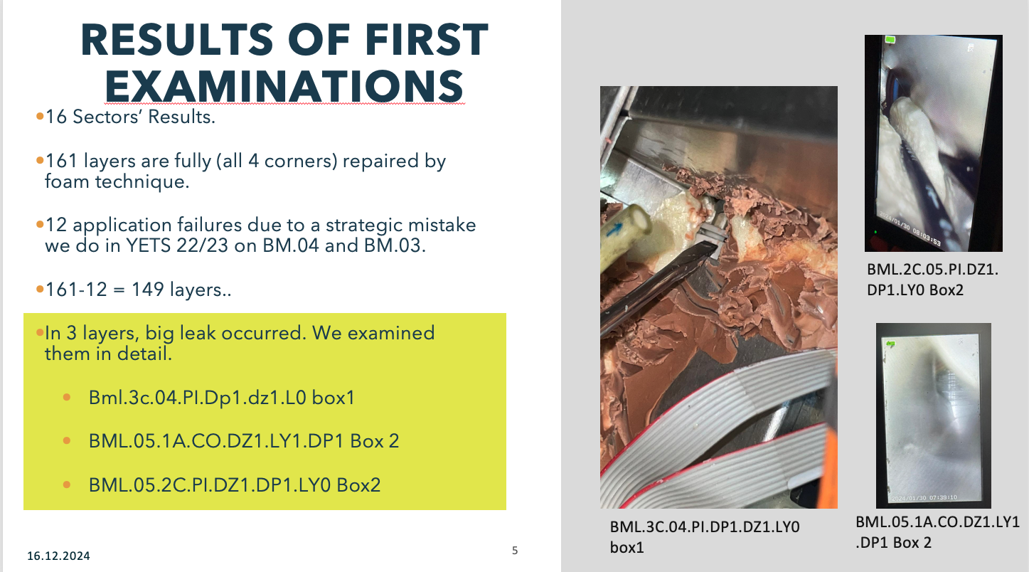
BM.05.PI
A SLIDE FROM 16.12.2024
BML.2A.05.PI.DZ1 – 4 CORNERS - INJECTION-NO LEAK ACCORDING TO GAS TEST.
  BML.2A.05.PI.DZ2 – ONLY CLAYING, NO INJECTION.
BML.3A.05.PI - – ONLY CLAYING, NO INJECTION.
BML.2C.05.PI.DZ1 – 4 CORNERS – INJECTION - LY1 HAS BIG LEAK! NO LEAK FOUND AT THE CORNERS WITH SNIFFER INVESTIGATION.
BML.3C.05.PI – NO INJECTION, ONLY CLAY.
BML.5C.05.PI – NO INJECTION, ONLY CLAY.
A PART from DETAILED GAS TEST REPORTS we developed in December.
BML.05.2C.PI.DZ1.LY0 | 100 | DP1 | F | F
BML.05.2C.PI.DZ1.LY1 | 0.23 | DP2 | F | F
BML.05.2C.PI.DZ2.LY0 | 1.15 | DP1 | C | C
BML.05.2C.PI.DZ2.LY1 | 100 | DP2 | C | C
BML.05.3C.PI.DZ1.LY0 | 0.09 | DP1 | C | C
BML.05.3C.PI.DZ1.LY1 | 100 | DP2 | C | C
BML.05.3C.PI.DZ2.LY0 | X | DP1 | H | NB,H
BML.05.3C.PI.DZ2.LY1 | X | DP2 | NB | NB
BML.05.2A.PI.DZ1.LY0 | 0.05 | DP1 | F | F
BML.05.2A.PI.DZ1.LY1 | 0.05 | DP2 | F | F
BML.05.2A.PI.DZ2.LY0 | 1 | DP1 | C | C
BML.05.2A.PI.DZ2.LY1 | 100 | DP2 | C | C
BML.05.3A.PI.DZ1.LY0 | 100 | DP1 | NB | H
BML.05.3A.PI.DZ1.LY1 | 1 | DP2 | E | IM
BML.05.3A.PI.DZ2.LY0 | 0.5 | DP1 | H | NB,E
BML.05.3A.PI.DZ2.LY1 | 100 | DP2 | IM | H
BML.05.5C.PI.DZ1.LY0 | 0.01 | DP1 | C | C
BML.05.5C.PI.DZ1.LY1 | 1.22 | DP2 | C | C

Slide 8
YETS 24/25 Foam Technıque gas tests
LAST WEEK: +8
STATUS: 19/17
are completed
Gas Tests
  17 Sectors will be tested. Each team can test 1-2 sectors per day.
    BM.04.PI
    BM.05.CO
    BM.05.PI
    BM.06.PI
    BM.03.CO
    BM.07.CO
    BM.09.CO
    BM.11.CO
    BM.15.CO
    BM.14.CO
    BM.12.CO
    BM.14.PI
    BM.12.PI
    BM.13.CO
    BM.13.PI
    BO.14.PI
    BO.12.PI
    BO.04.CO
    BO.06.CO
16.12.2024

Slide 9
The 1st plan and now
1st Plan
Foam T.
260
Foam+Standart
326
Updated Plan
Foam T.
400
27.01.2025

