Slide 1
Simulation of 3D sensors for 8” 3D project
G. Kramberger, Jožef Stefan Institute

Slide 2
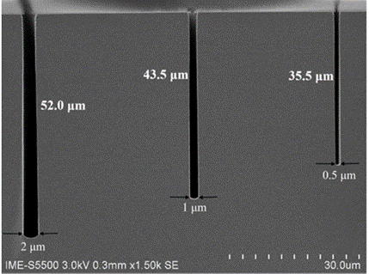
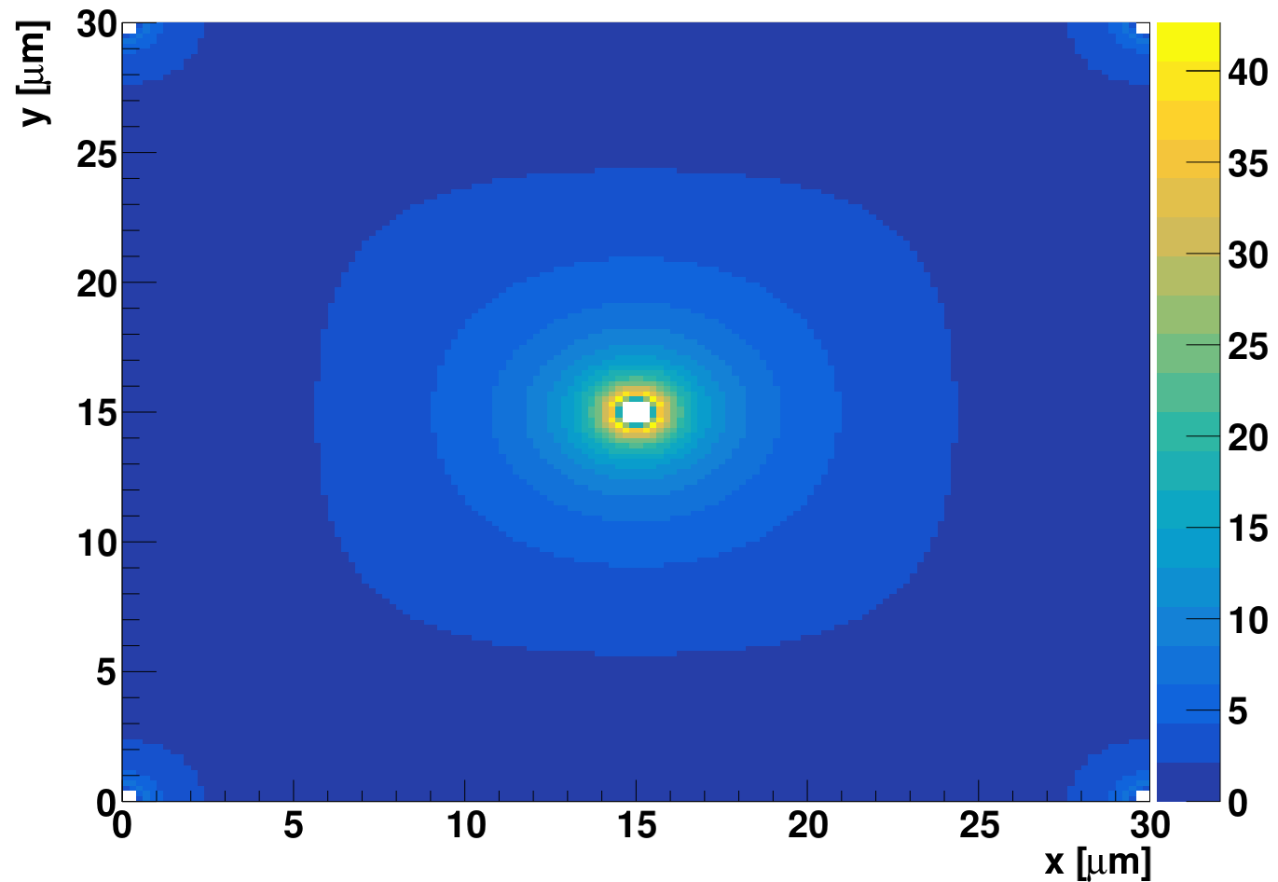
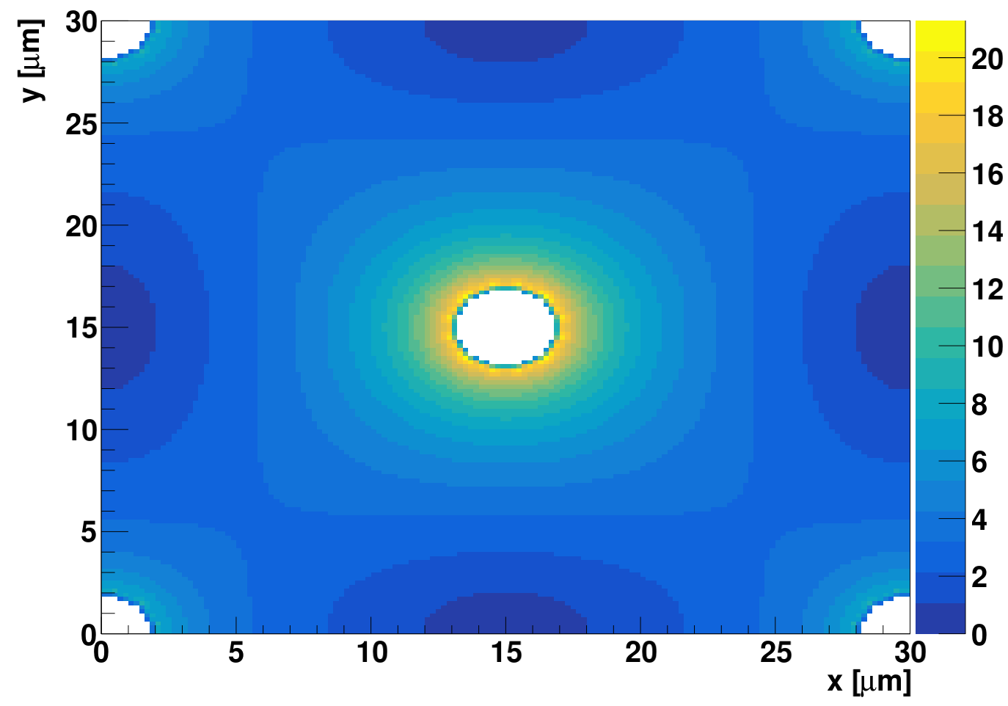
Small pitch narrow - column sensors
(square cell)
IME capability – aspect ratio
30x30 μm² cell
1.2 μm column
100 V, 10¹⁴ cm⁻³
30x30 μm² cell
4 μm column
100 V, 10¹⁴ cm⁻³
|E| [V/μm]
|E| [V/μm]
Can we progress from “solid state ionization chamber” to semiconductor “wire proportional chamber”?

Slide 3
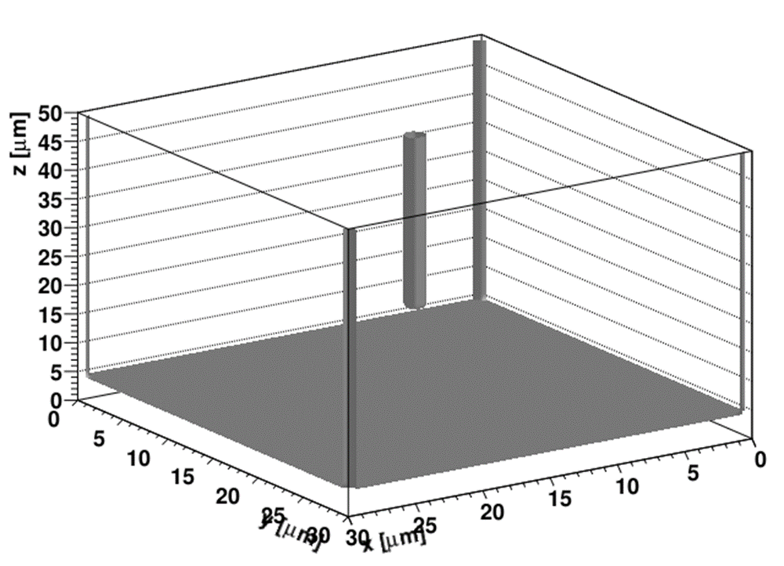
Design of the sensor – full 3D simulation
n+
p+
50 μm
p
25/30 μm
2R~1 μm
20 μm
25/30 μm
25/30 μm
1x1 and 2x2 cells were simulated
Small square cell size detector was investigated - a single sided process assumed:
30x30 μm²
25x25 μm²
20 μm gap
1 μm column diameter
5e13 cm⁻³ doping levels
50 and100 V, -20ºC
CFD~25% , shaping electronics with ~0.6 ns peaking time

Slide 4
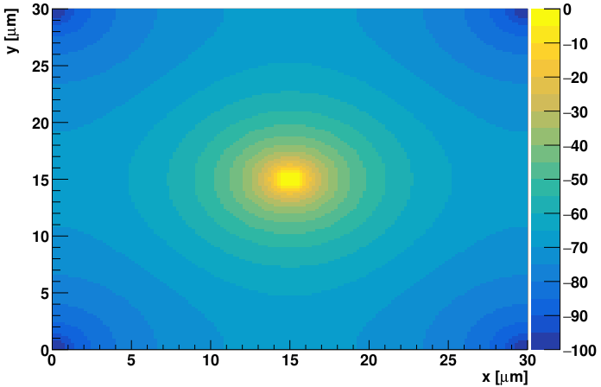
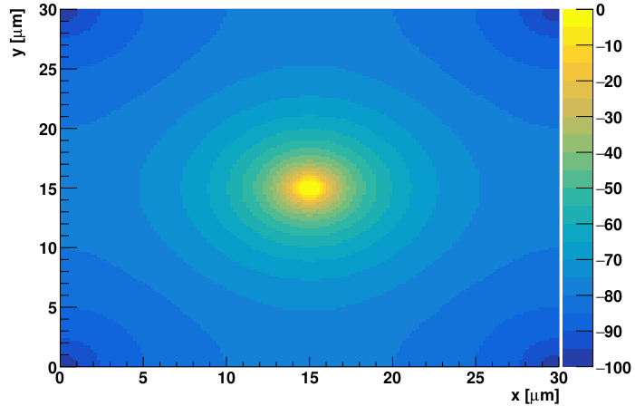
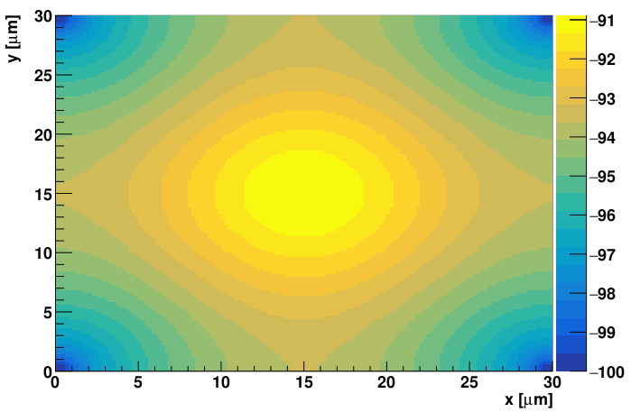
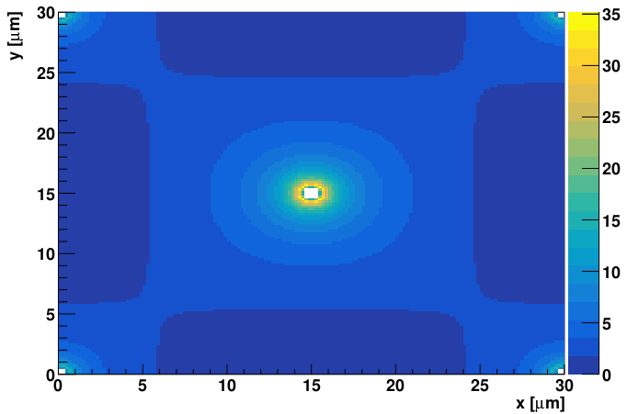
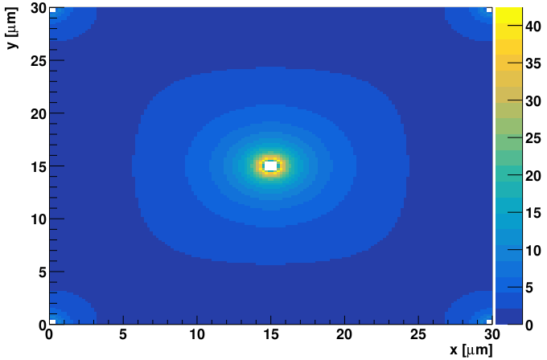
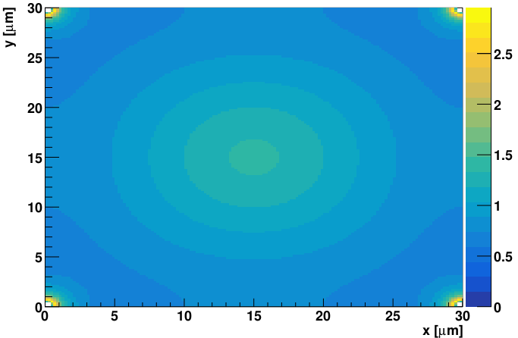
Potential distribution
Absolute value of the potential
U [V]
U [V]
U [V]
5 μm from the top
25 μm from the top
5 μm from the bottom
Absolute value of the electric field
5 μm from the top
25 μm from the top
|E| [V/μm]
|E| [V/μm]
|E| [V/μm]
5 μm from the bottom

Slide 5
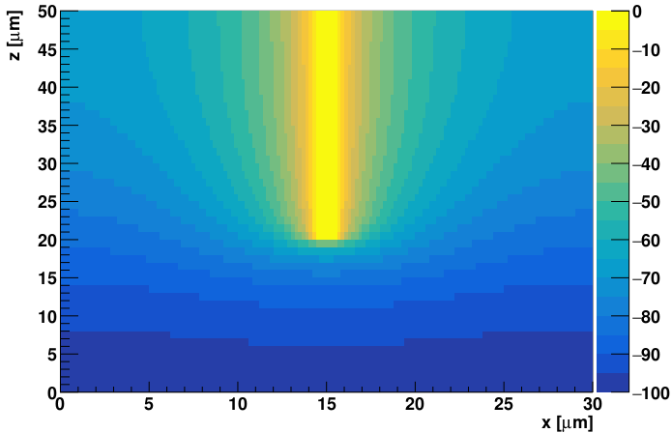
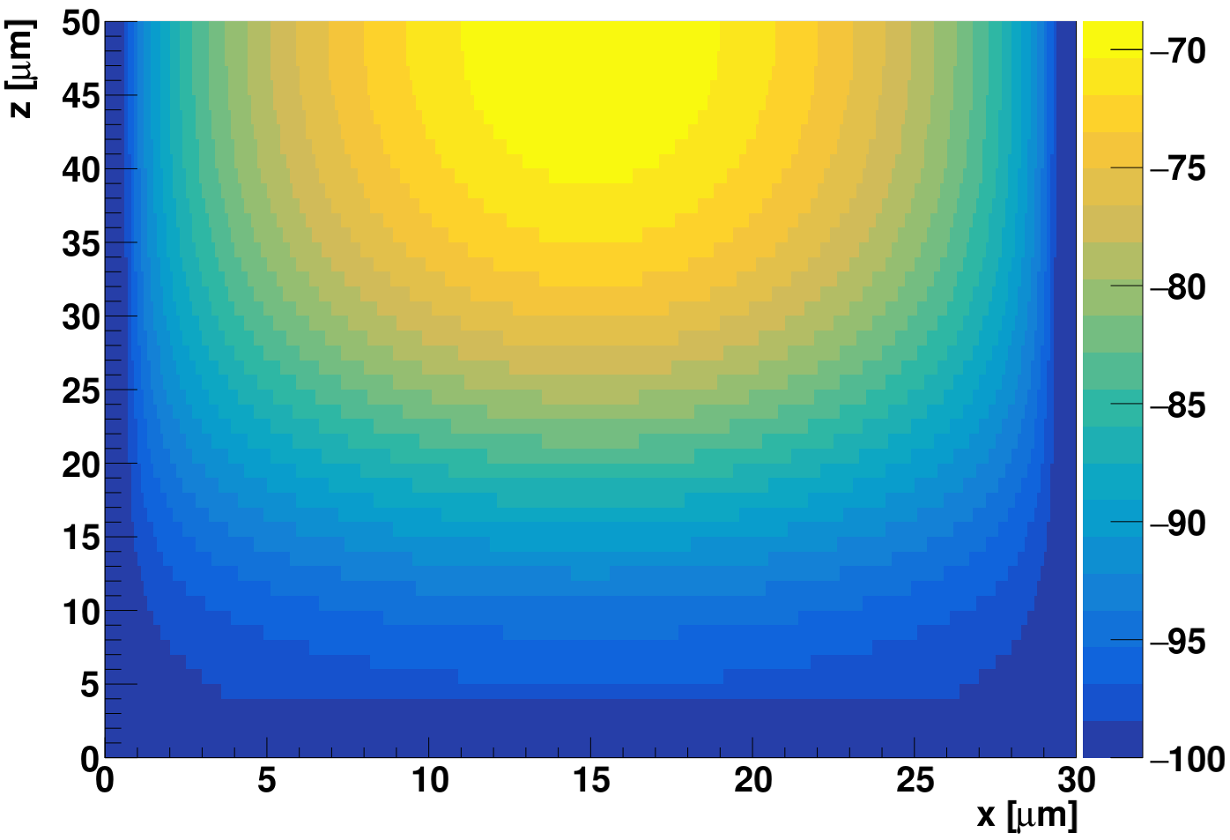
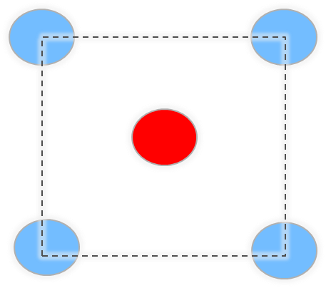
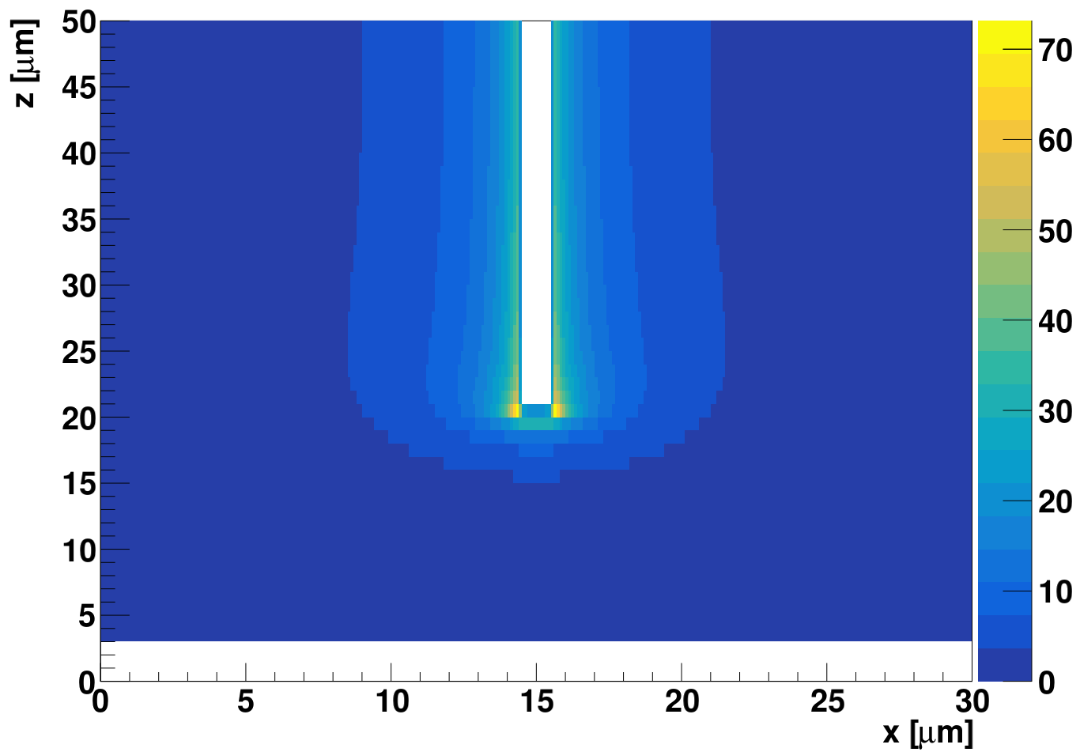
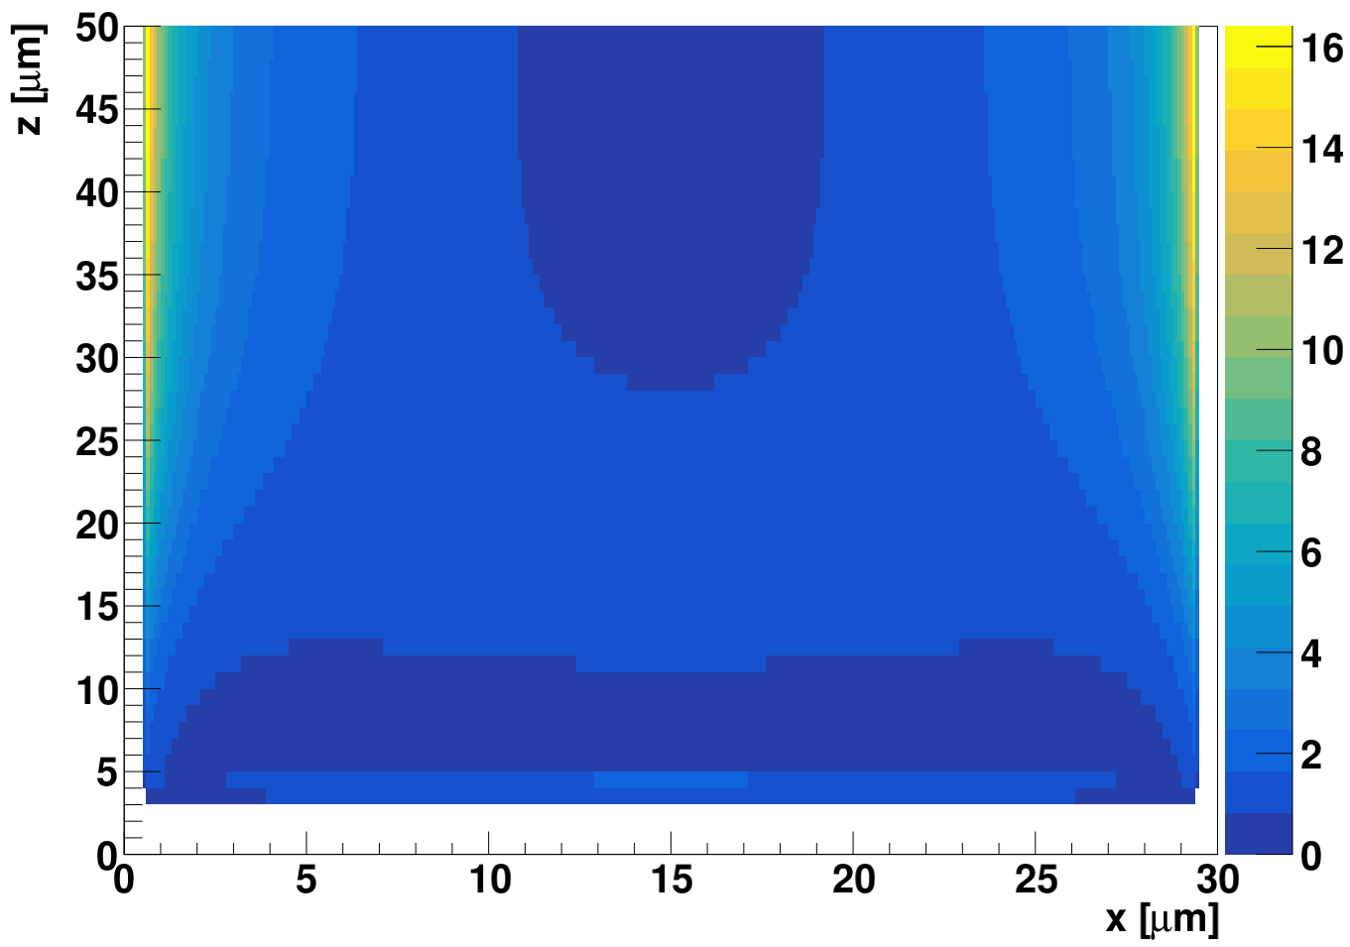
Potential and electric field simulation
U [V]
U [V]
XZ cross-section
The meshing of the sensor is important – otherwise non-realistic fields can be obtained
Note the high peak region close to the tip – a more realistic shape – rounded will be done soon
|E| [V/μm]
|E| [V/μm]

Slide 6
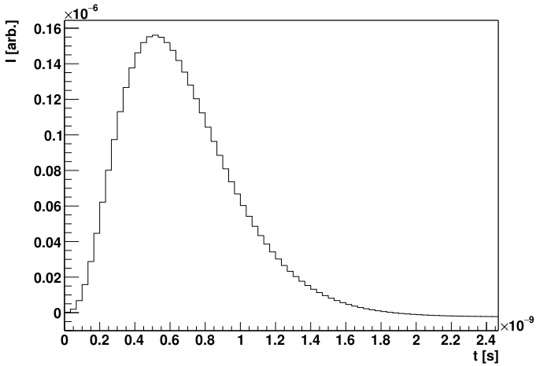
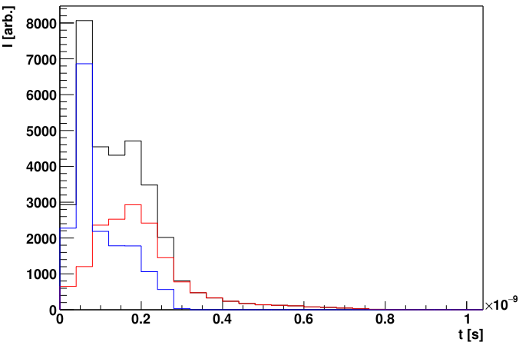
Signal simulation
“Imaginary transfer function” – something that integrates as long as the drift takes – similar rise time as recent ASICs (e. g. ALTIROC)
Simulations show some, but not significant, dependence of ToA spread on the choice of the transfer function
Response to a “dirac” pulse
Holes
Electrons
Total

Slide 7
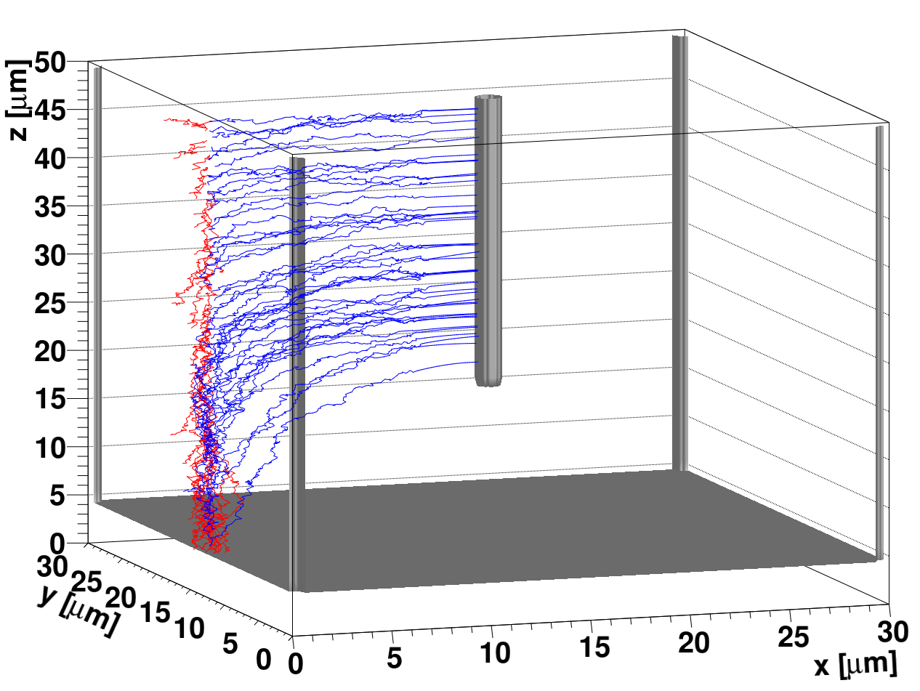
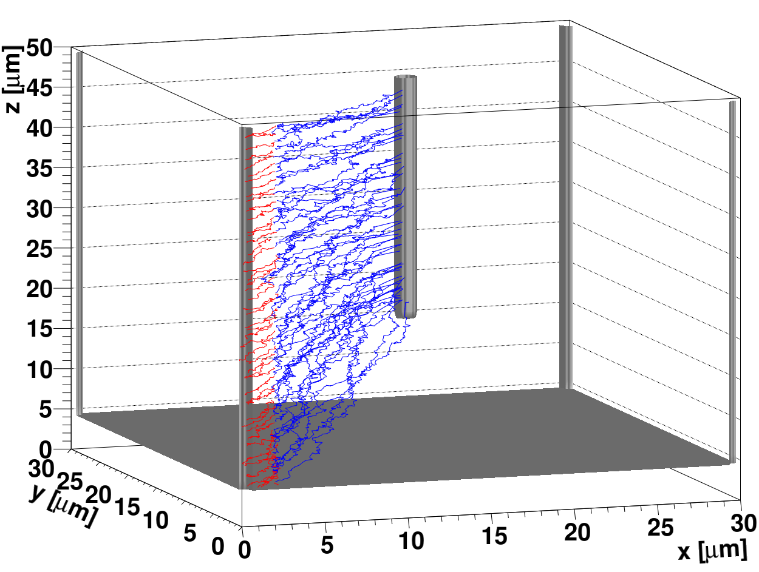
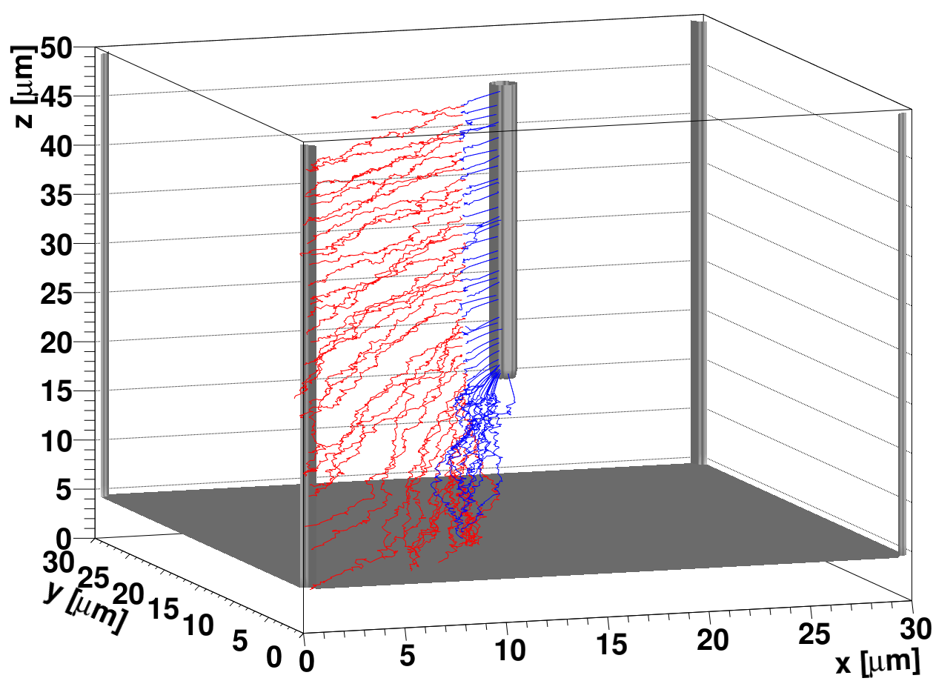
Simulated drift paths
There is clear difference between the drift paths :
  those ending at the tip of the junction column will have a different gain due to different peak fields
  there will be an intrinsic difference in gain for tracks over the surface of the cell (different gain for different tracks – that can have an adverse effect on the timing )
How much is the distance between the back plane and the tip is a matter of optimization – break down voltage vs. gain difference vs. timing vs. the yield and processing.
Using a single cell in simulations has a “wrong” weighting field

Slide 8
Simulation of half of the HL-LHC pixel cell - 25x25 μm² cell
N_{eff}=3e13 cm⁻³
V_{bias}=70 V
We get some gain, but not excessive (few times)
The gain is such that it compensates smaller signal
For thick sensors of small pitch there will be a lot of charge sharing – reducing the efficiency and time resolution
Thin small cell with gain would lead to superb performance
Simulated volume – 50x50 μm²
U_{w}=0
U_{w}=1
2R~1 μm
Thick sensor with large small pitch problem – charger sharing:
position resolution
reduction of efficiency
worse time resolution
larger data rate

Slide 9
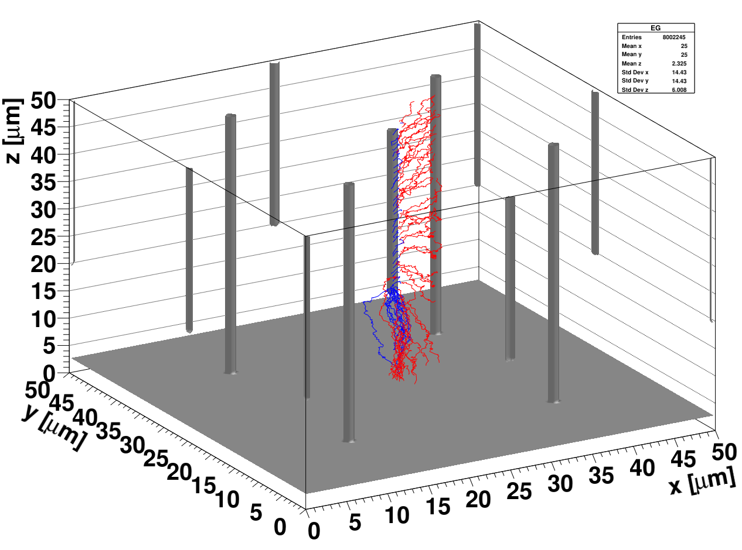
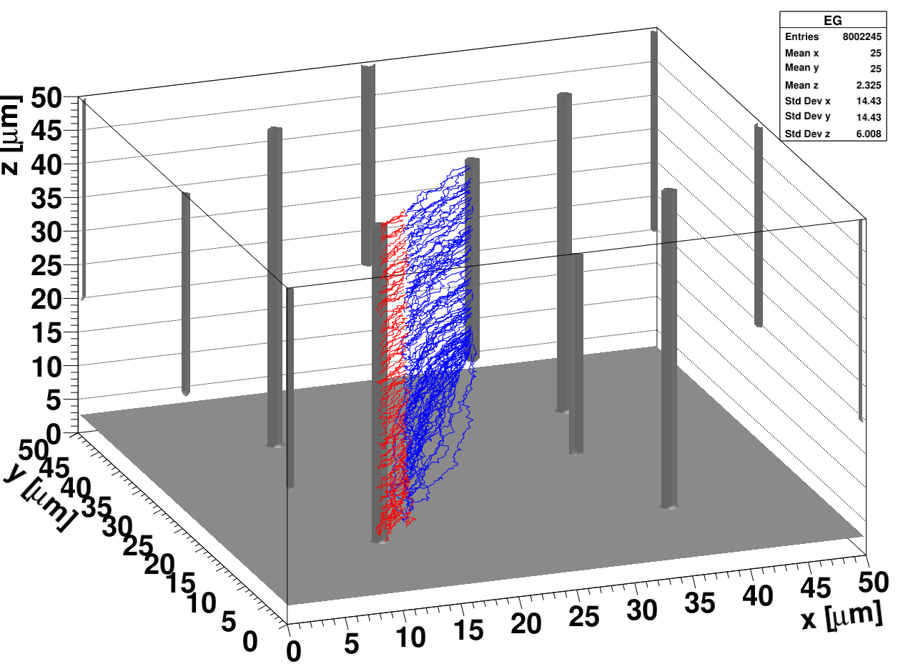
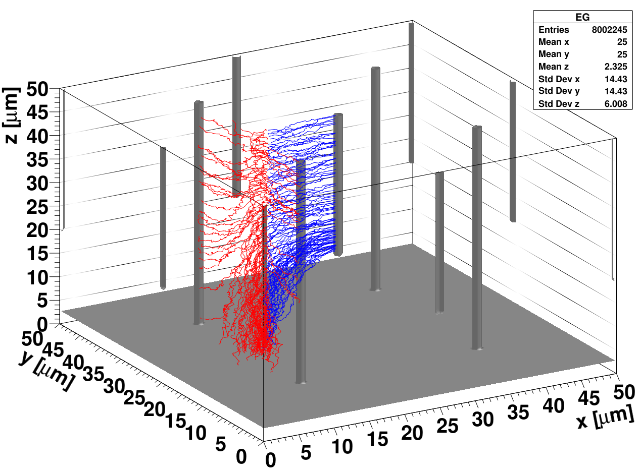
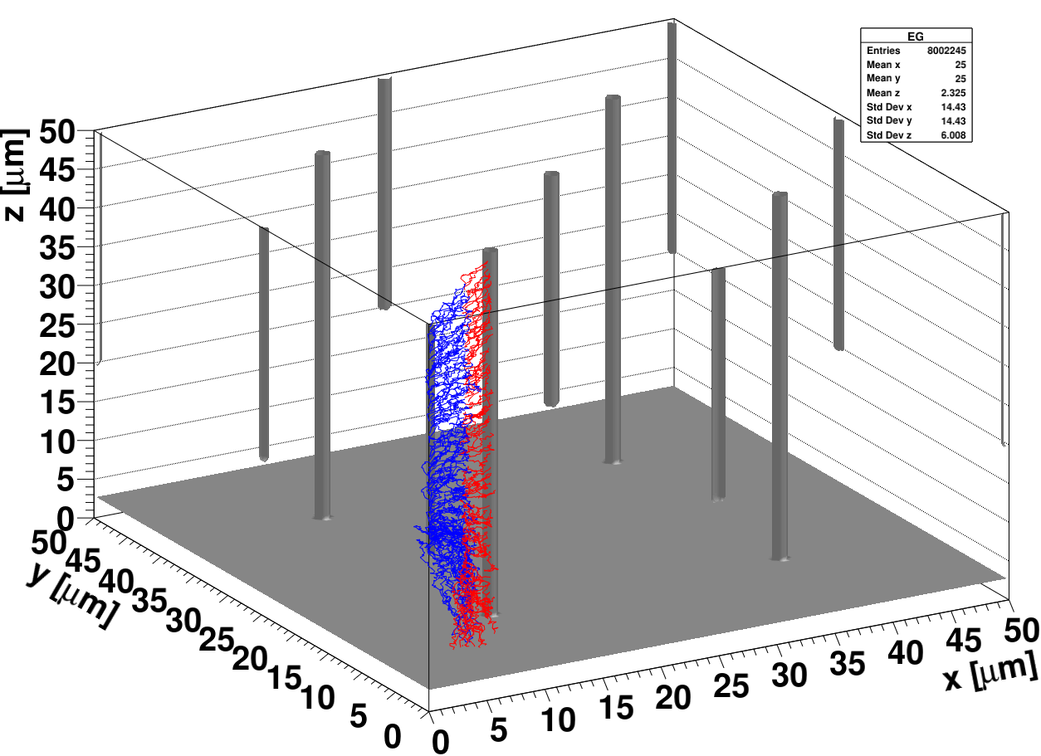
Simulation of the 25x25 mm2 cell
po1 2=-85.838394 (-39.406490, -46.431905)
pos 2=-62.629642 (-46.090750, -16.538891)
pos 3=-62.629642 (-46.090750, -16.538891)
pos 4=0.182072 (2.141266, -1.959194)

Slide 10
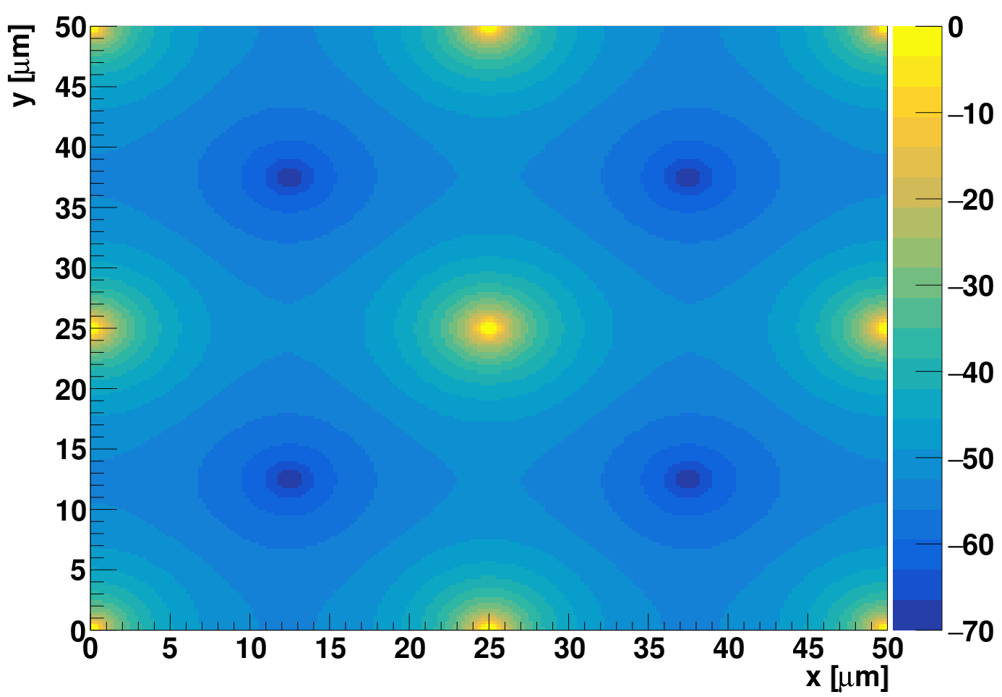
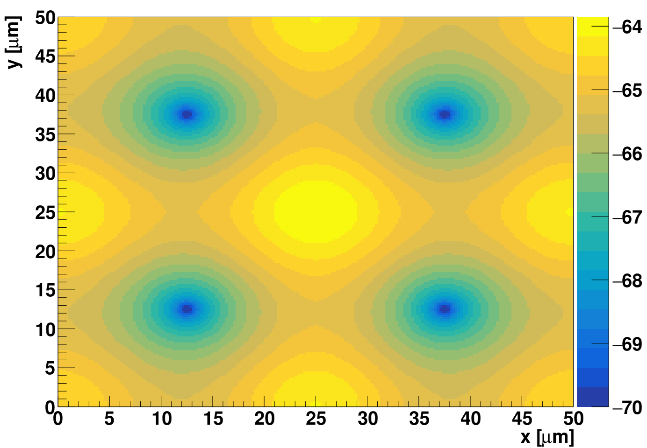
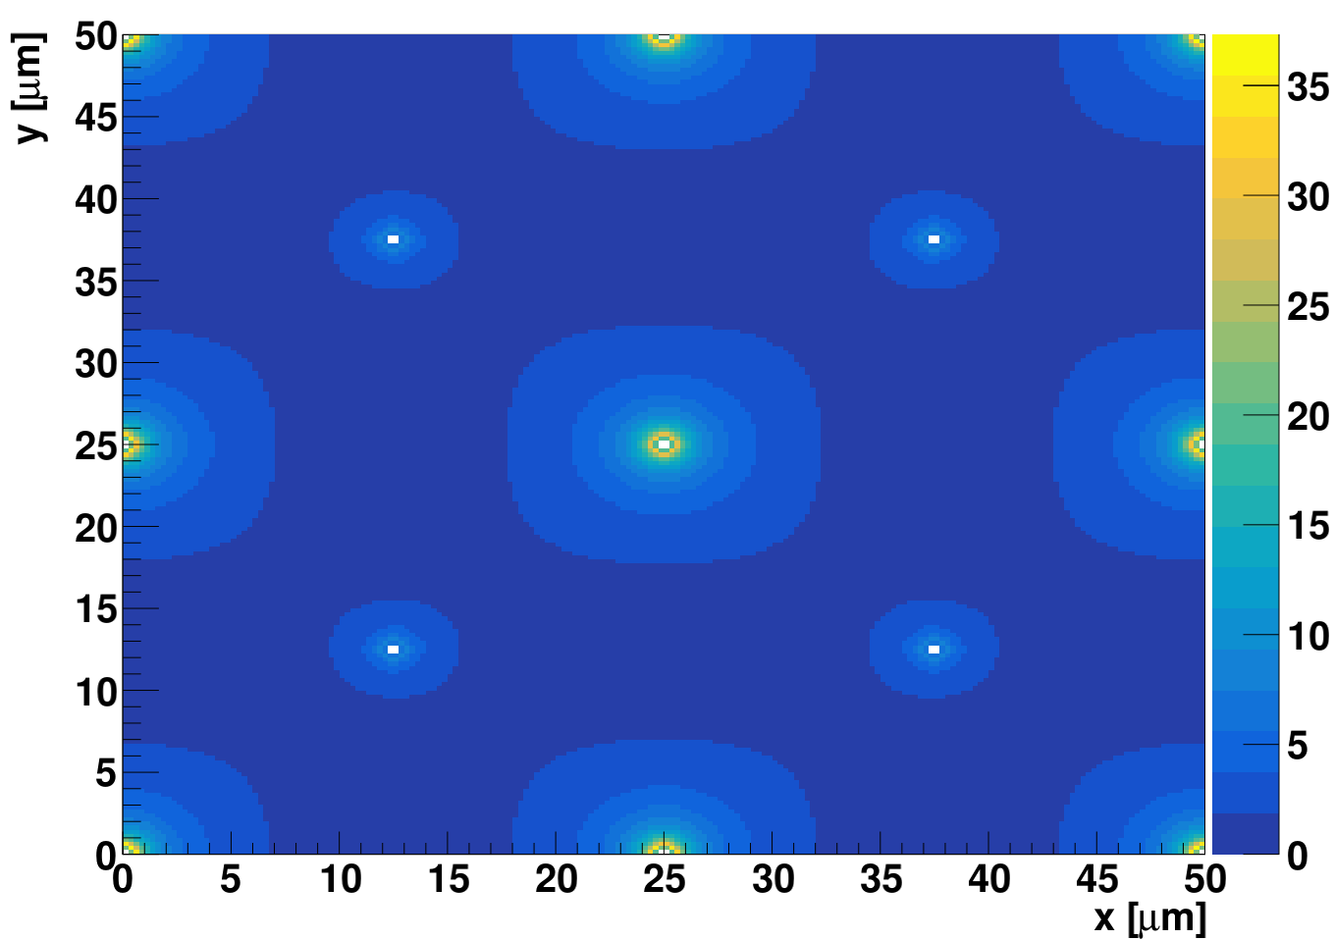
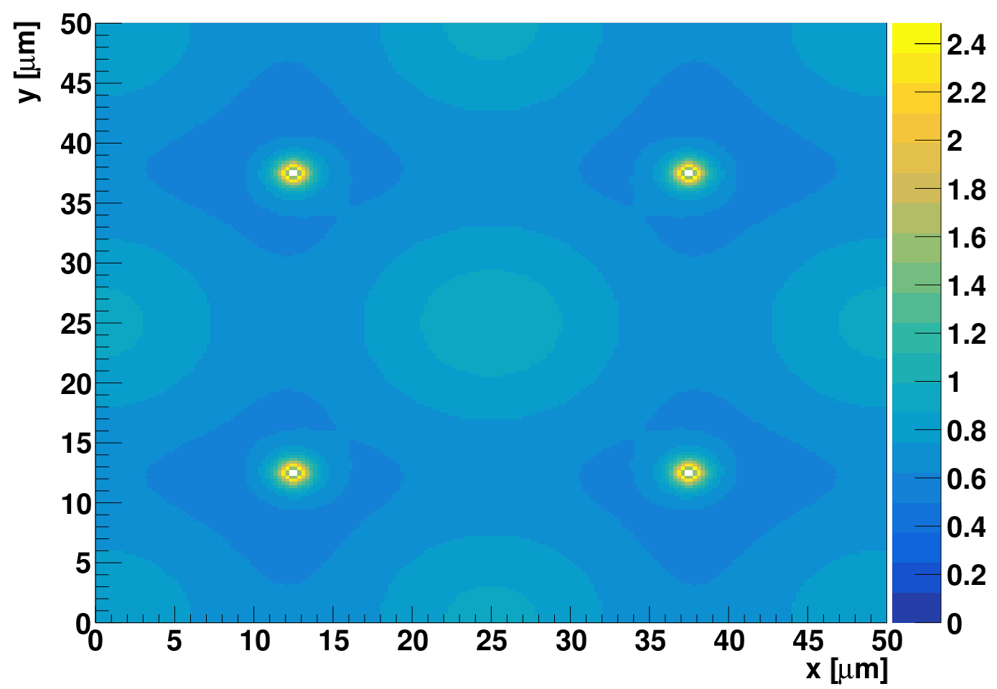
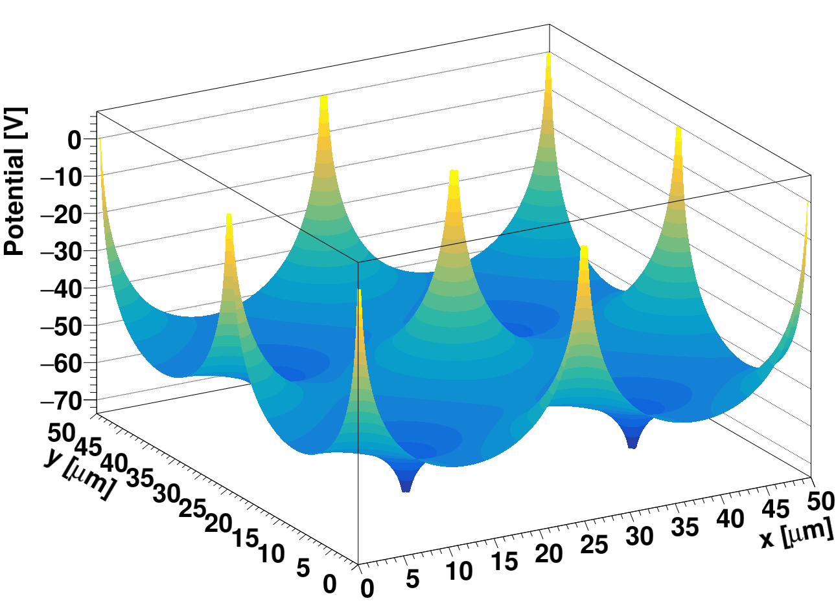
Example of field calculation
U [V]
U [V]
Field calculations show that there should be charge multiplication at the junction columns
5 μm from the top
5 μm from the bottom
5 μm from the top
5 μm from the bottom
|E| [V/μm]
|E| [V/μm]

Slide 11
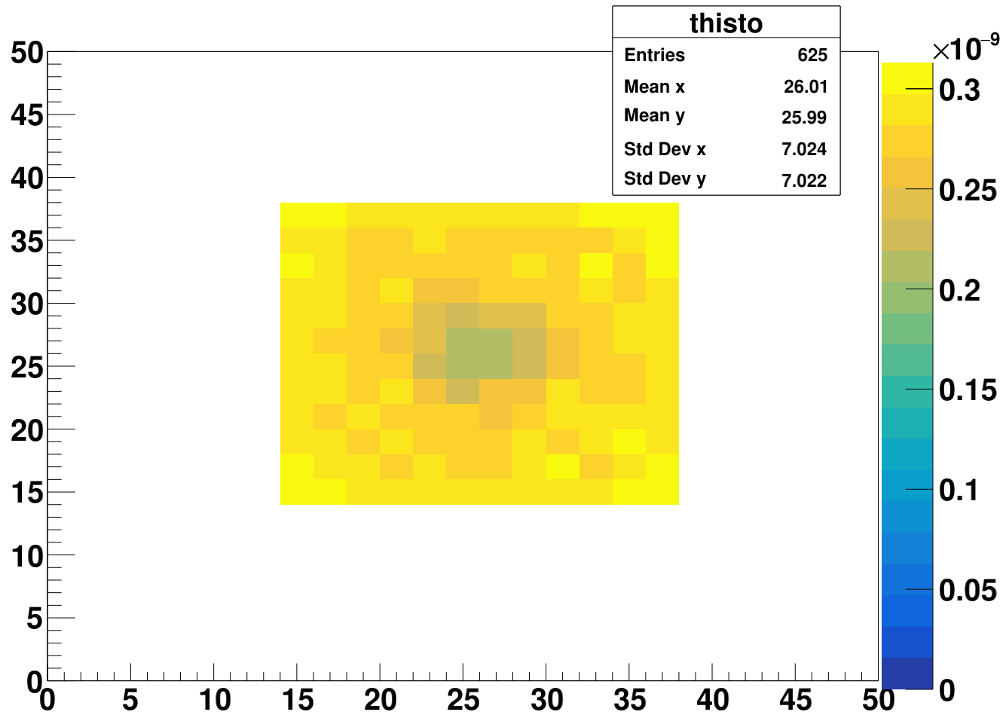
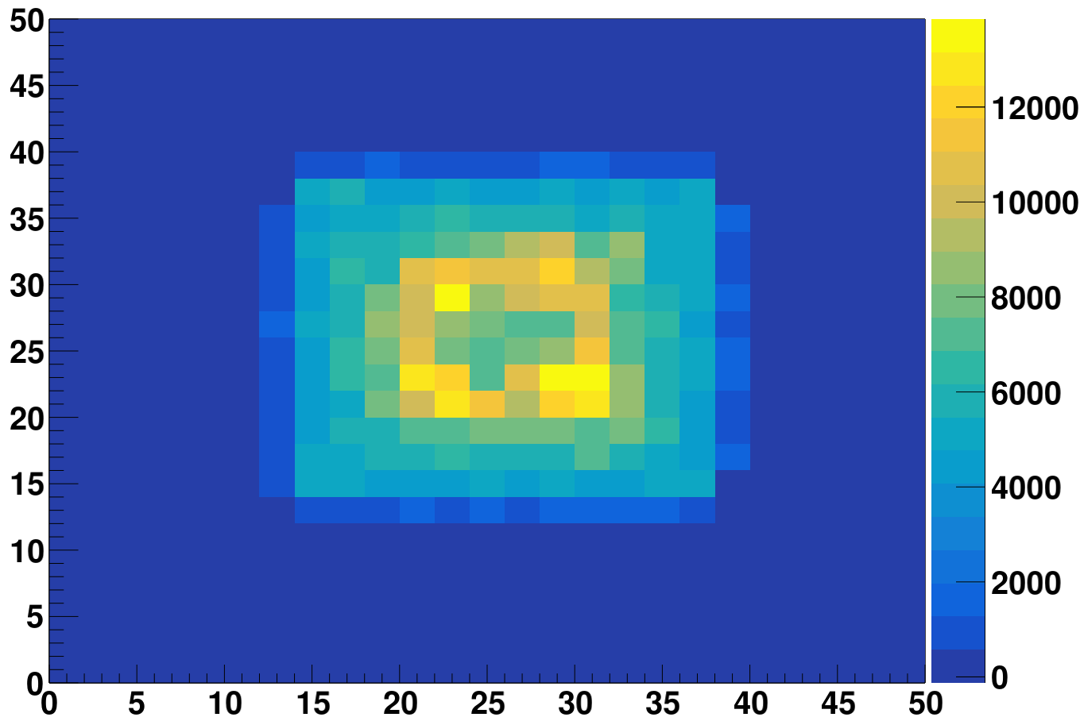
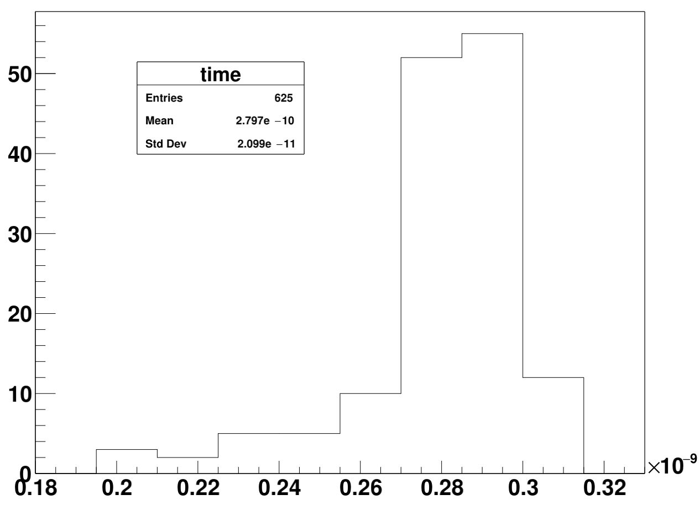
Simulation of CC and ToA
Collected charge distribution
Q [e]
ToA distribution
ToA [s]
~1 MIP is 3400 e
Large dispersion of CC across the cell:
variation of the gain from 2 to 4
Variation of the ToA with CFD~25% of ~20 ps is larger that without it (distortion component alone) which is around 10 ps

Slide 12
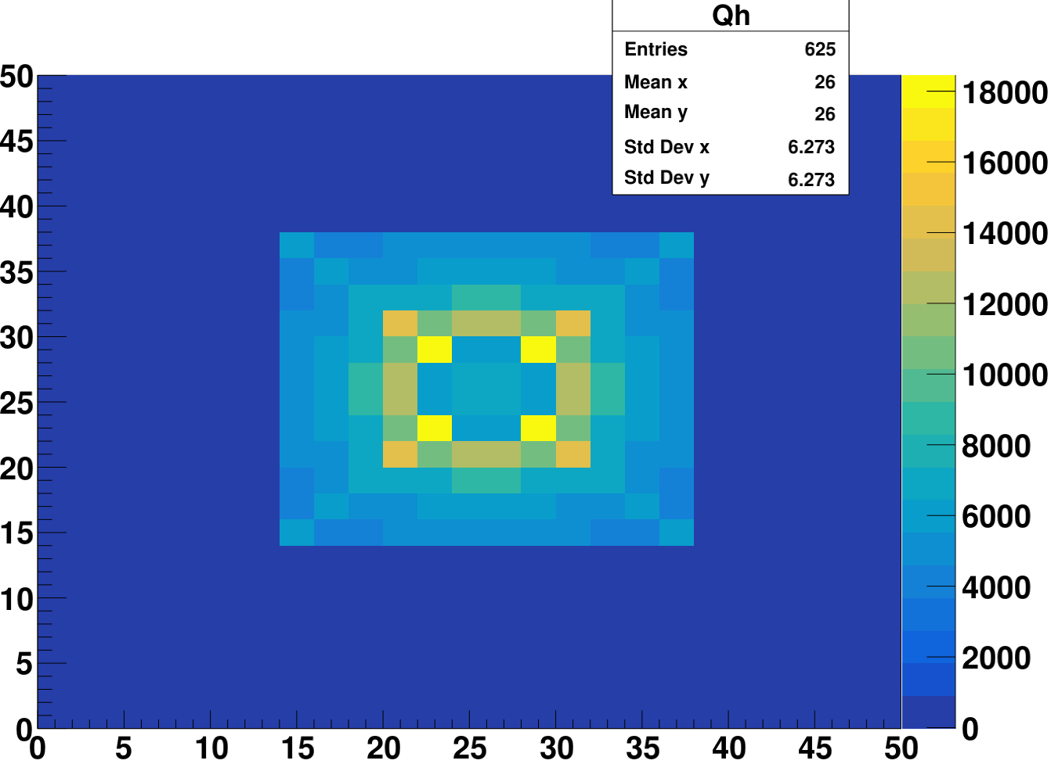
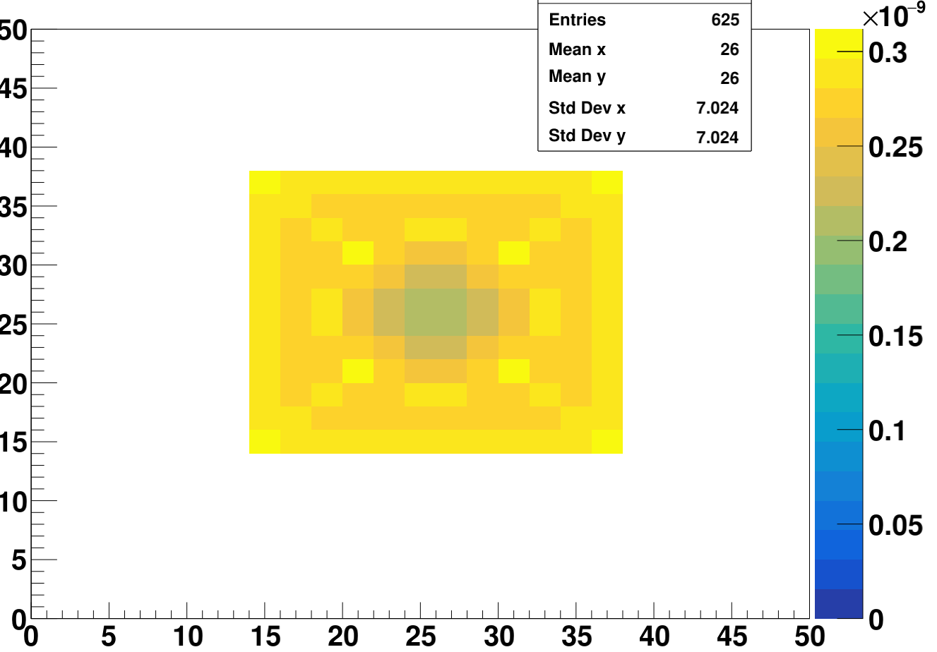
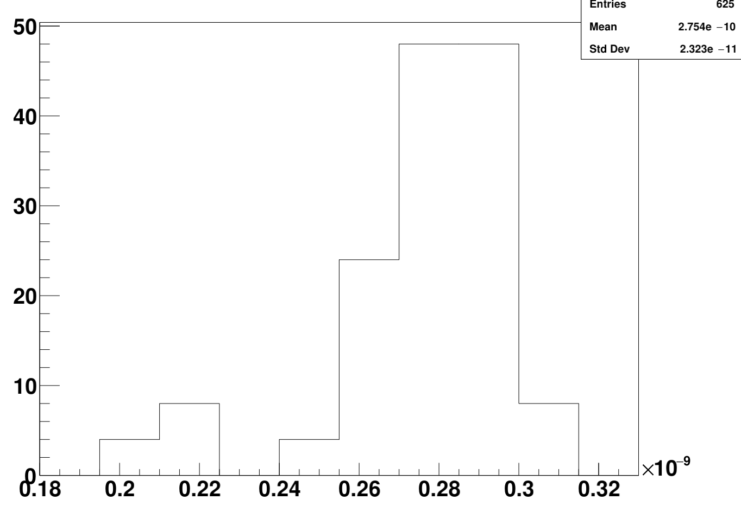
CC and ToA without diffusion
Q [e]
ToA [s]
No diffusion

Slide 13
Hexagon

Slide 14
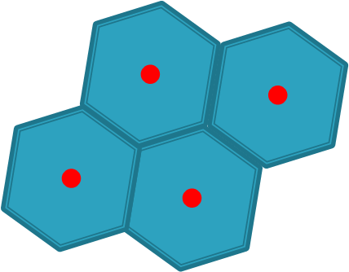
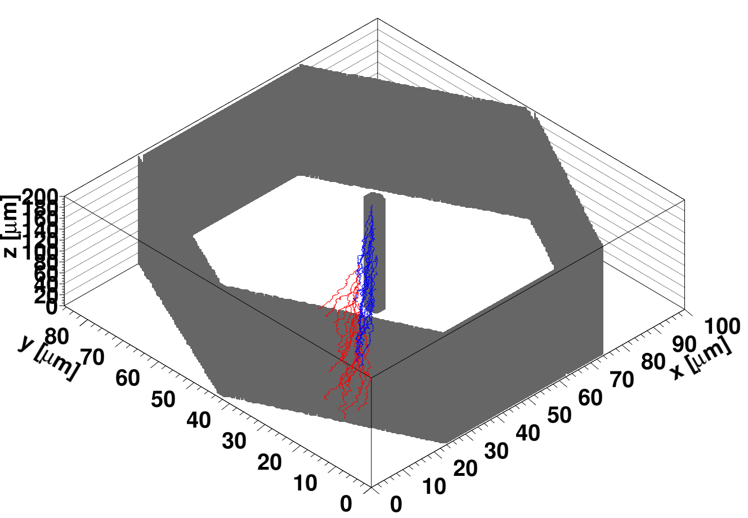
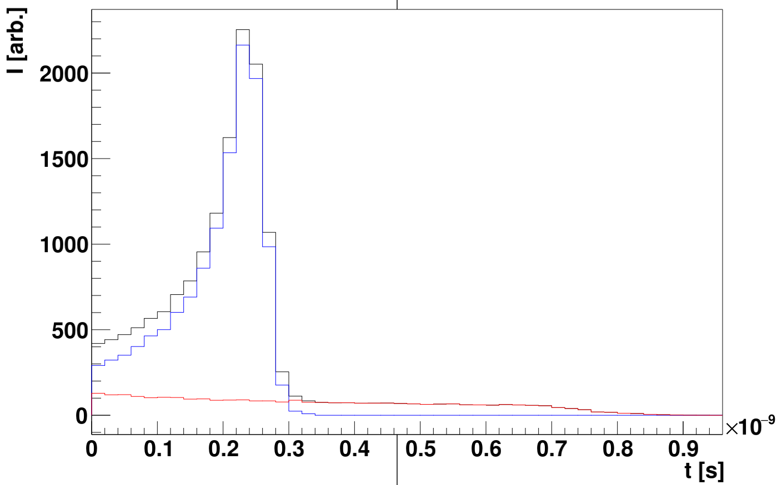
Hexagon trench detectors
n⁺ columns
p⁺ trench
p bulk
A BNL design for gamma ray detector – proposed already in 2004 by Z. Li.
central collecting electrode is completely isolated by hexagon – no cross talk to neighbors
Very short:
  collection time
  full depletion voltage
Holes
Electrons
Total
100x100x200 μm³
columns-6 μm, trench-4 6 μm
Neff=-2e12 cm⁻³
50V bias

Slide 15
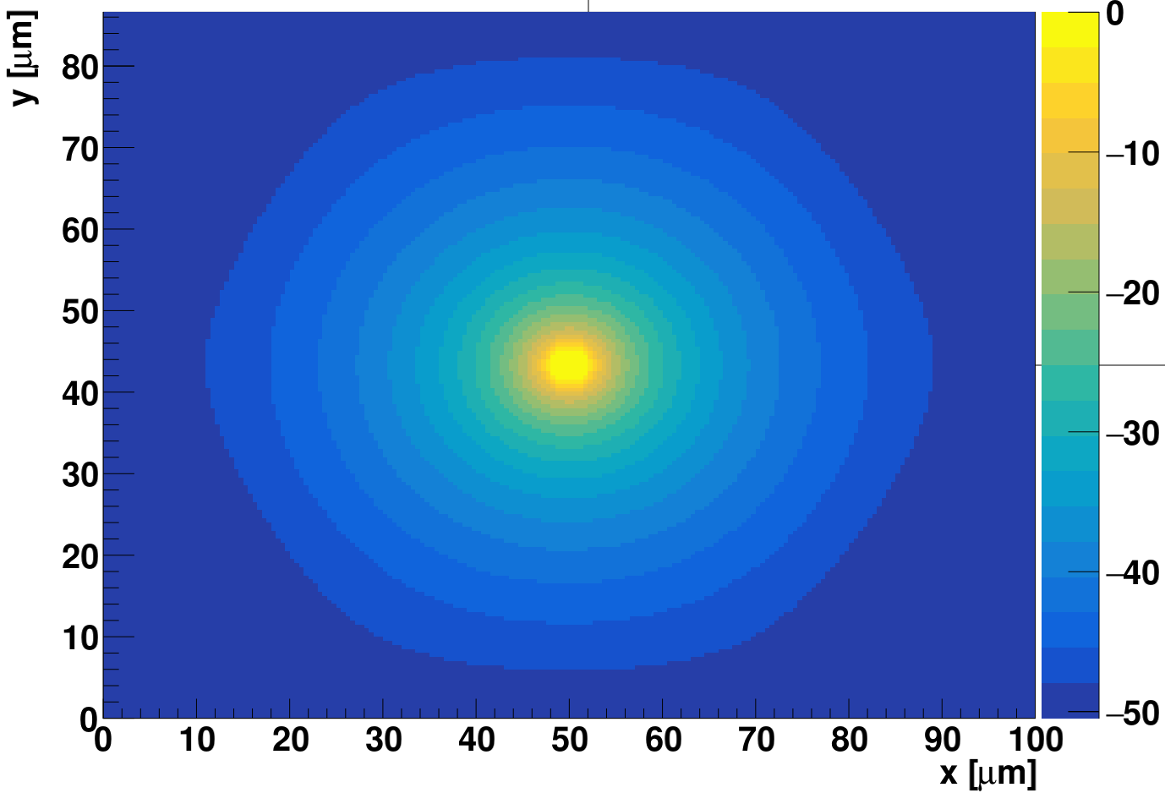
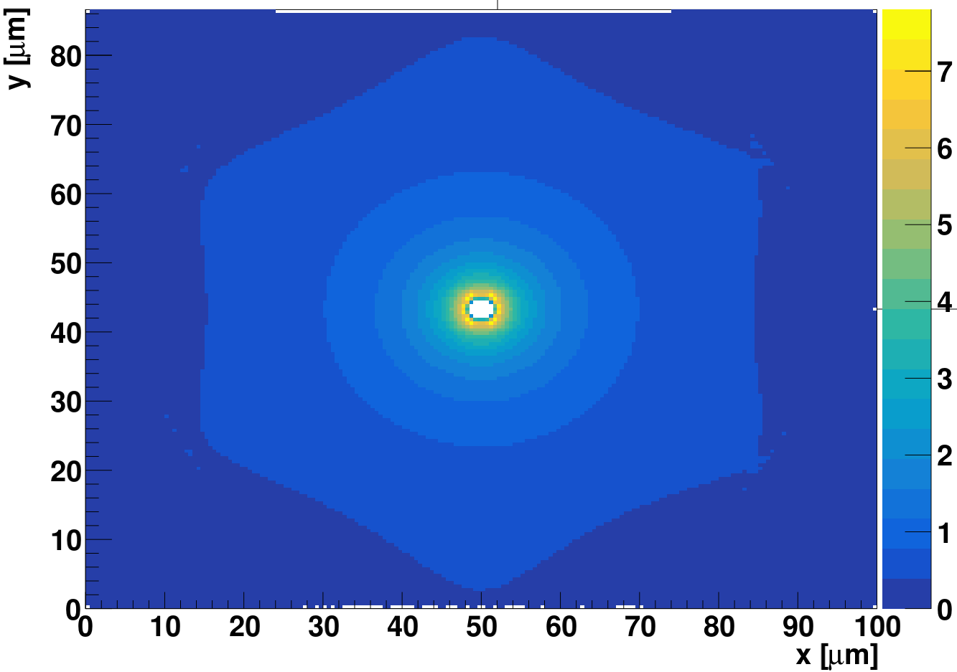
Example of field calculation
U [V]
|E| [V/μm]
This is in fact a 2D problem – no z dependence of potential/field
We will use 2D simulation to improve the details.
Next steps in simulations:
  not full through electrodes (processing details)
  narrow columns – devices with gain

Slide 16
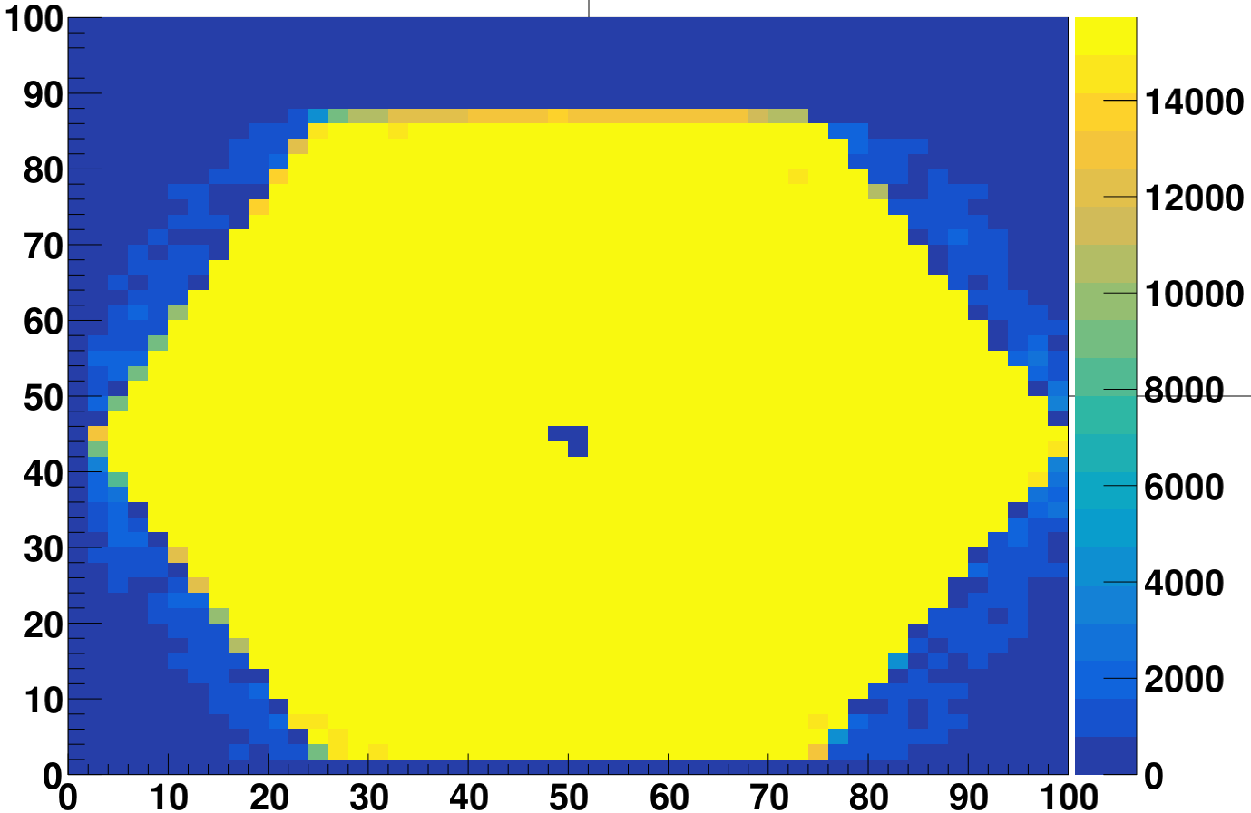
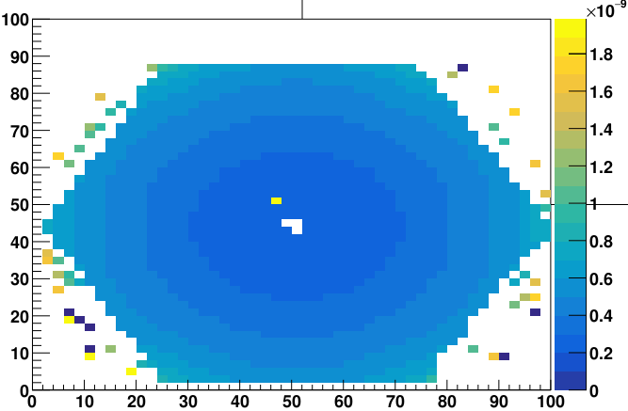
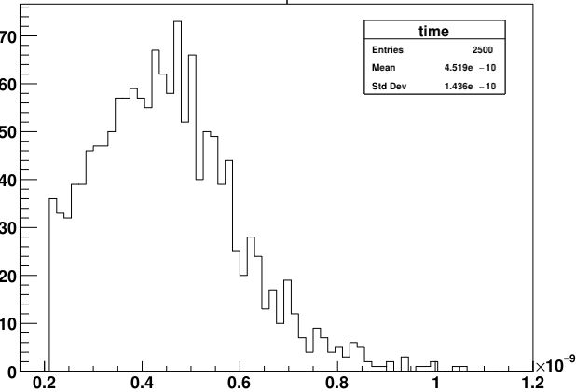
ToA and Charge collection
Q [e]
ToA [s]
Q [e]
ToA distribution spread 140 ps
Very homogenous charge collection efficiency
Very much as expected

Slide 17
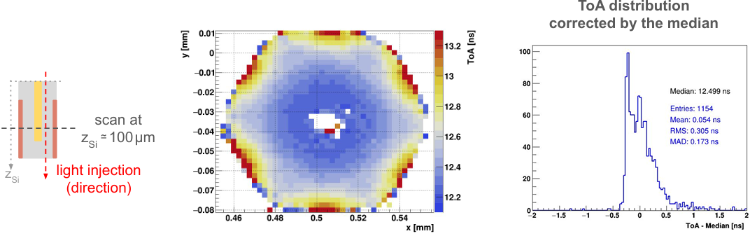
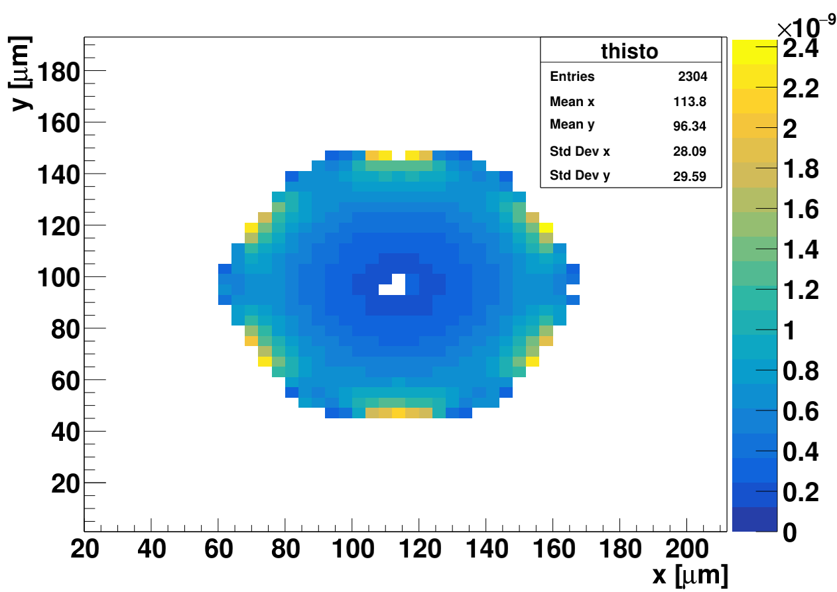
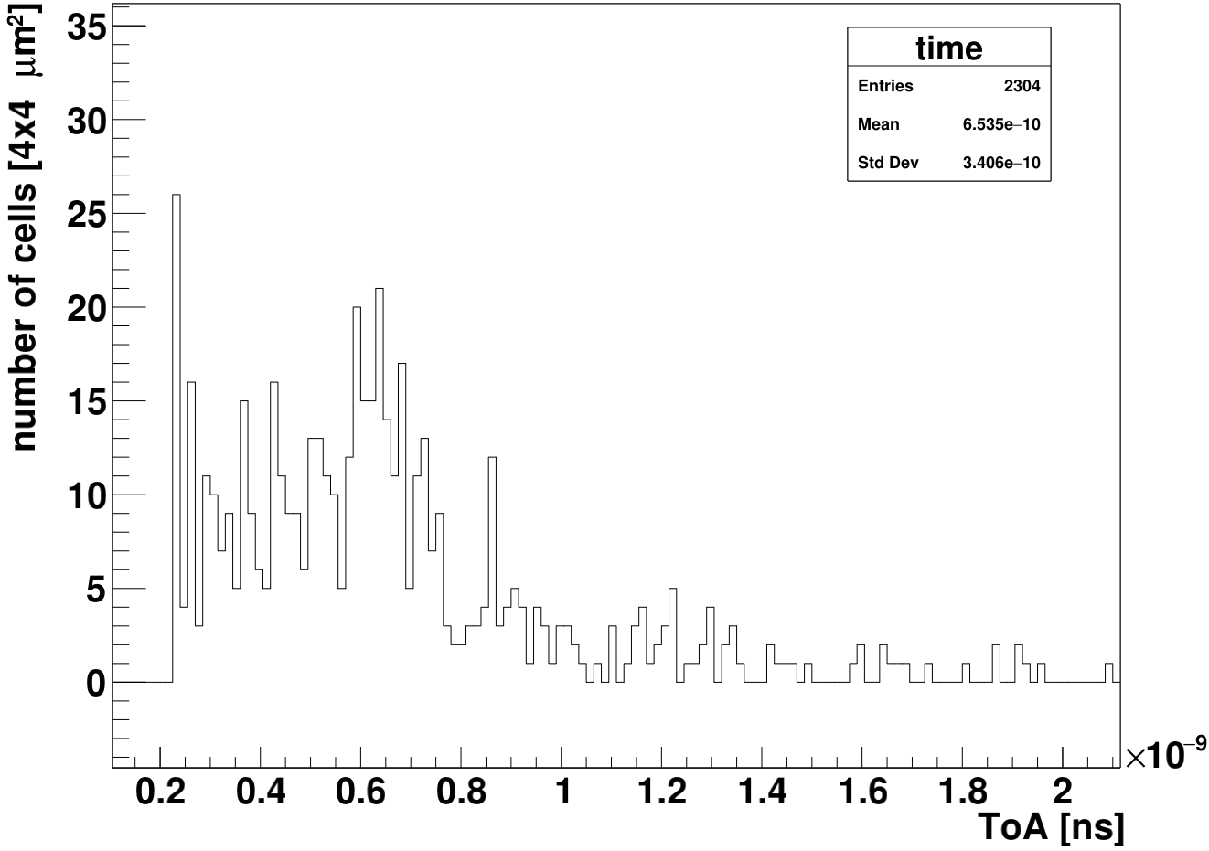
Simulation verification – TPA comparison
Assumptions:
electronics with 500-600 ps peaking time
10 μm “cigar” shape of TPA in z
p-type isolation not yet implemented (no oxide charge)
Simulation bining 4x4 mm²
RMS measured 305 ps
RMS simulated 340 ps

