Slide 1
SKA Observatory Reward
Einstein Telescope Workshop
Theresa Devaney
15/11/24

Slide 2
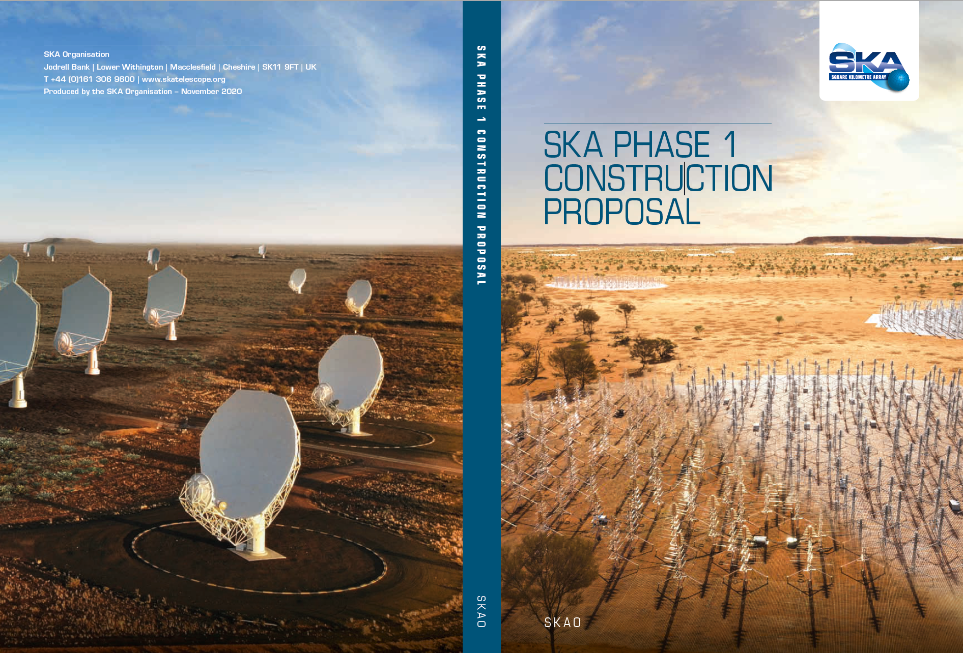
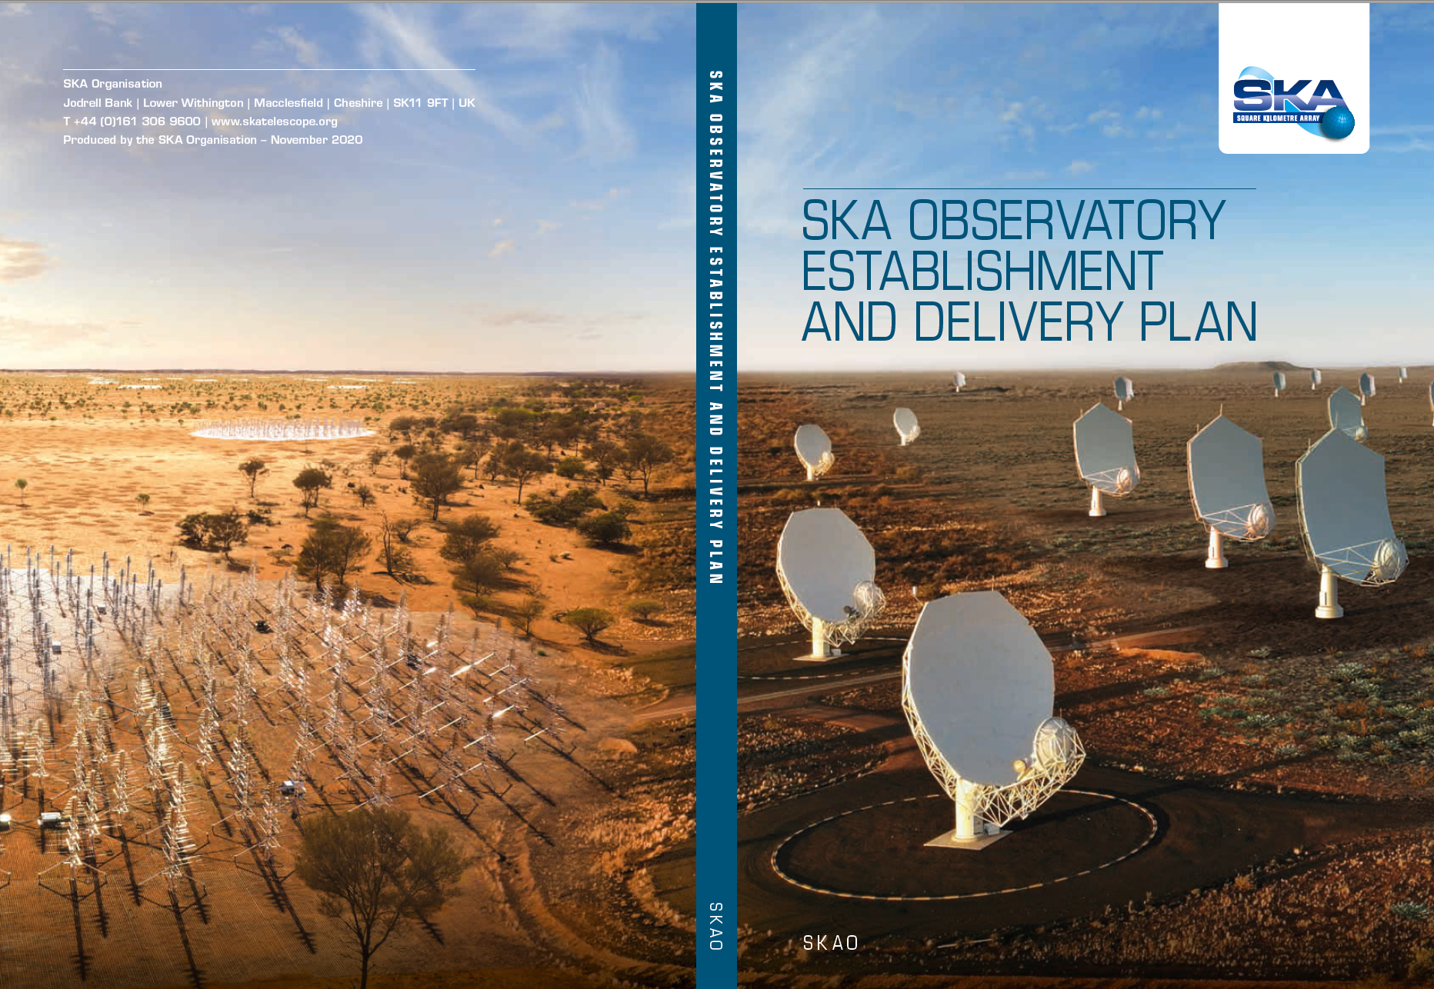
Delivering SKA Observatory
January 2021: The SKAO Convention entered into force and the SKAO was born as a legal entity.
February 2021: Council approval of founding policies of SKAO and the start of statutory transfer processes to facilitate the legal transition of SKA Organisation to SKA Observatory.
May 2021: The SKAO became operational when the previous company, SKA Organisation, along with its assets and people, was transferred to the SKAO. All staff now working for SKAO.
June 2021: SKAO Council approved the Construction Proposal and the SKAO Establishment and Delivery Plan
July 2021: Construction activities began

Slide 3
Transition - SKA Organisation to SKA Observatory
Key considerations for a smooth transition;
  Maintain business continuity and across the organisational boundary;
  Retention of staff across the organisational boundary;
  Agree legal framework to facilitate the transfer of staff, business assets and resources to the SKAO;
  Establishing the policies and operating model for SKAO.

Slide 4
Transition - SKA Organisation to SKA Observatory
Decision taken by SKA Organisation Board and the SKAO Council to enact a legal business transfer between the SKA Organisation company to the SKA Observatory;
  Business Purchase Agreement facilitated the legal transfer of business assets including staff;
  Staff transfer carried out in line with UK Transfer of Undertakings (Protection of Employment) Regulations 2006 (TUPE) - continuity of employment, terms and conditions and staff consultation regarding any changes.
  Staff Regulations approved at inaugural Council meeting in readiness for the statutory staff consultation process.

Slide 5
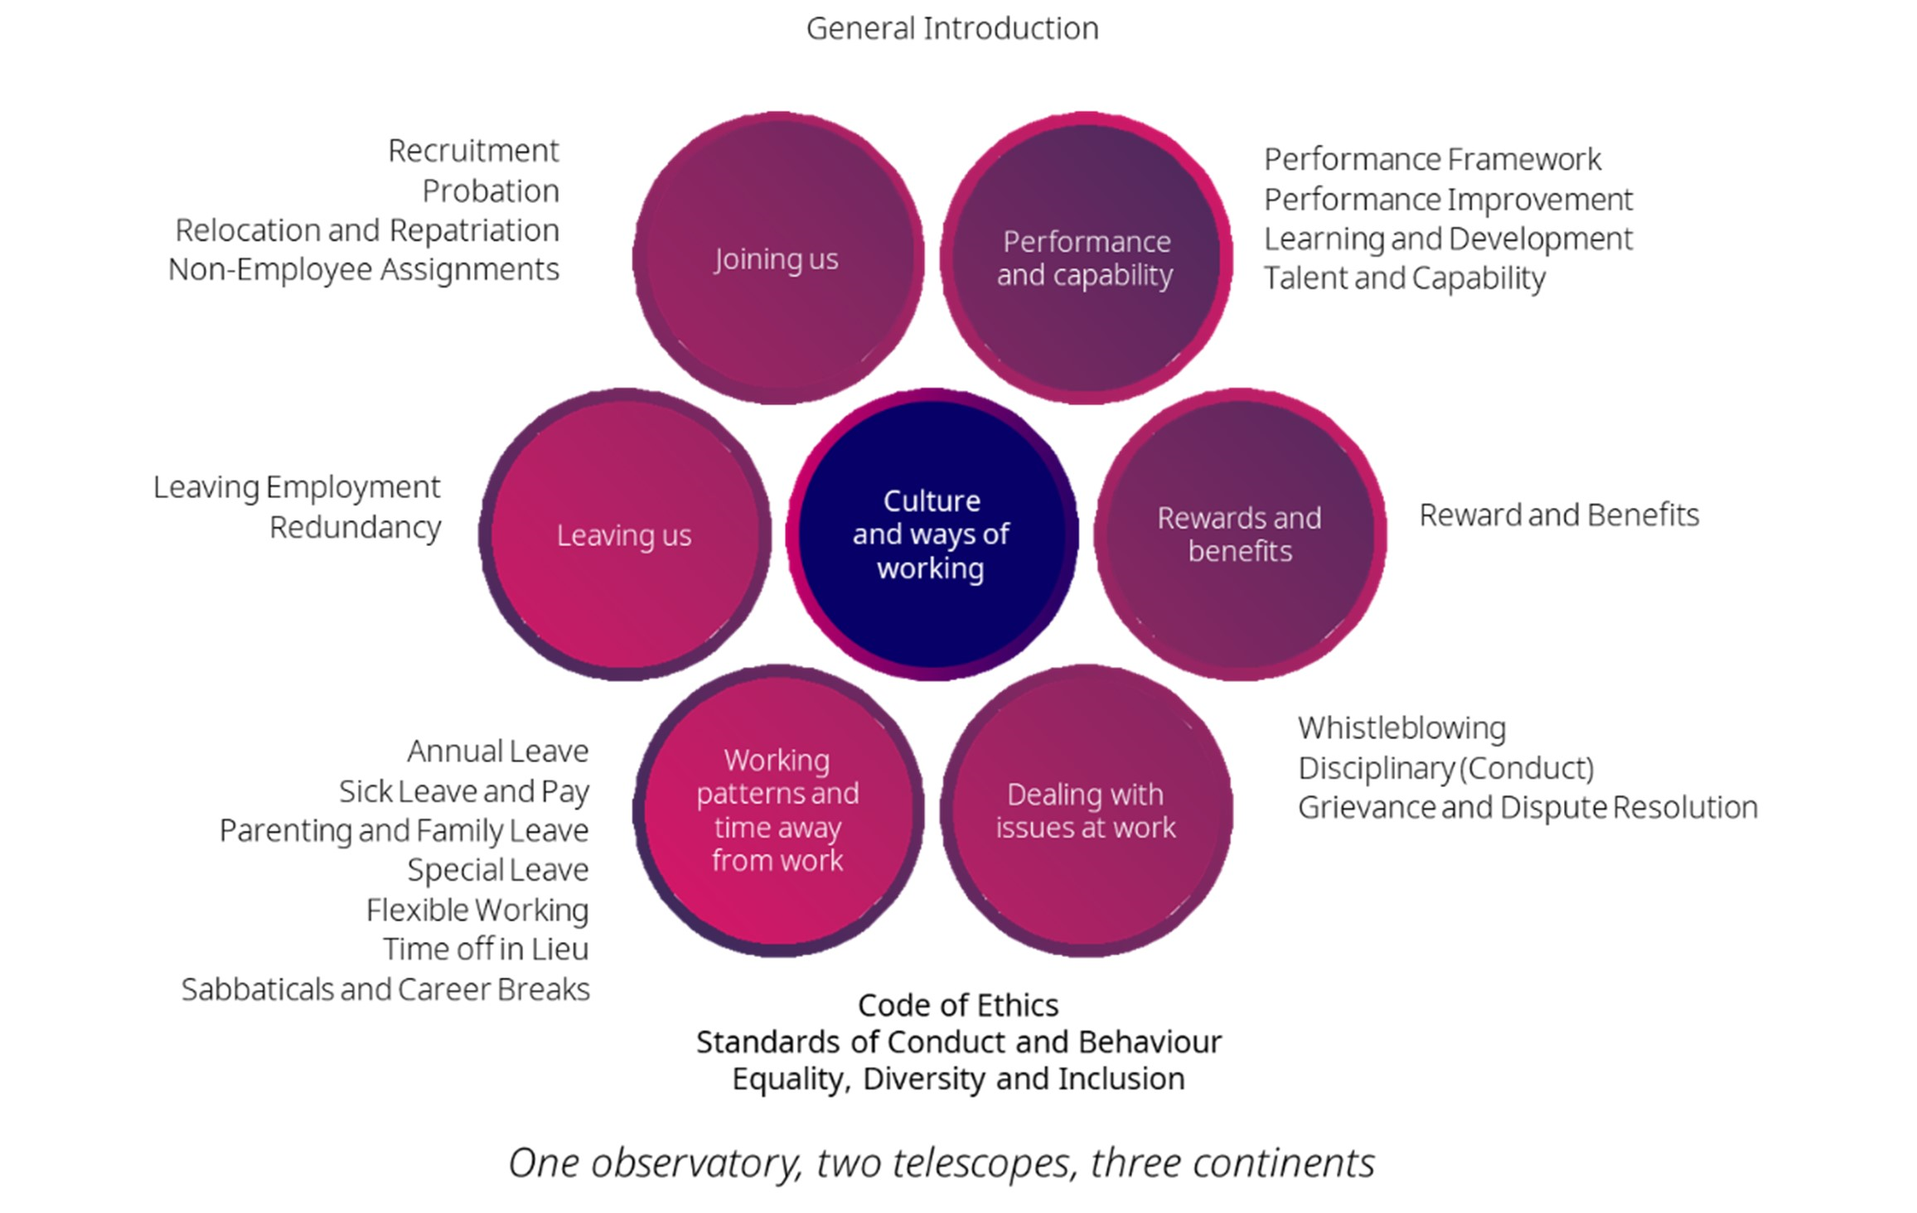

Slide 6
Recruitment and Attractionleave
In house recruitment team;
Roles advertised for each location internationally;
    SKAO Job portal;
    Specialist websites;
    LinkedIn;
    Conferences and other forums (e.g. 2024 IAU General Assembly in South Africa).
Assessment;
    Clear recruitment standards aligned to career and competency framework;
    Focus on Skills, experience, knowledge and behaviour.
Diversity Champion appointed on each recruitment panel;
Offers made against a career level and associated salary range.

Slide 7
Recruitment and Attraction(2)
Onboarding and Induction
  Welcome space for successful candidates - onboarding portal shared with staff ahead of first employment day;
  Additional support for international staff;
  Followed up by line manager support and detailed online induction via Learning Management System;
    5 modules – induction, Diversity and Inclusion, Information security, Anti Bribery and Phishing;
    3 policies for review and signature - Acceptable Use Policy, Standards of Conduct and Behaviour, Code of Ethics etc..

Slide 8
Reward and Benefits - Pay
Pay structure aligns with the SKAO Career Framework for SKAO employees;
Pay is aligned to local market pay data in Australia, South Africa and the UK with reference to global benchmarking data provided by Korn Ferry Hay;
Pay ranges aligned to grade levels, defined through career framework;
Pay ranges are linked to job size;
Progression through pay ranges contingent on competence and performance;
Annual pay review process is overseen by the SKAO Finance Committee and approved alongside the annual budget by the SKAO Council.

Slide 9
Reward and Benefits
Healthcare;
  all UK staff and International staff in Australia enrolled in corporate scheme;
  all South African staff paid an allowance through salary;
  all Australian local staff can claim costs of medical cover (subject to cap).
Group Life Insurance – pays out 3x annual salary.
Group income protection – pays out 50% of salary for up to 5 years if unable to work due to illness.
‘Social Security’ for international staff (nationals subject to local social security arrangements);
    seek to align with local benefits;
    examples include Childcare and disability benefits;
    funded from internal taxation of international staff.
International Support – provides up to 12% of salary against receipted expenses for additional costs associated with moving to and living in Australia, South Africa or the UK.
Annual flights home for international staff and their dependents.

Slide 10
Reward and Benefits - Pension
Pension – scheme type linked to contract type and location of employment;
    Employer contribution linked to employee contribution;
    Local scheme and international Retirement savings plan –defined contribution;
    Provides additional 8% contribution for international staff (as they are not contributing to state provision);
    International staff able to save an additional tax free sum each year into the plan.
Contract Type | Pension Scheme
UK Local | Local Scheme (Aviva)
All international Staff | International Retirement Savings Plan(Zurich)
Australia Local | Australian Superannuation
South Africa Local | Allowance paid through payroll
Employee Contribution | SKAO Contribution
0% | 12%
4% | 14%
8% | 16%

