Slide 1

Building Big Science Infrastructure – “Making Procurement Work (well)”
Understanding Objectives & Constraints to develop Strategy
Ian Hastings – Head of Procurement, Global Logistics and Insurance
October 2024
Notes:
Good day everyone, for those of you that don’t know me, my name is Paul Oosthuizen and I am part of the procurement team at SKA Observatory. Today i’ll give a presentation about the procurement approach for the BMS contract.

Slide 2

Topics
INTRODUCTION TO THE SKAO Observatory role of the SKAO Procurement Team Procurement legal framework Scratch Building Procurement Functionality How to Develop a new procurement Function Unintended consequences developing a procurement strategy Structure follows strategy The three pillars of procurement Conclusions Questions, thoughts & observations
Notes:
I’ll briefly cover aspects regarding our procurement Policies, tools, processes, and then focus on the BMS procurement timetable and contract type

Slide 3

Brief Introduction to the skao Observatory
        The SKAO (IGO), is a global collaboration of Member States whose mission is to build and operate cutting-edge radio telescopes to transform our understanding of the Universe and deliver benefits to society through global collaboration and innovation.
        Headquartered in the UK, its first two telescope arrays are being constructed in Australia and South Africa. Once operational they will be the two most advanced radio telescope networks on Earth.
        The procurement function sits within the SKAO finance family, is led out of the UK, with local offices in Australia and South Africa.

Slide 4
Procurement Legal Framework
The SKA Observatory (SKAO) is an Intergovernmental Organisation (IGO).
As an IGO the SKAO is not a legal entity under national or European law but governed by public international law.
The SKAO benefits from immunity from national jurisdiction and execution. Thus, legal disputes between the SKAO and its suppliers and contractors are not submitted to national courts but solved via international arbitration.
Furthermore, the SKAO is entitled to establish its own internal rules necessary for its proper functioning, including its own policies and procedures covering procurement.
The SKAO can legally restrict competition and apply FWR rules.
IGO status is also a significant benefit when exporting and importing Observatory goods.
These internal policies and procedures are drafted to reflect the highest ethical standards and current best practices around the sourcing and procurement of goods, services and works internationally.

Slide 5
Role of the SKAO Procurement Team
The SKAO Procurement Team:
Leads all sourcing activities for all Observatory contracts for goods, works and services.
Owns the SKAO’s suite of Procurement Policies and Procedures related to:
    sourcing of goods, works and services,
    Fair Work Return, and
    administering the acquisition of Member in-kind contributions.
Ensures compliance with the above policies and procedures.
Owns and constantly seeks to enhance the SKAO’s various P2P processes.
Develops, workable, attractive, procurement strategies and plans.
Curates the Observatory’s contract templates, including PO terms and conditions.
Administers the Observatory’s insurance portfolio, including claims.

Slide 6
Role of the SKAO Procurement Team (cont.)
Organises all global logistics and shipping, including ‘last mile’ logistics to both telescope sites.
Assist to PMs with any complex contractual issues and disputes.
Contract closures
However, the Procurement Team does not administer contracts or ensure supplier compliance post-award. For complex contracts, the management of contractors is undertaken by a dedicated SKAO Project Management function. Basic contracts (mainly supply contracts) are administered by the requestor.
This was a deliberate strategic decision to allow the Procurement Team to focus almost exclusively on construction sourcing activities.
So, how do you develop a new procurement function from scratch?

Slide 7
Scratch Building Procurement Functionality
The SKAO is my third procurement start-up since 2009. Over the last 15 years I’ve developed a basic ‘playbook’ to help me start-up successful procurement functions.
Some basics observations:
An effective procurement function is basically a series of interwoven business processes where everything is balanced and working together, ideally creating an efficient and effective ‘sourcing machine’, with embedded business controls, engineered to achieve defined strategic objectives. This concept is often described as an end-to-end ‘P2P’ process’.
Procurement (and associated supply chain management) is certainly not new; it’s been around as long as civilizations have been building things – try building a pyramid, or equipping an army, without a procurement function! Procurement is now a vital business strategy, and its importance will continue to grow as procurement becomes the main way to control organizational spending.
Structure follows strategy – define, develop and articulate strategy before building any structures.
Understand “what good looks like”.
Know, understand, and work with, rather than against, your own specific constraints.
Develop internal relationships and a deep “commercial” understanding of your organisation.

Slide 8
How to develop a new procurement function
Step 1 - Start with an idealized procurement model (an exemplar or template)
There is no ‘perfect’ procurement model for all organizations, as the best model depends on the organization's business strategy and goals. However, there are some general guidelines that can help you start building an effective procurement model:
An effective procurement model should exhibit all the following traits:
A respect for local/international legal frameworks
Encourage healthy competition and apply a ‘value for money’ approach
All cash - barter systems died out in the middle ages for good reasons!
Transparency
Fairness and equality
Efficiency of operation – time, cost and quality
Predictability and reliability – procurement processes that deliver attractive, reliable and predictable outcomes
Enabled by technology
Long term stability – gives you time to make a return investment

Slide 9
How to develop a new procurement Function (Cont.)
Step 2 – Understand your ‘real’ stakeholder objectives
Before attempting to develop an organizational strategy/model, first identify all stakeholder procurement objectives. This is easier said that done as stakeholder are always conflicted, they say they want one thing when really, they want something else. Here are just a few ‘classic’ examples:
“develop a procurement strategy aimed at reducing costs”
“encourage a competitive commercial environment”
“We need to go quickly with the procurement phase”
“ensure that all stakeholders achieve a minimum industrial return in the project”
“ensure that all stakeholders get a share of ‘noble’ work on the project”
“allow all stakeholders to achieve their national strategic industrial objectives”
“we must work with SMEs”
“we don’t care about industrial return; we are in this for the science” (I really love this one!)
When stakeholders start being transparent with their ‘real’ strategic objectives the task of building a sourcing machine can begin…………..

Slide 10
How to develop a new procurement Function (Cont.)
Step 3 – understand your constraints
The reality: most of your stakeholder objectives will be constraints, i.e., your stakeholders will value things that prevent you from implementing key aspects of your ‘idealized’ procurement model at step 1.
The legal status of your entity (could be a constraint but also part of the idealized procurement model as having IGO status is just great).
FWR considerations will always negatively impact opportunities for competition.
Your stakeholders will have specific industrial imperatives – its not just the value of work return that’s important for most stakeholders - the attractiveness of the work is also very important.
How much time to you have – identify everything with a long lead time. Always do the easiest things with the highest economic value first
IK Contributions bring another layer of issues and constraints to manage.
Funding constraints will always impact your ability to use the best (and most expensive tools).
As a start-up you will be tasked with running an efficient procurement campaign to construct one project – this will create a massive spike in procurement activity (a management challenge).
At this point you can try to explain to your stakeholders that all constraints can be worked around, however the work-arounds tend to come an additional cost – sometimes a big additional cost!
The further your stakeholders oblige you to move away you from the idealized procurement model at Step 1 the less efficient you will be – it’s a simple as that!

Slide 11


Unintended consequences
The cost of inefficiency: Two German automotive ‘classics’ from 1972, two different philosophies and systems of industrial production (free market vs. directed).
The closer you stick to a competitive, unconstrained procurement model, the higher the chance that you will end with a good outcome (and it takes about the same mass of materials (resources) to manufacture both cars!!!).
The morale of this slide: be very careful what you wish for!
o

Slide 12
developing A Procurement Strategy
So, You know what good looks like, you have discovered your stakeholder’s ‘real’ aspirations and objectives, and you understand all your significant constraints.
There should be a direct line of sight between constraints and your proposed procurement strategy.
Constraints and Strategies | Technical specifications
Must get contracts awarded quickly | Recruit a large procurement team recruit only experienced professionals start with manual processes then quickly automate
Stakeholders MUST perform specific contracts | Allocate (provisionally) contracts to Member countries
Only host country can practically perform infrastructure works | Define infrastructure as IK Decide on a work return weighting to apply to infrastructure

Slide 13
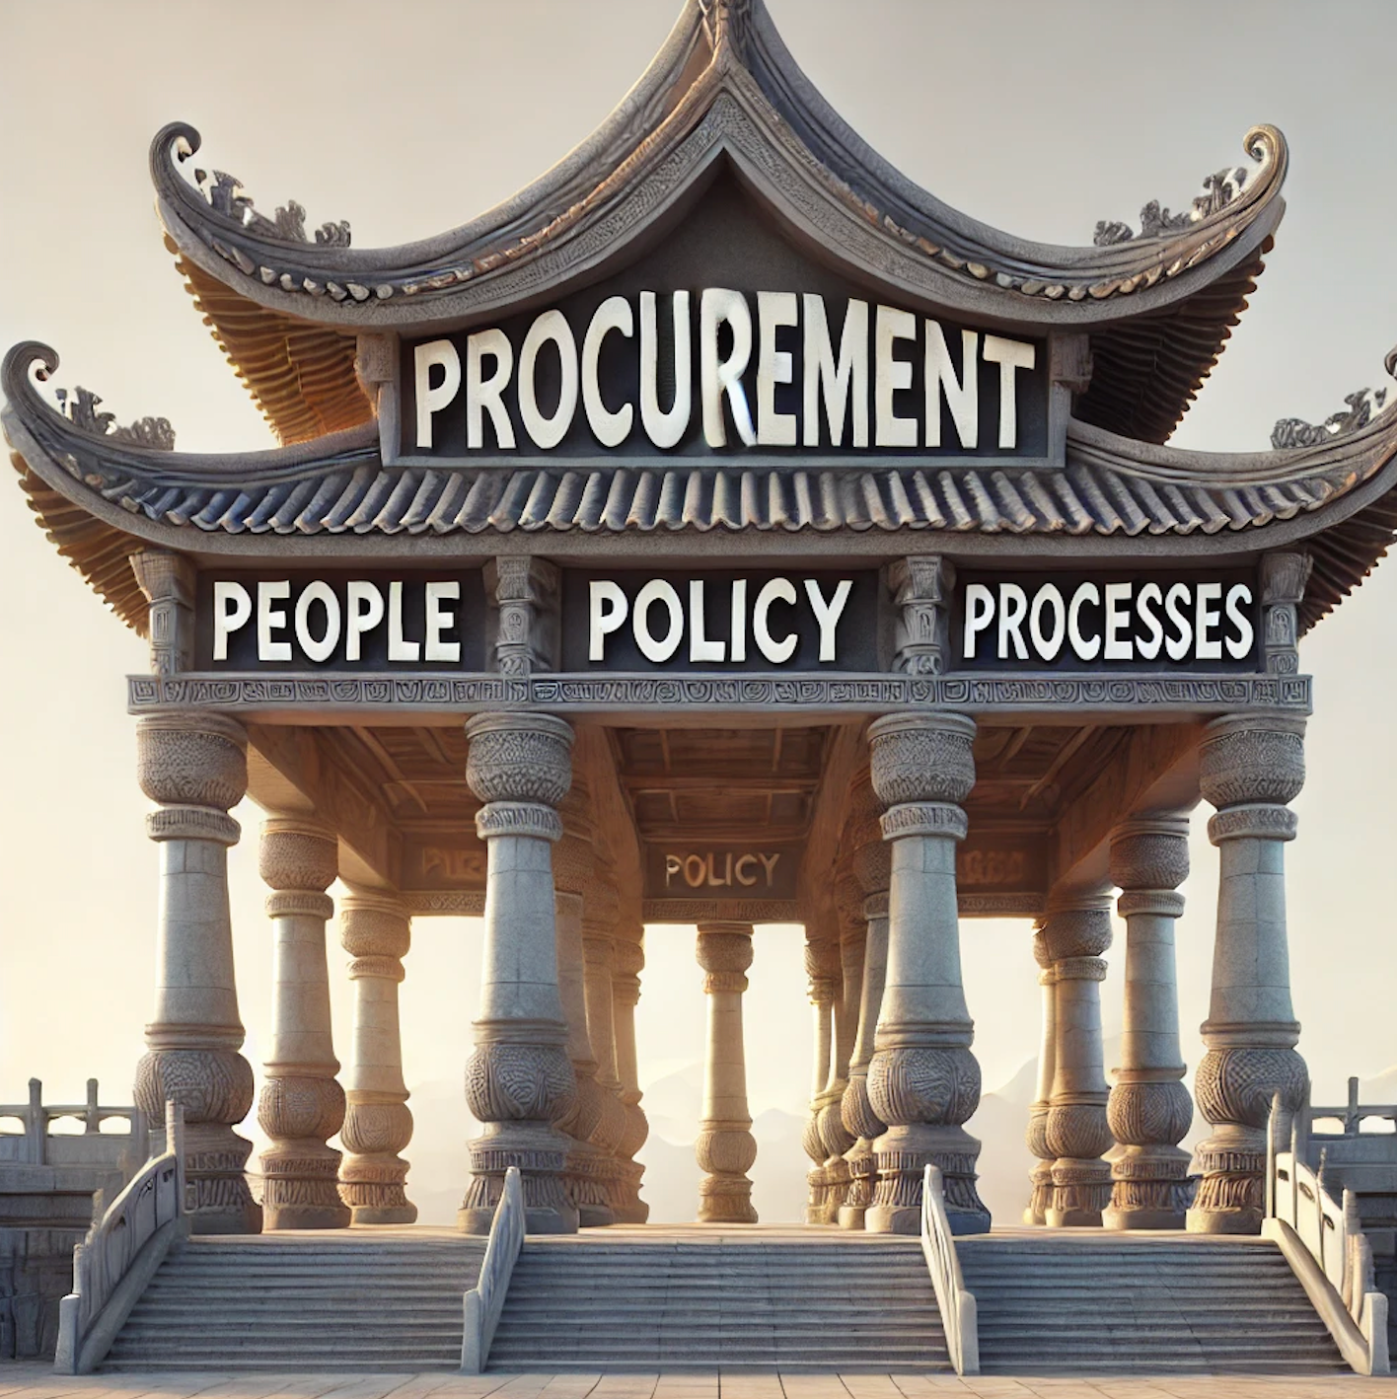
“Structure Follows Strategy………”
After developing an attractive overall procurement strategy and selling this to stakeholders, you can start thinking about putting in place an overall model for Procurement that will be able to deliver the overall strategy.
Over the years I have found it helpful to think of procurement in terms of procurement being supported by a strong foundation and three supporting pillars:
All built with strong foundations of Project Mgt.

Slide 14
Pillar 1 – people (org charts, JDs, budgets etc….)
You can’t run a procurement function without people. As a minimum you will need to consider the following:
Headcount – how many procurement FTEs and for how long?
Skills mix – should be aligned with forecast categories of spend i.e., if you need to source civil works then recruit highly skilled, construction procurement experts, if you need to source lots of computers then hire ICT category experts. Try to create a talent pipeline. Knowledge of local markets can be invaluable .
Workload profile – the number of procurement folks and their mix of skills will change over time. You might need to consider secondments, fixed-term contracts, bringing in consultants etc.
Timing - You will need significant procurement headcount in roles before awarding contracts – assuming you have scope documents ready, sourcing high value complex contracts can take 18 months or longer.
The rule of three – if you need to always have one person on duty you probably need to recruit three people to account for sickness, leave, training, maternity, folks leaving etc.
Recruitment lead-times – often takes 6 months or more to recruit skilled procurement staff and they are not easy to find!
Top down - try to recruit senior team members first and then empower them to recruit their own teams.
diversity and inclusion – you should embrace it!

Slide 15
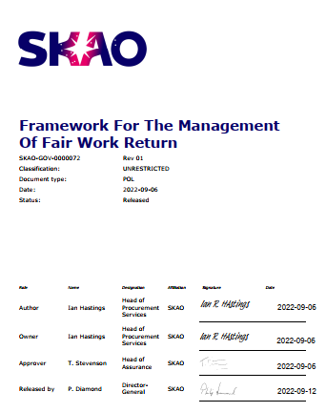
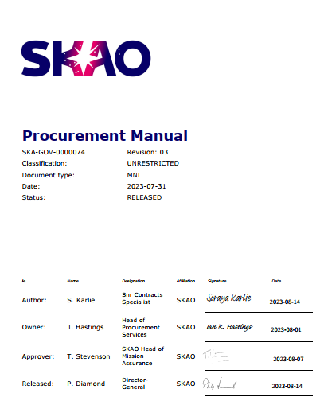
Pillar 2 – Policies
You can’t engage in transactional procurement without policies. As a minimum you will need:
procurement policies matched to legal entity status and stakeholder aspirations/constraints
An internal schedule of delegations of authority (ISODA) – who is empowered to approve what and when (normally based on values)
A governance structure linked to your ISODA
An IP policy – don’t underestimate how your IP policy will influence the quality of the technology you will be offered by industry
Some key guidelines:
Try to separate ‘policies’ from ‘procedures’ – its preferable have a separate procurement policy document and a separate procedural documents covering topics like FWR, IK Contributions. Don’t mix procedures for IK and cash procurement as they are not compatible.
Make procedures as simple and as easy to follow as possible (use diagrams and flow charts) – there are some super examples out there these days (UoM). Always remember that English is not everyone’s first language. Make it easy to find policies and procedures
Make it easy to amend procedures. Make it easy to delegate responsibilities.
Make it relatively easy to waive procedures (policy should rarely require waiving). Be an ‘enabler’ not a ‘blocker’ - allow requestors to source what they need.
Have a separate procedure covering any/all FWR considerations – the definition of Country of Origin is a perennial issue for everyone!
Takeaway: Achieving 100% compliance to a suite of poor policy documents does not make you smart, effective or efficient, just compliant…………and guess what; you still end up with the Trabant!

Slide 16
Pillar 3 – Process
You can’t engage in transactional procurement without processes. As a minimum you need:
Working governance structures with terms of reference (see Pillar 2) – you also need all approval workflows in place and working.
A contract readiness review structure
A robust goods/services receipting process and An account payable (AP) function (in fact you will basically need a full accounting system)
An ILO network (not essential but makes live much easier as you can reach more companies with your market surveys)
Thoroughly reviewed, sensible contract templates (if possible, use tried and tested templates such as FIDIC and NEC4)
A contract administration process (use a proprietary, market-leading system – even better; buy a tool that’s been developed to work with you contract templates)
A method of advertising contract opportunities – market surveys or expressions of interest (basically some sort of supplier portal)
Insurance considerations should be considered
Takeaway 1: Managing a fit for purpose procurement function in 2024 is virtually impossible without a functioning ERP system – implementing an ERP system, including all the procurement functionality, then ensuring it is reliable is not easy, quick or cheap.
Takeaway 2: you will inevitably be stuck with your choice of ERP system for many years so chose wisely!

Slide 17
Conclusions
        Start as soon as possible – achieving stakeholder consensus and buy-in takes time and can’t be rushed
        Always apply VFM, total cost of ownership methodologies when evaluating tenders
        You can’t achieve much without people – talent is not easy to recruit or retain, especially in a start-up. Always remember that a high performing team delivering a mediocre strategy will always beat a poorly performing team, however good the strategy.
        Big Science organizations are not agile – if you need to change strategy or policy it can be very challenging so get it right first time
        Most business processes are already fixed – there is little to no choice as ERP systems are built on standard business processes. You can customize standard ERP business processes but its going to be incredibly painful and expensive so stick with ‘out of the box’ functionality.
        Because of bullet 5, draft your procedures to be aligned with ‘standard’ ERP functionality.
        There is no ERP system in the world that has any functionality to deal with IK Contributions, however, you can use a variety of ‘hacks’ to make ERP systems compatible with IK Contributions.
        Finally, if you remember just one thing from my presentation, please remember the Porsche vs, Trabant slide and be very, very careful that your stakeholders don’t inadvertently end up with a very expensive Trabant ☺

Slide 18


Questions, thoughts & Observations
Over to you……………………….

