Slide 1
New AD e-cooler: gun v5 tolerances vs beam quality
(updated with latest CST simulations on 18 March 2025)
G. Khatri | SY-BI-XEI
06 March 2025,

Slide 2
Outline
Introduction
Electron gun design (version 5)
Acceptance criteria and e-beam quality
CST Simulation results: B-field scan, linear tolerances, angular tolerances
Summary

Slide 3
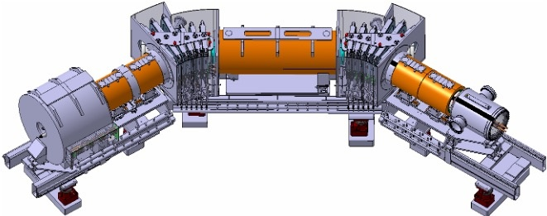
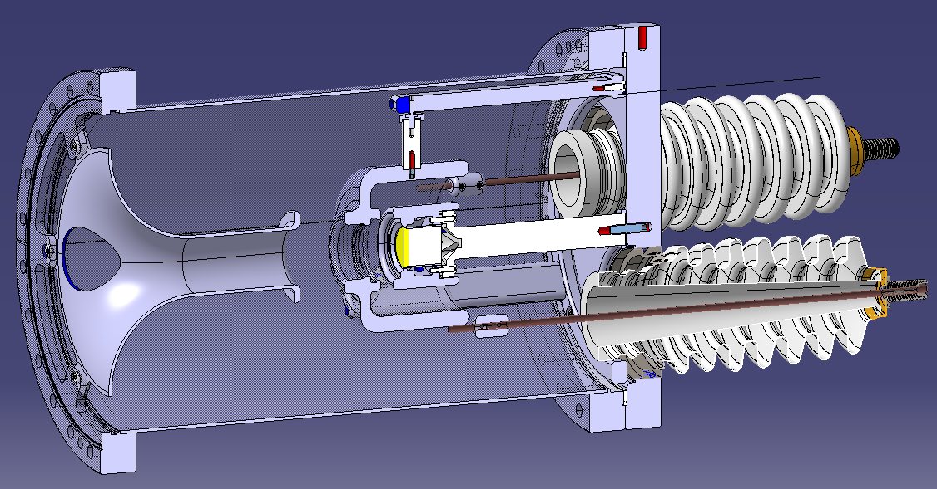
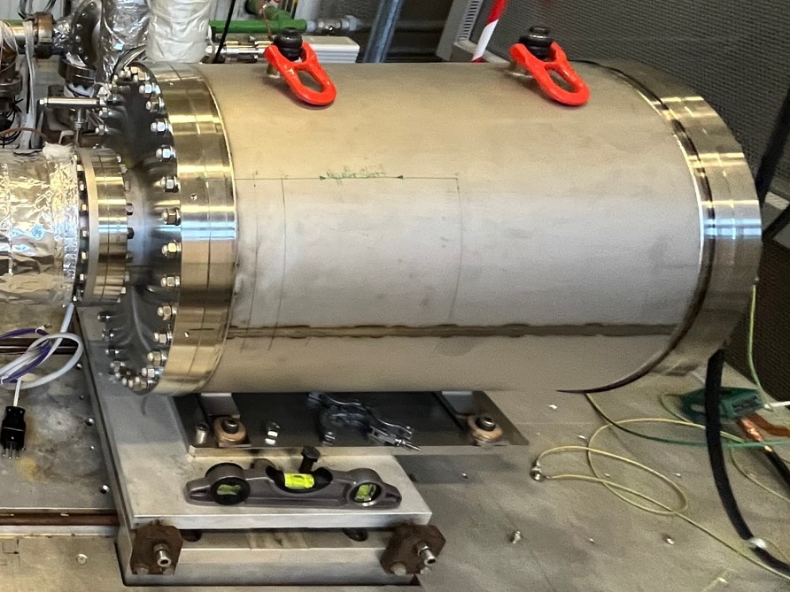
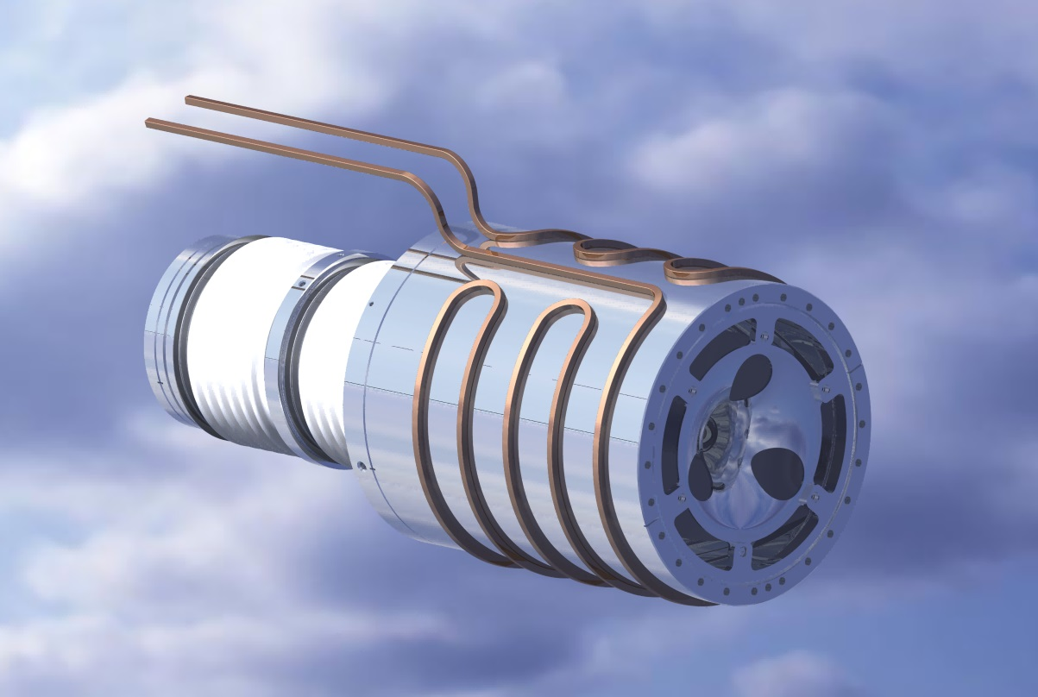
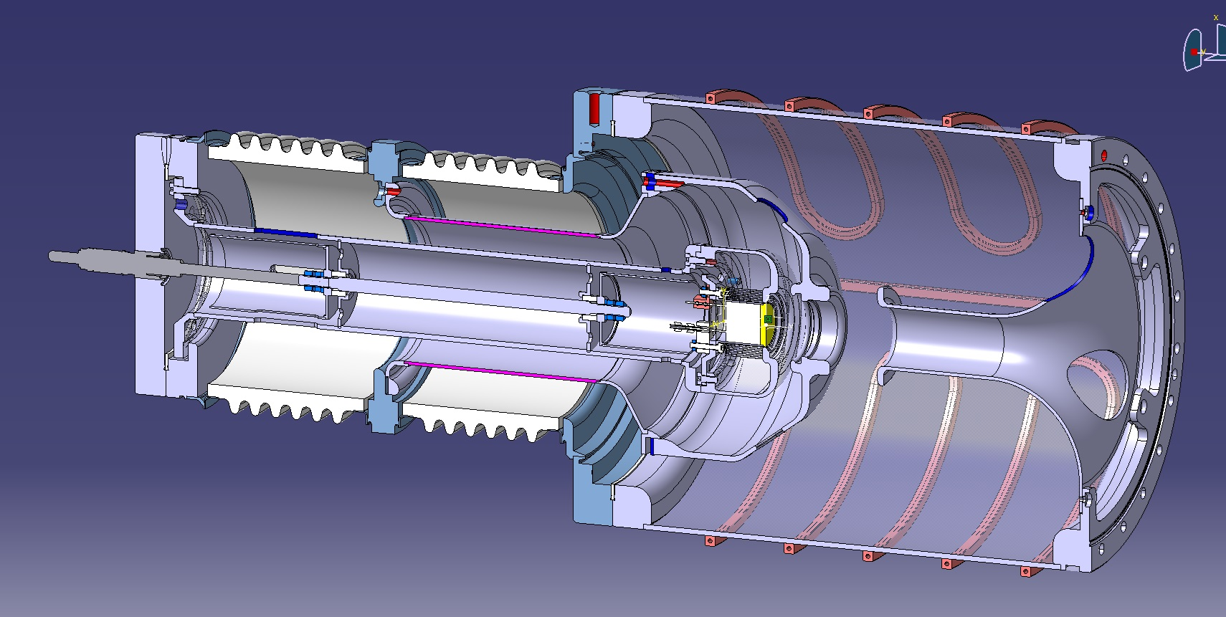
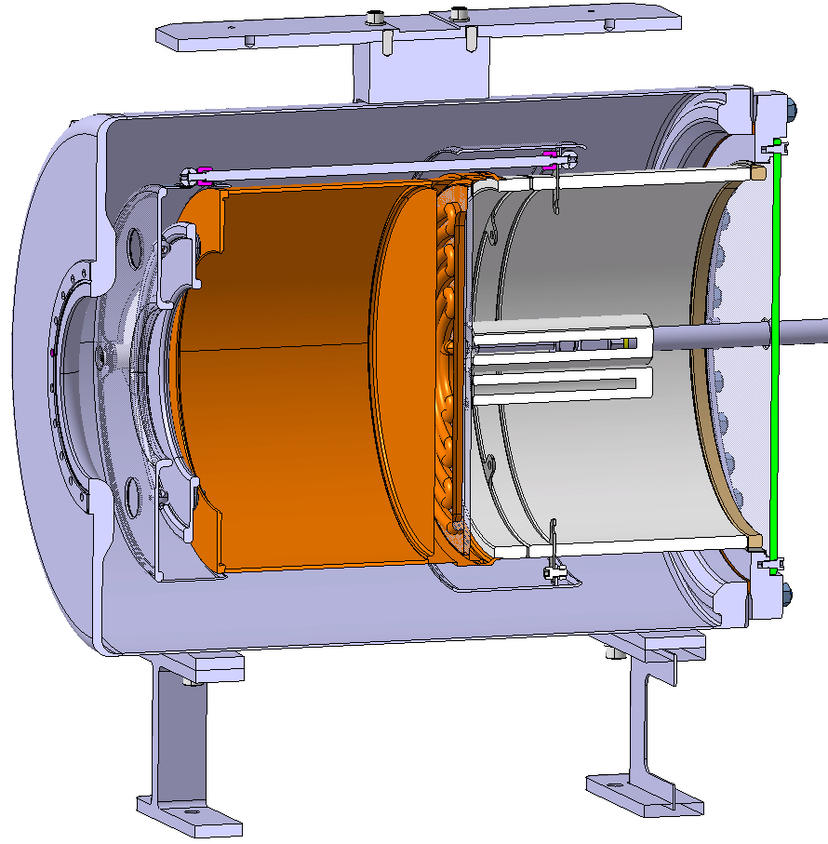
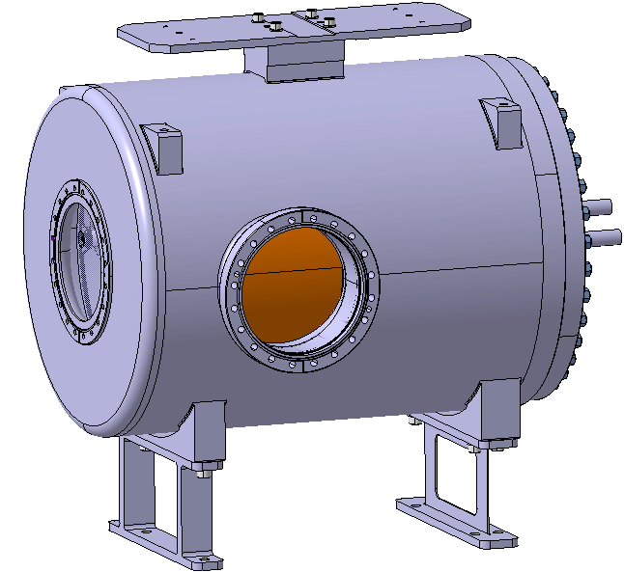
Introduction/Reminder
e-Gun
1st proto tested – lessons learned !
e-Collector
anode
cathode
HV feedthroughs
grid
Proto (improved) collector for present AD cooler fully tested and ready for OP
Final collector for new cooler under production, delivery in April 2025
2nd proto: revised, robust design based on 1st proto and current Russian gun
Cooling water for high ceramic resistance, wavy modulation better HV insulation
Production for test by June 2025
3D model by J. Cenede
ECTS test bench in b.236 has been improved to comply CERN electrical safety standards – A. Frassier/J. Cenede

Slide 4
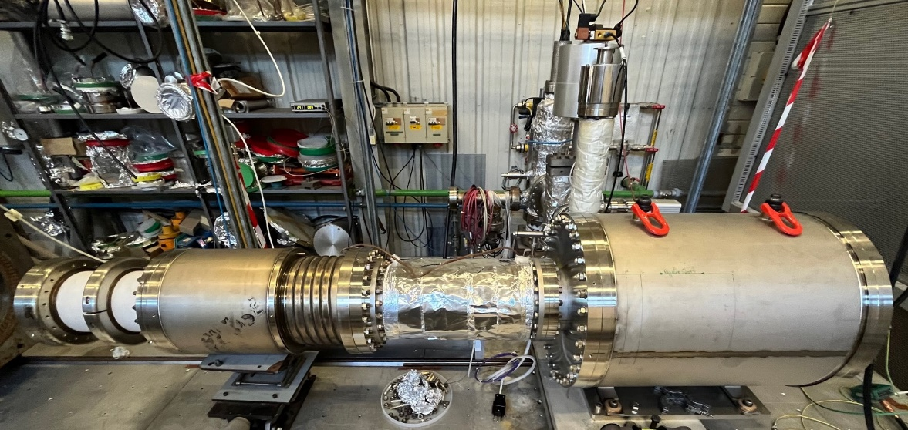
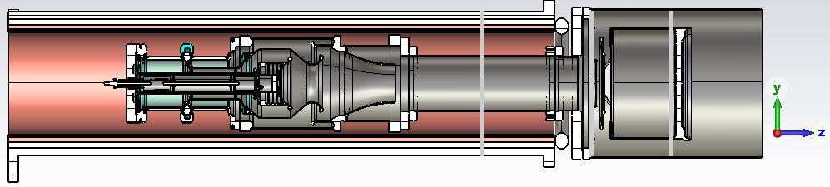
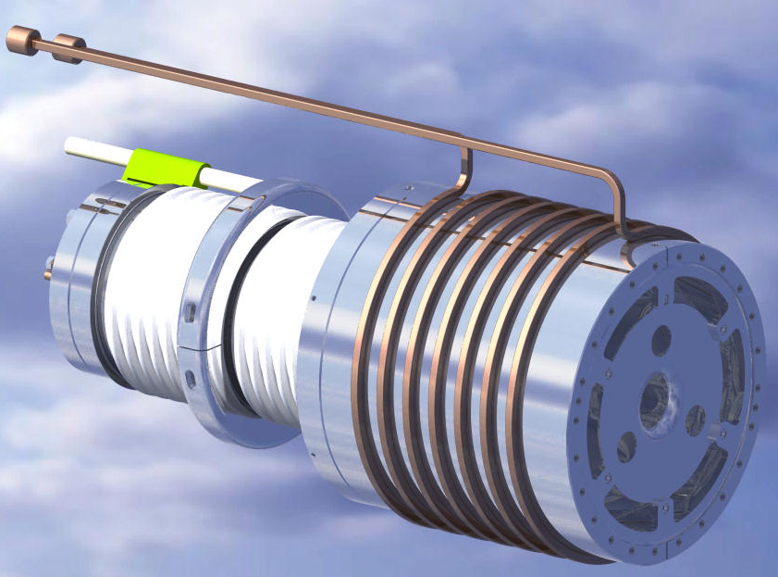
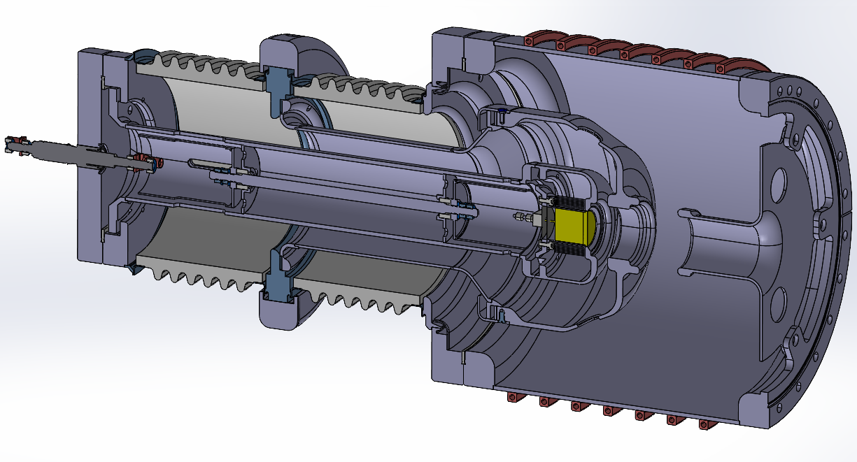
New electron gun design (version 5)
(a)
(b)
present AD gun
(Russian design)
HV insulation
ceramics
U_{grid}
vacuum chamber
with cooling water
on the exterior
cathode
Tantalum
foils
grid
Wehnelt
anode
U_{cath}
(d)
gun v5
(c)
design by J. Cenede

Slide 5
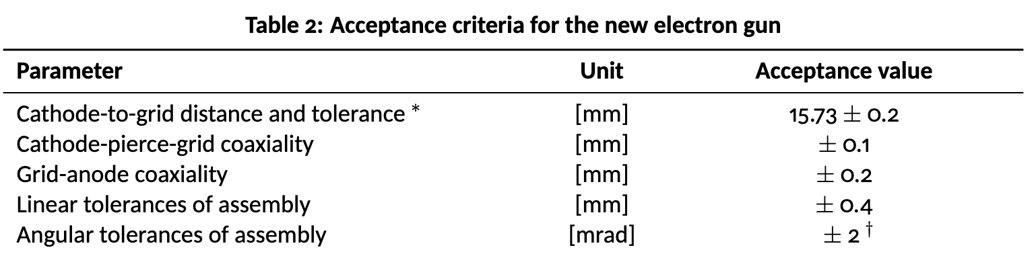
Gun acceptance criteria and beam quality
Any of the following misalignments will degrades electron beam quality and cooling performance
  gun sub assembly
  the gun axis with respect to the magnetic axis
The misalignment translated into transverse electron beam velocity has been simulated in CST Part. Studio
Required at room
temperature
(cold cathode)
Numbers to be updated in the
Document next version
EDMS: 3077160
See conclusion !

Slide 6
CST Studio simulations summary
Following slides show CST particle studio simulations of the electron beam extraction from the current gun design v5.2.
The simulation considers the realistic space charge effect.
Lower the transverse electron velocity (V_{tran}), the better is the beam quality !
B-field scan: Increasing from 900 Gauss to 2400 Gauss, (V_{tran}) goes down
Co-axiality (off-axis) scan: not noticeable degradation upto 0.5 mm
Angular scan (gun axis w.r.t. B-field axis): larger the angle, the larger is (V_{tran})

Slide 7
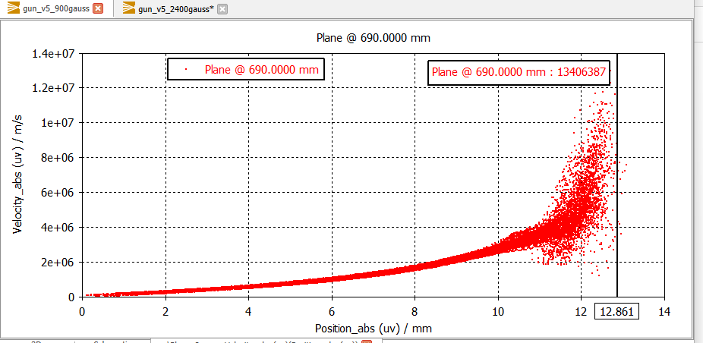
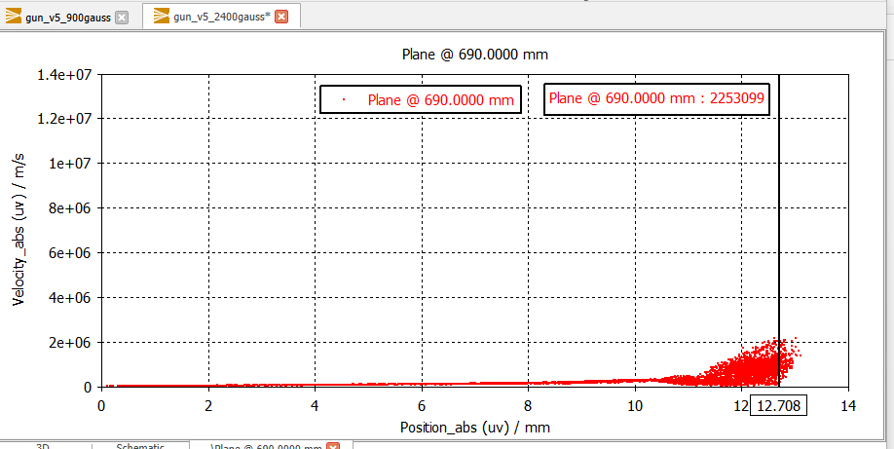
B-field vs transverse electron beam velocity
Transverse electron beam velocity as a function of radial position (0mm is beam axis, 12.5mm is beam edge)
As expected,
the transverse velocity reduces as we increase the B-field
The velocity increases with the beam radius
Note:
1E6 m/s velocity translates into 2.84 eV energy of the electrons.
1E5 m/s -> 28.43 meV
1E4 m/s -> 0.284 meV
B = 900 Gauss
B = 2400 Gauss

Slide 8
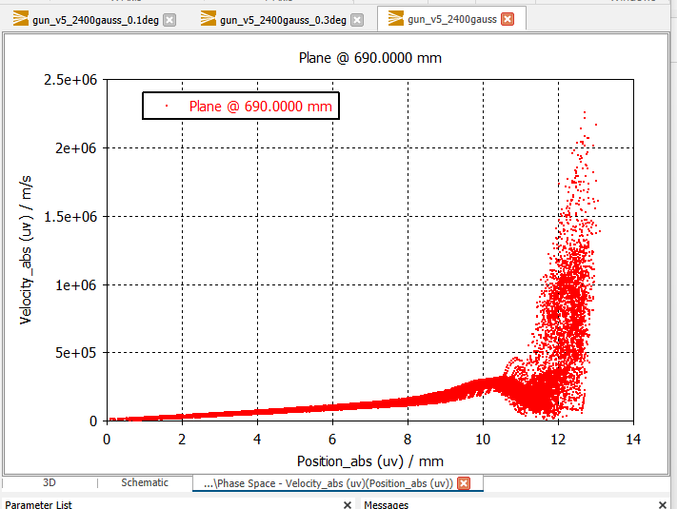
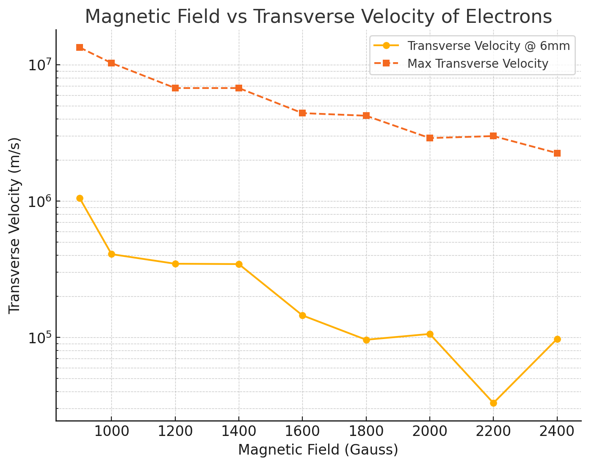

What I mean by max vs @6mm ?
See also A. Pikin plot here. Best to operate at slightly lower B field

Slide 9
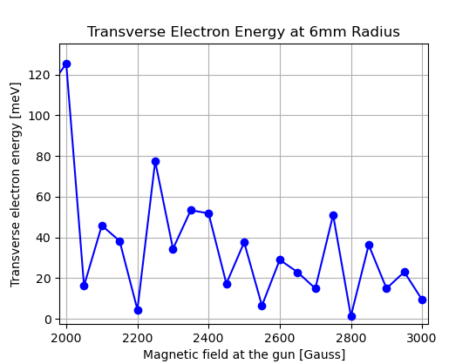
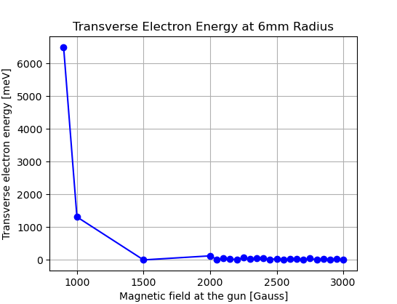
Transverse electron energy in meV vs. B-field

Slide 10
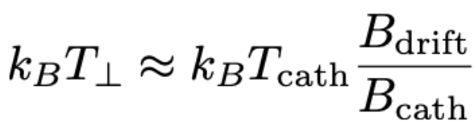
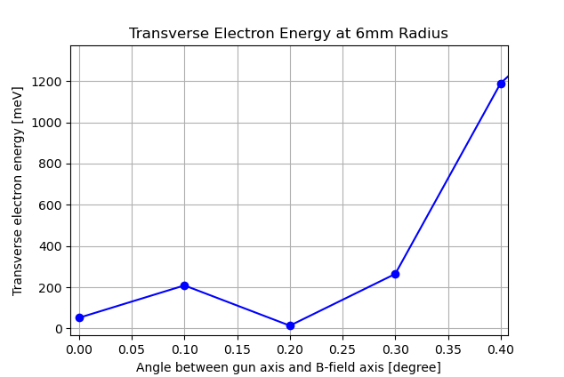
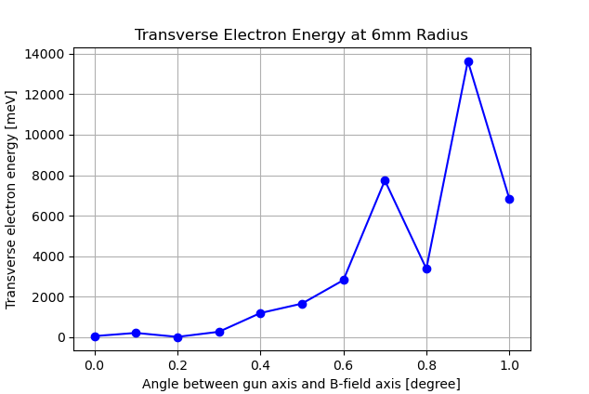
Angle (degree) vs transverse energy
Gun axis tilted with respect to the expansion solenoid field axis
Larger the angle, the worse the beam quality.
Not only the absolute value increases but also the energy spread increases (see next slide)
According to D. Gamba, the transverse temperature spread in drift should be below 100 meV
Thus the transverse temperature acceptable at the gun should be below 400 meV.
Which means 0.3 degree or 5 mrad
NB: 2 mrad ~0.115°

Slide 11
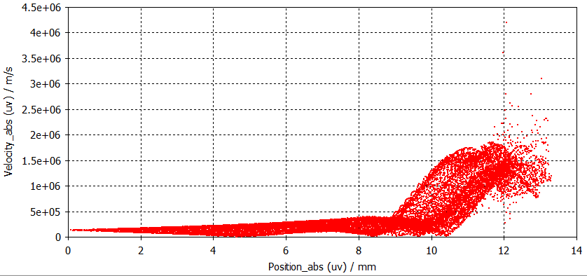
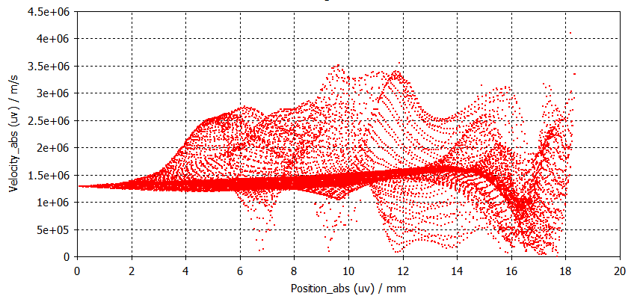
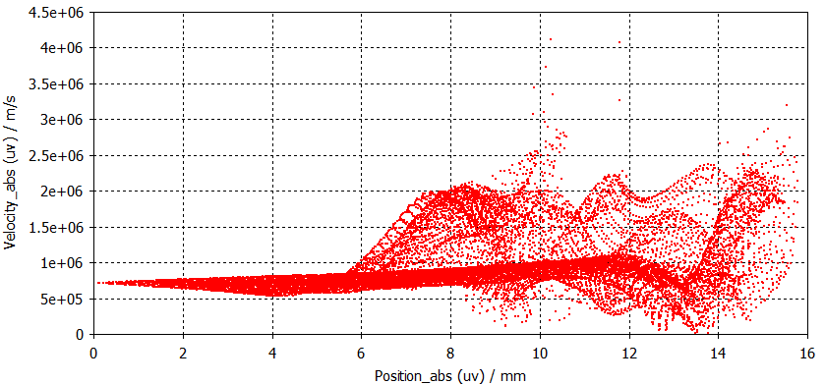
Angle (degree) vs transverse velocity
Not only energy increases but the energy spread also increases due to ExB forces.
Therefore, it is critical to align the Gun axis with the B-field axis !
angle = 0.1°
angle = 0.9°
angle = 0.5°

Slide 12
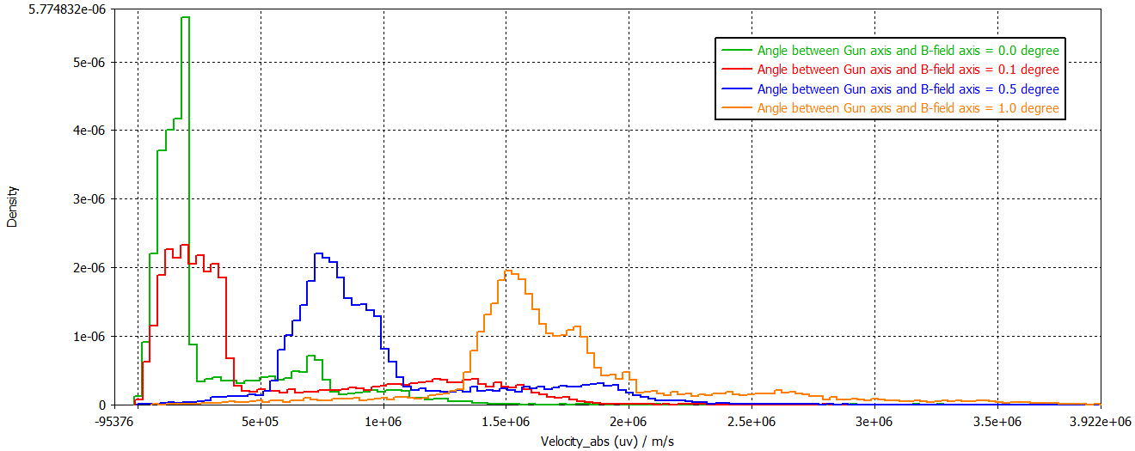
Transverse velocity spread when tilting gun in magnet (angular misalignment)
size of arrow showing approximate spread of the transverse temperature
By tilting the gun inside expansion solenoid, the transverse energy increases with the engle, but also the energy spread (temperature) increases, which is not good for cooler performance !
With the chaotic motion of electron as increase the angle, we increase the risk of electron losses and may reduce collection efficiency at the collector.
Thus, the gun axis should be aligned to magnetic field axis as best as possible within 5 mrad (~0.3 degree)

Slide 13
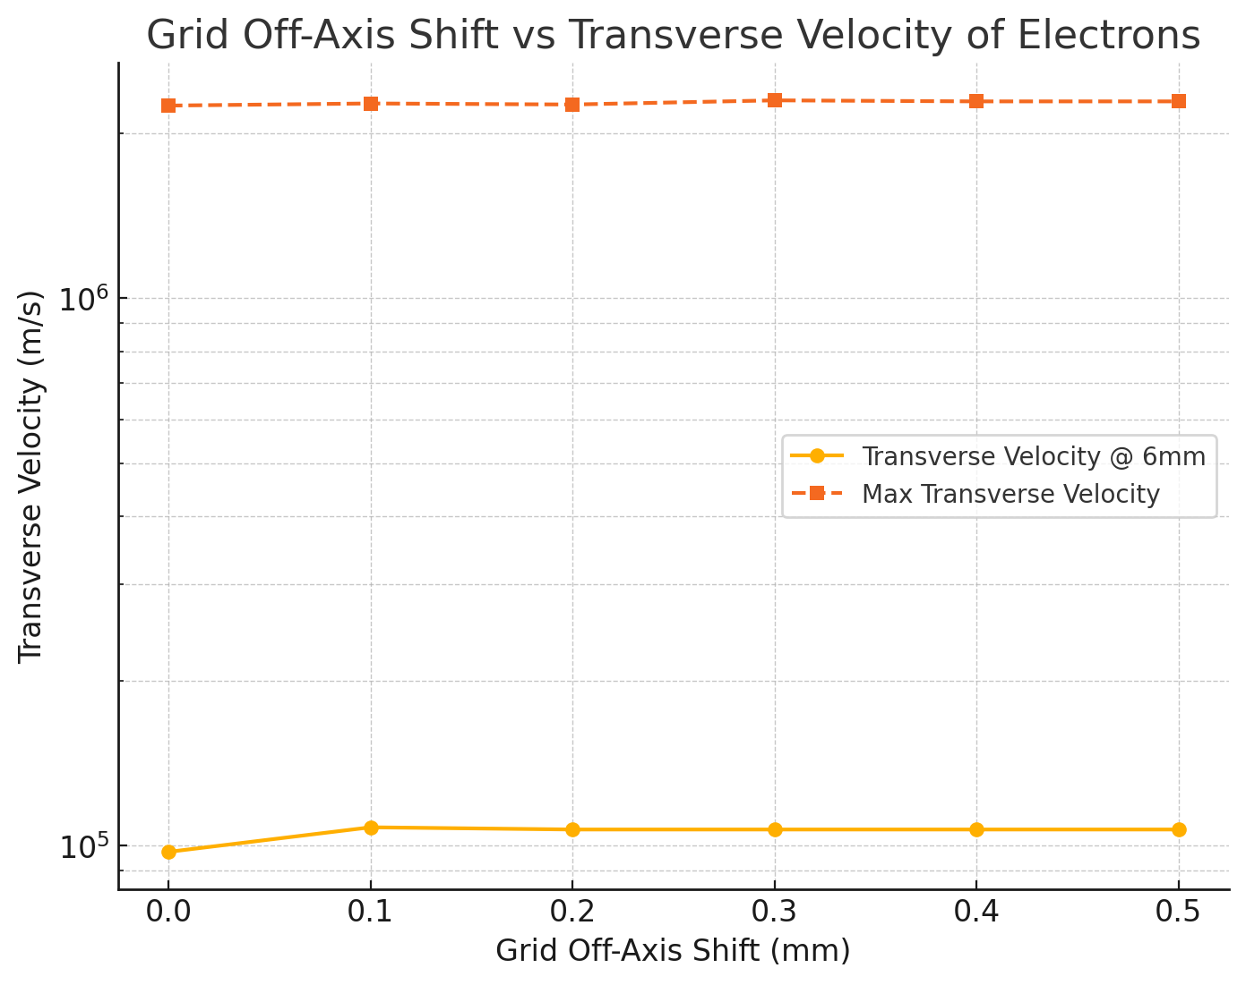
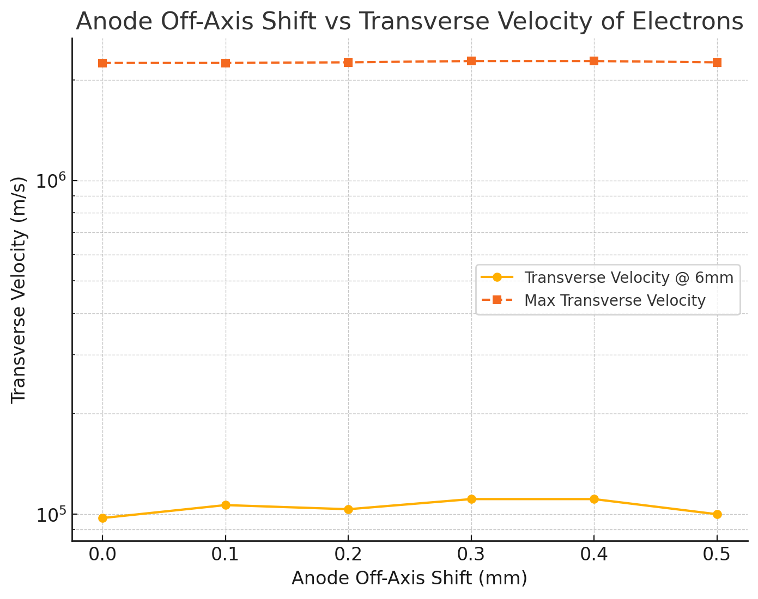
Grid/Anode off axis (co-axiality misalignment)
Gun sub assembly co-axiality misalignment within 500 um is acceptable !

Slide 14
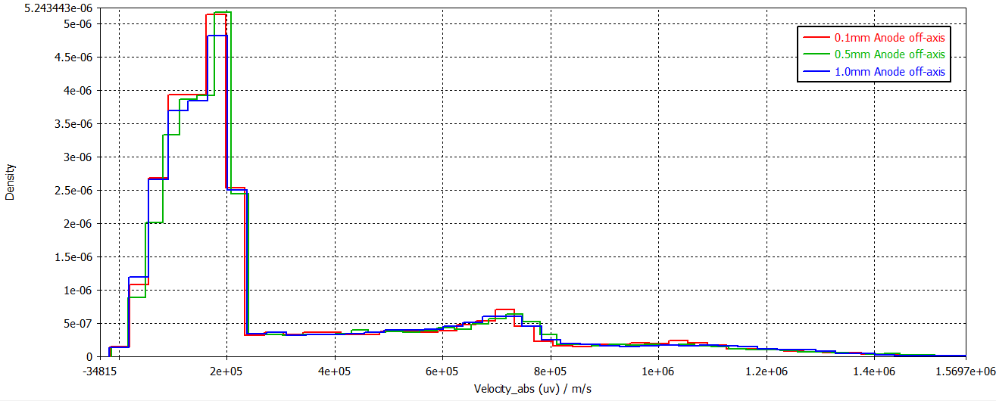
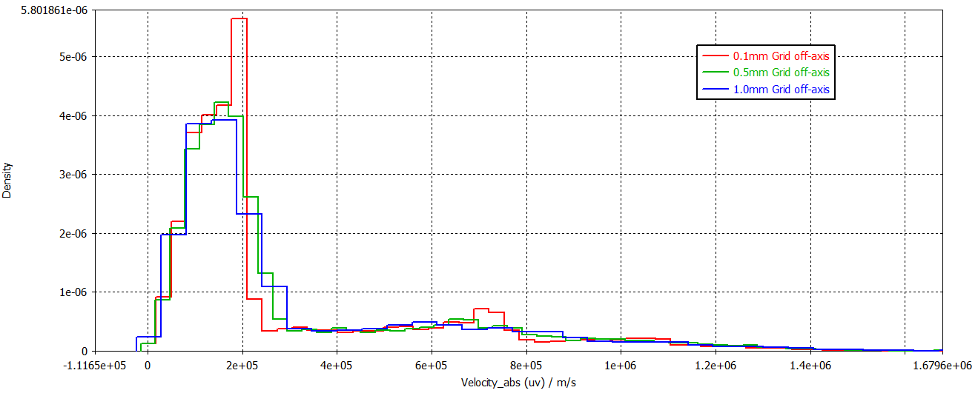
Transverse velocity spread when grid/anode off-axis (co-axiality misalignment)
for anode
By moving the grid or anode 1mm off axis (transversely), we do not see a huge spread in transverse velocity.
for grid

Slide 15
Conclusion
The simulation results came after the first draft design by J. Cenede. Here we provide more relaxed requirements on the alignment tolerances of the final gun assembly.
Keep angular misalignment between gun axis and magnetic axis to within 0 ± 5 mrad
The co-axiality (off-axis) of grid and anode should be within ± 1.0 mm
The linear (along beam axis) positioning of anode and grid should be within ± 1.0 mms
The grid to pierce/cathode distance can be +1mm or -0.5 mm (to avoid high voltage spark)
Above alignments are all to be provided at room temperature (for cold cathode) !

Slide 16
Acknowledgement
Thank you
Sasha, Fred, Adriana, Gerard and Davide for helpful discussions
Sameed for early simulations of the proto gun v4
Alex, Jean for their experience with the e-coolers
AD-CONS EC project members for their collaboration

Slide 17
EXTRA slides

Slide 18
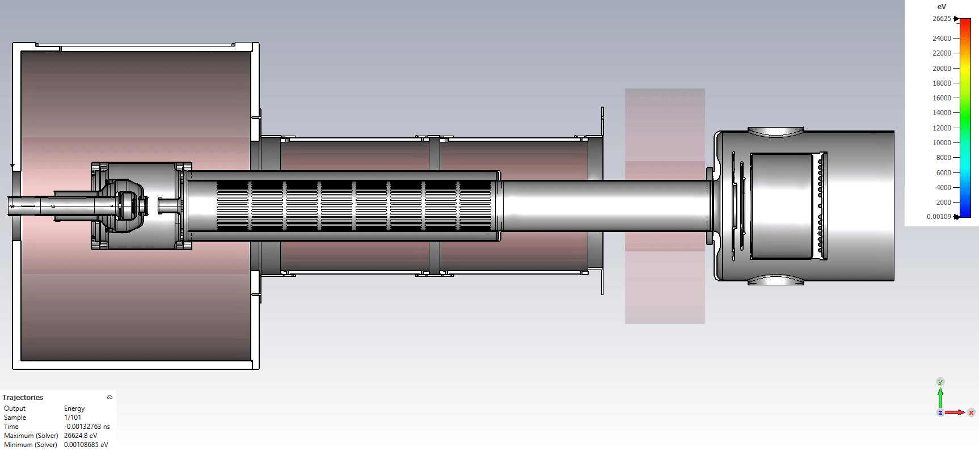
CST simulations check OK

Slide 19
Differences between Russian gun and v5
Smaller Cathode Flange: The cathode flange size has been reduced to DN100CF from DN150CF.
External Cooling Water Pipe: Unlike the current AD gun, the cooling water pipe will be positioned outside the vacuum chamber, rather than inside.
Modulated Ceramic Surface: A wavy shape has been added to the airside of the ceramic to increase the effective electron creeping distance, thus improving high-voltage insulation.
Smaller cathode of 25 mm: discipates less power ~200 Watts (old gun 240 Watts)

Slide 20
Design of gun v5 and report of proto tests
Gun v5 design can be found in Jira by J. Cenede:
https://its.cern.ch/jira/browse/BIXEI-588
Report on proto gun tests and results: EDMS: 3225048
https://edms.cern.ch/document/3225048
CATIA reference: ST1954551

Slide 21
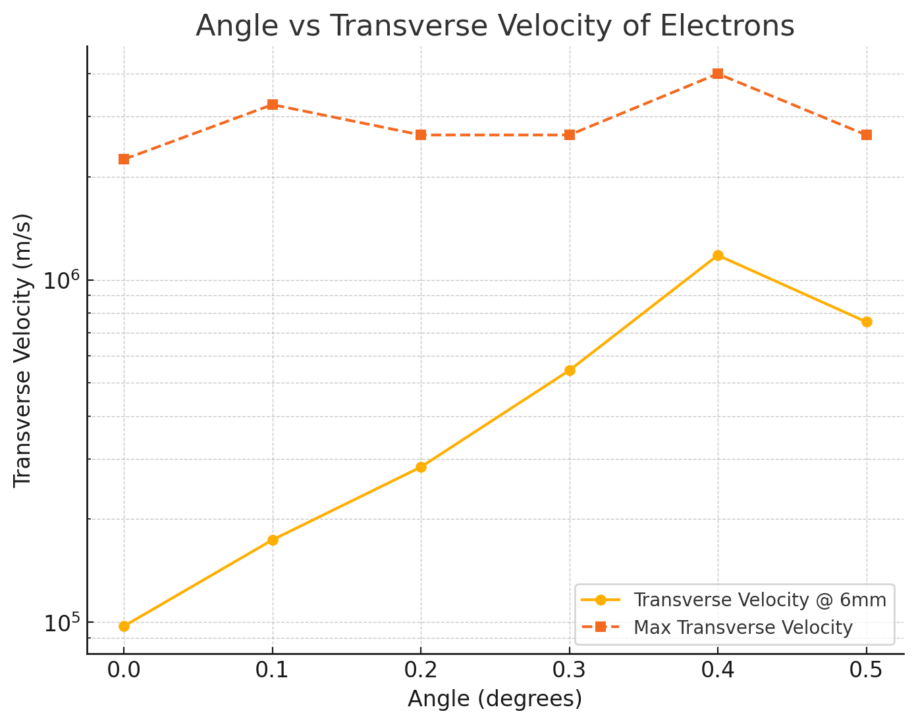
Angle (degree) vs transverse velocity (OLD plot)
Gun axis tilted with respect to the magnetic axis
The beam quality degrades as we increase tilt angle of the whole gun with respect to the magnetic field.
NB: 2 mrad ~0.115°

