Slide 1
EN-HE Updates
HI-ECN3 WP4 - Coordination meeting #10 – C. Duran Gutierrez, R. Rinaldesi – EN-HE
19-03-2024

Slide 2
Content
ECN3 Transfer tables
  Location of components and Works
Service Building – Equipment installation
  Power room and Control room
  CV Rooms
  Motorized trolley
Ongoing and future assessments
Questions

Slide 3
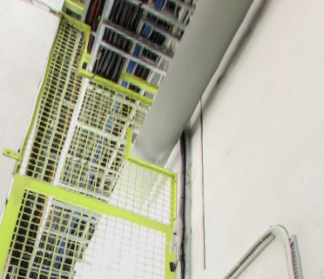
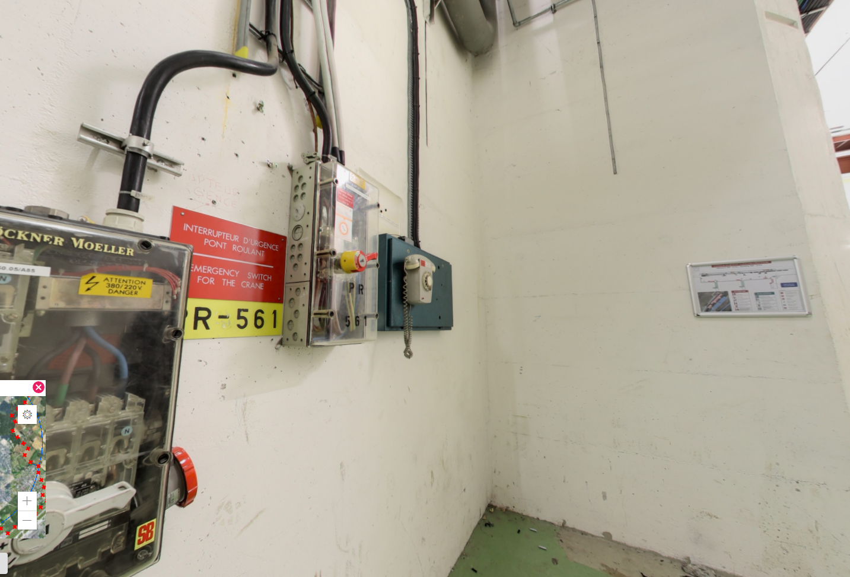
ECN3 Transfer tables
Location of components and works
Final proposal
Control panel installed outside the shaft
  On the gallery wall, in front of the lift.
Cable reel located outside the shaft, beneath the staircase, behind the lift
  There will be an opening in the wire mesh to allow the cable to pass through, along with a pulley system.
2
1
2
Possible control panel locations

Slide 4
ECN3 Transfer tables
Location of components and Works
Pending
Final determination of the control panel’s exact location and cable routing.
Exact location of the opening in the wire mesh for the pulley system.
Final quotation.
ECR
Pulley also located outside the shaft.
Small opening
Estimated dimensions = 450 x 70 mm
Exact location to be defined

Slide 5
Service Building – Equipment installation
Power Room and Control Room
IMPORTANT
To verify the general dimensions, weights and lifting points of all equipment to be installed.
Restrictions
Available space in the access platforms (3500x2700)
  Front access – 3380 mm width
  Lateral access – 2650 mm width
Height inside the structure – 4300 mm
Door size (2900x1600)
Guardrails (removable)
2650
3380

Slide 6
Service Building – Equipment installation
Power Room and Control Room
Available equipment for installation
An extension of the access platform will be required to access with a crane
Forklifts (?)
Control room
Power room

Slide 7
Service Building – Equipment installation
CV Rooms
First draft study analyzing possible sequences for the transportation and handling of CV equipment within the new service building (first installation and maintenance operations)
CV 1 – CV Room on the first floor
CV G – CV Room on the ground floor
CV 1
CV G

Slide 8
Service Building – Equipment installation
CV Rooms
CV Room – Ground floor
Cell operation room Doors 1) and 2) | 2068 x 2084 mm
CV-Room Door (3) | 2468 x 2484 mm
3
CV G
2
3
2
1
1
Option 1 – Transport with trolley through the Cell Operation Room

Slide 9
Service Building – Equipment installation
CV Rooms
CV Room – Ground floor
Cell operation room Doors 1) and 2) | 2068 x 2084 mm
CV-Room Door (3) | 2468 x 2484 mm
3
CV G
2
3
2
1
1
Option 1 – Transport with trolley through the Cell Operation Room
Option 2 – Handling with the crane and final transfer to CV room using a platform/trolley
Crane unloading area

Slide 10
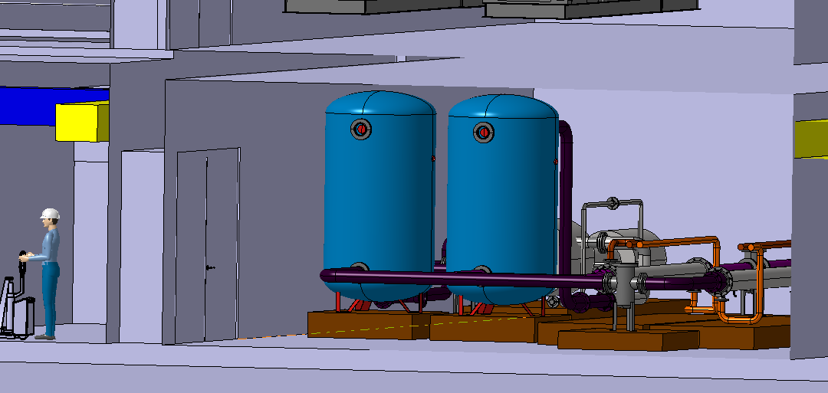
Service Building – Equipment installation
CV Rooms
1500
CV Room – Ground floor
Cell operation room Doors 1) and 2) | 2068 x 2084 mm
CV-Room Door (3) | 2468 x 2484 mm
CV-Room Height | 3600 mm
Precise transport and installation studies for the water tanks must be assessed.
The water tanks must be brought into a horizontal position and then rotated once inside the room.
However → 600 mm height margin with the ceiling
3000
3600
2484
ST1A11865_01

Slide 11
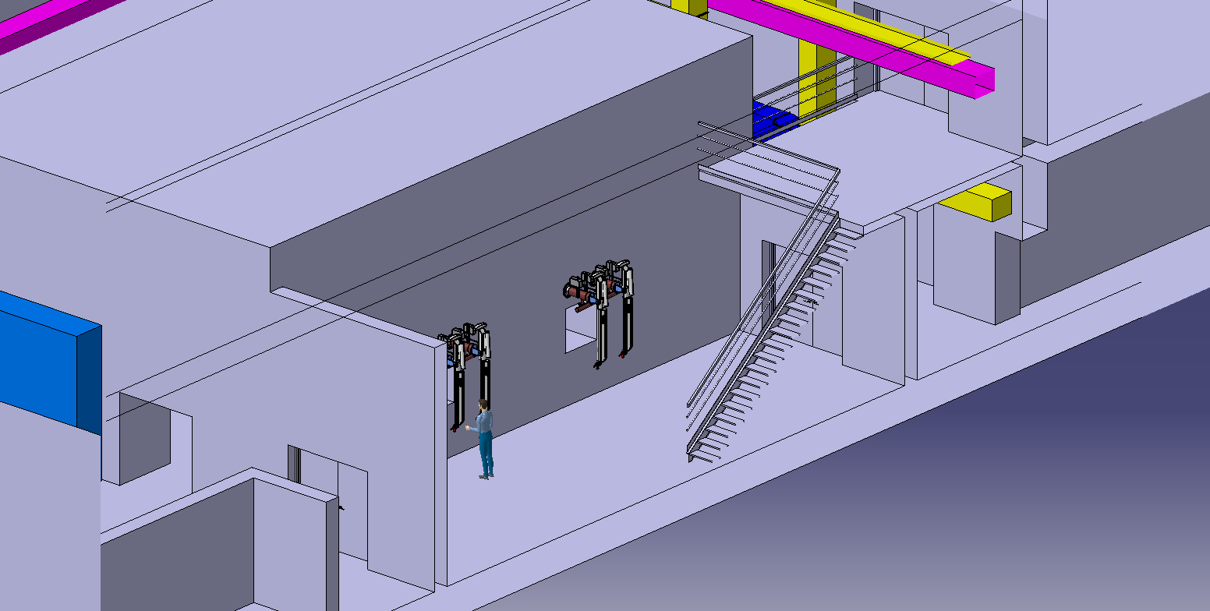
Service Building – Equipment installation
CV Rooms
CV Room – First floor
Cell operation room Doors 1) and 2) | 2068 x 2084 mm
CV-Room Door (4) | 2468 x 2084 mm
CV-Room Height (beams) | 7350 mm
CV 1
4
Removable
Guardrail (?)
1
2
5100
4000
1
Option 1 – Transport using a trolley through the Cell Operation Room + lifting with the crane
5500

Slide 12
Service Building – Equipment installation
CV Rooms
CV Room – First floor
Cell operation room Doors 1) and 2) | 2068 x 2084 mm
CV-Room Door (4) | 2468 x 2084 mm
CV-Room Height (beams) | 7350 mm
CV 1
4
Removable
Guardrail (?)
2
1
2
5100
4000
1
Option 1 – Transport using a trolley through the Cell Operation Room + lifting with the crane
Option 2 – Handling the object from the hall with the crane until it reaches the mezzanine
5500

Slide 13
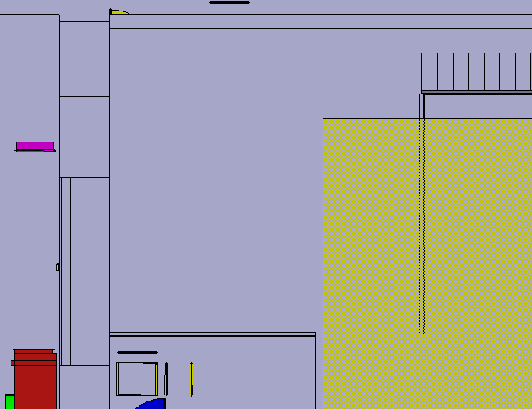
Service Building – Equipment installation
CV Rooms
CV Room – First floor
Cell operation room Doors 1) and 2) | 2068 x 2084 mm
CV-Room Door (3) | 2468 x 2084 mm
CV-Room Height (beams) | 7350 mm
1600
Auxiliary
hoist
Based on previous experience, the extra coverage we could gain:
To the wall ≈ + 200 – 300 mm
Long travel ≈ + 1500 – 2500 mm
Height ≈ + 500 mm
Crane coverage
3470

Slide 14
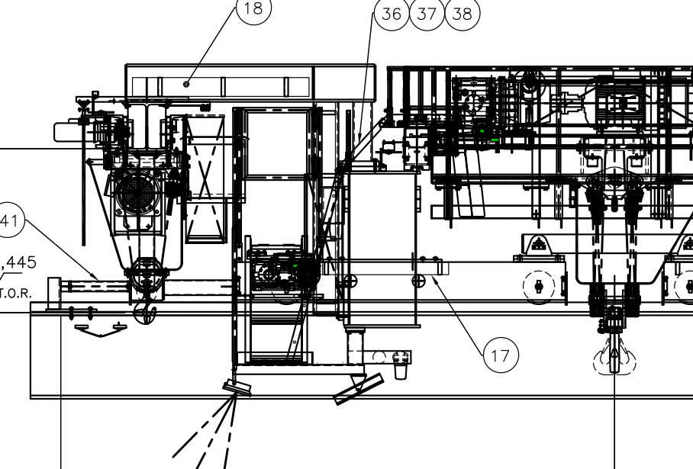
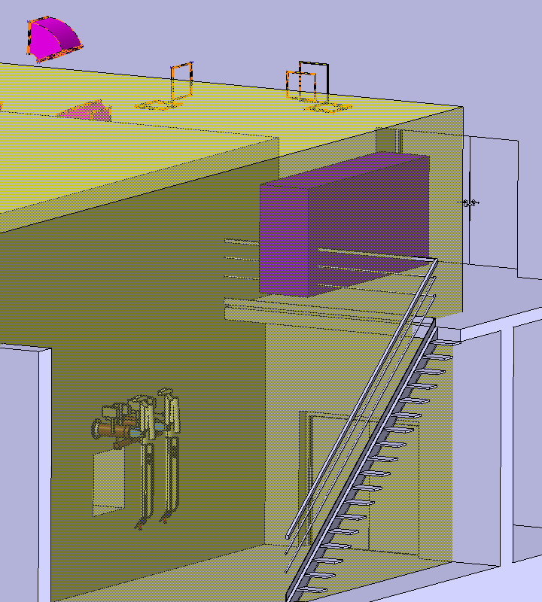
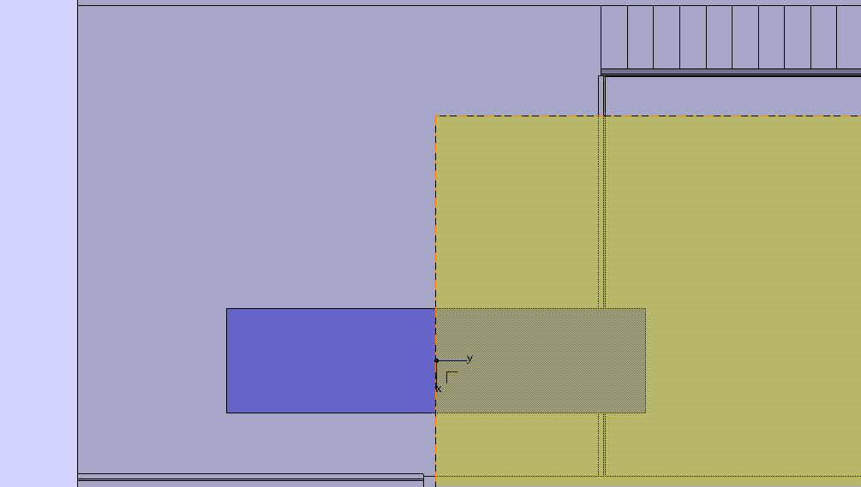
Service Building – Equipment installation
CV Rooms
Example of auxiliary hoist (PR 806)
CV Room – First floor
Cell operation room Doors 1) and 2) | 2068 x 2084 mm
CV-Room Door (3) | 2468 x 2084 mm
CV-Room Height (beams) | 7350 mm
CV Room – Equipment (first draft)
AHU unit | 4000 x 1000 x 1000 | 600 kg
Filters | 2314 x 650 x 1746 | 500 kg
Carbon Filter | 3870 x 888 x 1746 | 1110 kg
AHU and Carbon filters simulation handling
3300
Crane coverage
Proposed solution
Auxiliary hoist (extra crane coverage)
  Capacity to be defined
CoG

Slide 15
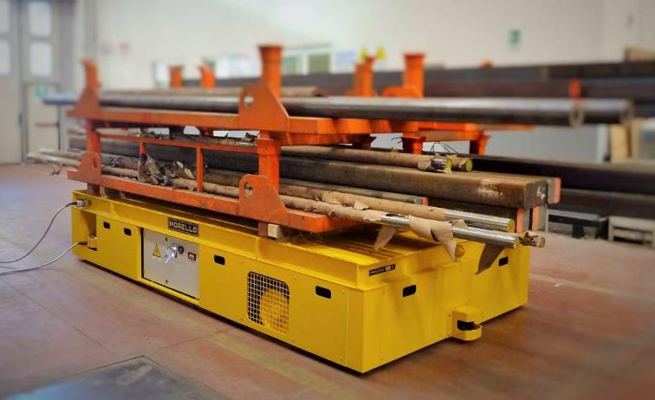
Service Building – Equipment installation
Motorized trolley
As discussed in the previous coordination meeting and the 1st BDF-TSAC
Best guiding system to be defined:
Rails → Might pose an issue when sealing the service cell
Therefore, a motorized trolley with multidirectional polyurethane wheels could be the best solution for transferring material from 911 to the service cell.
To be defined
Dimensions and capacity
Power system – Cable reel? Batteries?
  If using a cable reel, how to manage the cabling once the platform is inside the service cell?
  Failure scenarios for each option and potential solutions
Motorized platform with multidirectional wheels (Morello)

Slide 16
Ongoing and future assessments
Vacuum vessel
Lifting points
Spreader (motorized with auto-locking points)
Door
  Door removal procedure
  Lifting tool
Service cell crane
Specifications and estimated volume
Handling studies (procedures and tooling)

Slide 17
Questions
CV
Cabling and pipes through the 911 shaft → estimated volume and location within the shaft

Slide 19
ECN3 Transfer tables
9800
3550
2094
2515
770

Slide 20
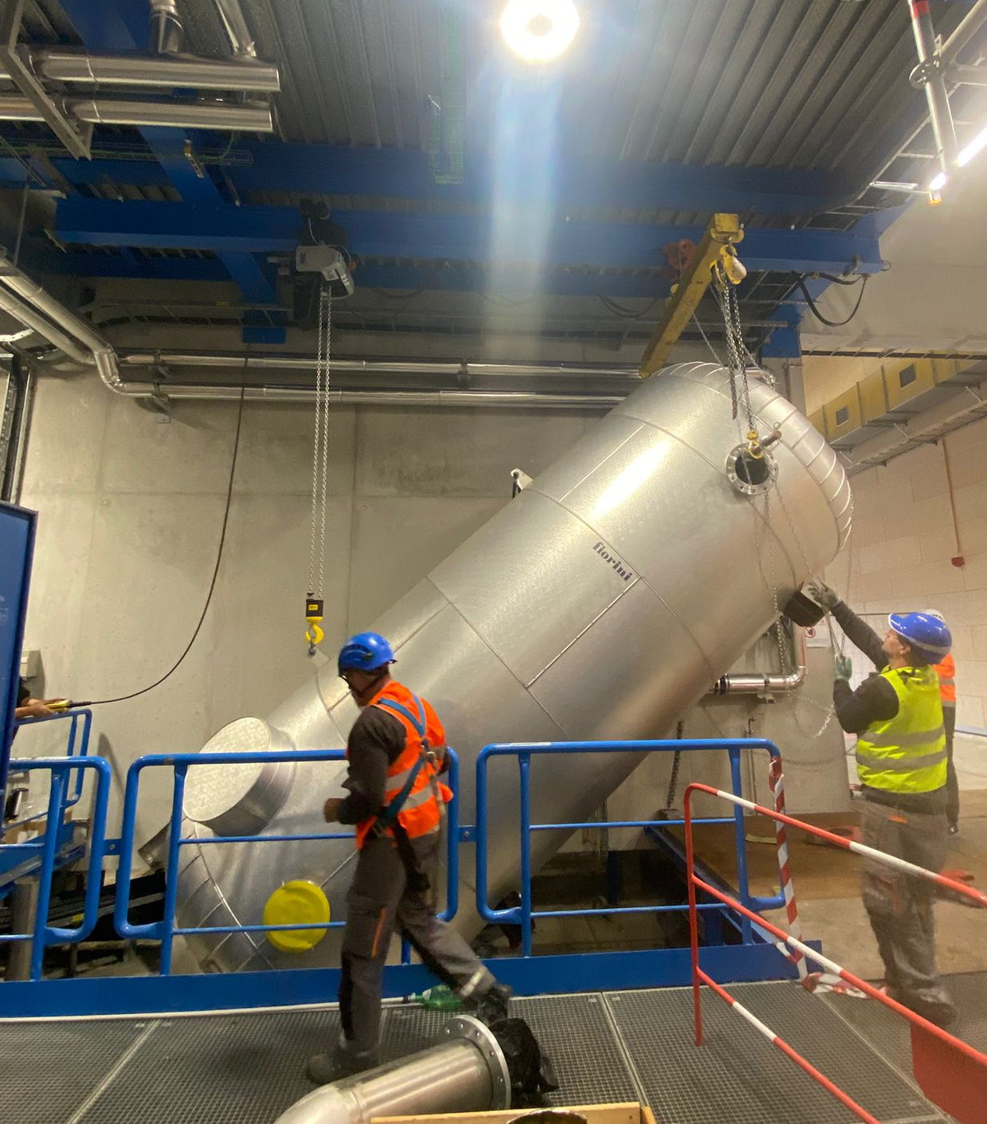
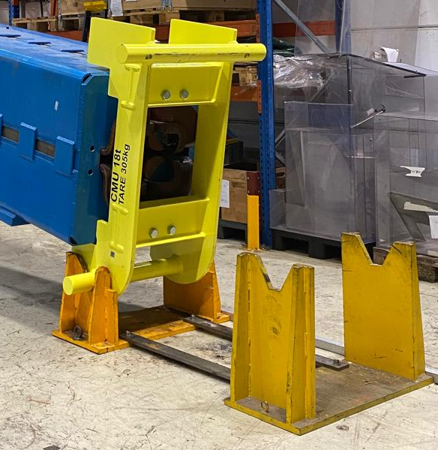
ECN3
4 lifting points
2 for Tcc8’s hook
2 for ECN3’s hook
SHiP experiment. Cryostat installation
2 lifting points for ECN3’s hook
+ bottom support
Similar operations
Direct slinging
Dedicated lifting beam
Option 1
Option 2
Studies ongoing

